Slide 1
Space gravitational wave antenna DECIGO and B-DECIGO
Seiji Kawamura (Nagoya University), DECIGO working group
GWADW
May 24, 2023, @ Elba, Italy

Slide 2
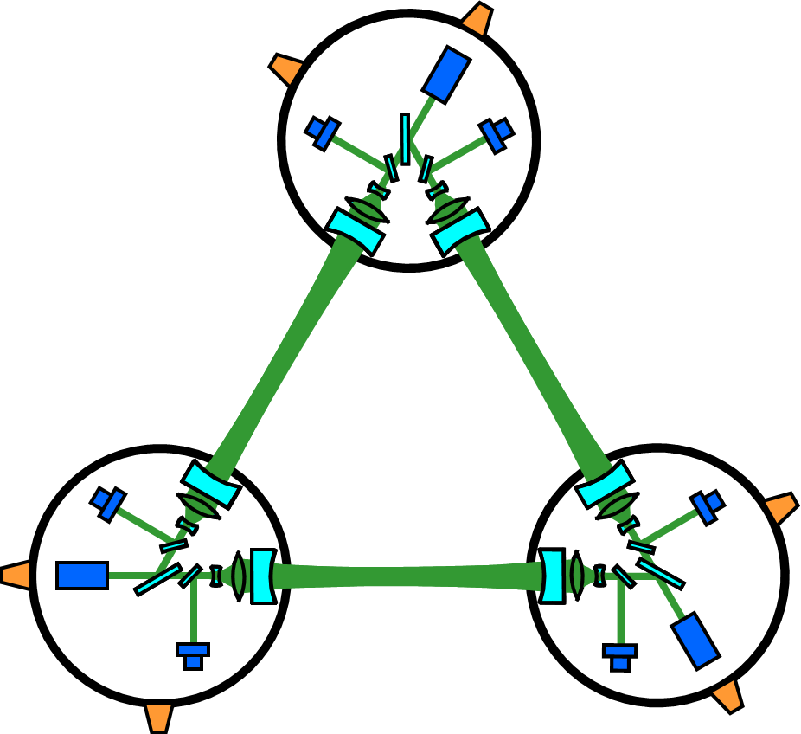
DECIGO
Deci-hertz Interferometer Gravitational Wave Observatory
frequency band: 0.1 Hz - 10 Hz
bridges the gap between LISA and ground-based detectors (GBD)
follow-up for LISA and predictor for GBD
Earth
Sun
1,000 km
FP cavity
Finesse: 10
Orbit
Mirror
R: 0.5 m
M: 100 kg
Thruster
  Seto, Kawamura, Nakamura, PRL, 2001
  Kawamura, et al., PTEP, 2021
Drag-free spacecraft
Laser
P: 10 W
λ: 0.515 μm
Pre-conceptual design

Slide 3
Target sensitivity and aimed science
10⁻¹⁹
10⁻²⁰
10⁻²¹
10⁻²²
10⁻²³
10⁻²⁴
10⁻²⁵
10⁻²⁶
Detect primordial gravitational waves (PGW)
Prediction of NS-NS coalescences
Measure acceleration of expansion of Universe
Reveal formation of intermediate-mass BH
Detect Primordial-BH related GWs
Improve accuracy of general relativity
PBH related
(1000 M z=10)
BH-BH
5 years
Coalescence
3 months
BH-NS
(10 M z=1)
1 cluster
Strain [Hz^{-1/2}]
NS-NS (z=1)
PGW (Ω_{GW}~2×10⁻¹⁵)
Correlation
(3 years)
10⁻³ 10⁻² 10⁻¹ 1 10 10² 10³
Frequency [Hz]

Slide 4
Update of PGW
10⁻¹⁹
10⁻²⁰
10⁻²¹
10⁻²²
10⁻²³
10⁻²⁴
10⁻²⁵
10⁻²⁶
The upper limit of PGW has been reduced by the Planck observations, etc.
The target sensitivity of DECIGO should be improved to enhance the possibility of detection of PGW.
1 cluster
Strain [Hz^{-1/2}]
PGW (Ω_{GW}~2×10⁻¹⁵)
PGW (Ω_{GW}~1×10⁻¹⁶)
Correlation
(3 years)
10⁻³ 10⁻² 10⁻¹ 1 10 10² 10³
Frequency [Hz]

Slide 5
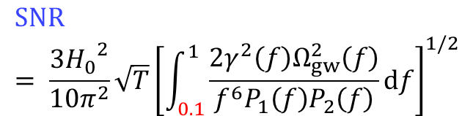
Optimization with quantum noise
The following parameters are optimized for the best SNR for a given mirror radius
        Cavity length
        Reflectivity of mirror
        Laser power (up to 100 W)
Considering only quantum noise
Constant mirror mass is assumed
$$SNR= \frac{3{H_{0}}^{2}}{10π^{2}}\sqrt{T}{\left[\int_{0.1}^{1}{\frac{2γ^{2}\left(f\right)Ω_{gw}^{2}\left(f\right)}{f^{6}P_{1}\left(f\right)P_{2}\left(f\right)}df}\right]}^{1/2}$$
Ω_{GW}~1×10⁻¹⁶
Cut-off frequency for double white dwarf (DWD) noise: 0.1 Hz
Iwaguchi, et al., Galaxies, 2021
Ishikawa, et al., Galaxies, 2021

Slide 6
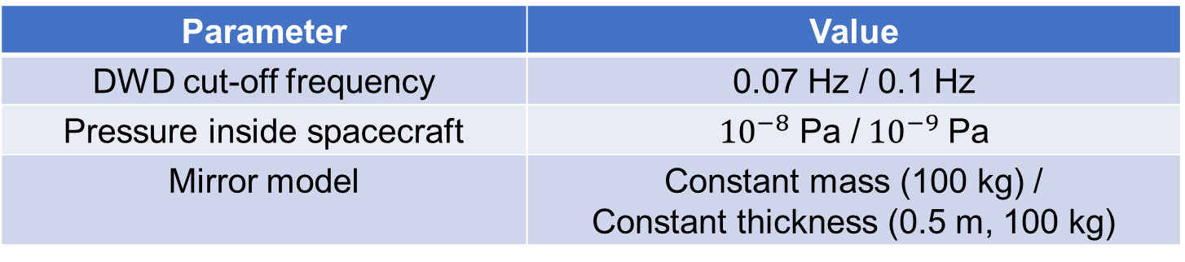
Optimization with thermal noise and DWD noise
Design parameters
For a given radius,
optimize the other parameters
Parameter | Range
Mirror radius | 0～1 m
reflectivity | 0～1
Laser power | 0～100 W
Arm length | No limit
Values/type for each model: 2³ in total
Parameter | Value
DWD cut-off frequency | 0.07 Hz / 0.1 Hz
Pressure inside spacecraft | ${10}^{−8}$ Pa /${ 10}^{−9}$ Pa
Mirror model | Constant mass (100 kg) / Constant thickness (0.5 m, 100 kg)

Slide 7
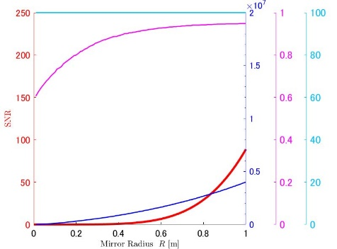
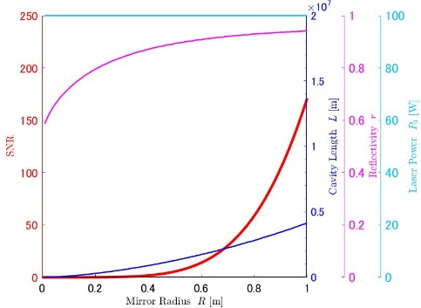
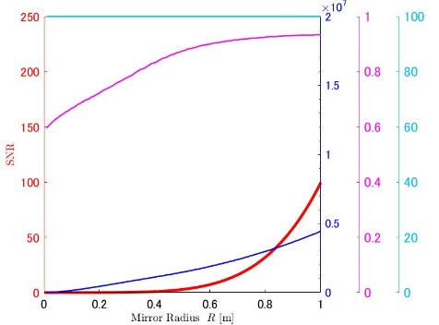
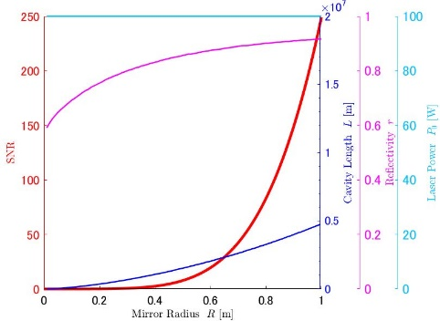
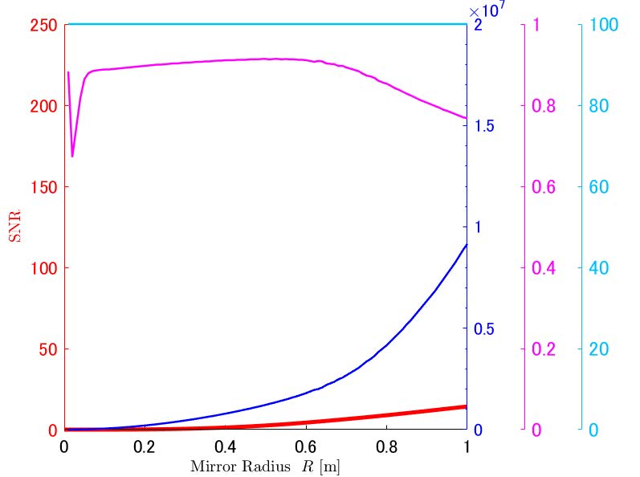

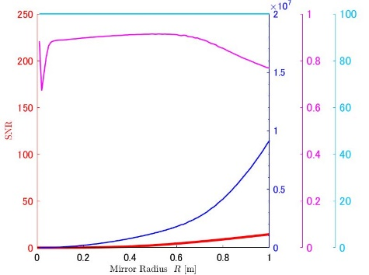
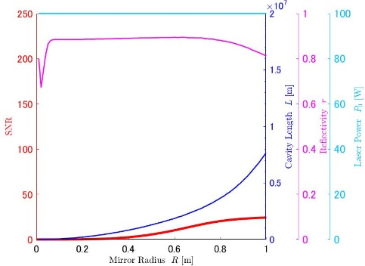
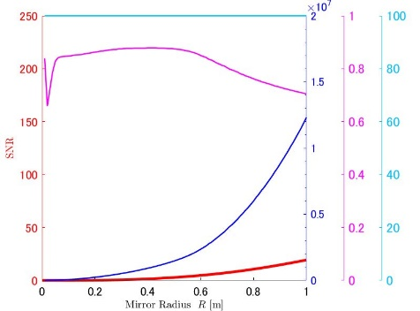
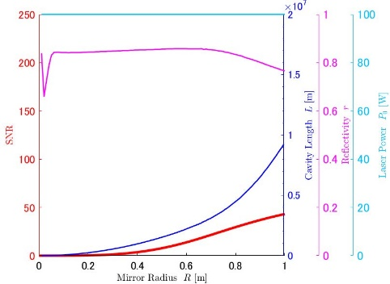
Results
10⁻⁸ Pa
10⁻⁹ Pa
10⁻⁸ Pa
10⁻⁹ Pa
Constant thickness
Cut-off frequency: 0.1Hz Cut-off frequency: 0.07Hz
Constant mass
Kawasaki, et al., Galaxies, 2022

Slide 8
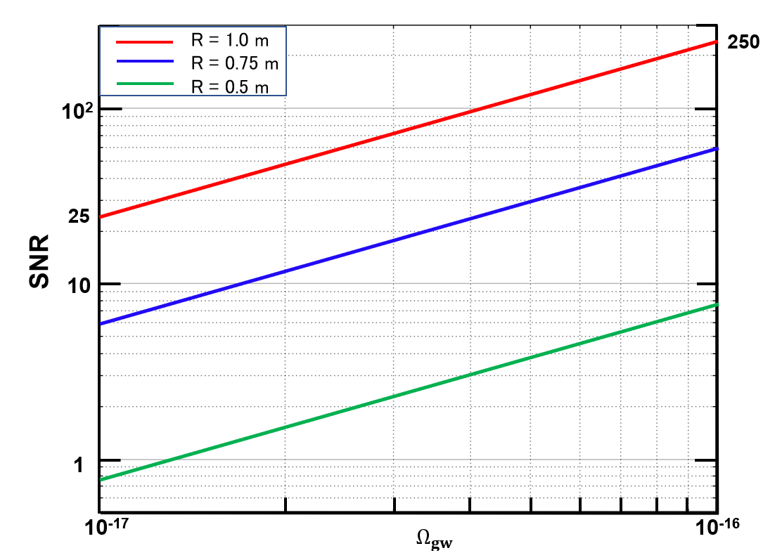
Relationship between
Ω_{GW}@0.1Hz and SNR
Considering quantum noise and thermal noise
Vacuum：10⁻⁹ Pa
DWD cut-off frequency: 0.07 Hz
Mirror: Constant thickness
Ω_{GW}
Predicted by Starobinski model
The current upper limit

Slide 9





Quantum locking with optical spring
Detuned
Detuned
Sub Cavity
Sub Cavity
Main Cavity
~1 m
1,000 km
~1 m
1/11
  Yamada, et al., PLA, 2020
  Yamada, et al., PLA, 2021
  Ishikawa, et al., PRD, 2023
  Posters in this workshop:
  Ishikawa, Shimizu, Umemura, Tsuji

Slide 10
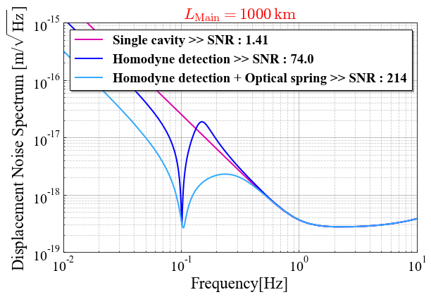
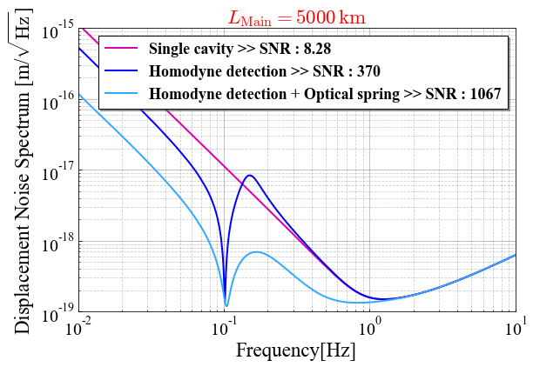
Sensitivity
Considering only quantum noise
DWD cud-off frequency: 0.1 Hz
Mass of mirror: 100 kg
Laser power: 100 W
PGW (Ω_{GW}∼1×10⁻¹⁶)
Radius of mirror: 0.5 m
Arm length: 1,000 km
PGW (Ω_{GW}∼1×10⁻¹⁶)
Radius of mirror: 1 m
Arm length: 5,000 km

Slide 11
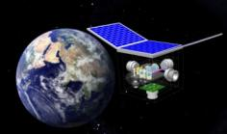
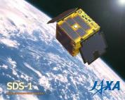
Roadmap
Now updating the roadmap
Target
 |  |  |  |  |  |  |  |  |  |  |  |  | 2034
Mission
Objectives | Test of key technologies |  |  |  |  |  |  |  |  | Detection of GW w/ minimum spec. Test FP cavity between S/C |  |  |  |  |  | Full GW astronomy
Scope | 1 S/C 1 arm |  |  |  |  |  |  |  |  | 3 S/C 3 interferometers 1 cluster |  |  |  |  |  | 3 S/C 3 interferometers 4 clusters
R&D
Fabrication
R&D
Fabrication
R&D
Fabrication
DICIGO Pathfinder
B-DECIGO
SWIM
DECIGO

Slide 12
B-DECIGO
Deci-hertz Interferometer Gravitational Wave Observatory
Prediction of timing and location of NS-NS (BH) coalescence
Revelation of origin of ~30 M BBH
Much better parameter estimation of binaries
Removal of foreground for DECIGO
Verification of technologies for DECIGO
Orbit: TBD
# of clusters: 1
100 km
FP cavity
Finesse: 100
Mirror
R: 0.15 m
M: 30 kg
Thruster
Drag-free spacecraft
Laser
P: 1 W
λ: 0.515 μm
  Nakamura, et al., PTEP, 2016
Conceptual design

Slide 13
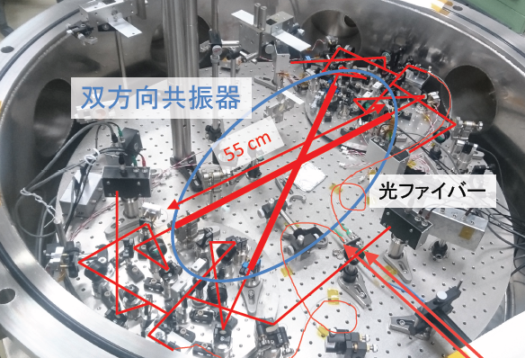
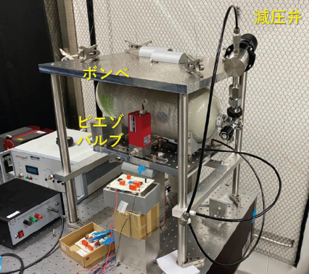
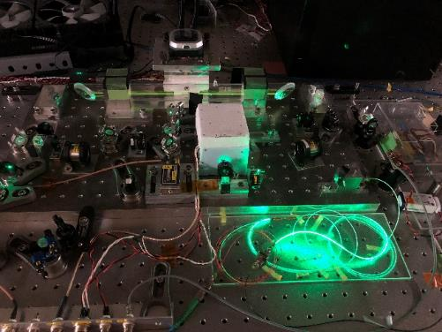
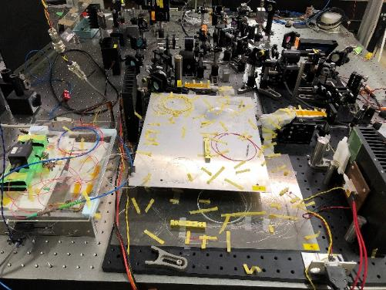
Progress on technologies for B-DECIGO
Dual-pass FP cavity Low-noise thruster
  Posters in this workshop: Ono
High-power stabilized laser

Slide 14
Related mission: SILVIA
SILVIA
  Space Interferometer Laboratory Voyaging towards Innovative Applications
  Candidate for small satellite mission at ISAS/JAXA in collaboration with DECIGO and infrared interferometer team
  Objectives: Demonstration of the formation flying technology and drag-free technology
Recent progress
  Feb. 2020: SILVIA mission proposed to ISAS
  Aug. 2020: Approved to proceed to “Idea implementation process”
  Dec. 2022: Approved to proceed to “Mission definition phase”
  Now: Study for mission definition underway

Slide 15
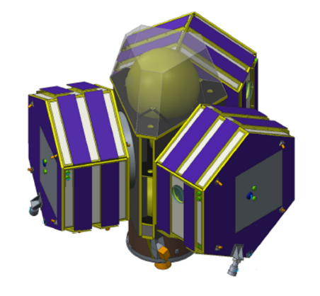
Summary
Image of
B-DECIGO
©NEC
DECIGO will accomplish a variety of science, including direct detection of PGW, for which we are updating DECIGO design.
B-DECIGO will verify technologies for DECIGO as well as accomplish a variety of science, including frequent prediction of NS-NS.

