Slide 1
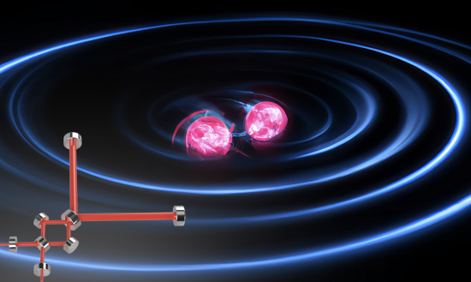

Gravitational Wave Detector for Post-Merger Neutron Stars
Teng Zhang, Huan Yang, Denis Martynov , Jerome Degallaix, Xinyao Guo, Patricia Schmidt,, Haixing Miao
https://doi.org/10.1103/PhysRevX.13.021019
GWADW 2023

Slide 2
What is at high frequencies?
CE-20km, 1.5MW
Quantum shot noise
Large space to explore

Slide 3
Why is high frequency difficult/different?
The speed of light is limited.
Antenna response of MI degrades toward high frequencies.
See more, https://doi.org/10.1103/PhysRevD.96.084004
Normal incidence.

Slide 4
Michelson interferometer at frequency c/2L
First half period
Second half period
L/c
L/c

Slide 5
Why is high frequency different/difficult?
The speed of light is limited.
Antenna response of MI degrades toward high frequencies.
Limited bandwidth of FP cavity in arms.
Coupled SEC-Arm resonance/SEC detuning
Negative dispersion schemes
Resonance shift
Bandwidth expansion
Optical losses in the SEC limit the sensitivity at high frequencies.

Slide 6
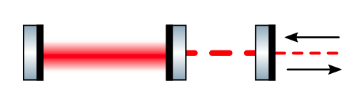
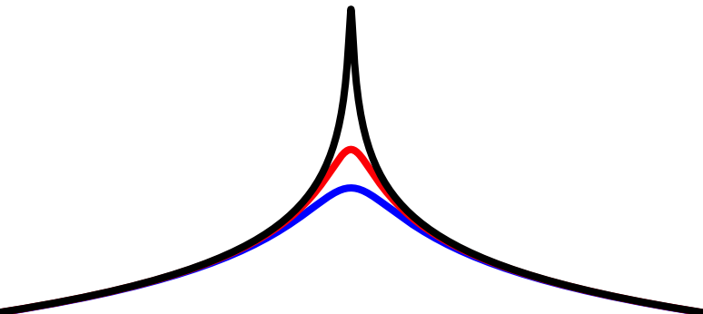
SEC loss limit
Loss
CE-20km, 1.5MW
Arm SEC
Length independent
Response of arm cavities to strain

Slide 7
Research directions
Improve high-frequency sensitivity
Scale based:
Long arm
Technology based:
High power
Low loss
New configuration?

Slide 8
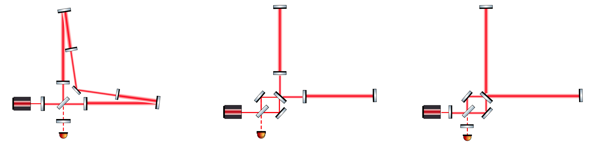
New configuration?
Loss
Loss
Loss
Loss
Triple coupled cavity in the arms
Triple coupled cavity in arms
A folded L-shaped cavity as the arm
Teng Zhang et al Phys. Rev. D 104, 122003
Teng Zhang et al Phys. Rev. X 13, 021019
Signals still generate in one cavity, where high frequency components get suppressed.
Signals generate in one cavity, where high frequency components get enhanced.

Slide 9
L-resonator (fox-smith interferomter) at frequency c/4L
First half period
Second half period
2L/c
2L/c

Slide 10
L-resonator (fox-smith interferomter)
Clockwise
Counter clockwise

Slide 11
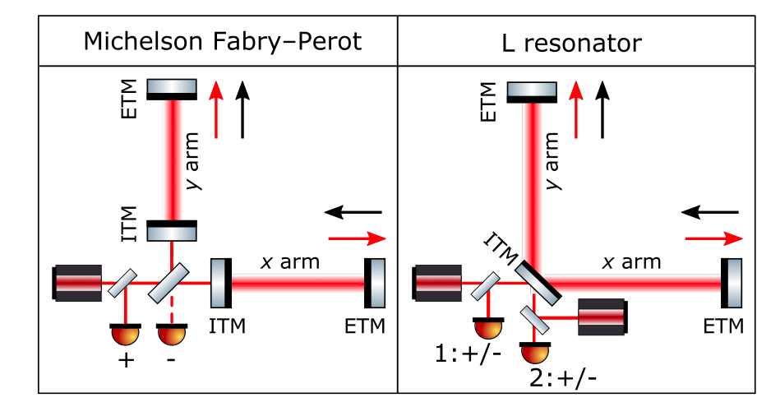
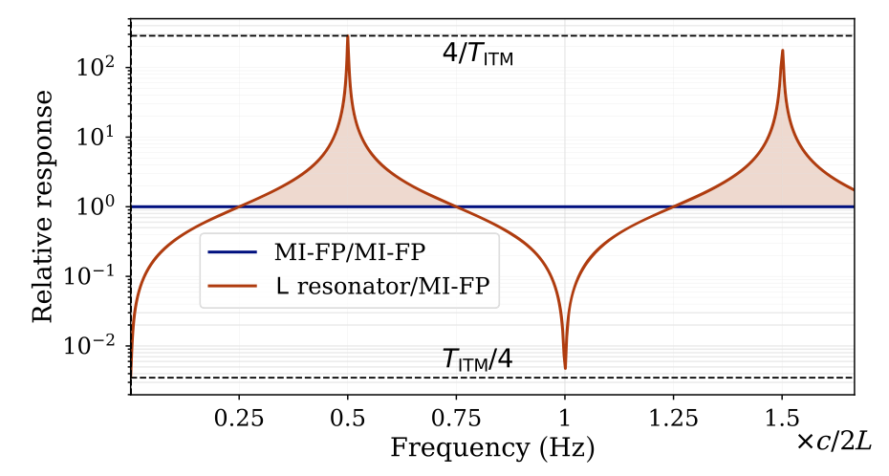
L-resonator (fox-smith interferomter)

Slide 12
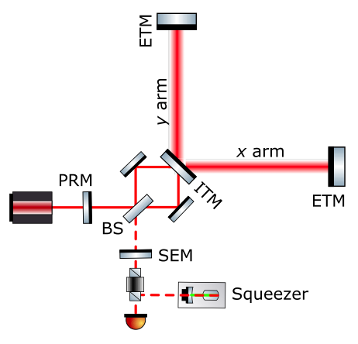
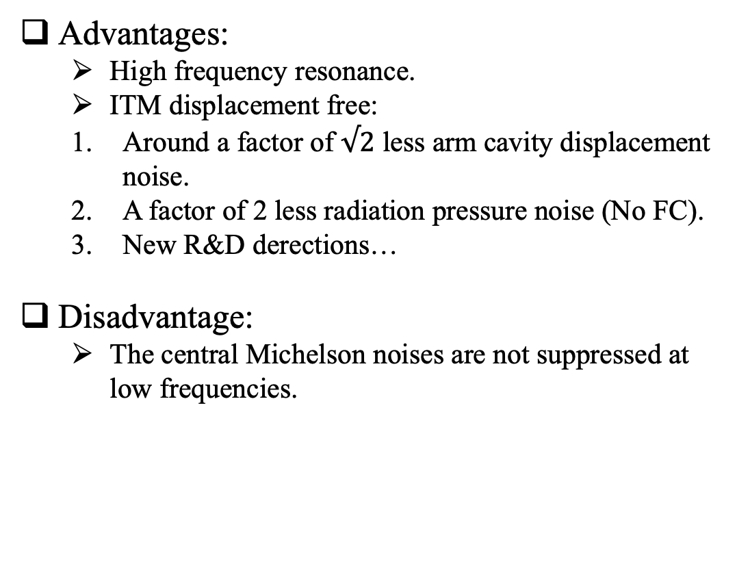
Dual recycled L-resonator Interferometer
Advantages:
  High frequency resonance.
  ITM displacement free:
  Around a factor of $√2$ less arm cavity displacement noise.
  A factor of 2 less radiation pressure noise (No FC).
  New R&D derections…
Disadvantage:
  The central Michelson noises are not suppressed at low frequencies.

Slide 13
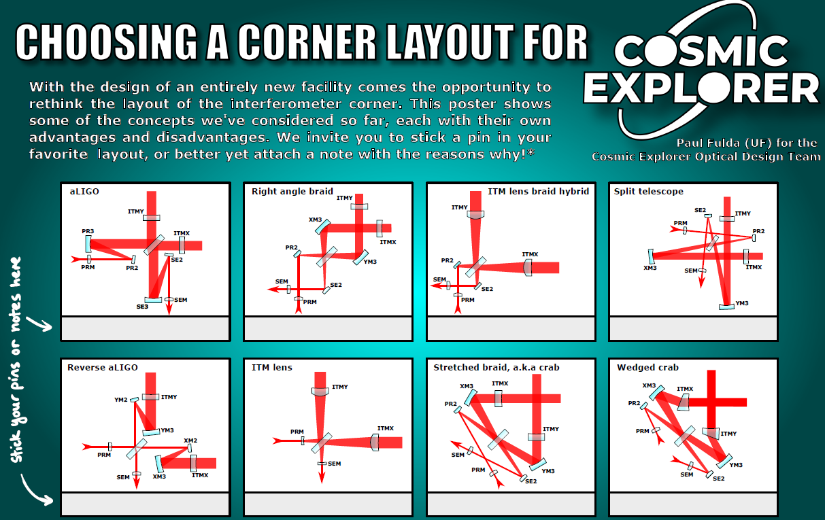
An upgrade option of CE?
It can fit the one+ of the optical layouts of CE.
DCC - G2300358

Slide 14
Dual recycled L-resonator Interferometer
CE-20km, 1.5MW
New-25km, 1.5MW

Slide 15
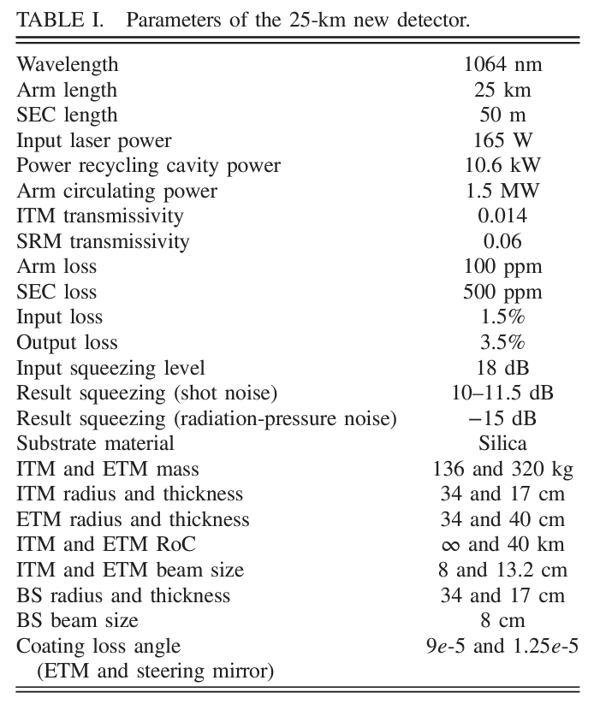
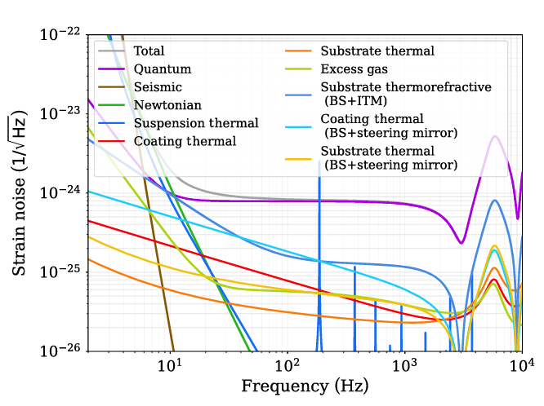
Dual recycled L-resonator Interferometer

Slide 16
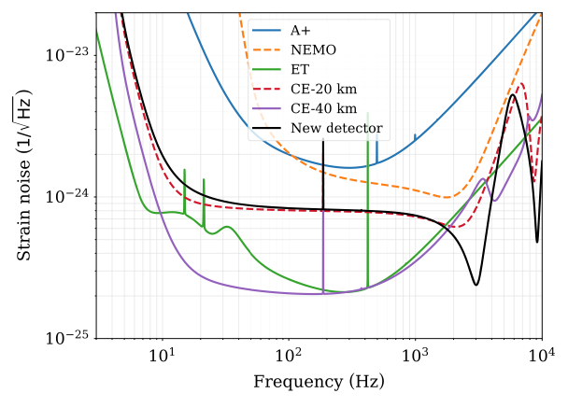
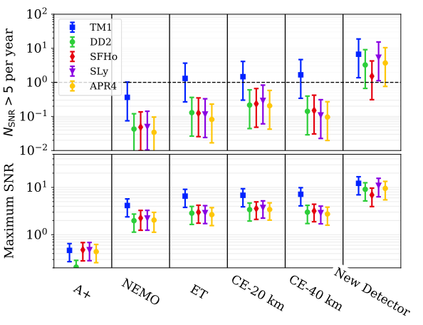
Sensitivity and science cases
Sensitivities
SNR & detection rate for PM-NS

Slide 17
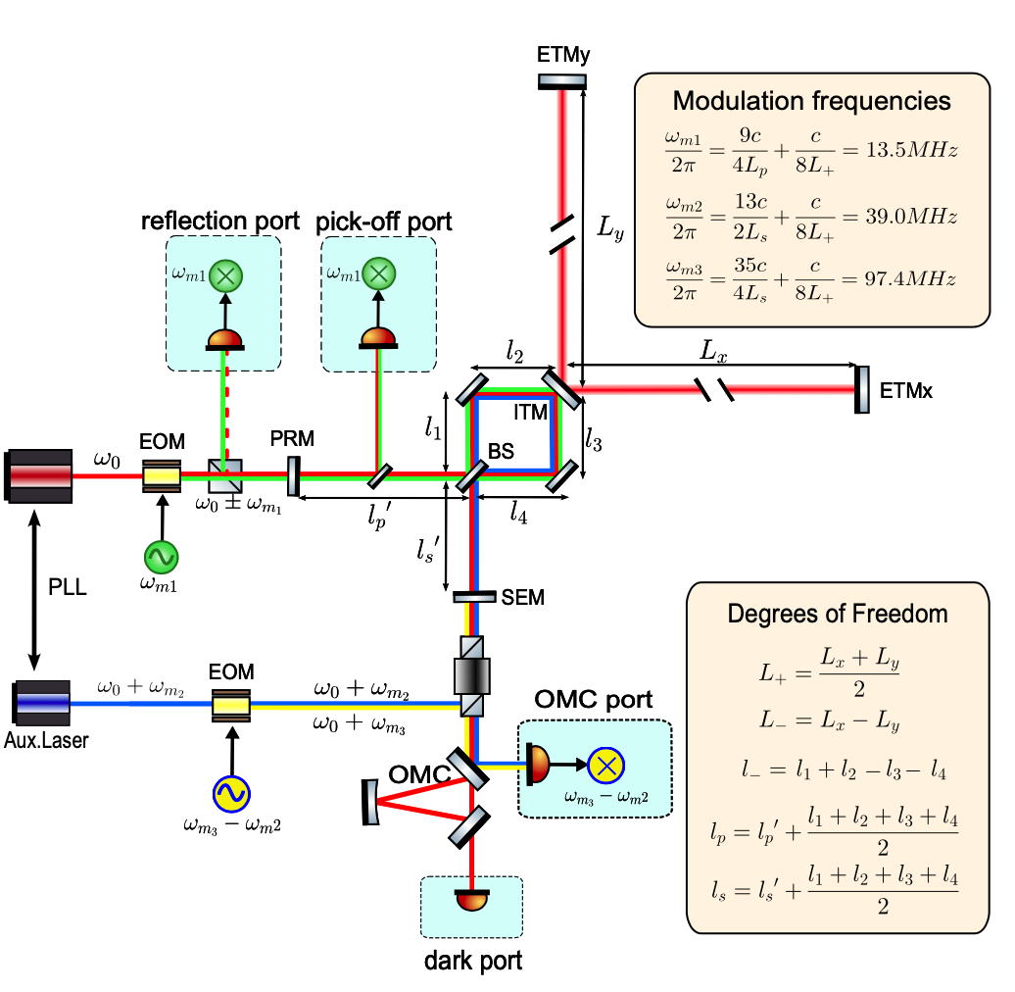
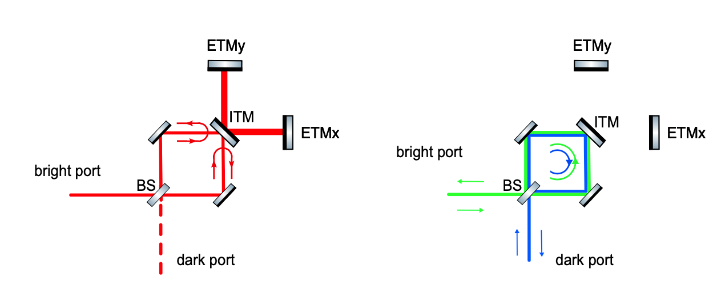
Sensing & control idea
One less degree of freedom (Michelson) to be controlled.
Schnupp asymmetry is not valid, SEC length is sensed by RF from the dark port (compatible with SQZ path)
Hierarchy control for PRC length and common arm length.
Xinyao Guo etal., P2300145

Slide 18
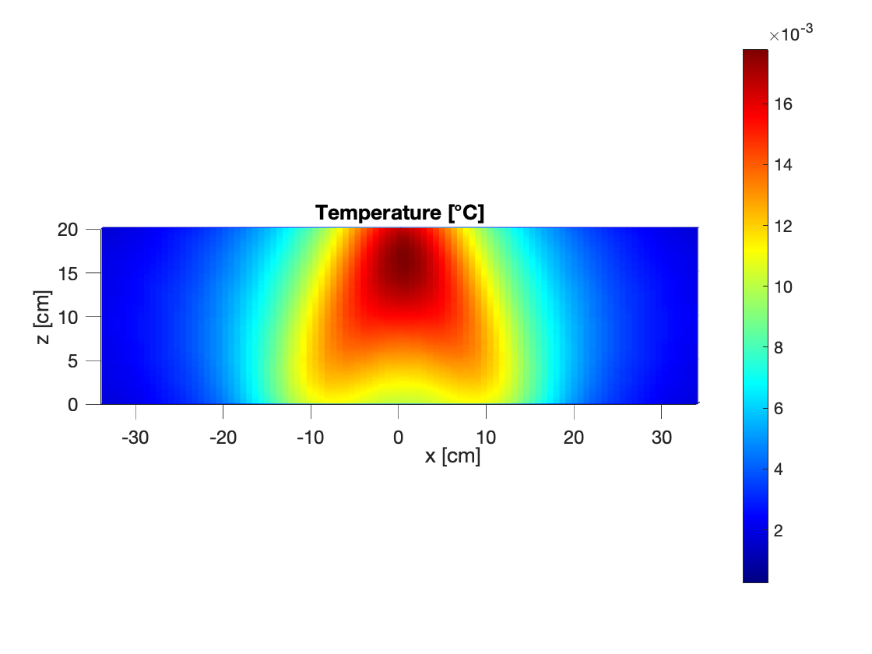
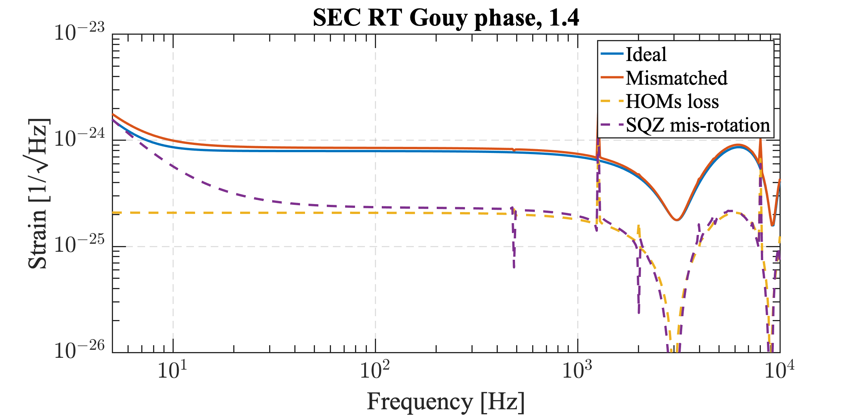
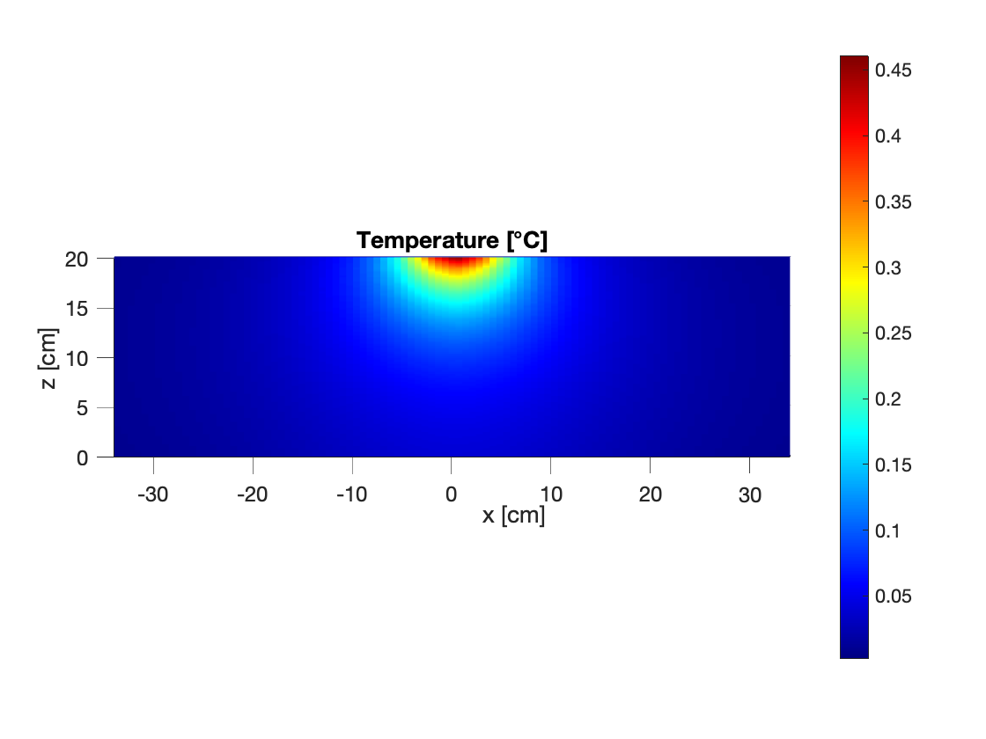
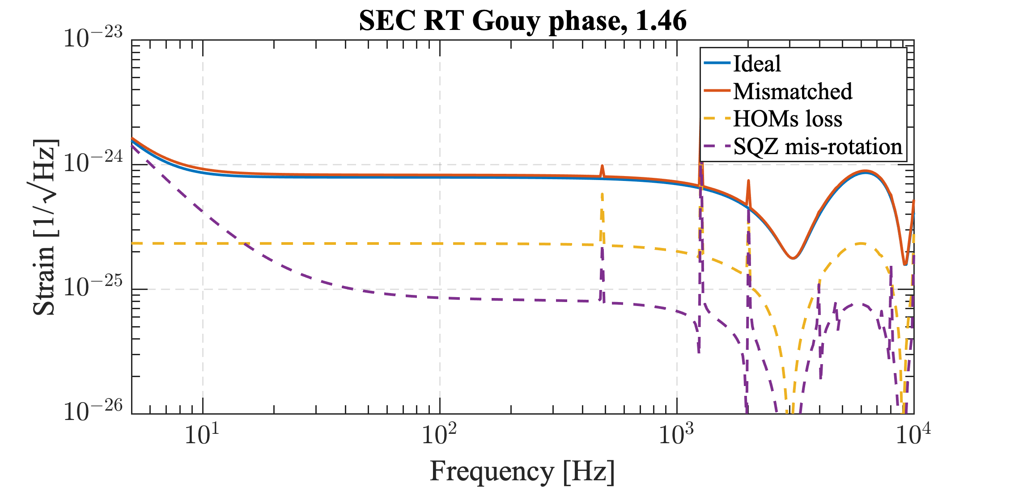
Thermal lensing & QN
Substrate absoprtion
TCS to be studied.
Here simply assume overal a factor of 8 OPD suppression.
The thermal lensing impact is case by case.
The igh frequency sensitivity is robust, while the low frequency sensitivity is susceptible.
Coating absoprtion

Slide 19
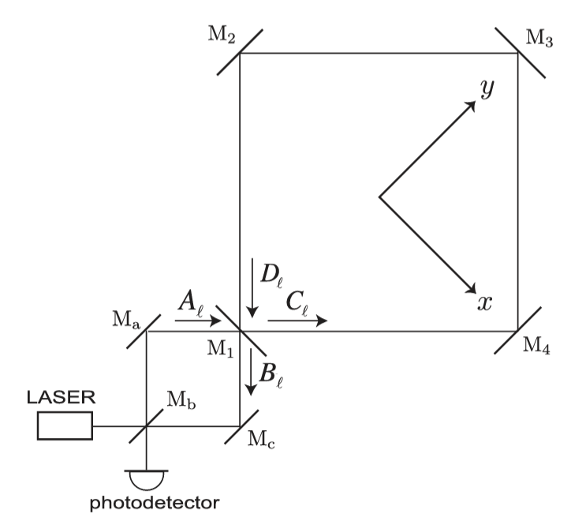
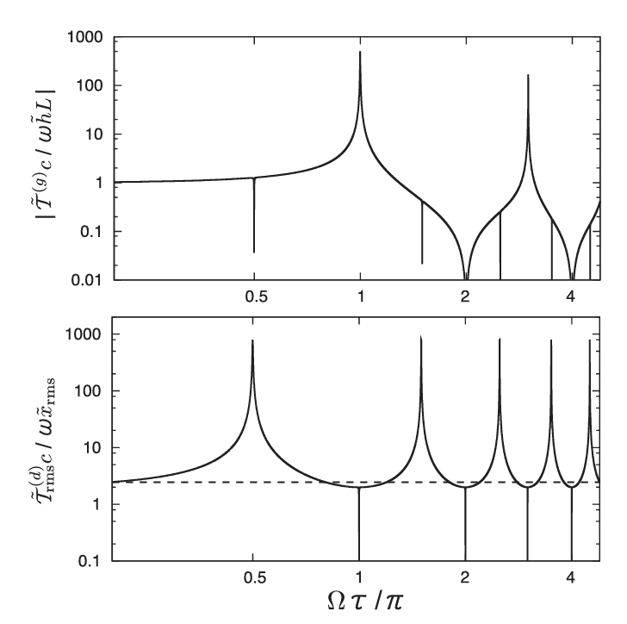
MHz signal detection
L-resoantor table-top detector
High frequeny GW response (c/4L).
Higher power (PRC + L-resonator) vs. Michelosn (PRC+ arm)
Narrow band is better for correlation measurement, e.g. of stochostic signal.
Sensitivity will be limited eventually by mirror thermal noise (bulk modes).
Resonant speed meter (displacement free interferometer)
High frequeny GW response (c/2L).
Higher power (PRC + Ring-resonator) vs. Michelosn (PRC+ arm).
Narrow band is better for correlation measurement, e.g. of stochostic signal.
Thank you!
Atsushi Nishizawa etal. Phys. Rev. Lett. 101, 081101 – Published 19 August 2008

