Slide 1
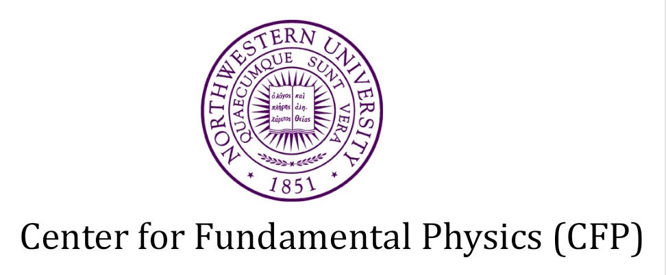
Detecting high frequency gravitational waves with optically levitated microdisks
George Winstone - Geraci Group

Slide 2
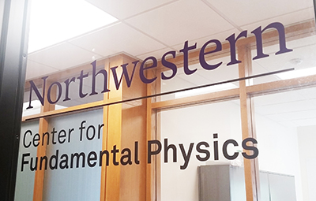
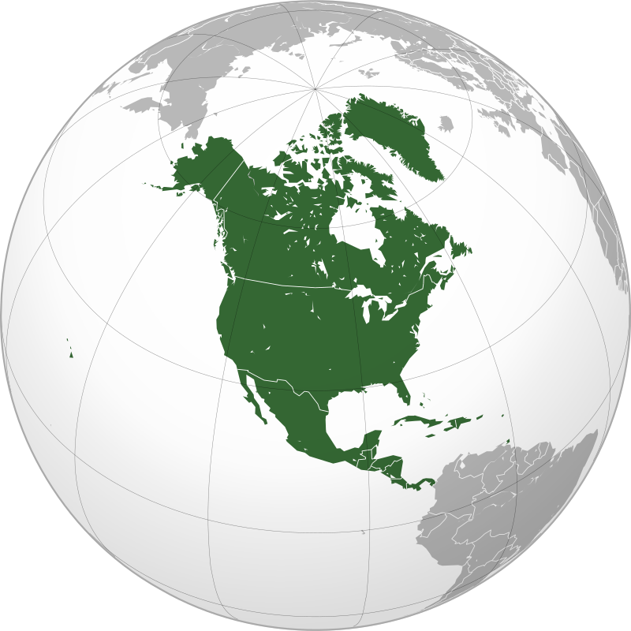
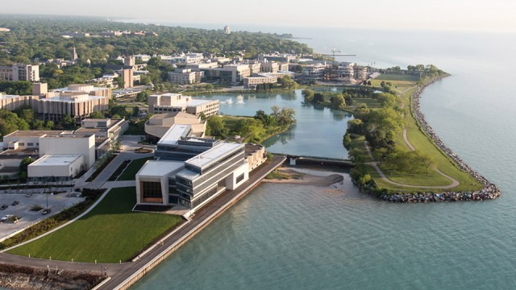

Slide 3
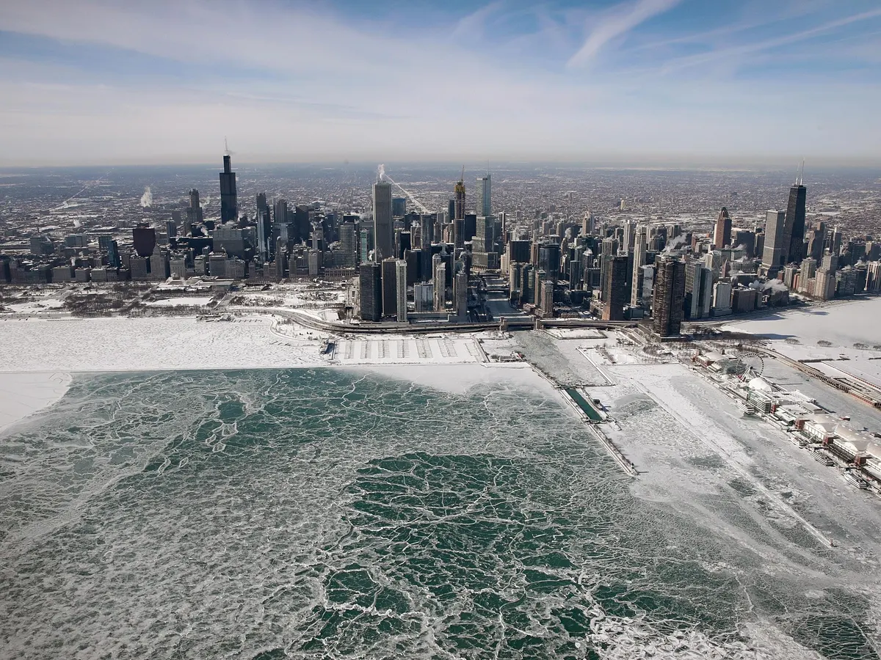
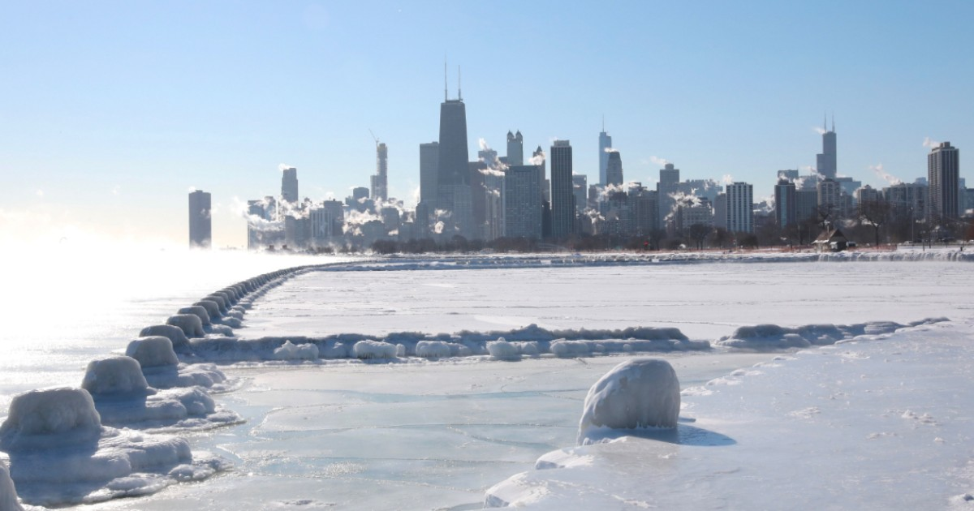
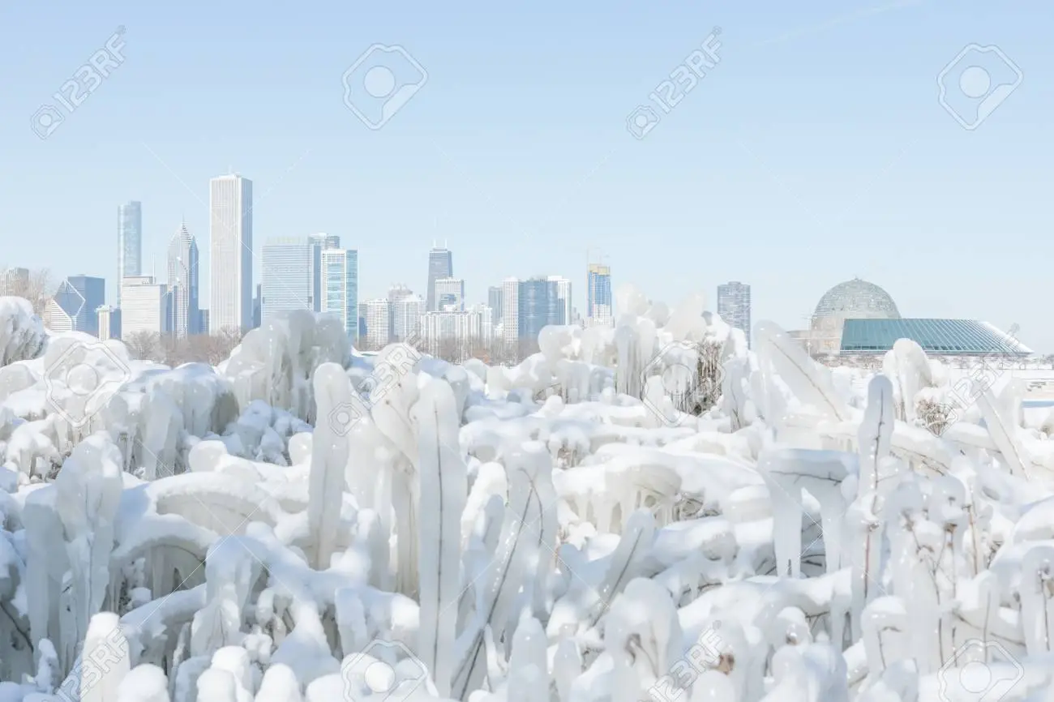

Slide 4
Structure of this talk
>Levitated Optomechanics introduction/refresher
>Gravitational waves context
>The Levitated Sensor Detector (LSD) gravitational wave experiment at Northwestern
>Preliminary characterisation of the test mass
>Ongoing technical challenges for first engineering run
>Summary
>Questions

Slide 5
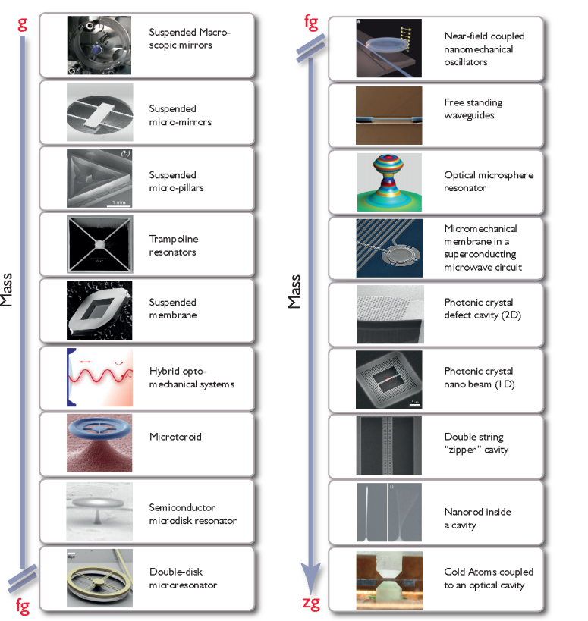
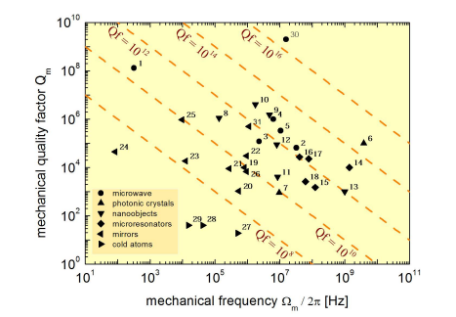
Optomechanics parameter space
Add q f m products to this slide
“Cavity Optomechanics” - https://arxiv.org/pdf/1303.0733.pdf

Slide 6
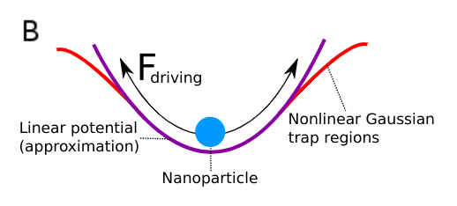
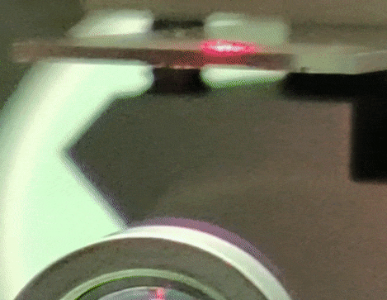
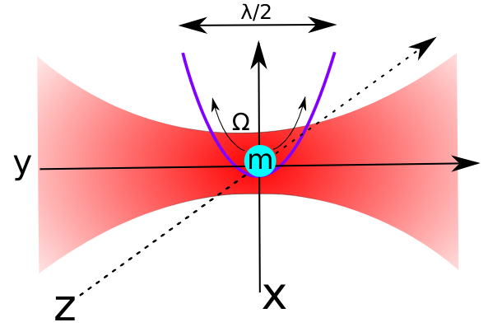
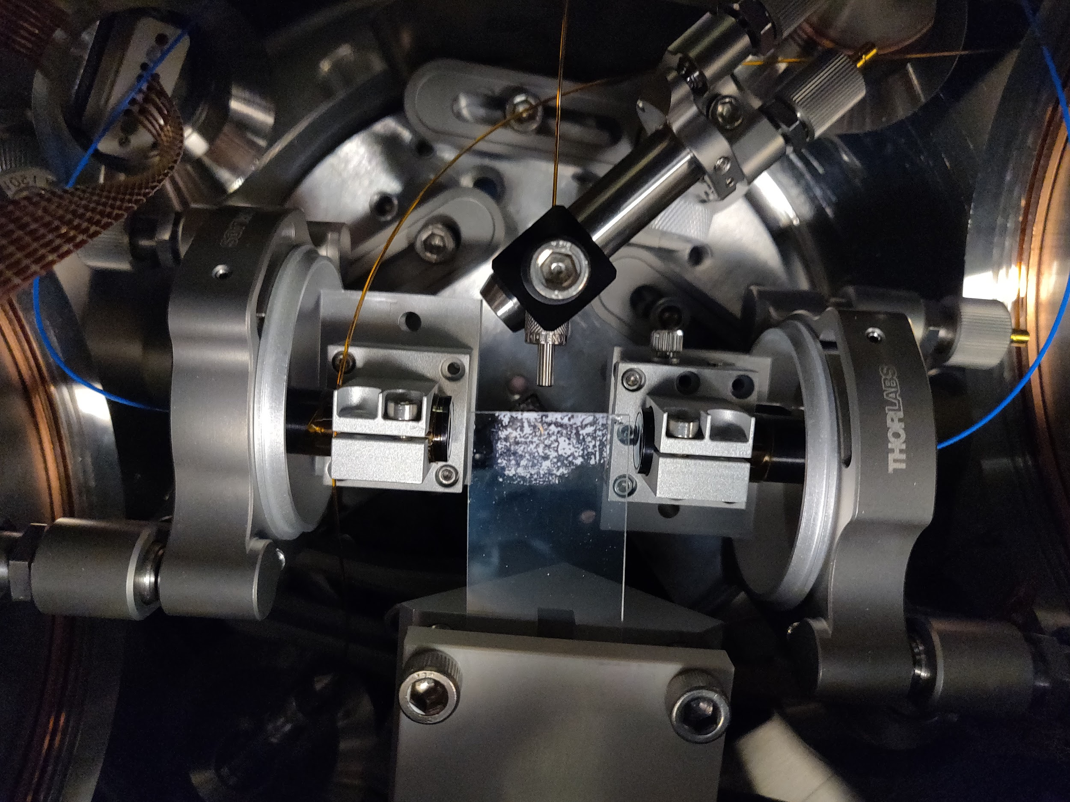
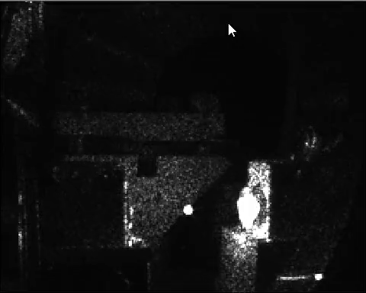
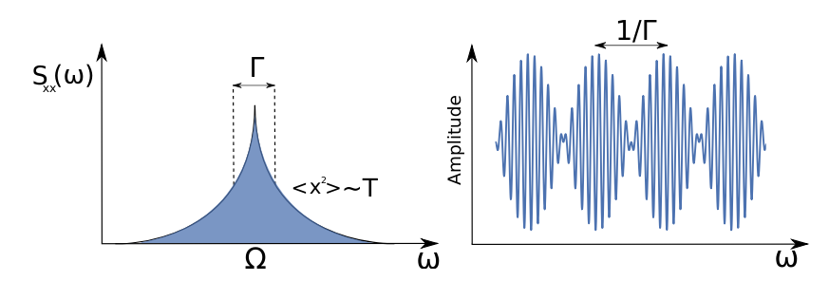
Levitated optomechanics - brief introduction
Polarisable dielectric particles act as high field seekers - trapped in laser focus
When particle is approximately spherical, acts as 3 decoupled harmonic oscillators.
Characteristic length scale 10’s nanometers to 10’s microns.
High Q factors ~ 10^10 demonstrated, 10^12 predicted
Can reduce the effective motional ‘temperature’ of such objects through feedback schemes
Ground state recently achieved in the field.
Expected future goals include matter wave interferometry - huge macroscopicity, expected to challenge present models of the limits of quantum mechanics.

Slide 7
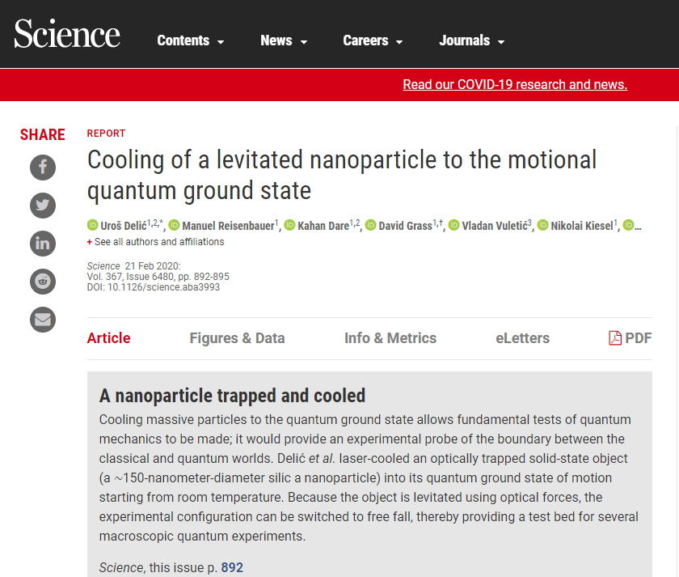
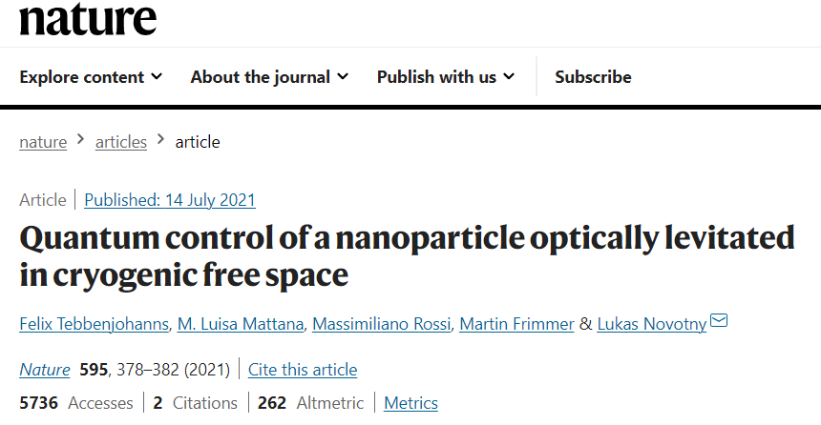
(Ground) state of the art:
Coherent scattering:
Measurement based cooling:
Notes:
Coherent scattering

Slide 8
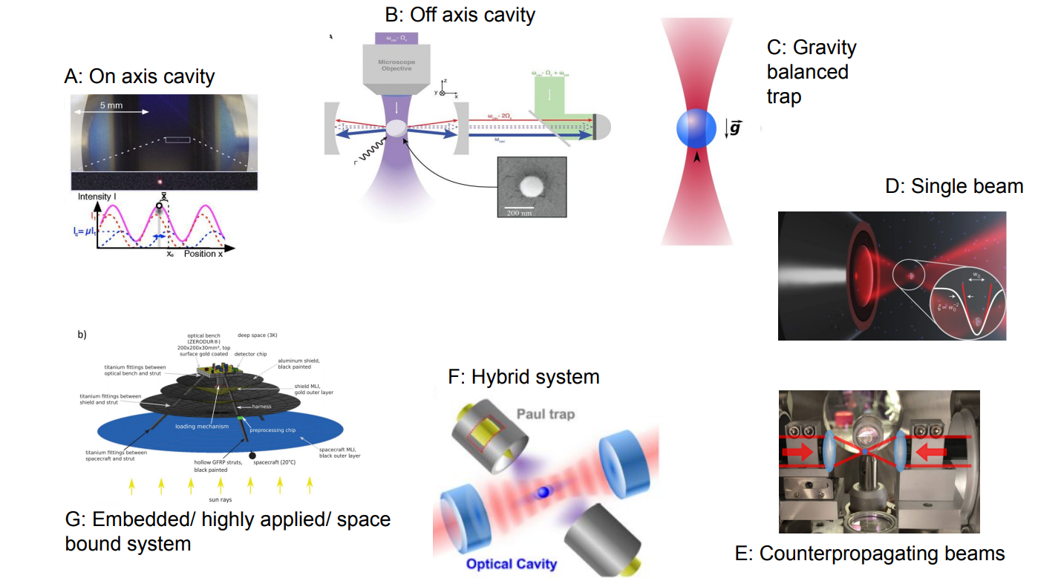

Slide 9
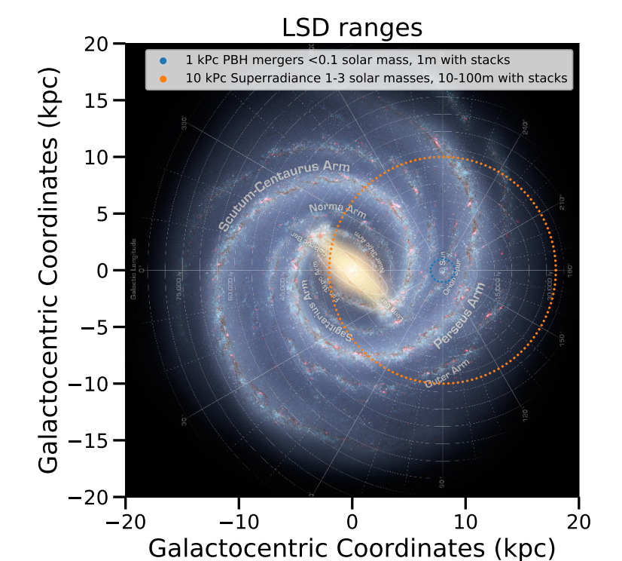
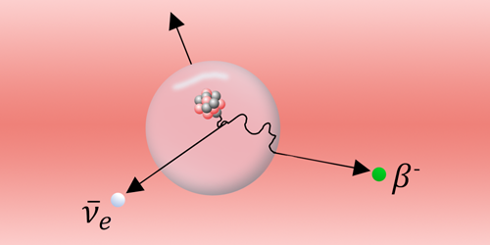
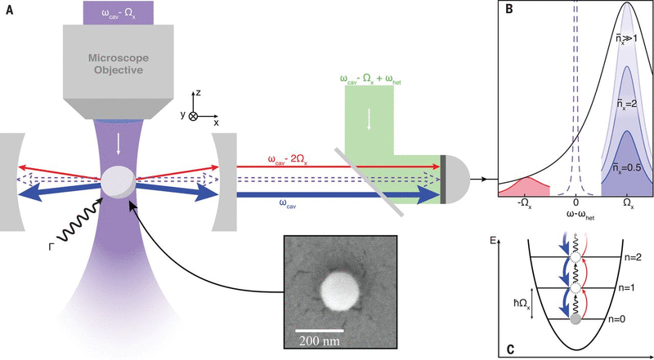
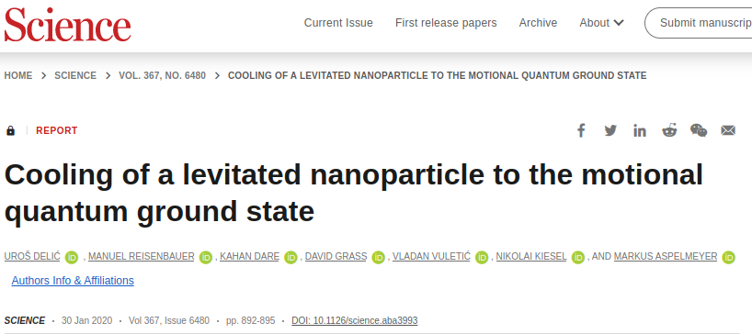
Tabletop low energy experiments (specifically levitated optomechanics) can contribute to wide ranging areas of physics!
Particle physics
Astrophysics
Quantum fundamentals

Slide 10
Levitated optomechanics - state of the art
Ground state - yes
Matter wave interference - no (perhaps next ten years)
Qubit copied on and off system - not yet (happened in membranes)
Heisenberg limited detection efficiency - yes
Unique features compared to other optomechanical systems - can turn the potential on and off. Simple mode structure
Notes:
Sensitivity comparison to other systems - well depends on how you measure it - ref markus’s review paper.
Why levitation - can turn potential on and off - (go shopping in Dave’s and andys paper for good ideas….like gigantic controllable arrays of the things…… )

Slide 11
How sensitive?
“Searching for new physics using optically levitated sensors” - David C. Moore, Andrew A. Geraci https://arxiv.org/abs/2008.13197

Slide 12
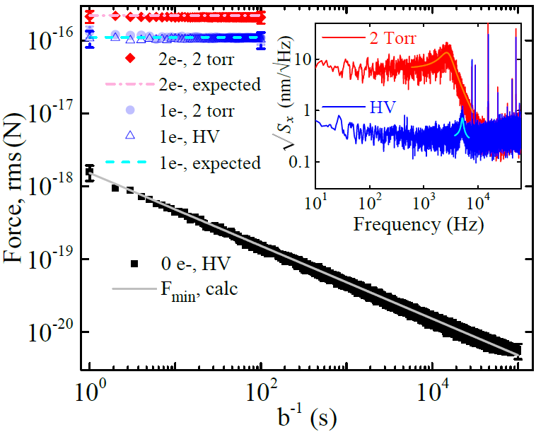
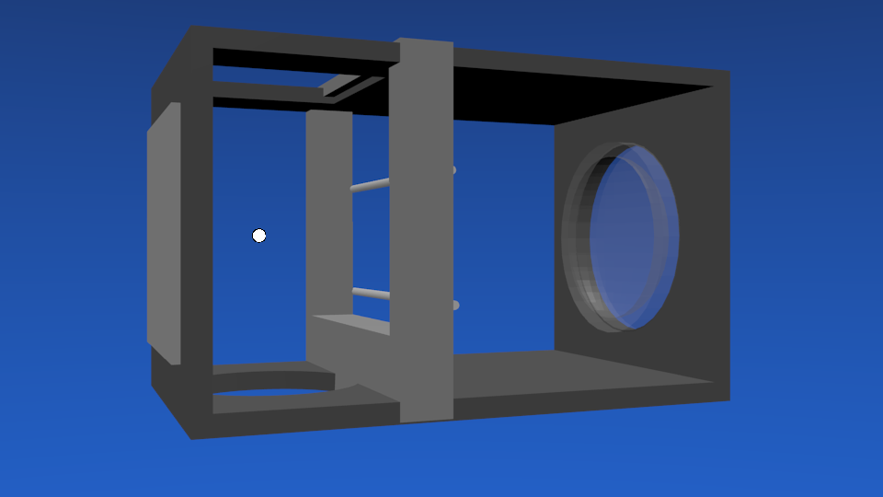
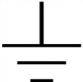
Previous sensitivity work: Zeptonewton force sensing
Electrostatic Calibration
90% of beads are neutral
Neutral beads stay neutral
Charge stays constant over days
6 zN
Calibration electrodes
Sensitivity
G. Ranjit, et.al. , Phys. Rev. A, 93, 053801 (2016).
See also David Moore (Monteiro, Fernando, et al. "Optical levitation of 10-ng spheres with nano-g acceleration sensitivity." Physical Review A 96.6 (2017): 063841.) and Markus Aspelmeyer (Magrini, Lorenzo, et al. "Real-time optimal quantum control of mechanical motion at room temperature." Nature 595.7867 (2021): 373-377.) for good limits on acceleration and displacement sensitivity respectively.

Slide 13
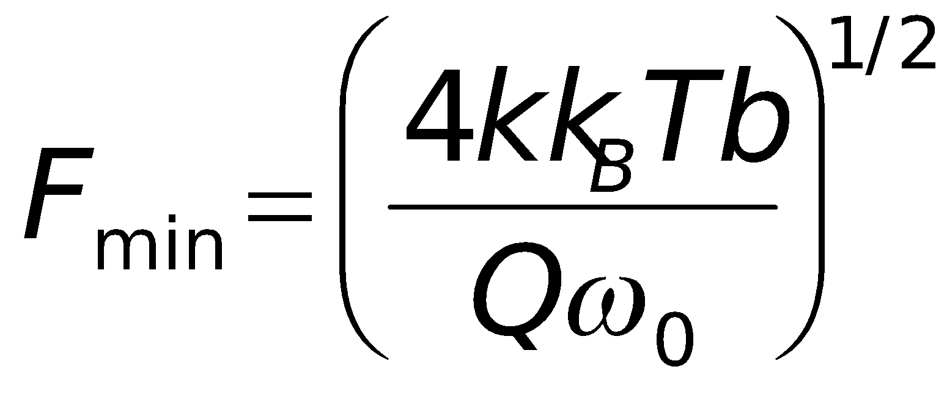
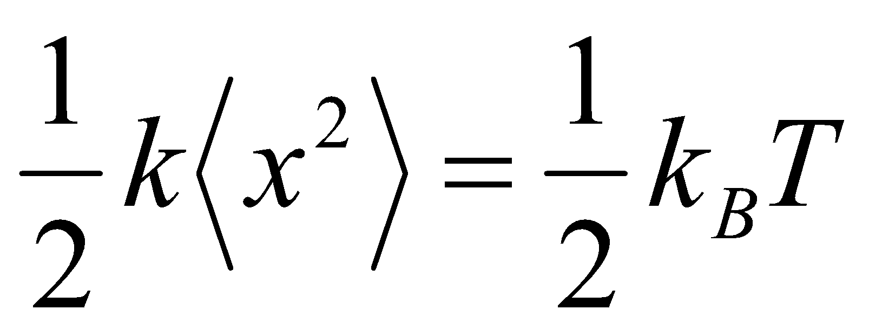
1st force sensitivity limitation: thermal noise
Brownian motion – random “kicks” given to particle due to thermal bath
Background gas
Microsphere
Random “kicks” are given to cantilever due to finite T of oscillator
Notes:
This is the classic bound, does not include quantum fischer information etc https://arxiv.org/pdf/2005.14642.pdf - good summary of QFI

Slide 14
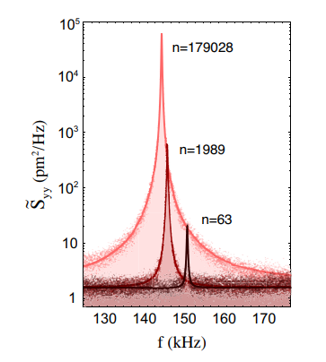
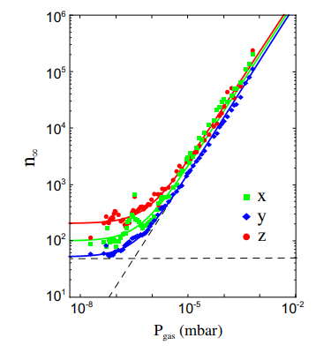
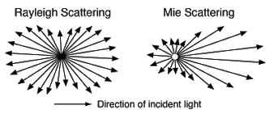
Photon recoil
COM temperature determined by balance of heating and cooling channels [1]:
Best numbers: ground state - Aspelmeyer and Novotny groups. -[2]
In general, force/acceleration/position sensitivity also determined by largest set of random numbers flowing into system.
Semi random momentum impulses from multi-directional scatter, also throws light outside of cavity mode.
[1] - Jain, Vijay, et al. "Direct measurement of photon recoil from a levitated nanoparticle." Physical review letters 116.24 (2016): 243601. [2] - Delić, Uroš, et al. "Motional Quantum Ground State of a Levitated Nanoparticle from Room Temperature." arXiv preprint arXiv:1911.04406 (2019).

Slide 15
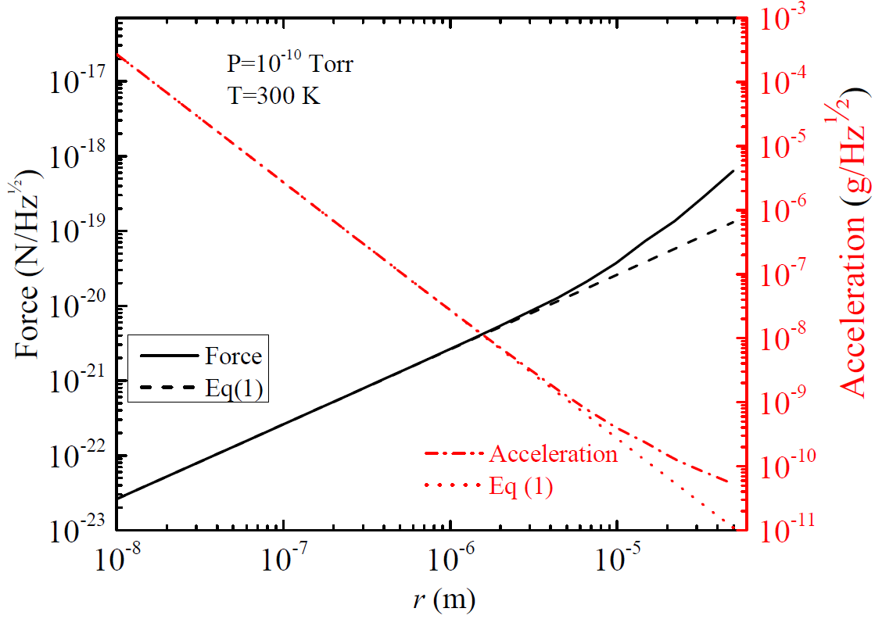
Photon recoil limit determines projected force sensitivity for sphere geometries
Photon recoil heating
Seen recently by
Novotny group
V. Jain et. al.,
PRL 116, 243601 (2016)
Photon recoil high dependant on particle geometry outside of Rayleigh regime
20 zN/Hz^{1/2} Gieseler, Novotny, Quidant (Nature Phys. 2013)
Z. Yin, A. Geraci, T. Li, Int. J. Mod. Phys. B 27,1330018 (2013).

Slide 16
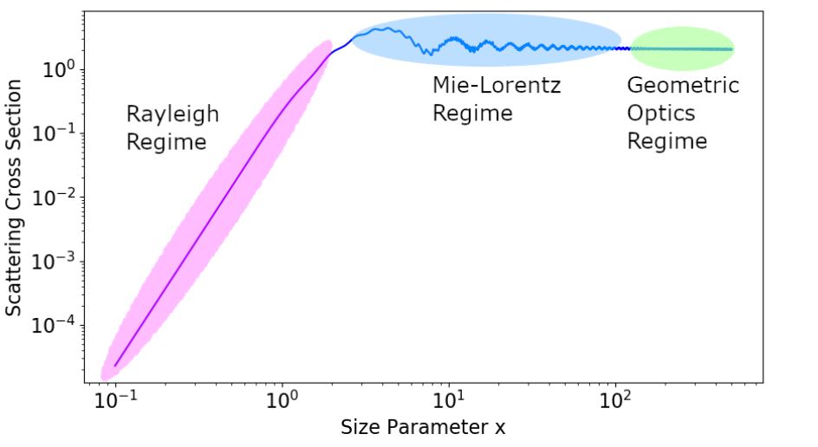

Slide 17
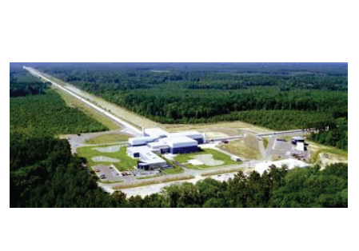
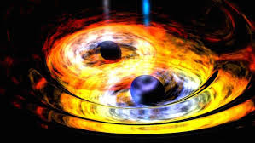
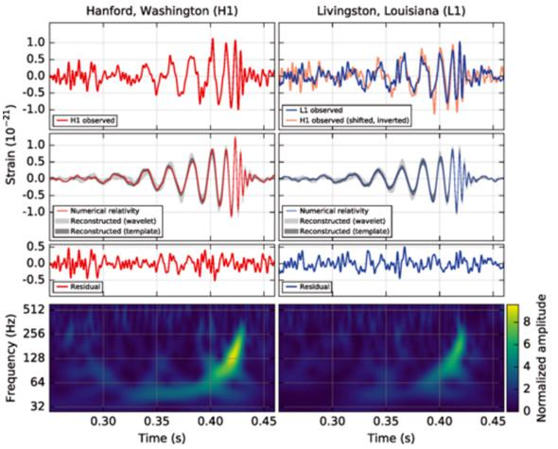
Gravitational waves
Ripples in space-time
Discovered by LIGO Sep 2015 !
Sources:
Inspirals of astrophysical objects
Inflation, Phase transitions, etc.
B. P. Abbott et al. (LIGO Scientific Collaboration and Virgo Collaboration)
Phys. Rev. Lett. 116, 061102 (2016).

Slide 18
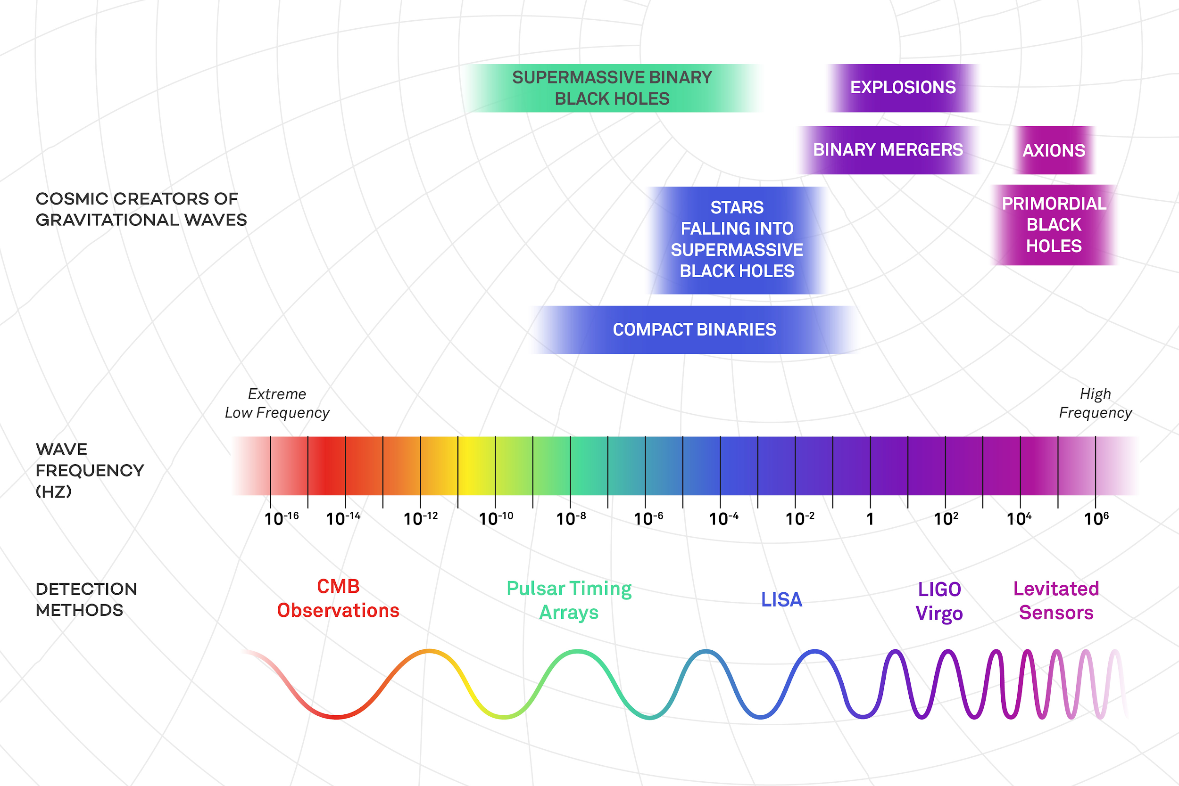
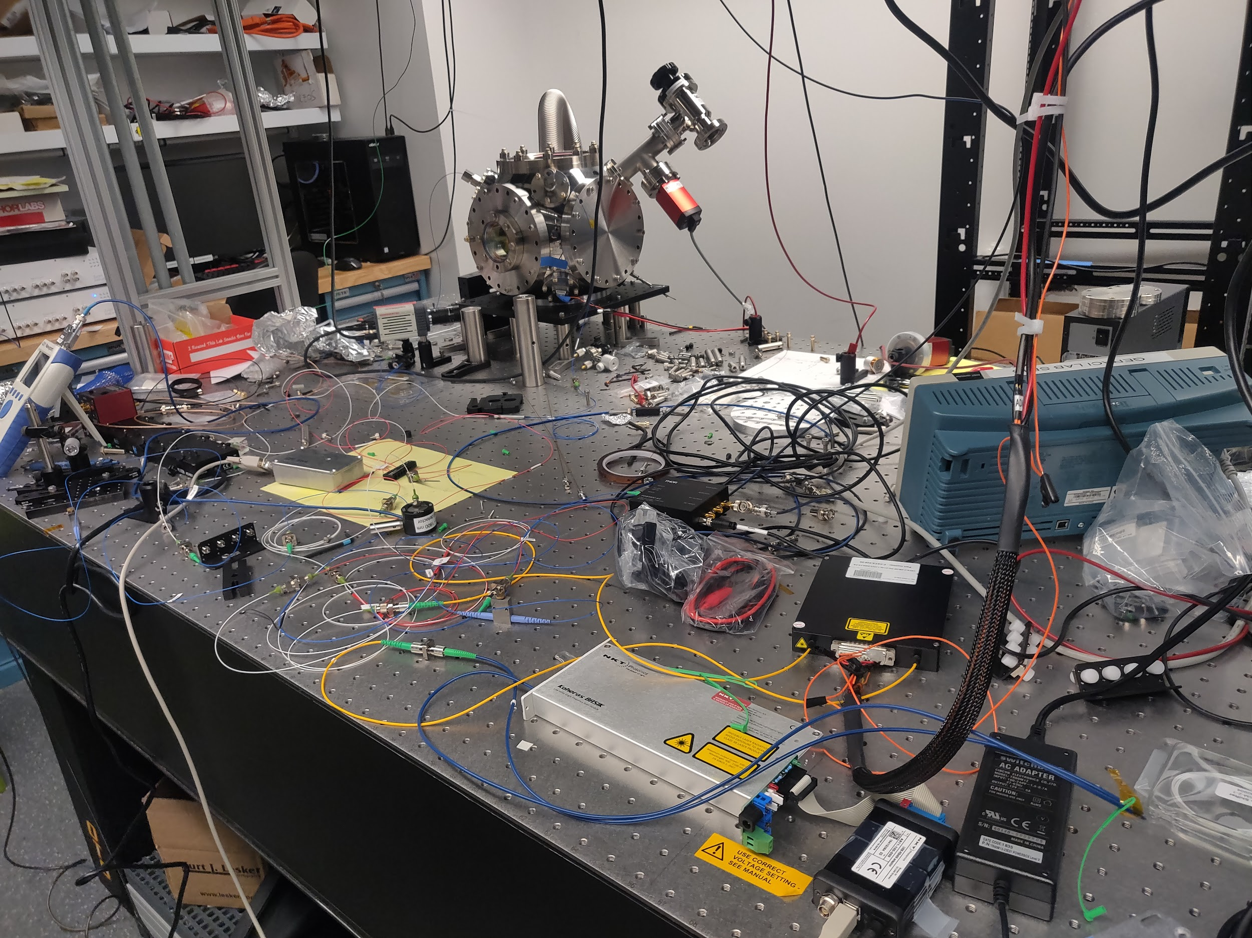
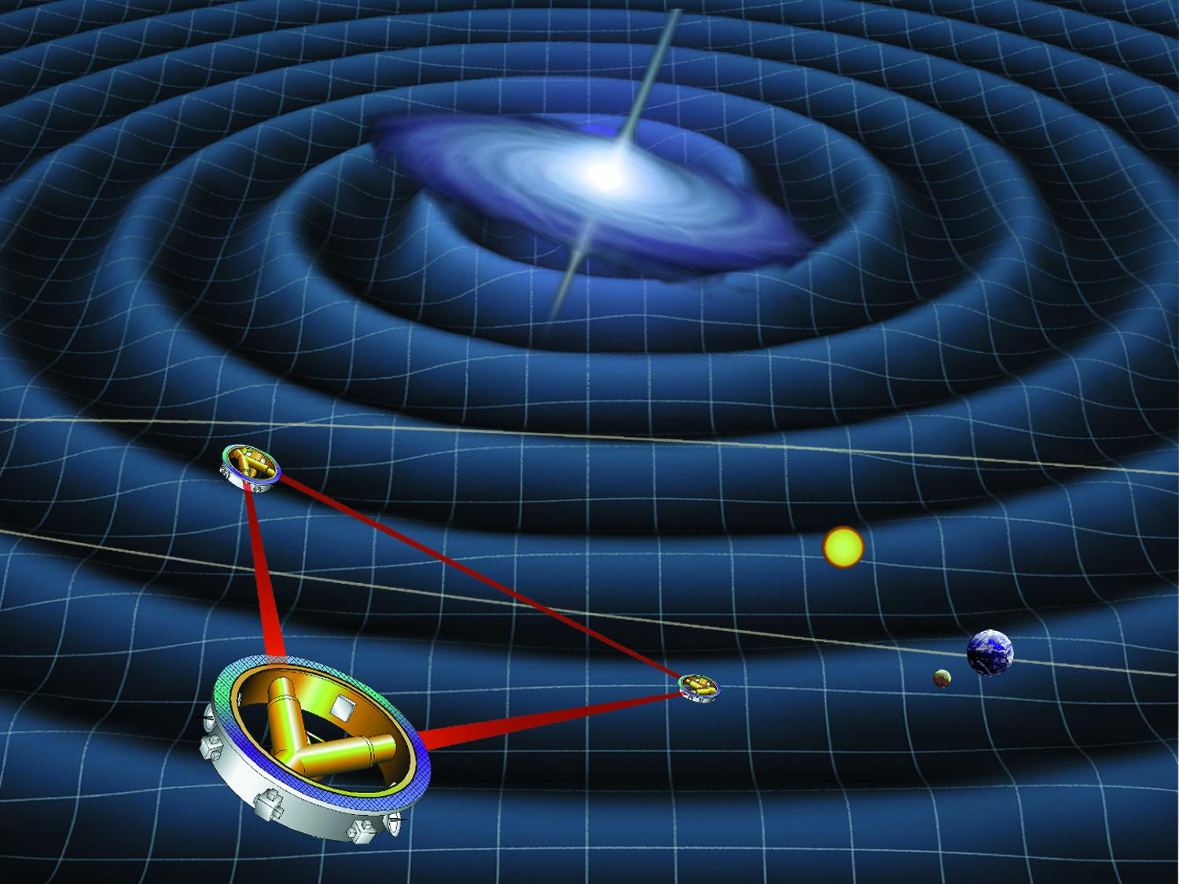
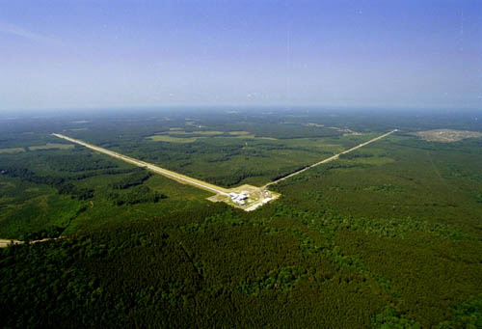
Frequency landscape for gravitational waves
Notes:
Relatively exotic physics and sources in contrast to existing gravitational wave studies, sub solar mass black holes , tail end of combact binary nutron star

Slide 19
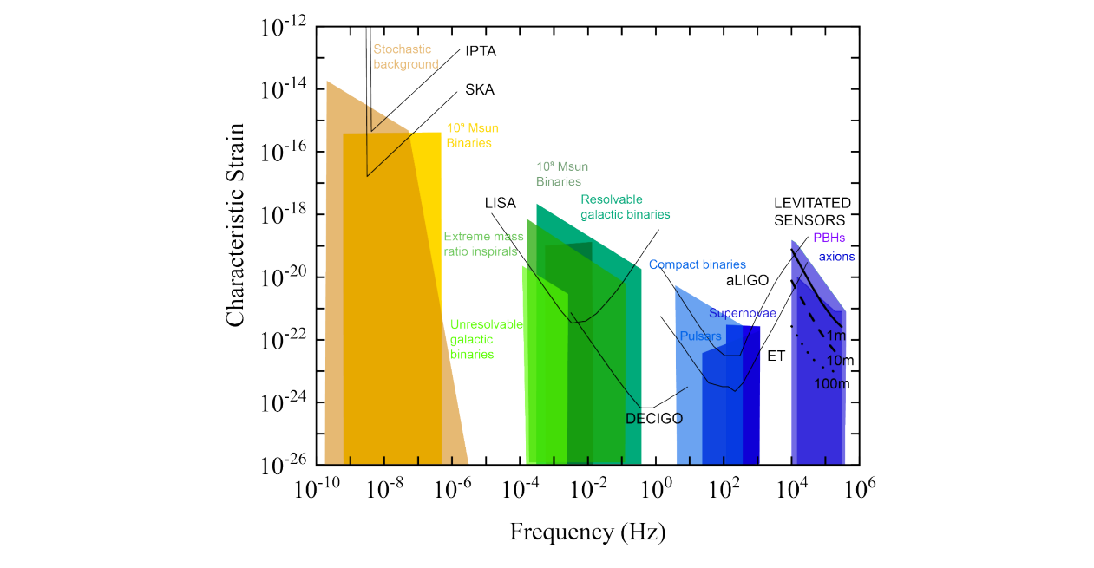
Frequency landscape for gravitational waves
“Searching for new physics using optically levitated sensors” - David C. Moore, Andrew A. Geraci https://arxiv.org/abs/2008.13197

Slide 20
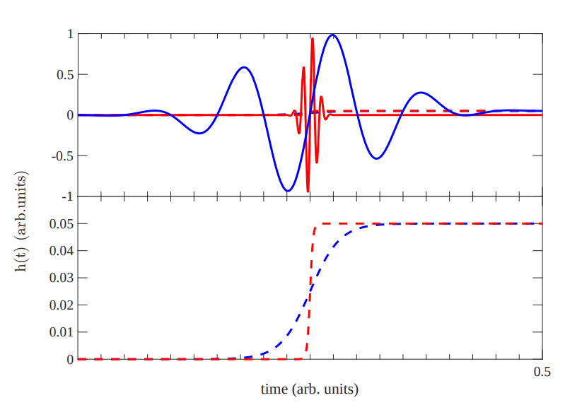
HFGW’s (10-100 KHz) and Cosmology
Detection of high frequency gravitational waves would significantly challenge cosmology [1], although less than a MHz detection
Transient events in such a band *might* be visible as memory events in lower frequency band [2]
Long term signals (axion cloud superradiance) would be much less visible in memory down conversion signals. (scales with length of envelope).
[1] - “Did Goryachev et al. detect megahertz gravitational waves?” -
Paul D. Lasky, Eric Thrane - https://arxiv.org/abs/2110.13319
[2] “Detecting Gravitational Wave Memory without Parent Signals” - Lucy O. McNeill, Eric Thrane, and Paul D. Lasky - https://journals.aps.org/prl/abstract/10.1103/PhysRevLett.118.181103

Slide 21
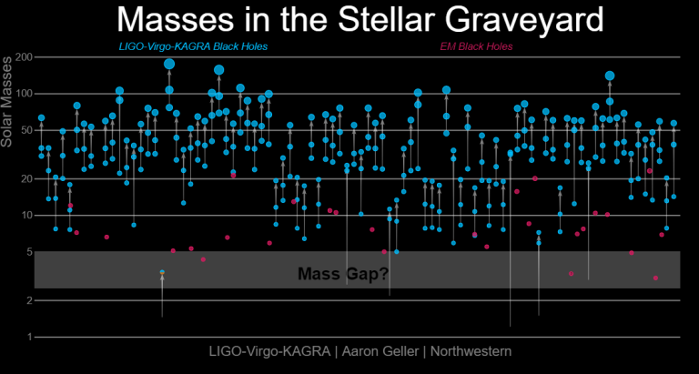
LIGO’s detected population differed (a little) from predictions - i.e the “mass gap”

Slide 22
How will a 10-100KHz levitated detector actually work?

Slide 23
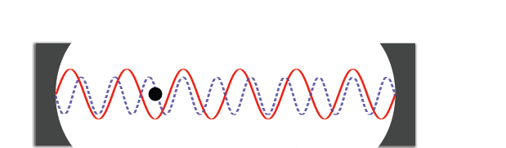
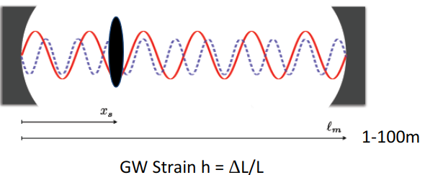
Levitated resonant bar detector
Laser
Laser intensity changed to match mechanical COM frequency of trapped particle to GW frequency
Length change from gravitational wave transduced to (resonant) optical force on levitated object
High force sensitivity already demonstrated in levitated optomechanics.
Fundamental sensitivity scalings are mass and center of mass frequency
A. Arvanitaki and AG, Phys. Rev. Lett. 110, 071105 (2013)

Slide 24
How could a tabletop experiment ever compete with a Billion dollar experiment
They don’t directly compete, different design frequencies
LIGO wasn’t designed to work above it’s cavity FSR
Different limiting noise processes with different frequency scalings.
LSD is a resonant bar sensor - only has sensitivity at the COM frequency of the levitated test mass

Slide 25
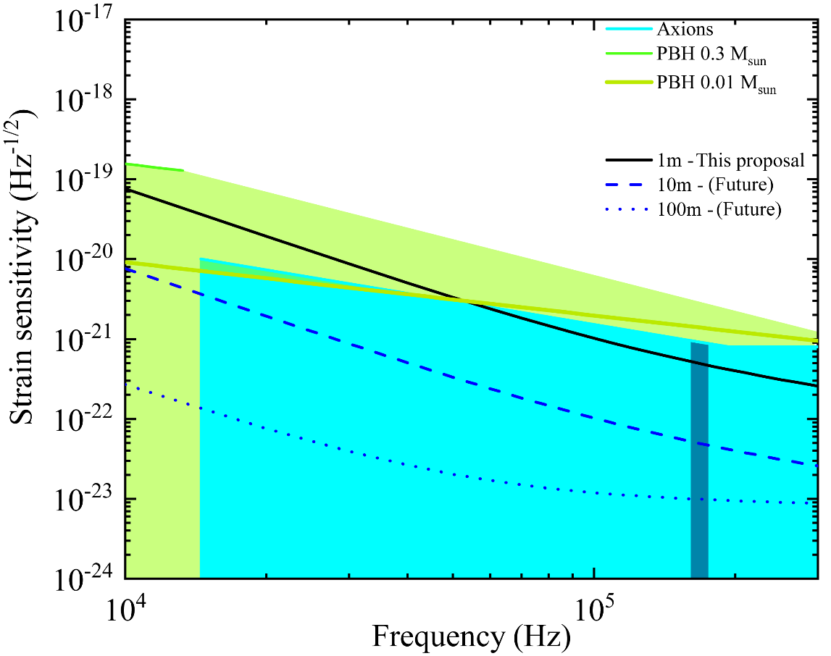
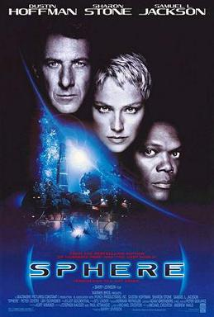
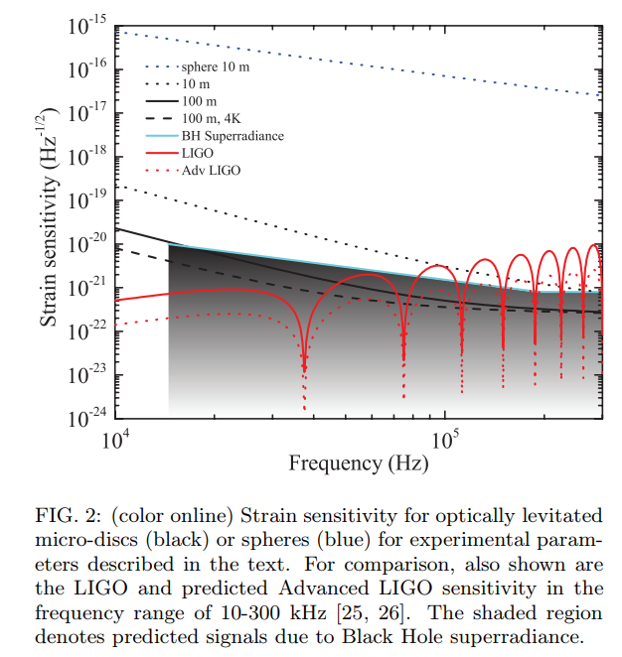
Novel Dark Matter search using HF GW detector
Resonant detector at each frequency
LIGO sensitivity decreases at high frequency (laser shot noise limited ). Levitated sensors have better HF noise scaling (thermal noise limited), seismic not a concern at HF.
Notes:
Discovery space plot, will return to this throughout talk. Colour shapes set bounds on axion see prl paper for details
Ligo gets worse at hf because shot noise limited, this experiment better at HF because brownian motion limited.

Slide 26
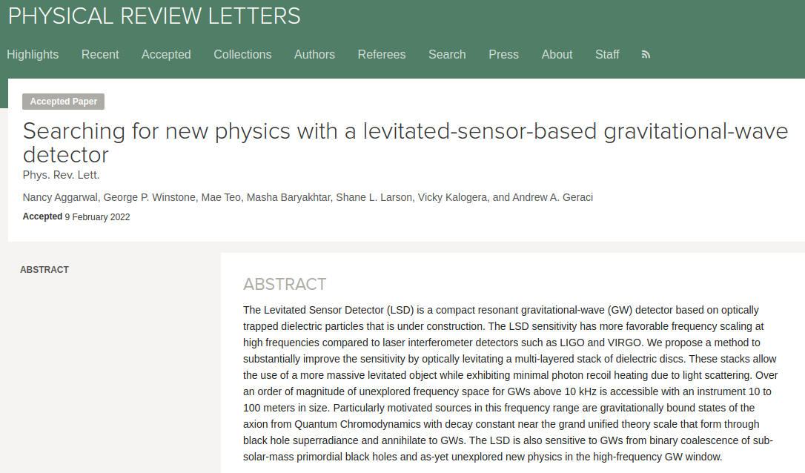
Detector optimisation paper in PRL

Slide 27
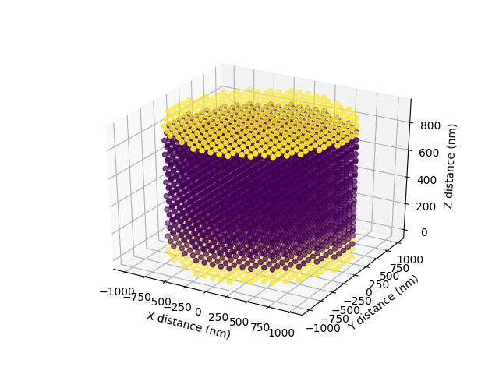
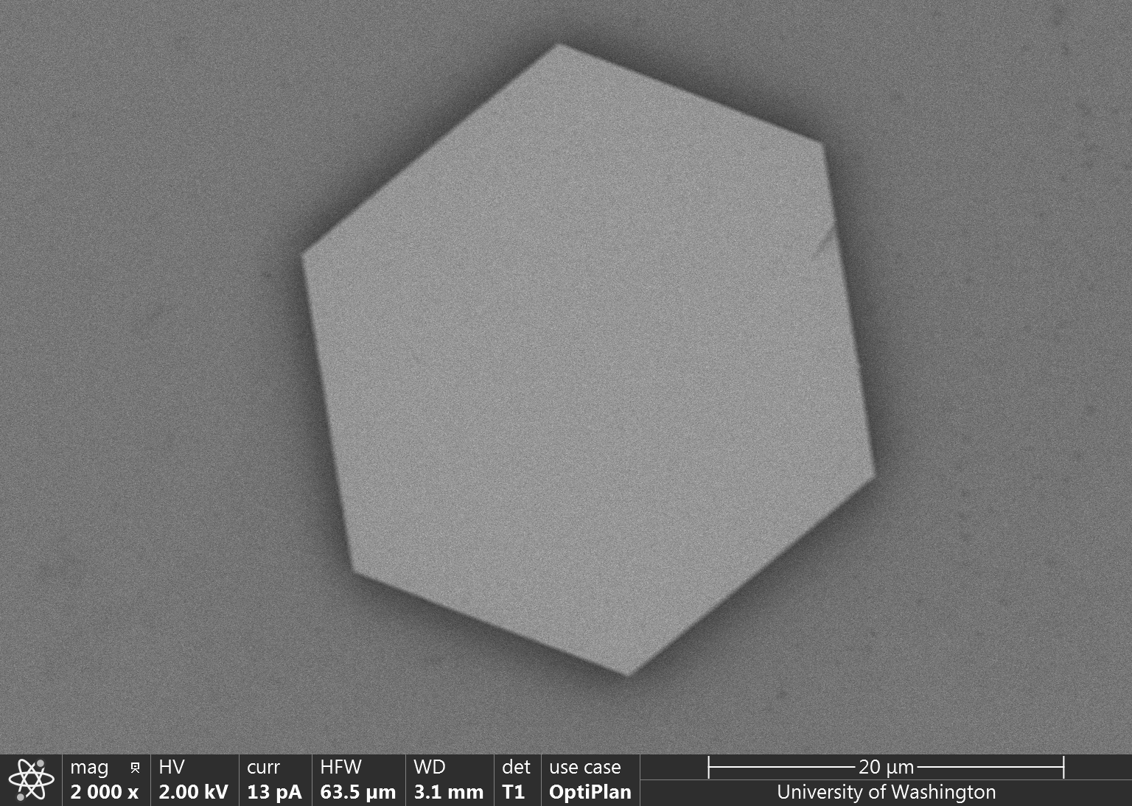
Levitated object optimisation
SiO2 Microdisc / NAYF Microhexagon
Si/SiO2/Si Nanostack

Slide 28
Design criteria for ideal levitated test mass:
>Flat at optical interface
>High center of mass frequency along cavity axis
>High mass
High center of mass frequency usually opposes high mass in optically levitated system - mass along standing wave “averages out” trapping field.
Alternate high and low refractive index to “grab” structure by optically responsive material with trapping wave antinodes, allow node to propagate through less optically responsive material to next node - less averaging out

Slide 29
High and low index breakfast alternated for high flavour at high mass
High and low refractive index alternated for high mechanical frequency at high mass

Slide 30
Levitated mass optimisation allows for accessing substantially more novel regimes of physics.!
Notes:
Add paper references to this slide

Slide 31
What do these ranges actually look like?

Slide 32
So, what are we doing right now?

Slide 33
Part I
1m interferometer construction

Slide 34
Vacuum system
Center chamber optics
End chamber optics
Out of chamber optics

Slide 35
Part II
High aspect ratio levitated test mass development

Slide 36
side
PZT launcher glass slide extends over trapping region
Directions of light for various detection channels marked
Fiber
diagonal
bottom

Slide 37
New hexagon results in PRL

Slide 41
6 - 1 = 5 degrees of freedom. Rotation around optical axis appears forbidden from light polarisation + crystal birefringence

Slide 42
Motional PSD of trapped objects depend strongly on geometry
Aspect ratio ~ 8:1
(2.5 µm in diameter and 300 nm thick
Aspect ratio ~ 15 - 25:1
(3 - 5 µm in diameter and 200 nm thick

Slide 43
Disk like objects are already in unique optomechanics parameter space, will get better with mass and center of mass frequency (optical power coupled - moving to cavity will substantially increase frequency)

Slide 44
High aspect ratio test mass improvement is ongoing, ideal is very flat and very large
Radius
Regularity

Slide 45
Information scatter from Rayleigh sphere
LIGHT scatter from disc
Tebbenjohanns, Felix, Martin Frimmer, and Lukas Novotny. "Optimal position detection of a dipolar scatterer in a focused field." Physical Review A 100, no. 4 (2019): 043821.
See also recent work by Oriol Romero Isart:
https://arxiv.org/abs/2212.04838
INFORMATION scatter pattern from mie-lorentz regime disc - an open question for now
A open question

Slide 46
Hexagonal prisms - summary
Match dynamics from FEM simulations *fairly* well - work currently ongoing
Would like to demonstrate low photon recoil than equiv mass sphere- work ongoing
Hexagons of different sizes and shapes have optimum detector placement in vastly different locations - cavity axes should be more favourable at larger sizes
Have to make them much bigger and push them to UHV!

Slide 47
High aspect ratio disk-likes occupy a very unique position in the levitated optomechanics parameter space.
More equivalent to a levitated trampoline than the nanosphere experiments.
Highest mass disk levitated ~ 0.1ng

Slide 48
Q: Where will putting the hexagons into the cavity over the summer get us?
~2000 stars within this volume
A: Not very far, would need to trap ~3000 current size hexagons in cavity to reach “stack” design masses
Or ~100 radially larger hexagons

Slide 49
Related critical technologies being developed in parallel

Slide 50
Disc fabrication - top down wafer processing instead of bottom up growing
Current disk-like levitated test masses, grown on the gram scale, enough to form a visible powder
Future bespoke levitated test masses, top down fabricated ~10’s of millions of devices per wafer
Notes:
Talk about top down heat dispersion, put power number from recent paper - good glass constraints

Slide 51
Trapping top down fabricated objects - open problem
Current trapping method: highly probabilistic
Desired trapping method: deterministic
~billions of objects launched, one trapped - “A gas of mirrors”
One launched one trapped

Slide 52
Direct particle loading at high vacuum - work in progress
~10⁷ g for R=150nm!
v
Faster experimental cycle and higher duty cycle
Less time spent in unstable pump down regime
Reduced need to re-tune feedback
Other UHV trapping methods such as LIAD may not be compatible with 10’s microns scale disk like geometry
Notes:
Talk about how marcus and novotny have different solutions here

Slide 53
Reducing particle velocity - replace viscous drag with “optical drag” at UHV
Falling particles
950 nm
0.5 W w=300 um
normal
slowed

Slide 54
In summary:

Slide 55
Required technologies before operation/ ongoing challenges:
>Construction of 1m prototype at northwestern approaching completion
>Improving the levitated object (manufacture stacks - careful control of water content)
>Trap a sufficiently large disc, demonstrate adequately low photon recoil, match experiment to theoretically predicted motional spectrum
>Learn how to load discs in high vacuum, or demonstrate ~month long lifetime for levitated disks (LIGO & related detectors have a high duty cycle)
>Signal readout from two micro disks trapped in michaelson configuration (different polarisation or frequency detuning)
>Other enabling technologies
Notes:
Discs may fall differently to spheres

Slide 56
LSD phase 1 construction
Levitate high aspect ratio high mass disc-like objects
Get disc-likes into 1m cavity
Higher mass larger radius disc/stack like production

Slide 57
Upcoming collaboration papers
Recent collaboration papers
LSD noise budget paper with transfer functions (Feel free to ask Nancy for an update)
0.1ng at 10KHz - order of magnitude mass increase in the levitated disk mass (at UHV)
Optimal detection of a levitated high aspect ratio disk like object
“Searching for New Physics with a Levitated-Sensor-Based Gravitational-Wave Detector”
Nancy Aggarwal, George P. Winstone, Mae Teo, Masha Baryakhtar, Shane L. Larson, Vicky Kalogera, and Andrew A. Geraci - https://journals.aps.org/prl/abstract/10.1103/PhysRevLett.128.111101
“Optical Trapping of High-Aspect-Ratio NaYF Hexagonal Prisms for kHz-MHz Gravitational Wave Detectors
George Winstone, Zhiyuan Wang, Shelby Klomp, Greg R. Felsted, Andrew Laeuger, Chaman Gupta, Daniel Grass, Nancy Aggarwal, Jacob Sprague, Peter J. Pauzauskie, Shane L. Larson, Vicky Kalogera, and Andrew A. Geraci (LSD Collaboration)” - https://journals.aps.org/prl/abstract/10.1103/PhysRevLett.129.053604

Slide 58
Acknowledgements - LSD specific
CIERA - theory
University of Washington - Hexagon growth
Shane Larson Vicky Kalogera Jacob Sprague.
Greg Felsted
Prof. Peter J. Pauzauskie
CFP - Experiment
Lars Forberger
George Winstone
Shelby Klomp
Andrew Laeuger
Aaron Zhiyuan Wang
Chethn Galla
Scott Grudichak
LSD construction
Stack fabrication

Slide 59
Acknowledgements
Geraci Group
From left to right: Alexey Grinin (PD), Nancy Aggarwal (PD), William Eom (G), Nia Burrell (G), Aaron Zhiyuan Wang (G), Chethn Galla (G), Andrew Geraci (PI), Cris Montoya (PD), George Winstone (PD), Chloe Lohmeyer (G), Shelby Klomp (G), Evan Weisman (PD), Andrew Poverman (G), Eduardo Alejandro (G), Andrew Laeugar (UG)

Slide 60
Questions?

Slide 61
DISCLAIMER
I am an experimental physicist without a background in the LIGO jargon
Please speak slowly and minimise acronyms

Slide 62
Backup slides beyond this point

Slide 63
Struggling to get back into the USA during covid?
Just sue the state department!

Slide 64
Acknowledgements
Geraci Group
BATCAT
Non-Newtonian short-range Gravity
Andy Geraci (PI)
Cris Montoya
(PD)
Eduardo Alejandro
(G)
William Eom
(G)
Evan Weisman
(PD)
Chethn Galla
(G)
Nia Burrell
(G)
Andrew Laeuger (UG)
ARIADNE- Dark Matter Search
Tabletop Gravitational Wave Detection
Cryo-tweezer
Nancy Aggarwal
(PD)
Chloe Lohmeyer
(G)
George Winstone
(PD)
Aaron Zhiyuan Wang
(G)
Shelby Klomp
(G)
Alexey Grinin
(PD)
Andrew Poverman
(G)

Slide 65
Fiber detection
Free-space detection

Slide 66
Y (vertical)
Side imaging
Z (axial)
-X (horizontal)
Quadrant Photodiode (QPD)
Y
Fiber
Bottom imaging
X

Slide 68
6 Different detectors pointed at same object.
Try to reduce unknown systematics in detection functions impact on qualitative interpretations.

Slide 69
side
PZT launcher glass slide extends over trapping region
Directions of light for various detection channels marked
Fiber
diagonal
bottom

Slide 72
Feedback mechanism & photon recoil
Temperature determined by balance of heating and cooling channels:
Best numbers: ground state - Aspelmeyer and Novotny groups. -[2]
Most parametric feedback setups presented limited by photon recoil - [1]
Methods for pushing past such a limit:
-->very high cavity cooperativity/optomechanical coupling
-->cooling very high frequency nonlinear motional modes (rotation, vibration of non spherical nanospheres)
-->Alternative feedback schemes (kalman filters,cold damping, coherent scattering, etc)
[1] - Jain, Vijay, et al. "Direct measurement of photon recoil from a levitated nanoparticle." Physical review letters 116.24 (2016): 243601. [2] - Delić, Uroš, et al. "Motional Quantum Ground State of a Levitated Nanoparticle from Room Temperature." arXiv preprint arXiv:1911.04406 (2019).
Notes:
FOKKER PLANK EQUATION TO GET TEMPERATURE BALANCE Most setups limited by the photon recoil limit, will come back to this later

