Slide 1
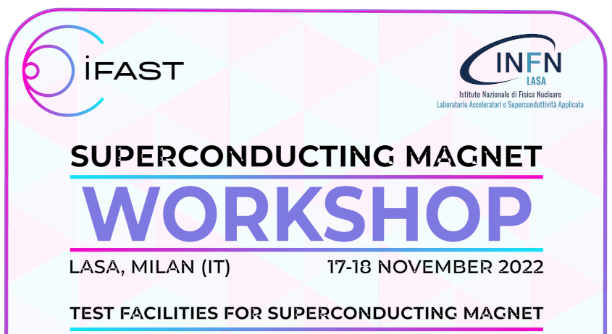
Superconducting magnet test facility and infrastructure SM18 at CERN
Gerard Willering
On behalf of the test and measurement section in the MSC group.
CERN, TE-MSC-TM

Slide 2
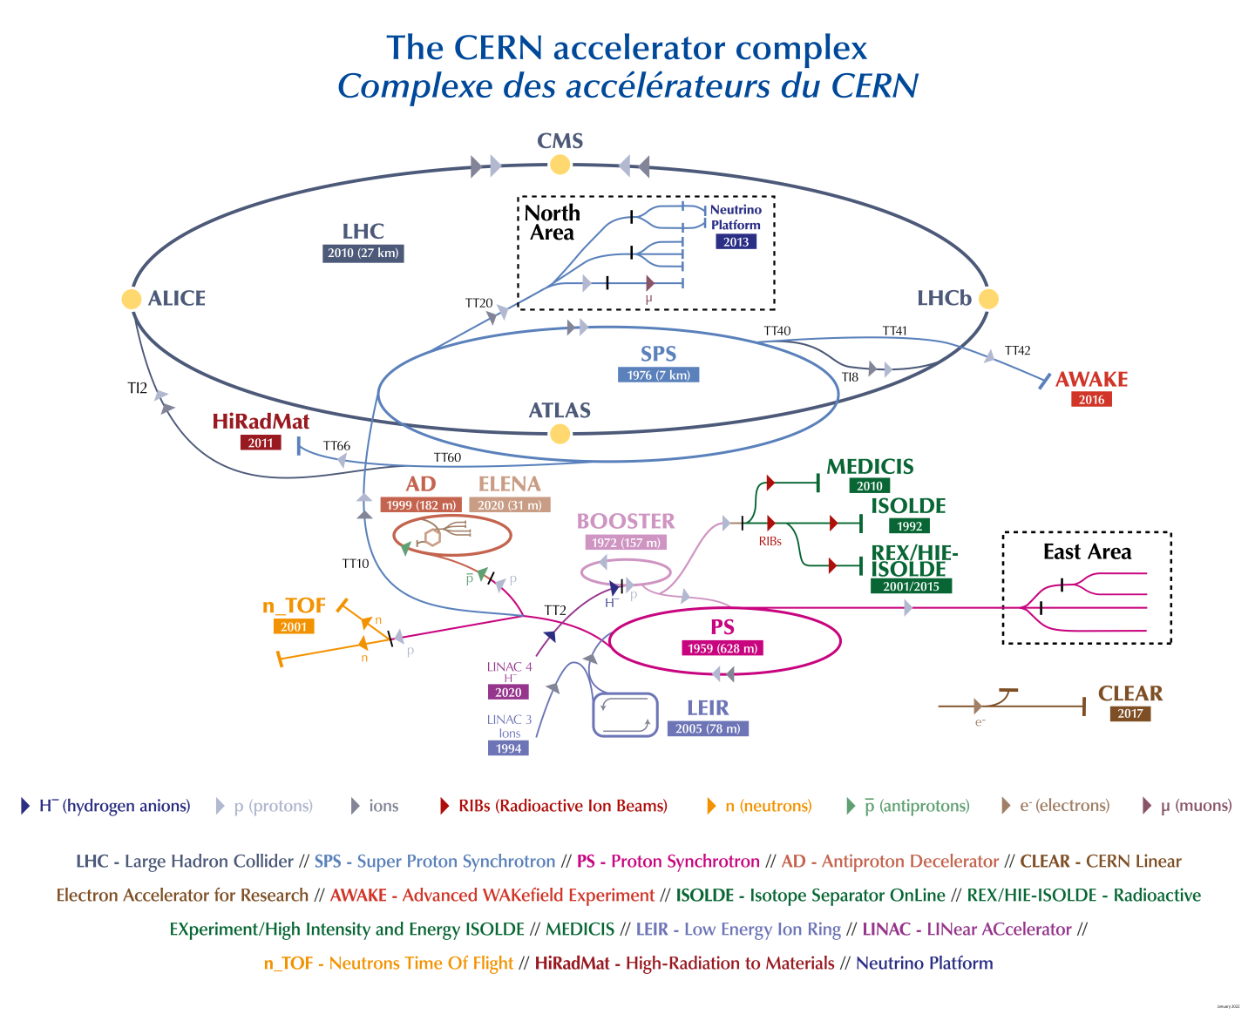
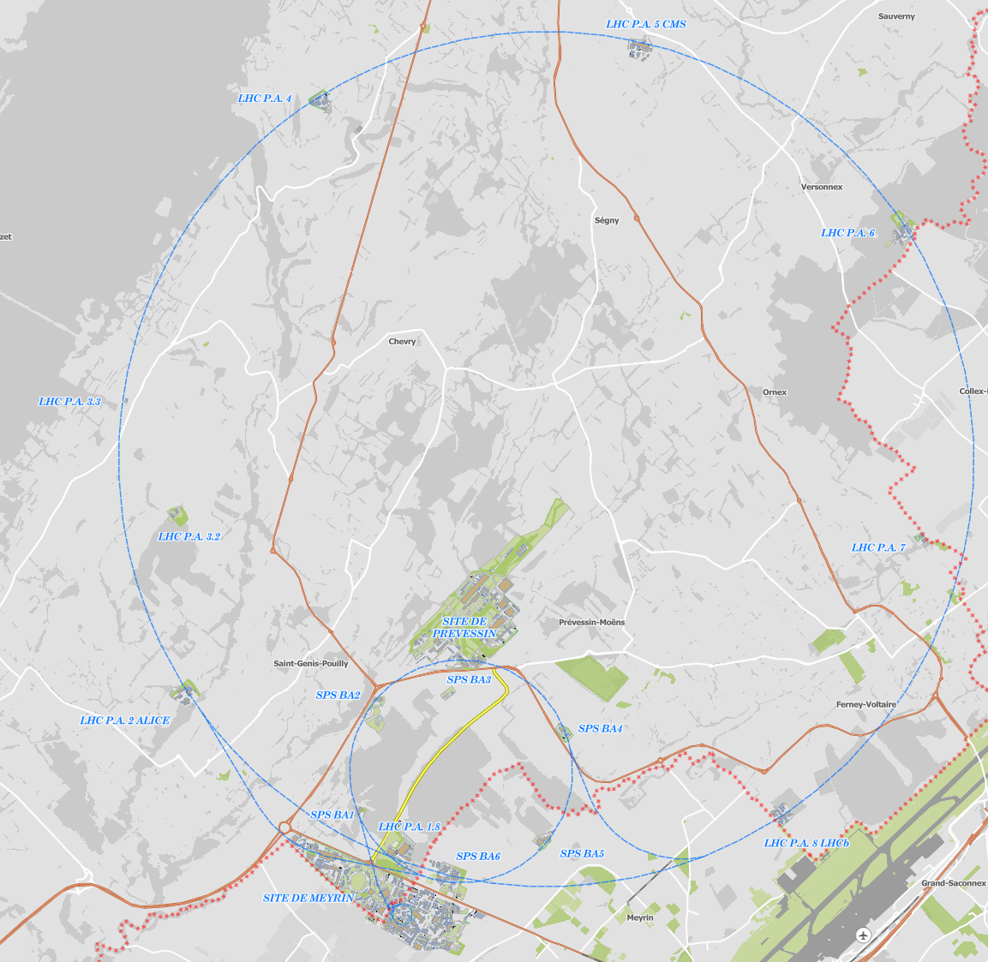
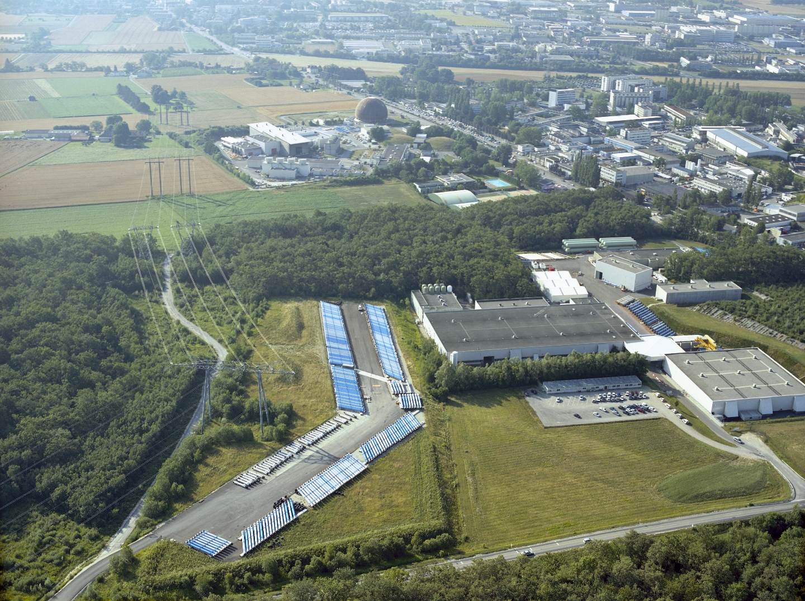
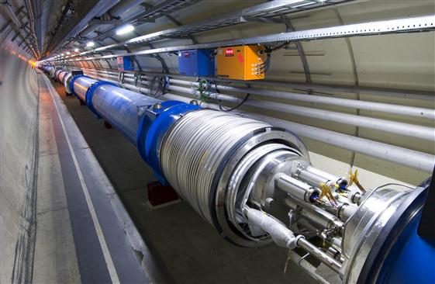
CERN has a large accelerator complex and uses superconducting magnets on a large scale.
It has a test infrastructure with a long history.
2005 image with magnets parked before installation in the LHC
SM18
Magnets installed in the LHC
SM18
Qualification tests required before installation

Slide 3
SM18 in 2023
~120 by 60 meter building dedicated to testing at cryogenic temperatures
4.5 K LHe: 35 g/s + 25 g/s
1.9 K pumping: 2*12 g/s
HL-LHC String test
Vertical cryostats
Horizontal magnets
SC-link
Cryogenics
Superconding RF cavities

Slide 4
Purpose CERN SM18 Superconducting Magnet Test Facility
Qualification of magnets before installation in the LHC/HL-LHC
  Mostly on horizontal test benches
Prototype and model magnet testing
  Mostly on vertical test benches
Test bed for enabling technology
  Power converters, data acquisition systems, quench detection systems, protection systems like CLIQ, energy extraction, etc.
Not treated in this presentation, but also present at CERN:
An extensive facility for testing superconducting cables, wires and tapes in background field.
A cryogenic test facility specialized in special cryogenics tests.
A magnet string test facility to perform a system test on a 70 meter long segment of the HL-LHC triplets.
Test facility for GSI-Fair multiplet magnets.

Slide 5
Requirements
Requirements for a superconducting magnet test facility
Cryogenics
High-current power converters
Quench detection
Active quench protection
Data acquisition
Magnetic field measurements
Not to forget:
A team of experienced mechanics, test operators and test engineers
Analysis tools

Slide 6
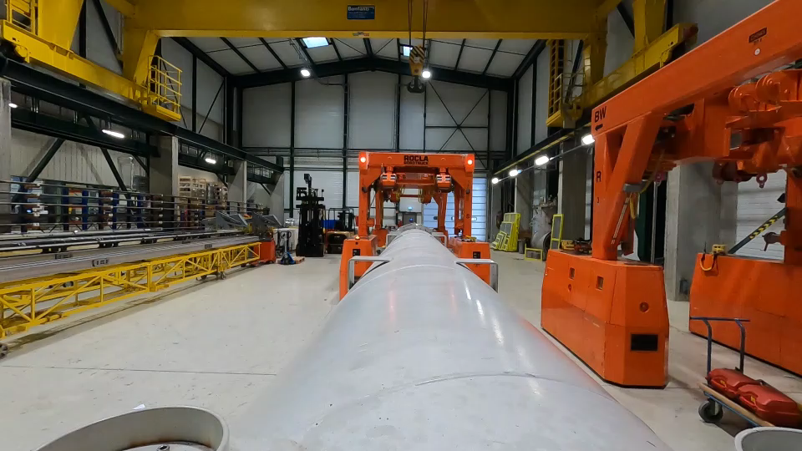
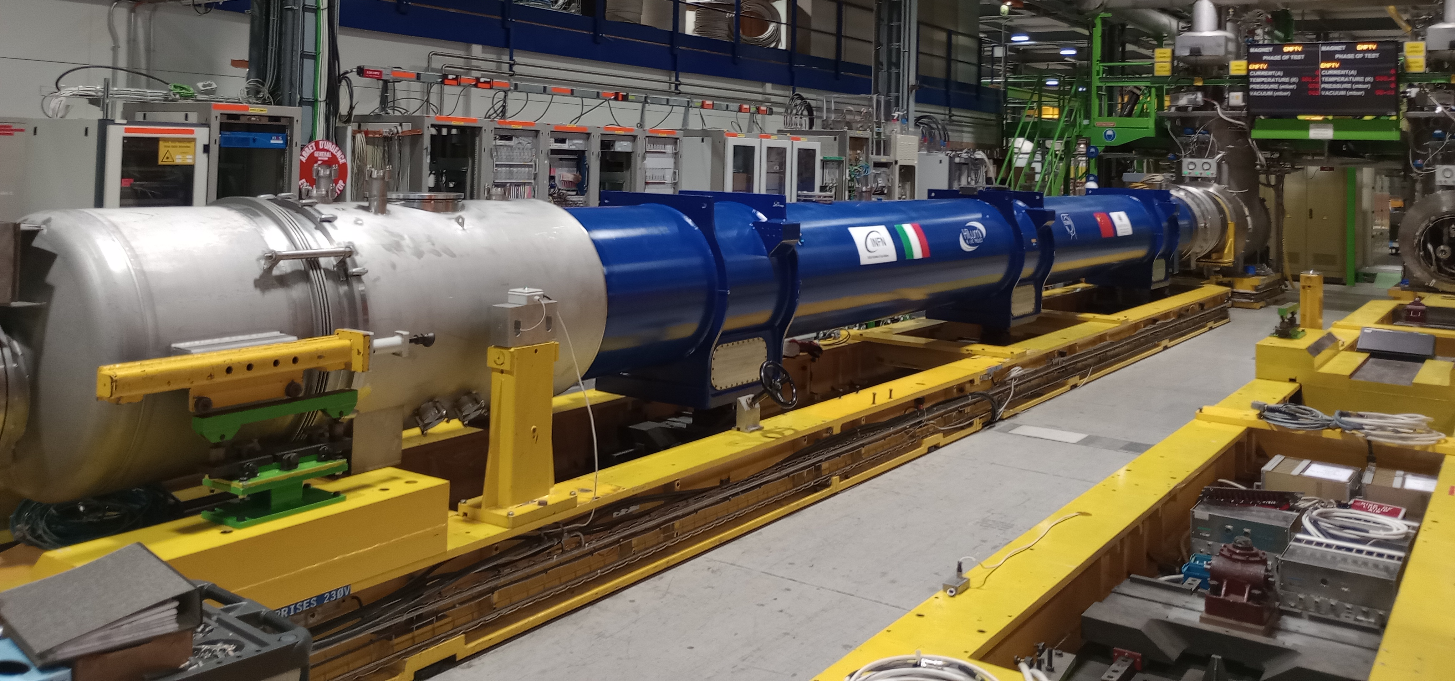
Horizontal test benches
Placement of an MQXF magnet on the horizontal test bench
D2 prototype – 15 meter long first full assembly for HL-LHC currently in test.
On horizontal test benches in the next 3-4 years:
Qualification for the HL-LHC for
~ 40 full magnet assemblies
~ 10 SC link systems
Horizontal benches are not used much for collaborations, since they are used for full magnet assemblies in their final cryostat.

Slide 7
Vertical test benches
5 cryostats
- Cluster D
- HFM (High Field Magnet)
- Variable Temperature Cryostat
- Siegtal Cryostat
- Long Cryostat

Slide 8
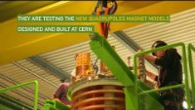
Cluster D cryostat
Longest vertical cryostat ~5.2 meter useful length
0.8 m diameter
30 kA power supply + EE
Two 2 kA power supplies + EE
Test at 4.5 K and 1.9 K
Precooling and warming up with controlled Ghe temperature.
https://www.youtube.com/watch?v=w1jdZHvl_-w

Slide 9
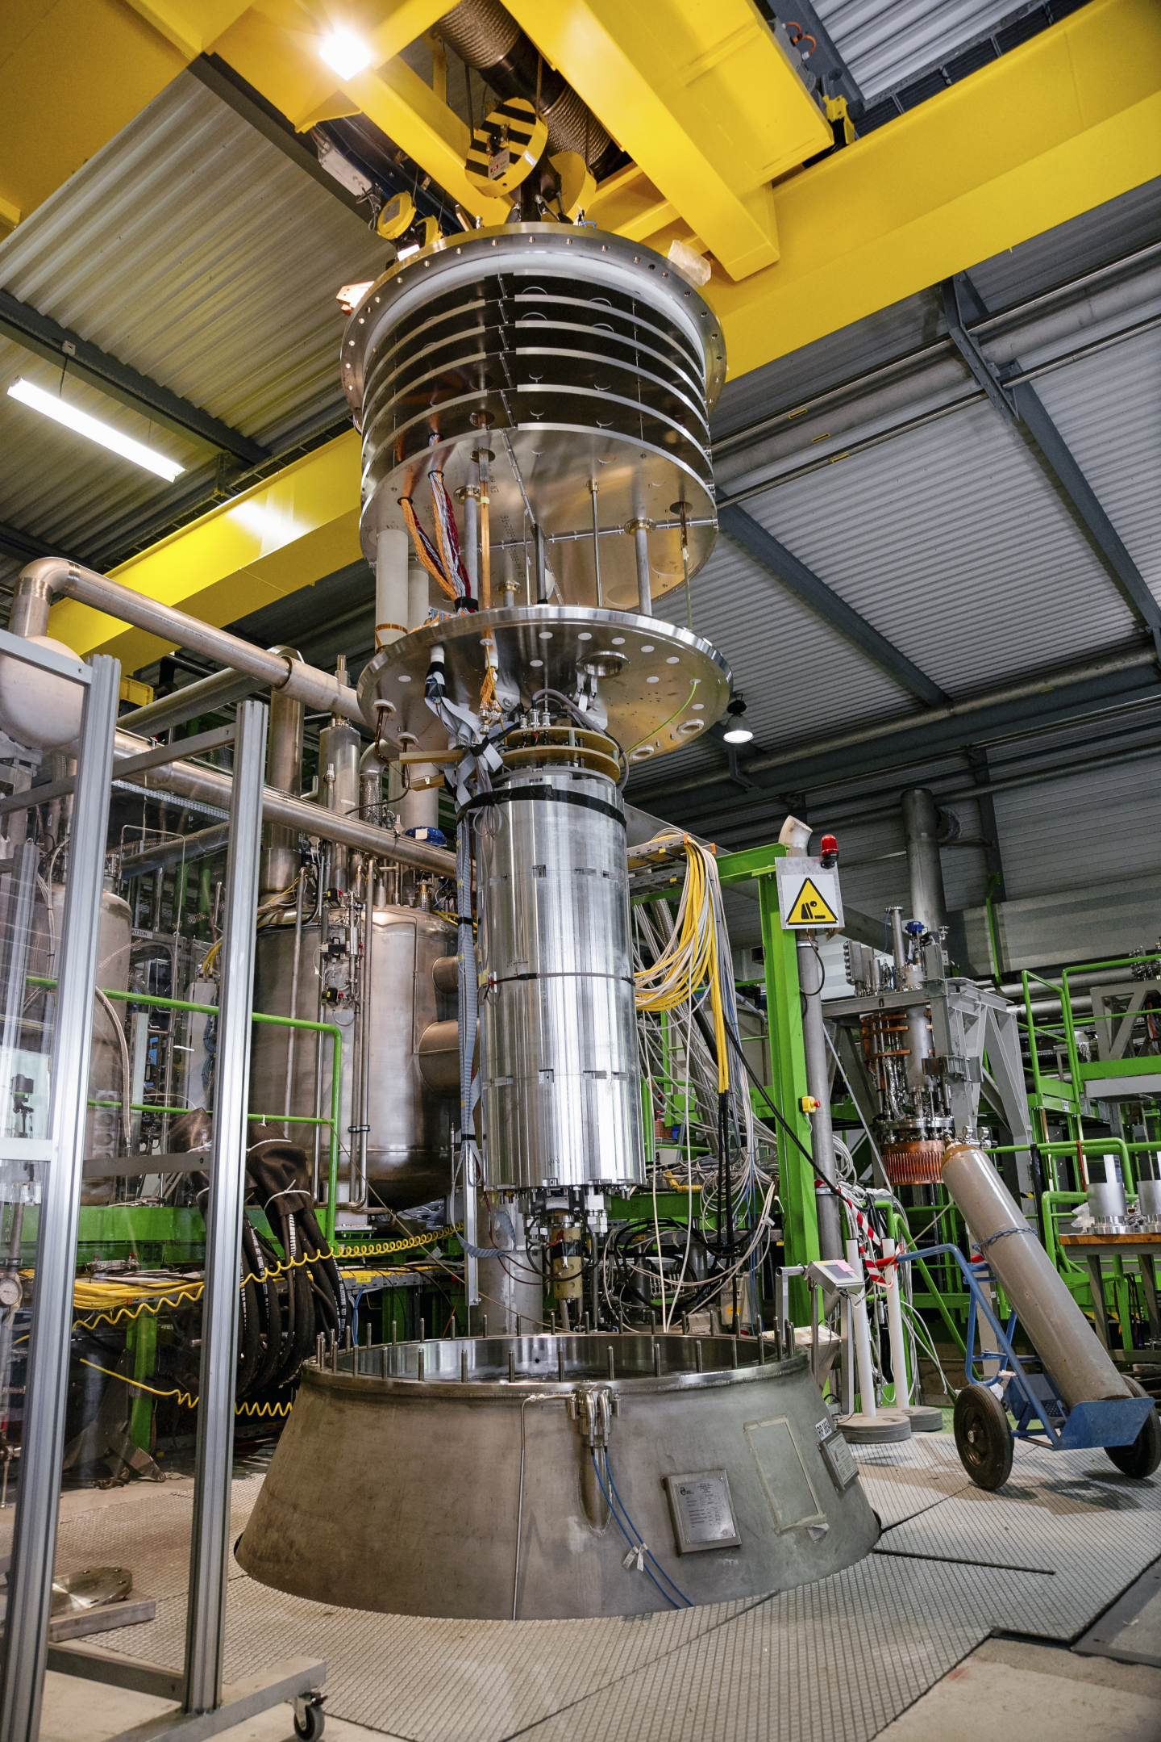
HFM cryostat
Widest vertical cryostat
~2.5 meter useful length
1.5 m diameter
20 kA power supply + 10 kA power supply for inserts
Possibility for 120 A and 600 A PCs.
Precooling and warming up with controlled Ghe temperature.
1.9 K and 4.5 K
Possibility to use a 150 mm aperture MBXFS dipole magnet as background magnet for HTS inserts (5.6 T at 1.9 K, 5.1 T at 4.5 K)

Slide 10
Variable Temperature Cryostat
4.5 K Lhe
4.5 K – 300 K GHe
Up to 20 kA power supply
Typically used for
Cold diode tests
HTS coils
1.2 meter useful length
0.5 meter diameter
Siegtal Cryostat
4.5 K and 1.9 K LHe
Up to 20 kA power supply
1.2 meter useful length
0.8 meter diameter
Long Cryostat
4.5 K and 1.9 K LHe
Up to 20 kA power supply
4.0 meter useful length
0.6 meter diameter

Slide 11
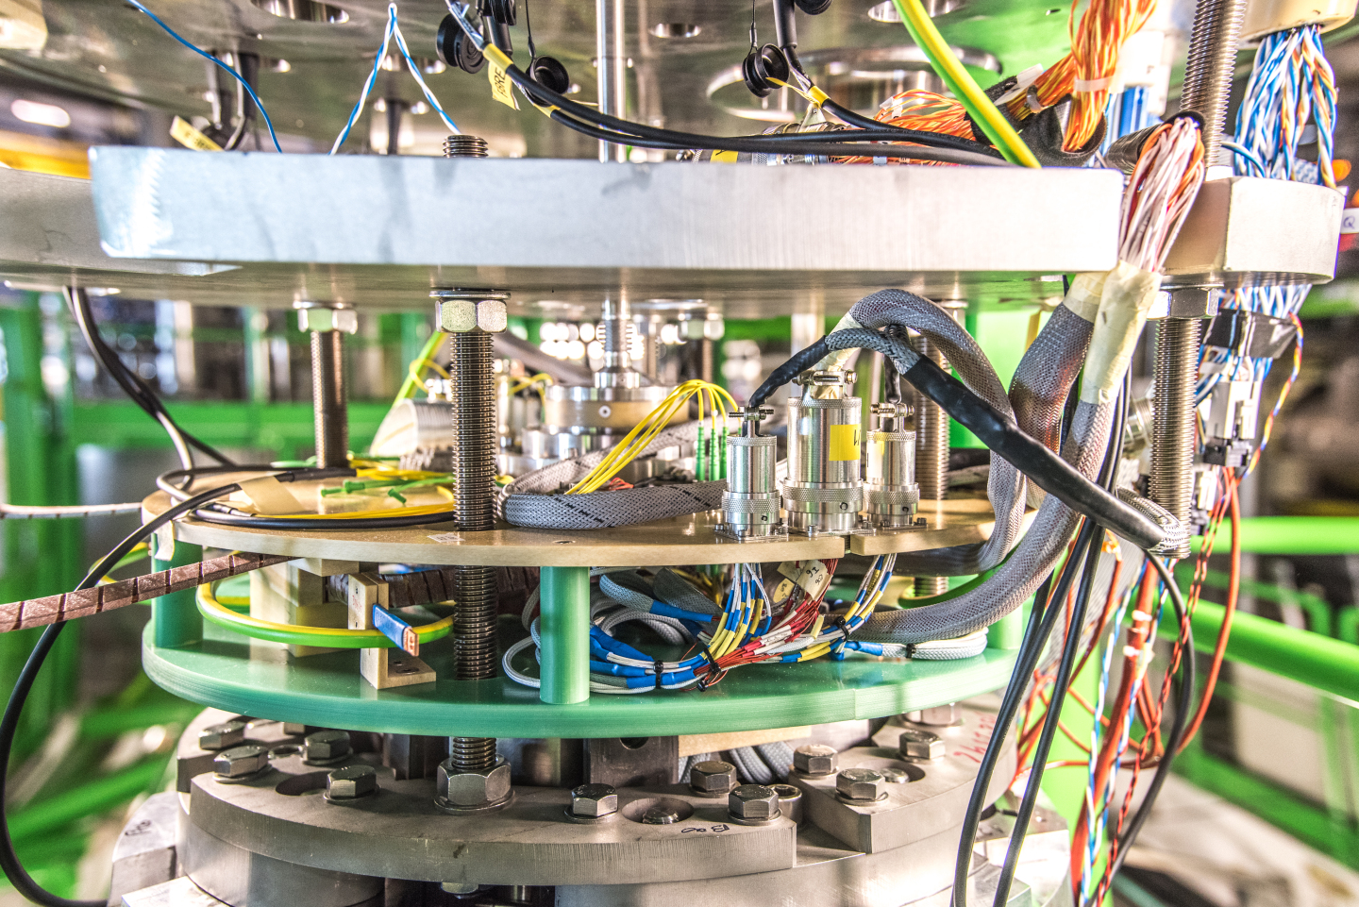
Instrumentation
Instrumentation feed throughs for all cryostats
Hundreds of wires for voltage taps and strain gauges
Fiber optics feedthrough
Cold rotating magnetic measurement shafts
Quench antenna pickup coils
Typically 2 of the 5 vertical cryostats are in parallel operation with typically 20-30 magnets tested each year.

Slide 12
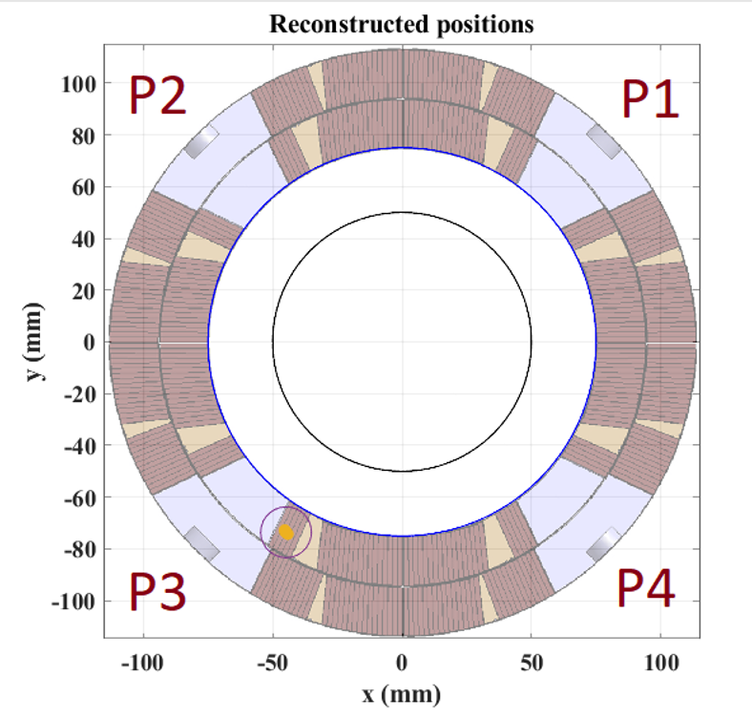
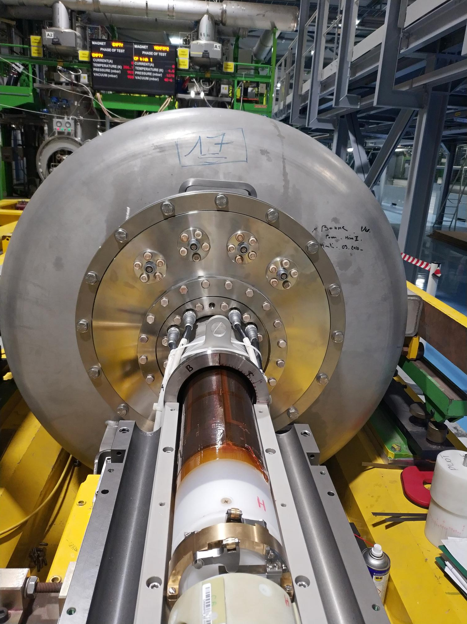
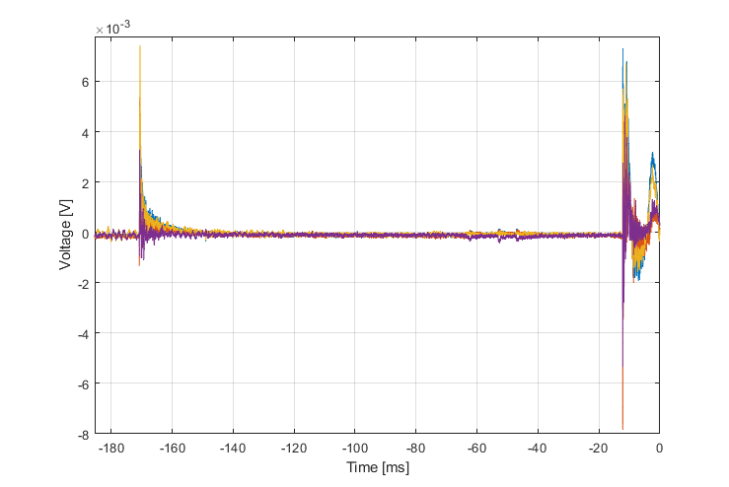
Instrumentation
Team expertise and development on most instrumentation types.
Example: Quench localization using flex PCB - B3,A3,B4,A4 sensitivity, 12 segments on 6 shaft = 48 channels

Slide 13
Collaborations and opportunities
In the past years, many magnets have been tested for (mostly European) collaborating institutes in collaboration frameworks, for example the 'Transnational access' within the ARIES framework.
Part of CERN's mission is to: "unite people from all over the world to push the frontiers of science and technology, for the benefit of all." Collaboration requests are welcome, both for superconducting magnet testing and expertise in test technology.
We work on a Knowledge Transfer collaboration contract template, which could open the door for commercial partners.
Many examples of win-win situations in collaborations, both for testing as for development of technology and methods.
  Technology and knowledge transfer to Freia magnet test station
  Magnetic measurement technology for STAARQ at CEA Saclay
  GSI super-FRS test station, based at CERN, but with GSI staff
  New collaboration with Uppsala on warm insert for magnetic measurements both at CERN and in Uppsala
  Today in test at CERN the PSI – CCT type magnet

Slide 14
Suggestions for collaborations:
When designing a magnet, it is important to include all aspects of instrumentation for test and magnet characterization.
Voltage taps, for protection and for investigation
Strain gauges and fiber optic sensors for stress measurements
Accelerometers and acoustic emission sensors for vibration pickup
‘quench antenna’ pickup coils
Rotating pickup coils for field quality measurements
Hall probes
Etc.
Last, but not least:
Define a test procedure and plan to acquire all characteristics needed for feedback to magnet design or to qualify the magnet for final operation needs.
For all aspects expertise is present at CERN, spread over different groups in the organization.

Slide 15
Summary on SM18 magnet test facility
Very versatile and large capacity test facility
Large expertise within magnet test team, also for analysis!
Expert support from many teams at CERN (power supplies, protection, cryogenics, etc)
High test throughput for the next years, with about 40 horizontal magnet assemblies, 10 SC links and some 20 to 30 test vertical magnets in test.
CERN has a long history in collaborations

