Slide 1

Quantum Fuzzy Inference in Particle Accelerator Control
Giovanni Acampora, University of Naples Federico II – giovanni.acampora@unina.it
Michele Grossi, CERN Quantum Technology Initiative – michele.grossi@cern.ch
Michael Schenk, CERN - michael.schenk@cern.ch
Roberto Schiattarella, University of Naples Federico II - roberto.schiattarella@unina.it

Slide 2
An Introduction on Fuzzy Logic
Fuzzy Logic was introduced by Lotfi Zadeh at UC Berkeley in 1965 due to uncapability of conventional computer logic to represent vague human concepts.
Fuzzy logic is an attempt to give computers the capability of dealing with uncertainty.
In fuzzy logic, the truth values of variables are any real number between 0 and 1 both inclusive
Fuzzy Control Systems: controller based on linguistic rules

Slide 3
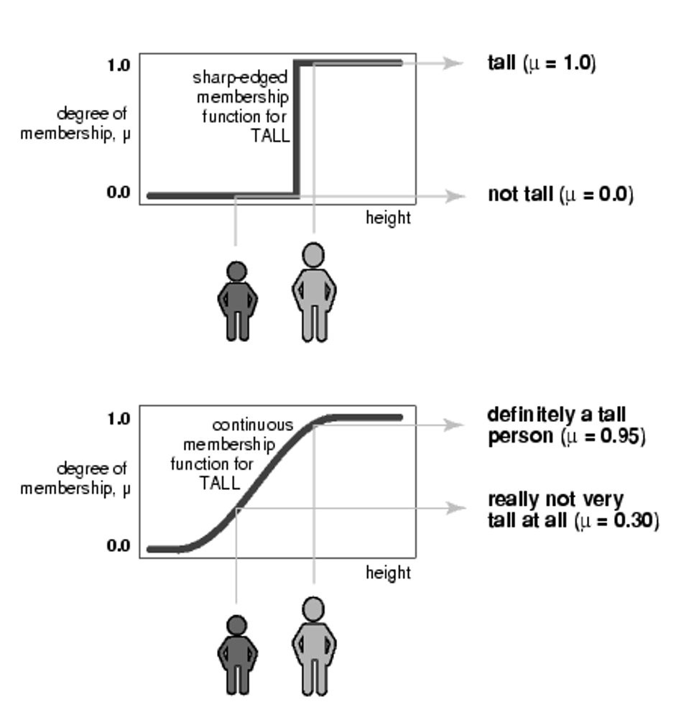
Fuzzy Logic and Fuzzy Sets
In fuzzy logic, the truth values of variables are any real number between 0 and 1 both inclusive.
A fuzzy set can be defined mathematically by assigning to each possible element in the universe of discourse a value representing its grade of membership in the fuzzy set.

Slide 4
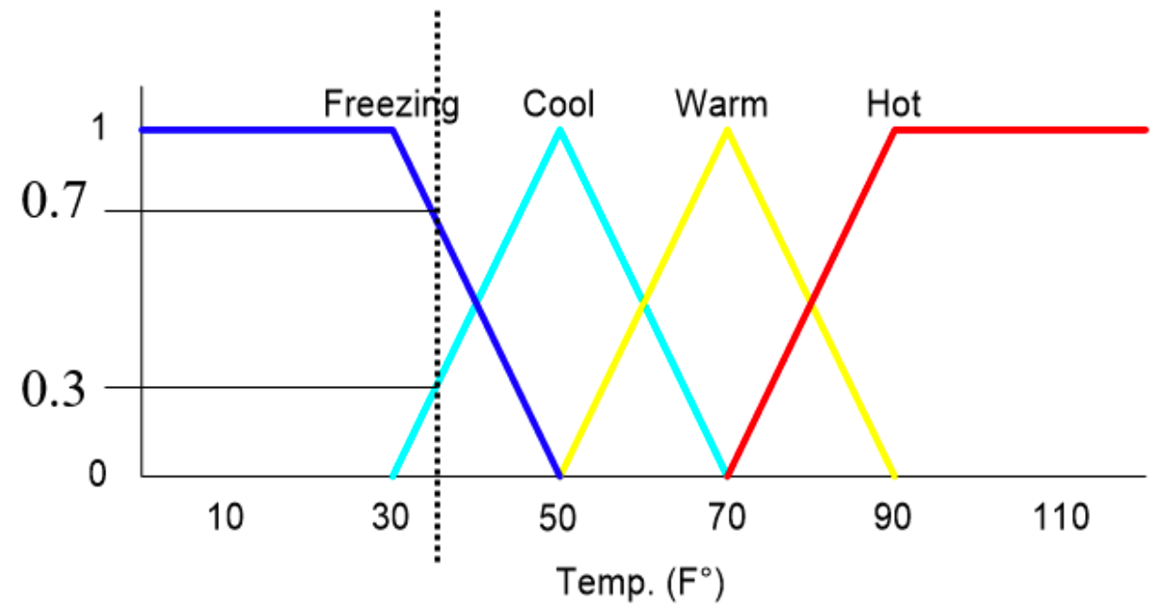
Fuzzy Variables
Fuzzy linguistic variables (or simply fuzzy variables) are defined in a universe of discourse and represented by a collection of fuzzy sets.

Slide 5
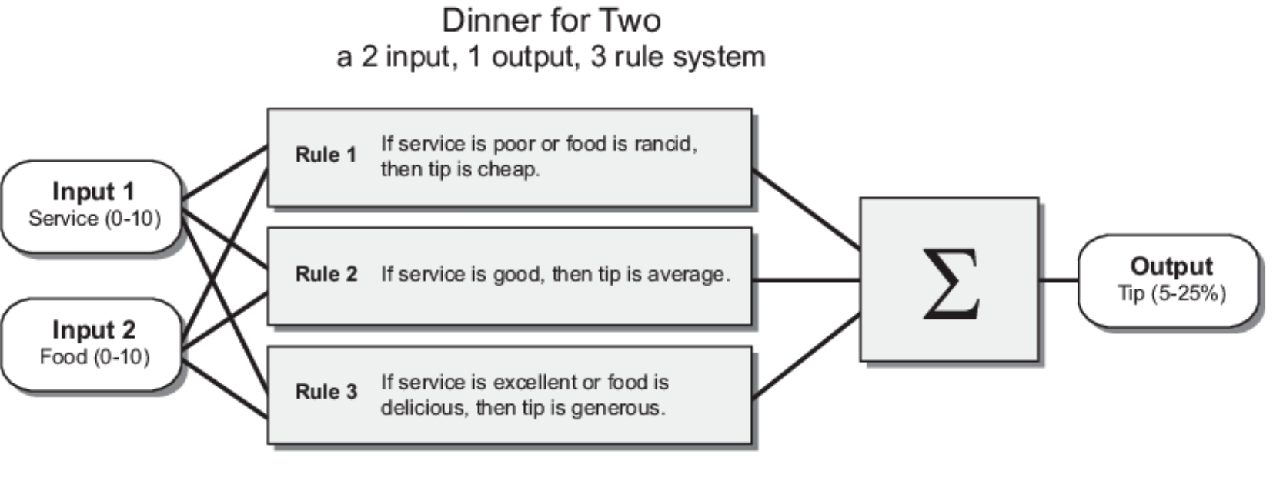
An Example of Fuzzy Controller: Tipper
The input are crisp
(non-fuzzy) numbers
limited to a specific
range
All rules are evaluated
using fuzzy reasoning
(fuzzy inference)
The results of the
rules are
combined
(defuzzified)
The output is a
crisp (non-fuzzy)
number.

Slide 6
A Quantum Fuzzy Inference Engine
A Quantum Fuzzy Inference Engine (QFIE) has been proposed in [1].
Features:
  Amplitude encoding of fuzzified values.
  Formulation of fuzzy rule base as a quantum oracle.
Advantages of a QFIE:
  Exponential advantage in the number of queries to the oracle
  Quantum computers can be programmed with linguistic rules.
[1] Acampora, Giovanni, Roberto Schiattarella, and Autilia Vitiello. "On the Implementation of
Fuzzy Inference Engines on Quantum Computers." IEEE Transactions on Fuzzy Systems (2022).

Slide 7
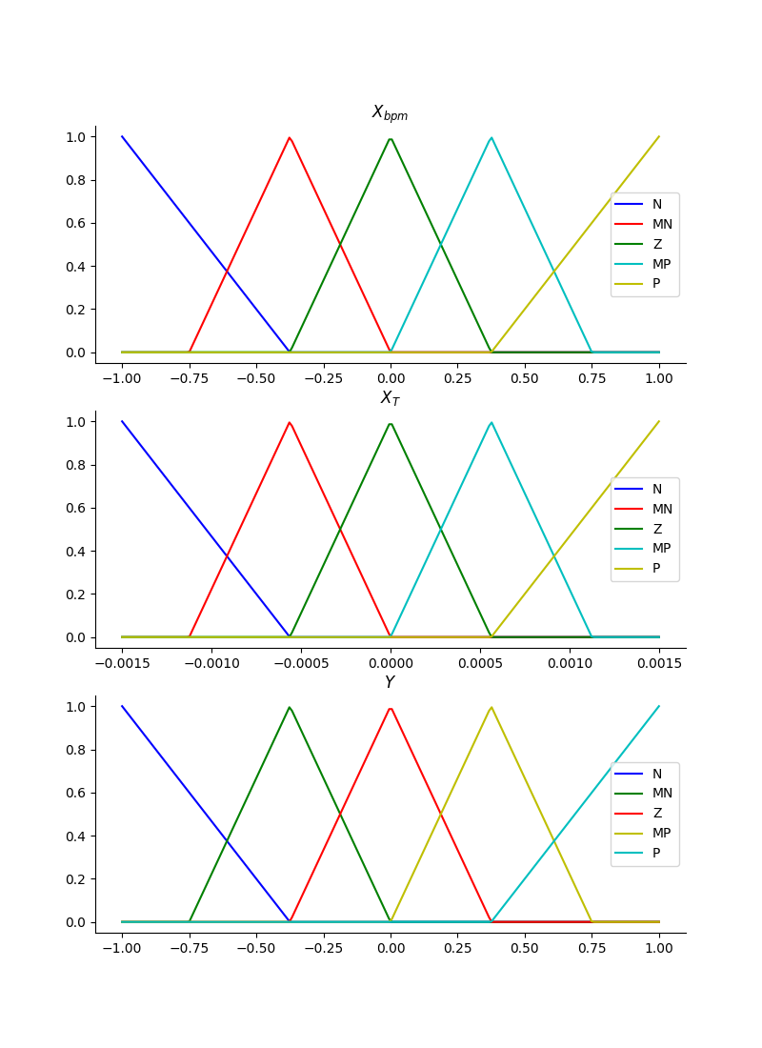
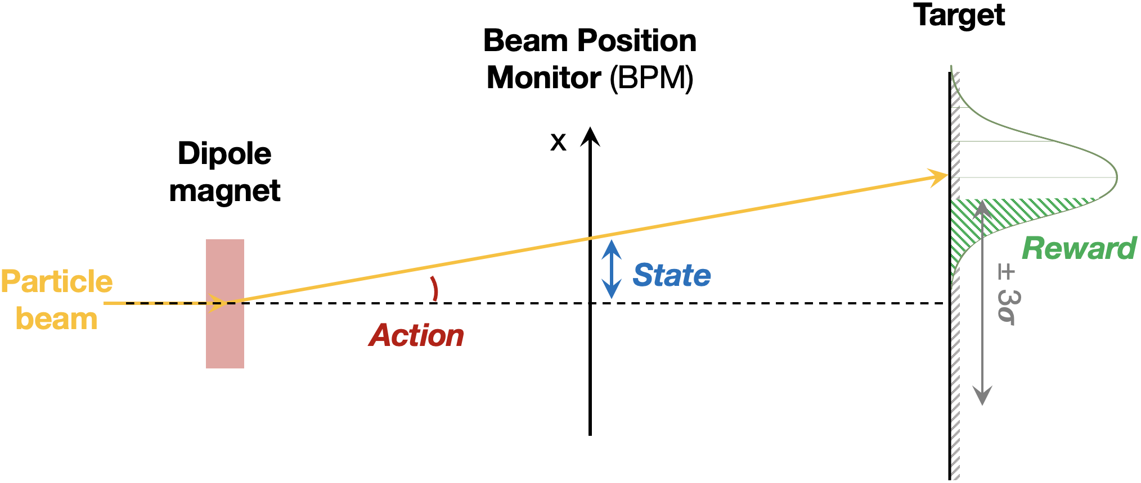
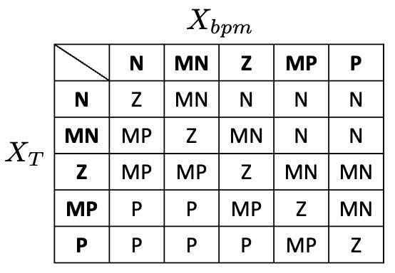
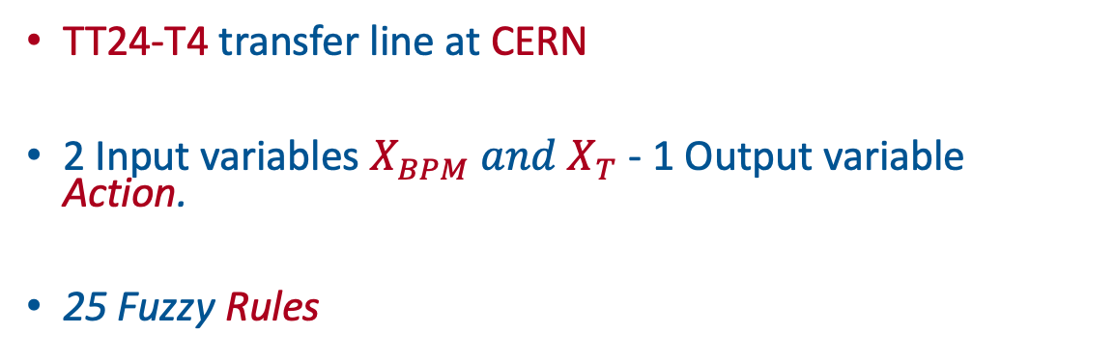
Target Steering Environment
TT24-T4 transfer line at CERN
2 Input variables $X_{BPM} and X_{T}$ - 1 Output variable Action.
25 Fuzzy Rules

Slide 8
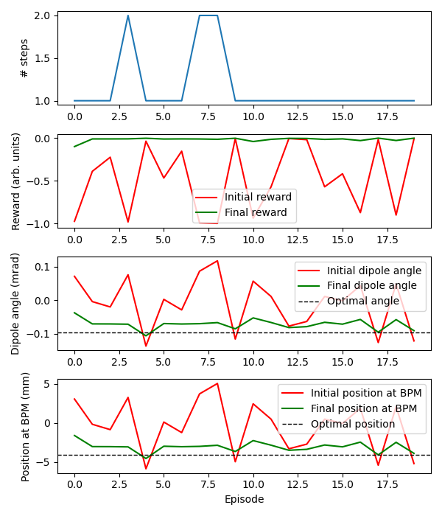

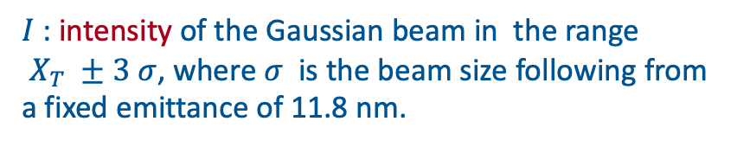
Experimental Results in Noiseless Simulations
$$Reward=−(1 −I)$$
$I$ : intensity of the Gaussian beam in the range
$X_{T} ±3 σ$, where $σ$ is the beam size following from
a fixed emittance of 11.8 nm.

Slide 9
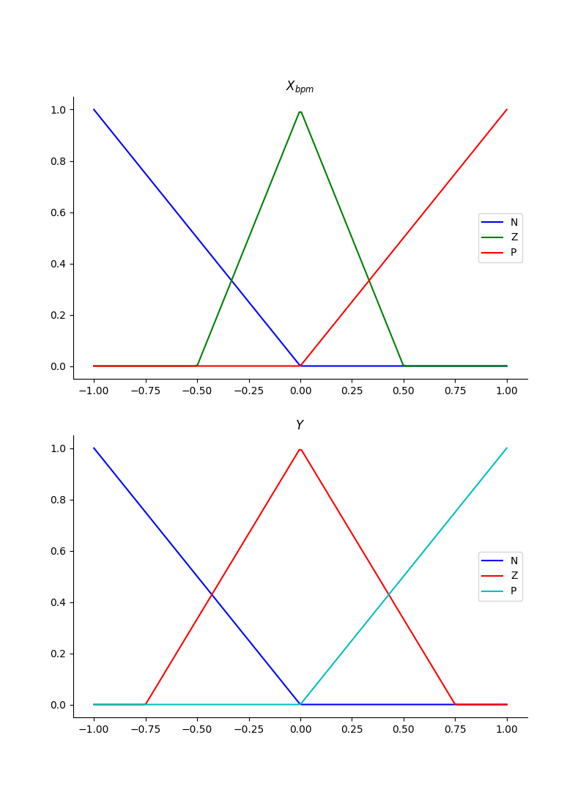
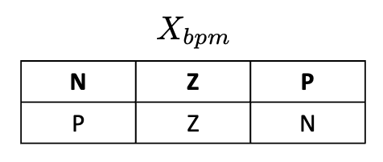
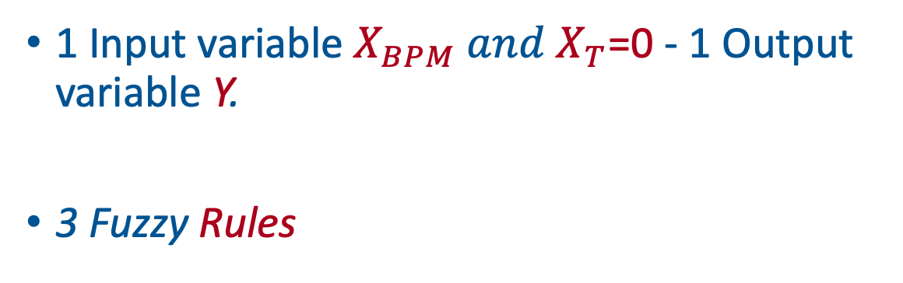
Experiments with real IBMQ devices
1 Input variable $X_{BPM} and X_{T}$=0 - 1 Output variable Y.
3 Fuzzy Rules

Slide 10
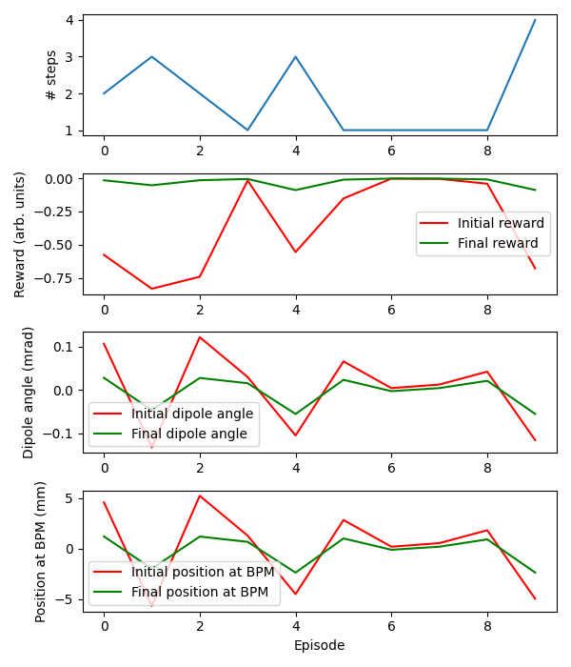
Experimental with real IBMQ devices
$$Reward=−(1 −I)$$
$I$ : intensity of the Gaussian beam in the range
$X_{T} ±3 σ$, where $σ$ is the beam size following from
a fixed emittance of 11.8 nm.

Slide 11
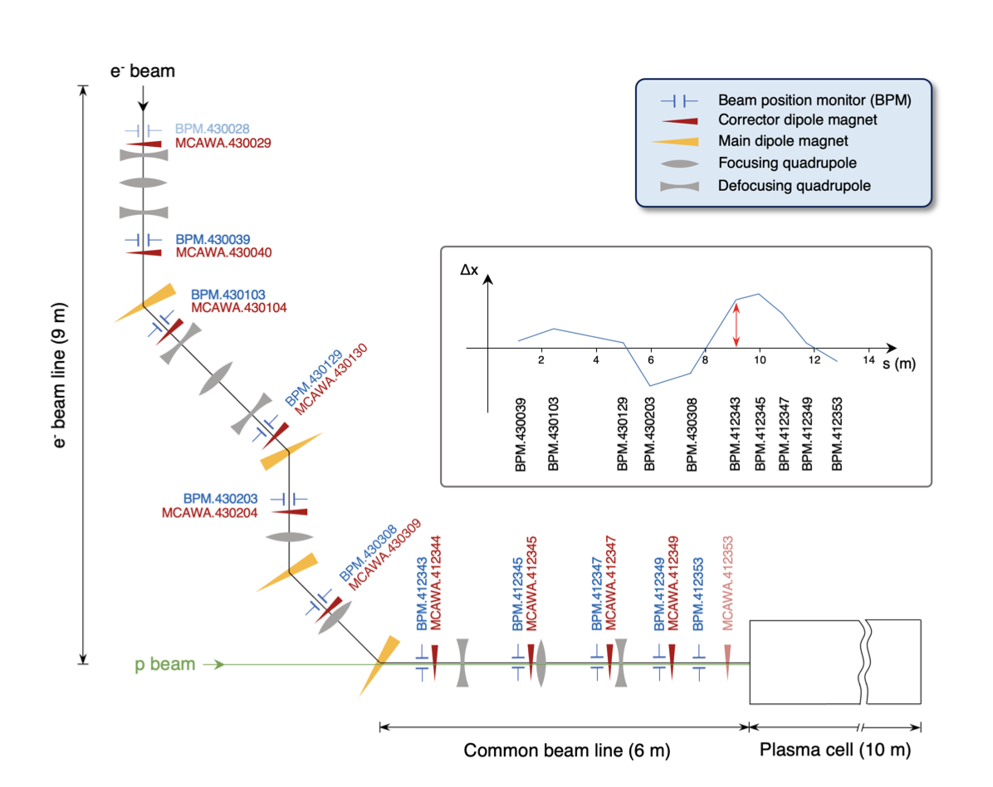
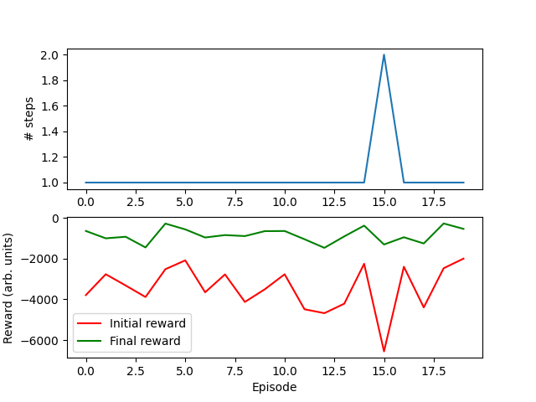
AWAKE Environment
Advanced Wakefield Experiment (AWAKE) at CERN
10-D Problem
2 input variables for each corrector dipole magnet controller

Slide 12
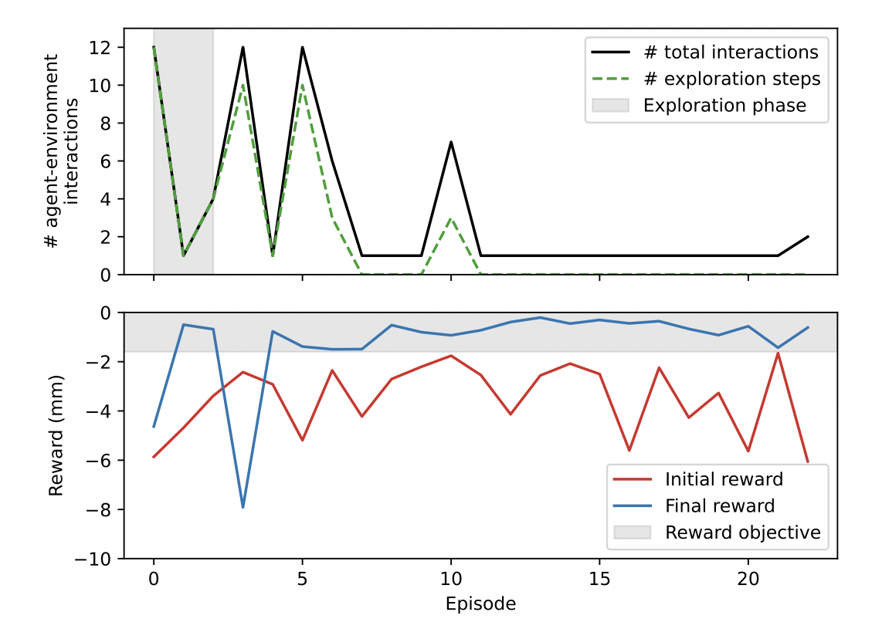
A Comparison with Quantum Reinforcement Learning
A quantum reinforcement learning approach for controlling the AWAKE environment has been proposed in [2].
Q-Fuzzy Control pros:
  No Training Phase
  Explainability of the model
Q-Fuzzy Control Cons:
  Simulations of 10 quantum circuits unfeasible for real beam line tests.
Evaluation on real beam line
[2] Hybrid actor-critic algorithm for quantum reinforcement learning at CERN beam lines – M. Schenk, E.Combarro, M.Grossi et all https://arxiv.org/abs/2209.11044

Slide 13
Conclusion
The Quantum Fuzzy Inference Engine proposed in [1] has been tested in controlling particle accelerators at CERN.
Promising results have been obtained both from simulations and real executions
From environment simulators to real accelerators.

Slide 14


Acknowledgments
A research proposal based on the topics presented in this paper allowed the author Roberto Schiattarella to be awarded with the IEEE CIS Graduate Student Grant in 2022 and the IonQ Research Credit Program.
We thank the ATLAS and the Quantum Technology Initiative at CERN for the support
QR Code for ‘ On the Implementation of Fuzzy Inference Engines on Quantum Computers ‘ paper
QR Code for QFIE Python Package

