Slide 1
Presentation EuPRAXIA-PP and ESFRI Agreements and Consortia
Ralph Assmann, INFN & DESY, Coordinator ESFRI and PP
Claudia Pelliccione, INFN, Project Officer EuPRAXIA-PP
Massimo Ferrario, INFN, Collaboration Board Chair
Collaboration Board Meeting, 25 Nov 2022, LNF, Frascati

Slide 2
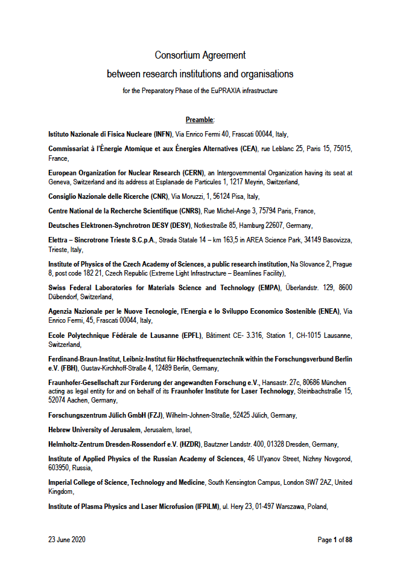
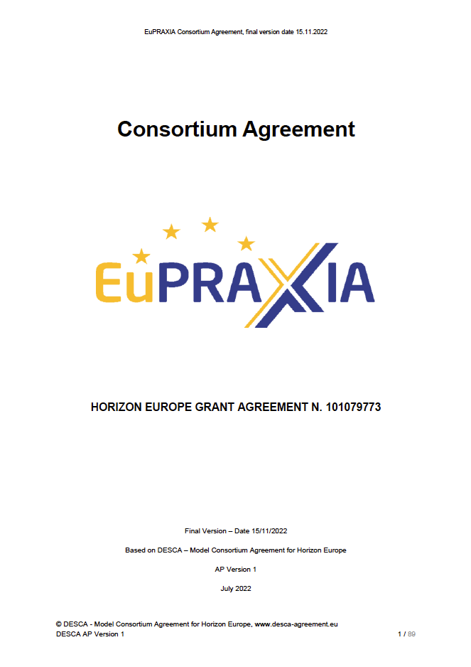
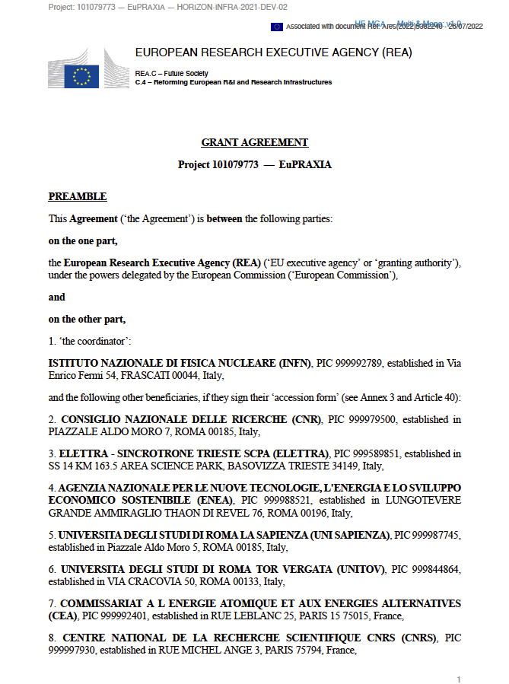
Documents

Slide 3
Documents

Slide 4
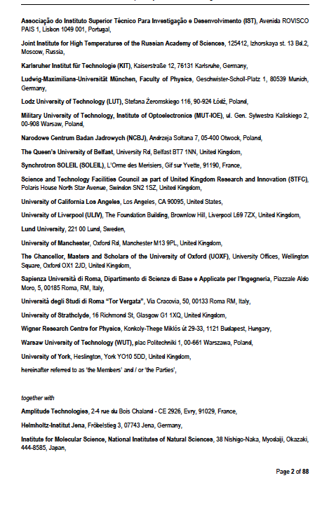
ESFRI Consortium Members

Slide 5
ESFRI Consortium
Formed for the application to the ESFRI roadmap, based on CDR institutes plus additional new institutes

Slide 6
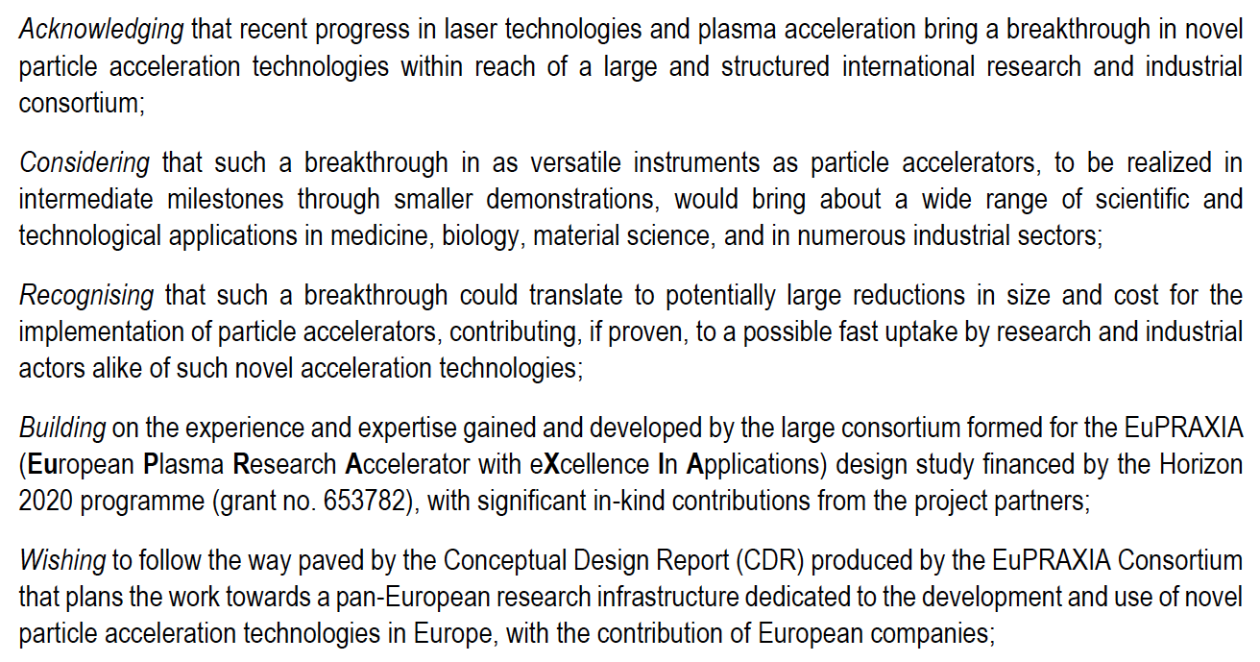
ESFRI Consortium Agreement I

Slide 7
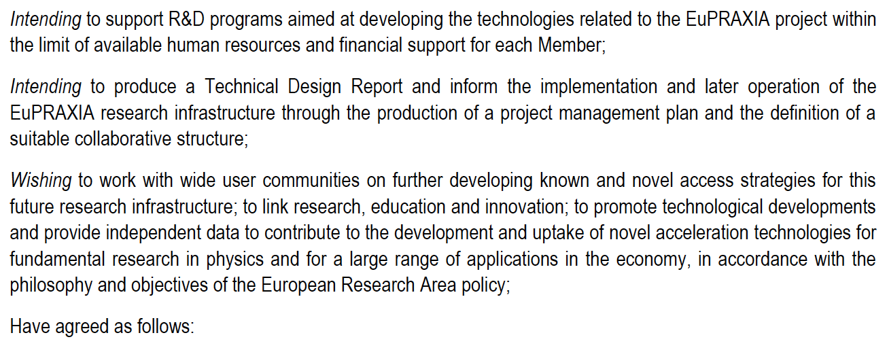
ESFRI Consortium Agreement II

Slide 8
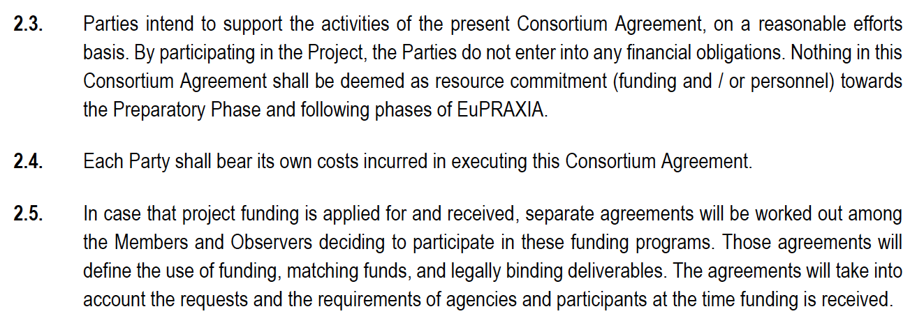
ESFRI Consortium Agreement III
The ESFRI consortium had no resources assigned to it and no deliverables → therefore not adaptable to the EU funded Preparatory Phase project (also including UK, CH funding plus specified in-kind resources) → new consortium, inviting all ESFRI institutes

Slide 9
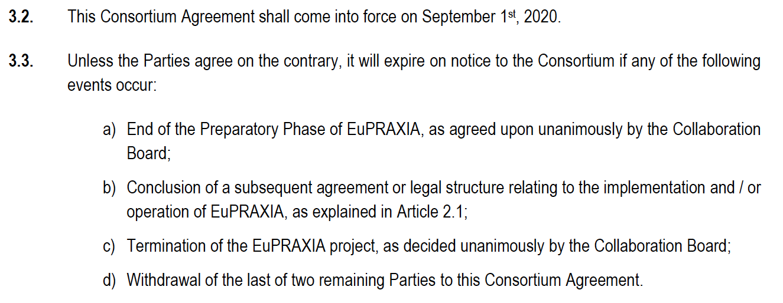
Duration of ESFRI Consortium Agreement

Slide 10
Documents

Slide 11
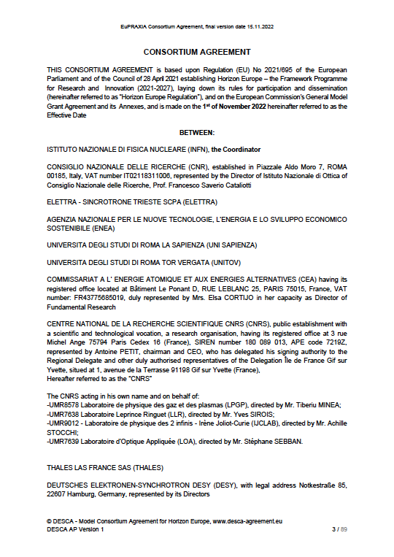
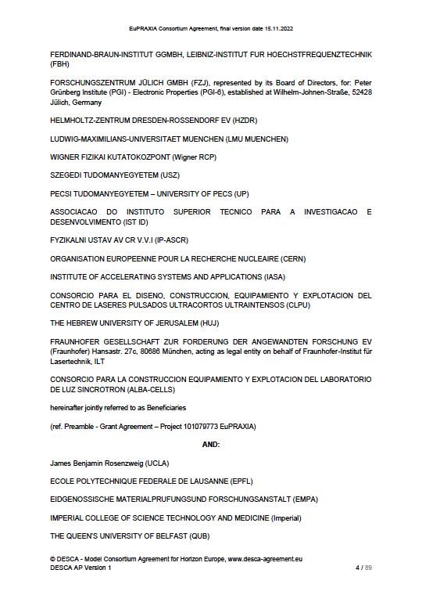
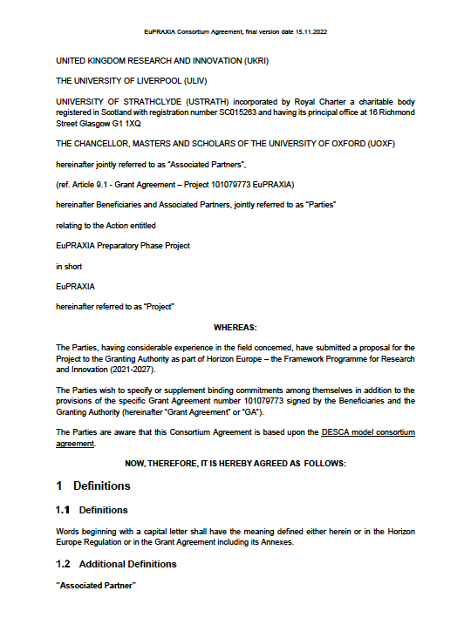
Preparatory Phase Consortium Members

Slide 12
Preparatory Phase Consortium Agreement I

Slide 13
Preparatory Phase Consortium Agreement II

Slide 14
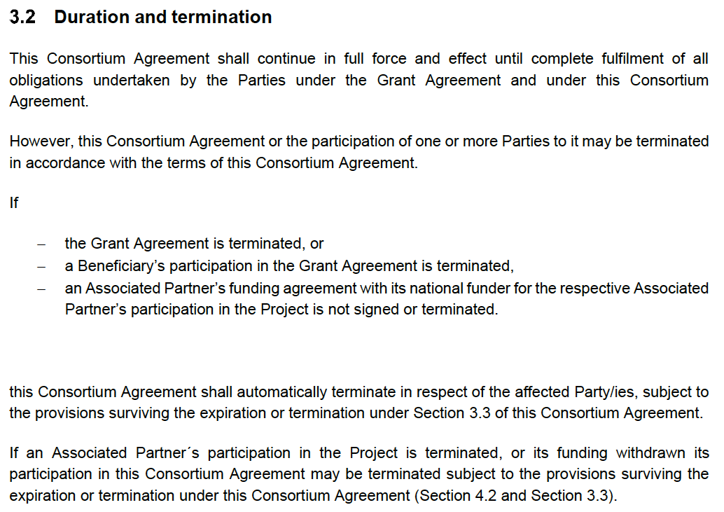
Duration of Preparatory Phase Consortium Agreement

Slide 15
Preparatory Phase Consortium Agreement III
(excerpts)

Slide 16
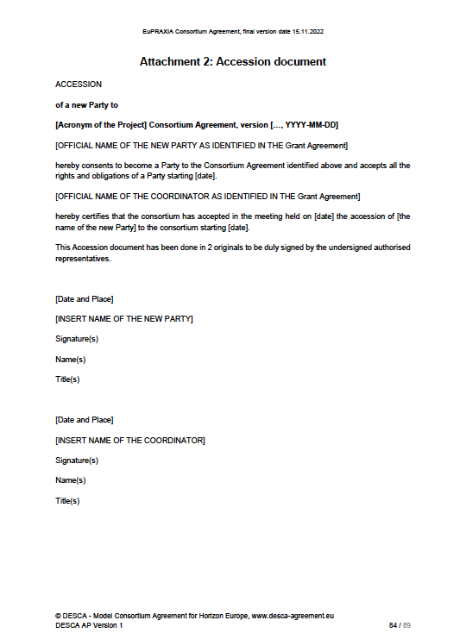
Preparatory Phase Consortium Agreement IV

Slide 17
Proposal

Slide 18
Proposal
In order to streamline the work and reduce number of official meetings and project bodies: → ESFRI parties not in PP join the PP Consortium through accession
We will then drive the project through the Preparatory Phase consortium that includes all partners and observers
The ESFRI consortium formally stays in place and will complete with the completion of the Preparatory Phase, as stipulated in its Consortium Agreement
We ask for
Approval to pursue this merger, involving the EU project officer for approval as well
Approval to follow-up on additional requests to join the consortium (not yet in PP nor in ESFRI)
Once ready we will organize CB of Preparatory Phase for formal votes on new members

