Slide 1
Presentation of Boards and Procedure to Form them
Ralph Assmann, INFN & DESY, Coordinator ESFRI and PP
Claudia Pelliccione, INFN, Project Officer EuPRAXIA-PP
Massimo Ferrario, INFN, Collaboration Board Chair
Collaboration Board Meeting, 25 Nov 2022, LNF, Frascati

Slide 2
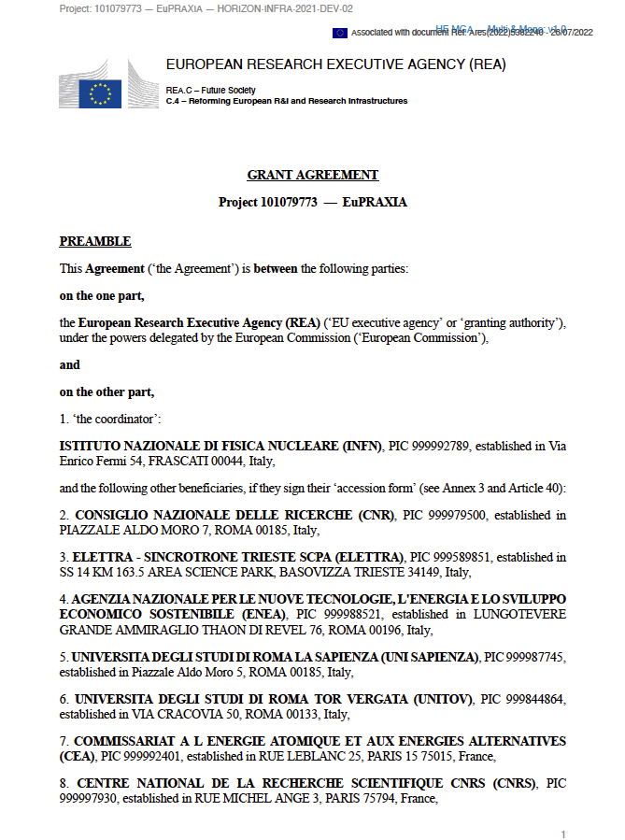
Documents Preparatory Phase

Slide 3
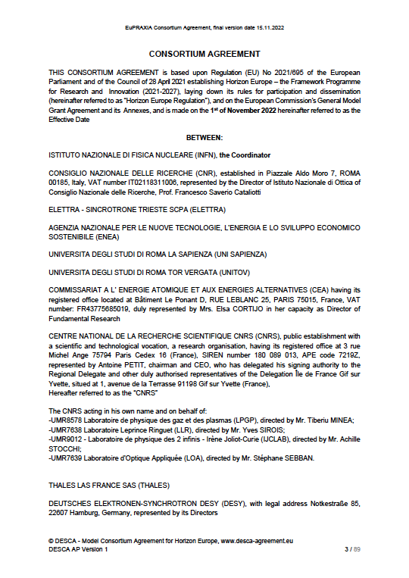
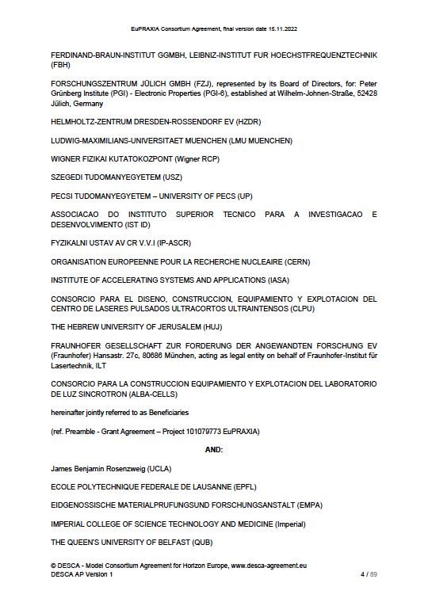
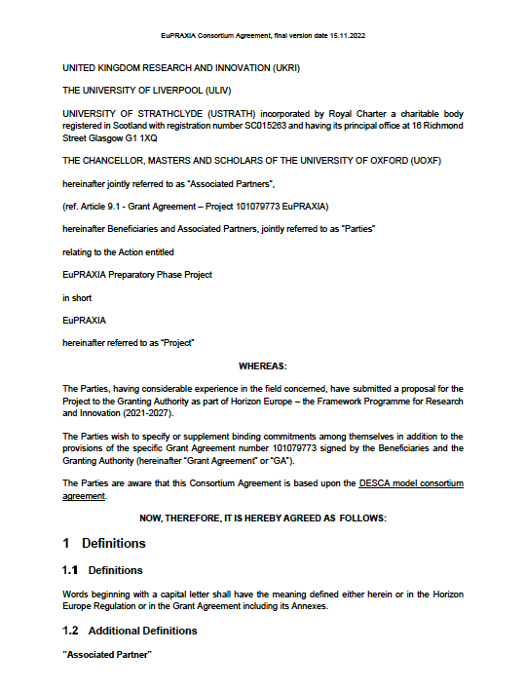
Preparatory Phase Consortium Members

Slide 4
Collaboration Board
(excerpts)

Slide 5
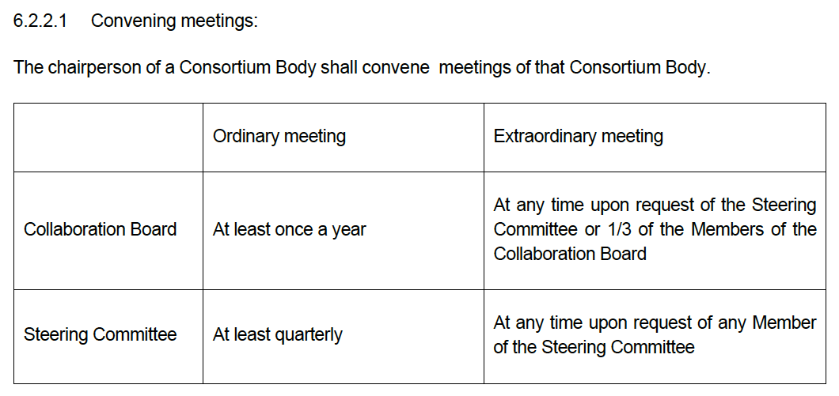
Preparatory Phase Consortium Agreement
(excerpts)

Slide 6
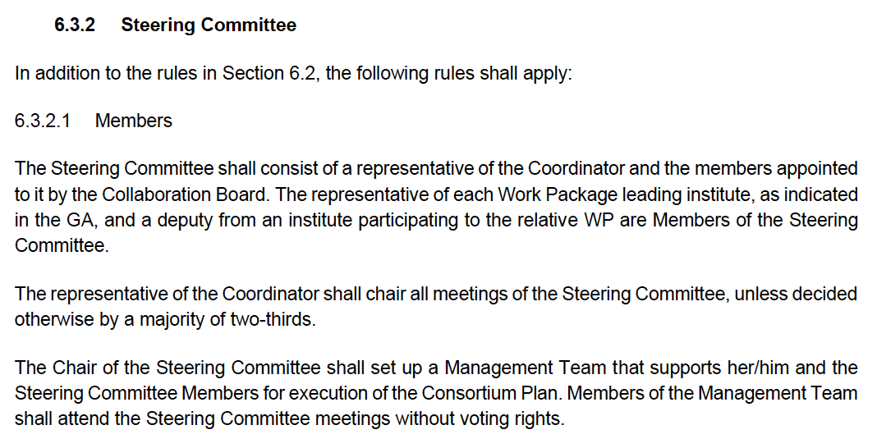
Steering Committee
(excerpts)

Slide 7
Management Team
(excerpts)

Slide 8
Senior Management Advisers
(excerpts)

Slide 9
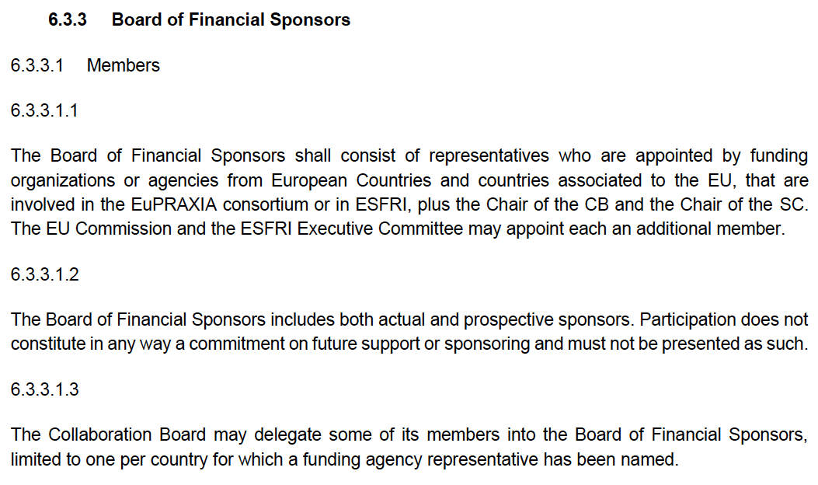
Board of Financial Sponsors I
(excerpts)

Slide 10
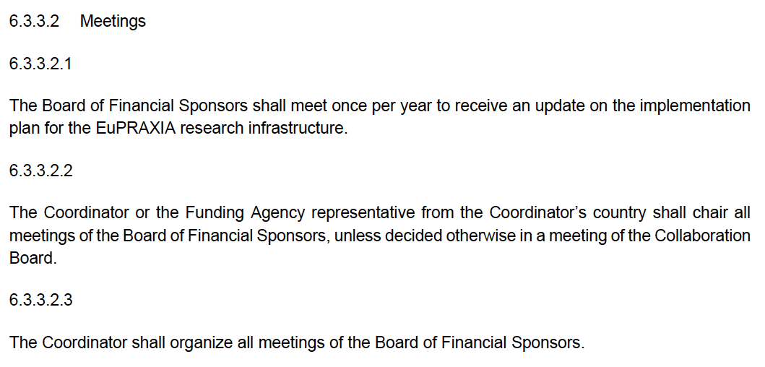
Board of Financial Sponsors II
(excerpts)

Slide 11
Scientific and Technical Advisory Board
(excerpts)

Slide 12
Proposals

Slide 13
Proposals
No additional members of the steering committee at the moment – only the ones foreseen in the CA. Therefore no vote needed.
CB members and WP co-leaders send proposals for the scientific and technical advisory board to Claudia Pelliccione.
Either a special CB meeting or remote voting procedure once we are ready to announce the various committees and boards.

