Slide 1
EuPRAXIA Doctoral Network
Carsten P Welsch
EuPRAXIA Preparatory Phase kick-off Meeting

Slide 2


Overview
BACKGROUND
RESEARCH
EuPRAXIA-DN

Slide 3


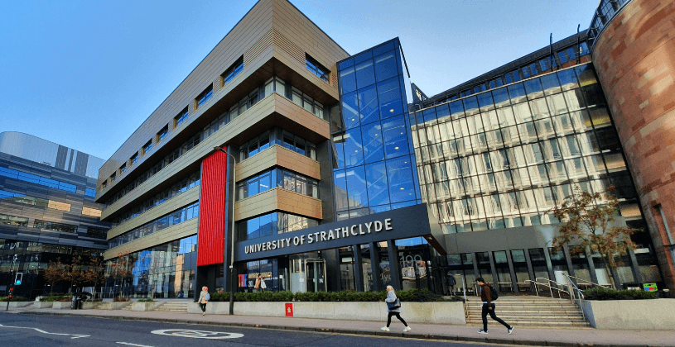
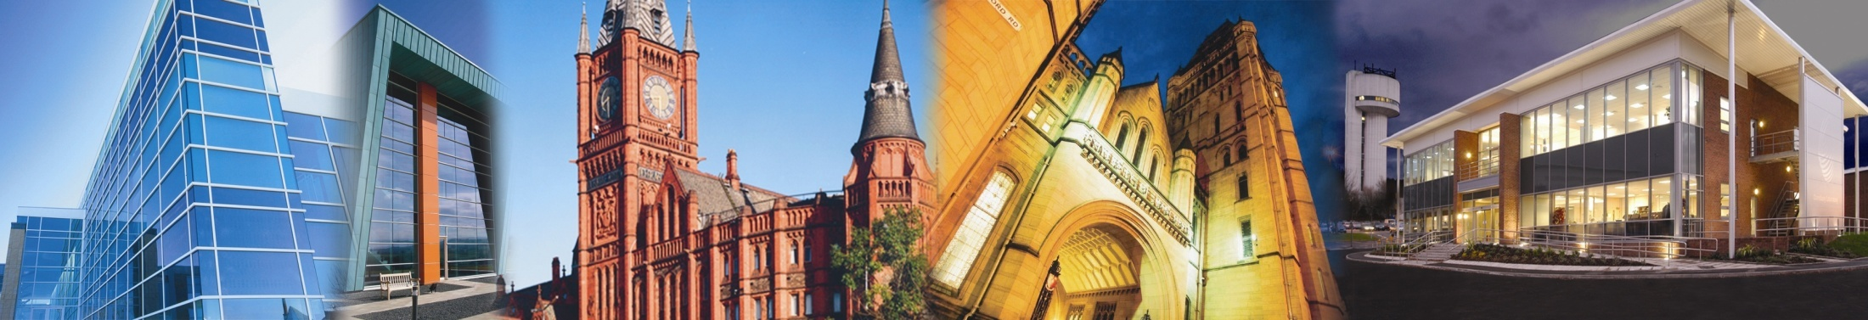





Accelerator Science Group
QUASAR Group:
+35 members (Postdocs, PhD students, admin staff)
Mainly based at CI, but also:
CERN
GSI
CNRS

Slide 4
The Cockcroft Model
(Universities) + (STFC: ASTeC and elements at DL)
+
Integration of all the above

Slide 5






Marie Curie Networks
(Beam Diagnostics, Physics) 4.2 M€, 32 partners
(Laser Applications, Engineering) 4.6 M€, 38 partners
(Accelerator Optimization, Physics) 6 M€, 35 partners
(Medical Accelerators R&D, Life Sciences) 4 M€, 24 partners
(Antimatter R&D, Physics) 4 M€, 26 partners
Largest portfolio of Marie Curie networks in any scientific area.
Also: Chair of STFC ETCC and member of UKRI TSAG.

Slide 6


Slide 7
ACCELERATING RESEARCH AND TRAINING
Carsten P Welsch
INFN-LNF
University of Liverpool
The Cockcroft Institute

Slide 8
What is EuPRAXIA-DN?
MSCA Doctoral Network with a budget of 3.2M €;
12 high-level Fellowships (10 Fellows will be funded by the EU, another two by the UKRI guarantee funds);
Interdisciplinary and cross-sector plasma accelerator research and training program carried out between universities, research centres and industry;
Allows for organizing (large) number of events;
Recognized importance of plasma accelerator R&D at European level!

Slide 9








Beneficiaries

Slide 10














Partner Organizations

Slide 11



Research
Laser & Plasma
Facility Design & Optimization
Applications
The network's main scientific and technological objectives are split into three closely interlinked work packages.

Slide 12
Training & Events
International school on plasma accelerators;
EuPRAXIA camps on focused research topics – always across the different project work packages;
Researcher skills training designed to prepare all Fellows for their future careers and make them attractive for employers in academia and industry;
Final conference and outreach symposium to present project results.
Events are open to all fellows and wider community !

Slide 13
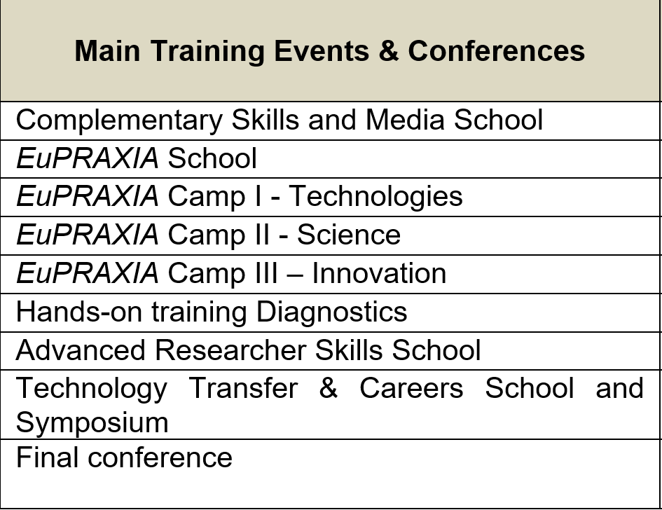
EuPRAXIA-DN Events - Details
Outreach symposium will be held in 2026 together with the LIV.INNO CDT to maximize impact;
Final conference location will be decided in due time.

Slide 14
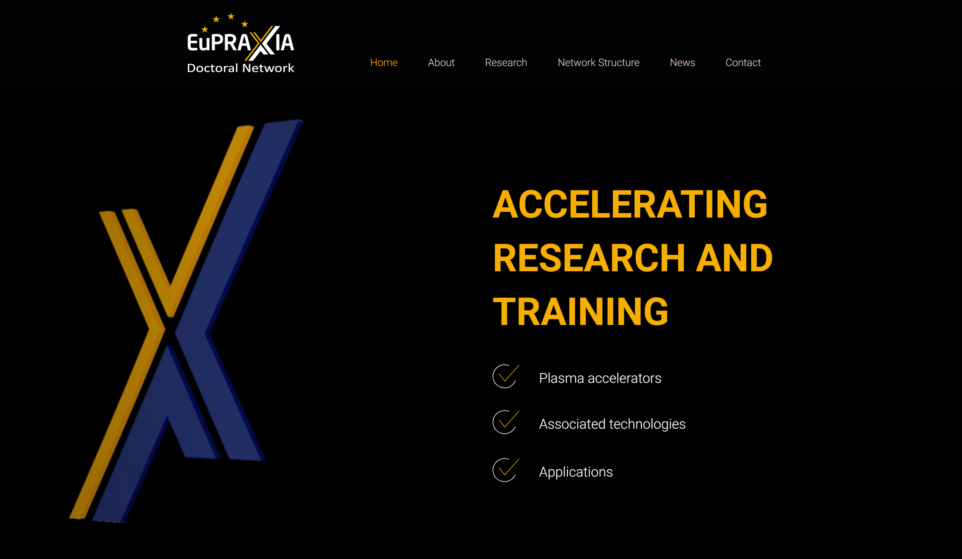
Project Website
EuPRAXIA logo to show identity, with added description
The EuPRAXIA ‘X’ as used in logo, on EuPRAXIA Files etc
EuPRAXIA gold and indigo tone used throughout website for headings, buttons, icons etc
www.eupraxia-dn.org

Slide 15
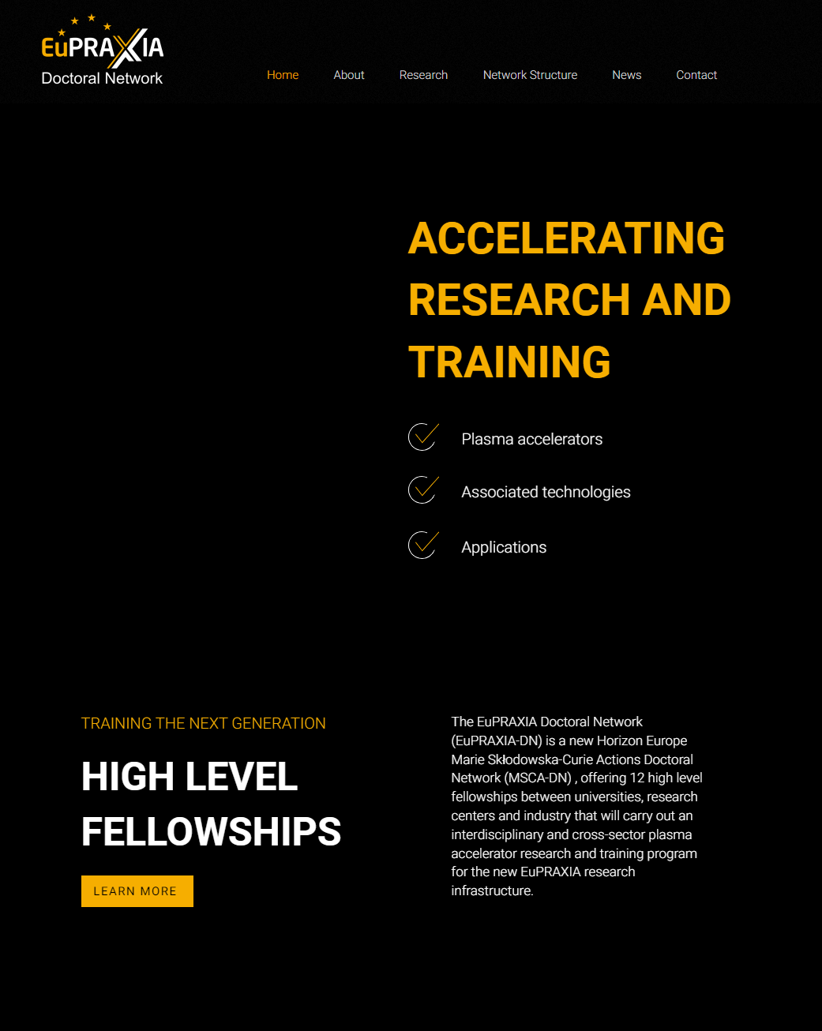
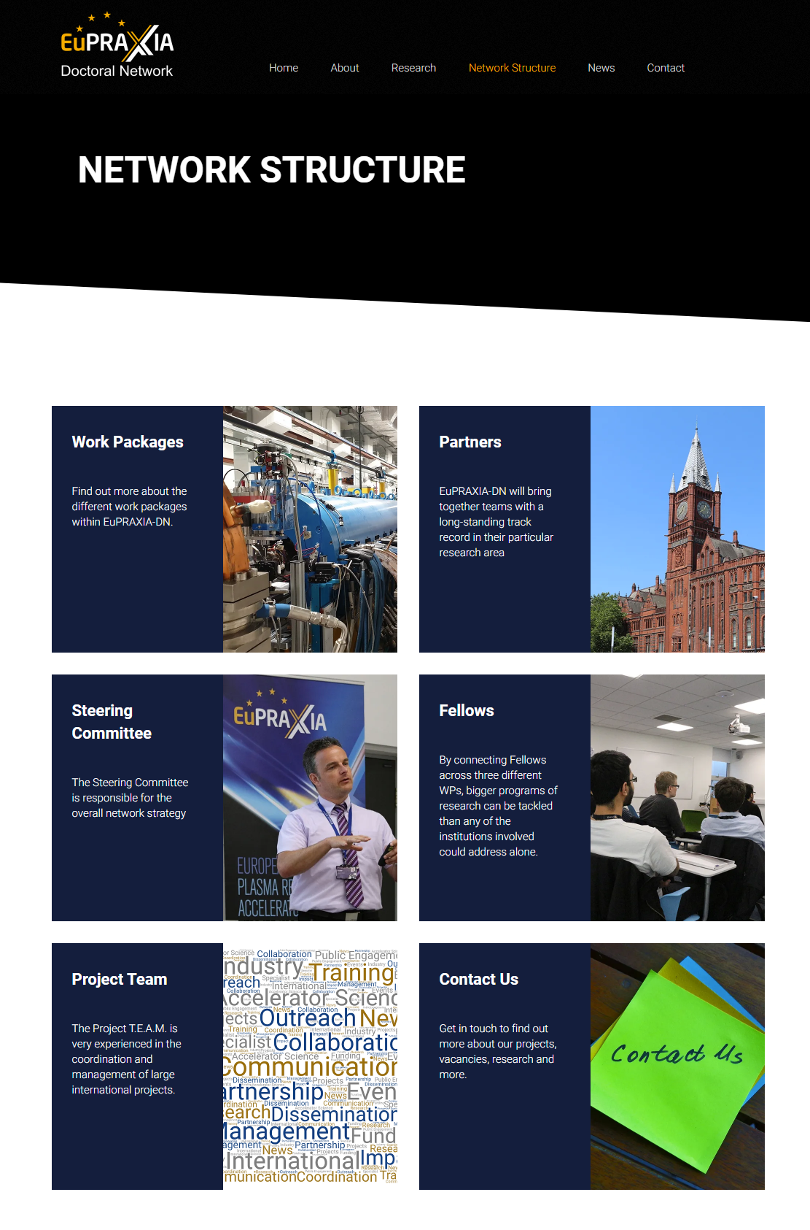
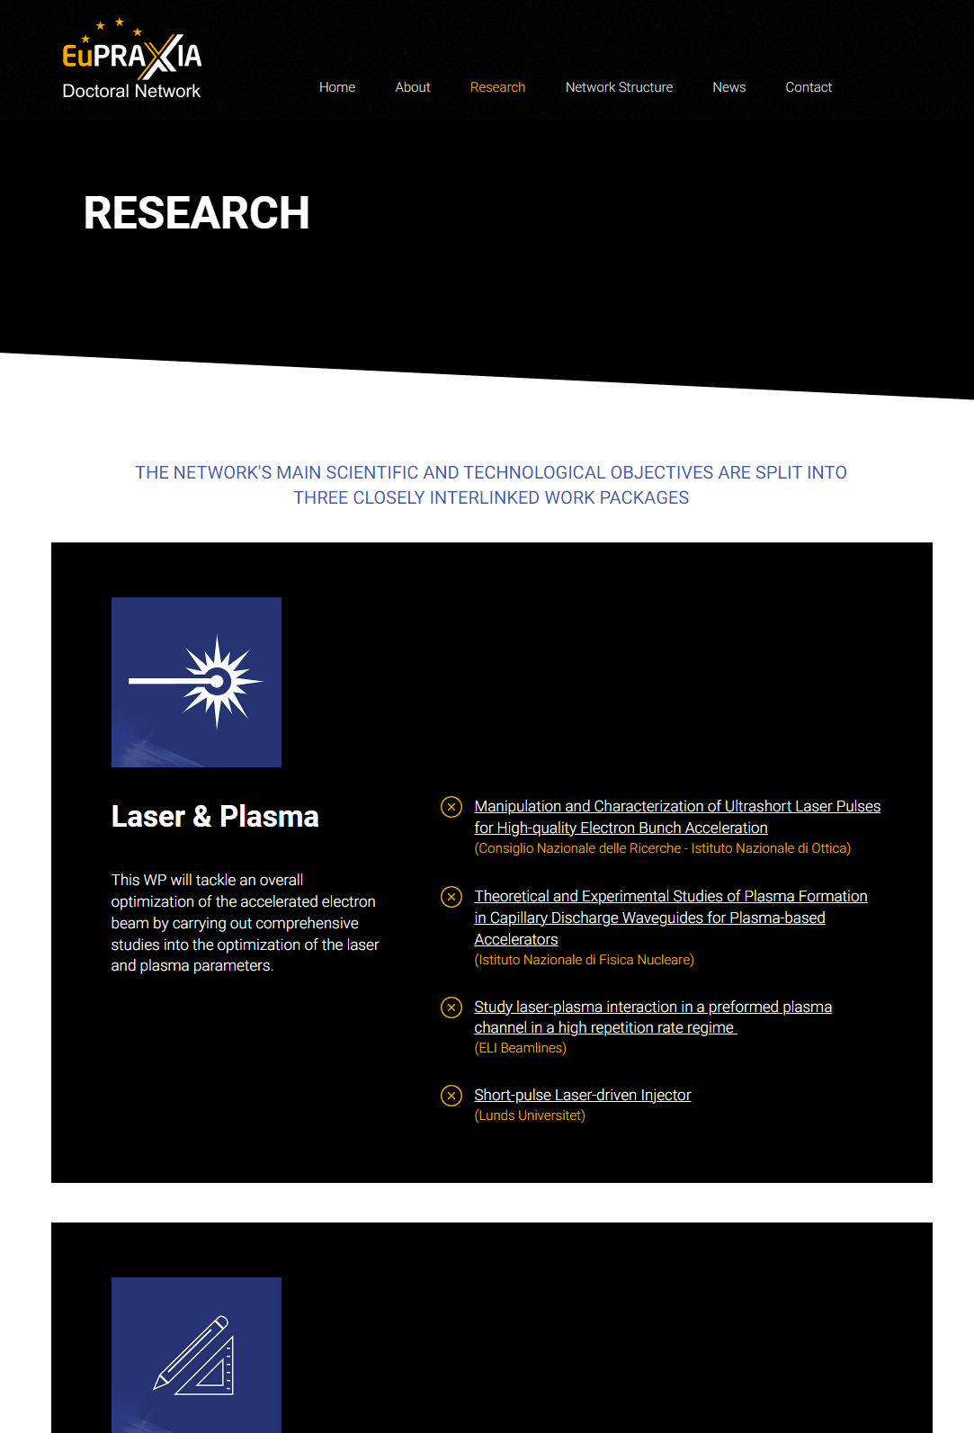
Project Website
www.eupraxia-dn.org

Slide 16
Dissemination
Research articles will be supported by international press release;
Two project brochures will be produced at the beginning and end of the project to highlight the Fellows’ research results;
Fellows will produce a video about EuPRAXIA-DN to raise awareness of research within the network;
School visits and outreach events;
The network will release a regular newsletter showcasing scientific results; highlight articles will feature in Accelerating News;
All activities will be supported by ULIV's established social media channels.

Slide 17

Position Vacancies
12 Fellowships on offer for start spring/summer 2023;
R&D projects across the 3 EuPRAXIA-DN work packages;
International training program
Excellent salaries will be offered.
www.eupraxia-dn.org

Slide 18
Summary
A major European initiative in plasma accelerator research will start in January 2023;
Three work packages address a number of important research challenges;
There are many opportunities for getting involved.
Spread the word – participate – benefit!

Slide 19
Contact and Further Details
Prof Carsten P Welsch
Project Coordinator
INFN-LNF
University of Liverpool
carsten.welsch@lnf.infn.it
www.eupraxia-dn.org

Slide 20


