Slide 1
WP11: Applications
Gianluca Sarri and Enrica Chiadroni
Queen’s University Belfast and Università la Sapienza di Roma

Slide 2
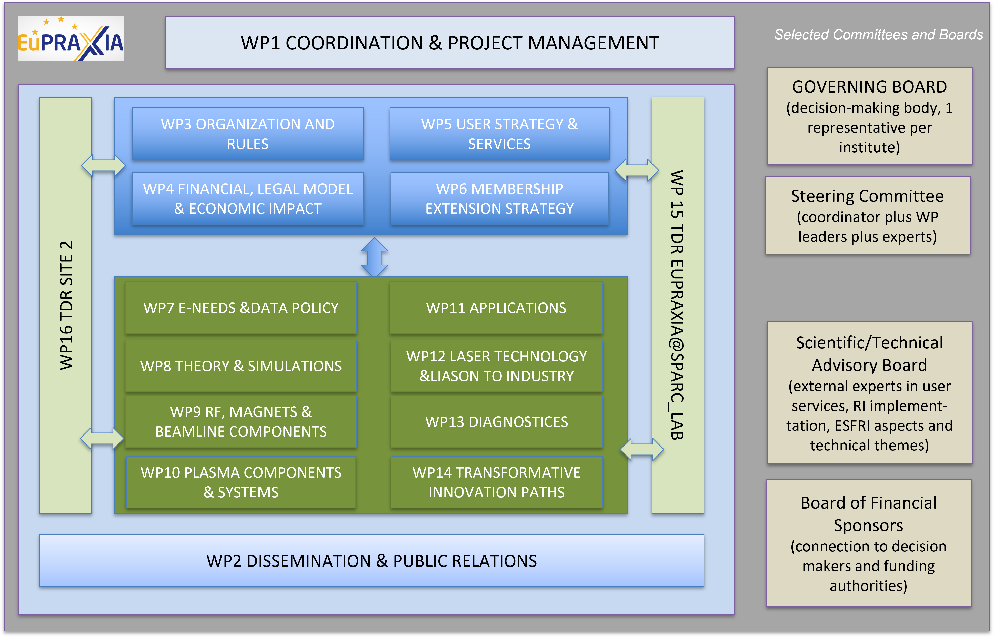
EuPRAXIA-PP Structure

Slide 3
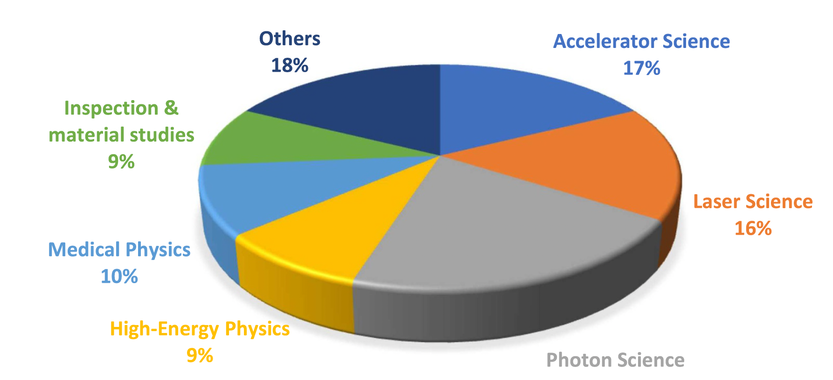

The Mission
Flagship Science Goals:
Flagship Science Goal 1: free-electron laser (FEL) X-rays
10⁹ - 10¹³ photons per pulse, 0.2 nm to 36 nm, 0.4 fs duration
Flagship Science Goal 2: betatron X-rays
10¹⁰ photons per pulse, energy of 5 –18 keV
Flagship Science Goal 3: low-energy positron beams
energies 0.5MeV - 10MeV, 10⁶ positrons per pulse, 20–90 ps duration
Flagship Science Goal 4: electron and positron beams
energies 100MeV - 5 GeV for high-energy-physics-related R&D
Flagship Science Goal 5: Compton scattering (ICS) source
narrow-band spectrum for precision nuclear physics and highly penetrative radiography for users.
Flagship Science Goal 6: multi-stage high repetition-rate plasma accelerator
in the GeV range to users from accelerator science.
Flagship Science Goal 7: Novel schemes of pump probe configurations
and ultra-precise timing will be researched, feeding back into laser science

Slide 4
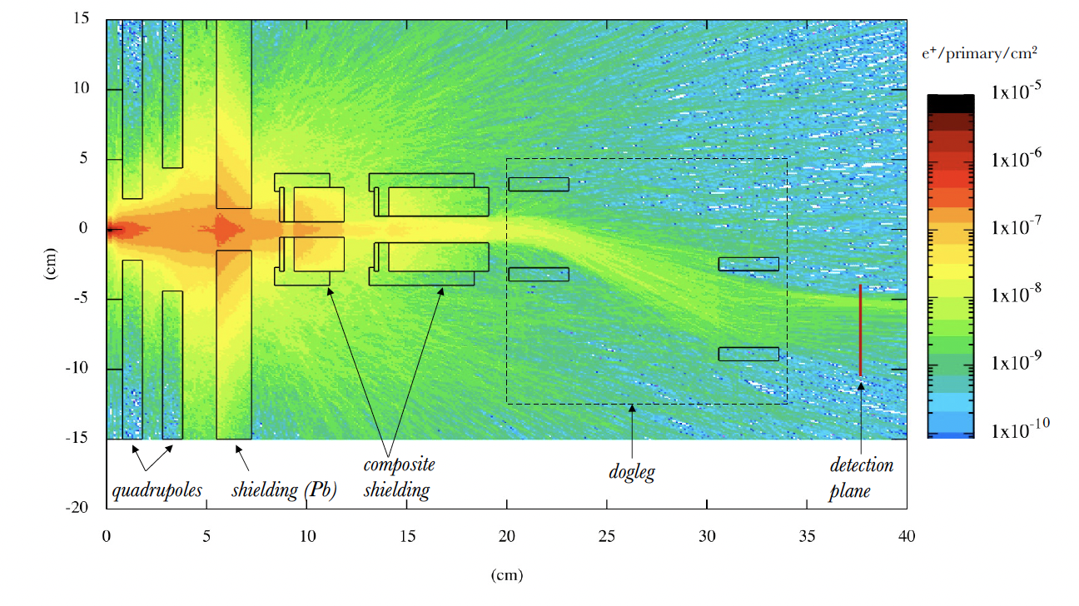
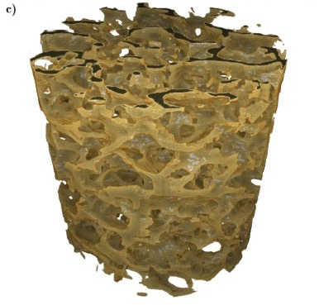
The Mission
From the ESFRI hearing…
EuPRAXIA RI services fields of Physical Sciences & Engineering and Food & Health:
  Compact and cost-efficient accelerator technology at scale of interest for industry, hospitals, universities (longer-term VHEE radiation therapy).
  Compactified free electron laser facility for e.g. research on viruses and bacteria, rapid screening of biological tissues, nanoparticles as pesticides.
  “Table-top” applications in manufacturing industry with non-destructive testing methods (compact X ray machine, deeply penetrating positron annihilation spectroscopy).
  Point-like emission X ray source, e.g. for material studies or for identifying early onset of cancer at micron-scale (calcification).
Positron sources for material scanning
Betatron tomography of bone tissue

Slide 5
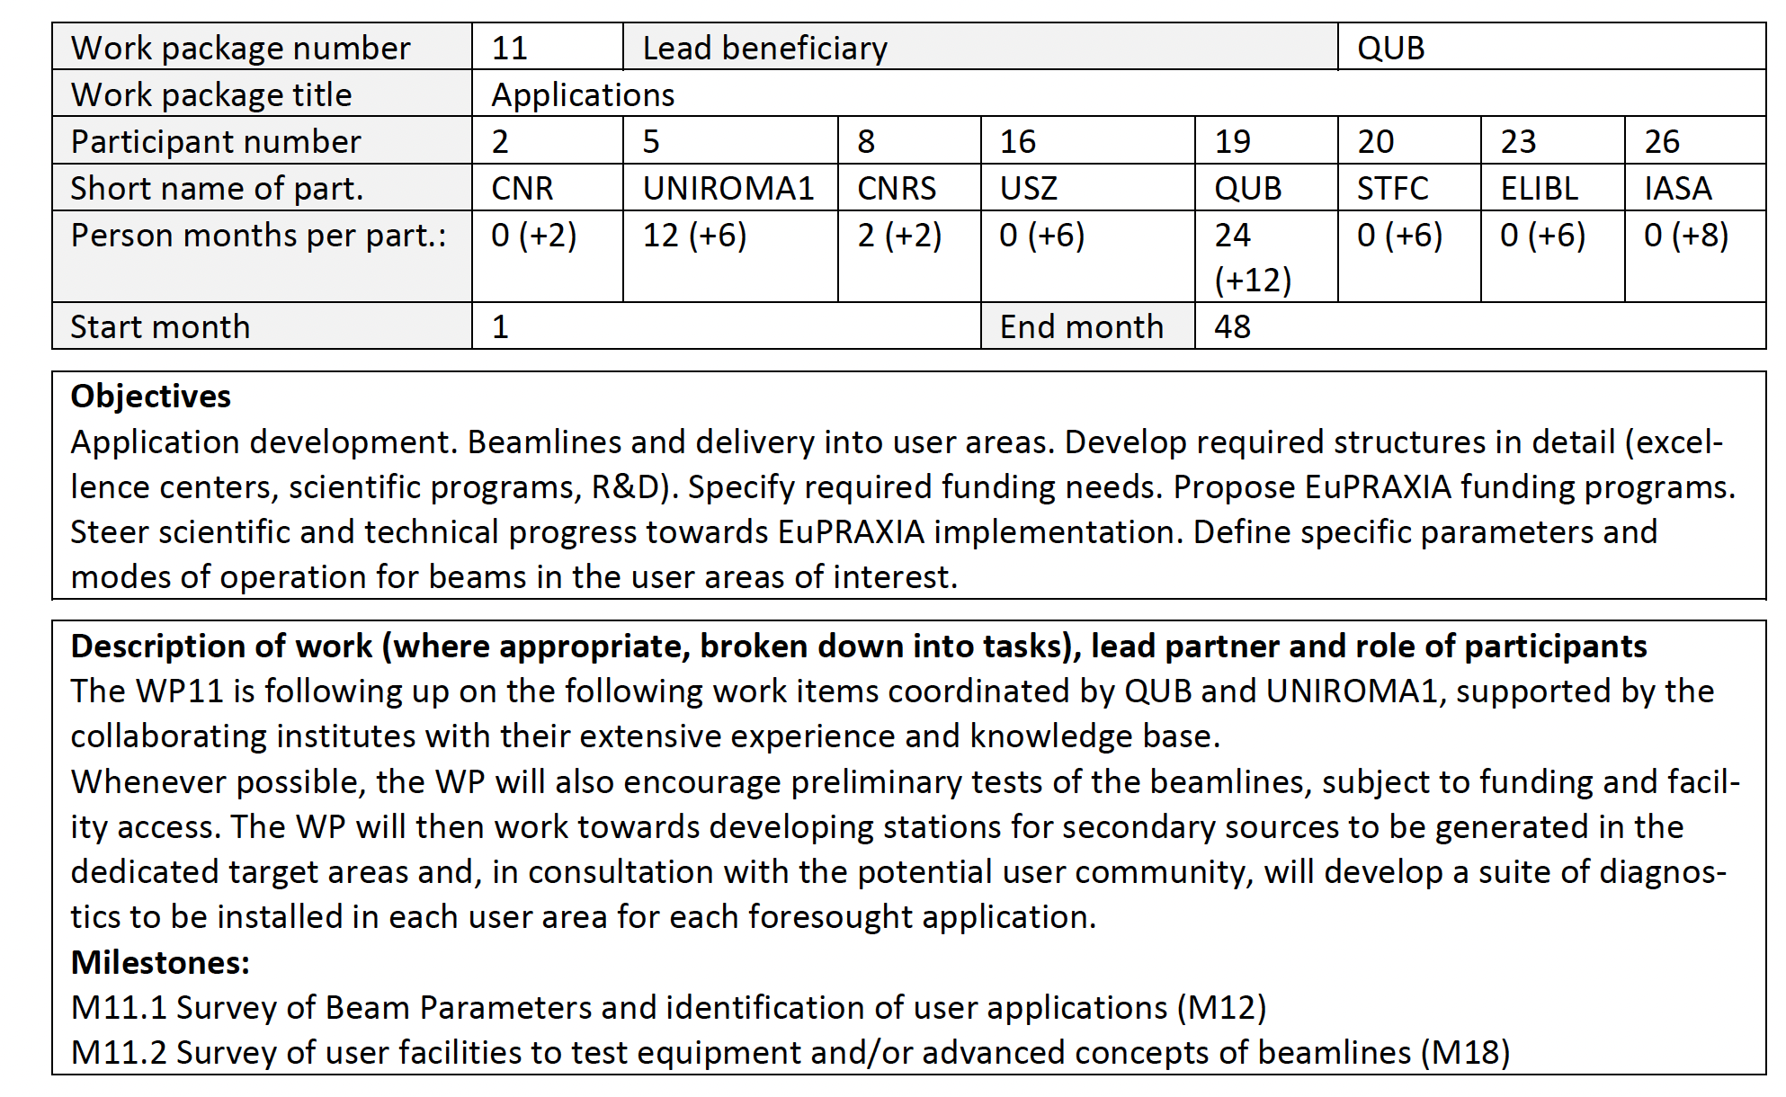








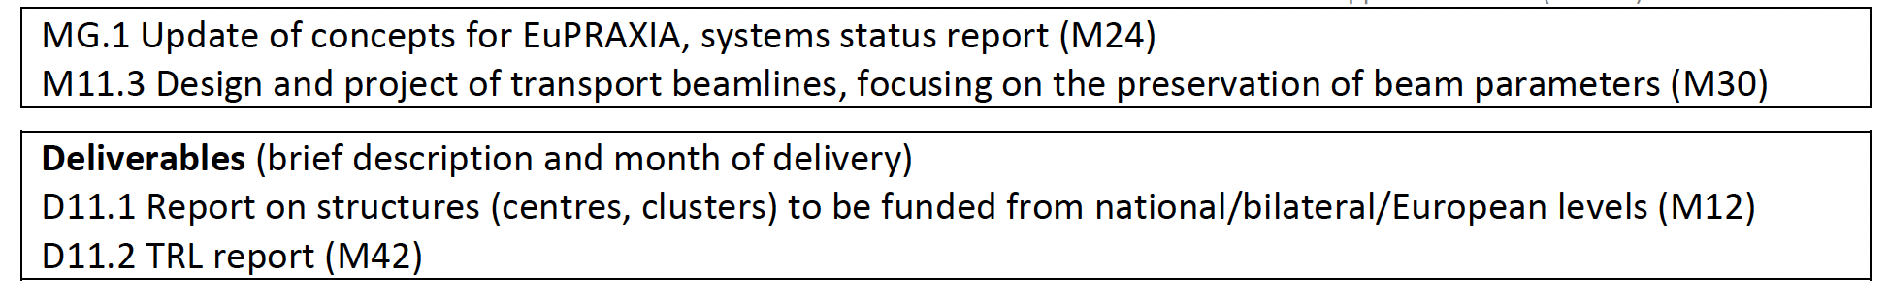
The Structure
Work Package Coordinators
Work Package Participants

Slide 6
What do we need to do?
Form a coherent and comprehensive structure of centres/initiatives to be funded at national/bilateral/European level
- Are there other institutes interested in joining or that we should involve? ➔ Collaboration with WP6
- What are the main current initiatives that could be integrated in WP11?
- What are the main existing facilities that we can use for R&D?
Carry out more extensive and capillary surveys of potential user needs and beam requirements
- What photon/electron/positron (other..?) beam parameters would be most useful? ➔ Collaboration with WP5, 9, and 10
- What would the end-stations look like? ➔ Collaboration with WP5, and 13
- What diagnostics and experimental capability do we need to provide to the users? ➔ Collaboration with WP5, and 13
3. Preparation towards Eupraxia TDR
- Design and project of transport beamlines ➔ Collaboration with WP8, 9, and 10
- Design and project of end-stations ➔ Collaboration with WP5, 13 and 16
- Beamline design for Eupraxia@Sparc-lab and for “Site 2” ➔ Collaboration with WP13 and 16

Slide 7
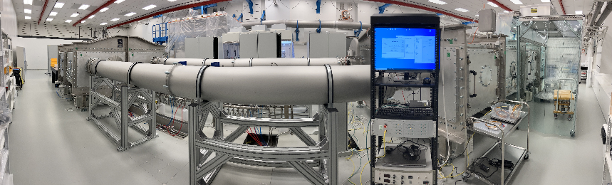
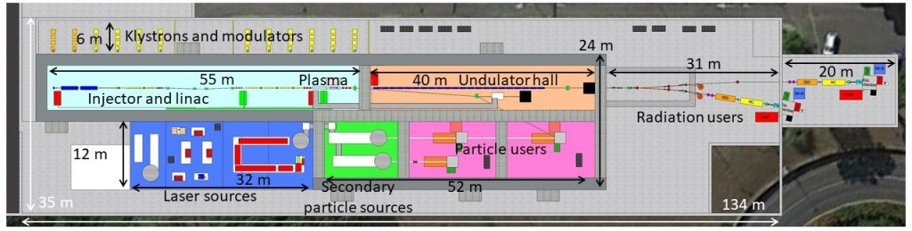
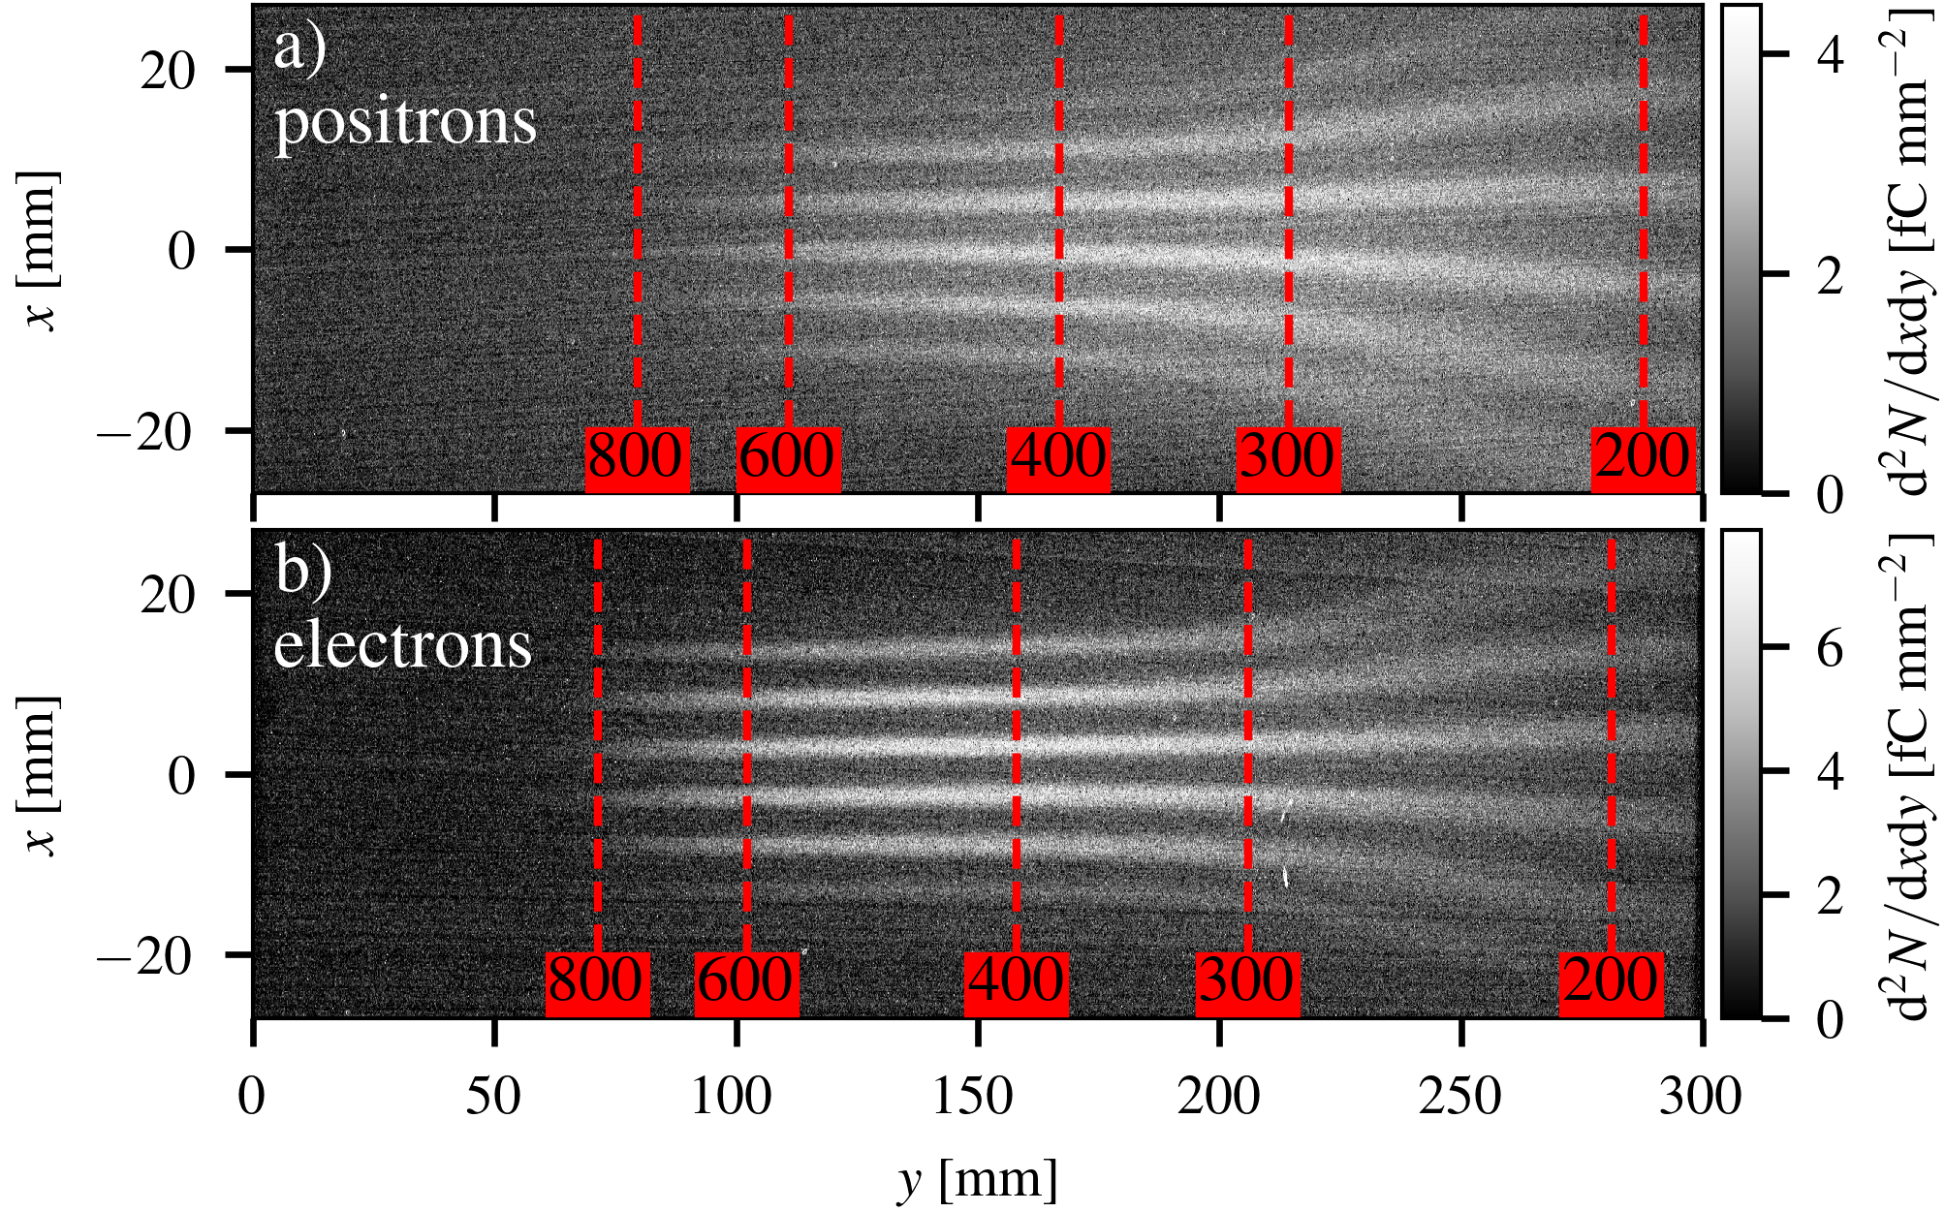
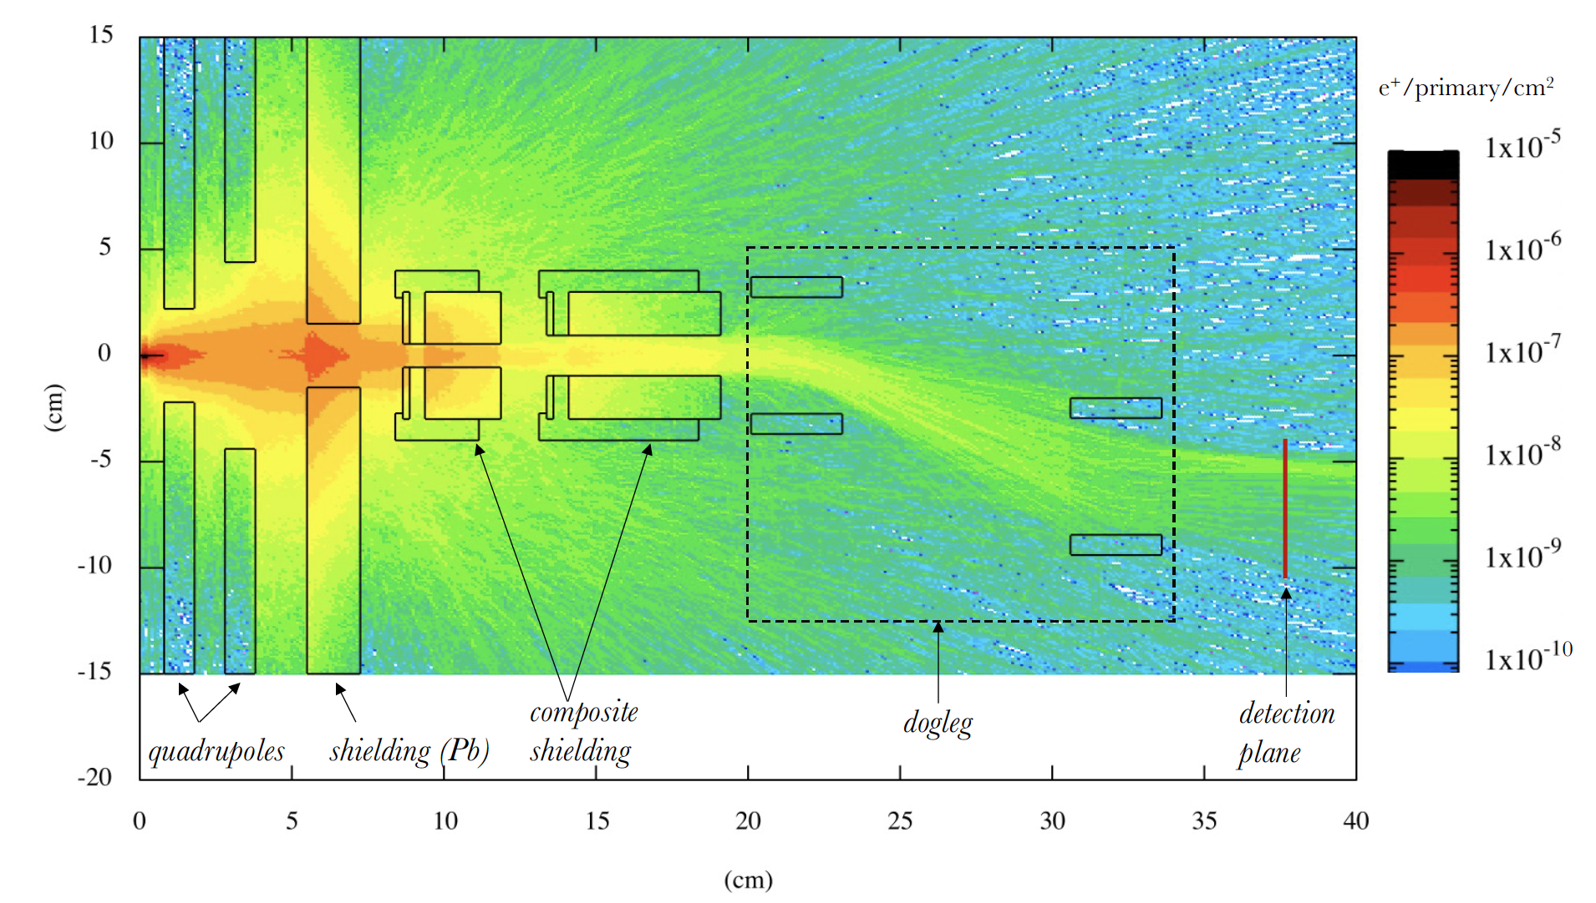
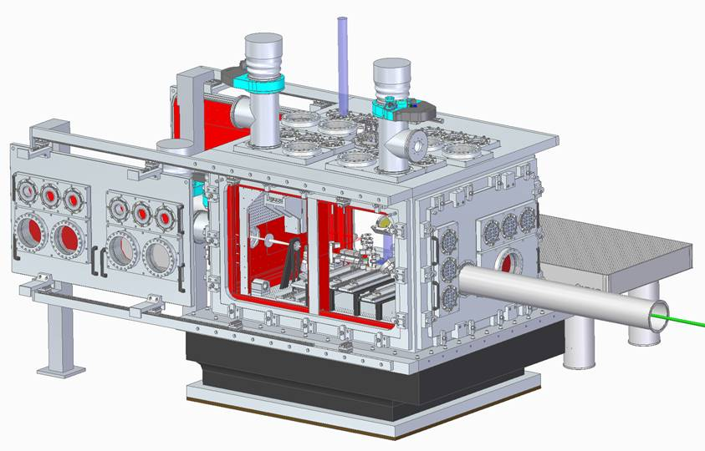
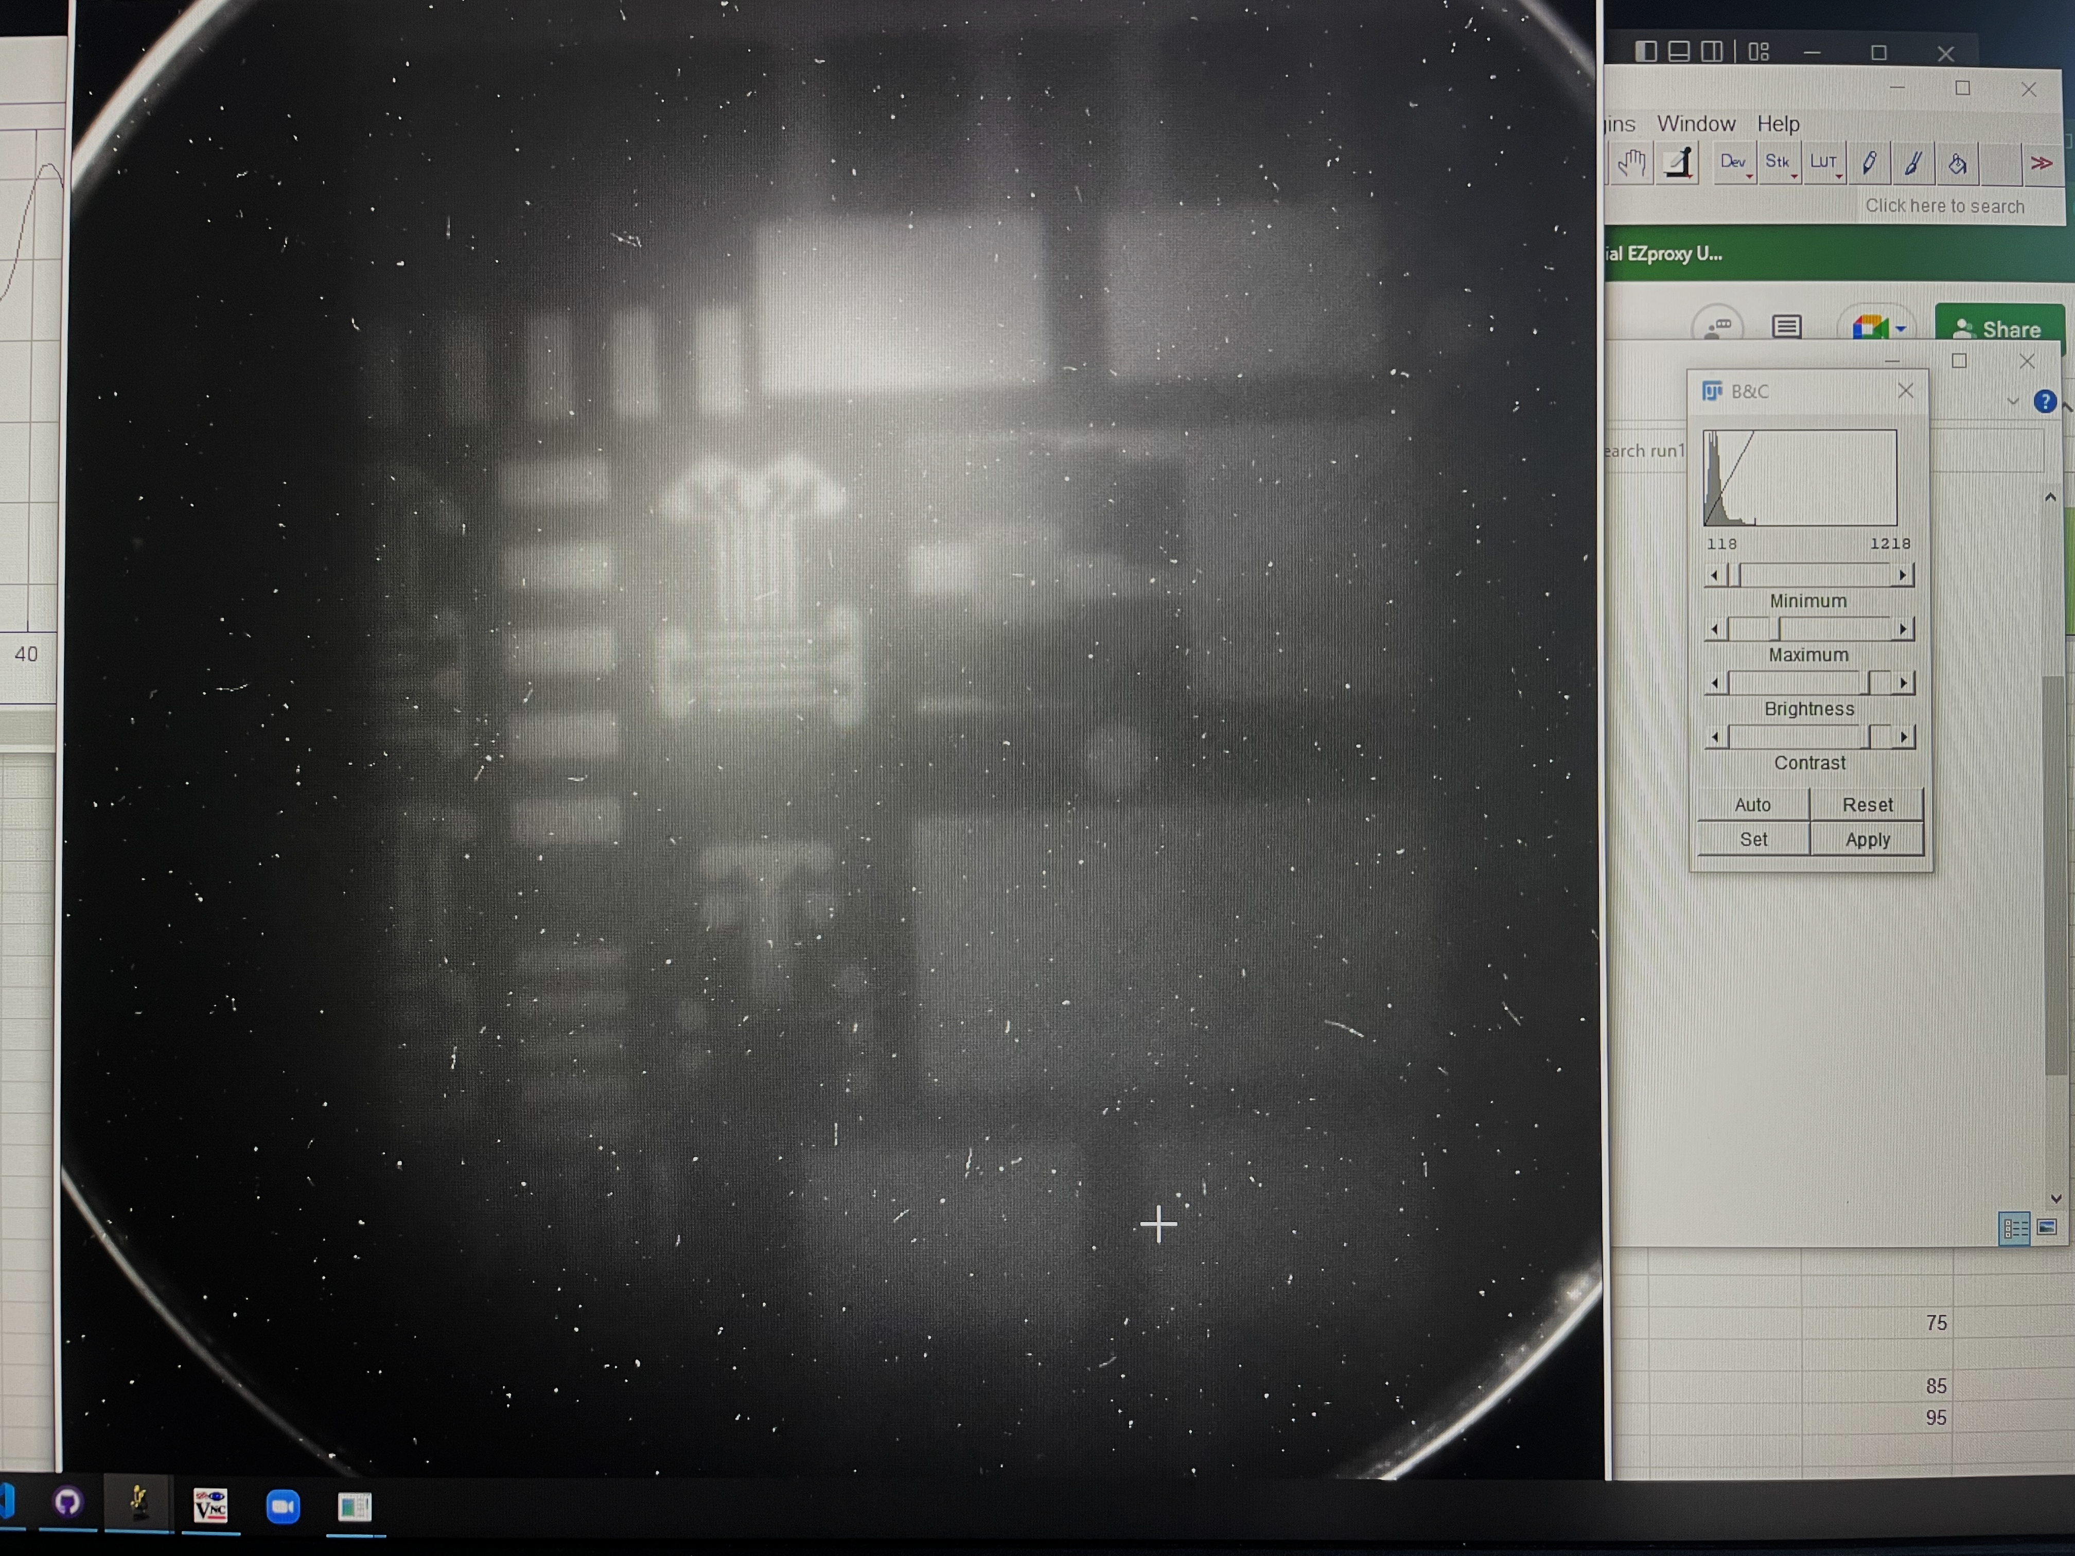
Examples of work that has already started
National level
Institutional level
LNF is developing a beam-driven source towards an FEL (Eupraxia@Sparc_Lab) and betatron sources
ELI_Elba at ELI-BL has been commissioned at low power
High- and low- energy laser-driven positron sources have been designed and built at QUB
Building on the experience of CLF, the UK has started the construction of EPAC (Extreme Photonics Application Centre)
QUB/STFC first experiments on Compton imaging

Slide 8
Let’s kick-off!
November kick-off
  This is our first meeting for the Preparatory Phase, an excellent chance to start discussions!
  First step would be to establish a structure of initiatives and of centres involved
  Start procedures for funding applications both at national and international level
Steering committee every 3 months
Dedicated workshop: „EuPRAXIA WP`s and Excellence Centers“
Feedback very welcome: workshop when, meetings required, …

Slide 9
Thank you for your attention!
Gianluca Sarri g.sarri@qub.ac.uk
Enrica Chiadroni enrica.chiadroni@uniroma1.it

