Slide 1
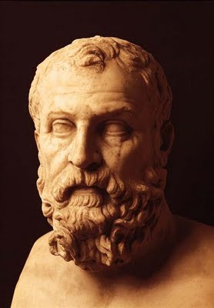
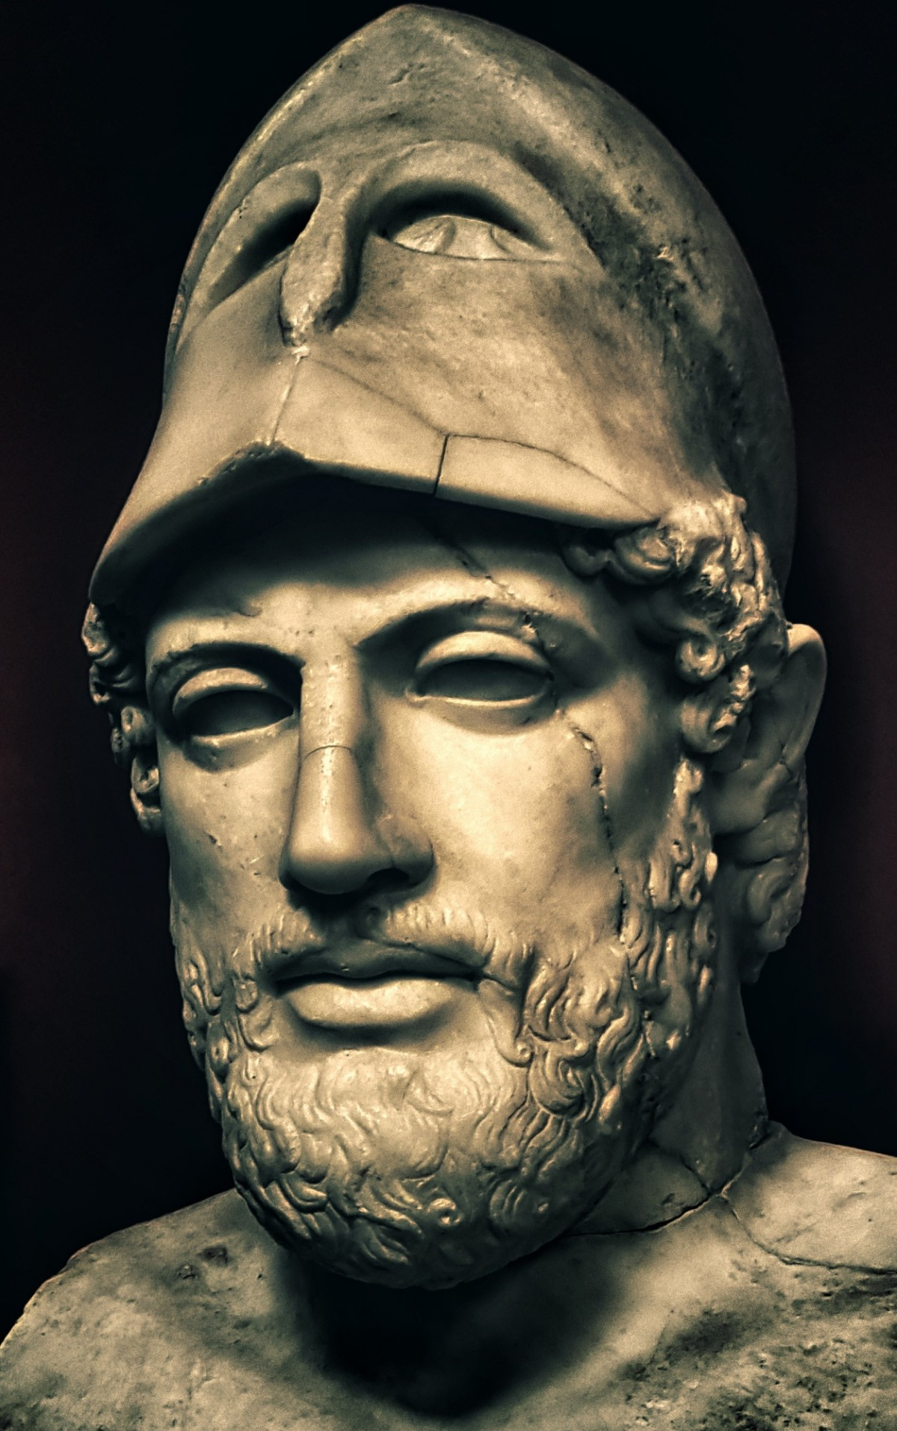
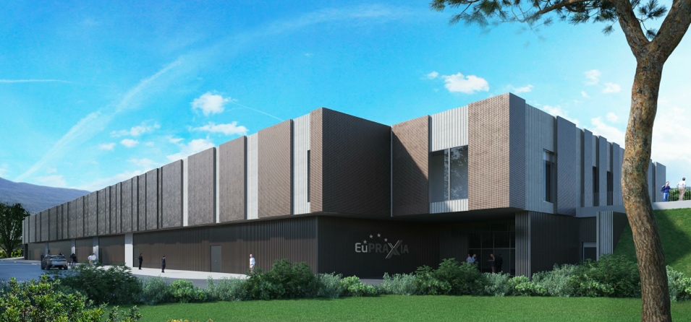
WP3: Organisation and Rules
2nd site
WP3 coordinators : Andrea GHIGO (INFN)
Arnd SPECKA (CNRS)

Slide 2
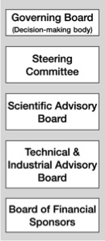
PP Steering Committee: Leaders Behind EuPRAXIA
WP1 - Coordination & Project Management
R. Assmann, INFN & DESY
M. Ferrario, INFN
WP2 - Dissemination and Public Relations
C. Welsch, U Liverpool
S. Bertellii, INFN
WP3 - Organization and Rules
A. Specka, CNRS
A. Ghigo, INFN
WP4 - Financial & Legal Model. Economic Impact
A. Falone, INFN
WP5 - User Strategy and Services
F. Stellato, U Tor Vergata
E. Principi, ELETTRA
WP6 - Membership Extension Strategy
B. Cros, CNRS
A. Mostacci, U Sapienza
WP7 - E-Needs and Data Policy
R. Fonseca, IST
S. Pioli, INFN
WP8 - Theory & Simulation
J. Vieria, IST
H. Vincenti, CEA
WP9 - RF, Magnets & Beamline
Components
S. Antipov, DESY
F. Nguyen, ENEA
WP10 - Plasma Components & Systems
K. Cassou, CNRS
J. Osterhoff, DESY
WP11 - Applications
G. Sarri, U Belfast
E. Chiadroni,U Sapienza
WP12 - Laser Technology, Liaison to Industry
L. Gizzi, CNR
P. Crump, FBH
WP13 - Diagnostics
A. Cianchi, U Tor Vergata
R. Ischebeck, EPFL
WP14 - Transformative Innovation Paths
B. Hidding, U Strathclyde
S. Karsch, LMU
WP15 - TDR EuPRAXIA @SPARC-lab
C. Vaccarezza, INFN
R. Pompili, INFN
WP16 - TDR EuPRAXIA Site 2
A. Molodozhentsev, ELI-Beamlines
R. Pattahil, STFC
WP’s on coordination & implementation as ESFRI RI (organization, legal model, financing, users)
WPs on technical implementation and sites

Slide 3
WP3 objectives
Objectives (as of “Part-B-Document”)
The primary objective of WP3 is to develop the organisational model of EuPRAXIA to ensure a sound and timely execution of tasks when the RI will be operational. For this purpose, WP3 will develop an organisational model.
The overall concept of EuPRAXIA is unusual for an accelerator facility and is breaking some borders in both the managerial as also the technical concept.
Models of organization of existing research infrastructures that include the participation of different research institutions and funding agencies will be compared.

Slide 4
WP3: Managerial concept
The overall managerial concept assumes that plasma acceleration must move to the next stage beyond the present level of 30 – 50 M€ projects in single laboratories or countries. At the next stage there should be sufficient resources to combine expertise from many European labs and from different technical fields for a next level ESFRI RI. It is assumed that the next stage cannot and should not be performed at several European countries and labs in parallel.
The overall managerial concept of EuPRAXIA therefore implements the scenario where the European field comes together for common design and construction of a European plasma accelerator facility, which shall be installed in two central locations for two complementary driver technologies (one for beam and one for laser drivers). Both sites share common technical designs, prototyping and production for many components. The model applied here takes the example of a large High Energy Physics detector, that is designed and constructed by a wide collaboration

Slide 5
WP3: Description of the work (remit)
The WP3 is following up on the following work items coordinated by CNRS and INFN and supported by the
collaborating institutes with their extensive experience and knowledge base:
• Benchmark organisational models of distributed pan-European research infrastructures in physics and
engineering -> WP1, WP2, WP4, WP5, WP6, WP7
• (Re)define EuPRAXIA-RI access policy -> WP1, WP5, WP6, WP7
• Convert services into org. requirements: EuPRAXIA-RI services, tasks & procedures ->WP1, WP5, WP15, WP16
• Complete the organisational plan with internal services, tasks, and procedures ->WP1, Wp5, WP15, WP16
• Identify the roles and responsibilities of each EuPRAXIA installation (Construction site and Centres of
Excellence) in the provision of services and internal procedure or task -> all technical WP
• Continuously interact with existing, operational research infrastructures to find solutions to operational
problems at EuPRAXIA -> WP1, WP2, WP5, WP6
• Assist WP6 in drafting the EuPRAXIA Terms of Services

Slide 6
WP3: Deliverables and Milestones
Milestones:
M3.1 Benchmark of comparable RI organisational models (M18)
M3.2 Organisational requirements: requirements for internal
procedures and tasks (M28)
M3.3 Responsibilities breakdown (M32)
Deliverables
DEL3.1 Report (R) on the decision for the 2nd Site (M18)
DEL3.2 Report (R) on the distributed RI Concept, including organization and rules (M42)
XFEL,ELETTRA,
ELI,EPAC,…
FACET
CTA, FERMI, ESO, GEL
CERN experiments
…
suggestions welcome

Slide 7
Items to be addressed in org. model (non-exhaustive)
scope for organizational model: site (laser- or beam-driven) specific rules
review management operational model : government and executive bodies
facility implementation
  integration of national + EU specific calls
  in-kind contributions
status: contributor-v/s co-developer v/s user
facility operation, e.g. initiation of shutdowns
access policy:
  collaborative accelerator R&D v/s “turn-key” beamline users
  experiment selection and beam time allocation
  cost evaluation and sharing
  technical, financial and logistic user support
health and safety regulations for collaborators and external users
publications policy, data policy,

Slide 8
WP3: first year actions
selection of existing distributed European RI for benchmarking of org. models
establish regular meetings with other organizational WP
engage discussions with and organise visit to 2nd site candidates
establish first draft of site selection criteria
(in collaboration with candidate sites and WP1 )
rules of publication, use of name and logo
EuPRAXIA will have the organizational model that YOU will shape, and follow rules that YOU will have set. YOUR input is required and will be requested.

