Slide 1
WP2 – Dissemination & PR
Carsten P Welsch / University of Liverpool

Slide 2
Communication
WP2 focuses on communication tasks coordinated by ULIV and INFN, supported by the collaborating institutes with their respective extensive experience, knowledge base and existing communication channels:
Updates of dissemination, exploitation, and communication plan
Development of links with industry
Contributions to an efficient EuPRAXIA User Office
Development of information material for identified target audiences and provision of the material to all project stakeholders
Important: Joined-up approach. Please let us know your communication contacts!
Aim: Connect and build our community. News from all of us are much more impactful – starting with the project launch.

Slide 3
EuPRAXIA Logo
Colour codes
Indigo
#2B3983
R 43
G 57
B 131
Gold
#FCAF17
R 252
G 175
B 23

Slide 4
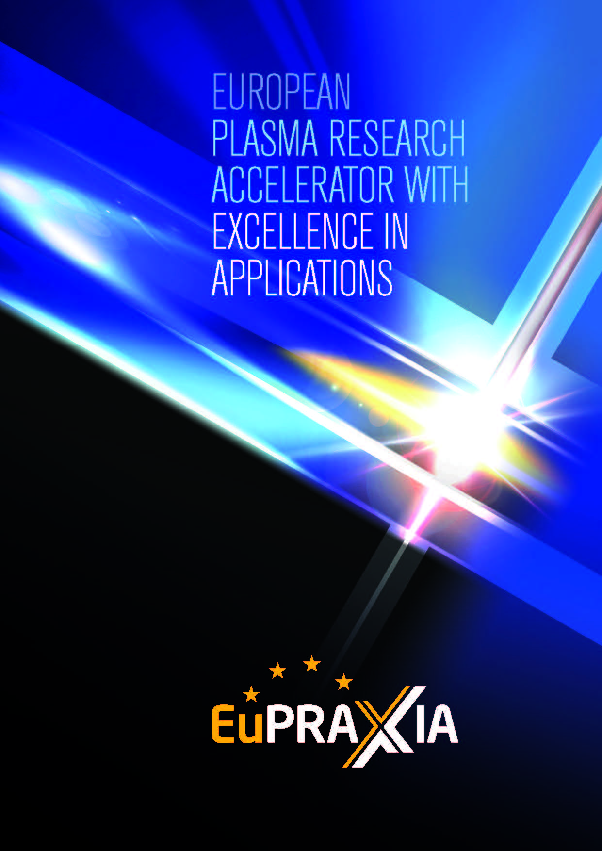
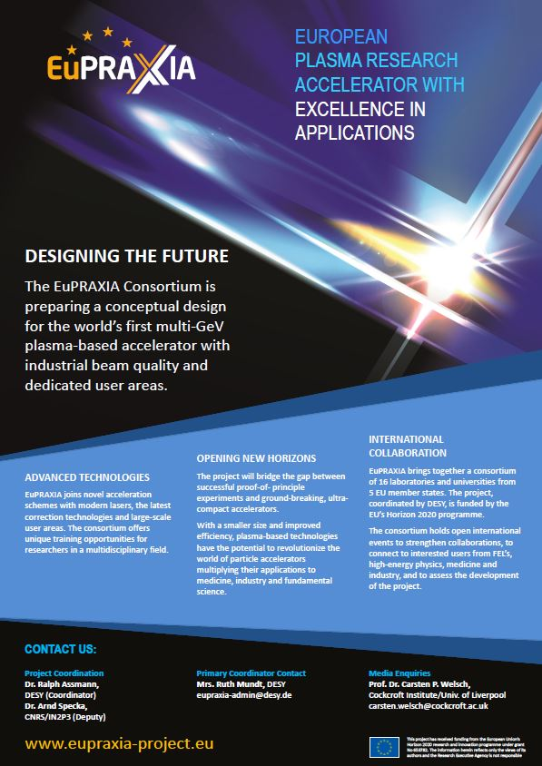
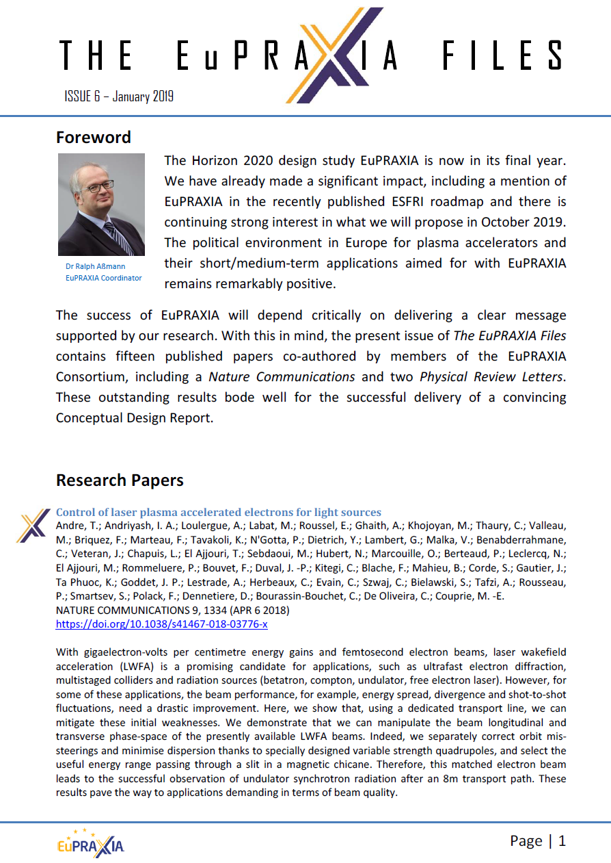
EuPRAXIA Communication

Slide 5
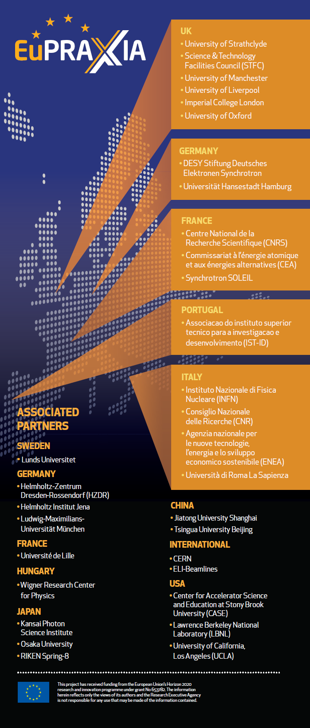
EuPRAXIA Events I
Dr. Ralph Assmann
DESY
Workshop on an European Plasma Accelerator
June 29th – July 1st, INO-CNR/INFN, Pisa, Italy

Slide 6
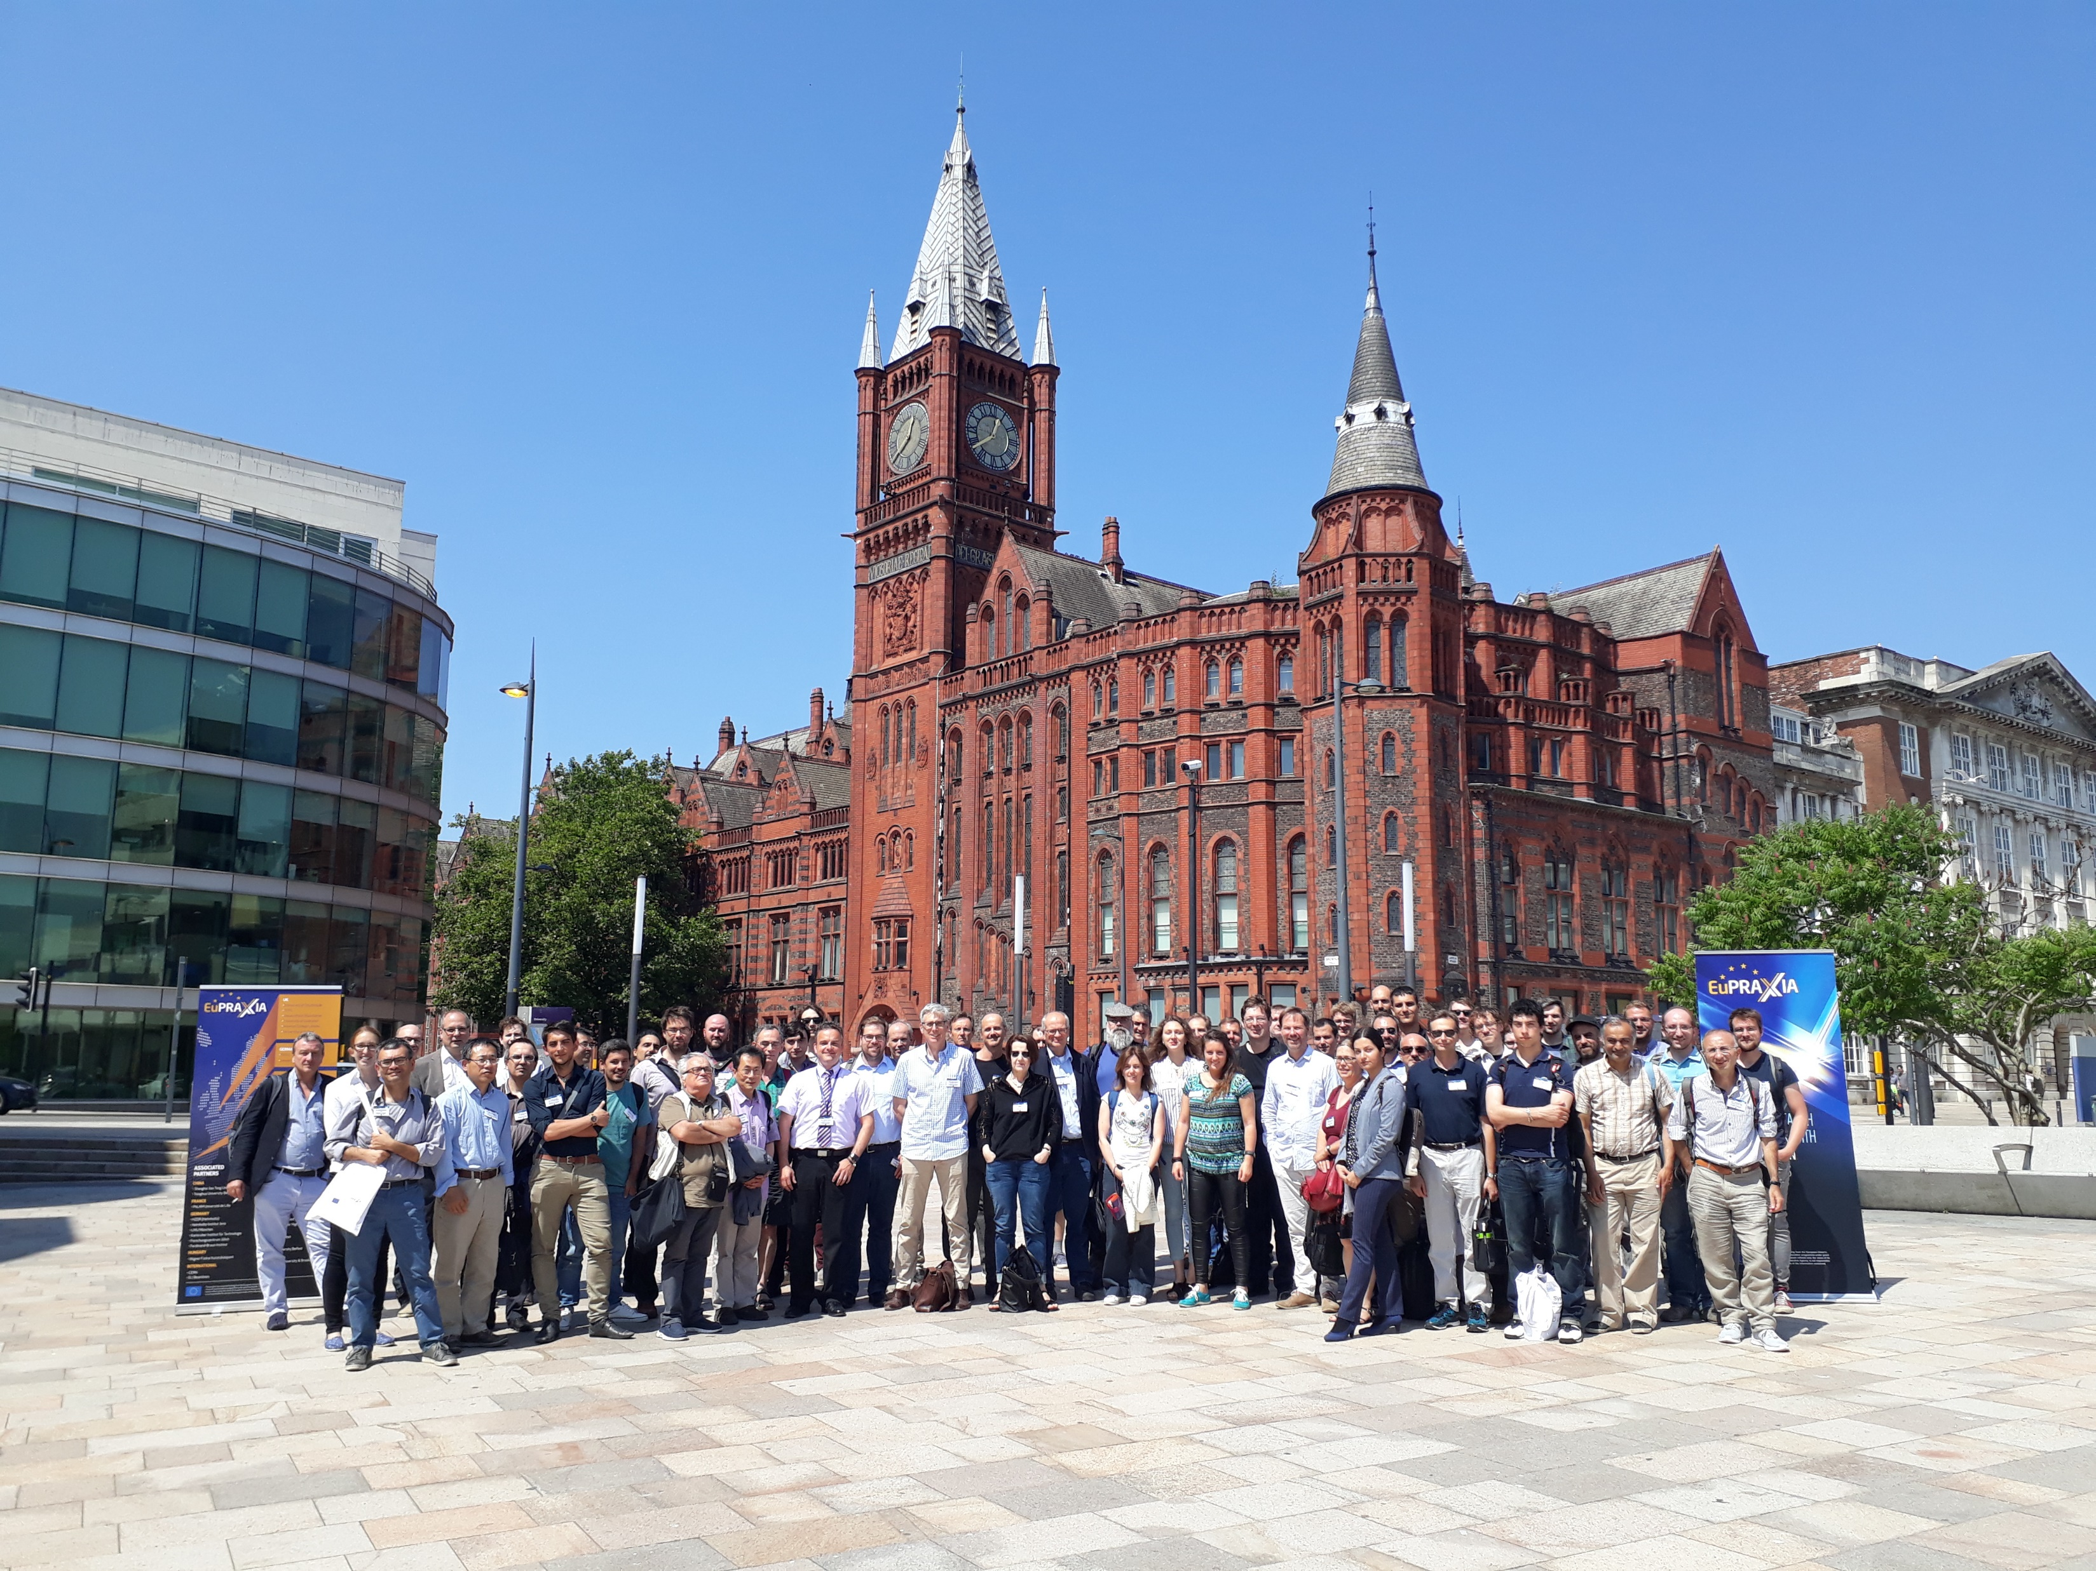
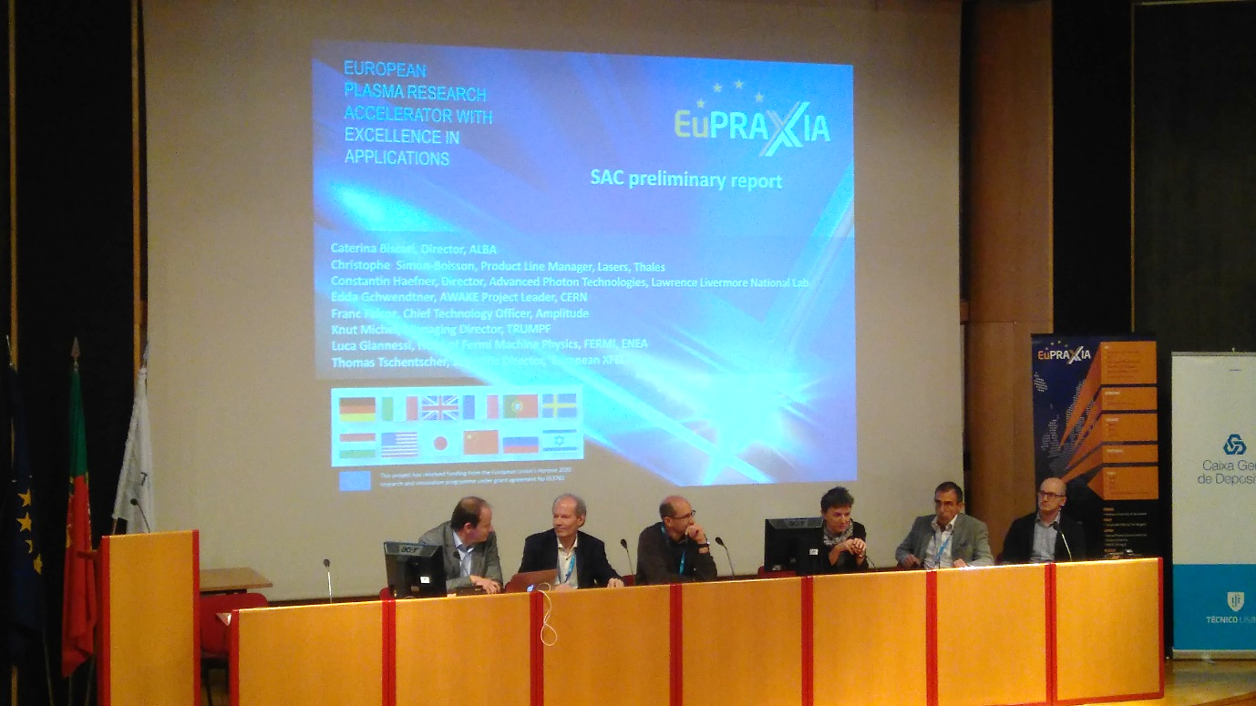
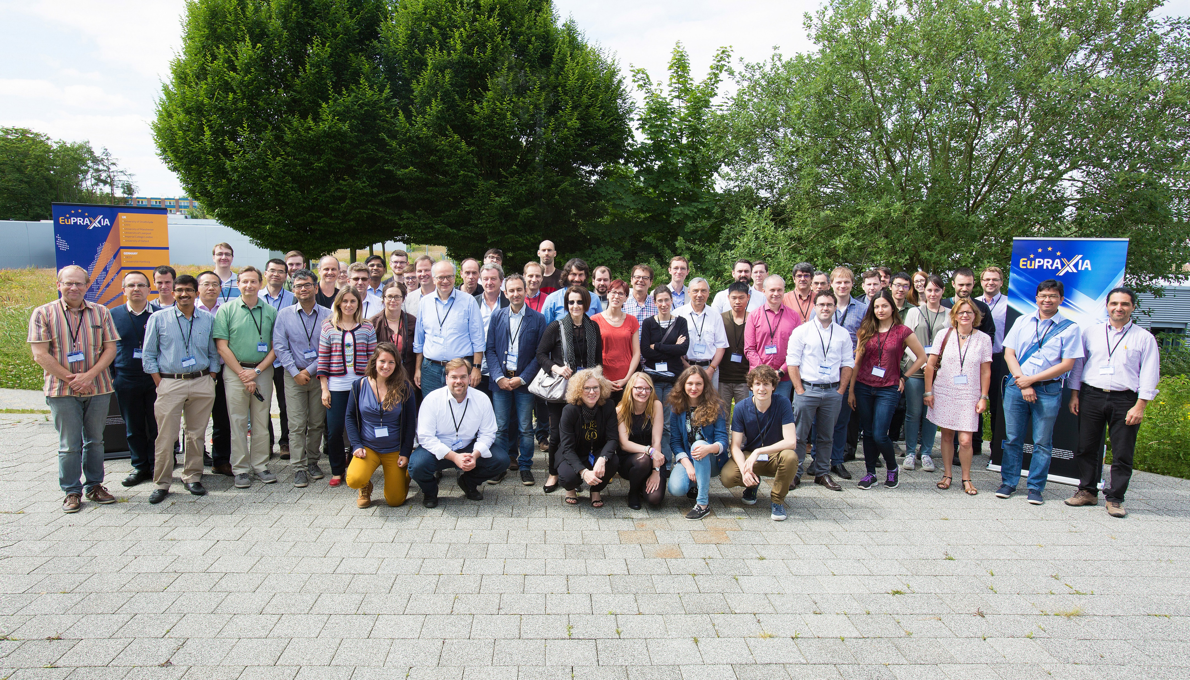
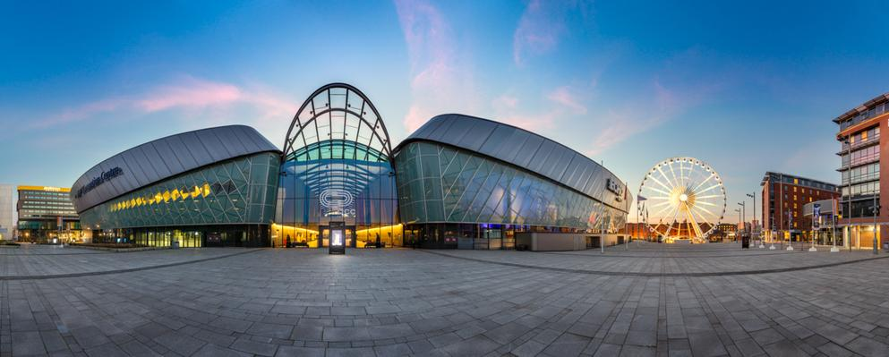
EuPRAXIA Events II

Slide 7
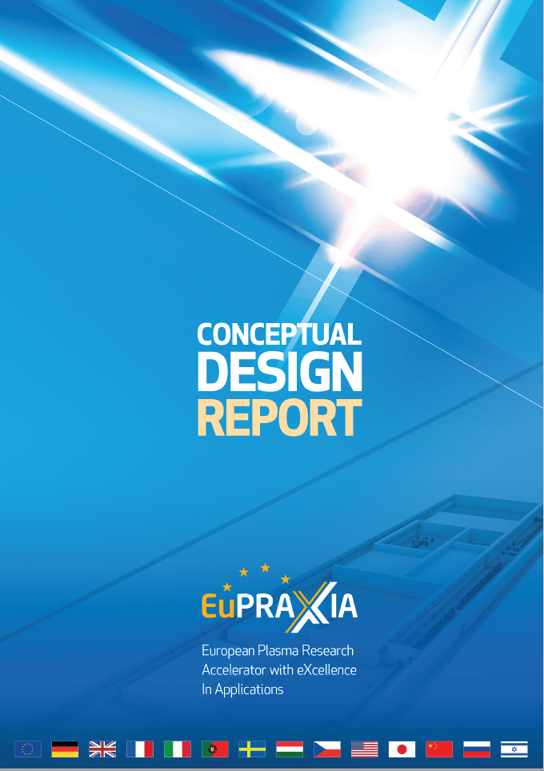
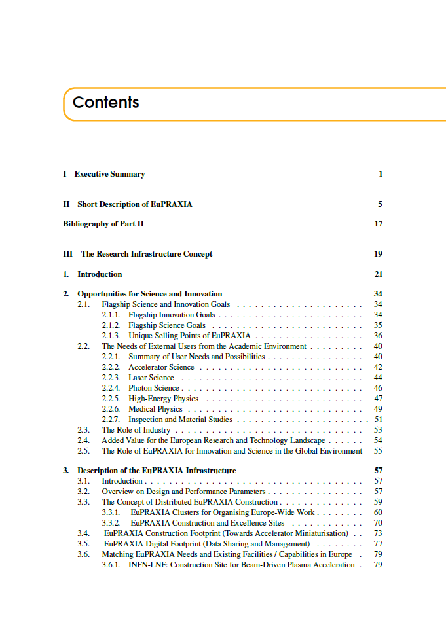
EuPRAXIA CDR

Slide 8
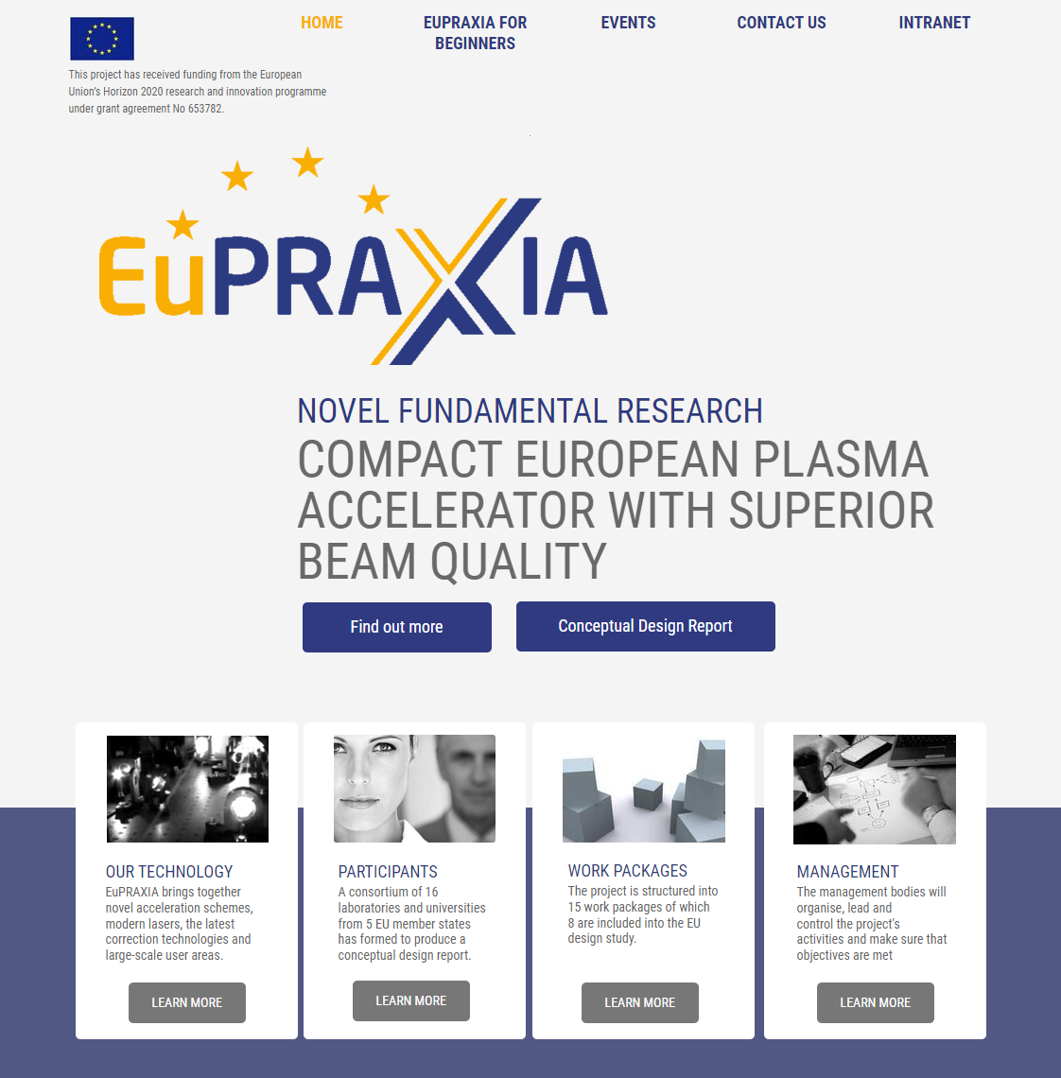
EuPRAXIA Study Website
Prominent EuPRAXIA logo
EuPRAXIA gold and indigo tone used throughout website for headings, buttons, icons etc

Slide 9
Project Deliverables
From our Grant Agreement:

Slide 10
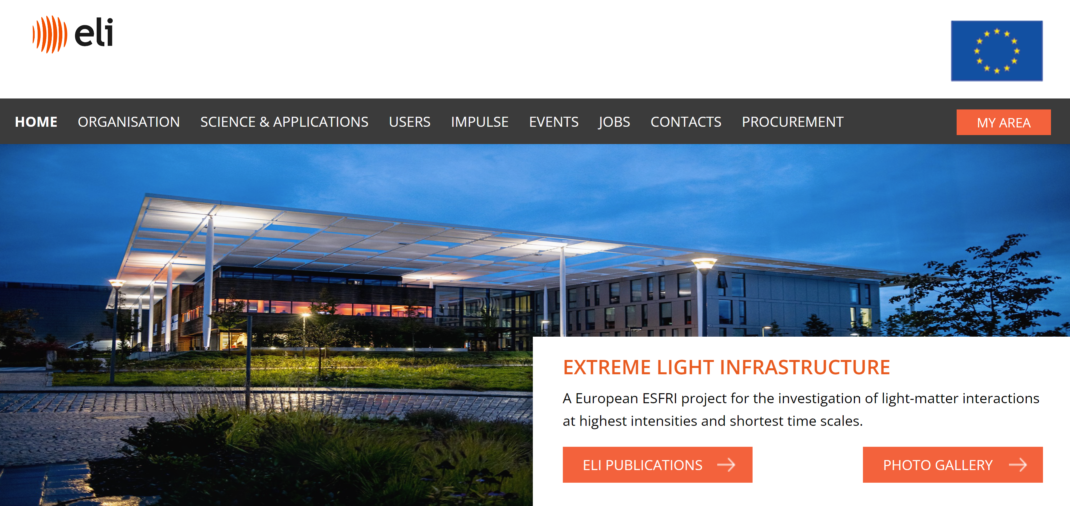
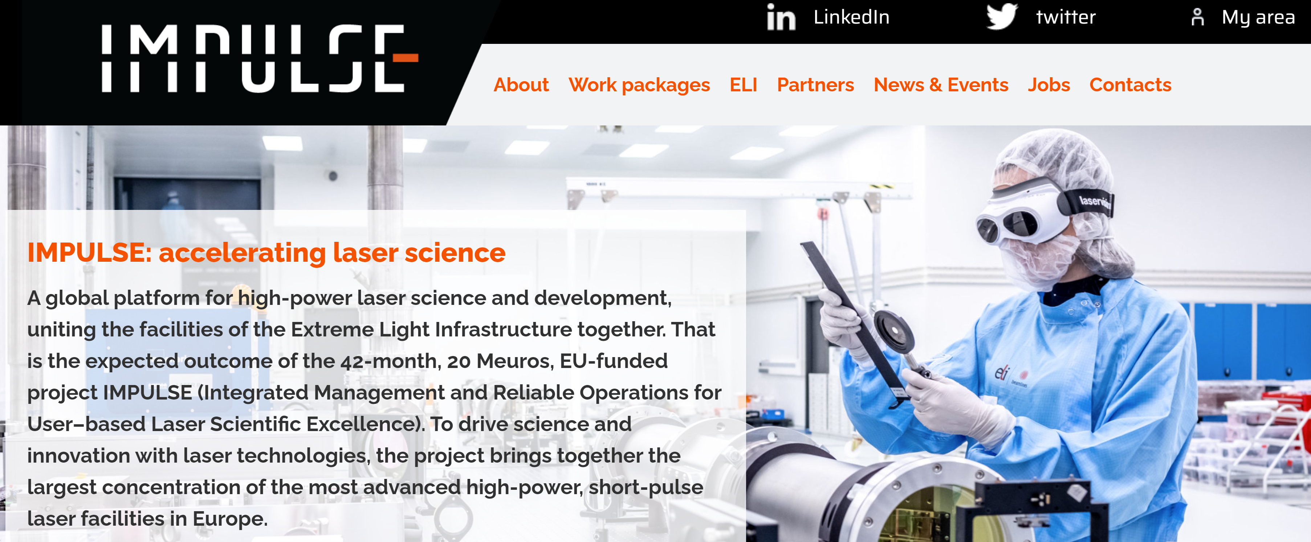
New EuPRAXIA Website
https://impulse-project.eu/
https://eli-laser.eu/

Slide 11
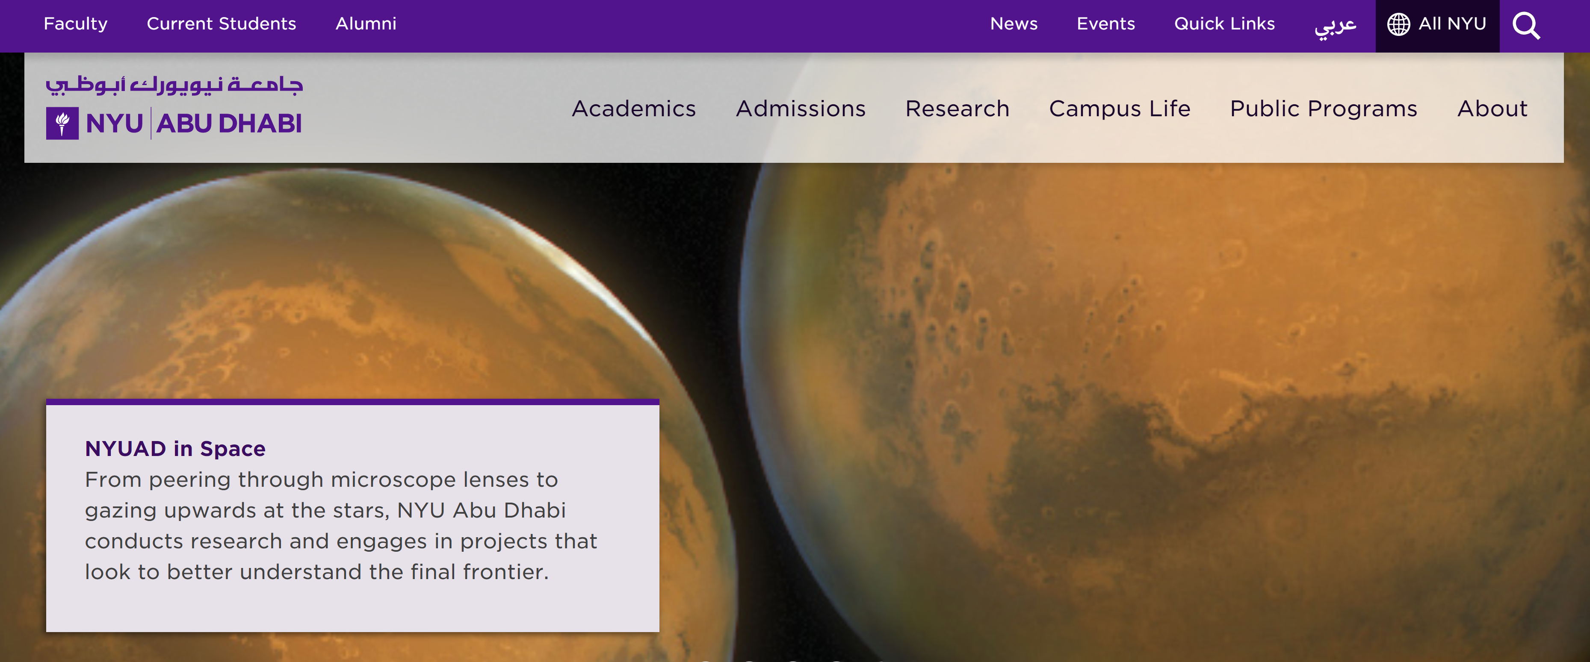
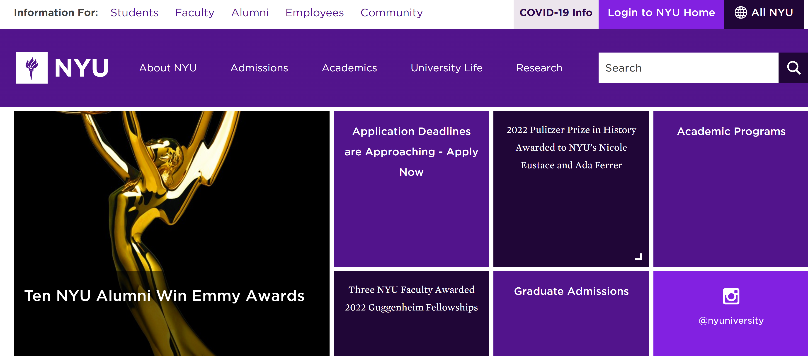
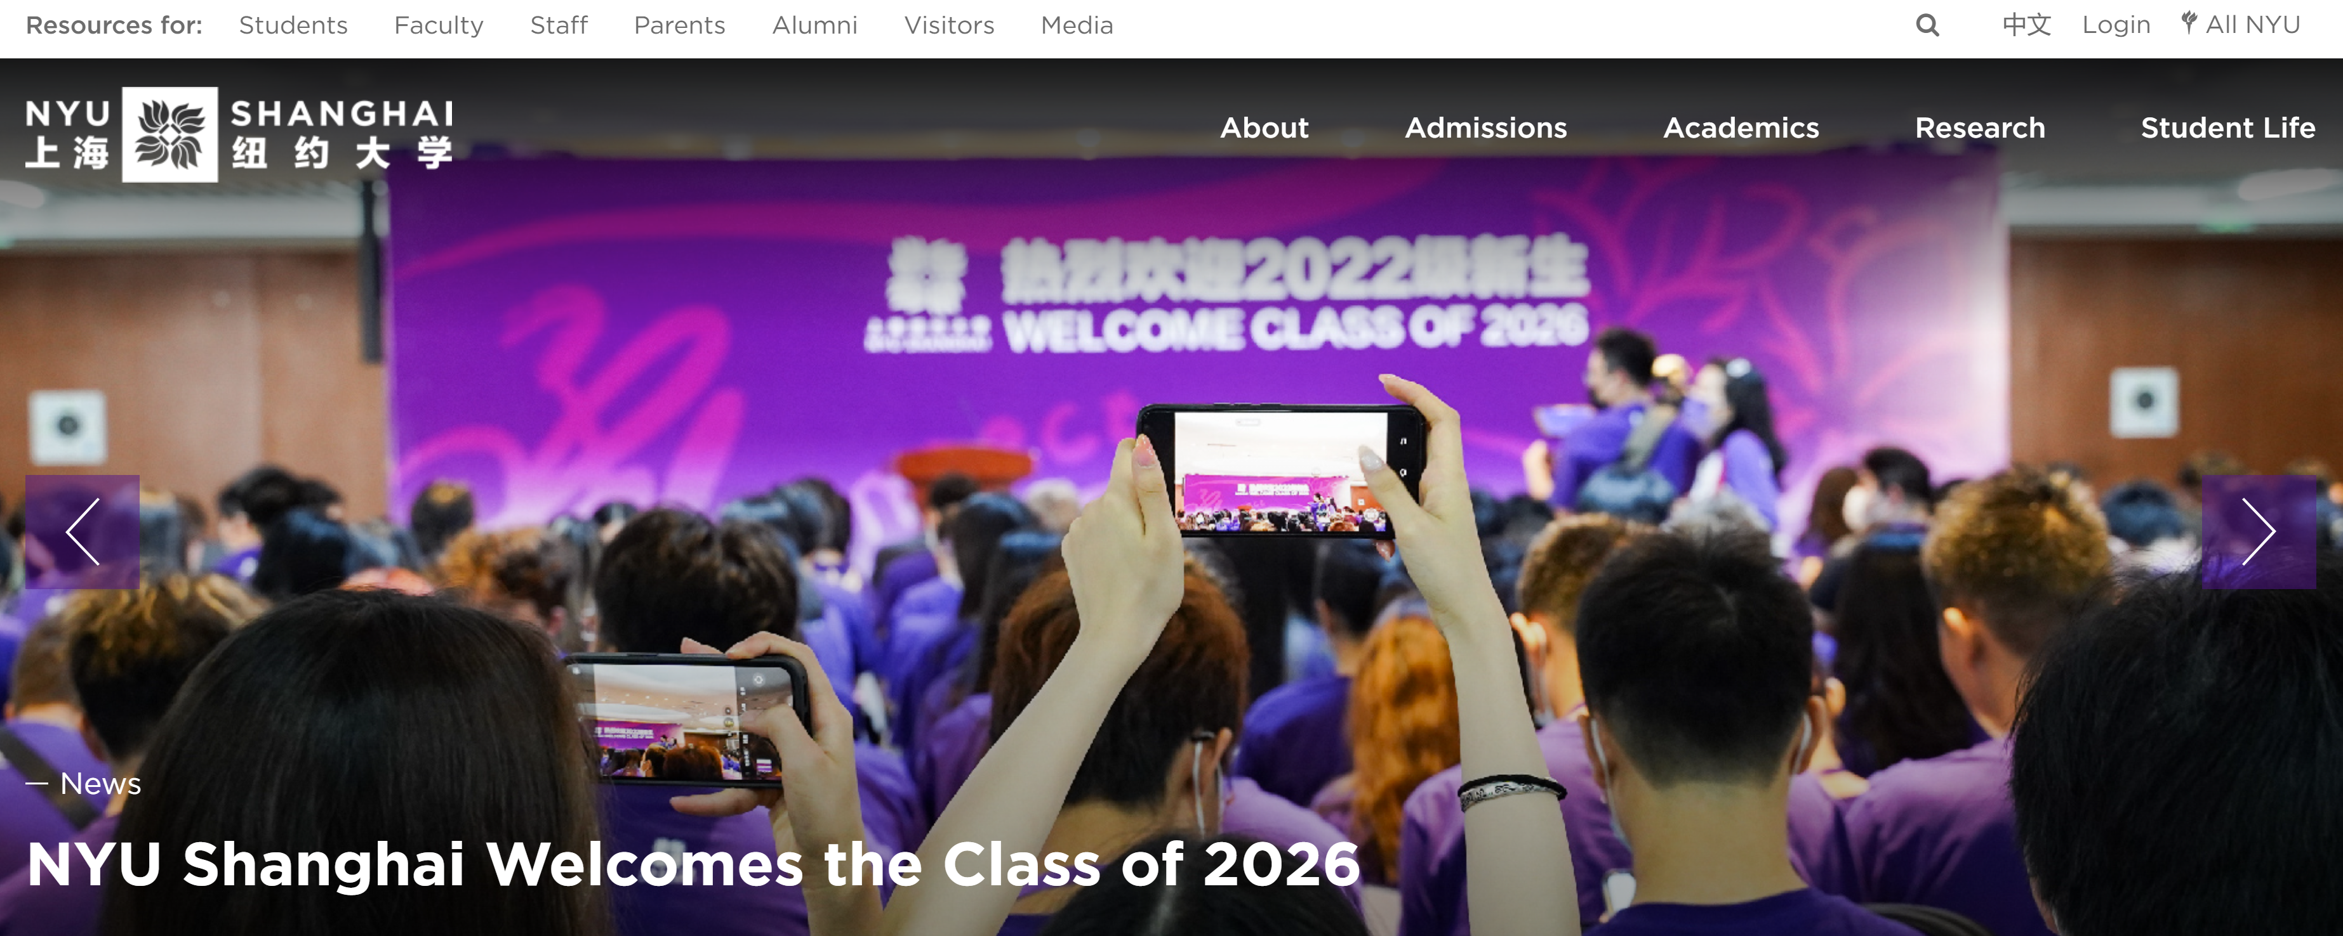
New EuPRAXIA Website
https://nyuad.nyu.edu/en/
https://www.nyu.edu/
https://shanghai.nyu.edu/

Slide 12
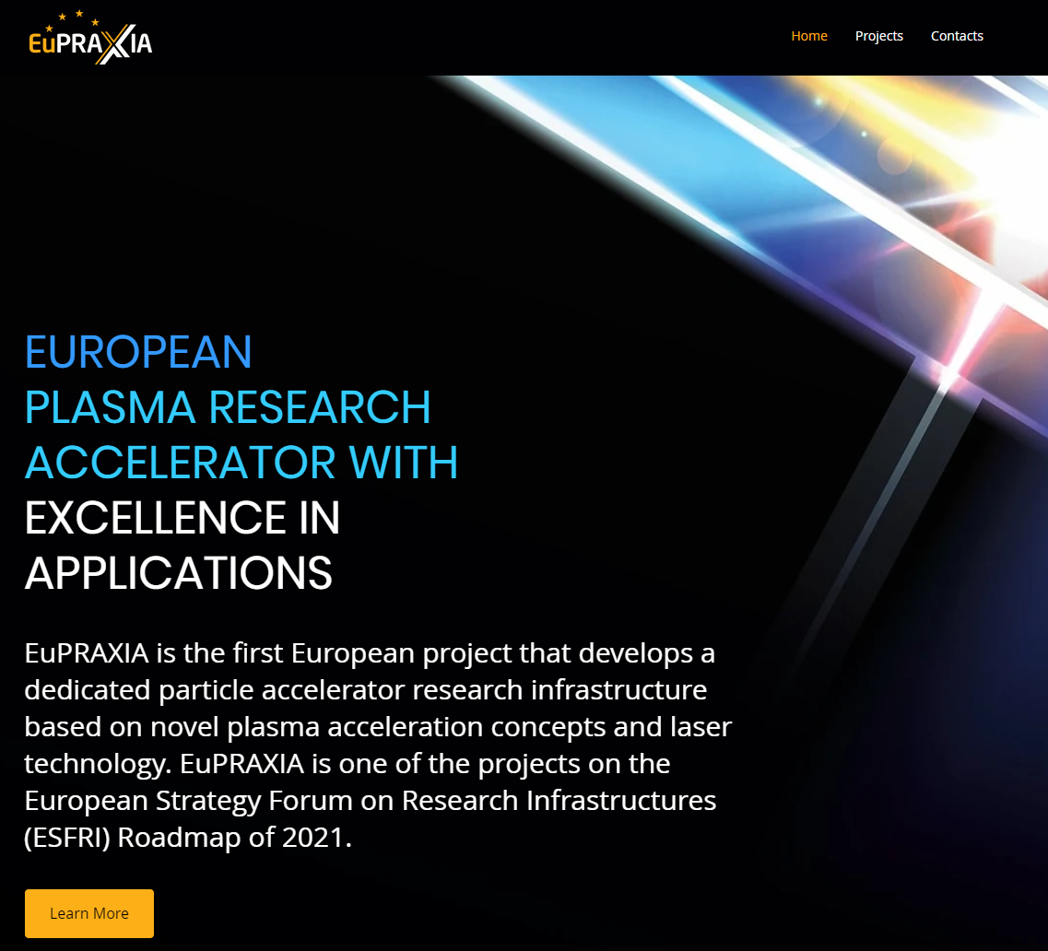
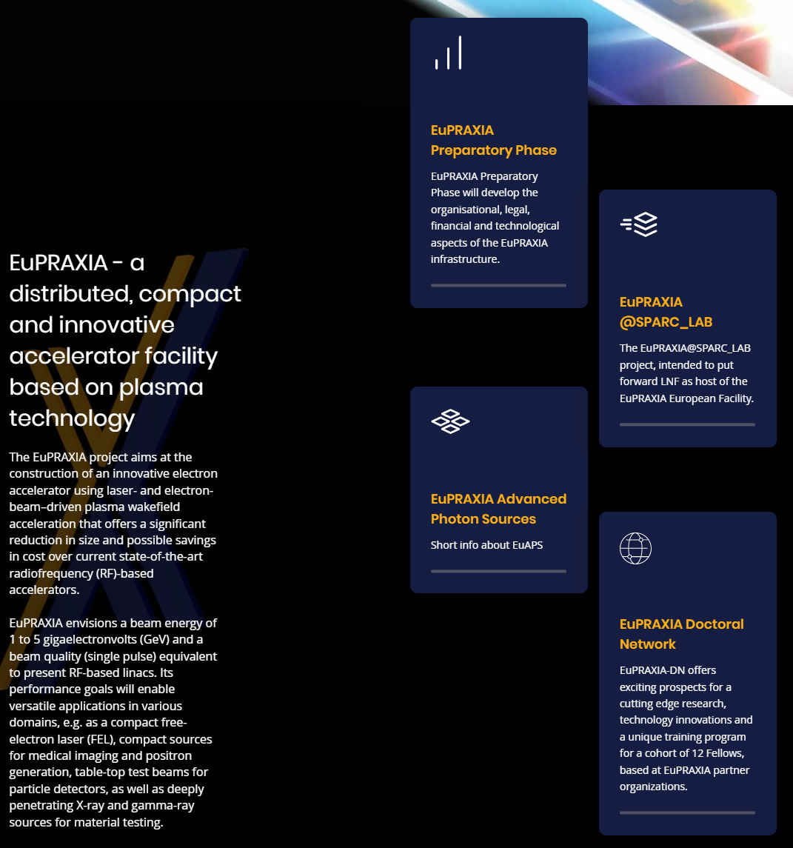
New EuPRAXIA Website Structure

Slide 13
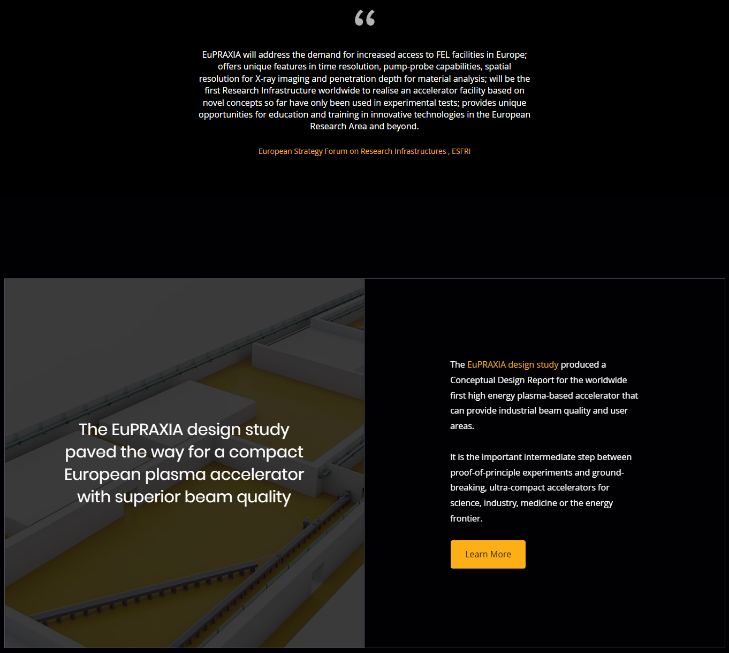
New EuPRAXIA Website Structure

Slide 14
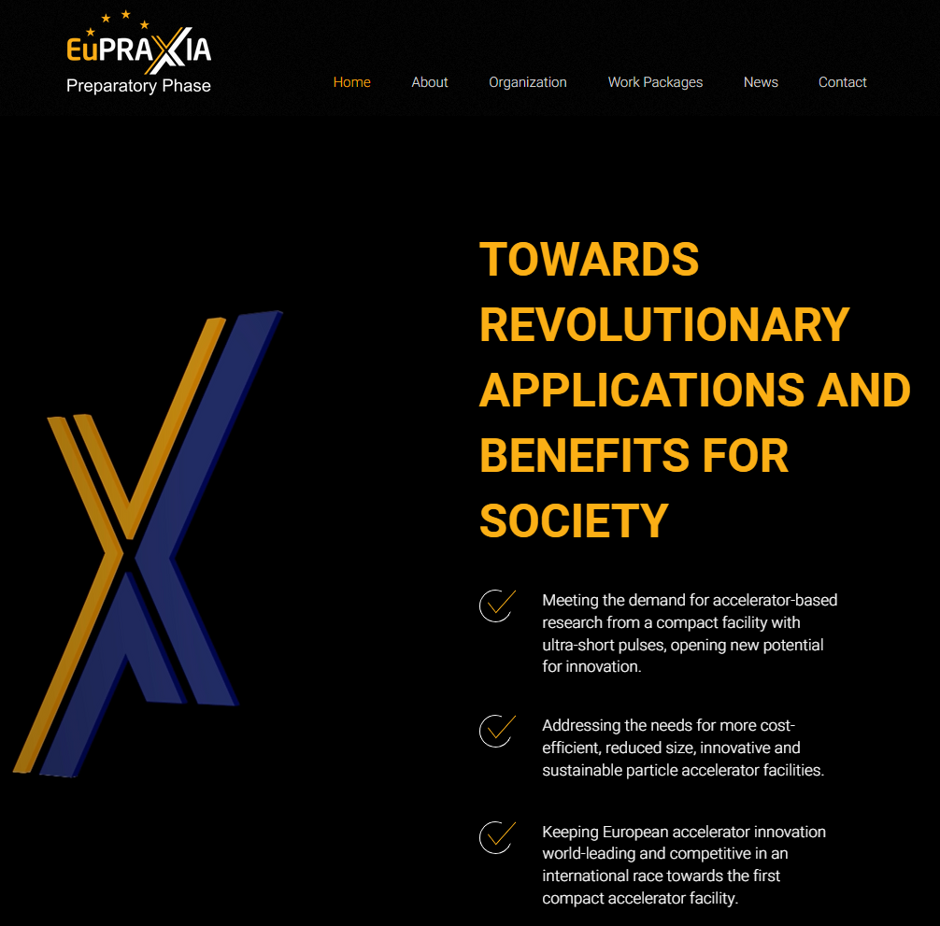
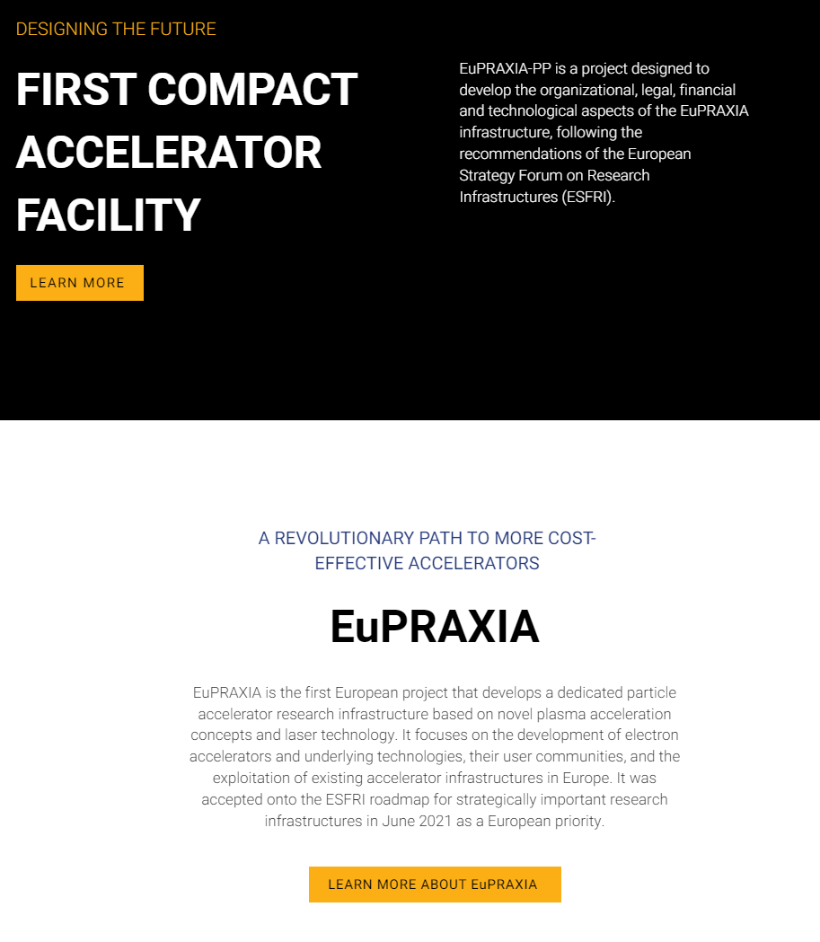
EuPRAXIA-PP Website

Slide 15
INFN LNF Outreach 2022-2023
The Education and Public Outreach Service (EPOS) of LNF fosters the scientific literacy through a wide program of initiatives addressed to students, teachers and general public to bridge science and society, either inside or outside the LNF site.
The main mission are to engage the public with science, to inform about the latest issues in research conducted by INFN-LNF and the collaborations, to raise awareness, curiosity and passion towards science and its applications and building network with the society.
Students
programme
Teachers
programme
General public
edu.lnf.infn.it

Slide 16
INFN LNF Outreach 2022-2023
Activities that involve EuPRAXIA
Primary and middle school students
Guided Tours to the Bruno Touschek Visitor Centre and LNF main experimental sites
Type of activity: informal education, out-of-school learning, guided tours, hands-on experiments
Discussed topics: INFN research activities, general and modern physics and its applications
Number of requests: almost 500 participants
Students
programme
INFN Kids summer camp, July
Type of activity: lectures, hands-on activities
Discussed topics: general and modern physics, research and technology and their applications
Number of expected participants: 30 students

Slide 17
INFN LNF Outreach 2022-2023
Activities that involve EuPRAXIA
High School students
International Day of Girls and Women in Science, 10 February 2023
Type of activity: frontal and dialogic lecture, round table
Topics: the role of girls and women in science, how to create an inclusive environment, how to overcome stereotypes
Number of expected participants: 200 students
Students
programme
INSPYRE – International School on modern Physics and Research, 27-31 March
Type of activity: lectures, hands-on activities, guided tours
Discussed topics: modern physics, research and technology and their applications
Number of expected participants: 120 students (foreign + Italian)
INFN LNF Summer School, June
Type of activity: lectures, hands-on activities, guided tours
Discussed topics: modern physics, research and technology and their applications
Number of expected participants: 60 students
Guided Tours to the Bruno Touschek Visitor Centre and LNF main experimental sites
Type of activity: informal education, out-of-school learning
Discussed topics: INFN research activities, modern physics and its applications
Number of requests: almost 3000 participants

Slide 18
INFN LNF Outreach 2022-2023
Activities that involve EuPRAXIA
University students
Excellence course addressed to Bachelor’s students, Accelerators Physics
Type of activity: lectures, guided tours, hands-on experiments
Dates: July (9 hours)
Students
programme
Excellence course addressed to Masters’ students, Accelerator Technology
Type of activity: lectures, guided tours, demonstrative experiments
Dates: July (9 hours)
Guided Tours to the Bruno Touschek Visitor Centre and LNF main experimental sites
Type of activity: informal education, out-of-school learning
Discussed topics: INFN research activities, modern physics and its applications
Number of expected participants: 600 students

Slide 19
INFN LNF Outreach 2022-2023
Activities that involve EuPRAXIA
Teachers’ program
Teachers
programme
High School Teachers
Title: Incontri di Fisica/Physics Meetings
Type of activity: training and refresher course aimed to promote and support learning/teaching of modern Physics, frontal lectures, hands-on experiments (see experimental activity: Plasma accelerators)
Dates: November 16-18, 2022
Number of participants: 192

Slide 20
INFN LNF Outreach 2022-2023
Activities that involve EuPRAXIA
Pomeriggi di scienza/Science afternoons
Type of activity: webinars broadcasted on INFN LNF YouTube channel, seminars held in person
dedicated to the latest issues in Physics and Science
Dates: December 2022 – June 2023
OpenLabs, INFN LNF open day
Type of activity: guided tours, public lectures, exhibitions, laboratory-based activities, scientific demonstrations and a
very rich program for kids.
Date: May 2023
Number of expected participants: 2500
General public
European Researchers’ Night – scieNcE Together project
Type of activity: informal education, lifelong learning, exhibition
Dates: September
The activity took place at: Città dell’Altra Economia, Roma
Number of expected participants: 6000
Guided Tours to the Bruno Touschek Visitor Centre
Type of activity: informal education, lifelong learning
Discussed topics: INFN research activities, modern physics and its applications

Slide 21
Summary
Exciting plans
Templates for all communication: please use these to establish and promote the EuPRAXIA brand;
Joined-up communication with material provided to partners on a very regular basis;
Science symposia and outreach events to create wider impact;
Education materials such as Surfatron online game, demonstrators and teaching material;
Structured engagement with policy makers and industry.
We look forward to working with you!

