Slide 1
Echelon
NVIDIA’s Extreme-Scale Computing Project

Slide 2












Echelon Team

Slide 3
System Sketch
Dragonfly Interconnect (optical fiber)
High-Radix Router Module (RM)
DRAM
Cube
DRAM
Cube
NV
RAM
Self-Aware
OS
L2₀
L2₁₀₂₃
MC
NIC
NoC
Self-Aware
Runtime
L0
L0
C₀
C₇
LC0
LC7
SM0
SM127
Processor Chip (PC)
Locality-Aware
Compiler &
Autotuner
Node 0 (N0) 20TF, 1.6TB/s, 256GB
N7
Module 0 (M)) 160TF, 12.8TB/s, 2TB
M15
Cabinet 0 (C0) 2.6PF, 205TB/s, 32TB
CN
Echelon System

Slide 4
Execution Model
Object
Thread
A
B
Global Address Space
A
Abstract Memory Hierarchy
Bulk Xfer
B
B
Load/Store
Active Message

Slide 5
Power is THE Problem
1
Data Movement Dominates Power
2
Optimize the Storage Hierarchy
3
Tailor Memory to the Application

Slide 6
  The High Cost of Data Movement
  Fetching operands costs more than computing on them
20mm
64-bit DP
20pJ
26 pJ
256 pJ
16 nJ
DRAM
Rd/Wr
256-bit
buses
500 pJ
Efficient
off-chip link
50 pJ
256-bit access
8 kB SRAM
1 nJ
28nm

Slide 7
Some Applications Have Hierarchical Re-Use

Slide 8

Applications with Hierarchical
Reuse Want a Deep Storage Hierarchy
L4
L3
L2
L2
L2
L2
L1
L1
L1
L1
L1
L1
L1
L1
L1
L1
L1
L1
L1
L1
L1
L1
P
P
P
P
P
P
P
P
P
P
P
P
P
P
P
P

Slide 9
Some Applications Have
Plateaus in Their Working Sets

Slide 10

Applications with Plateaus
Want a Shallow Storage Hierarchy
L2
L2
L2
L2
NoC
L1
L1
L1
L1
L1
L1
L1
L1
L1
L1
L1
L1
L1
L1
L1
L1
P
P
P
P
P
P
P
P
P
P
P
P
P
P
P
P

Slide 11
Configurable Memory Can Do Both
At the Same Time
Flat hierarchy for large working sets
Deep hierarchy for reuse
“Shared” memory for explicit management
Cache memory for unpredictable sharing
SRAM
SRAM
SRAM
SRAM
NoC
L1
L1
L1
L1
L1
L1
L1
L1
L1
L1
L1
L1
L1
L1
L1
L1
P
P
P
P
P
P
P
P
P
P
P
P
P
P
P
P

Slide 12
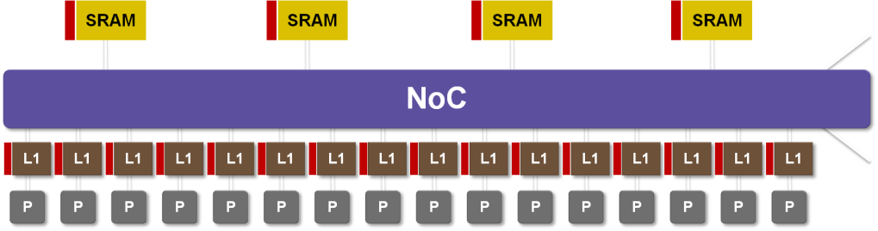
Configurable Memory
Reduces Distance and Energy
P
L1
P
L1
P
L1
P
L1
P
L1
P
L1
P
L1
P
L1
SRAM
SRAM
SRAM
SRAM
SRAM
SRAM
SRAM
SRAM
P
L1
P
L1
P
L1
P
L1
P
L1
P
L1
P
L1
P
L1
ROUTER
ROUTER
P
L1
P
L1
P
L1
P
L1
P
L1
P
L1
P
L1
P
L1
SRAM
SRAM
SRAM
SRAM
SRAM
SRAM
SRAM
SRAM
P
L1
P
L1
P
L1
P
L1
P
L1
P
L1
P
L1
P
L1
P
L1
P
L1
P
L1
P
L1
P
L1
P
L1
P
L1
P
L1
SRAM
SRAM
SRAM
SRAM
SRAM
SRAM
SRAM
SRAM
P
L1
P
L1
P
L1
P
L1
P
L1
P
L1
P
L1
P
L1
ROUTER
ROUTER
P
L1
P
L1
P
L1
P
L1
P
L1
P
L1
P
L1
P
L1
SRAM
SRAM
SRAM
SRAM
SRAM
SRAM
SRAM
SRAM
P
L1
P
L1
P
L1
P
L1
P
L1
P
L1
P
L1
P
L1

Slide 13
An NVIDIA ExaScale Machine

Slide 14
Lane – 4 DFMAs, 20 GFLOPS

Slide 15
SM – 8 lanes – 160 GFLOPS
L1$
Switch
P
P
P
P
P
P
P
P

Slide 16
Chip – 128 SMs – 20.48 TFLOPS
+ 8 Latency Processors
1024 SRAM Banks, 256KB each
SRAM
SRAM
SRAM
MC
MC
NI
NoC
SM
SM
SM
SM
SM
LP
LP
128 SMs 160GF each

Slide 17
Node MCM – 20TF + 256GB
150GB/s
Network BW
GPU Chip
20TF DP
256MB
1.4TB/s
DRAM BW
DRAM
Stack
DRAM
Stack
DRAM
Stack
NV
Memory

Slide 18
Cabinet – 128 Nodes – 2.56PF – 38 kW
NODE
NODE
ROUTER
NODE
NODE
NODE
NODE
ROUTER
NODE
NODE
NODE
NODE
ROUTER
NODE
NODE
NODE
NODE
ROUTER
NODE
NODE
MODULE
MODULE
MODULE
MODULE
MODULE
32 Modules, 4 Nodes/Module,
Central Router Module(s), Dragonfly Interconnect

Slide 19
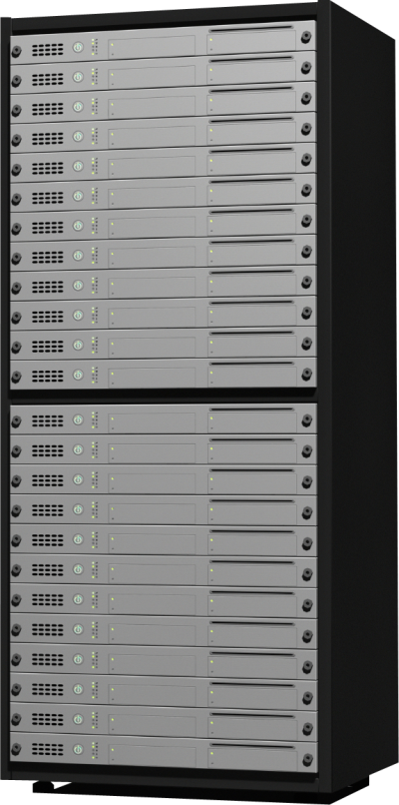
System – to ExaScale and Beyond
Dragonfly Interconnect
400 Cabinets is ~1EF and ~15MW

Slide 20
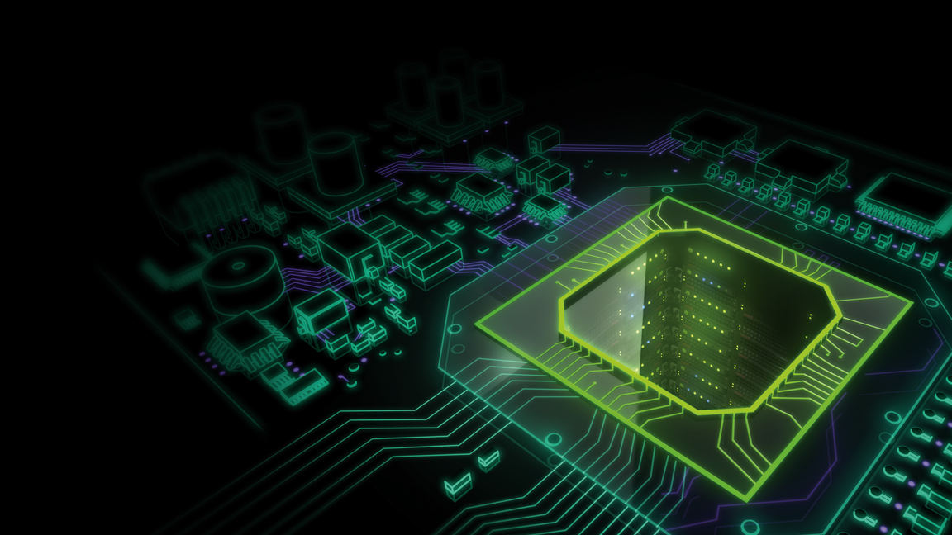

CONCLUSION

Slide 21
GPU Computing is the Future
1
GPU Computing is #1 Today
On Top 500 AND Dominant on Green 500
2
GPU Computing Enables ExaScale
At Reasonable Power
3
The GPU is the Computer
A general purpose computing engine, not just an accelerator
4
The Real Challenge is Software

