Slide 1
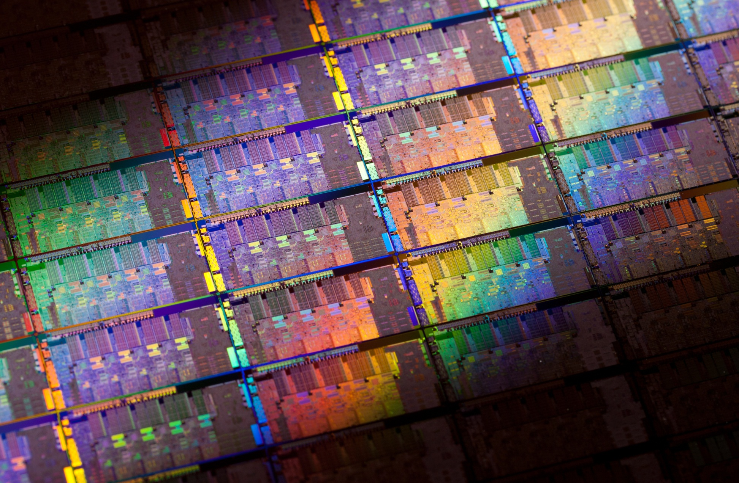


Intel® Architecture
for HPC
16 February 2011
Herbert Cornelius
Intel

Slide 2
Legal Disclaimer
INFORMATION IN THIS DOCUMENT IS PROVIDED IN CONNECTION WITH INTEL® PRODUCTS. NO LICENSE, EXPRESS OR IMPLIED, BY ESTOPPEL OR OTHERWISE, TO ANY INTELLECTUAL PROPERTY RIGHTS IS GRANTED BY THIS DOCUMENT. EXCEPT AS PROVIDED IN INTEL’S TERMS AND CONDITIONS OF SALE FOR SUCH PRODUCTS, INTEL ASSUMES NO LIABILITY WHATSOEVER, AND INTEL DISCLAIMS ANY EXPRESS OR IMPLIED WARRANTY, RELATING TO SALE AND/OR USE OF INTEL® PRODUCTS INCLUDING LIABILITY OR WARRANTIES RELATING TO FITNESS FOR A PARTICULAR PURPOSE, MERCHANTABILITY, OR INFRINGEMENT OF ANY PATENT, COPYRIGHT OR OTHER INTELLECTUAL PROPERTY RIGHT. INTEL PRODUCTS ARE NOT INTENDED FOR USE IN MEDICAL, LIFE SAVING, OR LIFE SUSTAINING APPLICATIONS.
Intel may make changes to specifications and product descriptions at any time, without notice.
All products, dates, and figures specified are preliminary based on current expectations, and are subject to change without notice.
Intel, processors, chipsets, and desktop boards may contain design defects or errors known as errata, which may cause the product to deviate from published specifications. Current characterized errata are available on request.
Penryn, Nehalem, Westmere, Sandy Bridge, and other code names featured are used internally within Intel to identify products that are in development and not yet publicly announced for release. Customers, licensees and other third parties are not authorized by Intel to use code names in advertising, promotion or marketing of any product or services and any such use of Intel's internal code names is at the sole risk of the user
Performance tests and ratings are measured using specific computer systems and/or components and reflect the approximate performance of Intel products as measured by those tests. Any difference in system hardware or software design or configuration may affect actual performance.
Intel, Xeon, Netburst, Core, VTune, and the Intel logo are trademarks of Intel Corporation in the United States and other countries.
*Other names and brands may be claimed as the property of others.
Copyright © 2010 Intel Corporation.

Slide 3

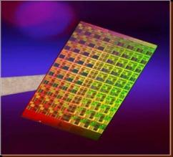
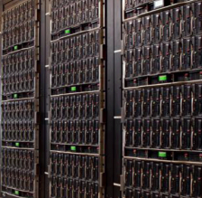
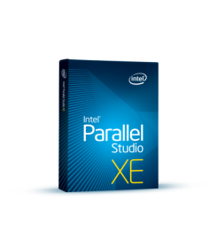
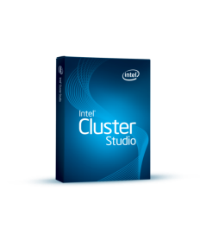
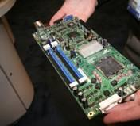
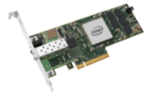
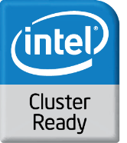

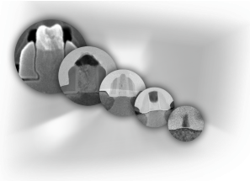
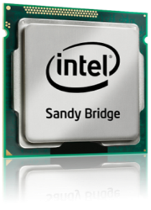
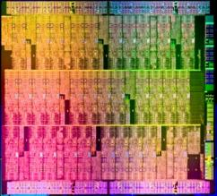
Intel in High-Performance Computing
Dedicated,
Renowned
Applications
Expertise
Tera/Exa-
Scale
Research
Large Scale
Clusters
for Test &
Optimization
Broad Software
Tools
Portfolio
Defined
HPC
Application
Platform
Platform Building
Blocks
Manufacturing
Process
Technologies
Leading
Performance,
Energy Efficient
Many
Integrated
Core
Architecture
A long term commitment to the HPC market segment

Slide 4
The Majority of all HPC-Systems are Clusters
(Source: IDC)
CLUSTER OF SHARED MEMORY NODES
Interconnect
Message Passing
between/inside Nodes
I/O
I/O
I/O
I/O
PGAS
. . .
M
M
M
M
Multi-Threading within each (SMP) Node
. . .
M
e.g.
P P
P P
P P
P P
CORE
CORE
CORE
CORE
CORE
CORE
CORE
CORE
CO-PROCESSOR
e.g.
Vectorization (SIMD) within each Core

Slide 5
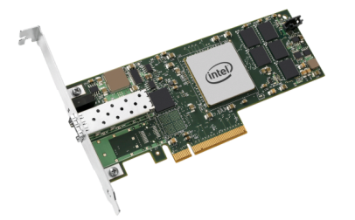
Intel Technology is Changing HPC
Performance, Energy Efficiency, Reliability, TCO
PROCESSOR
SOLID STATE DISK
10GbE
Scalable Performance and
Energy Efficiency
Optimize Performance for
I/O Intensive Apps and
Boot Drive Replacement
Bridging the Gap Between
1GbE and Infiniband*,
with RDMA
A platform approach to high performance
Notes:
5
5

Slide 6
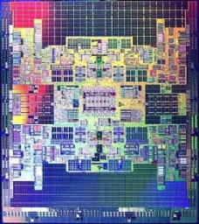
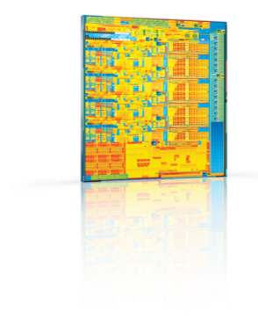
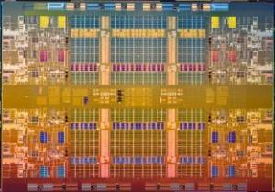
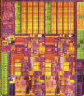


Wide Range of Processor Solutions
Embedded,
Consumer
Electronics
Embedded,
Mobile Internet
Devices
Laptop,
Desktop
Server,
Workstation
Mission
Critical
10X
10X
LOWER
POWER
HIGHER
PERFORMANCE
DEMAND
Compatible with the World’s largest Software and Platform Eco-System
Notes:
Embedded/Consumer Electronics ←→ ExaScale
Billions of transistors

Slide 7


GUIDING PRINCIPLES FOR SPEED & DENSITY
Energy Efficient
Faster
Cooler
Eco-Friendly

Slide 8
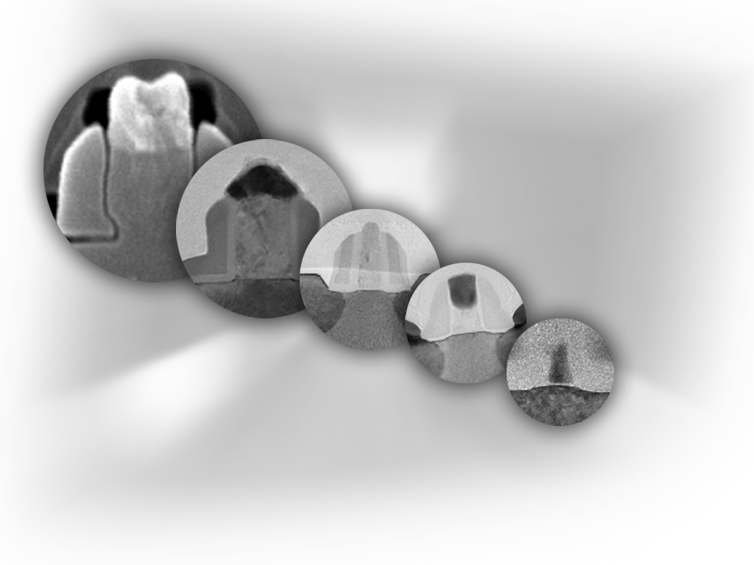
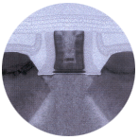
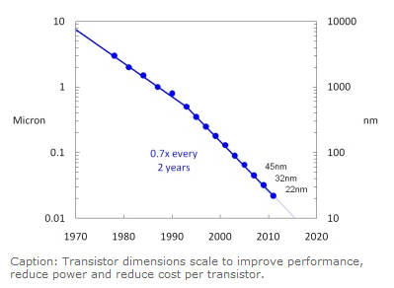

Moore’s Law: Alive and Well at Intel
Continuing Moore’s Law
each new process technology
allows up to:
Transistor Performance
+20%
Switching Power
-30%
180 nm
1999
130 nm
2001
90 nm
2003
Production
65 nm
2005
Development
On
Track
45 nm
2007
15nm
Research
32 nm
2009
22 nm
2011
Potential future options, no indication of
actual product or development, subject to change without notice.
Notes:
Next we move to see how we are strengthening our core assets. First, our leading edge silicon process technology.
2011 = 22 – 15 – 11 - 8 nm (every 2 years)
Predictable is the key word here.
45nm ramp is on track.
Intel has one to two-year competitive lead on high-k technology.
32nm development is on track with production expected second half of 2009.

Slide 9
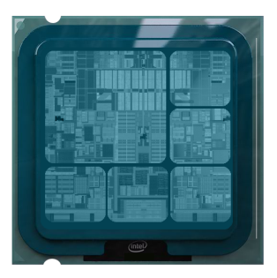
Intel® Architecture Processors
More Performance and New Capabilities Integration
CPU
F.P.
F.P.
F.P.
IMC
F.P.
IMC
GFX
SIMD
SIMD
SIMD
Integrated
Integer
Add
Integrated
Floating-Point
Add
Integrated
SIMD
Add
Memory
Controller
Add
Integrated
Graphics
and I/O
New Instructions

Slide 10
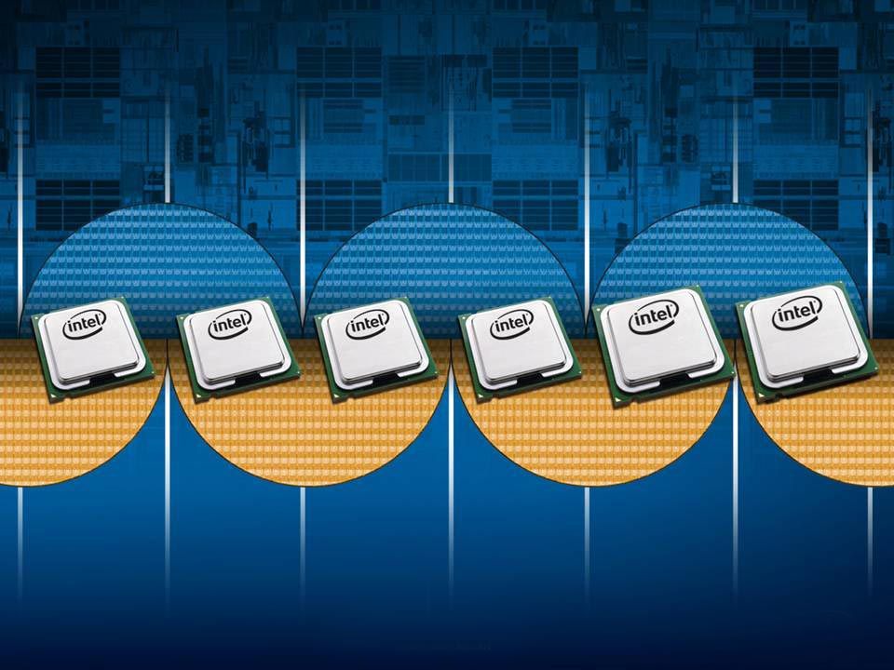
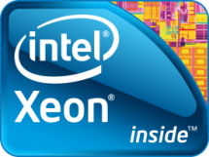
Tick-Tock Development Cycles
Integrate. Innovate.
TICK
TOCK
45nm
32nm
22nm
Penryn
Nehalem
Westmere
Sandy Bridge
Ivy Bridge
Future Proc.
Intel® Core™
Microarchitecture
Sandy Bridge
Microarchitecture
Forecast
SSE4.1
SSE4.2
AESNI
AVX
Future Instructions
Potential future options, subject to change without notice.
Copyright © 2010 Intel Corporation. All rights reserved.
*Other brands and names are the property of their respective owners

Slide 11

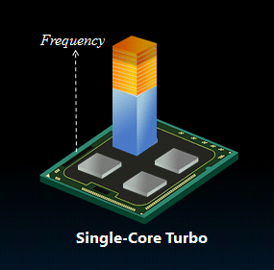
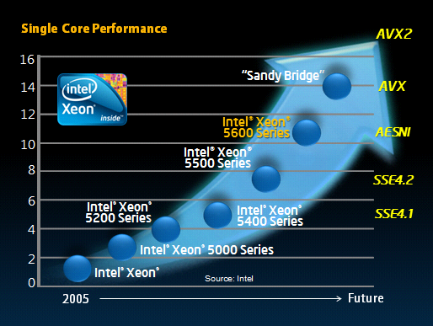
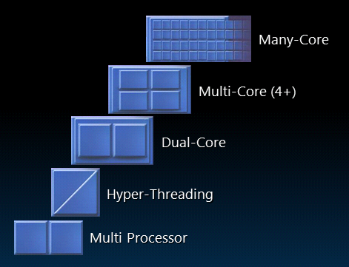
Increasing Performance and Energy Efficiency
Process Technology
22NM
Legacy
TURBO-BOOST
Core Architecture
AVX
Processors
MULTI/MANY-CORE
Note:
not all cores are equal !
Potential future options, subject to change without notice.

Slide 12


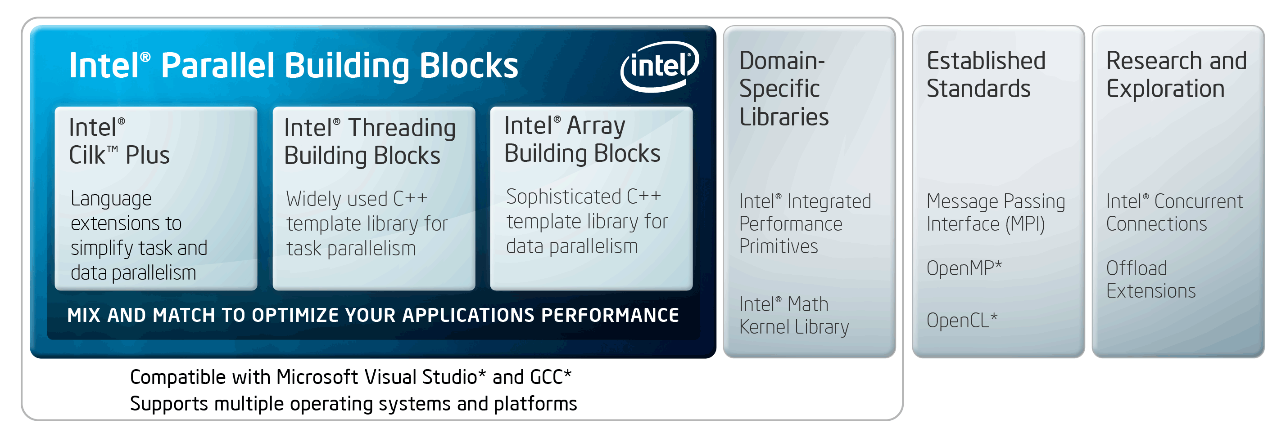
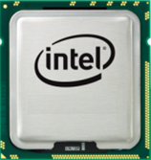
Intel HPC Programming
Cilk Plus (C/C++)
Intel Compilers (C/C++, FTN)
CnC (C++)
TBB (C++)
OpenMP (C++/FTN)
ArBB (C++)
MKL, IPP (C/C++, FTN)
MPI (C/C++, FTN)
Fortran90 Arrays (FTN)
CEAN (C++)
OpenCL (C/C++)
Co-Array Fortran (CAF)
Xeon®
Xeon®
Potential future options subject to change without notice.
Xeon®
Xeon®

Slide 13

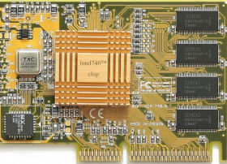
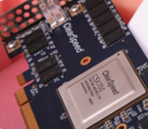
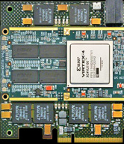
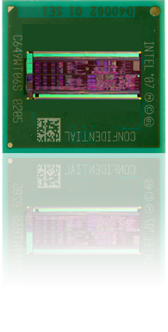

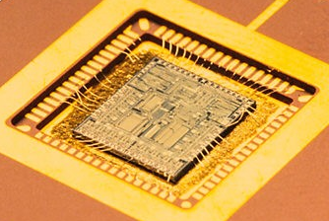
More Performance
Heterogeneous Computing Components
CPU
GFX
DSP*
FPGA*
CRYPT
PhysX*
YoA*
Your own ASIC
Notes:
PhysX = PPU Physics Processing Unit for Games

Slide 14
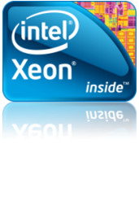
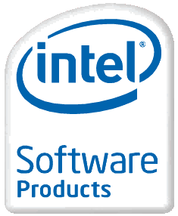
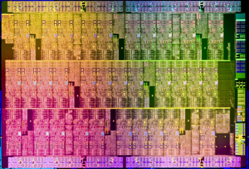
Multi-Core → Many-Core for Highly Parallel Computing
Industry Leading
Performance with Xeon®
Common Tools Suite and
Programming Model
Many Core for
Highly-Parallel Workloads
Xeon is right for most HPC workloads
Extending ISA (AVX, …)
Software tools become architecturally aware
(C/C++, FTN, TBB, ArBB, …)
Intel® Many Integrated Core architecture performance very promising for HPC
Extending IA to highly-parallel workloads and may-core computing maintaining existing programming models and software tools
Future options subject to change without notice.
Notes:
14
14

Slide 15
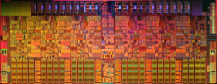
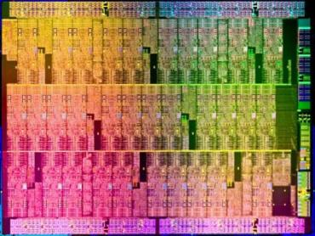

How to get High Performance and Energy Efficiency
for highly Parallel Workloads?
high F.P. performance (VPU/SIMD)
+
many integrated small energy efficient and
high-performance cores
small extreme energy efficient core
The Newest Addition to the Intel Server Family.
Industry’s First General Purpose Many Core Architecture

Slide 16
Knights Ferry - Aubrey Isle Processor
Multi-Threaded
Wide SIMD
. . .
Multi-Threaded
Wide SIMD
GDDR
GDDR
I$
D$
I$
D$
.
.
.
.
.
.
Fixed
Function
System & I/O
PCIe Interface
Memory Controller
Shared coherent L2 Cache
Memory Controller
GDDR
Multi-Threaded
Wide SIMD
. . .
Multi-Threaded
Wide SIMD
GDDR
I$
D$
I$
D$
Multiple IA cores 16-wide vector units (512b) 1024-bit ring bus
- In-order, short pipeline - Extended instruction set GDDR memory
- Multi-thread support Fully coherent caches - Supports virtual memory
Standard IA Shared Memory Programming
Future options subject to change without notice.
Notes:
http://download.intel.com/technology/architecture-silicon/Siggraph_Larrabee_paper.pdf

Slide 17

The “Knights” Family
Future Knights
Products
Knights Corner
1st Intel® MIC product
22nm process
>50 Intel Architecture cores
Knights Ferry
Development Platform
Future options subject to change without notice.

Slide 18
“Knights Ferry” Development Platform
Software Development Platform
Growing availability through 2011
Up to 32 cores, up to 1.2 GHz
Up to 128 threads at 4 threads / core
Up to 8MB shared coherent cache
1-2 GB GDDR5 shared memory
PCIe Card
Bundled with Intel HPC SW tools
Software development platform for Intel® MIC architecture

Slide 19
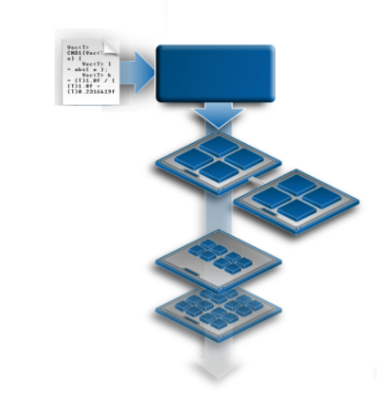
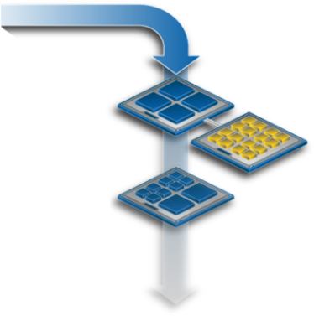
Intel® MIC Architecture Programming
Single Source Code
Same Programming Models
Compilers,
Libraries,
Runtimes
Common with Intel® Xeon®
Programming Models and Languages
C/C++, Fortran compilers
Intel SW developer tools
and libraries (MKL, PBB, ArBB, Cilk Plus, …)
Coding and optimization techniques
Ecosystem support
Intel® Xeon ®
processor
Intel® MIC architecture
co-processor
Intel® Xeon® processor family
Multi-Core
Many-Core
Eliminates Need for Dual Programming Architecture
For illustration only, potential future options subject to change without notice.

Slide 20
Example: Computing PI
# define NSET 1000000
int main ( int argc, const char** argv )
{ long int i;
float num_inside, Pi;
num_inside = 0.0f;
#pragma offload target (MIC)
#pragma omp parallel for reduction(+:num_inside)
for( i = 0; i < NSET; i++ )
{ float x, y, distance_from_zero;
// Generate x, y random numbers in [0,1)
x = float(rand()) / float(RAND_MAX + 1);
y = float(rand()) / float(RAND_MAX + 1);
distance_from_zero = sqrt(x*x + y*y);
if ( distance_from_zero <= 1.0f )
num_inside += 1.0f;
}
Pi = 4.0f * ( num_inside / NSET );
printf("Value of Pi = %f \n",Pi);
}
A one line addition from the CPU version
For illustration only, potential future options subject to change without notice.

Slide 21
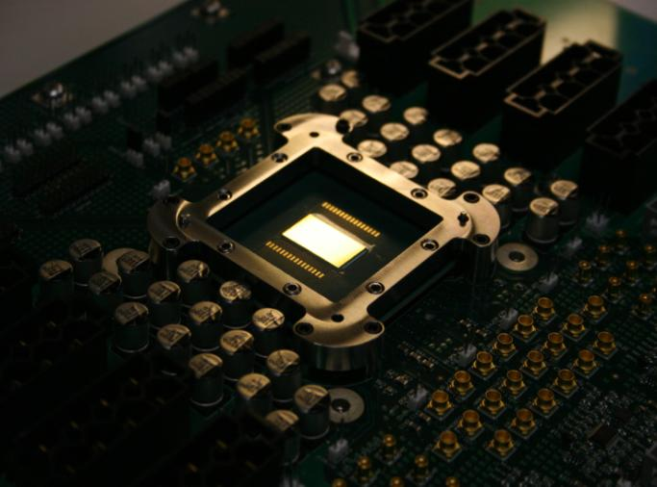
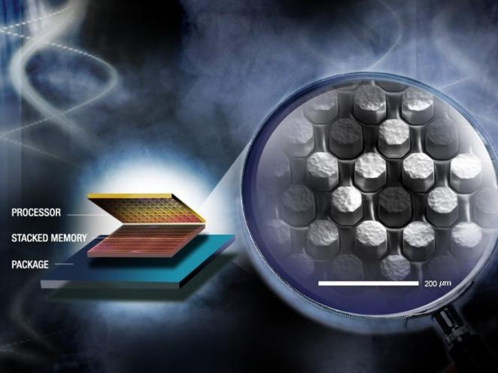
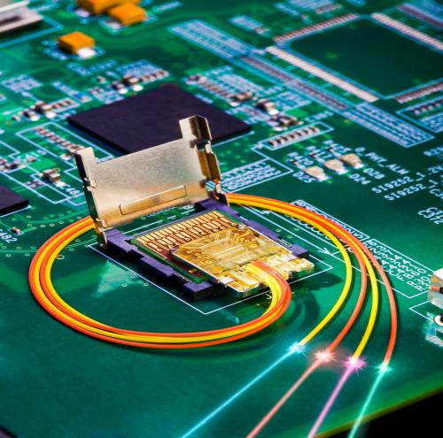
Intel TeraScale Research Areas
MANY-CORE COMPUTING
3D STACKED MEMORY
SILICON PHOTONICS
Teraflops of computing power
Terabytes of memory bandwidth
Terabits of I/O throughput
Future vision, does not represent real products.

Slide 22

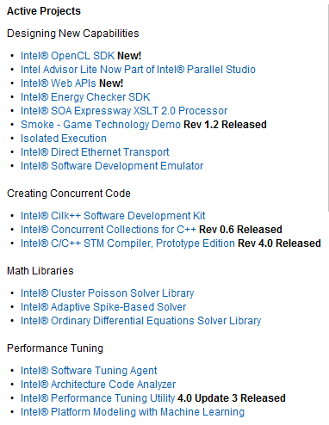
whatif.intel.com
Access innovations … in the formative stages

Slide 23
Let’s play Jeopardy!
And the answer now is ...
18,000,000,000,000
Notes:
18,000 BILLION for 30 minutes
Let’s play Jeopardy!
•And the answer nowis…..
•1,620,000,000,000,000
•The question….
•How many transistors did Intel build since the beginning of this talk? (We make about 10 billion/second)

Slide 24
Let’s play Jeopardy!
And the answer now is ...
18,000,000,000,000
The question ...
How many transistors did Intel build since the beginning of this talk?
(we make about 10 billion/second)
Notes:
18,000 BILLION for 30 minutes
Let’s play Jeopardy!
•And the answer nowis…..
•1,620,000,000,000,000
•The question….
•How many transistors did Intel build since the beginning of this talk? (We make about 10 billion/second)

Slide 25


Slide 26
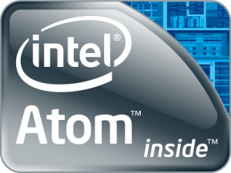
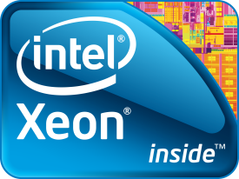
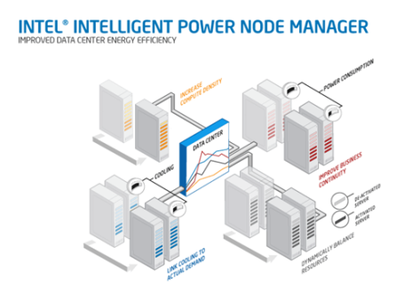
Energy Efficient Computing with IA
Energy Efficient Integrated Cores
SSD
Intel® Energy Checker SDK
Intel® Intelligent Power Node Manager
whatif.intel.com, www.intel.com/technology/nodemanager

Slide 27
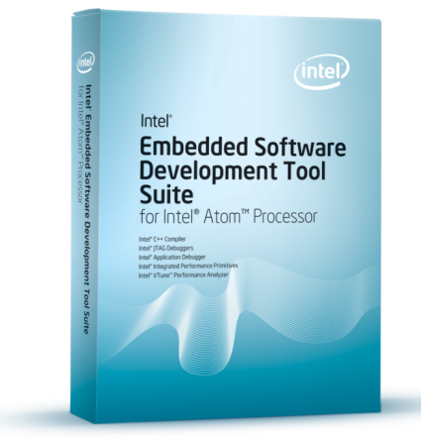
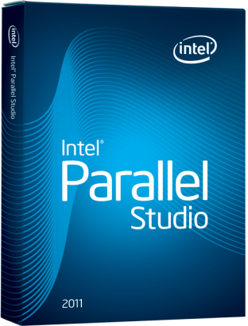
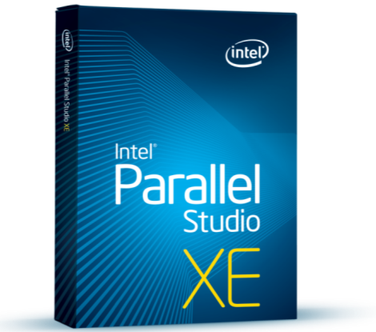
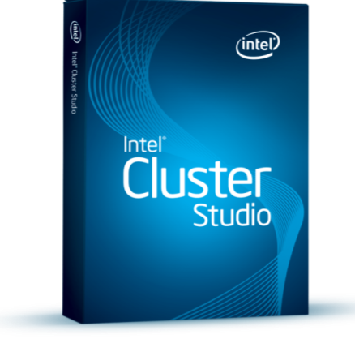
Four Product Lines for Diverse Needs
C/C++ developers targeting Intel® Atom™ Processors based Embedded or Mobile devices | C/C++ developers Microsoft Visual Studio* Take advantage of multicore | C/C++ and Fortran developers Windows* and Linux* High performance, cross platform apps | C/C++ and Fortran developers on Windows* and Linux* High performance MPI clusters
Efficient Performance
Essential
Performance
Advanced
Performance
Distributed
Performance

