Slide 1
Chief Technology & Innovation Office
Cloud Computing Unit & Davinci-1 HPC system
CN HPC Spoke 2 Kick Off
14-10-2022

Slide 2
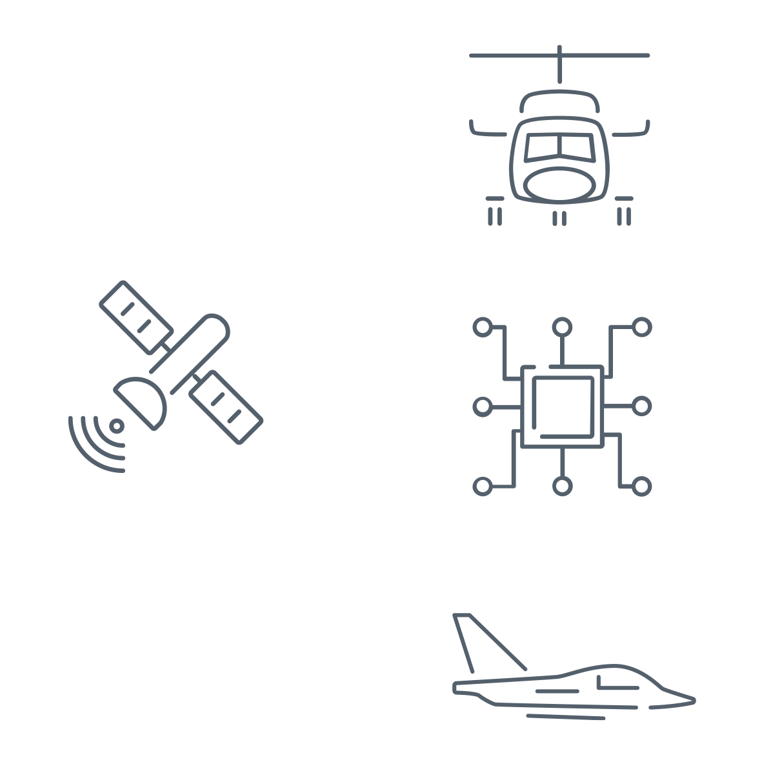
LEADER IN AEROSPACE, DEFENCE AND SECURITY
Leonardo is a global company that develops multi-domain operational capabilities in the Aerospace, Defence and Security sector, with an integrated offer of high-technology solutions for military and civil applications.
BUSINESS SECTORS
SHAREHOLDER COMPOSITION*
HELICOPTERS
DEFENCE ELECTRONICS
& SECURITY
0.5%
Electronics Division
Cyber & Security Solutions Division
Leonardo DRS (100%)
Leonardo UK/Electronics/Cyber (100%)
MBDA* (25%)
Hensoldt (25.1%)
Elettronica (31.3%)
Larimart (60%)
7.1%
Helicopters Division
PZL-Şwidnik (100%)
Kopter (100%)
Leonardo UK/Helicopters (100%)
NH Industries (32%)
44.7%
INSTITUTIONAL INVESTORS
MINISTRY OF ECONOMY AND FINANCE
RETAIL INVESTORS
INSTITUTIONAL UNIDENTIFIED
TREASURY SHARES
17.5%
30.2%
AERONAUTICS
SPACE
Aircraft Division
Aerostructures Division
ATR* (50%)
Eurofighter GmbH (21%)
Telespazio* (67%)
Thales Alenia Space* (33%)
AVIO (29.6%)
90% of the institutional float is held by international funds
24% of investors are signatories of the Principle for Responsible Investments (PRI)
* Joint venture | % Leonardo’s share
*As of February 2022

Slide 3
INNOVATION AND TECHNOLOGY
Industrial skills and a long-term vision allow Leonardo to lead technological innovation over time.
Digitalisation is the driver that accelerates the sustainable transformation of new technological cycles, enabling the integration between digital and manufacturing and supporting the green transition.
13% of revenues
9,600 people
6.2 petaflops
equal to €1.8 bn for research & development activities in 2021
involved in R&D and engineering
of computing power
27.1 petabytes
collaborations with more than
of storage capacitiy
90 universities
and research centres
REVENUES
NEW ORDERS
ORDER BACKLOG
EBITA
€ 14.1 BN
€ 14.3 BN
€ 35.5 BN
€ 1.1 BN

Slide 4

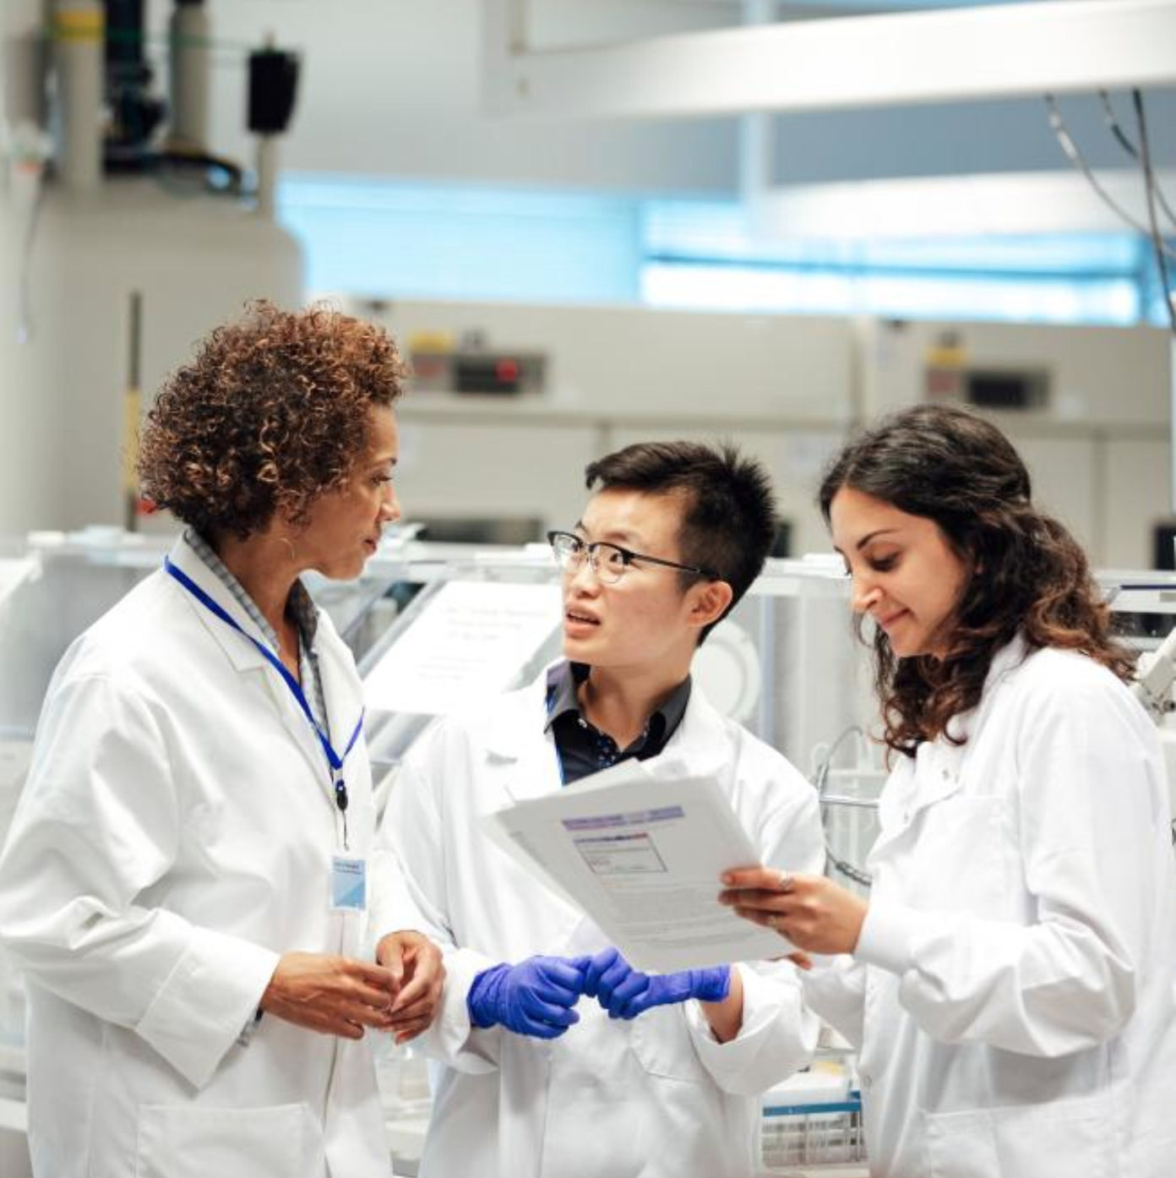
The Leonardo Labs – Mission
  The Leonardo Labs are technology incubators intended to support Leonardo’s long-term research and its development of cutting-edge technologies, particularly in the digital sphere. They stem from the desire, not just to remain on the frontline of innovation, but to anticipate it, thereby improving the products and services offered to customers and boosting the Group’s long-term growth prospects. The goal is to be the driver of national technology to direct and support the entire ecosystem of customers, industrial partners and universities
  The technological areas of the laboratories are defined within the “Masterplan 2030 for Innovation”, one of the pillars on which the strategic plan “Be Tomorrow - Leonardo 2030” is based, an ambitious and far-sighted vision, which aims to contribute to progress sustainable, safety and a more hospitable future.
  Leonardo’s laboratories will also allow to feed a continuous flow of talents and to ensure flexibility and renewal of professional skills, based on a model according to which young research fellows and doctoral students of international origin work together with experts and internal researchers at Leonardo’s Divisions.
Leonardo Corporate Research Lab

Slide 5
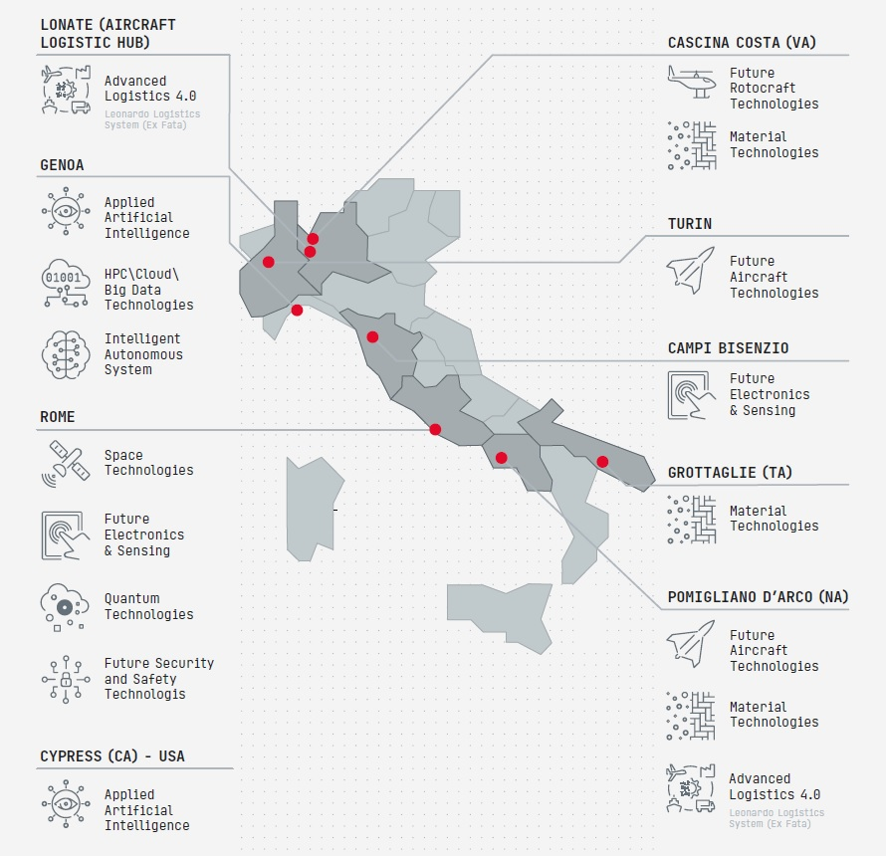
The Leonardo Labs – Numbers
The main Leonardo Labs numbers are:
    11 Leonardo Labs (in 6 regions in Italy and 1 in the USA)
    9 Research areas
    38 Research units
    4 Joint external laboratories
    136 Research fellows at end 2022
In the support at the activities of Leonardo Labs is available the newborn supercomputer Davinci-1. These are the main numbers of Davinci-1:
  4th in the aerospace sector behind only to NASA
  JAXA, DLR agencies;
  24th in the private company supercomputers;
  150th in the top 500 worldwide supercomputers;
  5 Pflops of computing power;
  20 PByte of cumulative storage capacity.
Leonardo Corporate Research Lab

Slide 6

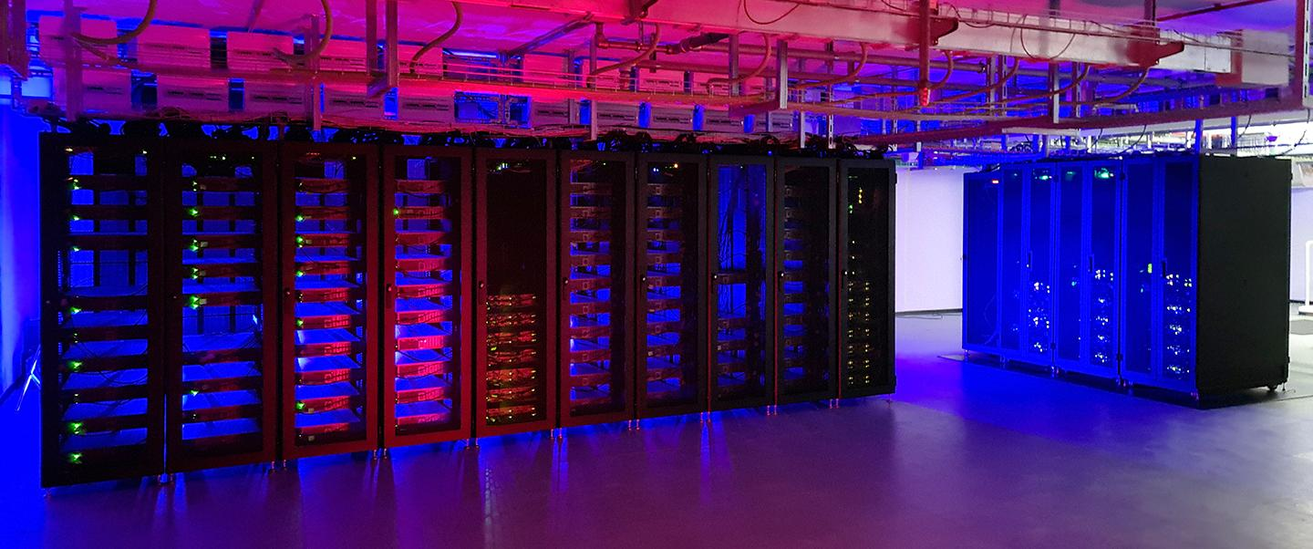
Leonardo High Performance Computing System
    New key player for Leonardo: davinci-1
    Extremely powerful and versatile HPC hybrid cluster, designed as general-purpose computing infrastructure to satisfy the different needs of Leonardo’s Divisions (Advanced Simulations, Big Data, Artificial Intelligence)
    HPC infrastructure – Davinci-1
    56 Intel Xeon Platinum nodes (purely CPU)
    60 + 20 (fat) AMD nodes w/ 4 NVIDIA A100 GPUs
    3 visualization nodes w/ 2 NVIDIA RTX8000 GPUs
    2 PB home/work + 10 PB archive Lustre storage
    Mellanox network (GbE, InfiniBand HDR)
    GNU / Intel / NVIDIA Compilers
It is transversal to the activity of all business areas and the Leonardo Labs network.
It supports the Group's digital transformation process.
It is an integrated supercomputing and cloud computing platform which combines flexibility and computing power.

Slide 7
Applications Areas
Leonardo Labs are based on an integrated innovation approach in which all technological areas are interconnected and interact synergistically, making the most of common points.
At the base lies the davinci-1 with its computing and storage capabilities that are exploited by HPC and Cloud technologies, used by all the technologies and domains of the upper level.
The third level is composed of Big Data and AI technologies which are both independent research areas and a founding element for the other research areas.
An example is the convergence of the AI, Big Data, HPC technology domains in the creation of the Digital Twin platform for design, validation and support operations of our platforms
Digital Desing
Certification by Simulation
NowCasting Forecasting
Digital Twin
Predictive Maintenance
Multi Objective Optimization
AI Model Training

Slide 8

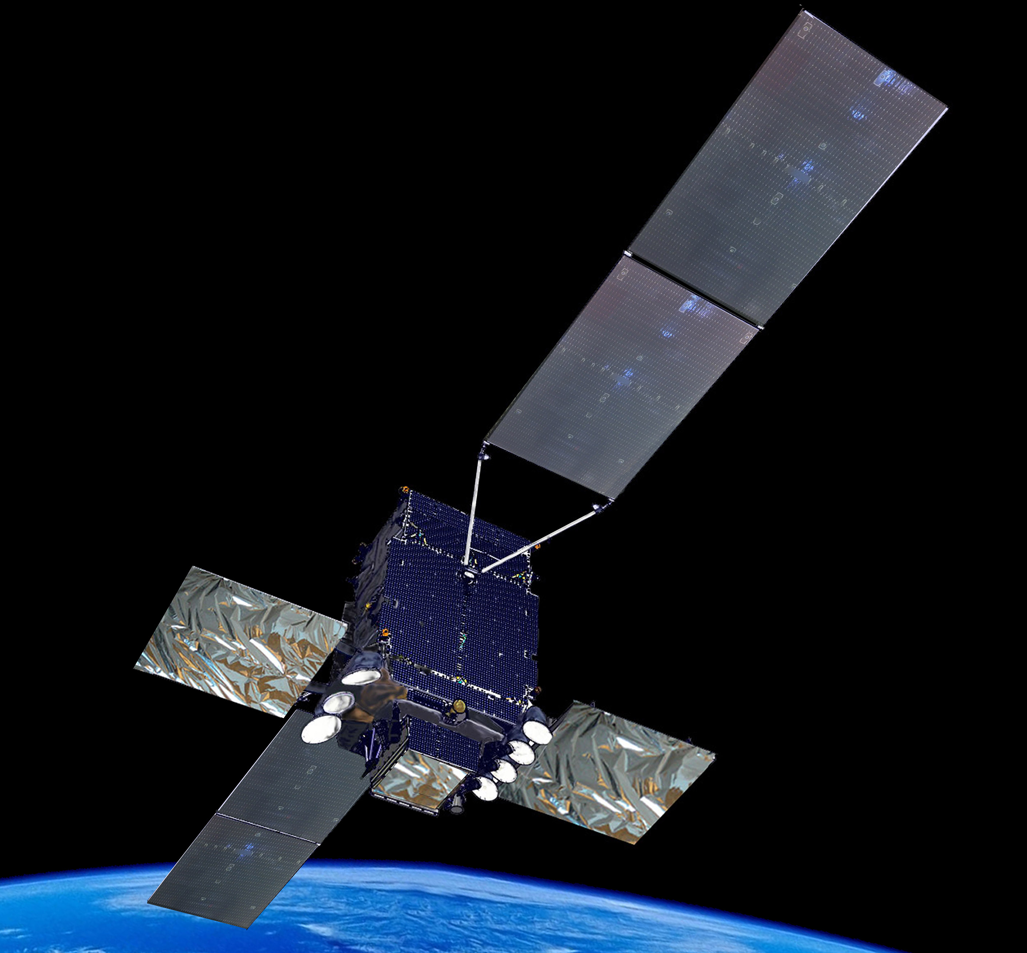
SPACE
Leonardo covers the entire value chain of the space industry, from the manufacturing of satellites and orbiting infrastructure to the production of high-tech equipment and sensors, in addition to the development of new space applications and the management of satellite services up to propulsion and launching systems.
Satellite services for the design, development, launch and in-orbit control of space systems, and services and applications for Earth observation, communications, navigation and satellite localisation.
Satellite systems for telecommunications, navigation, Earth observation, probes and rovers
for space exploration, and multi-function orbiting modules.
Instruments: electro-optical and hyperspectral payloads, laser transmitters and robotic systems for space exploration and the study of our planet.
Equipment: photovoltaic panels, atomic clocks, attitude sensors, power distribution systems, orbital micro-propulsion.
>2 million
>50%
>50
radar images acquired by COSMO-SkyMed, the constellation of ASI and the Italian Ministry of Defence
of the living space of the International Space Station developed by Thales Alenia Space
atomic clocks on board the Galileo constellation

Slide 9

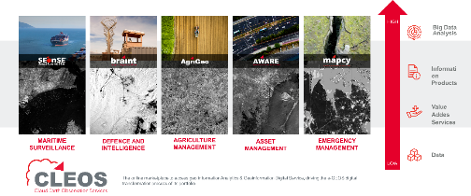






TPZ relevant assets&skills
Skills/Competences
Assets
Profound knowledge of
Thematic End User needs
In several vertical applications (maritime, agriculture, forestry, environmental monitoring, infrastructure and asset management, cultural heritage, insurance, D&I)
Remote sensing Opt./SAR data processing
Optical (Multispectral/Hyperspectral) / SAR signal processing to derive model based observations and measurements and monitoring capacity from single image or multitemporal time series
Digital Platforms
HPC / Cloud / Big Data / Microservices
Management and exploitaiton of scalable computing infrastructure and processing platforms, on prem and in various cloud environments
Modelling (Hydraulic/Climate/
Agriculture) and scenario simulation
Design and implementation of modelling and scenario simulation tools to build flood risk and impact scenarios, including climate change effects
The Application Platforms, CLEOS, GAFMap, GAFPortal and T-DROMES jointly have all the necessary elements to built a Digital Twin System capable to bring together heterogeneous data and models to implement a DigitalTwin
Data
COSMO-SkyMed (I and II Gen), SAOCOM and other multimission EO data, but also access to heterogeneous non EO data (AIS, mobile phone, in situ sensors, drones, DEMs)
Artificial Intelligence
ML/DL networks applied to several geosptial challenges (object detection, anomaly detection, trend analysis, ..) and data (satellite, eaerial ,drone imagery, social media, marine traffic, …)
Matera G/S is a relevant asset to deloy large scale processing capabilities co-located with large EO data archives
Leonardo Labs and GI Competence Centres offer a multidisciplinary network of corporate labs focussed on digital technologies
HPC (LDO, e-GEOS) are powerful computing infratsructures that can be federated in wider EU networks (EuroHPC)
3D modelling
Desing and implementation of detailed 3D models from satellite/aerial/drone imagery at multiple scales and LOD.
Infrastruc.
Global Market Footprint, thanks to the transnational network of Telespazio Group

Slide 10
Space Data Space Proposal
Space Data Space Proposal
Objectives
Support the data economy within the space economy
Build a market place to promote services and networking
Promote the adoption of GAIA-X standards and guidelines
Coordinate with similar actions at EU level
Contribute to the digitalization of the SME working in the space value chains
Coordinate with the Digital Innovation Hub

Slide 11



Space Data Space Proposal
Embedding space ecosystem into data value chain
Data sources
Standardized data
Optimized data
Sharing models
Data use
Input sensor and data layer
Aggregation and normalization of data within local, interoperable repositories
Sharing prerequisites through harmonized access management
Depending on the legal basis ad use case
Data, insights, software and algorithms as a service
Space satellite sensor
National Hubs
Data
research institutions
Space Based sensor
Metadata
Security & access management
Use case
Insights
providers
Use case
Observatory
Data catalogue
Data Space
FAIR data
Findability Accessibility
Interoperability Reusability
Data Space
data repository
PAAS
Marketplace
Harmonized Privacy management
Marketplace
user communities
ESA - DIAS
ASI - SSDC
Federated learning algorithms
SAAS
Federated learning algorithms
Data and tools to realize the data value chain are enablers of digital transformation in all sectors

Slide 12
Space Data Space Concept
Space Data Space Proposal
Users
(End / Intermediate)
Communities
Service providers
Use Cases
Thanks to this project space data will become a part of an open, transparent digital ecosystem, where data and services can be made available, collated, and shared in an environment of trust
This is the mission that we want to stimulate through the creation of this space data space and welcoming every other actors of the space value chain, like academia and research institutions
Market Place Portal
Data Scientist
Federation Services
(Gaia-x) Data labelling
Data providers
Infrastructure providers

Slide 13
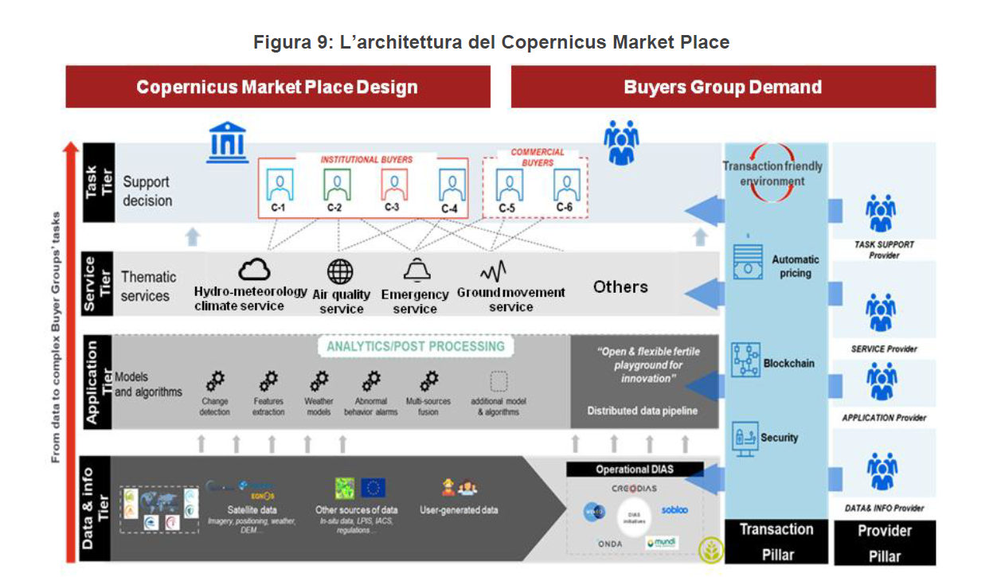
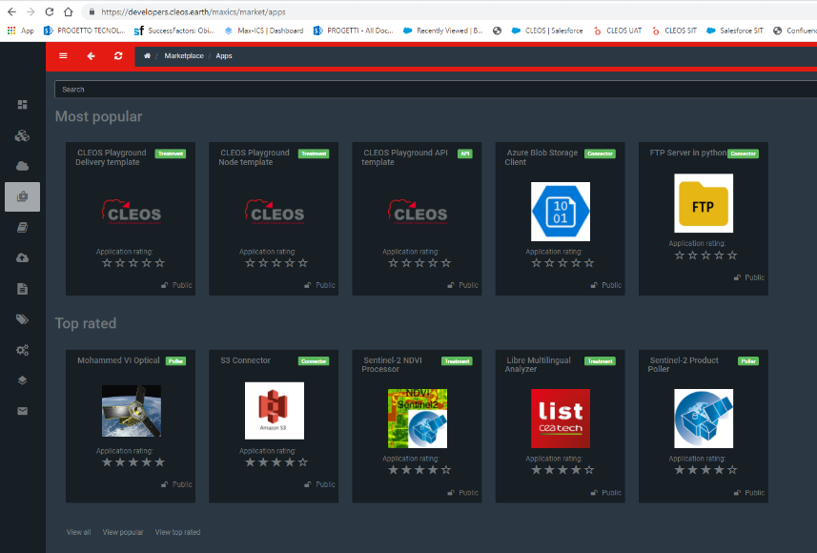
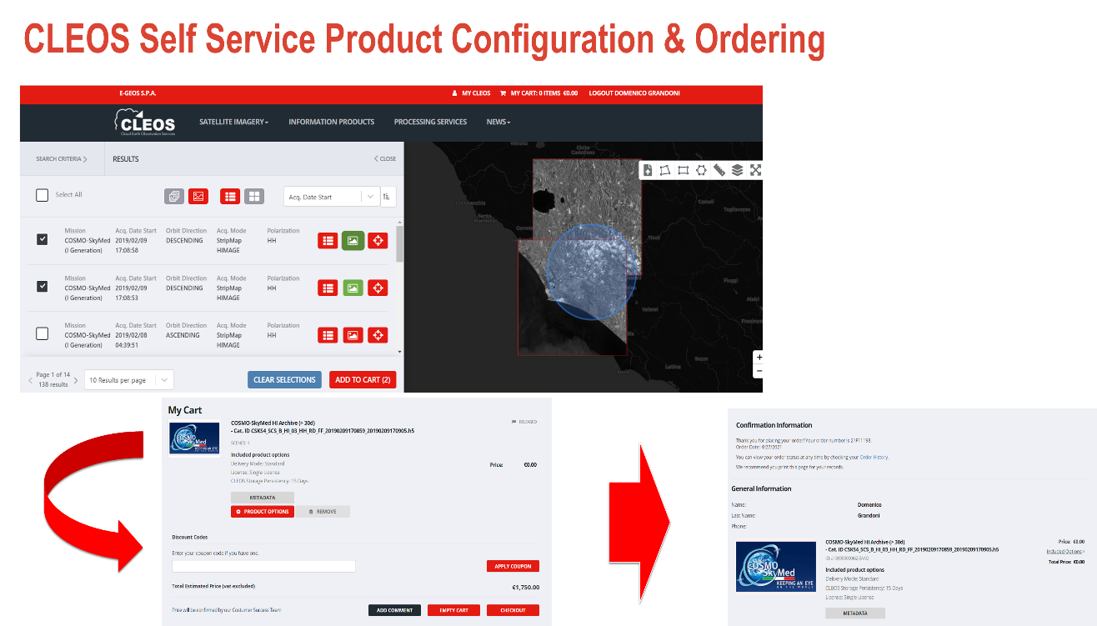
WP2 Marketplace: initial experiences and link to Space Economy (CoMaP)
Space Data Space Proposal
CLEOS (Cloud Earth Observation Services) is the marketplace of EO data, Information Products, Processing Services developed and operated by e-GEOS to provide a single digital access point to a wide offering that federates also other partners form different domains.
CLEOS features also a Developer Portal where developers (e-GEOS, partners, customers) can build their applications also re-using building blocks/code shared via an internal marketplace of applications.
The Copernicus Marketplace (CoMaP) will be developed in the framework of the Mirror Copernicus and PNRR initiatives and it will build a transaction-friendly environment where institutional and commercial Buyers Groups can search, configure and buy validated geospatial data and services offered by the Industry
The CoMaP concept is similar to the Space Data Space, although it focusses on a specific Space domain (Earth Observation)

Slide 14

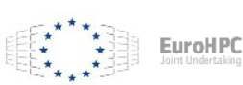








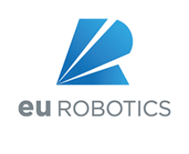


Leonardo within the European Innovation ecosystem
Leonardo is actively involved in many European Initiatives and projects on AI, HPC, Cloud/Edge Computing and participates to many H2020/HE, EDIDP, EDF projects on HPC, AI, Cybersecurity and Advanced Digital Skills, like:

