Slide 1
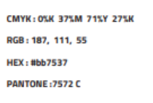
Wrap up + Next Steps

Slide 2
What now?
First of all, our thanks to all the participants to this kick-off, especially to the WP leaders who spent most of the last two weeks preparing the sessions!
Clearly, the kick-off has shown that there is a lot of interest / material / critical mass behind the project
Readiness / technological complexity / innovation varies quite a lot between proposals; the next weeks will be spent in studying what we got → meetings with WP leaders
As said, this is a start of a journey, we are NOT freezing use cases / ideas now
For administrative matters, we now have guidelines (thx Alessia e Eleonora) → here
We keep open the doc for questions, they will be redirected to the Hub → here
We, in the next days / few weeks, will recap with industries to see how to go on

