Slide 1
Ratio psi(2S)/J

Slide 2
Plans
Measurement of the the Xsect ratio separately for the prompt and non prompt components
We need acceptances, efficiencies, yields
First issue: efficiencies do not factorize at low pT (use MC or T&P? )
Still to decide the binning ( crucial for the psi’ )
Pre-Approval foreseen for half February

Slide 3
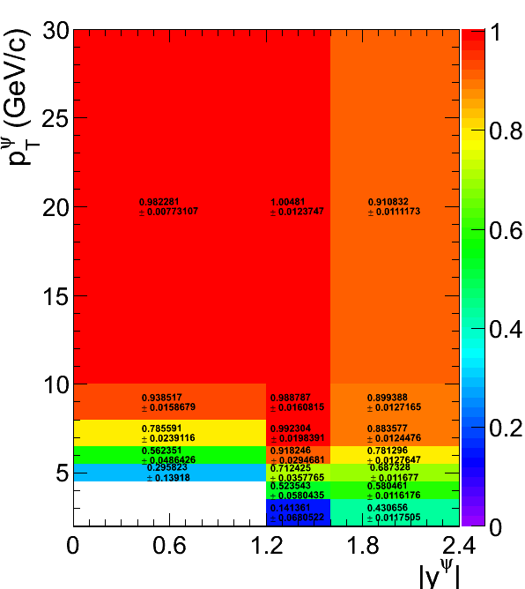
Efficiency ratio psi(2S)/J

Slide 4
Mass Fit
This talk focuses on the fitting issues, actually we have two different procedures:
Fit of the two peaks separately (reduces free parameters)
Fit in the full mass interval [2.6, 4.0]
In both cases we use Exp for Bkg, CB for the psi’ and CB+Gauss for the J/psi
In both cases a prefit in the sidebands regions and in the peaks is used to set meaningful starting points, in case 2. also a separate fit is performed to fix several shape parameters (n,alpha in the CB’s)
Two cases considered: ALL types and GG only
DoubleMu0 HLT used on the full 2010 stat (40 1/pb)
Binning used for now: 3 bins in Y (1.2, 1.6, 2.4) and 10 bins in pT (0., 1.25, 2, 2.75, 3.50, 4.50, 6.50, 10, 20, 30, 50)

Slide 5
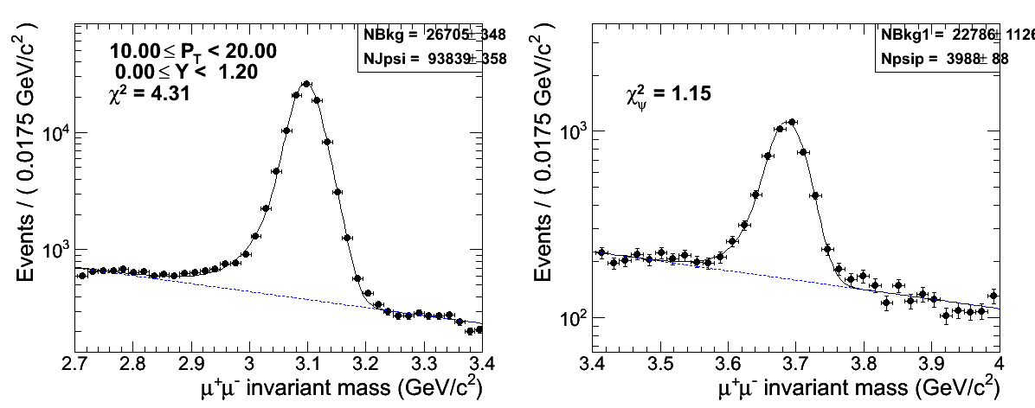
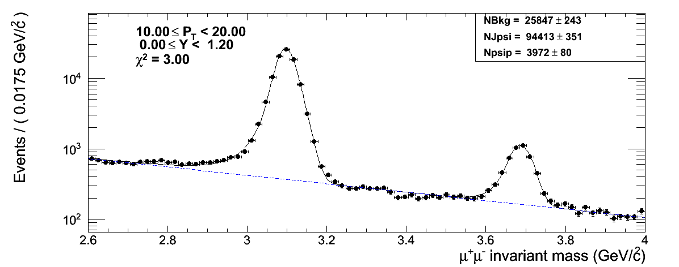
Method 1 vs Method 2 (All Types)

Slide 6
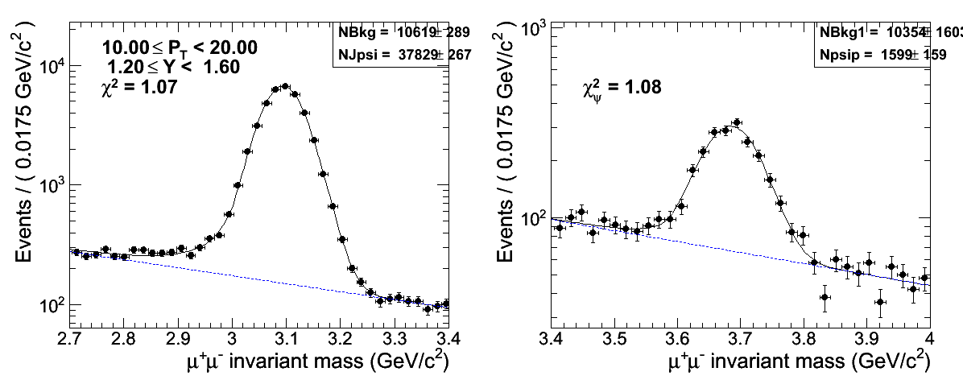
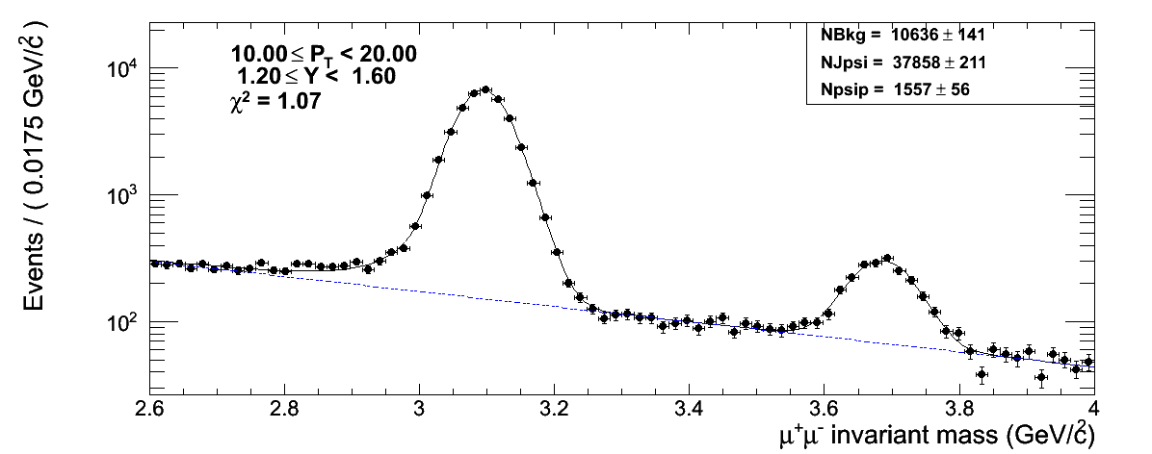
Middle rapidity

Slide 7
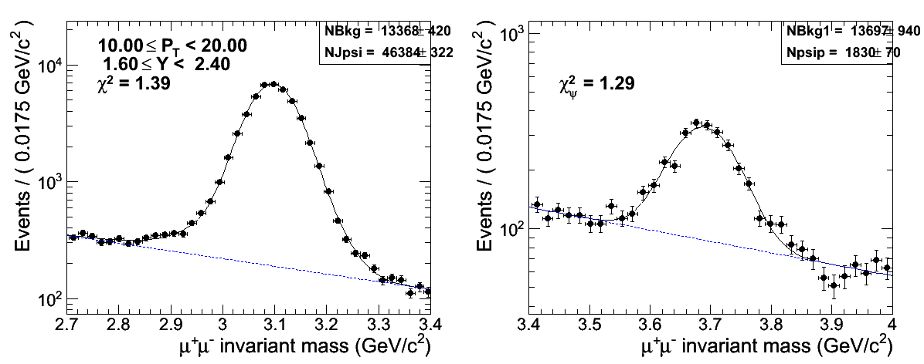
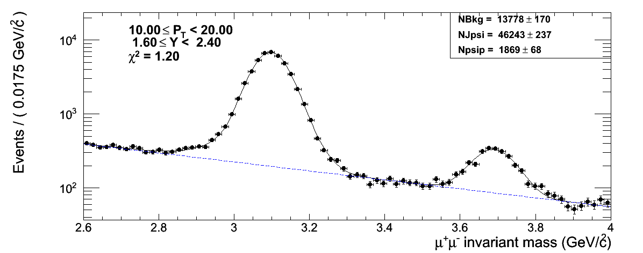
Forward

Slide 8
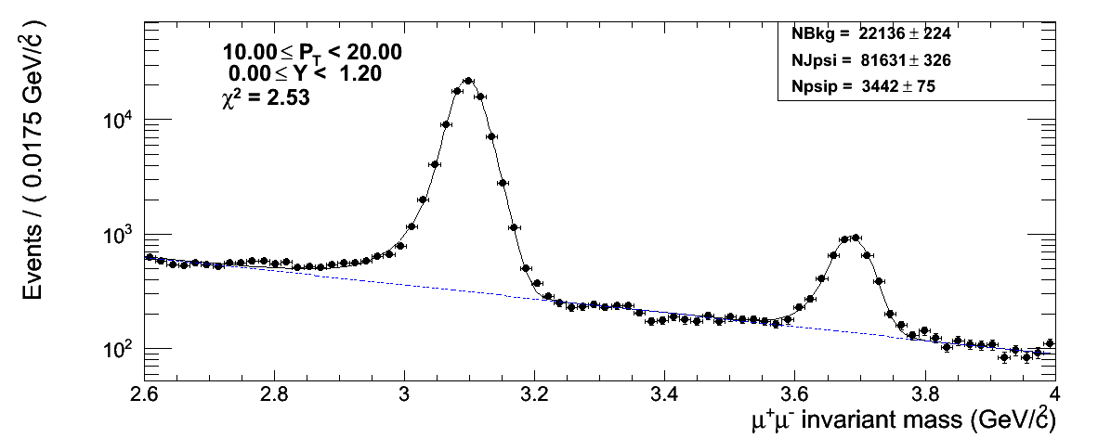
Comparison ALL vs GG
GG
They are basically the same in all bins
ALL

Slide 9
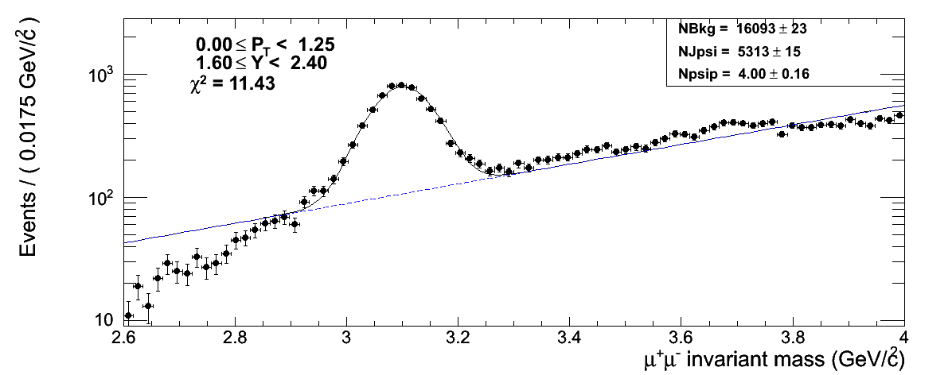
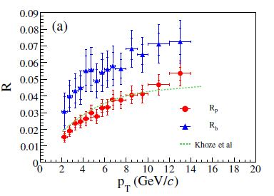
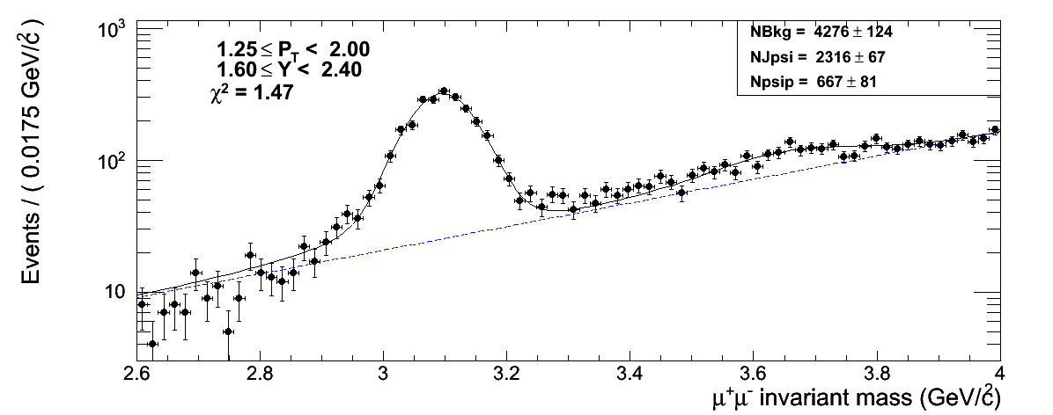
Issues
At low pT (forward rapidity) the psi’ is not so visible (fittable) due to higher bkg, and lower ratio to J/psi, in particlar a lifetime fit is not possible:
We have to start the measurement at 2 GeV/c (in analogy with CDF)

Slide 10
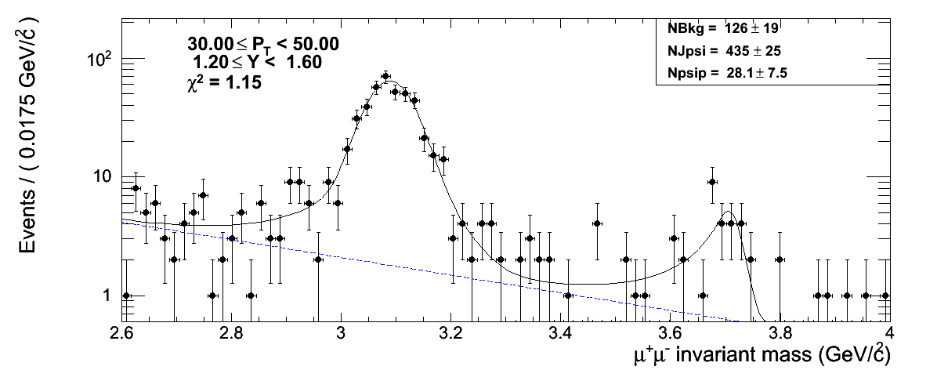
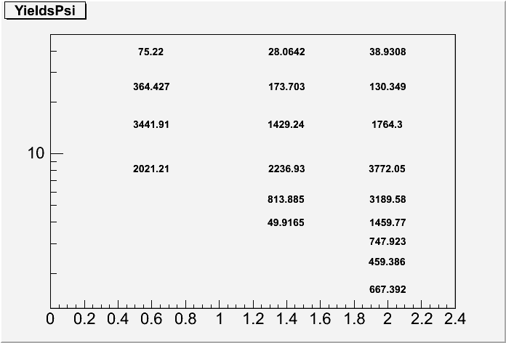
Binning for psi’ J/psi ratio
The psi’ yield must be arount 1k to have a stable lifetime fit with a good S/N (10)
Impossible to go below 2 GeV/c
Old Binning (0., 1.25, 2, 2.75, 3.50, 4.50, 6.50, 10, 20, 30, 50)
Propose for new Binning (2, 3, 4, 5, 6, 8, 10, 15, 30)
Possibly use 4 Regions in Y (0, 0.6, 1.2, 1.6, 2.4) to be directly comparable with CDF

Slide 11
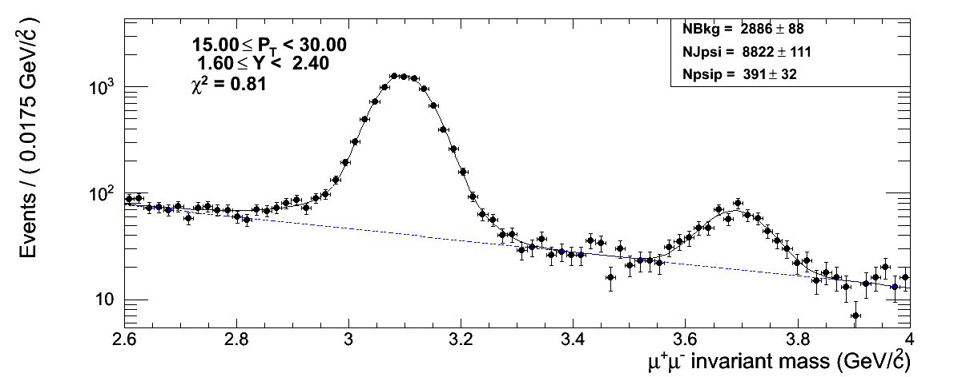
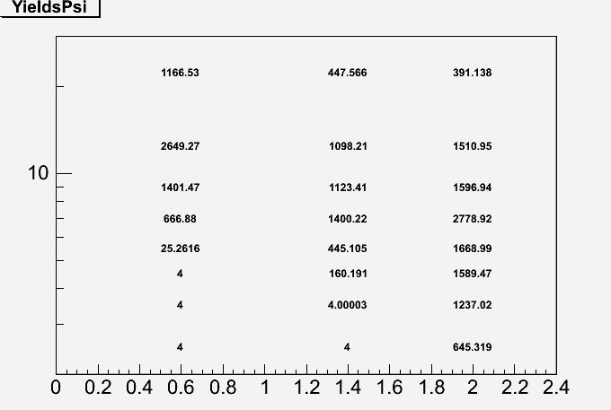
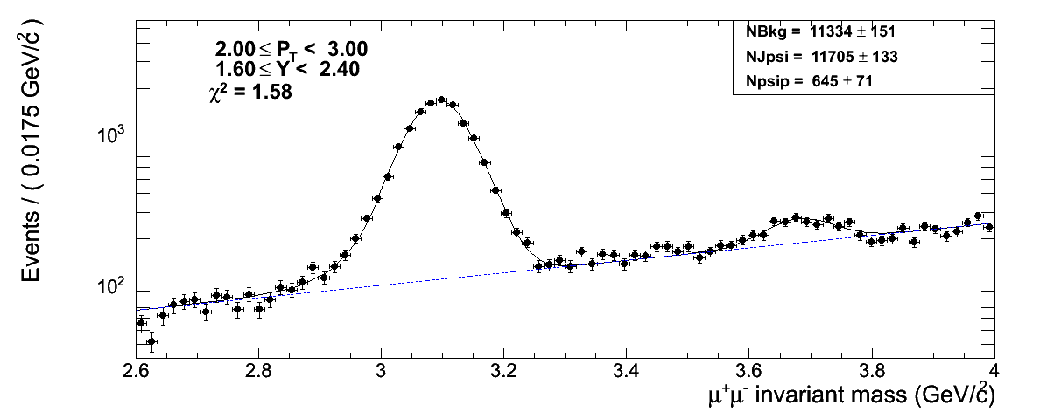
A first try with new binning
Despite the low yield we have good S/B
2 GeV/c
Difficult to fit for lifetime

Slide 12
Conclusions and To Do
We can use the full range fit
We can use only the GG pairs
Test the new binning (especially the lifetime fit)
Optimize the fit in a way to reduce the number of free parameters and enhance stability
Produce new results in a week timescale
Use the new reprocessing with 3_9_X (Muons PD not yet available)

