Slide 1
Updates on J/PSI polarization
Luigi Calligaris
CMS Pisa meeting
13/01/2011

Slide 2
Outline
Data used for this analysis
Definiton of sidebands
Simulations on the contamination of the background by the signal, in the sidebands
P_{T} dimuon distribution for different triggers
Cos θ and φ distributions in different reference frames of the positive muon

Slide 3
Data used in the analysis
Used data from October 30th production
Run 2010A data
HLT_DoubleMu0
HLT_Mu0_TkMu0_Jpsi
Run 2010B data
HLT_Mu0_TkMu0_OST_Jpsi
HLT_Mu0_TkMu0_OST_Jpsi_Tight_v1
Implementing now code for new released data TTrees
Nov 4th ReReco – Dec 6th production

Slide 4
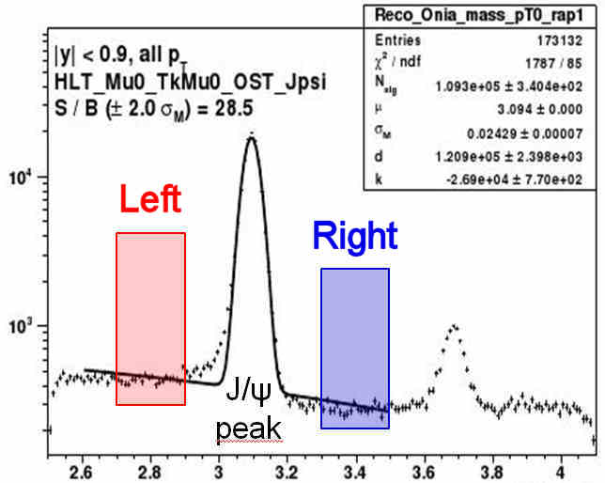
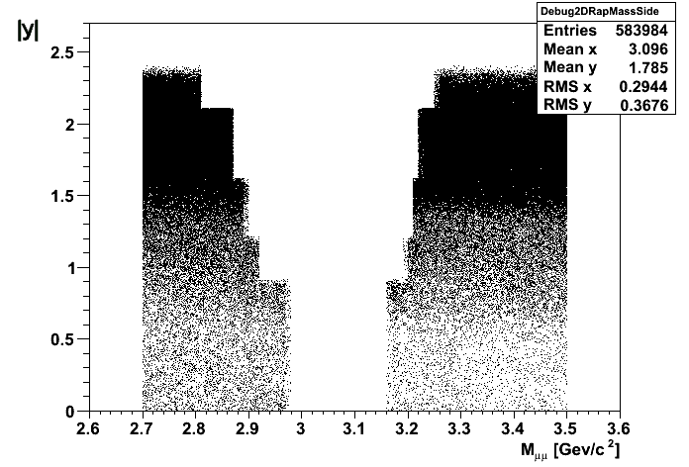
Defining Sidebands
Left sideband: from 2.7 GeV/c² to 5σ left of the J/ψ peak Right sideband: from 3σ right of the peak to 3.5 Gev/c²
The peak position and σ depend on the |η| bin being considered.
This is shown in the figure on the right, a 2D plot of events accepted into the sidebands in the |η| - M_{μμ} plane

Slide 5
Contamination of the SB with signal
Took a MC sample of dimuons coming from J/ψ decay, with detector and FSR smearing
Estimated the amount of signal falling into the left sideband due to FSR tail
Total: 1.7%
Worst: 3.8% (low P_{T}, mid rapidity)
Best: 0.7% (high P_{T,} forward rapidity)

Slide 6
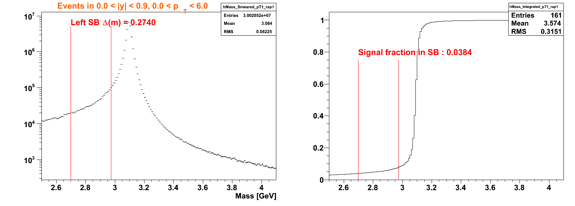
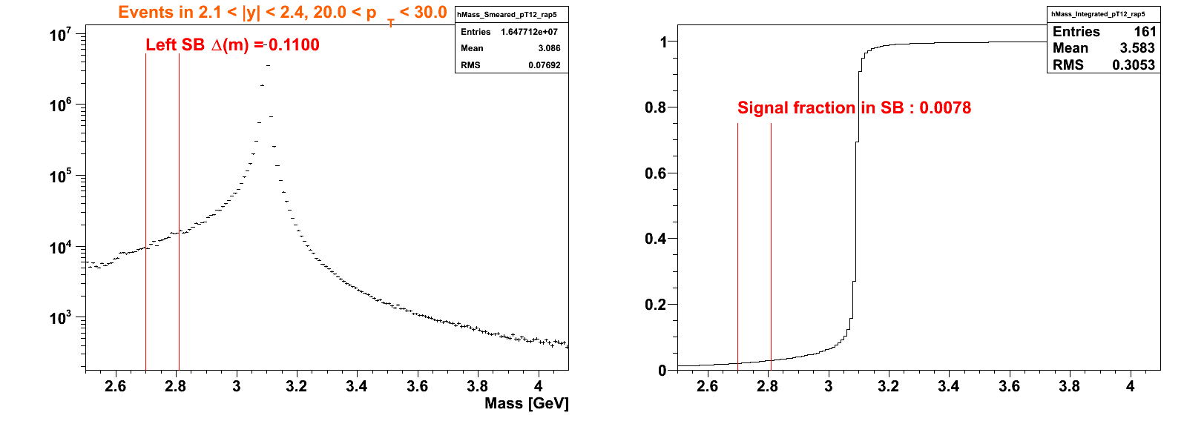
Contamination of the SB with signal
0.0<|η|<0.9
0.0<P_{T}<6.0
Worst case
2.1<|η|<2.4
20.0<P_{T}<30.0
Best case

Slide 7
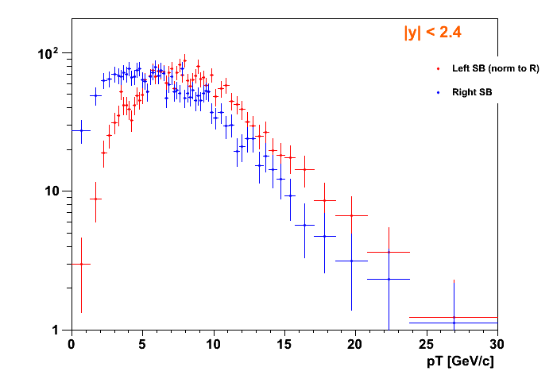
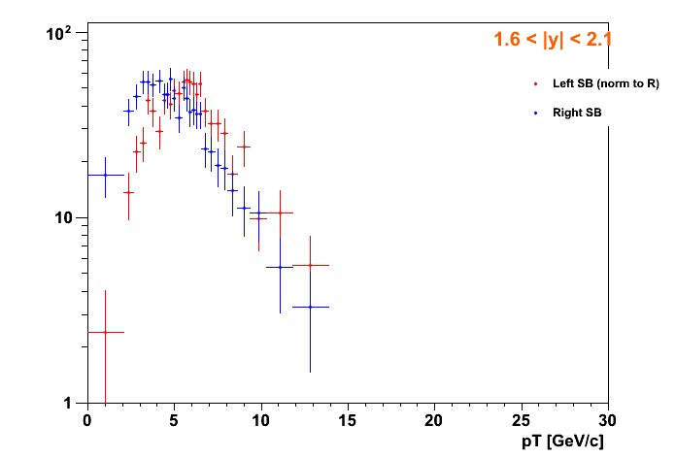
P_{T} spectrum for HLT_DoubleMu0
|y| < 2.4
1.6 < |y| < 2.1
Big difference in P_{T} between two sidebands
Detail for 1.6 < |y| < 2.1
Statistics is low

Slide 8
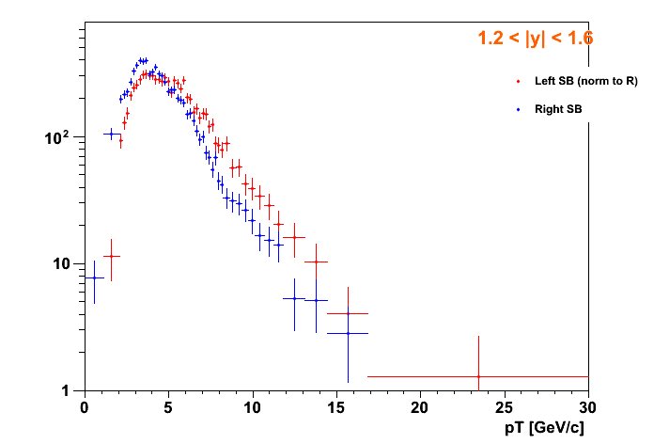
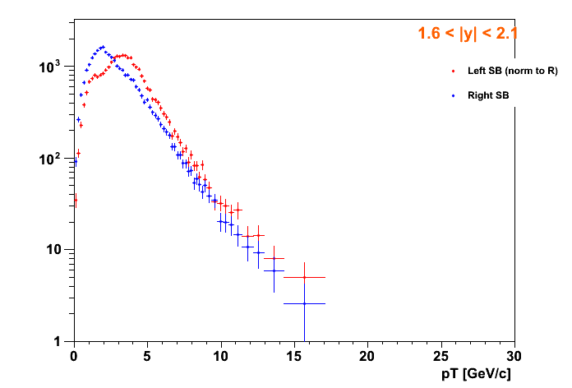
P_{T} spectrum for HLT_Mu0_TkMu0_Jpsi
1.2 < |y| < 1.6
1.6 < |y| < 2.1
P_{T} spectrum is ‘‘similar’’ in this rapidity bin…
…but behaves differently in the next one

Slide 9
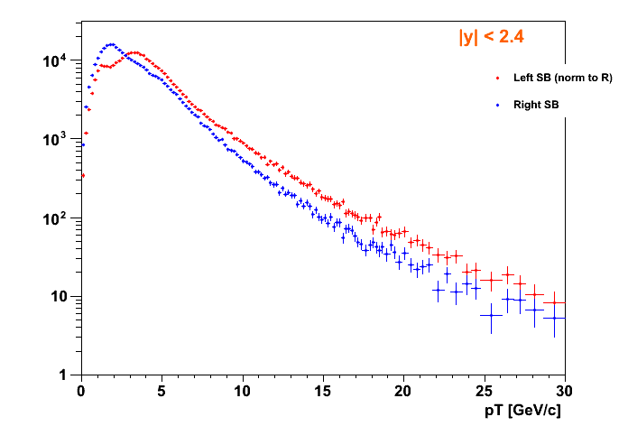
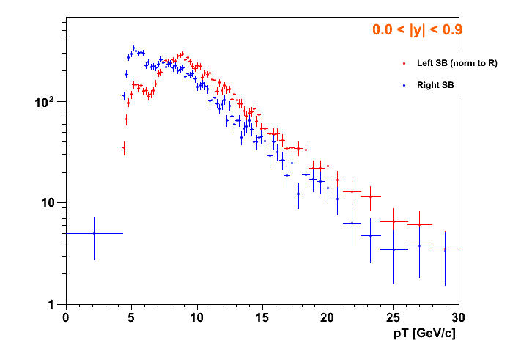
P_{T} spectrum for HLT_Mu0_TkMu0_OST_Jpsi (the trigger which had the biggest statistics in the data used)
all |y| < 2.4
0.0 < |y| < 0.9
The higher mass SB has a peak at lower P_{T} than the low mass SB
For this trigger, the mid rapidity distribution shows a strange pattern due to kinematics cuts

Slide 10
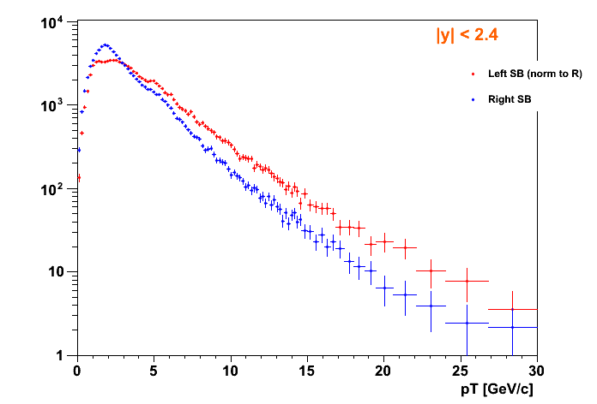
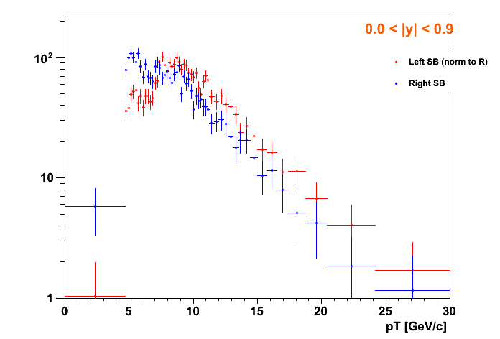
P_{T} spectrum for HLT_Mu0_TkMu0_OST_Jpsi_Tight_v1 (this trigger is a close parent of the former)
all |y| < 2.4
0.0 < |y| < 0.9
The left (low inv. mass) sideband seems to be harder in P_{T} than the right one
Also for this trigger the mid rapidity distribution shows a zig-zag pattern
(the triggers are parents)

Slide 11
Cosθ and φ in different frames
The following are 2D plots of the Cosθ and φ of the positive muon in the dimouns considered, for different reference frames.
In the plots a cinematic dependence of the distribution in the two variables can be seen as we cycle trough different rapidity and P_{T} bins.
Last but not least, there may be an effect due to ‘‘cowboy’’ dimuons inefficency.
I will show data for the trigger path for which we have the highest statistics: HLT_Mu0_TkMu0_Jpsi

Slide 12
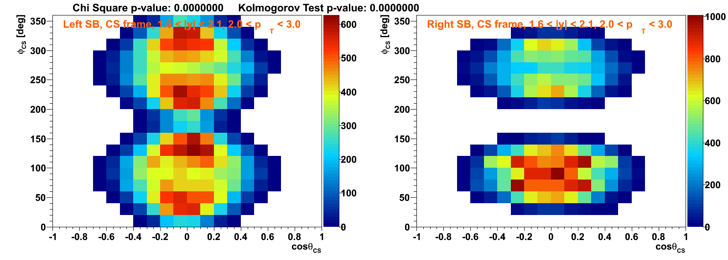
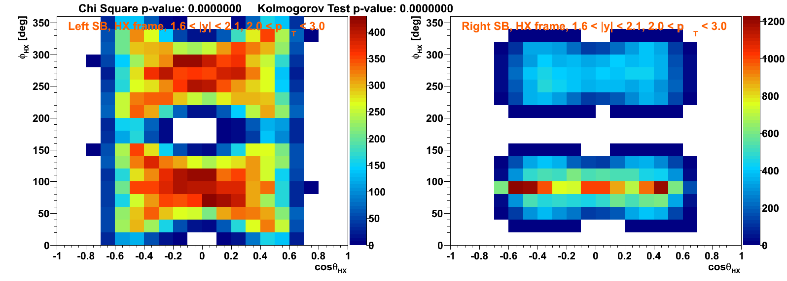
CS and HX frames HLT_Mu0_TkMu0_Jpsi 1.6 < |y| < 2.1 2.0 < P_{T} < 3.0

Slide 13
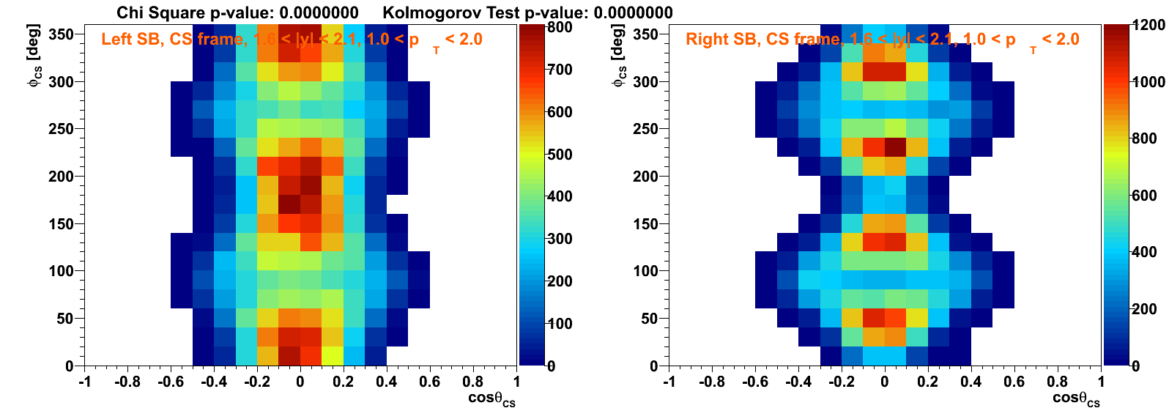
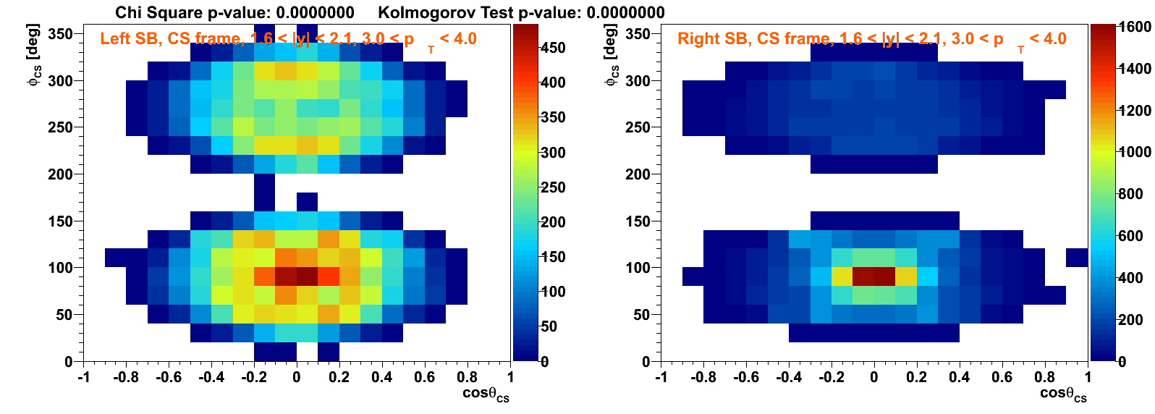
HLT_Mu0_TkMu0_Jpsi 1.6 < |y| < 2.1 2.0 < P_{T} < 3.0

Slide 14
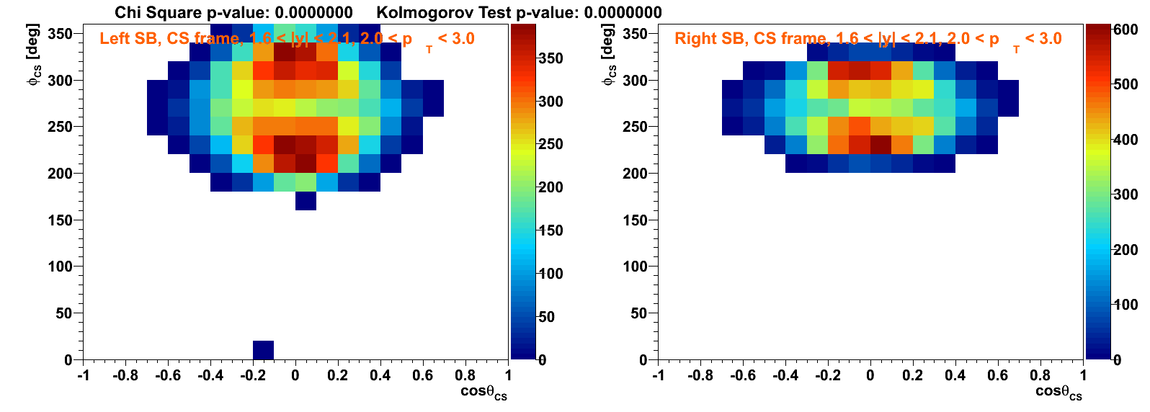
Differences between HLT_Mu0_TkMu0_OST_Jpsi and HLT_Mu0_TkMu0_OST_Jpsi_Tight_v1
The former has been configured to reject all the dimouns which are ‘‘cowboys’’.
This rejection can be seen in these pictures, indeed there are no events in the lower part.

Slide 15
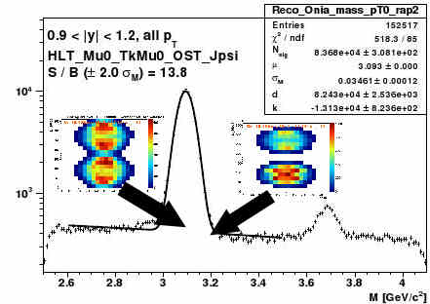
Purpose of the previous graphs
Get an estimate of the «polarization» of the background muons under the peak from those in the two SB
Take an intermediate value of the two to estimate the contribution of background to the polarization fit

Slide 16
Where to find more infos
QTF Workspace > Polarization > Data Quality Checks > Distributions from Mass Sidebands https://espace.cern.ch/cms-quarkonia/onia-polarization/Data%20Quality%20Checks/Mass%20sidebands.aspx
QTF Workspace > Polarization https://espace.cern.ch/cms-quarkonia/onia-polarization/
About reference frames and the analisys http://arxiv.org/abs/1006.2738
‘‘Seagulls and Cowboys’’ https://espace.cern.ch/cms-quarkonia/upsilon/Lists/slides/Attachments/31/correlations_gavin_2010_05_10.pdf https://espace.cern.ch/cms-quarkonia/onia-polarization/Lists/Meetings/DispForm.aspx?ID=39

