Slide 1
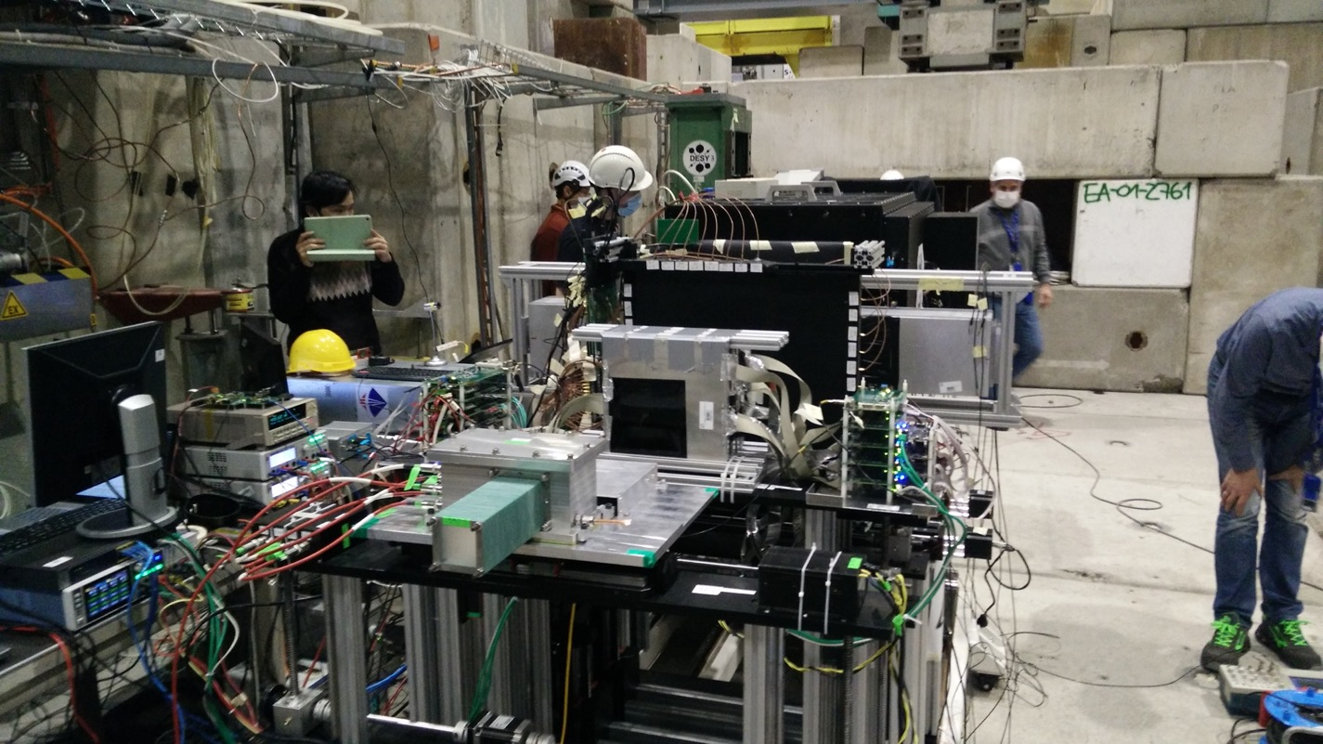
2021 test beam, only as reference

Slide 2
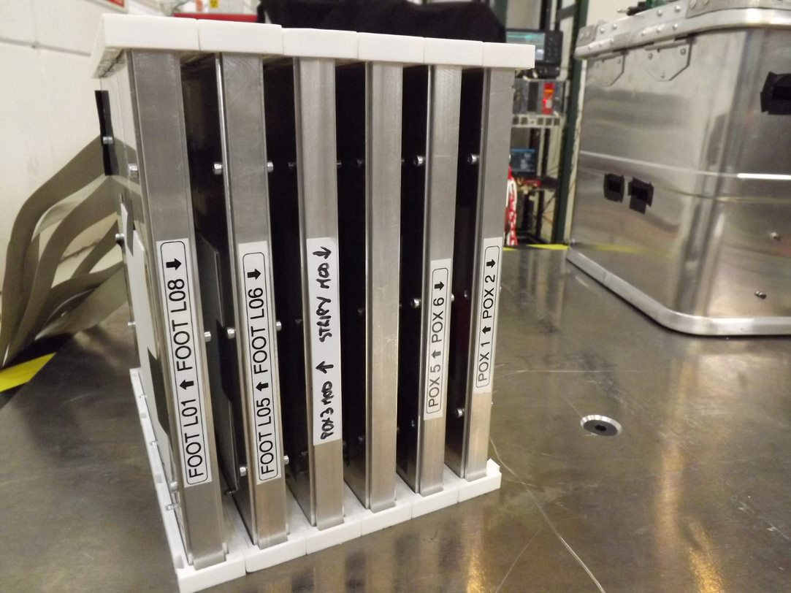
Perugia SCD hardware, simply put on top of table, no particular fixation

Slide 3
beam heigh with respect to the table: ~9 or ~15 cm

Slide 4
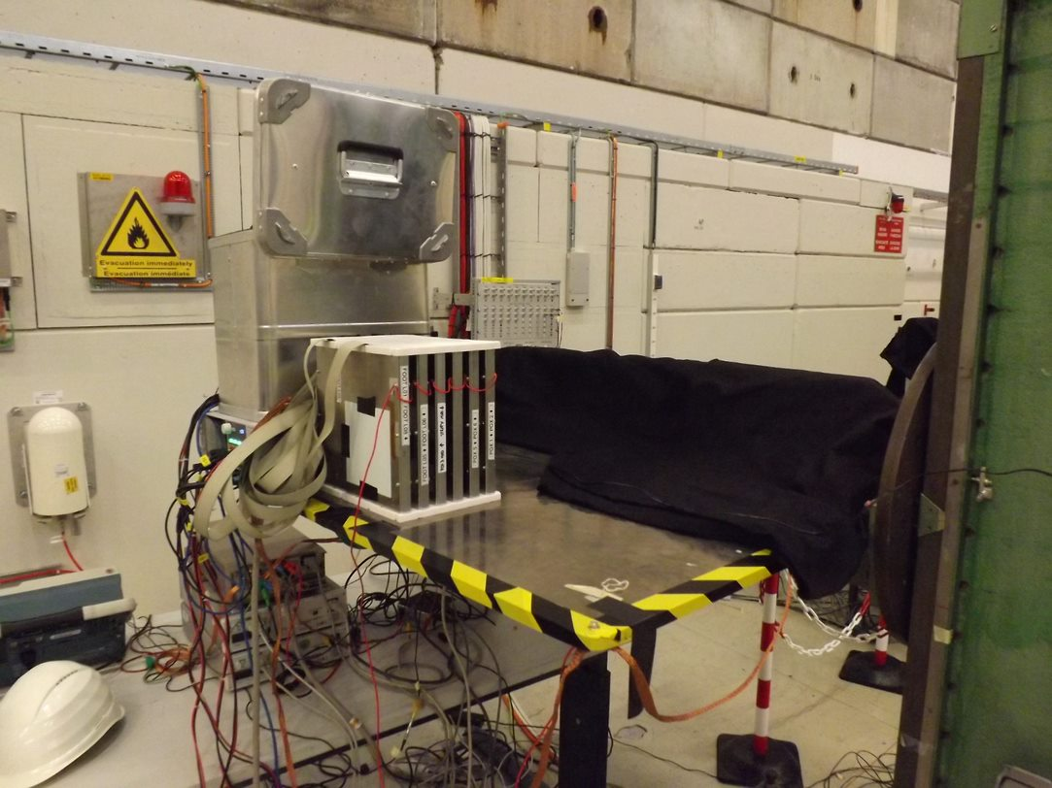
possible arrangement of the detectors on a simple table
vertical shifts possible with pre-defined spacers
horizontal shifts possible with simple ‘slide’ of the box

