Slide 1
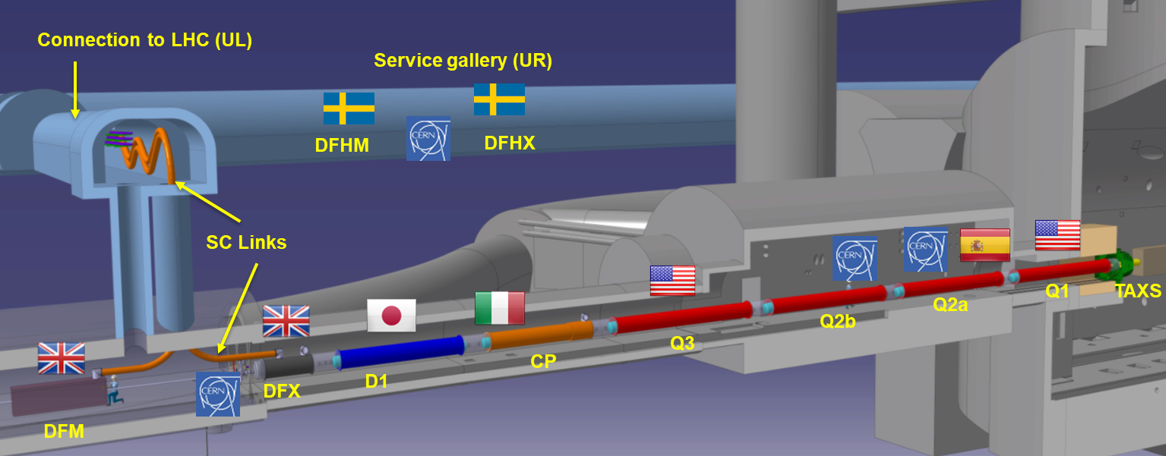



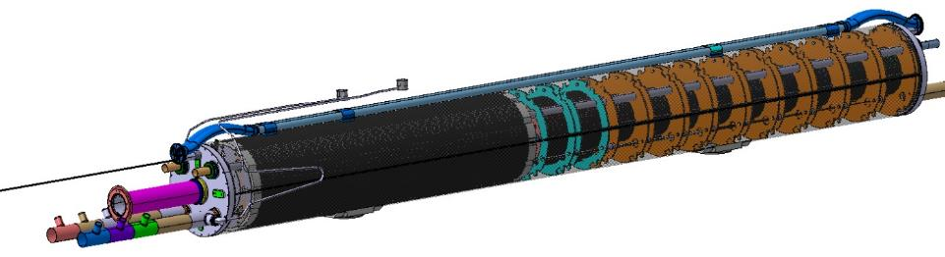

THE LOW BETA SECTION and the High Order Correctors
~70 m
a4
a3
a6
a5
b3
a2
b6
b5
b4
By H. Prin

Slide 2
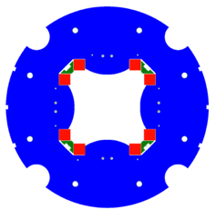
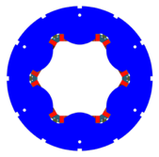
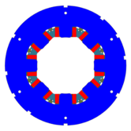
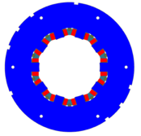
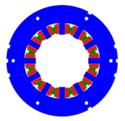
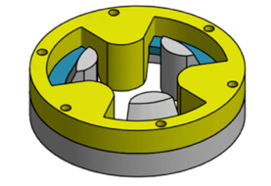
HO Corrector Magnets Zoo
MQSXF
MCSXF
MCOXF
Design
Construction & Test
5 prototypes
54 series magnets
OD320
OD460
a3
b3
a4
b4
a2
First superferric magnets in a High energy accelerator ring
MCDXF
MCTXF
Prototypes tested 2016-2020
Geometrical lengths:
200 mm - 265 mm
12P, S4P: 540 mm – 580 mm
a5
b5
a6
b6
Round Coil Superconducting Magnet
MgB₂demonstrator

Slide 3
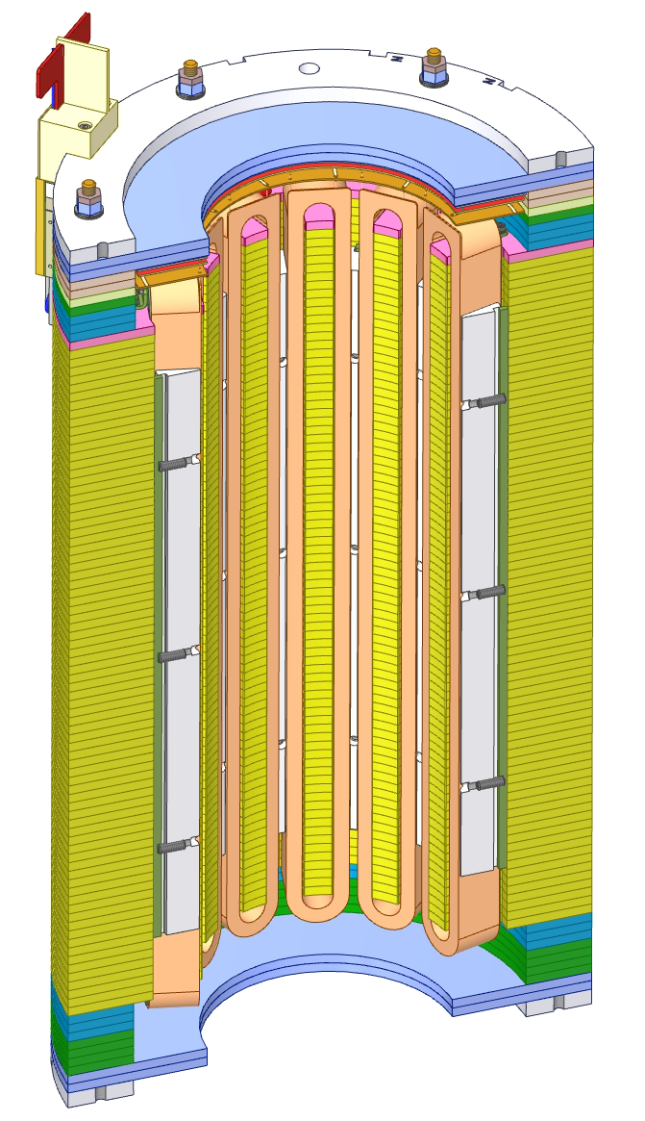
Superferric Design
KE3085 INFN production and test of 54 series magnets
NbTi coils
Racetrack
Insulation by S2 glass reinforced material
Superferric design
Compact and modular
Not very expensive
Strong contribution of the iron poles
Field quality influenced by the shape of the poles
Quench protection
No energy extraction (but 4P)
60% margin @ 1.9 K
magnet | Integrated strength | Margin @4.2 K | Margin @1.9K
4P S | 0.700 Tm | 42.3 % | 57.1 %
6P | 0.095 Tm | 53.4 % | >60 %
8P | 0.069 Tm | 54.4 % | >60 %
10P | 0.037 Tm | 58.9 % | >60 %
12P N | 0.086 Tm | 54.9 % | >60 %
12P S | 0.017 Tm | 54.4 % | >60 %
Longitudinal dimension
Quench protection
Small dimension: 84kN series production mass (6 families)
constraints

Slide 4
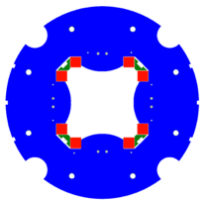
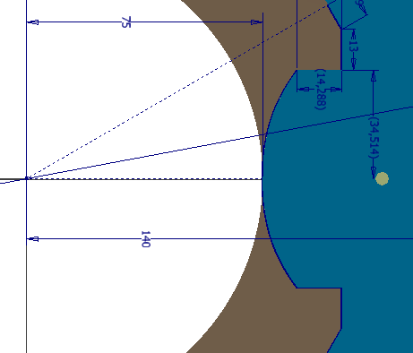
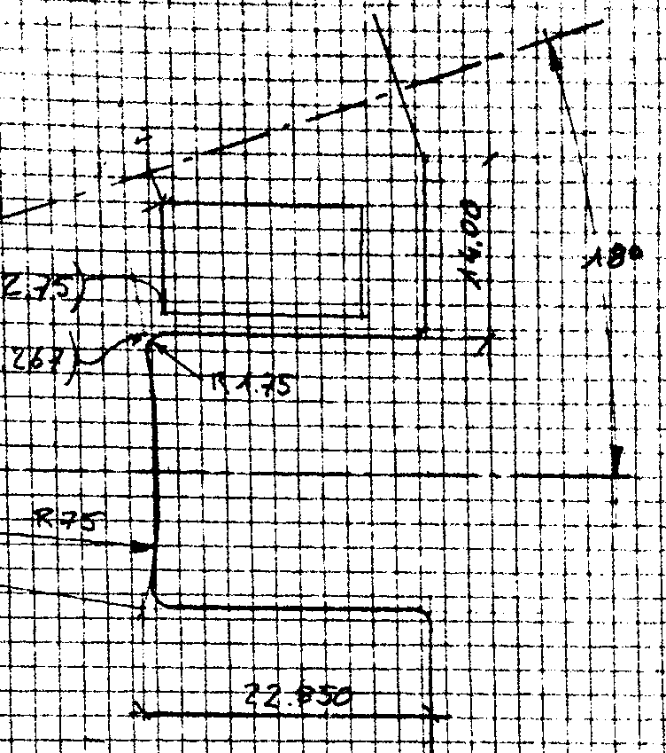
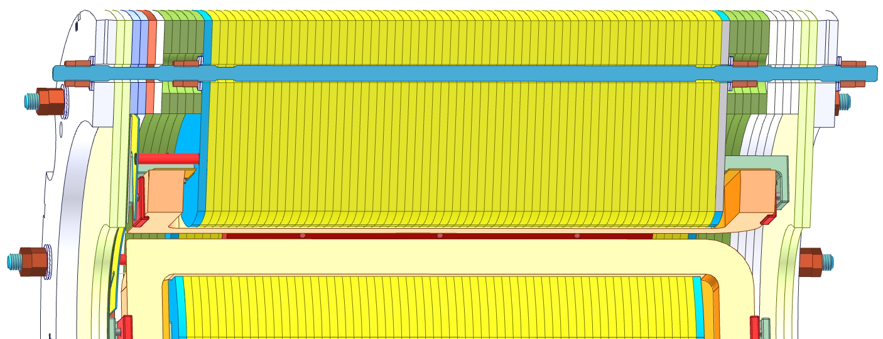
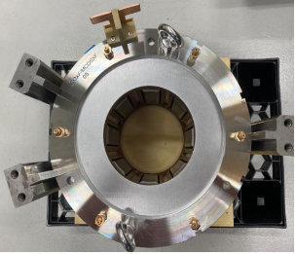
Mechanics
Alignment slots
pole shape
ARMCO laminations
- More than 3000 laminations
- machined by wire edm in&out profiles
- 8 geometries
End plates stainless steel
- Alignment slots
- Inner and outer diameter for beampipe alignment
CuBe tie rods
5 families
coils
modifed ideal
n= 2; 3
B
pole
ideal shape
ARMCO
iron
non magnetic
wedges
maximum area
n > 3
CuBe rod
flux return plates
pole
Racetrack coils
sketch by G. Volpini

Slide 5
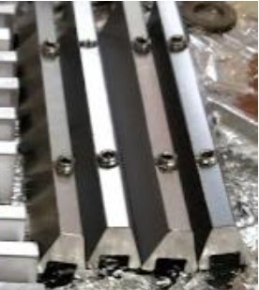
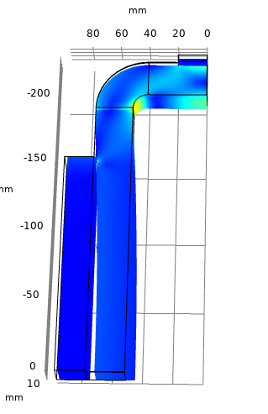
Force Management
Simplified models
Prepared by experts but useable by not experts
reducing the computation time and the time to answer questions
Example: update the wedges tolerances
and machining procedure during the
series production
Longitudinal prestress on iron
Avoid lamination movements during transpotation or installation
1D model
Two step prestress (pole and full magnet)
Prestress on coils
Partially supported
Longitudinal
  1D model
Wedges prestress
  Avoid coils movements/falling
  1D adn 3D model
Longitudinal support
coil
wedge
3D modelling of the coils for stress managenment
wedge
a.u.

Slide 6
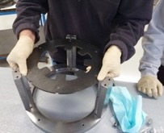
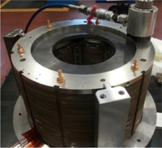
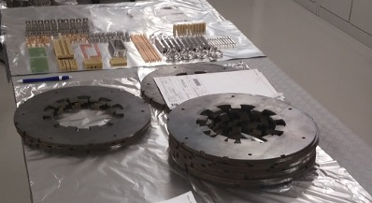
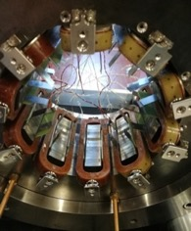
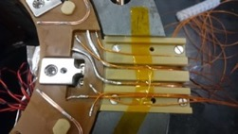
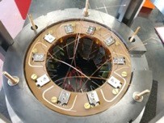
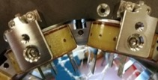
Assembly
lamination
Procedure developed at LASA on prototypes
6P, 8P, 10P assembled at LASA
Series magnets assembled in industry
Pole laminations
Inner CuBe rods-loading
Coils centering and fixing
Connections
Final laminations
Outer CuBe rods-loading
alignment frame
upper PCB
PCBs fixing
coil
bridge
lower PCB
CuBe rods
Longitudinal support
wedge

Slide 7
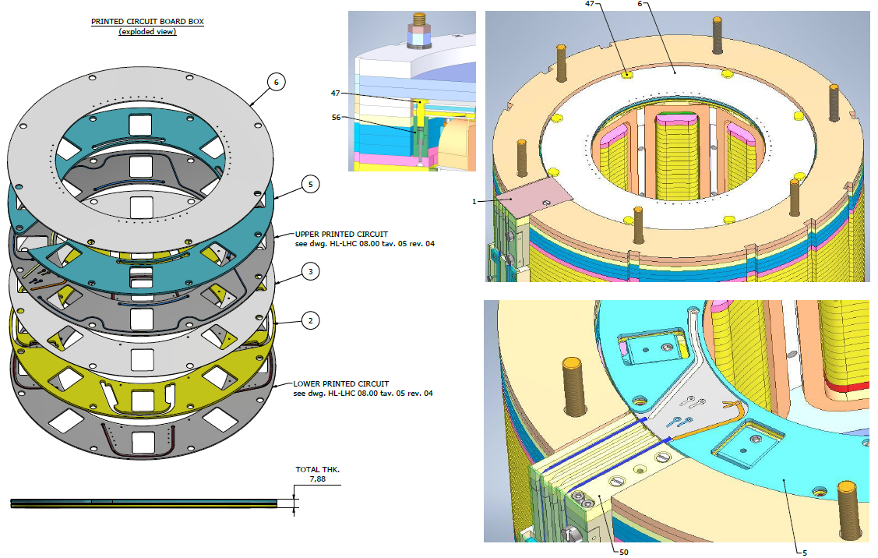
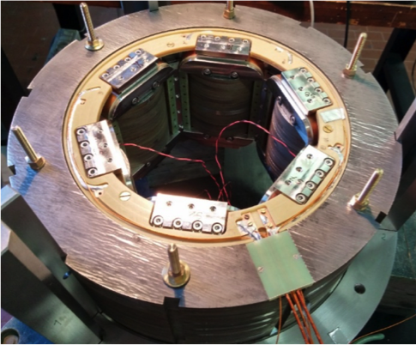
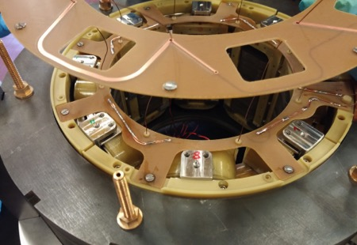
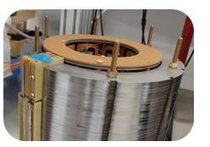
The Electrical Connections
The coils are connected in series
Duratron support disk
Printed Circuit Boards
Thin Cu on PCBs
PCB box
On duratron columns
Duratron disks
copper thick laminations (1 mm)

Slide 8
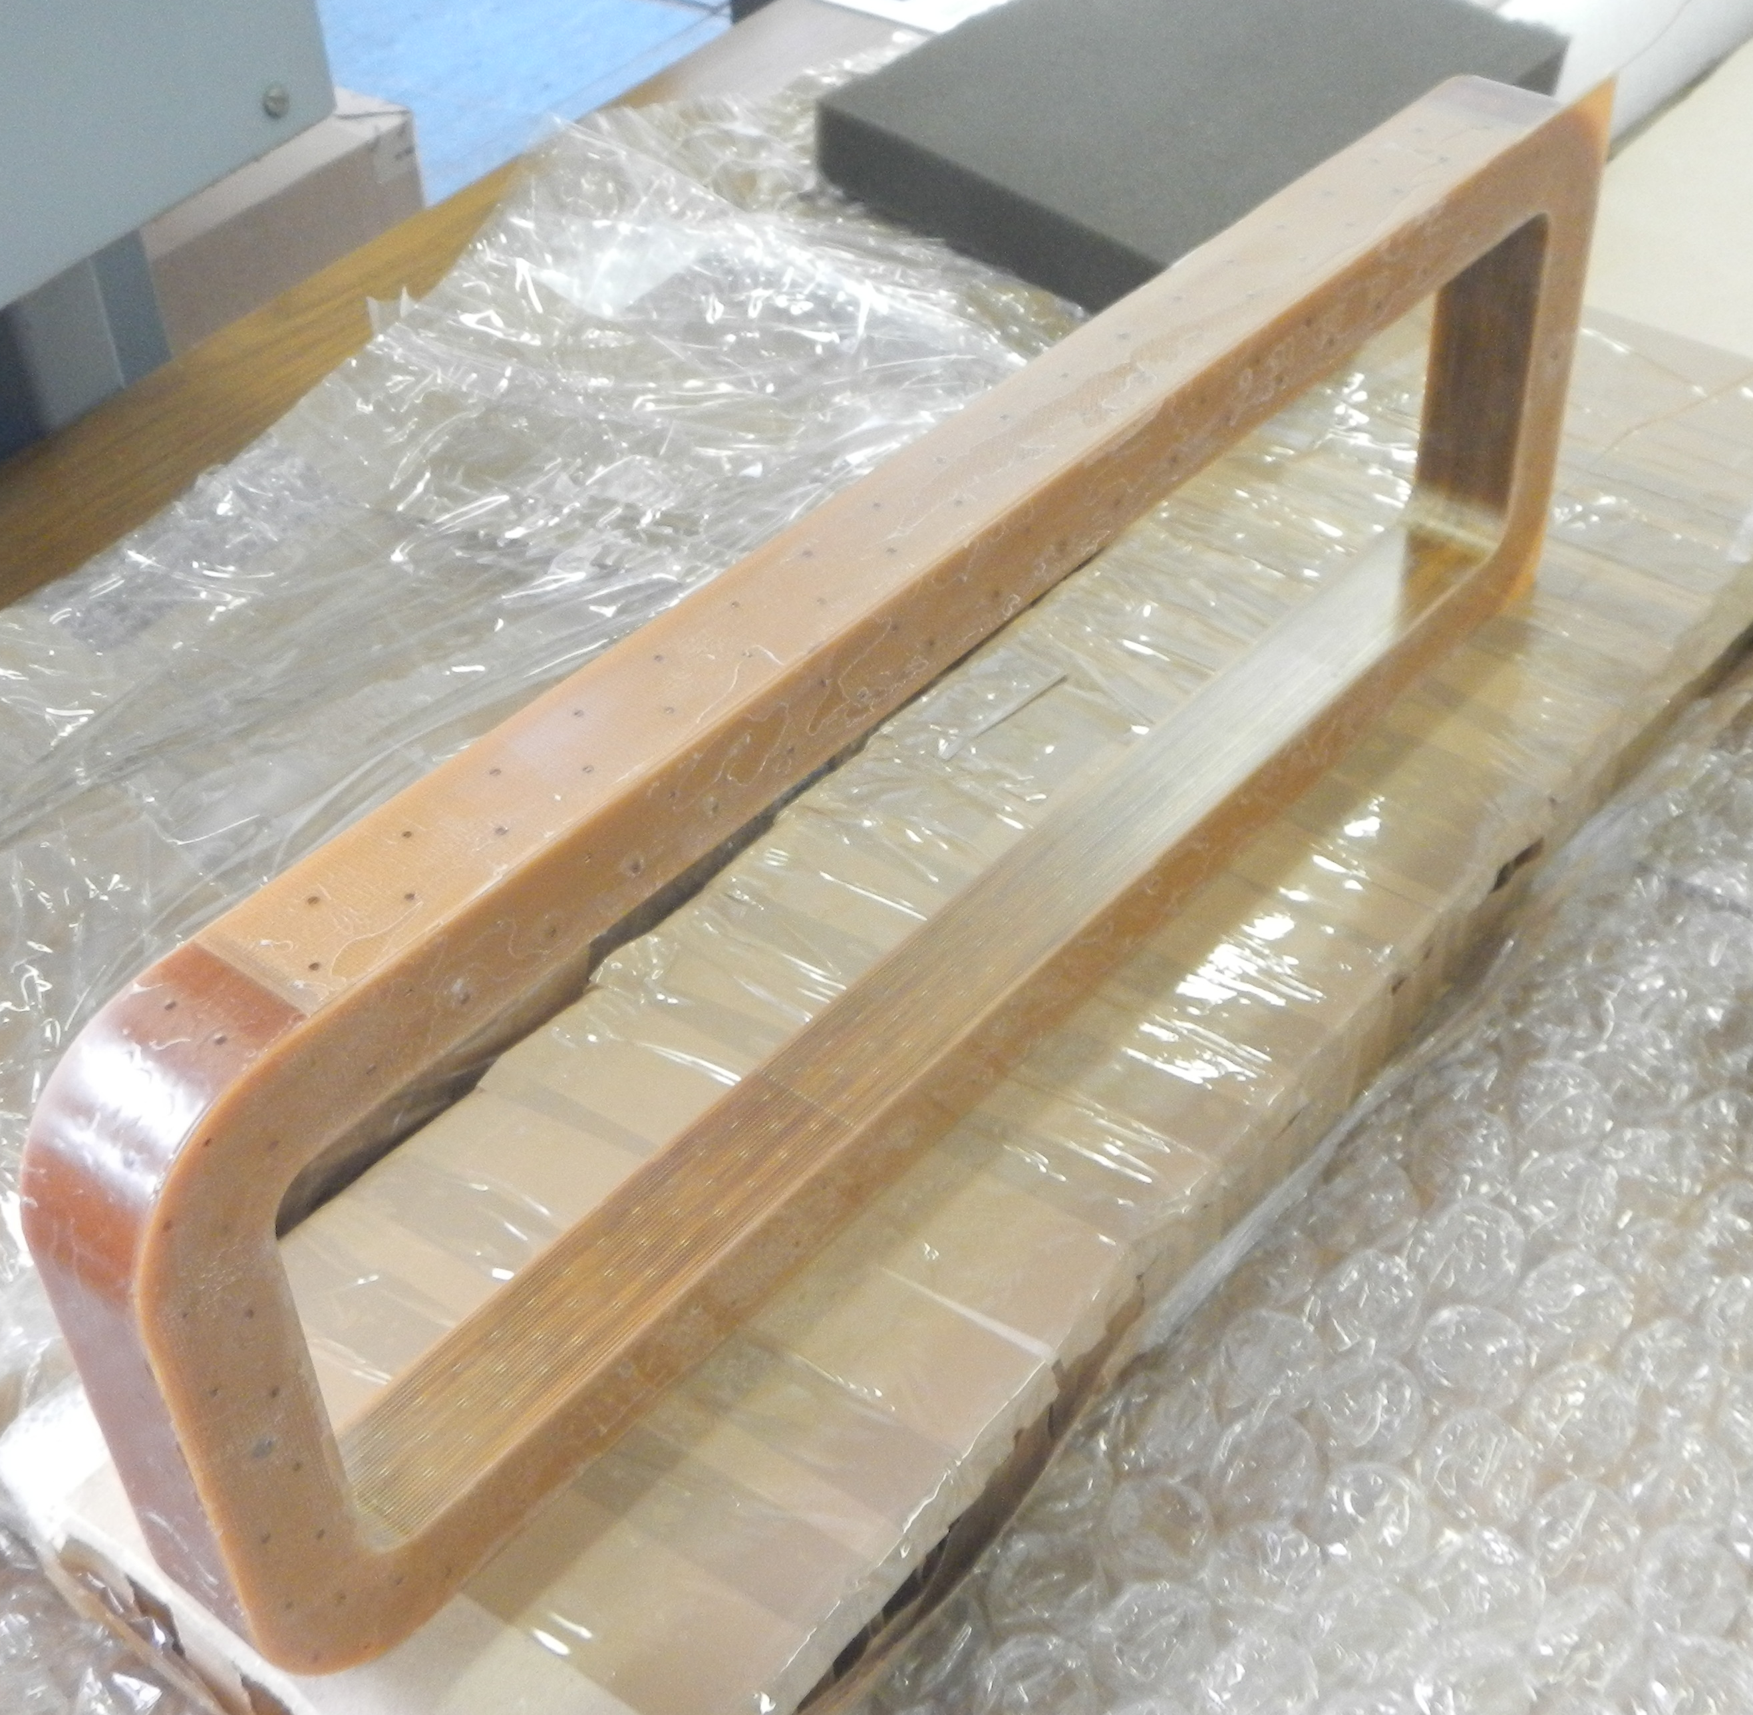
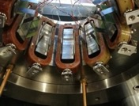
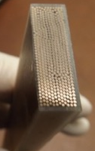
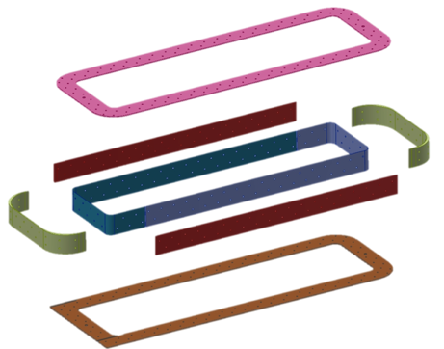
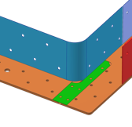
Coils
Racetrack, same design, but 6 families
Single wire up to 750 turns
External S2 reinforced material
Production learning curve in industry
QA at in industry during production
457 mm
130 mm
Machined from bulk
0.15 mm
sheet
498 mm
1.0 mm
1.5 mm
insert
out
in

Slide 9
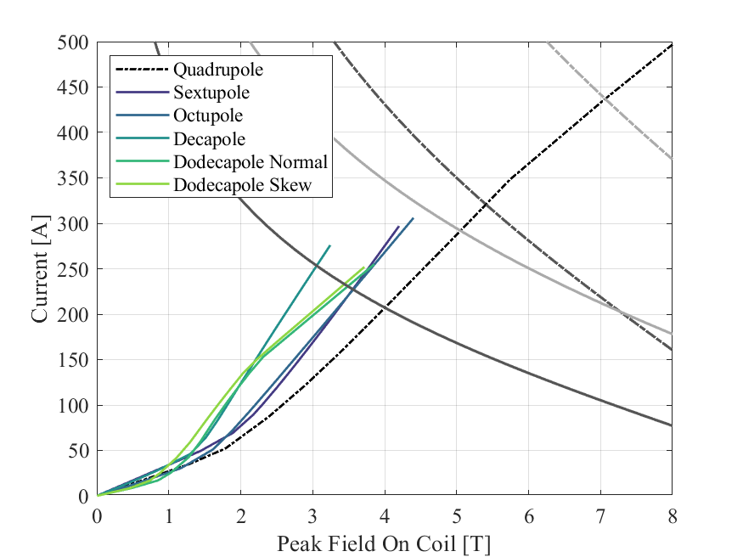
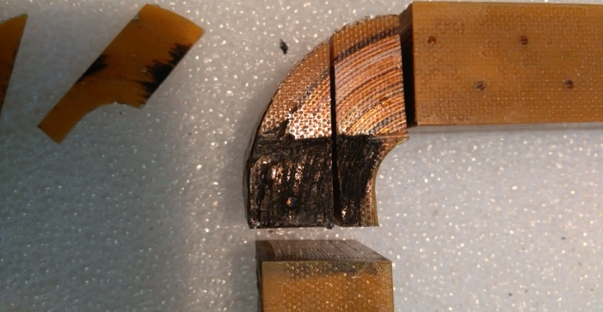
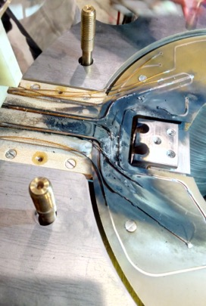
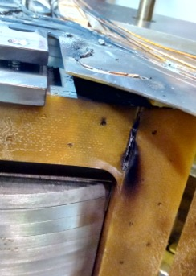
The Load Lines
What happens if something goes wrong?
0.7 mm @ 4.2 K
0.7 mm @ 1,9K
0.5 mm @ 1.9K
Working point of skew quadrupole
0.5 mm @ 4.2 K
Working point
6P, 8P and 10P may be installed as normal or skew
Many designs, one wire
Different designs, same protection scheme
Except for the skew quadrupole
Analysis by Sorbi-Prioli
Mitigation: input wire additional protection layer

Slide 10
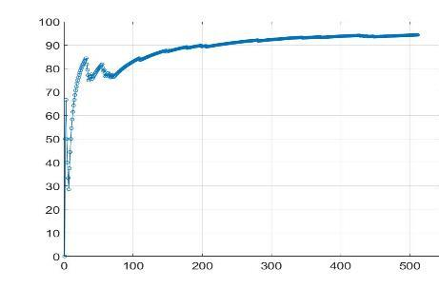
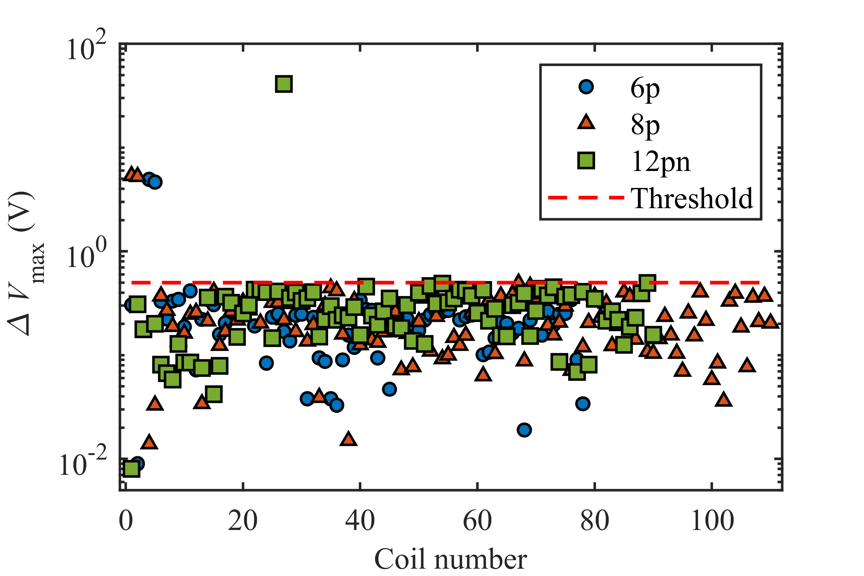
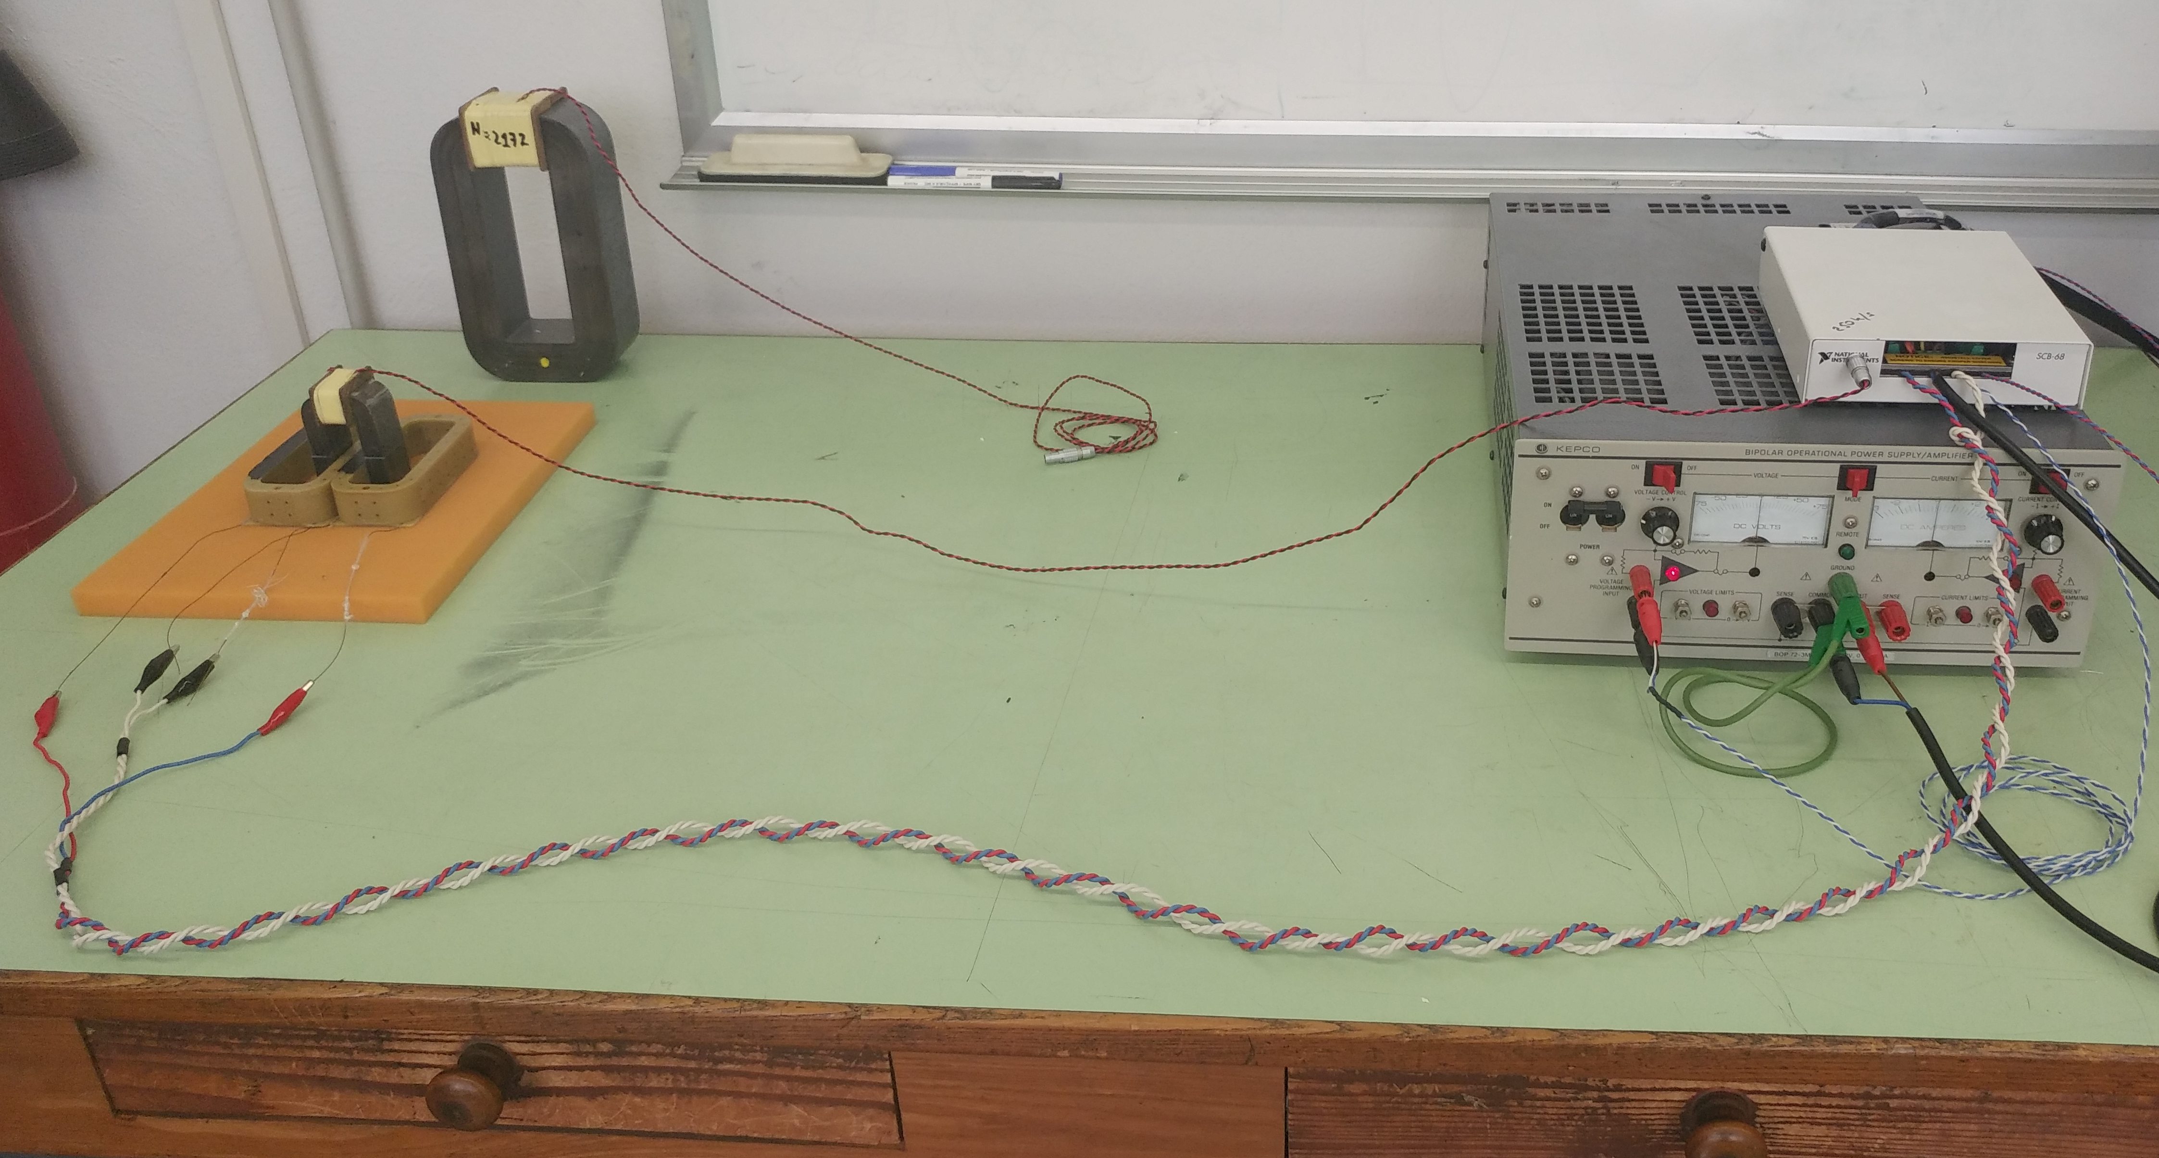
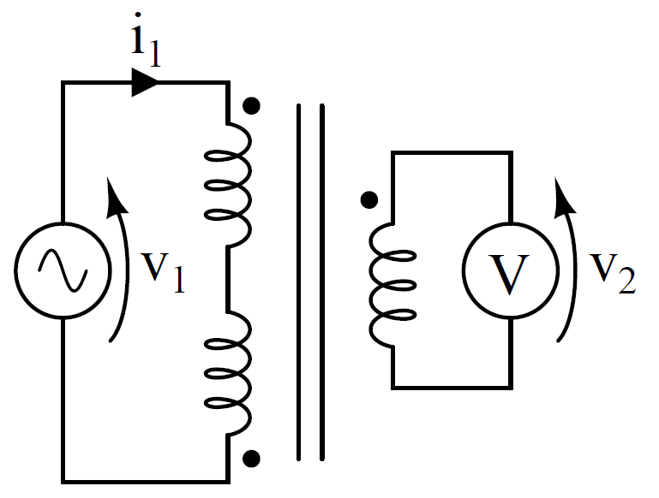
QC coils
Produced coils 508
29 NC (6%)
QC developed by LASA
Measurements in industry
The number of turns is checked through a custom measurement setup
Surge test at V0 = 2 kV to detect internal insulation defects
Voltage to ground tests
Mechanical dimensions
Learning curve
Percentage of conform coils vs produced coils
Inter-turn short
One turn less

Slide 11
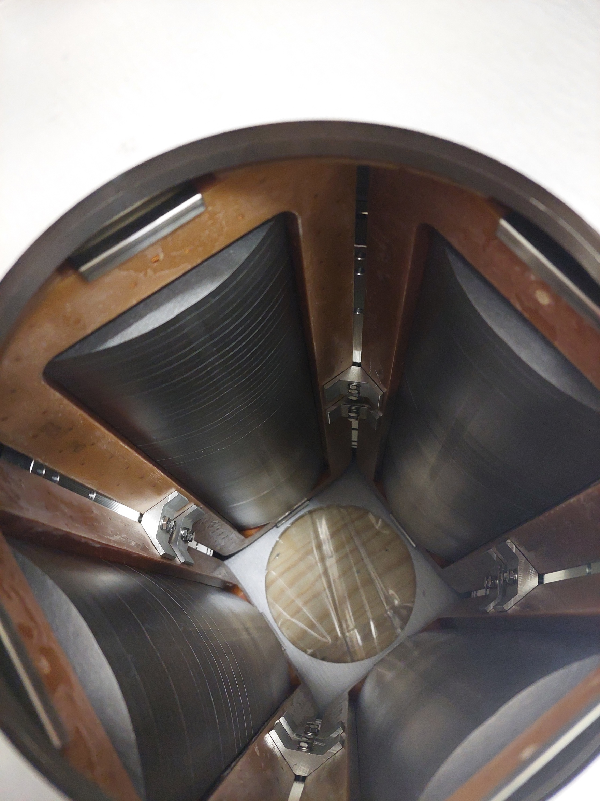
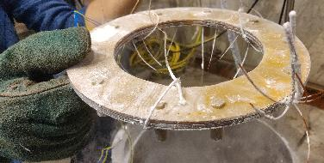
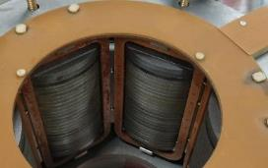
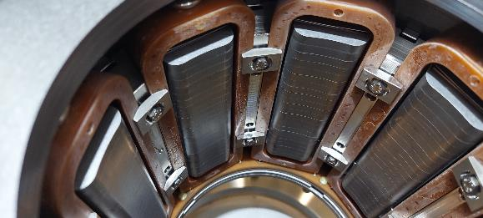
Major Design Iterations
50% ingrated field increment for 6P-8P-10P
  Requested by beam dynamic group
  Solved by flexibility (more pole laminations and longer coils) – 30% length increase
Wedges additional supports fixed by spring washers to improve wedges stability in octupoles and quadrupoles 4P and 8P
  In vertical tests some wedge unloads and moves
  The main (root) reason is friction during assembly (not fully manageable)
  Novel solution by additional supports and spring washers
Splices mechanical protection box
  Avoid shorts due to metallic chips in helium

Slide 12

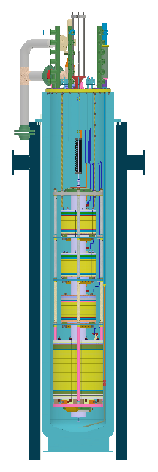
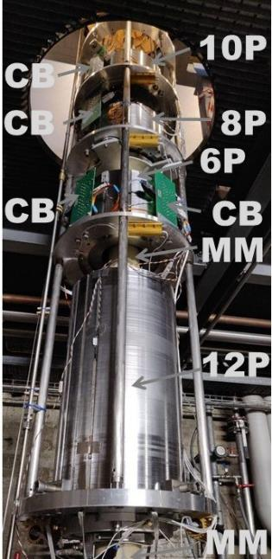
The Test Station at LASA
Four HO correctors cooled at 4.2 K
  Each magnet powered individually
  Magnetic Measurements
Power converter 600 A
  Dump resistance 1 Ω or 1.5 Ω
  IGBT polarity switch by LASA
  IGBT for quench protection
Field probe for the series by CERN
  Each magnet measured individually
  No cross talk

Slide 13
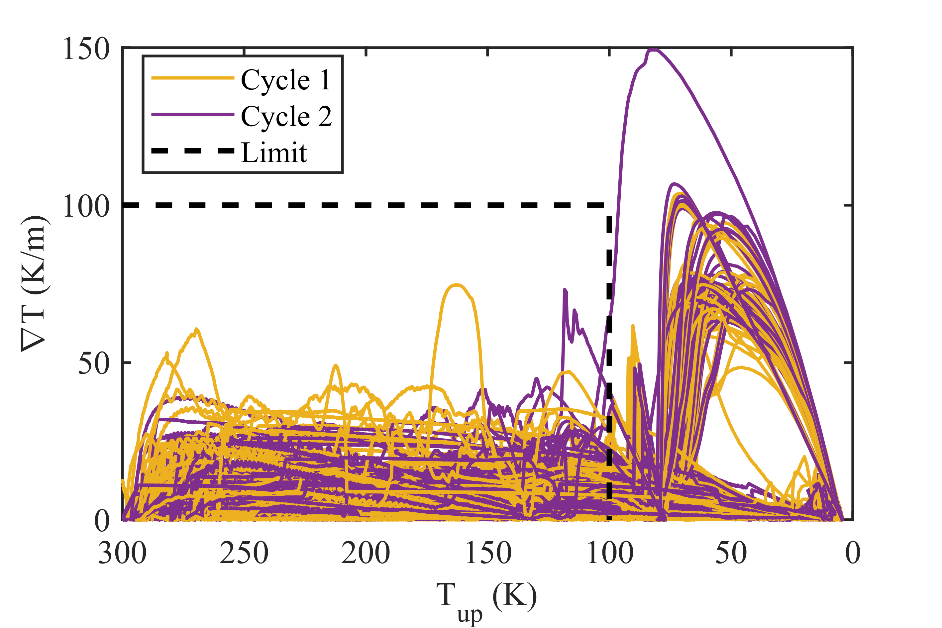
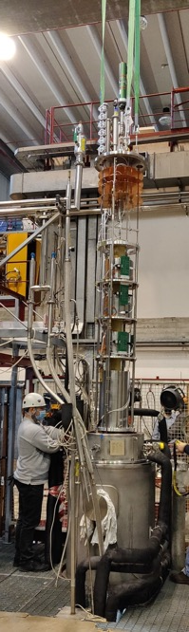
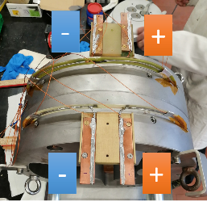
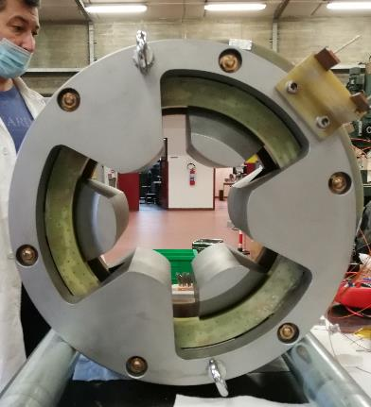
What Are We Testing?
Powering
Training (both polarities)
Endurance test 1h at ultimate
Magnetic field measurement
Field integral 1% to 3% wrt simulations
Field integral reproducibility <0.1%
Field quality high reproducibility
Transfer function very good agreement with simulations, high reproducibility
Quenched coil recostruction via Magnetic Measurements
96 Thermal cycles
Round Coil Superconducting Magnet
2 MgB₂ coils
Reached 230 A (1.5 I_{nom})
By R. Valente

Slide 14





















Training in Last 12 Months

Slide 15



Magnetic Measurements Example
Calculated
Reproducibility 0.2%
Allowed harmonics 100 U
Integrated field repeatibility 0.1% at nominal current
Second assembly repeatibility 0.05%(measured)
Integrated field simulated vs measured 2% or lower for all HO correctors
The measurement of the 12p was a challenge

Slide 16

Quenched Coil(s) Measurement
Superconductors get magnetized during operation due to the Persistent Screening Currents in the filaments of the conductors
Transition to normal resistive state cancel the magnetization
Quenched coils will not have residual magnetization
Post quench fourier analysis of the remnant magnetic field
S. Mariotto and M. Sorbi. SuST, 35(1):015006, nov 2021.
1
4
The system is able also to localize quench coils in multiple ways:
Shape of Flux is different
Harmonics Amplitude depends by:
  Number of quenched coils.
  Position of the coils.
Harmonic Phase combination reconstruct uniquely the different quenched coils
Multiple coils quench in quadrupole observed

Slide 17


Tested Magnets
Cooled magnets 59
Compliant magnets 50
Delivered to CERN 85%
MM all magnets except one
8@CERN and others @LASA
Last coils produced in July 2021
Last magnets produced in Oct 2021
@CERN
Tested
Produced
magnets
First series magnets (HL-LHC) delivered to CERN in March 21

Slide 18


Training History of Quadrupoles
Second assembly
Coils already trained
nominal current
49%
20%
15%
ampere
ampere
Half quenches above nominal current
Most quenches are coil training
event number

Slide 19


Integration and Dissemination
Mechanical integration Assembly in building 180, CERN by H. Prin
9 correctors alligned
beampipe
by E. Todesco
Dissemination (prototypes and series)
15 poster/oral at congress (Magnet Technology – Applied Superconductivity Conference – International Particle Accelerator Conference – Società Italiana di Fisica)
2 Master Thesis
1 PhD Thesis

Slide 20
CONCLUSIONS
The D2 design choices has been assessed by the successful tests of the short model and prototype.
Considering that between the prototype and the series we had to intervene with some additional modifications, the first magnet in the series is considered as a pre-series(with all the characteristics complying with D2 requirements for use in the HL-LHC).
The construction of the first magnet of the series has started in July 2022, and the series is planned to be completed by the end of 2024.
The design of the HL-LHC High Order Correctors is solid
Construction of 54 HO Correctors in industry
All HOC are powered at cold, 85% delivered to CERN, testing ends in few weeks
The results are very reproducible for each family with a good agreement with simulations
An innovative quench recostruction method has beed developed
The integration in the first cold mass started
D2 and the HO Correctors are not on the critical path of HL-LHC.

Slide 21
THANK YOU

