Slide 1



SECONDA GIORNATA ACCELERATORI, INFN-LNS, Catania
[MICRON] Opportunità e Applicazioni di strutture acceleranti miniaturizzate
metalliche (banda Ka) e dielettriche (ottiche)
Luigi Faillace (INFN-LNF), Giuseppe Torrisi (INFN-LNS)
on behalf of MICRON collaboration
MIniaturised aCceleRatOrs Network
μICRON

Slide 2
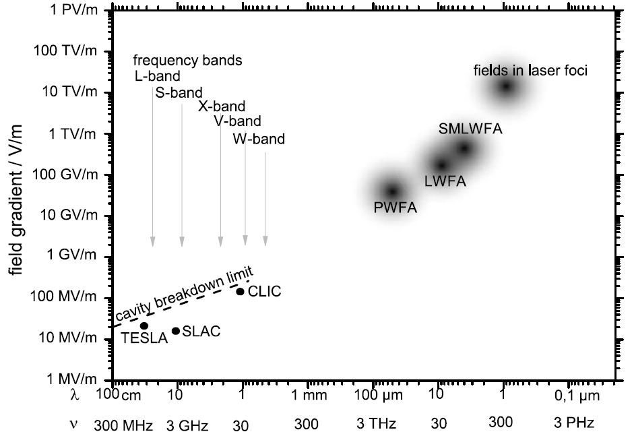
MAIN GOAL
High gradients innovative accelerating structures enable miniaturized particle accelerators
schematic overview of the accelerating gradient for different
types of accelerators
TARGET OF THE PROSAL
Accelerating Gradient: ~ 100 MV/m - 2 GV/m
laser-plasma interaction

Slide 3
MAIN GOAL
High gradients innovative accelerating structures enable miniaturized particle accelerators
schematic overview of the accelerating gradient for different
types of accelerators
TARGET OF THE PROSAL
Accelerating Gradient: ~ 100 MV/m - 2 GV/m
Metallic Structure from Ka to W-band (35-200 GHz, mm-wavelength)
laser-plasma interaction
2) Dielectric Laser Accelerator (DLA) structures operating at optical wavelengths (~ 1- 5 µm)

Slide 4
MAIN GOAL
High gradients innovative accelerating structures enable miniaturized particle accelerators
schematic overview of the accelerating gradient for different
types of accelerators
TARGET OF THE PROSAL
Accelerating Gradient: ~ 100 MV/m - 2 GV/m
Metallic Structure from Ka to W-band (35-200 GHz, mm-wavelength)
laser-plasma interaction
2) Dielectric Laser Accelerator (DLA) structures operating at optical wavelengths (~ 1- 5 µm)
on-chip optical-wavelength
DLA
metallic
mm-wave LINAC

Slide 5
MAIN GOAL
High gradients innovative accelerating structures enable miniaturized particle accelerators
schematic overview of the accelerating gradient for different
types of accelerators
TARGET OF THE PROSAL
Accelerating Gradient: ~ 100 MV/m - 2 GV/m
Metallic Structure from Ka to W-band (35-200 GHz, mm-wavelength)
laser-plasma interaction
2) Dielectric Laser Accelerator (DLA) structures operating at optical wavelengths (~ 1- 5 µm)
on-chip optical-wavelength
DLA [1]
metallic
mm-wave LINAC
THz-driven
DLW LINAC [2,3]
[1] R. Joel England et al., Rev. Mod. Phys. 86, 1337-2014
[2] E. Nanni, et al., Nat Commun 6, 8486 (2015).
[3] F. Lemery, et al.” Commun Phys 3, 150 (2020).

Slide 6


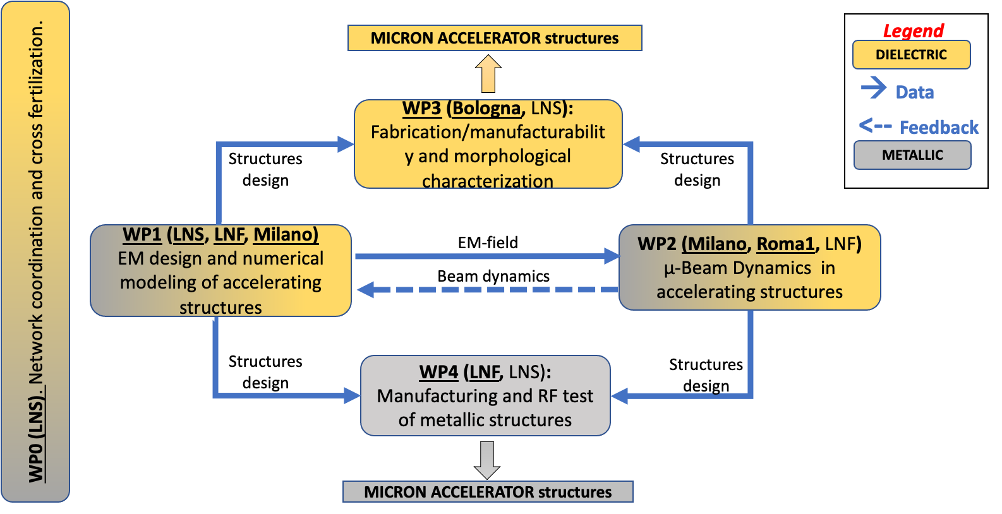

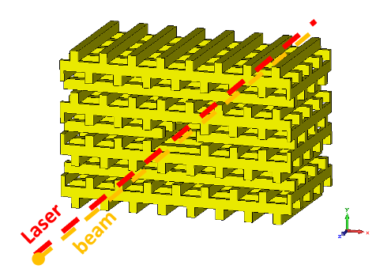

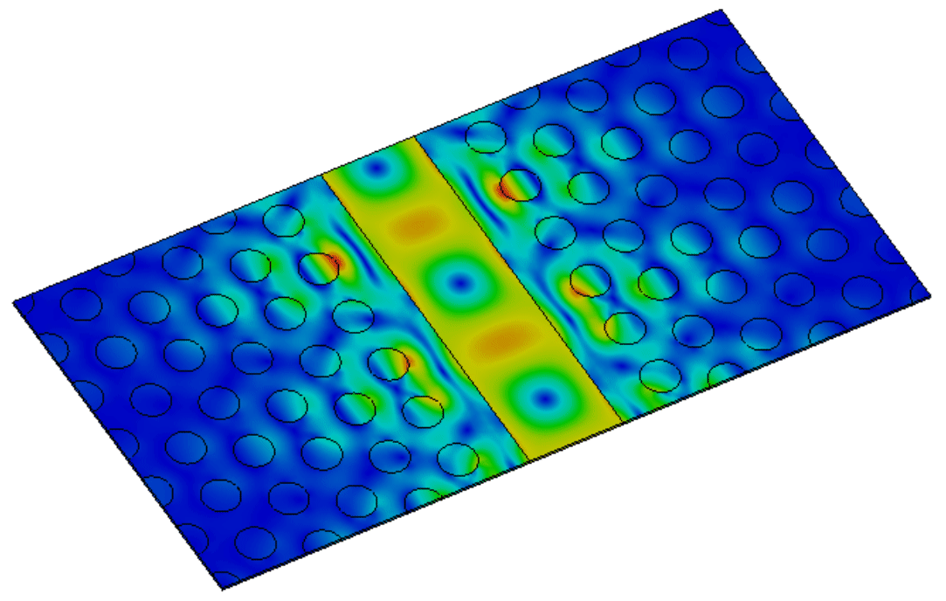


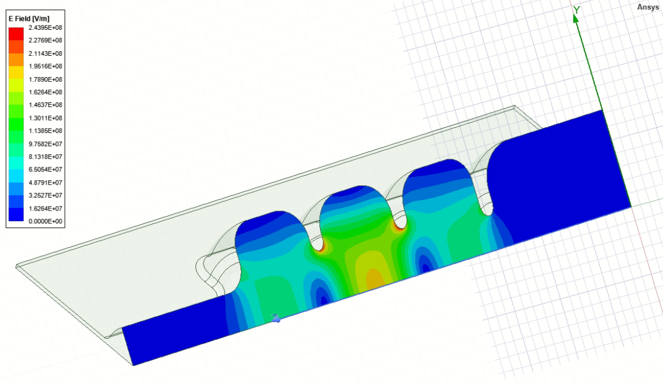

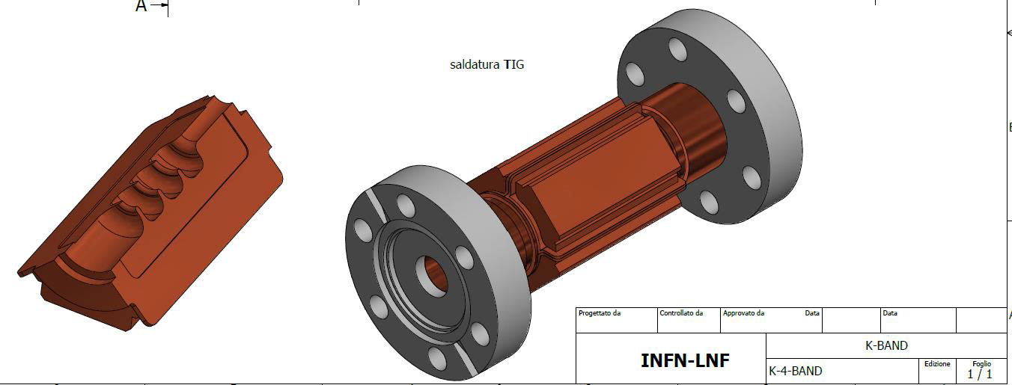
MIniaturised aCceleRatOrs Network (MICRON)
Design and Prototyping of high gradient dielectric and metallic accelerating structures
Ka-band accelerating structures

Slide 7

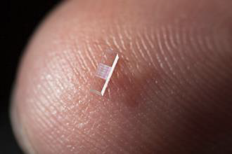
Dielectric Laser Accelerator (DLA)
advantages, recent results, possible applications and limitations
Notes:
straight to the point

Slide 8
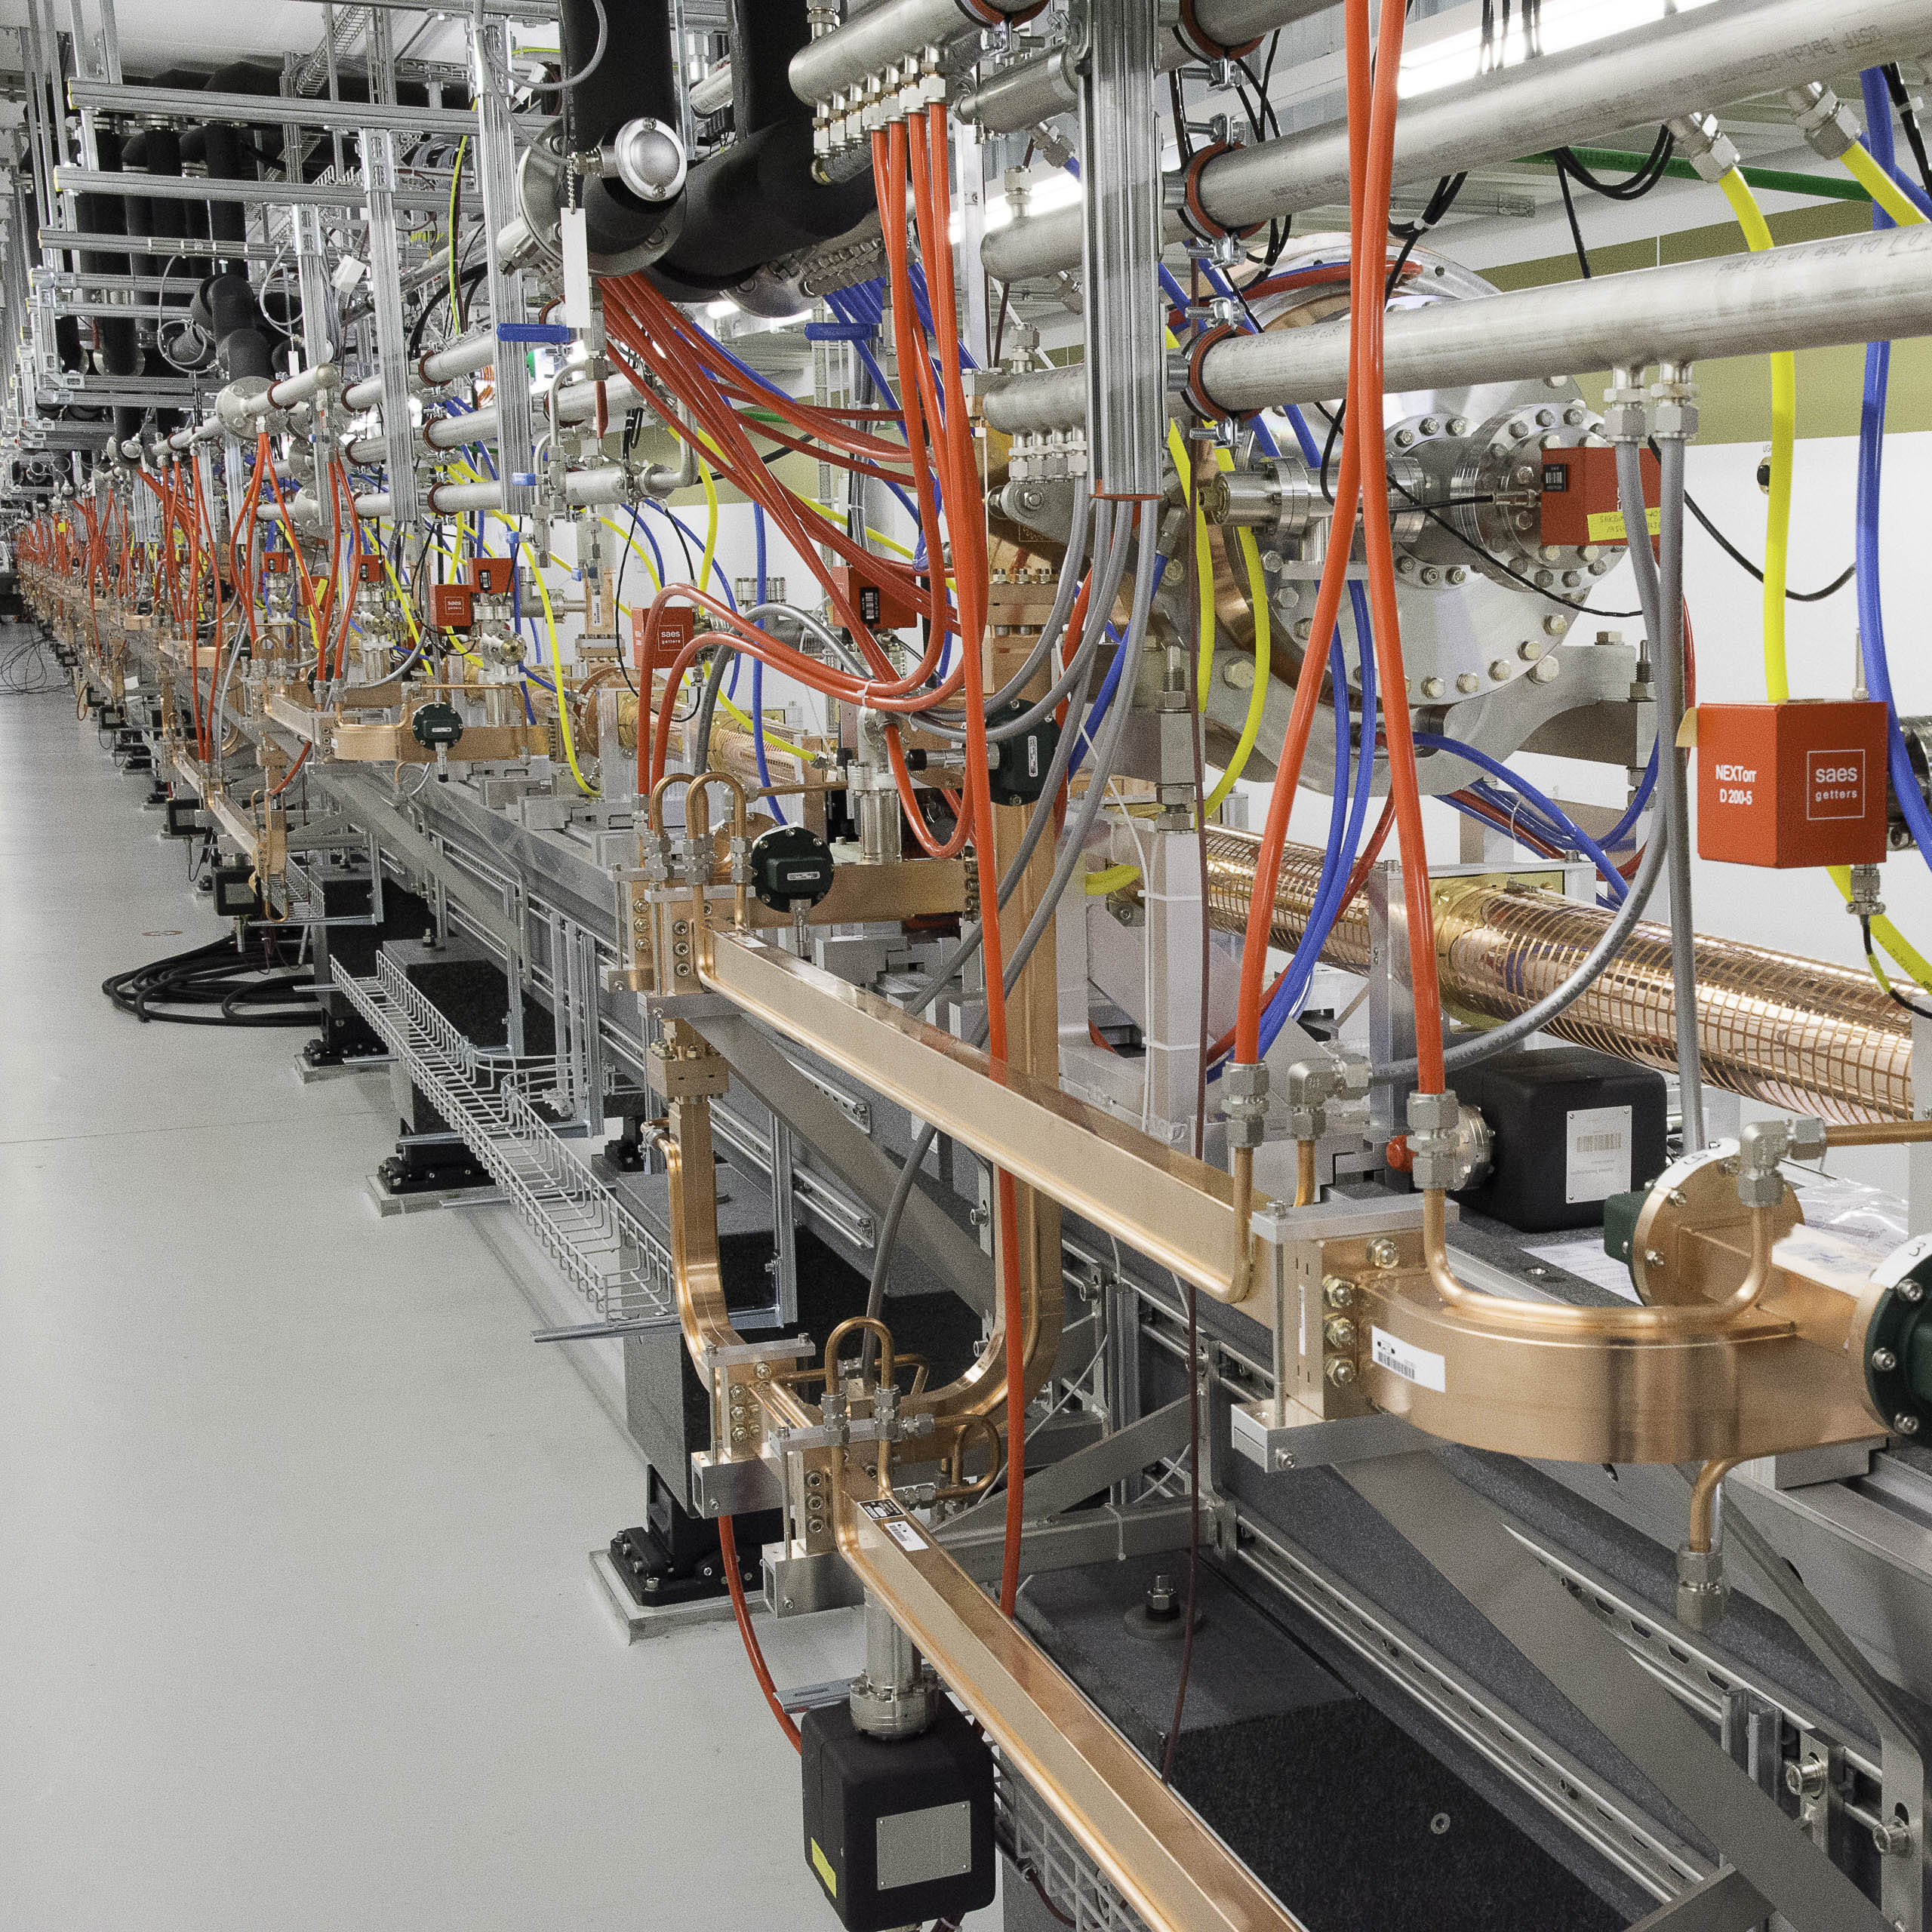
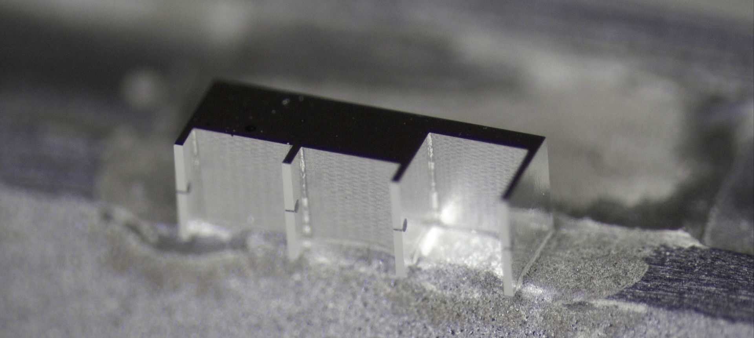
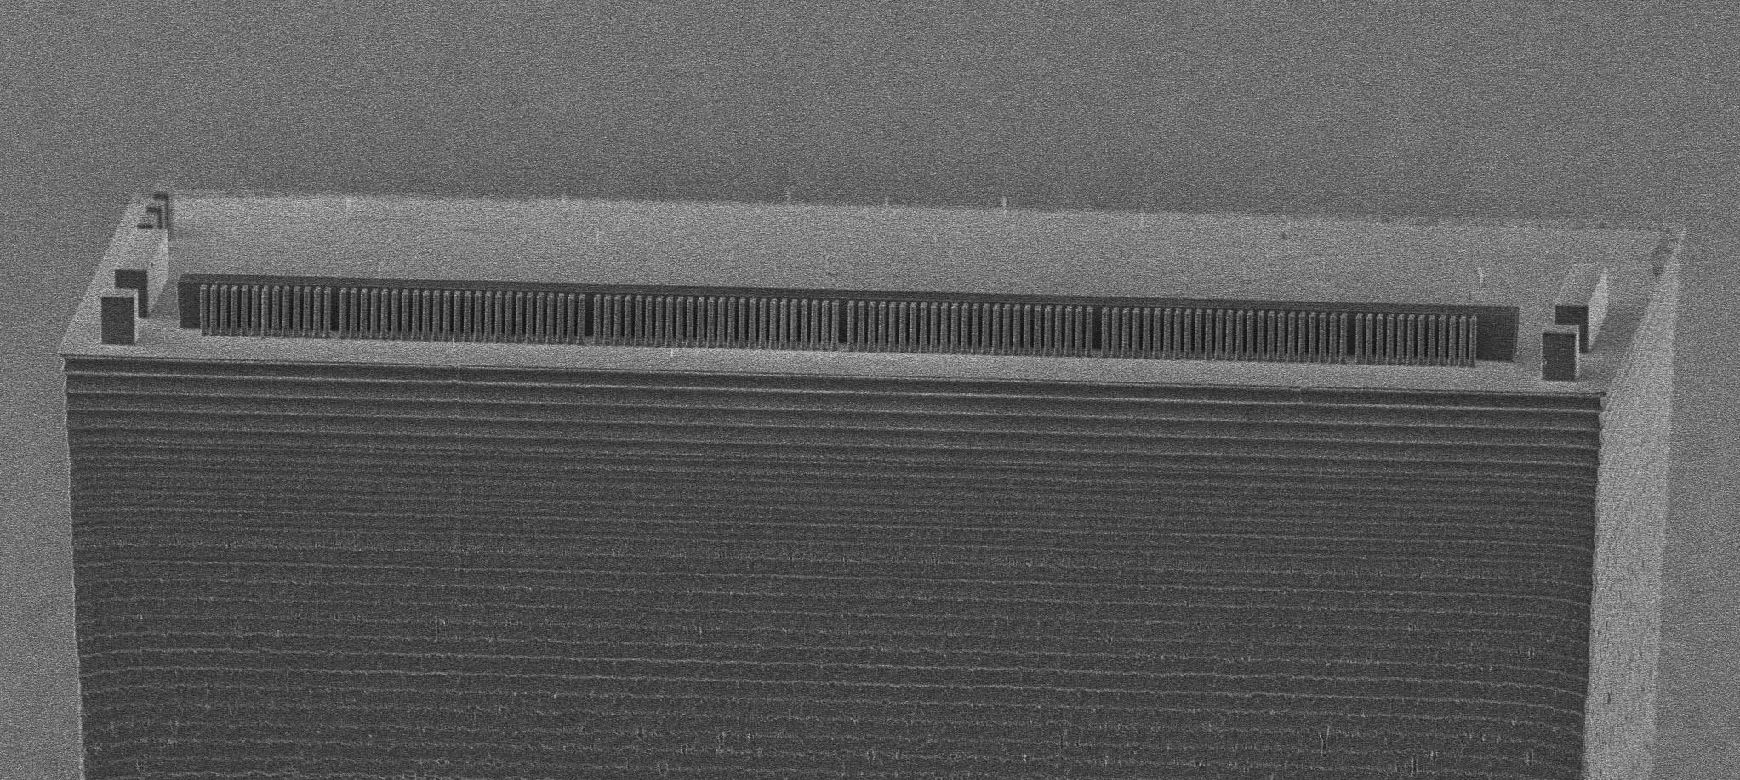
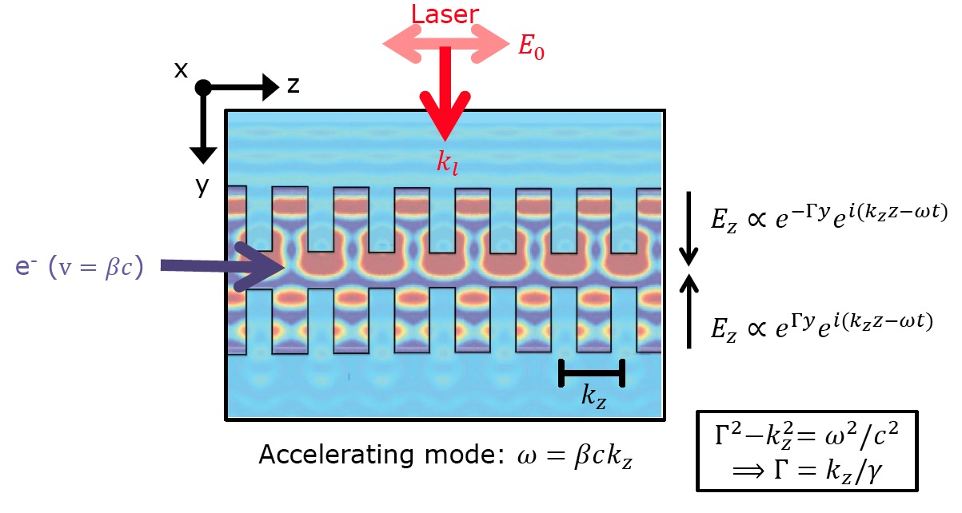
From Radio Frequencies to Infrared Light
Simple idea: Use scale-invariance of Maxwell equations and shrink down size of particle accelerators by 4 orders of magnitude.
Replace RF power (cm-wavelength) with laser (um-wavelength)
Material properties are frequency dependent -> dielectrics
Beam dynamics challenges
DLA typical parameters
[Rasmus Ischebeck, Structure-based accelerators (e.g. ACHIP) and advanced radiation generation schemes, talk @the 2022 EuroNNAc Italy 18- 24 September 2022] [https://agenda.infn.it/event/28376/contributions/178676/
Parameter | RF | DLA
Power Source | Klystron | laser
Wavelength | 2-10 cm | 1-10 µm
Bunch Length | 1-5ps | 10-100 as
Bunch Charge | 0.1- 4 nC | 1-10 fC
Norm. Emittance | 0.1-1 µm rad | 1-10 nm rad
Rep Rate | 1-1000 Hz | 100 MHz
Material | Metal | Dielectric
Unloaded Gradient | 10-50 MV/m | 1-10 GV/m
DLA Operating Principle
Notes:
Transparent laser-driven nanoscale dielectric structures whose near fields can synchronously accelerate charged particles
In dielectric laser acceleration, electrons traverse nanostructured dielectric geometries, gaining energy via interaction with laser-induced accelerating fields9,15-19. These fields are generated by imprinting a periodic spatial modulation to the perpendicularly incident laser wavefront that matches the periodicity of the structure and leads to optical near-field modes travelling along the structure surface (see Figure 1). Electrons with a velocity matching the phase velocity of one of the surface modes are accelerated if injected at an appropriate phase. Notably, DLAs are based on a vacuum scheme, similar to RF accelerators, and the imparted energy gain scales linearly with the incident optical field strength, presenting clear advantages over nonlinear acceleration schemes requiring matter20-21.

Slide 9
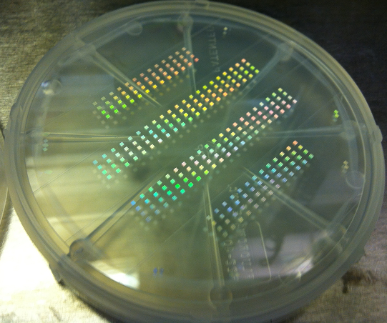
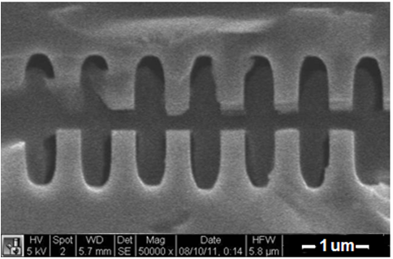
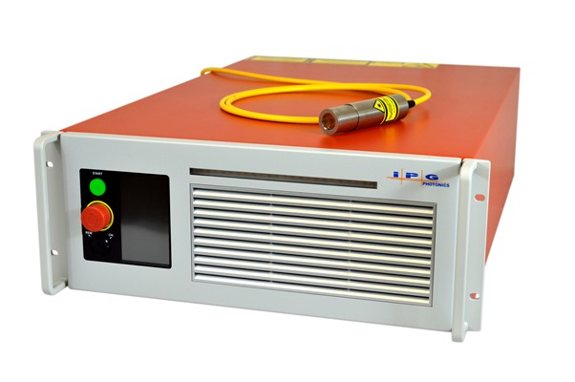
DLA leverages advances in two major areas: solid state lasers + semiconductor fabrication
Me & My Lab
DLA
Co-prop. schemes
Conclusions
Not high peak power lasers!
Fabricated using techniques of the integrated circuit industry.
Parameter | DLA Value
Wavelength | 2 µm
Pulse Duration | 100 fs
Pulse Energy | µJ – mJ
Laser Power | 100 W
Rep Rate | 100 MHz – KHz
Laser Efficiency | 30%
Cost/laser | $200k
[Pietro Musumeci, Accelerator on a chip program overview invited talk @ EuroNNAc La Biodola Bay, Isola d'Elba, Italy 18- 24 September 2022] https://agenda.infn.it/event/28376/contributions/179636/
SEM images of DLA prototypes
Available now
“off the shelf”
fused silica
silicon
Solid-state laser

Slide 10
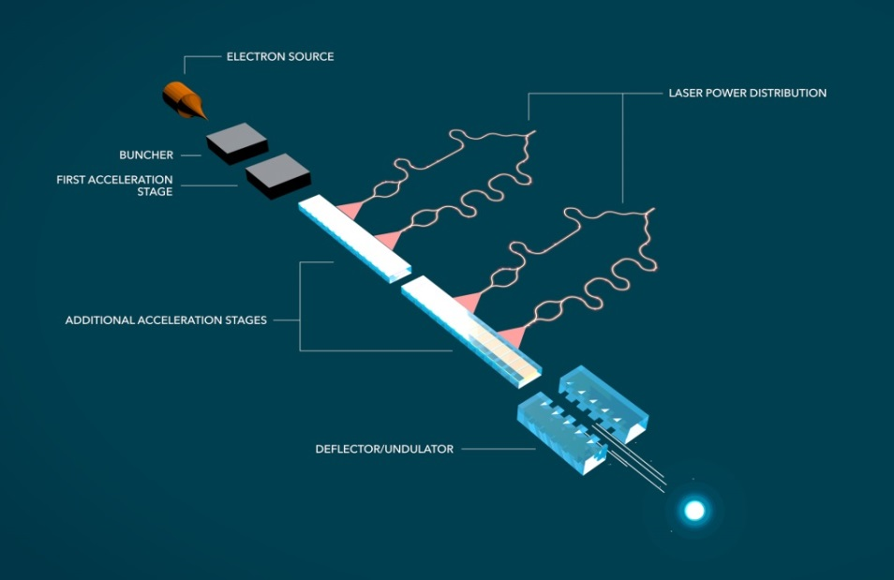





Overview of a Dielectric Laser Accelerator final concept design
Hirano et al., “A compact electron source for the dielectric laser accelerator”, Appl. Phys. Lett. (2020)
Schonenberger et al., “Generation and Characterization of Attosecond Microbunched Electron Pulse Trains via Dielectric Laser Acceleration”, Phys. Rev. Lett. 123, 264803 (2019)
Black et al., “Net Acceleration and Direct Measurement of Attosecond Electron Pulses in a Silicon Dielectric Laser Accelerator”, Phys. Rev. Lett. (2019)
Niedermayer et al., “Three Dimensional Alternating-Phase Focusing for Dielectric-Laser Electron Accelerators”, Phys. Rev. Lett., 125, 164801 (2020)
Sapra et al., “On-chip integrated laser-driven particle accelerator”, Science, 367, 6473 (2020)
From SLAC newsroom: “$13.5M Moore Grant to Develop Working ‘Accelerator on a Chip’ Prototype” (November 19, 2015)
Notes:
Aim to achieve entirely on-chip electron source to relativistic electron
So far, each step is being researched independently
Relativistic regime demonstration remains critical to demonstrate scalable accelerator
This is a quick overview of the final concept design of a Dielectric Laser Accelerator. The idea is that you have an entirely on chip electron source by way of nanotips, then a buncher and first accel stage. The buncher and first accel are separated because in the non-relativistic regime maintaining the laser field in sync with the electrons as they swiftly accelerate is extremely difficult. In fact, the part of ACHIP tasked with pursuing this regime is aiming for energy doubling within the next year, from around 100 to 200 keV, but this will merely be a proof of concept for future non-relativistic work. After this, the relativistic regime will require a complex waveguide system to allow power distribution to the accelerator structure. The actual relativistic acceleration component is the subject of this presentation, but research into power distribution is also ongoing.
In Practice, the relativistic structures we are going to talk about today are mostly dual grating structures, illuminated on top by a pulse front tilted IR laser. This PFT provides the necessary phase velocity matching, such that a slice of the electrons travelling through the structure will feel the effects of the laser pulse. These structures tend to be judged by their total energy gain, their ability to couple the incoming laser power to the electron acceleration, and finally when dynamic effects come into play, by their capture rate.

Slide 11
Overview of a Dielectric Laser Accelerator final concept design
Hirano et al., “A compact electron source for the dielectric laser accelerator”, Appl. Phys. Lett. (2020)
Schonenberger et al., “Generation and Characterization of Attosecond Microbunched Electron Pulse Trains via Dielectric Laser Acceleration”, Phys. Rev. Lett. 123, 264803 (2019)
Black et al., “Net Acceleration and Direct Measurement of Attosecond Electron Pulses in a Silicon Dielectric Laser Accelerator”, Phys. Rev. Lett. (2019)
Niedermayer et al., “Three Dimensional Alternating-Phase Focusing for Dielectric-Laser Electron Accelerators”, Phys. Rev. Lett., 125, 164801 (2020)
Sapra et al., “On-chip integrated laser-driven particle accelerator”, Science, 367, 6473 (2020)
MIniaturised aCceleRatOrs Network
MICRON
From SLAC newsroom: “$13.5M Moore Grant to Develop Working ‘Accelerator on a Chip’ Prototype” (November 19, 2015)
Notes:
Aim to achieve entirely on-chip electron source to relativistic electron
So far, each step is being researched independently
Relativistic regime demonstration remains critical to demonstrate scalable accelerator

Slide 12
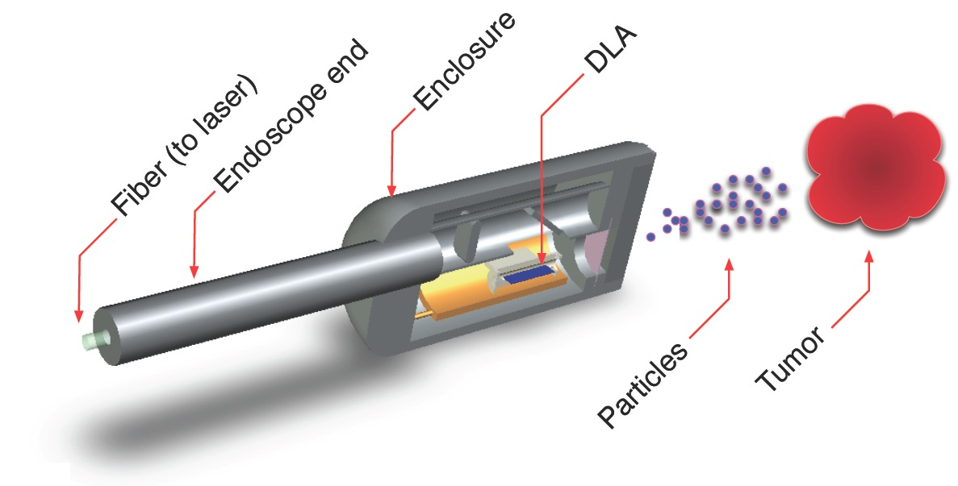
DLA APPLICATIONS and potential areas of scientific interest
Me & My Lab
DLA
Co-prop. schemes
Conclusions
APPLICATION | FIELD | TIME-SCALE
Compton X-ray Source | Medical | Mid
Catheterized Electron Source | Medical | Mid
Proton/Hadron Therapy | Medical | Long
Low-power EUV for inspection | Medical | Long
Linear Collider | HEP | Long
Micro-beams for radiobiology | Science | Near
UED/UEM Source | Science | Near
Compact XFEL | Science | Long
Multi-Axis Tomography | Science | Long
Colliding Beam Fusion
High energy physics
Radiation generation
Electron diffraction and imaging
NEAR TERMS applications as stepping stones
England et al., Rev. Mod. Phys. 86, 1337 (2014)
Notes:
• Nano- or micro-beam for radiobiology and radiation chemistry
• Ultrafast electron diffraction, X-ray pulses at sub-fs time scales
ultrafast science (molecular movies, atomic physics).
Compact, portable scanners for security (Nuclear Fluorescence), phase contrast imaging and medicine.

Slide 13
MIniaturised aCceleRatOrs Network
MICRON
Design (EM&BD) and fabrication/fabricability of
“Copropagating” schemes for DLA (Photonic Crystal-based structures)
as a possible path towards MeV energy gain

Slide 14
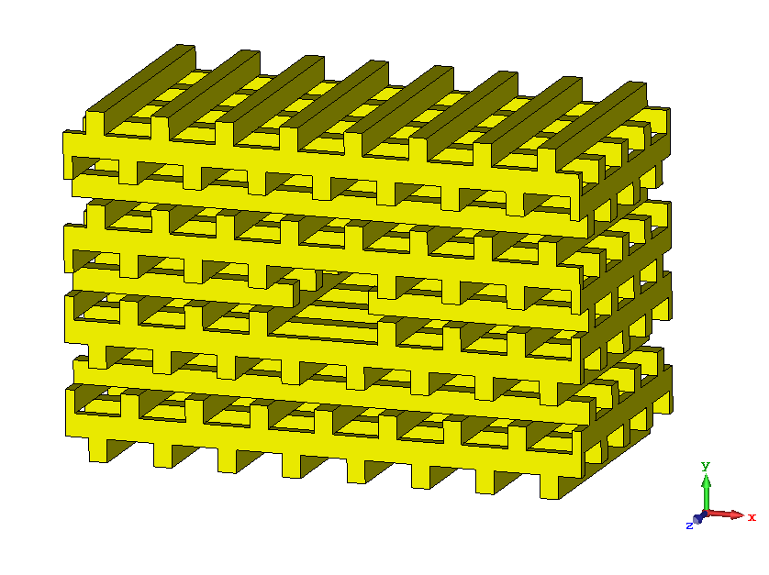
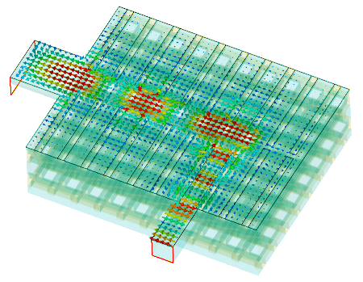
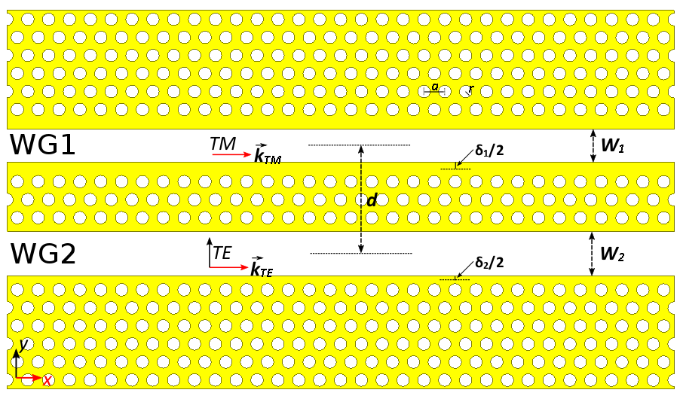
Copropagating schemes for Dielectric Laser Accelerators
What we mean for Copropagating?
Copropagating/Collinear schemes
vs
Cross-propagating schemes
Laser
Laser
beam
beam
beam
Laser
Laser
beam
Laser
beam

Slide 15
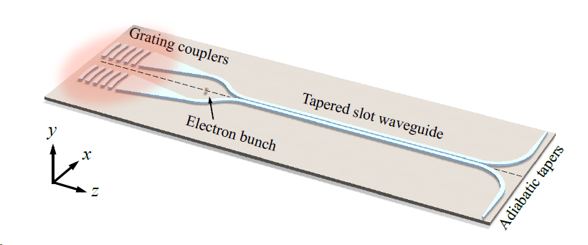
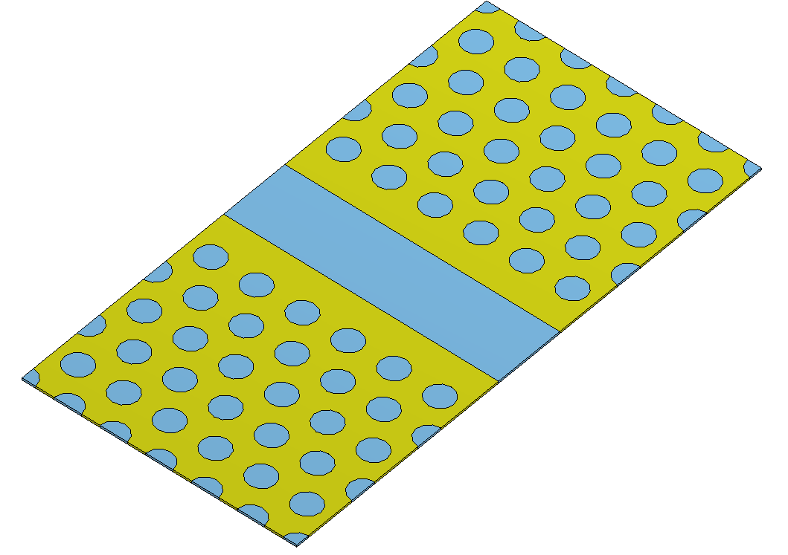
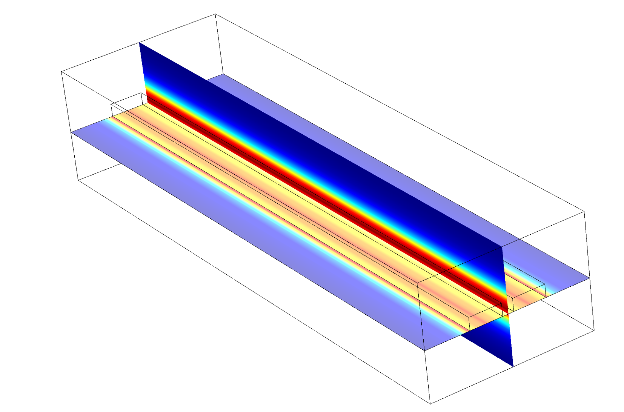
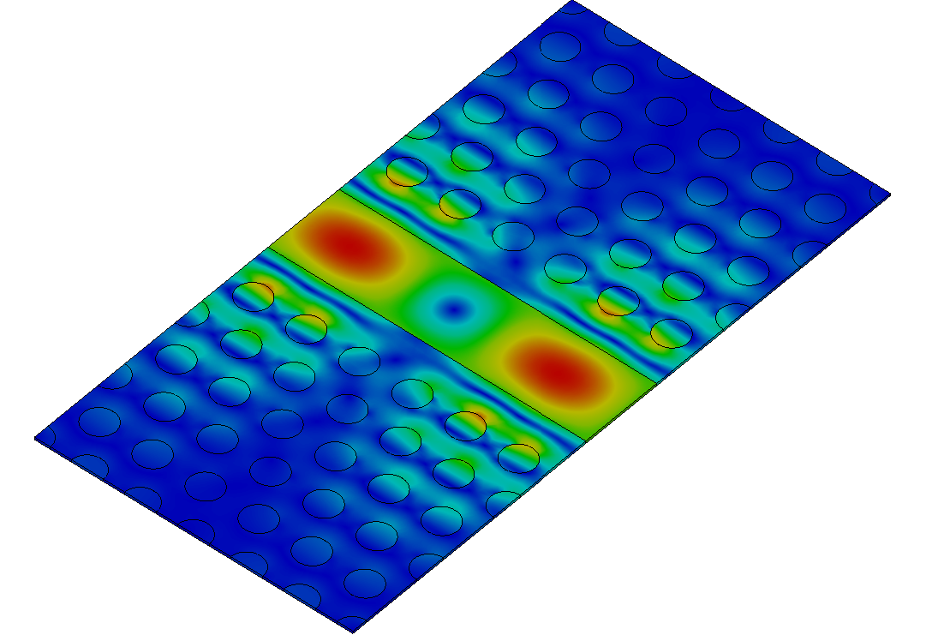
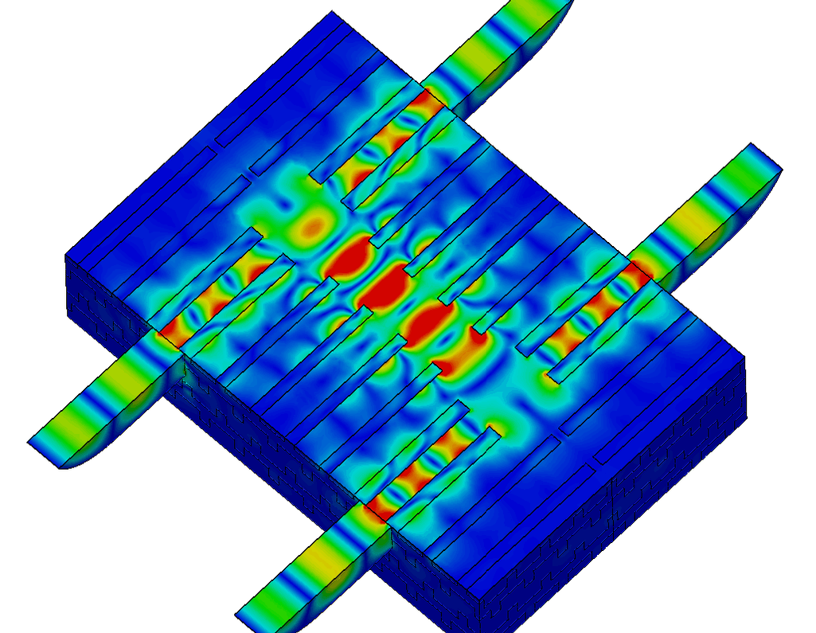
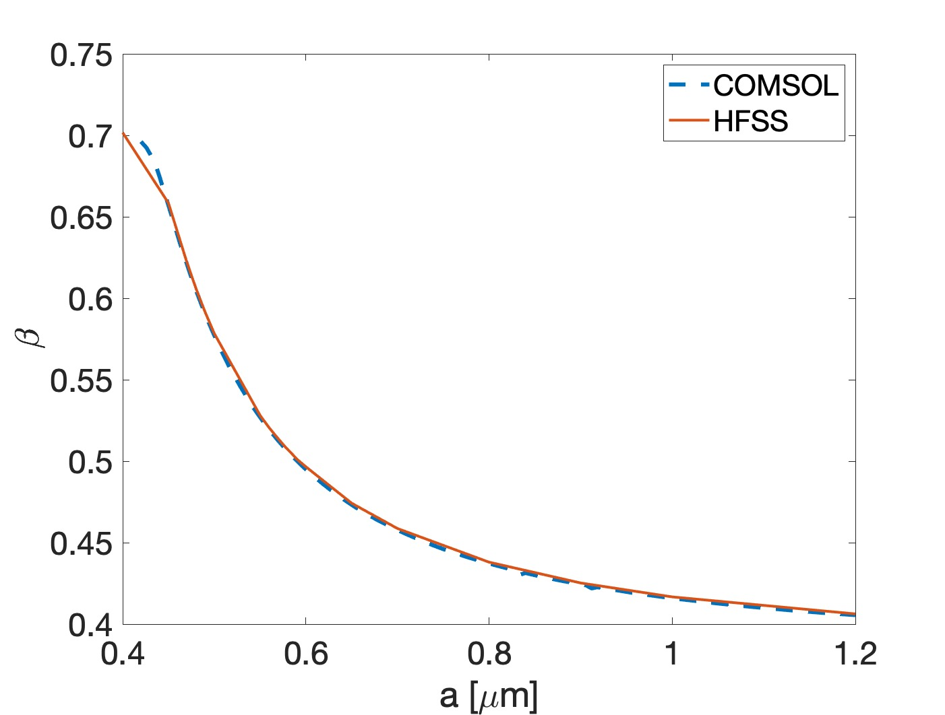
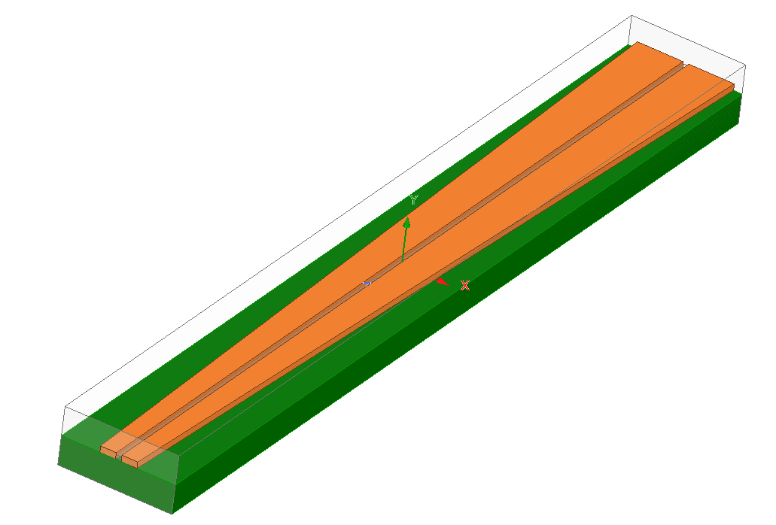
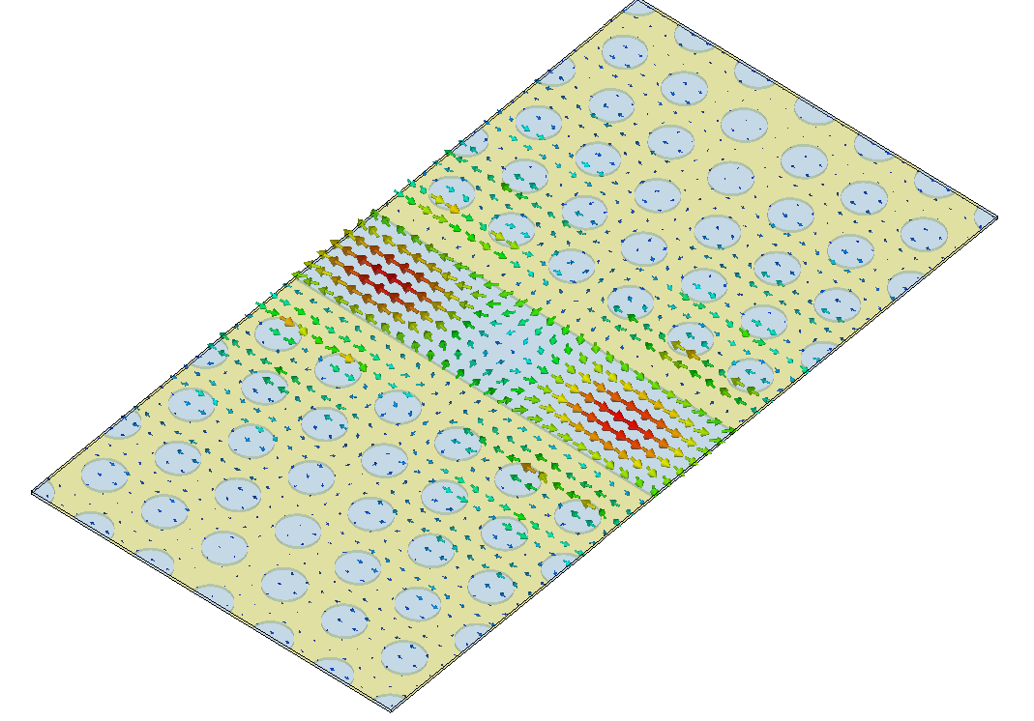
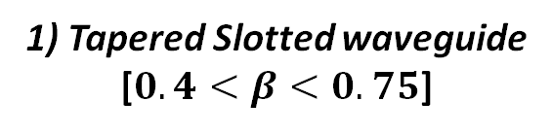
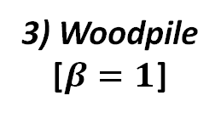
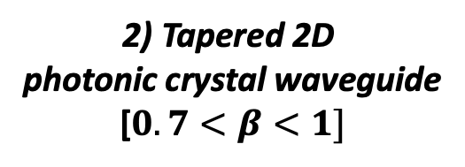
Phase velocity “tapered” Structures
1) Tapered Slotted waveguide
[$0.4<β<0.75$]
2) Tapered 2D
photonic crystal waveguide
[$0.7<β<1]$
3) Woodpile
[$β=1$]

Slide 16

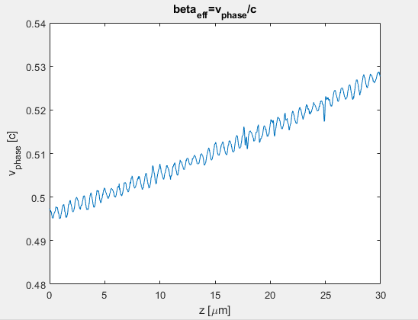
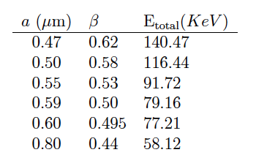

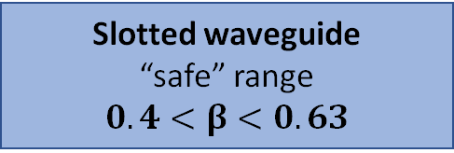
Tapered slot waveguide for sub-relativistic electrons
a
a
“Tapered” Geometry
a_{f}
a_{f}
$β$ variation due to the slot width size a tapering
Phase velocity variation along the waveguide
Slotted waveguide
“safe” range
$$0.4<β<0.63$$

Slide 17
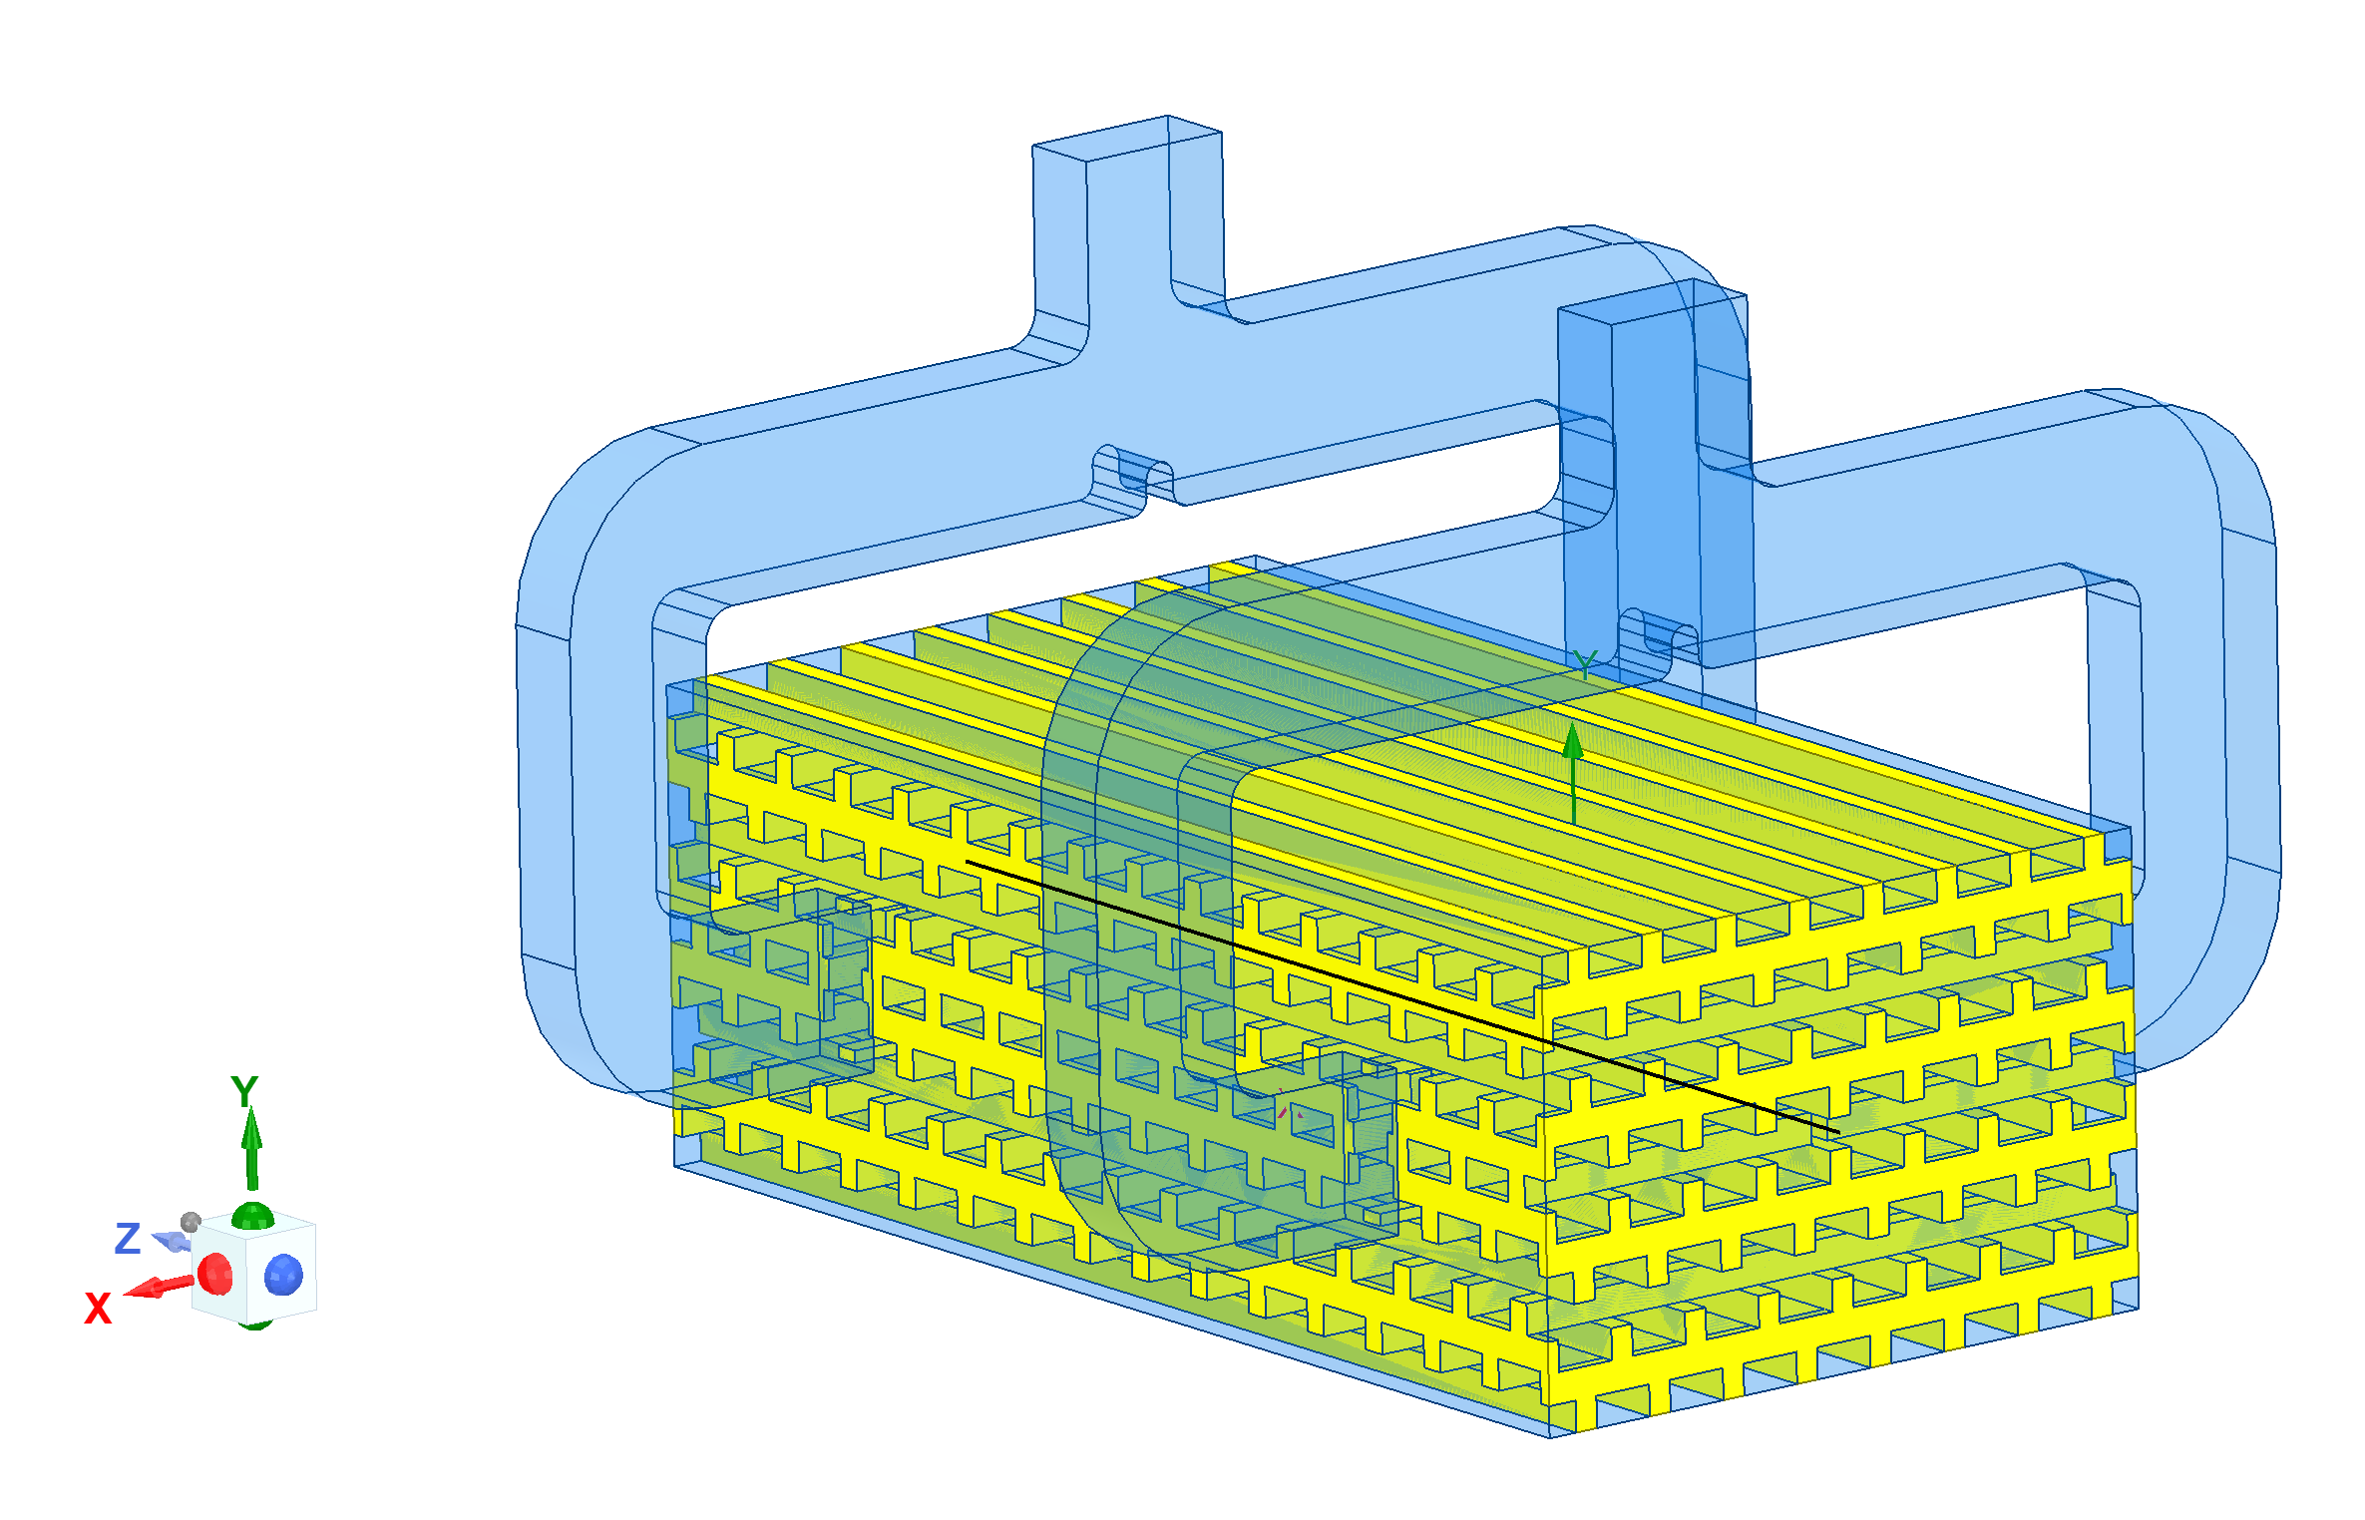
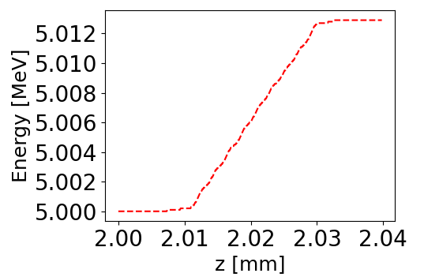
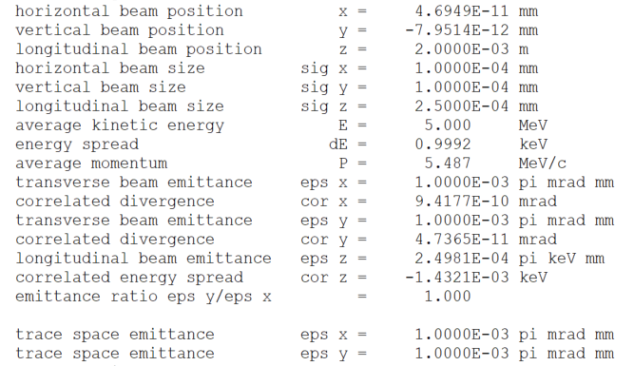
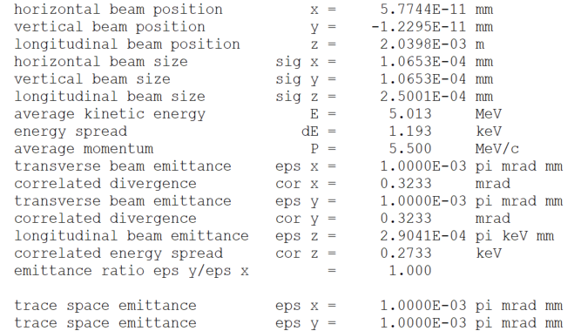

ASTRA (A Space Charge Tracking Algorithm https://www.desy.de/~mpyflo/)
Preliminary Simulation 1-D on axis E_{z} field imported from the woodpile simulation
L=30 µm
Input beam
envelope
Output beam
$$λ=5 µm$$
400 MV/m
Acc. Gradient

Slide 18
DLA Fabrication

Slide 19
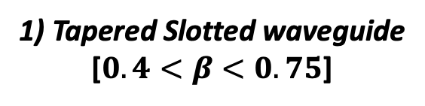
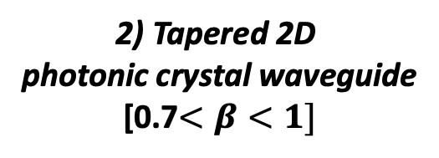
DLA Fabrication
1) Tapered Slotted waveguide
[$0.4<β<0.75$]
2) Tapered 2D
photonic crystal waveguide
[0.7$<β<1]$
3) Woodpile
[$β=1$]
OK

Slide 20
DLA Fabrication
1) Tapered Slotted waveguide
[$0.4<β<0.75$]
2) Tapered 2D
photonic crystal waveguide
[0.7$<β<1]$
3) Woodpile
[$β=1$]
OK

Slide 21
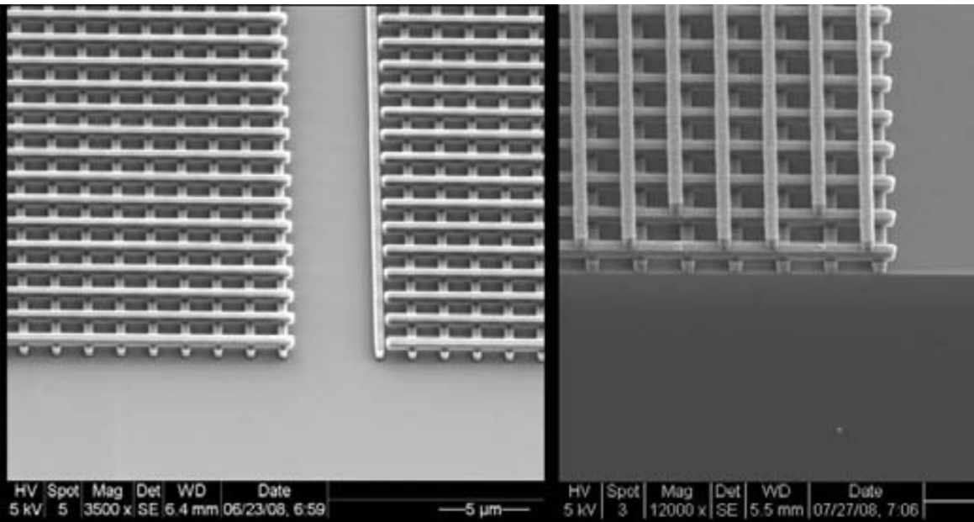
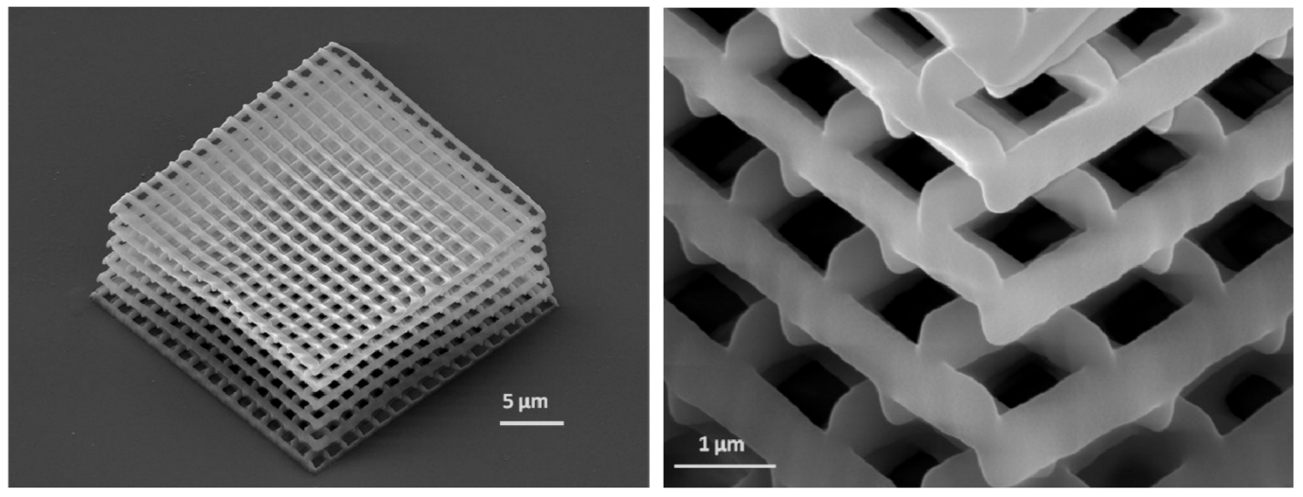
Woodpile structure fabrication - overview
Layer deposition (min. feature size: 450 nm)
General process involves building up the structure layer by layer, using silicon dioxide as a matrix in which silicon features are embedded.
Then, a selective etch is done to remove the silicon dioxide, resulting in a free standing structure of silicon and vacuum.
Direct laser writing (min. feature size: 100 nm)
By moving the focus of the laser beam three dimensionally, arbitrary 3D structures can be written into the volume of the material.
C. McGuinness, R.L. Byer, E. Colby, B.M. Cowan, R.J. England, et al., “Woodpile structure fabrication for photonic crystal laser acceleration”, AIP Conf. Proc. 1086 (2009) 1, 544-549, DOI: 10.1063/1.3080965;
I. Sakellari, E. Kabouraki, D. Gray, C. Fotakis, A. Pikulin, N. Bityurin, M. Vamvakaki, M. Farsari, "High-resolution 3D woodpile structures by direct fs laser writing," Proc. SPIE 8456, Nanophotonic Materials IX, 84560E (15 October 2012); https://doi.org/10.1117/12.930155.

Slide 22
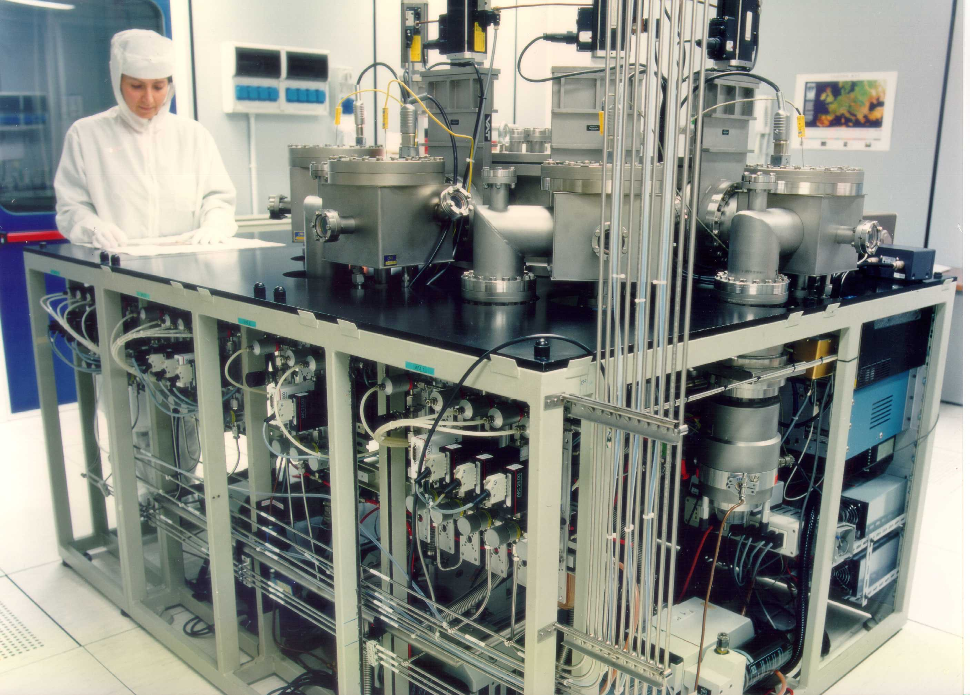
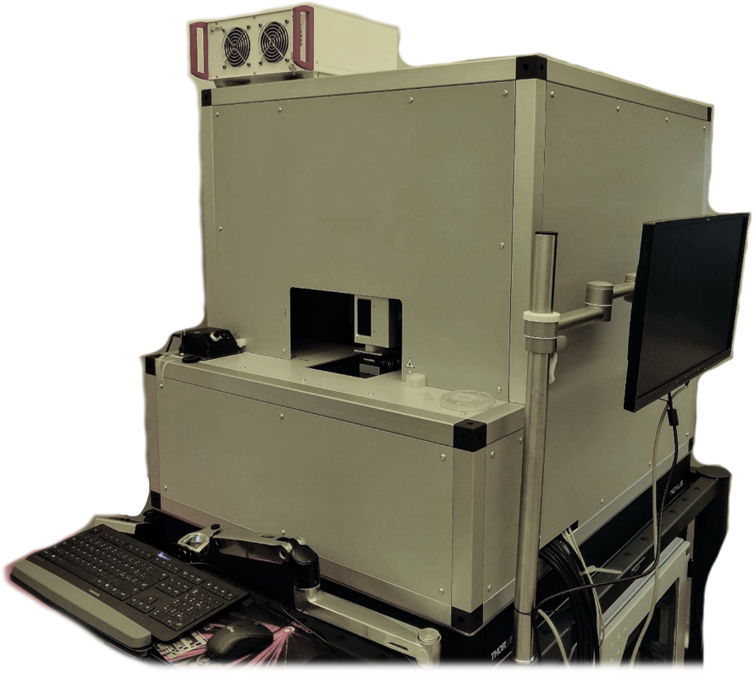
DLA Fabrication
3D printing at the micro- / nano- scale
Laser nanoFab
M4D System by Laser nanoFab
TPP setup
CVD / Plasma-enhanced chemical vapor PECVD deposition of Si

Slide 23
Latest Results
DLA Fabrication
start
23

Slide 24
Conclusions & Persp
Notes:
straight to the point

Slide 25
TALK, CONF., PUBL.
White paper submitted to Snowmass AF6 (Advanced Accelerator Concepts): “Laser-Driven Structure Based Accelerators”, J. England, D. Filippetto, G. Torrisi, A. Bacci, G. Della Valle, D. Mascali, G. S. Mauro, G. Sorbello, P. Musumeci, J. Scheuer, B. Cowan, L Schachter, Y-C. Huang, U. Niedermayer, W. D. Kimura, R. Li, R. Ishebeck, E. I. Simakov, P. Hommelhoff, R. L. Byer , arXiv:2203.08981 https://arxiv.org/abs/2203.08981
Mauro, G.S.; Torrisi, G.; Locatelli, A.; Bacci, A.; De Angelis, C.; Mascali, D.; Sorbello, G. Numerical Simulation of a Hollow-Core Woodpile-Based Mode Launcher for Dielectric Laser Accelerators. Appl. Sci. 2022, 12, 2609. https://doi.org/10.3390/app12052609
Book Project “High Resolution Manufacturing From 2D To 3D/4D Printing: Applications in Engineering and Medicine” Photonic applications Part II - Impact on “Dielectric laser accelerators” and other case studies, C. De Angelis, Andrea Locatelli, Giorgio S. Mauro, R. Rizzoli, G. Sorbello and G. Torrisi,
Talk Copropagating schemes for high gradient Dielectric Laser Accelerators (DLAs)” @The 3rd International Workshop on “Ultrafast Beams and Applications” 4-8 July 2022 at CANDLE Institute in Armenia, UBA22 Workshop, Yerevan, Armenia
Poster@ International Workshop on Breakdown Science and High Gradient Technology (HG2022) 16–19 May 2022 “COPROPAGATING SCHEMES FOR DIELECTRIC LASER ACCELERATORS (DLAS)” G. Torrisi, D. Mascali, G. S. Mauro, A. F., M. M. Costanza (DIEEI, Catania), A. Bacci, G. Sorbello, C. De Angelis, A. Locatelli
Poster@ HIGH GRADIENT 2022 workshop, L. Faillace, B. Spataro, M. Behtouei, M. Carillo, V. Dolgashev, G. Mauro, M. Migliorati, G. Torrisi, “Design and Prototyping of high gradient Ka-band accelerating structures, poster at HIGH GRADIENT 2022 workshop.”
Poster@ IPAC’22, B. Mostafa et al, Studies of a Ka-Band High Power Klystron Amplifier at INFN-LNF, Proceedings of IPAC'22, Bangkok, Thailand.
“Copropagating schemes for high gradient Dielectric Laser Accelerators (DLAs)” submitted to SIF, 108° Congresso Nazionale 12 -16 settembre 2022, Milano
G. Torrisi, G. Mauro, G. Sorbello, A. Usmani, C. De Angelis, A. Locatelli and A. Bacci, “Copropagating Schemes for Dielectric Laser Accelerators (DLAs)” XIV Riunione Nazionale di Elettromagnetismo Catania, 18-21 settembre 2022
“deposited patent n. 102021000021158 “Metodo per progettare una struttura accelerante dielettrica che supporta un modo TE210-like perturbato” G. S. Mauro, D. Mascali G. Torrisi, S. Gammino, INFN, G. Sorbello UniCT, G. Della Valle, PoliMI
Master degree Thesis, M. M. Costanza 31/03/2022, UniCT, DIEEI, CDL Ing. Delle Telecomunicazioni
ERASMUS Master degree Thesis, A. Usmani , UniCT, DIEEI, CDL Ing. Delle Telecomunicazioni
N. 2 lessons on DLA and RFQ @ Corso Fisica degli Accleleratori (Dr. David Mascali) anno Accademinco 2022-2023
Seminario B. Spataro, “Development of X-band and Ka band high gradient structures”, 9/5/2022
N. 2 lessons on “Beam Dynamics”, A. Bacci, 28/4/2022 e 11/5/2022

Slide 26
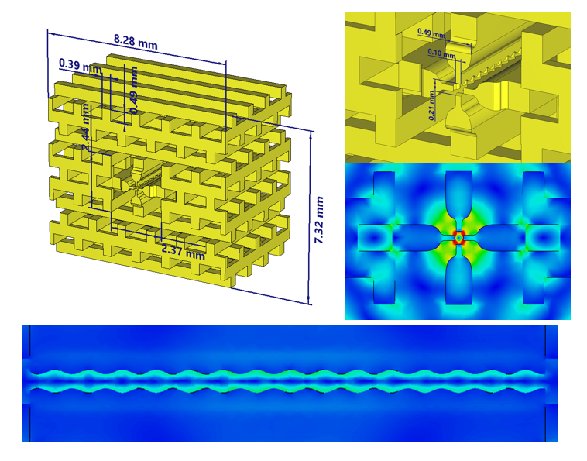

Conclusion and perspectives
Next step: numerical study of DLA structures for very low-$β$ (0.05 to 0.2) particle acceleration (protons).
DIELECTRIC woodpile-based RFQ
Patent pending
Metodo per progettare una struttura accelerante dielettrica che supporta un modo TE₂₁₀-like perturbato
(Ita. Patent pending n. 102021000021158)
By: G. S. Mauro, G. Torrisi, D. Mascali, G. Sorbello, S. Gammino (INFN-LNS),
G. Della Valle (PoliMi)
G. Torrisi et al; Feasibility Study and Perspectives of proton Dielectric Laser Accelerators (p-DLA): from nanosource to accelerator scheme arXiv:2106.13701 [physics.acc-ph]

Slide 27
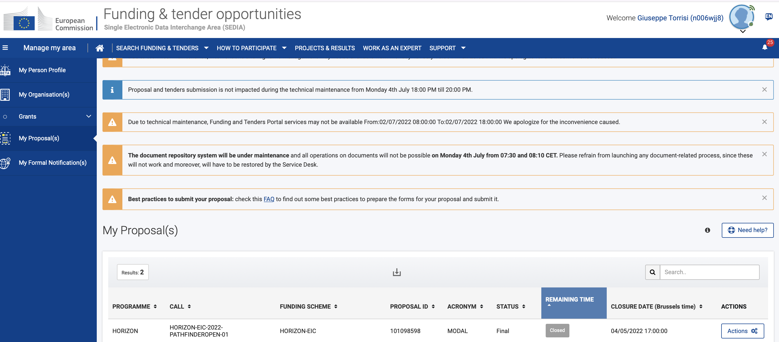
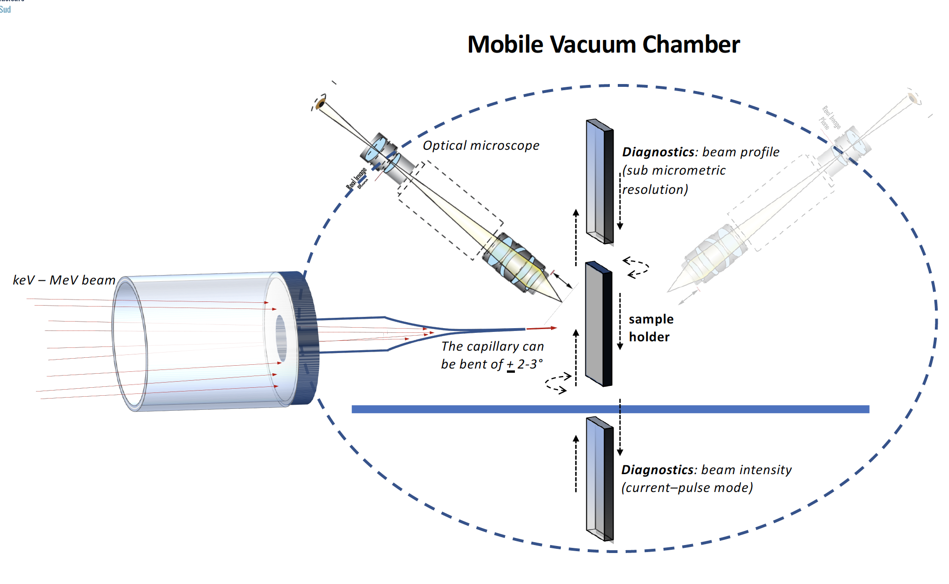
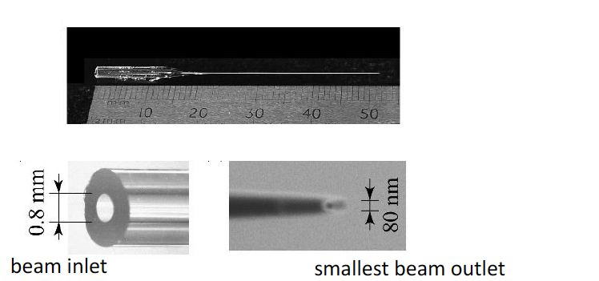
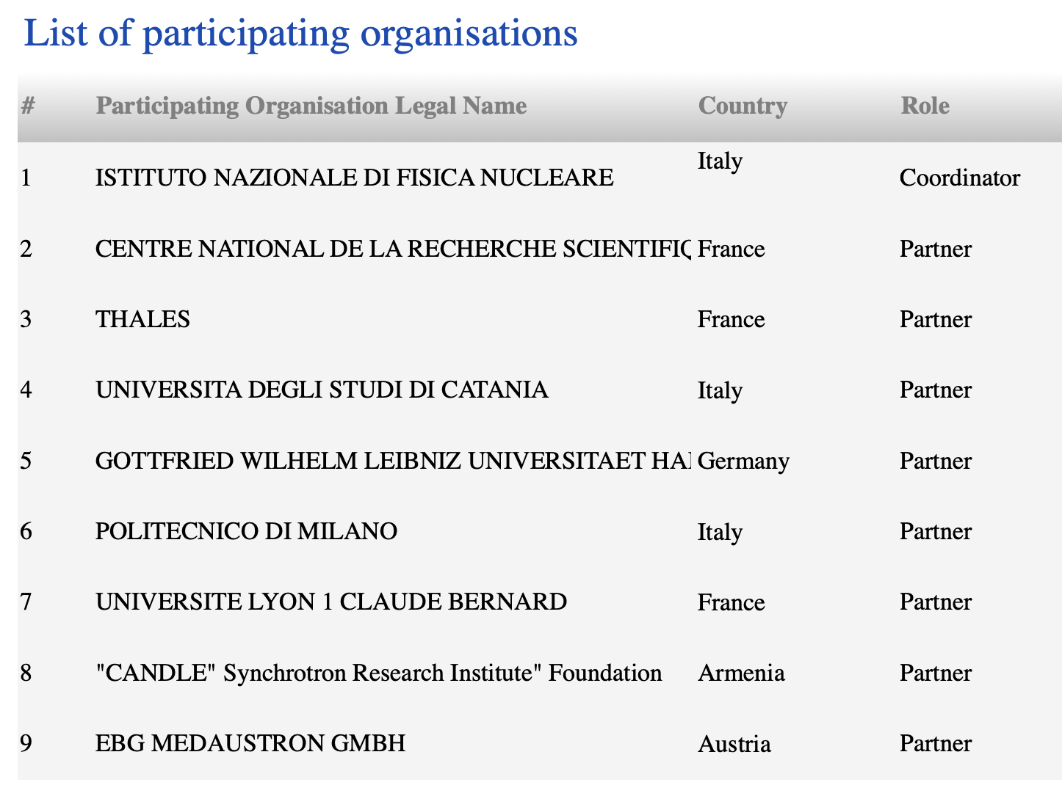
PNRR ECOSISTEMA SAMOTHRACE
(SiciliAn Micro and NanO TecHnology Research and InnovAtion Center)
Submitted/Rejected /Resubmitted Proposal
Pathfinder Call
Micro Optical Dielectric AcceLerator (MODAL)
[~3 M€]
Submitted/Funded Proposal
Italian NextGenerationEU plan
120 million euros of budget to be used in three years
17 founding members and 28 overall partners including 4 universities, 5 research institutes, 4 large international companies and 10 small and medium-sized enterprises
WP2. Micro e Nano beams for Health and Energy
Proposal Evaluation:
Unfortunately, despite the “very good” score [4.5/5, 4.5 for each CRITERION (Excellence, Impact, Quality/Implementation)] the project has not been funded, "given the budgetary resources available for the call”
Micro and nano capillaries made of dielectric
materials with beam guiding properties
Ion beam suitably collimated produced by
ECR ion sources and accelerators
• Arrays of micro-sized beamlets

Slide 28
Altre “Applicazioni:” Rivelatori
Microwave Cavities and Detectors for Axion Research
Quantum Axion Searches: ”Due to its unique low-charge high repetition rate bunch format this approach may provide a possible source technology for proposed fixed-target light dark matter searches using single few-GeV electrons”;
Agrawal, A., et al; “Tunable High-Q Photonic Bandgap Cavity”. Microwave Cavities and Detectors for Axion Research. vol 245. Springer, Cham.
A high-Q microwave dielectric resonator for axion dark matter haloscopes, R. Di Vora, D. Alesini et al; PHYSICAL REVIEW APPLIED 17, 054013 (2022)

Slide 29
MIniaturised aCceleRatOrs Network (MICRON)
Design and Prototyping of high gradient dielectric and metallic accelerating structures
Ka-band accelerating structures

Slide 30
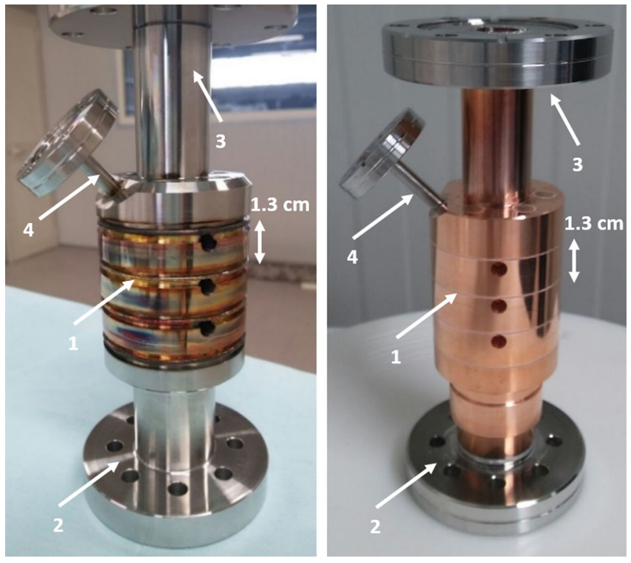


Motivations and Applications
Higher RF frequency → higher accelerating gradients → first high power RF tests 1984, Loew and Wang, experimental curve
Technology improvements → Systematic high-gradient test (SLAC, KEK, CERN and INFN), over last two decades
New: braze-free cavities manufacturing, which does not involve any high-temperature process
Proper material choice, mechanical and thermal treatment increase the maximum allowed field gradients and reduce the vacuum RF breakdown.
From SLAC high-gradient tests, TIG and EBW welded hard-copper
X-band RF cavities, from INFN-LNF →
Max $E_{surf}\sim 195\sqrt{f(GHz)}$
1. Frequency scaling to Ka-band (34-36 GHz)
2. Adopting Open RF structures: “split-open” cavities made of two-halves, four quadrants or multiple-sectors.
3. Hard-copper RF structures: material processing/handling below temperatures (about 800 - 1000 °C) that significantly change the mechanical properties
→ stay below Annealing (500 °C )→ TIG Welding
Dolgashev VA, Faillace L, Spataro B, Tantawi S, Bonifazi R. High-gradient rf tests of welded X-band accelerating cavities. Physical Review Accelerators and Beams. 2021 Aug 10;24(8):081002.
Applications
Research on RF Breakdown Rate and RF Breakdown Physics;
Electron beam longitudinal phase-space manipulation in FELs (EuPRAXIA@INFN-LNF, CompactLight FEL, UC-XEL@UCLA)
Multi-frequency accelerators (S. Tantawi, SLAC)
Development of single and multi-frequency high-power RF klystrons
MICRON experiment. Funded by INFN Committee V.
Previously funded experiment by INFN Committee V: DiElectric and METallic Radiofrequency Accelerator (DEMETRA) 2015-2018

Slide 31

1st YEAR MILESTONES
METALLIC
RF STRUCTURES
2nd YEAR MILESTONES
✓
M1. Evaluation of Figure of Merits on the numerical model
(R_{Sh} > 150 MΩ/m, Q> 5000)
M3. RF and Beam dynamics design optimisation of multi-cell structure (collaboration with Roma1)
M4. Mechanical engineering and executive drawings for the Fabrication and Welding of the multi-cell cavity with mode launcher for low-power RF tests to be conducted during the 3rd year @RF-Lab LATINO, INFN-LNF)
3.1 Fabbricazione Campioni
(ordine approvato)
3.2 Misure metrologiche/test campioni (fine anno)
3.3 Misure Temperatura vs weling/brazing,
e feedback al modeling
✓
M2. Manufacturability test
(tol < +- 3µm, Ra< +- 50 nm)
✓
✓

Slide 32


Cavity Design and Prototyping – Multiple parts open structures
Parameter | Value
Resonant frequency, f [GHz] | 35.982
Quality factor Q | 6000
Shunt impedance [MΩ/m] | 160
H_{max} [MA/m] | 0.6
E_{max} [MV/m] | 400
Power loss [MW] | 0.75
a [mm] | 2
a/λ | 0.24
t [mm] | 0.635
Iris ellipticity | 1.38
Accelerating Gradient (MV/m) | 150 MV/m
Phase advance per cell (deg) | 180
  Quadrants (4 slots and sectors) vs. Closed structure (w/o slots)
  Similar longitudinal shunt impedances;
  Higher lower-modes separation;
  Higher vacuum pumping capacity through slots;
  The quality factor decreases by only 2%.
TIG welding on the outer slots → avoiding high temperature brazing and/or diffusion bonding processes (the typical assembly methods widely used to manufacture ultrahigh vacuum accelerating devices) which - occurring at about 800–1000 °C - significantly change the cavity mechanical properties.
Main RF Parameters
The electric field in the middle cell is two times higher in the middle cell in order to localize and analyze the RF breakdown events.

Slide 33






Ka- band cavity Samples Manufacturing: 2 and 4 sectors
Machined sectors for the 4-quadrants Cavities
Drawing of the 4-quadrants structure prototype for TIG welding and morphological tests.
All cavity sectors were manufactured by using a CNC 5-axis milling machine.
Machining tool is crucial:
Tungsten-carbide tool → Tolerance = +- 10 µm; Roughness with Ra = 1.6 µm.
Diamond tool with spherical radius < 1 µm → Tolerance = +- 5 µm; Roughness with Ra < 80nm.
multi-cell cavity with mode launcher (this year)
Machined sectors for the 2-halves Cavities

Slide 34

TIG welding tests, visual inspection and temperature monitoring of Ka-band “split-open” metallic RF
  Checklist for positive procedure outcome
Successful execution of each weld bead/seam in order to assure vacuum tightness of the cavity.
The cleanliness of the inside surfaces of the cavities: visual inspection for absence of oxidation after cutting the cavity samples;
The temperature of the cavity surfaces always below the annealing one (mechanical properties significantly change after heating above 590 ◦C), in order to keep the hardness of the copper.
Experimental Set-up
The TIG welding was performed with the use of protective gas from the torch (50% He, 50% Ar) with flow set at 13 l/min.
Further flushing of inert gas was applied inside the cavities (100% Ar).
The maximum current value set on the TIG machine was 175 A.
A thermocouple was placed on the cavity inner surfaces through a hole in the cavity body.
The data for the temperature plots were obtained from the video recordings

Slide 35


Temperature Monitoring of RF surfaces
Show piece: ID2/4
For this bead the welding was performed at 125 A with a peak temperature of 252 °C. The weld seam was observed to be well executed.
Similar behavior for all samples.
Below copper annealing temperature
The picture of the cavity was taken after the cleaning process to remover the external dirt on the outer surfaces due to the welding.

Slide 36

Visual Inspection
We opened the four-quadrant cavity named ID5. This cavity (like the others) has been kept in a protective nitrogen atmosphere for the entire period since the welding process.
The opening was carried out by removing one of the four weld seams by means of a Dremel cutter → No thermal alteration.
The appearance of the cavity is shiny and there are no traces of oxidation in the area where there was direct flushing of argon.
The central area where argon was flowing (Zones 1, 2, 3 and 4), the appearance remains bright. At a visual analysis, there are no traces of oxidation.
The areas closest to the weld seam (zones A, B, C) show instead the presence of oxide, but it is to be considered that in those areas due to the direct contact between the surfaces to be welded, the presence of inert gas was absent and therefore such result was expected.

Slide 37




Ka-Band RF Mode Launcher
Four-port mode launcher for dipole and quadrupole component cancellation
(optimization for maximum power transfer in-progress)
Four-port mode launcher with 4-quadrants cavity
(optimization in-progress)
Four-port mode launcher is matched with the resonant Ka-band structure made of four quadrants;
The reflection coefficient at the RF input power port is S11 < -13 dB;
The RF cavity on-axis electric field profile shows the same behavior as the isolated structure.
The estimated input RF power is Pin = 0.85 MW in order to obtain an accelerating gradient about E_{acc}=150 MV/m in the middle cell.

Slide 38
Publications and conference posters
L. Faillace, B. Spataro, M. Behtouei, M. Carillo, V. Dolgashev, G. Mauro, M. Migliorati, G. Torrisi, Design and Prototyping of high gradient Ka-band accelerating structures, International Workshop on Breakdown Science and High Gradient Technology (HG2022)
V. Dolgashev, B. Spataro, L. Faillace, R. Bonifazi, Innovative compact braze-free accelerating cavity, Jinst, September 19, 2018
Dolgashev VA, Faillace L, Spataro B, Tantawi S, Bonifazi R. High-gradient rf tests of welded X-band accelerating cavities. Physical Review Accelerators and Beams. 2021 Aug 10;24(8):081002.
Behtouei M, Faillace L, Migliorati M, Palumbo L, Spataro B. New Analytical derivation of Group Velocity in TW accelerating structures. InJournal of Physics: Conference Series 2019 Nov 1 (Vol. 1350, p. 012112). IOP Publishing.
Dolgashev VA, Faillace L, Higashi Y, Marcelli A, Spataro B, Bonifazi R. Materials and technological processes for High-Gradient accelerating structures: new results from mechanical tests of an innovative braze-free cavity. Journal of Instrumentation. 2020 Jan 27;15(01):P01029.
M. Behtouei, B. Spataro,’ A SW Ka-Band linearizer structure with minimum surface electric field for the compact light XLS project’, Nuclear Inst. and Methods in Physics Research, A 984 (2020) 164653
B. Spataro et al.,’A novel exact analytical expression for the magnetic field of a solenoid’, Waves in Random Complex Media, 10 October 2020
Ka-band Klystron Development (single and multifrequency)
Spataro B, Behtouei M, Di Paolo F, Leggieri A. A low-perveance electron gun for a high-efficiency Ka-band klystron. The European Physical Journal Plus. 2022 Jul 5;137(7):769.
Leggieri A, Behtouei M, Burt G, Di Paolo F, Spataro B. A novel harmonic klystron configuration for high power microwave frequency conversion. arXiv preprint arXiv:2212.12359. 2022 Dec 23.
B. Spataro et al.,’’The Ka-band High Power Amplifier Design Program of INFN’, Vacuum 191 (2021) 110377
B. Spataro et al.,’ Ka-band Linearizer for the Ultra-Compact X-Ray Free Electron Laser at UCLA’, Nuclear Inst. and Methods in Physics Research, A 1013 (2021) 165643
M. Bethouei, B. Spataro et al, ’ Relativistic Versus Nonrelativistic approaches to a low Perveance High Quality Klystron Matched Beam for a High Efficiency Ka-band Klystron’, MDPI, 10 November 2021, Instruments 2021, 5, 33
F. Marrese, B. Spataro et. al.,’ Multiphysics Design of High-Power Microwave Vacuum Window’ , Journal of Microwaves, Optoelectronics and Electromagnetic Application, Vol. 21, N. 1, March 2022.
Castilla A, Apsimon R, Burt G, Wu X, Latina A, Liu X, Syratchev I, Wuensch W, Spataro B, Cross AW. Ka-band linearizer structure studies for a compact light source. Physical Review Accelerators and Beams. 2022 Nov 9;25(11):112001.
Castilla A, Zhang L, Wu X, Wuensch W, Spataro B, Latina A, Cross AW, Burt G, Syratchev I, Behtouei M, Liu X. JACoW: Development of 36 GHz RF Systems for RF Linearisers. JACoW IPAC. 2021;21:4518-23.
Thales company is investing in Ka-band High RF power klystrons.
THANKS for your ATTENTION!
This work was supported by the INFN Committee V for the funding of the MICRON experiment.

Slide 39

SECONDA GIORNATA ACCELERATORI, INFN-LNS, Catania
THANK YOU!
[MICRON] Opportunità e Applicazioni di strutture acceleranti miniaturizzate
metalliche (banda Ka) e dielettriche (ottiche)
Luigi Faillace, Giuseppe Torrisi
on behalf of MICRON collaboration

