Slide 1
Accelerators Development at Elettra Sincrotrone Trieste
Simone Di Mitri
Elettra Sincrotrone Trieste
Univ. Trieste, Dept. Physics
on behalf of Elettra Team & FERMI Team

Slide 2
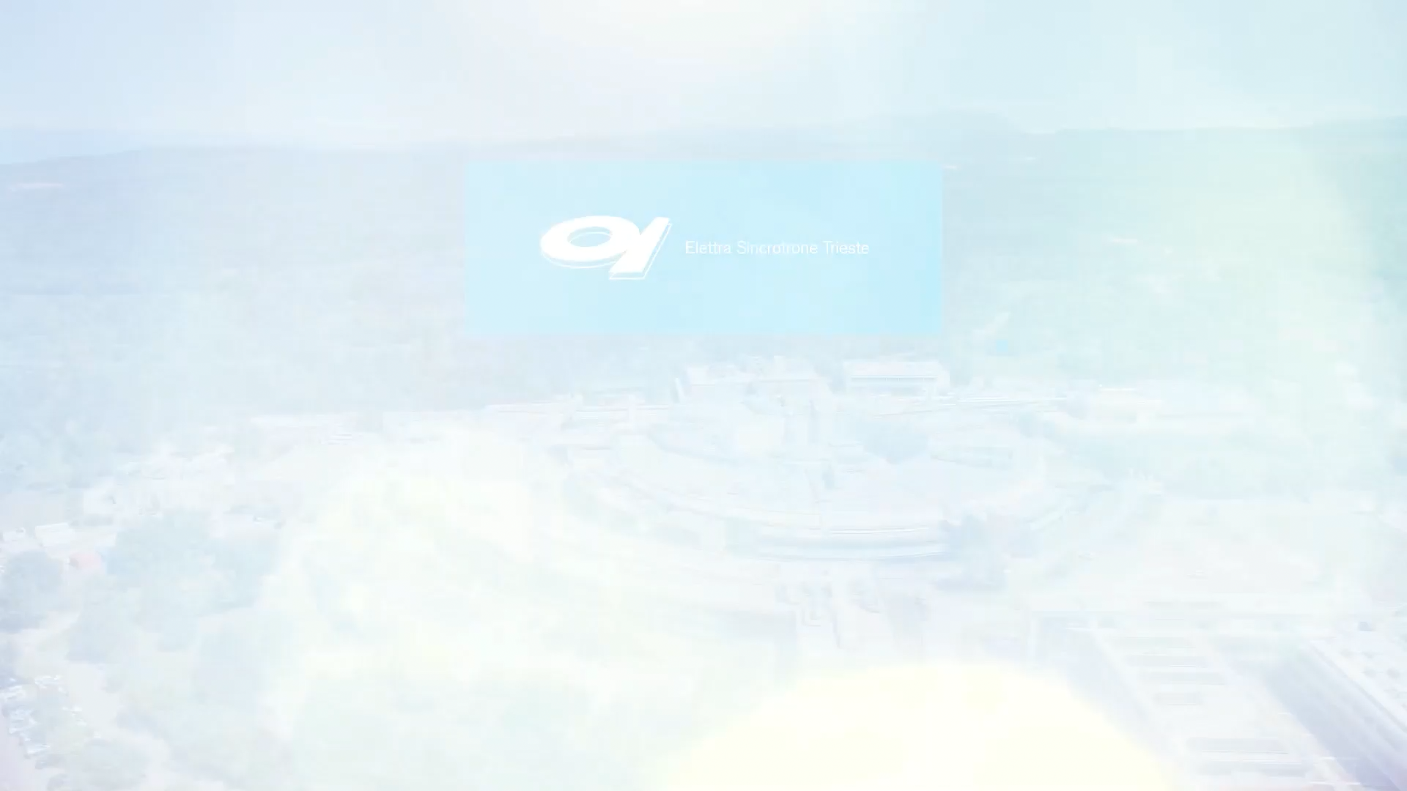
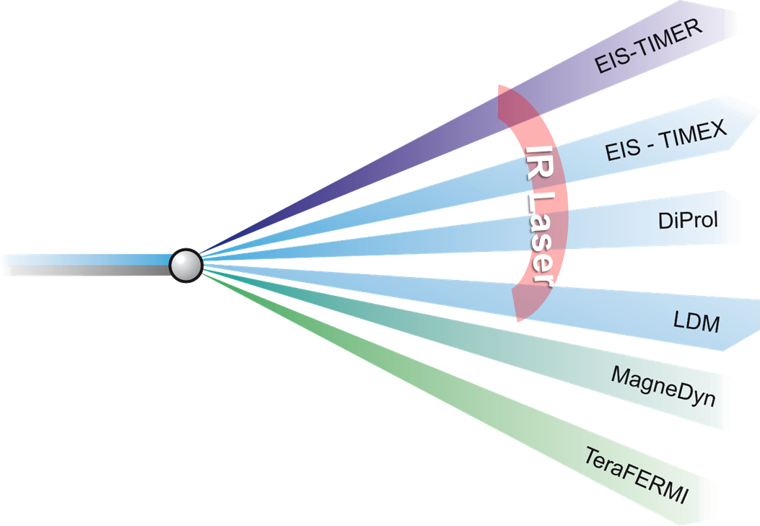
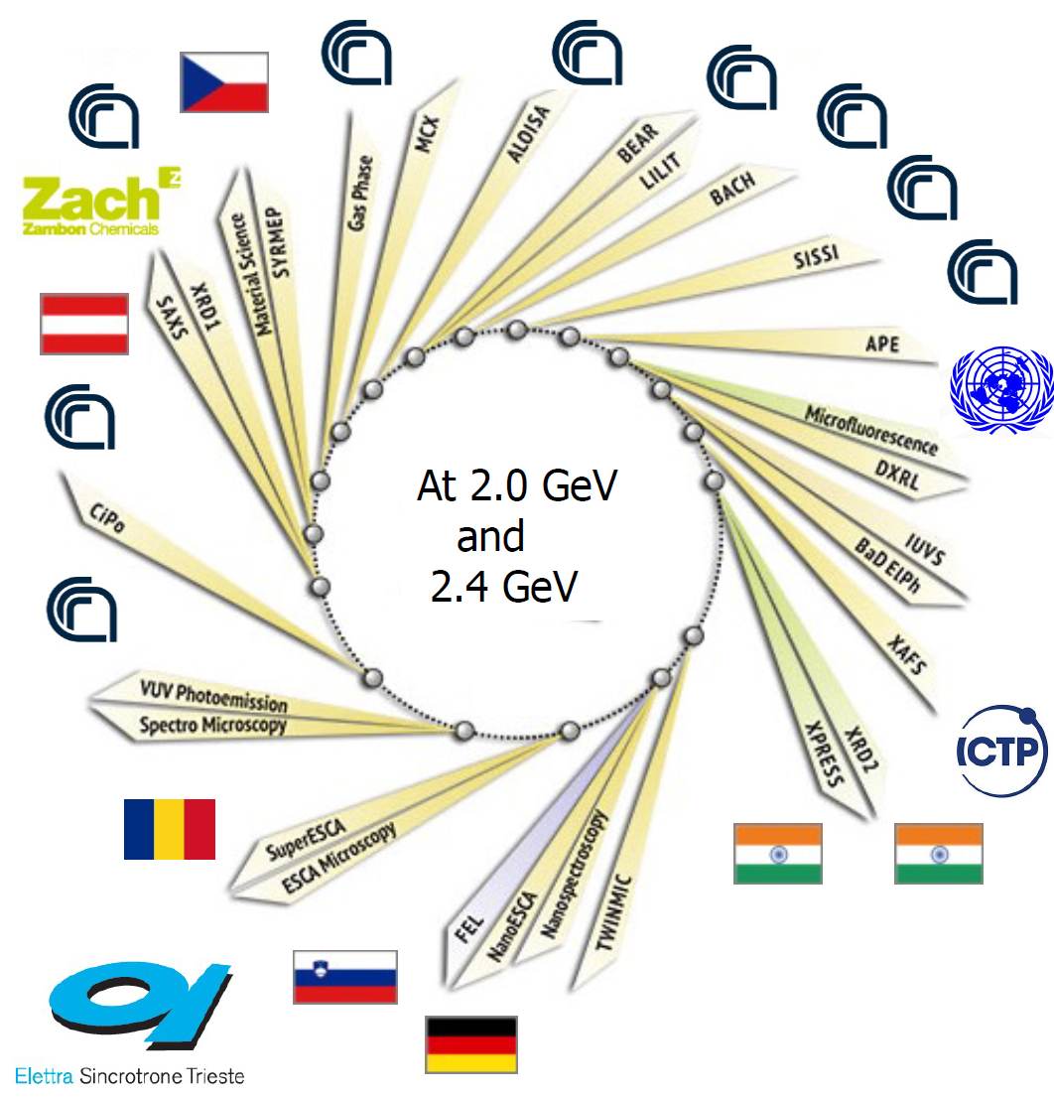
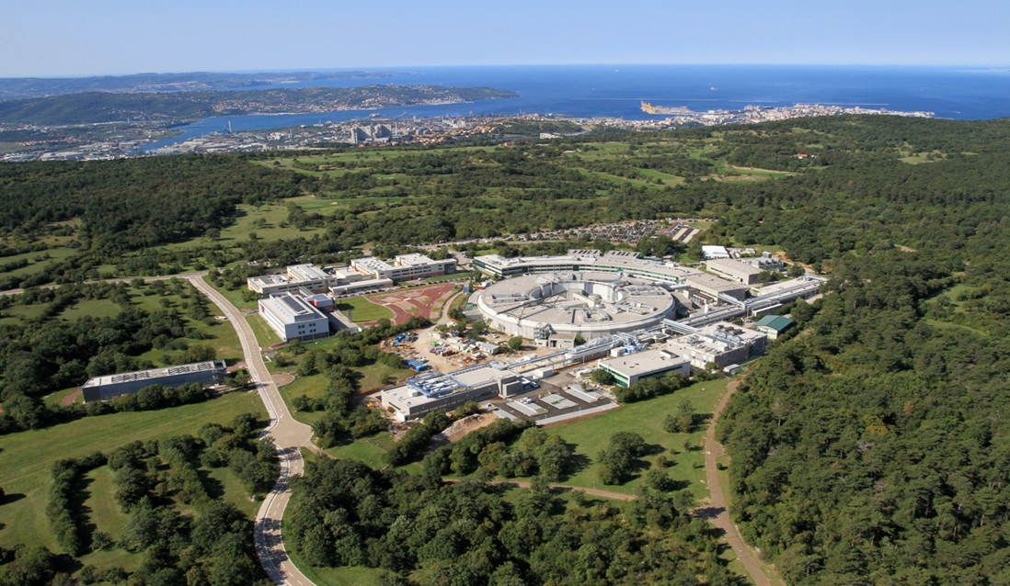
Light Sources
ELETTRA, SRLS:
in operation since 1994
FERMI, FEL:
in operation since 2010

Slide 3
From Elettra to Elettra2.0
E. Karantzoulis, Project Leader
A. Fabris, Executive Officer
 |  | ELETTRA | ELETTRA 2.0
In operation since |  | 1994 | 2027
Availability |  | 5000-user / 6400-tot
e-Beam energy | GeV | 2.0 (75%) – 2.4 (25%) | 2.4 (2.0 for some time)
Photon energies | keV | 0.020 – 35 | 0.060 – 50
#Beamlines (#ID, #Bends) |  | 28 (17, 7) | 32 (17, 3+2)
Hybrid filling patterns |  | yes
ID occupancy | % | 30 | 40
Circumference | m | 259
Magnetic Lattice |  | 12 x 2BA | 12 x S6BA-E
Hor. emittance, coupling | nm rad, % | 7 – 10, 1% | bare 0.212, 3%
Max. ave. current | mA | 310 – 160 | 400
Brilliance
× 100-1000
(1-10 keV)

Slide 4
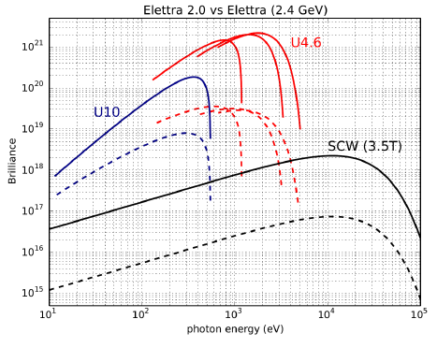
Science drivers
Reduction in e-beam emittance → reduced beam size, increased peak brightness will lead to:
gain in the emitted/transmitted signals from samples
reduced acquisition time for all types of spectroscopies and X-ray scattering techniques
implementation of photon-hungry techniques (high pressure exps. with anvil cells and dilute samples, spin-resolved ARPES)
improvement of the lateral resolution with focusing optics down to a few nm scale (e.g. nano-PES, nano-ARPES)
Transversal coherence will open unique opportunities for coherence-hungry methods:
Coherent Diffraction Imaging (CDI) with chemical specificity
Ptychography
X-ray photon correlation spectroscopy (XPCS)

Slide 5
Boundary conditions
Keep same:
building and circumference
long SS-ID position
full-energy injection (linac+booster)
e-beam energy(-ies)
diverse filling patterns
emittance swap in booster
main operation at 2.4 GeV
hybrid, single/few bunches
Improve:
horizontal emittance
beam dimensions @ LS-ID
intensity
ID occupancy
47-fold
(35-x,6-y)μm, (6-x’,2-y’)μrad
400 mA @ 2.4 GeV
∼40%, +4 beamlines

Slide 6
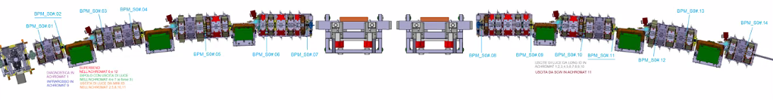
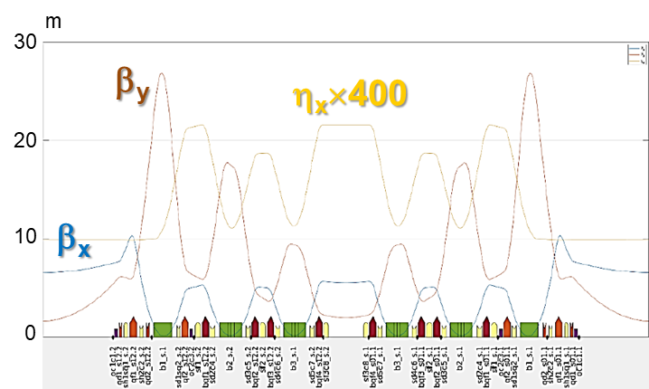
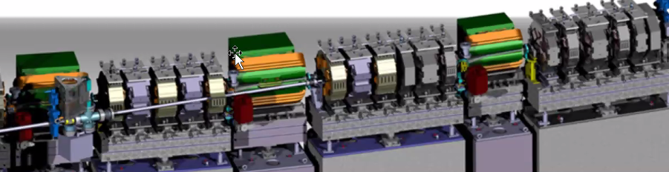
Magnetic lattice
ref. E. Karantzoulis, D. Castronovo
All magnets:
iteratively designed vs. extraction chambers
independently powered
water-cooled
Transv. (-21 T/m)
& Long. gradient
H-shifted quads by -5.6 mm
(anti-bends, 0.4deg)
LS
Transv.
gradient
(-18 T/m)

Slide 7
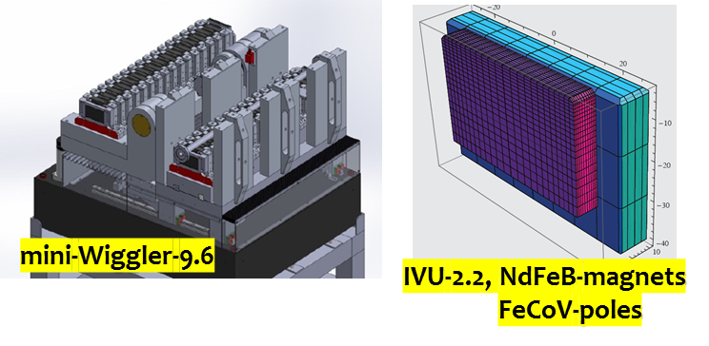
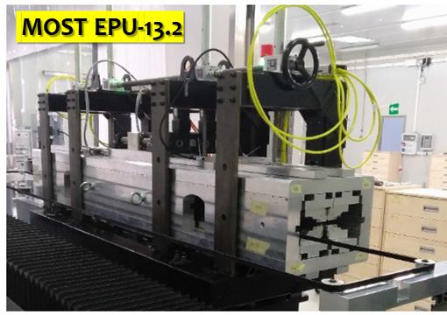
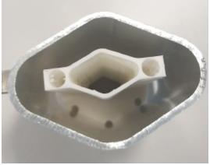
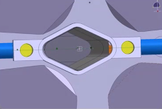
Other upgrades
Insertion devices
Vacuum chambers
Main RF
27 x 17 internal (1.5 mm thickness)
4 x up to 130 kW solid state RF transmitters
Cu (45%), Al (20%), S. Steel (35%)
0.5 μm NEG-coated (90% )
Injection
Traditional off-axis 4-kickers bump & 3 septa, supplied by low-emittance optics and emittance swap in the Booster ring (near difference resonance at extraction)
Multipoles
Short IDs,
dipoles,
injection
Long IDs

Slide 8

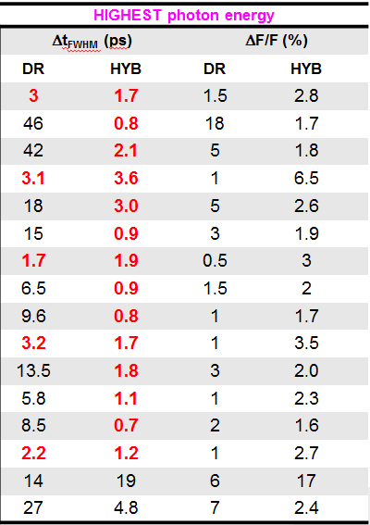
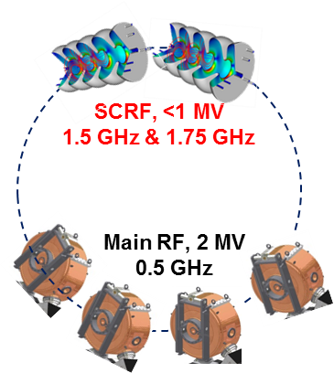
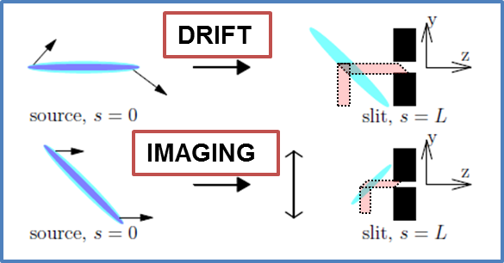
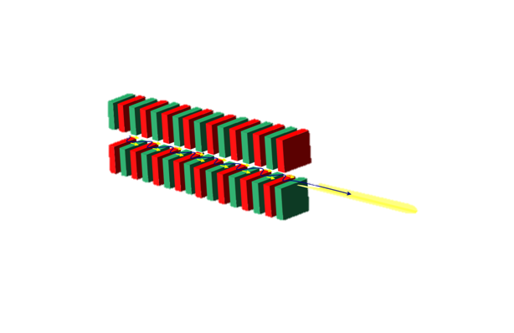
Crab cavities for MHz, ps-long X-rays
4 × pure-Nb @ 4.5 K, 1 MV @ 3 & 3.25 GHz
steady-state, periodic deflection of a camshaft bunch
Sub/few ps pulse duration at multiple beamlines, at > 0.2 keV photon energies
Up to 1 MHz rep. rate (1 tilted bunch in a dark gap)
∼1-few % flux relative to standard single bunch emission
Preserving transverse coherence
Impact on standard bunches: vertical emittance x 2, bunch charge x 2

Slide 9
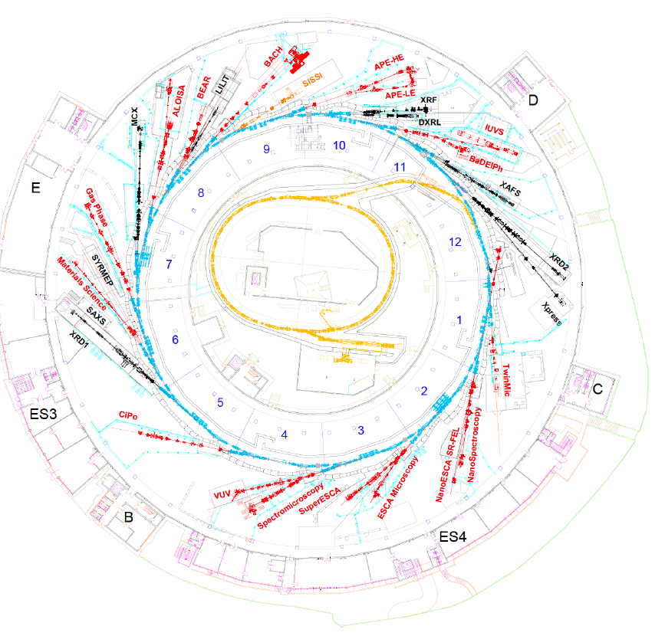
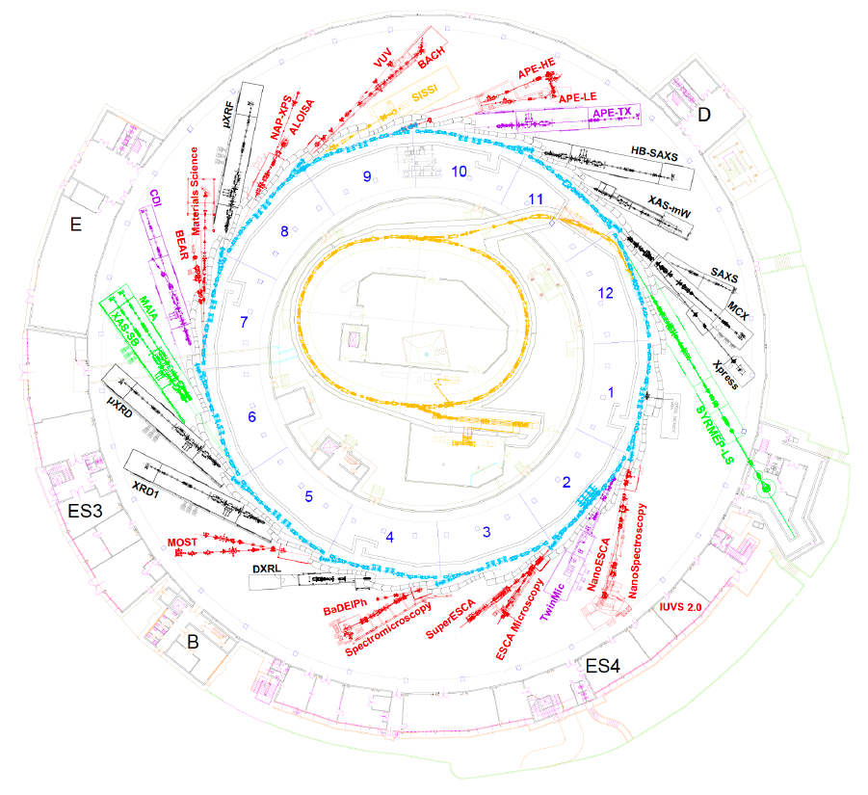
Beamlines
ref. S. Lizzit, L. Gregoratti
BLs Funding & Operation:
39% by Elettra
33% by CNR
28% shared, other Institutions
IVUs
Hard x-rays, 10 → 9
VUV – soft x-rays, 17 → 15
IR/THz, 1
BLs kept as now, 14
BLs moved, 7
BLs new, 10
Tender x-rays, 0 → 4
Super-bends, 0 → 3
BLs from undulators, 19
BLs from mini-wiggler, 2
BLs from SC-wiggler, 3
BLs from bends, 4
BLs from Super-bend, 3
UV laser lab
< 30 eV

Slide 10
From FERMI to FERMI 2.0
C. Masciovecchio, Project Leader
 |  | FERMI | FERMI 2.0 (concept)
In operation since |  | 2010 | 2029 ?
#Beamlines |  | 6
Repetition Rate |  | 10, 50 Hz
e-Beam energy | GeV | 0.9 – 1.55 | 0.9 – 1.85
Peak current | kA | 0.7 |  | 1.0
IDs |  | Apple-II, | Apple-II,
FEL scheme, default |  | HGHG, HGHG-FB | EEHG, EEHG-FB
Photon energies, fundam. | eV | FEL1: 12 – 62 FEL2: 62 – 310 | FEL1: 15 – 124 FEL2: 62 – 620
Pulse duration | fs | 10 – 150 | < 5 – 50
Temporal and spectral shaping |  | yes
Water window

Slide 11
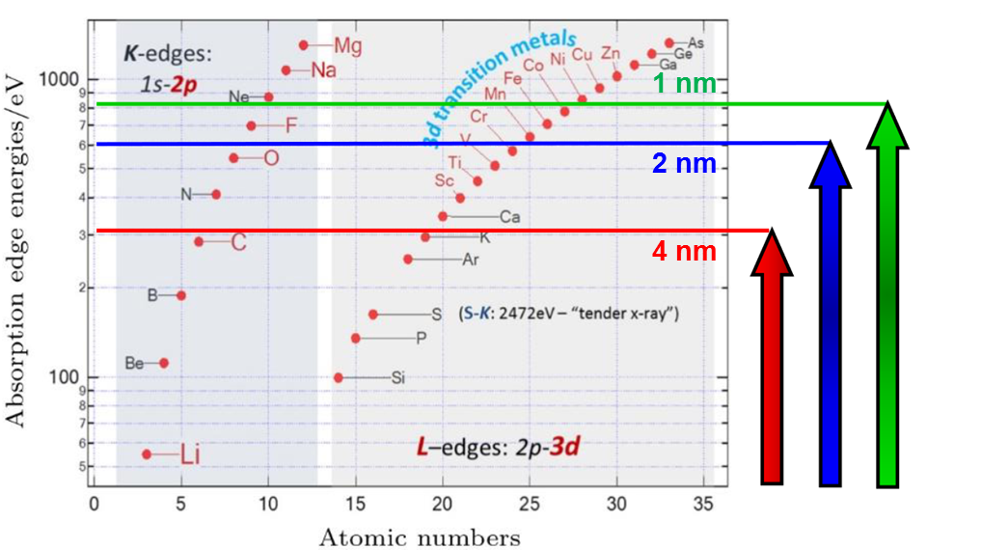
Science drivers
ref. C. Masciovecchio
Resonant exps. exploiting processes of few fs-lifetime (X-Abs., Small Ang. XS, CDI,…)
Nonlinear optics (large wave-vectors)
Ultra-fast chemistry
Water window
Coherent control
shorter Δt (<10 fs) +
shorter λ (N,O K-edge) +
longitudinal coherence

Slide 12
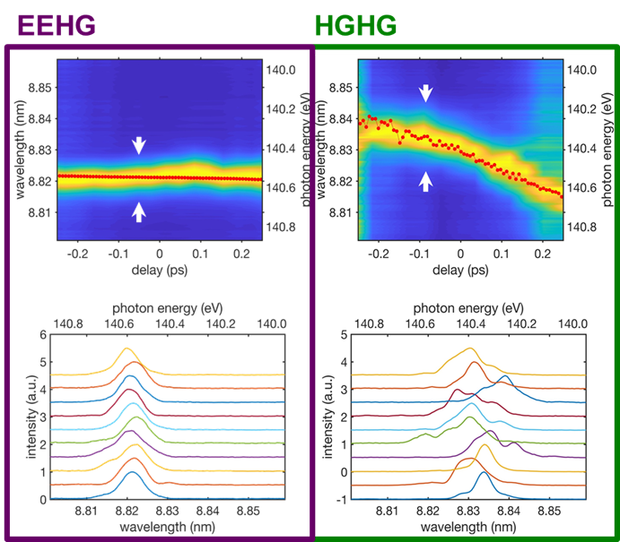
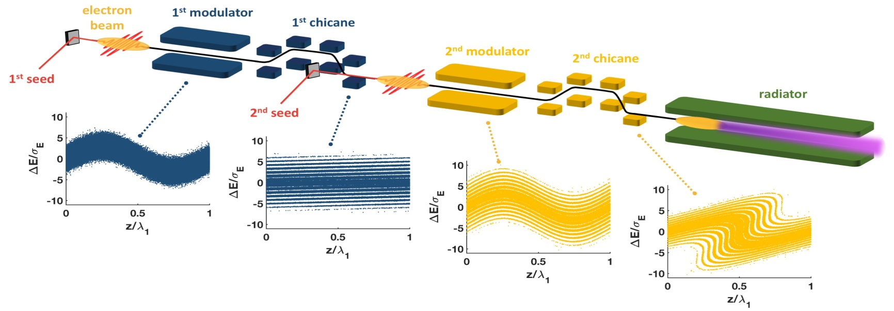
FEL upgrade to EEHG(-FB)
ref. E. Allaria, P. Rebernik, C. Spezzani
FEL-1
FEL-2

Slide 13
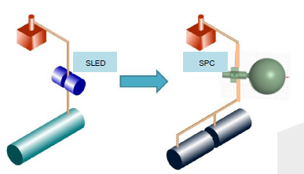
Linac upgrade
ref. M. Trovo’, N. Shafqat
Present Linac Energy
1.5 GeV @ 10Hz
Target Linac Energy
1.8 GeV @ 50Hz
Solution
Low Wakefield S-band 30 MV/m
Arcing and rusting issues in 30-years old RF structures
In-house RF design completed in 2019
Commitment to PSI for the construction of a short prototype and 2 structures.
Replace L4.7, H-TDC → 1.67 GeV op.
2 structures installed in 2022
(39 MV/m proven)
Replace L2-L4 → 2 GeV op.
Replace L3-L4 → 1.87 GeV op.

Slide 14
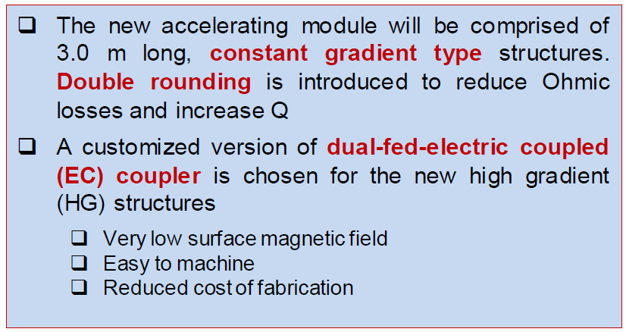
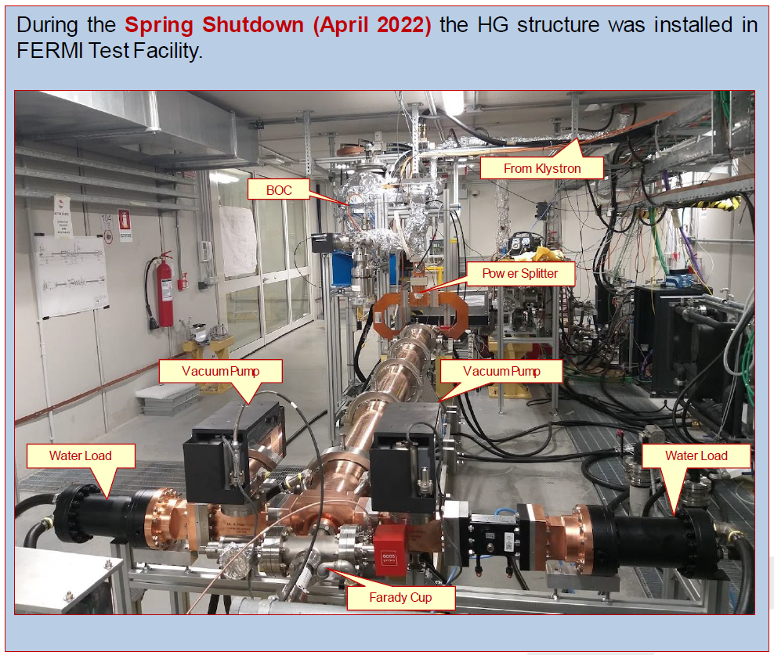
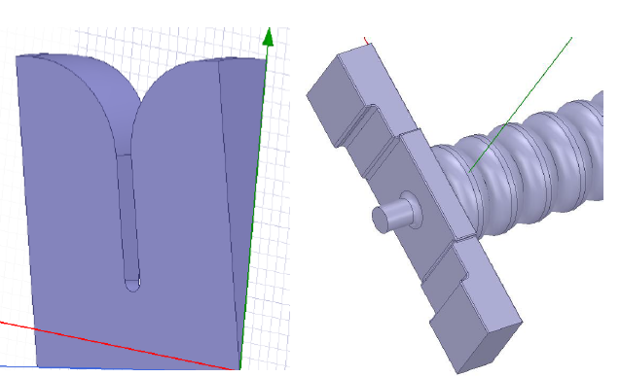
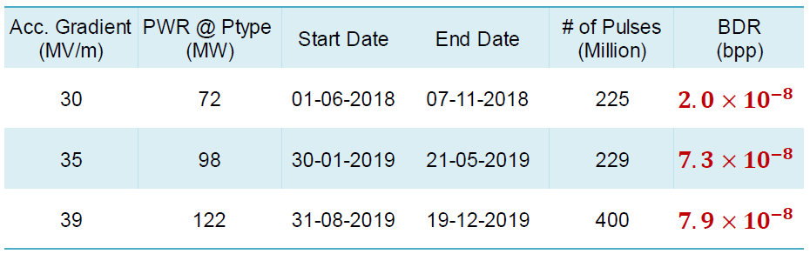
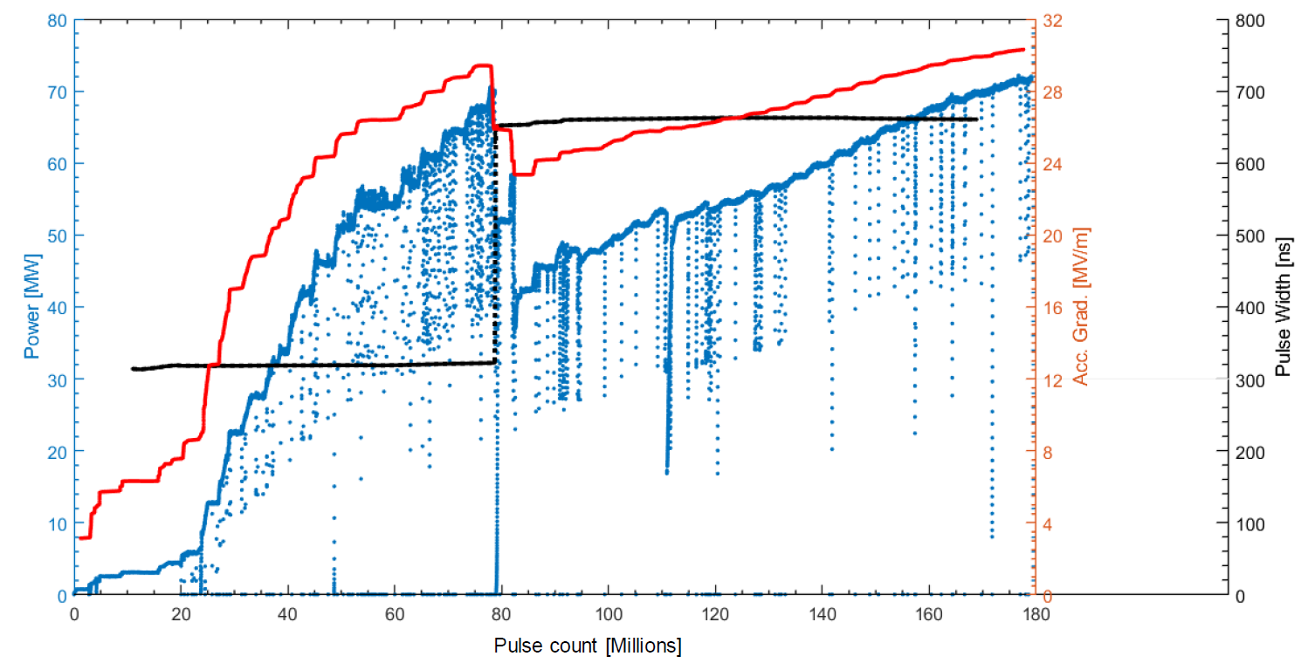
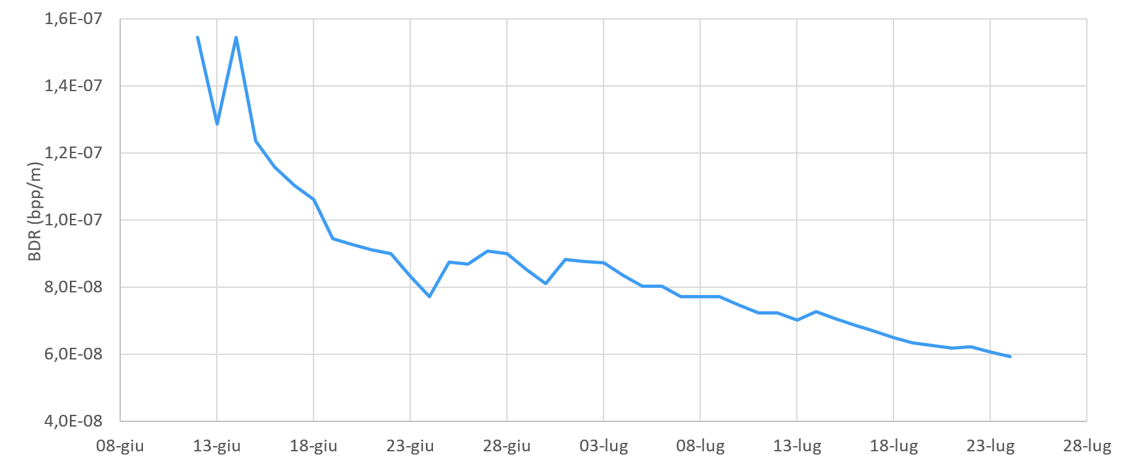



Design, prototype, full structure RF test
9-cells prototype RF test
RF conditioning history
BDR based on reflected power faults history
$$30MV/m$$
$$@ 72MW$$
$$\sim {10}^{−8}$$

Slide 15
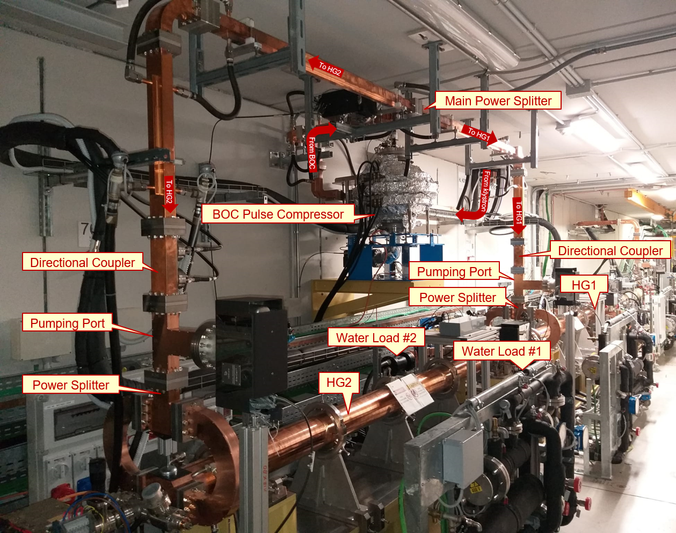
Installation and conditioning in FERMI
The 2nd HG structure (HG2) was installed directly at FERMI linac without conditioning
Since installation is done without any phase shifter so precise phase calculations were done to ensure that both HG1 and HG2 are in phase.
Due to user beam operation requirements and reduced operational hours due to power management the conditioning of HG2 is bit slower.

Slide 16
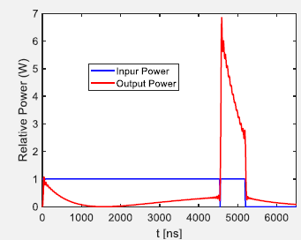
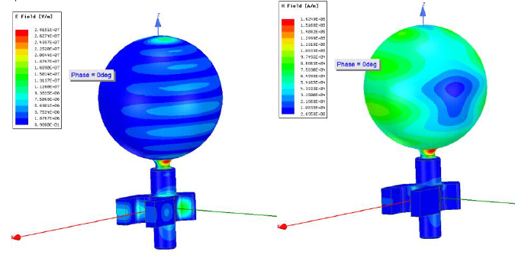
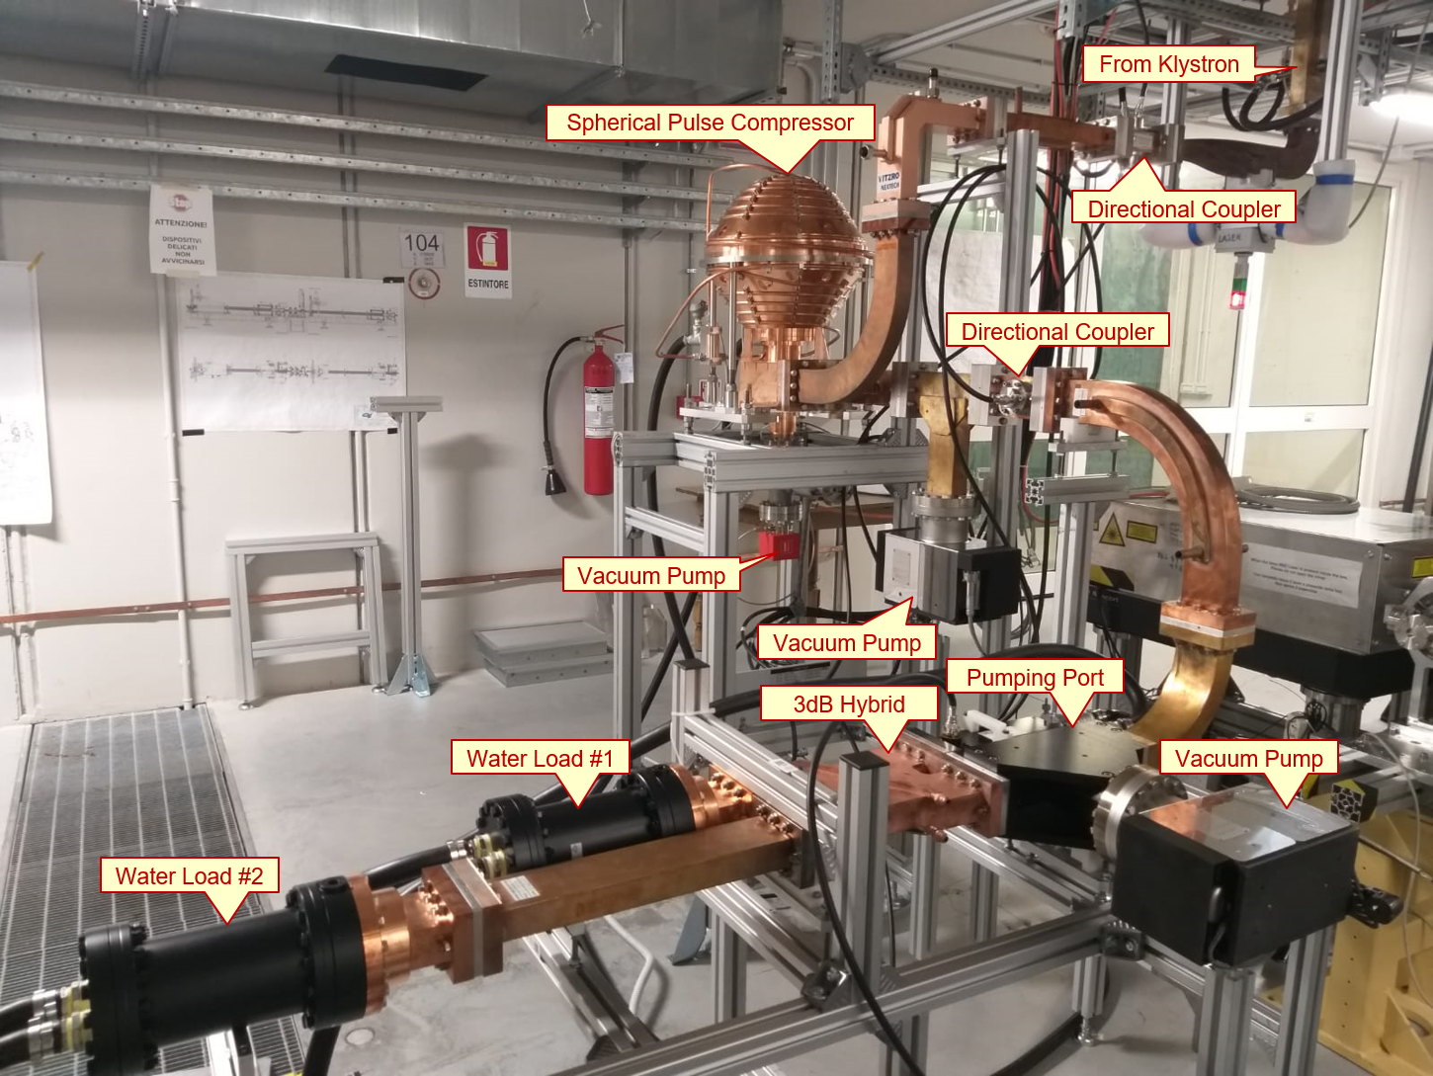

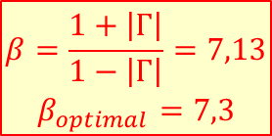
Spherical Pulse Compressor RF test
3.5-fold compression, up to 90 MW output power
To be installed in 2023
$$\begin{matrix}β=\frac{1+\left|Γ\right|}{1−\left|Γ\right|}=7,13 \\ β_{optimal}=7,3\end{matrix}$$
RF Parameters
f₀ | 2.99801 | GHz
Nominal Temperature | 35 | ºC
Mode | TM13
Q0 | ≈140000
Coupling Coefficient | 7.2±0.1
E @ 45 MW | 28.16 | MV/m
H @ 45 MW | 169.75 | kA/m
In-house design
Manufactured by
Conditioning Results
Output RF Power | 90 | MW
Pulse Length | 700 | ns
Input RF Power | 26 | MW
Pulse Length | 4000 | ns
Operating Temperature | 32.25 | ºC
Power Multiplication Factor | 3.45

Slide 17
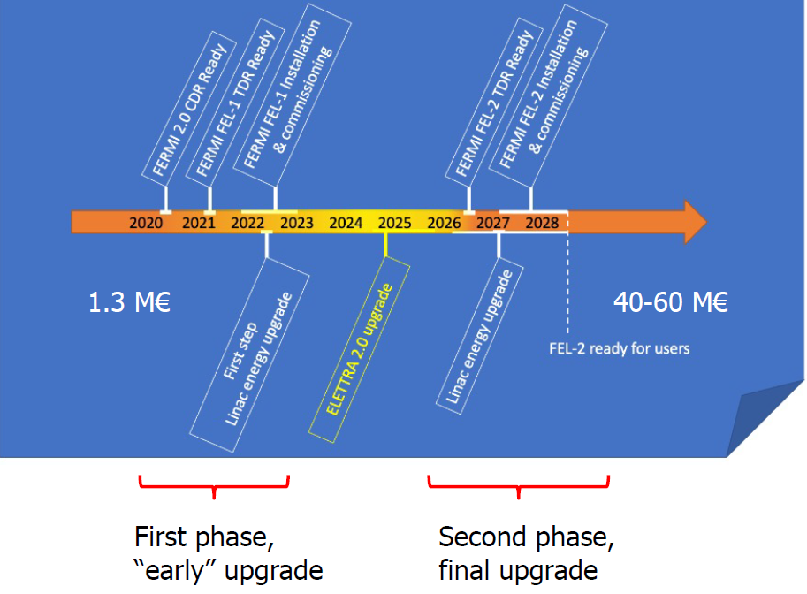

Time plan

Slide 18
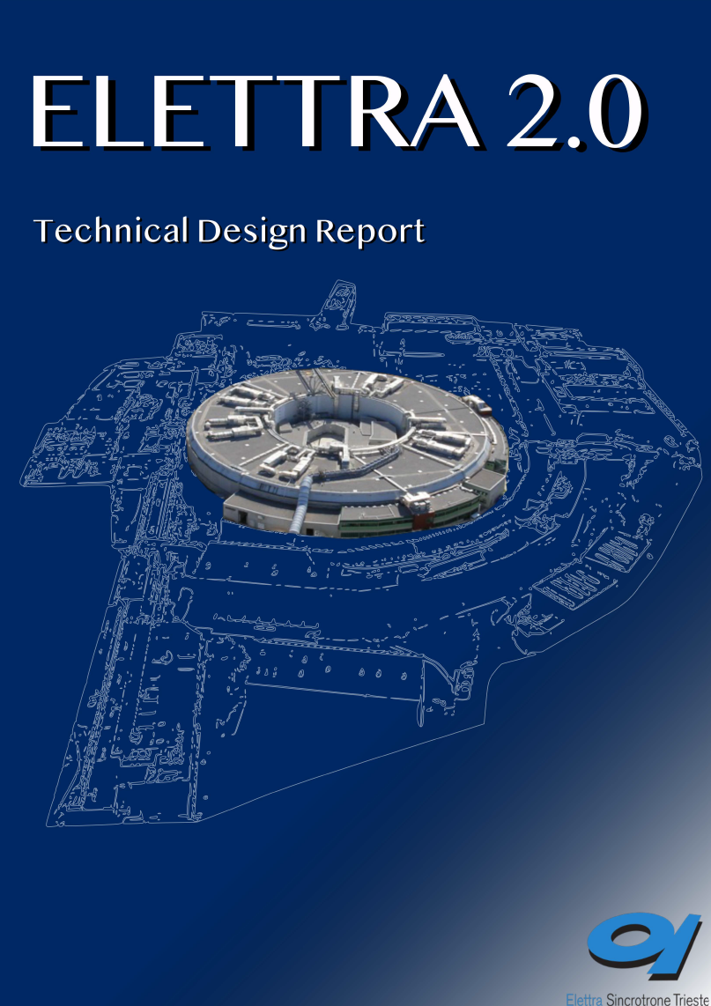
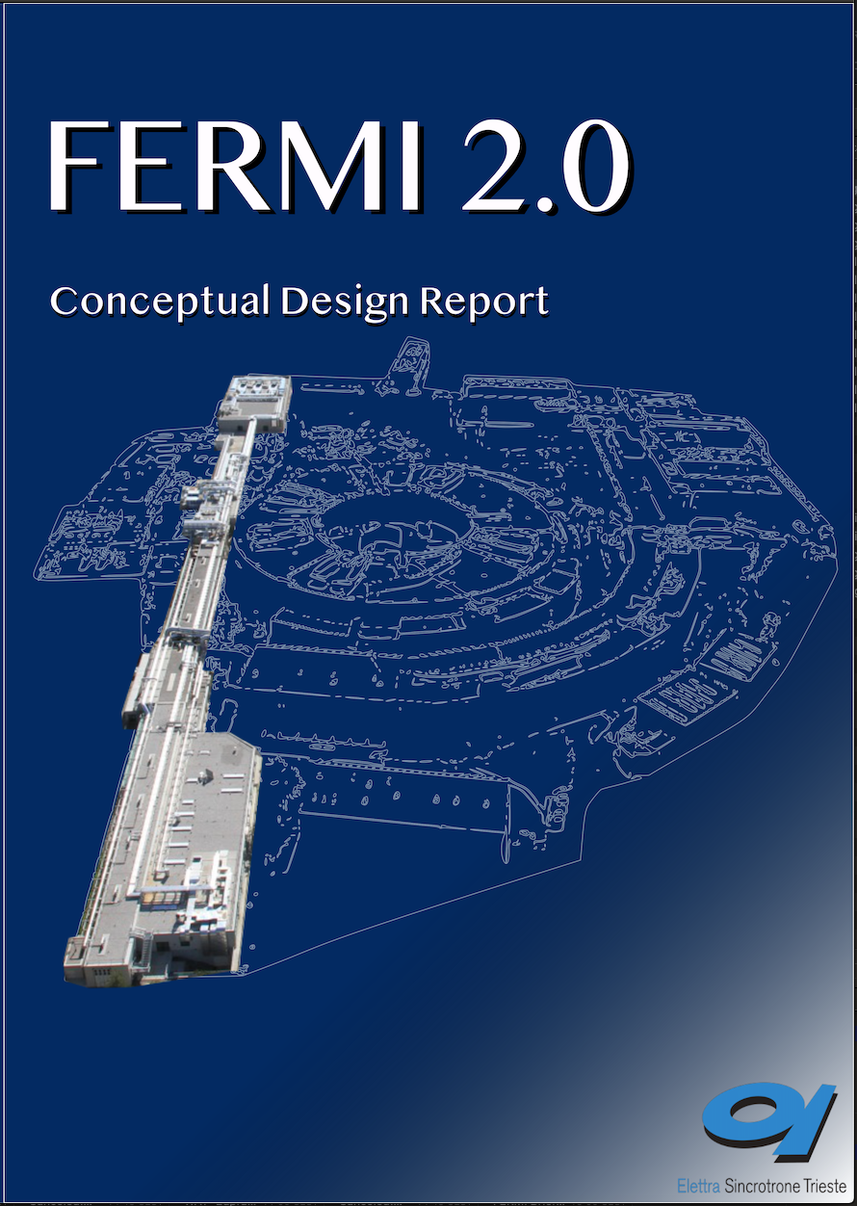
Bibliography
Elettra 2.0 TDR
https://www.elettra.eu/images/Documents/ELETTRA%20Machine/Elettra2/TDR-Machine-Infrastructures-Final-compresso.pdf
Elettra 2.0 physics and design
E. Karantzoulis and W. Barletta, "Aspects of Elettra 2.0 design", NIM A 927 (2019) 70–80
Crab cavities
X. Huang PRAB 2016 & NOCE 2017
A. Zholents et al. NIM A 2015
FERMI 2.0 CDR
https://www.elettra.eu/images/Documents/FERMI%20Machine/Machine/CDR/FERMI2.0CDR.pdf
FERMI FEL physics & upgrade
E. Allaria et al., Nat. Phot. 6 (2012), Nat. Phot. 7 (2013)
P. Rebernik et al., Nat. Phot. 7 (2019)
L. Giannessi, C. Spezzani et al., Proc. of IPAC 2022, TUPOPT018 and TUPOPT019
FERMI linac physics & upgrade
C. Serpico et al., Rev. Sci. Instr. 88 (2017)
N. Shafqat et al., NIM A 867 (2017), NIM A 979 (2020)

Slide 19
Thank you for your attention

Slide 20
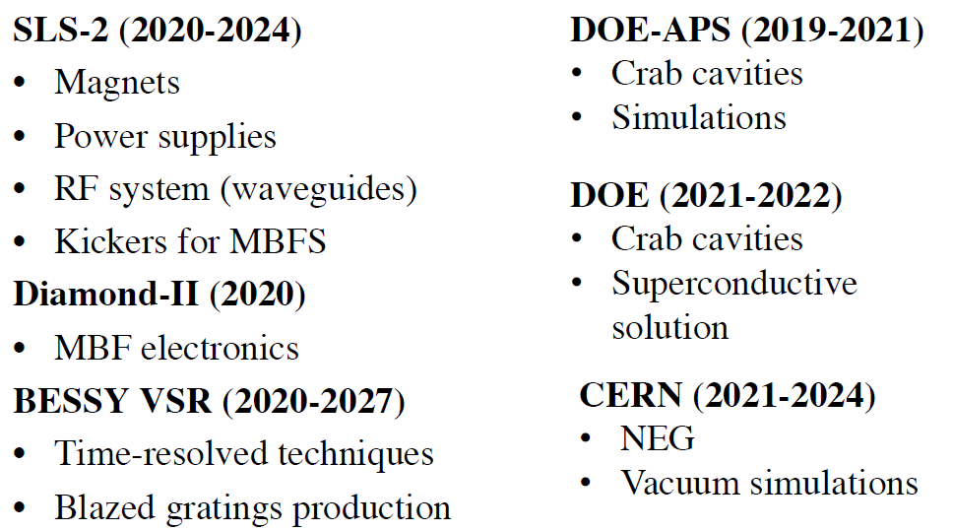
Collaborations and Commitments
Solid state RF transmitters
Multipole magnets
BPM electronics
CDI undulator
CDI experimental station
X-press detector
Electron analyzers
MCX diffractometer
SYRMEP Life Science Beamline
…

Slide 21
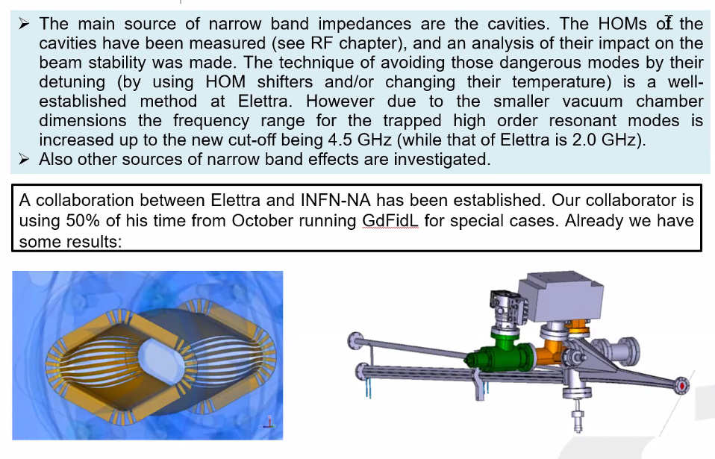
Impedances
ref. A. Passarelli (INFN-NA), E. Karantzoulis, C. Pasotti, S. Cleva (Elettra)
Estimated with well-known formulas, successfully benchmarked for Elettra. Low gap chambers and RF transitions “dominate” the BB impedance of vacuum components.
|Z///n| = 0.8 Ω, |Z⊥| = 0.5 MΩ/m → -0.8 kHz/mA (0.6 @ Elettra)
k// = 20 kV/pC → 3 kW parasitic loss @ 400 mA (with 3HC)
TMCI threshold ∼5 mA
Collaboration with INFN-NA for modelling of special chambers.
HOMs in RF cavities modelled and measured in the past
HOM counteracted with shifters and temperature control, 3HC for longitudinal MB instabilities, transverse and longitudinal feedback.
Damping times ∼ (5, 9) ms vs. (10, 13) ms in Elettra
RF L1 mode characteristic time ∼0.04 ms vs. 0.003 ms in Elettra

Slide 22
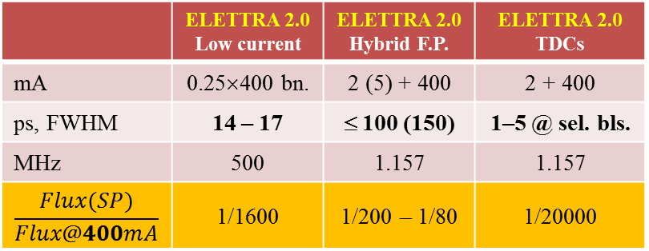
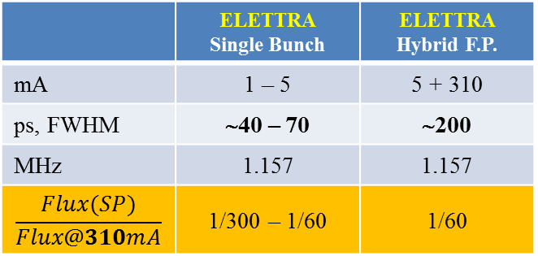
Elettra-TR vs. Elettra2.0-TR
Maximum total stored current is 310 mA @ Elettra-2GeV, 400mA @ Elettra2.0-2.4 GeV
❷ Total stored current in Low Current mode is 100 mA
ELETTRA @ 2 GeV
ELETTRA2.0 @ 2.4 GeV
ELETTRA @ 2 GeV
 | Single Bunch | Hybrid F.P.
mA | 1 (5) | 5 + 310
ps, FWHM | ∼40 – 70 | ∼200
MHz | 1.157 | 1.157
 | 1/300 (1/60) | 1/60
ELETTRA2.0 @ 2.4 GeV
 | Low current | Hybrid F.P. | CC
mA | 0.25×400 bn. | 2 (5) + 400 | 2 + 400
ps, FWHM | 14 – 17 | ≤ 100 (150) | 1–5 @ sel. bls.
MHz | 500 | 1.157 | 1.157
 | 1/1600 | 1/200 (1/80) | 1/9000
❶
❷
❶
❶

Slide 23
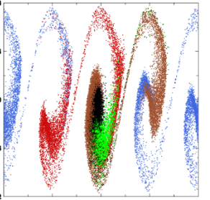
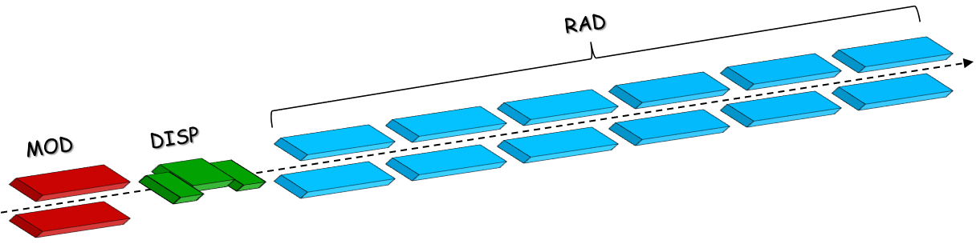
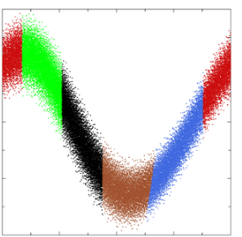
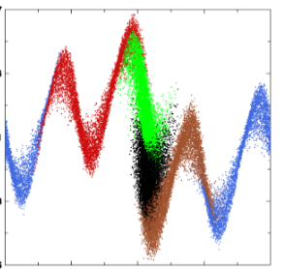
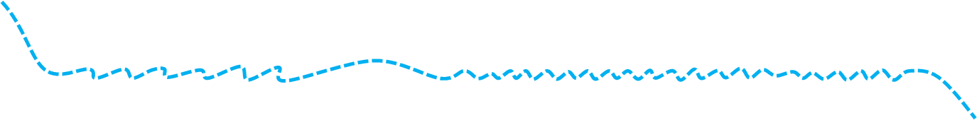

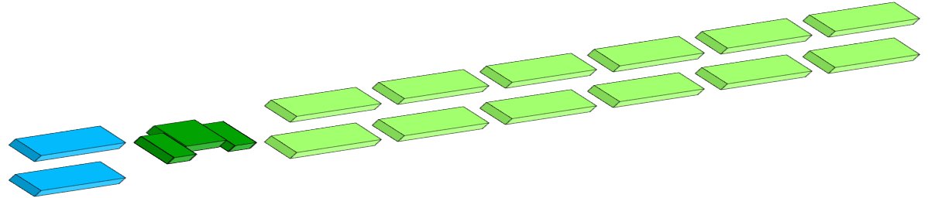
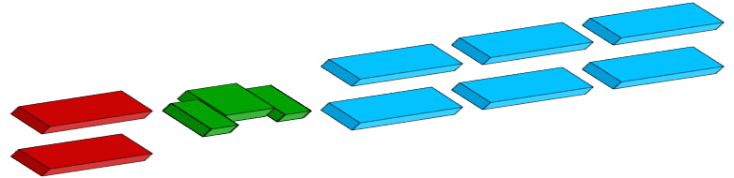

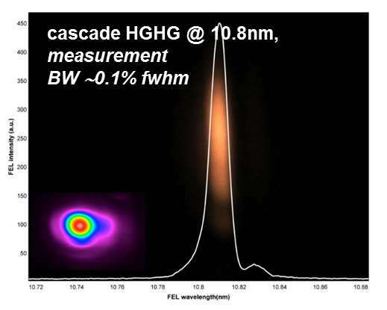
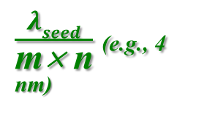



HGHG and HGHG-FB
E
$$λFEL= \frac{λseed}{n}$$
E
z
E
z
z
e⁻ beam
FEL1: HGHG
$\frac{λseed}{\text{m}\text{× }\text{n}}$ (e.g., 4 nm)
$$λFEL,n=\frac{λu}{2nγ2}(1+\frac{K^{2}}{2})$$
λ_{seed}
$\frac{λseed}{n}$(e.g., 32 nm)
λ_{seed} (e.g., 260 nm)
FEL2: Fresh Bunch
“fresh” ( = low energy spread) electrons

Slide 24






e-Beam phase space
N. Shafqat et al., NIM A 867 (2017)
Longitudinal wake
Transverse wake
today
today
upgrade
upgrade
Higher order energy chirps suppressed
Linear compression to 1 kA
Transverse wakefield instability suppressed (proj. emittance / 100)
700 pC, 400 fs for “Fresh Bunch” scheme
24

Slide 25

Lasers upgrade
ref. M. Danailov
Lasers determine availability, reliability and ultimate performance:
PIL : Ti:Sa amplifier upgraded to single pump for more reliable and stable operation.
Seed lasers:
< 60 fs-OPA on FEL1, < 45 fs-THG on FEL2, now available to users; < 200 nm-OPA on FEL2 in preparation.
SLU (pump on sample):
hollow fiber pulse compressor for < 15 fs-UV

