Slide 1



ARYA experiment: Collective effects and instabilities - Present and future
Napoli -LNF-Roma1
M.R. Masullo - M. Migliorati
LNS 02-3-2023
Thanks to Vittorio for all his work and presence

Slide 2
What are collective effects and some useful definitions
Collective effects: class of phenomena in beam dynamics. The evolution of charged particles in a beam depends on both the external EM fields and the extra EM fields created by the other particles.
Increasing beam density (high intensity, high current, high brightness), we can no longer consider the beam as a collection of non-interacting single particles.
The collective interactions can become significant over a defined threshold which depends on the beam intensity instabilities, losses, beam degradation
It is a kind of loop: the particle beam distribution creates EM fields depending on the external environment, which in turn impact the particle distribution and so on.
The beam dynamics is still governed by the Lorentz force but using the total EM fields, summing the external fields due to magnets, RF cavities with new self-induced perturbation fields.

Slide 3
What are collective effects and some useful definitions
Self- induced
EM fields
Space - charge
due to beam self-field (even with PEC and PMC boundaries)
EM interaction with its synchrotron radiation
  Electromagnetic interaction with environment
  charges and currents induced in surrounding structures creates EM fields (wake fields in TD)
  in FD the impedance concept is used. The chamber surface is not PEC or not smooth
Coulomb scattering – collisional effects
Intra-beam scattering
    Touschek effect
EM fields created by a different charge distribution
Electron clouds
positive beams interact with photo-electrons from synchrotron radiation or electrons from ionized gas molecules. Primary electrons hit the wall → secondary electrons emitted from chamber surface.
Avalanche process generated, creating cloud of electrons around the positive beam
Beam-beam (colliders)
Ion trapping (electron beams)

Slide 4
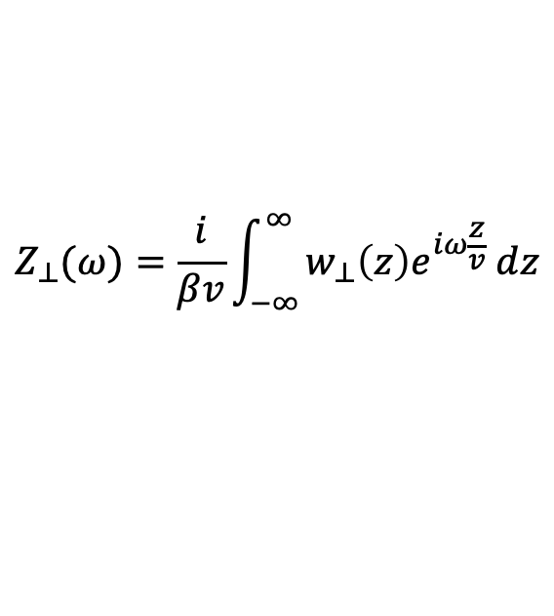
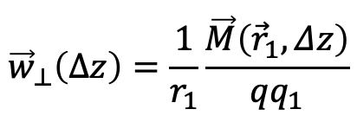
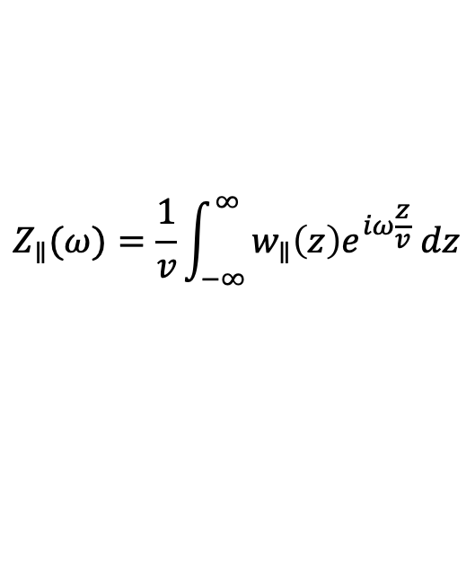
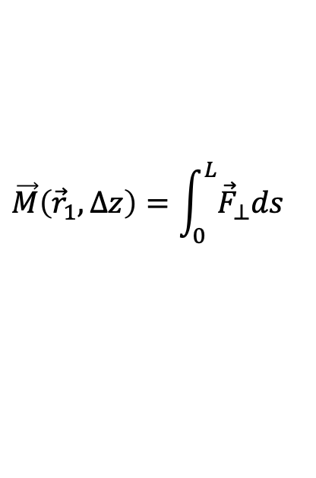
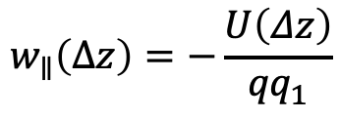
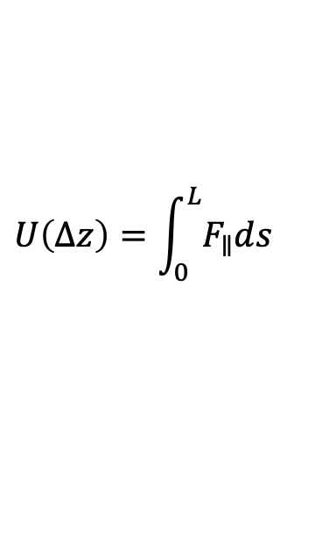
Wake fields, impedances
$$\vec{F}=q\left[E_{z}\hat{z}+\left(E_{x}−vB_{y}\right)\hat{x}+\left(E_{y}+vB_{x}\right)\hat{y}\right]≡{\vec{F}}_{∥}+{\vec{F}}_{⊥}$$
$$U\left(Δz\right)=\int_{0}^{L}{F_{∥}ds}$$
$$w_{∥}\left(Δz\right)=−\frac{U\left(Δz\right)}{{qq}_{1}}$$
Longitudinal wake function
$$\vec{M}\left({\vec{r}}_{1},Δz\right)=\int_{0}^{L}{{\vec{F}}_{⊥}ds}$$
$${\vec{w}}_{⊥}\left(Δz\right)=\frac{1}{r_{1}}\frac{\vec{M}\left({\vec{r}}_{1},Δz\right)}{{qq}_{1}}$$
Transverse dipole wake function
$$Z_{∥}(ω)=\frac{1}{v}\int_{−∞}^{∞}{w_{∥}\left(z\right)e^{iω\frac{z}{v}} dz}$$
Coupling impedance
$$Z_{⊥}(ω)=\frac{i}{βv}\int_{−∞}^{∞}{w_{⊥}\left(z\right)e^{iω\frac{z}{v}} dz}$$
Can influence the motion of trailing particles, in the longitudinal/transverse directions, leading to:
energy loss,
beam instabilities,
secondary effects (excessive heating of components at or near chamber wall)
MITIGATION:
carefully design the vacuum chamber with different cross-sections,
check the surface resistivity (coatings)
Impedance budget is required when designing a new machine, study mixed effects (see Mauro’s talk)

Slide 5
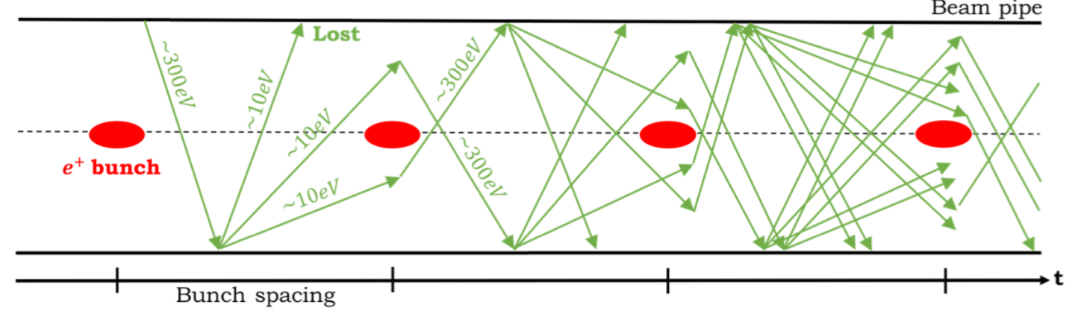
Electron-cloud
Electron multiplication – e⁻ cloud formation:
  e⁻ generation due to:
    photoemission
    residual gas ionization
    desorption from the losses on the wall
  e⁻ (primary) acceleration in the field of passing bunches
  Secondary emission with efficiency larger than one (Secondary Electron Yield – SEY), when the primary electrons hit the inner pipe walls with high enough energy
Consequences
on the machine:
pressure rise,
outgassing,
heat load,
on the beam:
coherent instability (both single and multi-bunch driven),
emittance growth,
luminosity and Energy loss.
MITIGATION Strategies
Surface modifications (geometrical, use low SEY material),
electron scrubbing during machine operation,
electrodes,
external solenoids.
NEG, a-C
Laser Surface Structures

Slide 6
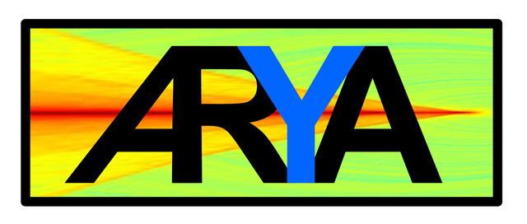
Pushing the machine performance new mechanisms were revealed, the main challenge consists in studying the interplays between these intricate phenomena, as it is very often not possible to treat the different effects separately.
SurfAce and mateRial studies for Accelerator TechnologY And related topics
INFN has a longstanding tradition and a series of highly developed competences on issues related to various aspects of the ongoing global effort in accelerator technology. A dominant aim in our study is the reduction of instabilities due to beam interaction with surrounding environment in future accelerators.
The ARYA project is subdivided in Working Packages (WP’s). The national responsible: Roberto Cimino –LNF in 2020 and from 2021 on, is Maria Rosaria Masullo -Napoli. All the WP’s will tackle research challenges which are studied in international collaborations, more specifically, for Hi-Lumi LHC and FCC.
The goal is to put together a series of competences present in the INFN, and internationally recognized on various aspects related to research in the field of collective effects, to contribute, with publications and nurturing international collaborations, to maintaining the leadership role of the INFN for the studies of these issues transversal to different types of accelerators (present and future).

Slide 7
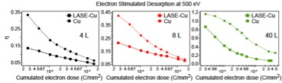
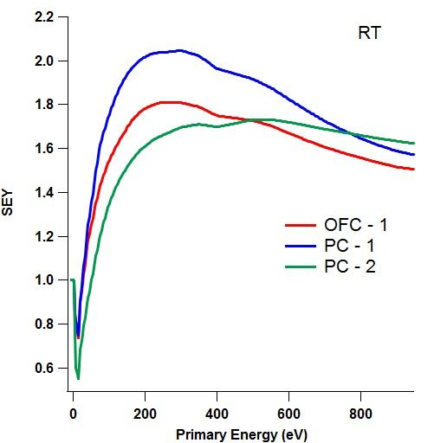
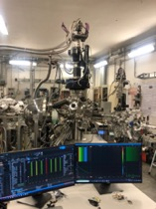
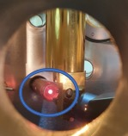
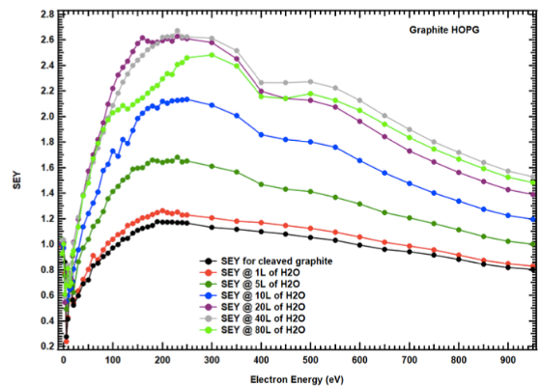

WP | TITLE | UNITS INVOLVED | RESPONSIBLE
WP1 | Comparative study and characterization of stimulated desorption induced by electrons and photons. | LNF-INFN CERN | M. Angelucci & L. Spallino
WP4 | LHCspin: Validation of the surface properties of the accumulation cell with atomic Hydrogen. | CERN LNF-INFN | P. Di Nezza & M. Angelucci
LNF-INFN
Na-INFN
Roma1-INFN
CERN
WP1:
  Understanding of the effects induced by the interactions of surfaces with electrons and photons as a function of adsorbed gases, coatings and morphology.
  Combined studies of XPS, SEY, ESD, on materials(LIPSS, LASE, a-C, etc.)
  Electron stimulated desorption measurements on porous surfaces
  SEY measurements at RoomT e LowT on LIPSS samples in collaboration with Naples unit
WP4:
  Install and test the atomic Hydrogen UHV source
  SEY reliminary measurements on cryosorbed H₂O on Cu and graphite
Workshop e⁻Cloud’22

Slide 8
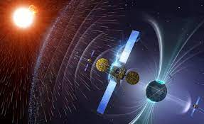
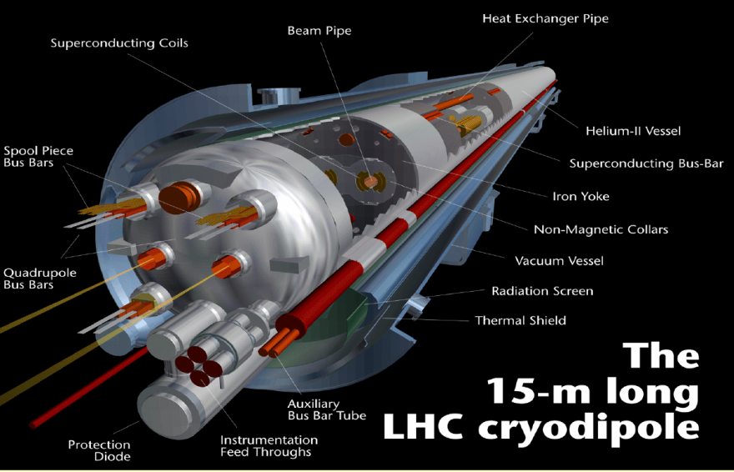

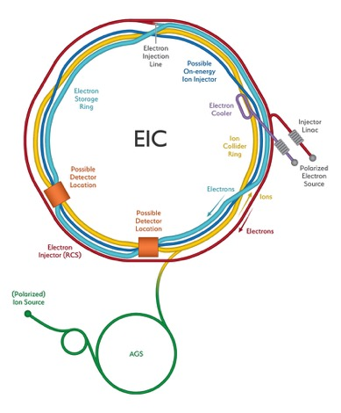

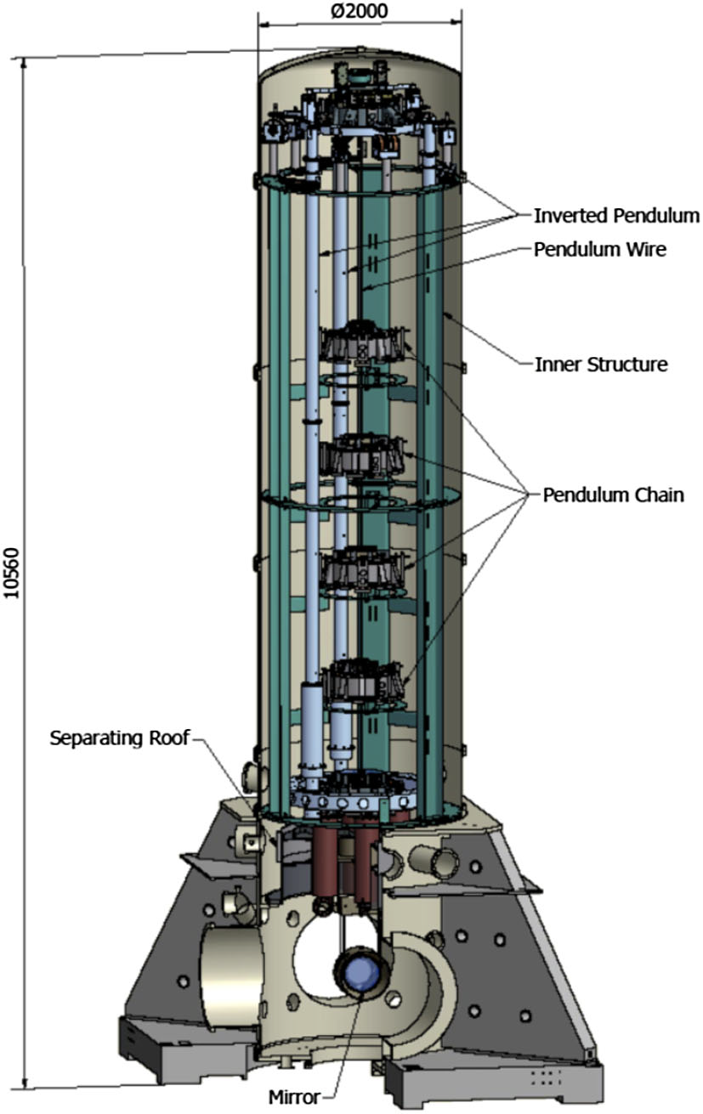
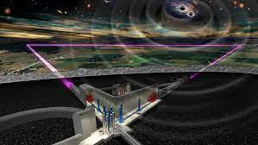
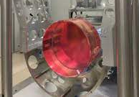

AcceleratorsR&D
Multipacting
Thermal and non thermal desorption from ices condensed on interstellar dust. Analogy with ices condensed inside LHC vacuum chamber
Aerospace
Astrochemistry
Electron-Ion Collider
Einstein Telescope
(Cryogenic Vacuum and SEY mitigation)
EIC
Electron cloud mitigation
Cryogenic Vacuum Issues
(Frost and Charging mitigations)

Slide 9
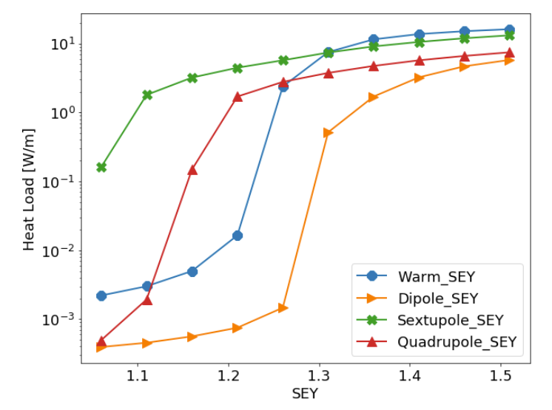
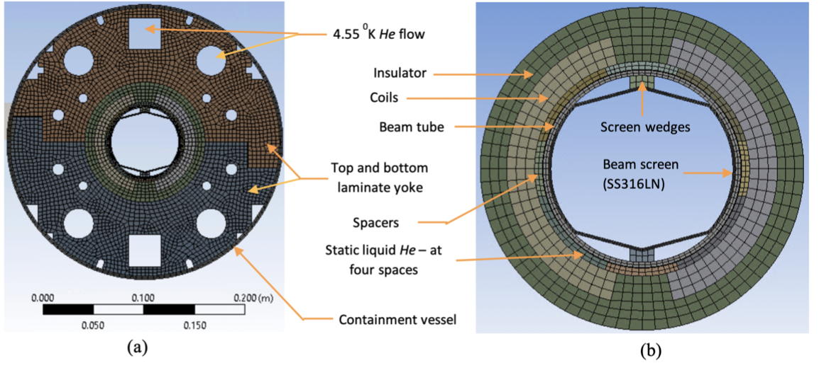
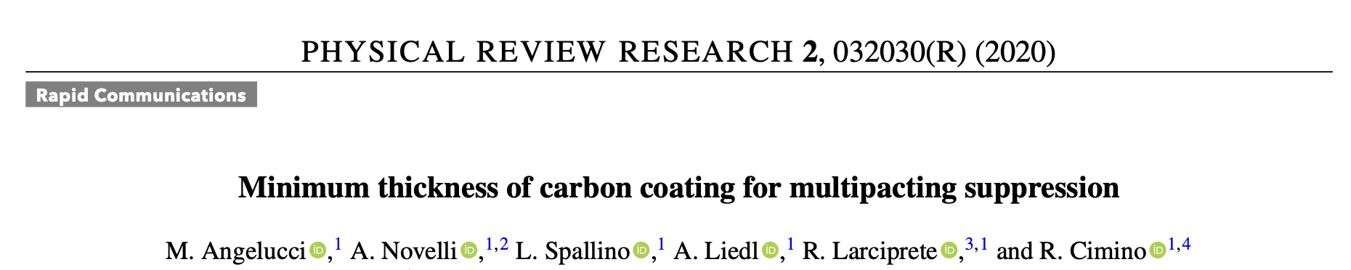
EIC
To avoid high RW heating and electron cloud, a beam screen (BS) will be installed in the beampipe of the RHIC superconducting magnets.
EIC BS beam screen will be made of:
Non-magnetic 316LN stainless steel.
Oxygen-free high-conductivity (OFHC) copper.
Very Low SEY coating. (a-C)
δ < 1.06 (Challenging!!!)
- The a-C coating must be optimized for very low SEY.
- Once the correct deposition procedure has been found, industrial production must be validated (on site)
Minimum Thickness of a-C coating
SEY Characterization of coated surfaces at LNF
Development of a system for SEY measurements
To be performed on site
INFN / DOE MoU

Slide 10
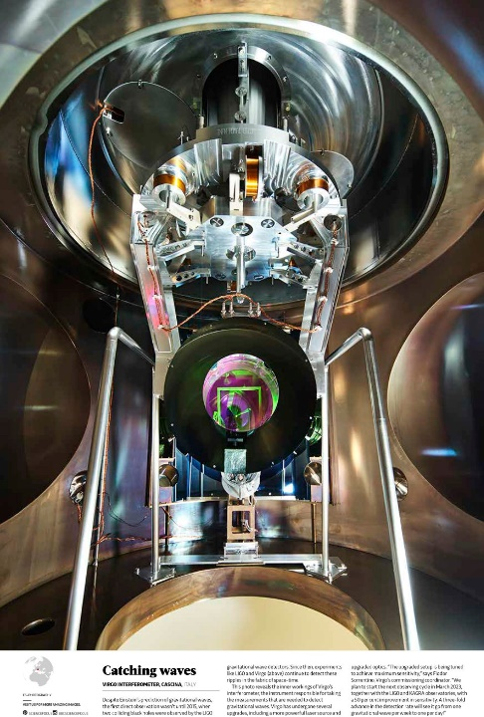
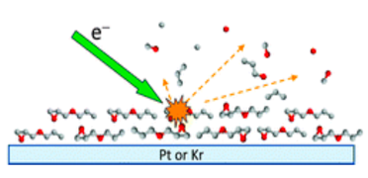
LT SEY and e⁻ des. studies are driving mitigation mechanism for the
Einstein Telescope:
Frost mitigation by electron desorption (ESD)
Charge mitigation by low en. electrons
Mirror

Slide 11
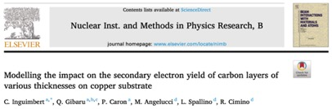
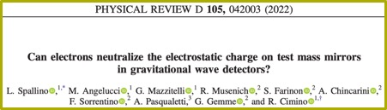

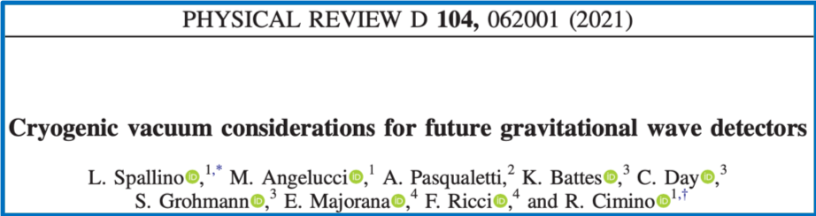
Example of activity

Slide 12
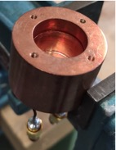
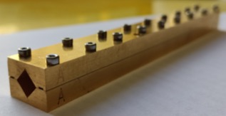
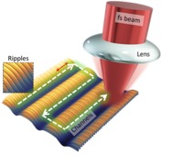
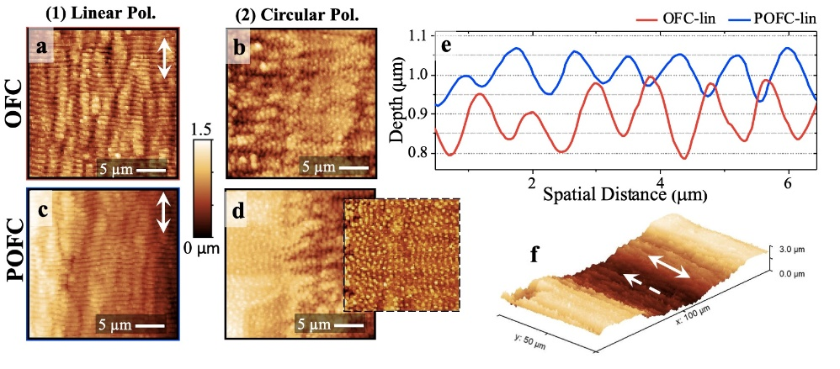
Electromagnetic characterization is fundamental to evaluate accelerator performance limitations and build up a machine impedance model: two different methods
WP | Titolo | Unità coinvolte | Responsabile
WP3 | Impedance study and reduction methodologies; study, construction and characterization on new periodic laser structured conductive surfaces | Na-INFN Roma1-INFN CERN LNF-INFN | M.R. Masullo A. Passarelli
Surface impedance of the beam pipe depends on electromagnetic properties of coatings.
Sub-THz waveguide
• small skin-depth
Dielectric resonator
• high sensitivity
NEG (Non-Evaporable Getter)
LIPSS: Laser Induced Periodic Surface Structure
• homogeneous coating
• conductivity comparable with copper
• small samples
a-C (Amorphous carbon)
• coating thickness issues

Slide 13
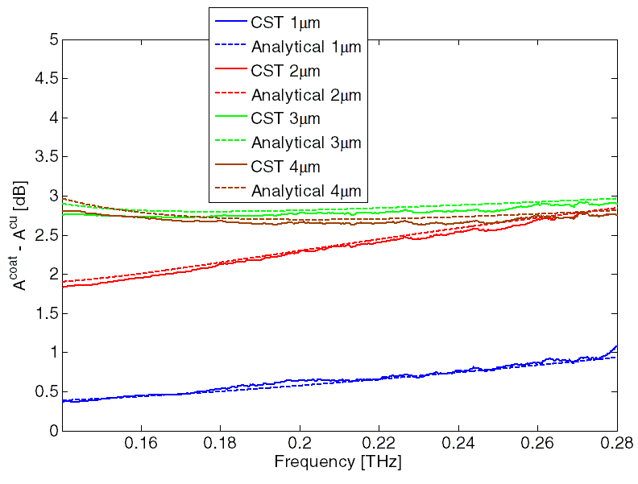
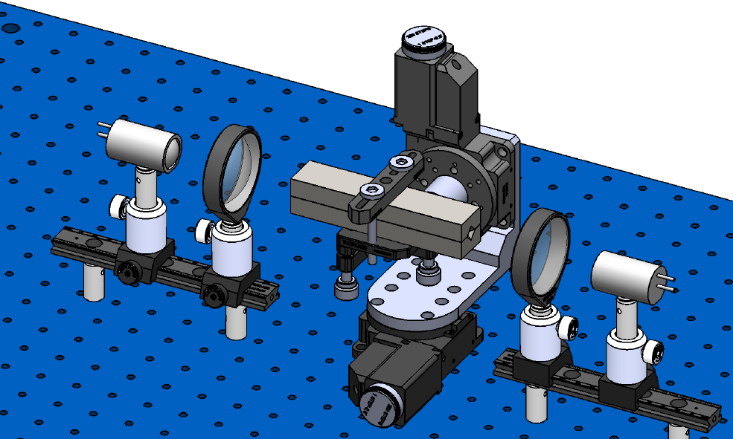
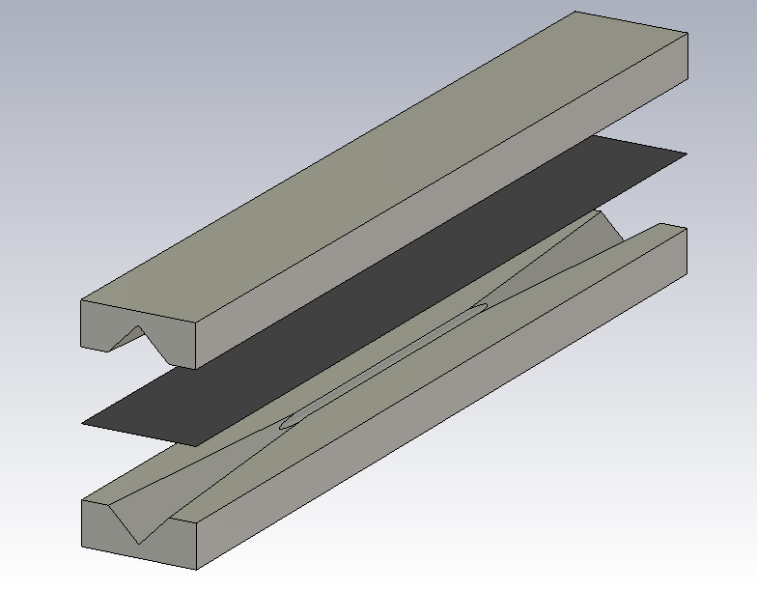
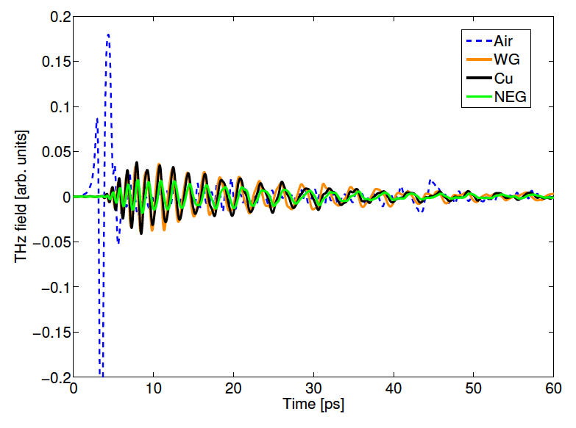
Electromagnetic characterization of coatings in sub-THz
Signal attenuation in DUT with coating
Reliable analytical tool
EM characterization
TD measure
FT

Slide 14
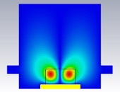
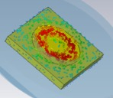
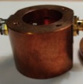
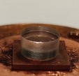
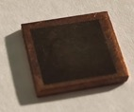
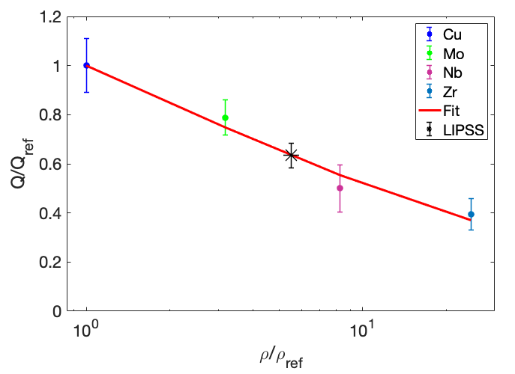

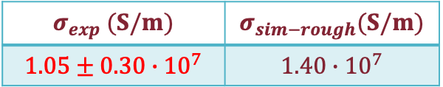
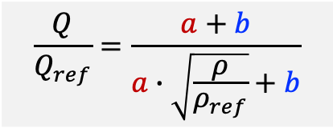
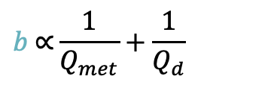
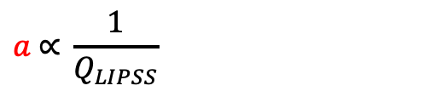
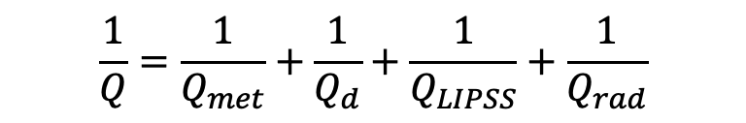
Electromagnetic characterization of LIPSS with dielectric cavity
E field (${TE}_{011}\text{)}$
current on sample
$$\frac{1}{Q}=\frac{1}{Q_{met}}+\frac{1}{Q_{d}}+\frac{1}{Q_{LIPSS}}+\frac{1}{Q_{rad}}$$
Internal walls
Inside dielectric
On sample
Pure copper as reference material-use a calibration curve
Maximun secondary electron yield
LIPSS conductivity value
$$σ_{exp} (S/m)$$ | $$σ_{sim−rough}(S/m)$$
$${1.05±0.30∙10}^{7}$$ | $${1.40∙10}^{7}$$
$$a \text{∝} \frac{1}{Q_{LIPSS}}$$
Losses on the sample
$$\frac{Q}{Q_{ref}}=\frac{a+b}{a∙\sqrt{\frac{ρ}{ρ_{ref}}}+b}$$
$$b \text{∝}\frac{1}{Q_{met}}+\frac{1}{Q_{d}}$$
Losses in the rest of the cavity

Slide 15

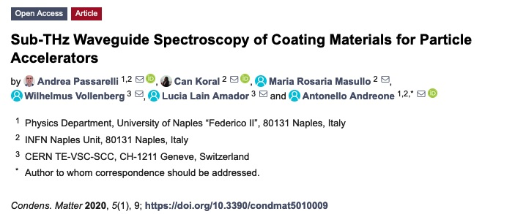
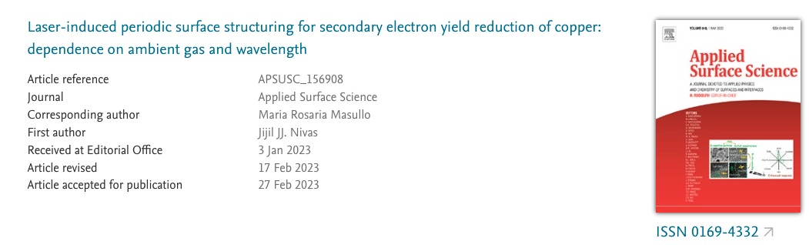

Example of activity within CSN5
Accepted for publication

Slide 16
ARYA WP2
The activity on collective effects has been carried out in Roma1 in the last years also thanks to two CNS5 experiments:
MICA: Mitigate Instabilities in Circular Accelerators.
ARYA: SurfAce and mateRial studies for Accelerator TechnologY And related topics
WP2 | Beam dynamics studies and material properties for future accelerators | Roma1-INFN Na-INFN LNF-INFN CERN | M. Migliorati

Slide 17

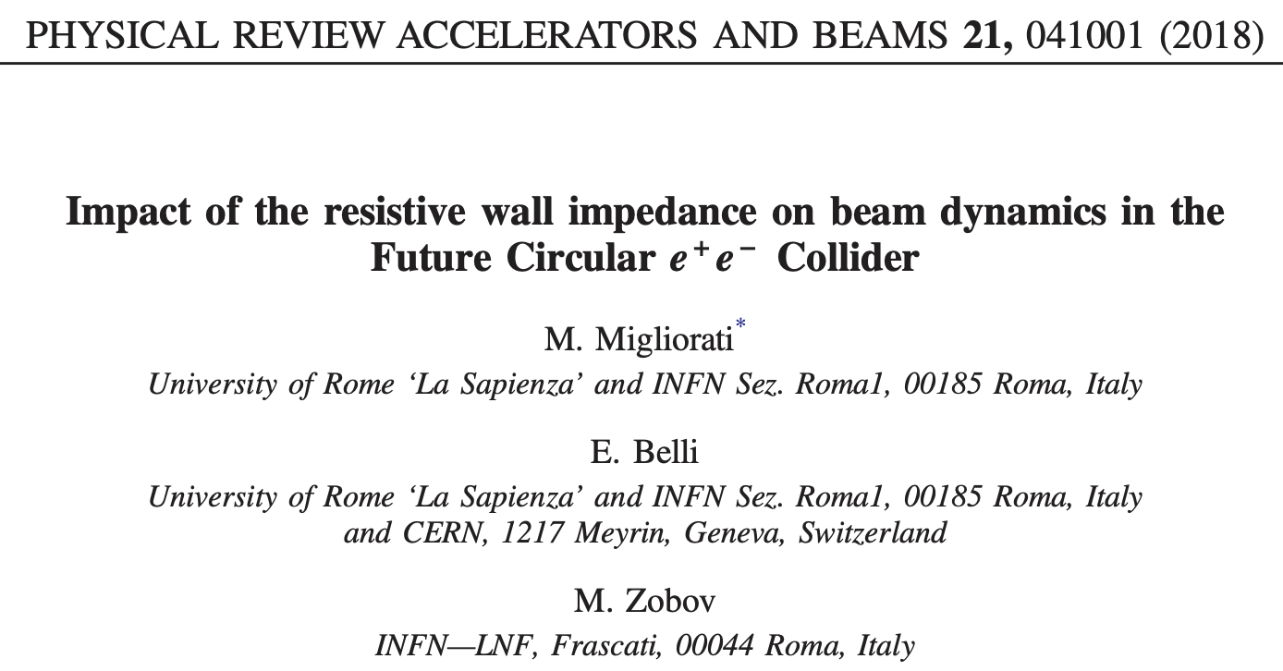
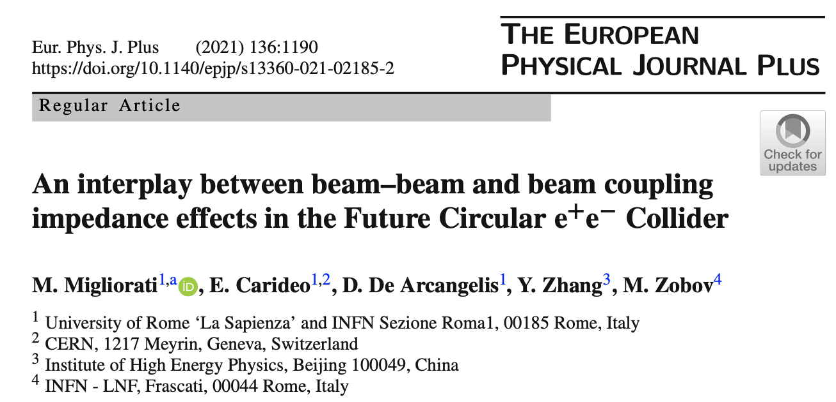

Example of activity within CSN5: contribution to the FCC project

Slide 18
Example of activity within CSN5: contribution to the FCC project
An impedance model for the FCC-ee machine is under development. Beam dynamics studies demonstrated the strong effect of the resistive wall impedance for such a large machine.
One of the major consequences of the study was the decision to reduce the NEG coating of the 100 km of machine from 1 𝜇m to 150 nm to reduce the impact of the RW impedance.

Slide 19


Example of activity within CSN5: contribution to the FCC project
The inclusion of beamstrahlung effect changes the bunch behaviour

Slide 20

Example of activity within CSN5: contribution to the FCC project
Consequences on beam dynamics: wakefields in FCC-ee have a strong impact in many effects, not only impedance-induced instabilities

Slide 21


Example of activity within CSN5: contribution to the FCC project
only transverse wakefield, resistive feedback, 10 turns damping time
long. + transverse wakefield, resistive feedback, 10 turns damping time

Slide 22


Example of activity within CSN5: contribution to the FCC project
Beam beam with 4 IPs and longitudinal wakefield
$β_{x}^{∗}=15$ cm
$β_{x}^{∗}=10$ cm

Slide 23
Collective effects and collaborations
INFN has a longstanding tradition and a series of well developed competences on issues related to the different aspects of the ongoing global effort in accelerator technology aiming to the reduction of collective effects in future accelerators.
LNF, Na, and Roma1 are collaborating in international contests on issues aiming to optimize the performance of most of the existing and future circular colliders:
HiLumi LHC, the upgrade project to increase LHC luminosity by a factor of 10 beyond its design value: Na is involved in the study of mitigation strategies for e-cloud and material EM characterization
FCC (Future Circular Collider): INFN and Roma1 are also participating to the global effort (lead by CERN) to study a post-LHC particle accelerator in a worldwide context. Roma1 is in charge for the evaluation of collective effects.
Electron Ion Collider (EIC): LNF is involved in experimental activities on coating materials for mitigating electron cloud instabilities in the BLN project.
SuperKEKB: in 2021 and 22, Roma1 was leading the Transverse Mode Coupling Instability subgroup of the International Task Force created to deal with some instability issues of SuperKEKB. In 2023 a new group on collective effect has been formed in order to bring together experts on working on beam instabilities in the most important collider projects in the world.
Upgrade of ELETTRA 2.0: since 2021 Na is responsible for the study of innovative engineering solutions of new machine elements considering the reduction of the beam coupling impedance
ONERA lab (The French Aerospace Lab ): LNF is involved on research for new materials with low SEY compatible with aerospace environment

Slide 24
Beam instruments/measurements at SuperKEKB

Slide 25
  Conclusions
The subject of collective instabilities is one of the main topics facing modern high performance accelerators
It is particularly important in all the applications that require accelerators with high current densities (high intensity, high current, high brightness)
Even if the roots of this subject are more than 50 years old, it is still a cutting-edge in the beam physics
Many researchers have been working over the years on this subject and very elegant and well-established theories have been proposed explaining many experimental observations
However, we still need to understand in more detail the interplays among different mechanisms (e.g. impedance and beam-beam, feedback effects, …) and in particular we need to better understand the mitigation techniques

