Slide 1
I.FAST e INFN
Una lunga e proficua collaborazione
Maurizio Vretenar, CERN
Project Coordinator
Seconda giornata acceleratori, 02.03.2023

Slide 2
Summary
Wider objectives and genesis of I.FAST: introduce the collection of activities into a coherent global picture.
The role of Italy in I.FAST: INFN, Elettra, CNR, Italian industry.
Accelerator R&D in the future EU programmes: General trends, next Work Programmes, risks and opportunities.

Slide 3
Integrating Activities for accelerators and the new Innovation Pilot I.FAST
FP6
CARE 01/2004 – 12/2008
5 years, 15.2 M€ EC contribution
Long tradition of EC support to particle accelerator R&D: four successful Integrating Activities have raised 43 M€ EC funding over 16 years (2.7 M€/yr).
EuCARD 04/2009 – 03/2013
4 years, 10.0 M€ EC contribution
FP7
Integrating Activities
Integrating Activities and Innovation Pilot: Development of cross-boundary subjects, not directly followed by large laboratories, with added value coming from collaboration and sharing of resources.
EuCARD-2 05/2013 – 04/2017
4 years, 8.0 M€ EC contribution
ARIES 05/2017 – 04/2022
5 years, 10.0 M€ EC contribution
H2020
I.FAST is a new step in this progress, including for the first time a large industry representation (1/3 of participants!)
Innovation Pilot
I.FAST 05/2021 – 04/2025
4 years, 10.0 M€ EU contribution

Slide 4
I.FAST and Particle Accelerators
Innovation Fostering in Accelerator Science and Technology
An Innovation Pilot, supporting Innovation in Particle Accelerator technologies.
Particle accelerator community entering the age of open innovation:
Sharing of ideas between scientific institutions and companies, to improve high technology products and to identify new products and markets.
Creation of an innovation ecosystem
(Keywords: community, trust, openness, creativity, connection to industry)

Slide 5
Wider goal and Consortium
Wider goal (from the Commission’s Work Programme):
“Demonstrate the role of Research Infrastructures in the
translation of Open Science into Open Innovation”.
Consortium of 48 beneficiaries
8 large RI operators,
12 national research centres,
12 universities,
16 industrial partners (1/3, including 11 SMEs)
from 15 European Countries, supported by 12 partner organisations and >20 collaborating institutions, working on 40 R&D Tasks to develop a portfolio of technologies for the next generation of particle accelerators.
Timeline: 4 years, starting 1 May 2021.
Resources: 10 M€ EC contribution, out of a total project cost of about 19 M€ (co-funding principle).

Slide 6
The role of I.FAST in accelerator research
For the entire XX century, fundamental science as driving force for the development of new accelerators, with its continuous quest for higher energies required to discover new particles.
Today, extrapolating present technologies to reach new physics goals may soon bring accelerators towards the limits of sustainability (dimensions, complexity, cost, energy consumption).
In parallel, increasing demands are coming from accelerators for applied science (photon and neutrons) and healthcare, while new societal applications are appearing.
The scientific goal of I.FAST is to support the development of new more sustainable technologies for basic and applied science, promoting at the same time the transfer of these technologies to society and to a wider accelerator market.

Slide 7
The three I.FAST pillars
These goals correspond to the three I.FAST «pillars», which defined the priorities given in the selection of I.FAST activities following the bottom-up call.
Additional focus areas: training and management of technology infrastructure.
This strategy is coherent with the priorities announced in the 2020 Update of the European Strategy for Particle Physics, and more at large with the priorities of the particle accelerator user communities.
From the EC
From the accelerator community

Slide 8
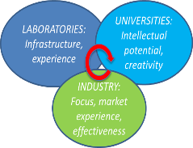
I.FAST Priorities
A project made of “co-innovation” R&D activities with industry, at different Technology Readiness Levels (TRL).
On three priority lines:
Transversality, exploiting synergies between accelerators for different users: particle and nuclear physics, photon and neutron science, medicine and industry.
Collaborative schemes involving laboratories, university and industry.
Priority to long-term R&D topics, beyond the specific needs of approved projects and developments.

Slide 9
Genesis and structure of I.FAST
Bottom-up call in 2019, 101 proposals submitted for:
Strategies: study groups to define “roadmaps” for specific technologies.
Prototypes: construction with industry of prototypes at high TRL, with EC contribution ~ 500 k€.
Developments: development, often with industry, of technologies at lower TRL, with EC contribution ~ 100 k€.
37 proposals selected by a special Committee on the basis of scientific excellence and coherence with the priorities of the accelerator community.
Proposals grouped in 9 “thematic areas” (Work Packages), each made of a strategy with one or more prototypes and developments.
4 “transverse” WPs (Coordination, Training, Industry, Innovation).
1 M€ for a second internal call for proposals in 2023-25.
WP
1 | Coordination, dissemination
2 | Training, communication, outreach
3 | Industry engagement
4 | Managing Innovation, new Materials
5 | New concepts, performance improvements
6 | Novel particle accelerators concepts and technologies
7 | High brightness synchrotron light sources
8 | Innovative superconducting magnets
9 | Innovative superconducting cavities
10 | Advanced accelerator technologies
11 | Sustainable concepts and technologies
12 | Societal applications
13 | Technology Infrastructure
14 | Ethics Requirements
9 thematic areas
Each of the 37 proposals becomes a Task

Slide 10
The I.FAST Structure
The result of this selection process is a large project covering many topics.
Large autonomy for the Task Leaders in managing their Task and in producing the Milestones and Deliverables.

Slide 11
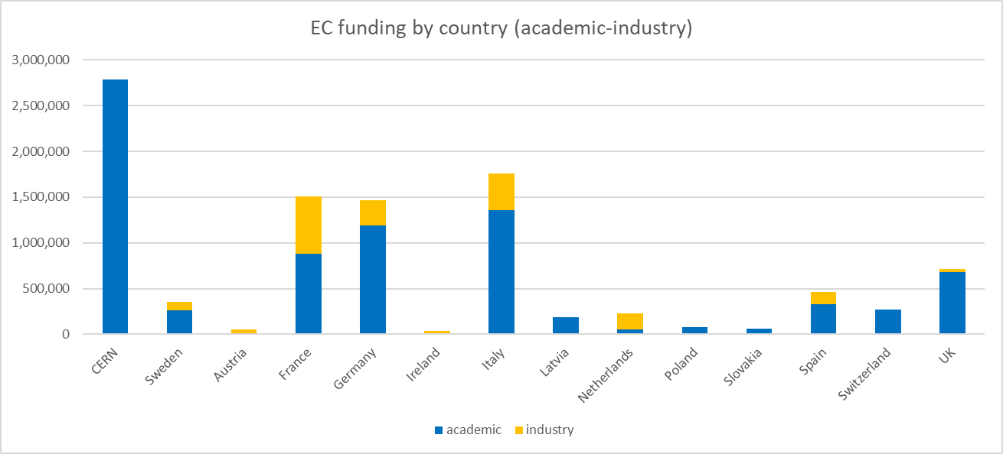
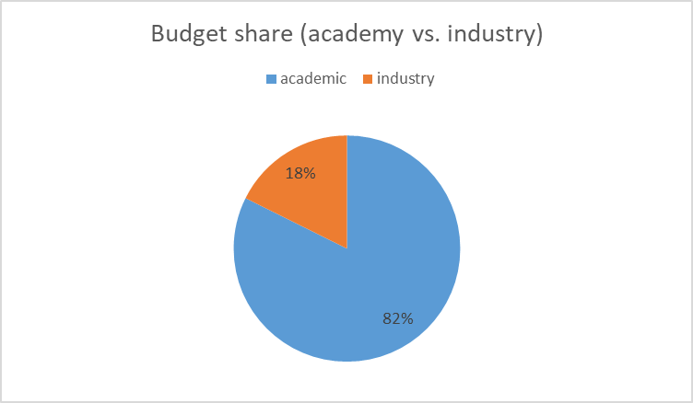
I.FAST Budget
Counting only the R&D WPs (4-13), industry share is 24%
Note: CERN has 1.834 M€ of «coordination» budget (management, communication, KT, Innovation Fund). R&D part (WP 4-13) is only 955 k€.
Overall, Italy is the participant country with the largest share of EC contribution (20.2%)
Overall funding rate 35% (ratio EC contribution / total cost)
18.6 M€ total project cost

Slide 12
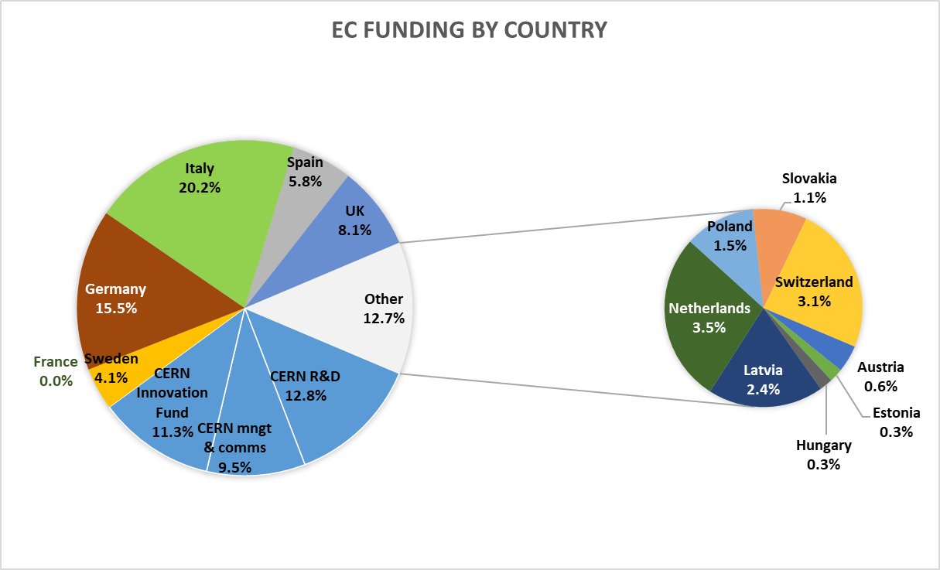
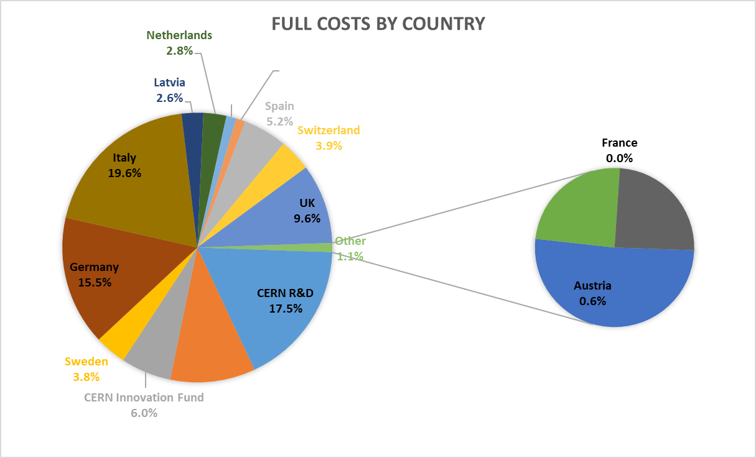
Share of EC contribution and project cost
Italy: 20.2% of EC contribution, 19.6% of total project cost.

Slide 13
Italian contribution to I.FAST - financial
Beneficiary no. | Beneficiary | Person-months | Personnel costs | Travel | Equipment and consumables | Other direct costs | Sub-contracting | Material direct costs | Total direct costs | EC requested funding (including overheads)
21 | CNR | 17.0 | 85,000.00 | 37,500.0 | 10,000.0 | 15,500.0 | 0.0 | 63,000.00 | 148,000.00 | 70,000.00
22 | COMEB | 49.0 | 171,500.00 | 7,000.0 | 85,000.0 | 0.0 | 0.0 | 92,000.00 | 263,500.00 | 157,000.00
23 | ELETTRA | 23.0 | 138,100.00 | 38,000.0 | 0.0 | 125,000.0 | 0.0 | 163,000.00 | 301,100.00 | 168,000.00
24 | INFN | 268.0 | 1,287,200.00 | 115,500.0 | 335,000.0 | 153,500.0 | 0.0 | 604,000.00 | 1,891,200.00 | 1,015,012.50
25 | KYMA | 35.0 | 220,500.00 | 26,400.0 | 225,000.0 | 9,500.0 | 0.0 | 260,900.00 | 481,400.00 | 275,000.00
26 | PICCOLI | 6.0 | 30,000.00 | 0.0 | 10,000.0 | 0.0 | 0.0 | 10,000.00 | 40,000.00 | 30,000.00
27 | PoliMi | 22.0 | 112,640.00 | 3,000.0 | 0.0 | 0.0 | 0.0 | 3,000.00 | 115,640.00 | 73,000.00
Total |  | 420.0 | 2,044,940.00 | 227,400.00 | 665,000.00 | 303,500.00 | 0.00 | 1,195,900.00 | 3,240,840.00 | 1,788,012.50
INFN has by far the largest share with 1.015 M€
Followed by Kyma (275k), Elettra (168k), COMEB (157k)

Slide 14
Italian contribution to I.FAST - scientific
3 WP Coordinators: M. Morandin (WP3, Industry engagement), N. Pastrone (co-coordinator WP5, muon collider), E. De Matteis (WP8, innovative SC magnets).
Task 2.4: Industrial Training associated with Knowledge Transfer (UU, CEA, CERN, CIEMAT, CNRS, DESY, INFN
Task 3.1: Coordination and industrial partnership support (INFN, DESY, CIEMAT, CERN, CEA)
Task 4.1&4.2: Management of Innovation Fund (CERN, CNRS, INFN)
Task 5.1: MUon colliders STrategy network (MUST) (INFN, CERN, CEA, CNRS, KIT, PSI, UKRI)
Task 6.1: Novel Particle Accelerators Concepts and Technologies (DESY, INFN, CERN, CEA, UOXF, CNRS)
Task 6.2: Lasers for Plasma Acceleration (CNR, CERN, INFN, CNRS, THALES)
Task 7.2: Enabling technologies for ultra-low emittance rings (KIT, UOXF, CERN, SOLEIL, DLS, INFN, PSI, KYMA)
Task 7.3: Variable Dipole for the upgrade of the ELETTRA storage ring (CERN, CIEMAT, ELETTRA, KYMA)
Task 7.4: Very high gradient RF Guns operating in the C-band RF technology (INFN, PSI, COMEB, VDL-ETG)
Task 7.5: CompactLight Prototype Accelerating Structure (ELETTRA, CERN, INFN, COMEB, VDL-ETG, TMD)
WP8 Tasks 8.1 to 8.5: Design and construction of CCT magnet demonstrators
WP9 Tasks 9.1 to 9.6: Superconducting thin film coated cavities
Task 10.2&10.3: Additive Manufacturing Survey and Refurbishing (PoliMi, RTU, CERN, CNRS, CEA, INFN, TalTec)
Task 10.4: Development of AM-manufactured superconductive RF cavities (INFN, CNRS)
Task 11.3: Permanent Magnet Quadrupoles for Ultra Low-Emittance Rings (UKRI, DLS, KYMA)
WP12, AMICI Network

Slide 15
Italian contribution to I.FAST - highlights
Key strategic R&D lines:
Muon colliders (INFN-LNF)
Plasma acceleration (INFN-LNF)
RF guns (INFN-LNF)
Light source technology (Elettra, Kyma)
CompactLight (Elettra)
CCT SC magnets, incl. HTS (INFN-LASA)
Thin film coatings (INFN-LNL and PD)
Additional contributions:
Management of Innovation Fund
Collaboration with industry
What is missing:
(Important WP’s in I.FAST with no Italian contribution):
Sustainability and sustainable technologies
Societal applications of accelerators
Project management

Slide 16
Added values for INFN and Italy
Additional budget and visibility for strategic R&D lines of the organisations.
Integration in a network of international connections and support, impacting on the visibility and reputation of the scientific system.
Participation in a programme with well defined project management culture and reporting methodology.

Slide 17
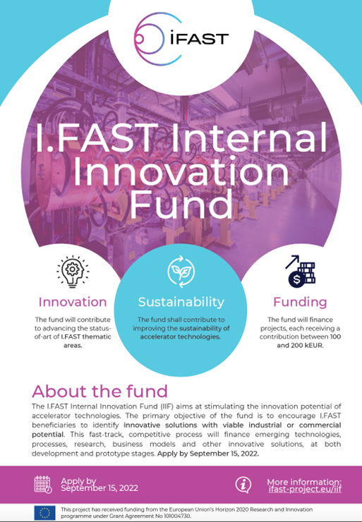
Highlights: the I.FAST Innovation Fund
Task 4.2, Management of the Innovation Fund.
1 M€ funding to an internal competitive call for innovative projects, starting early 2023, for a duration of 2 years. In advance on schedule (awarding at M20 instead of M24)
Funding between 100 and 200 k€ per project;
Consortium: at least one I.FAST beneficiary and one industry;
Initial TRL 3 or higher (from proof-of-concept to laboratory/environment validation);
Project contributes to improving sustainability of particle accelerator technologies;
Project must have potential for industrialisation or commercialisation.
Project must have potential to attract more resources than what deployed by IFAST alone.
18 projects submitted, 8 selected by a 10-member Evaluation Committee:
2 on high-efficiency RF, 2 on superconductivity, 2 on particle sources, 1 on laser plasma acceleration, 1 on additive manufacturing.
Smooth selection procedure and excellent quality of the selected projects!

Slide 18
Italy in the I.FAST Innovation Fund
 |  | kEUR | kEUR
Name | Institute | Budget beneficiary | Budget partner | Total
1. PM for klystron | CERN | 15 |  | 115
 | ELYTT | 100
2. HIGHEST | CERN | 10 |  | 160
 | CSIC |  | 50
 | Ceraco |  | 100
3. FE cathode | PSI | 100 |  | 200
 | VDL | 100
4. KAIO | CNRS | 180 |  | 200
 | CNR | 20
5. SSPA driven CFA | UU | 200 |  | 200
6. msec flash | INFN | 40 |  | 160
 | HZDR |  | 110
 | Piccoli | 10
7. AM for ion source | INFN | 75 |  | 100
 | CERN | 25
8. AM vacuum chambers | RHP | 75 |  | 100
 | SBI |  | 25
TOTALS |  | 950 | 285 | 1235
Total 125 k€ funding over 1.235 M€ budget
(10%, slightly lower than Italian participation in I.FAST)
INFN gets 115 k€
6. Millisecond flash lamp treatment for SRF accelerating cavities (INFN, HZDR, PICCOLI) - develop a novel thermal process to improve performances of superconducting (SC) coating by suppressing (reducing) Cu substrate heating.
7. AM applications of refractory metals for Ion Source cavities (INFN, CNR) - develop new Refractory Metals Alloys specifically designed for Additive Manufacturing (AM) to improve the physical performance of the ion sources (Ta-based and/or Nb- based alloys).

Slide 19
I.FAST Project Review
A Review of the project (period 1, first 18 months) took place on 9 February (reviewer: Prof. Zeyrell of Ankara University, REA project officer: A. Ventura).
Very well prepared presentation by WP Coordinators and Task Leaders.
Very positive results:
The agreement for WP8 new work plan and budget was endorsed by the PO, no need for an Amendment.
Similarly, an extended scheme for industry exchanges was approved.
Final comments by the reviewer: big progress, excellent labs, fine results, only few delays without impact on the overall schedule. The final report is very positive.

Slide 20
Withdrawal of 2 industrial partners
WP on SC magnets Tasks 8.4, Construction of a curved CCT magnet demonstrator and Task 8.5, Construction of the HTS CCT demonstrator.
Two industrial companies (BNG and Scanditronix) have sent a letter to the Coordinator asking to quit the Project because they “cannot fulfil the milestones to build the requested hardware with the budget available”: “material and energy prices have risen dramatically since the start of the project. We are thus not any more in the position to allocate R&D money … into I.FAST.”
Actions:
Instead of declaring the companies as defaulting partners, the Project will keep them in the collaboration, with 0 or minimum EC contribution, and try to redistribute their work to others. Thanks to the tireless work of the WP8 management, a satisfactory solution worked out:
Elytt (3rd magnet company in the project) has already agreed to take BNG’s part in Task 8.5.
We have explored solutions for Task 8.4: internalisation to another I.FAST partner, or another magnet company. Possible descoping and increasing risks (technical and delay).
A solution has been recently agreed (internalisation to CIEMAT).

Slide 21
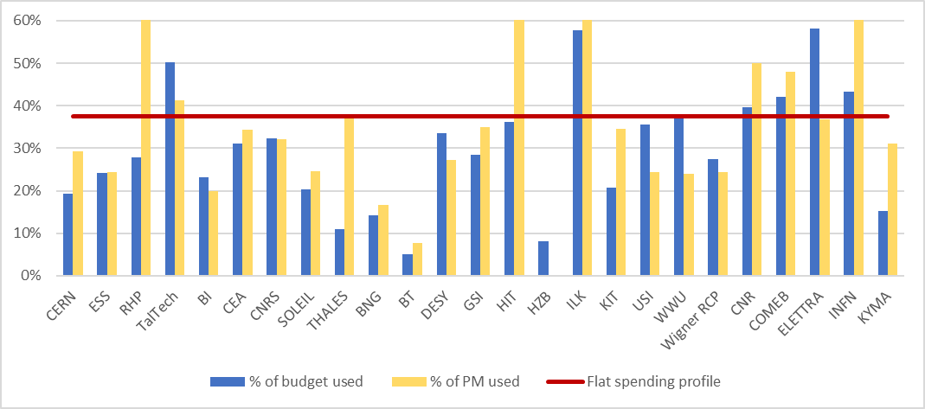
Use of resources in P1 – Full costs
Utilisation of personnel and resources per beneficiary during P1 (May 2021 – October 2022).
The resources cover the full costs incurred by the beneficiaries (EC contribution + matching funds, without overheads) and are shown as percentage of the estimated total man-power and budget for the complete duration of the project.
INFN has already spent 60% of personnel and 42% of material costs (37.5% if linear at M18)

Slide 22
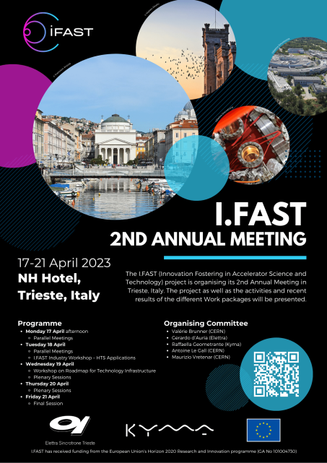
Annual Meeting 2023 in Trieste
Industry Workshop on HTS developments and applications, Tuesday 18/4
Workshop on Roadmap for Technology Infrastructure, Wednesday 19/4
Plenary sessions We 19/4-Fr 21/4
Multidisciplinary Workshop on AI and accelerators, Thursday 20/4
Presentation of IIF Projects, Fr 21/4
Visits of Elettra, Wednesday 19/4, and Kyma, Friday 21/4.
Welcome cocktail at the historical Caffé Tommaseo, dinner banquet at the Yacht Club, visits of the city.

Slide 23
Future EU accelerator programmes
We get our funding from the Research Infrastructure part of Horizon Europe – that was the only one with a reduced budget w.r.t. Horizon 2020.
The political messages in Brussels (DG/RTD) are not very clear: change of DG (J.E.Paquet to M. Lemaitre from 16.2), continuous changes of RI HoU (L. Karamalis is leaving, replacement not appointed yet). The transition to subcontracting RI calls and Programme is also detrimental.
In this lack of political guidance, the RI Work Programme Committee (international, italian repr. G. Pappalardo) has taken the lead and decided to reorient the calls towards RI’s providing “services”. No more “communities” (H2020 to HE), no more “innovation” (allegedly moved to the new EIC).
Some of our activities of interest can move to the new INFRA-TECH calls (10M for common development of advanced instruments by at least 3 RI’s of European relevance), or continue in the INFRA-DEV calls (design studies).
We keep claiming that a general project centred on a series of low-TRL activities developed by consortia of laboratories with a strong industry participation (innovation) is essential for the progress of particle accelerator technologies in Europe, serving multiple user communities.

Slide 24
Short, medium and long term TIARA programme
The TIARA Collaboration Council (chair: E. Nappi, coordinator J.M. Perez, scientific secretary M. Vretenar) is closely following the preparation of new calls and proposals for accelerators, and is constantly in contact with the EC to promote our activities.
HORIZON-INFRA-2024-TECH-01-01: R&D for the next generation of scientific instrumentation, tools, methods, solutions for RI upgrade
INFRA-TECH call, 10 M€, 12.03.2024, 1 proposal bw. “intense muon beams” and “HTS magnet technology”. + one more on plasma wakefield?
Short
(2024)
Medium
(WP 2025/
2027)
Long
(next Horizon
2028-2035)
HORIZON-INFRA-2024-DEV-01-01: Research infrastructure concept development
INFRA-DEV call, 3 M€, 12.03.2024, so far 1 proposal on “gamma factory”
Present to the RI Unit a proposal for a post-IFAST call in 2025 (new Work Programme 25+ in preparation) for “innovation-like” activities for the 3 INFRA-INNOV advanced communities (accelerators, synch. light instruments, detectors), goal 10 M€ each.
Aim for a long-term co-funded partnership for accelerators in the next Horizon programme.

Slide 25
Thank you for your attention!

Slide 26
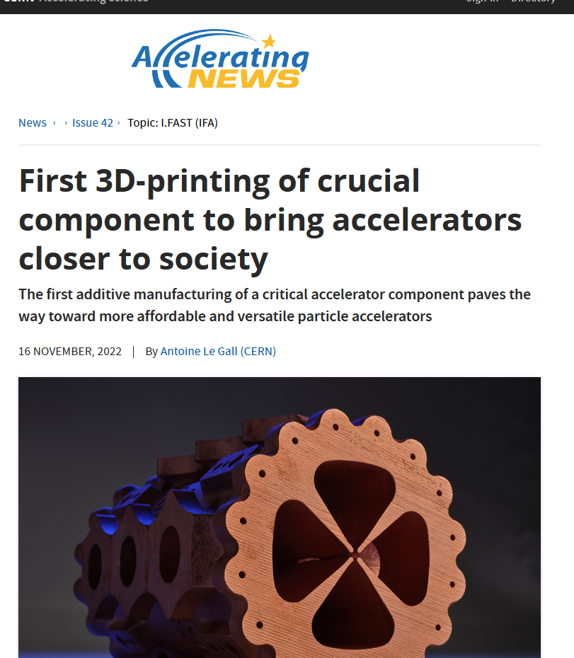
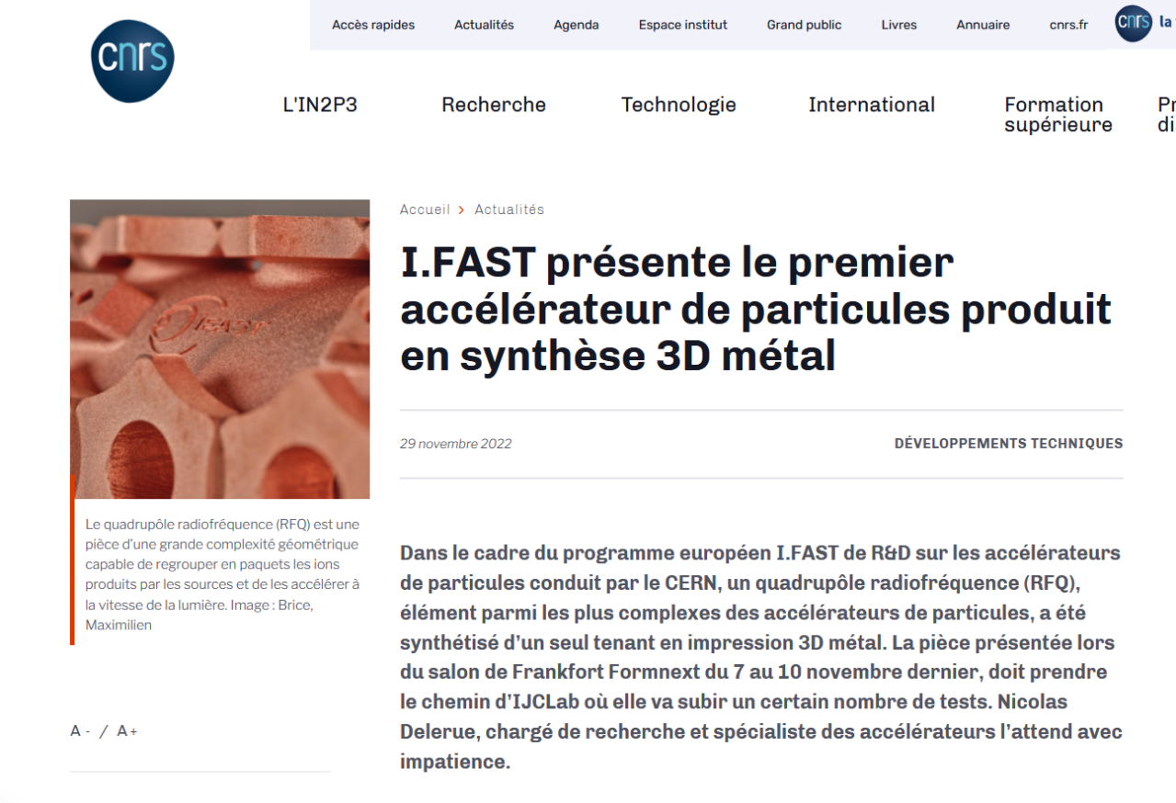
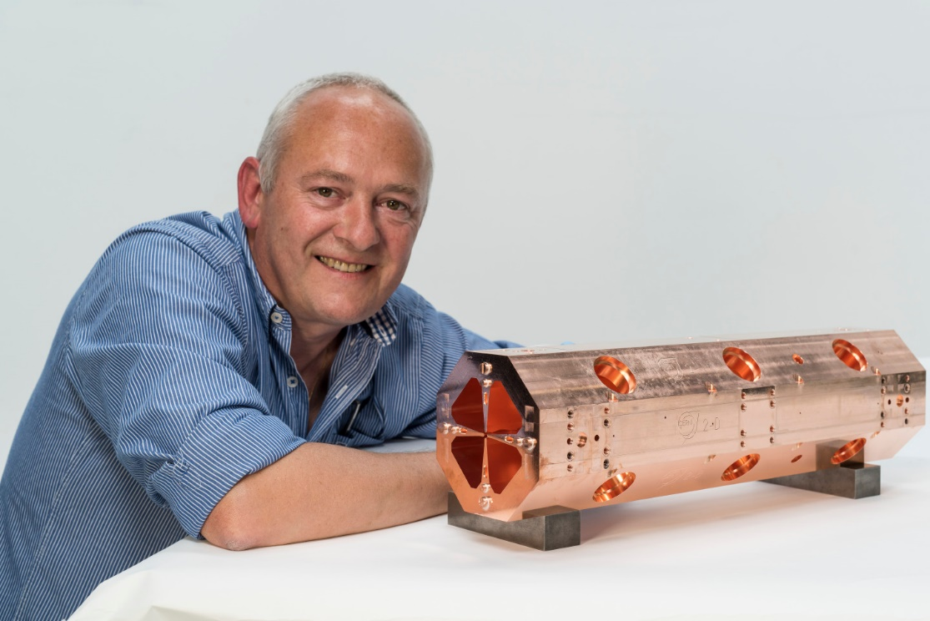
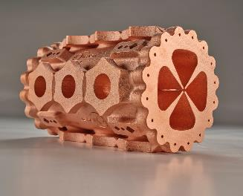
Highlights: Additive-Manufactured RFQ
Task 10.2, Additively-Manufacturing (AM) survey and potential developments.
Aimed at identifying specific needs for AM (3D printing) in accelerators, no prototyping foreseen. At the start of work, the Radio Frequency Quadrupole (RFQ) compact copper linear accelerator for medical and industrial applications was identified as a component that could greatly profit from AM in terms of production time and cost.
The Task has contacted industrial partners, and Trumpf AG has agreed to produce at no cost for the project a full-scale prototype that is being tested by the Task. Trumpf is joining the Consortium as Partner Organisation.
Wide impact: articles, exhibitions, press release, CERN Bulletin, Accelerating News, CNRS newsletter, CORDIS.
The 3D-printed version
The original RFQ, machined and brazed

Slide 27
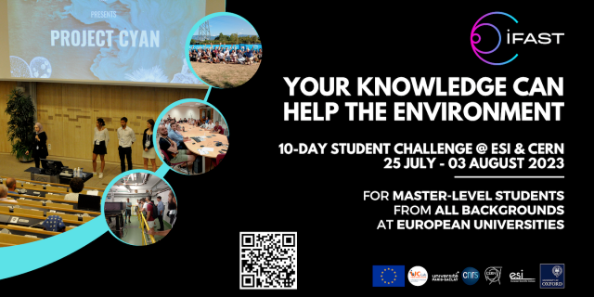
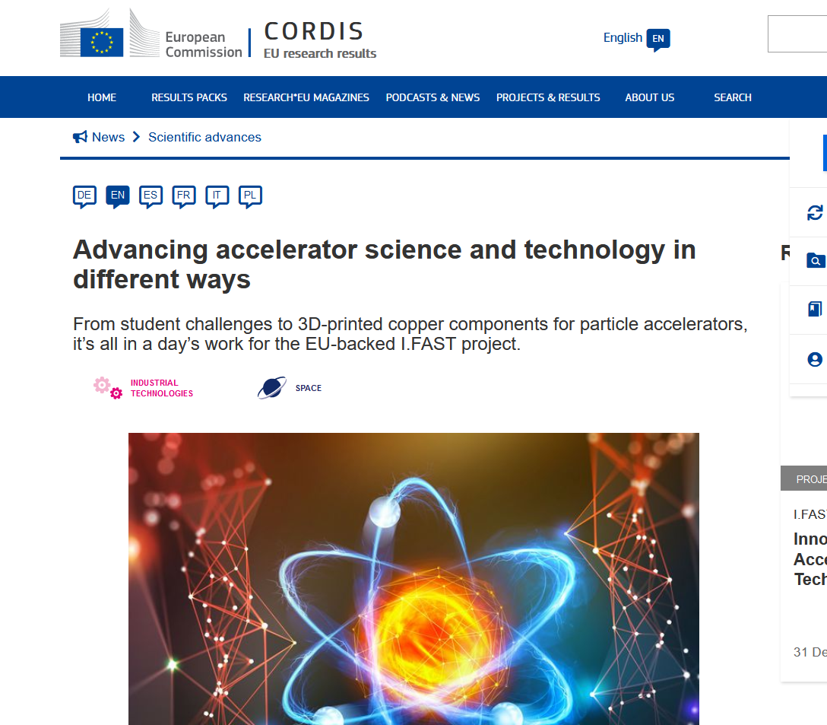
Highlights: Challenge Based Innovation
Task 2.3, Challenge-Based Innovation (CBI) with particle accelerators.
Residential challenge for 24 master students with different backgrounds organised in 4 teams to propose new applications of accelerators for the environment.
Winner: project CYAN for stopping eutrophication (harmful algal bloom) in lakes.
Strong success, projects will be followed-up, articles on CERN Bulletin, Accelerating News and other newsletters, CORDIS. Will be repeated in 2023.

Slide 28
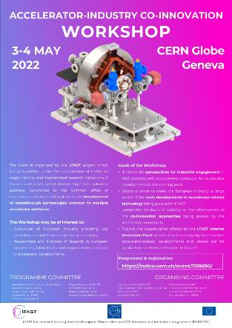
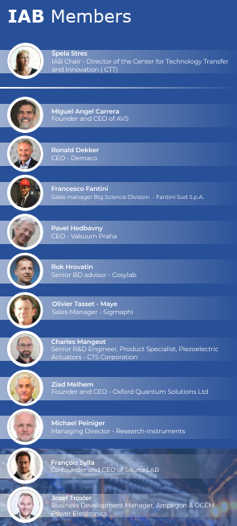
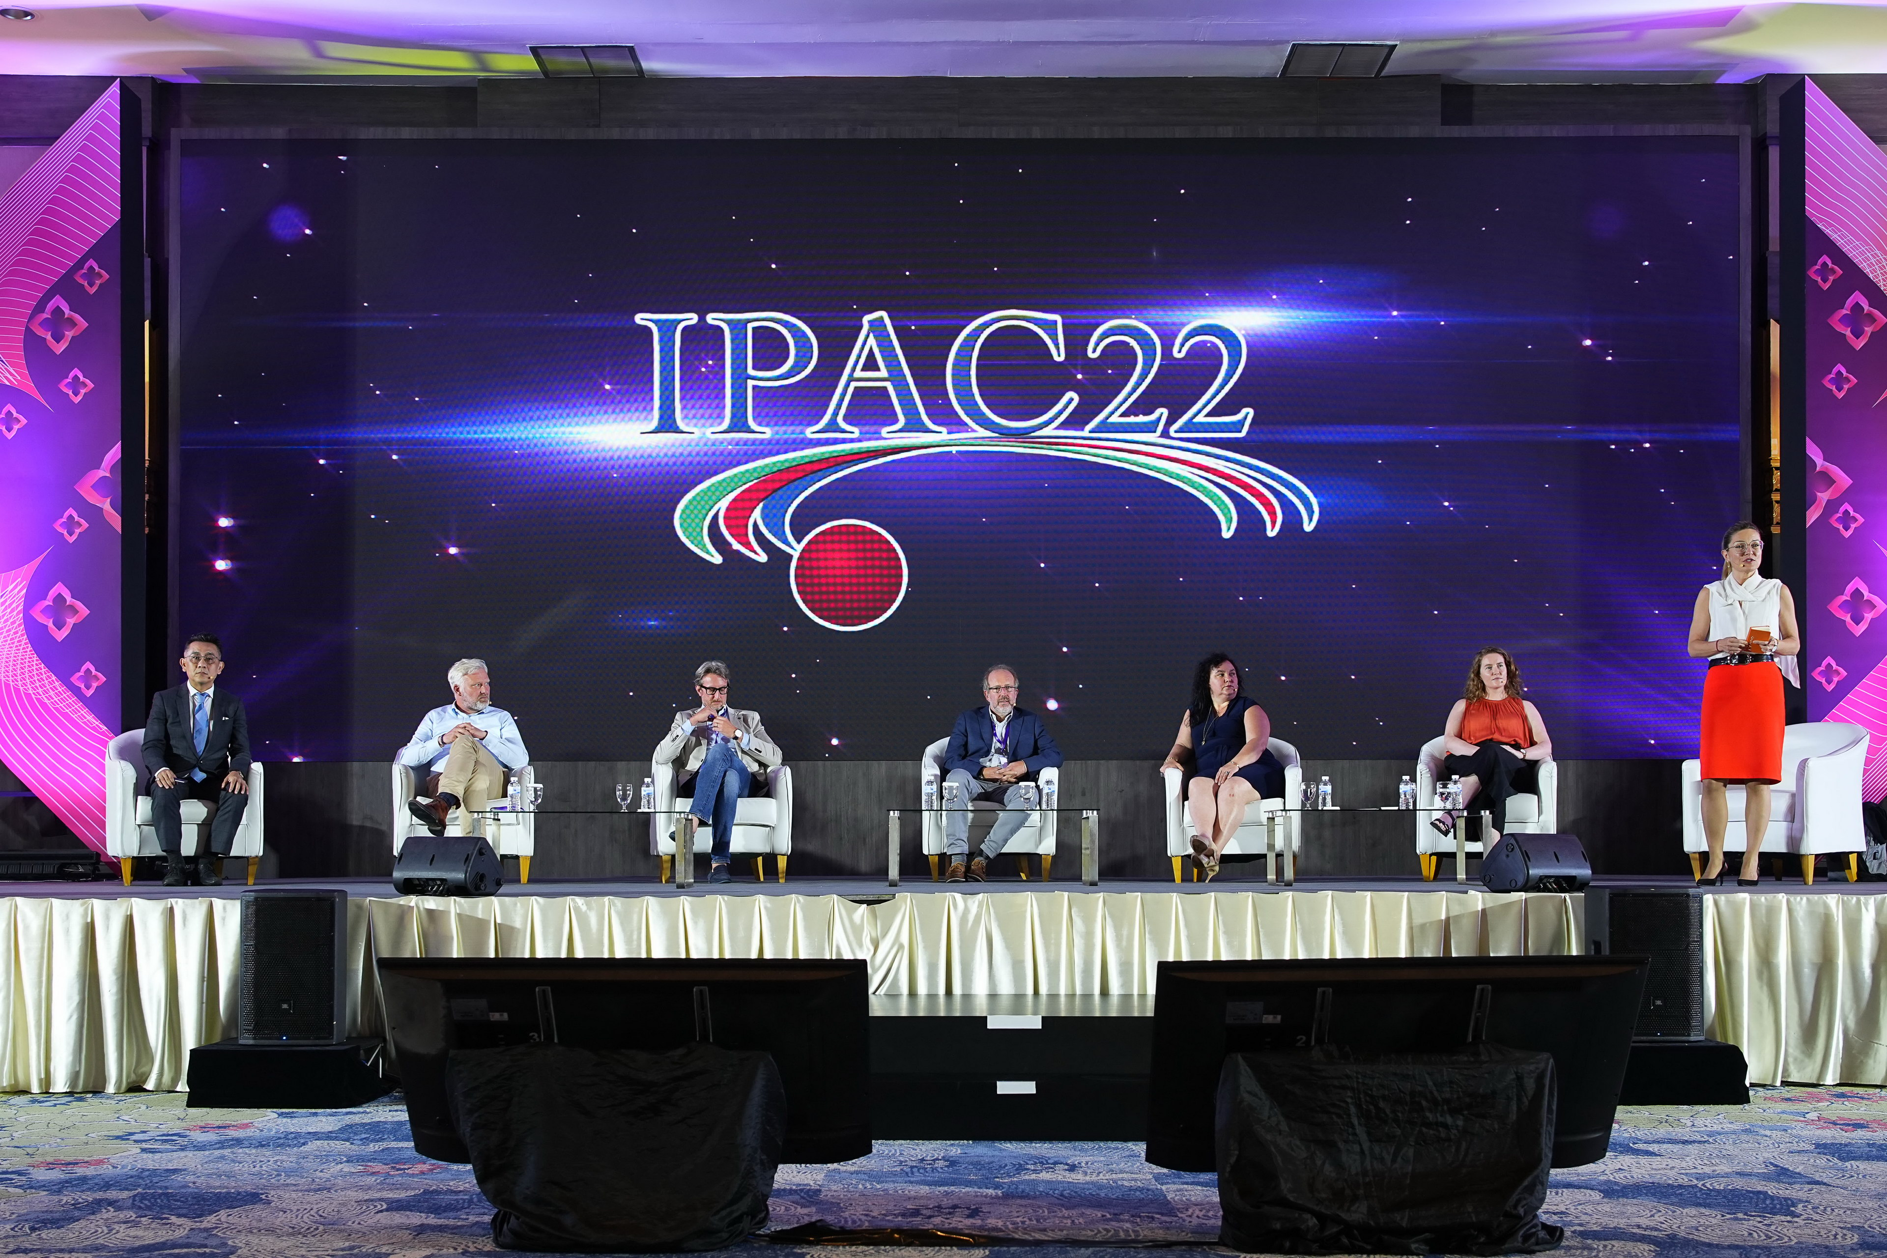
Highlights: Industry participation
Task 3.1 Industry engagement coordination and industrial partnership support
Engagement of industry has been so far excellent:
16 industrial partners,
12 industry members in the I.FAST Industry Advisory Board,
230 registered participants in the 1st I.FAST Accelerator-industry co-innovation workshop, 91 from industry.
Many interesting discussions, resulting in the creation of the “Accelerator Science and Technology Permanent Industry Forum” that will continue after I.FAST. The Terms of reference will be presented and discussed at the next Annual Meeting.
The Coordinator was invited to present the I.FAST industrial strategy at the 2022 International Particle Accelerator Conference (Bangkok, June 2022), at the EPS Forum in Paris, and at the Big Science Business Forum in Granada.

Slide 29
Problems: the Industry training programme
Task 2.4, Industrial Training associated with Knowledge Transfer.
Traineeship programme to support exchanges of personnel between laboratories and industry, by providing grants that could be used for the trainee’s salary, travels and subsistence costs.
The original work plan foresees “training of industrial engineers and technicians at European accelerator development laboratories” – one of the two (industry or laboratory) must be an I.FAST Beneficiary. Original scheme: 10 grants of 8’000 € each.
So far, the scheme had limited success, only 2 successful applications out of 10 positions foreseen.
Analysis of the reasons: companies have limited personnel availabilities to let their young engineers leave for 1 or 2 months.
To solve the issue within the general objectives of the Task, the Project has foreseen to extend the call to transfers in both directions, allowing also young engineers and technicians from accelerator development laboratories to train for 1 or 2 months in an accelerator-related industry.
A call in this sense has been already issued, but before allocating grants we need the support of the Project Officer and possibly of the Reviewer.

