Slide 1
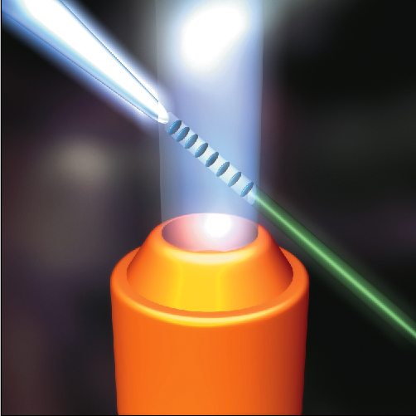



PNRR_EuAPS
EuPRAXIA Advanced Photon Sources
Massimo Ferrario
https://euaps.infn.it/
Seconda Giornata Acceleratori - Catania 2-3 Marzo 2023

Slide 2
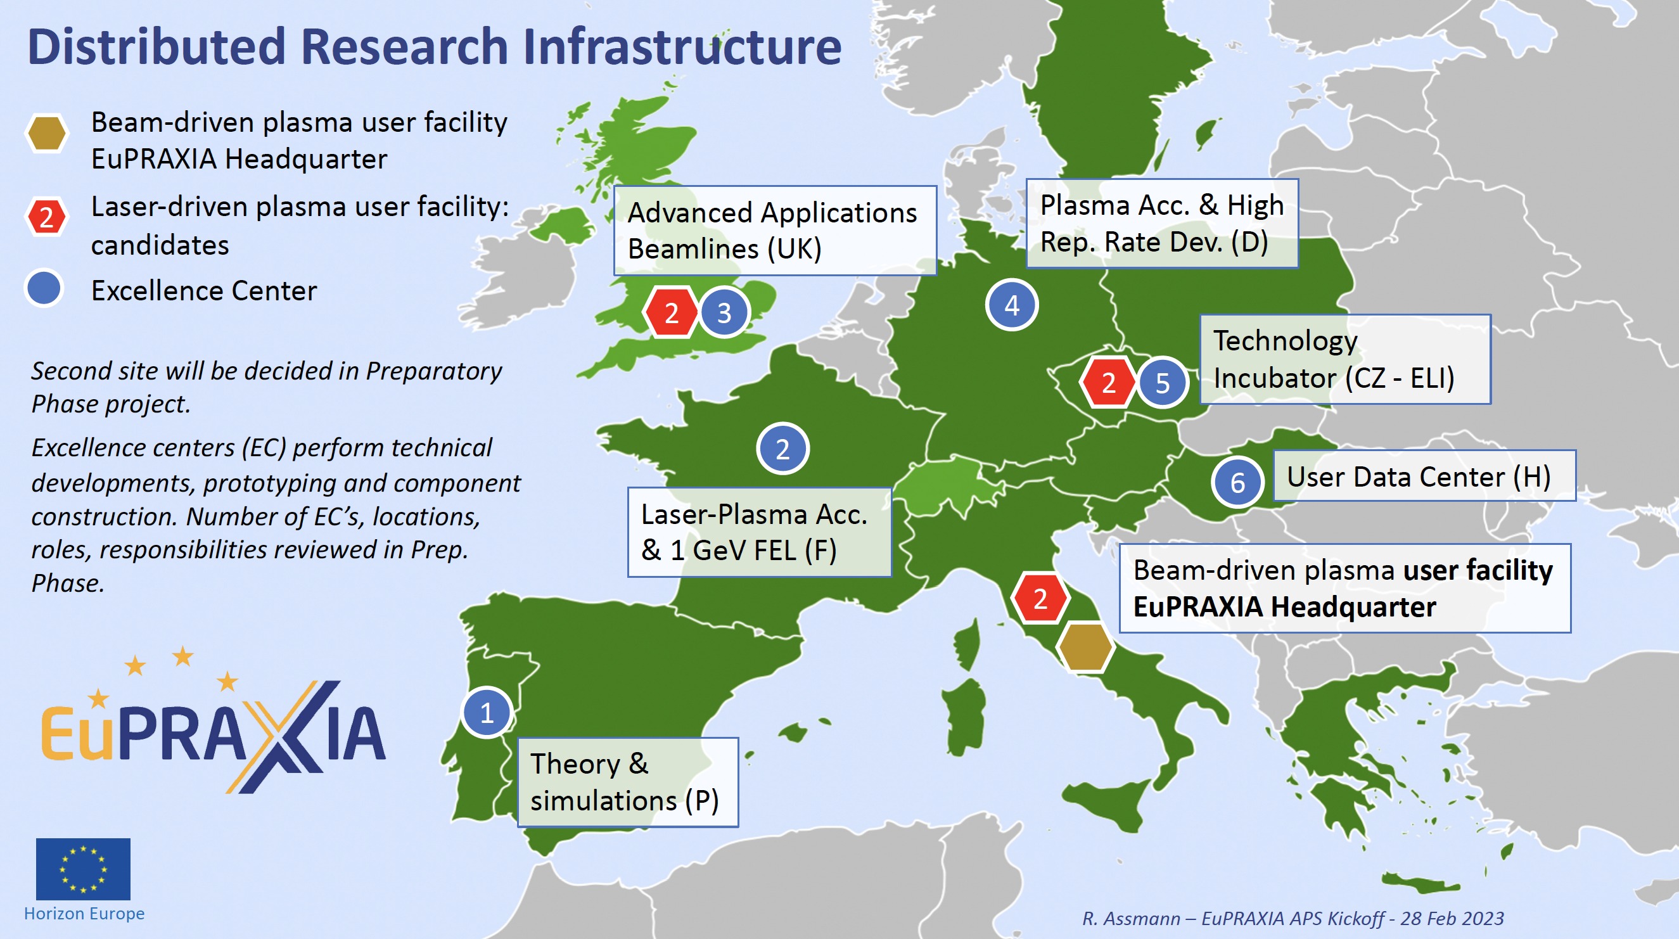


Slide 3
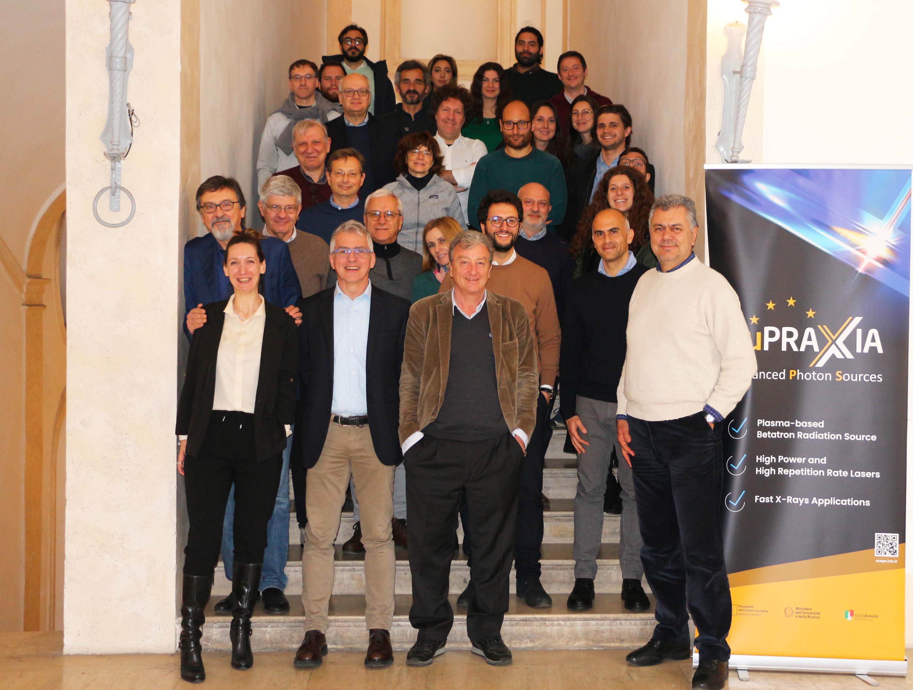
EuAPS Kick Off Meeting – February 28, 2023 – INFN Headquarter https://agenda.infn.it/event/34318/
Progetto PNRR Infrastrutture di Ricerca
Budget 22,3 Meuro
Durata: 01/12/2022 – 30/05/2025 (+ 6 mesi e comunque non oltre il 31/12/2025)
Obiettivo:
a) Realizzazione di una sorgente di betatrone (INFN-LNF)
b) Realizzazione di un laser ad alta potenza (INFN-LNS)
c) Realizzazione di un laser ad alta frequenza di ripetizione (CNR-INO)
Massimo Ferrario (INFN-LNF) Seconda Giornata Acceleratori - Catania 2-3 Marzo 2023

Slide 4
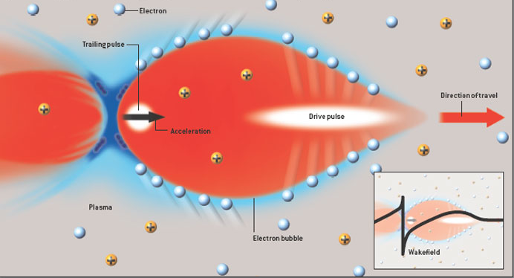
Principles of Laser Plasma Wakefield Acceleration and Betatron Radiation
Massimo Ferrario (INFN-LNF) Seconda Giornata Acceleratori - Catania 2-3 Marzo 2023

Slide 5
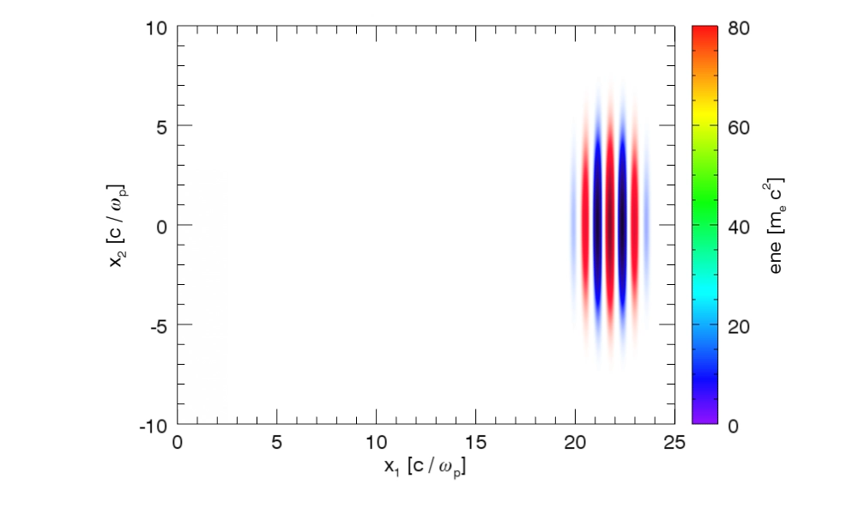
Example: a0 = 5; laser spot-size: 3 microns; laser duration: 12fs; plasma density = 6x10^19.
Courtesy J. Vieira, R. Fonseca/GoLP/IST Lisbon
Massimo Ferrario (INFN-LNF) Seconda Giornata Acceleratori - Catania 2-3 marzo 2023

Slide 6
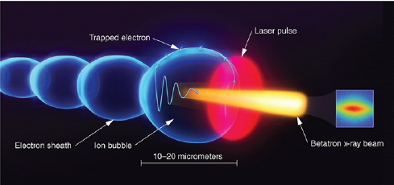
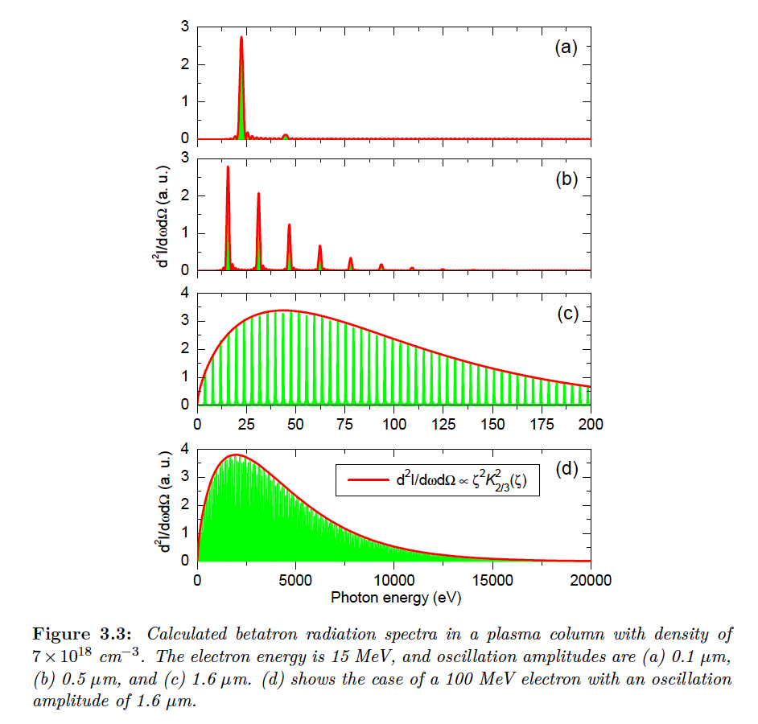
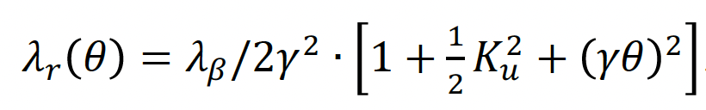





K_{u}<1
$$λ_{β}=\sqrt{2γ}λ_{p}$$
K_{u}>1
$$ω_{c}=3K_{u}γ^{2}ω_{β}$$
K_{u}>>1
$$N_{ph}∝N_{e}N_{β}K_{u}$$
$$K_{u}=γk_{β}r_{β}$$
$$r_{β}^{}=\frac{2\sqrt{a_{0}}c}{ω_{p}}$$
EuAPS Kick-off Meeting Roma , 28 February 2023, INFN Head quarter

Slide 7
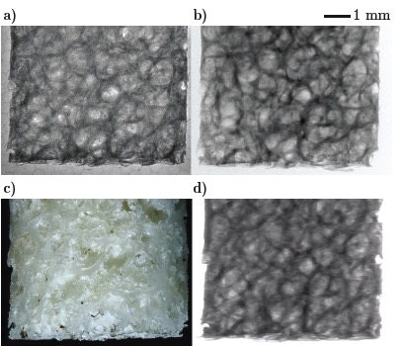
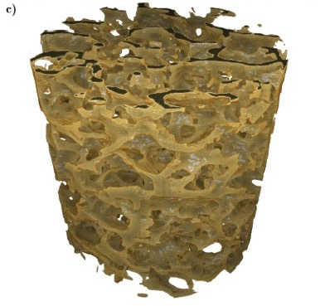
Betatron X Rays: Compact Medical Imaging
J.M. Cole et al, “Laser-wakefield accelerators as hard x-ray sources for 3D medical imaging of human bone”. Nature Scientific Reports 5, 13244 (2015)
Physics & Technology Background:
Small EuPRAXIA accelerator → small emission volume for betatron X rays.
Quasi-pointlike emission of X rays.
Sharper image from base optical principle.
Quality demonstrated and published, but takes a few hours for one image.
Advancing flux rate with EuPRAXIA laser by factor > 1,000!
EuPRAXIA technology
μCT Scanner
Added value
Sharper images with outstanding contrast
Identify smaller features (e.g. early detection of cancer at micron-scale – calcification)
Laser advance in EuPRAXIA → fast imaging (e.g. following moving organs during surgery)
3D tomography of human bone
EuPRAXIA laser advance (industry)
will push rate from 1/min to 100 Hz.
Ultra-compact source of hard X rays → exposing from various directions simultaneously is possible in upgrades
Macro-photography
Radioactive source
Massimo Ferrario (INFN-LNF) Seconda Giornata Acceleratori - Catania 2-3 Marzo 2023
Notes:
Massimo

Slide 8
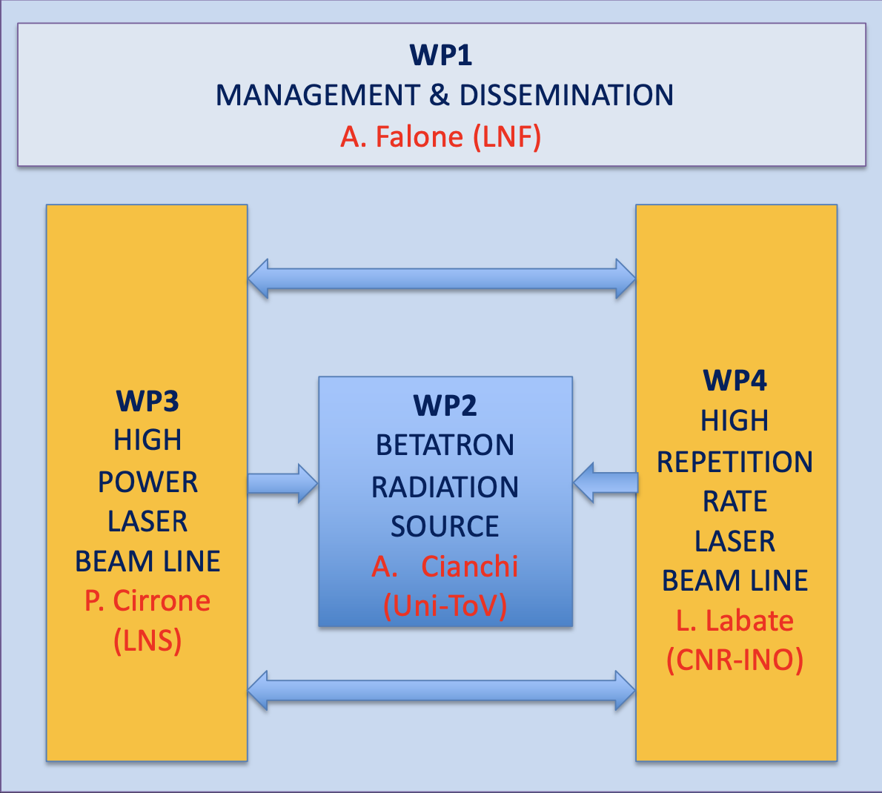
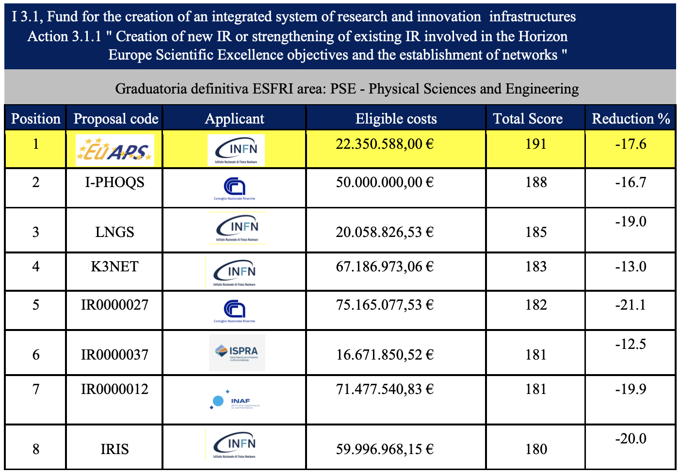
EuPRAXIA Advanced Photon Sources Proposal
Started on February 13th, 2022 - Submitted on February 28th , 2022
EuAPS Scientific Coordinator: M. Ferrario (INFN-LNF)
EuPRAXIA/EuAPS Integration: R. Assmann (DESY & INFN)
EuAPS got the highest score among IR
A. Falone (LNF)
A. Cianchi
(Uni-ToV)
P. Cirrone
(LNS)
L. Labate
(CNR)
Massimo Ferrario (INFN-LNF) Seconda Giornata Acceleratori - Catania 2-3 Marzo 2023

Slide 9

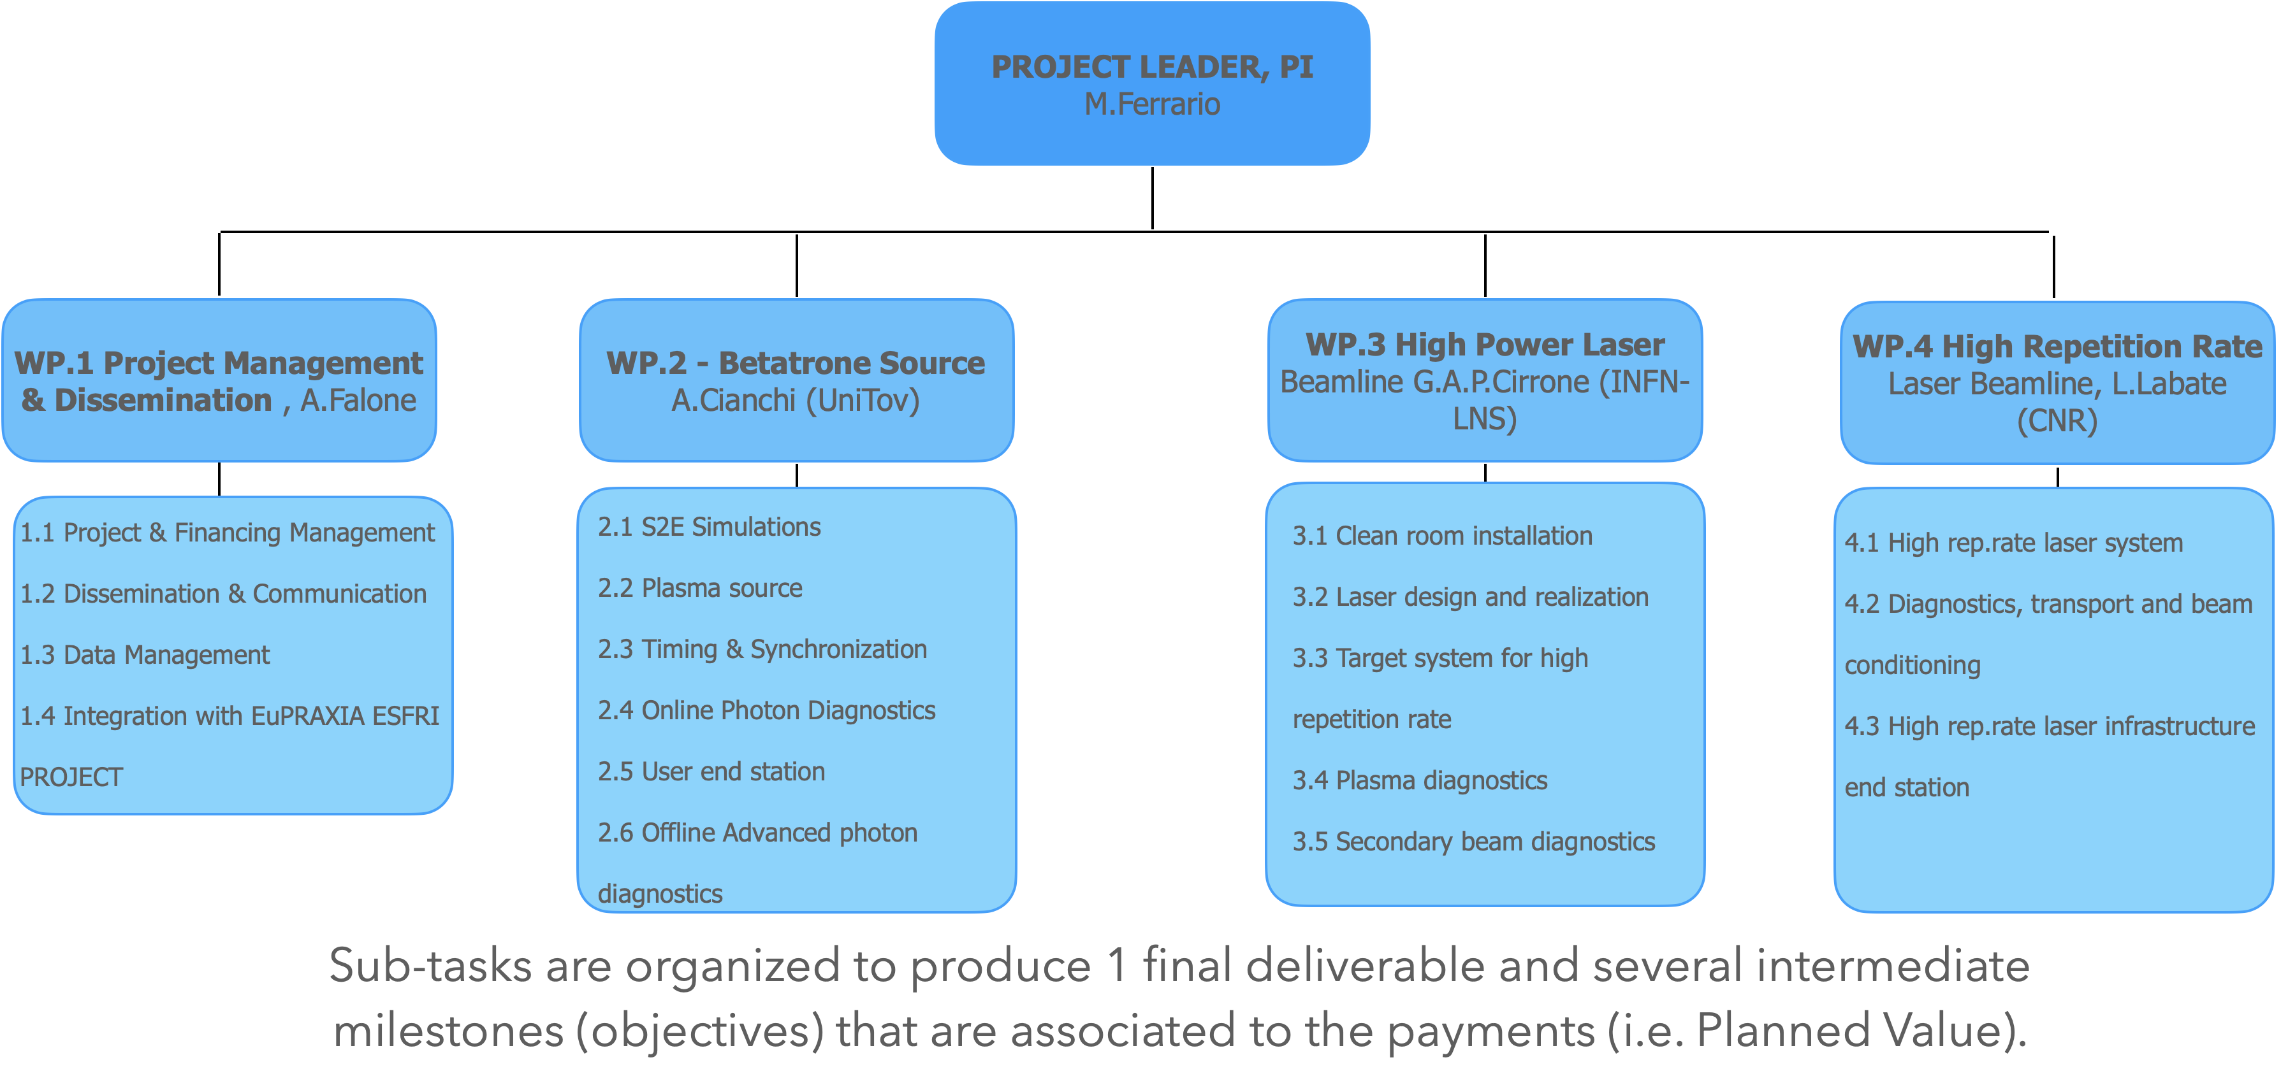
Work Packages
Massimo Ferrario (INFN-LNF) Seconda Giornata Acceleratori - Catania 2-3 Marzo 2023

Slide 10
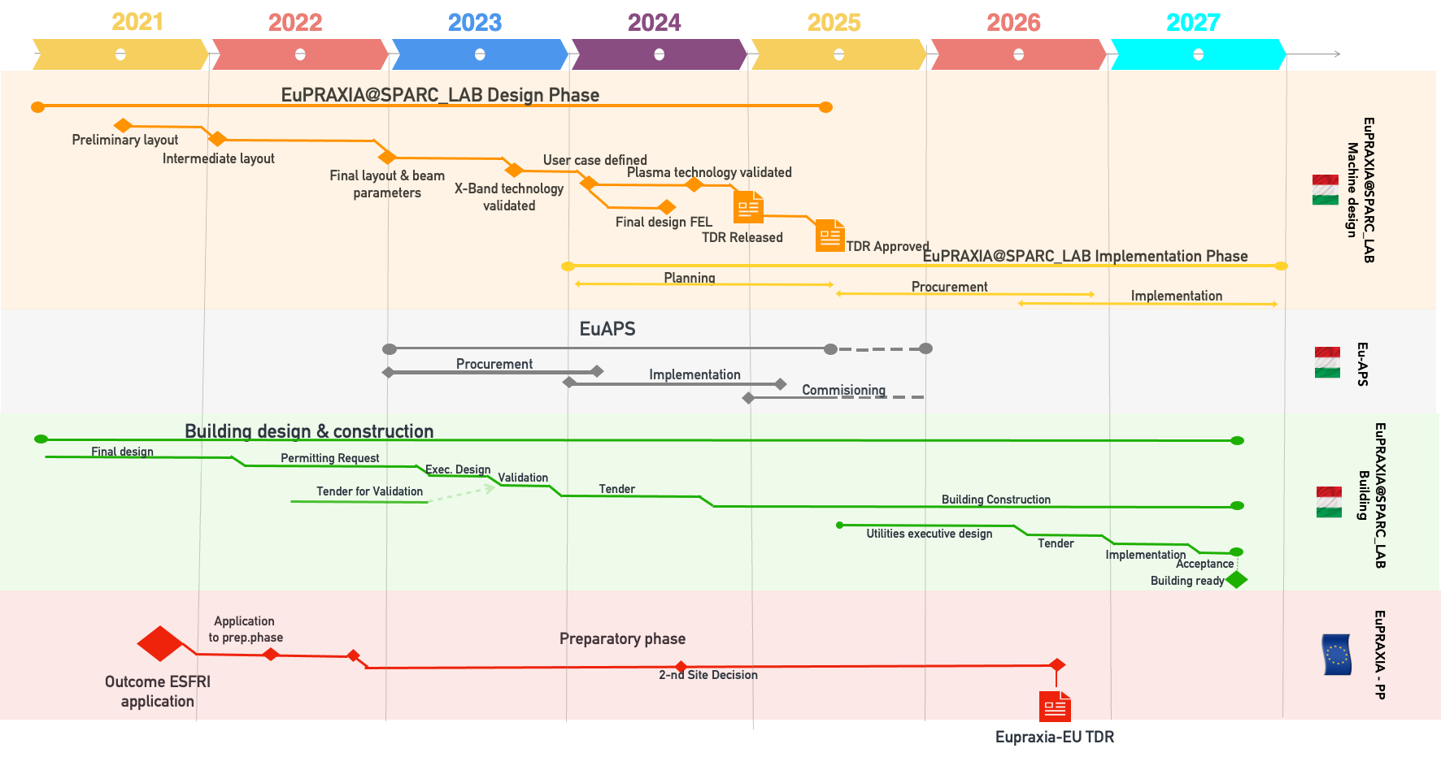
EuPRAXIA Timeline
Massimo Ferrario (INFN-LNF) Seconda Giornata Acceleratori - Catania 2-3 Marzo 2023

Slide 11
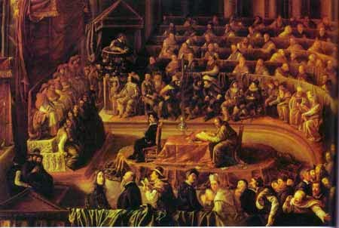
Scientific Advisory Committee
The Scientific Advisory Committee is made up of international experts from the scientific community and has the purpose of guiding the progress of the project from a technical-scientific point of view, suggesting priorities and activities to be addressed and will evaluate the general technical-scientific state of progress.
Gianluigi Arduini (CERN)
Victor Malka (Weizmann Institute)
Rajeev Pattathil (RAL)
James. B. Rosenzweig (UCLA)
Gianluca Sarri (Queen University of Belfast)
Massimo Ferrario (INFN-LNF) Seconda Giornata Acceleratori - Catania 2-3 Marzo 2023

Slide 12
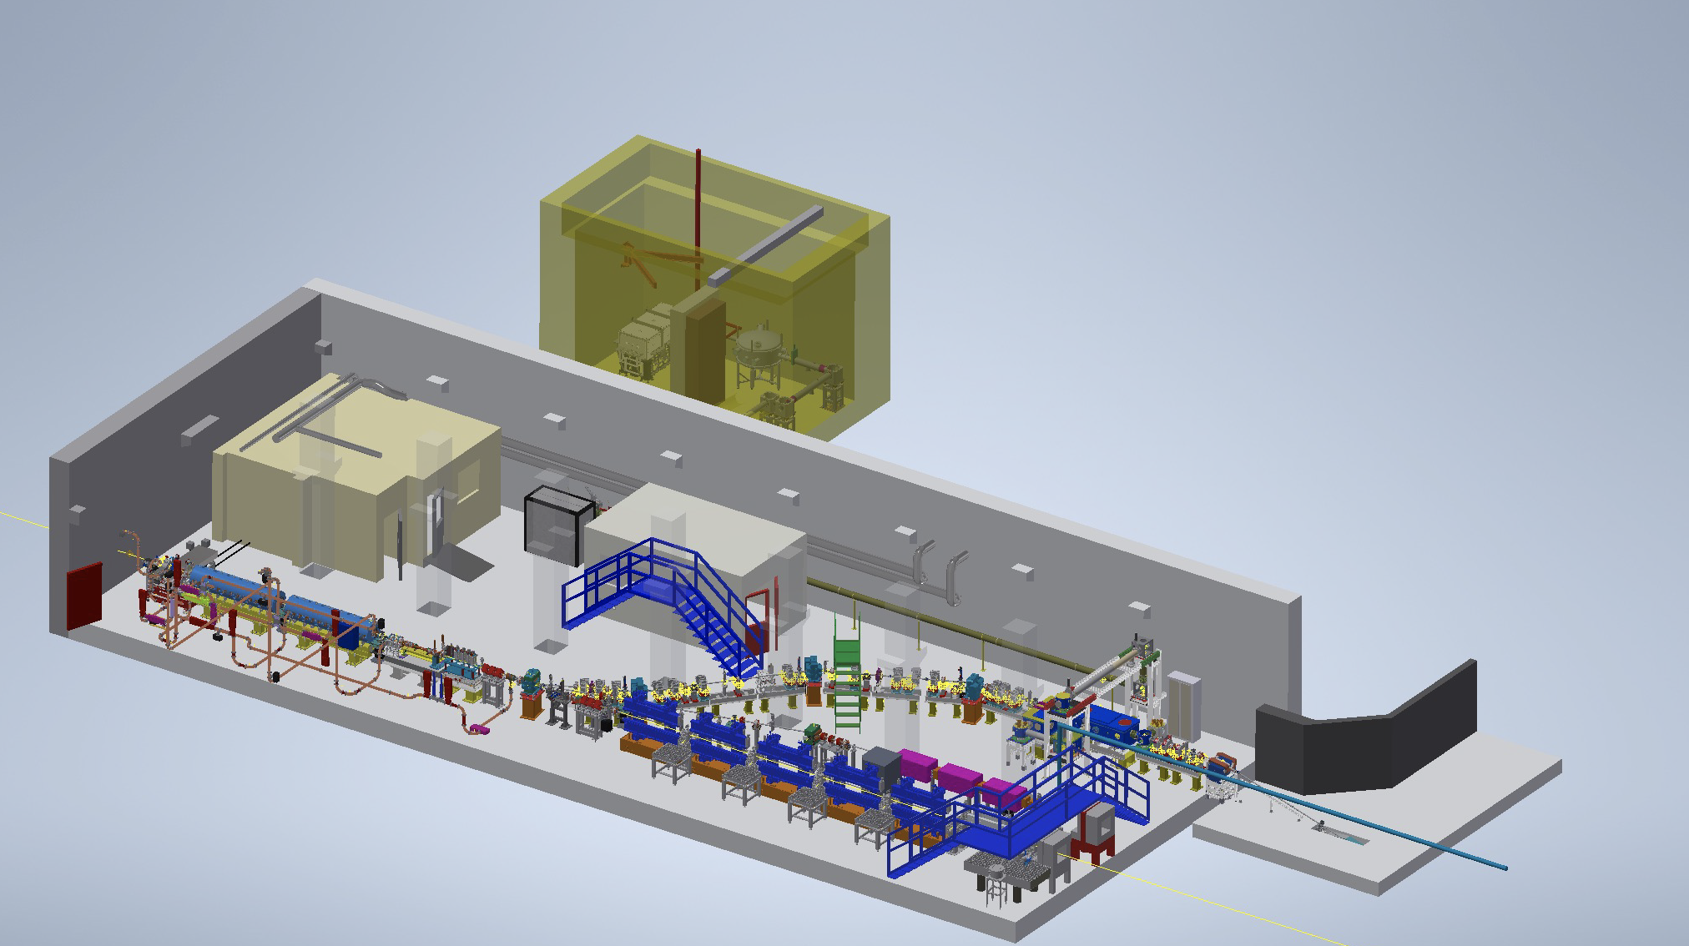
WP2 - Betaron Radiation Source at SPARC_LAB
Electron beam Energy [MeV] | 50-800
Plasma Density [cm⁻³] | 10¹⁷ - 10¹⁹
Photon Critical Energy [keV] | 1 - 10
Nuber of Photons/pulse | 10⁶ – 10⁹
LWFA
TNSA
Betatron
PWFA
LWFA
FEL
THz
Massimo Ferrario (INFN-LNF) Seconda Giornata Acceleratori - Catania 2-3 Marzo 2023

Slide 13
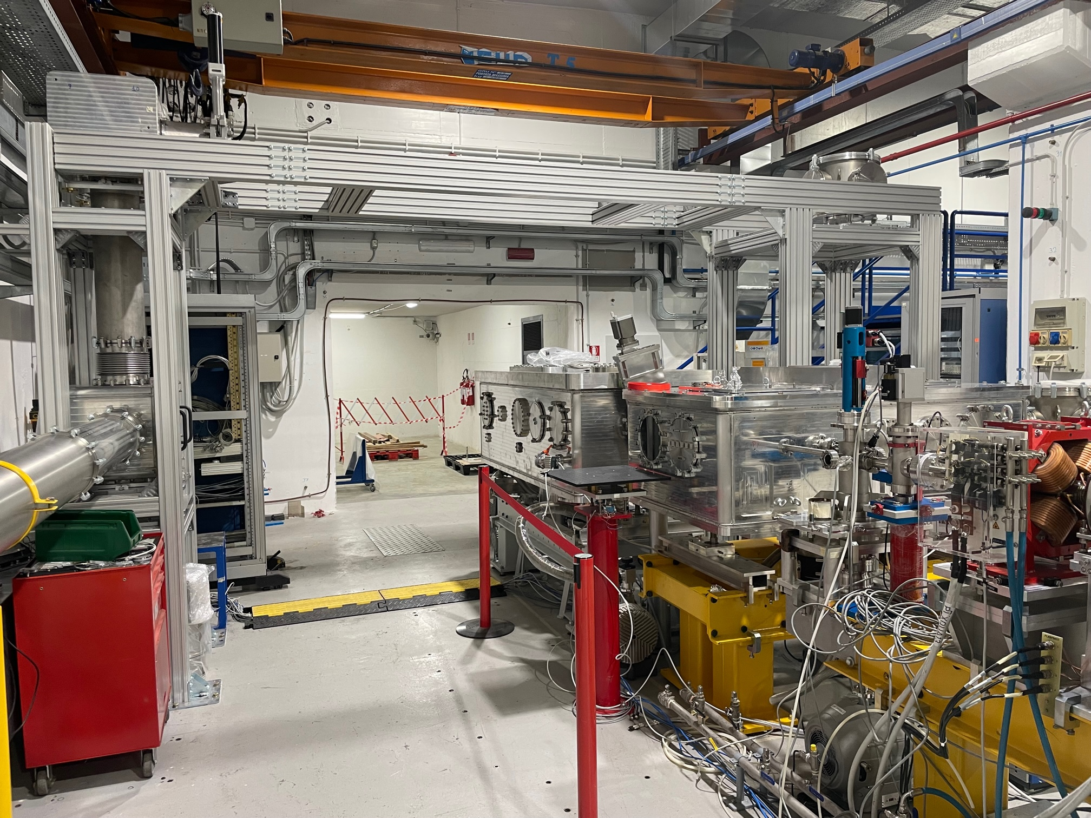
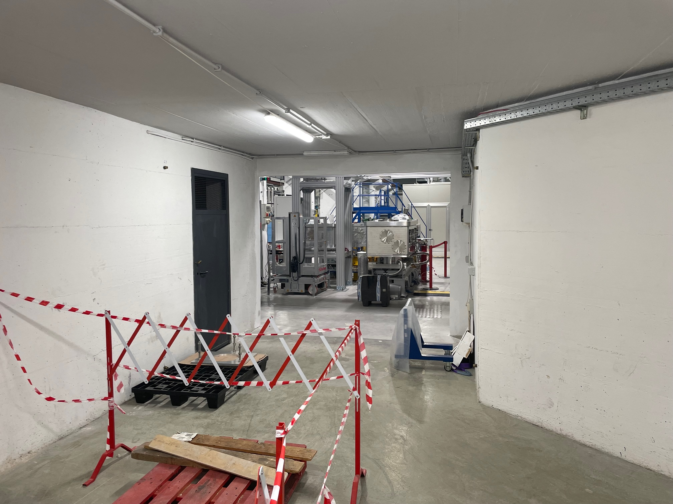
Massimo Ferrario (INFN-LNF) Seconda Giornata Acceleratori - Catania 2-3 Marzo 2023

Slide 14
Betatron Radiation X-ray Source
Ultrafast - laser pulse duration tens of fs useful for time resolved experiments (XFEL tens of fs, synchrotron tens to 100 ps).
Broad energy spectrum - important for X-ray spectroscopy.
High brightness - small source size and high photon flux for fast processes.
Large market - 50 synchrotron light sources worldwide, 6 hard XFEL’s and 3 soft-ray ones (many accelerators operational and some under construction).
K_{u}<1
K_{u}>1
$$ω_{c}=3K_{u}γ^{2}ω_{β}$$
K_{u}>>1
$$N_{ph}∝N_{e}N_{β}K_{u}$$
Courtesy F. Stellato and A. Balerna

Slide 15
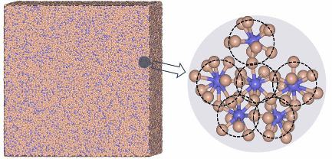
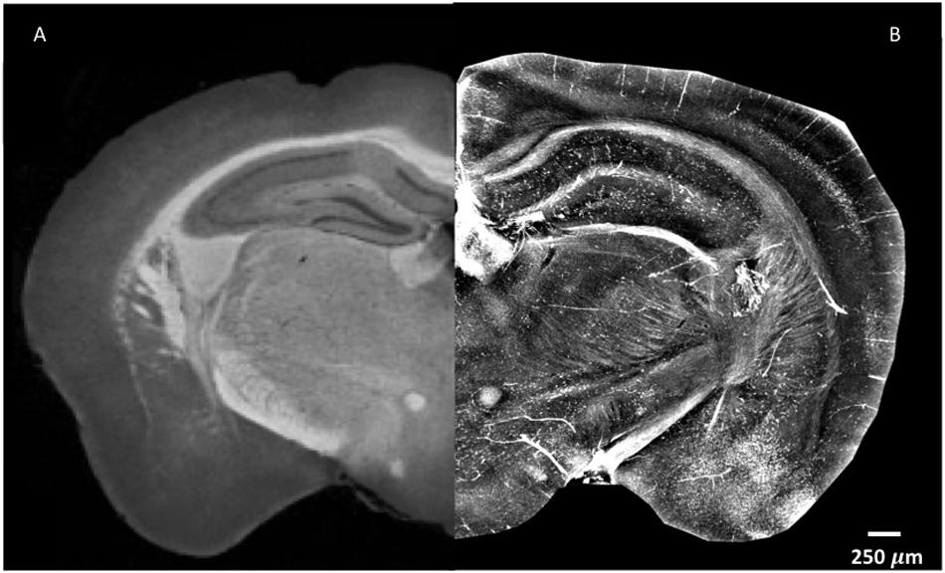
Betatron Radiation X-ray Source
Imaging
Absorption (ABS) and Phase Contrast (XPCI) mode
X-ray Spectroscopy XAS and XES for material science studies at atomic scale.
XPCI δ>> β
at high x-ray energies
ABS
ABS
XPCI
J. Ding et al. PNAS 2017
Mouse brain
F. Palermo et al. Frontiers in Neuroscience 2020
Notes:
XAS or X-ray Absorption Spectroscopy
XES or X-ray Emission Spectroscopy

Slide 16
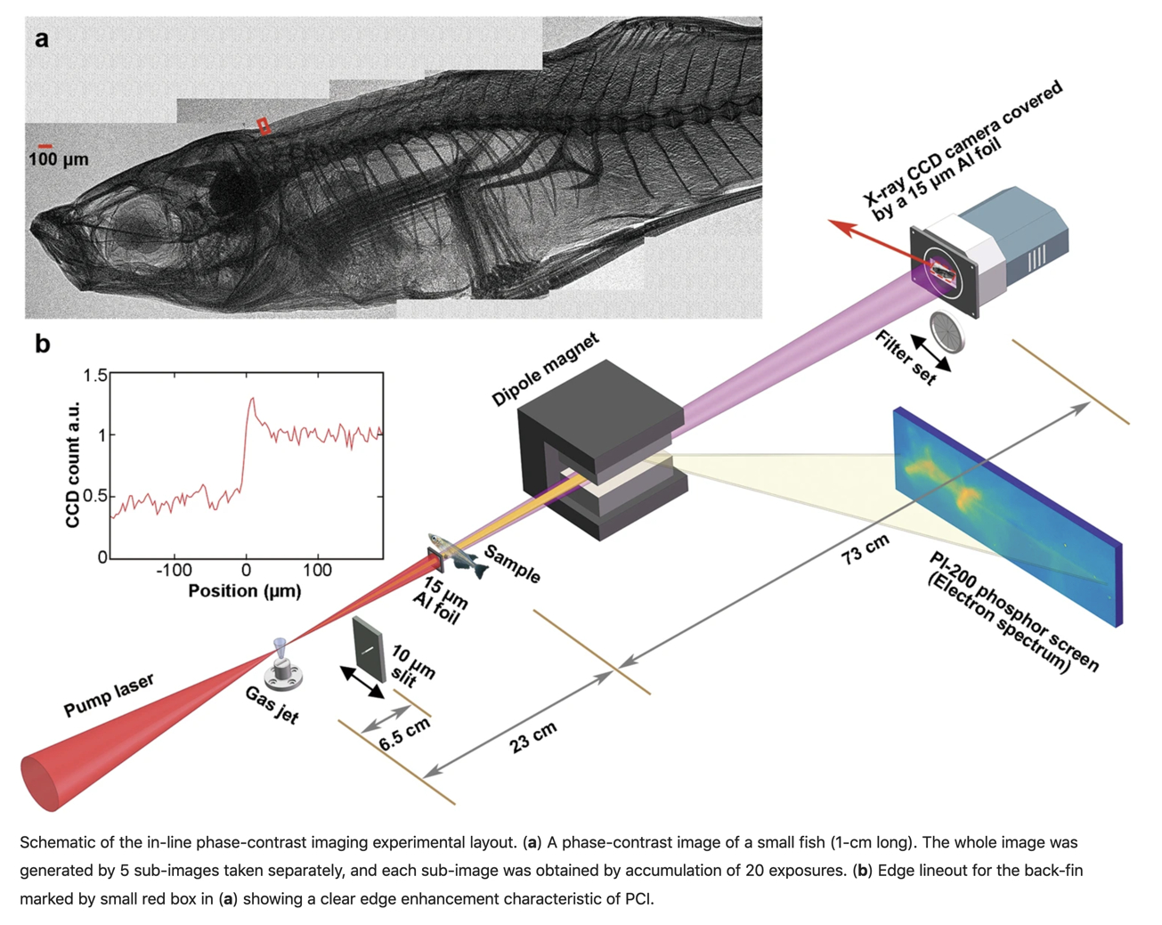
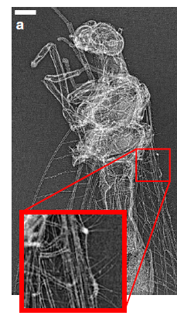
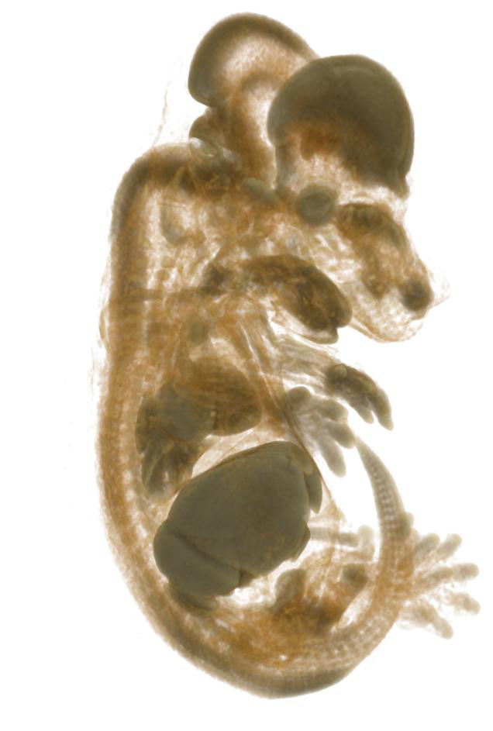
Betatron Radiation and Imaging
Imaging at EuAPS
1) static
2) time resolved
3) related to laser induced dynamics.
B. Guo et al. Sci. Rep. 2019
High-resolution phase-contrast imaging- XPCI of biological specimens using a stable betatron X-ray source.
J. Wenz et al. Nature Comm. 2015
Micro-tomography - Bet. Rad.
J. M. Cole et al. PNAS 2018
Notes:
Cole Tomographic reconstruction from the laser-betatron scan similar to that shown in Movie S1 but with the volume rendering options adjusted to make lower density regions appear more transparent, enhancing the appearance of internal features. - https://www.pnas.org/doi/suppl/10.1073/pnas.1802314115

Slide 17
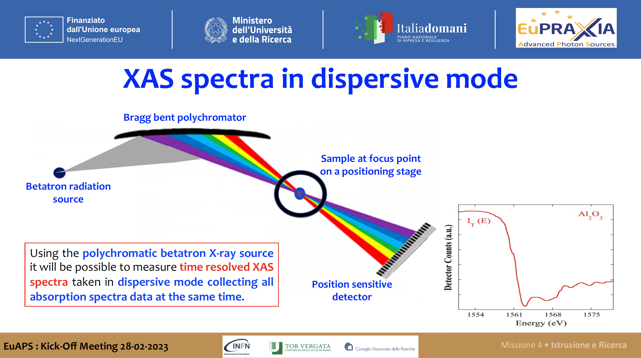

Slide 18
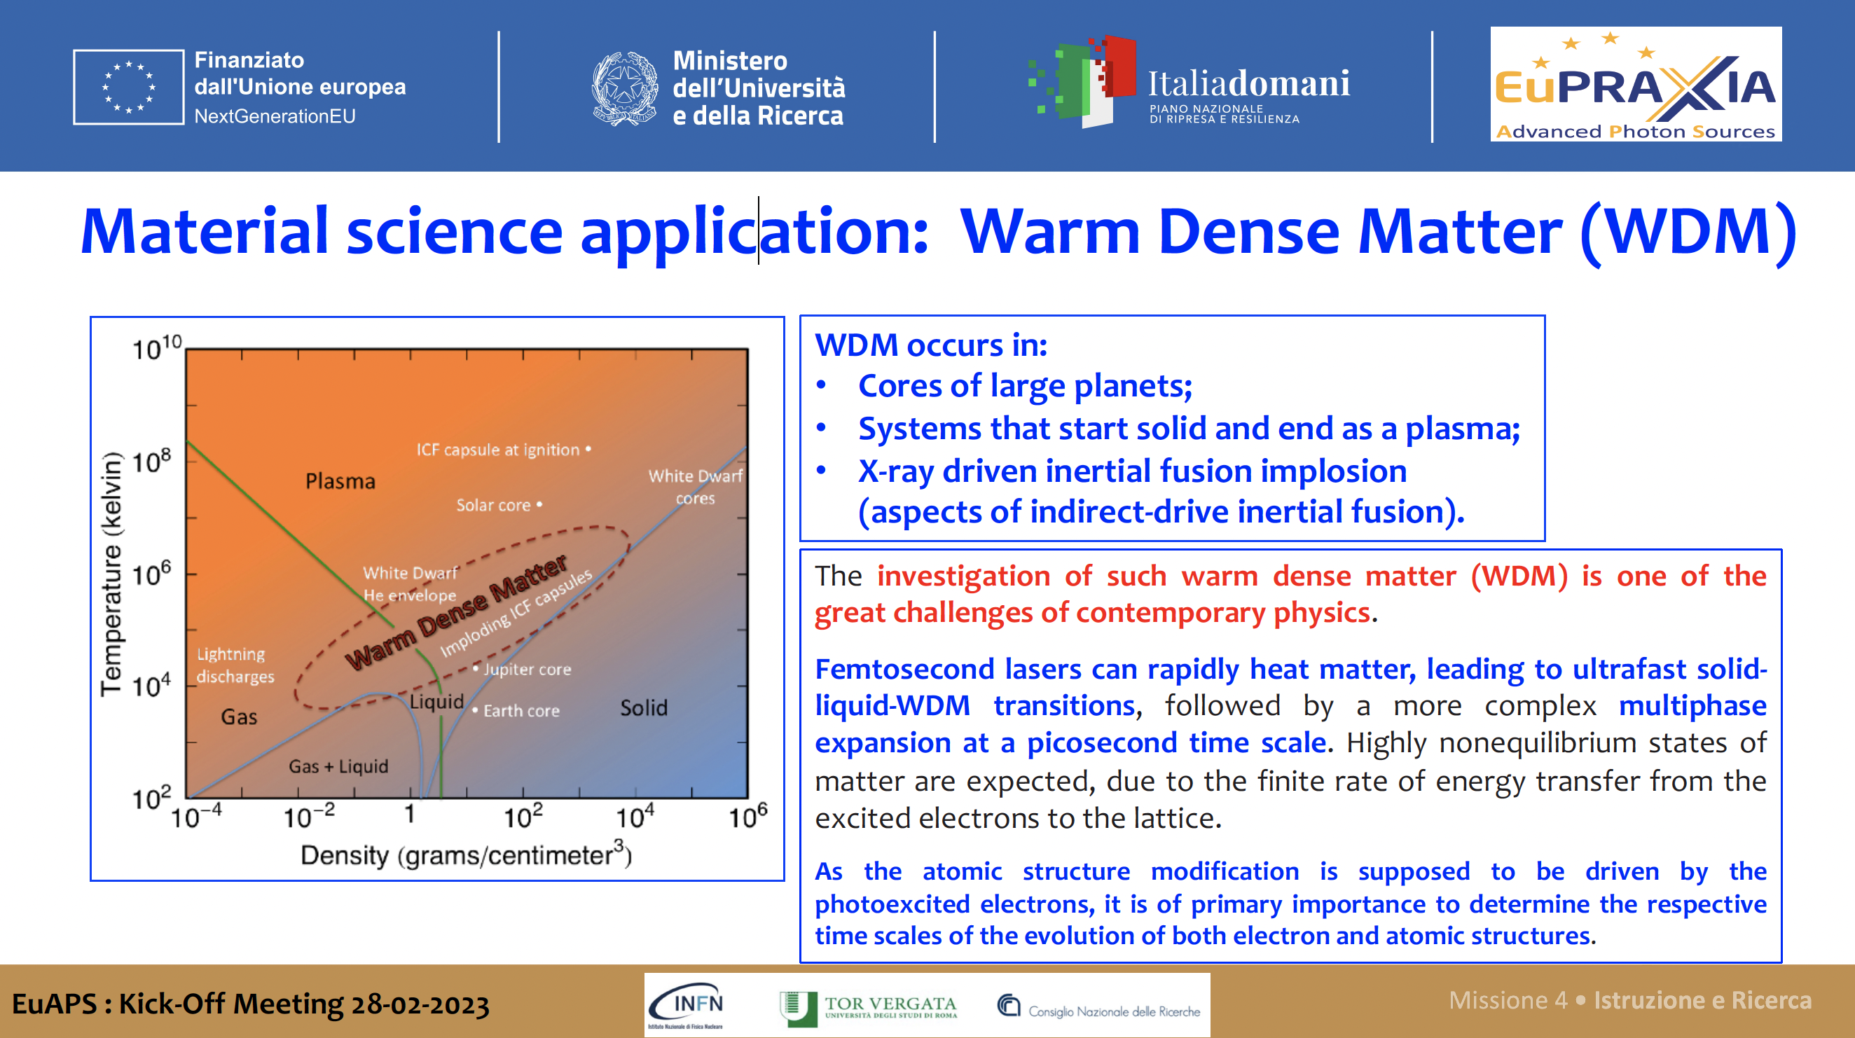

Slide 19
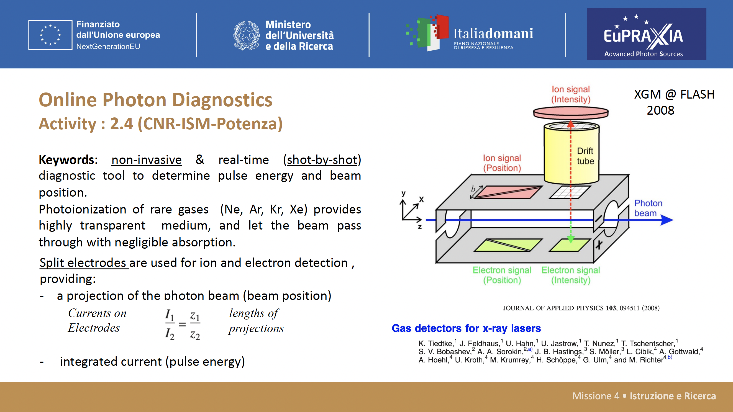
From FEL to Betatron?

Slide 20
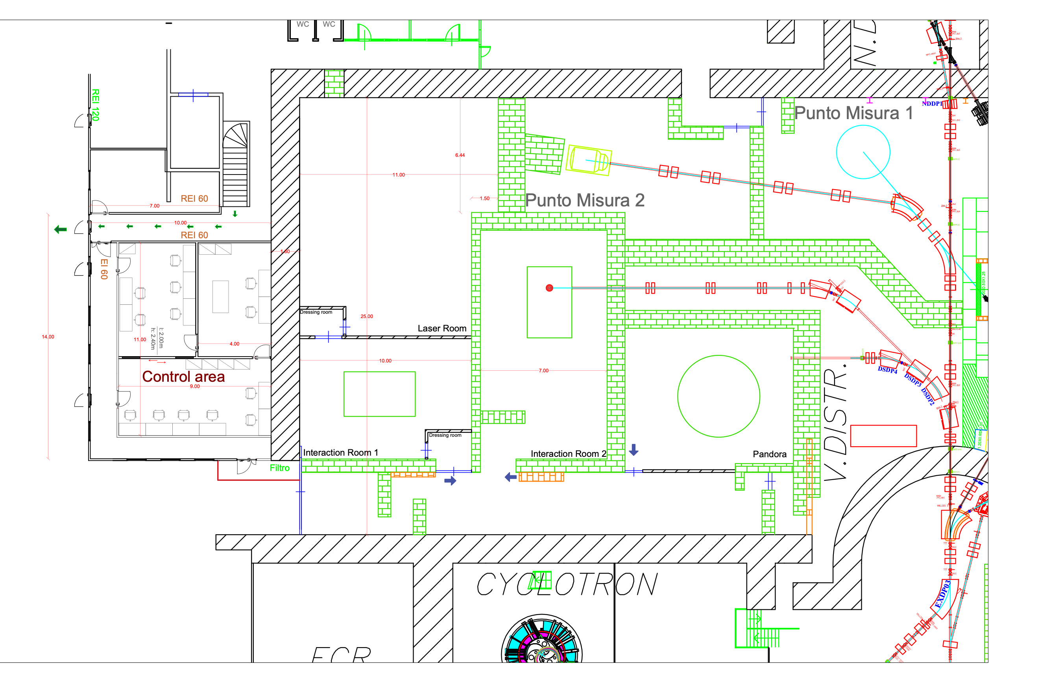
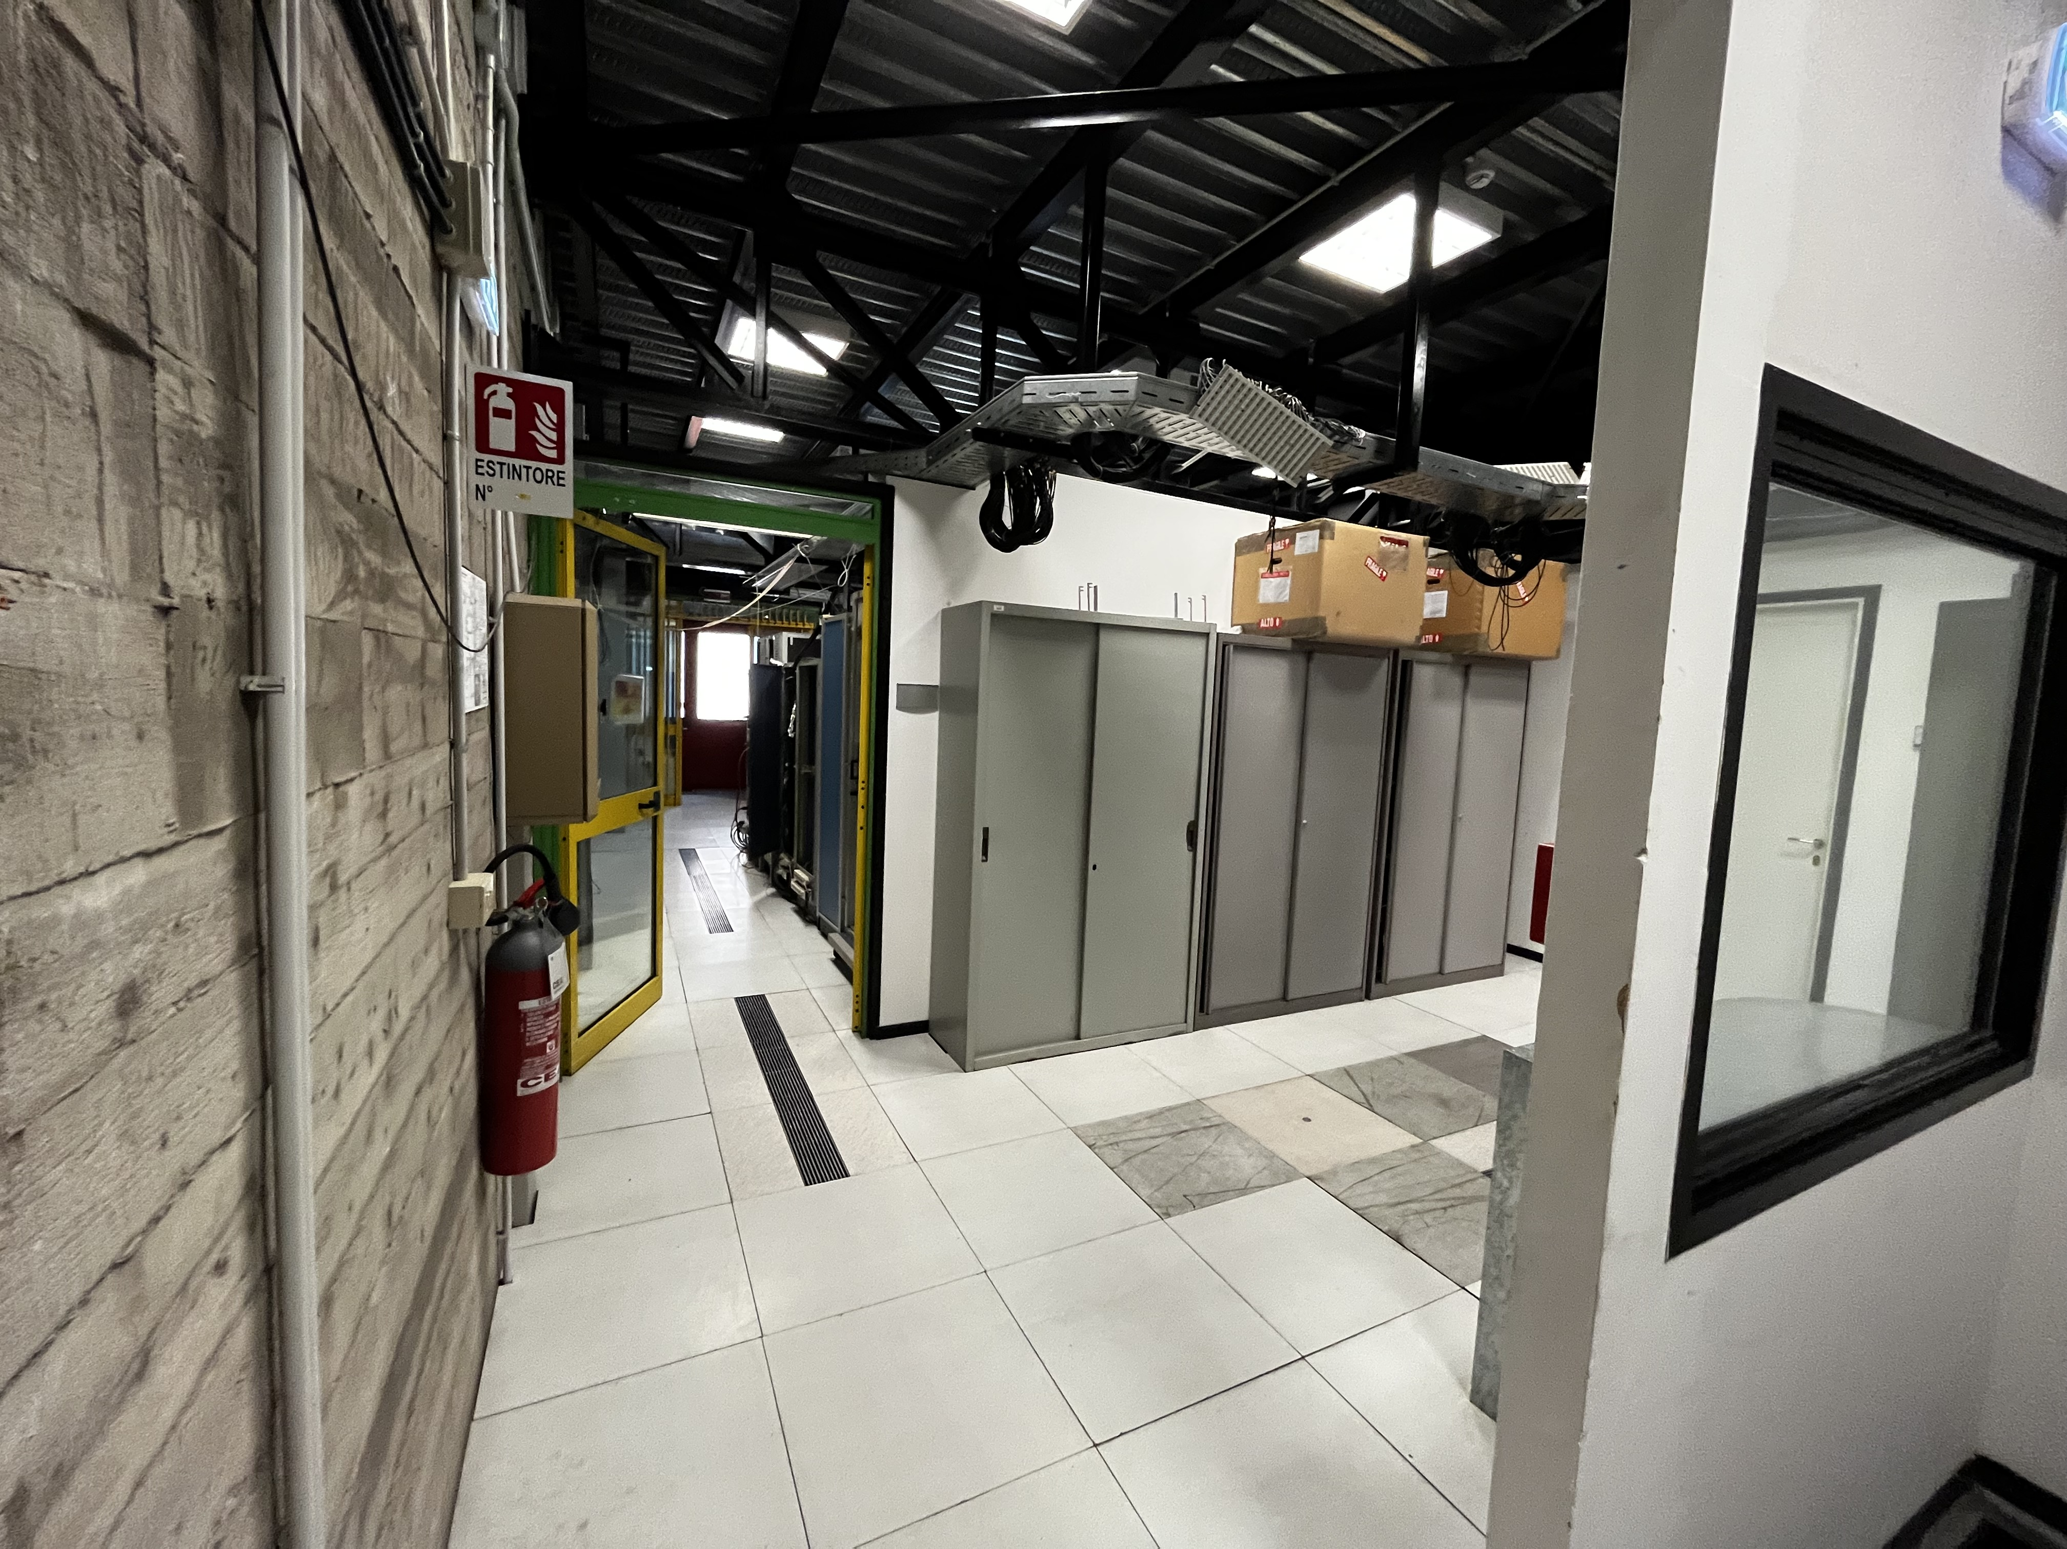
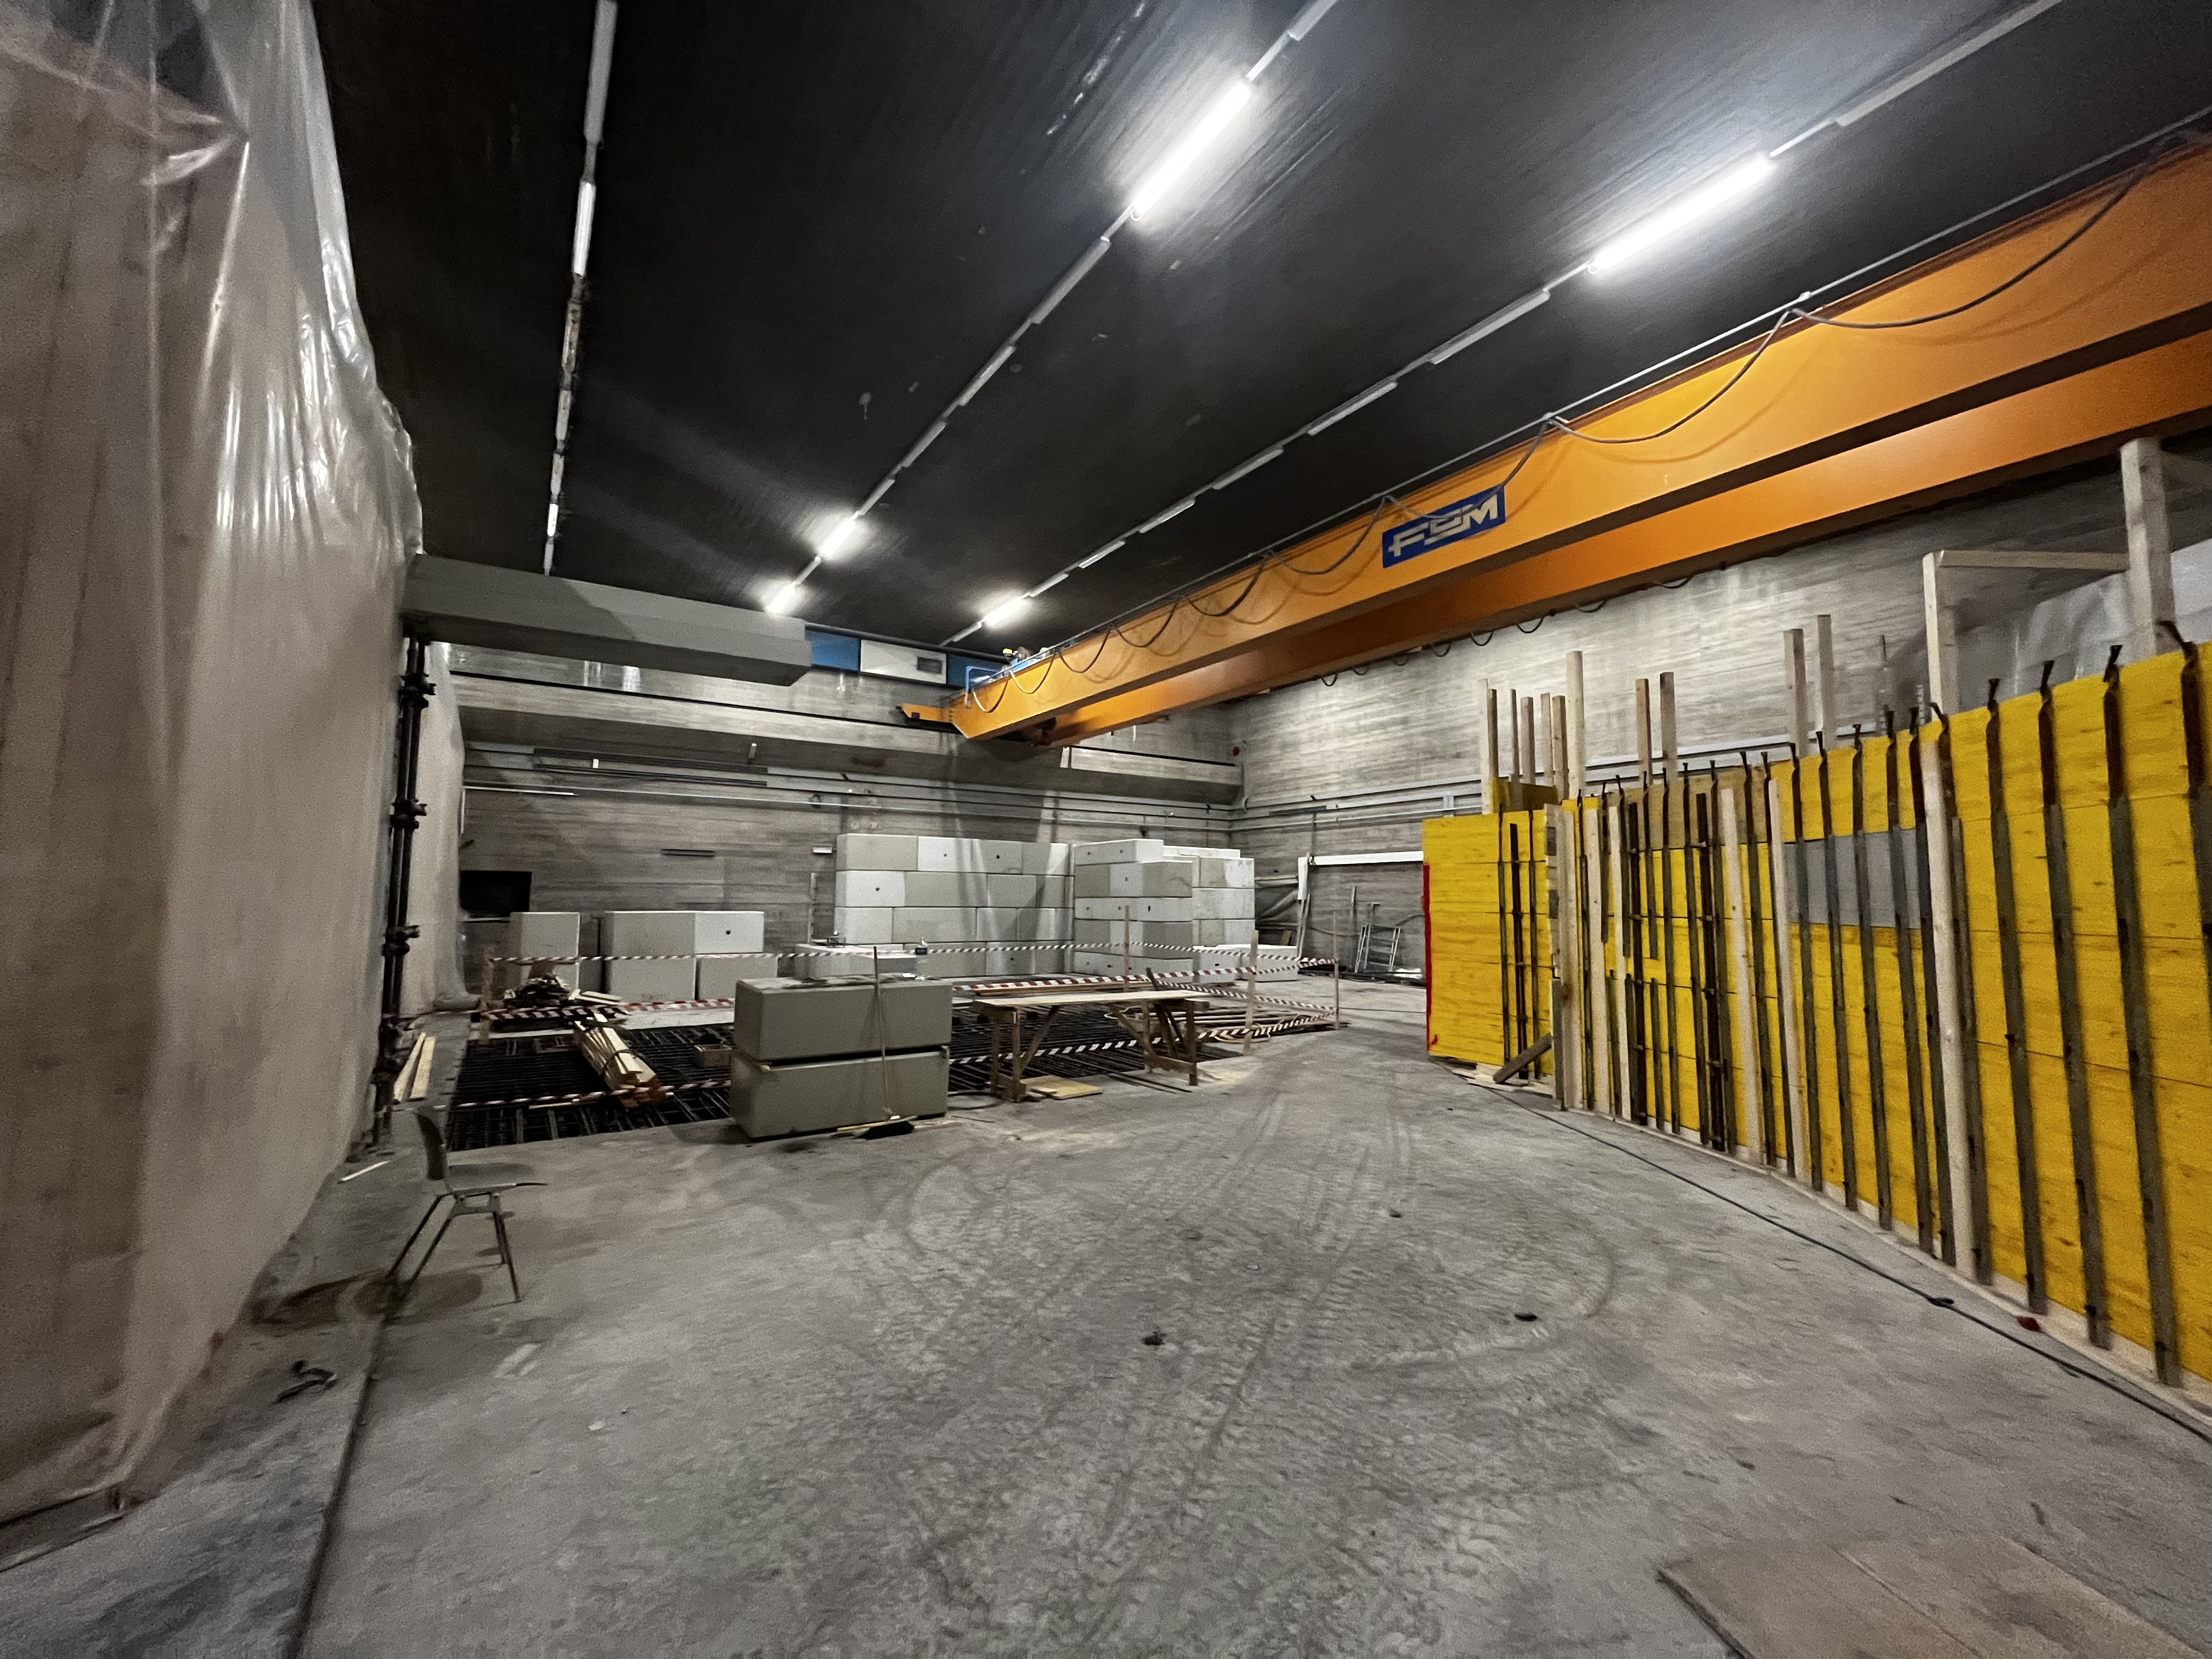
WP3 - I-LUCE (INFN-Laser indUced radiation acceleration)
Laser area
Control and Users’ area
LNS
Interaction room 2: nuclear, fusion, warm dense matter, stopping power studies
Interaction room 1:
protons, ions, electrons, neutrons accelerations
EuAPS Kick-off Meeting Roma , 28 February 2023, INFN Head quarter

Slide 21
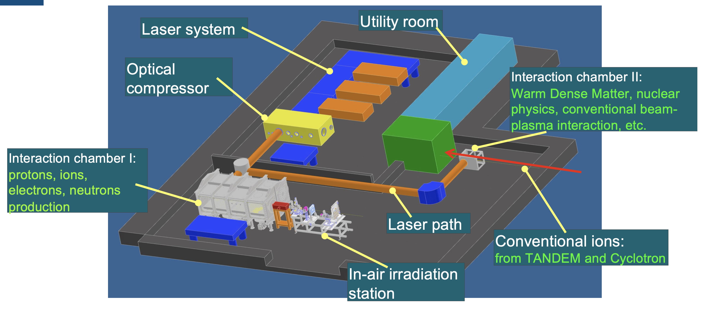
I-LUCE

Slide 22
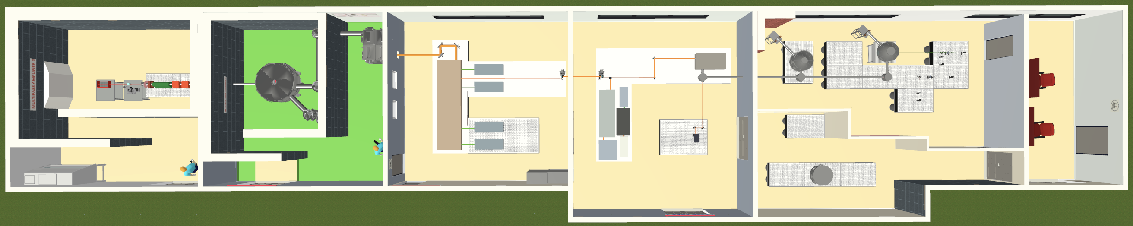
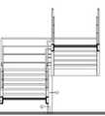

WP4 - J-class, 100Hz laser infrastructure @CNR-INO Pisa
Full 100 Hz system at Joule level will allow to tackle operational issues and mechanical stability
Underground bunker
100 Hz
Intense Laser Irradiation Laboratory
Existing Building (B) LASER
New bunker Designed for high dose irradiation (100 Hz)
Beam
transfer
to bunker
Laser beam
100 Hz / 100 W
Street level
Shielding
Laser
New bunker
Signals
H=3m
L=20 m
Bunker size: 3 m (H) x 6 m (L) x 18 m (P) (max 20 m)
Part of the IPHOQS (ELI/LENS/CUSBO Photonics Infrastructure), and Tuscan Health Ecosystem 4.5 M€ dedicated funding @ CNR-Pisa)

Slide 23

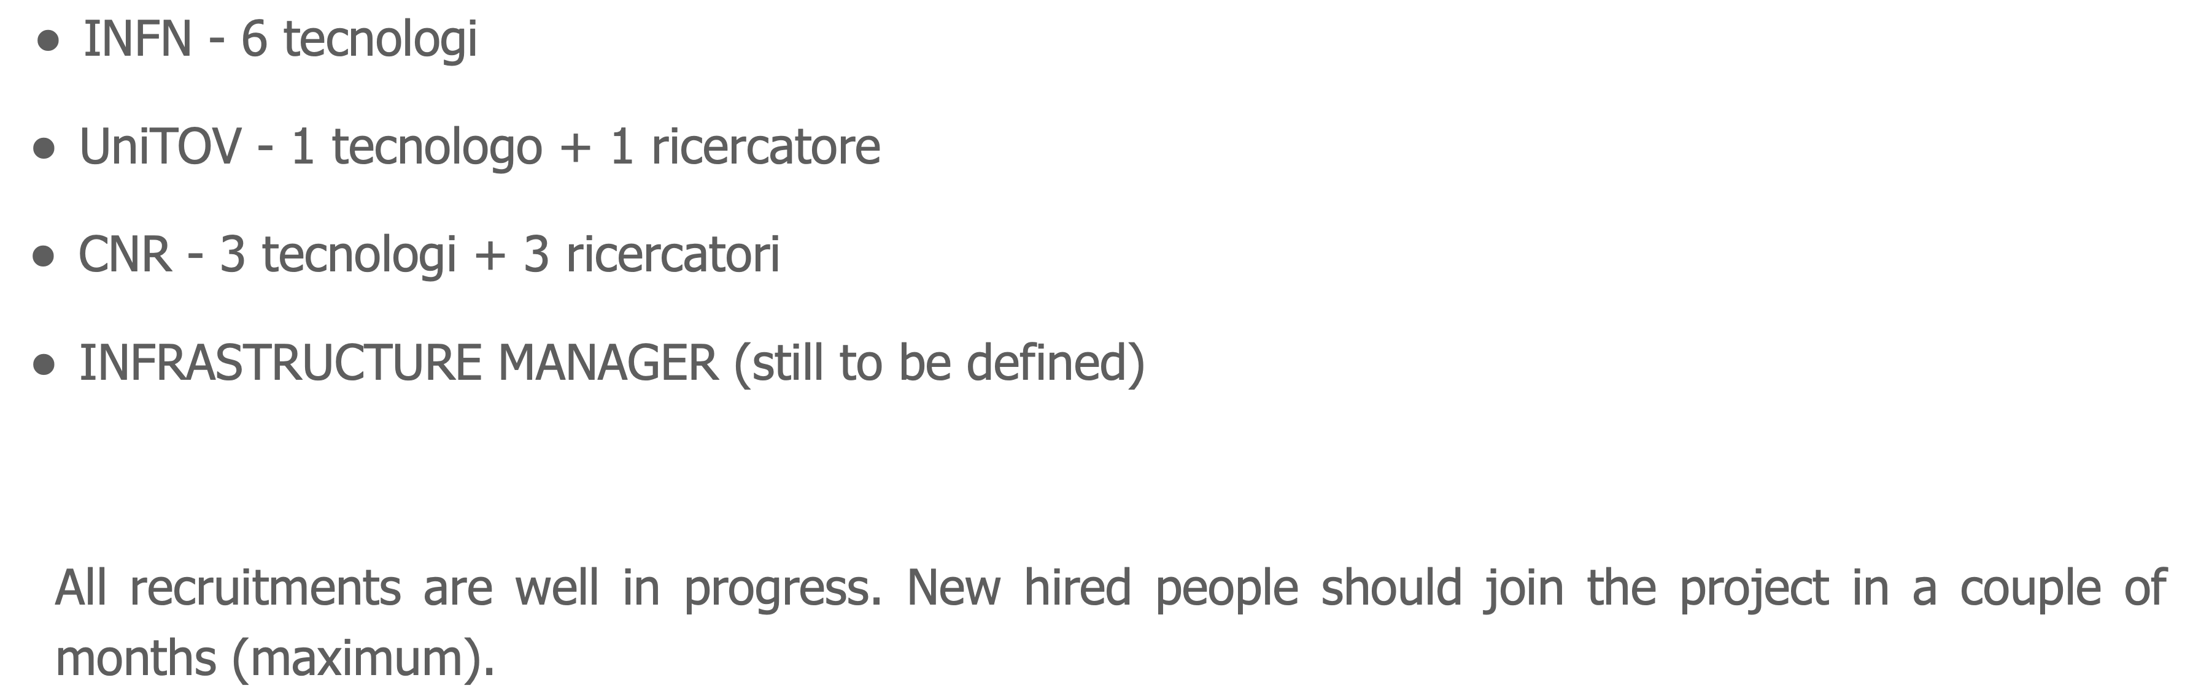

Recruitment
Antonio Falone
antonio.falone@lnf.infn.it
EuAPS – Kick Off Meeting 28-02-2023

Slide 24
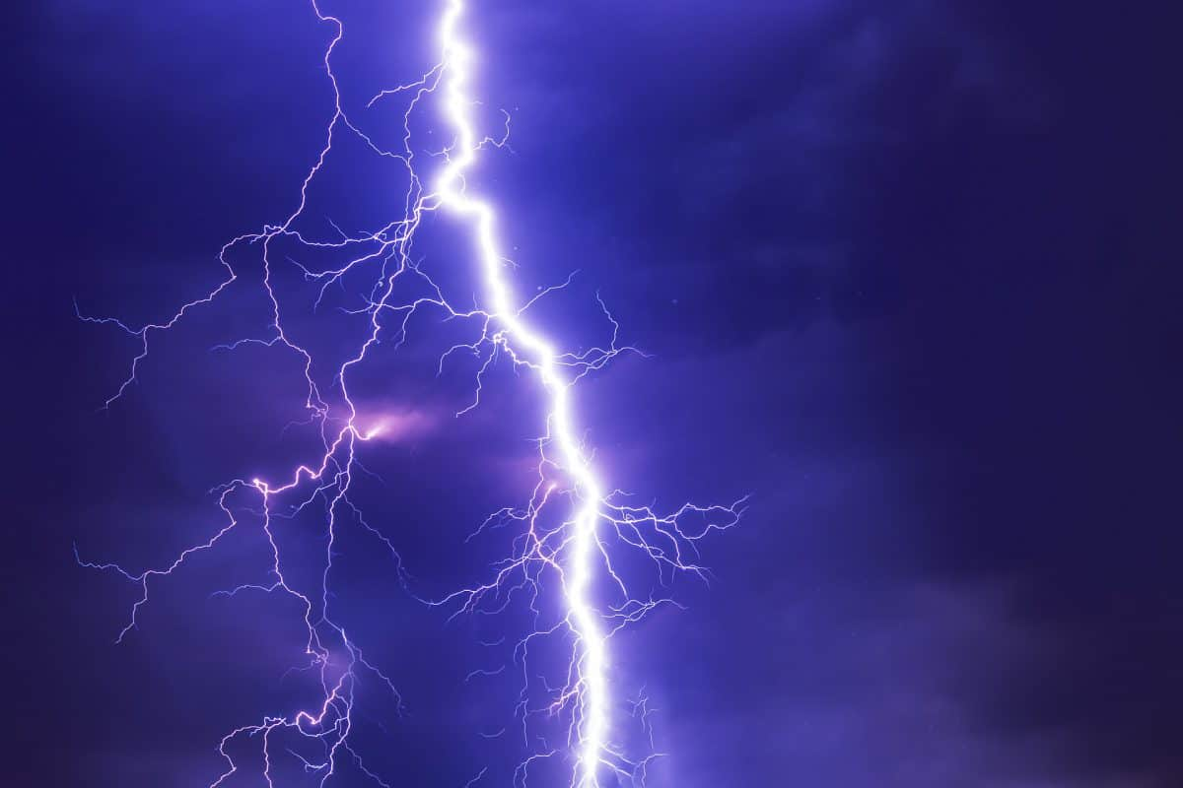
Art. 11 - Obblighi del Soggetto Attuatore
A seguito della selezione, ciascun Soggetto Attuatore delle progettualità connesse all’investimento PNRR oggetto del presente Avviso, si obbliga:
a) …….
t) ad individuare entro il 31 dicembre 2023, ai sensi del decreto legislativo 18 aprile 2016, n. 50, del decreto-legge 31 maggio 2021, n. 77, nonché di tutte le altre norme di settore applicabili, i soggetti Realizzatori;
x)…….
Massimo Ferrario (INFN-LNF) Seconda Giornata Acceleratori - Catania 2-3 Marzo 2023

Slide 25
Conclusions
One of the ambitions of EuAPS is to be the first operating brick of the EuPRAXIA project well in advance compared to the EuPRAXIA time scale.
Thus bringing together laser, plasma and advanced accelerator scientists with radiation user’s experts to promote the blooming of a new scientific community well prepared to efficiently exploit the scientific opportunities of EuPRAXIA.
Significant advancement in Laser Technology for EuPRAXIA
X-ray users beam line scientific case in preparation, medical applications
A lot of new interesting beam physics still possible (various plasma configurations, plasma undulator and FEL, beam diagnostics, limitations for LC)
Timeline constrains on the procurements may be difficult to accomplish within the 2023.
A consistent remodulation of the work plan is needed and it will be submitted in March.
Massimo Ferrario (INFN-LNF) Seconda Giornata Acceleratori - Catania 2-3 Marzo 2023

Slide 26
Thank for your attention

Slide 27
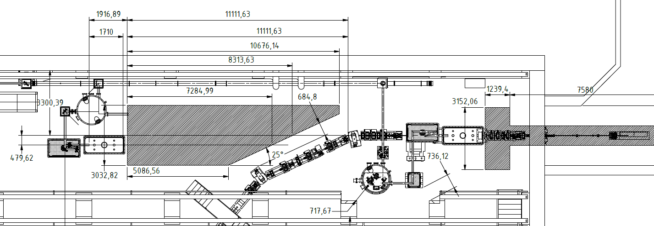
WP.2 Betatron Radiation Source
EuAPS setup fits in two different positions inside the SPARC bunker
Both of them have advantages and disadvantages
The final position will be defined before the summer based on these parameters:
  Best source performance
  Possibility to capture the electron in the future in a dedicated beamline
  Space for users, including future upgrade
  Different schemes for betatron production
Courtesy A.Cianchi

Slide 28
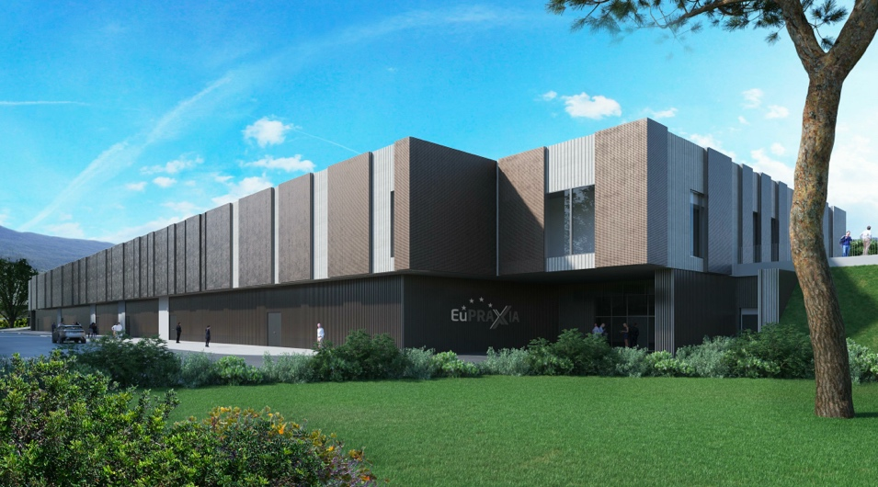
Headquarter and Site 1: EuPRAXIA@SPARC_LAB
Frascati`s future facility
> 108 M€ invest funding
Beam-driven plasma accelerator
Europe`s most compact and most southern FEL
The world`s most compact RF accelerator (X band with CERN)
EuAPS Kick-off Meeting Roma , 28 February 2023, INFN Head quarter

Slide 29
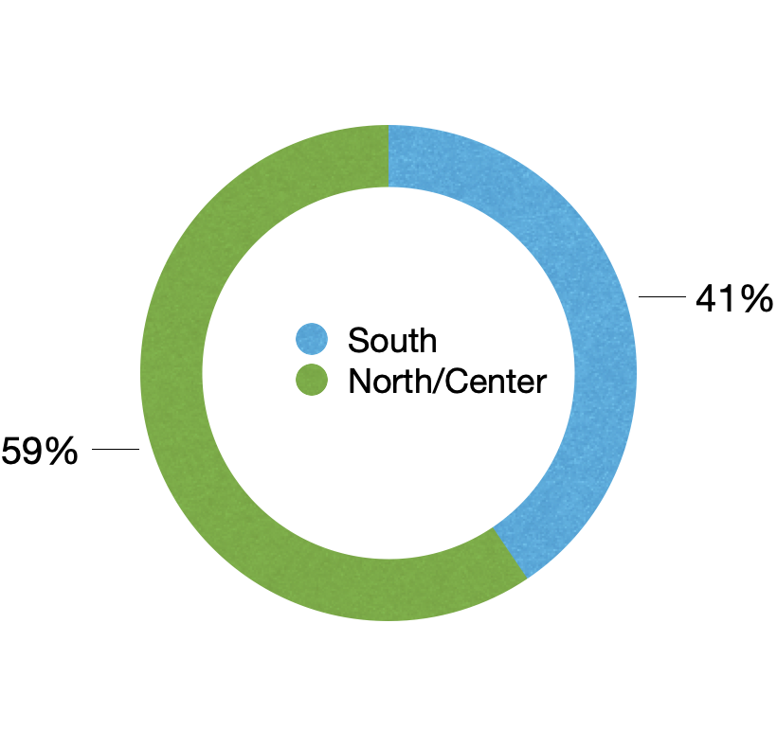
Geographical distribution
CNR-INO, Pisa
CNR-ISM, Potenza
Rome
INFN – LNF, Frascati
UniTOV, Roma
CNR – ISM,Montelibretti
Milan
INFN-MI
Catania
INFN-LNS
Antonio Falone
antonio.falone@lnf.infn.it
EuAPS – Kick Off Meeting 28-02-2023

Slide 30
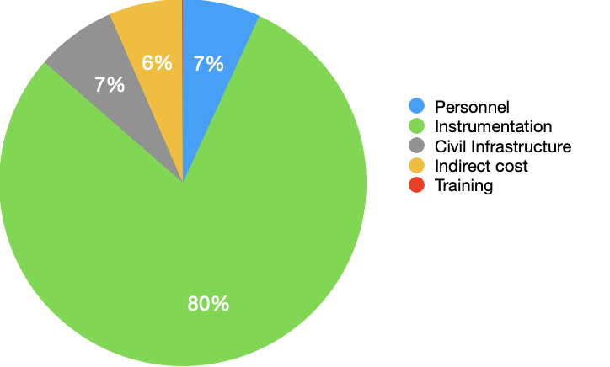
Distribuzione Budget
Costs included in the request for funding (€)
 | To be located within the eight southern regions | To be located outside the eight southern Regions | Total requested grant
Fixed term personnel specifically hired for the project | 270.000,00 | 1.258.000,00 | 1.528.000,00
Scientific instrumentation and technological equipment,software licenses and patent | 6.917.812,47 | 10.865.386,00 | 17.783.198,47
Open Access,Trans National Access, FAIR principle implementation | 0,00 | 0,00 | 0,00
Civil infrastructures and related systems | 1.300.006,38 | 280.000,00 | 1.580.006,38
Indirect costs, including running costs | 575.081,15 | 869.302,00 | 1.444.383,15
Training activities | 0,00 | 15.000,00 | 15.000,00
Total | 9.062.900,00 | 13.287.688,00 | 22.350.588,00
CNR-INO, Pisa
CNR-ISM, Potenza
Rome
INFN – LNF, Frascati
UniTOV, Roma
CNR – ISM,Montelibretti
Milan
INFN-MI
Catania
INFN-LNS

Slide 31
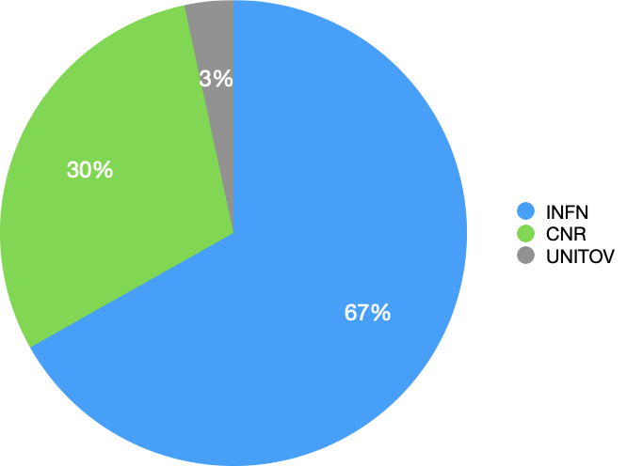
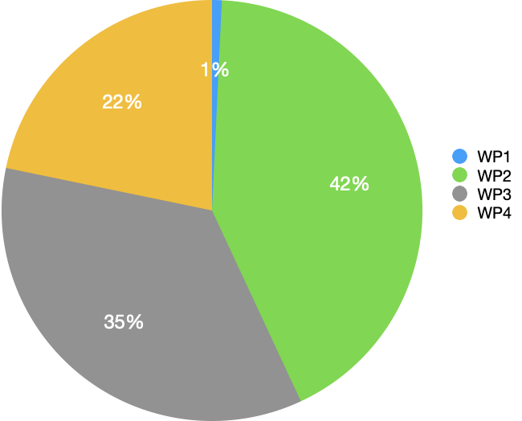
Budget baseline
Distribution per item
Distribution per institution
Distribution per WP
Antonio Falone
antonio.falone@lnf.infn.it
EuAPS – Kick Off Meeting 28-02-2023

Slide 32
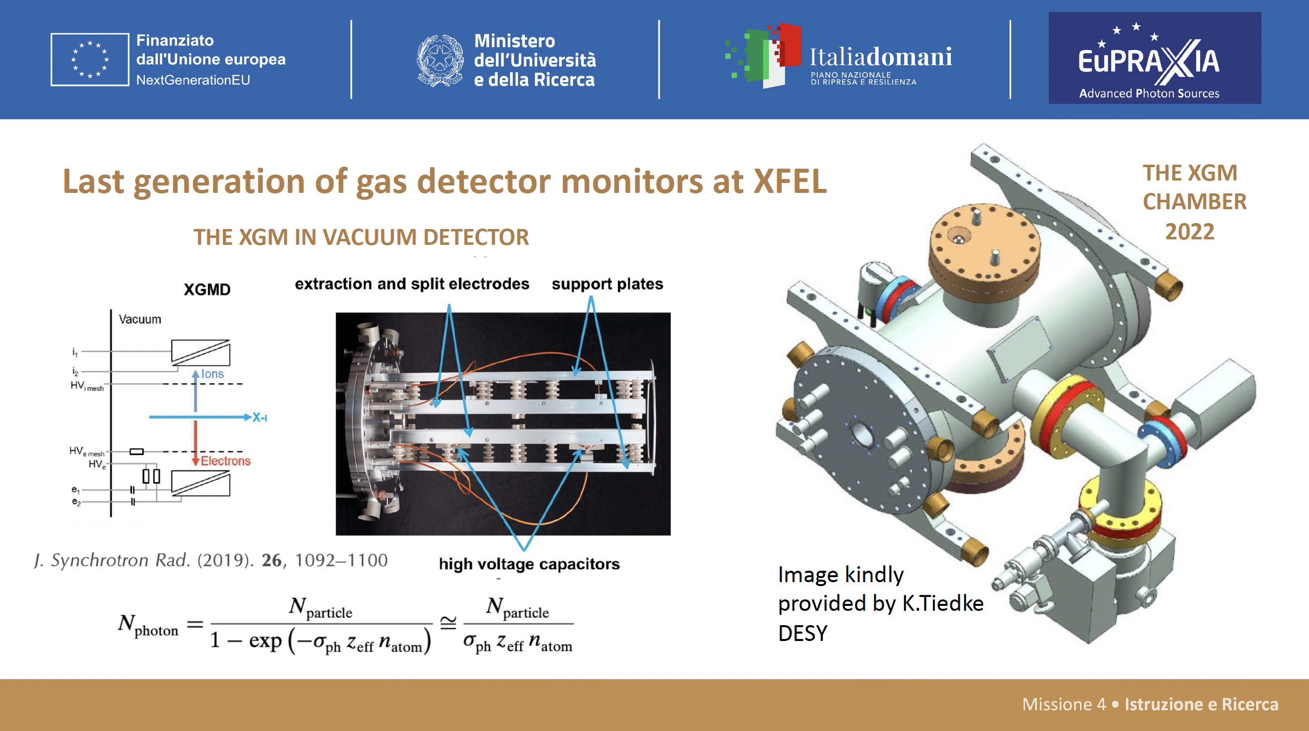

Slide 33
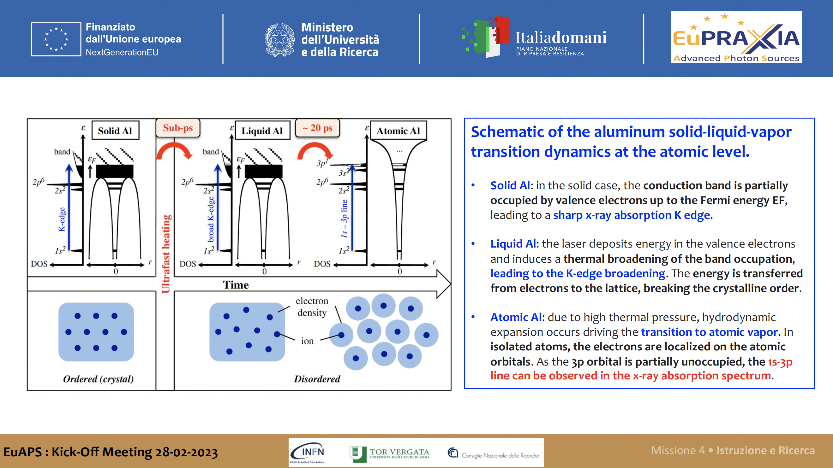

Slide 34
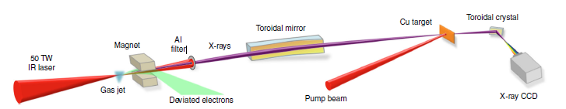
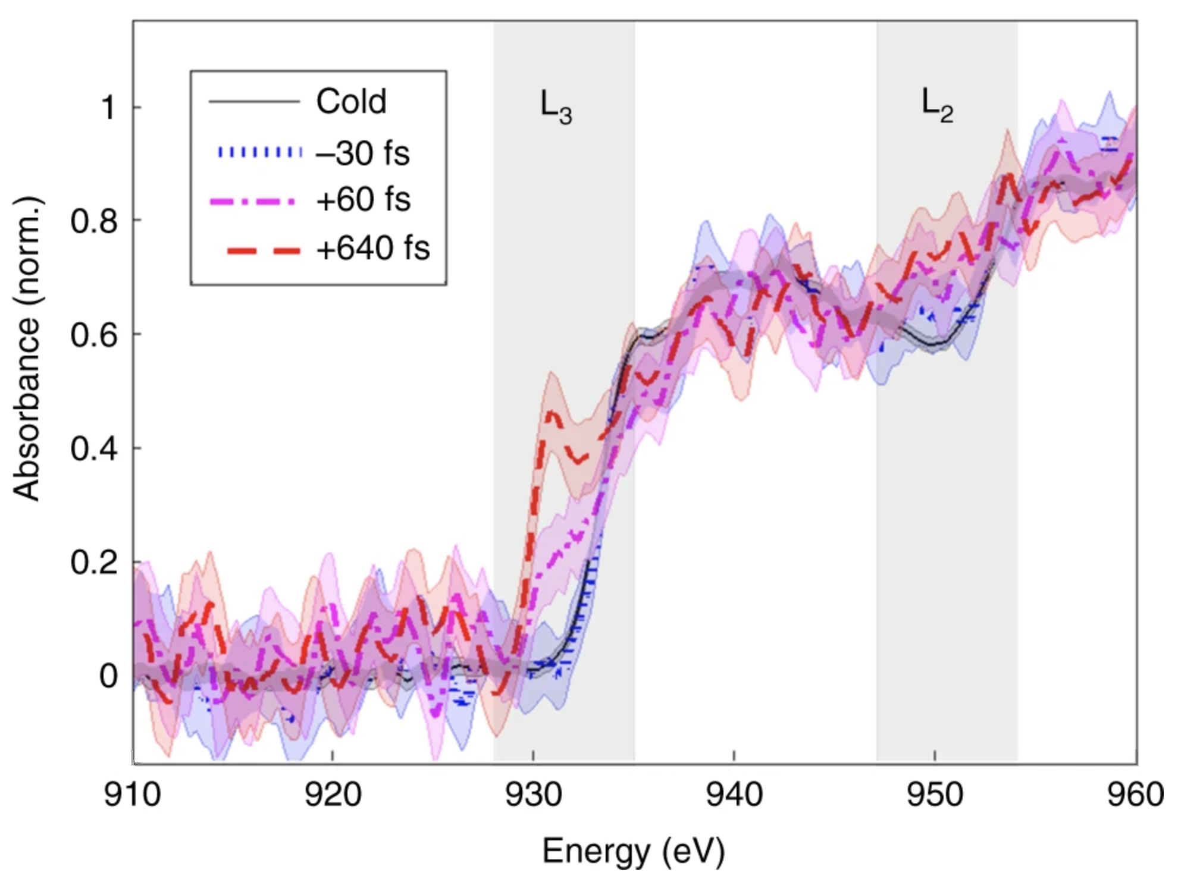
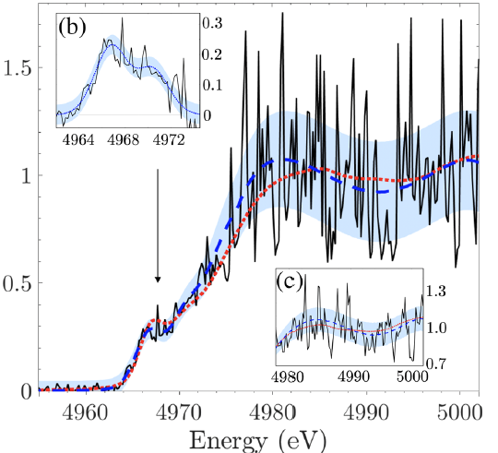
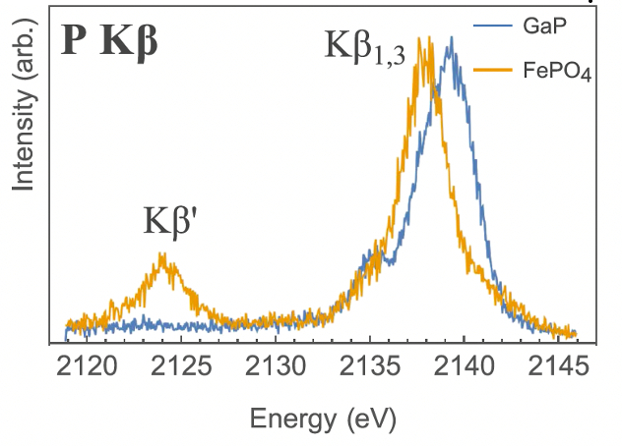
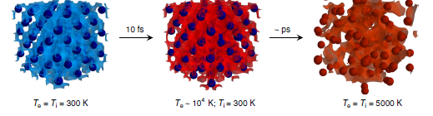
Betatron Radiation and Spectroscopy
X-ray Spectroscopy at EuAPS
1) XAS or X-ray Absorption Spectroscopy
2) XES or X-ray Emission Spectroscopy
Static or time-resolved or pump-probe material science studies at atomic scale
Cu L edges
Single-shot absorption measurements on Titanium
B. Kettle et al. Phys Rev Lett 2019
XES XRF K_{β} lines
M. Holden Rev. Sci. Instrum. 2017
Laser-excited dynamics in metals
B. Mahieu et al. Nature Comm. 2018

Slide 35

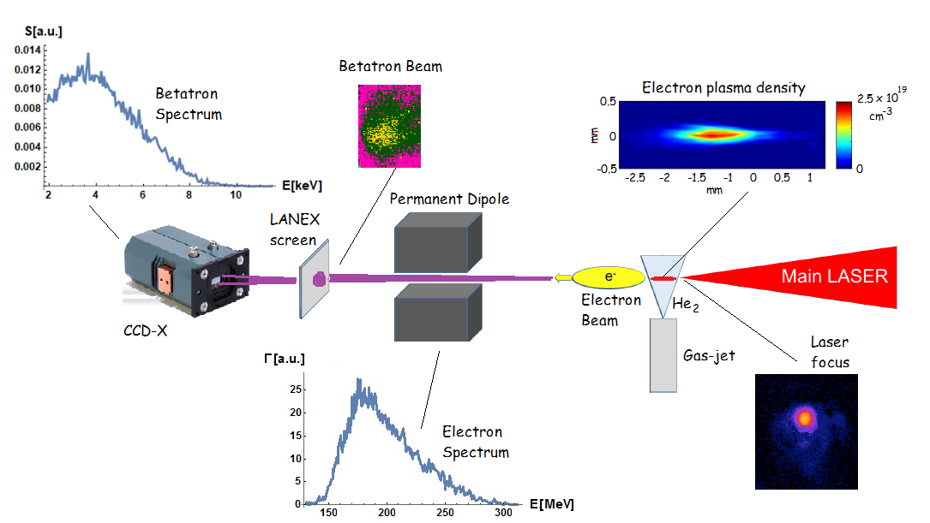
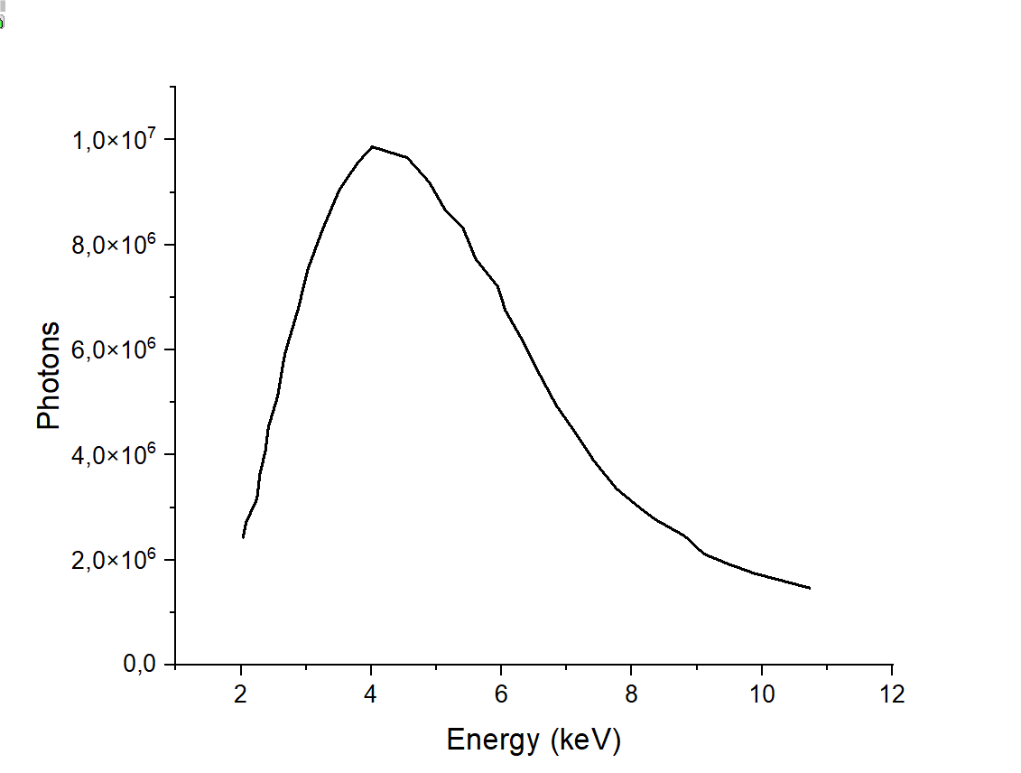
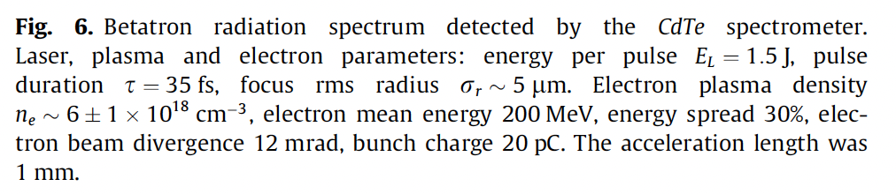
Previous Betatron Radiation experiment with FLAME
EuAPS Kick-off Meeting Roma , 28 February 2023, INFN Head quarter

Slide 36




Betaron Radiation Source at EuPRAXIA@SPARC_LAB
$$\frac{d^{2}I}{dωdΩ}\left(θ=0\right)≅\frac{N_{ β}3e^{2}}{2 π^{3}ε_{0}c} γ^{2}{\left(\frac{ω}{ω_{c}}\right)}^{2}K_{\frac{2}{3}}^{2}(\frac{ω}{ω_{c}})$$
According to this simulations, the expected EuPRAXIA betatron radiation spectrum will range from about 1 nm down to the hard X-ray region (less than 1 Å).
Some degree of tunability is possible
Betatron Imaging (PCI, CT) => sub-μ resolution
Betatron X-ray tme-resoved spectroscopy (XAS)
Beam Diagnostics
FEL Seeding
Betatron coherence
EuAPS Kick-off Meeting Roma , 28 February 2023, INFN Head quarter

Slide 37


WP4. High average power laser beamline (CNR-INO)
A new high average power laser beamline, featuring ultrashort duration, J-class energy laser system at high rep rate (100Hz), to be installed at the Intense Laser Irradiation Laboratory of CNR-INO in Pisa
The new laser system, at the forefront of current ultrashort/ultraintense laser technology, will match the performances required for the EuPRAXIA front-end laser
Beamline accessible via a dedicated user station in a new underground area, built taking advantages of synergies with another NG-EU infrastructure (IPHOQS).
Studies in the following fields (among others) will be made possible:
Ultrashort and ultraintense laser development
Among others: high power optics, laser damage, new laser and optical materials/coatings, laser components, thermal management
Established sources of energetic particles with high average flux
Among others: particle beams for applications in radiobiology and medicine, material studies with charged particles (for instance, PIXE), study of novel materials for advanced applications (fusion science, space applications, ...)

Slide 38


Towards EuPRAXIA 2nd Site
EuPRAXIA
PW class,
100 Hz repetition rate,
multi kW average power,
diode pumped
Full thermal load transport
Eupraxia laser development is aimed at delivering more efficient, kW class PW laser driver for plasma acceleration at >100 Hz rate
EuAPS
50 TW peak power
100 Hz repetition rate
100 W average power
Diode pumped
Thermal load effects
s
CURRENT
PW class,
Hz repetition rate,
≈10 W average power
flashlamp pumped
No thermal load transport

Slide 39


Slide 40

EuAPS Timeline
EuAPS Kick-off Meeting Roma , 28 February 2023, INFN Head quarter

