Slide 1
HB2TF
High Brightness Beams Test Facility
Dario Giove
on behalf of the HB²TF collaboration
3 March 2023

Slide 2
HB²TF
High-brightness electron beam sources are critical elements in the path to the success of upcoming projects, such as linac-based light sources and industrial-scale UV lasers.
Disparate needs are driving injector design in different directions: high beam power for IR and UV FELs, low transverse emittances for linac-based x-ray light sources, and emittance aspect-ratio control for linear colliders.
The present proposal is related to the development of a High Brightness Beams Test Facility (HB²TF) at the INFN-LASA laboratory.
The proposal is aimed to pool different experiences and capabilities so far available in research groups at the LASA laboratory along with the contribution from accelerator groups in other INFN sites and in foreign labs.

Slide 3
HB²TF in a nutshell
The proposal to develop a High Brightness Beams Test Facility (HB²TF) at the INFN-LASA laboratory has been approved by INFN-CSN5 for the period 2023-2025. HB²TF aims to provide a high power and high brightness CW beam. The beam will provide different bunch charges at different repetition rate and energies.
This impressive flexibility is part of the originality of the facility and will allow the usage of the beam for some advanced experiments.
Under these assumptions, the facility is composed of different elements that can be grouped into the following sections:
• An electron source.
• A first acceleration stage (DC).
• A beam manipulation and transport stage.
Electron Source
First acceleration stage
Beam manipulation stage
Photocathode
DC Gun
Bunchers and solenoids

Slide 4
HB2TF Summary
Layout of the HB2TF proposal

Slide 5
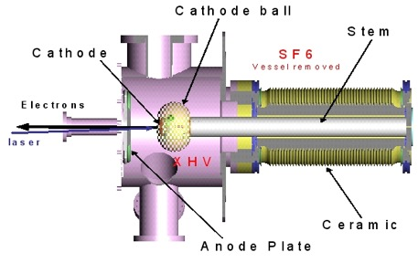
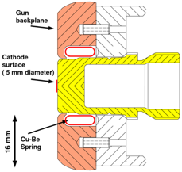
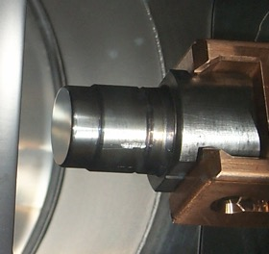
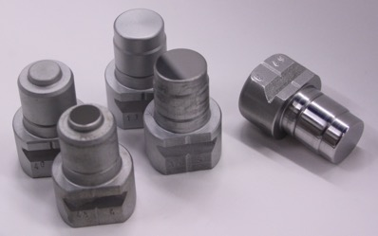
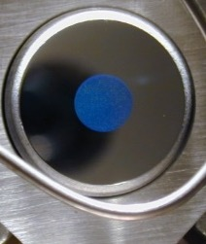
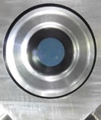




Photocathodes
$$B=\frac{N_{part}}{A Ω}≈\frac{I}{ε_{x}ε_{y}}$$
Photocathodes are used as a source of electrons in high brightness beam photoinjectors
Illuminated by a laser beam, photocathodes emit electrons at proper phases
in a high electric field region, necessary to accelerate the electron bunch
to high energy to compensate for space charge and optimize beam emittances
To generate the required electric field, the most common solutions are DC and RF guns
  $ε=\sqrt{ε_{RF}^{2}+ε_{SC}^{2}+ε_{th}^{2}+ε_{rough}^{2}+…}$
$ε_{RF}^{2}$= 0 (DC gun)
INFN Mo plug
Cs₂Te Photocathodes
Photocathode requirements:
  High Quantum Efficiency (QE) (order of %) with good spatial uniformity (> 90%)
  Low dark current
  Long operative lifetime Stable operation
  Fast response time
  Low thermal emittance (higher brightness)
$QE\left[\%\right]=\frac{I\left[A\right] E_{ph}\left[eV\right]}{P_{laser}\left[W\right] }·$100

Slide 6

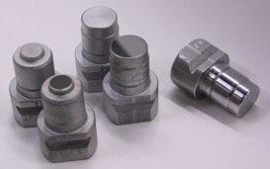
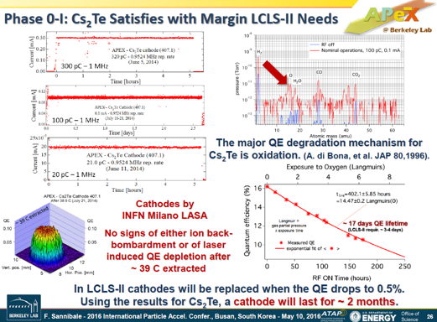
INFN LASA Cs₂Te Photocathodes
INFN LASA produces Cs₂Te photocathode since 90s and it’s a reference lab for this activity
With a continuous interplay between collaborators and R&D, we today growth
cathodes with an operational lifetime (24/7) in the user facilities increased
from few months to few years, that are a reference for many accelerator
complex for users
More than 150 photocathodes delivered up to now
Cs₂Te photocathodes have been demonstrated usable also for CW operation
Facilities/injectors: FLASH and PITZ (DESY), FAST (FNAL), APEX (LBNL), LCLS-II (SLAC)
INFN Mo plug is now a “standard” allowing exchange of photocathodes between
facilities: EU (DESY, STFC), US (FNAL, LBNL, BNL, SLAC, UCLA, Cornell),
China (IHEP, SHINE, Dalian)
Extracted charge: ~ 23 C
1063 days of oper. until now
INFN Mo plug
CW (1 MHz) operation in APEX gun

Slide 7
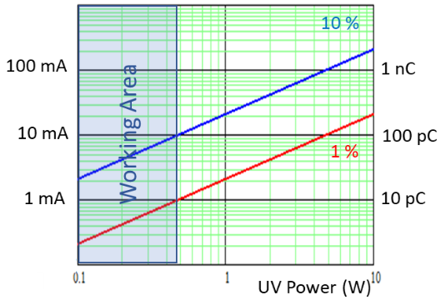
Photocathodes for HB²TF
For HB²TF Cs₂Te photocathodes will be used as electron sources
  Average QE at the production ≥ 10% in UV range, in operation typically used until QE 0.5%
  Vacuum quality: low 10⁻¹⁰ mbar (in the production stage), low 10⁻⁹ mbar (in operation mode)
Laser system (Yb laser, λ^{fund} = 1035 nm, P = 10 W, Rep. Rate from 1 to 93 MHz, 190 fs):
  UV is needed for the photocathode operation: λ^{4th} = 258.75 nm, P = 0.5 W
Photocathode requirements in operation:
  Q: up to 50 pC; Iave up to 5 mA
  Lifetime (as long as possible)
  On-line: QE and reflectivity characterization
  After operation, photocathodes will be
  analyzed in the production system (post-usage)

Slide 8
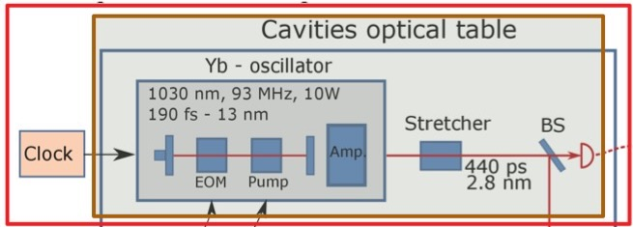
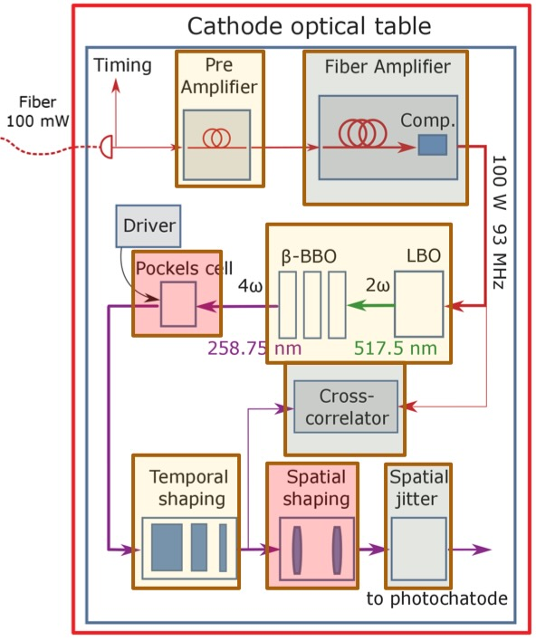
Laser scheme
A UV laser running at 258.75 nm by fourth harmonic generation from a mode locked Yb laser will be used to have electron emission. The expected pulse length on the photocathode is planned to be 20-30 ps to mitigate the space charge effect in the emission and acceleration process in the DC gun. The long bunch generated in the DC gun is focused by solenoids magnets before injection into the sub harmonic bunchers.

Slide 9
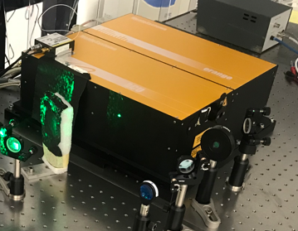
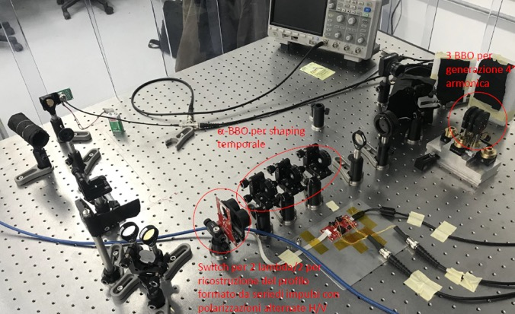
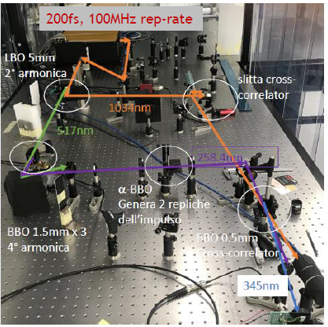
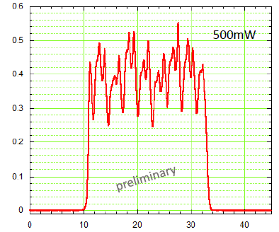
Laser scheme & components
Temporal pulse shaping stacking (3 cristalls alpha-BBO)
Femtosecond Fiber Laser @1040 nm
2nd and 4th harmonics generation scheme

Slide 10
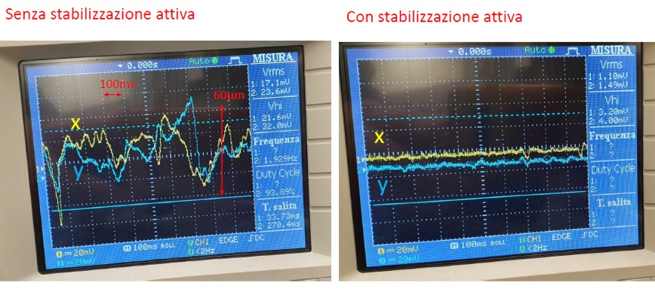
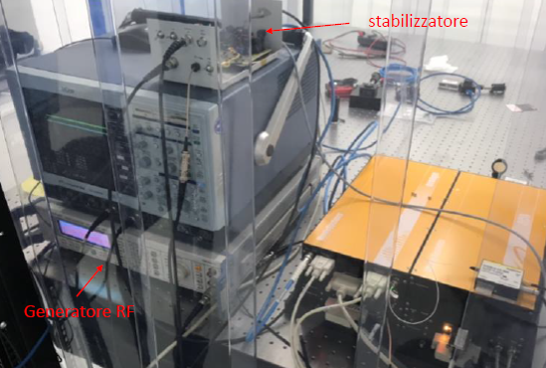
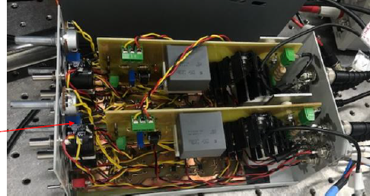
Laser scheme & results
Spatial stabilization of the laser on the photocathode
Stabilization of the laser rep-rate referenced to external RF
Feedback control electronic circuits.
A 4 quadrant photodiode is used to generate the error signal

Slide 11
DC Guns
An electron gun is a component that produces a narrow, collimated electron beam that has a precise kinetic energy.
They are used in a lot of application but today we will discuss their usage in particle accelerators.
Electron guns may be classified by the type of electric field generation (DC or RF), by emission mechanism (thermionic, photocathode, cold emission, plasmas source), by focusing (pure electrostatic or with magnetic fields).
A DC gun provides a robust and already well-developed solution with proven and well documented successful operations at high repetition rate.
Our reference solution is the “inverted insulator” design developed at JLAB.
A user agreement has been signed in 2021with JLAB to take advantage of their experience in this component.

Slide 12
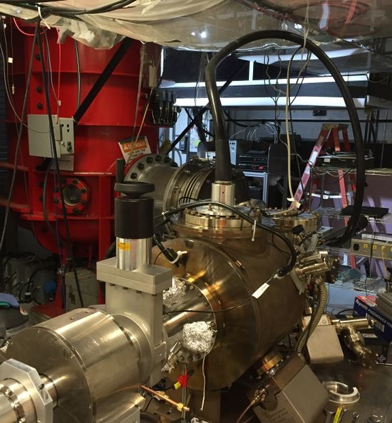
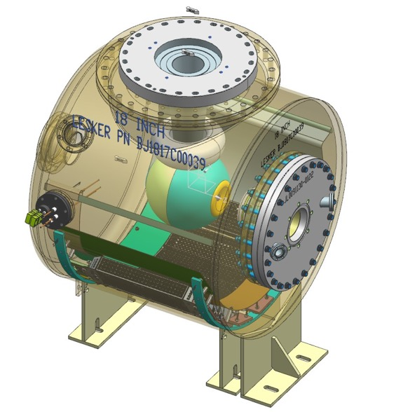
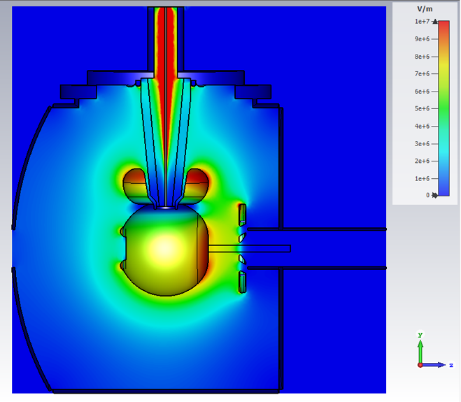
DC Gun
Courtesy of
C. Hernandez Garcia
J-Lab

Slide 13
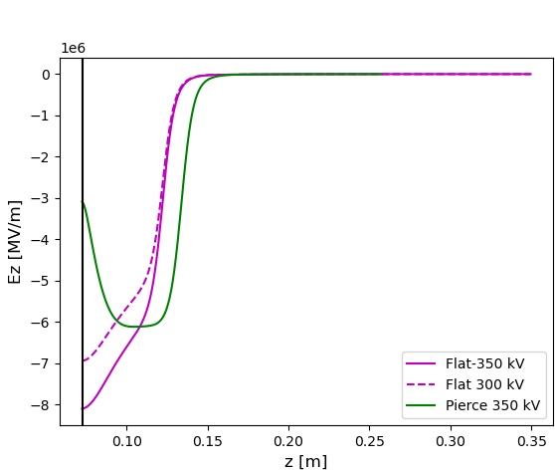
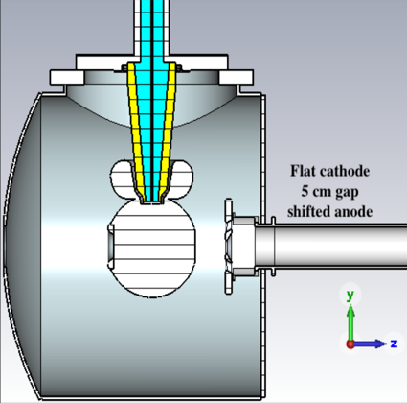
HB2TF Current Activities – DC Gun cathode
2023
Update
The Flat-cathode Ez profile works very well.
We tested some different cases:
ΔV = 250 kV (as BriXSinO gain case) not in the fig.
ΔV = 350 kV (maximum gain case)
ΔV = 300 kV (most reasonable operative gain case) The one we are going to use as reference value
Flat-cathode 300 kV

Slide 14
HB2TF Current Activities – DC Gun Vacuum Chamber
2023
Update
JLAB has provided 3D drawing of the full DC gun
Work is in progress with SAES Vacuum to design, possibly, a new vacuum chamber that
prevents asymmetries as the actual one (improvement appreciated by JLAB for future Guns)
We will go through some optimization cycles based on vacuum and electrostatic design. JLAB support available when needed
A first main modification on the chamber has been the one that removed the couple of lateral 45° pipes for laser entry. They will not allow to have the solenoid as close as we need. The laser will enter on the beam axis through a devoted box (see picture and further later comments)
The expect final design is foreseen in Summer this year
SAES is also interested in the final surface finishing for HV of the gun components

Slide 15
HB2TF Current Activities – Photocathode Transfer System
2023
Update
System design based on INFN LASA RF gun transfer system
Under study, new mechanism for LASA PLUG photocathode insertion into the HV cathode sphere (based on JLAB design) with impact on the inner sphere design (improvement that may allow to use INFN photocathodes in JLAB based desing Guns)
Preliminary cost estimate from SAES Rial Vacuum is available

Slide 16
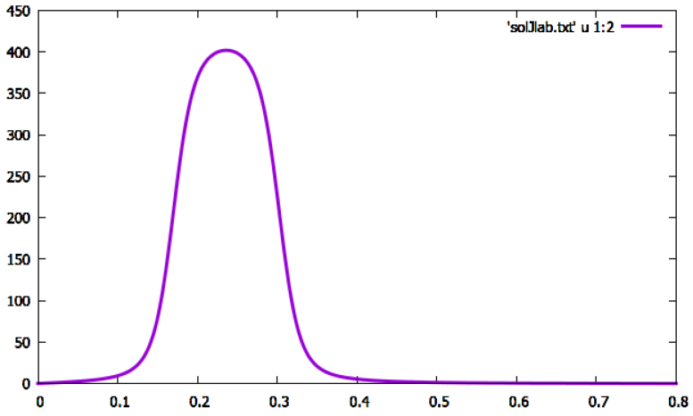
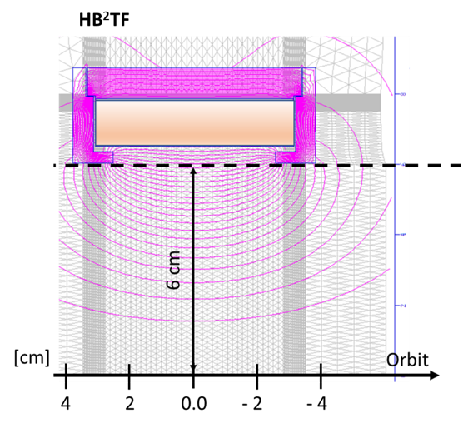
HB2TF Current Activities – Focusing Solenoid
2023
Update
DC Gun Solenoid Magnetic Field Profile
(the solenoid peak is at the closest distance from the cathode i.e. 270 mm)
B_{z} [G]
Z [m]

Slide 17
HB2TF Current Activities – Main HV Power Supply
2023
Update
The experiment has been designed to consider a power supply able to:
Deliver at least 350 kV (up to 400 kV may provide a safer margin)
Deliver up to 5 mA (to cope the beam current required).
At the proposal time we submitted a quote from XP-Power company that has been the company of choice from JLAB and other labs.
In January we asked quotes at the following companies:
XP-Power (USA with local representative)
FUG (Germany)
Heinzinger (Germany)
Teslaman HV Power Supply (China)
Genvolt (UK).
We get an answer only from XP-Power ! The other companies were not able to provide a product at least similar to the one we requested.

Slide 18
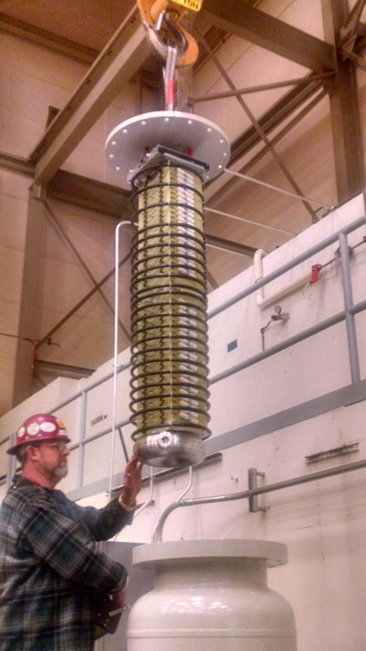
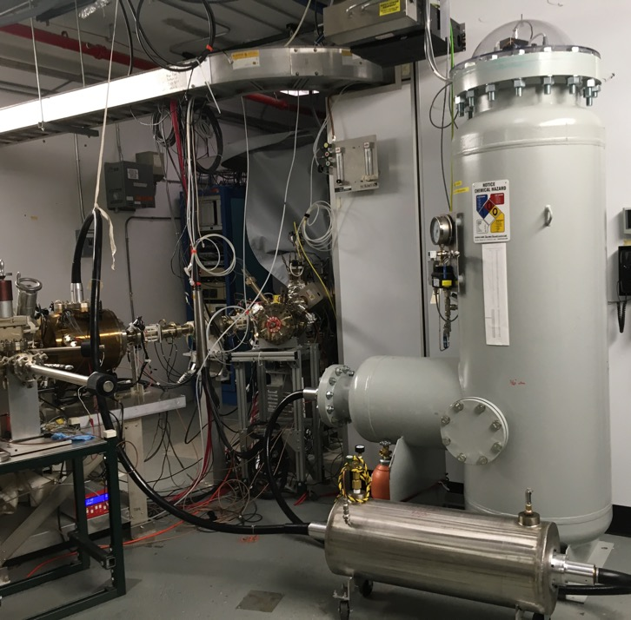
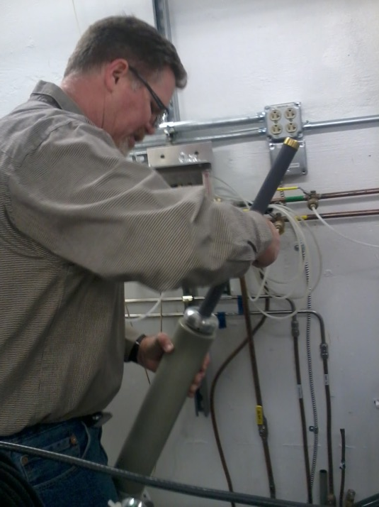
HB2TF Current Activities – SF6 tank and Limiting Resistor
2023
Update
SF6 tank
Limiting Resistor

Slide 19
HB2TF Current Activities – SF6 tank and Limiting Resistor
2023
Update
High voltage resistor
7 bar SF6
We have a preliminary quote for both of them

Slide 20
Beam Manipulation
The beam dynamics study developed for this project takes as a reference the possibility to design an injector that in a near future may be used for an ERL.
This concept can be made explicit as follows: beam energies as low as possible (what will never be recovered) compatible with a beam brightness high enough to drives experiments.
Looking at this framework the beam dynamics (BD) studies carried out so far were aimed to couple the injector of HB²TF to a SC booster to produce a beam with energy of 4.5 MeV, an emittance of about 1.2 mm- mrad and a rms bunch length of about 1.2 mm.
To obtain high brightness beam it is of paramount importance to keep emittance growth under control.
Low energy and high brightness results into a BD space charge dominated that is one of the points of interest of this proposal.

Slide 21
Beam Manipulation
The electron bunches generated by the DC Gun have long longitudinal profile so to avoid emittance dilution. But, in order to minimize nonlinear energy spreading due to RF waveform in the foreseen booster, bunches need to be compressed to shorter length after the gun. As the beam is still non-relativistic at this point, the simplest method of bunch compression is the velocity bunching.
To this end, we choose the sub-harmonic bunching solution, employing two β < 1, 650 MHz spherical re-entrant shape copper cavities. The beam energy before entering the first and second cavity are assumed to be 300 keV and 638 keV, respectively.
The specific frequency of the buncher has been chosen as a subharmonic of the foreseen 1.3 GHz SC booster.
This makes the HB2TF buncher quite unique, with the requirement to accelerate the beam.

Slide 22
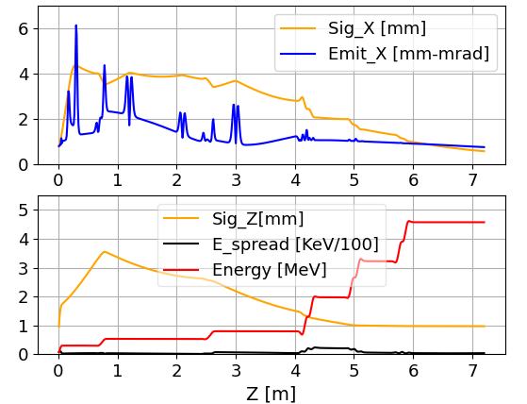
HB2TF Current Activities – Beam Dynamics
Main data:
50 pC Bunch charge
DC-gun @300keV
New line solen. respect
New Bunchers profiles
Bunchers with E_{peak} = 2.7 MV/m
2023
Update
Considering all progress and consolidated points previously discussed a new working point has been identified.
Region of the cryogenic booster needed to rise the beam energy before entering the typical dispersion line that inject any ERL

Slide 23
HB2TF Current Activities – Beam Dynamics
Final operating point features:
50 pC Bunch charge
DC-gun @300keV
New line solen. respect
New Bunchers profiles
Bunchers with E_{peak} = 2.7 MV/m
2023
Update
Region of the cryogenic booster needed to rise the beam energy before entering the typical dispersion line that inject any ERL
Charge | Sig_ X [mm] | Emit_nx[mm-mrad] | Sig_z [mm] | ΔE [keV] | Energy [MeV]
50 pC – 300 keV | 0.56 | 0.74 | 0.97 | 3.5 | 4.56

Slide 24
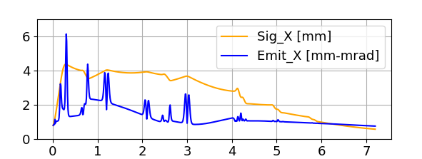
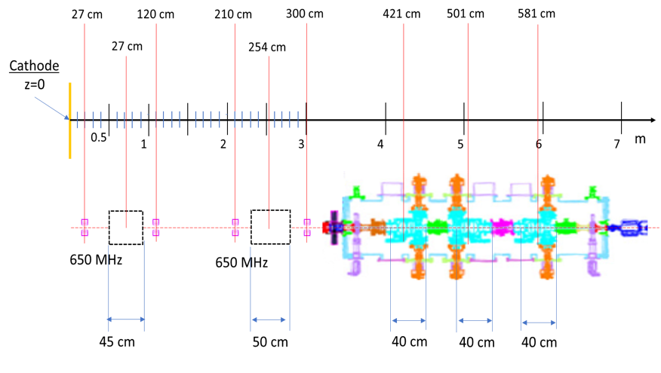
HB2TF Current Activities – Beam Dynamics
2023
Update
Slit position for emittance measurement. Position before the solenoid; the measure
has be done out of the B_{z} field tails
If the emit is measured before the solenoid can be turned off.
The slit can be hosted also downstream the solenoid but in this case it has to be turned on, to be checked the Bz tails.
This measure is still under discussion
Screen position from 50-120 cm seems a reasonable range

Slide 25
HB2TF Current Activities – RF Bunchers
2023
Update
Due to the high economical Impact of the RF bunchers and related power amplifiers plant there has been a discussion within the collaboration about the following points:
choice of the 1.3 GHz and then 650 MHz frequency chain
optimization of the power figure required.
The first issue has been analyzed in terms of available elements at other harmonics of the main 1.3 GHz (866 MHz, for example). The discussion does not show any availability of suitable RF cavities or power elements. Moreover two other elements have been considered:
the expertise of the RF researchers in 1.3 GHz and related main harmonic has been considered a major asset in the project and their efforts will balance the extra work required (this for example if we would like to consider a change to the 800-400 MHz of the PERLE project)
since the maximum machine rep. rate is 1.3 GHz/14 the only compatible sub harmonics frequencies considerable for these devices must be related to an integer divisor of 14, i.e. 2 and 7, therefore 1.3 GHz = 650 MHz and 21.3 GHz = 185.7 MHz

Slide 26
HB2TF Current Activities – RF Bunchers
2023
Update
Due to the results obtained in BD simulations a possible configuration of the E_{zmax}= 2.7 and 3.4 MV/m may be considered with a significant reduction in power requirements

Slide 27
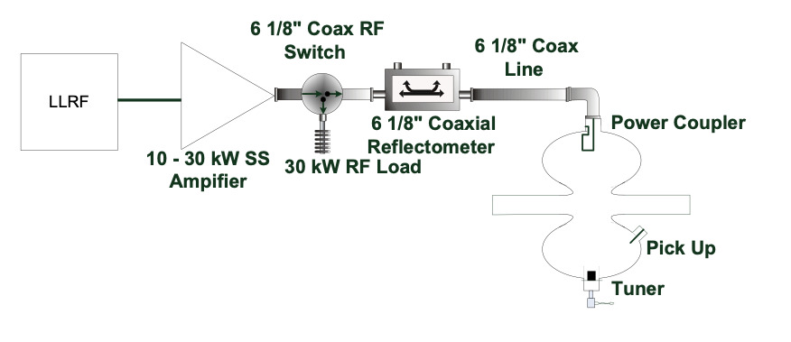
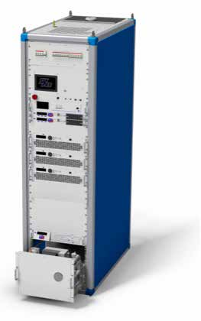
HB2TF Current Activities – RF Plant
2023
Update
First technical meeting with the company SYES (Italy) to discuss their solution in the SSA market.
We will continue to better specify our requirements BUT we understand that we may take really advantage from most of the solutions actually foreseen (LLRF integration, cooling schemes, RF modularity.
A further meeting will be held in March 2023.

Slide 28
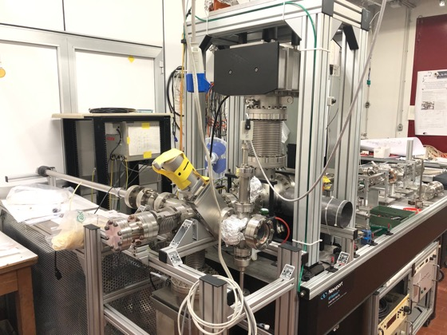
HB2TF - Laser Pulse Tests – Pulse Transport -
2023
Update
Laser tests are going on in the laser lab coupled to the Photocathode stress Test Bench
Pulse transport over 140 m of special optical fiber are undergoing
15 February 2023
Experimental laser and beam line transport assembled and under test using a Molibdenum Cathode and the laser pulse

Slide 29
Thanks for your attention !

