Slide 1
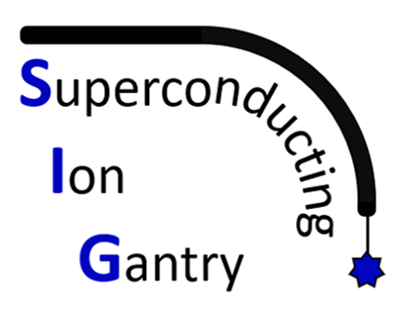
SIG: A Technology Development Program Toward A Compact Superconducting Ion Gantry
Marco Prioli on behalf of INFN-Milano, UniMi, INFN-Genova, UniGe, INFN-LNF, INFN-Torino, UniTo, CNAO
Seconda Giornata Acceleratori, INFN-LNS Catania, Marzo 2023 – M. Prioli

Slide 2
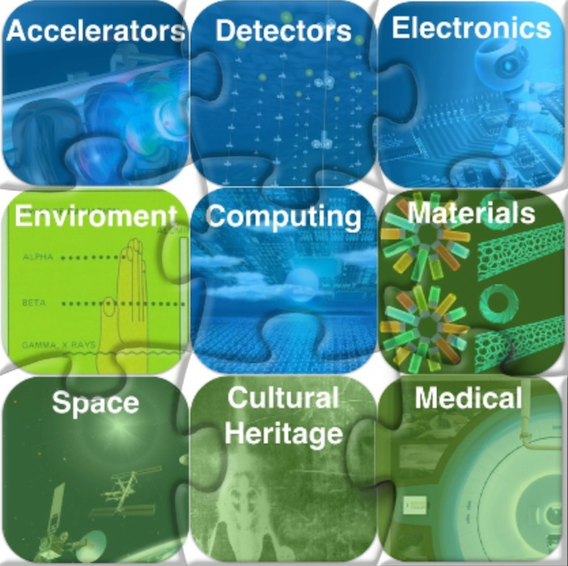
What is SIG
SIG = Superconducting Ion Gantry
Scope: study and development in 3.5 years of the key technologies for the next generation ion gantry of “only” 50 tons. This R&D of SIG will enable non-coplanar ion irradiation, greatly increasing the quality of the cancer treatment.
Competitive 2021 call to INFN-CSN5
Time span: ~3.5 years 2022 – mid 2025
Budget: 1 M€ (+ 600 k€ Ext. Funds: CNAO+CERN)
Personnel: 50 FTE-y (12 FTE-y Fellows included in the budget)
From: https://web.infn.it/csn5

Slide 3
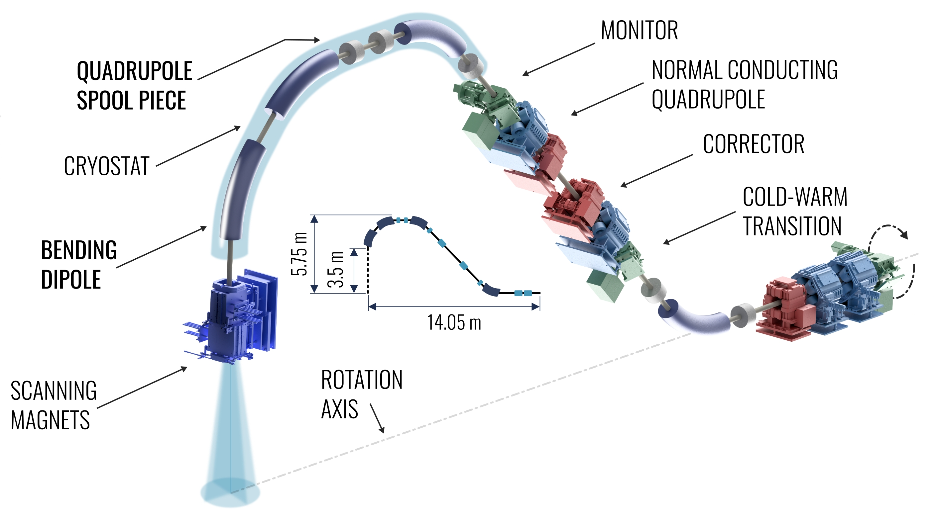
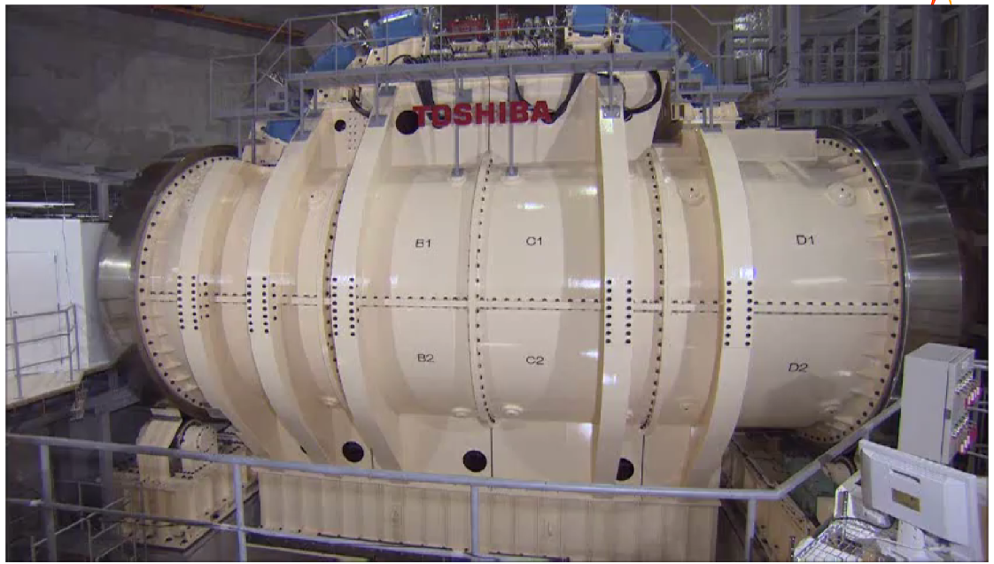
Gantry key features
Particles up to a rigidity of 6.6 Tm (430 MeV/u carbon ions)
14 m long, ~50 tons weight
4 T curved superconducting dipoles
Superconducting spool piece quadrupoles
Downstream scanning magnet system
Dose Delivery and Range Verification Systems for adaptive cancer treatments
Ion gantry @ Himac (Jp) by TOSHIBA
~300 tons, 11m diameter, 13m length

Slide 4
Project structure
WP1: Project coordination – Principal Investigator: L. Rossi (INFN-MI)
WP2: Superconducting dipole magnet demonstrator – Technical coordinator: M. Prioli (INFN-MI). Group: INFN-MI, INFN-GE, CERN, CNAO
WP3: Scanning magnet system – Technical coordinator: L. Sabbatini (INFN-LNF). Group: INFN-LNF, CNAO
WP4: Dose Delivery System (DDS) – Technical coordinator: S. Giordanengo (INFN-TO)
WP5: Range Verification System (RVS) – Technical coordinator: E. Fiorina (INFN-TO)

Slide 5
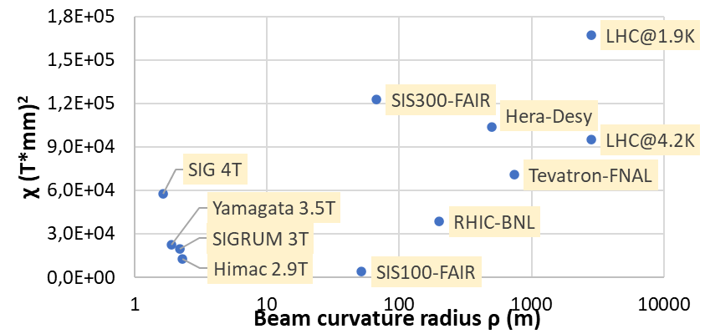
WP2: scope
WP2 scope: design, construction and test of a curved superconducting demonstrator magnet (SDM) for ion gantries
SIG is the successor of SIGRUM by CERN and Tera Foundation (link) with updated params:
present SIG (previous SIGRUM)
Cos-θ coils
Pure dipolar field: 4 T (3 T with gradient)
Bore diameter: 80 mm (70 mm)
Small curvature radius: 1.65 m (2.2 m)
Angular sector: 30°
High field ramp-rate: 0.4 T/s (0.1 T/s)
Compatible with conduction cooling (no LHe) but no optimization
Complexity
A parallel program at CERN is devoted to the construction of a straight thermal demonstrator

Slide 6
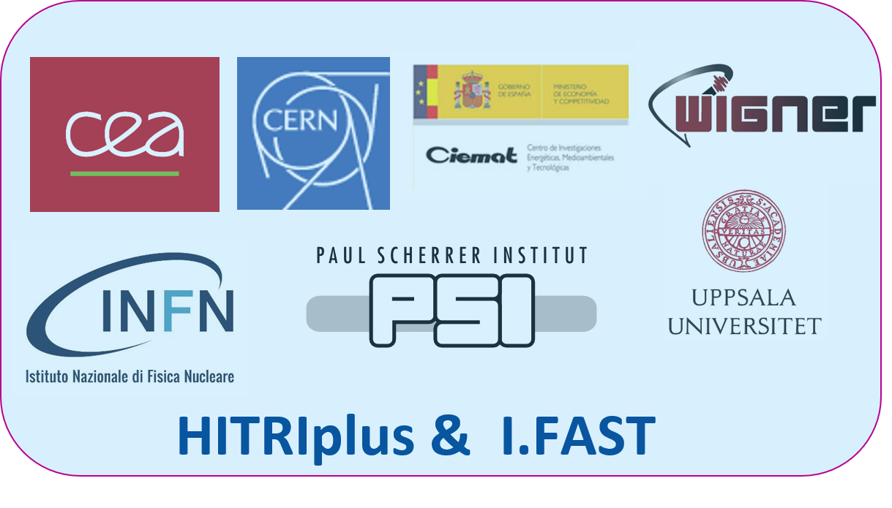
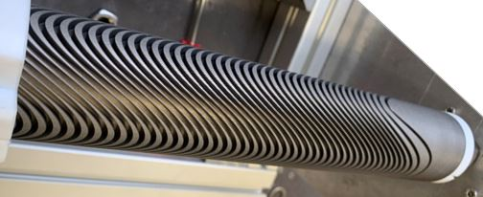
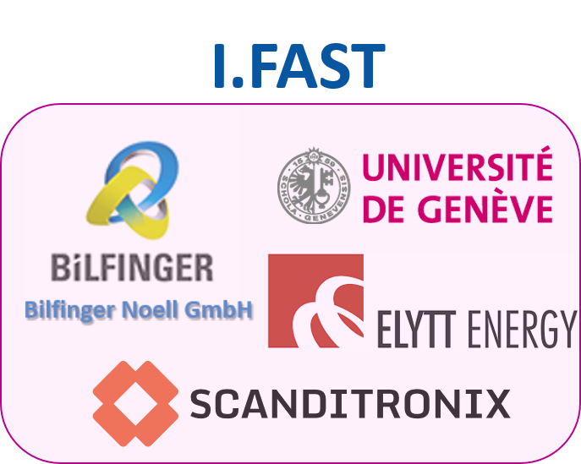
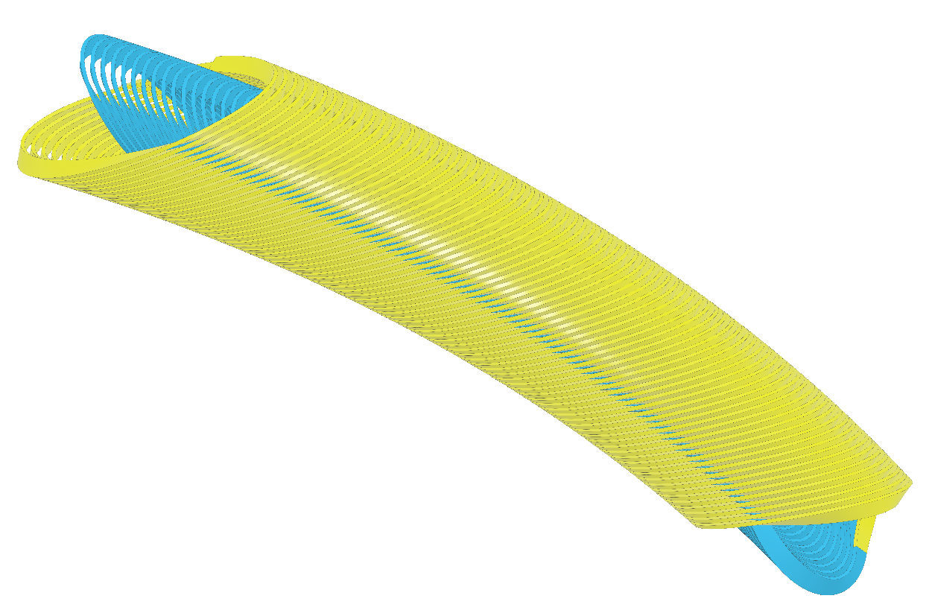
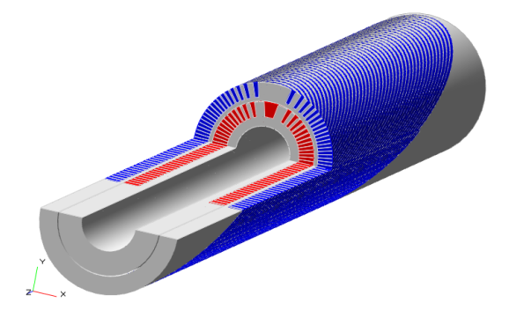
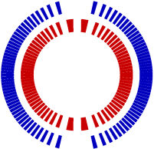
European Projects on SC magnet design for Gantry¹
WP8 - Innovative Superconducting magnets
Institutes/Companies Partners
exploring CCT with HTS and combined function! Labs → Industry (two demonstrators)
Outer layer
Courtesy of Xiaorong Wang
WP8 - Superconducting magnet design
CURVED CCT with R = 1.65 m (Ion gantry-oriented)
¹L. Rossi et al., "A European Collaboration to Investigate Superconducting Magnets for Next Generation Heavy Ion Therapy," in IEEE Transactions on Applied Superconductivity, vol. 32, no. 4, pp. 1-7, June 2022, Art no. 4400207, doi: 10.1109/TASC.2022.3147433.
Courtesy of Tengming Shen
Courtesy of E. De Matteis

Slide 7
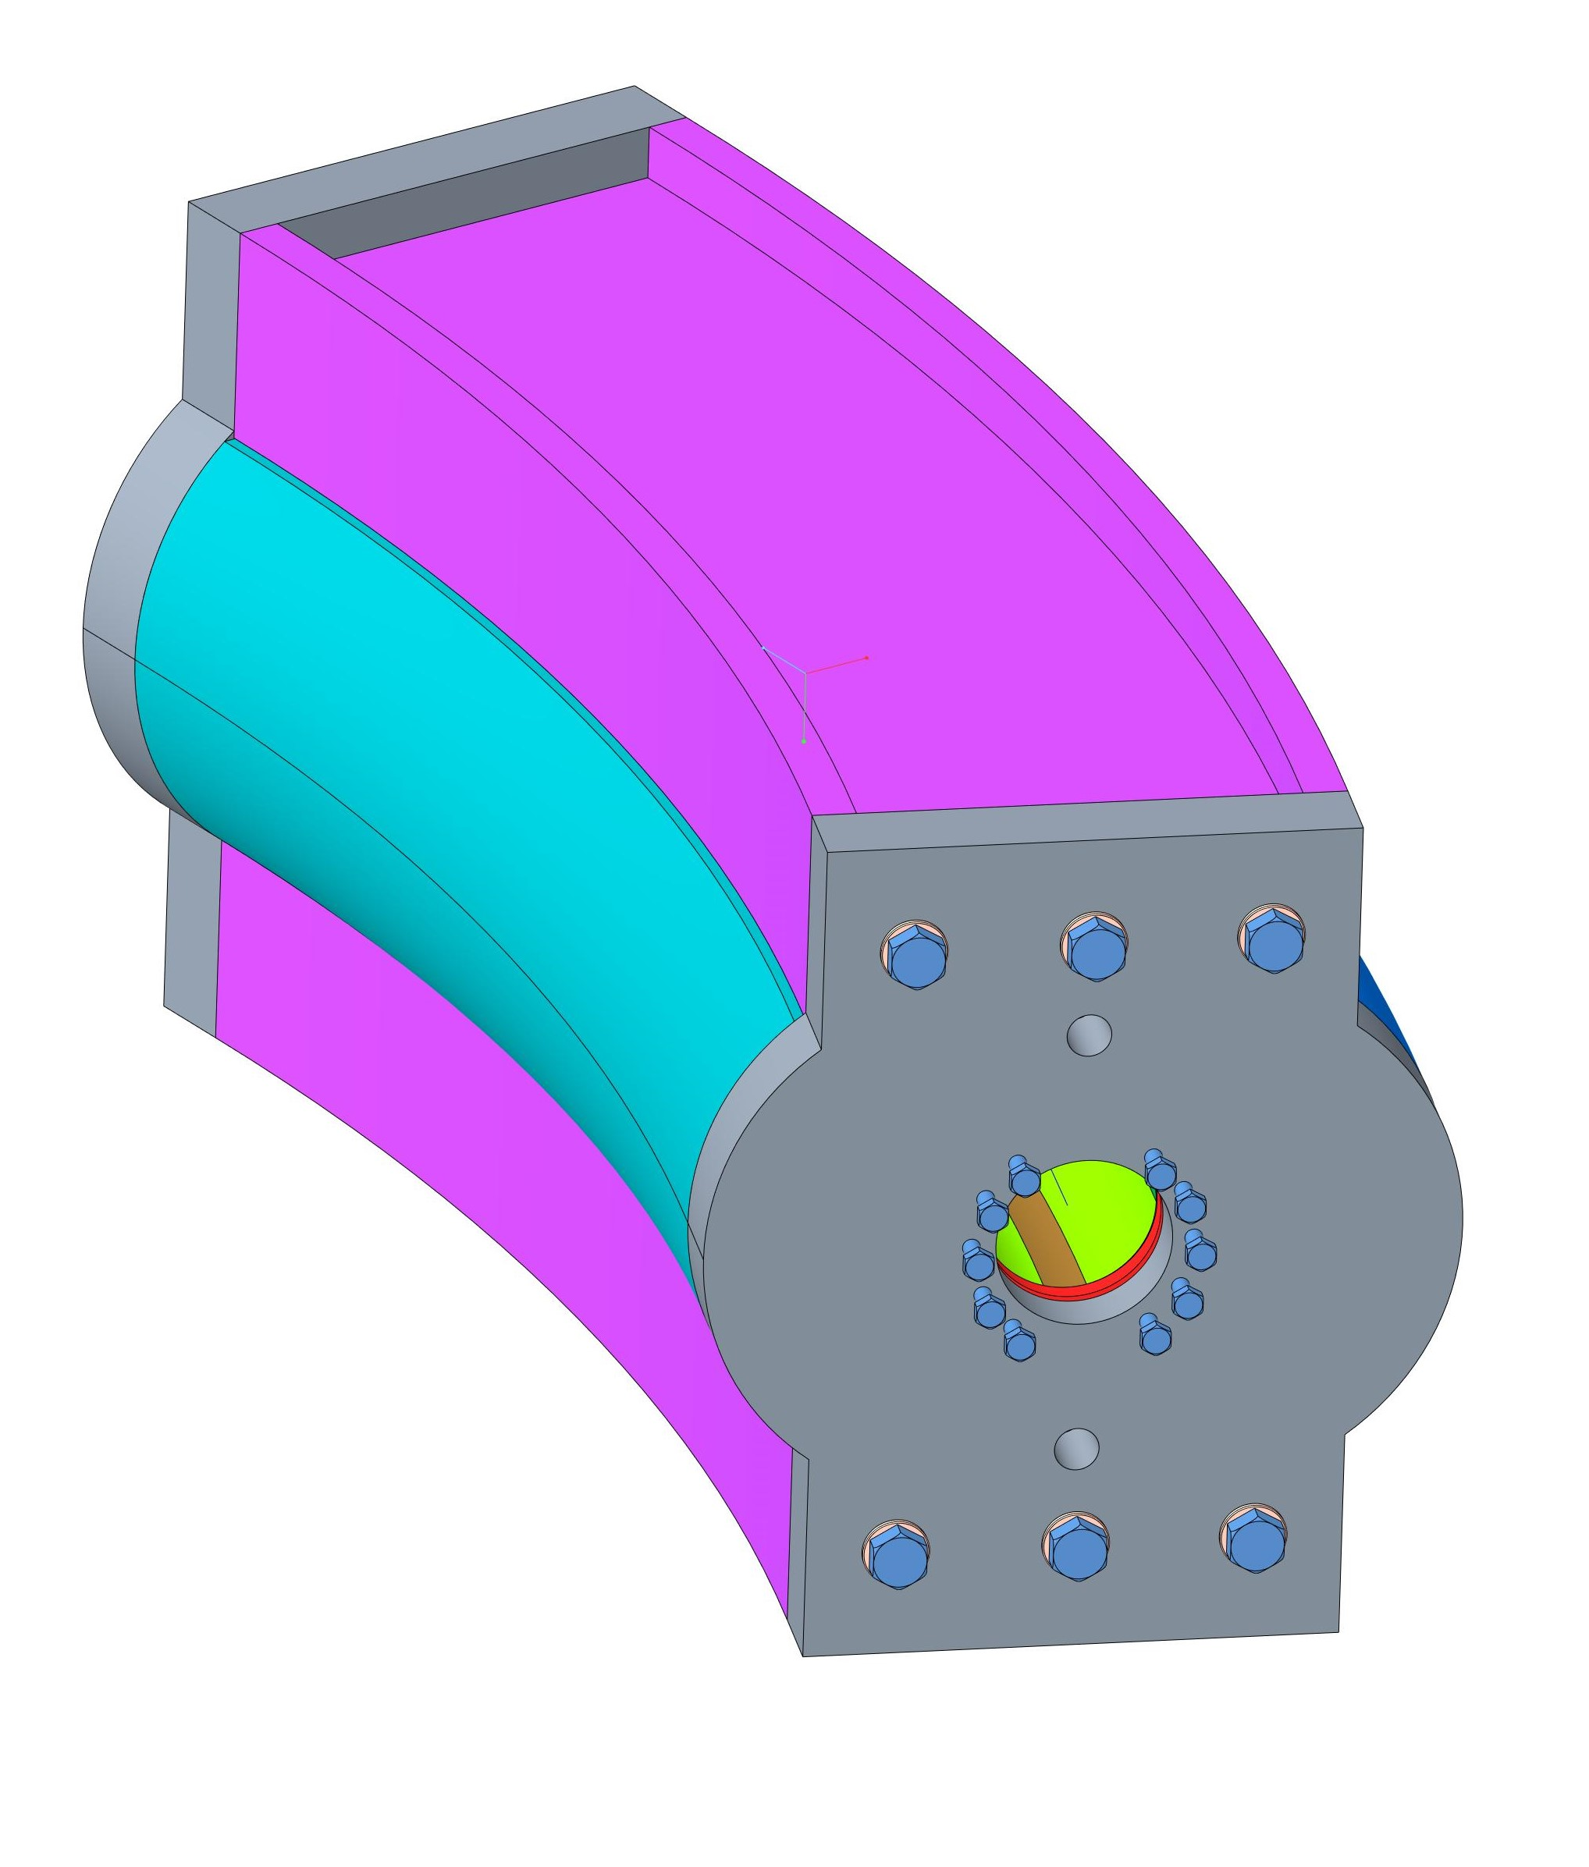
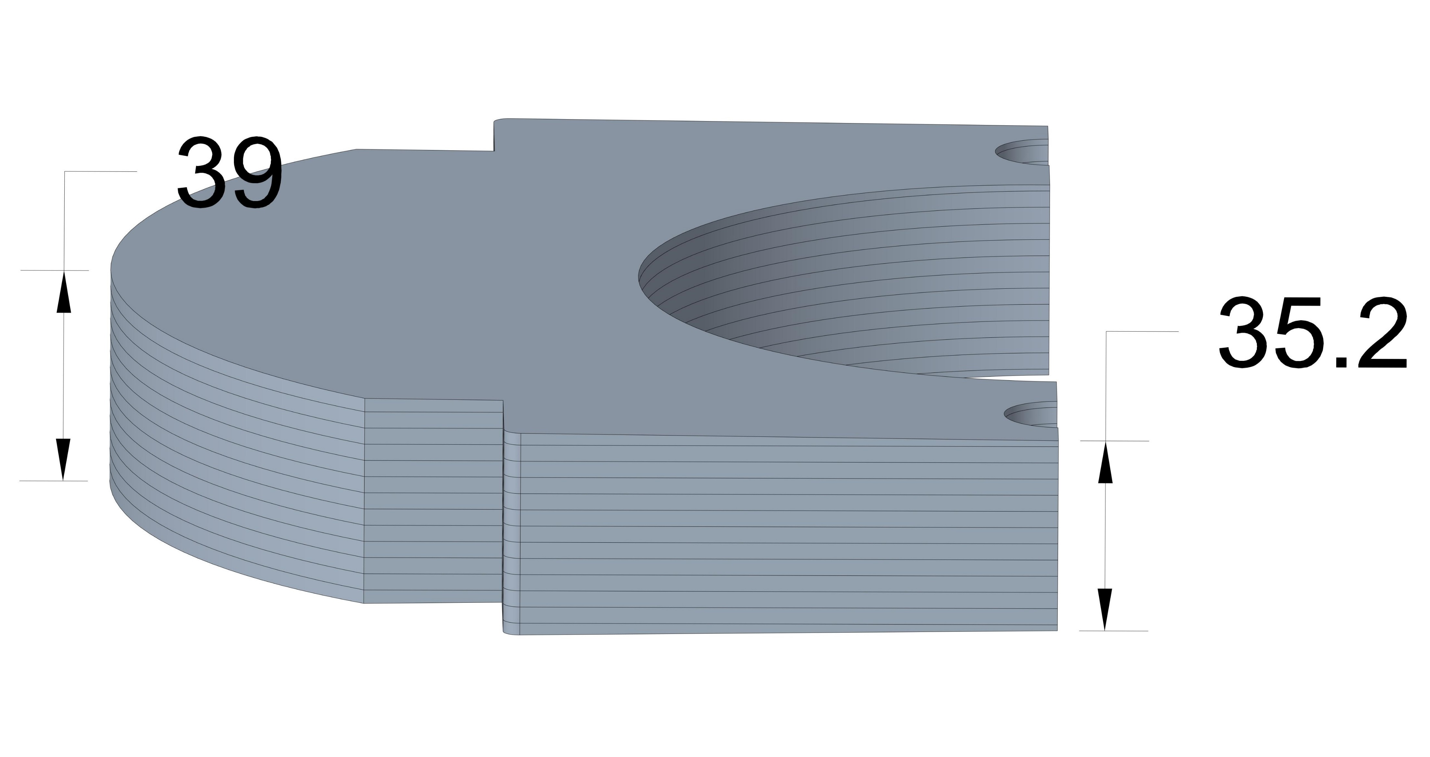
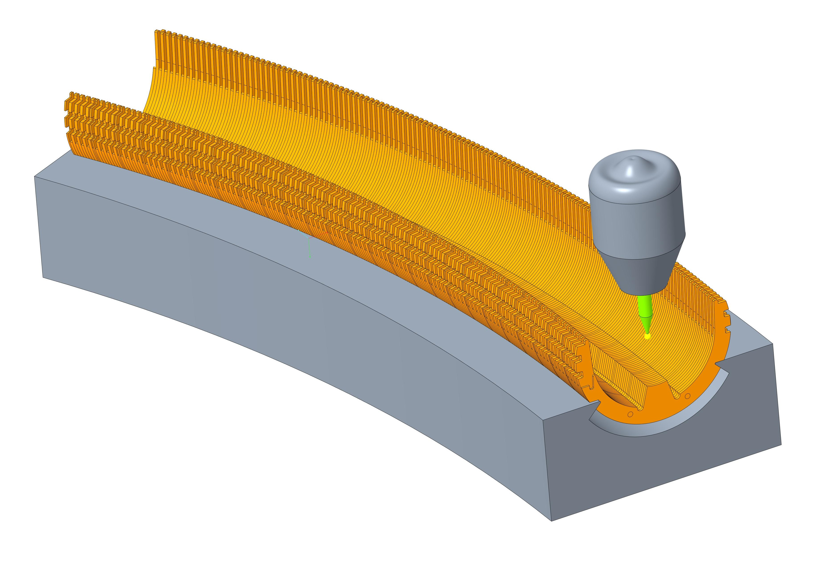
INFN-MI/GE, UniMi/Ge
WP2: magnet curvature
WP2 accent is on the magnet curvature, why it is so demanding?
Modelling
Mathematical (e.g., definition of harmonics, together with HITRIplus W.G..)
Software tools for optimization consider straight geometry
Some design steps become iterative (e.g., ends design & integrated field)
Winding and manufacturing strongly concave coils → dedicated tooling
Mechanical
Selection of materials and manufacturing techniques
Structural concept
Curved magnet assembly
(preliminary!)
Courtesy of S. Farinon, R. Cereseto
Curved collar assembly
Tapered yoke laminations

Slide 8
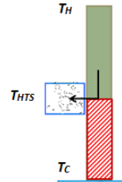
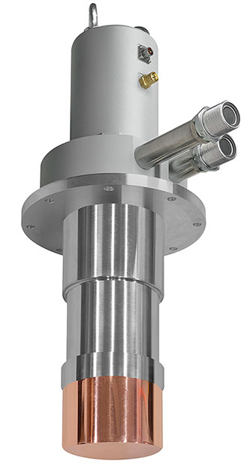
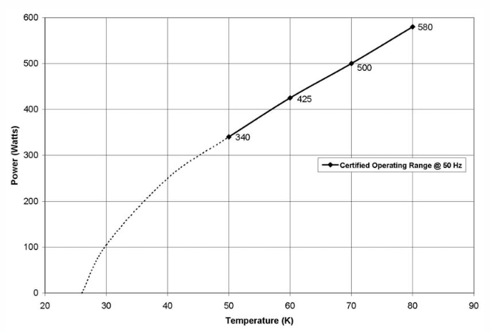
INFN-MI/GE, UniMi/Ge
WP2: main findings (1)
300 K
A possible showstopper was identified: conduction cooling of current leads requires a high power. For the resistive part between 300 K and 60 K:
$$\frac{Q_{c,min}}{I}=46\left[\frac{W}{kA}\right]$$
→ The operational current must be minimized
60 K
HTS
4.7 K
Cable | Discorap III gen. | CERN LHC05
Strand diameter [mm] | 0.821 | 0.48
Operational Temperature [K] | 5 | 5
Operational Current [A] | 4195 | 2790
$Q_{c,min}$ [W] | 2 x 193 | 2 x 128
Margin on Load Line [%] | 28.1 | 21.9
Temperature Margin [K] | 1.49 | 1
Inner Layer Turns | 24 | 35
Outer Layer Turns | 29 | 43
Example: Cryomech GM AL600: 425 W @ 60 K

Slide 9
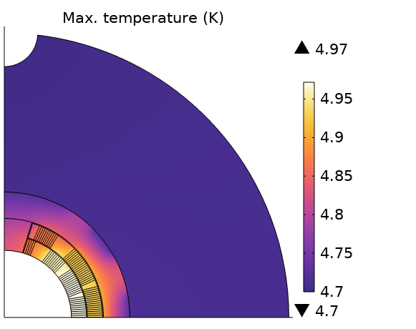
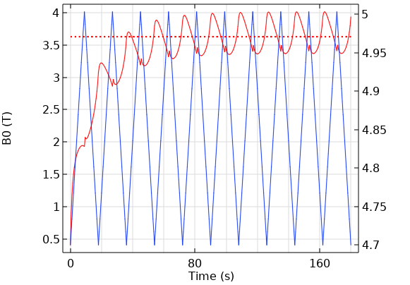
INFN-MI/GE, UniMi/Ge
WP2: main findings (2)
Cable | Operational current (kA) | Max. dB/dt (T/s) | Coil loss (W/m)
Discorap III gen. | 4.2 | 0.4 | 1
CERN LHC05 | 2.8 | 0.15 | 0.98
Future ad-hoc | 2.8 | 0.4 | 1
B’ = 0.4 T/s seems within reach for the final prototype
Coil loss ~ 1 W/m with a low-loss cable design (DISCORAP experience)
For the demonstrator, too long lead-time for such a dedicated cable → LHC05 with reduced ramp-rate
The final prototype will inherit DISCORAP and LHC05 beast features
 | Straight part | Int. l = 1.1 m (45°) | Ends
Conductor loss | 1 W/m | 1.1 W | 0.18 W
Iron hyst | 0.32 W/m | 0.35 W | 0.14 W
Eddy current | 0.37 W/m | 0.41 W | 0.41 W
Total |  | 1.9 W | 0.7 W
2.6 W * 1.5 = 4 W @ 4.7 K

Slide 10
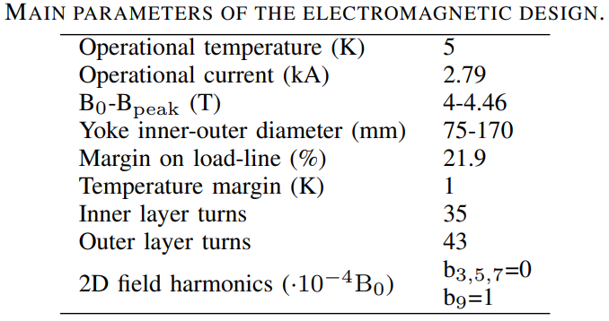
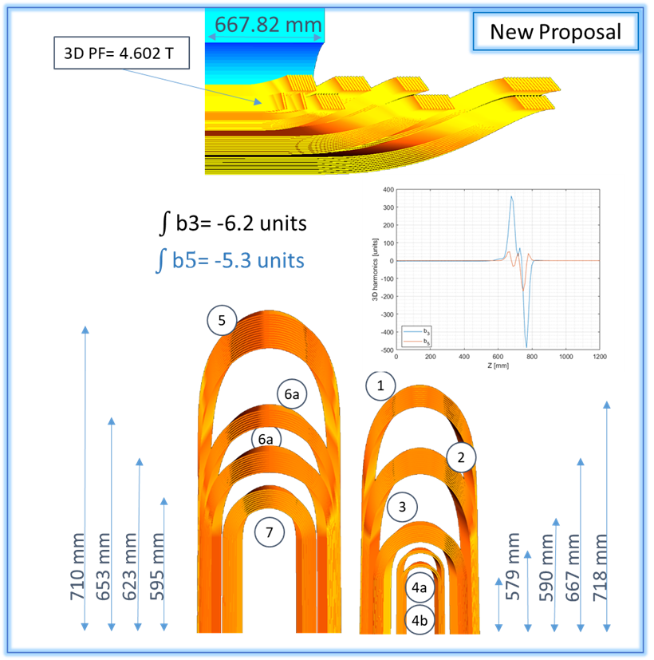
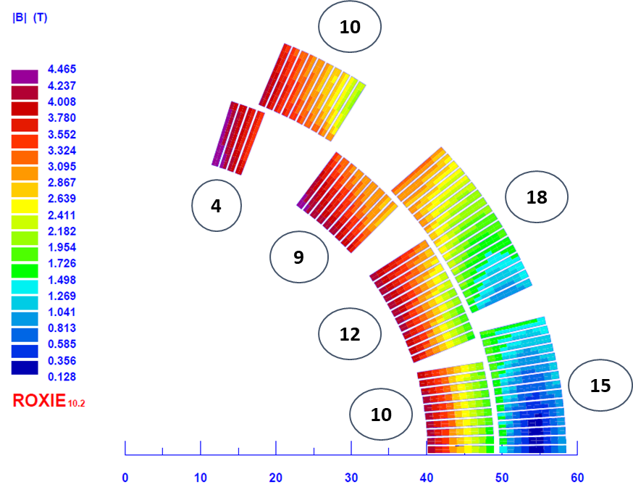
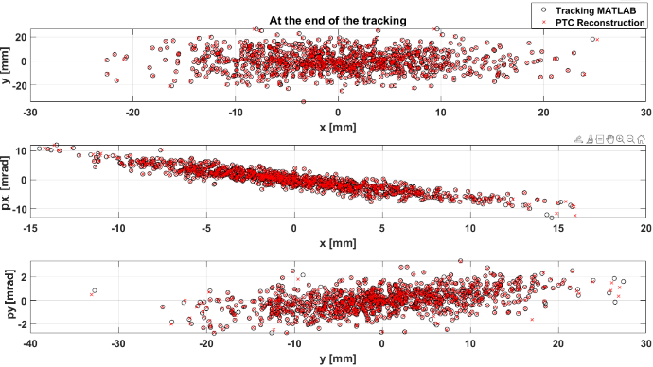
INFN-MI/GE, UniMi/Ge
WP2: electromagnetic design
OPERA 3D curved
Electromagnetic design loop closed!
ROXIE 3D straight
ROXIE 2D
Beam optics simulations (CNAO)
Courtesy of E. Felcini

Slide 11
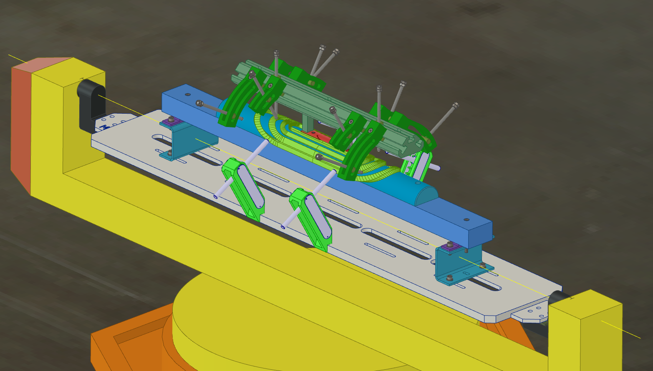
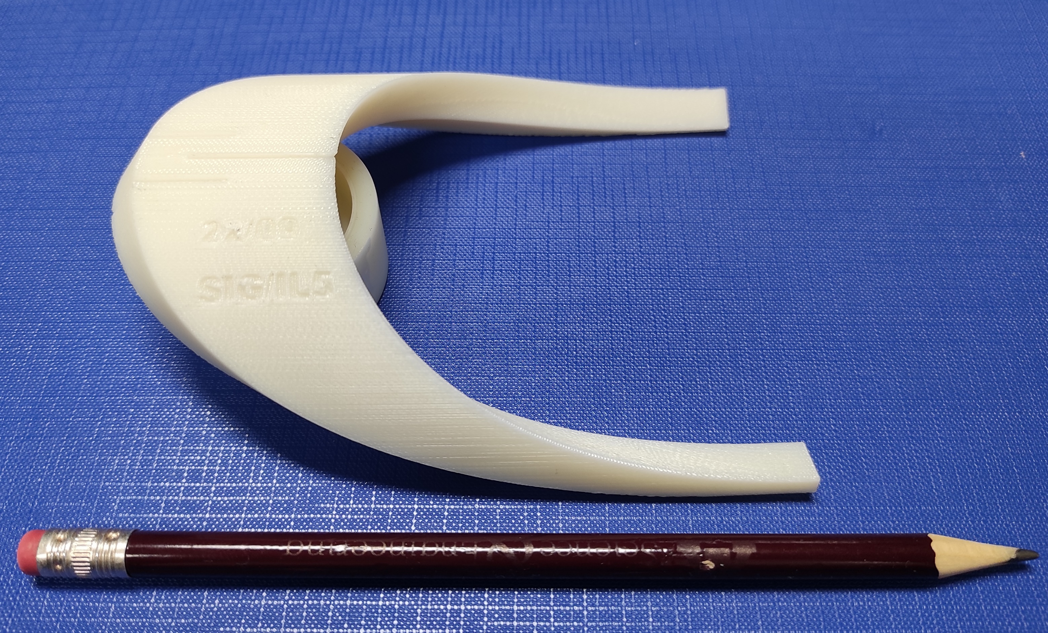
INFN-MI/GE, UniMi/Ge
WP2: present efforts
We are now concentrated on the preparation of the winding trials, fundamental to have design iterations
CERN winding table installed
Cable tensioner foreseen in March
Design of winding tooling and components ongoing
Plan: 2x50 m Cu cable from CERN on May, first straight practice coil by July
Winding table
Straight practice coil
End-spacer
Courtesy of A. Palmisano

Slide 12
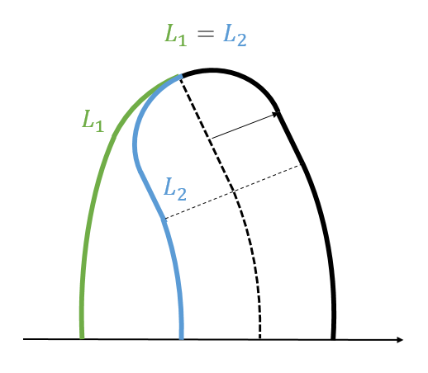
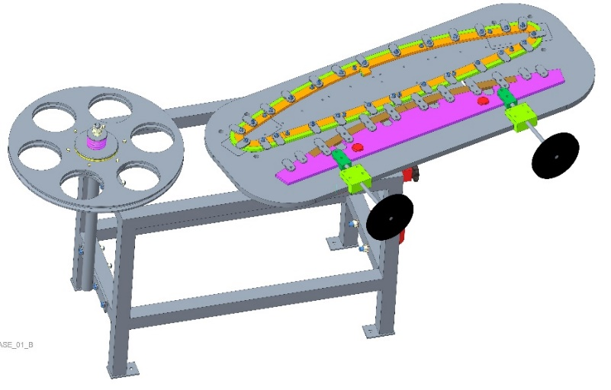
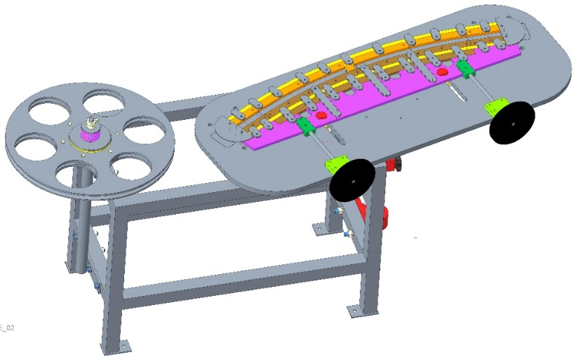
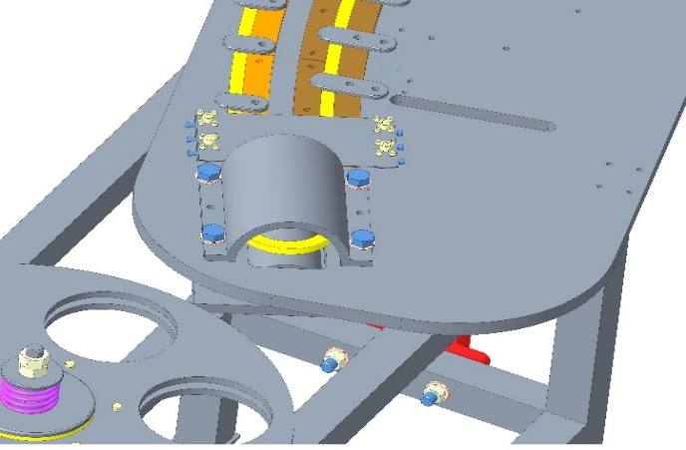
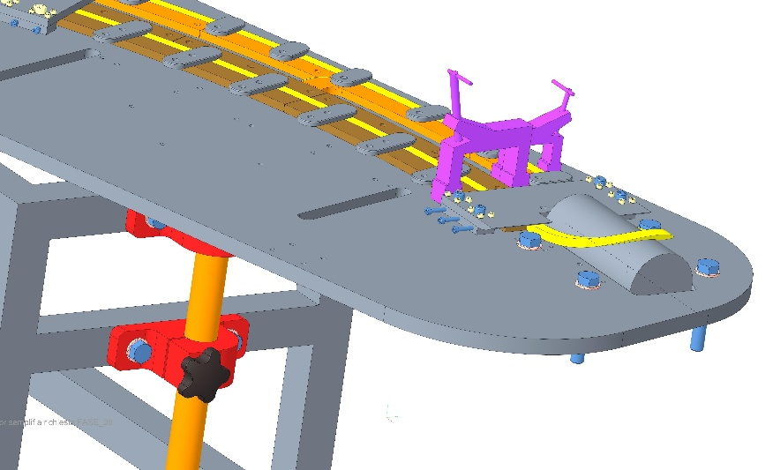
INFN-GE, UniGe
WP2: alternative winding technique
Alternative winding technique developed for a coil block magnet
At first the coil is wound in a convex shape ($L_{1}$) and then it is pushed to obtain the final concave form ($L_{2}$)
Courtesy of A. Gagno, R. Cereseto
1. The coil is wound on a manual rotating table
2. A template pushes one side of the coil in order to obtain the final shape
3. The table is equipped with a support that inclines the heads

Slide 13
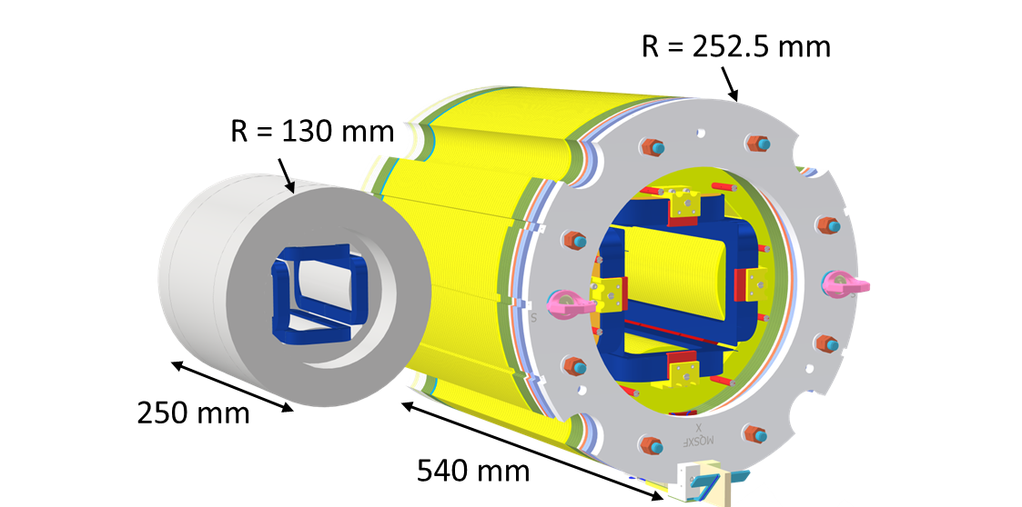
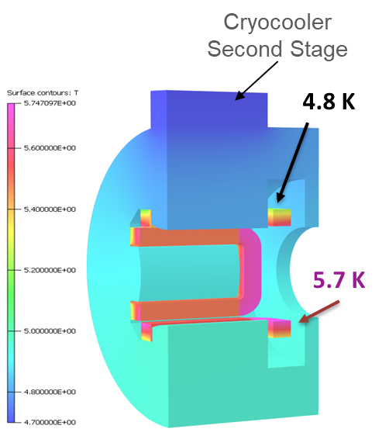
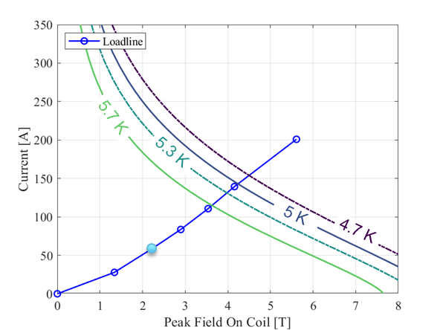
INFN-MI, UniMi
WP2: quadrupole spool pieces
HL-LHC Skew quadrupole
SIG spool piece quadrupole
The gantry optical layout requires spool piece quadrupoles at each end of the dipole magnets
One possibility is to leverage on the INFN-MI LASA experience on the superferric HOC magnets for HL-LHC
First design:
40 T/m @ R_{ref} =26.7 mm of magnet field gradient
175 mm of magnetic length
60% margin on the loadline @ T = 5.5 K.
Indirect Cooling (gas vs cryocooler)
The thermal design is more demanding!
Courtesy of S. Mariotto, F. Mariani

Slide 14
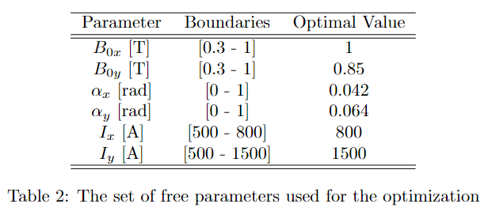
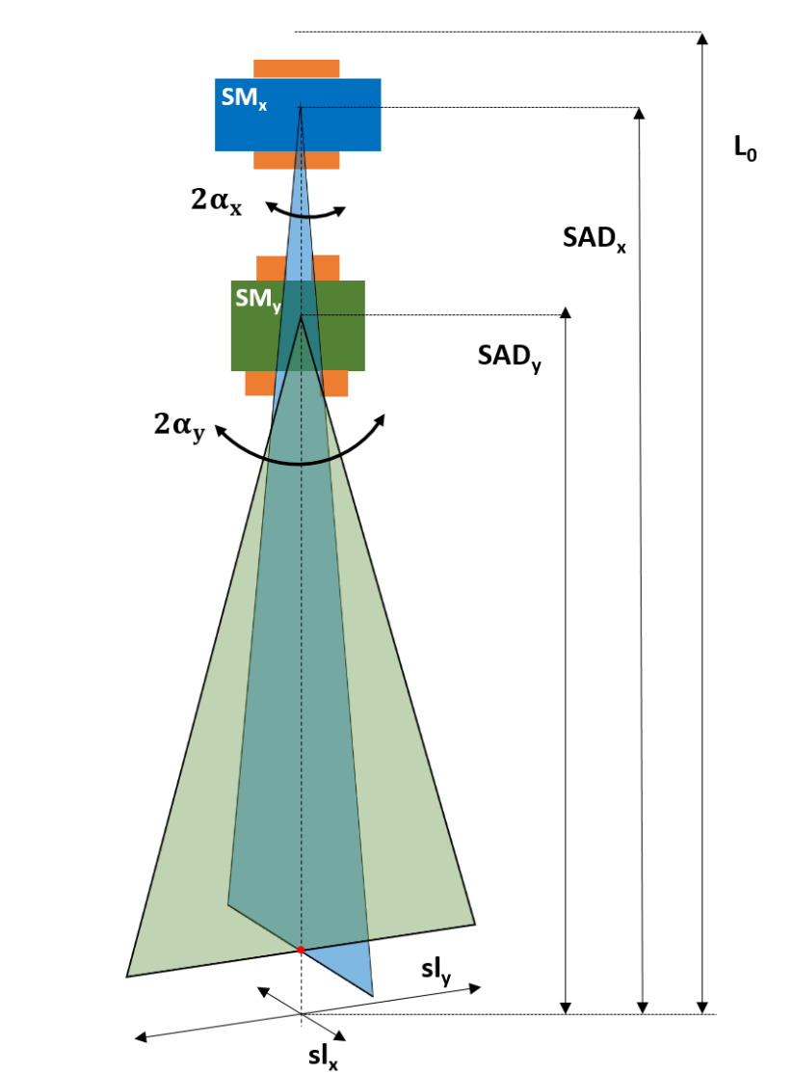
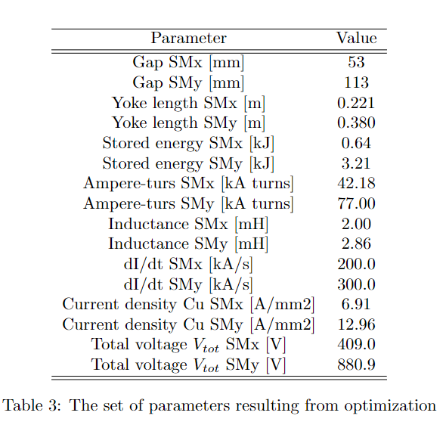
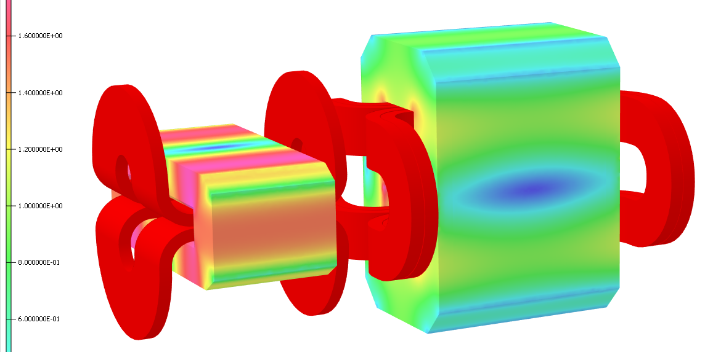
Coordinated by CNAO in SIGRUM
WP3: scanning magnet system
Design targets:
Wide area 240 x 300 mm²
Scanning speed: 20 m/s
Beam accuracy better than 0.5 mm
Technical implications:
Demanding power supply (MedAustron) → Possibility of including a complete system demonstrator
Field repeatability 0.3 % in transient
Courtesy of E. Felcini

Slide 15
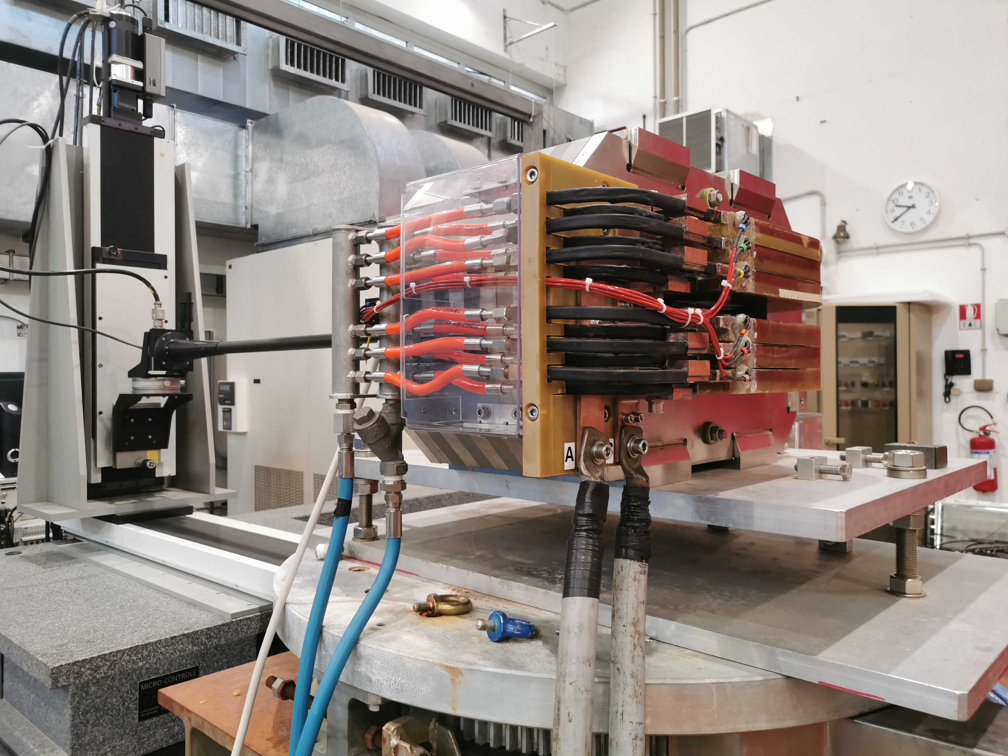
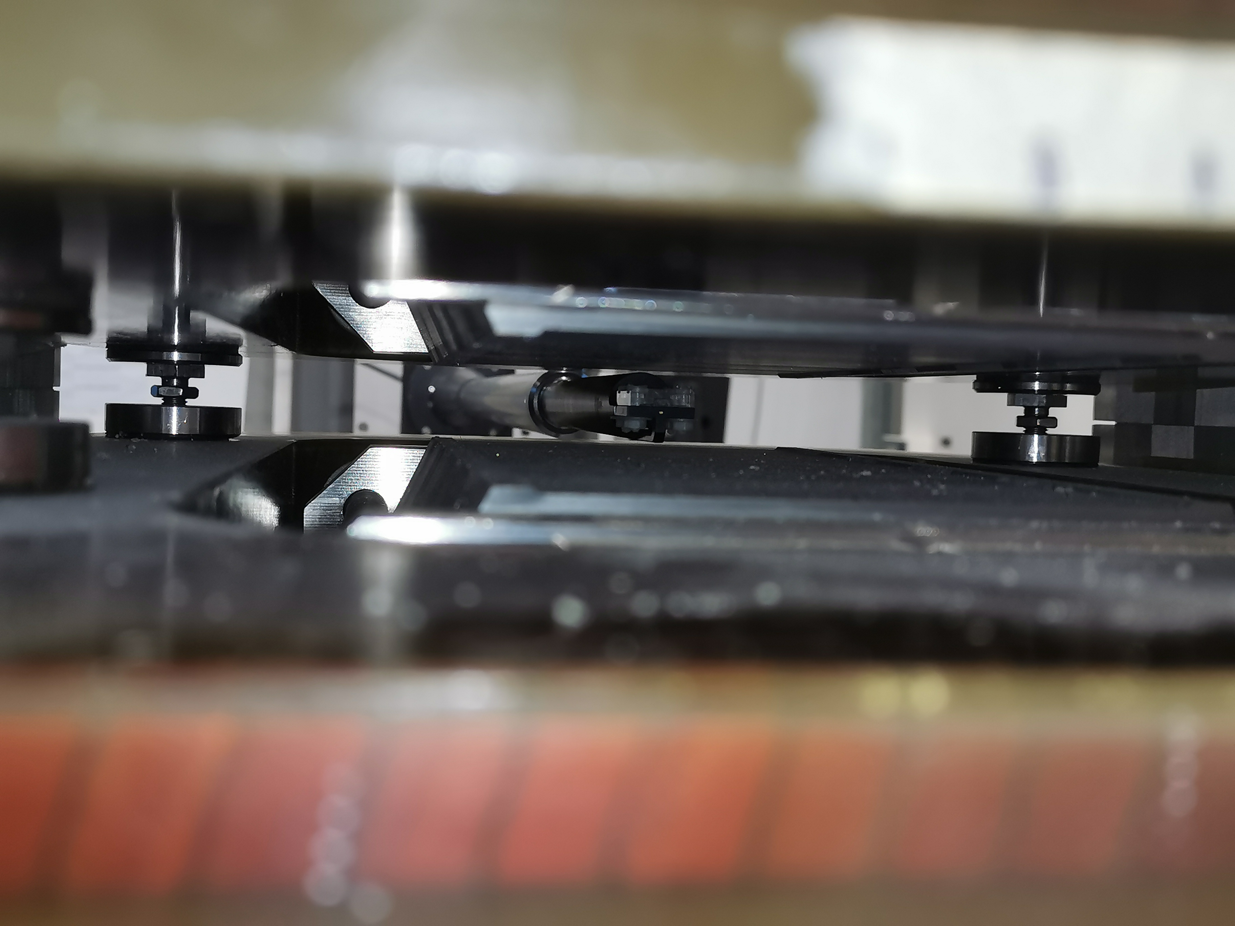
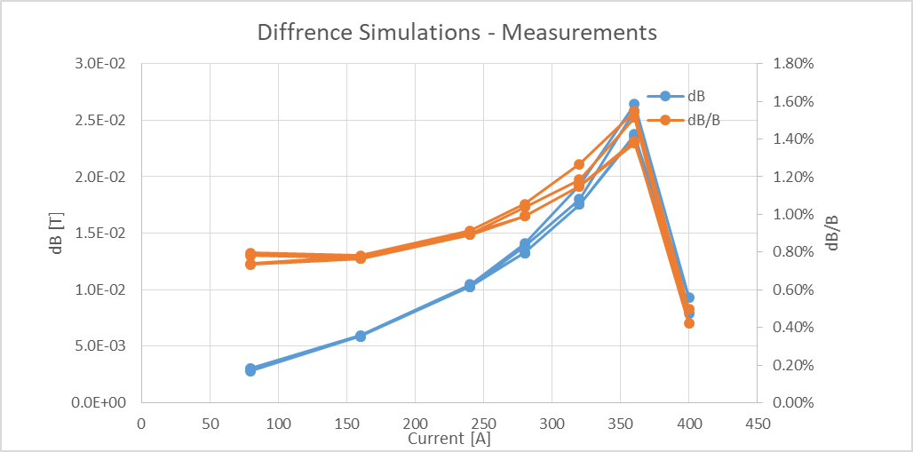
INFN-LNF, CNAO
WP3: scanning magnet system
Present efforts:
3D numerical models for the optimization of the magnet design
Study of the magnet’s crosstalk, hysteretic and dynamic effects
Characterization of the FeCo properties at INFN-LNF
Option: real time modelling of the dynamic effects for field feedback?
Courtesy of L. Sabbatini, A. Vannozzi
Courtesy of E. Felcini

Slide 16
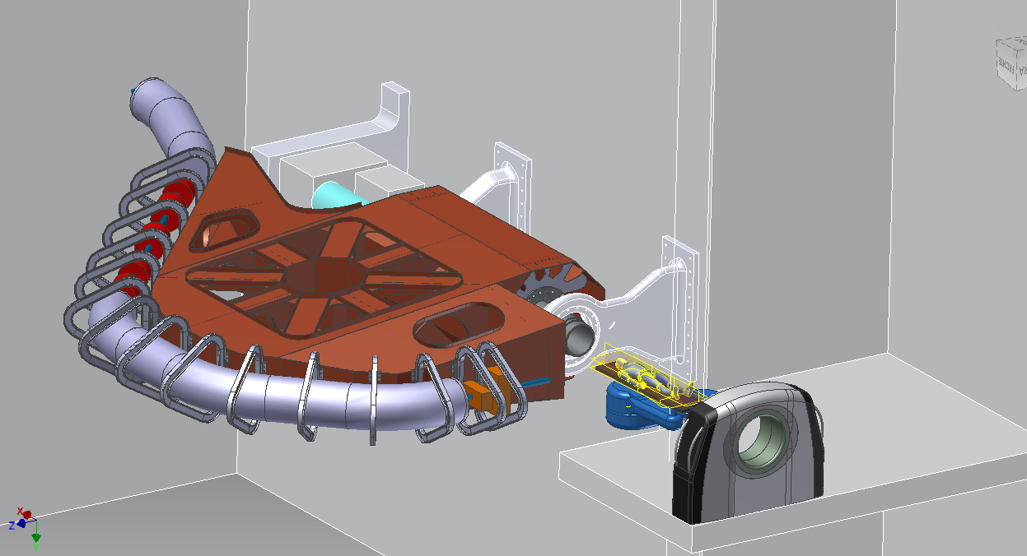
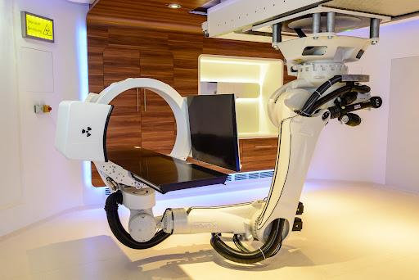
INFN-TO, UniTo
WP4 & WP5: integrated DDS & RVS
Courtesy of S. Giordanengo, E. Fiorina​, R. Sacchi
General scope: accurately and safely delivering the prescribed radiation dose by monitoring and controlling, in real-time:
Parameters of the scanned particle beam (DDS)
Its effect on the patient (RVS) Paves the way to adaptive treatments!
Design features:
Mechanical integration in the ion gantry
First integrated system optimized for ions:
Accurate and fast beam monitoring system for ions
Accurate RVS signals analysis with DDS signal synchronization
Online dose quality feedback with integrated GPU-based calculations
courtesy of M. Pullia (CNAO)
robotic arm in use at MedAustron for patient positioning → possible solution for RVS mechanics?

Slide 17
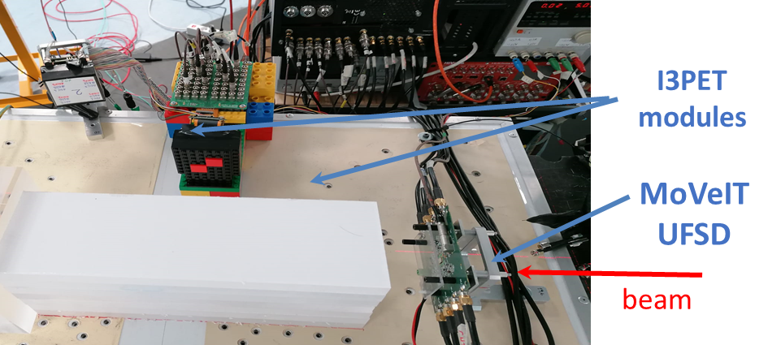
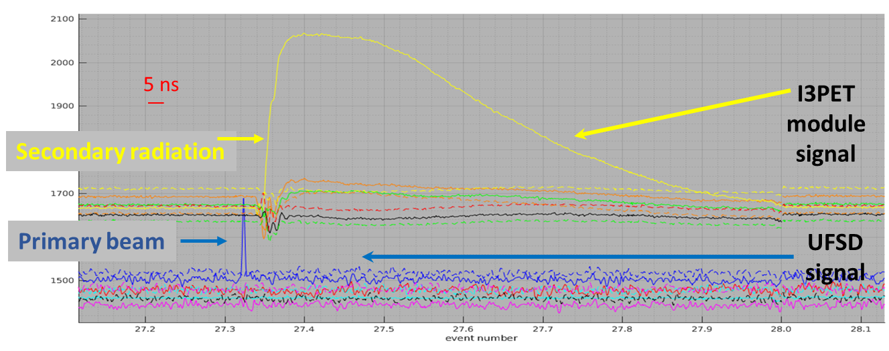
INFN-TO, UniTo
WP4 & WP5: starting point
Courtesy of S. Giordanengo, E. Fiorina​, R. Sacchi
Results with protons
DDS: MoVeIT detectors for protons RIDOS GPU-based dose calculation RVS: I3PET modules Algorithm for secondary radiation data analysis
First I3PET proton beam test (June 2021):
primary-secondary radiation coincidences identified!!!

Slide 18
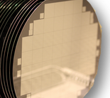
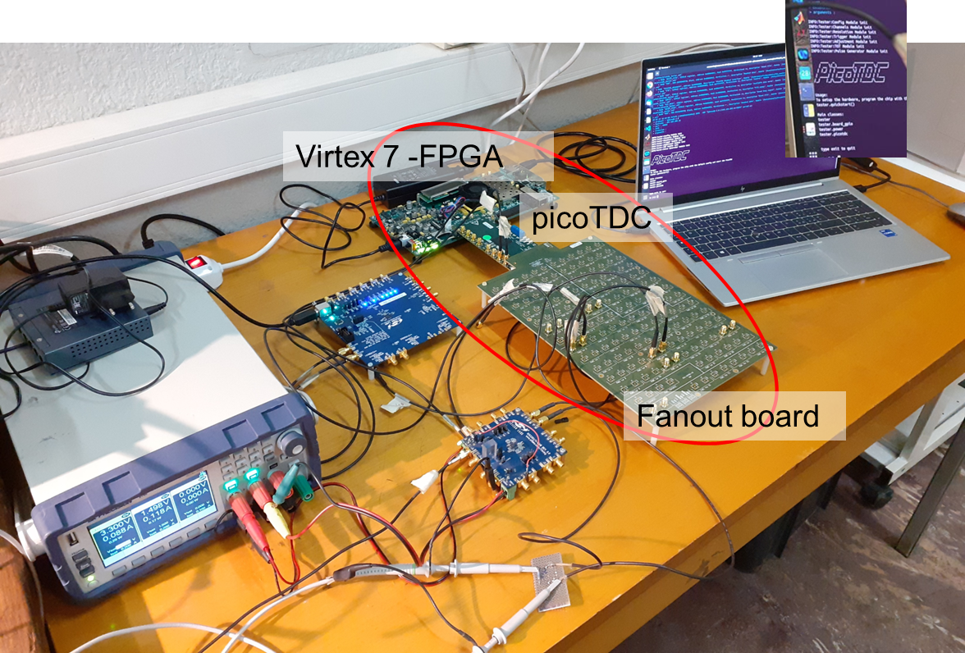
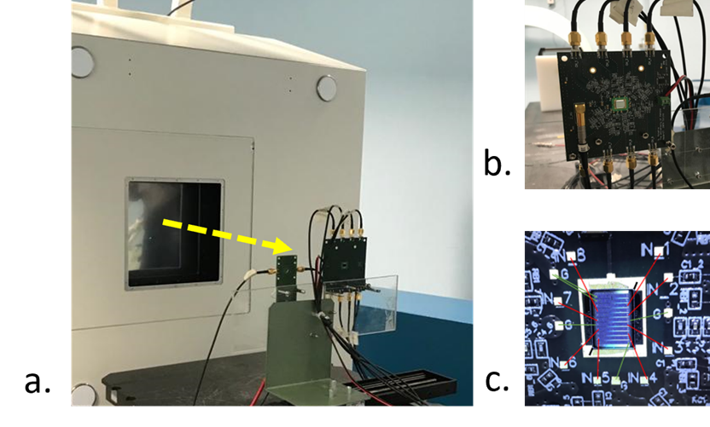
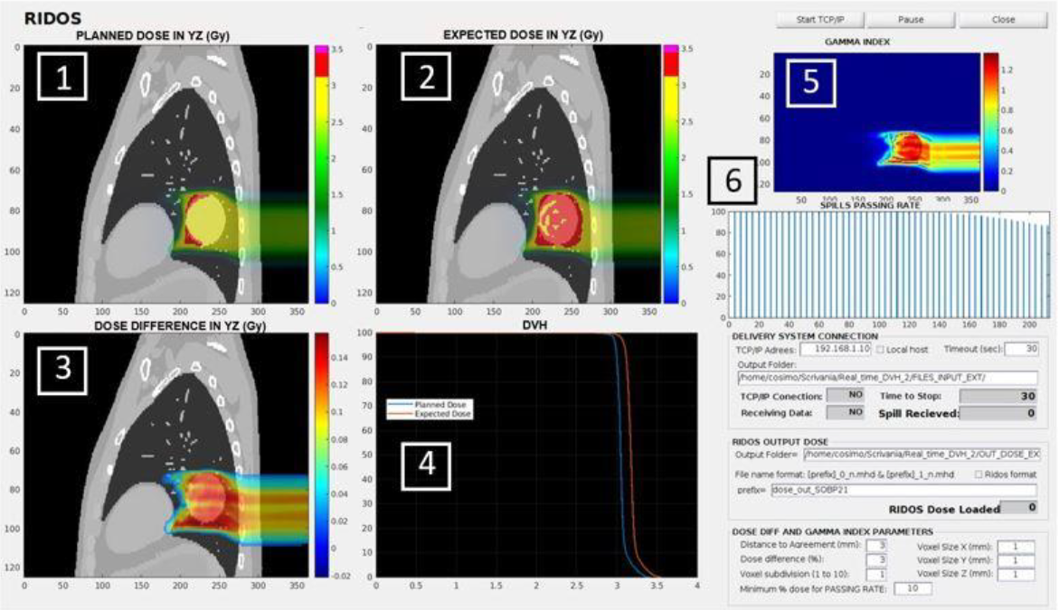
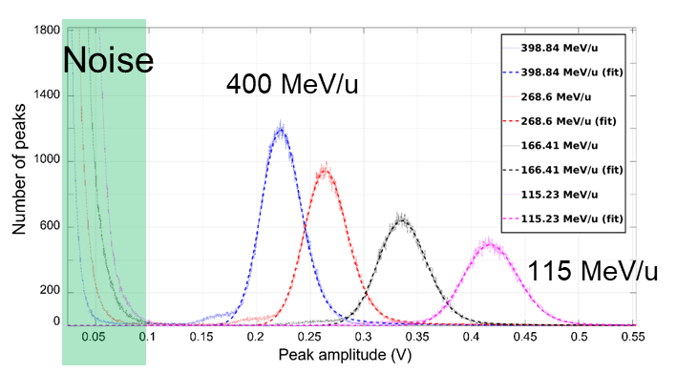
INFN-TO, UniTo
WP4: DDS tasks
Courtesy of S. Giordanengo, E. Fiorina​, R. Sacchi
T4.1 – Thin planar silicon sensors for Carbon ion counter
T4.2 - Single ion crossing time measurement
T4.3 – GPU-based data analysis for online dose verification
- Single ion signal
- Ionization density effects
- Radiation resistance
- Proof of Concept to provide the time stamps for ions with high efficiency.
- Start counter for range verification system.
New GPU-based algorithms to exploit ion treatments (ADAPTIVE PT) with a very fast data analysis for online feedback on the dose delivered.
→ Collaboration with GSI within the RAPTOR project (ETN – H2020)
Real-Time Adaptive Particle Therapy Of Cancer
PLANNED DOSE (Gy) DELIVERED DOSE (Gy)
First characterization at CNAO with carbon ions
pico-TDC ASIC for precise time-tagging of up to 64 inputs channels, 3ps or 12ps binning
very low jitter (<1ps)
Virtex 7 FPGA
ONLINE results: (1) planned and (2) delivered doses, (3) dose difference, (4) DVH, (5,6) gamma index

Slide 19
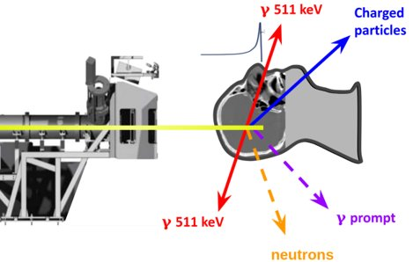
INFN-TO, UniTo
WP5: RVS tasks
Courtesy of S. Giordanengo, E. Fiorina​, R. Sacchi
Effective RVS for ion gantry based on PET and/or PGT (Prompt Gamma Timing) techniques
OPEN ISSUES | R&D WP5 TASKS
Production of secondary radiation (prompt photons and positron emitters) by ions (from He to O) dramatically reduced wrt to proton beams. Extensive study not performed yet. Feasibility of a hybrid approach PGT-PET for ions to be demonstrated | 5.1 Detector development PG detector (LaBr3 + SiPM) PGT-PET detector (from I3PET project, LFS + SiPM) DDS-RVS integrated DAQ (ASIC-based, collaboration with WP4) 5.2 Detector optimization study beam test at CNAO and GSI
Standard data analysis methods not available for online ion range verification | 5.3 PET-PGT reconstruction algorithms Maximum A Posteriori (MAP) based algorithm for PET Maximum Likelihood Expectation Maximization (MLEM) based for PGT Algorithms developed in collaboration with University of Lubeck
Feasibility of a full-size RVS for an ion gantry | 5.4 MC simulations evaluation of the final RVS performance

Slide 20
Conclusion & acknowledgement
The SIG project brought together a motivated community for a substantial contribution to the technology development of ion gantries
2.5 years to deliver effective technology demonstrators!
I would like to thank all the (direct and indirect) collaborators
INFN Milano & UniMi | INFN-Genova & UniGe | CERN | CNAO | MedAustron | INFN-LNF | INFN-Torino & UniTo
L. Rossi M. Prioli A. G. Carloni G. Ceruti E. De Matteis F. Mariani S. Mariotto A. Palmisano M. Sorbi S. Sorti M. Statera R. U. Valente | R. Musenich S. Farinon E. Bianchi R. Cereseto A. Gagno F. Levi | E. Gautheron M. Karppinen D. Tommasini L. Gentini | M. Pullia E. Felcini S. Savazzi A. Mereghetti M. Donetti G. Frisella | C. Kurfuerst M. Pivi | L. Sabbatini A. Vannozzi L. Pellegrino A. Trigilio | S. Giordanengo E. Fiorina​ R. Sacchi R. Cirio F. Mas Milian S. Garbolino C. Galeone E. Data A. Fadavi F. Pennazio​ P. Cerello​ V. Ferrero ​ R.J. Wheadon​ S. Ranjbar

