Slide 1
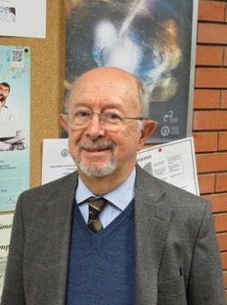
A Vittorio, grazie.
Accelerator physics lost a great scientist, and a great person
Vittorio Giorgio Vaccaro passed away on 11 February 2023 in his town, Naples.
Full Professor of electromagnetic fields and free-space propagation at the University Federico II of Naples, he is been active in the field of accelerator physics throughout his career – after working on the Intersecting Storage Ring (ISR), the first high intensity collider, at CERN between 1966 and 1969
His contributions remain key in the field of beam physics, having introduced during his pioneering studies the fundamental concepts of beam coupling impedance and stability diagrams.
He was knowledgeable, wise, jovial, forward-thinking, with a wide culture spanning from physical to human sciences and an open mind
Proud to be Neapolitan and always ready to explain to everyone the rich history of his region and also expressions of the Neapolitan language
In 1966 he defined the founding concepts for the characterization of accelerators with respect to the stability of the beams, by defining the concept of accelerator impedance. Subsequently, in collaboration with A. G. Ruggiero, he established, the stability criteria, inventing the well-known universal maps of stability, closely related to the concept of impedance. In 1969, he introduced the concept of the wake field. The results were applied in the design of the ISR and these concepts continue to be used, in particular to evaluate the performance limits of circular accelerators.

Slide 2
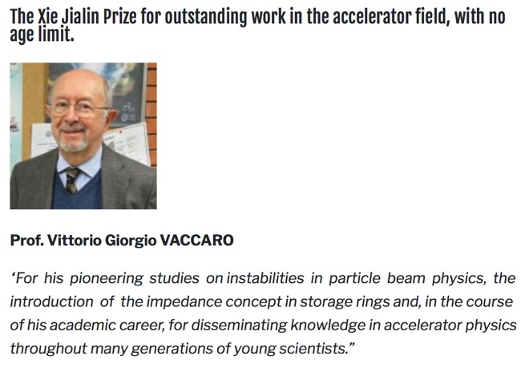
IPAC ‘19- Australia

Slide 3
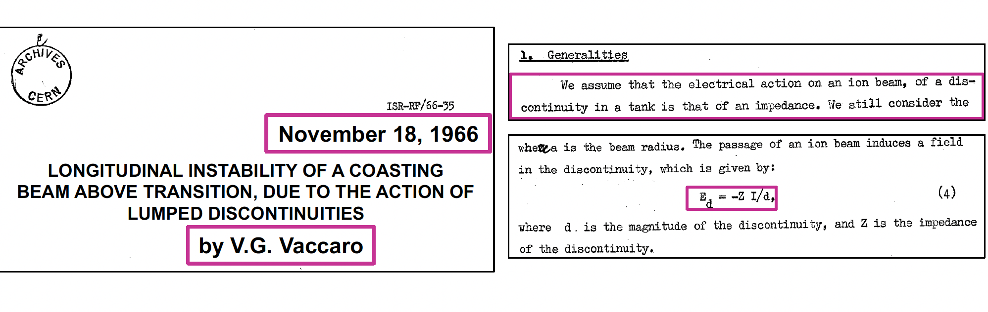
A pioneer on beam coupling impedance …
The concept of beam coupling impedance
applied to accelerators dates back to
1966-67, when it was introduced to express
the self-induced EM fields
  First from a lumped discontinuity (e.g., an RF
  cavity)
  Later on generalized to a distributed source
  around the machine (e.g., the resistive vacuum
  chamber
His viewpoint was to start from a source current going to the voltage through an impedance

Slide 4
With Andy Sessler
Febraury 1967
With Sandro Ruggiero

Slide 5
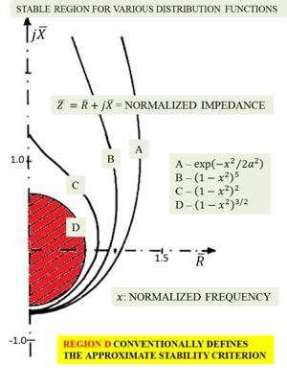
A pioneer on stability diagrams
The concept of impedance was then
instrumental to define the stability
diagrams and stability region approach
  First introduced for a coasting beam in the
  longitudinal plane
  Applied to ISR
In spite of the limited calculation tools
of the time, stability regions were derived for a wide range of beam momentum spread distributions
Universal stability maps
Keil-Schnell (read circle) became more known in beam physics than Ruggiero-Vaccaro….

Slide 6
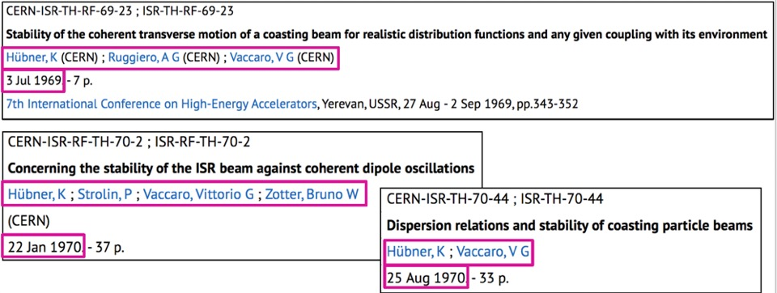
A pioneer on stability diagrams

Slide 7
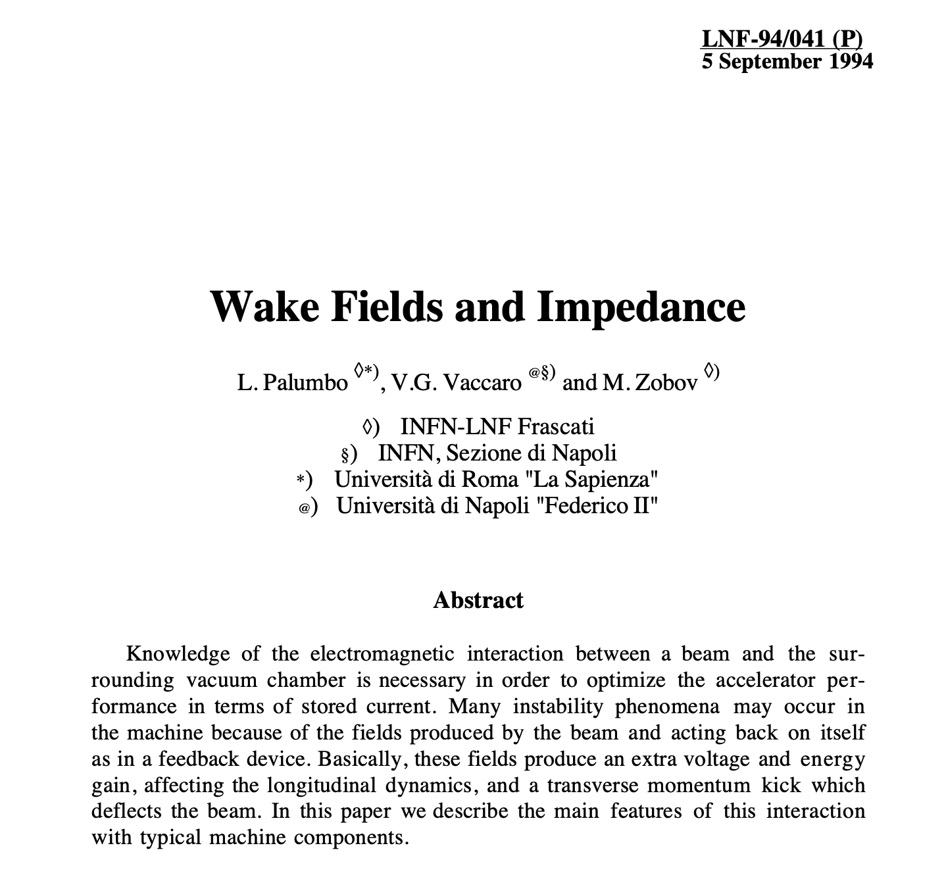
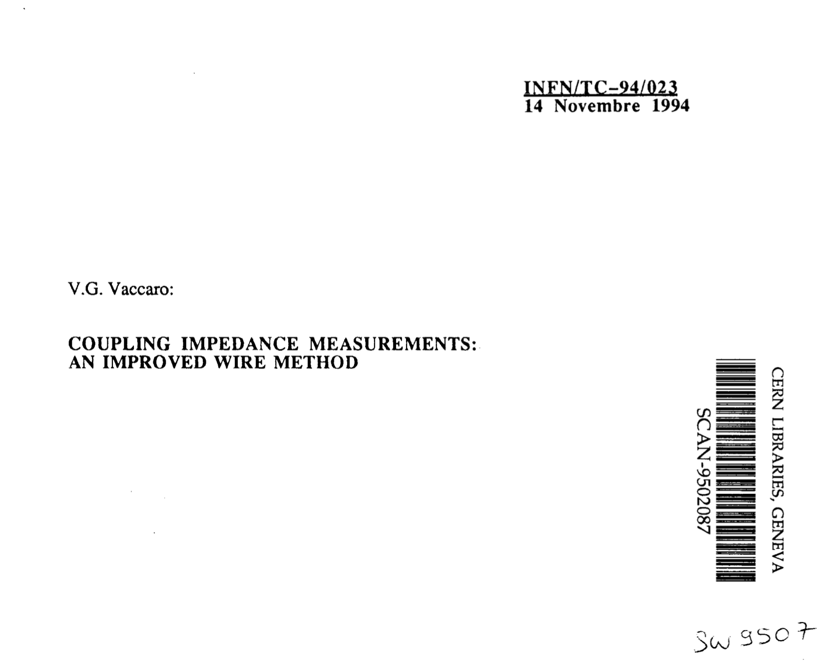
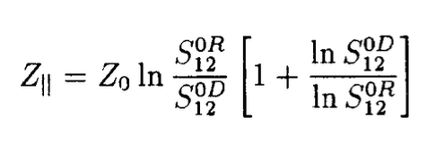
Vittorio left CERN in 1969 to start and pursue his academic career at the University ”Federico II” of Naples, working on Electromagnetism problems
After a break of less than 10 years, he came back to accelerator physics
European projects: EHF
His work was still linked to key results and reference papers, e.g.
  Review of full theory of wake fields and impedances (extension of his previous work
  to time domain and transverse plane!)
  Establish an improved formula for the estimation of beam-coupling impedances
  from bench measurements

Slide 8
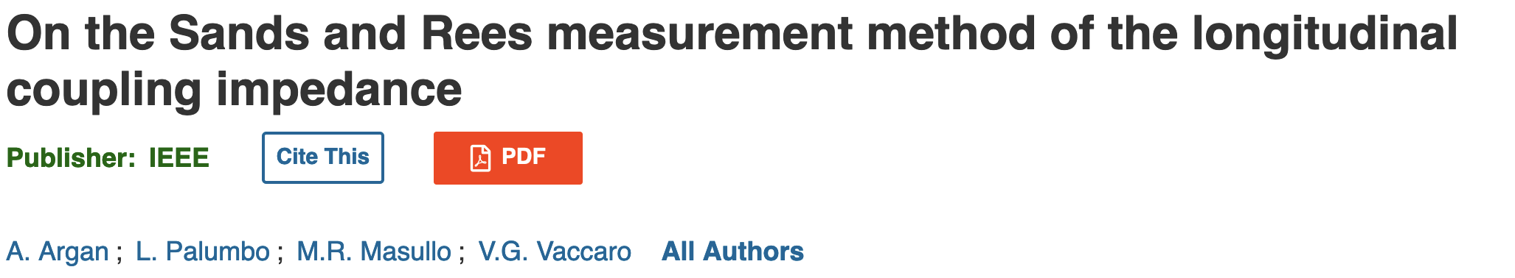
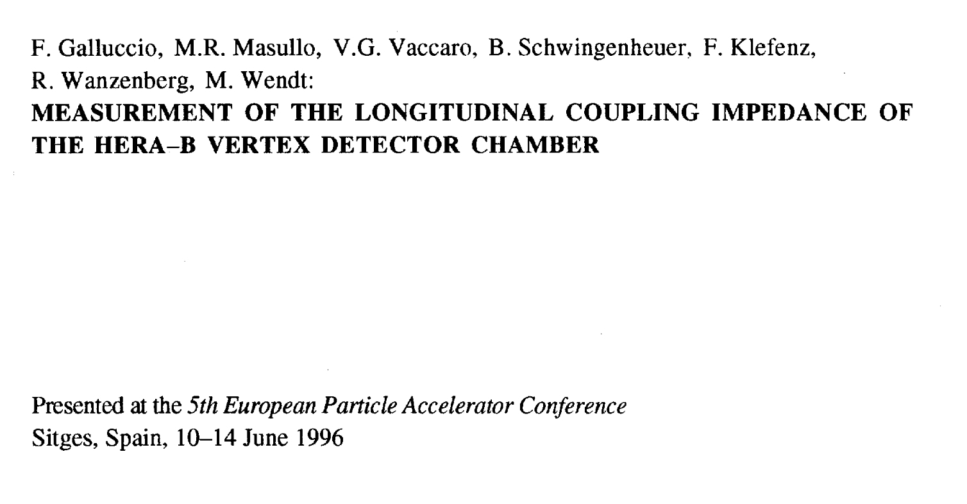
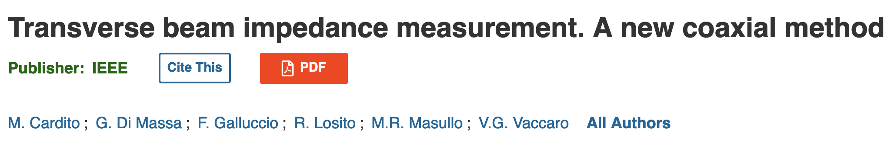
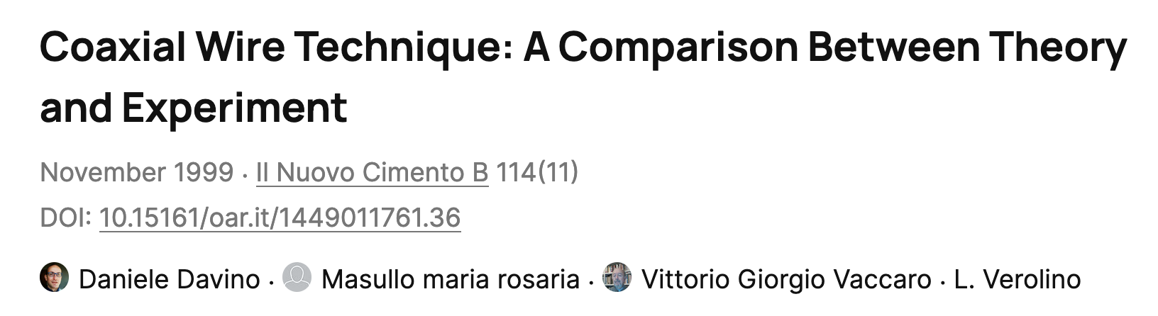
Not only theoretical research but also experimental one
According to a well accepted theory, by means of the measured scattering parameters in setup with stretched wire one may get the Coupling Impedance
However, its results are only partially reliable at least in some range of frequencies. This is due to the presence of the wire which perturbs the measurement making uncertain some results. The presence of the wire, indeed, shifts the cutoff frequency to zero by introducing a TEM mode.
This implies that all the resonances which should in reality fall in the cutoff region will be depressed

Slide 9
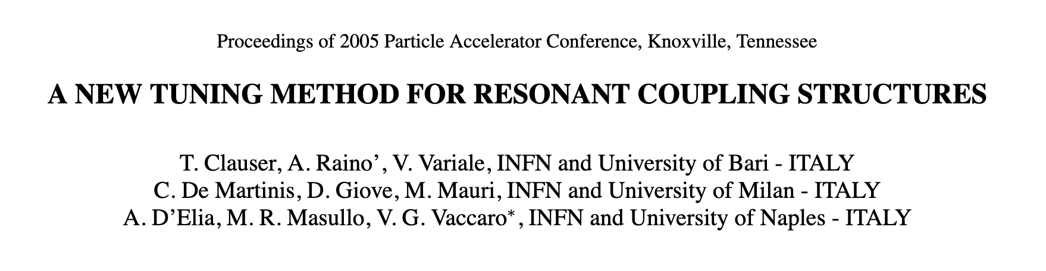
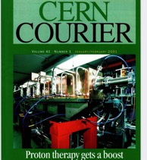
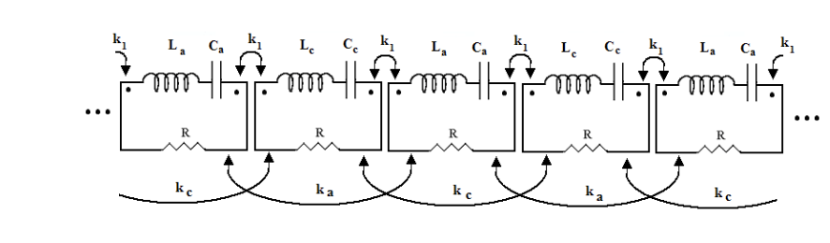
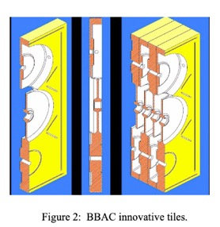
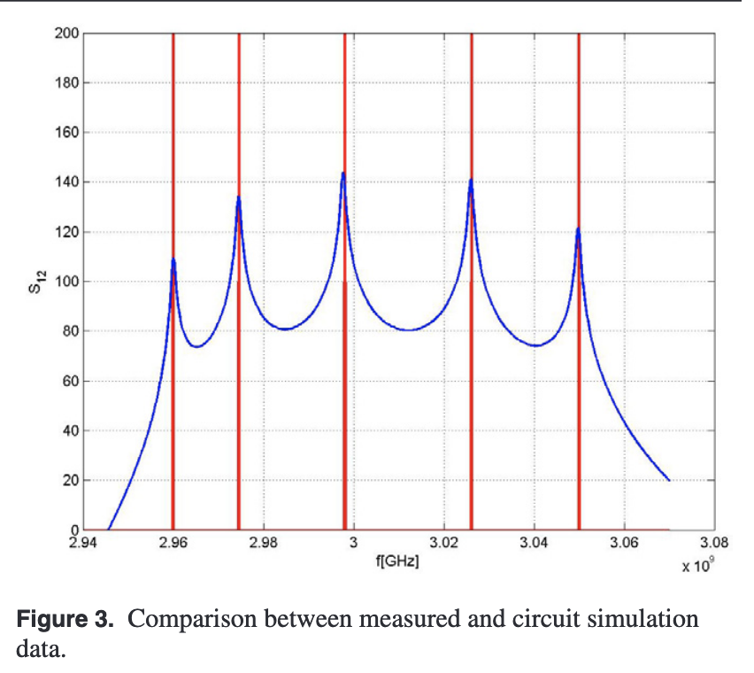
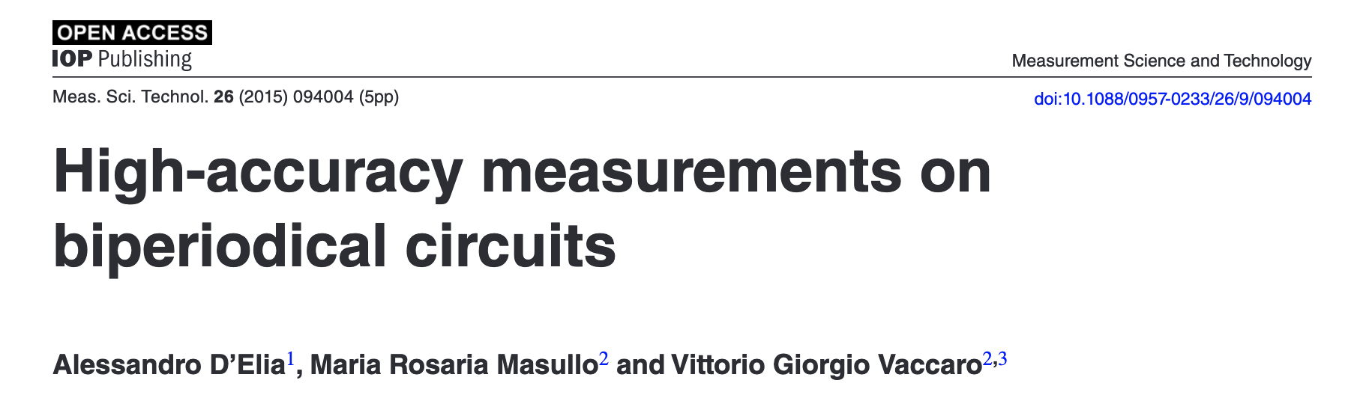
Prothotherapy linac projects: LIBO and ACLIP-PALME
CERN-INFN (Na, Ba, MI) and UNIMI-UNINA
INFN (Na, Ba, MI) and UNIMI-UNINA-UNIBA
Patent Nr 2008 A25

Slide 10
Since 2008 for some periods as Scientific Associate at CERN (most recently at the BE-ABP-ICE unit)
Vittorio began working on a range of semi-analytical impedance calculations and involved a large number of young scientists, e.g.,
impedance of a C-shaped magnet (kicker),
impedance of step transitions, resistive wall of elliptical beam chambers,
Mixed Mode Matching (MMM) techniques for impedance of inserts (cavity, iris, finite length collimator, etc.)
picked up some cutting edge subjects like development of alternative bench measurement techniques (e-gun, antenna)
Collaboration with researchers of the INFN-division of Roma1 for the study of the coupling impedances and stability of the LHC beams especially for vacuum chambers portions with unconventional shapes (C-shaped kicker magnets, step transition, resistive wall impedance of an elliptical chamber).

Slide 11
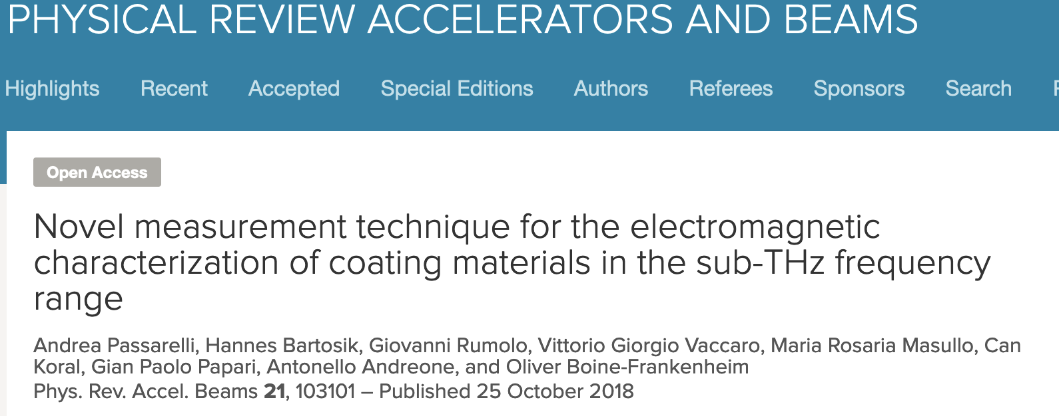
Last works
Coupling impedances evaluation for a bi-layer coated vacuum chamber
Telescopic measurement technique for high Q-factor evaluation
Coupling impedances for vacuum chambers portions with unconventional shapes

Slide 12
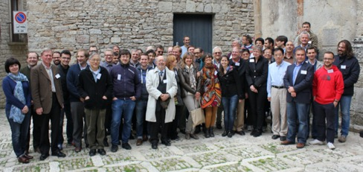
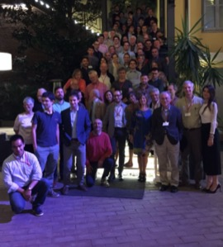
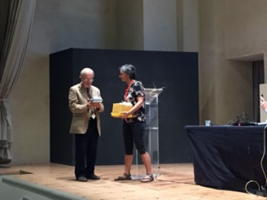
Workshops on Impedance
ERICE 2014
First Impedance Workshop co-chaired with Elias and me
BENEVENTO 2017: Workshop on Impedances and Beam Instabilities
We gave Vittorio a honorary plaque to congratulate him on the first 50 years of beam-coupling impedances !!

Slide 13
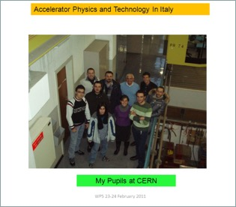
Vittorio and his school
My best scientific production
Always proud of the young scientists that he trained and supported.
Luigi Palumbo (Università la Sapienza)
Godehard Wuestefeld (Bessy)
Eliana Gianfelice (Fermilab)
Caterina Biscari (Direttrice di Alba, Spagna)
Maria Rosaria Masullo (INFN Napoli)
Francesca Galluccio (INFN Napoli)
Augusto Lombardi (INFN Legnaro)
Roberto Losito (Staff CERN)
Giovanni Rumolo (Staff CERN)
Antonio Palmieri (INFN Legnaro)
Alessandro Masi (Staff CERN)
Alessandro D’Elia (European Synchrotron Radiation Facility - Grenoble)
Mauro Migliorati (Università la Sapienza)
Sara Lanzone (IBA,Belgio)
Claudio Serpico (Research Instruments -Germany)
Marco Panniello (Arktis, Swiss)
Carlo Zannini (CERN fellow - staff )
Giovanni De Michele (Adam, Swiss)
Renato Di Prisco (University of Lund)
Alessadro Danisi (ITER)
Nicolò Biancacci (CERN fellow- staff)
Serena Persichelli (LBNL)
Andrea Passarelli (INFN fellow )
Sorry if someone is not in the list
And many other CERN fellows

