Slide 1
Challenges in AI
for Medical Image Analysis
Alessandra Retico
Istituto Nazionale di Fisica Nucleare
Sezione di Pisa
alessandra.retico@pi.infn.it
ML_INFN Hackathon, Bari, November 21-24, 2022
next

Slide 2
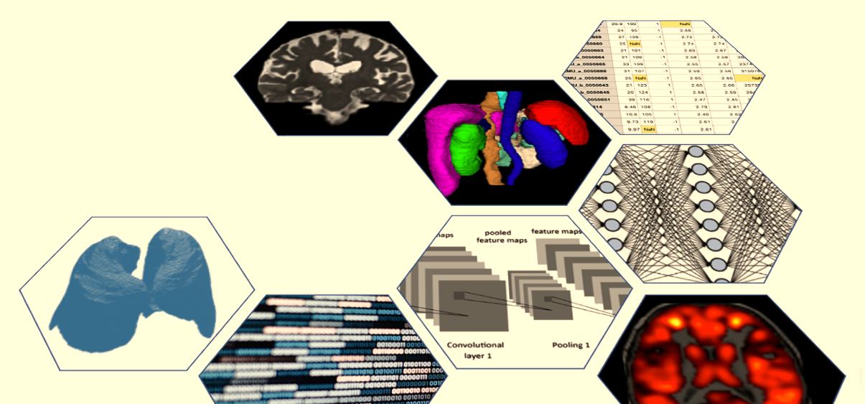
Outline
State of art and future goals of AI in Medical Image Analysis
Open Issues and Challenges:
Limited availability of annotated data
Mining data from multiple sources
Reliability of AI-based systems
Explainability (XAI)

Slide 3
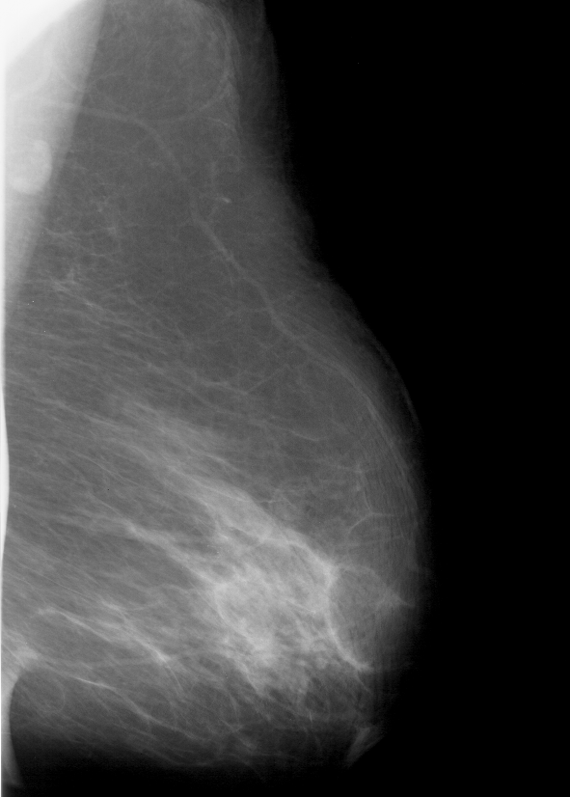
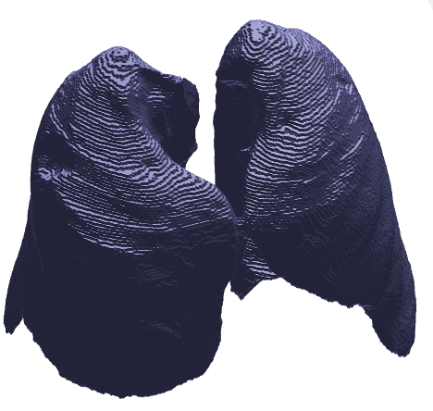
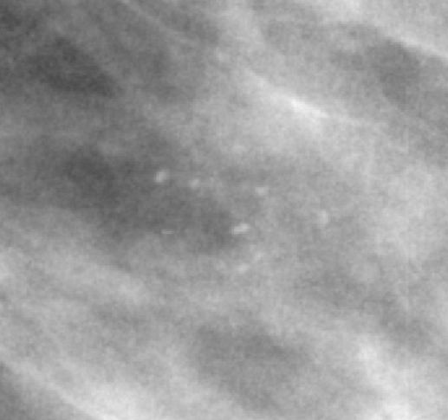
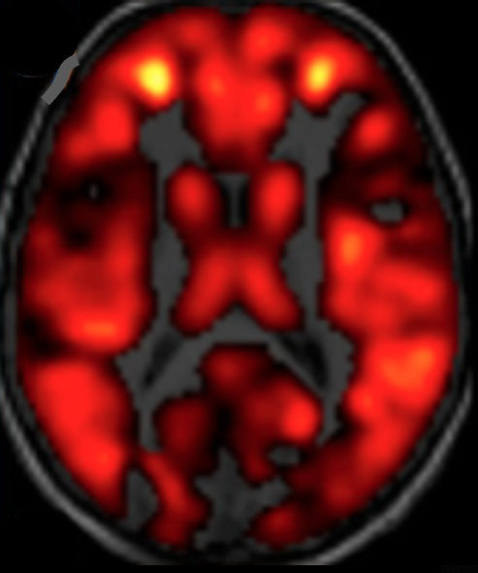
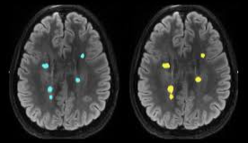
AI in Medical Image Analysis
Notes:
[3] Sample RF. Ice Maker Market Report Coverage Report Coverage Base Year : Market Size in 2020 : Forecast Period : Forecast Period 2021 to 2027 CAGR : Details Report Coverage 2027 Value Projection : Historical Data for : No . of Pages : Tables , Charts & Figures : Segm 2021:2021–7.
superresolutuon
https://doi.org/10.1101/2022.01.24.22269144

Slide 4
AI in Medical Image Analysis: performance and impact
Comparison between DL models and health-care professionals (HCP) in the same sample
[14 studies/82, different diseases]:
a sensitivity of 87.0% with 95% CI [83.0–90.2] for DL models and 86.4% [79.9–91.0] for HCP
a specificity of 92.5% with 95% CI [85·1–96·4] for DL models and 90.5% [80.6–95.7] for HCP
➔ DL models and HCP show equivalent performance
[Liu et al. A comparison of deep learning performance against health-care professionals in detecting diseases from medical imaging: a systematic review and meta-analysis. Lancet Digit Heal 2019;1:e271–97]
Radiologists can guide the introduction of AI into healthcare. They will not be replaced by AI, which, in turn will:
standardize the level of reporting across different clinical centres
speed up the diagnosis process and allow radiologists to perform more value-added tasks
[Pesapane F, Codari M, Sardanelli F. Artificial intelligence in medical imaging: threat or opportunity? Radiologists again at the forefront of innovation in medicine. Eur Radiol Exp 2018;2]
Notes:
[1] Pesapane F, Codari M, Sardanelli F. Artificial intelligence in medical imaging: threat or opportunity? Radiologists again at the forefront of innovation in medicine. Eur Radiol Exp 2018;2. https://doi.org/10.1186/s41747-018-0061-6.
[2] Liu X, Faes L, Kale AU, Wagner SK, Fu DJ, Bruynseels A, et al. A comparison of deep learning performance against health-care professionals in detecting diseases from medical imaging: a systematic review and meta-analysis. Lancet Digit Heal 2019;1:e271–97. https://doi.org/10.1016/S2589-7500(19)30123-2.
[4] Oren O, Gersh BJ, Bhatt DL. Artificial intelligence in medical imaging: switching from radiographic pathological data to clinically meaningful endpoints. Lancet Digit Heal 2020;2:e486–8. https://doi.org/10.1016/S2589-7500(20)30160-6.

Slide 5
AI in Medical Image Analysis: meaningful endpoints
AI algorithms for medical imaging must be effectively evaluated before they are used in clinical practice.
The performance obtained in the R&D stage is difficult to maintain in the clinical use.
➔ Both the generalizability of AI algorithms and the benefits of AI-assisted care relative to conventional care should be proved
[Park SH, Han K, Jang HY, Park JE, Lee J, Kim DW, et al. Methods for Clinical Evaluation of Artificial Intelligence Algorithms for Medical Diagnosis. Radiology 2022:1–12]
It is not enough for AI to efficiently detect image abnormalities/pathological conditions. AI imaging studies should be refined to predict clinically meaningful endpoints, e.g.: lesion malignancy, need for treatment, patient survival.
[Oren O, Gersh BJ, Bhatt DL. Artificial intelligence in medical imaging: switching from radiographic pathological data to clinically meaningful endpoints. Lancet Digit Heal 2020;2:e486–8.]

Slide 6
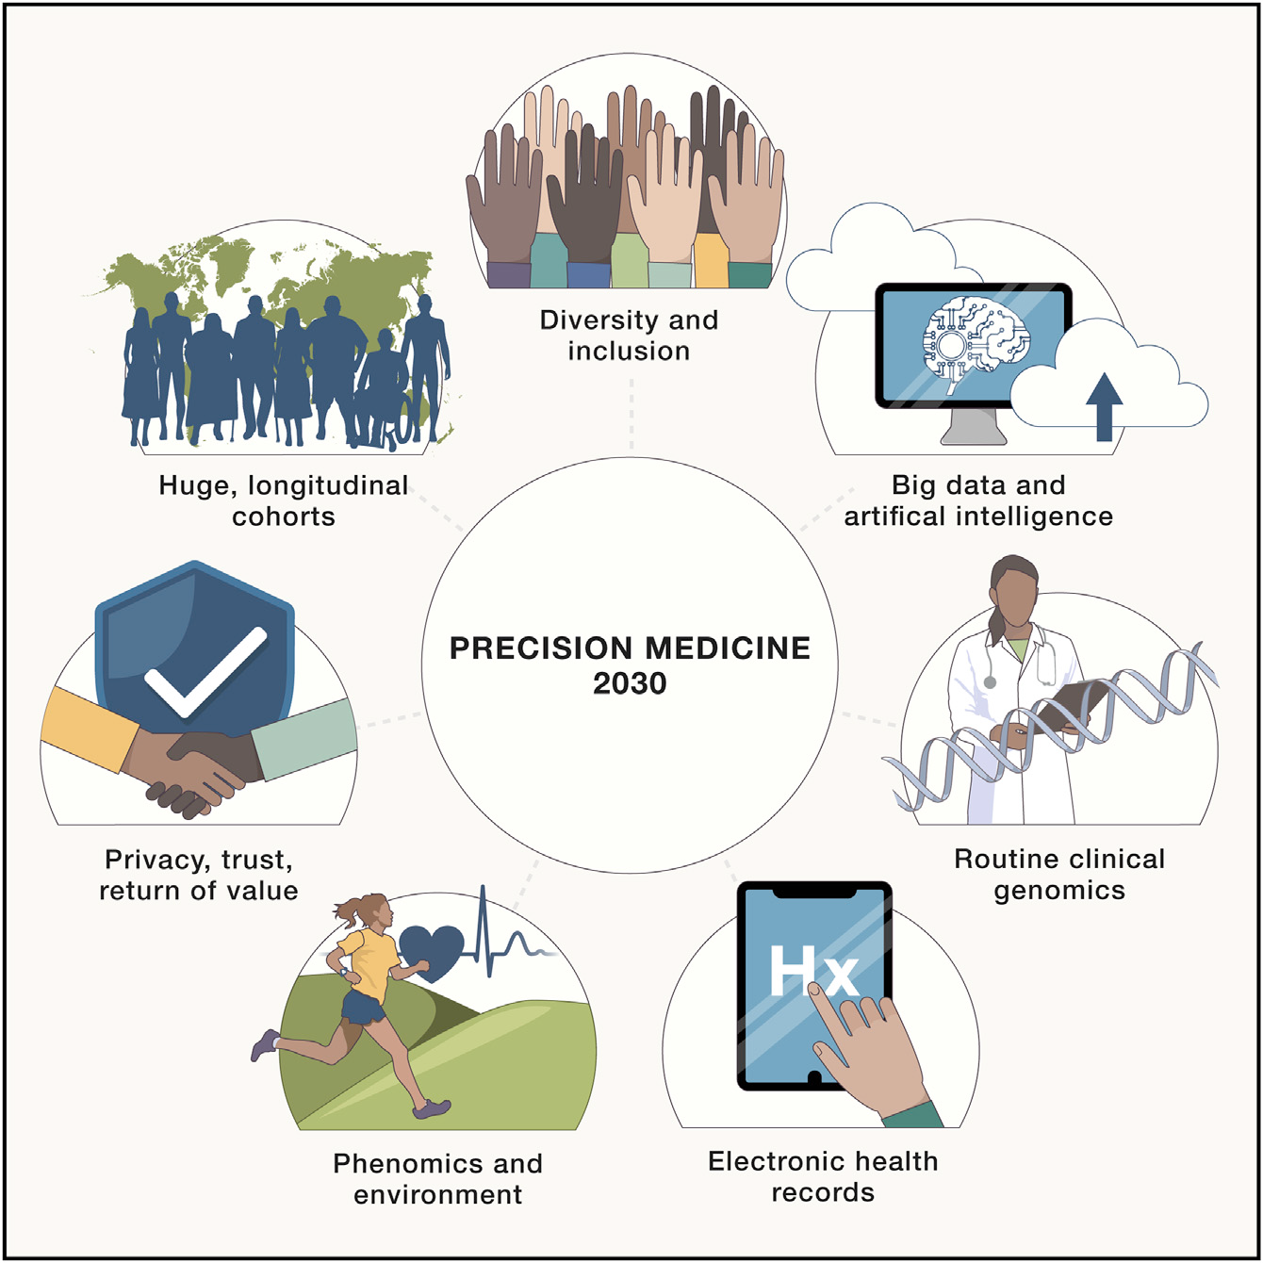
Future goal: Precision Medicine
Precision medicine promises improved health by accounting for individual variability in genes, environment, and lifestyle.
Precision medicine will continue to transform healthcare in the coming decade as it expands in key areas:
huge cohorts,
artificial intelligence (AI),
routine clinical genomics,
phenomics and environment,
returning value across diverse populations.
[Denny and Collins, Precision medicine in 2030—seven ways to transform healthcare. Cell 2021;184:1415–9. https://doi.org/10.1016/j.cell.2021.01.015.]

Slide 7
Open AI issues to address (with AI)
Open Issues and Challenges:
Limited availability of annotated data
Transfer learning
Data augmentation: synthetic data generation
Automated data labelling
Mining data from multiple sources
Reliability of AI-based systems
Explainability (XAI)

Slide 8
Difficulties in gathering large annotated samples in the medical field
Data annotation by human experts is an extremely time-consuming task, which may require:
the collection of additional information stored in other data storing systems,
expertise in segmenting meaningful regions in images,
specific knowledge to assign class labels.
In the medical imaging field, segmentation of organs or
lesions can be affected by inter- and intra-reader variability.
Reader 1 Reader 2
In most cases, medical data samples available for training machine learning models are of limited size due to difficulties in collecting annotations.
Samples of limited size may be not fully representative of the pathology to study
This is particularly true in case of heterogenous manifestations of a disease

Slide 9
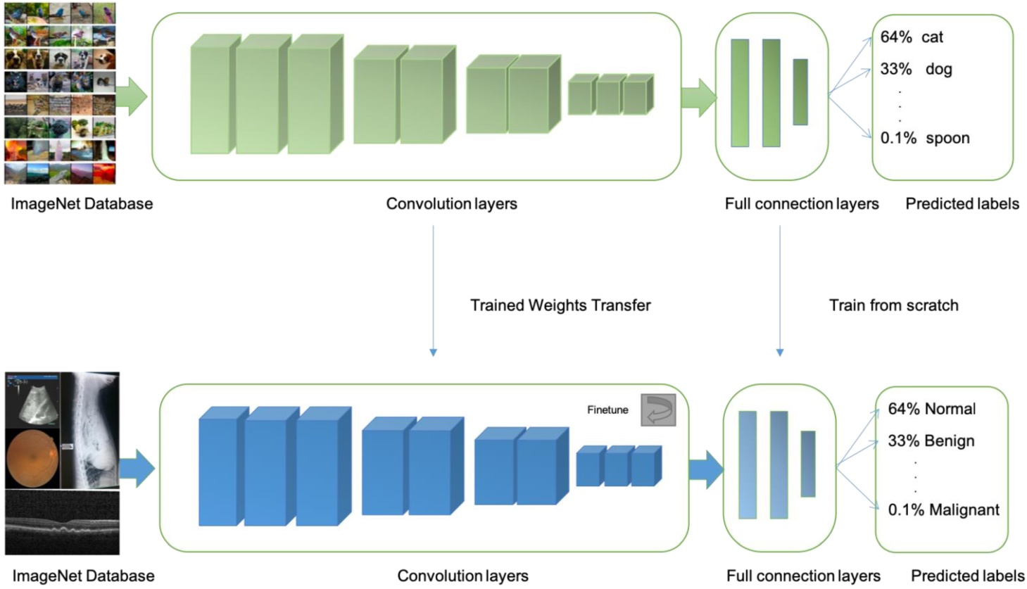
Limited availability of annotated data: Transfer learning
In case of small datasets
[ i.e. when # of training examples << # of trainable parameters ]
we can avoid training DL models from scratch and take advantage of the knowledge already acquired on other data and/or in other tasks
➔ Transfer Learning
DenseNet121, ResNet50, Inception are widely used pretrained Deep Neural Networks.
Typically, they are trained on ImageNet
Medical Image database
[Xu et al. Current status and future trends of clinical diagnoses via image-based deep learning. Theranostics, 9(25), 7556–7565 (2019)]
Notes:
(1, Atelectasis; 2, Cardiomegaly; 3, Effusion; 4, Infiltration; 5, Mass; 6, Nodule; 7, Pneumonia; 8, Pneumothorax; 9, Consolidation; 10, Edema; 11, Emphysema; 12, Fibrosis; 13, Pleural_Thickening; 14 Hernia)

Slide 10
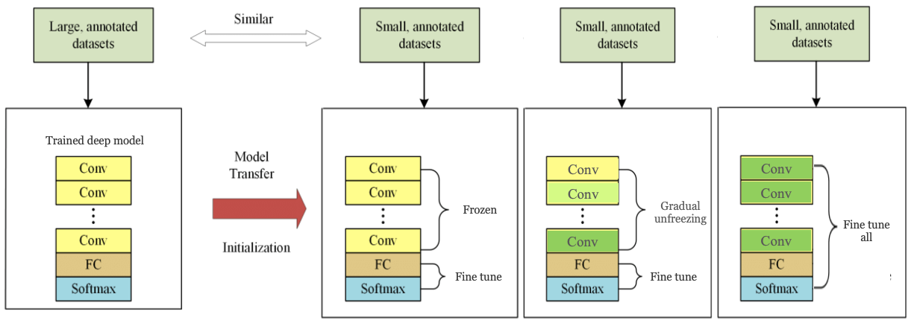
Transfer learning (TL)
Different approaches (TL) can be implemented:
CNN as feature extractor: All but the last feed-forward layer(s) of the network are frozen. The only weights that are trained are those in the last layers.
Discriminative learning rates with gradual unfreezing: The first layers of a network typically learn general features (e.g., lines, circles, colors, etc.). Thus, the weights in those layers should be changed less than the weights of the downstream layers which are more specialized in the target task.
Fine tune all CNN simultaneously: None of the weights are frozen. The pretrained network is used as a starting point.
CNN as feature extractor
Discriminative learning
Retrain the whole model
Similarity between source and target datasets, and target dataset size matter
Fixed feature extractor
Similar
Fine tune the model
Size of the target dataset
Small
Large
Fine tune also appropriate first layers
Different
Fine tune the model or train from scratch
Similarity between source and target dataset

Slide 11
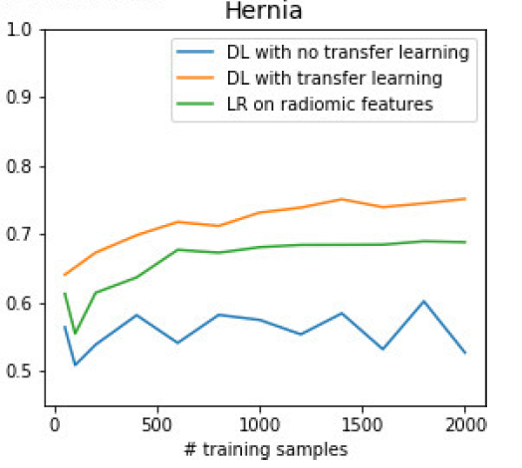
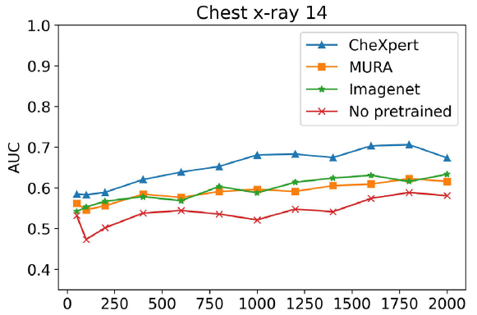
Transfer learning (TL)
https://paperswithcode.com/dataset/chestx-ray14
…
Comparison of three different TL methods, using DenseNet121, and different training dataset sizes and different classification tasks.
Results:
Traditional ML can perform better that DL for small datasets; if DL is used, TL performs better.
Fine-tune-all and gradual-unfreezing methods perform very similar
Features learned may not be as general as currently believed:
TL from models trained on the same anatomical site is equivalent to using ImageNet
TL is useful for small datasets (N < 2000)
Traditional ML vs DL (w and w/o TL)
Different TL methods
(orange points are very close to green ones)
AUC
Similarity between source and target datasets
CheXpert: Chest X-ray images
MURA: Musculoskeletal RX images (elbow, finger, forearm, hand, humerus, shoulder, and wrist)
ImageNet: natural images
[Romero et al. Targeted transfer learning to improve performance in small medical physics datasets. Medical Physics, 47(12), 6246–6256 (2020)]

Slide 12
Limited availability of annotated data: Data augmentation
Data augmentation is a popular method for increasing the size of a training dataset
Modifications are applied to the training cases to generate further representative samples which simulate changes in acquisition and anatomical variation of patients
The aim is to improve model generalization capability and thus the performance on the test set.
Augmentation methods include:
Basic image manipulation and deformable techniques:
tissue deformations, artefacts due to patient movement), within physically plausible limits
DL-based approaches:
They can automatically learn the representations of images and generate realistic additional examples
Examples of commonly used basic and deformable data augmentation techniques
Original
Zooming
Rotation
Gaussian noise
Elastic Deformation
Motion blurring
[Lizzi et al (2021). Quantification of pulmonary involvement in COVID-19 pneumonia by means of a cascade of two U-nets: training and assessment on multiple datasets using different annotation criteria. IJCARS, https://doi.org/10.1007/s11548-021-02501-2]
Notes:
Geometric transformations are the most common basic augmentation used. These transformations are most commonly affine such as scaling (3b), translating (3c), rotating (3d), reflecting (3e) and shearing (3f) or some- times perspective transforms including skew (3g)
the use of a randomly gener- ated displacement field that may be applied to a 2D image t
The DL-based augmentation approaches can automati- cally learn the representations of images and generate realistic images to increase the model’s generalisability and reduce overfitting during training.
set parameters for deformation that remain within physically plausible limits.

Slide 13
Limited availability of annotated data: Data augmentation
Synthetic data generation with GAN
Generative adversarial networks (GAN) can generate plausible images via the adversarial training of a generator G and a discriminator D.
Adversarial training refers to the competition between the two networks G and D.
An equilibrium is eventually reached, where the generator can approximate data from the target data distribution and the discriminator predicts ‘real’ or ‘generated’ for its input data with 50% probability.
Realistic synthetic data can be generated by the generator via sampling the fixed distribution p(z) for data augmentation.
Conditional GAN can be used to create new data through domain adaptation: the trained model can embed an adaptation from a certain source of data onto a different source of data (e.g. generation of mammographic masses from lung nodules)
[Chlap, P., Min, H., Vandenberg, N., Dowling, J., Holloway, L., & Haworth, A. (2021). A review of medical image data augmentation techniques for deep learning applications. Journal of Medical Imaging and Radiation Oncology, 65(5), 545–563. https://doi.org/10.1111/1754-9485.13261]

Slide 14
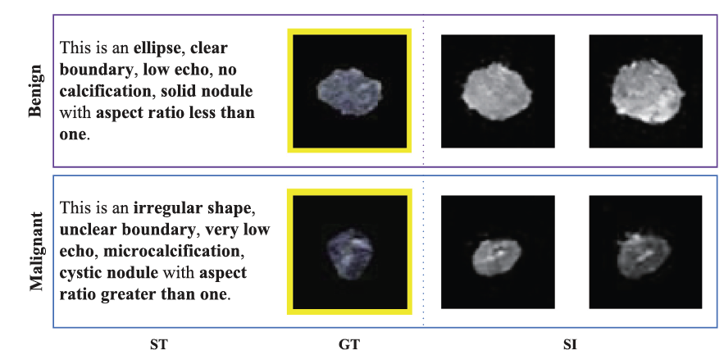
Limited availability of annotated data: Data augmentation
Synthetic data generation with knowledge guided adversarial network
Knowledge-guided adversarial augmentation method for synthesizing medical images
A Term and Image Encoder is implemented to extract domain knowledge from TI-RADS reporting by radiologists
The domain Knowledge is used as novel condition to constrain the Auxiliary Classifier Generative Adversarial Network (ACGAN)
➔ KACGAN
Standardized terminology Ground Truth Synthetic Images
[Shi et al. Knowledge-guided synthetic medical image adversarial augmentation for ultrasonography thyroid nodule classification. Comput Methods Programs Biomed 2020;196:105611]

Slide 15
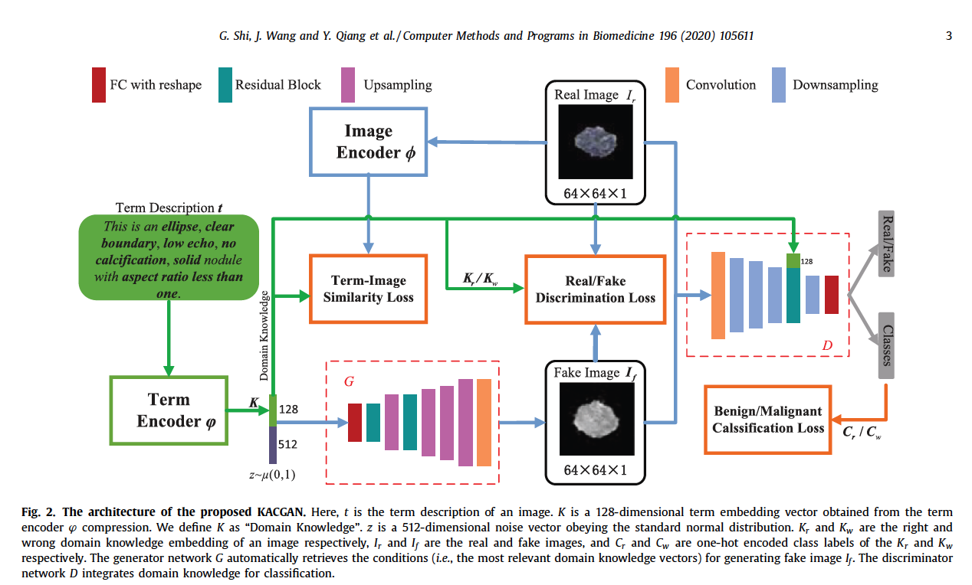
Limited availability of annotated data: Data augmentation
The KACGAN model consists of three stages:
extracting domain knowledge from standardized terminology by using term encoder ϕ,
constructing and training the KACGAN model using the patch images and the domain knowledge for synthetic medical image augmentation,
combine the synthesized images for improve performance in ultrasonography thyroid nodules classification.
Domain knowledge data augmentation leads to a 4% improvement of AUC, with respect to traditional augmentation methods → AUC = 95%
[Shi et al. Knowledge-guided synthetic medical image adversarial augmentation for ultrasonography thyroid nodule classification. Comput Methods Programs Biomed 2020;196:105611]

Slide 16
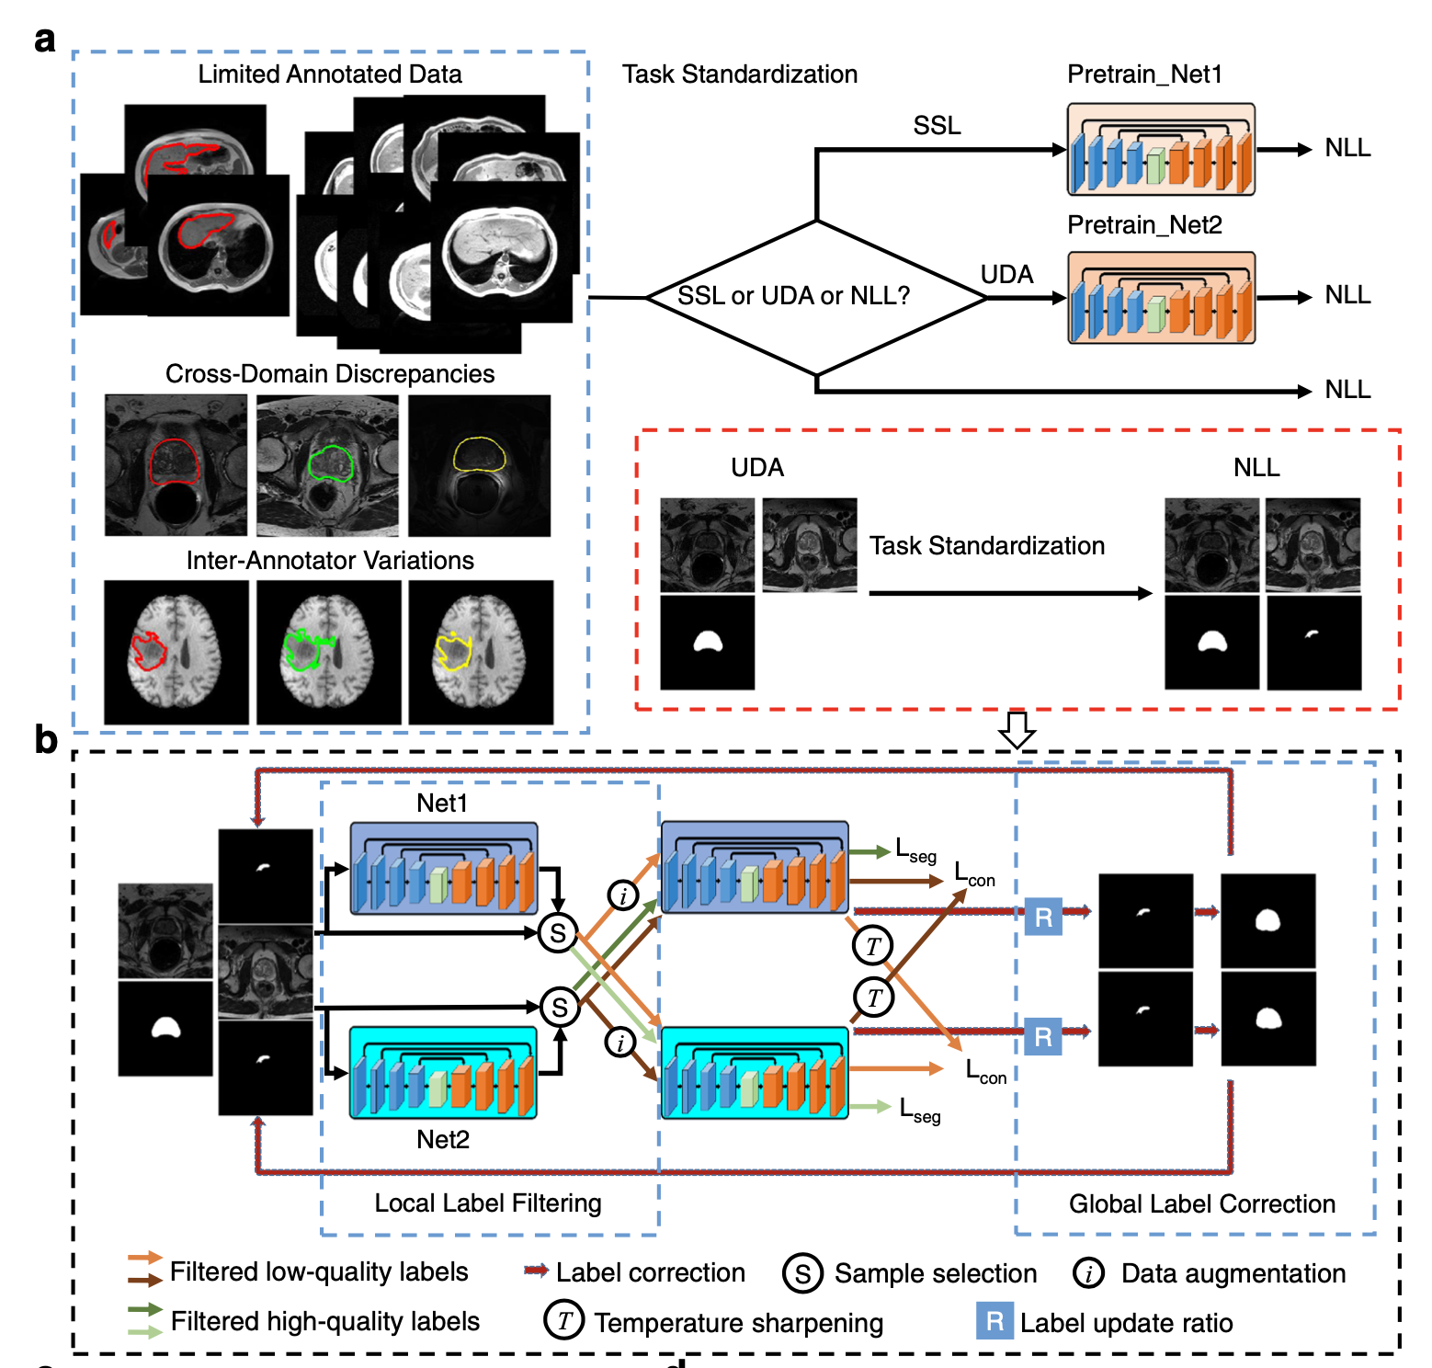
Limited availability of annotated data: Automated data labelling
Annotation-effIcient Deep lEarning (AIDE):
an open-source framework to handle
imperfect training datasets.
To address the most frequently encountered challenges in clinical applications:
Learning with imperfect datasets having limited annotations (semi-supervised learning, SSL),
Lacking target domain annotations (unsupervised domain adaptation, UDA),
Containing noisy annotations (noisy label learning, NLL)
By using only 10% of training data annotations, AIDE achieved comparable segmentation results to those obtained by fully supervised models accessing to 100% annotated training data and to those provided by independent radiologists.
Only the NLL problem needs to be addressed
[Wang et al. Annotation-efficient deep learning for automatic medical image segmentation. Nature Communications, 12(1), 1–13 (2021)]

Slide 17
Open AI issues to address (with AI)
Open Issues and Challenges:
Limited availability of annotated data
Mining data from multiple sources
Multimodal Fusion
Imputation of missing data
Reliability of AI-based systems
Explainability (XAI)
Notes:
Data imputation

Slide 18
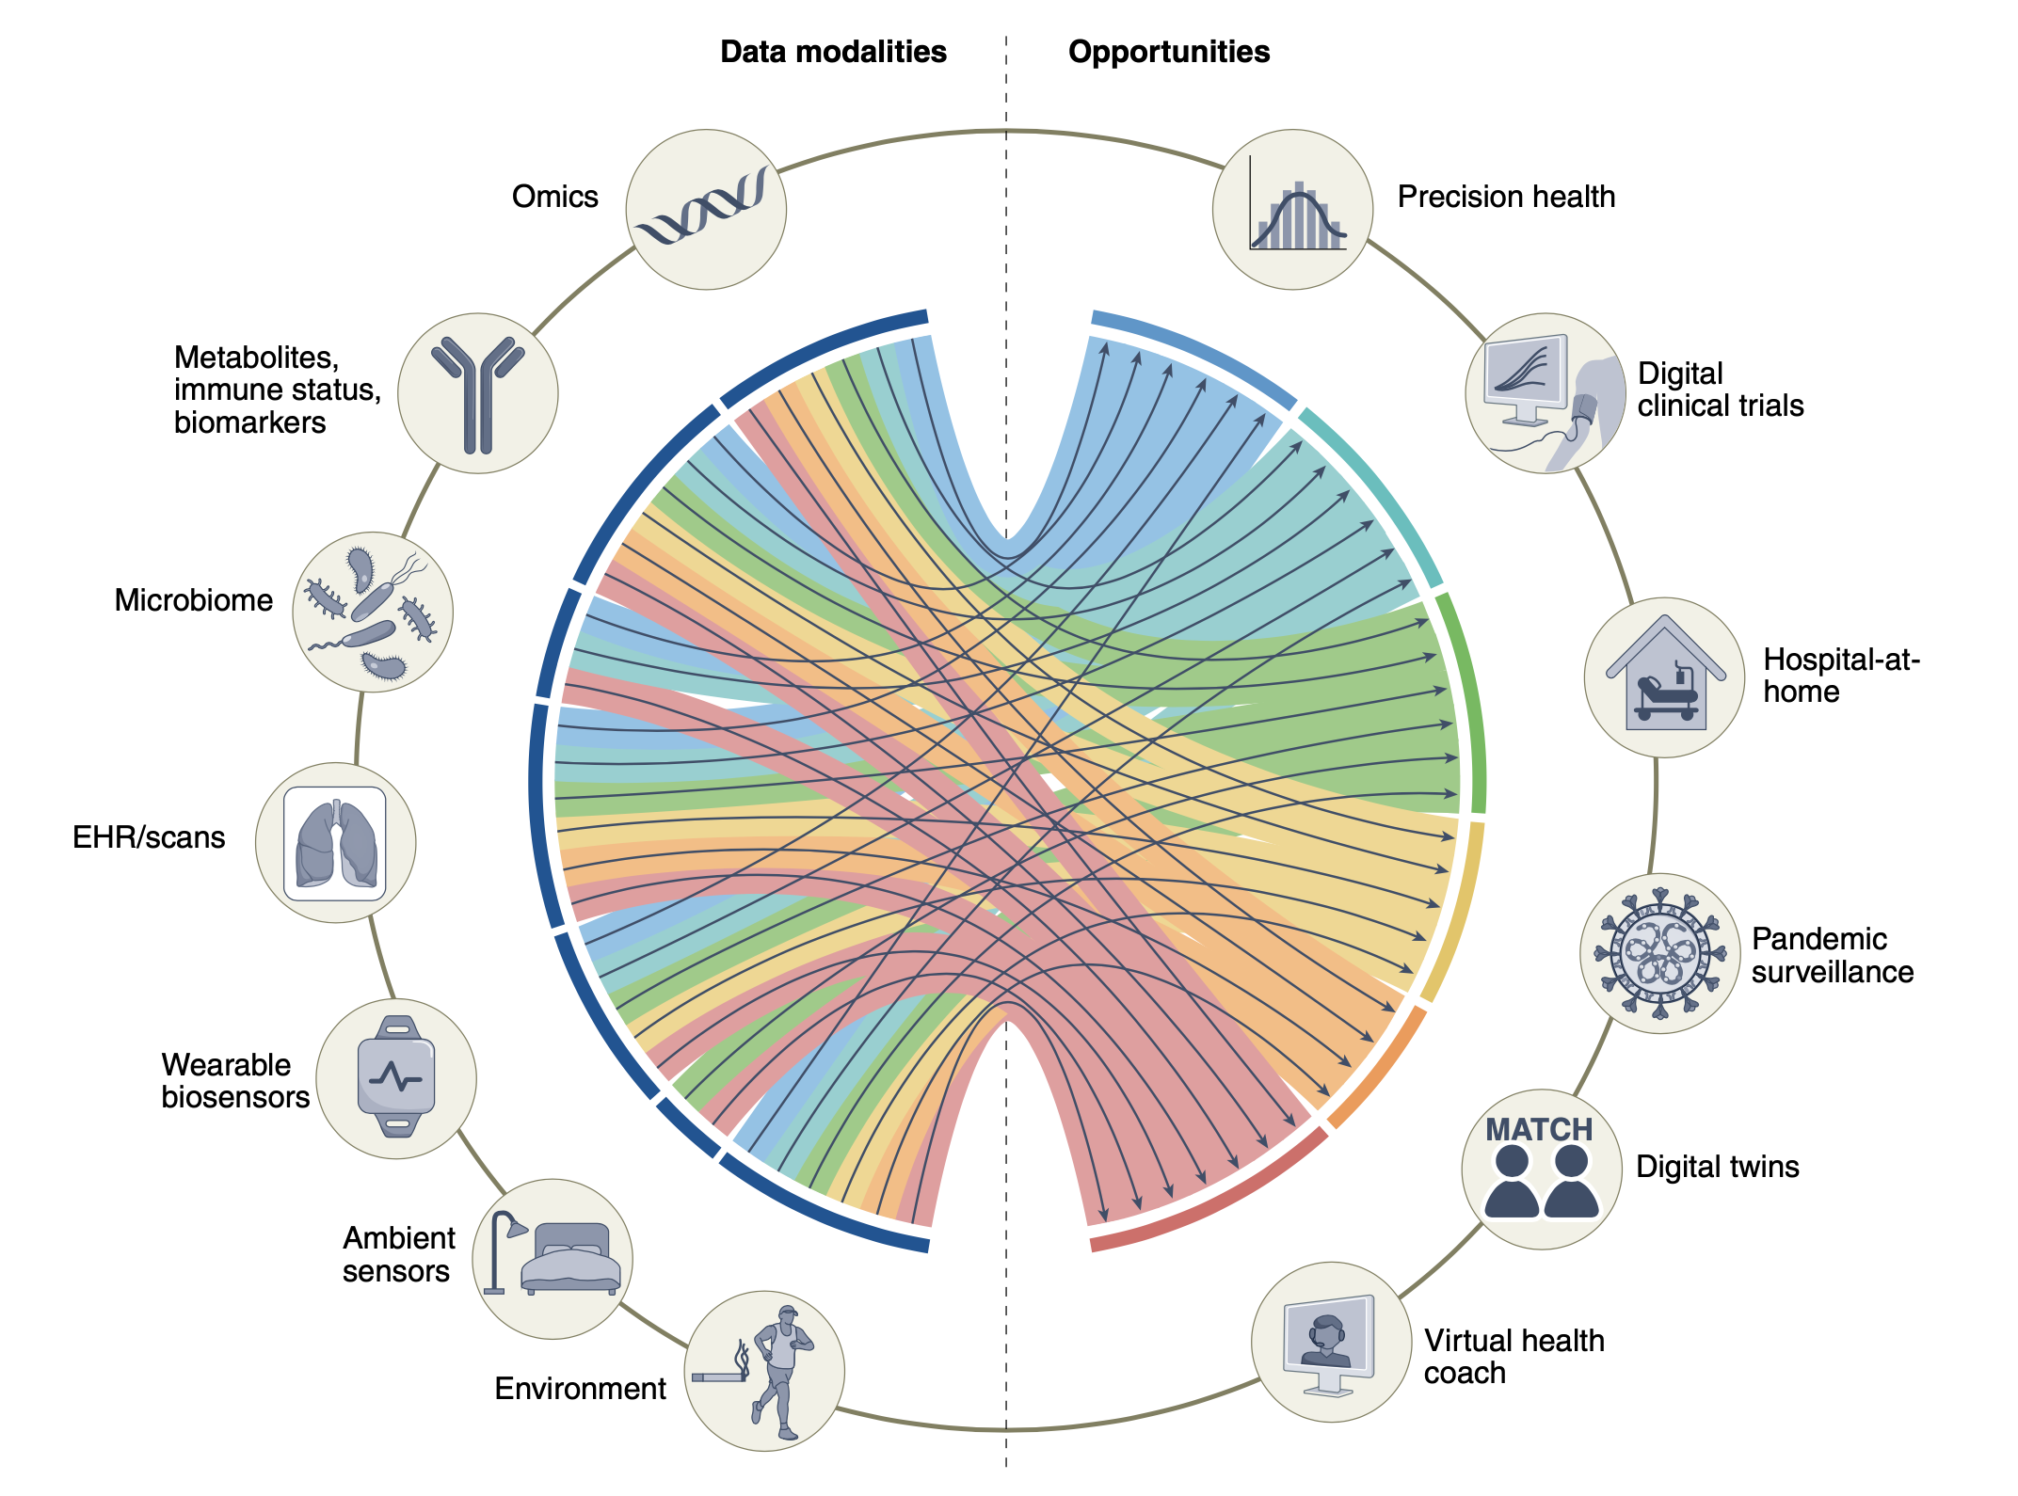
Integration of data from multiple sources
Data modalities and opportunities for multimodal biomedical AI
The integration of the complementary information encoded in omics data, electronic health records (HER), imaging data is expected:
to increase the understanding of human health and disease conditions
to allow personalized preventive, diagnostic and therapeutic strategies
UK Biobank (started in 2006) enrolled more than 500k participants to follow for 30 years.
The integration of these very distinct types of data remains a challenge.
[Acosta et al (2022). Multimodal biomedical AI. Nature Medicine, 28(9), 1773–1784. https://doi.org/10.1038/s41591-022-01981-2]

Slide 19
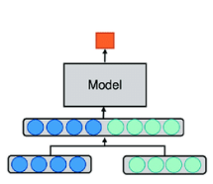
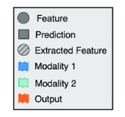
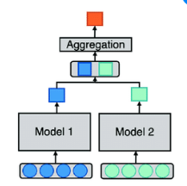
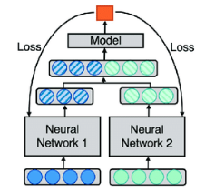
Multimodal learning
Data from different modalities should be combined → Multimodal Fusion
Early fusion:
It is the simplest approach. Input modalities or features are concatenated before any processing.
Late fusion:
Separate models are trained for each modality and the output probabilities are combined at the end. It a simple and robust approach, but any possible information encoded in the interaction between data modalities is missing.
Joint fusion:
The representations of the different modalities are co-learned and combined during the training process. It allows for modality-specific preprocessing and also capturing the interaction between data modalities.
Early fusion
Late fusion
Joint fusion
Notes:
Early fusion: While simple, this approach is not suitable for many complex data modalities.

Slide 20
Prediction of COVID-19 severity: the covidcxr hackathon
https://ai4covid-hackathon.it/ Challenge on chest X-ray and clinical data of patients with COVID-19 pneumonia
The goal:
to predict the severity of patient outcome (severe/mild)
To explain the model
Dataset:
~1100 CXR for training
~500 CXR for test

Slide 21
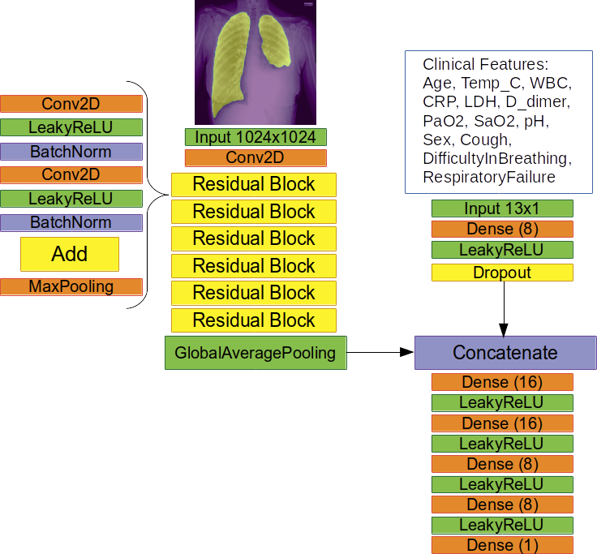
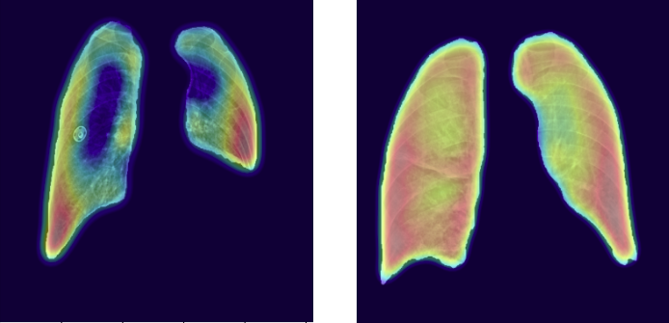
Prediction of COVID-19 severity: the covidcxr hackathon
Multi-input AI model
Explainability: The grad-CAM technique produced saliency maps, which indicate whether the classifier is looking at the right parts of the image when assigning a certain class label
Correctly classified by the multi-input CNN
GT: mild GT: severe
AI: mild AI: severe
Misclassified by the multi-input CNN
The AIM-WG team achieved the 4th place with a 74% accuracy in predicting patient prognosis on the hackathon test set
GT: mild GT: severe
AI: severe AI: mild
Outcome prediction:
(severe/not severe)
[Lizzi et al, Fully automated deep learning based system for COVID-19 patient outcome prediction, Intelligence-based medicine, under review]

Slide 22
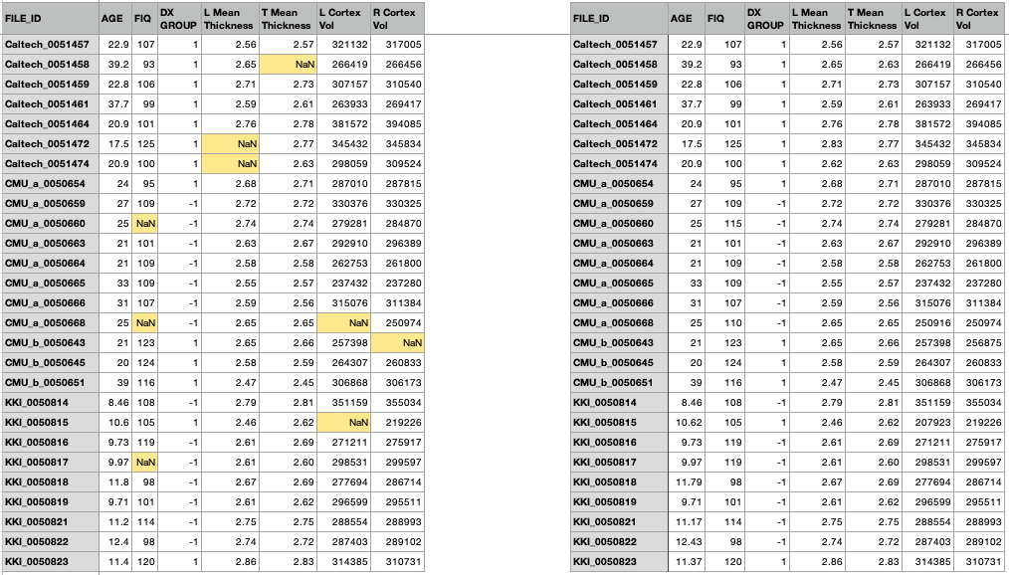
Missing values in multimodal analysis
A high proportion of missing data may affect multimodal data collections.
Simply excluding patients with missing data:
reduces the dataset dimensionality
may lead to a selection bias
Data imputation techniques
Infer missing values from the existing part of the data.
Basic approaches:
For numerical features:
replacing missing values with the mean/median of the non-missing values in a column
replacing with a «0» or constant value
For categorical features:
replacing missing values with the most frequent values within each column
ML-based approaches (multivariate approach):
k Nearest Neighbors classification (k-NN): it looks at the nearest observations in the training sample and imputes the missing value from that of the neighbours
data imputation
feature2
kNN with k=3
(f1, f2, f3)
f3 = avg(f3_{neighbors})
feature1
[Cismondi et al, Missing data in medical databases: Impute, delete or classify? Artif Intell Med 2013;58:63–72. https://doi.org/10.1016/j.artmed.2013.01.003.

Slide 23
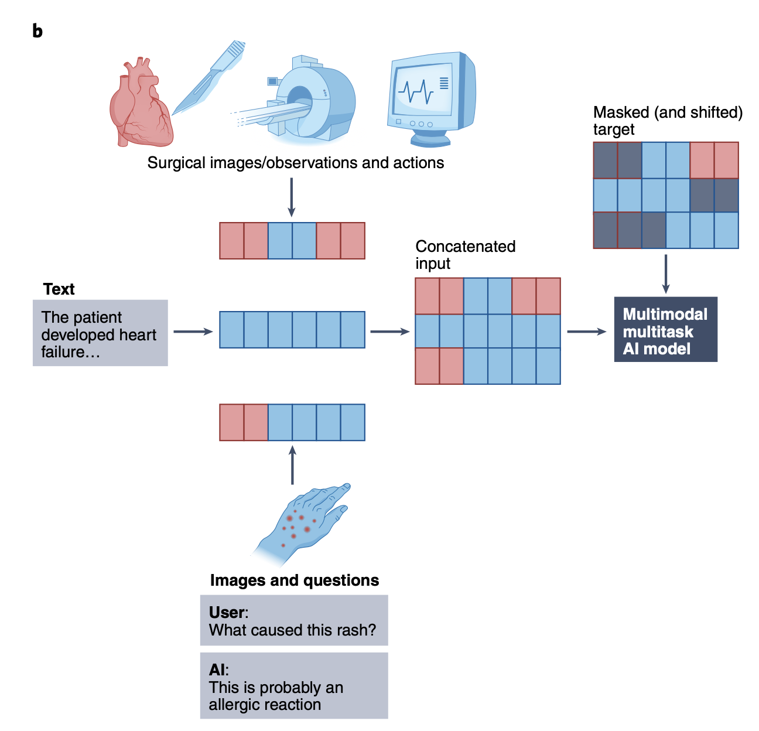
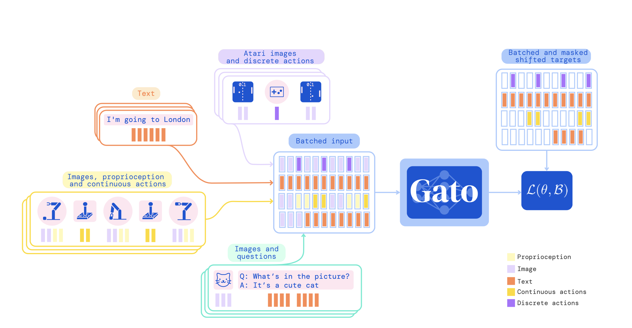
Missing a modality in multi-input analysis
Multimodal multitask architectures
Distinct input modalities (images, tokenized text and actions) are fed to the network as input,
the network only sees partial input to make a prediction
the network then learns to handle multiple modalities and tasks.
DeepMind has developed Gato, a generalist agent which can decide based on its context whether to output text, joint torques, button presses, or other tokens.
[Reed et al, A Generalist Agent (Nov. 2022), Trans Mach Lear Research , https://arxiv.org/abs/2205.06175 ]
➔ The trained network can provide predictions even in case of missing blocks of input information
[Acosta et al (2022). Multimodal biomedical AI. Nature Medicine, 28(9), 1773–1784. https://doi.org/10.1038/s41591-022-01981-2]

Slide 24
Open AI issues to address (with AI)
Open Issues and Challenges:
Limited availability of annotated data
Mining data from multiple sources
Reliability of AI-based systems
Robustness to inappropriate inputs
Explainability (XAI)

Slide 25
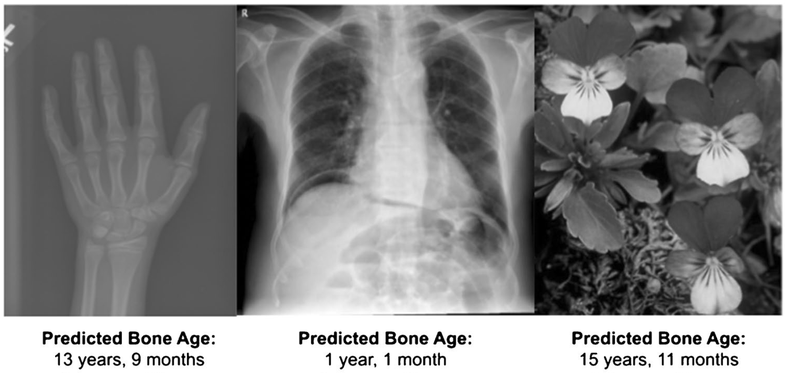
Reliability of AI systems
What happens when an AI algorithm trained for a specific task is executed on “inappropriate input data”?
Typically, it provides its prediction!!!
[Yi et al (2022). Can AI distinguish a bone radiograph from photos of flowers or cars? Evaluation of bone age deep learning model on inappropriate data inputs. Skeletal Radiology, 51(2), 401–406. https://doi.org/10.1007/s00256-021-03880-y]
To avoid feeding an AI algorithm with a wrong input:
Image type/quality can be evaluated by another AI algorithm, and possibly discarded if not appropriate
[Fantini et al. (2021). Automatic MR image quality evaluation using a Deep CNN: A reference-free method to rate motion artifacts in neuroimaging. Computerized Medical Imaging and Graphics, 90, 101897. https://doi.org/10.1016/j.compmedimag.2021.101897]
Outputs of a CNN trained to predict bone age from RX of left hands
Motion-free vs motion corrupted images
~
x
x

Slide 26
Open AI issues to address (with AI)
Open Issues and Challenges:
Limited availability of annotated data
Mining data from multiple sources
Reliability of AI-based systems
Explainability (XAI)

Slide 27
Conclusions
Medical devices produce daily an incredible amount of digital information that is not fully exploited for diagnostics, therapy or research.
To exploit the potential of such big data in Medicine advanced computational approaches (including AI-based ones) are needed to handle and analyze heterogeneous data.
Clinicians could benefit from AI-based systems to improve diagnosis, treatment and monitoring of a wide range of pathologies, thus moving closer to the goal of precision medicine.
A dedicated multidisciplinary effort is needed to develop successful applications
«… we are far better at collating and storing such data, than we are at data analysis.»
[Acosta et al (2022). Multimodal biomedical AI. Nature Medicine, 28(9), 1773–1784. https://doi.org/10.1038/s41591-022-01981-2]

Slide 28
thank you for your kind attention!
next
Contact: alessandra.retico@pi.infn.it
INFN, Pisa Division
https://www.pi.infn.it/aim/

