Slide 1
UNIVERSITÀ DEGLI STUDI DI BARI ALDO MORO
Dipartimento Interateneo di Fisica Michelangelo Merlin
Third ML-INFN Hackathon: Advanced Level
Explainable Artificial Intelligence (XAI)
Alessandro Fania
23/11/2022
Bari Applied Physics (INFN Group-5)
1

Slide 2
Overview
What is Explainability?
Why is Explainability important?
Is feature importance a good solution?
Explainable Artificial Intelligence
Grad-CAM
SHAP
Application on VGG16 Model
Conclusion
2

Slide 3
What is Explainability?
«Explainability is the degree to which a human can understand the cause of a decision»
Tim Miller-Explanation in artificial intelligence: Insights from the social sciences
3

Slide 4
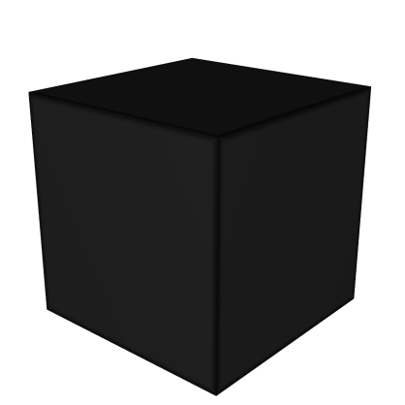
What is Explainability?
Machine Learning and Deep Learning models are difficult to understand
They are often treated as Black Boxes
Black box
Input data
Predicted output
4

Slide 5
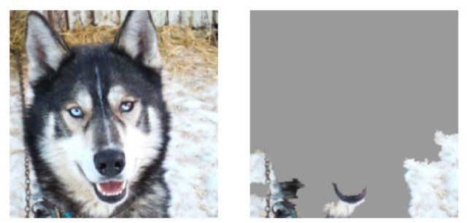
Why Explainability is so important?
Helps analysts to understand system outputs simply and quickly.
Explainability can provide recommendations and spot anomalies for analysts to investigate
Sometimes AI can give an output that’s correct but for the wrong reasons.
Likewise, Explainability makes possible to understand why a mistake was made and even train the system to stop it from happening again.
This driver for Explainability provides some overlap with the General Data Protection Regulation (GDPR): the customer has the right to obtain explanations.
The European Commission recently published the first draft of its Artificial Intelligence Regulation which stipulating requirements around AI and Explainability.
-a husky (on the left) is confused with a wolf, because the pixels (on the right) characterizing wolves are those of the snowy background.
5
https://towardsdatascience.com/from-data-to-decisions-bef3649f0b17

Slide 6
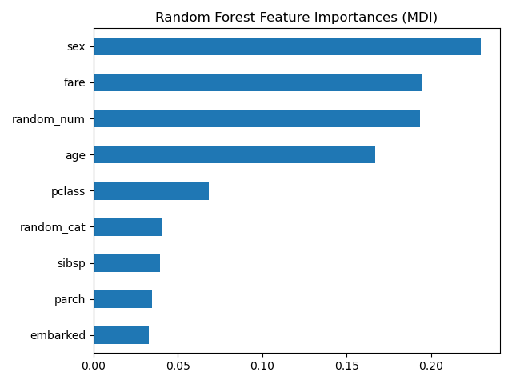
Is feature importance a good solution?
Disgregate the final predicton to a single feature attribution and untangle interaction between features are very difficult tasks.
A possible way to solve this problem would be to use the feature importance.
An example is the Mean Decrease Accuracy implemented in the random forest, in which the importance of a feature is evaluated by the change in performance after the variable is deleted.
Is then feature importance a good solution?
6
https://towardsdatascience.com/interpretable-machine-learning-with-xgboost-9ec80d148d27

Slide 7
Is feature importance a good solution?
Every good feature importance should have the following properties:
Consistency: a change of the model so that it relies more on a feature (ex. Decision trees), should not decrease the importance of that feature.
Accuracy: given a fixed metric to measure importance of a model, the attribution of each feature should add up to that metric.
Insightfulness: a feature ranking does not provide a good explanation of how a feature increase or decrease the model output.
Unfortunately, it is not always possible to have this situation
In addition, feature importance gives global information, not on the single prediction
For all these reasons, feature importance is not the best strategy to promote Explainability.
7

Slide 8
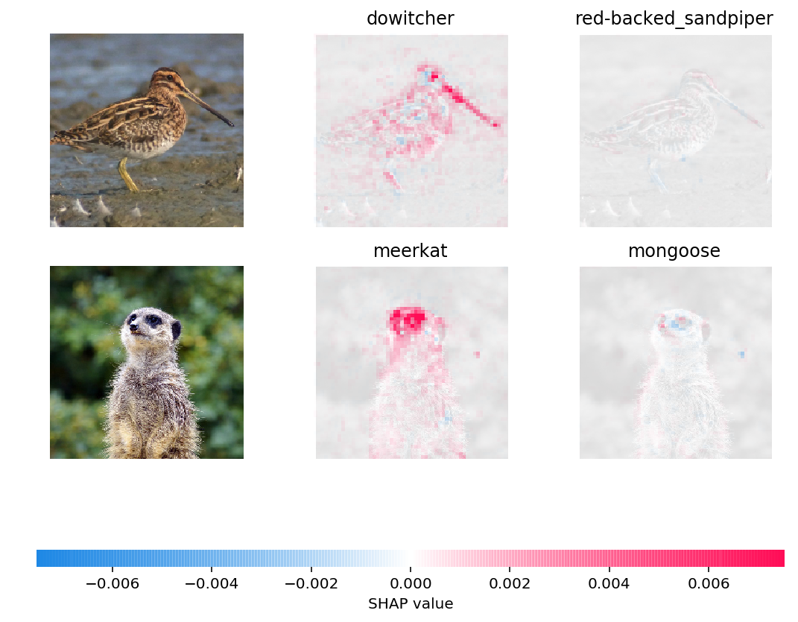
Exaplainable Artificial Intelligence
One possible solution is to use eXplainable Artificial Intelligence (XAI) models.
In this short presentation we will see:
Grad-CAM
SHAP
8

Slide 9
Grad-CAM

Slide 10
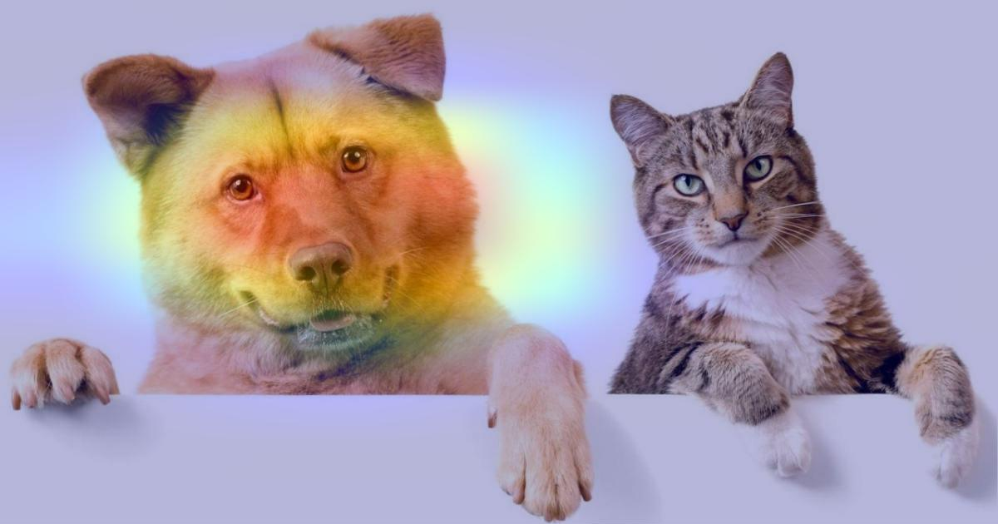
CAM-model
What is a CAM model?
Class Activation Maps (CAM) are a technique to get the discriminative image regions used by a CNN to identify a specific class in the image.
In other words, a class activation map lets us see which regions in the image were relevant to this class.
-Area of the image that explains a prediction "Dog"
The idea is to use the feature maps of a CNN model as weight to explain a certain prediction
10

Slide 11
CAM-Architecture
11

Slide 12
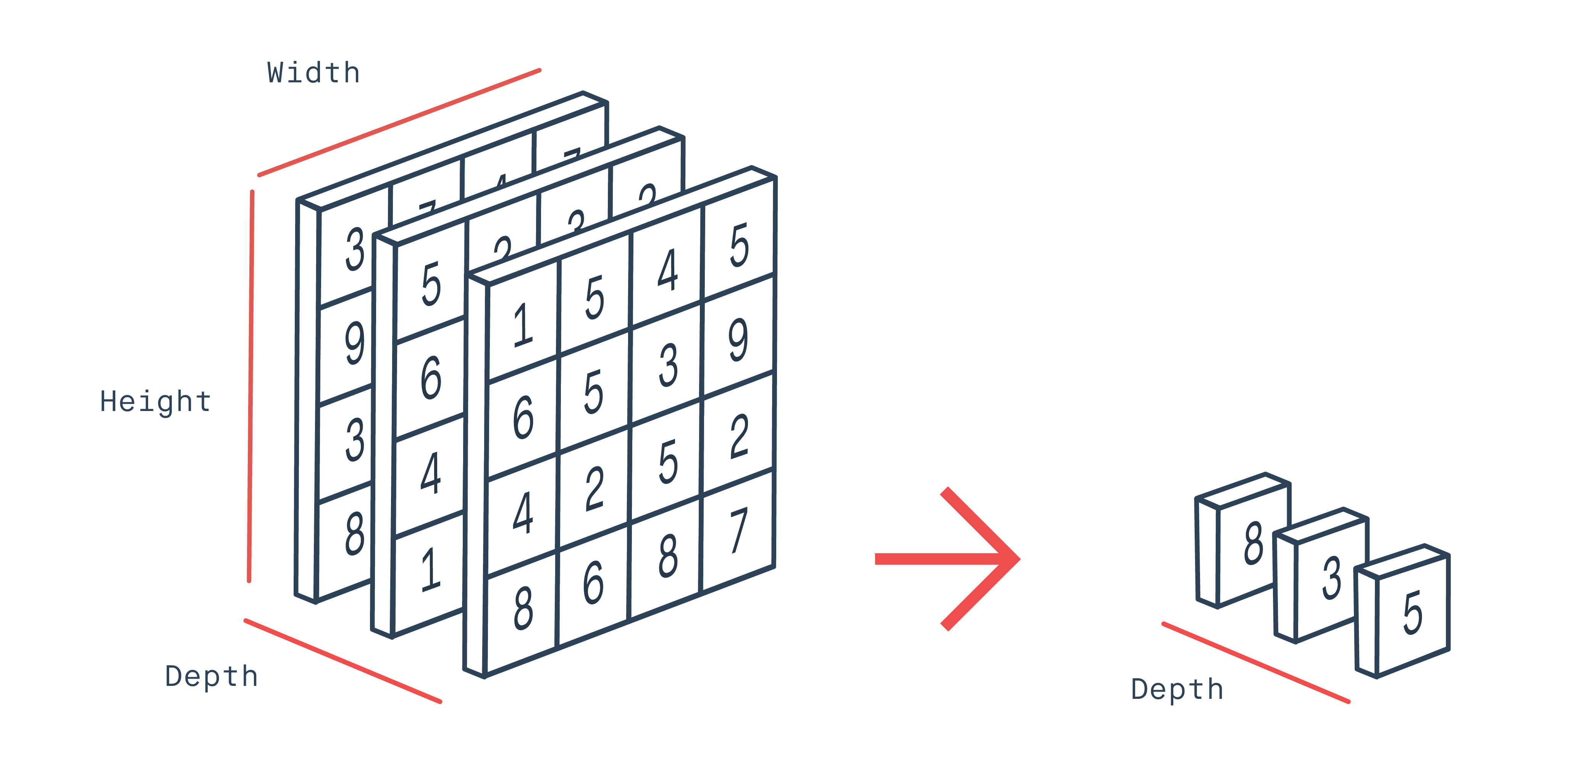
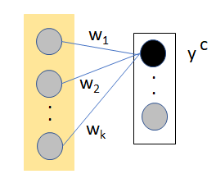
CAM-Algorithm
Post the last convolutional layer in a typical neural network through Global Average Pooling you get weights from feature maps
A weight is then assigned to each output per category by either augmenting dense linear layers with softmax or by stacking linear classifiers atop of GAP.
12

Slide 13
CAM-Algorithm
We can then express the $c_{th}$ output of the network as:
$k_{th}$ feature map
$Y_{c}$ represents the score of the $c_{th}$ class
Z is the number of pixels in feature map
13

Slide 14
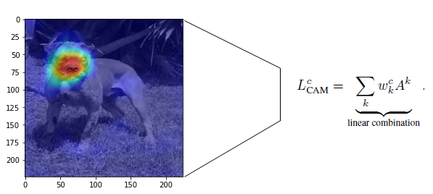
CAM-Algorithm
We finally get the class map:
The assumption of the CAM model is that the final score can always be expressed as a linear combination of pooled average feature maps.
14

Slide 15
CAM-Cons
CAM only works on architectures that have Global Average Pooling (GAP) as a layer before the Dense that deals with the classification:
Limitations:
The model needs to be modified in order to use CAM.
The modified model needs to be retrained, which is computationally expensive.
Since fully connected Dense layers are removed. the model performance will surely suffer. This means the prediction score doesn’t give the actual picture of the model’s ability.
The use case was bound by architectural constraints, i.e., architectures performing GAP over convolutional maps immediately before output layer.
15

Slide 16
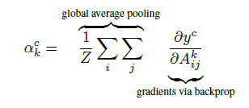
Grad-CAM
A possible solution is to use backpropagation to calculate the weights of the maps.
Gradient Class Activation Map (Grad-CAM)
Next, a ReLU function is applied to zero the negative values of the gradient.
Selvaraju, Ramprasaath R., et al. "Grad-cam: Visual explanations from deep networks via gradient-based localization." Proceedings of the IEEE international conference on computer vision. 2017.
16

Slide 17
Grad-CAM Architecture
17

Slide 18
Grad-CAM
Pro
Unlike CAM we are not bound to use only the features maps of the last convolutional layer, but we can concentrate our analysis for each conv layer of our network.
Grad-CAM is a generalization of CAM.
Cons
Consider only positive gradients.
It is applicable to:
CNNs with fully-connected layers (e.g. VGG) without any modification to the network.
CNNs used for structured outputs like image captioning.
CNNs used in tasks with multi-modal inputs like visual Q&A or reinforcement learning, without architectural changes or re-training.
18

Slide 19
SHAP

Slide 20
SHAP-Introduction
SHAP is a model agnostic explainer:
Its purpose is to "imitate" the model used.
It gives an understandable explanation of a local prediction of a model by assigning to each feature a value.
Lundberg, Scott M., and Su-In Lee. "A unified approach to interpreting model predictions." Advances in neural information processing systems 30 (2017).
20

Slide 21
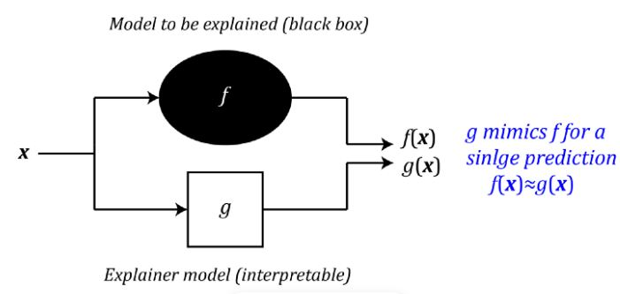
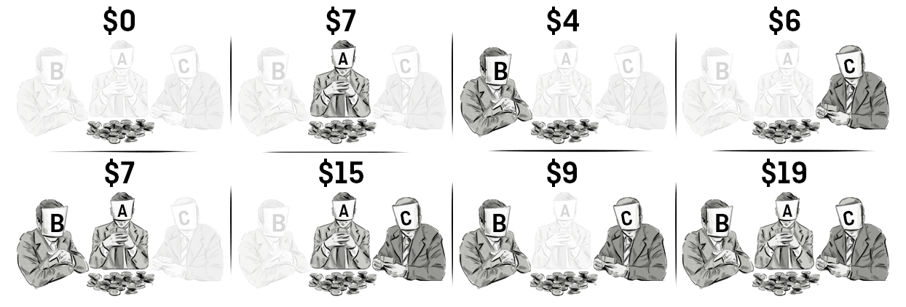
SHAP-How it works
How to achieve this?
It uses the concept of Shapley Value.
The Shapley value is a mathematical concept in game theory that was introduced by Lloyd Shapley in 1951 [72], later awarded the Nobel Prize in Economics for this work.
-worth of a coalition on which is Shapley value based on
21

Slide 22
SHAP-How it works
Let’s consider a game in co-operative with m numbered players and call F the set of such players.
$F=\left\{1, 2, 3, 4,…, m\right\}$
We then define an S coalition as a subset of F, which also includes the empty set without players.
An example of the possible coalitions with 3 players
22

Slide 23
SHAP-How it works
Let us now define a function ν, called a characteristic function, which associates each coalition with a real number. The value ν(S) will be called the worth of the coalition S and represents the total gain obtained by the coalition if the members act together.
Obviously in the trivial case:
At this point, for the calculation of the value of {3}, for example, you can proceed by subtracting:
The aim now is to assess what each player’s contribution is in the total payoff.
23

Slide 24
SHAP-How it works
Considering the number of permutations and summing up on all other possible combinations we get:
where $\left|F\right|!$ is the total number of permutations of the grand coalition, S indicates the coalition and $S∪\left\{i\right\}$ indicates the coalition with the addition of i.
The ${\text{φ}}_{i}$ value is called Shapley Value and represents the average contribution of the player, or variable, i.
24

Slide 25
Shapley Values in Machine Learning
How translate this in Machine Learning?
SHAP (Shapley Additive Explanation)
Input data
Simplified local inputs
(generally $z^{′}∈\left(0,1\right)$)
$$x$$
$$z^{′}$$
Input model
$$f\left(x\right)$$
$$g\left(z^{′}\right)$$
Explanatory models
If $x≈z^{′}$ then $f\left(x\right)=g\left(z^{′}\right)$
25

Slide 26
Shapley Values in Machine Learning
We assume:
SHAP values
Additive Feature Attribution
$c_{i}$ represent the contribution of each feature.
$c_{0}$ is the average output of the model.
Easy to interpret.
26

Slide 27
Shapley Values in Machine Learning
How we calculate SHAP values?
Player
Feature
27

Slide 28
Shapley Values in Machine Learning
Finally we get:
Shapley values calculated using the conditional expectations are called SHAP values.
28

Slide 29
Shapley Values in Machine Learning
It is proved that the function $g\left(z^{′}\right)$ has the following property:
Local Accuracy:
If $x≈z^{′}$ then $f\left(x\right)=g\left(z^{′}\right)$.
Missingness:
If $z^{′}=0$, then ${\text{φ}}_{i}$ $=0$.
Consistency:
If feature contribution changes, the feature effect cannot change in the opposite way.
29

Slide 30
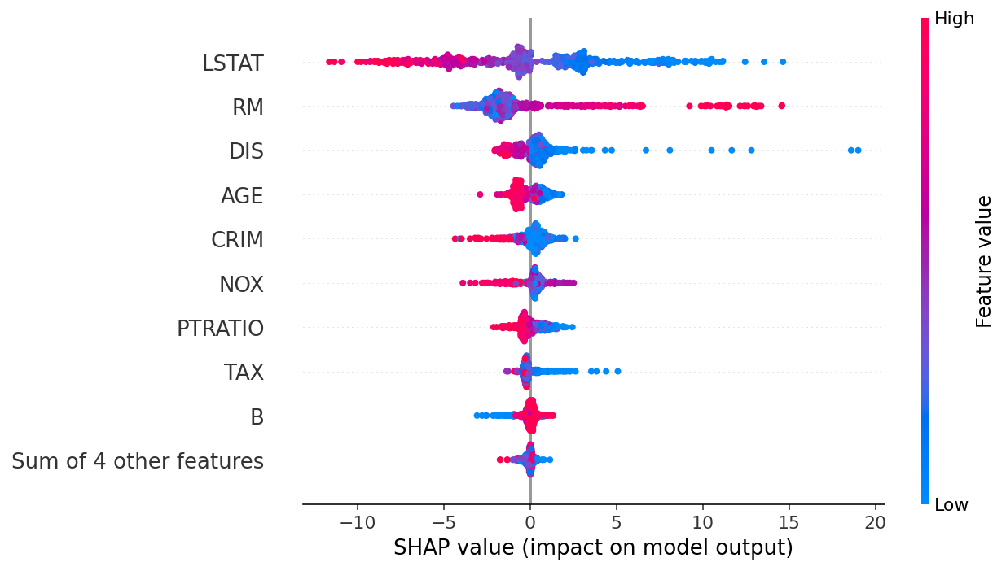
SHAP-Plot
The SHAP library allows the display of SHAP values for each feature of the model.
In the example opposite, the distributions of the SHAP values of a model are shown.
The values in red refer to high values of the feature, compared to the starting distribution, vice versa the blue values to low values.
The most impactful features for the model are placed at the top.
This plot refers to a test sample but can also be used for a local instance.
30

Slide 31
SHAP for Deep Learning: DeepExplainer vs GradientExplainer
The SHAP model is also adapted for the explanation of deep learning models.
The function in question is DeepExplainer:
It can have both tabular and image data as input.
In the case of images, pixels will be considered as features to which to assign the SHAP values
Another very similar function is GradientExplainer:
it is possible to assign importance to the various intermediate layers of the neural network.
In the case of a CNN the shap value is assigned to the pixels of the feature maps.
31

Slide 32
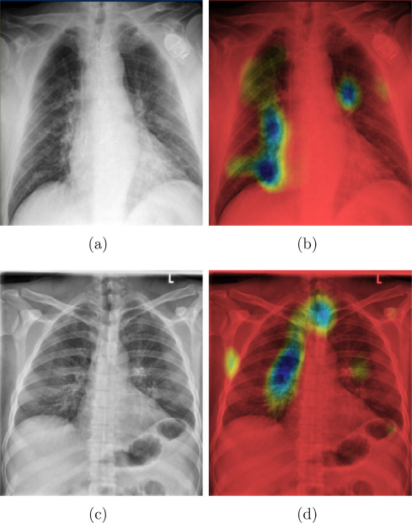
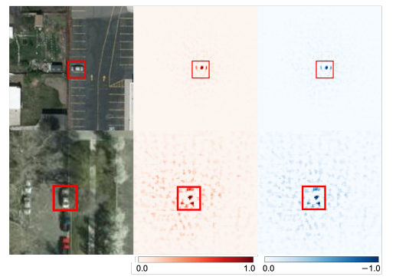
Grad-CAM and SHAP applications
There are numerous applications of the models seen.
Fields range from analysis of medical imagery, satellite data and much more.
H.Panwar et al. A deep learning and grad-CAM based color visualization approach for fast detection of COVID-19 cases using chest X-ray and CT-Scan images, 2020
H Kawauchi et al. SHAP-Based Interpretable Object Detection Method for Satellite Imagery, 2022
32

Slide 33
Application on VGG16Model

Slide 34
VGG16 model
VGG16 is a type of CNN (Convolutional Neural Network) that is considered to be one of the best computer vision models to date.
VGG16 is able to classify 1000 images of 1000 different categories with 92.7% accuracy. It is one of the popular algorithms for image classification and is easy to use with transfer learning.
34

Slide 35
DEMO

Slide 36
Grad-CAM vs SHAP?
Grad-CAM and SHAP are different explainable methods:
Grad-CAM:
Based on Feature maps
Consider only positive gradients.
Applicable only on CNNs.
SHAP:
Pixel based.
Give explanation of how the value of the feature influenced the prediction.
Applicable on several models.
In conclusion, which is better?
The best way is to consider the consensus method.
If not possible, consider to use the most reasonable one.
36

Slide 37
Conclusions
In summary:
The development of increasingly efficient algorithms that are difficult to interpret;
The increasingly frequent use of artificial intelligence models in various areas, especially in the medical field;
The recent rules that regulate the use of personal data for economic purposes;
It is essential to consider the role of explainability
In this presentation we have presented models of XAI applied to images, but of course there are many other applications for tabular data.
The soil is very fertile for the development of interpretable models.
37

Slide 38
Thanks for your attention
Questions?

Slide 39
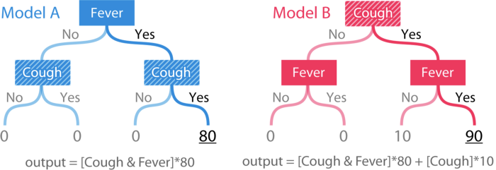
What about consistency?
The output of the models is a risk score based on a person’s symptoms. Model A is just a simple “and” function for the binary features fever and cough. Model B is the same function but with +10 whenever cough is yes.Cough is clearly more important in model B than model A.
39

Slide 40
What about consistency?
A widely used method as gini importance can lead to such clear inconsistency results.
Assume that 25% of our data set falls into each leaf, and that the datasets for each model have labels that exactly match the output of the models. This is the error from the constant mean prediction of 20.
After splitting on fever in model A the MSE drops to 800, so the gain method attributes this drop of 400 to the fever feature.
Splitting again on the cough feature then leads to an MSE of 0, and the gain method attributes this drop of 800 to the cough feature.
In model B the same process leads to an importance of 800 assigned to the fever feature and 625 to the cough feature.
40

Slide 41
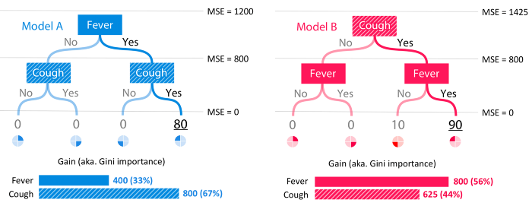
What about consistency?
Features near the root of the tree to be more important than features split on near the leaves.
When cough becomes more important its attributed importance drops.
41

Slide 42
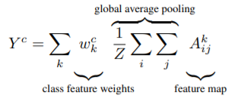
Grad-CAM is a generalization of CAM (proof)
From the expression of $Y_{c}$:
Let’s call:
Partial derivating we get:
Generalization of CAM
42

Slide 43
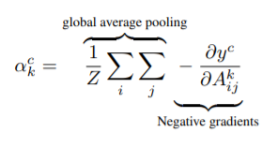
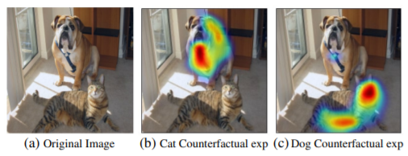
Another use of Grad-CAM
Counterfactual Explanations:
The network can be made to change its predictions by negating the gradient of $y_{c}$ with respect to feature maps $A^{k}$of a convolutional layer.
Thus, the importance weights now become:
43

Slide 44
Grad-CAM vs Shap-CAM
44

