Slide 1
EVM Earned Value Management and relationship to the RLS Resource Loaded Schedule

Slide 2
These slides contain a “quick” introduction. I apologize in advance if the slides contain statements or definitions or explanations which seem overly simple or obvious. It is not meant to be a comment on anyone’s level of understanding. We have seen in DarkSide mgmt meetings and in meetings with the Forti committee that seemingly simple labels like “cost” and “budget” can lead to extended discussion on exactly what these labels mean in a specific context.
All explanations of earned value that one finds online or in books begin simple, stating the definitions as the concepts are introduced, and then touch upon more complex details.

Slide 3
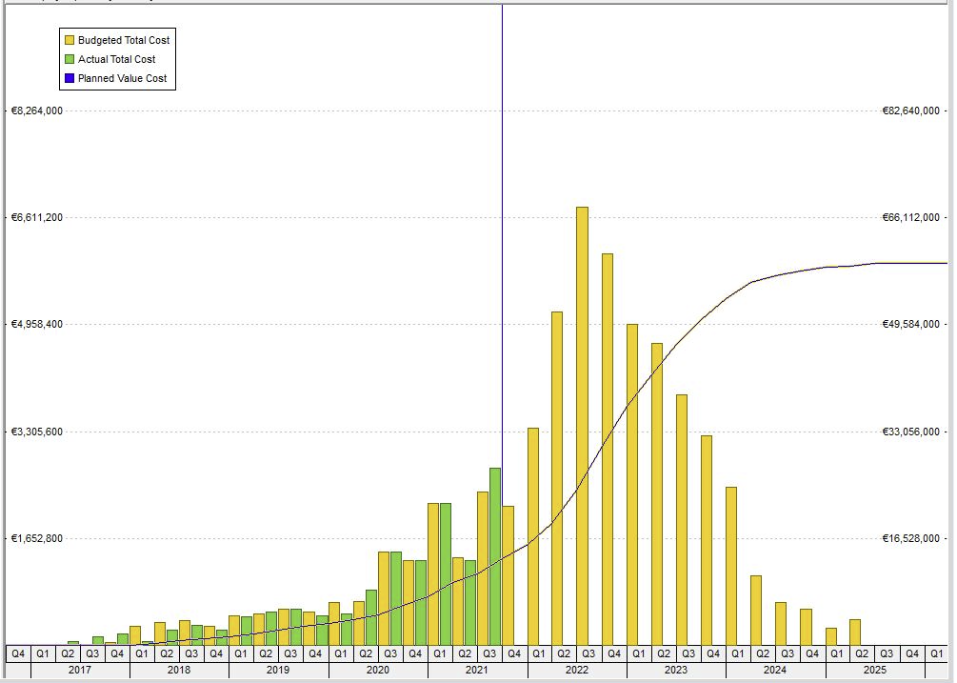
RLS → Costs vs Time
We have a plan for building a detector. It consists of many linked activities which design, procure, fabricate, assemble and install the components which come together to make the detector.
A schedule tells us the timeline of this plan, showing when we plan the activities to happen.
A Cost Book (or similar spreadsheet) lists the costs for the materials and manpower needed to execute the activities in the schedule plan.
A Resource Loaded Schedule combines the schedule plan and costs/resources, displaying the time-dependence of costs.
For DarkSide-20k, the full plan for “building the detector” includes the detector development phase, going back to 2017, and includes work towards Aria and Urania starting from 2016 when INFN funding for these was started. Therefore the Plan Start date in the RLS is January 2016.
Activity planned cost
Activity planned schedule
The graph shows the typical format for displaying the time-dependence of costs.
The vertical bars provide the costs within a specific time unit - - costs per quarter year for example, or costs per month.
The (thin) line which rises from left to right shows the cumulative cost over time. It generally has this “S” shape for a design + fabricate + install project. The right side of the S-curve plateaus at the value of the total cost when all the activities are completed.
The graph is created using DS-20k RLS data, however it is the SHAPE of the data and not the absolute values which are the point in this discussion. So apologies for unreadable axis values but the values are not relevant.
Cost vs time
Time
per unit time on one axis
and cumulative cost on the other axis
Cost

Slide 4
RLS → Costs vs Time → Value which is Earned
Cost vs time
Earned Value is the name of a process used to analyze the cost and schedule performance of a project - - analyze both of those together, because they are tied together in the RLS.
The total cost can also be labeled as the total value of your project.
Each activity cost provides a piece of that total value.
When an activity is completed, the cost value of the activity has been earned – meaning the incremental cost value is added to the accumulating total value.
Time
Total planned value
Cost
50% value
Date when 50% value is planned to be reached
Again, it is SHAPE being emphasized for this example, not the precise values
This is the origin of the Earned Value name. As activities complete, their value is earned.
The S curve of the planned cumulative cost value over time provides a prediction: at a certain date, the completed activities are planned to accumulate a predicted value.

Slide 5
RLS → Costs vs Time → Value which is Earned
Cost vs time
The S curves of the cumulative cost value over time provide a prediction: at a certain date, the completed activities will have accumulated a predicted value.
There are actually three S curves which are used in EV analysis.
The one shown in the graph at right is the baseline Planned Value.
The RLS cost (value) assigned to each activity is the budgeted cost in the baseline plan. The time required to complete each activity is the schedule baseline plan.
Time
Total planned value
Cost
50% value
Date when 50% value is planned to be reached
At regular intervals we request status progress of current activities from all WBS managers. The status data says which activities have completed, and which are still in progress, at the date when current status is requested. Completed activities earn their value – a euro value – and they earn it at the status date.
We get a second S curve – the cumulative value of the completed work (activities) versus the date when the work (the activity) completed. This curve represents the work accomplished == the value earned, versus time
The third S curve comes from accounting, and not from the RLS. It is the Actual Cost as of the same status date.
We get the Actual Costs from all the institutions which are spending the funds : purchasing parts, paying personnel, setting up contracts with vendors, etc.

Slide 6
Three S curves in Earned Value
The graph below is a simple illustration of the three S curves used in Earned Value.
The Planned Work curve is the Baseline Plan from the RLS.
The status date is a date in the recent past, when status data was most recently collected from all Managers.
The purple EV curve is the collective earned value from all the activities completed by the status date, as reported by Managers.
The red AC curve is the accumulated spent funds, which is data obtained from our various accounting sources.
There are important accounting facts which should become clear at this point:
>> Actual Costs are known only after purchases and contracts have been paid for.
>> Activities earn their value when they are completed, not when they are started.
>> The finish dates of planned activities – those with costs assigned - correspond to the date when the funds are spent or paid out, not when funds are committed.
>> In cases where funds must be committed (obligated) before work can start (e.g. a vendor contract) then the planned start date cannot be before funds are committed (in general, the start date for such activities corresponds to the date the vendor contract is signed)

Slide 7
Standard EV metrics
Here is a more standard illustration of the three S curves, along with the typical earned value “metrics” calculated using the three S curves: cost and schedule variance (how much deviation from the baseline plan) and the Estimate at Completion (a projection of the current trend).
The diagram becomes more complicated very quickly – which is why you try to start simple and work up to this.
Corrective actions can be taken to align the purple, red and green curves if these diverge. There are multiple options. Management can redirect existing resources to bring the purple and red curves into alignment with the green curve. Or the green curve can be modified – change the baseline – to reflect the reality of the purple and red curves. Additional funds can be requested to cover projected cost overruns. Or work scope can be reduced, reducing the projected cost overruns; this means, again, modifying the green planned curve.
The point of Earned Value is to identify trends so that course corrections can be performed as needed. The Actual and Earned curves must be updated regularly so that trends are exposed in a timely way.

Slide 8
Is it cost or budget?
In the committee reviews, there was some discussion of what the word “budget” refers to – it is cost estimates, or the funds requested, or the funds received? For me, there was an additional element missing in the discussion which is also important to define – something which we call obligation cost, maybe also called commitments.
All those words define specific aspects of accounting. The question is not “do you label this cost or budget?”. Both are used, and they refer to specific aspects of the accounting process.
Costs, budget, funding, obligations can all have dates associated with them – a single Activity (for example, an activity which purchases and fabricates a part for the detector) can have a cost estimate, a budget, funding, an obligation cost and finally an actual cost. Each of those terms used by the accounting process and each is applied at different time periods during the Activity. Which means this one Activity can have a date when funding for it was requested, which is different from the date when the budget was assigned, which is different from the date when the cost was obligated, which is different from the date when an invoice is paid.
The dates for the Activity in the RLS correspond to when the work is performed – the work start and the work finish. The Activity Start date is not, typically, the date when funding is requested or when funding is received.

