Slide 1
DART WARS Periodic Report Josephson Travelling Wave Parametric Amplifiers
Emanuele ENRICO

Slide 2
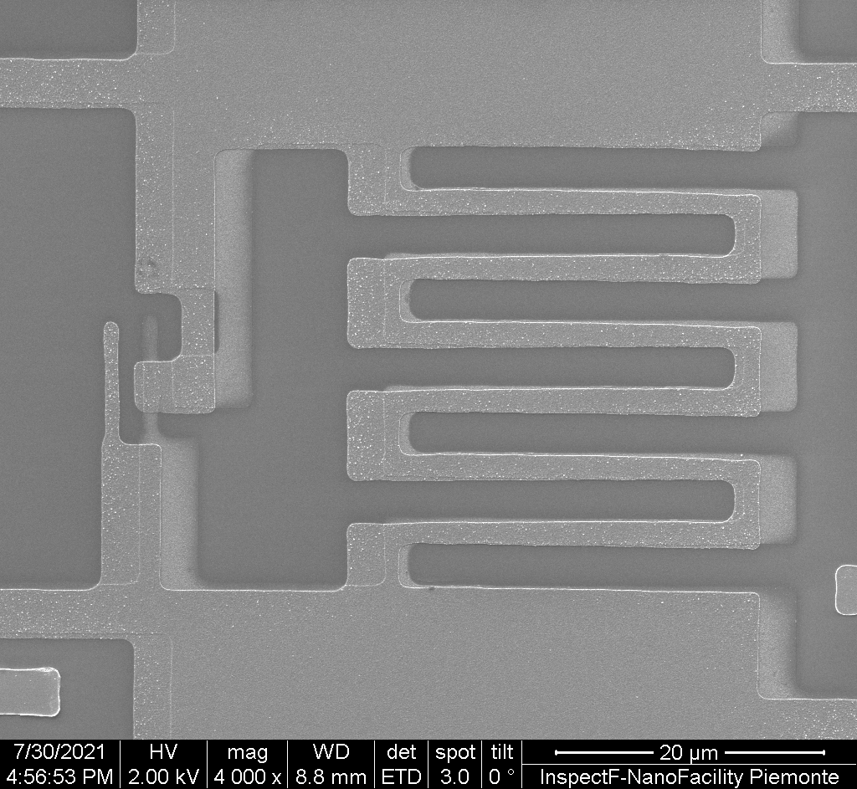
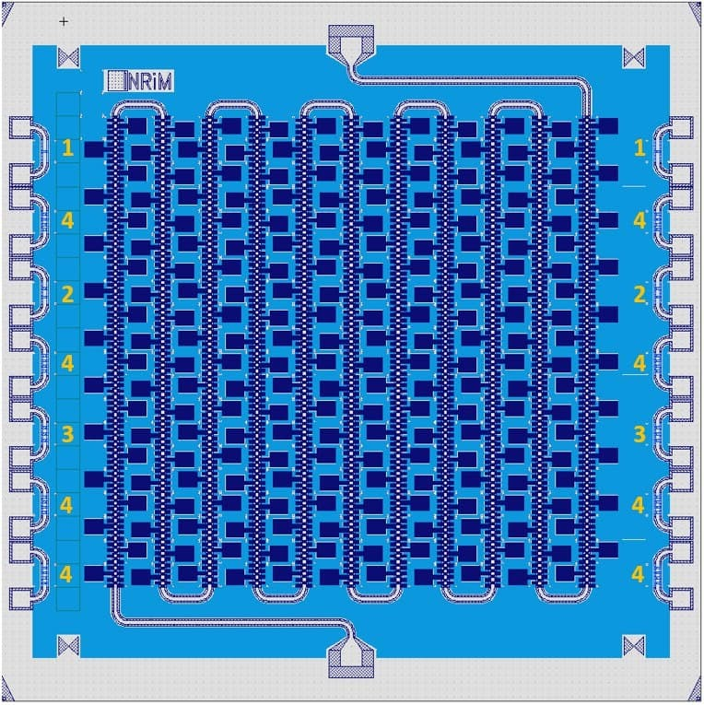
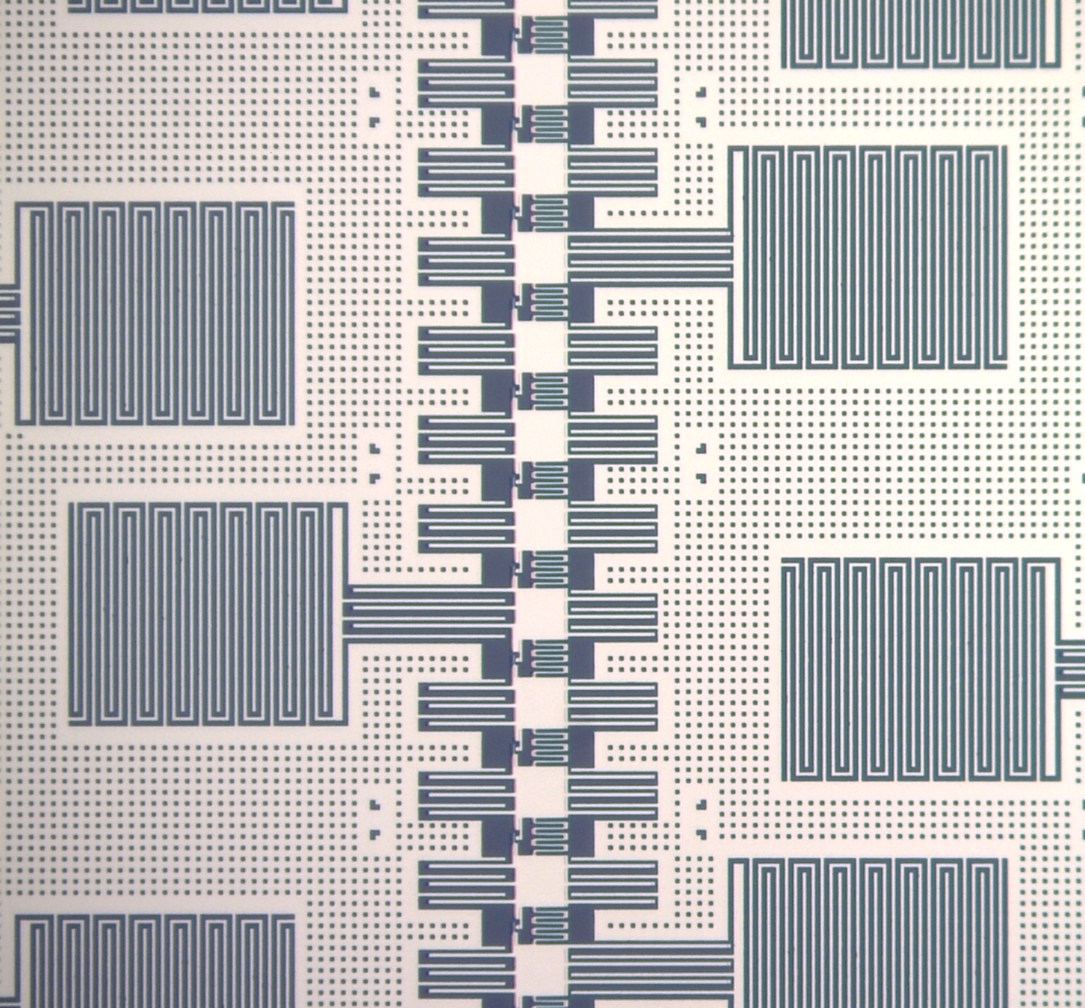
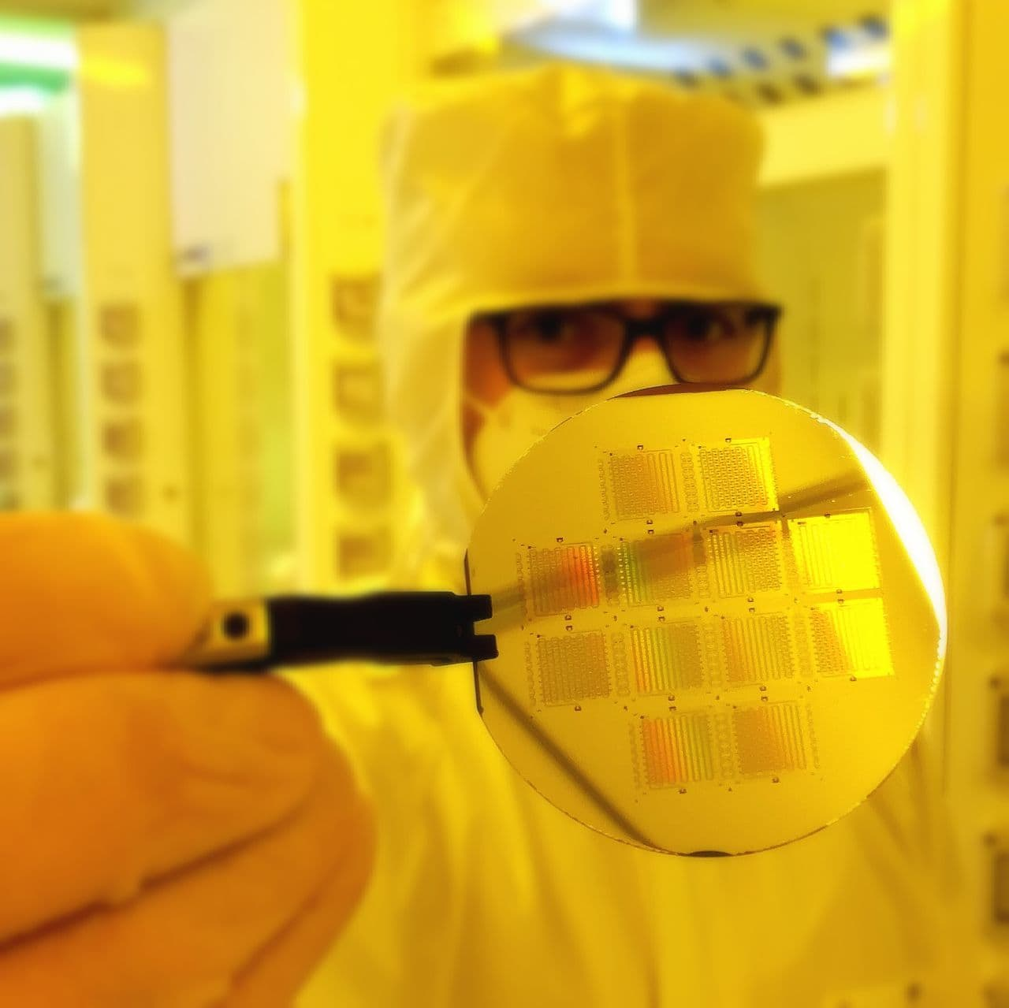
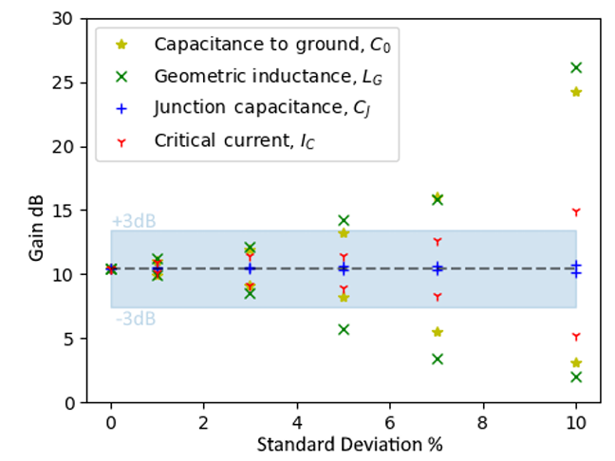
JTWPA based on RF-SQUID
2
JTWPAs (2nd gen) based on UV litho for small-scale prototypical production
Josephson
junction
Josephson Junction spread of parameters deeply affect the amplifiers performances and due to the exponential dependance of its properties, Josephson tunnel junctions are the bottleneck of the whole device
from: The Effect of Parameter Variations on the Performance of the Josephson Travelling Wave Parametric Amplifiers, https://arxiv.org/abs/2112.07766
DART WARS Periodic Report – Emanuele ENRICO – 09/09/2022

Slide 3
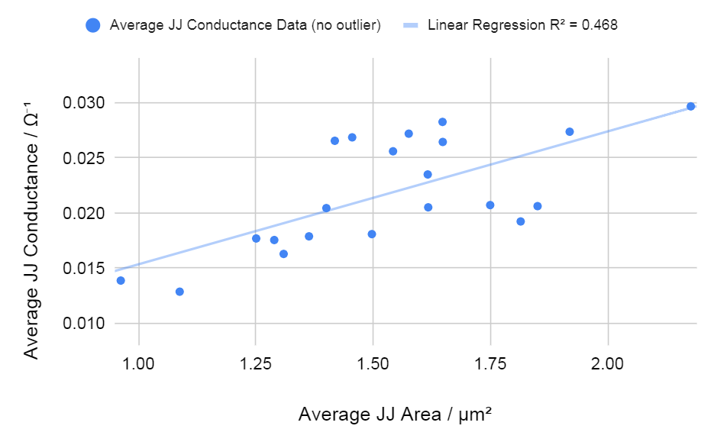
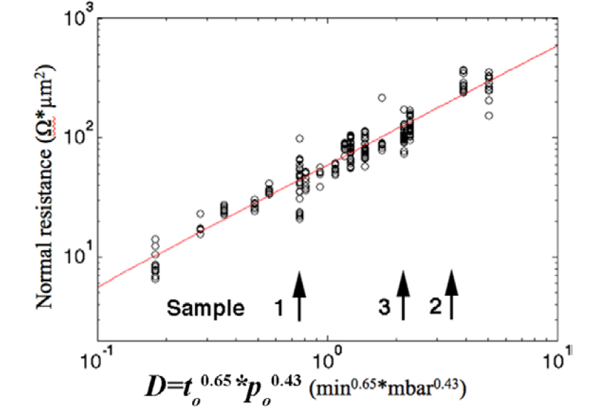
Josephson Junctions - area/oxidation interplay
2
Calibration points following the model presented in
L J Zeng et al 2015 J. Phys. D: Appl. Phys. 48 395308)
INRiM ID15 - Area vs. Conductance correlation
INRiM ID20_Q3
JTWPA TARGET
(DARTWARS)
INRiM ID15
INRiM ID11
INRiM ID15
JTWPA17
INRiM ID5
Run to run predictability and repeatability
On-Wafer reproducibility and homogeneity
DART WARS Periodic Report – Emanuele ENRICO – 09/09/2022

Slide 4
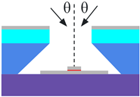
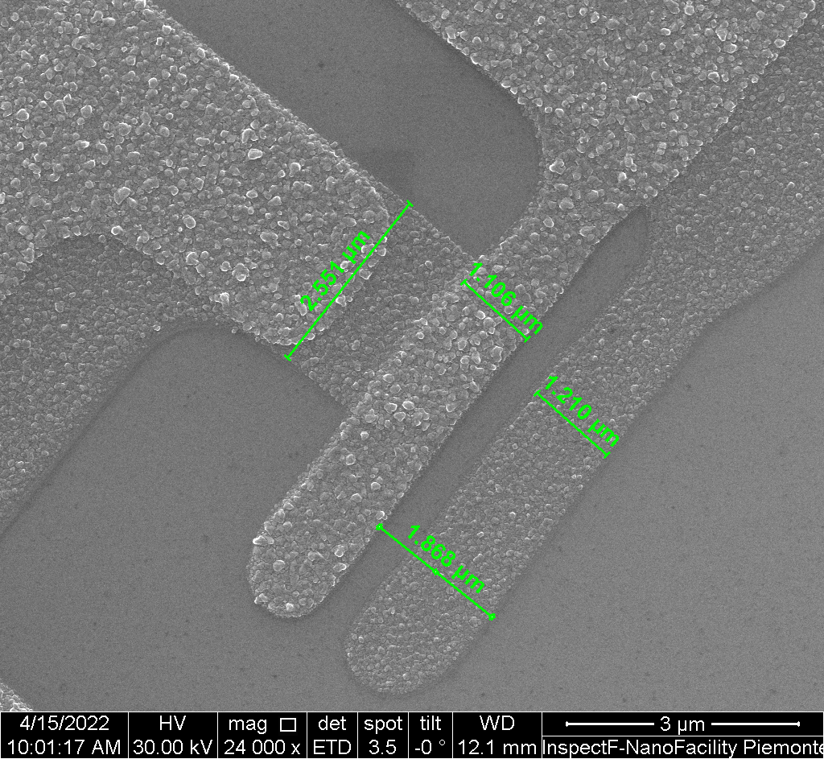
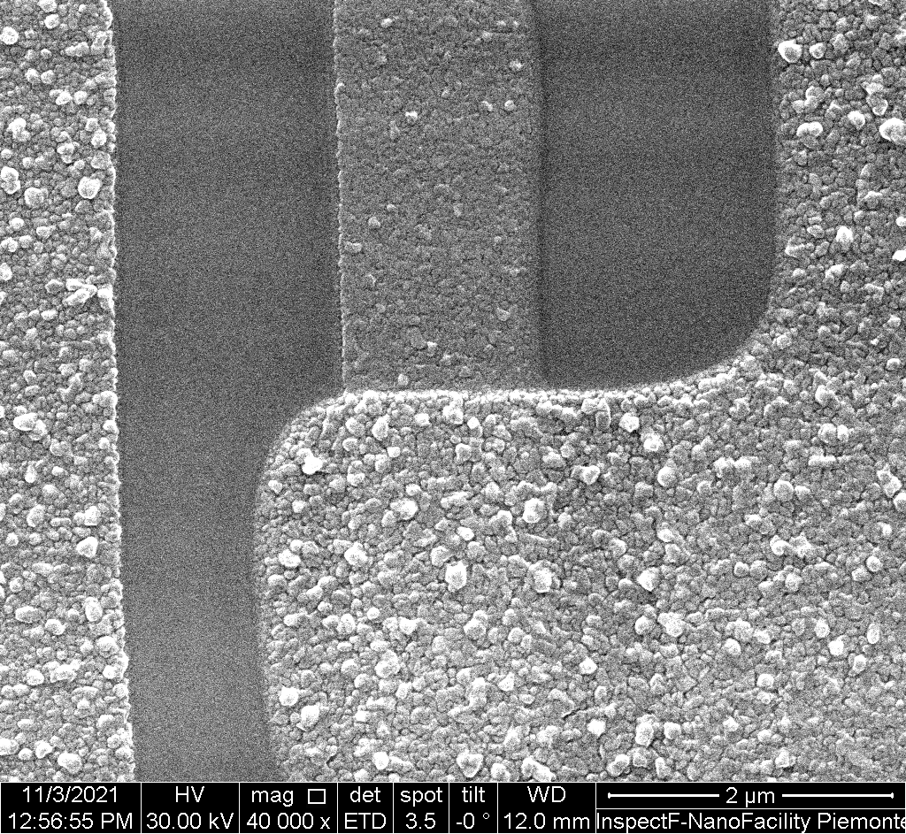
Josephson Junctions - layout and grain-size optimization
2
Increased Dolan (shadow mask) bridge size guarantee mechanical stability and straight JJ edges resulting in greater area reproducibility
(Junction area 3 um² -> C_{J} 150 fF -> RF-SQUID plasma frequency reject second(third) harmonic generation spurious tones)
Increased deposition rate guarantees reduces hillocks formation and reduces roughness of the bottom layer (base electrode for the JJs)
DART WARS Periodic Report – Emanuele ENRICO – 09/09/2022

Slide 5
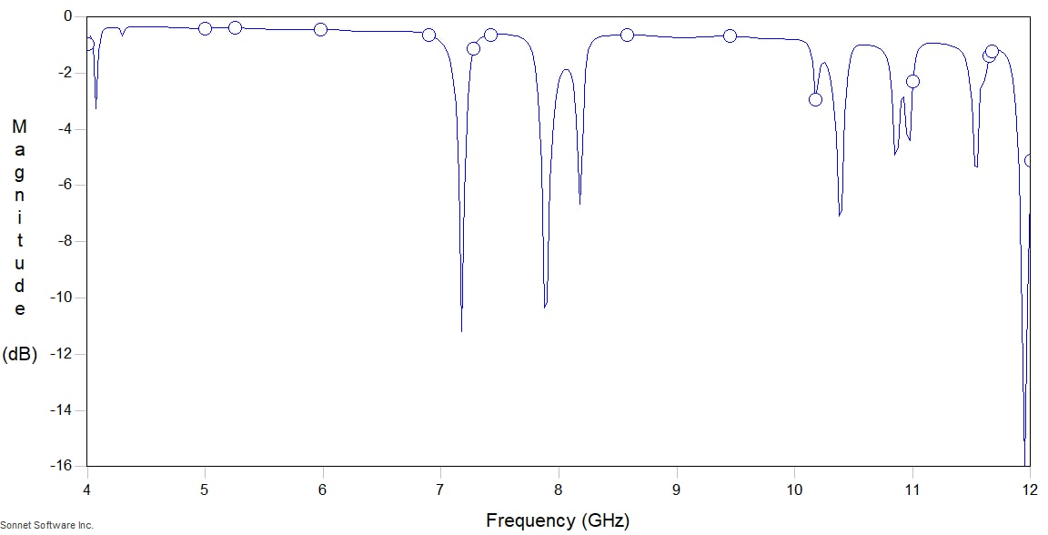
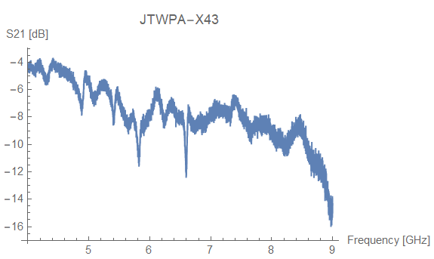
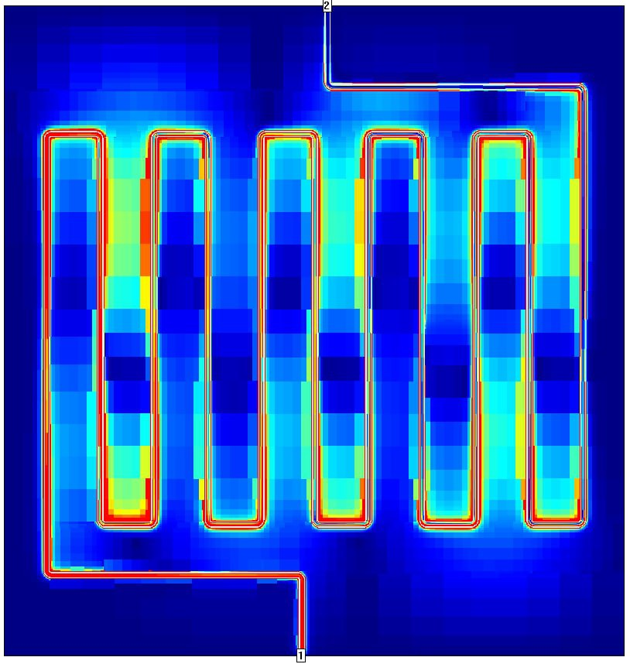
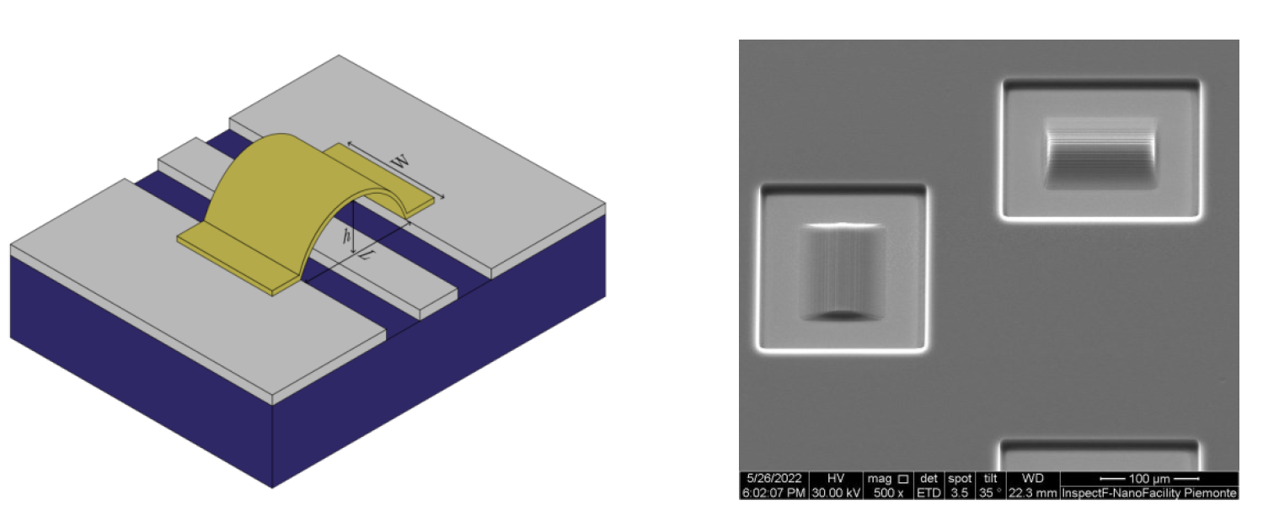
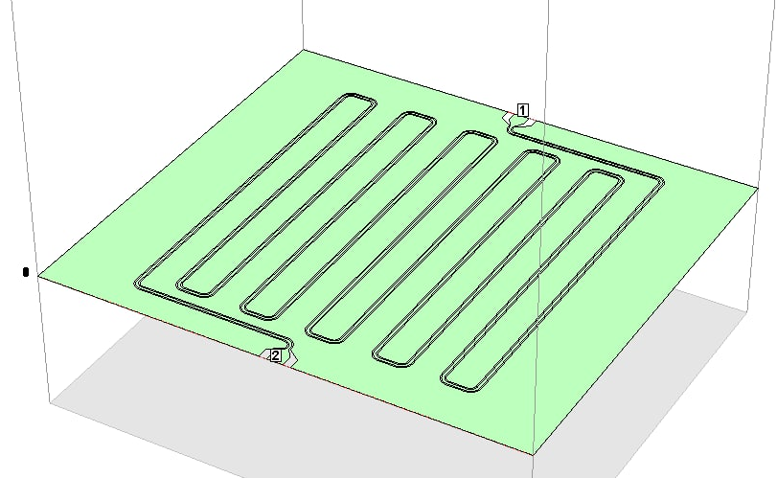
Slotline modes rejection:
suspended bridges
2
Experimental transmission properties (VNA @ 300 mK) show several dips in the amplifier band
Suspended bridges promote ground plane voltage uniformity rejecting slotline modes
3D suspended structure developed at INRiM via grayscale UV lithography compatible with Al-base Coplanar Wave Guides devices (eg. JTWPAs)
DART WARS Periodic Report – Emanuele ENRICO – 09/09/2022

Slide 6
JTWPA – Status and Future Plans
32
V
Fabrication of the first JTWPA generation based on standard (research-grade) technology
Definition of the Al-based Josephson junctions (prototypical-grade) technology (deposition and oxidation) at PiQuET lab (INRiM)
Design, fabrication and electrical/morphological characterization of test structures containing hundreds of Josephson junctions (JJ_TestArray_##) for the extrapolation of the run-to-to and chip-to-chip spread parameters
Design of the JTWPA second generation elementary cell from the junctions parameters
Development of a numerical model based on the node equations system for the a-priori quantification of the circuit parameter spread effects
Installation of a dry dilution refrigerator @INRiM with 600 uW of cooling power @ 100 mK for the in-house characterization of JTWPAs and Junctions (first cooling July 2022, fabrication speedup)
Fabrication of the second generation JTWPAs prototypes (currently in progress in INRiM)
In-house measurement of the second gen. Prototypes (october 2022)
Selected prototypes shipped to the consortium (november 2022)
Fine tuning of the fabrication parameters and startup of the third generation of JTWPAs with optimized cell (Josephson inductance replaces geometrical one for compactness) (end of 2022)
V
V
V
V
DART WARS Periodic Report – Emanuele ENRICO – 09/09/2022

