Slide 1
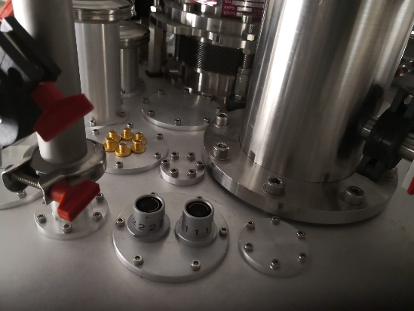
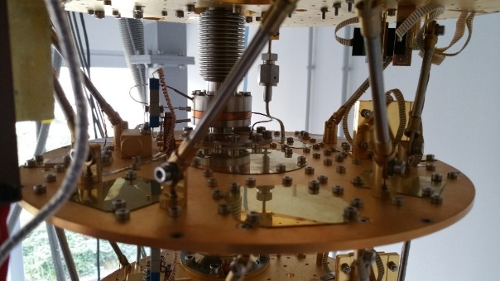
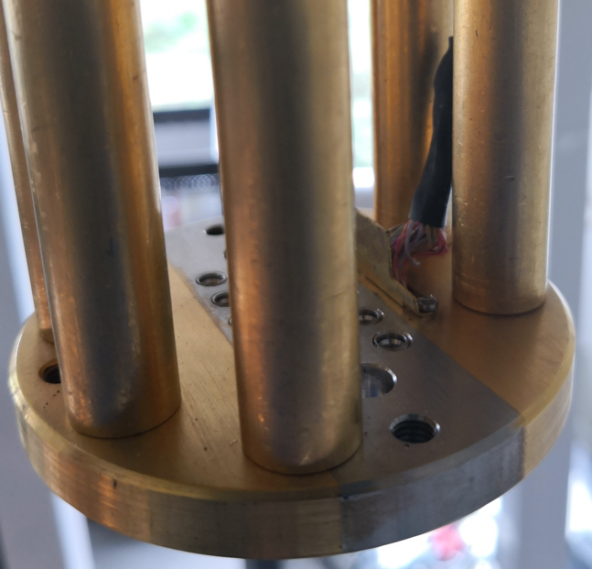
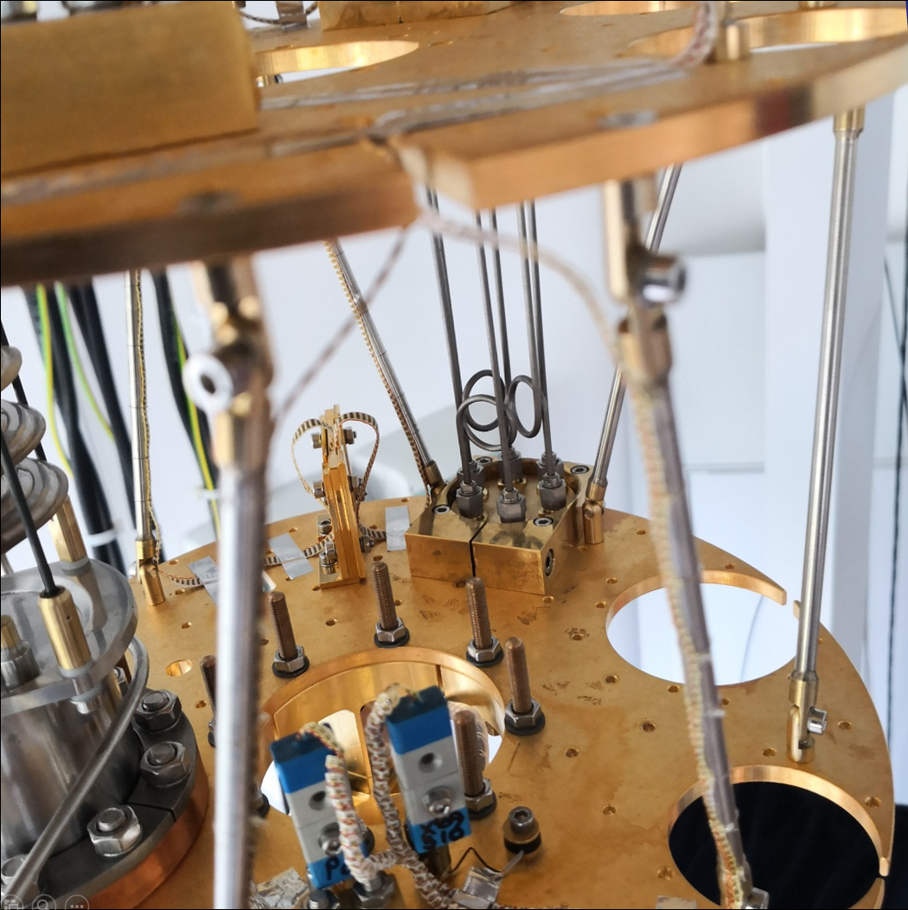
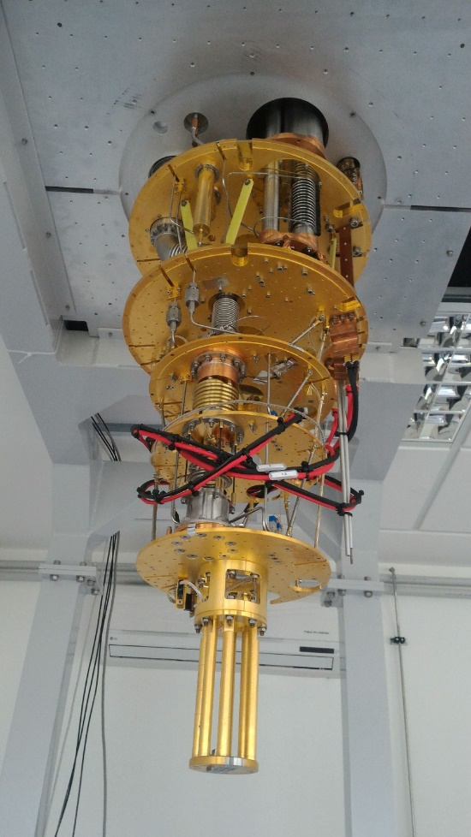
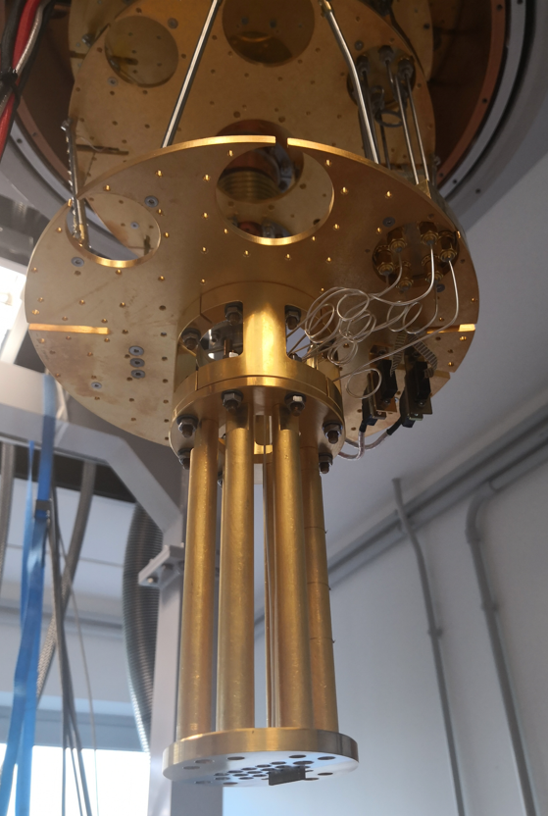
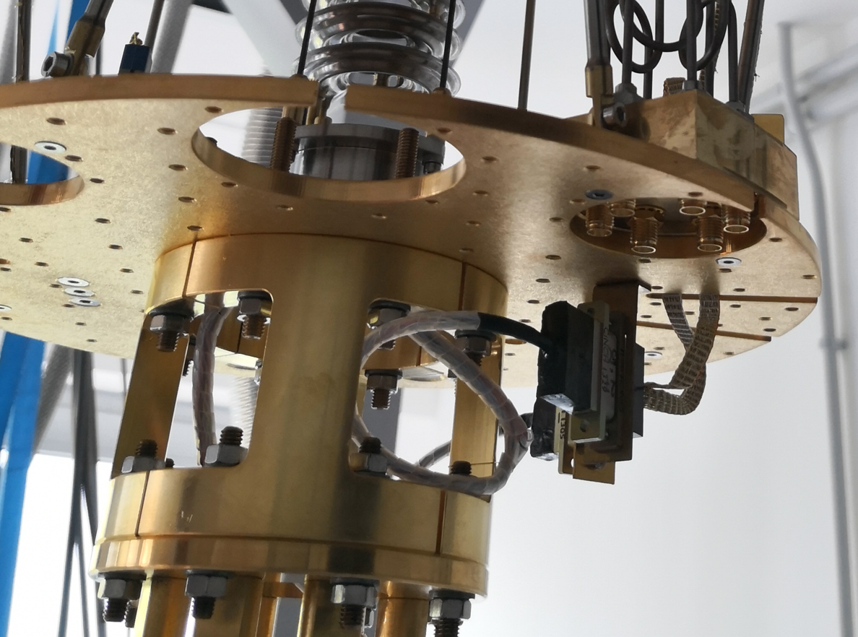
Dilution Fridge – 10 mK
Space for Cryo-amplilier
DC lines
RF lines
DC&RF
DC –Omn.
PCB Space
DC -USB
+adapt.

Slide 2
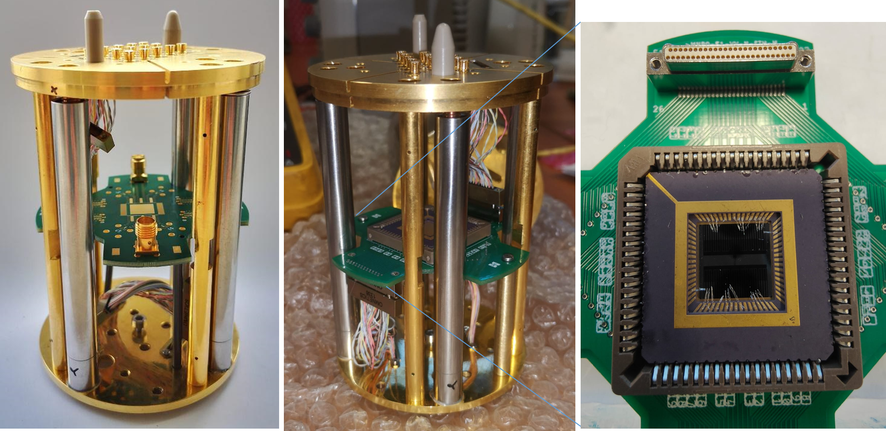

Slide 4
R5_3mV-4term
R5_3mV-4term-norm

Slide 5
L3-40mV-4term
L3-40mV-4term-norm

