Slide 1




Characterization of Josephson junctions for JTWPA at T = 0.3K
V. Granata°, C. Mauro°, C. Barone°, G. Carapella°, L. Fasolo*, E. Enrico* and S. Pagano° for the DARTWARS collaboration
°Physics Department, University of Salerno, Italy
*INRiM, Turin, Italy
INFN, Italy

Slide 2
Outline
Experimental setup
Samples description
Preliminary results
Conclusions and outlook

Slide 3
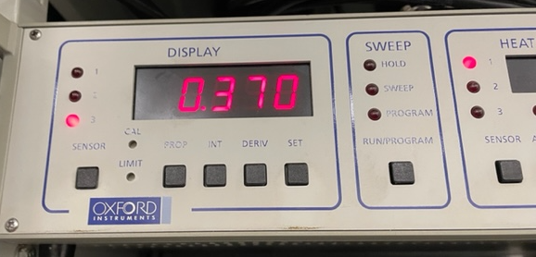
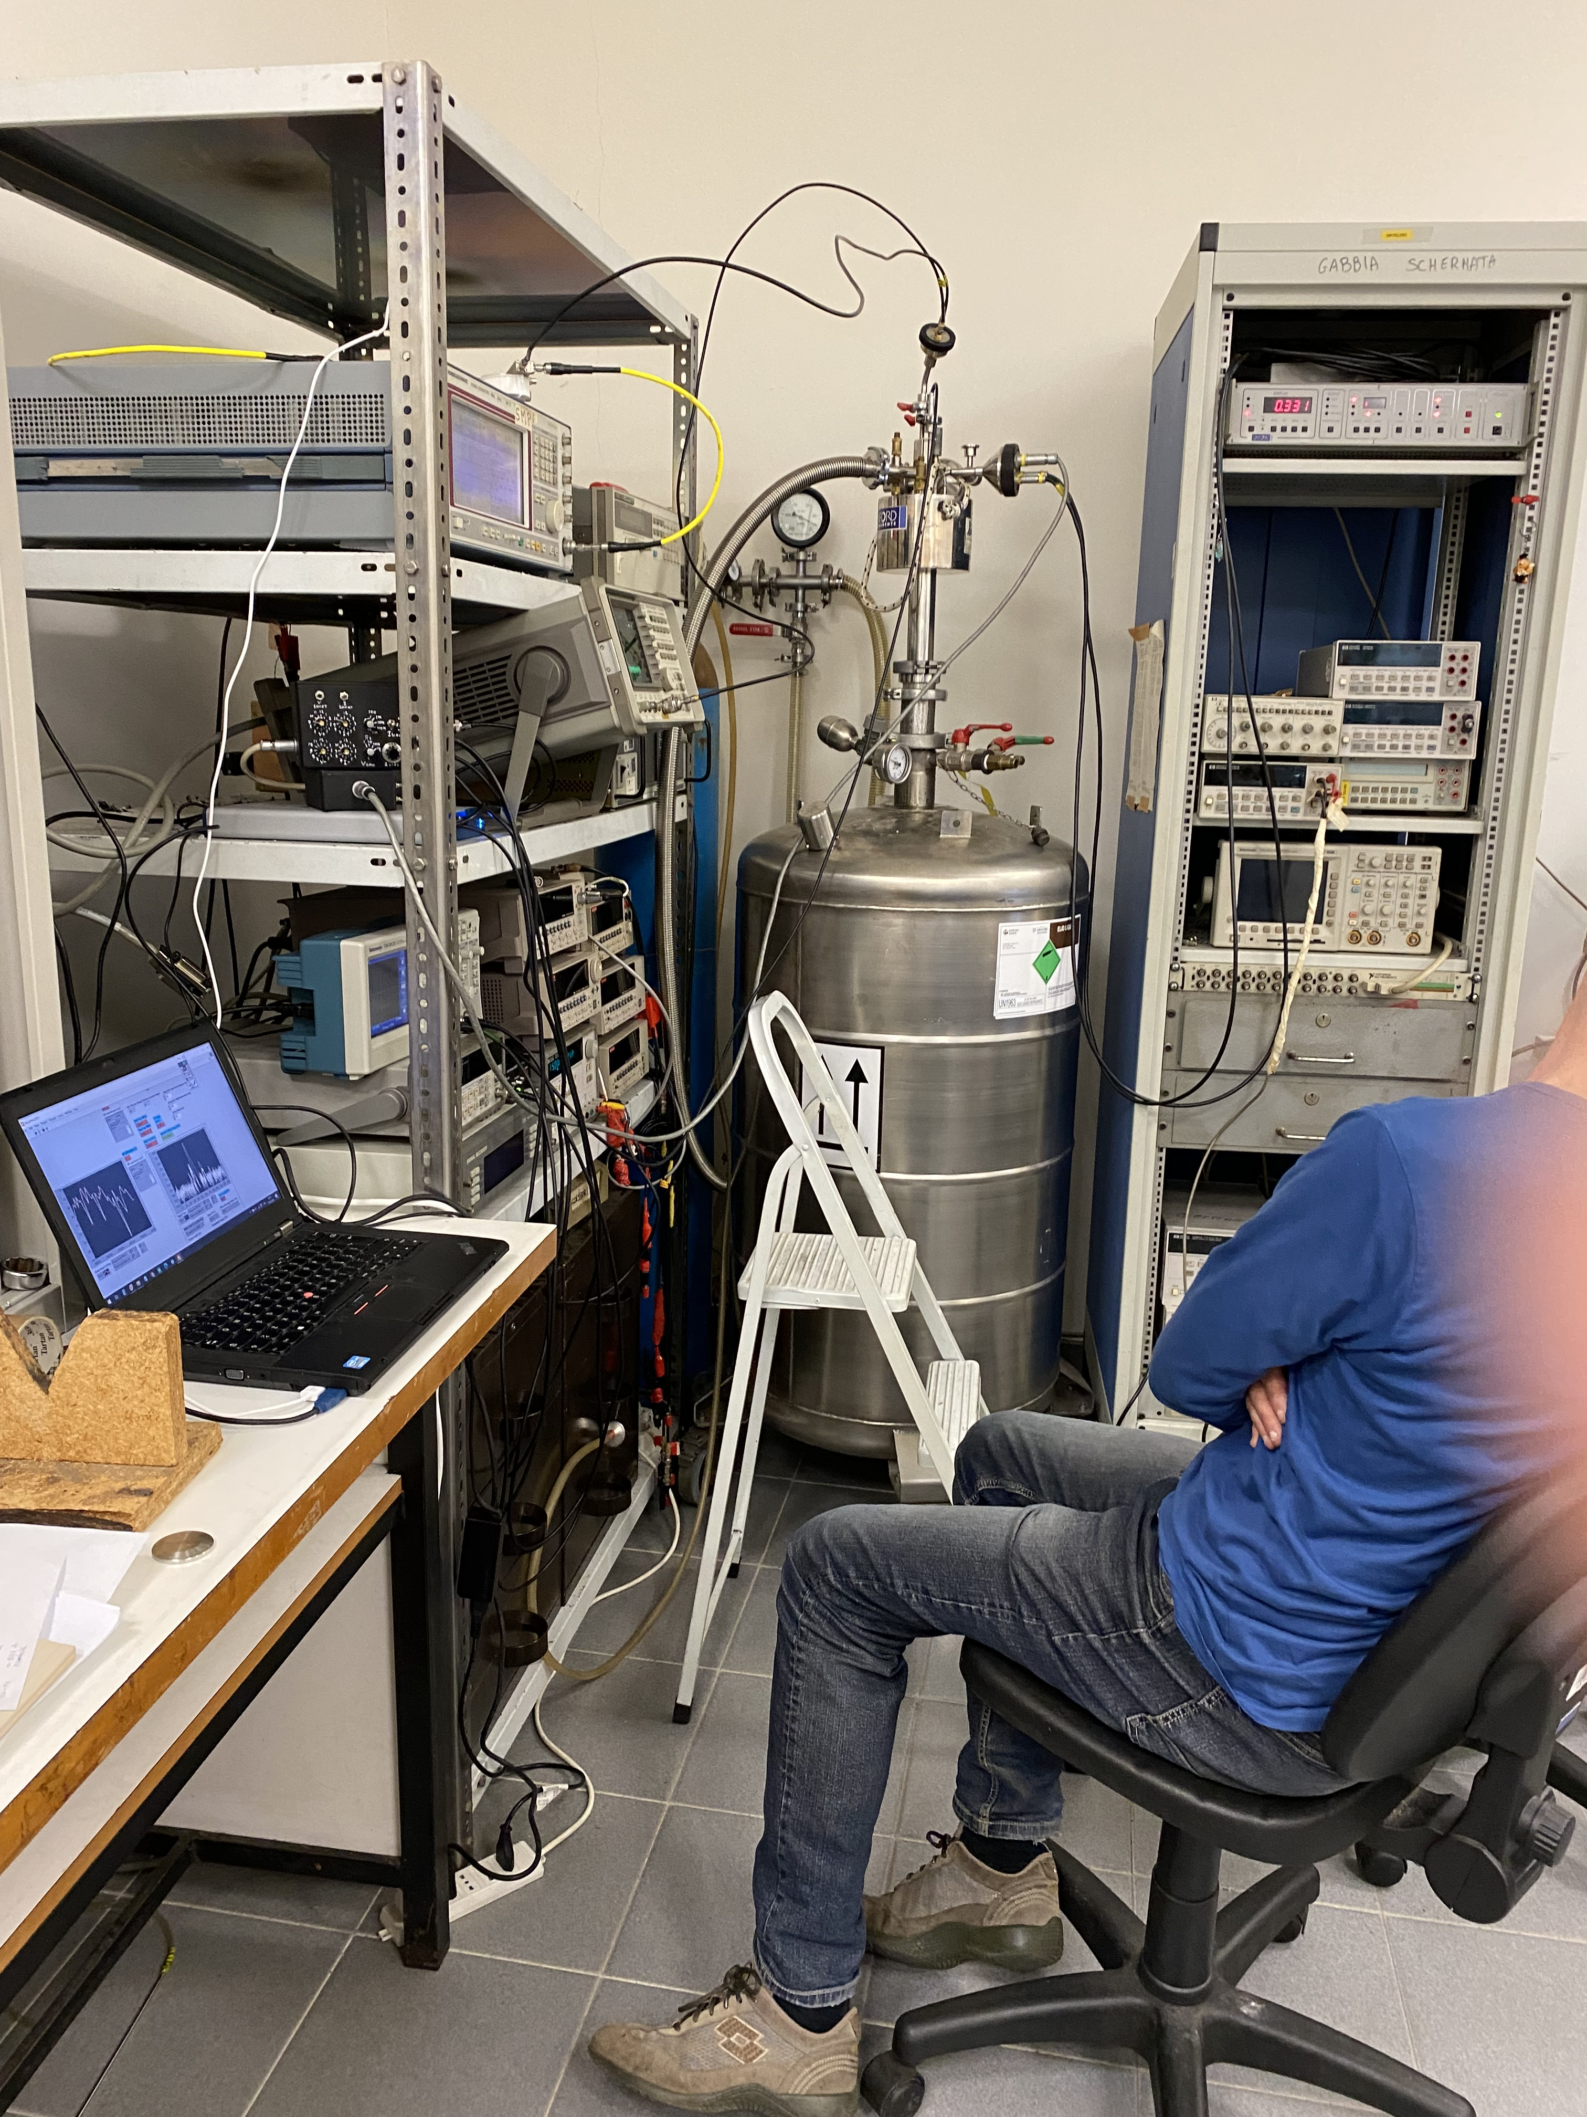
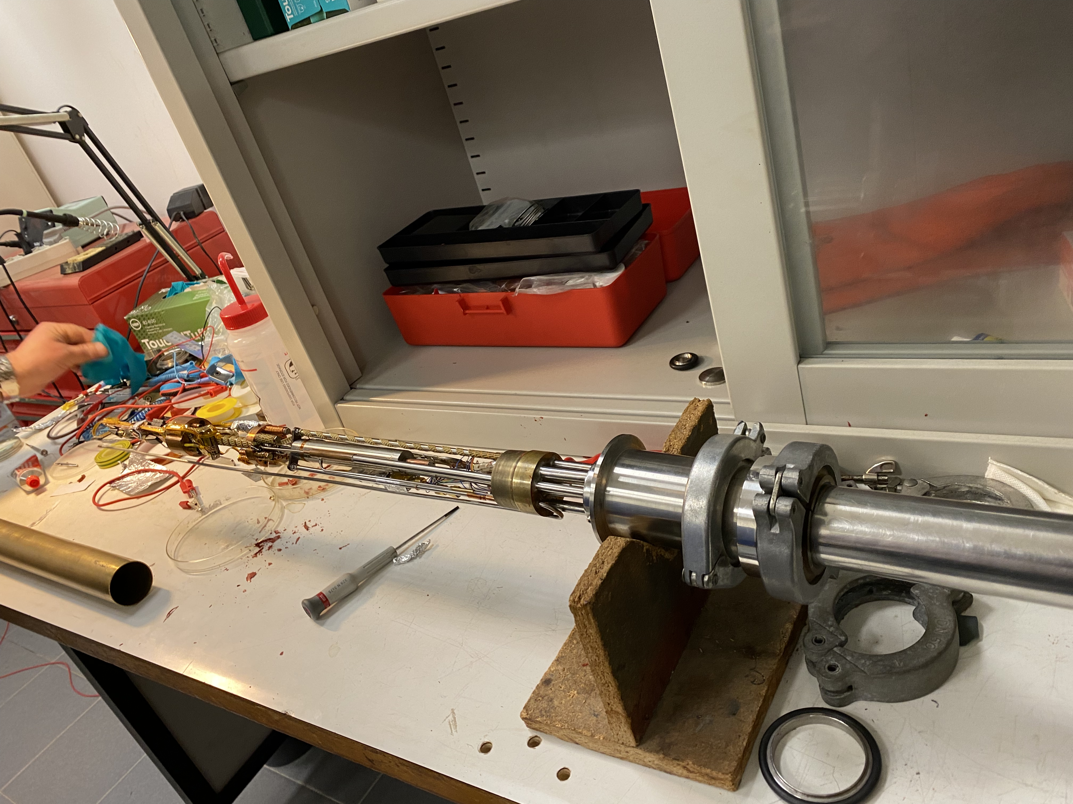
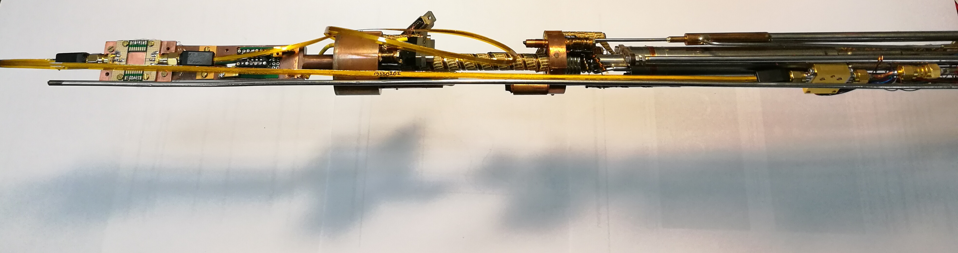
Cryogenic setup
Oxford Heliox VL ³He cryostat
Base T = 245mK Cooling Power = 40 μW at T < 290 mK
Hold time = several hours Recycle time = 1h
OK for testing Al based junctions
Needed adaptations for MW signals
shield
⁴He stage
Cryogenic
Amplifier @ 4.2K
Sample stage
³He stage
1K pot
RF in
RF out

Slide 4
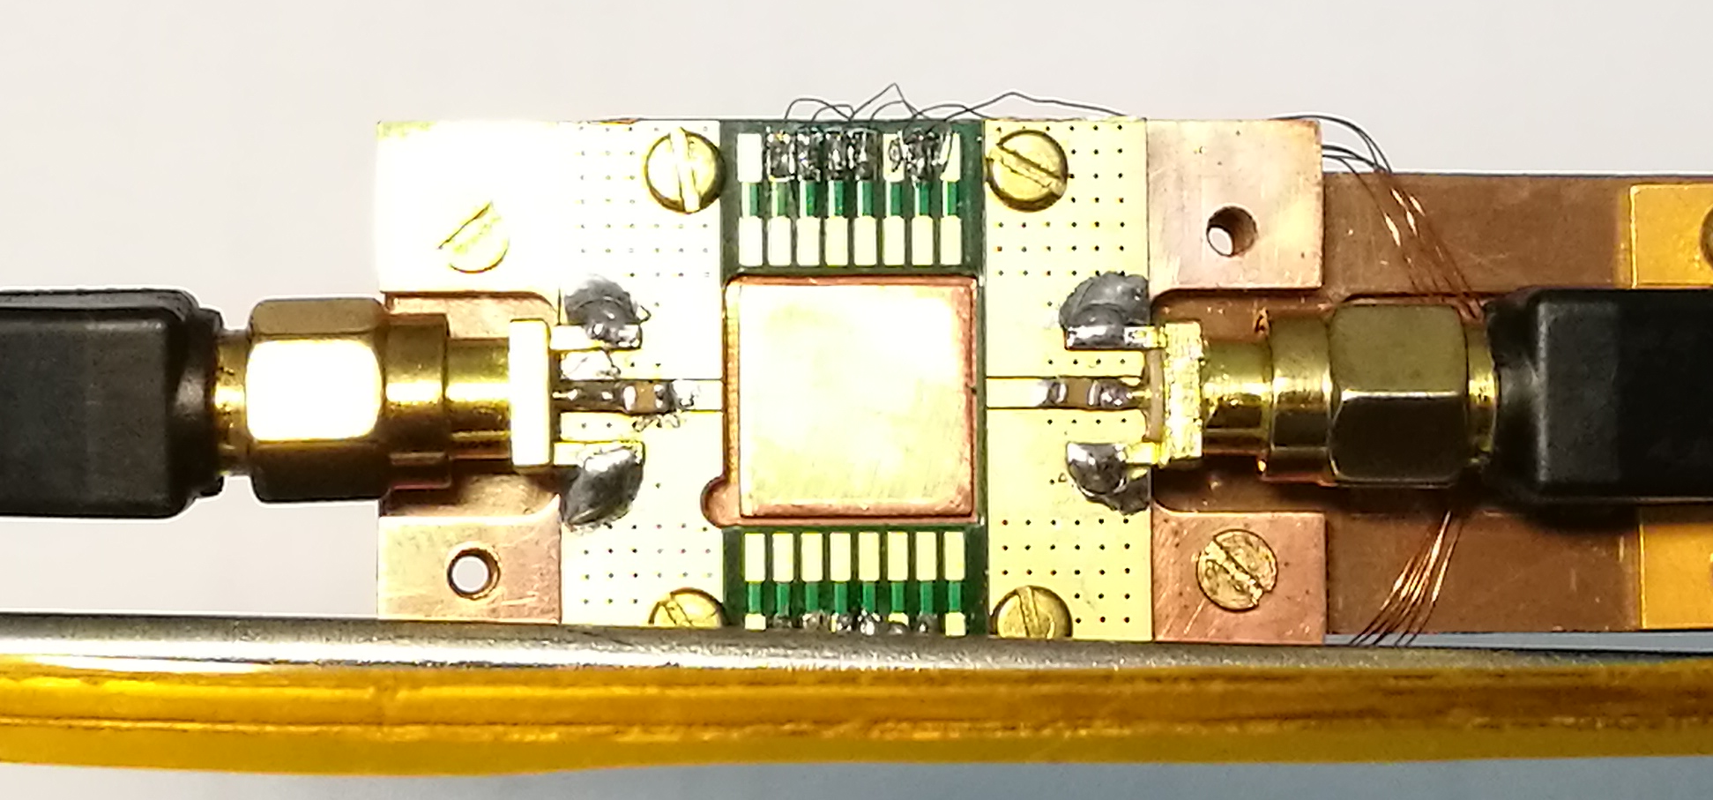
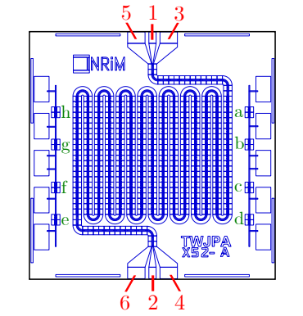
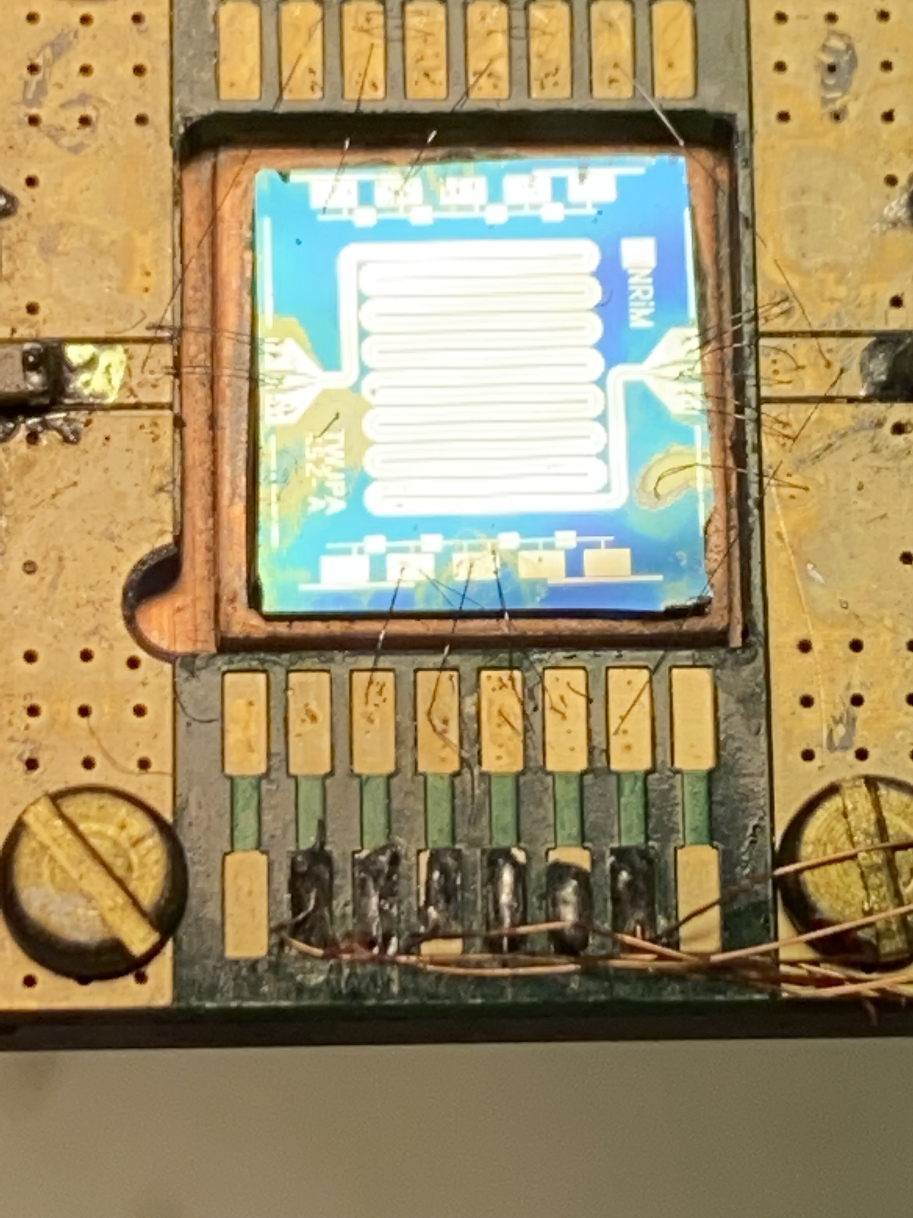
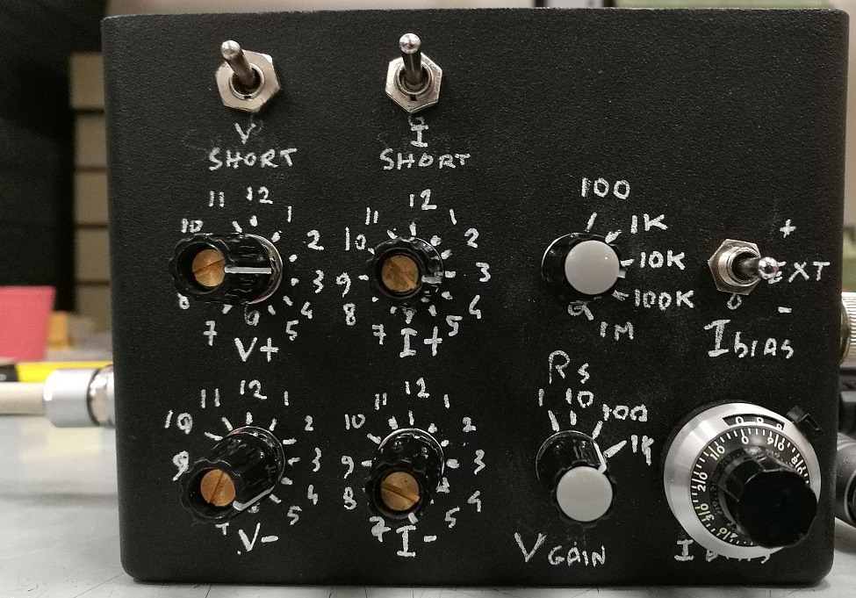
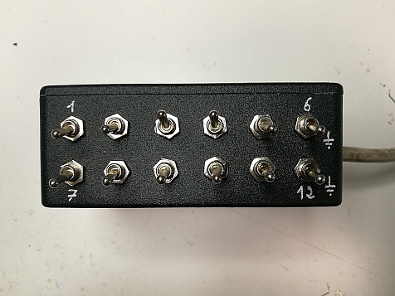
DC Setup
Sample holder
PC
TWJPA X52-A
Ultrasonic bonding
RF out
RF in
DAC/ADC
DC bias and JJ test lines
Filtering and grounding box
Low Noise DC readout

Slide 5
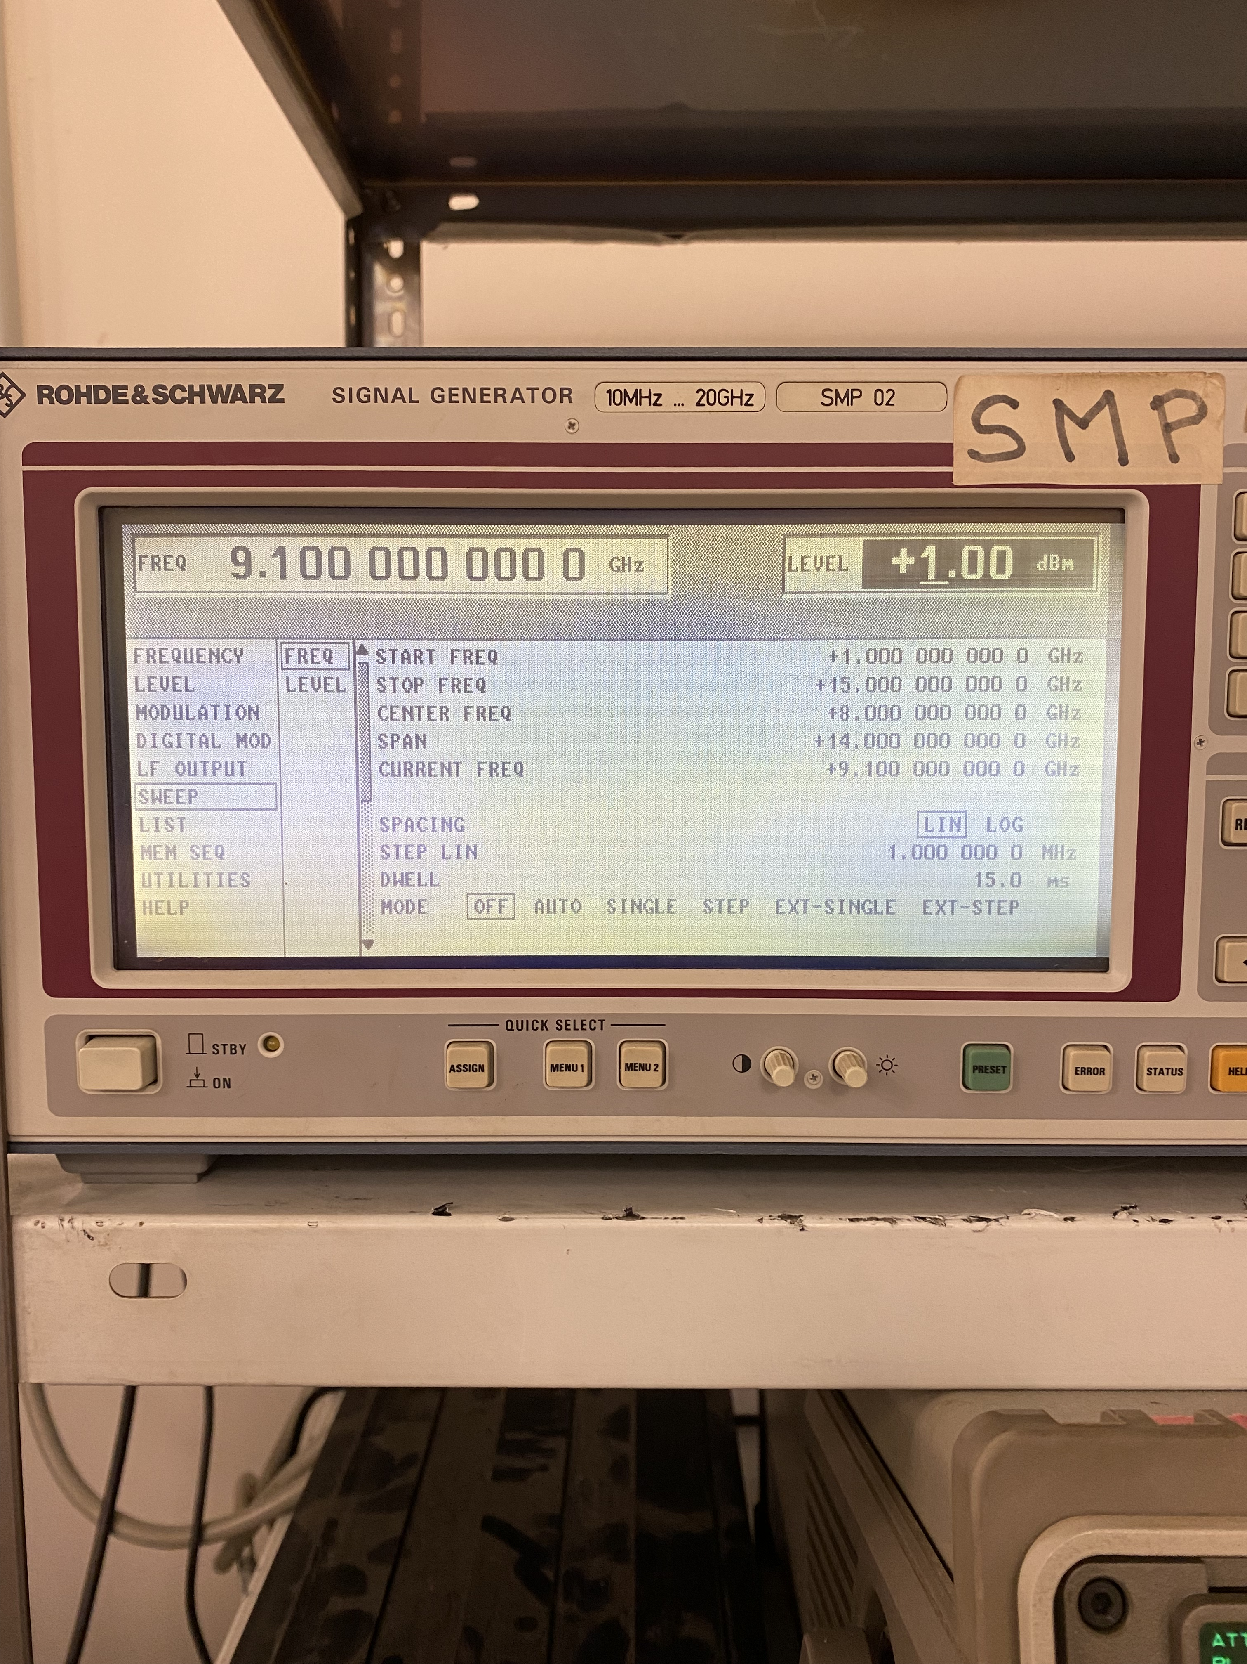
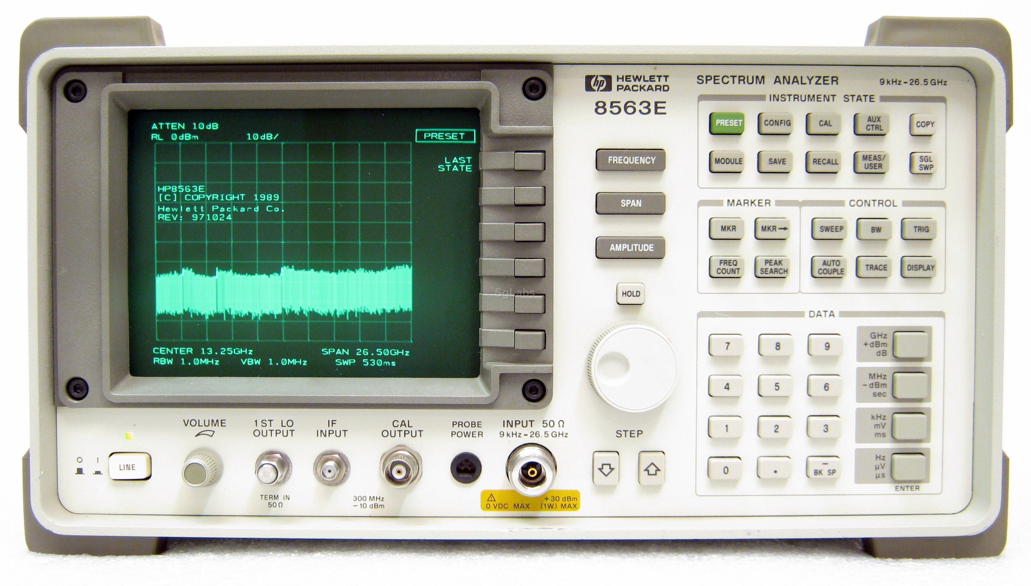
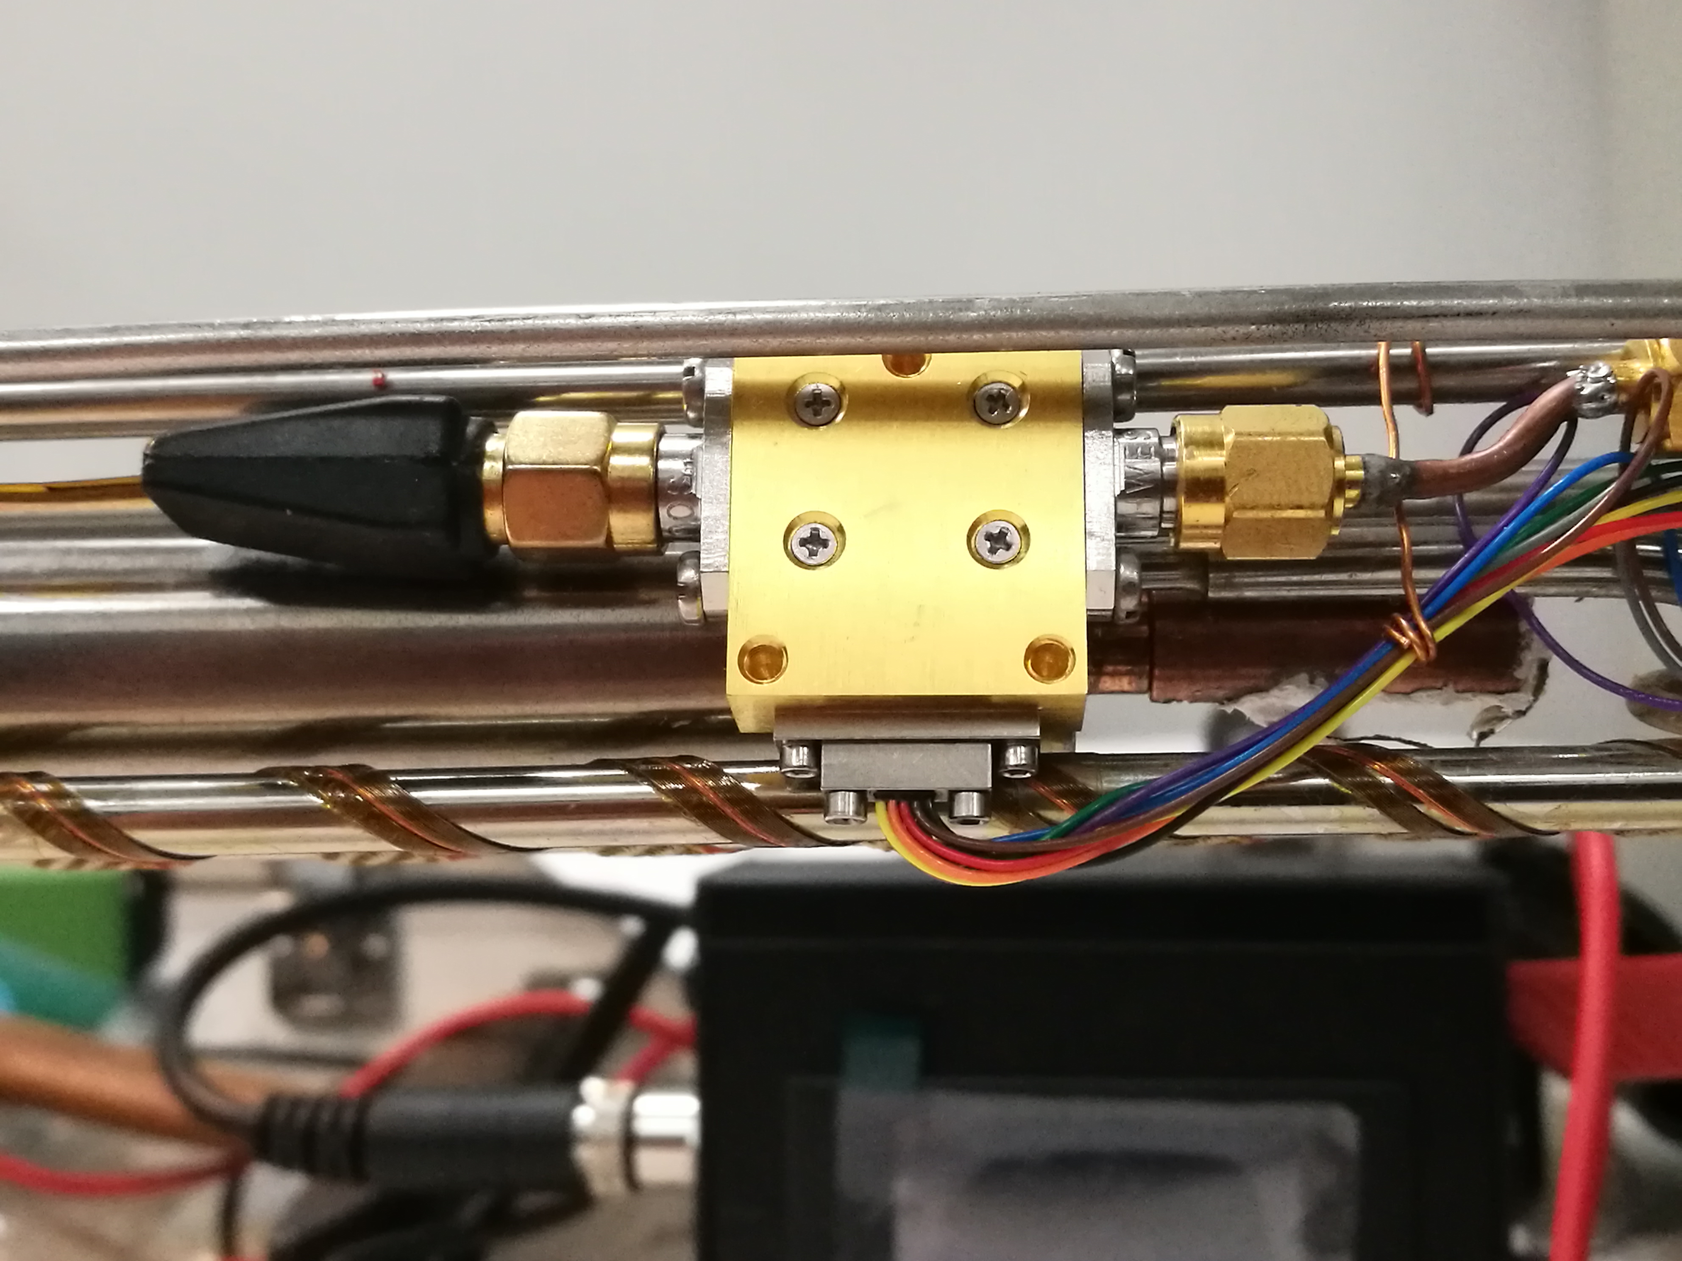
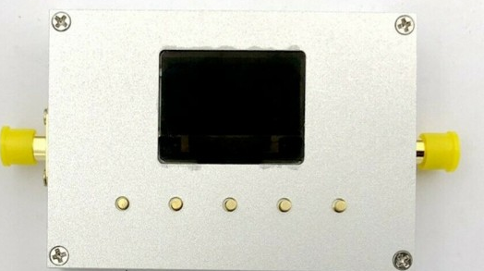

RF setup
0-20 GHz generator (Pump)
20 dB dir coupler
0-10 dB var attenuator
0-19 GHz generator (Signal)
TWJPA (0.3 K)
Cryogenic amplifier (4.2 K)

Slide 6
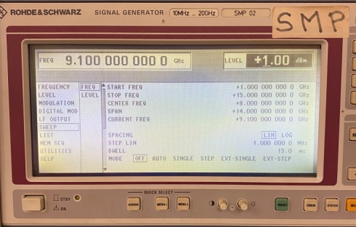
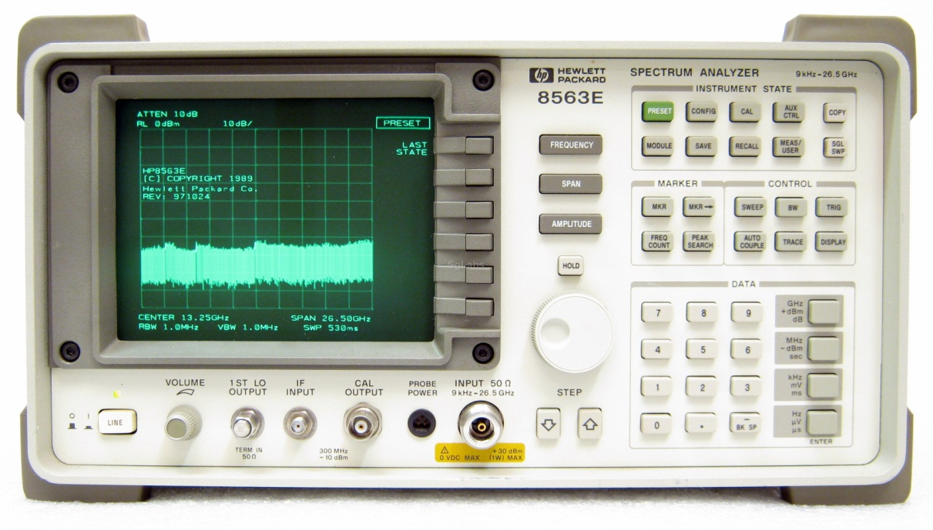
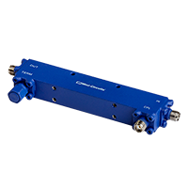
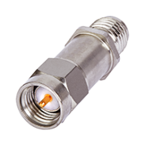
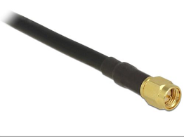
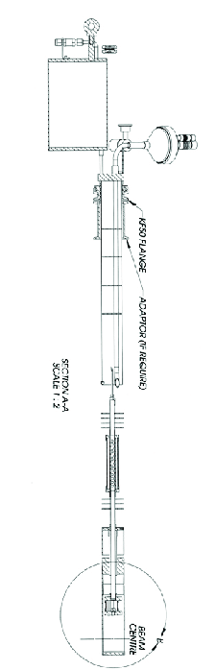

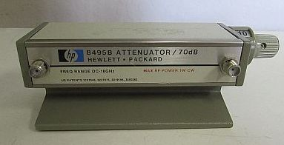
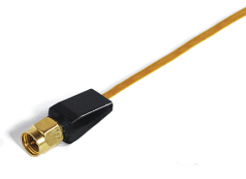
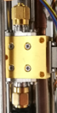
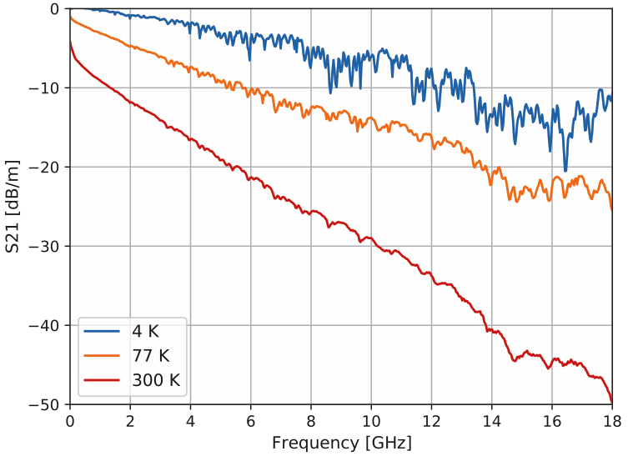
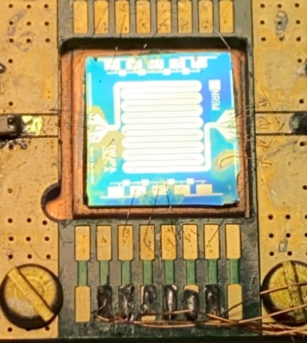


RF setup
System calibration
0-20 GHz generator (Pump)
9 kHz -26.5 GHz spectrum analyzer
20 dB attenuator
20 dB dir. coupler
Heliox ³He insert
RF in
RF out
T = 1.5K
T = 4.2K
0-19 GHz generator (Signal)
0-10 dB var. attenuator
Cryogenic Low Noise Amplifier
LNF 0.3-14 GHz Gain ∼36 dB
Cri/oFlex 2 (CF2
Cri/oFlex 2 (CF2)
TWJPA (0.3 K)

Slide 7
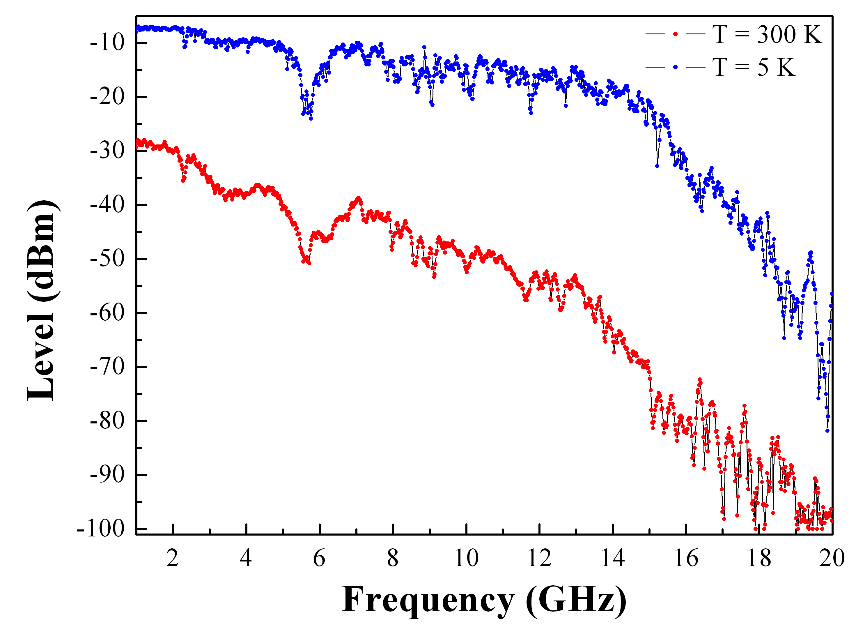
RF setup
IN/OUT measurement of frequency response with sample bypassed
Input Power = -30 dBm
Amplifier gain 40 dB
Results:
Overall coax lines attenuation@ 1GHz = 17 dB
Beside a geometrical resonance at 6 GHz, the frequency response decreases linearly of 10 dB from 1 to 14 GHz (the amplifier bandwidth)
Geometrical resonance

Slide 8
JTWPA: samples description
Design and production by the Istituto Nazionale di Ricerca Metrologica (INRiM, Turin, Italy)
Two designs of JTWPA have been realized:
gen.1 (X_52) is made by a repetition of N = 990 elementary cells, cell size 63 μm, total length ≈ 6.25 cm. Each cell is made by a parallel of a JJ and an inductor (RF SQUID).
Substrate: p-doped, 100 oriented, Si/SiO₂(300nm)
The geometry is defined by a single-step (EBL) process. (LONG PROCESS)
JJs: Al(30 nm)/Al-Ox/Al(80 nm) deposited by a ultra-low pressure electron beam evaporator, equipped with a tiltable sample holder that ensure the possibility to create exploiting the Niemeyer-Dolan technique.
Design parameters:
Critical current of Josephson junctions: 𝐼_{𝐶} = 2 μA
Josephson junction capacity: 𝐶 = 200 fF
Inductance of the Josephson junction at the working point: 𝐿_{𝐽} = 258.5 pH
Geometric inductance: 𝐿_{𝑔} = 120 pH
Plasma frequency: 𝜈_{𝑝} = 38 GHz
Resonator quality factor: 𝑄 = 100
8 test units (PCU) are present on both sides of the chip for JJ characterization

Slide 9
JTWPA: sample fabrication process
The test units present on the JTWPA chip X_52, figure a), reproduce the JTWPA cells but without the RF SQUID structure: in each cell is eliminated alternatively the JJ , figure b), or the inductor figure c).

Slide 10
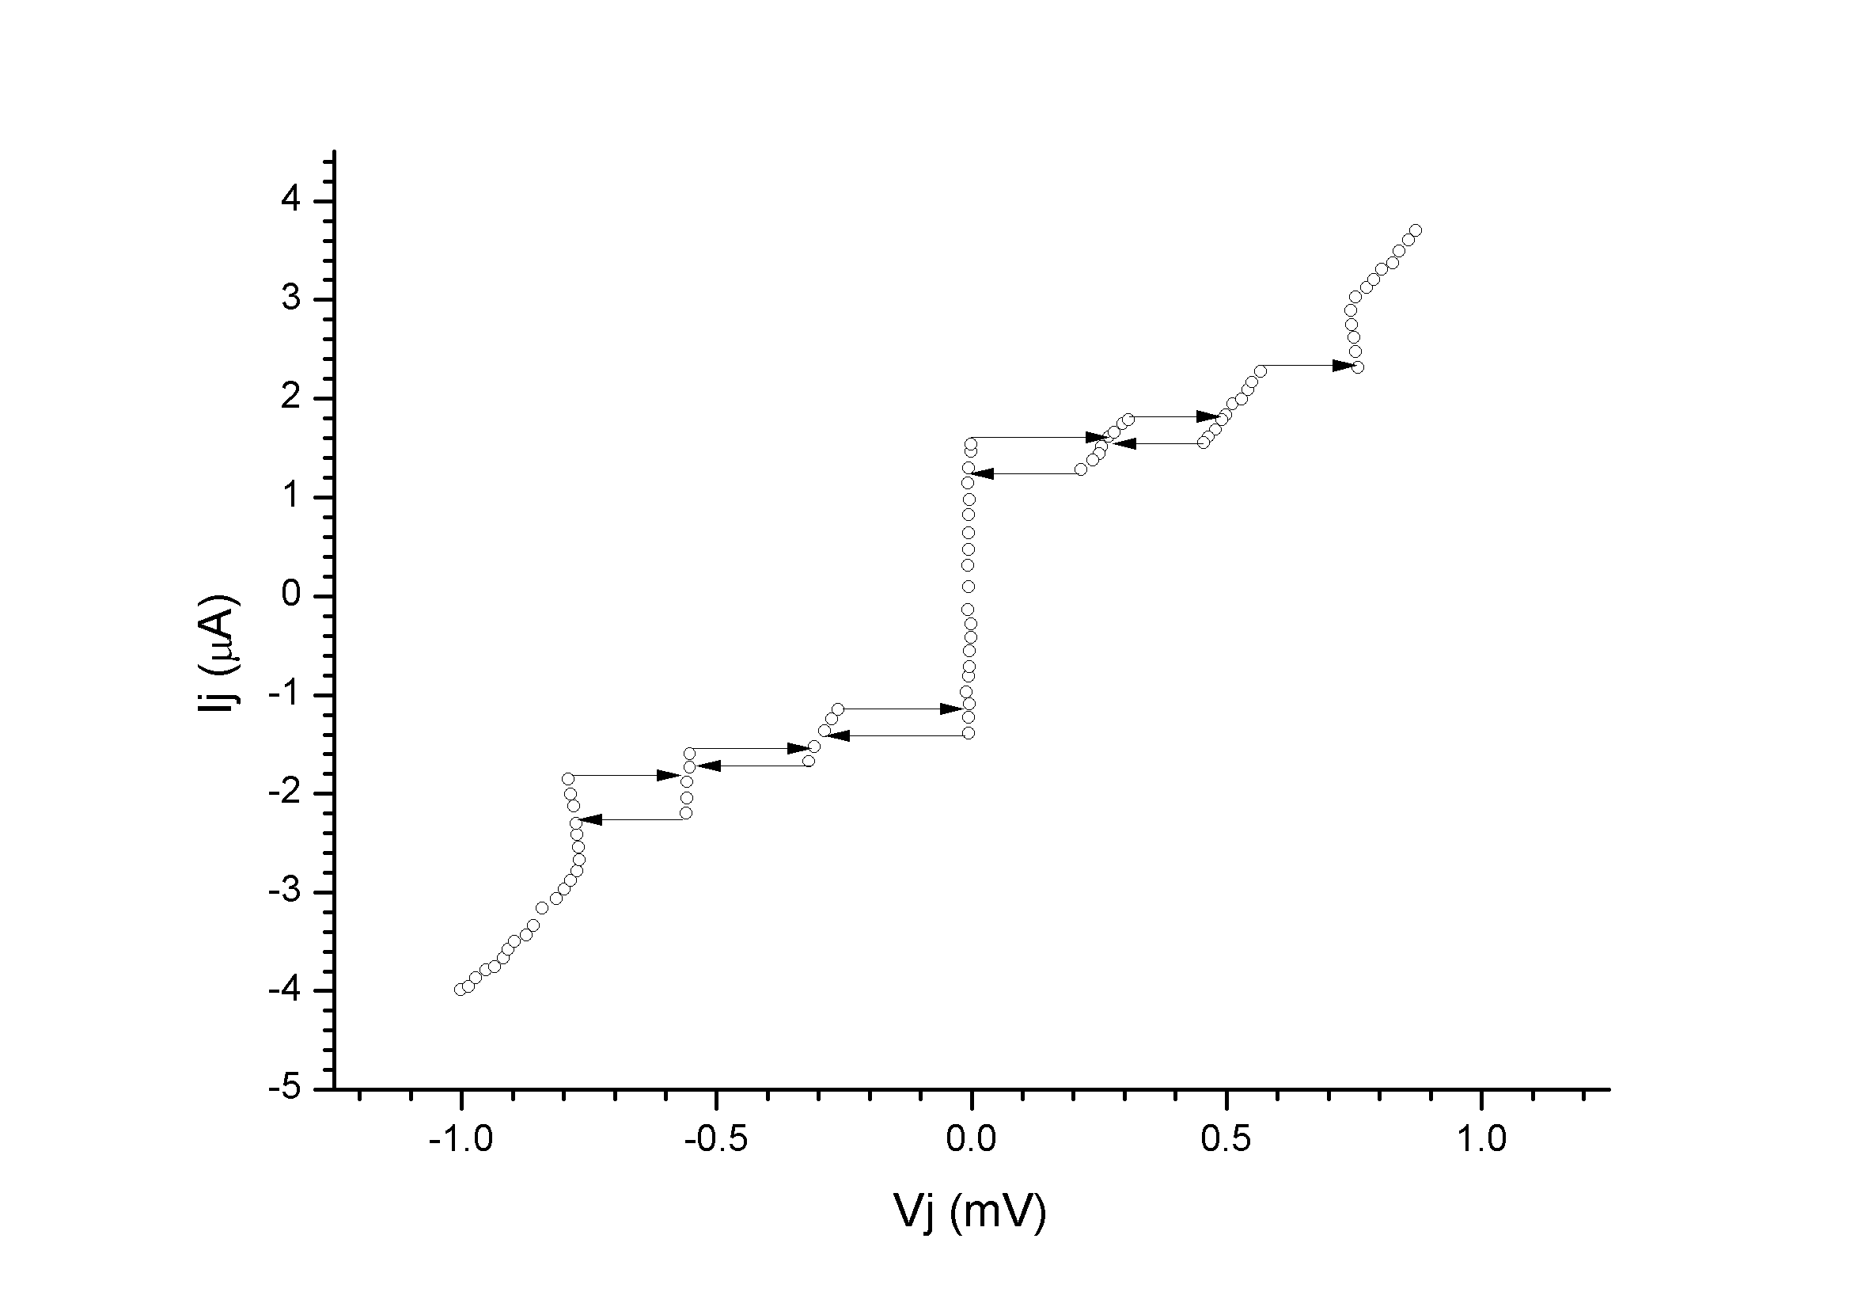
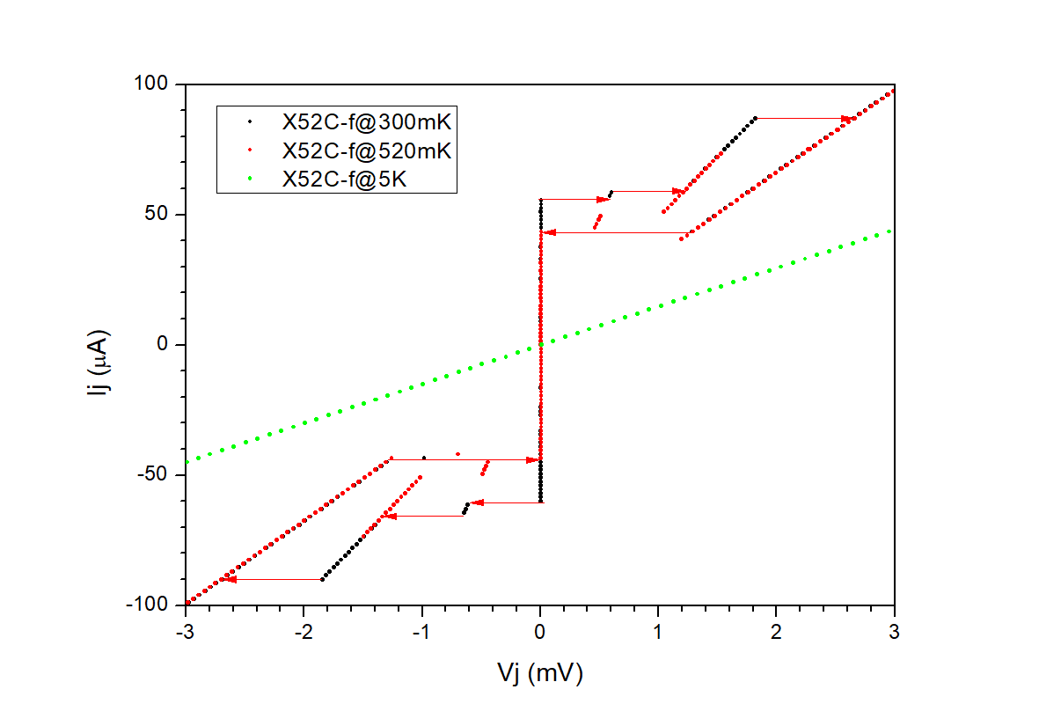
DC Measurement Results
Test array X_52A_c 3 JJs in series
CHIP X_52
DC characterization of test structures
X_52A_c:
  T = 0.350 K
  I_{c} = 1.6 μA, 1.9 μA and 2.3 μA
  R_{n} = 237 Ω → 79 Ω/junction
X_52A_d:
  Short
X_52C_f:
  IV critical currents are too high at 300 mK, probable short in the tunnel barrier
The measurements of other test junction in the same chip give open or short circuits, due to damaged JJs. The damage of the JJs is most probably due to ESD discharges during the chip mounting procedure (bonding, chip and sample holder handling). This procedure has to be revised to eliminate the problem
Test array X_52C_f 3 JJs in series

Slide 11
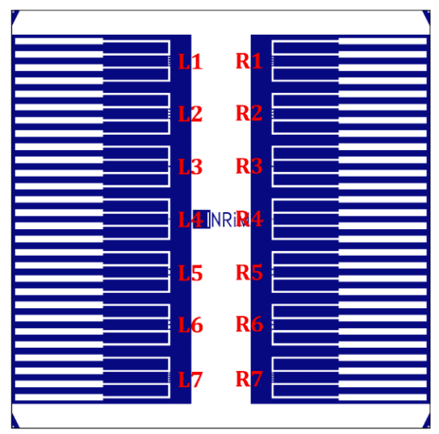
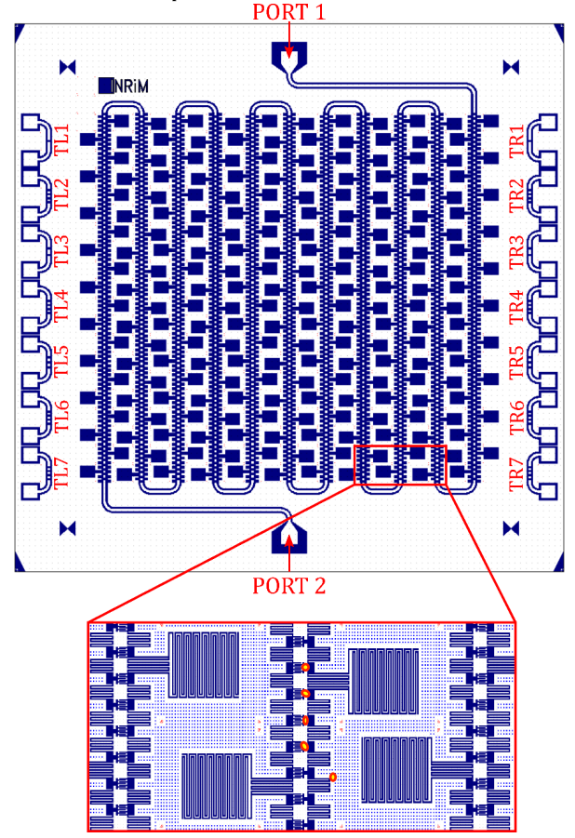
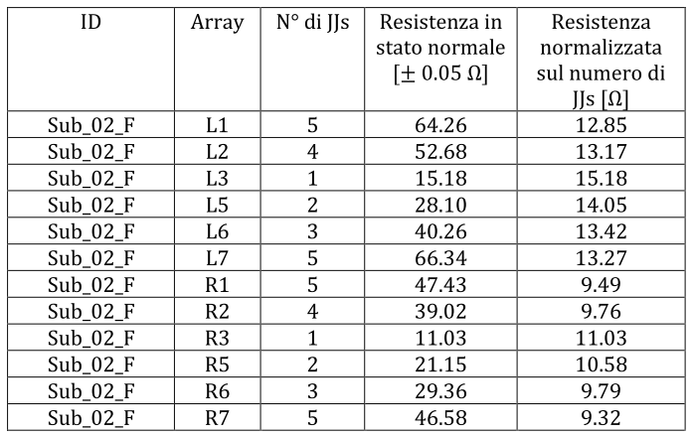
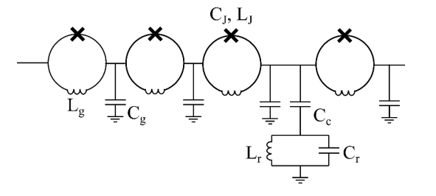
JTWPA: samples description
gen 2 chips
ID_013_01 JTWPA
Complete redesign of TW
Added lumped resonant structure for resonant phase matching
No EBL lithography (faster turnaoround)
Added Ti underlayer for base electrode to improve surface uniformity
SUB_02 Test chip
Test chip with several JJ arrays with 1 to 5 junctions
JJ resistance measured at MIB at room temperature
Chips delivered
ID_013_01_A JTWPA
ID_013_01_B JTWPA
SUB_02_F test JJ arrays
SUB_02_J test JJ arrays
SUB_02
ID_013_01

Slide 12
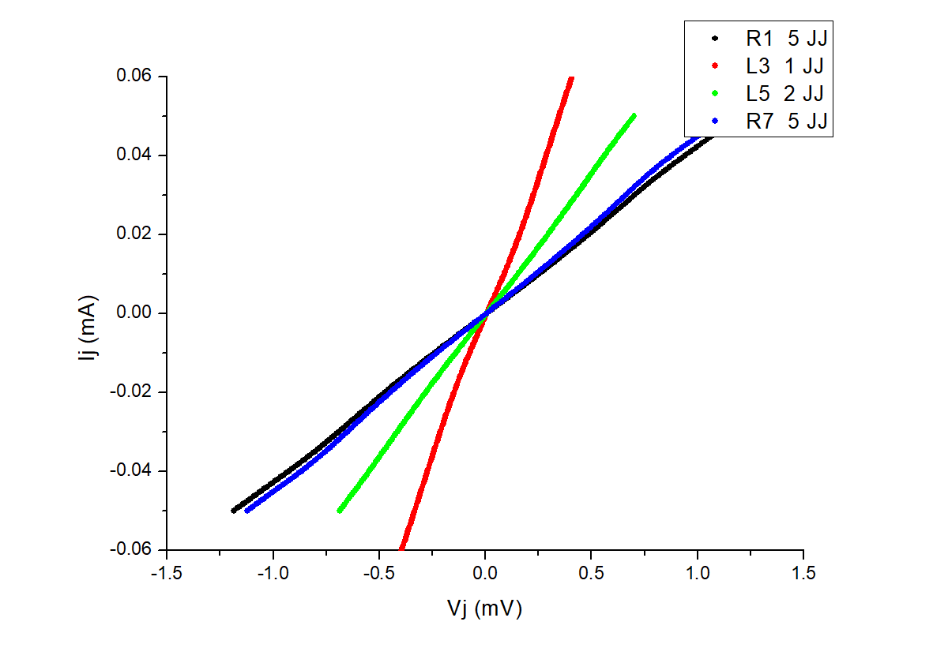
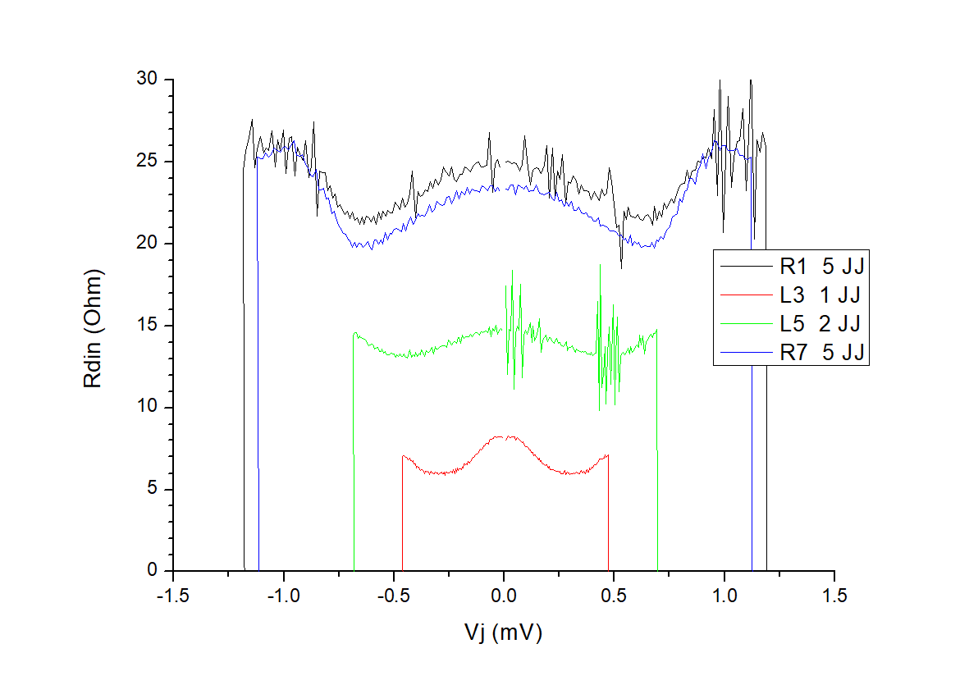
DC characterization of JTWPA gen 2
DC Measurement Results
chip SUB_02F
The I-V curves show signatures of superconducting gap (see dV/dI plots)
No critical current visible.
At T = 400 mK one at least of the junction electrodes is still in the normal state.
This is most probably due to the bilayer Ti(5nm)/Al(25nm) used as base electrode which has decreased its Tc below 400 mK
Therefore it is not possible to test the RF properties of JTWPA

Slide 13
Conclusions
We have tested 2 types of JTWPA: X_52 and ID_013_01 and a test chip: SUB_02
The cryogenic setup works down to 300 mK but we are facing thermal stability problems at the base temperature, that will be addressed.
The RF setup works and we have performed a basic characterization
The DC measurements of the 1° generation JTWPA (X_52) show JJ with critical current in the correct range, but with a relatively high dispersion.
The chip is very sensitive to ESD and a more accurate handling procedure is necessary
The 2° generation chips (both ID_013_01 and SUB_2) do not show critical currents down to 350 mK. The opening of superconducting gap is evident at 400 mK but at least one of the electrodes is still in the normal state.
After discussion with colleagues at INRIM, we have concluded that this is due to the presence of a bi-layer Ti/Al as base electrode in the 2nd generation chips, which strongly decreases its critical temperature. Such bilayer will be eliminated in next chips

Slide 14
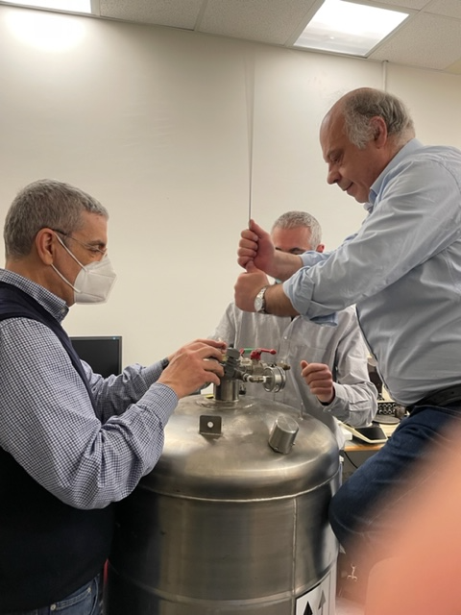
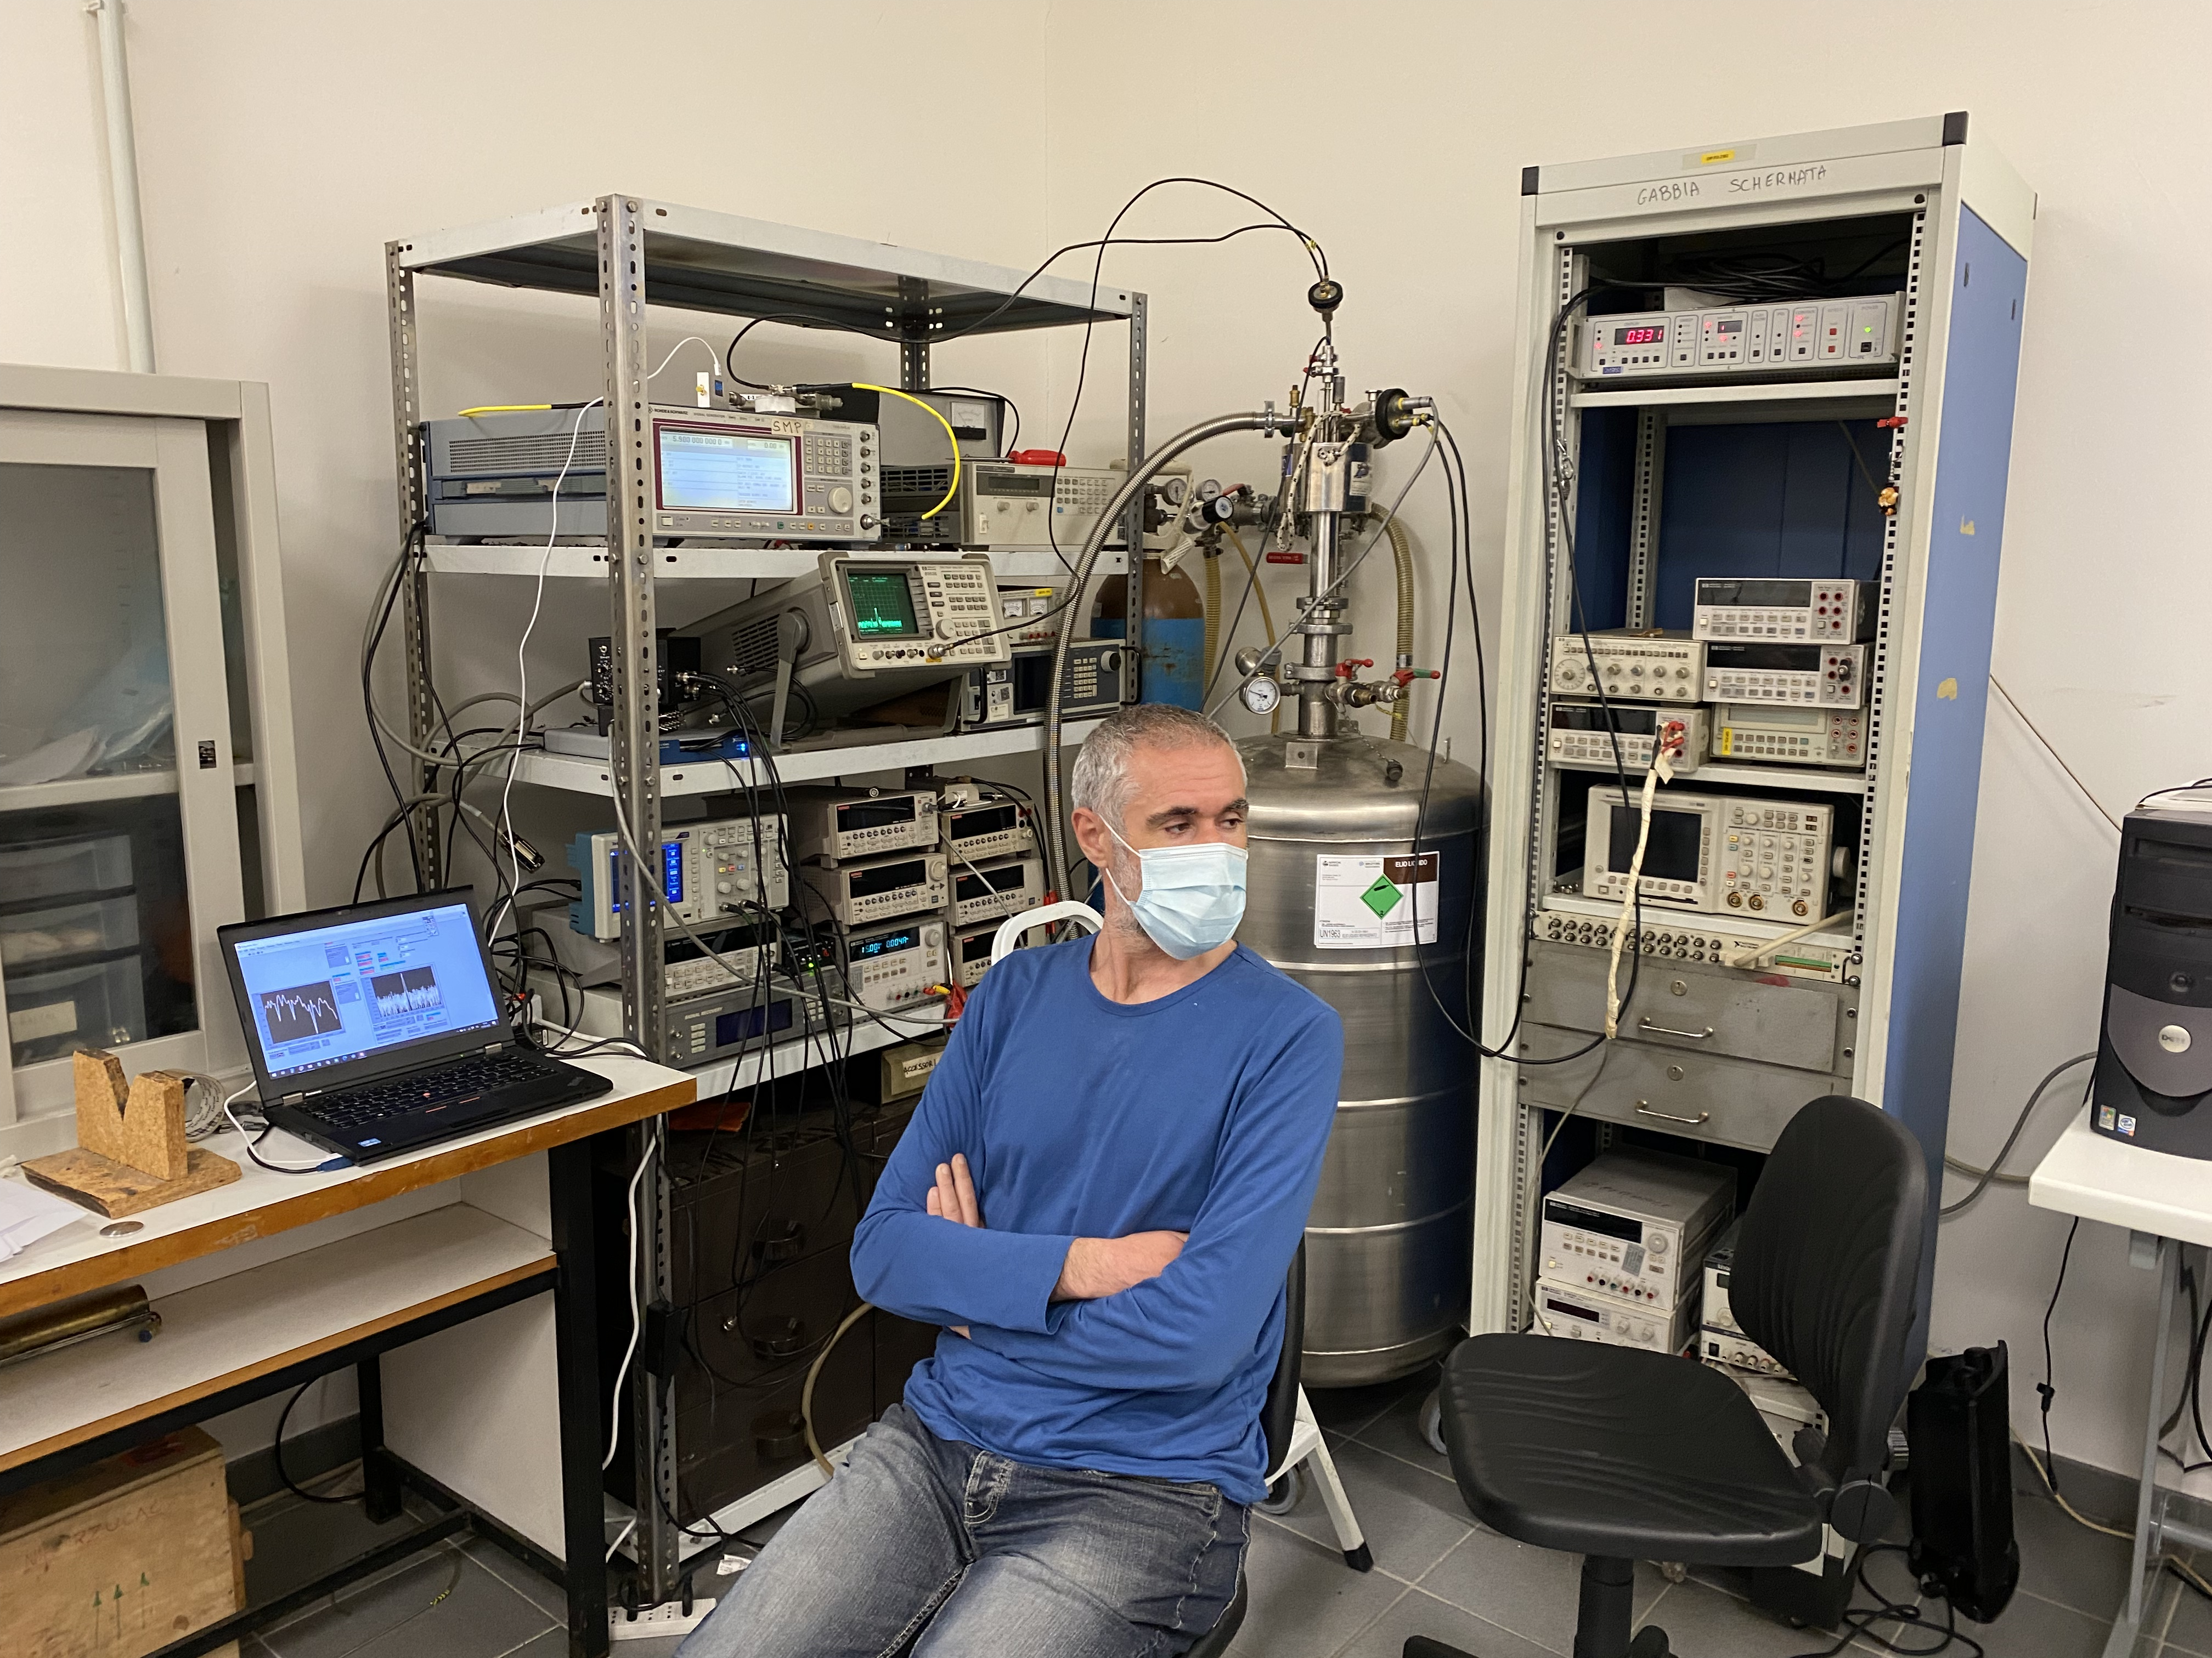
Preliminary Results
The Salerno group

