Slide 1
dRICH Vessel Analysis
Engineer: C. Taylor
Approver: P. Orfin
Date: 25 Aug 2021

Slide 2
Outline
Technical Requirements
Material Comparison
Recommendations
Analysis

Slide 3
Technical Requirements
dRICH Vessel Analysis

Slide 4
Specifications
Source: S. Dalla Torre, 11 August 2021 Presentation
    Entrance and exit walls can deform up to 1-2 cm
    Entrance and exit wall deformation should not induce backbone deformations
    Lateral walls can be thick and rigid (sensor – backbone interface)
    Gas radiator pressure <= 3 bar (absolute)
    Sensor operating temperature = 30-40°C
    Material must be nonmagnetic

Slide 5
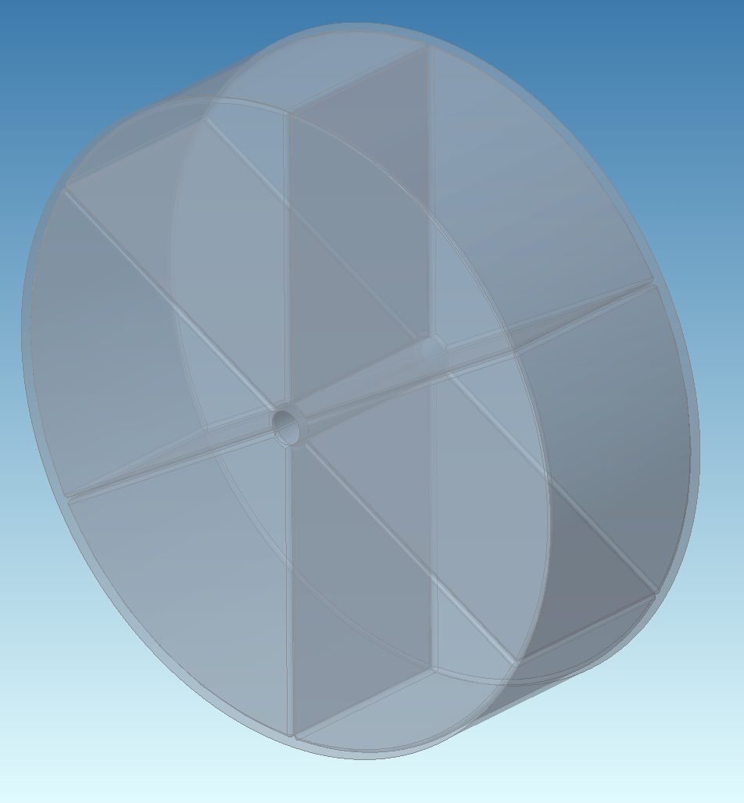
Geometry
sd1
sd0
Vessel Shape
I.D. | Value (cm) | Description
sd0 | 130 | Overall Length
sd1 | 200 | Outer Radius
sd2 | 10.5 | Beam Tube ID
sd3 | Varied | Beam Tube Wall
sd4 | Varied | Endcap Thk. (2x)
sd5 | Varied | Cylinder Wall
sd6 | Varied | Rib Thk. (6x)
sd3
sd4
sd2
sd6
sd5

Slide 6
Analysis v.2 – 25 Aug 2022
(Ribs Added)
Static Structural using Design of Experiments in ANSYS 2022 R2

Slide 7
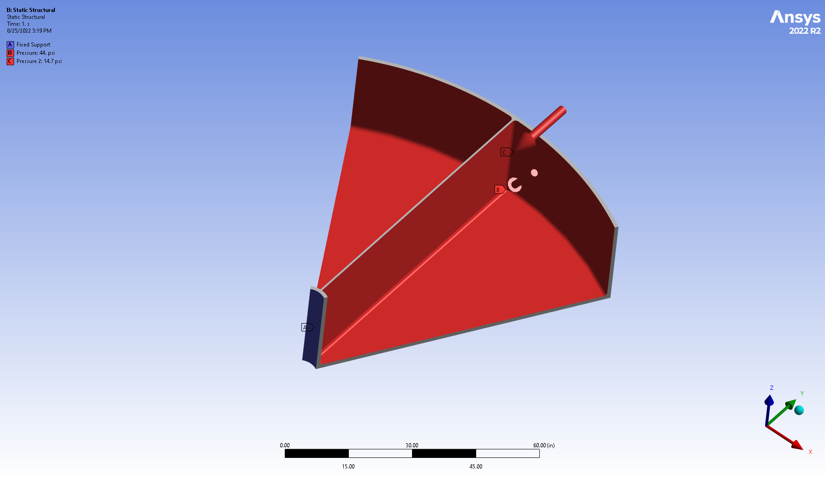
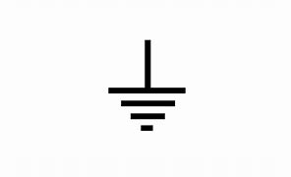
Load Conditions
14.7 psi
  Analysis was performed using a 60° wedge
  Analysis does not include gravity
Mirror Symmetry
3 bar (absolute)
Vacuum
(Beam Tube)
Cyclic Region Symmetry

Slide 8
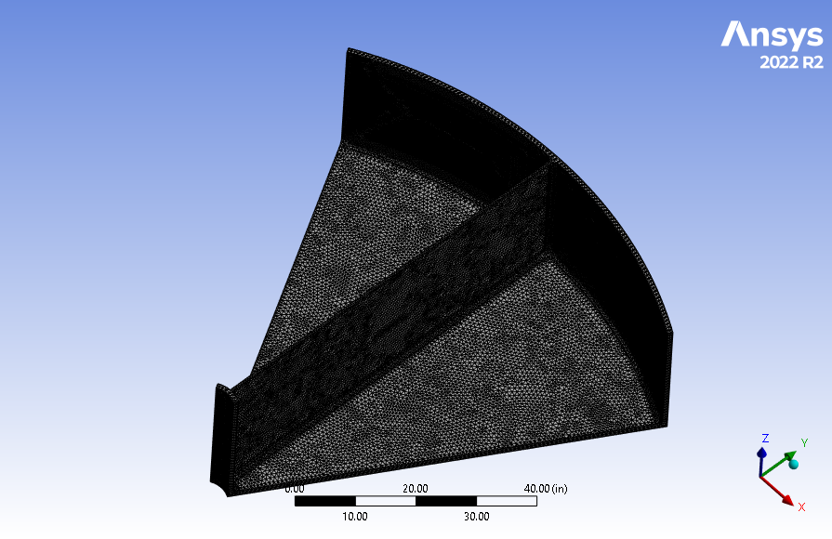
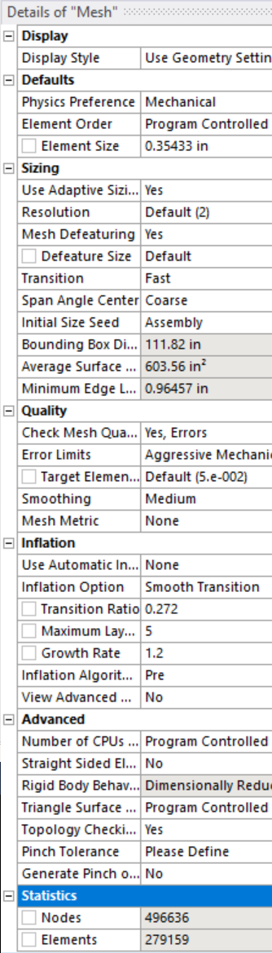
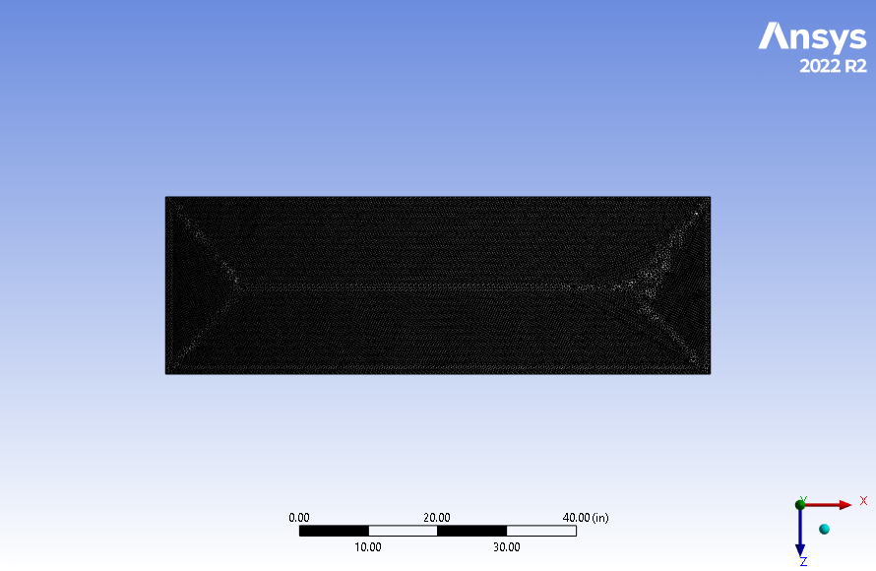
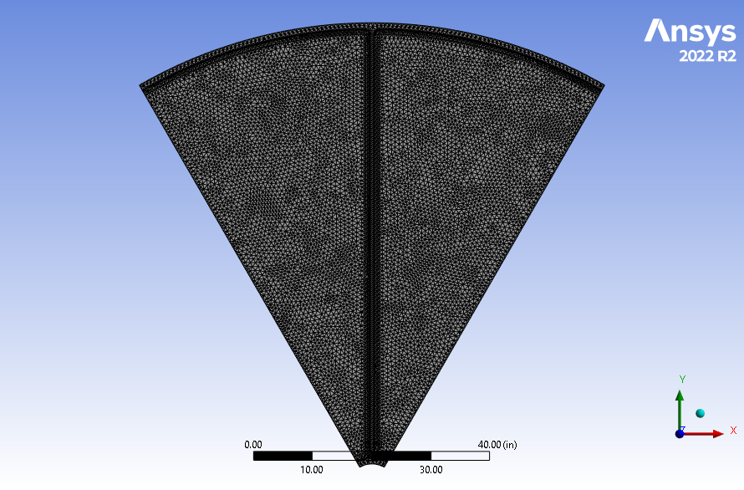
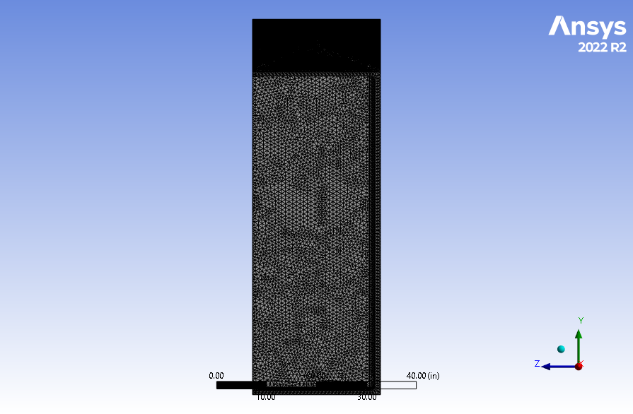
Mesh Details

Slide 9
Mesh Study
Used for this study

Slide 10
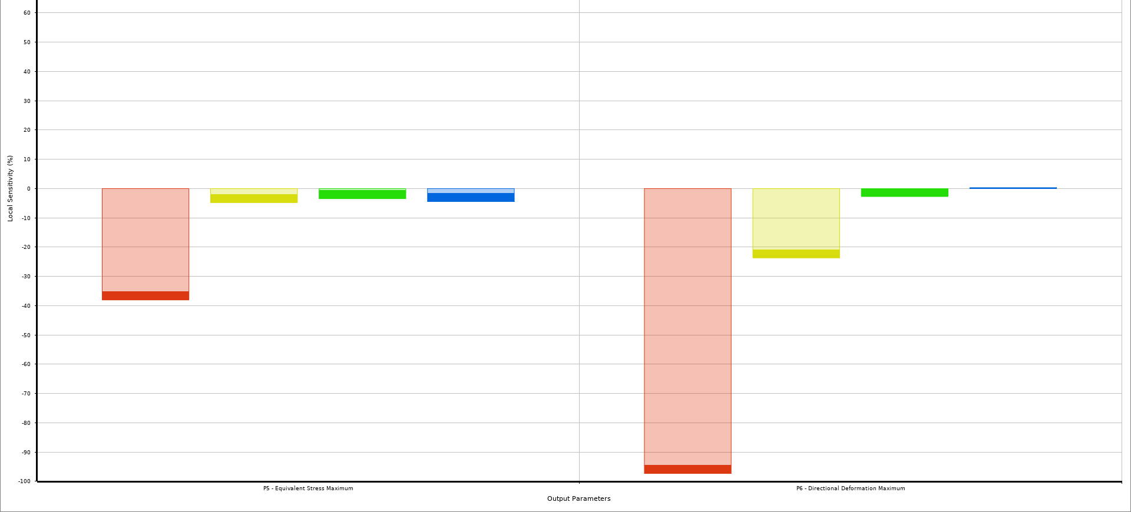
Sensitivity of Thicknesses
Endcap
Wall
Rib
Beam Tube
Endcap
Wall
Rib
Beam Tube
Local Sensitivity (%)
Max Stress
Max Deformation (Z-dir)
The endcap thickness is the main contributor to results

Slide 11
Endcap Thickness vs. Stress
Note: The intersection of the black solid and red dash lines indicates the thickness required for a Factor of Safety of 1 on the yield strength for a given material.
Titanium Ti-6Al-4V (Grade 5) Yield Stress
(see 9/10/2021 Analysis)
Titanium (Grade 12) Yield Stress
Aluminum 6061-T6 Yield Stress
304 Stainless Steel Yield Stress

Slide 12
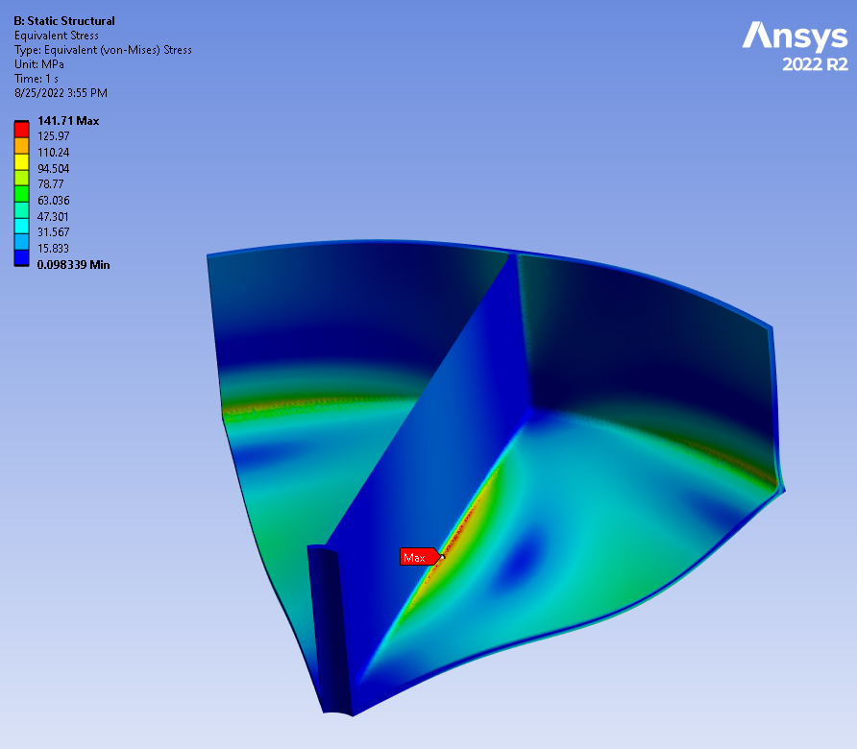
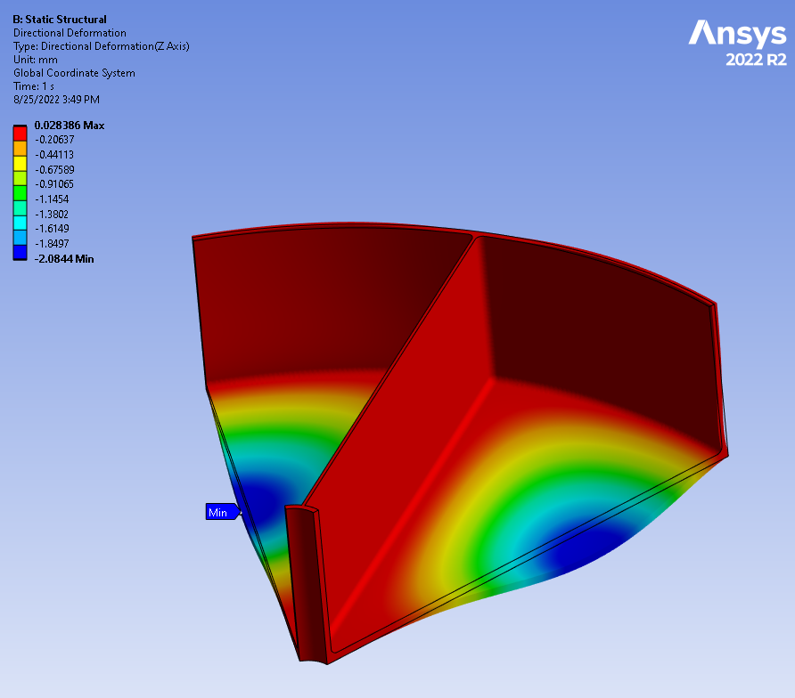
Static Structural Results
Note: Results are shown for a 304 stainless steel vessel with 3 cm [1.2 in] endcaps and a 2.5 cm [1.0 in] wall thickness including an Ø21.0 I.D. x 2.5 cm thick beam tube. Weight as shown is 22,800 lbs. (1,900 x 6 sections x 2 halves).
σ_{max} = 142 MPa
Δ_{Z-dir} = +0 / - 0.21 cm
Max stress is the limiting factor for the thickness required

Slide 13
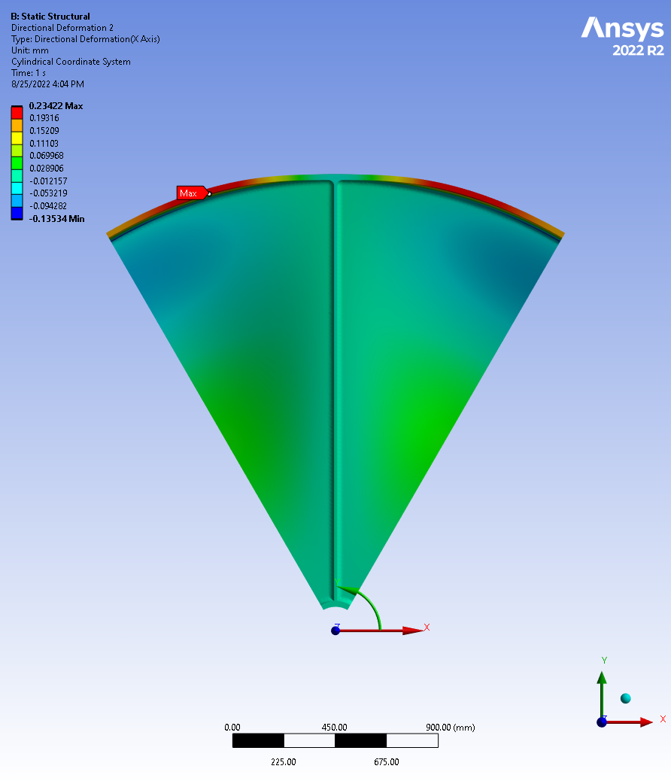
Radial Deformation
Deformation
The maximum radial deflection of the vessel wall is 0.02 cm when analyzing a stainless steel vessel with 3.0 cm thick endcaps and 2.5 cm thick vessel walls.
Deformation is measured in the X-Dir on a cylindrical coordinate system.
Cylindrical CSYS

Slide 14
Material Comparison
Material properties were obtained from MatWeb.com

Slide 15
Strength to weight comparisons
*Notes:
The material cost estimates are intended to show order of magnitude only. Actual costs will be dependent on fabrication method of the final design.
Costs have been estimated using quotes provided for 1x48x60 inch plates of each material. A cost per unit volume was calculated and used to determine the material cost listed below.
Radius | 200 | cm
Endplate Thickness | 3 | cm
Vessel Wall Thickness | 2.5 | cm
Length | 130 | cm
Rib Thickness (6x) | 2.5 | cm
Volume | 1.53 | m^3
 | Density | Weight |  | Yield Strength | Deflection @ 3 bar | FoS @ 3 bar | Material Cost*
 | (kg/m^3) | (kg) | (ton) | (MPa) | (cm) |  | ($)
Aluminum 6061-T6 | 2698.8 | 4132.1 | 4.6 | 276 | 0.59 | 1.9 | $ 51,060
Titanium Ti-6Al-4V (Grade 5) | 4428.8 | 6780.9 | 7.5 | 880 | 0.36 | 6.2 | $ 882,280
Titanium (Grade 12) | 4511.8 | 6908.1 | 7.6 | 380 | 0.39 | 2.7 | $ 882,280
304 Stainless Steel | 7999.5 | 12248.1 | 13.5 | 215 | 0.21 | 1.5 | $ 174,090

Slide 16
Recommendations

Slide 17
Things to consider
The ribs can be optimized to remove the material not participating in the stress distribution further light weighting the design.
Titanium alloys provide an optimal blend of material properties for this application (i.e., strength to weight ratio). A cost vs. benefit analysis would need to be performed to justify this alternative.
How is this vessel supported?
Questions / Comments?

