Slide 1
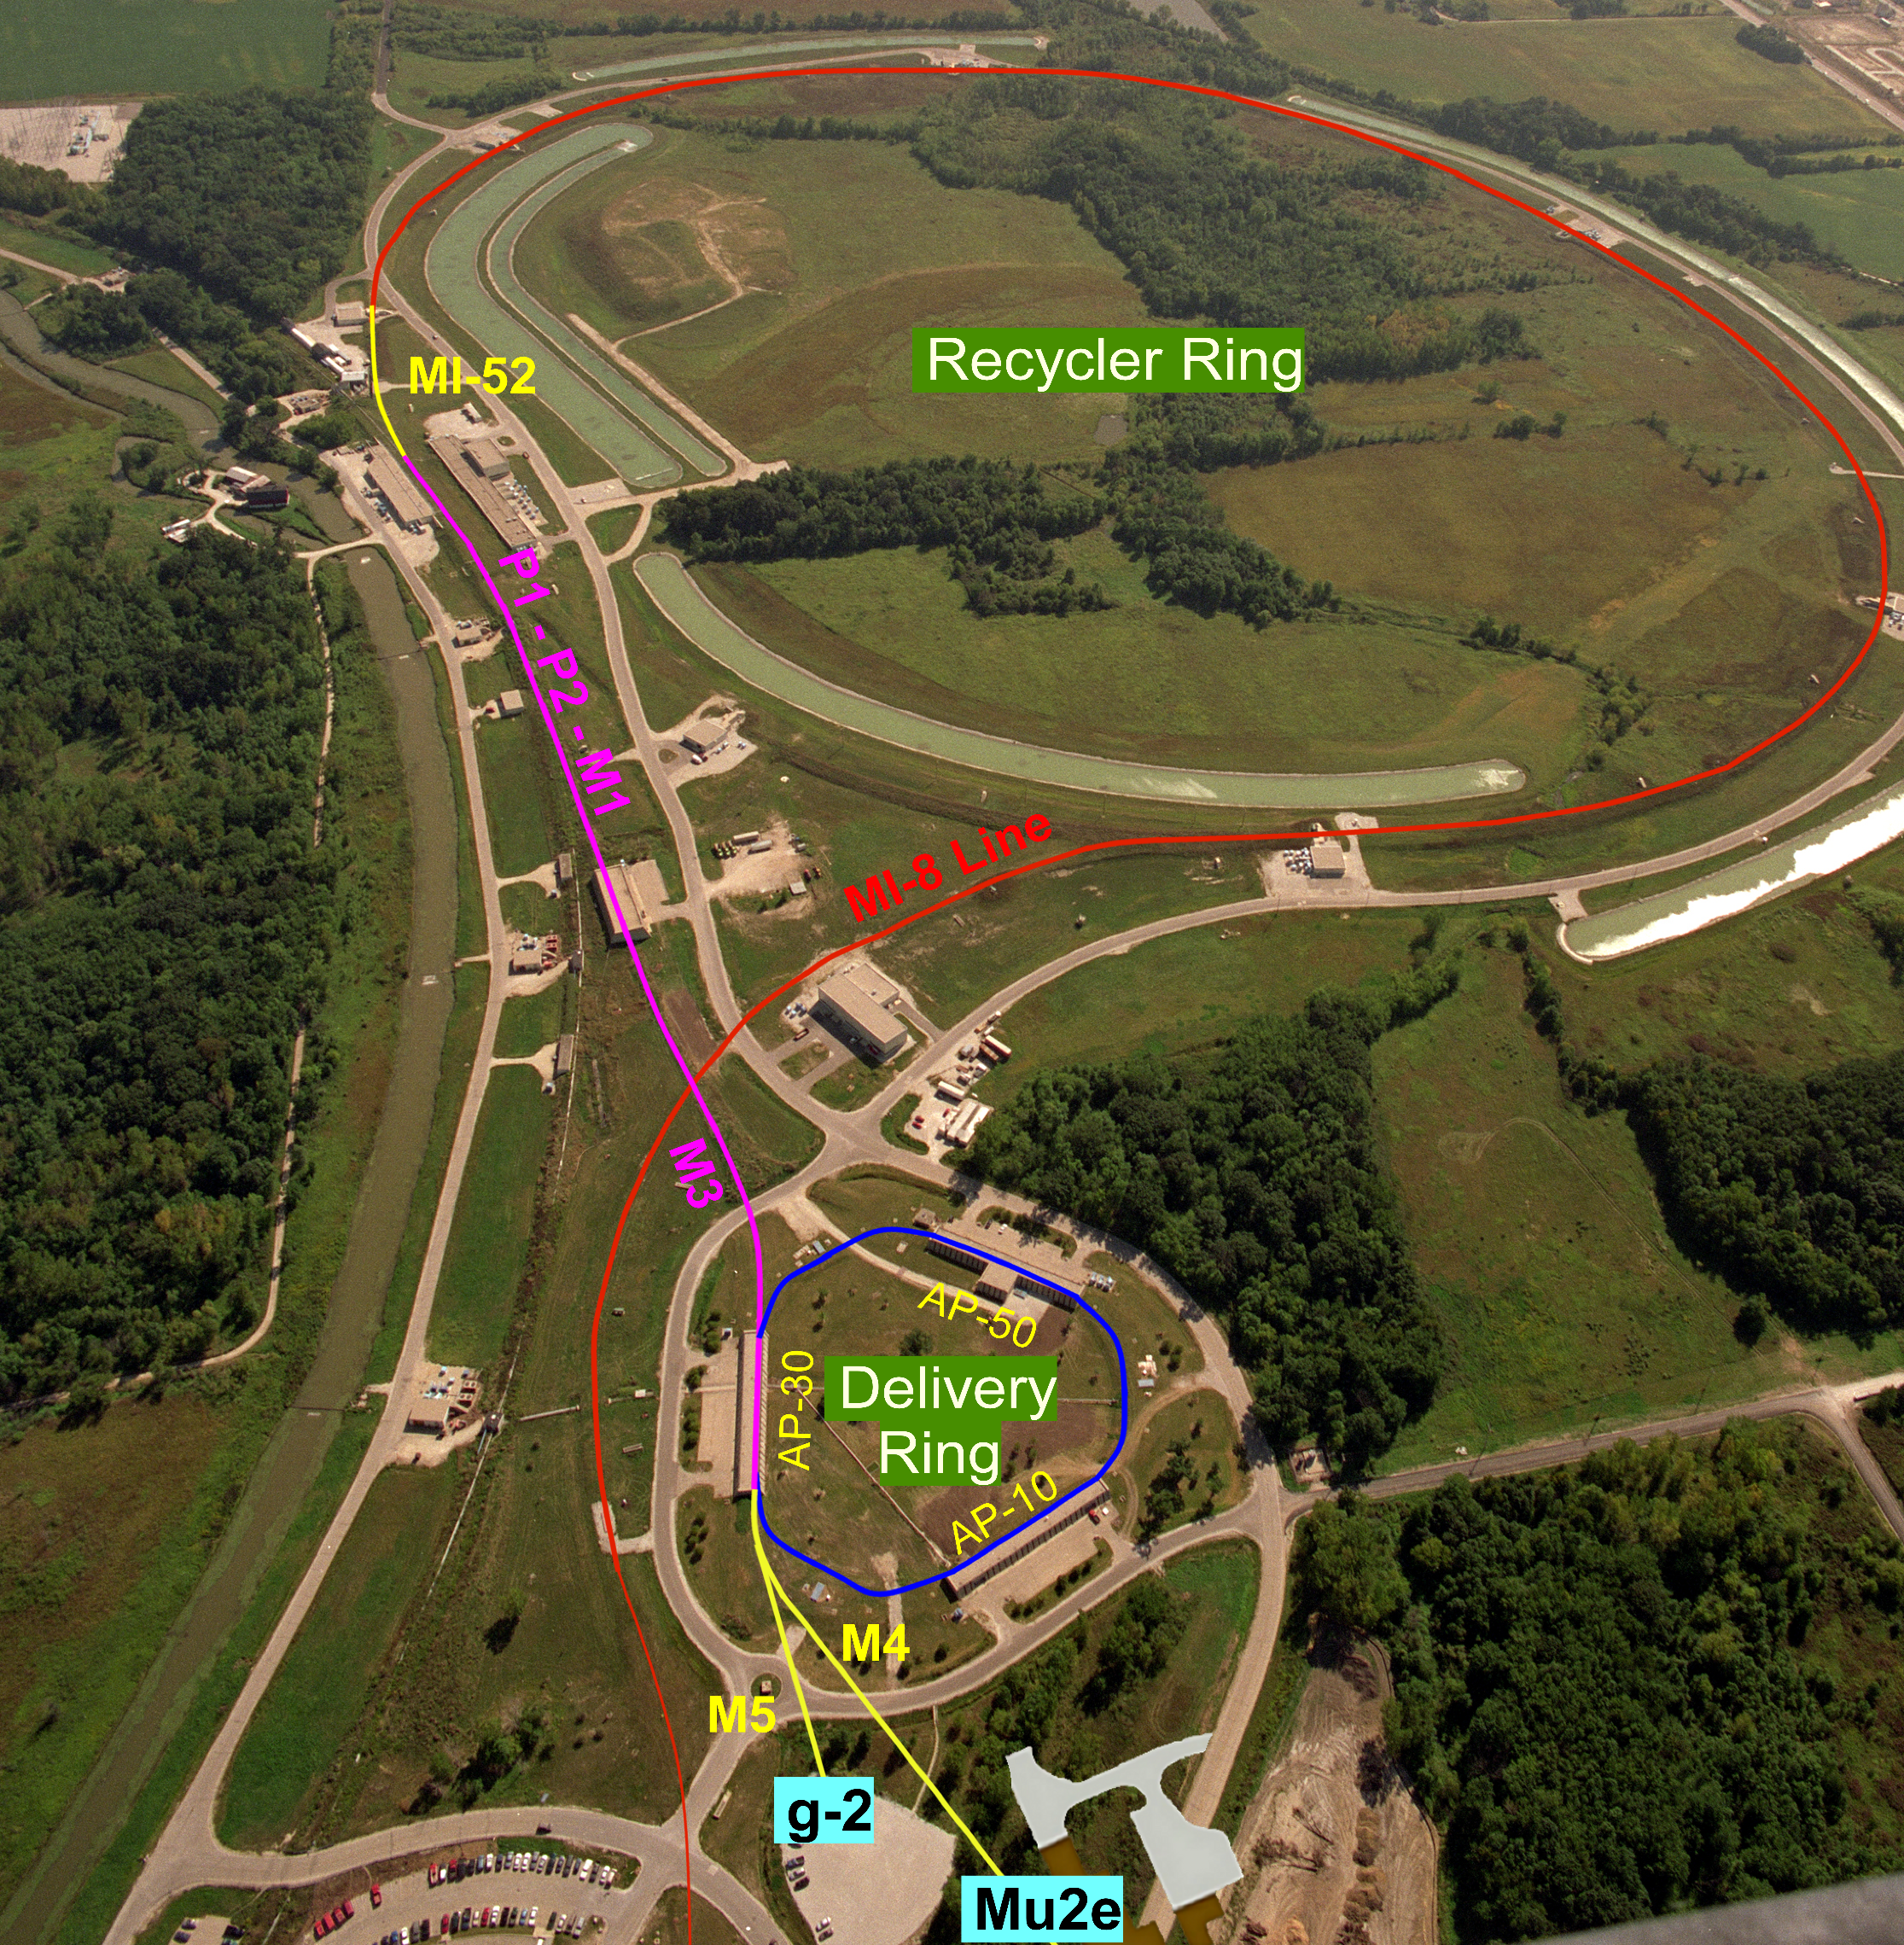
General information about the SX for Mu2e
Bird view to the Accelerator beam lines
ESS

Slide 2
General information about the SX for Mu2e
Some important SX parameters
Parameter | Design | Limit
Max beam intensity in the ring (one bunch) | 1.0e12p
Max full bunch length | 230ns
Length of one spill period | 43 ms | >20 ms
Average intensity per pulse (extracted beam) | 39 Mp | <50 Mp
Reset time between spills | 5ms
Spill Duty Factor | >60% | 60%
Extraction efficiency | 98.5% | >98%
Beam left over at abort | <5% | <5%
Operation point (Q_{x}/Q_{y}) | 9.650/9.735
Injected beam 95% norm. emittance (ε_{x}/ε_{y}) | 16/16 [π-mm-mr]
Beam momentum spread (rms) | 0.15%
Horizontal Chromaticity | 1 | >1

Slide 3
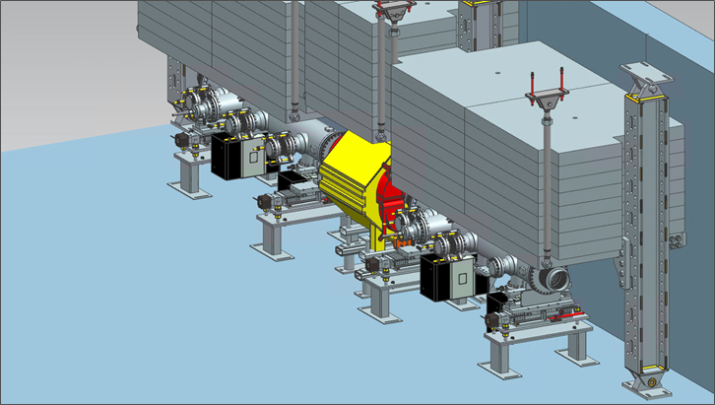
Beam losses and radiation control
In-tunnel shielding around the septa in D30
All beam losses originate in the septa
Total losses – up to 120W
Up to 1R/hr on the surface of some septum parts
Very shallow shielding – rad level on the ground is a serious concern
Rad safety detectors placed in the tunnel

Slide 4
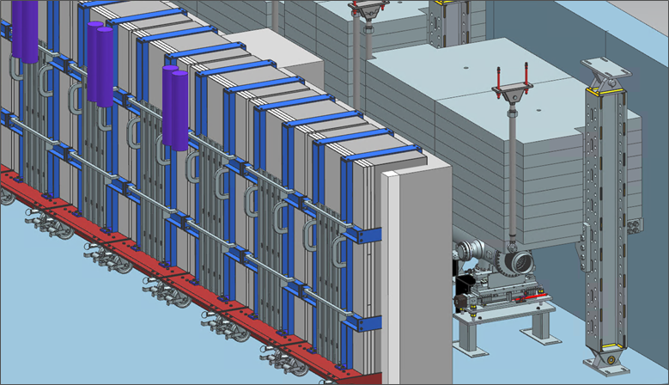
Beam losses and radiation control
In-tunnel shielding around the septa in D30
Needed due to high losses
All beam losses originate in the septa
Total losses – up to 120W
Up to 1R/hr activation on the surface of some septum parts
Very shallow shielding – rad level on the ground is a serious concern
Rad safety detectors placed in the tunnel

Slide 5
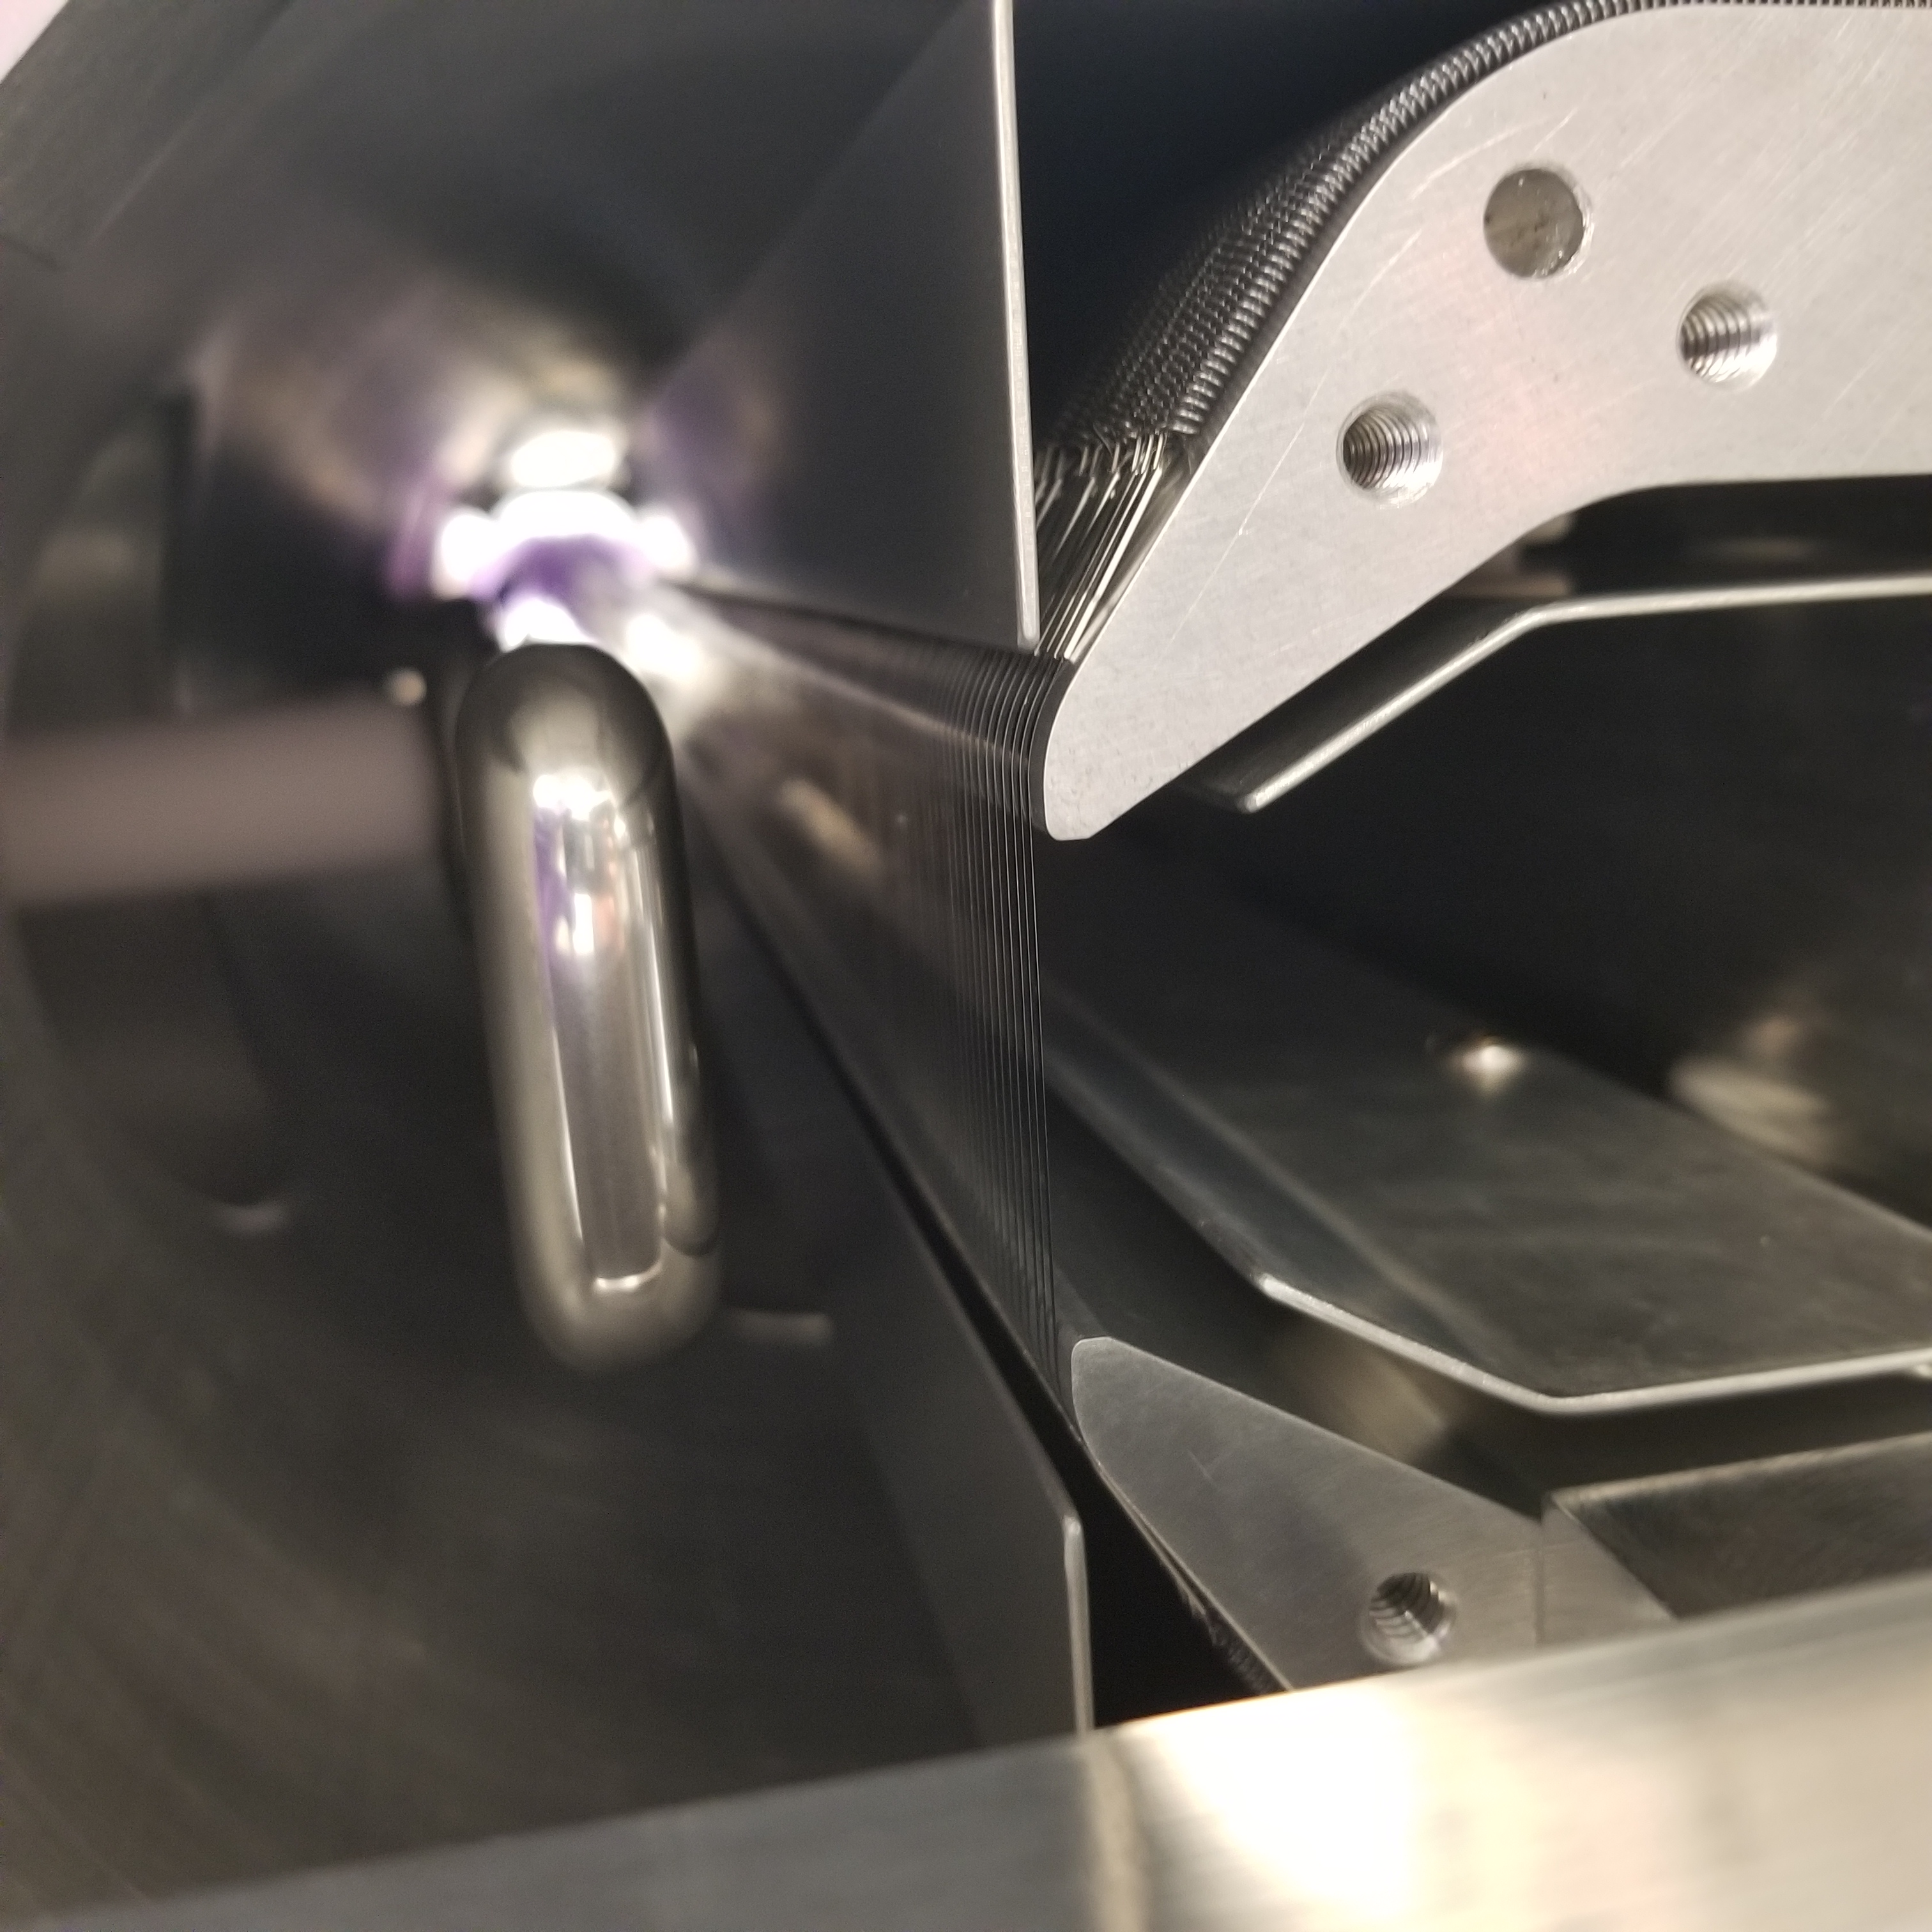
Septum
W/Re foils 1mm/25μm
Effective thickness 50μm
Beam losses occur due to beam passing through the thin septum plane.

Slide 6
Shadowing deflector location options
A way to reduce the beam losses at Slow Extraction:
Diffuse the beam away from the septum plane (shadow)
Use diffuser
Use the bending crystal
Recent studies show this can be still effective at 8GeV

Slide 7
Shadowing deflector location options
Placement
option 1
ESS2
ESS1
Placement
option 2
Diffuser
Q203
Q202
Beam
~1.2m
Option 1: deflection >50μ/30cm=170μR (Δϕ=3°)
Option 2: deflection >50μ/100cm=50μR (Δϕ=12°)

Slide 8
Beam/crystal dimensions
MS in bulk Si:
$$σ_{ms}^{rms}=200μR∙\sqrt{\left(\frac{L}{2mm}\right)}$$
50-100 μm →200 μm ?
~25mm
Deflection 300μR
Beam
0.4 mm
1mm?
– depends on width
Needs simulations

Slide 9
Beam structure
Avoid any structure in this area
Support structure
High intensity beam core
Low intensity beam tail

Slide 10
Crystal length along the beam | 0.5 mm. Feasible, but not easy. 1 or 2 mm would be better for us, please let me know which is the max thickness you accept. If needed we can perform channeling simulations to assist you on this decision. | Desired 0.4mm 1mm may be possible Need simulations to determine performance impact
Crystal + support height | 60 mm. Would 55 mm be acceptable ?. In that case, Please consider that active region of the crystal would be about 25 mm. | See cartoon
Width | 0.1-0.2 mm. That looks challenging, but I have ideas to reach also 0.1 mm. How important is this parameter ? Which is the max width you can accept ? | Desired 0.1mm 1-2mm may be possible
Crystal + support weight | < XXX grams (depends on the goniometer, should not be challenging) | Not critical
Channeling plane | <110>
Channeling axis | <111> or <110>
Miscut for planar channeling | To be defined (this might impact the cost and delivery time). Would a value around 0.1 deg be acceptable ? (if yes things would be easier) | Will calculate
Torsion | To be defined (which is the vertical size of the beam?) | Vertical beam rms 2mm Shift possible; Tails possible
Bending | 300±XX urad | Precision not critical
Miscut for axial channeling | 0±18 mrad
Dislocation density | < 1 cm² | Acceptance, dechanneling?
Holder materials | Please list acceptable materials for the bending device. | Metals

Slide 11
The crystal would be very thin, not easy to handle: crystal would be flexible, this would make a challenge to properly control and characterize its deformational state. | Understood
Would exploitation of axial channeling be an option for you ? That would provide steering efficiency higher than volume reflection | Discuss
Does the crystal+holder assembly needs to be bake-out compatible ? If yes, could you please provide details about the bake-out cycle ? | Assume no
Does the goniometer need to be vacuum compatible ? If yes, could you please provide bake-out details ? | Challenging
How many degrees of freedom do you need ? I guess you need at least
a linear stage to position the crystal on the beam→which would be the travel range ? | Yes
a rotational stage to align the crystal to channeling | Yes
do you also need a vertical stage to vertically the crystal ? I guess not | No
would use of axial channeling be an option ? If so a second rotational stage would be needed. | Discuss
Is the area where the crystal will operate a highly radioactive area ? This might represent a challenge for electronics and motors of the goniometer. | Moderately
Is there any space constraint for the goniometer and the associated vacuum chamber ? | Must fit into the BP insert

Slide 12
Backup: from previous meeting

Slide 13
Beam/crystal dimensions
Ideal case;
Hair-like crystal – is this possible?
50-100 μm
>10mm
Beam
Beam
50-100 μm
<100μm?
<100μm?
Not a hard constraint, but how small can it be?
0.5mm – relatively easy
1mm – need to check with simulations
How large can be VR?
Need >50μR

