Slide 1
Calorimeter Overview
S. Miscetti
Meeting with CSN1 referee
5/9/2022

Slide 2
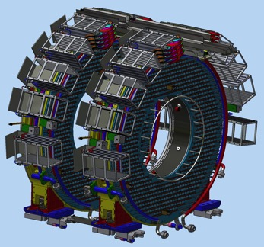
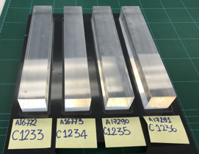
Calorimeter Scope
Purpose:
The calorimeter provides
Software trigger with good time resolution
PID - μ rejection of 200 with
high e⁻ reconstruction efficiency
Cluster seeding for track reconstruction
< 10% Energy resolution
< 500 ps Time resolution
Detector:
The system with the largest international participation
2 annular disks to evade low momentum background
Each disk composed of 674 pure CsI crystals ( 1 Ton weight)
Dimensions: 34 x 34 x 200 mm³ (~10X₀)
Read out by two 2x3 arrays of 6mm x 6mm
UV extended SiPMs through a vacuum gap
SiPMs mounted directly on preamps (FEE)
Digital electronics on surrounding crates
Calibration with radioactive source and laser systems
Electron test beam 2017
Operate with very high reliability in vacuum and radiation hard environment → -10 ℃ for SiPMs

Slide 3
Calorimeter Technical Status: the big summary
100 % of Crystals since 2020, 100% of SiPMs produced since 2019
Radiation hardness test on FEE completed before production. 100% FEE produced in 2021, 75% tested
Integration of Readout Units (SiPM+FEE+Holders+F. Cages) well underway, 72%
Mechanics parts produced and tested on a Dry Mount run at INFN for disk 1, for disk 0
FEE-MB cables 100% produced
Laser head + primary and secondary distributors procured
Laser fibers 50% produced (i.e. for the first disk)
Source Al. tubing produced, neutron generator arrived and installation planned in Mu2e
VST performed in vacuum, at different temperatures and with irradiated sensors with Module-0
CRR for MB completed→ production in progress
CRR for digital boards (DIRAC) planned for fall 2022. Prototypes in hands.
Tender already assigned. Expected delivery (driven by chain supply issues) March 2023.
Notes:
Bob takes this slide for 4 detectors.
This slide is like the previous review slides: Accomplishments over the Last Year & Plans for Next Year, but instead of Plans for next year, it’s plans to reach the KPPs
George – Pick one or two things and define how we made the choices we made and what it implies to the remaining work
This is where we are, constrained to this and describe how we get to the end.

Slide 4
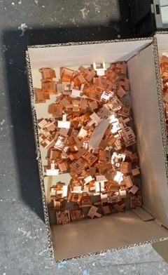
SiPM gluing on copper holders
All SiPM holders produced (1500 pieces)
All cleaned with ultrasound batch + marked with HW numbering
2 SiPMs glued per Holders
1583 x2 SiPMs glued on 1583 Holders
SiPM holders
Marking and
Final product
Final products

Slide 5
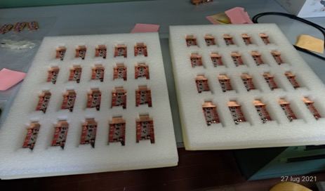
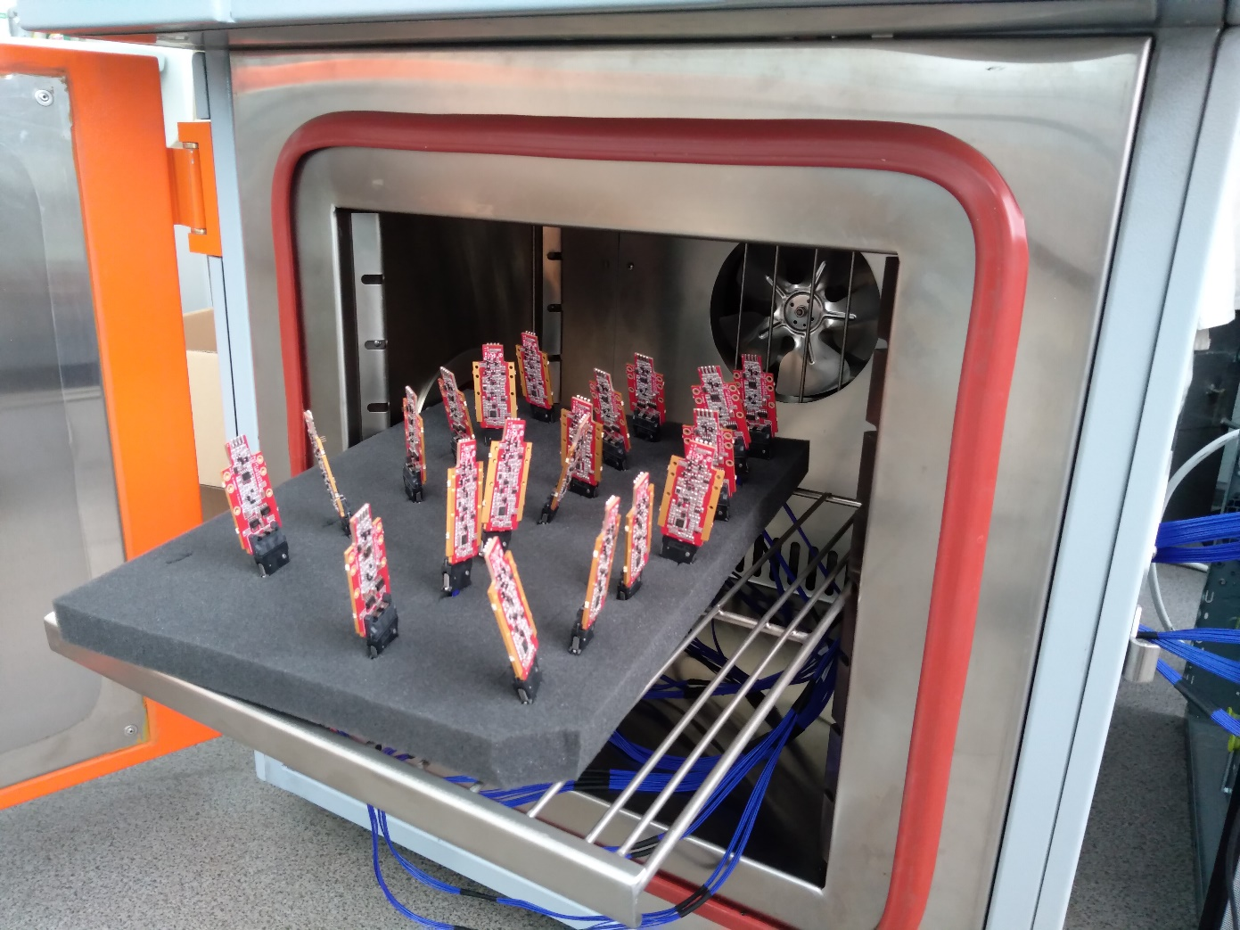
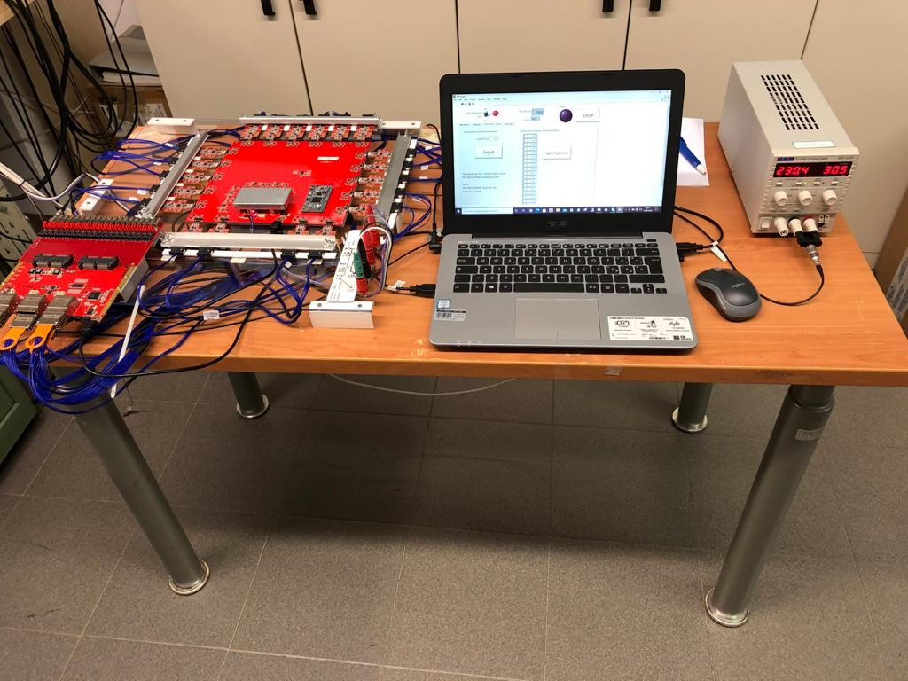
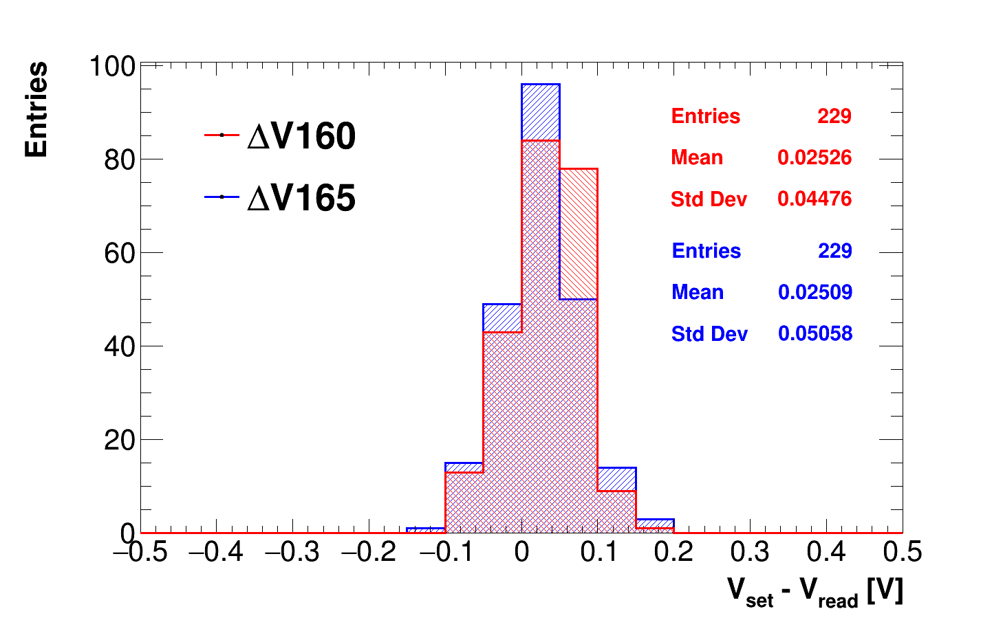
Calo electronics: FEE
3510 FEE boards produced, 3300 shipped to JINR for calibration
Two levels QC : Burn-IN in climatic chamber, Calibration of HV, amplification and signal shape.
2500 done and back to LNF → HV calibration performed again @ LNF for cross-check
800 still at JINR ➔ problems due to Ucrain- Russia war
Impossible to get them back
Elevated to Risk

Slide 6
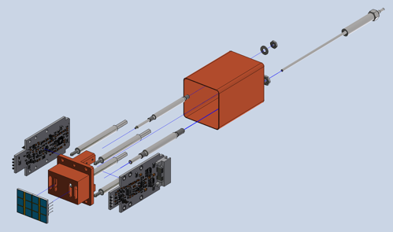
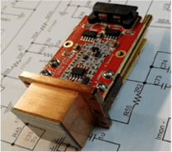
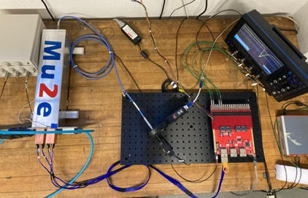
Readout Units (SiPM+FEE+FC) status
1066/1500 Holders + Faraday Cage (RO) assembled

Slide 7
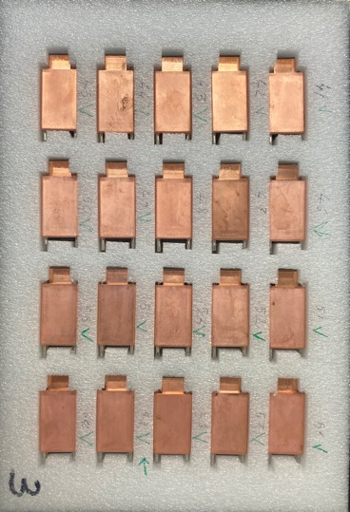
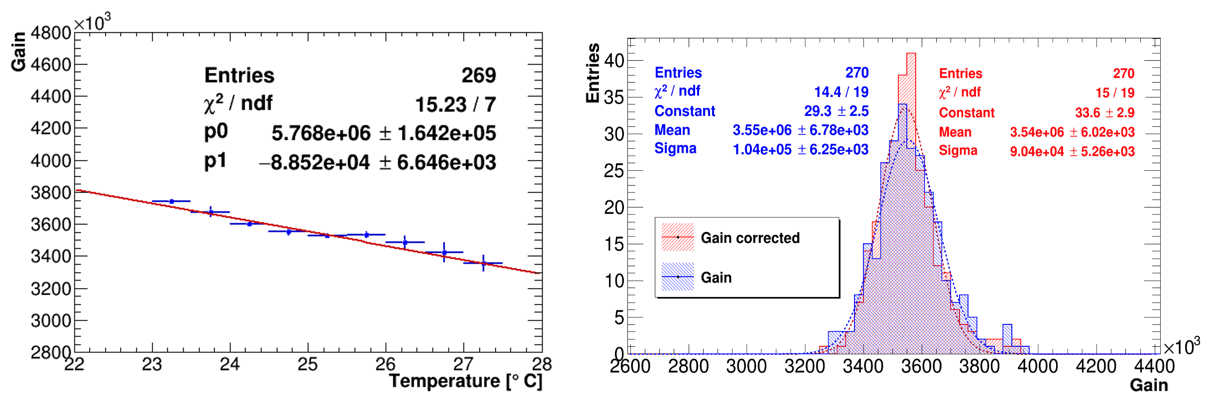
Readout Units (SiPM+FEE+FC) QC status
1066 ROU assembled, 600 tested at QC station, 100 Shipped
Complete 1200 for Oct 2022, 4 boxes ready to ship @ 100/box

Slide 8
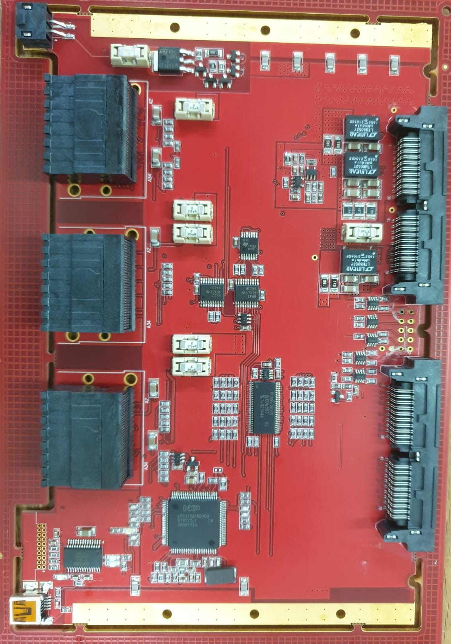
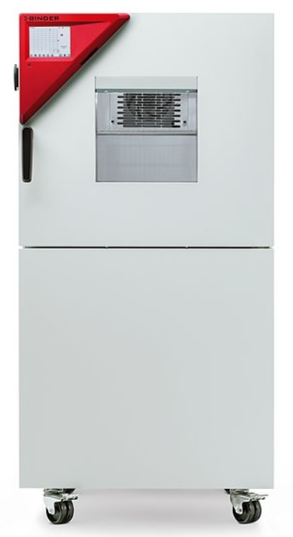
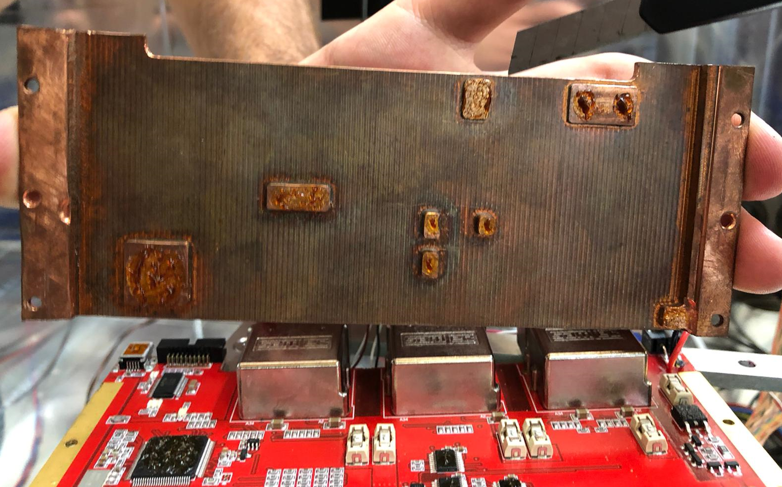
Digital electronics: Mezzanine Boards
After final irradiation (TID and neutrons) and B tests → design frozen
CRR completed in September 2021 and recommendations replied
Tender assigned. MB pre-series started end of 2021
First 10 “pre-series” boards delivered in March
→ Test of firmware, QC and Burn In done in June
→ Failing production quality tests: bad soldering
8/10 fixed, 4 under production anew
After final tests, new pre-series production
of 10 boards expected for Sep 2022
Pre-series Mezzanine board
QC station
Climatic
Chamber

Slide 9
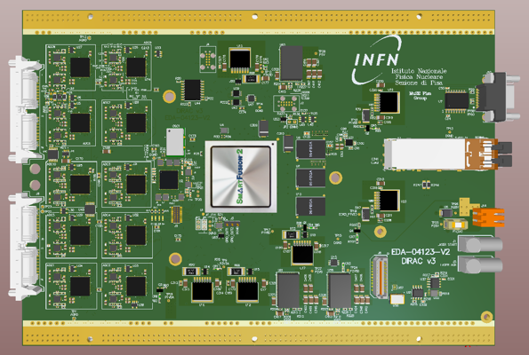
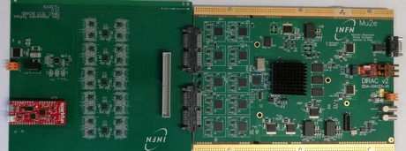

Digital electronics: DIRAC Boards
DIRAC is the digital board handling calorimeter data
5 Prototype V2 tested in 2021
Dirac V3 vs Dirac V2:
  small errors corrected, AutoReset added
Perform preCRR for DIRAC completed in Feb 2022
Tender assigned in Italy @ DF electronics
V3 prototypes on hand ( Dedicated Talk by F. Spinella)
20 ch board, 5 ns sampling
Same analog inputs and ADC
as of DIRAC V1, fully tested in 2019
New Rad-hard FPGA PolarFire
New VTRX readout (TDAQ)
Dose Test of components OK
B-Field test of DC-DC converter OK
Thermal tests with Cardlocks and
copper plate OK
Dirac board
Pulse board
Dirac board

Slide 10
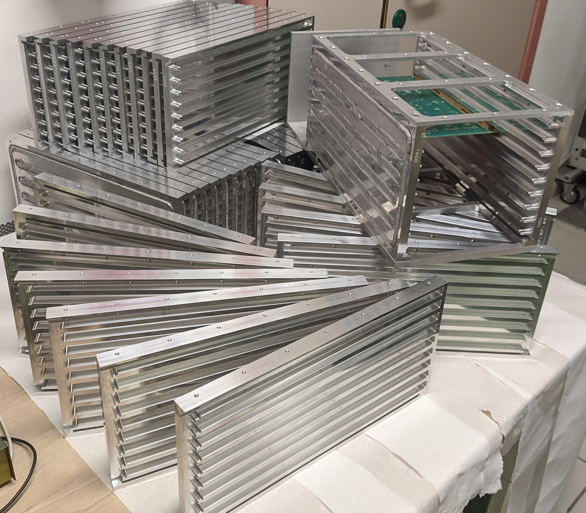
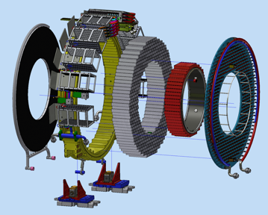
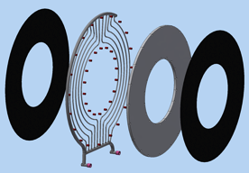
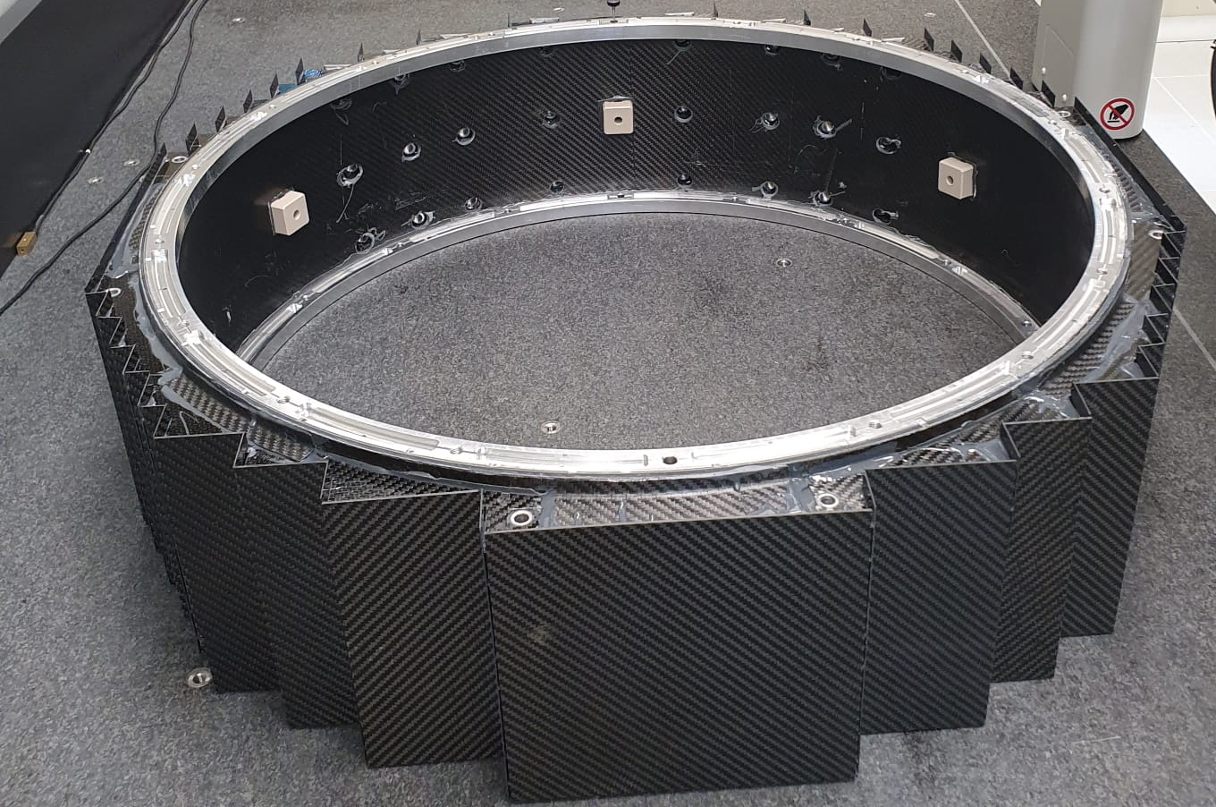
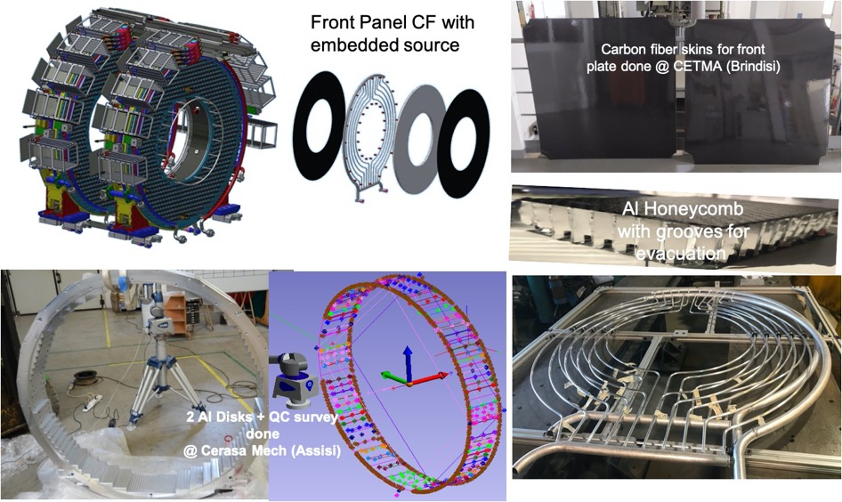
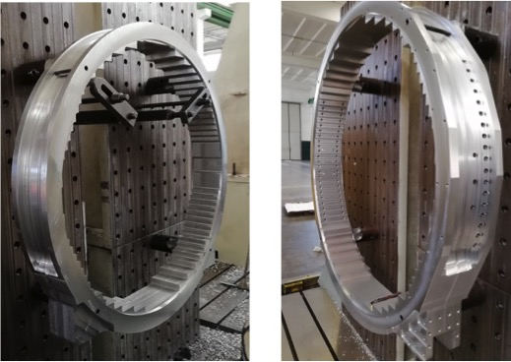
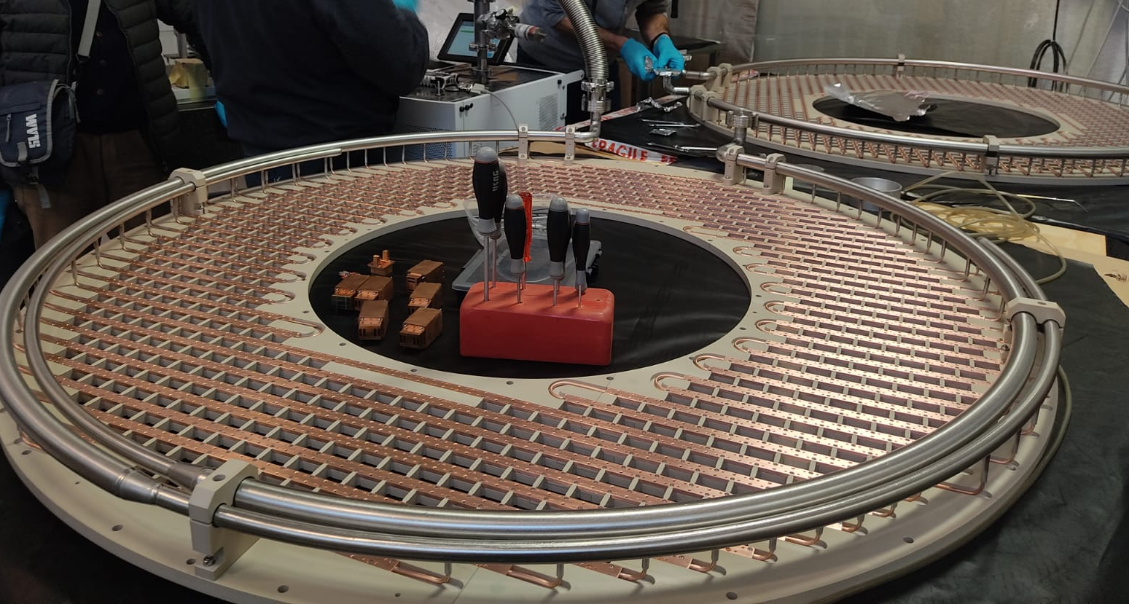
Calorimeter Mechanics: realization of large parts
Front Panel CF with
embedded source
Pipes
Crates
Carbon Fiber
Inner Ring
Integrated in July 2022
Calorimeter
Feet
Aluminum
Support Disk
FEE plate
in PEEK
Front Plate: CF+Al Honeycomb+
Al Source Tubing
See dedicated talk from Fabio for Assembly

Slide 11
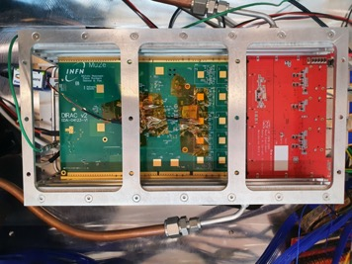
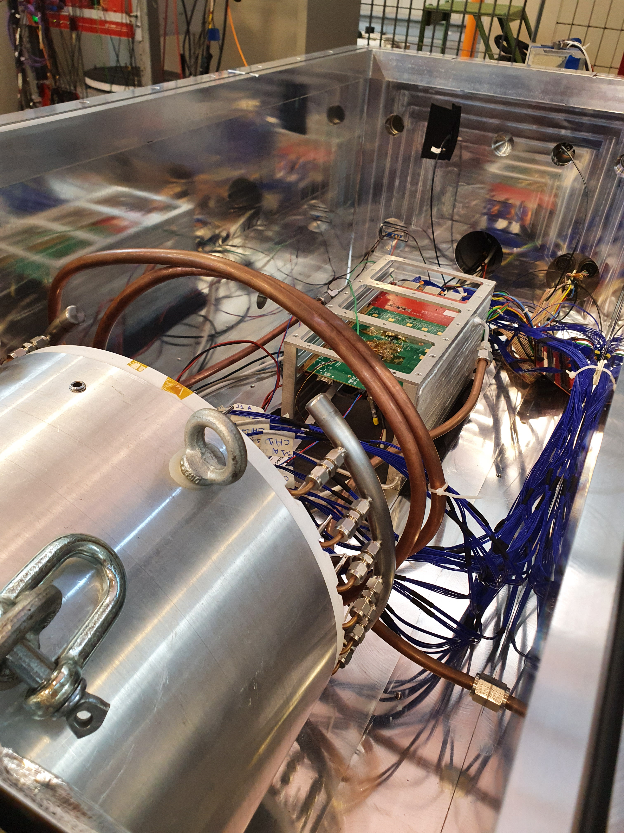
Calorimeter Vertical Slice test
10 months of operation with full Vertical slice test up to DIRAC Only serial readout. Fiber readout being integrated in OTSDAQ
Data collected in vacuum, at low T and with irradiated sensors
Tdiff of SiPMs/Crystal
σ = 270 ps
MIP charge distributions
DT (ns)

Slide 12
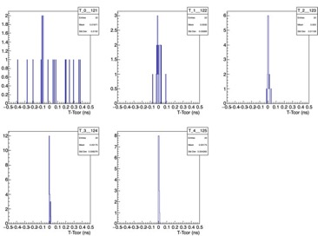
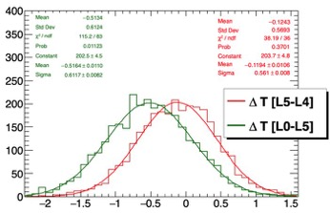
Calorimeter VST : a summary of results
200 keV Noise
400 mV/MIP
T0-align
T0-calibration done with iterative ”alignment” method ( residual better than 10 ps)
Results of timing btw all pairs really excellent ( < 300 ps)
No correction for travelling yet .. Good place for MC-comparison

Slide 13
Simulated Cosmic Ray Tracks in KPP Configuration
- Software trigger selection completed
6 hours needed calibrate:
energy scale @ 0.8 %
T0 alignment at 10 ps
→ Time resolution at 200 ps/MIP
<MIP> =20 MeV
RMS = 0.16 MeV
<T0s> =10 ps
RMS = 12 ps

Slide 14
Assembly & Installation scope
Prepare Clean Room for Installation
Mechanical assembly of Disk-1 (downstream)
Crystal stacking of Disk-1
ROU installation of Disk-1
Route FEE Cables from ROU-MB of Disk-1
Repeat in parallel for Disk-0 with a shift of few months
Assemble/insert MB on Disk-1/ Assemble/Insert DIRAC on Disk-1
Prepare TDAQ and services in SIDET → Install CRT + test ½ disk
Prepare/install services in Mu2e building (Cables/Pipes/Flanges/Racks)
Prepare installation tooling → move to enclosure
Cable/survey and test in Mu2e hall + Cosmic ray data taking
Complete control for heater system on Inner Ring
Fabio’s report
Next
Assembly
steps
Next
Installation
steps
Notes:
Change yellow highlighted text in header to your subsystem.

Slide 15
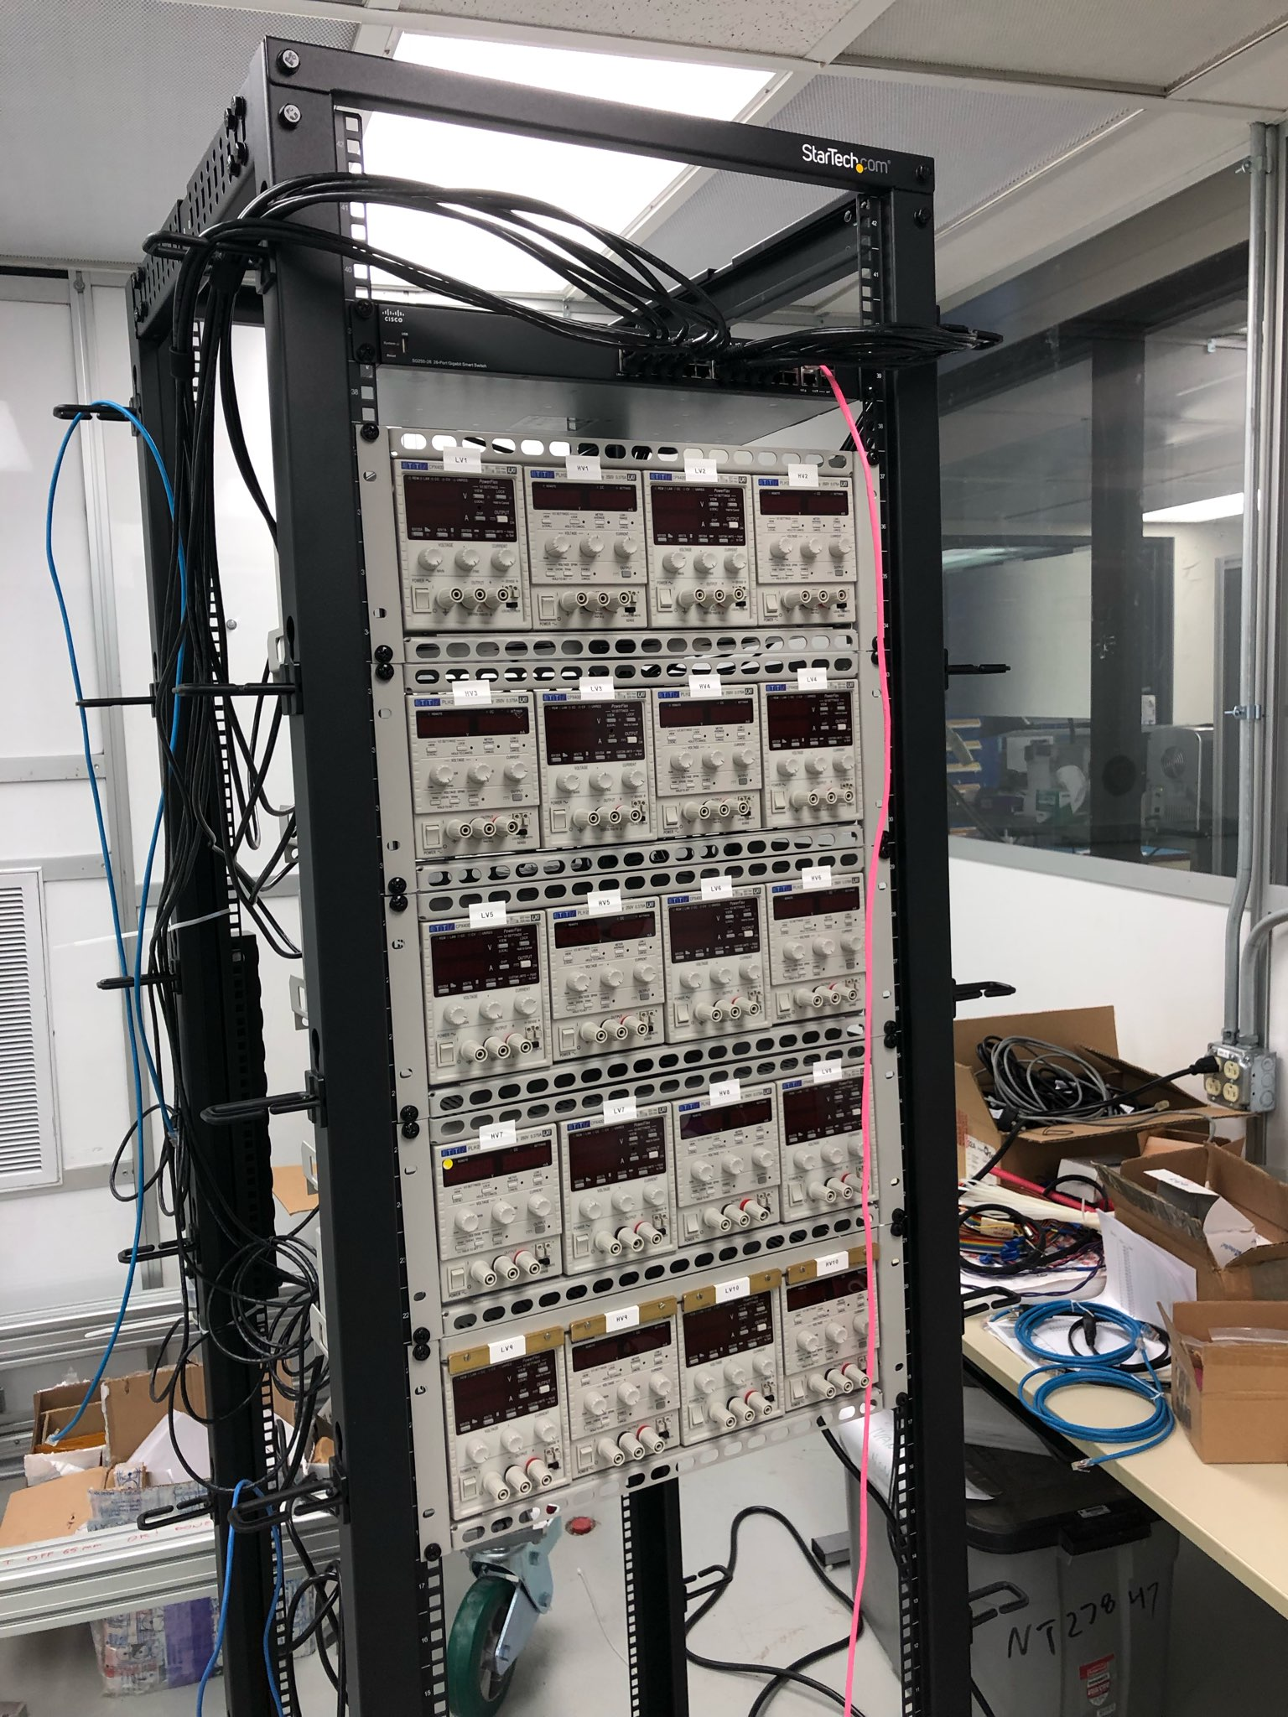
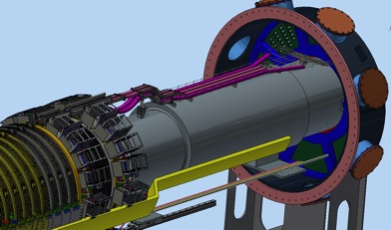
475.07.08: Parallel work on calorimeter services
Most of Cable and fiber services from TDAQ to IFB procured
LV/HV supplies procured and tested. Installation in TDAQ room in progress
For LV, successful test of temperature inside Rack crates with max emulated load OK
Next steps working on:
→Ethernet cabling, preparation of interface box for LV/Hvcables size match
→HV interlock system

Slide 16
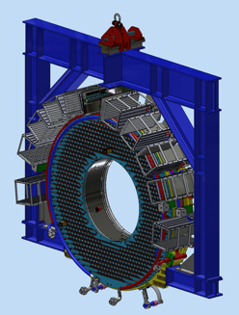
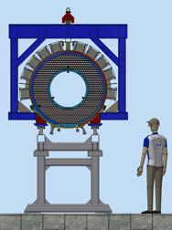
475.07.08: Calorimeter Installation and Integration
→ 90% of IFB-FeedThroughs procured
Missing procurement of IFB Rear (Design ready) and Radial (Design in progress) flanges
Still working on the procurement of cable/fiber services inside the DS
→ Still working on integration of cooling and calibration systems
→ Progressing on designs for installation toolings

Slide 17
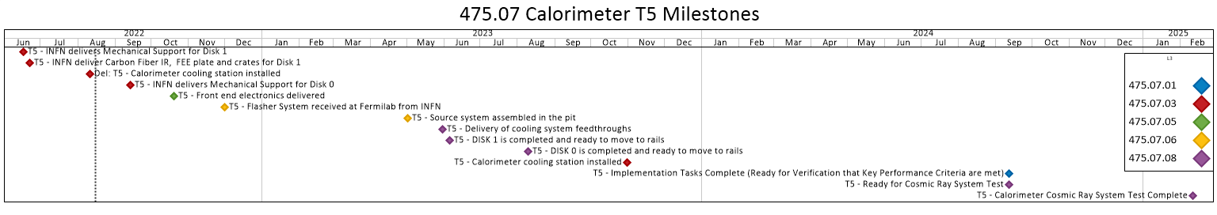
Schedule: 475.07 Calorimeter by Milestones
DONE
2022
2023
2024
The Calorimeter is well off the project critical path
Move to pit
Route /cable services
Connect
calo to IFB
Calorimeter CR test
Notes:
George – talk about an ordered list of activities.
Milestone waterfall

Slide 18
Calorimeter Cartoon Schedule
Current CD-4 Milestone
PS Fabrication
TS Fabrication
DS Fabrication
Critical path for the
Calorimeter system
Runs through the
Detector Solenoid
to Integration,
Installation and
commissioning
Solenoid Installation and Commissioning
Mechanics
RO delivery
Project Closeout
April 1
MB electronics
DIRAC electronics
Assembly and test of Disk- 1
Assembly and test of Disk- 0
Source assembled
Cooling Station
Project Complete
July 2025
Install in Hall
CR test
Detector KPP
Feb 2025
Solenoid KPP
April 2025
FY22 FY23 FY24 FY25 FY26

Slide 19
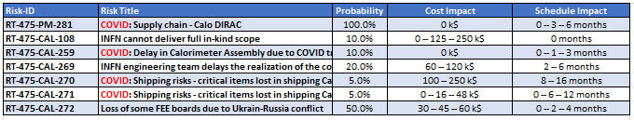
Calorimeter Risks
Risk Register pulled from Sharepoint: Docdb 4320

Slide 20
Additional Material

Slide 21
Mu2e Calo Calibration source
Neutrons from a DT generator in the Mu2e building irradiate a fluorine
rich fluid (Fluorinert)
The activated fluid is piped to the front face of the disks
The following reaction chain grants photons at 6.13 MeV
+ 1 or two escape photons
The produced gamma’s illuminate uniformly the
calorimeter crystals
Few minutes of data taking allows to
cross-equalize and calibrate each crystal
at O(%) precision

Slide 22
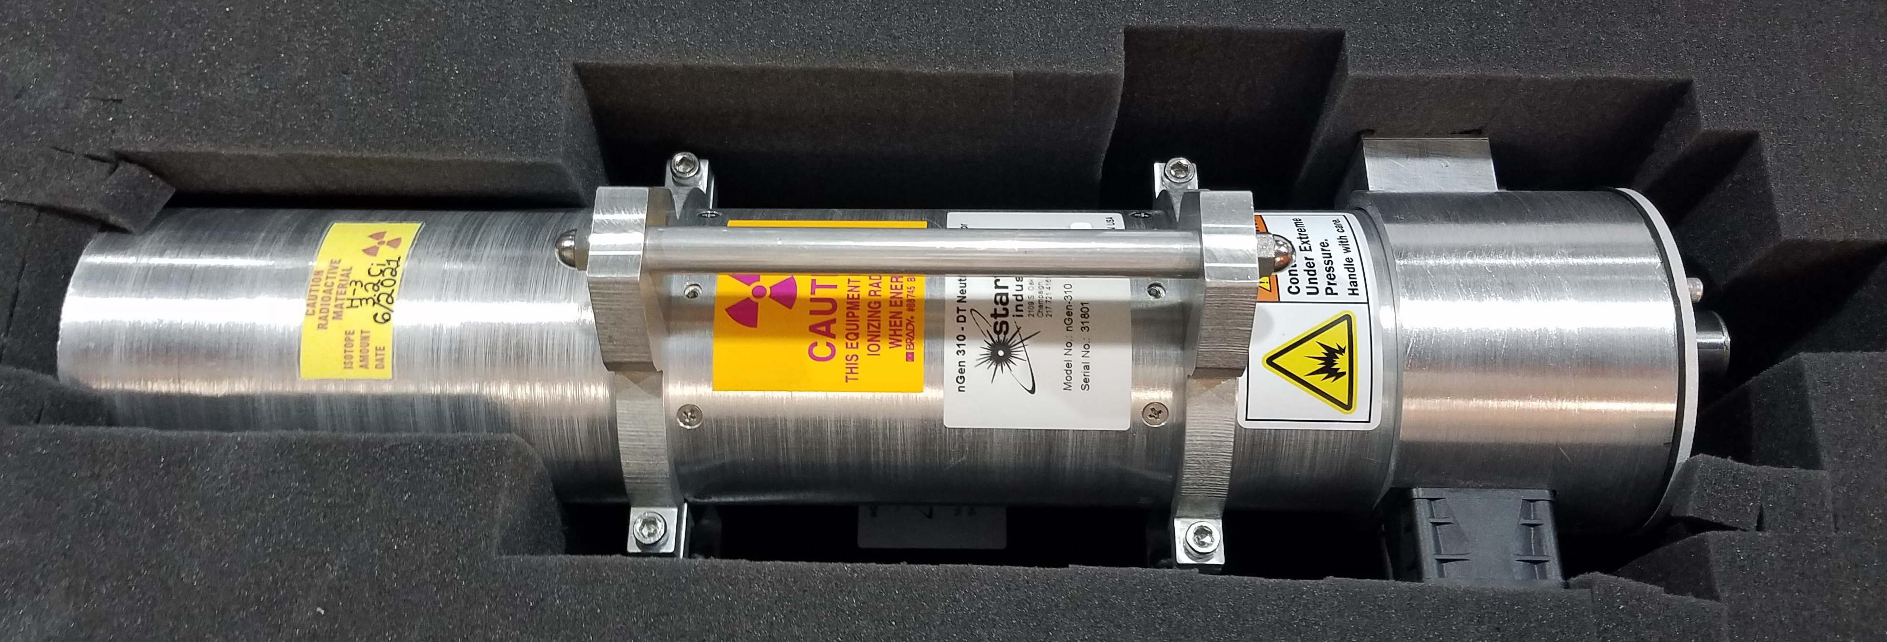
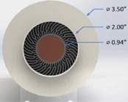
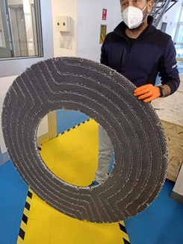
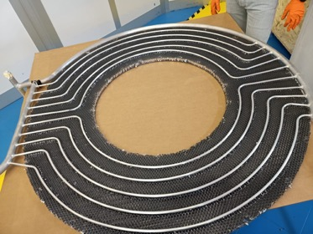
Calorimeter Source: generator and Alluminum Tubing
Starfire nGen-310 with Tritium fill
  1e9 n/s, 14 MeV
DT generator is at FNAL (SITE 40)
  3.2 Ci Tritium as of June 2021
  Working to set up acceptance test at FNAL
DT generator yield test
  Plan to do in Mu2e hall
  FNAL radiation physics will measure neutron rate using activation of Al foil, neutron Rossi sphere
Procedure for acceptance test mostly written
Aluminum Tubes realized from Caltech/FNAL
and shipped to INFN → now being integrated on
Carbon Fiber/Honeycomb front plates.
Work on control system in progress

Slide 23
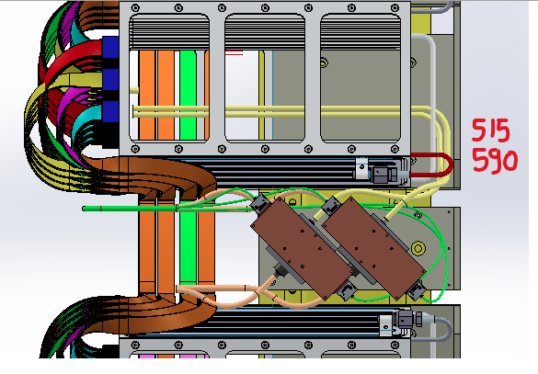
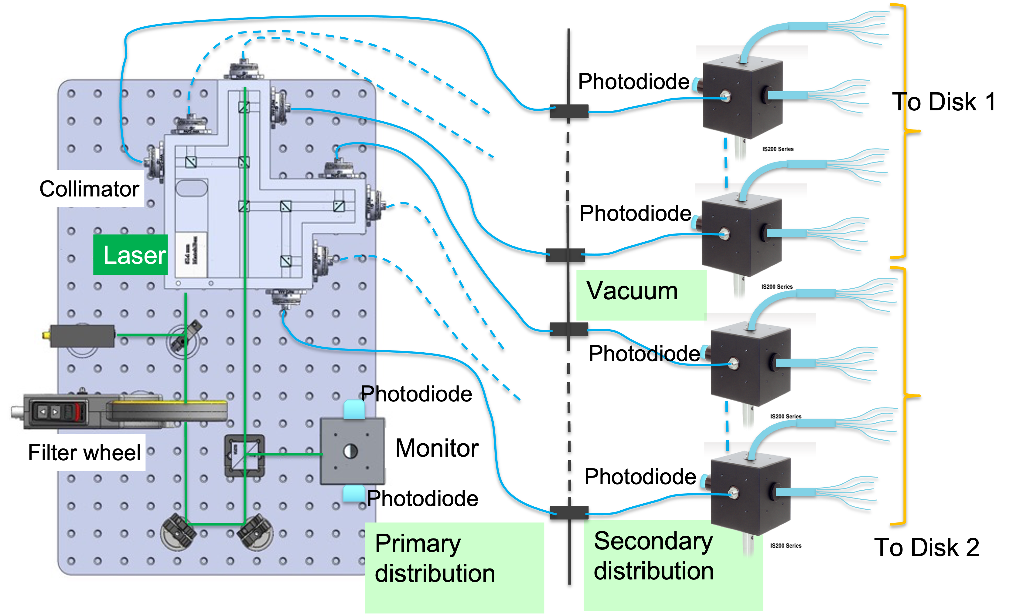
Status of Laser
Design of the laser calibration system finalized including local monitoring on disk (outgassing of Teflon holder of the bundles,
rad hard test on fiber bundles done)
Fibers length frozen for the fibers’ routing
Procurement in progress, completed at 80%
Remaining work to do:
Test of the complete system, from the laser to the SiPMs
(new FEE high gain produced & FNAL access required)
Integration with the TDAQ system
Design and realization of the Interlock box

Slide 24
WBS 475.07.08 Completed Scope
Prepared Clean Room for Installation
Mechanical assembly of Disk-1 (downstream)
Crystal stacking of Disk-1
Technical progress is on track
Lessons learned incorporated into re-baseline plans
Interfaces are well defined
Remaining work is well understood (next slides )
➔Due to COVID, the mechanical integration and the preparation of the RO units have been carried out @ INFN requiring a lot of effort for shipment, custom duties and new lab organization
now that situation is ameliorated we have started shipping back everything to FNAL
Notes:
Change yellow highlighted text in header to your subsystem. Use Stefano’s & Ryan’s talk format. Show pictures and include bulleted list.
In this template, I have removed references to Director’s Review Recommendations

Slide 25
WBS 475.07.08: Assembly/integration + Installation
Detailed steps per Disk-1
1. Assembly and survey of the mechanical support (Al disk + FEE plate + CF IR)
2. Leak test of FEE plate
3. Crystal outgassing + crystal stacking and front plate assembly
4. Crates, services and manifold installation + leak test
5. Readout units (ROU) installation
6. MB insertion in crates and ROU-MB cabling
7. Test of cable routing and ROU units, board by board
8. Installation of DIRAC boards in crates
9. CR data taking at SIDET ( ½ disk )
In parallel .. Preparation of Disk-0
Ready to Move , preparation of Installation tooling
Parallel preparation of services from TDAQ to IFB
Parallel preparation of LV/HV supplies
Parallel preparation of flanges
Set-Oct-2022
Nov-Dec-2022
Mar -2023

Slide 26
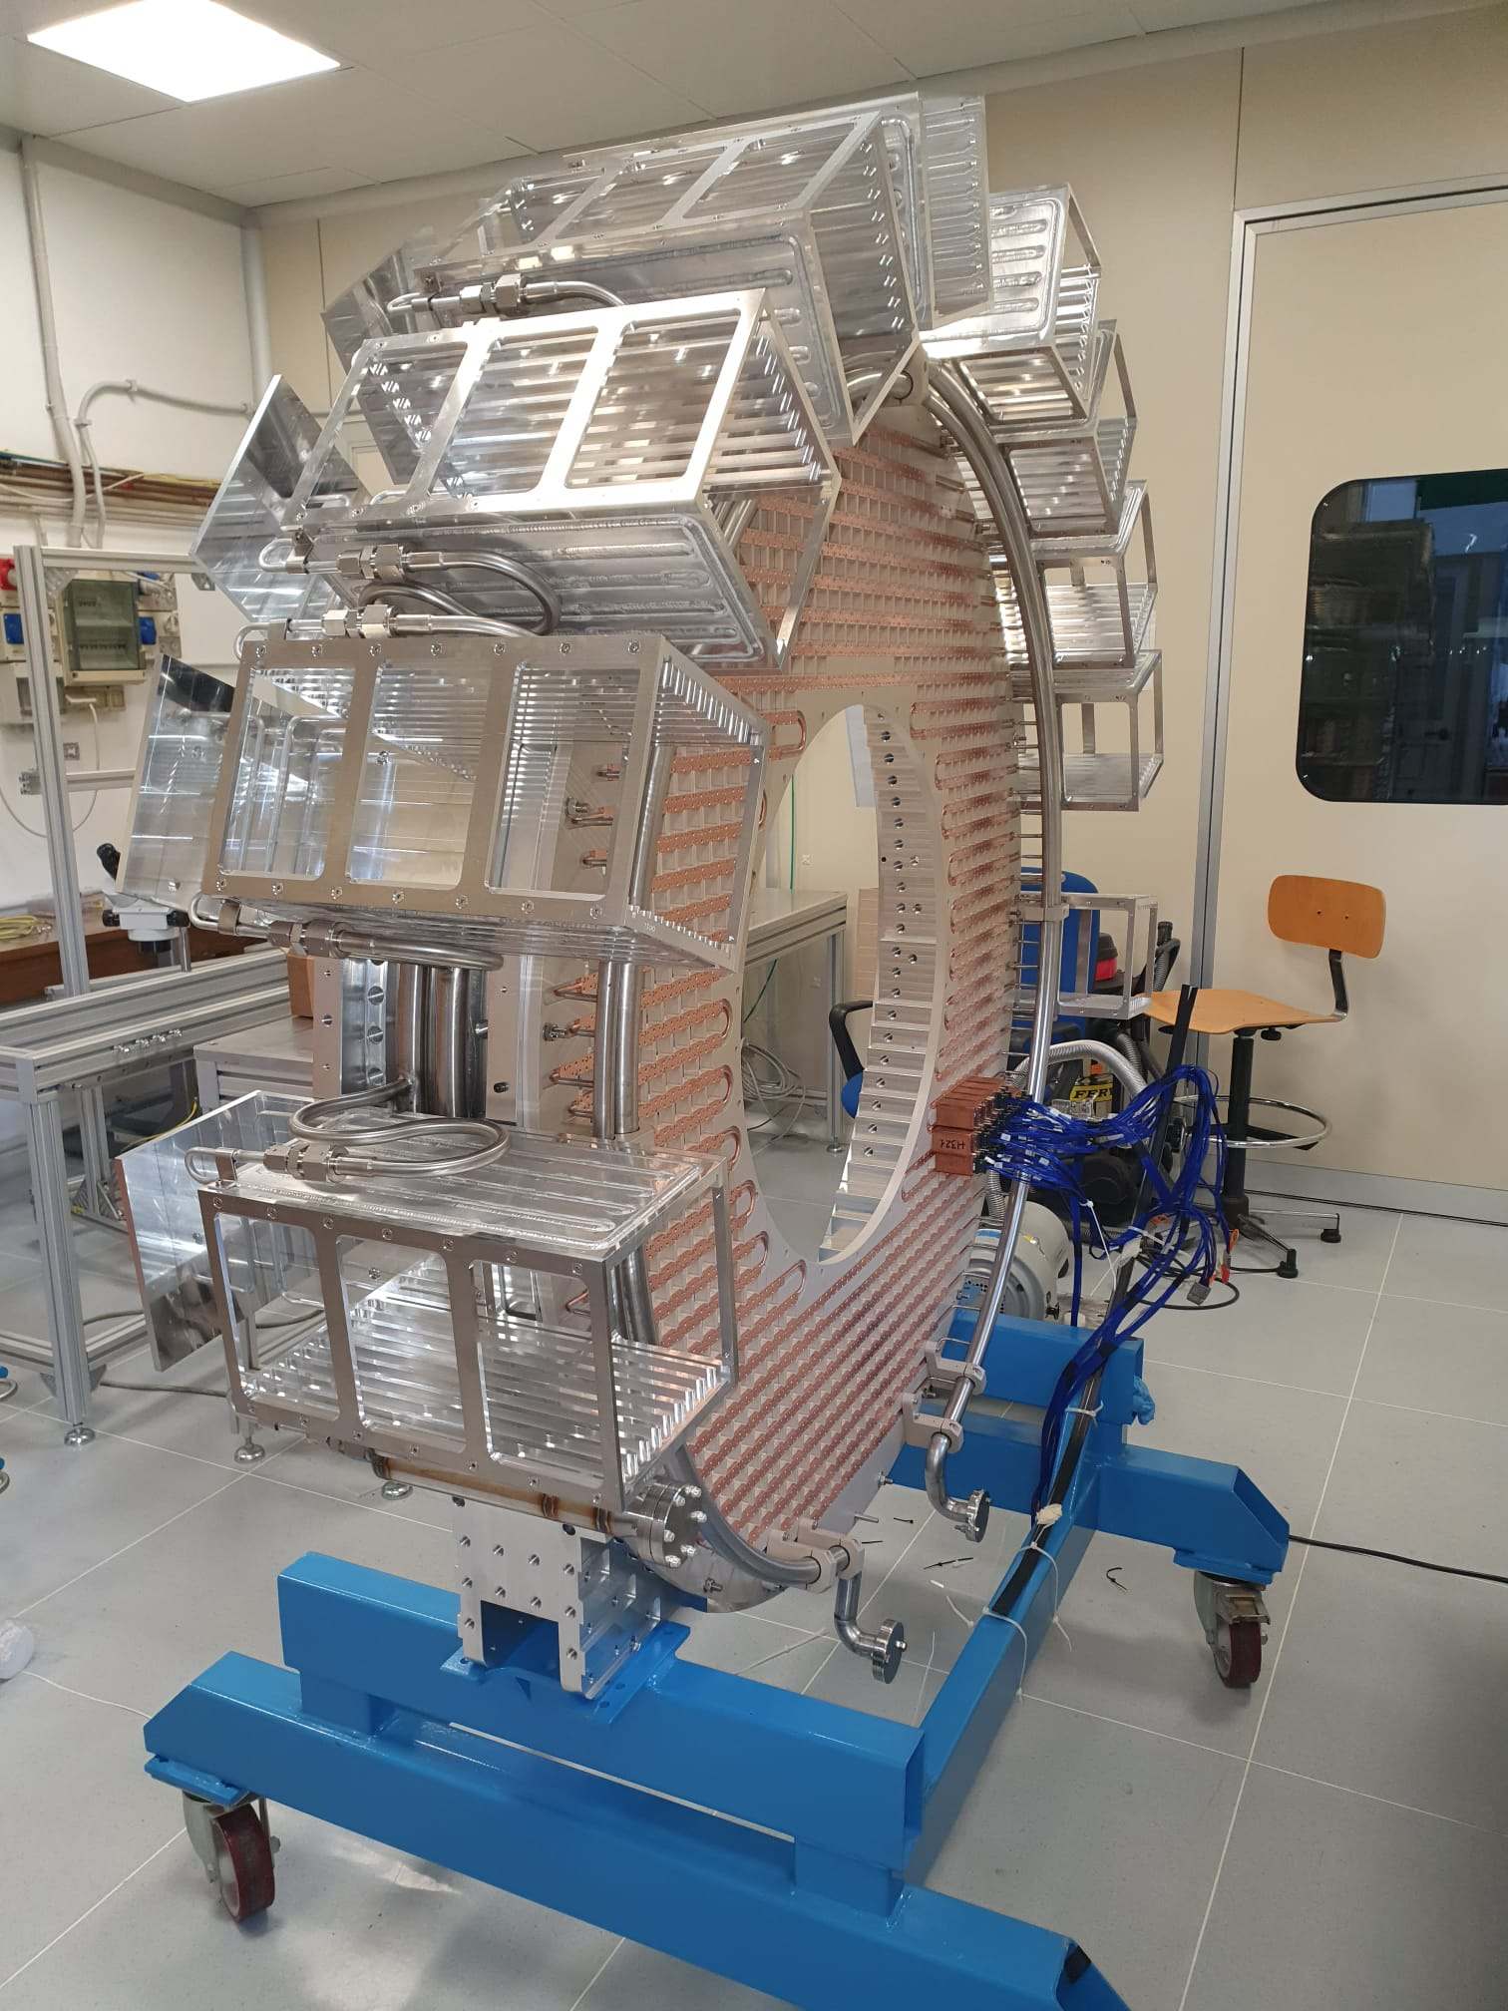
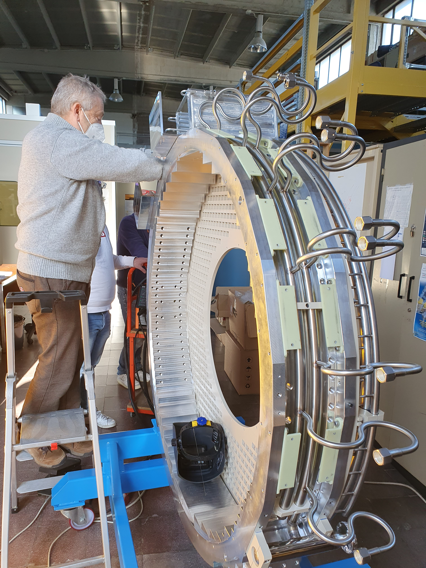
Learning lesson: Dry Fit sequence at LNF in ASTRA laboratory (Jan-May 2022)
Outer Ring + Back Plate
+ Manifolds
Outer Ring + Back Plate
+ Manifolds + Crates

Slide 27
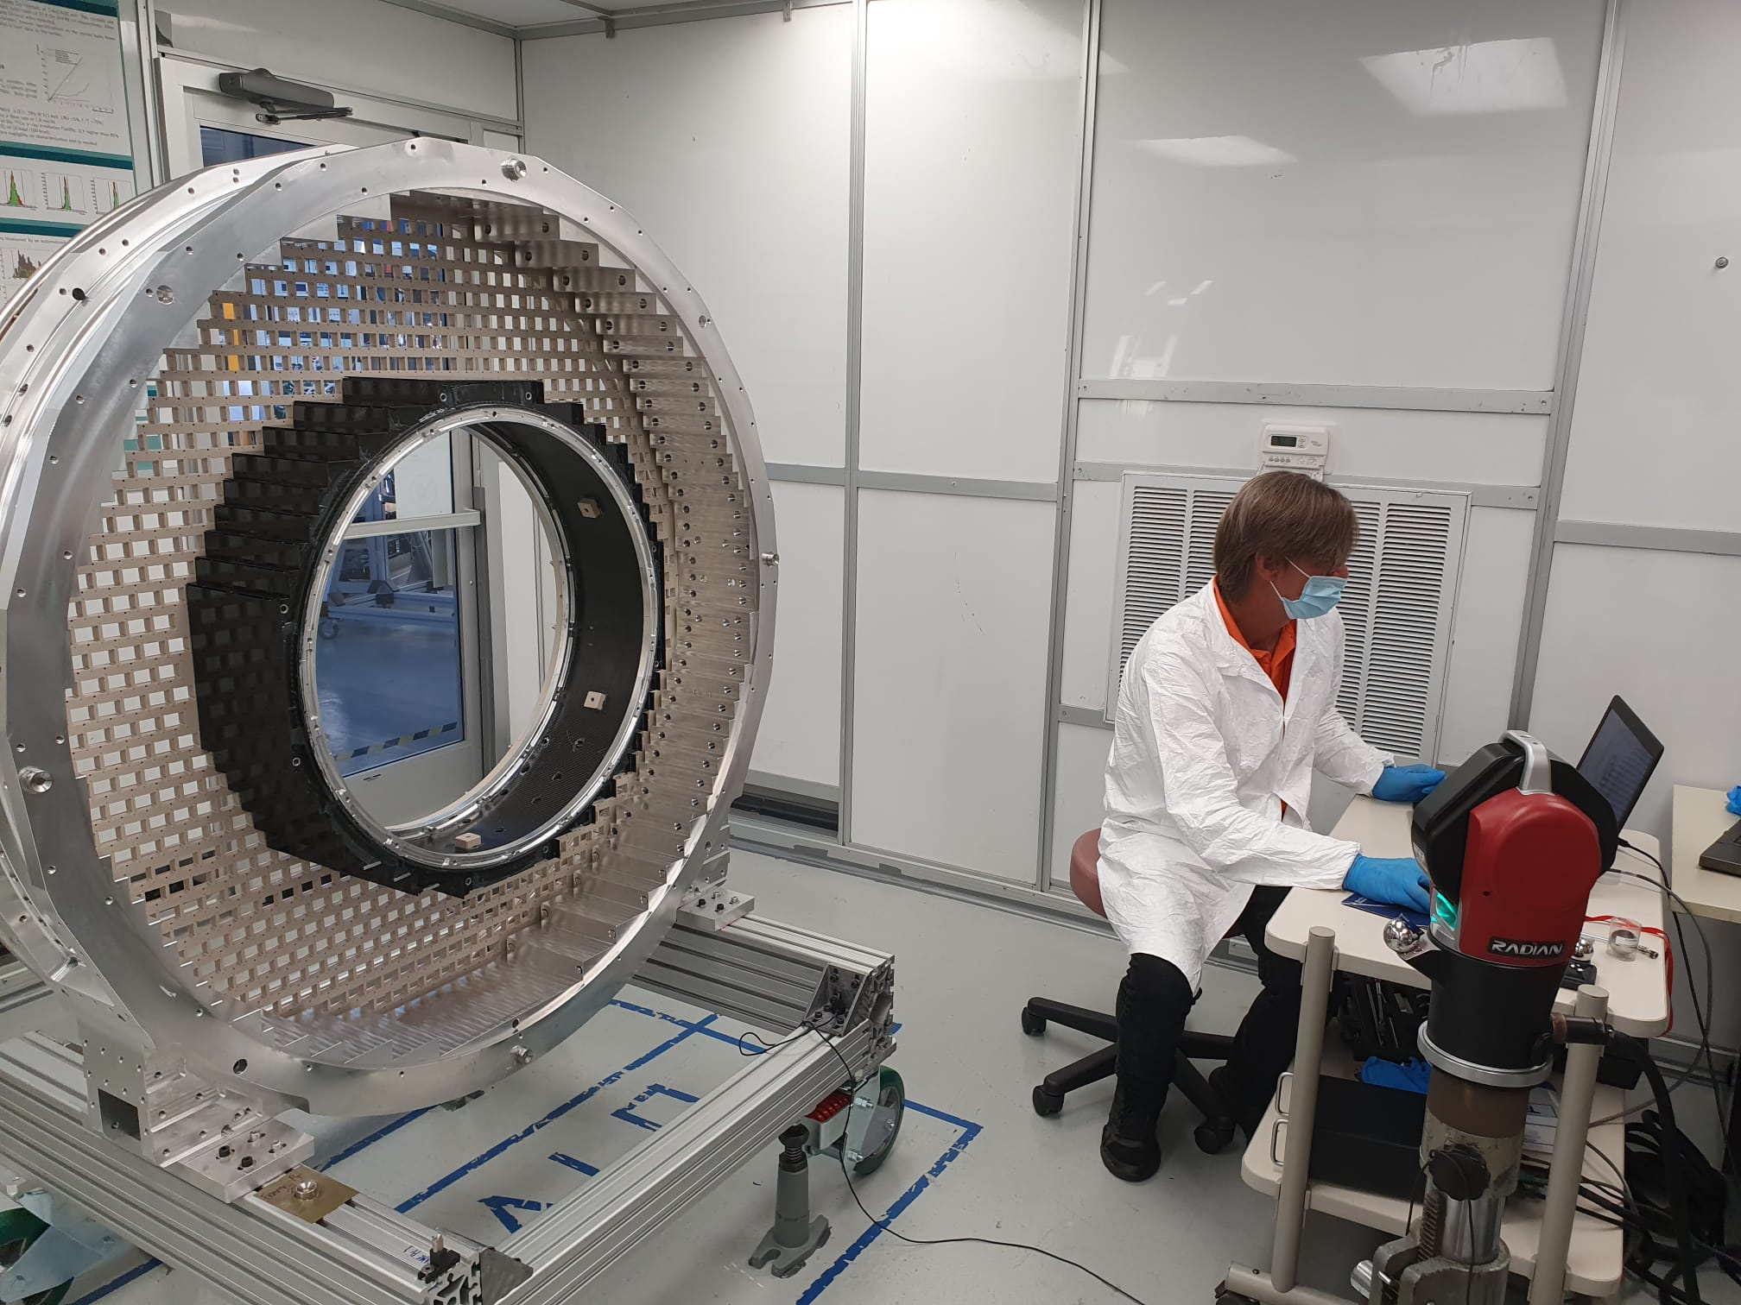
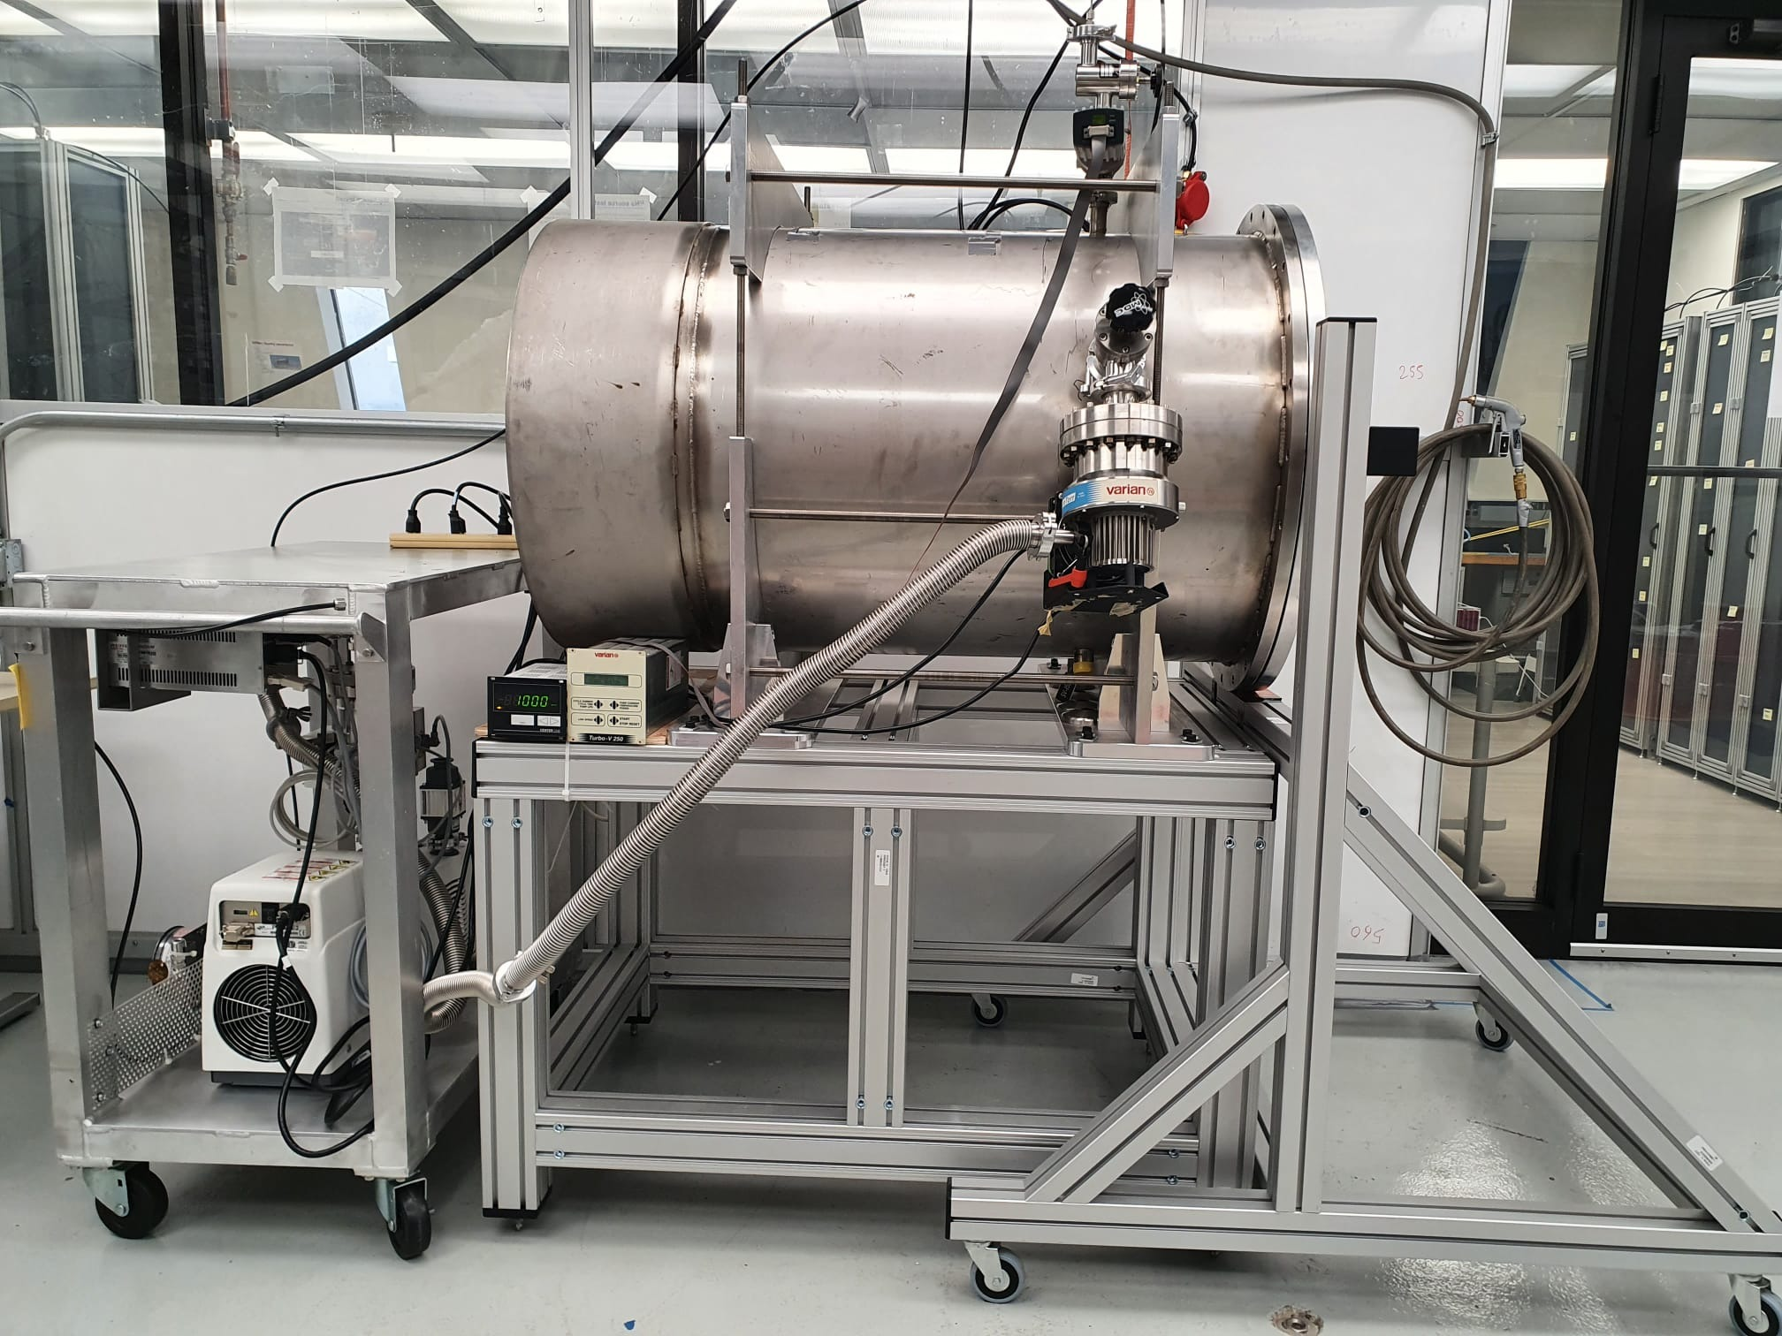
475.07.08: Preparation of clean room in Sidet
Preparation of the assembly room in Sidet almost completed
→ Clean Room ISO-7, services
→ Outgassing vessel mounted + ORC for the Outgassing vessel
→ final adjustments in progress: N2 lines, bottles, ORC + calorimeter tent

Slide 28
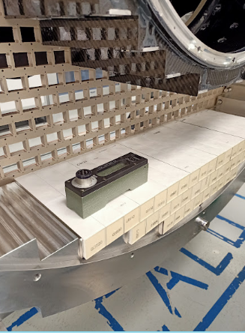
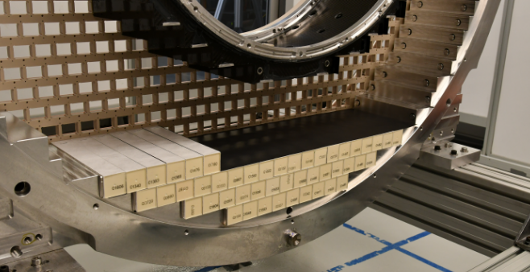
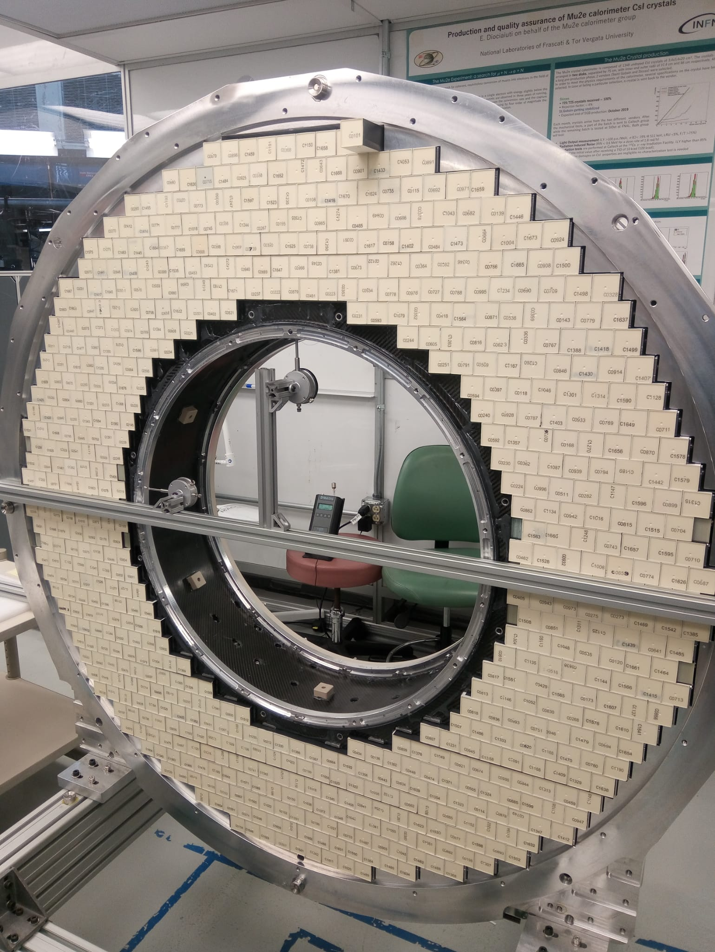
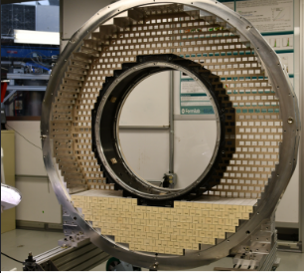
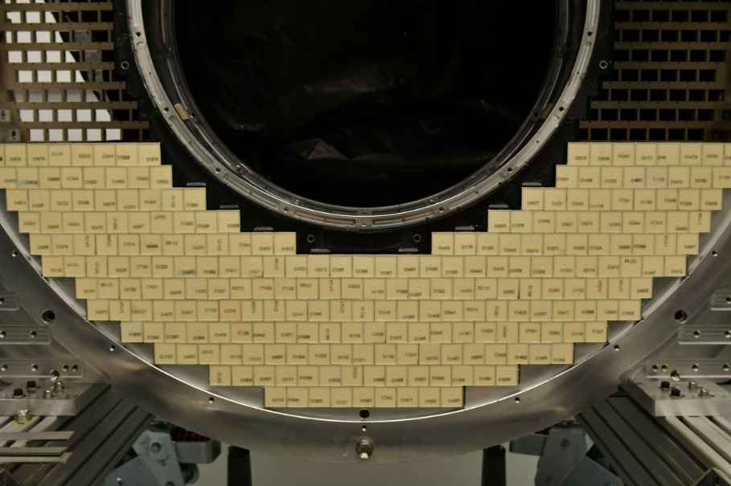
Assembly of disk-1 in Sidet (Step – 1 )

Slide 29
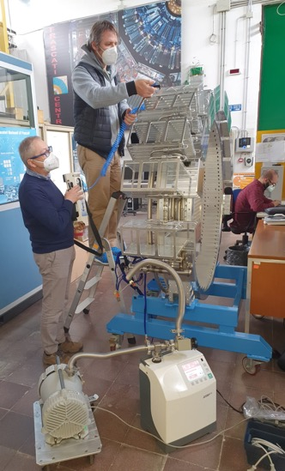



475.07.08: crates and manifolds leak test (repeat from dry-fit)
Leak test on downstream crates
Leak test on upstream crates
Excellent results on leak test ( 10⁻¹⁰/10⁻¹¹ mbar*l/sec)

Slide 30


475.07.08: RO units + cable routing from mockup to final
NEXT STEPS
Complete cable
routing test to crates
Shipment to FNAL
of all large mechanical
parts for disk 1 done
in May 2022

Slide 31
Remaining Scope and delay chain issues
preCRR for DIRAC done, CRR planned for the summer with completion of VST
with fiber readout and SEU test with proton beam.
All DIRAC components available at the firm except from Polar Fire FPGA
→ See dedicated talk by F. Spinella
→ Supply chain delay of 52 weeks mitigated by integrating the disk with MB and
DIRAC prototypes for cabling and testing. Delay inserted in P6.
Low: 0 , i.e. assume current delivery date from vendor partial delivery
Med: +3 months based on discussion with vendor
High: +6 months maximum expected boundary
0 3 6
Additional Months
Notes:
Big deal for covid and supply chain
George’s talk – include Subsystem procurements that are key to driving the integration
IFB, concrete are big procurements

Slide 32




Tuning the installation steps in images
Hard services are packed ..
Check if source welding is accessible
Routing cabling from IFB
to Disk1 then move to Disk0
Feet should be already on rails
before lowering the disk

Slide 33
Calorimeter cooling lines , fluid and such
Coolant fluid to be used is: 3M Novec 649 Engineering fluid.
MAWP (Maximum Working Pressure) :
10 Bars
Max/Min Temperature in the pipes:
-22 C – room temperature
Max flow: Line 1 (Crates)
1.36 kg/sec, Line 2 ( SiPM) 2.5 kg/sec
Material compatibility:
→Viton is excluded
Gasket or O-Ring in NBR (Gomma Nitrile Butadiene)
Peek

