Slide 1
Mu2e-experiment Overview
Project Rebaseline
Stato dell’esperimento Solenoids
  Accelerator
  Tracker
  Calorimeter
  CRV
Cost and Schedule
S.Miscetti
Meeting with Referees
5-Sep-2022

Slide 2
Rebaseline of Project
The Project cannot be completed before the CD-4 milestone of 12/31/22.
There are two, largely independent, drivers of this delay
  The COVID-19 pandemic has significantly delayed the project completion date
    Biggest impacts are to the Tracker, Transport Solenoid and Calorimeter
  Delays at General Atomics have pushed the project completion date beyond the CD-4 milestone
    Impacts Production and Detector Solenoids.
    Biggest indirect impact is to Muon Beamline.

Slide 3
Bottom Line Up Front
Significant and impressive technical progress on all fronts
Mu2e project cannot be completed before the CD-4 milestone or within TPC
  COVID has significantly delayed field work on the TS, Accelerator and detectors
    Replanned field work with COVID protocols has resulted in increased costs (more work stations/tooling, work inefficiencies, etc.)
    COVID supply chain issues have resulted in cost increases and increased lead-times.
  Critical path magnets (PS and DS) have been significantly delayed due to vendor performance issues
  Lack of resources has caused schedule delays in completing designs and fabrication
  Additional contingency draws result from underestimating design complexity
  Schedule delays have turned into draws on contingency that will cause the project to exceed the TPC
Original Project contingency has been depleted. Project will run out of funds by early Q2FY23.

Slide 4
Bottom Line Up Front
  A Project rebaseline is required
    Project is 85% complete. A new plan is in place, but additional time/money is needed to execute that plan to completion.
    TPC including estimate uncertainty and project risks: $316.0M
    Early CD-4 date of June 20, 2025
Director Review done on May 2022
OK for technical points
A lot of recommendations for Cost/Schedule/Risks
DOE IPR Rebaseline Review → 13-15 Sept/2022
ICE (Independent Cost Review) → 28 Sept/2022

Slide 5
475 – Mu2e project – Remaining Scope
 | Level 2 | % Complete | Major Remaining Scope by Accelerator L3
475.01 | Project Management | 88.4% | LOE
475.02 | Accelerator | 88.3% | Final focus, ESS, Extinction System, Extinction monitor
475.03 | Civil Construction | 99.2% | Concrete work for proton absorber albedo trap
475.04 | Solenoids | 85.2% | PS/DS payment milestones, TS assembly, QPS, Cryo & Solenoid installation
475.05 | Muon Beam Line | 55.3% | Vacuum system, Collimators, Proton absorbers, beam stop, stopping target monitor, detector support, shielding
475.06 | Tracker | 81.0% | Remaining panels/planes, electronics, tracker assembly, services, installation/integration
475.07 | Calorimeter | 83.8% | Disk assembly, electronics, source system, services, installation & integration
475.08 | Cosmic Ray Veto | 88.0% | Remaining modules, electronics, installation & integration of modules for detector KPP configuration
475.09 | Trigger and Data Acquisition | 87.3% | Readout fiber plant, servers, detector readout support
 | Total | 84.5%
Notes:
% Complete determined from Mu2e BCP dataset looking at the Cost Performance Report by WBS or CA.
% complete defined = Cumulative to Date “Earned”/ At Complete “BAC”
Also shown in % Complete Column

Slide 6
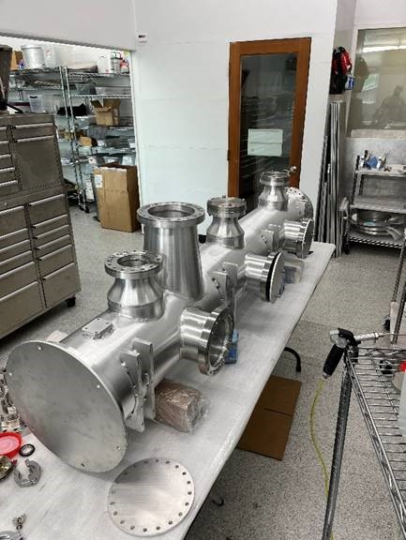
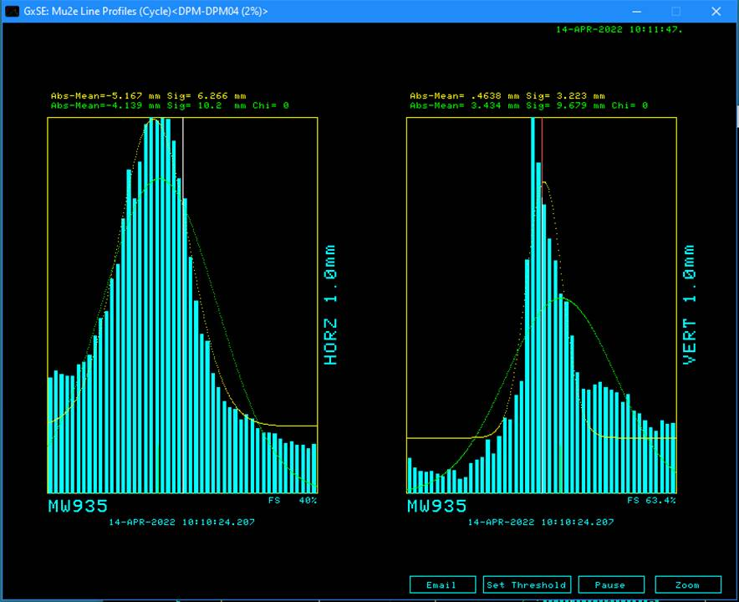
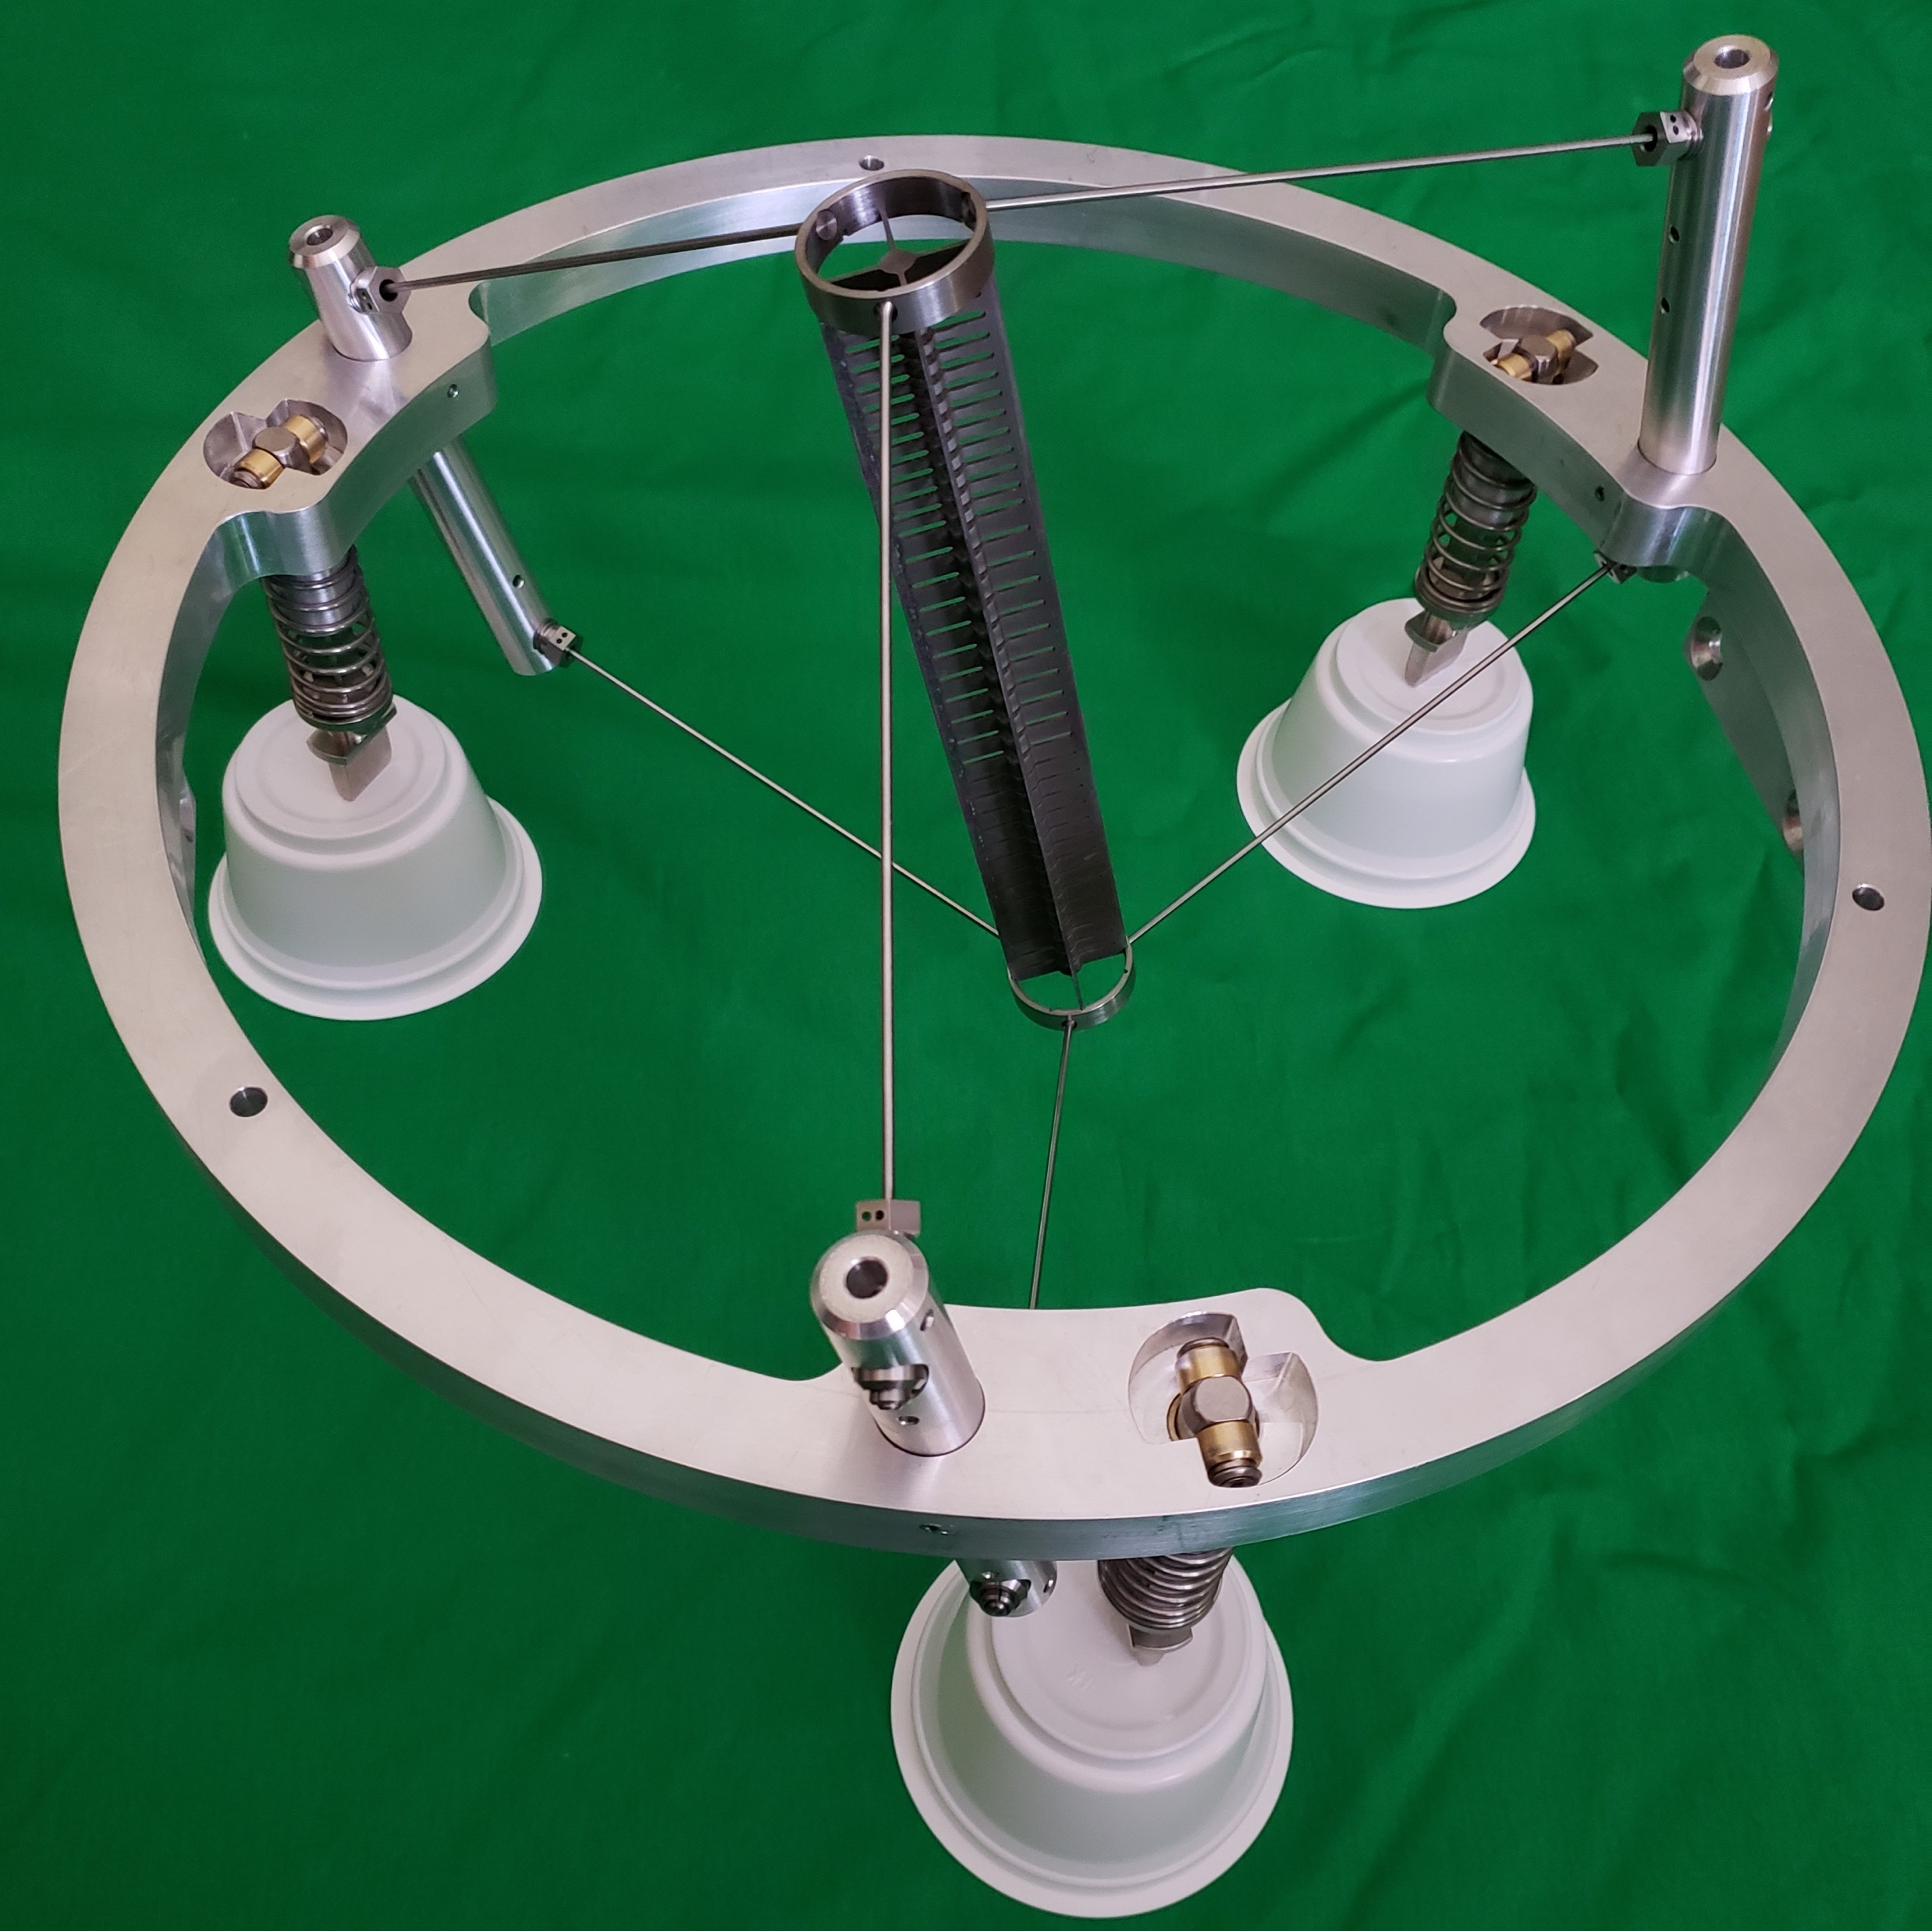
Accelerator – 88% Complete
Remaining Scope
Complete assembly of 2 production ESS
Complete Extinction System AC Dipoles
Install Extinction Monitor System
Fabricate remaining beamline elements (ESS, Final Focus, AC Dipoles, power supplies, etc.)
Install HRS into the PS
Complete remote handling system controls, cart & RHR door
Completed Scope
KPP Achieved - Demonstrated 8GeV proton beam transport to the M4 beamline diagnostic absorber
Prototype electrostatic septa (ESS) fabricated. Production ESS components procured.
Extinction AC Dipole ferrites -100% delivered, mechanics procured. Extinction monitor sensors/readout assembled.
Production target fabricated. Prototype target handler mechanics complete.
Challenges & Plans
Work with division heads to ensure availability of resources to execute remaining scope of work (MOA)
Continue to advocate for strong support of Operations for beam commissioning (e.g. resonant extraction studies)
Remaining work well understood

Slide 7
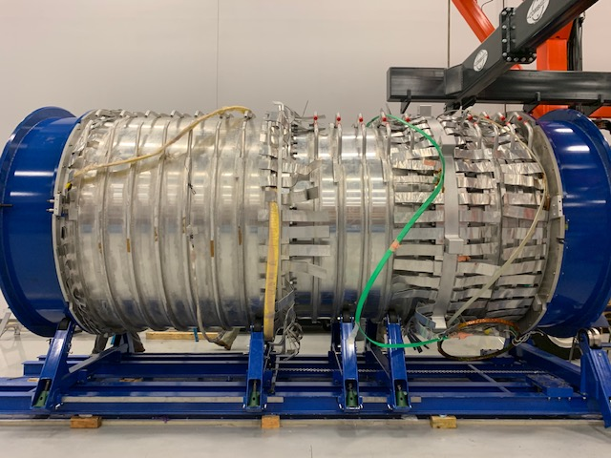
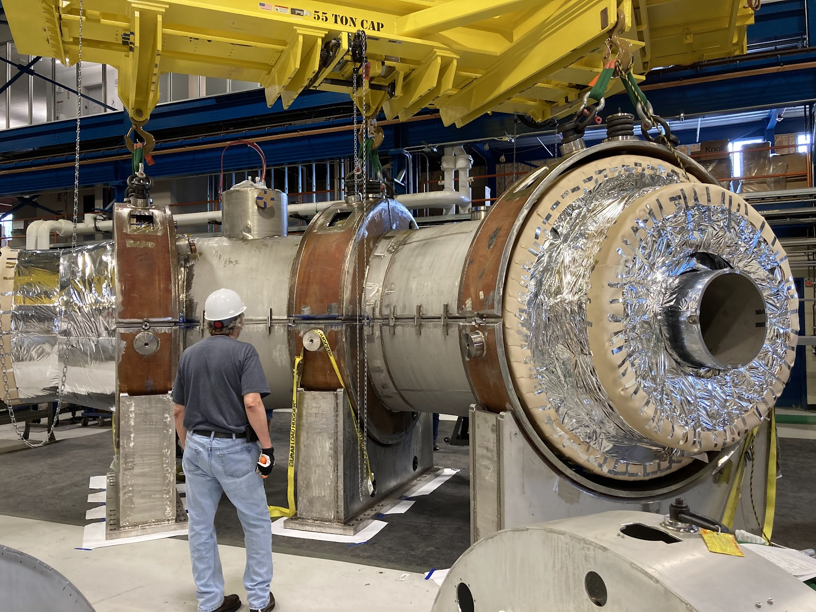
Solenoids – 85% Complete
Remaining Scope
Complete DS coils. Complete PS/DS cold mass assemblies, cryostat, ship to Fermilab (Vendor). Install. Power test.
Cryostat TSu/TSd. Install. Power test.
Complete installation of cryogenic feedboxes and xfer lines. Complete connections to solenoids.
Complete Quench Protection System installation & programming. Complete field mapping programming.
TSu
PS1
PS2
PS3
Completed Scope
PS/DS designs complete. 100% PS coils fabricated. DS coils 77% complete. (Vendor)
TS design complete. TS cold mass fabricated (vendor). All units passed acceptance tests at FNAL. TSu/TSd cold masses and thermal shields assembled.
PS/TSu cryogenic feedboxes installed. 8 transfer lines completed. 2/4 mid-run interconnects completed.
2/4 cryogenic feedboxes installed. All 8 transfer line segments in place. 3/4 midrun interconnects nearly complete
Challenges & Plans
Working with vendor to mitigate further PS/DS schedule delays
Work with division heads to maintain cryo tech support to mitigate cryo transfer line cost and schedule
Work with division heads to maintain solenoid engineering & tech support for TS assembly (MOA)
Identified replacement power supply L3. Working with divisions on identifying team for installation tasks (MOA).
Remaining technical scope well understood. Additional complexity reflected in replan.

Slide 8
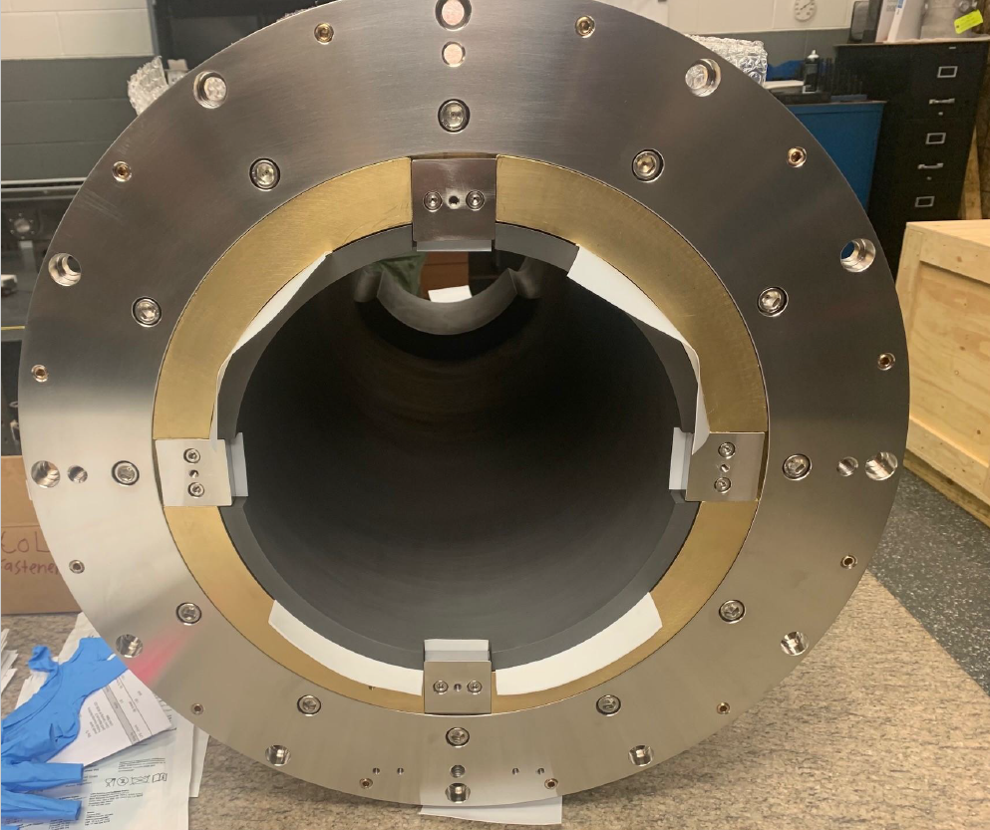
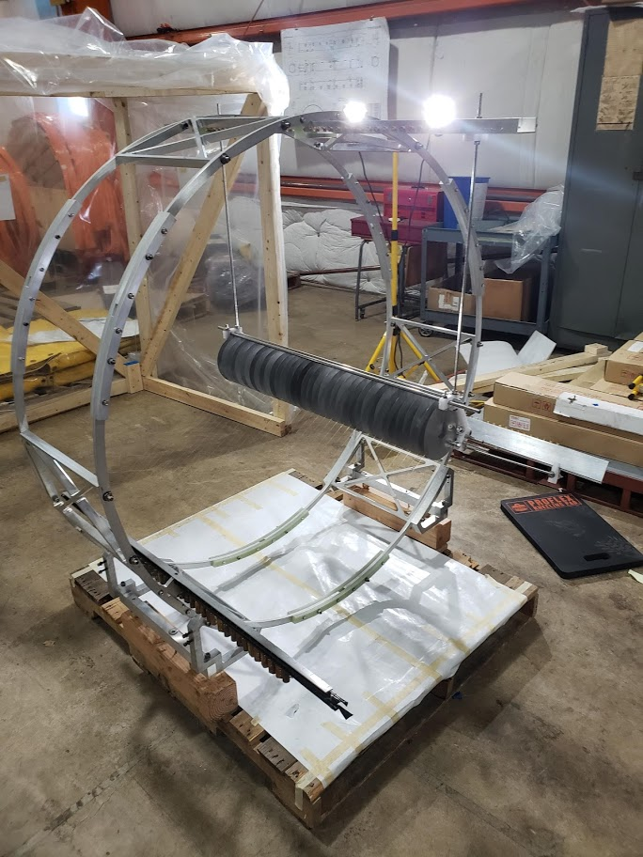
Muon Beamline – 55% Complete
Remaining Scope
Complete major collimator component procurements, and advance fabrication of antiproton stopping window housing
Get POs in place for major Muon Beam Stop components and for remainder of DS internal shielding
Finalize detector support system component designs
Finalize DS endcap design (IFB and VPSP) and get procurement underway
Completed Scope
Stopping target assembled
Procurement of collimators in progress, COL1 delivered
Bids for major component of Muon Beam Stop provided by potential vendors
Developing and testing readout for STM Continuing to refine designs for STM infrastructure
Developed design for trench cable management system
Challenges & Plans
Working with detector subsystem leads to clarify and finalize detector services, feedthroughs and infrastructure interfaces
COVID related component cost escalation captured in RLS. Residual risk captured in risks.
Working with divisions to ensure availability of high-demand, key resources (MOA)
Identify and minimize potential for interferences (or other surprises) during the installation process
Many procurements are in process

Slide 9
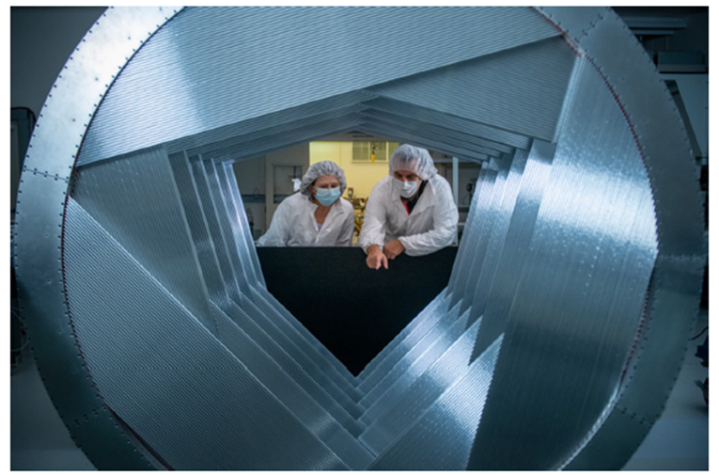
Tracker – 81% Complete
Remaining Scope
Complete production of Tracker Panels
Assemble Tracker Planes, Frame & Stations
Complete fabrication and installation of electronics (AMB, preamps, DMBs)
Complete infrastructure (HV, LV, gas & cooling)
Challenges & Plans
COVID impact to close-proximity fabrication work and supply chain issues included in replan.
Continue to work with vendors to mitigate electronics supply chain challenges. Electronics risk included in risk register & replan.
Retain experienced technical resources from university partners to support tracker assembly. Continue onboarding additional effort supported by Research funds.
Completed Scope
Produced 92% of Tracker Panels
Produced 56% of Tracker Planes
Completed electronics designs
Demonstration of KPP quality cosmic tracks in VST
Panel/plane production well understood. Electronics risks captured in risk register & plan

Slide 10
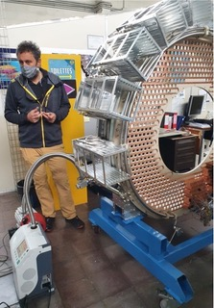
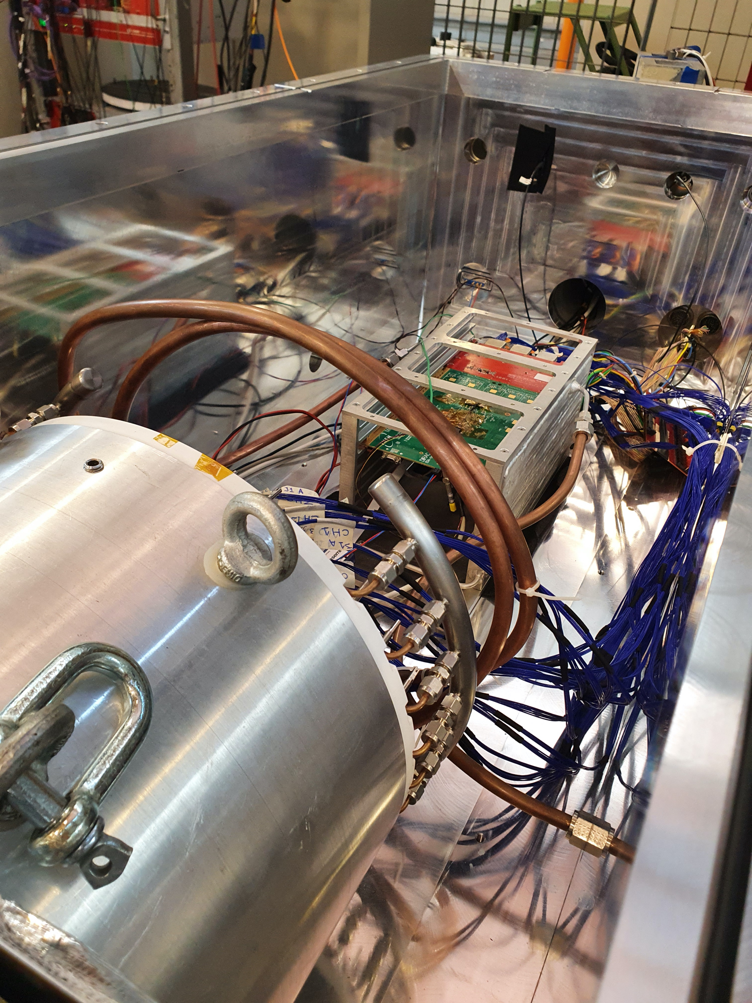
Calorimeter – 84% Complete, DOE only
Remaining Scope
Complete assembly of disks (install crystals, instr. (racks, photodetectors, FEE, cooling, etc)
Complete cooling system design, fabrication & installation
Complete installation & commissioning of source system
Completed Scope
All SiPMs glued. ROUs being assembled/tested
All mechanical parts fab’d/assembled @ INFN & FNAL
Source : Al tube produced, Neutron gen. received
Rad-hard FEE and cables production completed. MB production started. Dirac V3 prototypes produced.
VST with Module-0, final FEE, MB, DIRAC v2 in vacuum
Procurement of service cable and feedthroughs
Challenges & Plans
Increase INFN team presence @ FNAL to complete calorimeter assembly
Recover/produce anew the missing FEE @ JINR
Complete production of DIRAC boards
Work closely with vendors to mitigate FPGA supply delay-chain. Electronics delays included in replan. Residual uncertainty included in risk register.
Disk 1 assembly underway at FNAL. Electronics risks included in replan.

Slide 11
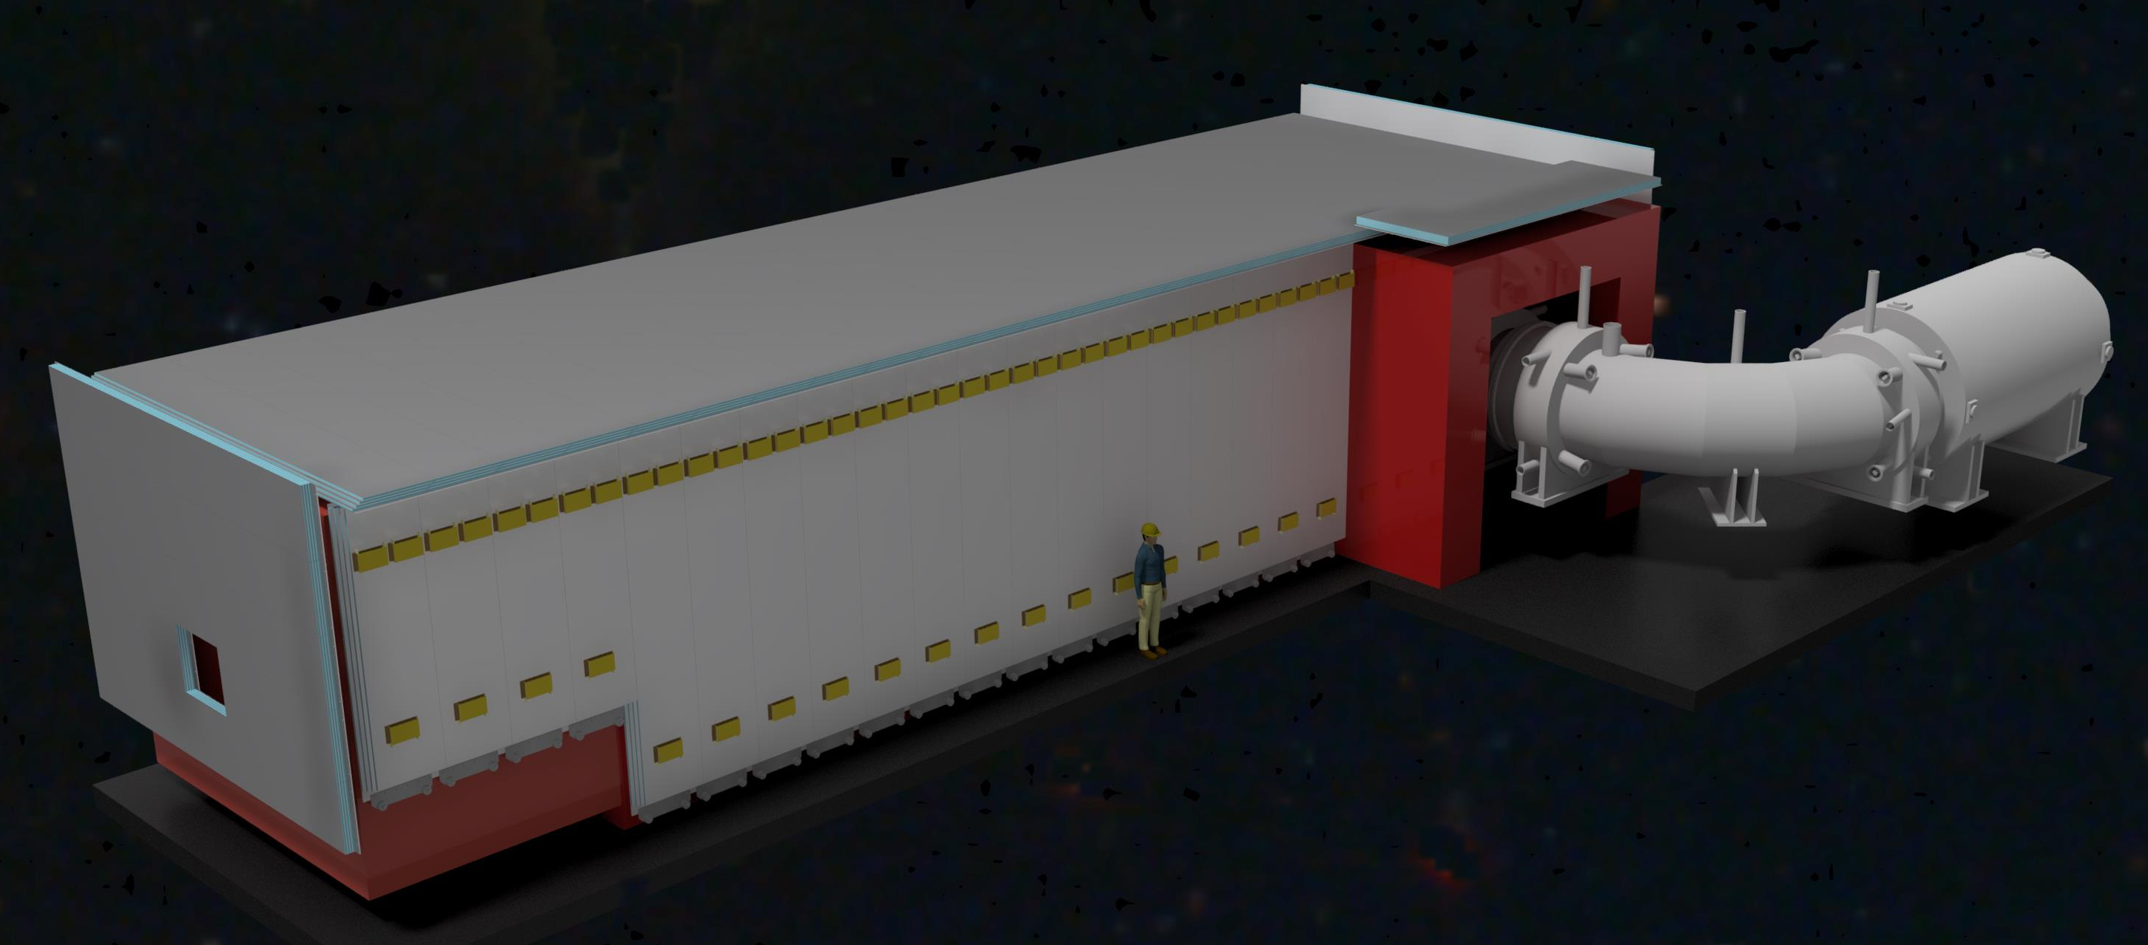
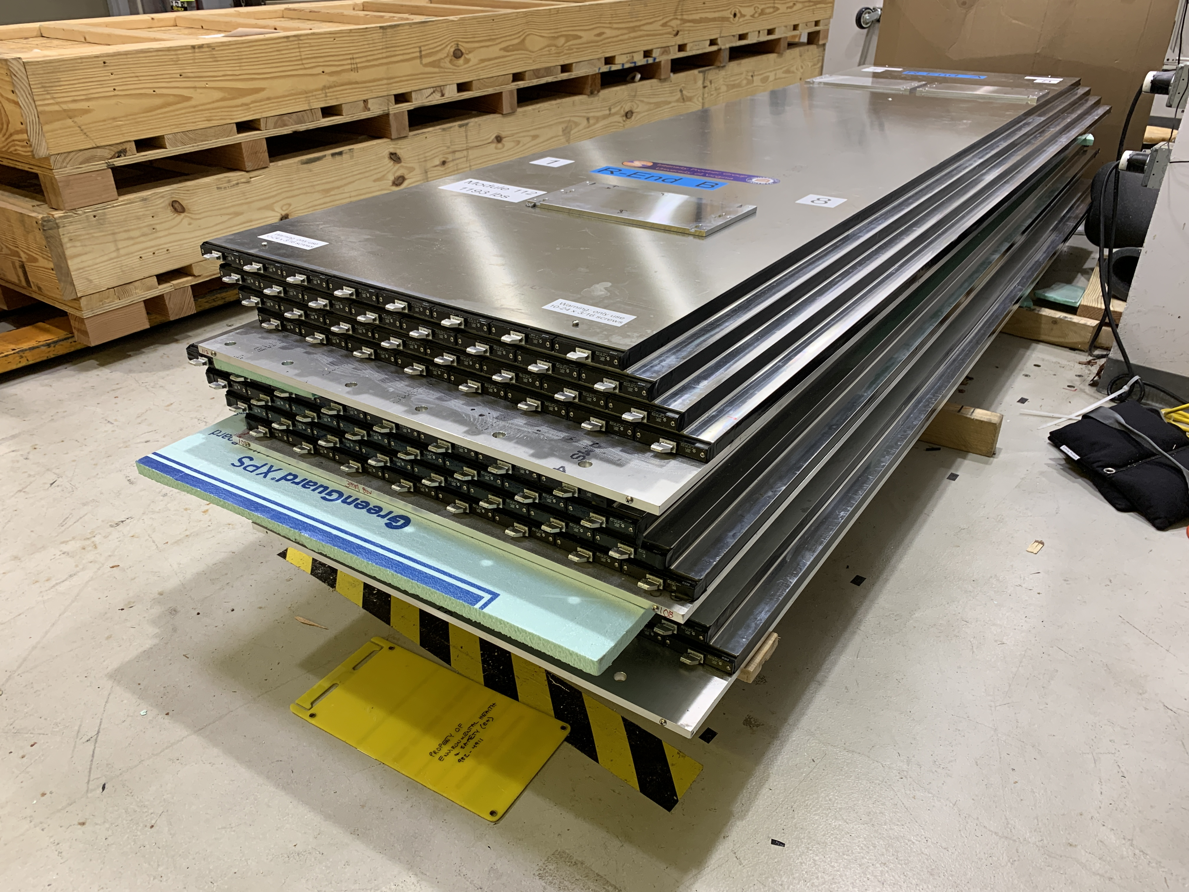
Cosmic Ray Veto – 88% Complete
Remaining Scope
Complete module fabrication (83/83)
Complete layout/firmware of FEB-II. Produce & test FEB-II.
Produce & test Readout Controller (ROC)
Test support structure design needed for CRR
Completed Scope
Successfully fabricated 68/83 modules (82%)
Support structure design completed
Successfully completed VST with FEB-I
Shipped all modules to Wideband (68/83)
Challenges & Plans
Complete development/fabrication of FEB-II. FEB design changed due to FPGA unavailability.
Electronics supply chain issues. Electronics delays included in replan. Residual uncertainty included in risk register.
Module production nearly complete. Electronics risks similar to other detectors.

Slide 12
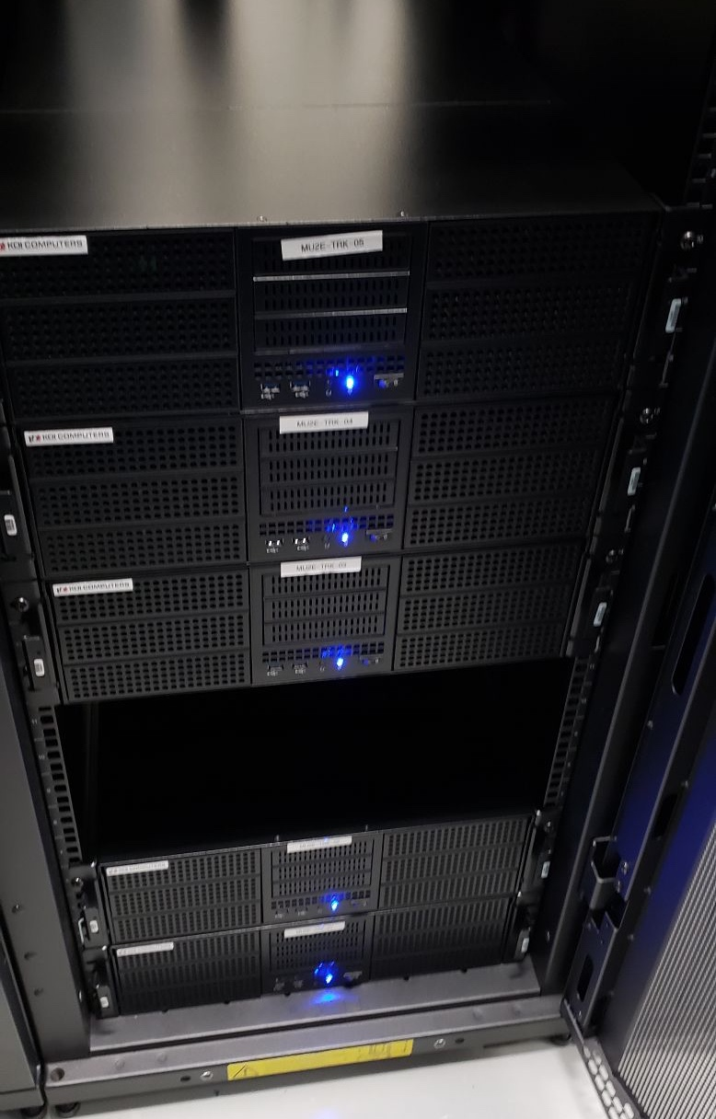
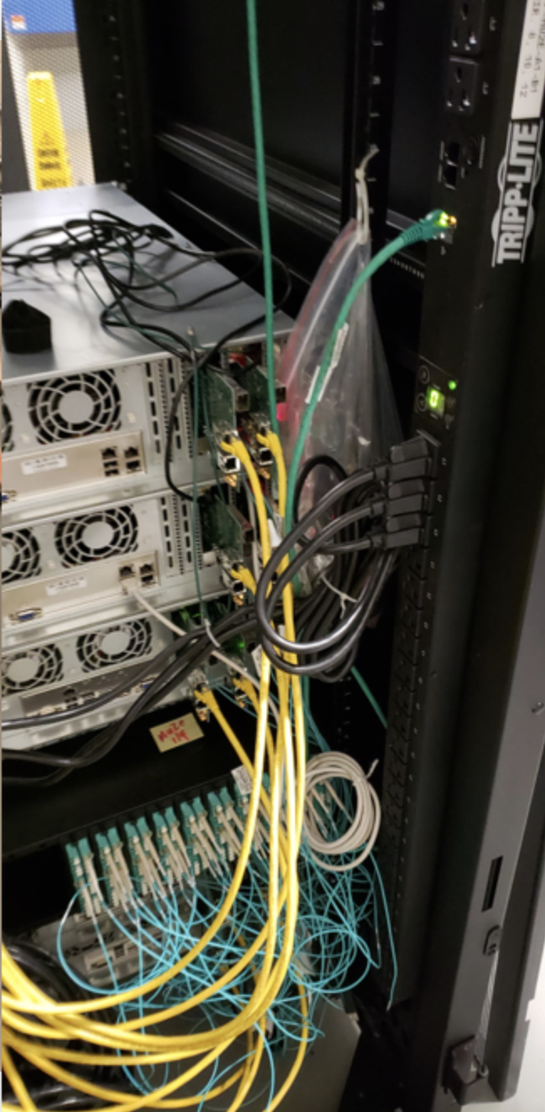
TDAQ – 87% Complete
Remaining Scope
Stable operation DTC chain in DAQ room. Purchase DAQ servers.
Support integration of detectors into Vertical Slice Tests (Round 2 (COVID)) for systems …
Mature Mu2e Operations path. Mature Offline and Run Info interface.
Server purchase, VST and HST support. Scale up Hardware Event Building.
Integrate detectors into DAQ at Mu2e hall.
Partial DAQ room installation complete.
Working to mature the path forward to Mu2e Operations.
Completed Scope
Stable10-DTC chain at test stand.
Trigger processing time target achieved.
Partial DAQ room installation LIVE
Demo of 3-subsystem software chain.
Challenges & Plans
FPGA/firmware knowledge transfer to new hires
Background/Noise impact on Trigger processing benchmarked. Collaboration engagement is critical in continuing optimization.
All critical features of TDAQ fully demonstrated.

Slide 13
Project Summary
Exceeds TPC ($274M)
Major Cost Increase Drivers (Diff):
PS/DS Vendor Delays, COVID-related impacts, underestimated design complexity, lack of resources
Major ETC: Complete remaining Solenoid, Accelerator & Detector fabrication/assembly;
muon beamline component fabrication & installation, detector installation & commissioning
Risks weighted by cost impact.
Schedule delays from impact to critical path (basically from Solenoid risks)
are spread over all subsystems.

Slide 14
Summary of Rebaseline Ask (Cost)
Charge #2
 | Cost
EAC | $294.2M
Estimate Uncertainty | $11.0M
Risk based contingency (90%CL) | $10.8M
Total | $316.0M
COVID Impacts (Externals) | $15.2M
Total (excl COVID Impacts) | $300.9
FY21-FY25 funding profile: $42.7M
Total funding : 273.7+42.7 = $316.4M
10% cap
Original TPC*1.10 = $301.0M is ~$185k below
Mu2e Baseline TPC: $273.677M EAC: $294.2M (incl COVID)
Obligations-to-Date: $258M Costs-to-Date (ACWP): $248M
Remaining budget: $16M Costs-to-Go: $50.8M
(incl. $9M of open commitments)
Costs through June Status

Slide 15
Schedule & Critical Path
Charge #2
Detector Solenoid Fabrication at the vendor
Magnet Delivery November 2023
Installation, Checkout, Cooldown
KPP 3: Power DS Magnet
CD 4 Preparation and Review
Vendor work on Detector Solenoid
Magnet Delivery! November 2023
Installation, checkout,
cooldown
Power DS Magnet
CD 4 Prep

Slide 16
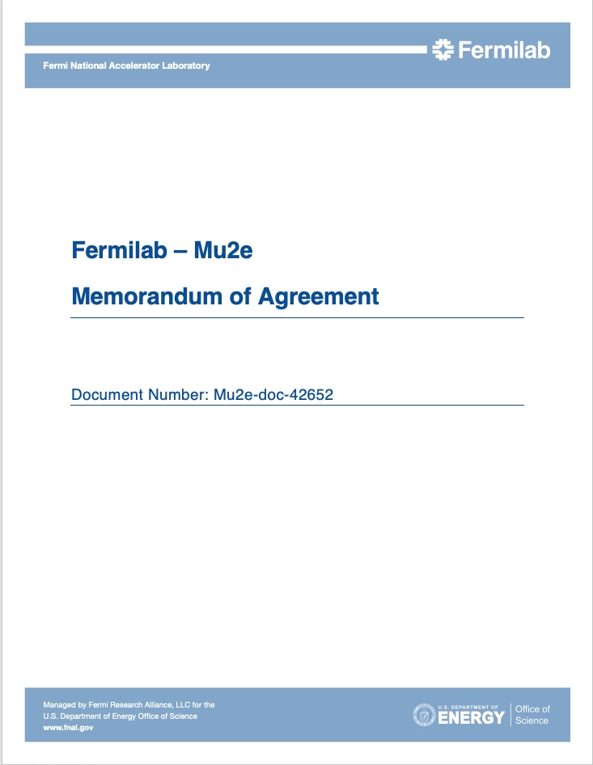
Memorandum of Agreement
A Memorandum of Agreement (MOA) between the Mu2e Project and the Laboratory has been written and agreed to by all parties.
  Communicates Project resource needs to the laboratory
  Allows for resource planning by both the Lab and the Project (in the case of lab resource shortfalls)
  Helps to ensure strong support going forward

Slide 17
Schedule
Current CD-4 Milestone
Delays from Solenoid vendor, COVID impacts and resource availability pushed completion date past CD-4 milestone
PS Fabrication
TS Fabrication
DS Fabrication
Solenoid Installation and Commissioning
Accelerator and Beamline Construction
Project Closeout
April 1
TDAQ
Early date. Schedule float based on risk analysis will be used to determine new CD-4 date for BCP.
Tracker Construction/Installation/Integration
Calorimeter Construction/Installation/Integration
Detector KPP
Feb 2025
Cosmic Ray Veto/”Installation”/Integration
Cosmic Ray System Test
Project Complete
June 2025
Acc KPP
Mar 2025
Solenoid KPP
Apr 2025
FY22 FY23 FY24 FY25 FY26

Slide 18
ADDITIONAL MATERIAL

Slide 19
Summary of Rebaseline Ask (Schedule)
Charge #2
 | Schedule | Comments
Early Finish Date | June 2025
Schedule Risk (90% CL) | 27.2 months | Based on risk analysis (90% CL)

Slide 20
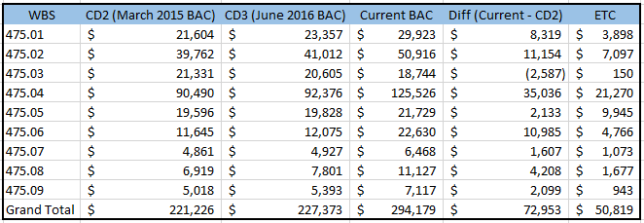
WBS 475. Evolution of Project Costs (k$)
Charge #3
Major Cost Increase Drivers (Diff):
PS/DS Vendor Delays, COVID-related impacts, underestimated design complexity, lack of resources
Major ETC:
Complete remaining Solenoid, Accelerator & Detector fabrication/assembly; muon beamline component fabrication & installation, detector installation & commissioning
Exceeds TPC ($274M)
Notes:
Current (BAC) = Cost Book (of the Mu2e BCP dataset): Use the Full Burden + ESC column for BAC
ETC (remaining budget as of April 1) – Use the Unique dataset, pick the Fermi lab (remaining scope as of April 1) and use the Full Burdened + ESC = ETC

Slide 21
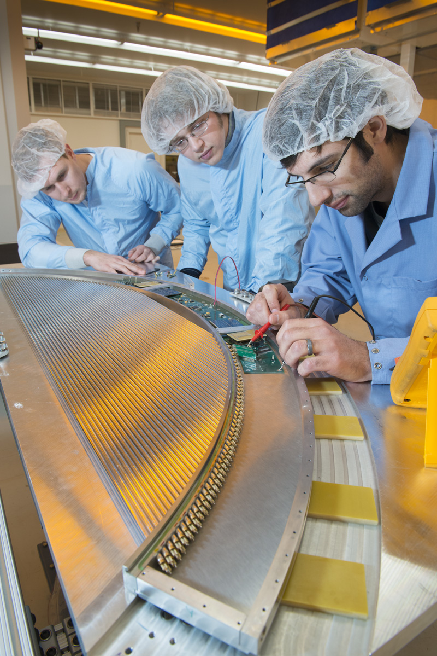
COVID Delays overall impacts
Pre COVID
COVID has had a significant impact on all aspects of the project.
  Shutdowns
  Reduced staff on site that continues
  COVID safe working protocols
    Social distancing – impacts efficiency
    Masks
    Additional work planning requirements – impacts efficiency
  Quarantines – Have hit us many times
Activities that used to take 8 hours now typically take 11 – 12 hours
  ~ 70% efficiency
COVID-precautions

Slide 22
COVID other Impacts
Mu2e is a mature Project that depends on completing field work
Largest impacts to detector systems and Transport Solenoid
Biggest impact is to Tracker panels because of close proximity work
  Panel production model involves a large crew of undergrads
Significant impact to Calorimeter due to recall of INFN personnel to Italy
  Continue to have problems getting INFN colleagues back to Fermilab
CRV module construction at Virginia impacted by limited availability of undergraduates and social distancing requirements.
Acceptance testing of TS modules and cold mass construction significantly impacted by shutdown, occupancy limits, social distancing and COVID quarantines. Now this is OVER
COVID occupancy limits likely to persist at least through the summer.

