Slide 1
FRIDA-WP1
FLASH mechanism
I Annual Meeting
Pisa 27-28/9/2022

Slide 2
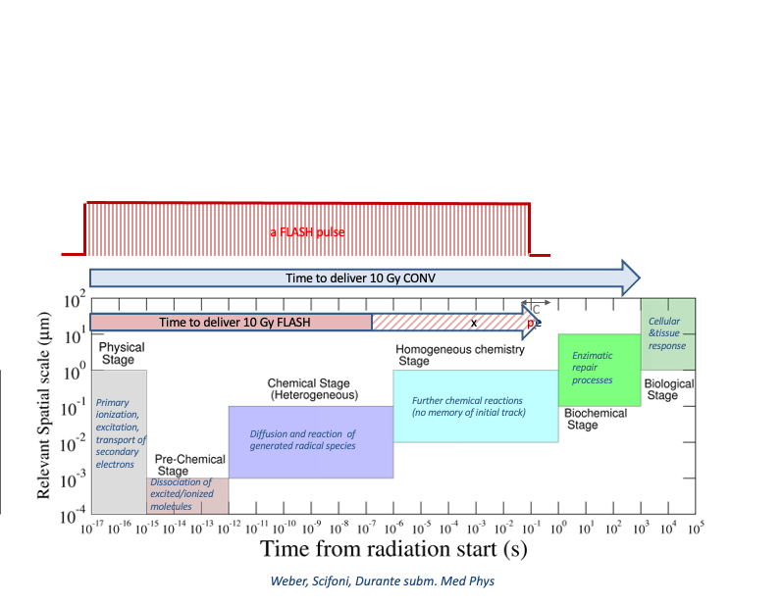
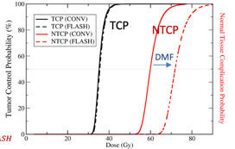
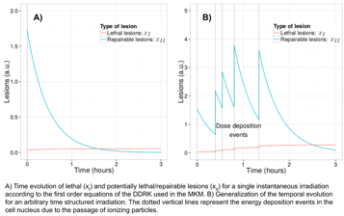
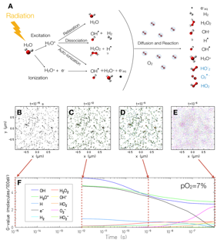
FRIDA WP1: Understanding FLASH
A. Attili talk
Multiscale modelling of the FLASH effect
Task 1..3
NTCP modeling
Dedicated in vitro/ex vivo experiments
M.Costa talk
Task1.1
Radiation Chemistry
From hetero to homo
Task 1.2
DNA damage repair kinetics
G.Camazzola talk
Manganaro wt al Med Phys 2017
Cordoni et al. Rad Res 2021
Boscolo et al. Radiother. Oncol. 2021
M.Battestini talk

Slide 3
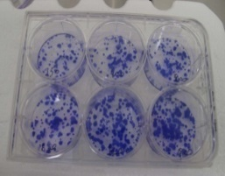
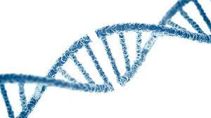
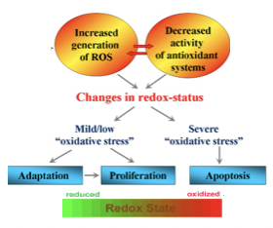
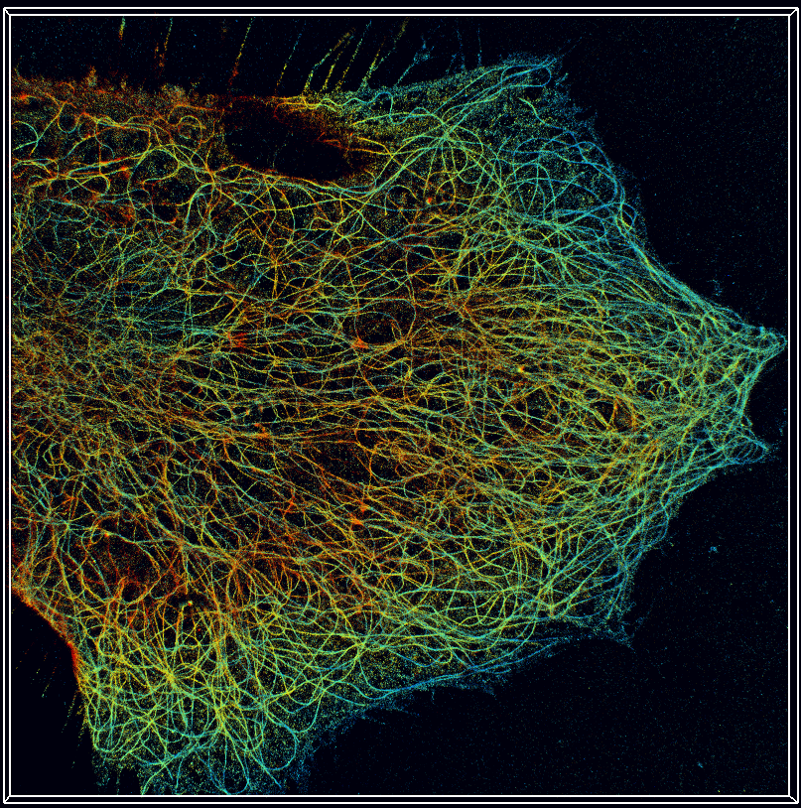
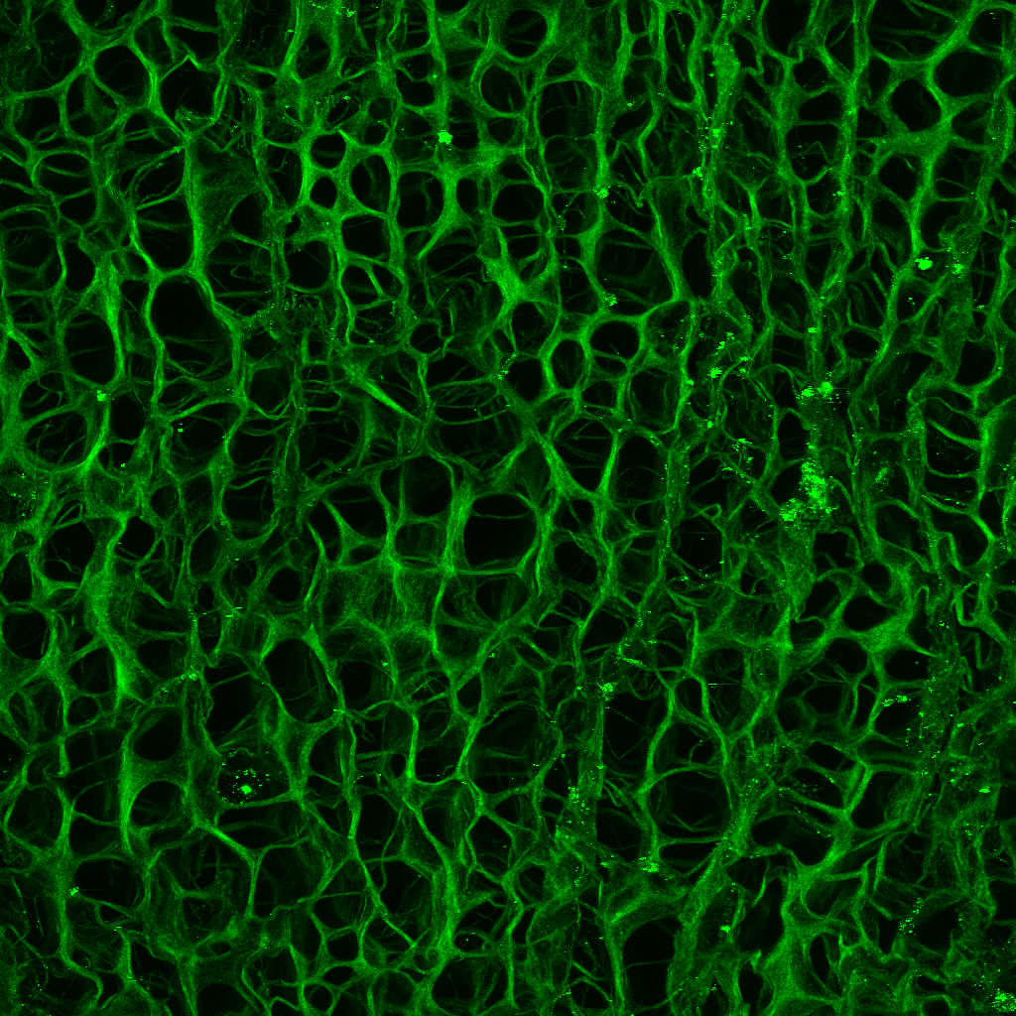
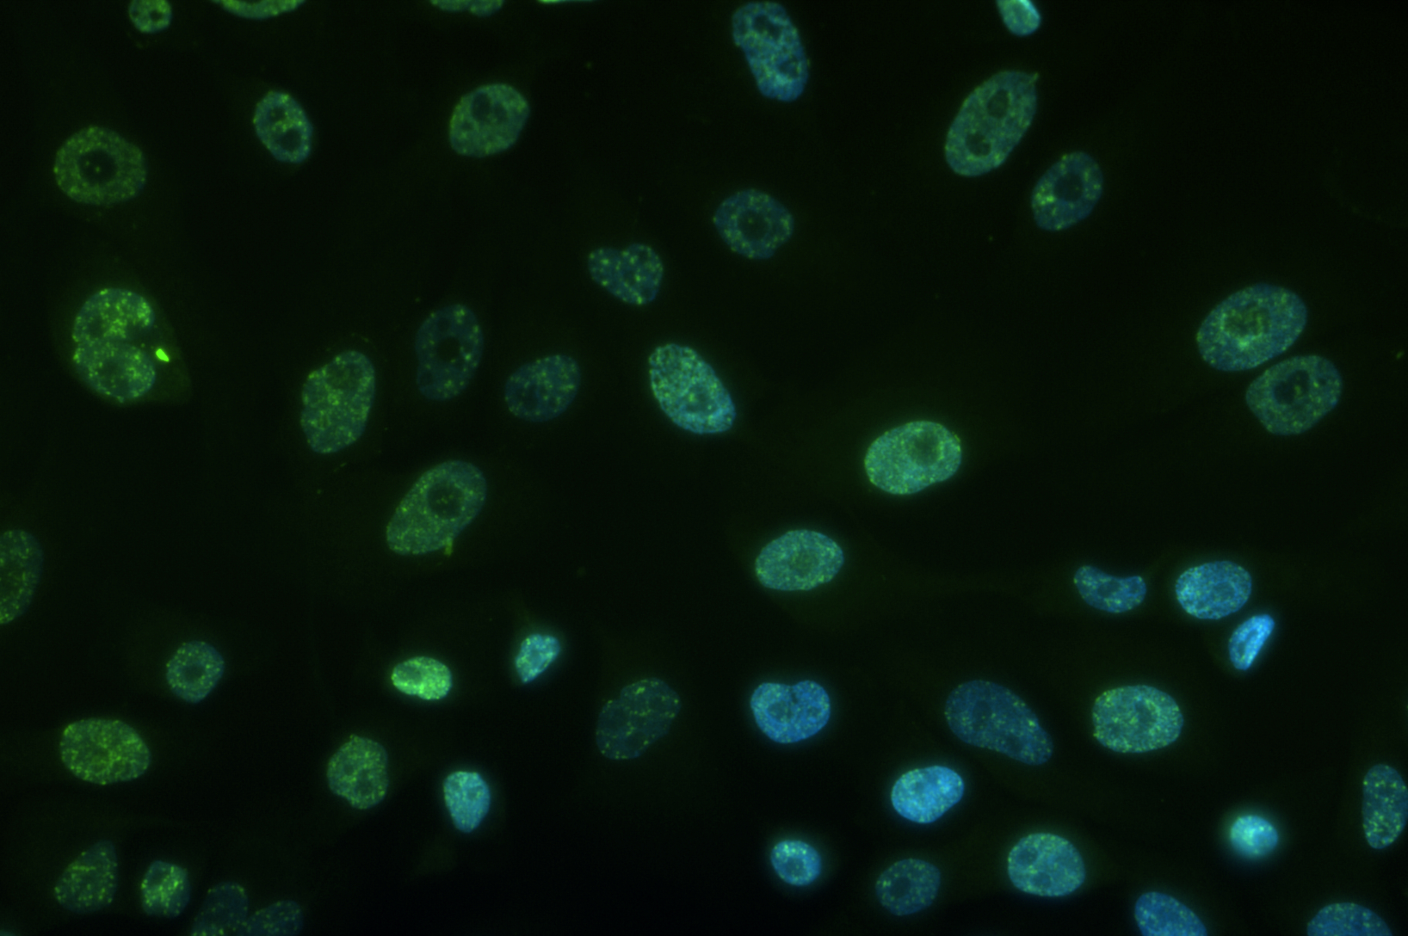
FRIDA Working Package 1 (WP1) - Radiobiology
In vitro characterization of FLASH-dependent biological effects in [O₂]-modified environments
Cell models and Experimental Conditions
Cell Lines
MCF10A
MDA-MB-231
Dose Rates
Conventional
FLASH (1)
FLASH (2)
Dose range
Lowest 4Gy
Highest 25Gy
Oxygen Concentration
20% [O₂] Normoxia
5% [O₂] Physioxia
0.5% [O₂] Hypoxia
Biological endoints
Cell survival
by clonogenic
survival assay
DNA damage by
immunofluorescence
assay for gH2AX and 53BP1
Immunological profile
(cytokines expression by luminex assay)
Gene Expression Profiling
by RNAseq
ROS production
Quantitative
microtubule modifications
Collagen structure modifications

Slide 4
FRIDA WP1: M&D Gant
✓
✓
✓
✓
✓
✓
✓
✓ = Advanced status
✓ = Started

Slide 5
Budget
TIFPA/RM3 team Desperately Looking for a skilled PostDoc!

Slide 6
Discussion

Slide 7
(Possible) Link to Planning
“Static “Optimized Plan
Temporal delivery information:
(t_{scan} ,t_{spot} , pathway constraints
Dose&Dose Rate optimization
DMF (D,Dr, pO2)
Pure DDRO
DMF weighted dose opt
pO₂ 3D map
from functional imaging
e.g. MRI/FMISO PET registered to CT
FLASH optimized Plan

Slide 8
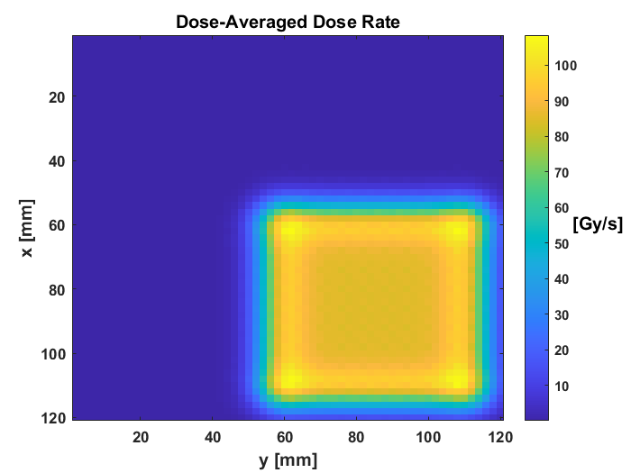
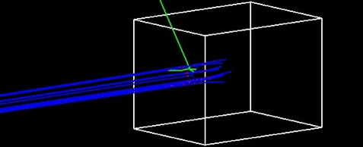
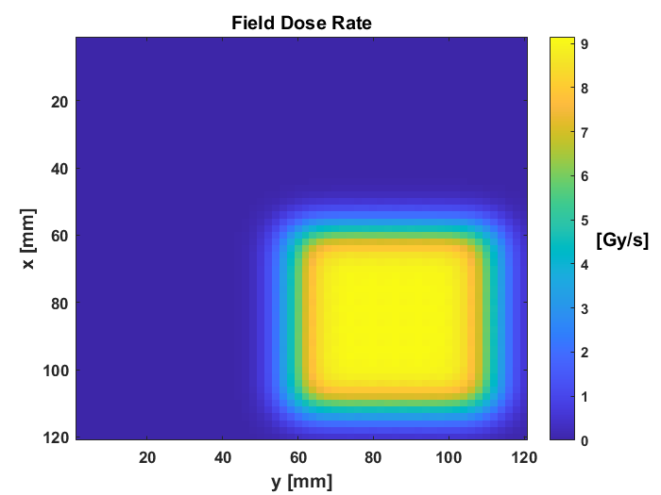
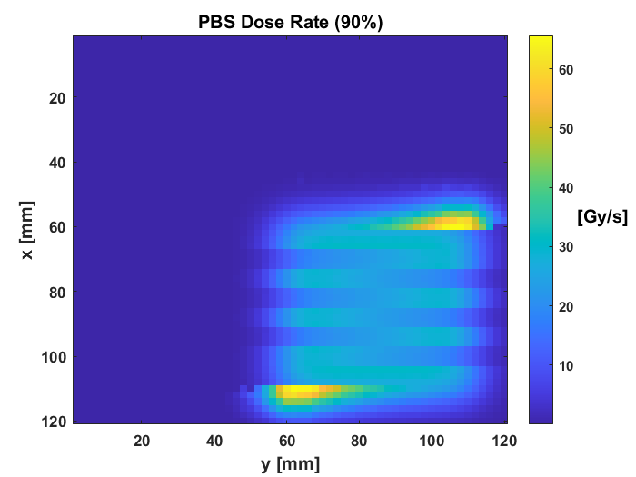
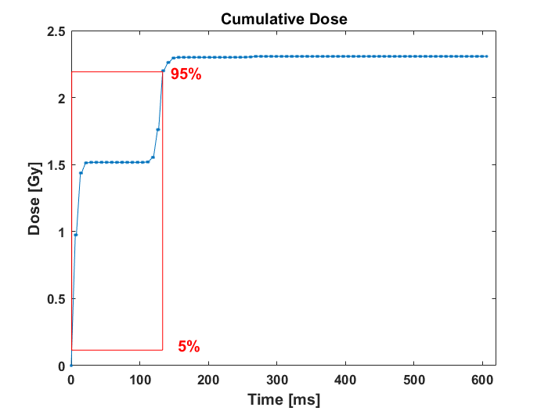
Impact of dose delivery
«Effective» Dose Rate scoring at voxel level
$$100 MeV p$$
$$H_{2}O$$
Tumor
$${DADR}_{i}=\sum_{j=1}^{n}{\frac{\left(d_{ij}w_{j}\right)\left(d_{ij}{BI}_{j}\right)}{\sum_{j=1}^{n}{d_{ij}w_{j} } }}$$
M. Battestini
$${DR}_{i}^{PBS}=\frac{D_{i}−2d_{t}}{T_{i}}$$
$$D_{i}−2d_{t}$$
$${DR}_{i}^{field}=\frac{D_{i}}{t_{f}}$$
$$T_{i}$$

Slide 9
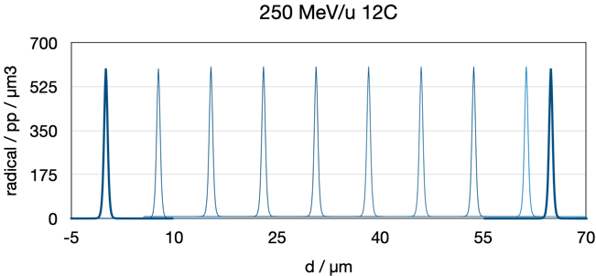
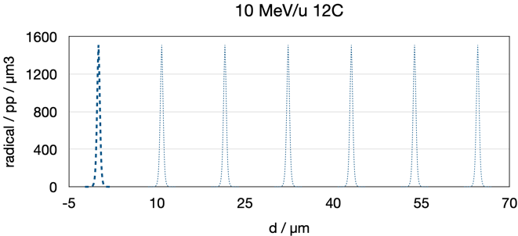
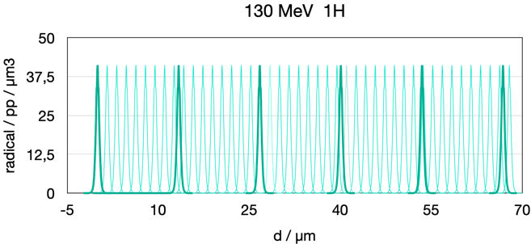
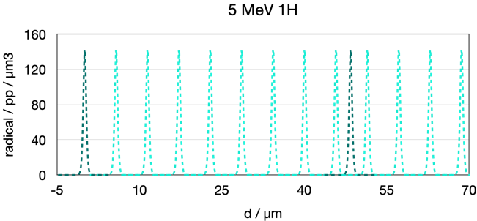
Total radical yelds Intertrack probability: p vs C
Entrance channel (10 Gy)
Tumor region (10 Gy)
Overall Dose Rate ~ 54Gy/s
DADR ~ 3870 Gy/s
Boscolo et al. In prep.
Notes:
If I look in the tumor region due to the higher LETs, however this effect is not there anymor. Thus assuming the dose rate of the DADR I arrive to the conclusion that inter track effect can happen for proton radiation and in the entrance channel

Slide 10
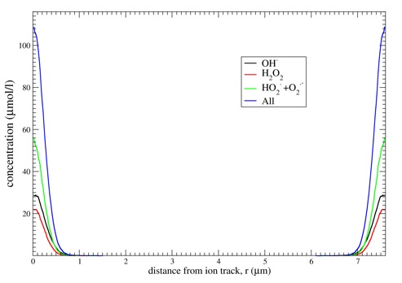
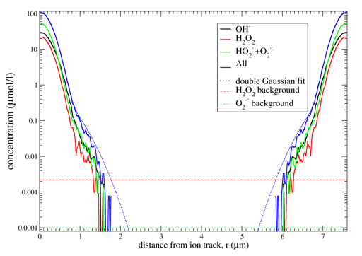
Intertrack impact and threshold concentrations
Conditions of the in vivo
Positive experiment
(Tinganelli 2022)
ADR=100 Gy/s
DADR = 3870 Gy/s
E=240 MeV/u
pO₂=7%
At 10 μs,
even in the more
optimistic conditions,
overlap between radical tracks occur below their background concentration levels
Scifoni et al. in prep for PMB

Slide 11
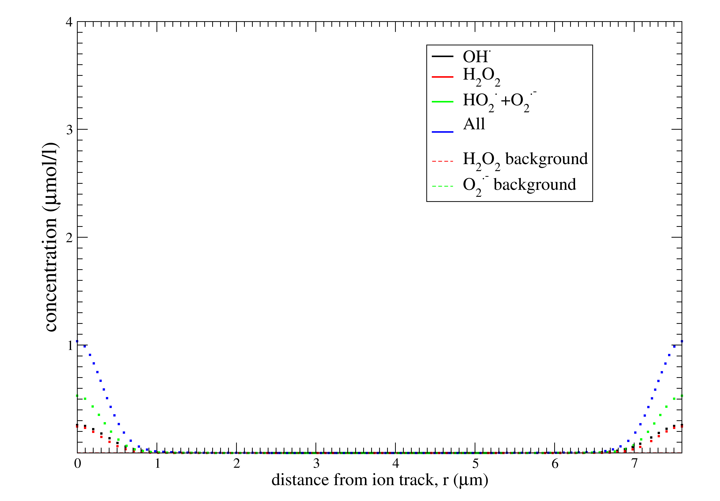
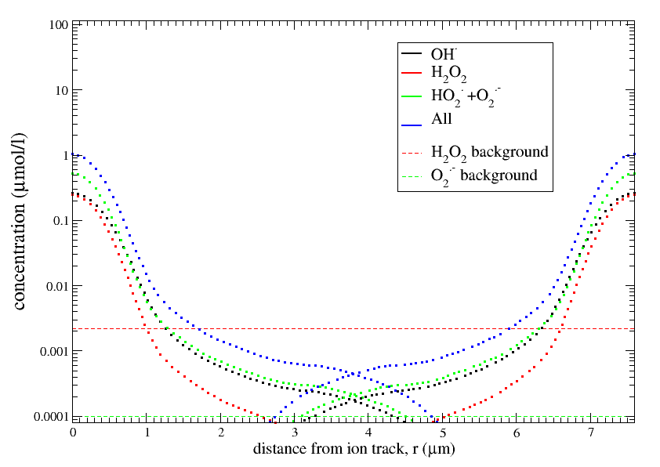
Intertrack impact and threshold concentrations
Conditions of the in vivo
Positive experiment
(Tinganelli 2022) :
ADR=100 Gy/s
DADR = 3870 Gy/s
E=240 MeV/u
pO₂=7%
At 20 μs,
using TRAXCHEM-ext
A very tiny region of superimposition starts to appear, but still mostly beyond the threshold of background levels
Scifoni et al. in prep for PMB

