Slide 1
FRIDA:
FLASH Radiotherapy with hIgh Dose-rate particle beAms
WP1 - data collection for DMF/FMF Modeling
July 15, 2022
A Attili, E Scifoni, F Tommasino, M Battestini et al.

Slide 2
WP1 - “data-driven” DMF / FMF - Systematic exp. Data collection
IDs
ID / Reference | Table / Figure
Bio
In vivo / in vitro | Biological system | environment | pO2 | Endpoint | Value | Value min | Value max
Radiation type
Source | Particle | Energy (MeV) | LET (keV/μm)
Dose time structure
Dose total (Gy) | Dose per pulse (Gy) | Dose rate avg. (Gy s-1) | Dose rate inst. (Gy s-1) | N. impulses | Erogation time (s) | dt impulse (ns) | PRF

Slide 3
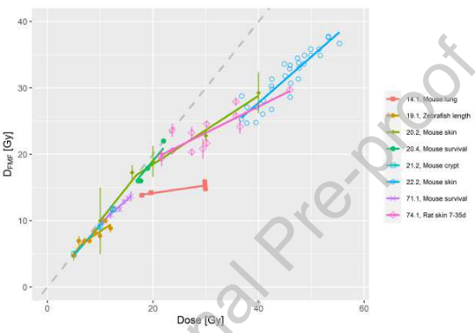
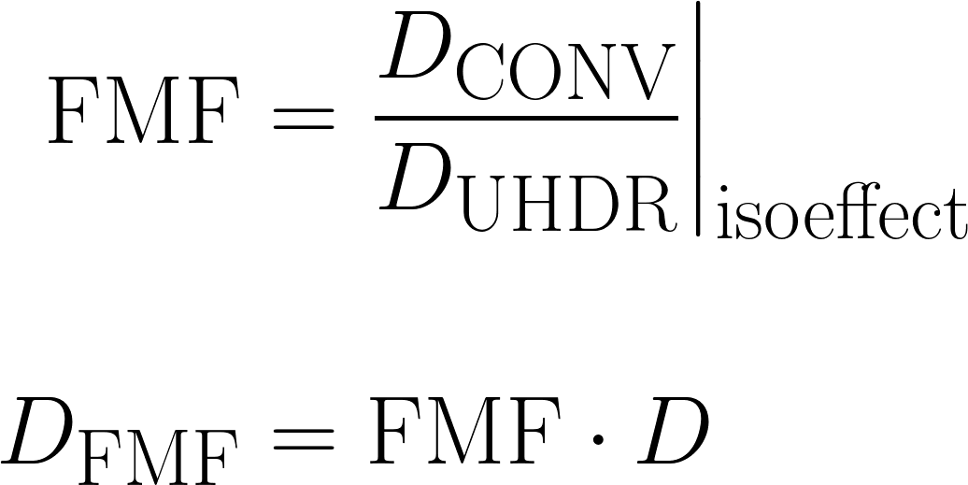
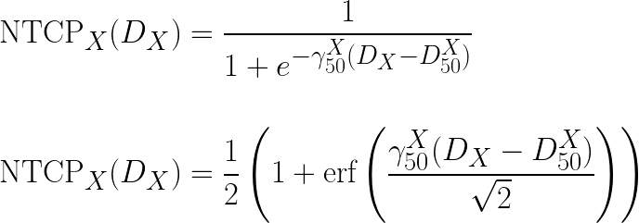
Example of FMF modeling from NTCP data
Böhlen, T. T., Germond, J., Bourhis, J., Vozenin, M., Ozsahin, E. M., Bochud, F., Bailat, C., & Moeckli, R. (2022). Normal tissue sparing by FLASH as a function of single fraction dose : A quantitative analysis. International Journal of Radiation Oncology, Biology, Physics.
Notes:
\begin{align*}
\text{NTCP}_X(D_X) &= \frac{1}{1+e^{-\gamma_{50}^X(D_X-D_{50}^X)}}\\
\\
\text{NTCP}_X(D_X) &= \frac{1}{2}\left(1 + \text{erf}\left(\frac{\gamma_{50}^X(D_X-D_{50}^X)}{\sqrt{2}}\right) \right)
\end{align}

Slide 4
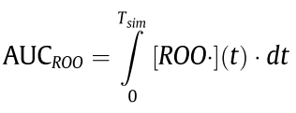
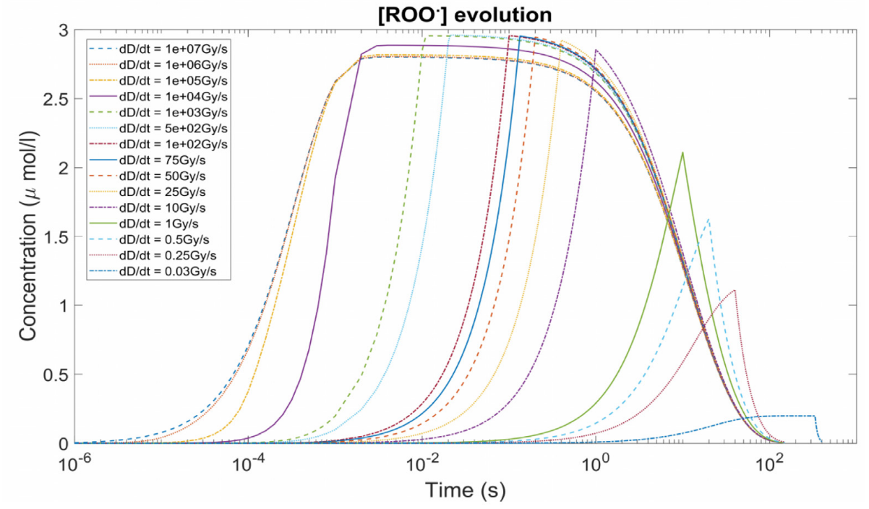
Flash effect evaluation in TPS: Labarbe et al (2020) approach to NTCP
Radical recombination in uHDR shortens the lifetime and limits the radiolytic yield of ROO⋅ and could protect normoxic tissues against the deleterious effects of radiation.
Notes:
\begin{align*}
\text{NTCP}_X(D_X) &= \frac{1}{1+e^{-\gamma_{50}^X(D_X-D_{50}^X)}}\\
\\
\text{NTCP}_X(D_X) &= \frac{1}{2}\left(1 + \text{erf}\left(\frac{\gamma_{50}^X(D_X-D_{50}^X)}{\sqrt{2}}\right) \right)
\end{align}

Slide 5
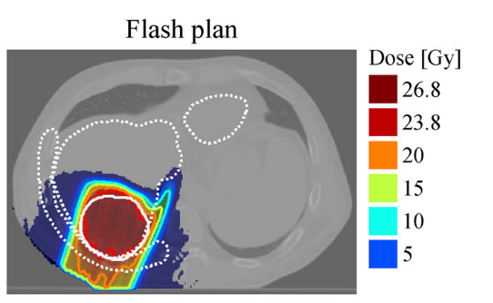
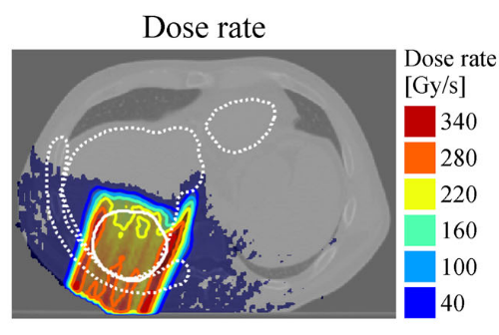
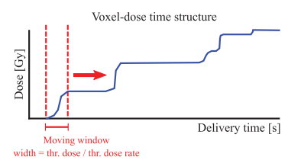
Step 1 : Voxel-based evaluation of dose rate: dD(t)/dt
Plots from Marco Swartz et al (2022)
Notes:
\begin{align*}
\text{NTCP}_X(D_X) &= \frac{1}{1+e^{-\gamma_{50}^X(D_X-D_{50}^X)}}\\
\\
\text{NTCP}_X(D_X) &= \frac{1}{2}\left(1 + \text{erf}\left(\frac{\gamma_{50}^X(D_X-D_{50}^X)}{\sqrt{2}}\right) \right)
\end{align}

Slide 6
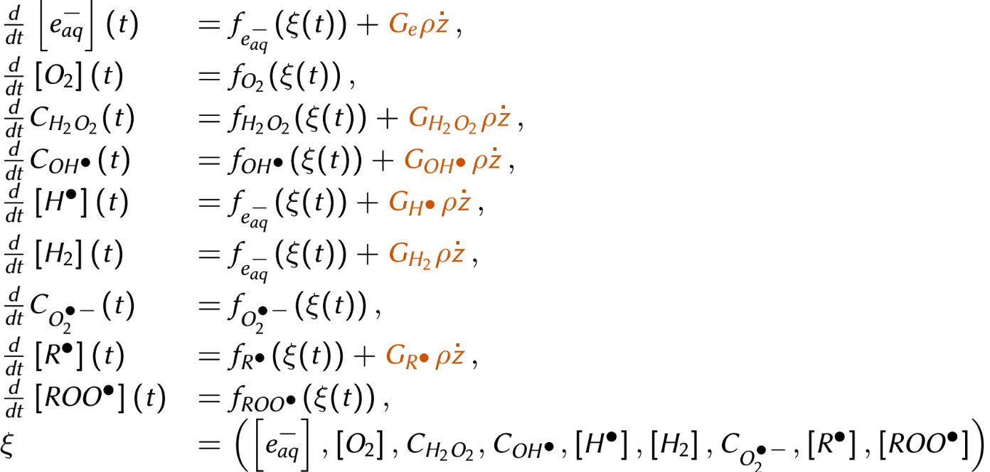
Step 2 : Impl. of chemical reaction dynamics for arbitrary dD(t)/dt
Notes:
\begin{align*}
\text{NTCP}_X(D_X) &= \frac{1}{1+e^{-\gamma_{50}^X(D_X-D_{50}^X)}}\\
\\
\text{NTCP}_X(D_X) &= \frac{1}{2}\left(1 + \text{erf}\left(\frac{\gamma_{50}^X(D_X-D_{50}^X)}{\sqrt{2}}\right) \right)
\end{align}

Slide 7
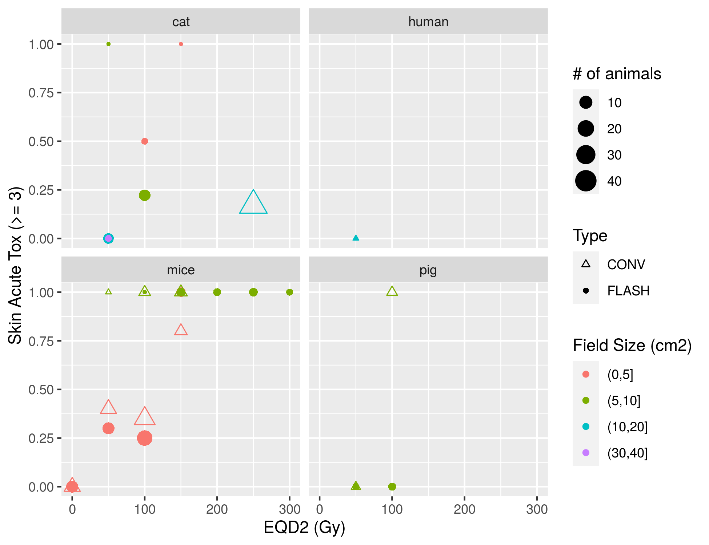
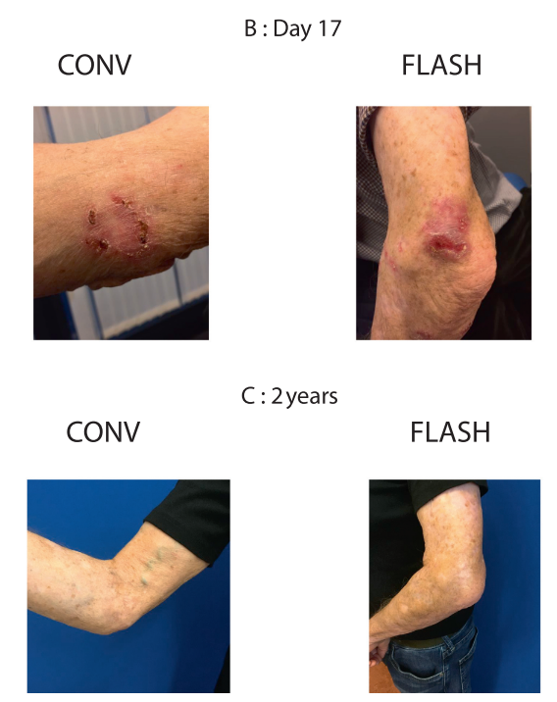
Volume effects in Flash (?)
Gaide et al. (2022). Radiotherapy and Oncology, 174, 87–91.
Notes:
\begin{align*}
\text{NTCP}_X(D_X) &= \frac{1}{1+e^{-\gamma_{50}^X(D_X-D_{50}^X)}}\\
\\
\text{NTCP}_X(D_X) &= \frac{1}{2}\left(1 + \text{erf}\left(\frac{\gamma_{50}^X(D_X-D_{50}^X)}{\sqrt{2}}\right) \right)
\end{align}

Slide 8
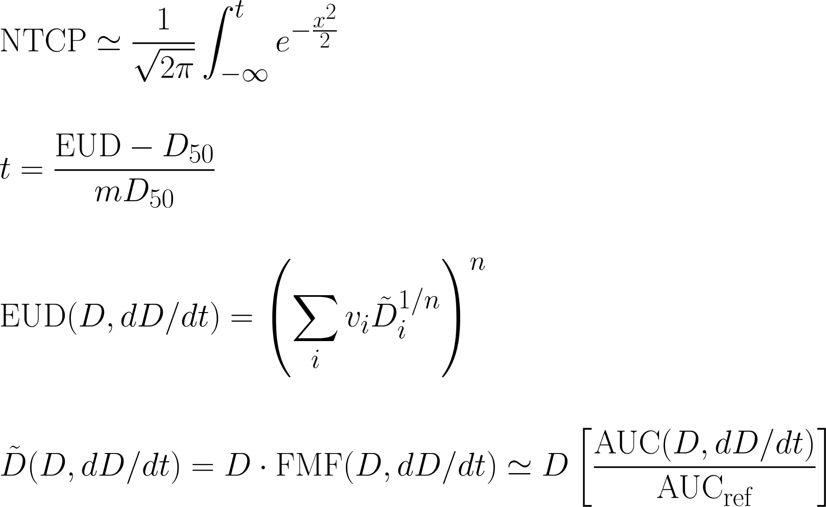
Step 3 : Evaluation of EUD(D, dD/dt) and NTCP (?)
Volume effect parameter
Notes:
\begin{align*}
\text{NTCP}_X(D_X) &= \frac{1}{1+e^{-\gamma_{50}^X(D_X-D_{50}^X)}}\\
\\
\text{NTCP}_X(D_X) &= \frac{1}{2}\left(1 + \text{erf}\left(\frac{\gamma_{50}^X(D_X-D_{50}^X)}{\sqrt{2}}\right) \right)
\end{align}

