Slide 1
Across the stages: merging the chemical stages to the Generalized Stochastic Microdosimetric Model (GSM²) as an insight in UHDR biological mechanism
M. Battestini, F. G. Cordoni, M. Missiaggia, A. Attili, F. Tommasino,
C. La Tessa, M. Fuss, M. Krämer, G. Camazzola, D. Boscolo, E. Scifoni
FRIDA General Meeting
Pisa, September 27 – 28, 2022

Slide 2
Outline
FRIDA WP1 – Task 2
The Generalized Stochastic Microdosimetric Model (GSM²)
Brief overview
Towards UHDR: the multiscale GSM²
Workflow
Preliminary results
Summary and outlook
Current investigations
Future goals

Slide 3
FRIDA WP1
Task 2:
TD-DNA damage modeling in FLASH conditions
Weber, Scifoni, Durante, Med. Phys. (2022)

Slide 4
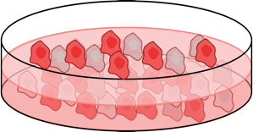
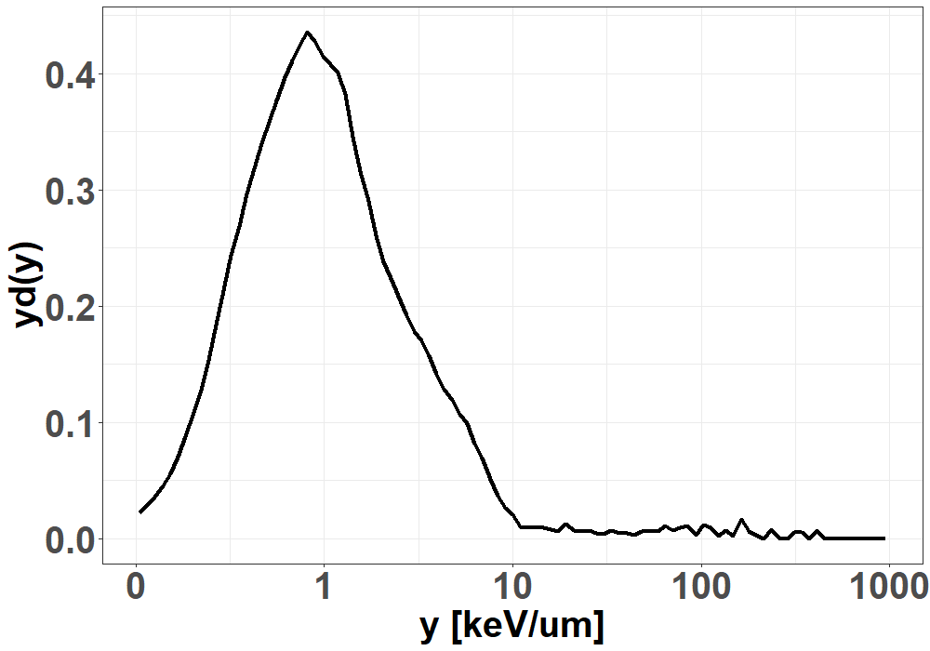
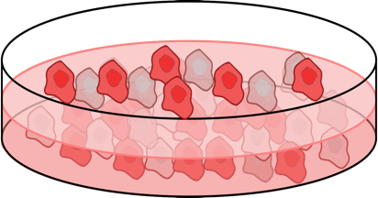
The Generalized Stochastic Microdosimetric Model (GSM²)
A fully-probabilistic model that includes several multiscale spatio-temporal stochasticity
Cordoni et al., Phys. Rev. E (2021) and Rad. Res. (2022)
Outcome 1
time
Outcome 2
Ionizing radiation stochasticity
Damage formation stochasticity
Temporal evolution of damages stochasticity
Cordoni et al., PTCOG 2022
27/09/2022
4

Slide 5
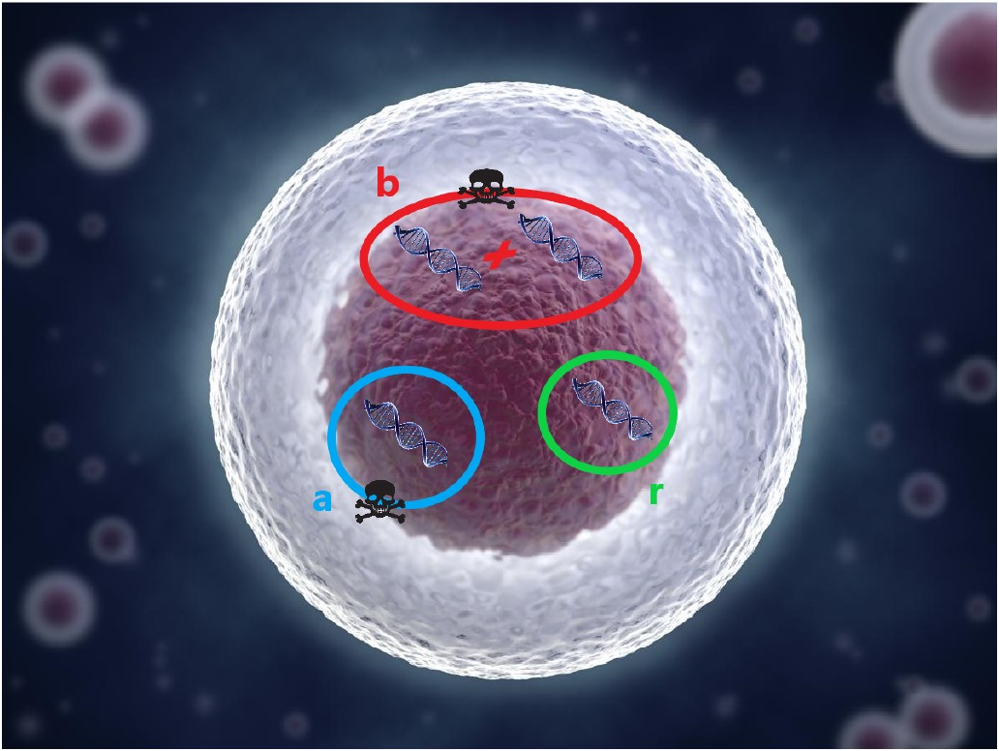
Dynamics of DNA lesions
GSM² allows detailed computation on DNA damage kinetic, formation and consequent survival probability
Cordoni et al., Phys. Rev. E (2021) and Rad. Res. (2022)
27/09/2022
5

Slide 6
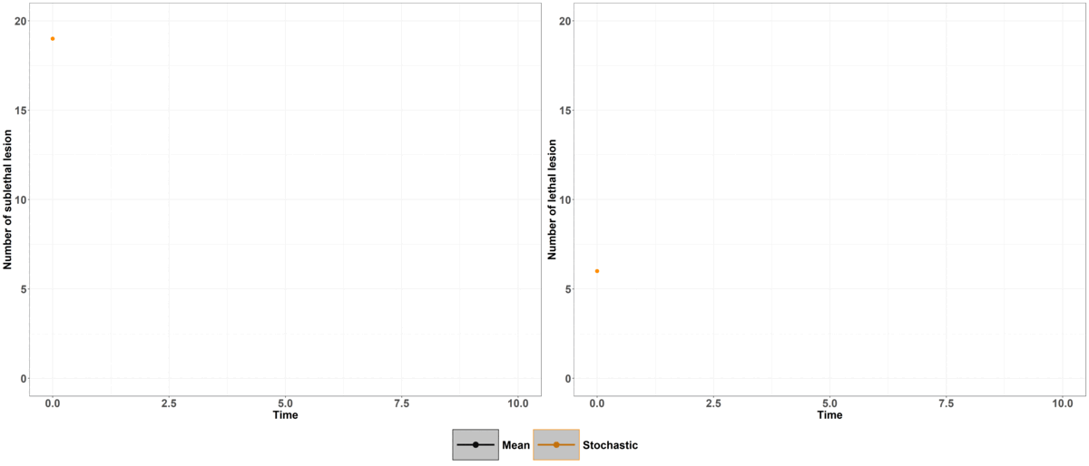
Temporal evolution of radiation damage
The mean value does not correctly describe the lesions evolution
Cordoni et al., Phys. Rev. E (2021)
27/09/2022
6

Slide 7
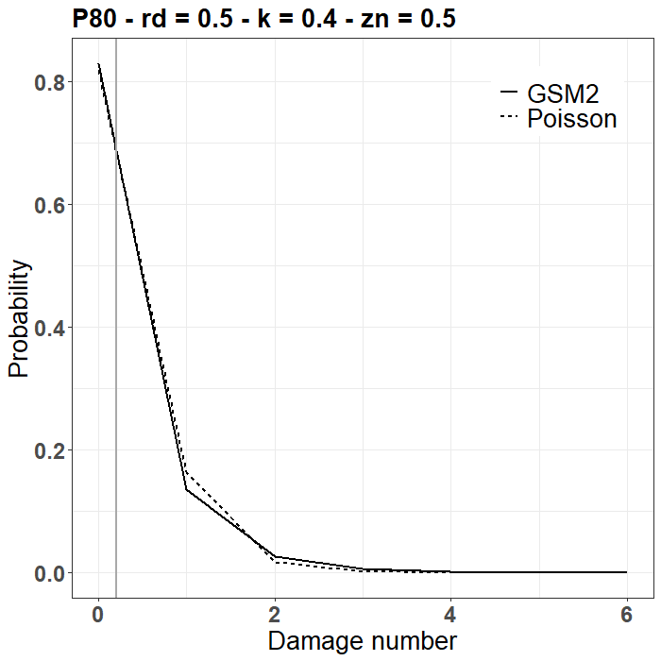
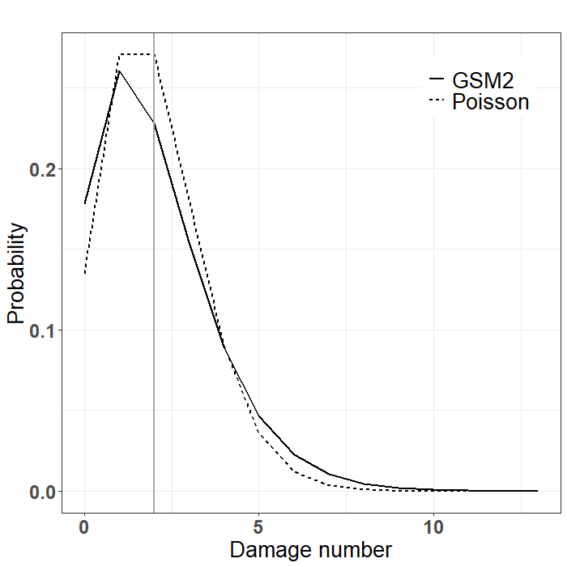
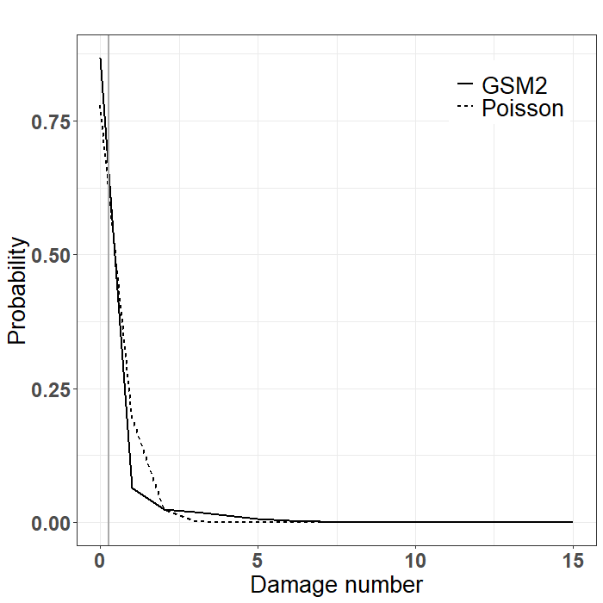
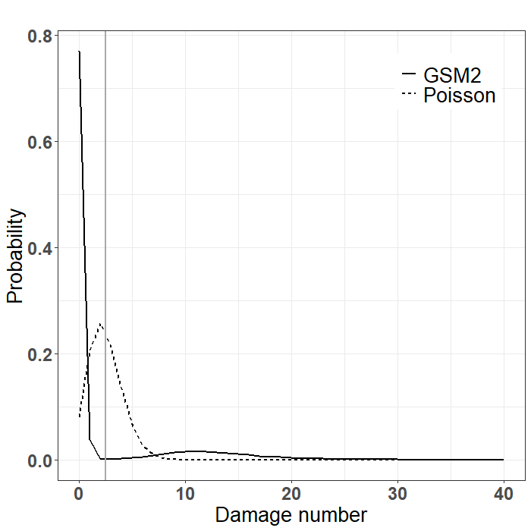
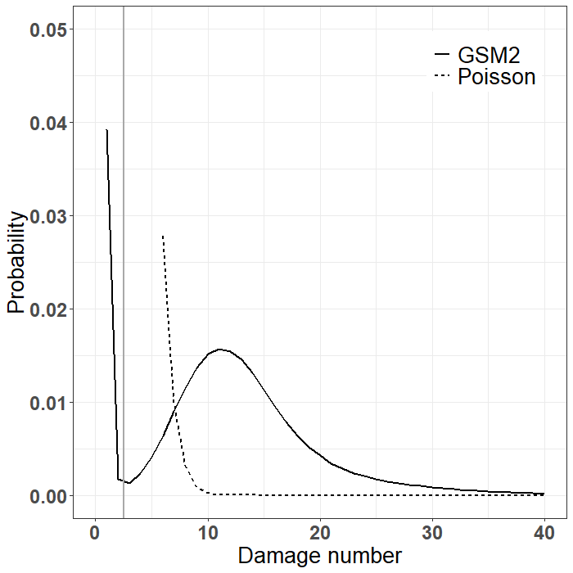
Impact of full spectrum consideration
DOSE
LOW LET
LOW DOSE
PROTONS
PROTONS
LOW LET
HIGH DOSE
Initial sub-lethal DNA damage distribution
LET
OXYGEN
OXYGEN
HIGH LET
LOW DOSE
HIGH LET
HIGH DOSE
Missiaggia et al., Submitted to Radiation Research (2022)
27/09/2022
7

Slide 8
Extending GSM² in UHDR conditions
Aim:
To include dose-rate time structure
To include fast chemical reaction kinetics
Chemistry stochasticity
Cordoni et al., FRPT 2021 and PTCOG 2022

Slide 9
Main assumptions for FLASH effect
Particles arrive before chemical reactions finish (temporal proximity)
Dose rate
$$\dot{D}>\overline{\dot{D}}$$
Particles arrive close enough to interact (spatial proximity)
Dose
$$D>\overline{D}$$
Different concentration between tumor and normal tissue (differential selectivity)
Radical recombination
$${ROO}^{⋅}$$

Slide 10
Main FLASH mechanistic hypothesis
The multiscale GSM²
Transient hypoxia
Radical recombination
Intertrack effects
Immune system driven

Slide 11
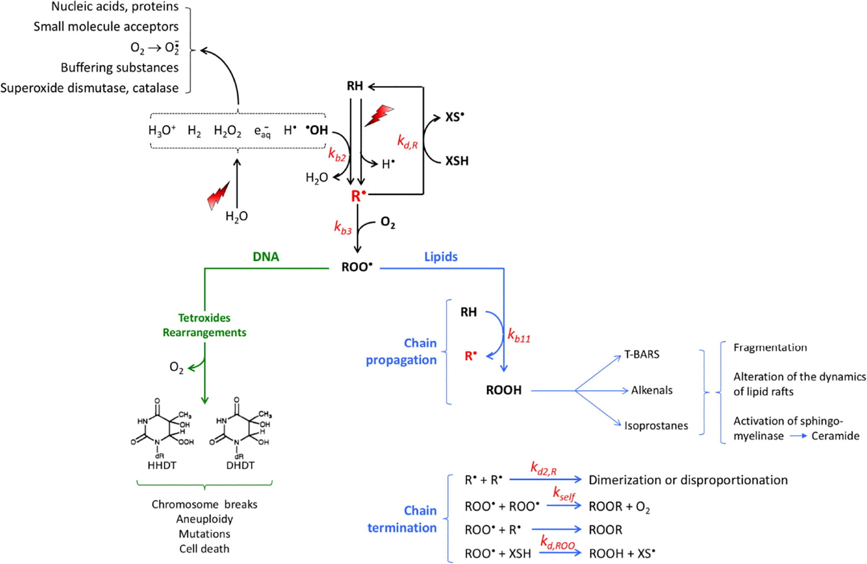
Fast chemical reaction kinetics
Reaction rates of 9 species described by a system of ordinary differential equations
$$\left\{\begin{aligned}\frac{dD\left(t\right)}{dt}=\dot{D}, t≤T_{irr} \\ &\frac{dD\left(t\right)}{dt}=0, T_{irr}<t≤T_{sim}\end{aligned}\right.$$
Labarbe et al., Radiother. Oncol. (2020)

Slide 12
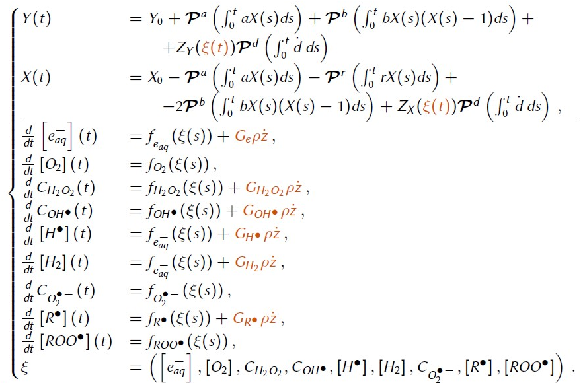
The multiscale GSM²: temporal evolution of lesions
Temporal evolution of sub-lethal and lethal lesions
Joint evolution of the slow biological processes and the fast chemical processes
Fast chemical reaction kinetics

Slide 13
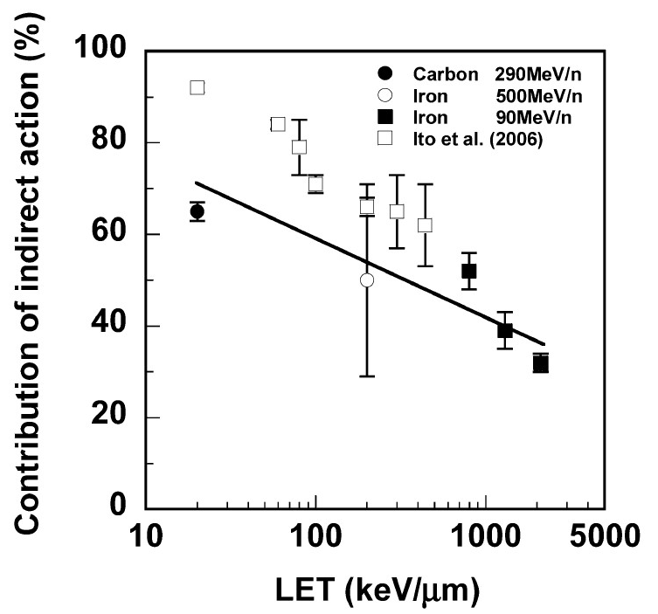
The multiscale GSM²: the DNA damage
DNA damage yield:
Conventional assumption: the DNA damage is proportional to the dose
FLASH assumption: reduction of the DNA damage yield due to high concentration of a certain radical
$$k=constant \left[{Gy}^{−1}\right]$$
$$k \left(\left[radical\right]\right)$$
Main assumption:
$$k_{D}=(1−f)∙k$$
Hirayama et al., Radiat. Res. (2009)
$${k⟶k}_{D}+k_{I} \left(\left[radical\right]\right)$$
$$k_{I}=f∙k$$

Slide 14
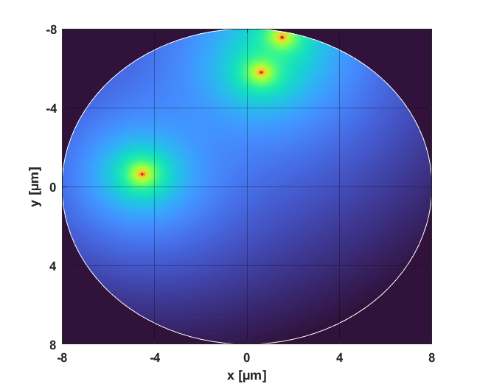
The multiscale GSM²: the workflow
Division of cell nucleus into domains
Track hitting
80 MeV p
Cell nucleus
Track hitting and energy deposition
If k
At t_{j+1} next process between a,b,r,k
The i-th domain receive the dose z_{i} at time t_{j}
If a,b,r
Update of the number of lesions
The dose is distribuited using the amorphous track (Scholz and Kraft, Adv.
Space Res. (1996))
Domain
Chemical equations solved from t_{j} to t_{j+1}
z_{i} into the chemical equations
Next time t_{j+1} DSBs undergo a process a,b,r,k

Slide 15
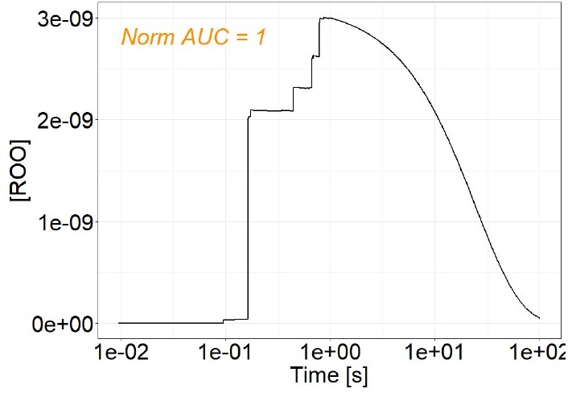
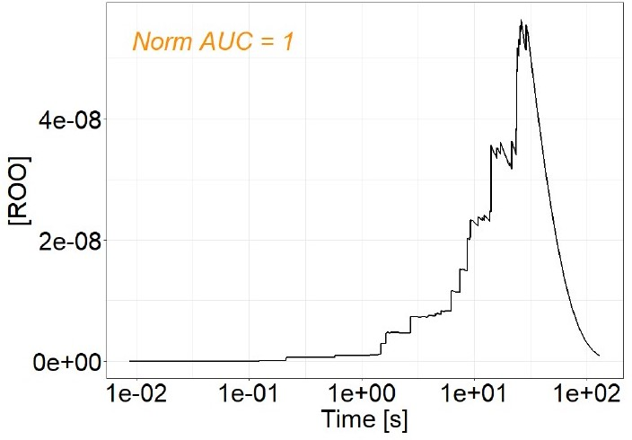
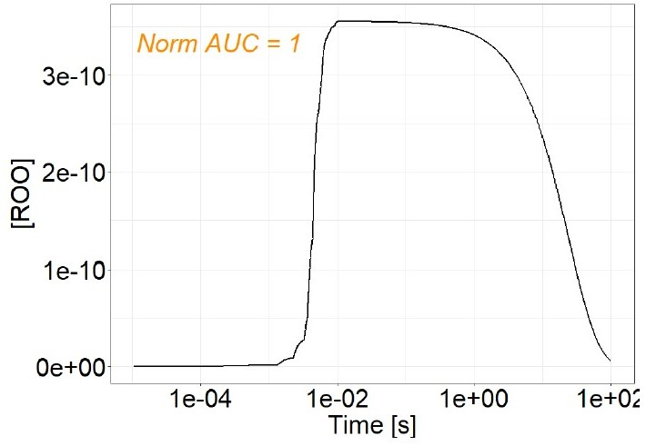
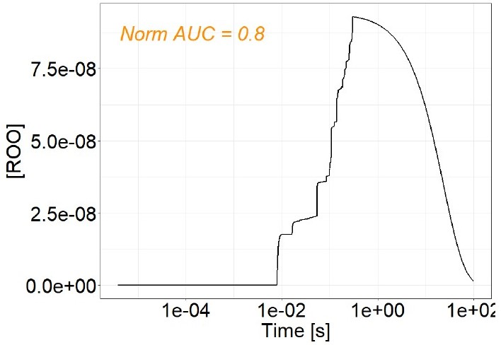
The organic peroxyl radicals $\left[{ROO}^{⋅}\right]$ time evolution
1 Gy
30 Gy
$$D$$
$${AUC}_{{ROO}^{⋅}}=\int_{0}^{T_{sim}}{\left[{ROO}^{⋅}\right]\left(t\right)dt}$$
1 Gy/s
Cellular damage
100 Gy/s
$$\dot{D}$$
Labarbe et al., Radiother. Oncol. (2020)
Preliminary results

Slide 16
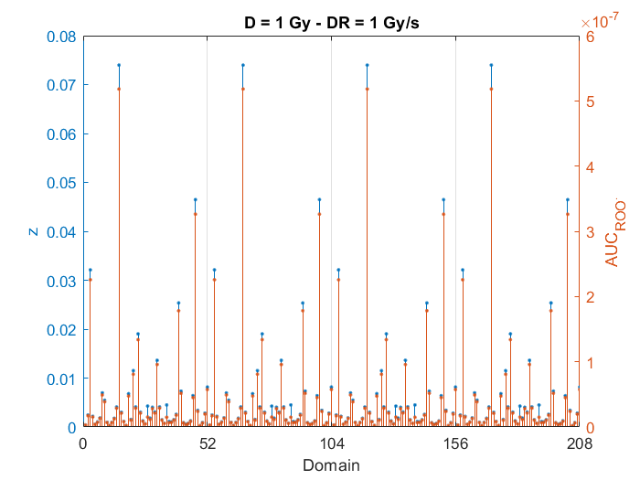
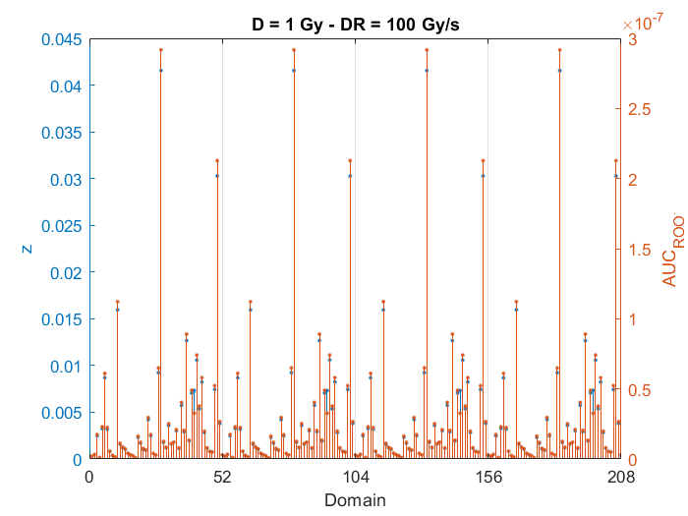
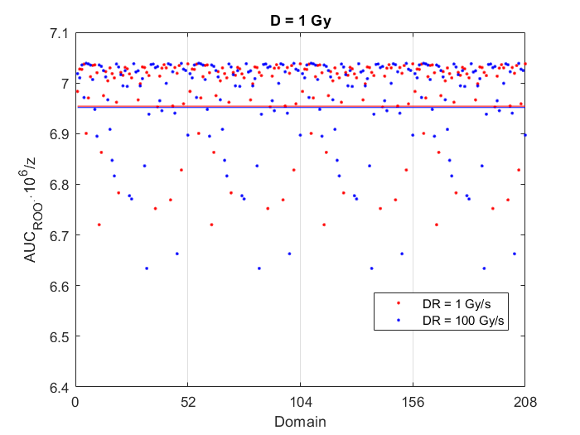
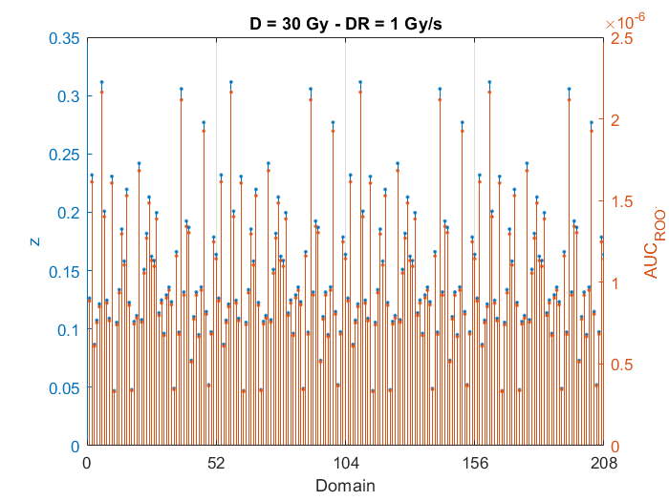
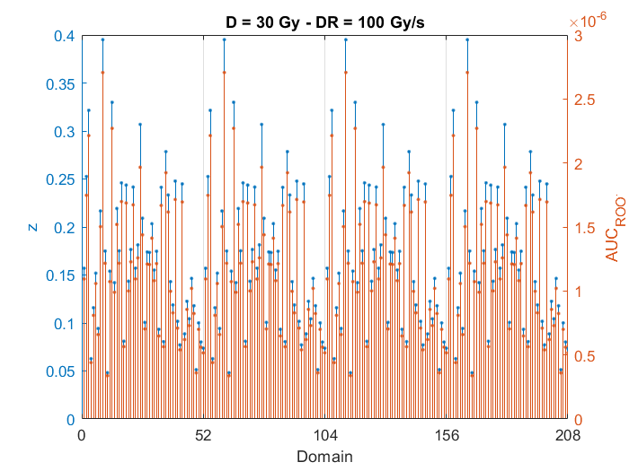
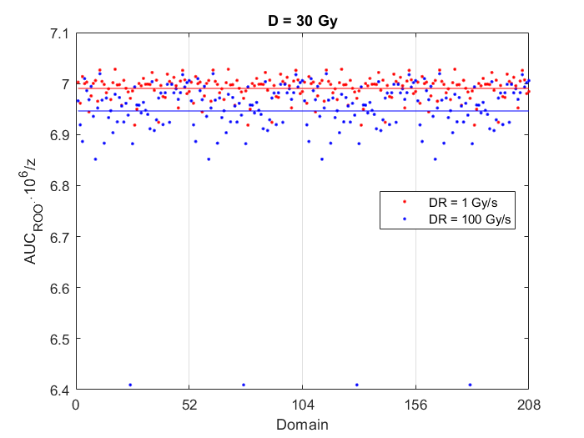
${AUC}_{{ROO}^{⋅}}$: dose and dose rate dependence
Preliminary results

Slide 17
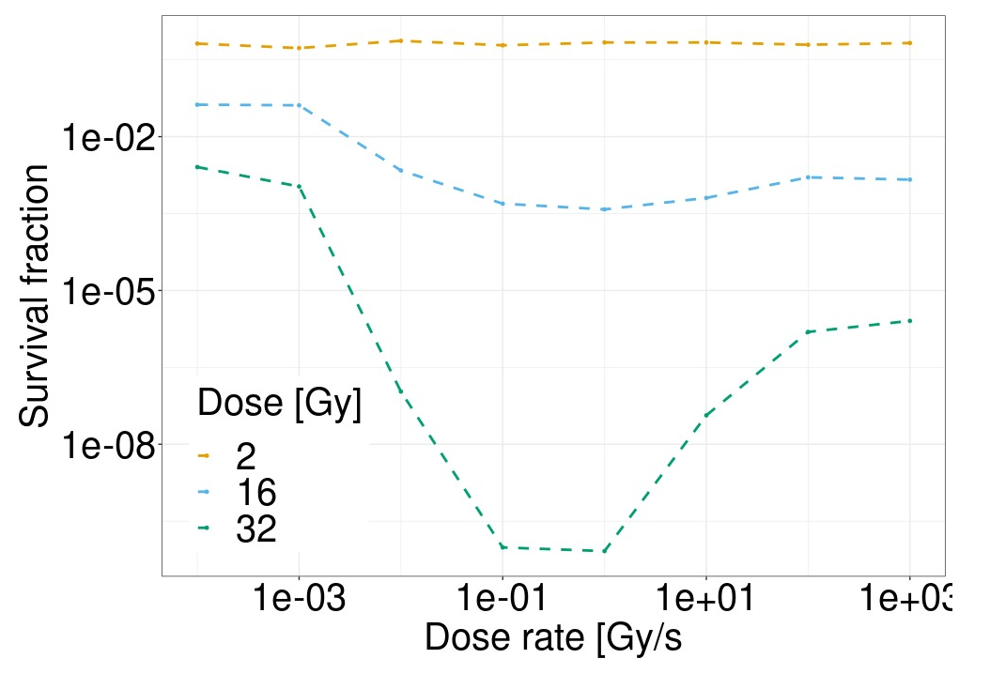
The multiscale GSM²: survival vs dose rate
Indirect DNA damage yield
HSG cells
$$k_{I} \left(\left[{ROO}^{⋅}\right]\right)=k_{I}∙{AUC}_{{ROO}^{⋅}}^{norm}$$
$${AUC}_{{ROO}^{⋅}}^{norm}=1$$
$$k_{I}=0.8∙k$$
80 MeV p
Both high dose and high dose rate play a crucial role in the sparing of normal tissue
$${AUC}_{{ROO}^{⋅}}^{norm}<1$$
Preliminary results

Slide 18
Summary
The multiscale GSM²
Track hitting and energy deposition
$\left[{ROO}^{⋅}\right]$ time evolution
${AUC}_{{ROO}^{⋅}}^{norm}$ and $k_{I} \left(\left[{ROO}^{⋅}\right]\right)$
Sub-lethal and lethal lesions
Survival fraction
Empirical results
vs
Multiscale GSM² results
Trend agreement for dose and dose rate dependence

Slide 19
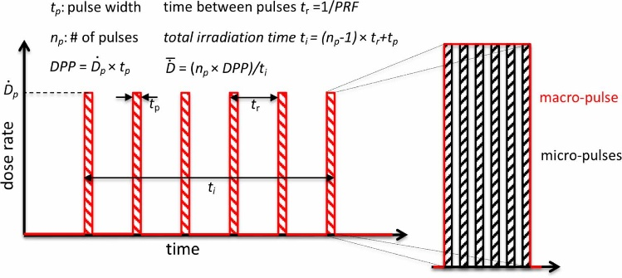
Ongoing work
Indirect DNA damage
Repair and double death
Impact of other radicals
$$k_{I} \left(\left[{ROO}^{⋅}\right]\right)=k_{I}∙{DREF}_{DSB}\left(\left[{ROO}^{⋅}\right]\right)$$
$$r \left(\left[radical\right]\right)$$
$b \left(\left[radical\right]\right)$
$${ROO}^{⋅}$$
$${OH}^{⋅}$$
…
?
Any dose delivery structure
Different LET regimes
Heterogeneous chemical stage
80 MeV p
18 MeV p
149 MeV C
…
Reaction-diffusion model
Camazzola, Fuss, et al., FRPT 2021
Work
in
progress
Esplen et al., Phys. Med. Biol. (2020)

