Slide 1
Towards the homogeneous chemical stage of radiation damage: new extension of the TRAX-CHEM code
Gianmarco Camazzola
Heidelberg University FRIDA meeting – 27/09/2022

Slide 2
Outline
Introduction
Direct & Indirect Radiation Damage
Implementation of Radiation Damage on a Track Structure Level
Necessity of the Homogeneous Chemical Stage
Towards the Homogeneous Chemical Stage
Phases of the Extension
Code Implementation
Results
New Reaction-Diffusion Model
Validation in Water
The Biological Environment
Work in Progress & Outlook

Slide 3
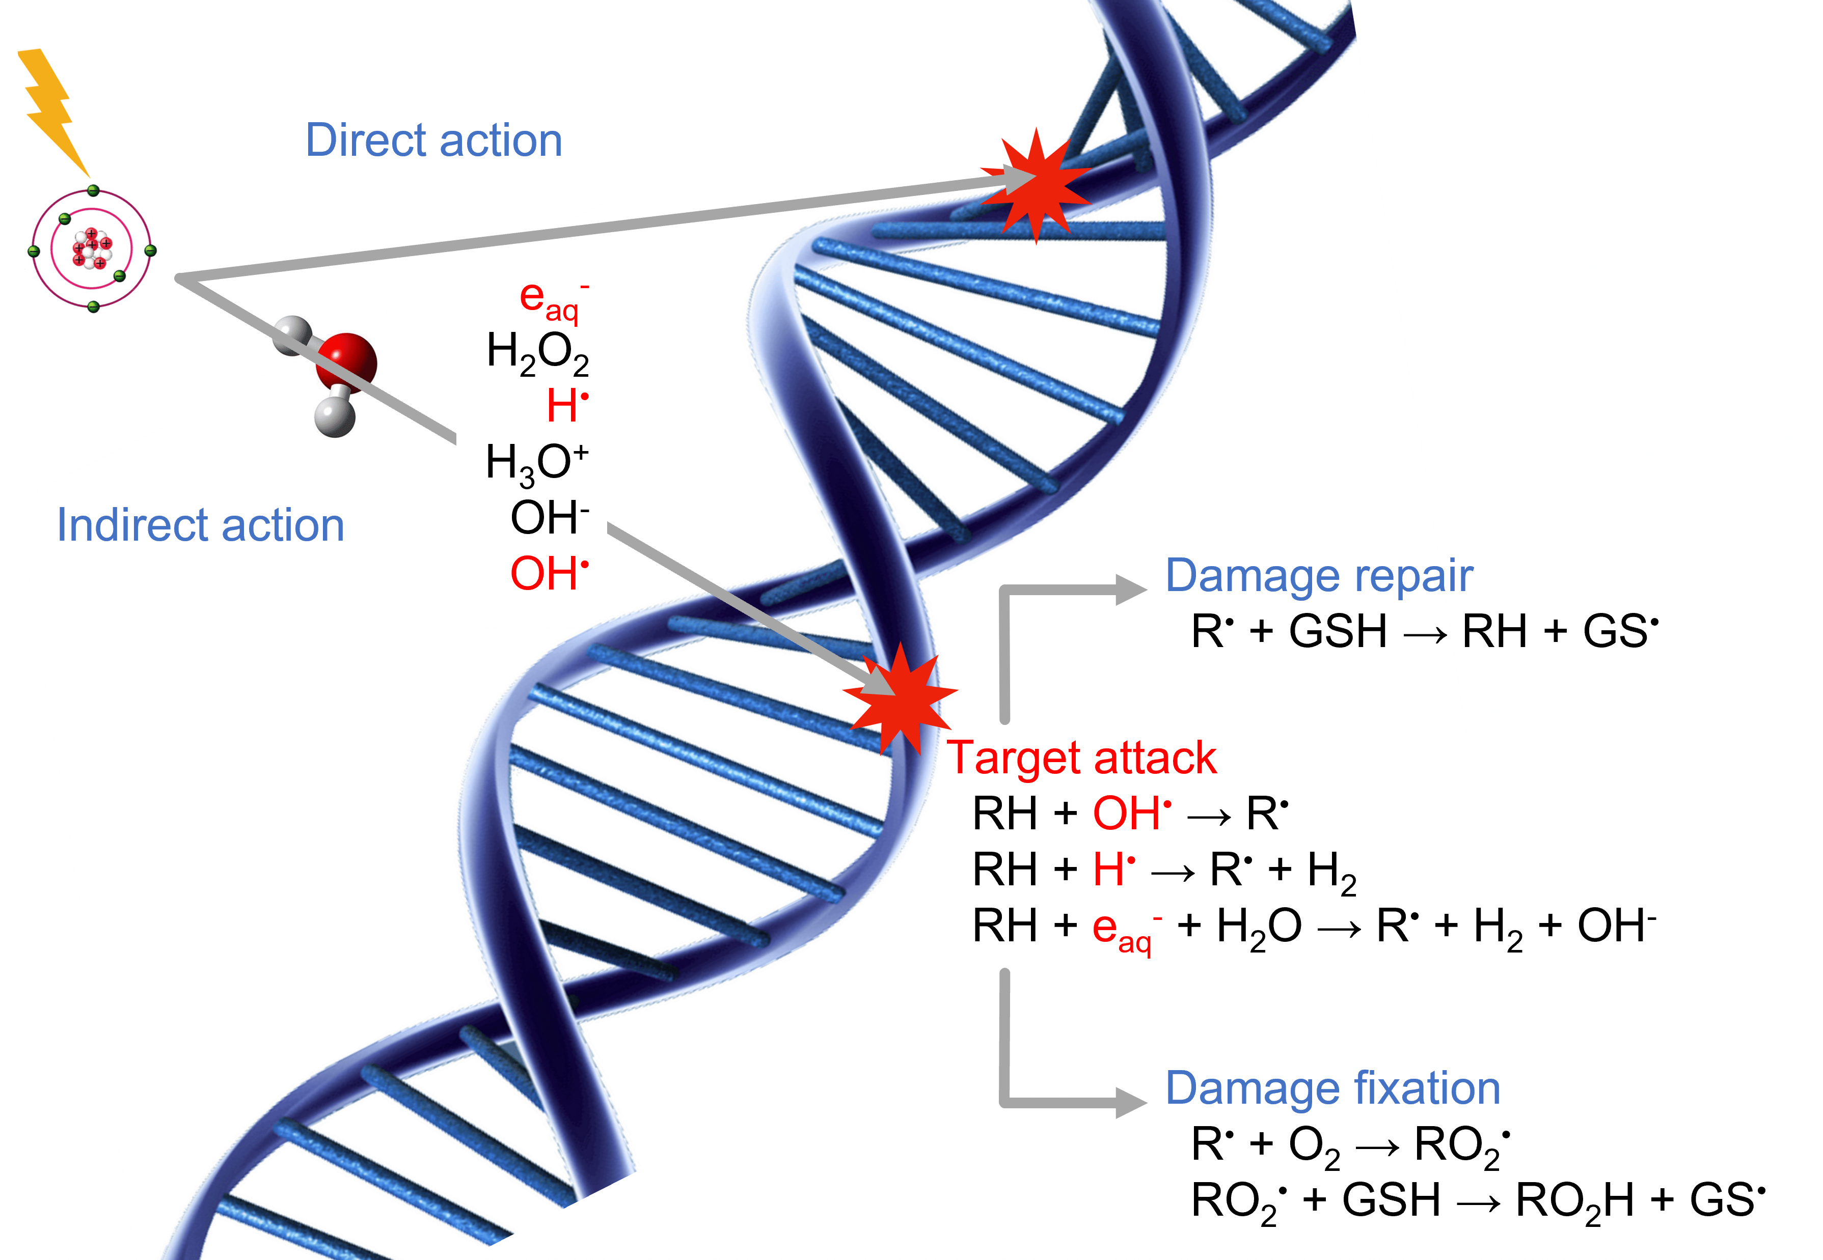
1.a Direct & Indirect Radiation Damage
Why indirect damage:
150MeV protons → indirect action to plasmid DNA¹ > 90%
150MeV/u He ions → indirect action to cell killing under hypoxic conditions² ≈ 52%
¹ Schlathölter et al., Int. J. Nanomed. (2016)
² Hirayama et al., Radiat. Phys. Chem. (2009)
Figure: Direct and indirect radiation damage to the DNA double strand (RH). Adapted from Boscolo, PhD thesis, TU Darmstadt (2018).

Slide 4
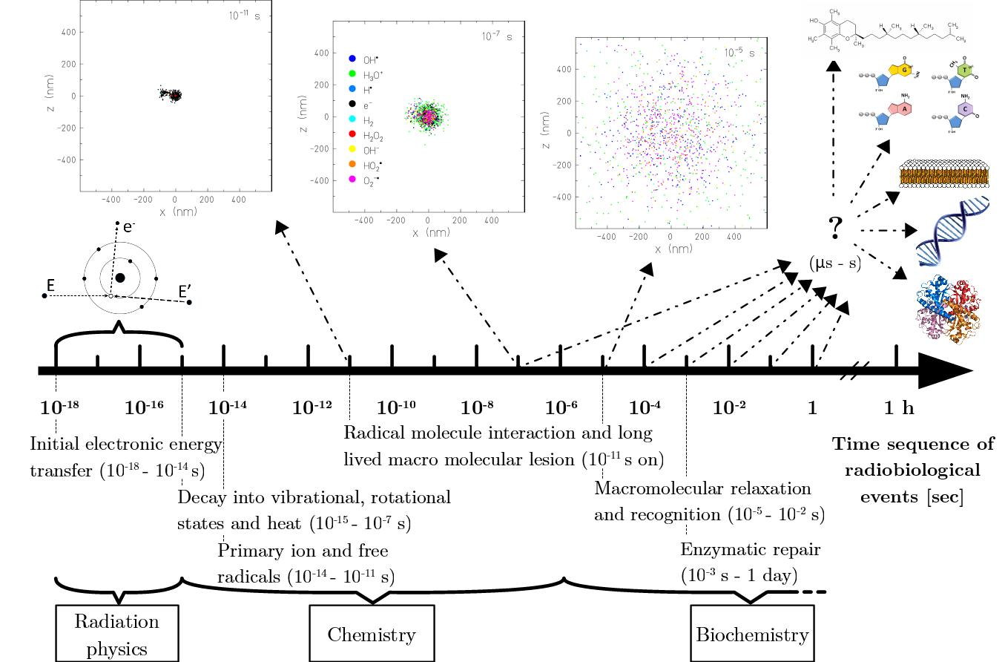
1.b Implementation of Radiation Damage on a Track Structure Level
Event-by-event
TRAX-CHEM^{1,2}
Typical FLASH pulse
¹ Boscolo et al., Chem. Phys. Lett. (2018)
² Boscolo et al., Int. J. Mol. Sci. (2020)

Slide 5
1.c Necessity of the Homogeneous Chemical Stage
Simulation of chemical damage induced by radiation in a biological target → introduce biological environment: pH & biomolecular solutes (concentration values, rate constants, diffusion coefficients) → simulate up to longer time scales (μs-s) the fate of toxic radiolytic yields (indirect radiation damage) → provide more detailed information on the variation of chemical endpoints with radiation (e.g. LET) and environment (e.g. oxygenation) properties
Extension of Monte Carlo track structure code TRAX-CHEM into the homogeneous biochemical stage of radiation damage → species sparsely distributed & reactions with biological environment prevail → not covered by modelling codes presently available

Slide 6
2.a Phases of the Extension
«PHASE I» – heterogeneous, discrete reaction-diffusion model (TRAX-CHEM)
«PHASE II» – transition, reaction-diffusion model with concentration distributions
«PHASE III» – homogeneous, classical reaction model

Slide 7
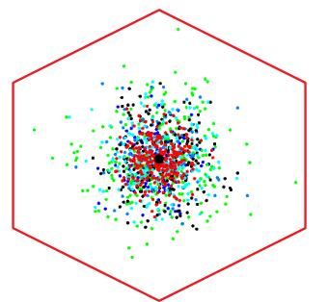
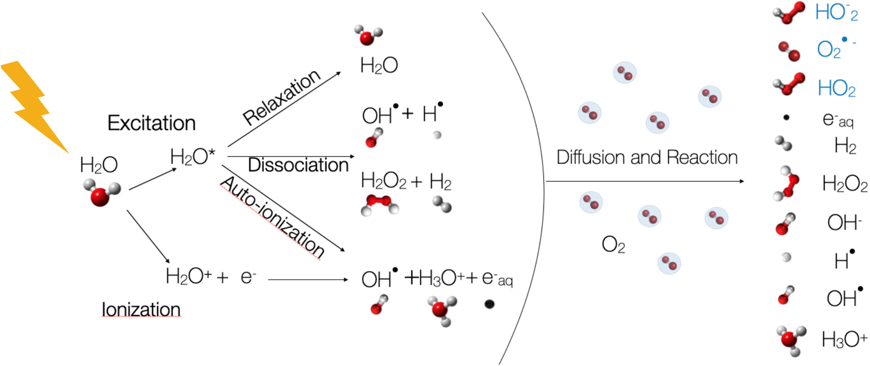
2.a Phases of the Extension
«PHASE I» – heterogeneous, discrete reaction-diffusion model (TRAX-CHEM)
y
Highly stochastic events with heterogeneous concentrations → Monte Carlo irreplaceable
Score all single radicals and molecules positions, within an area determined by Dose-LET relation
$$\frac{1}{ϕ}=\frac{1.6⋅{10}^{−9}⋅LET}{D⋅ρ}$$
x
Figure: Production channels of radicals and molecules featuring water radiolysis. Adapted from Boscolo et al., Radiother. Oncol. (2021).

Slide 8
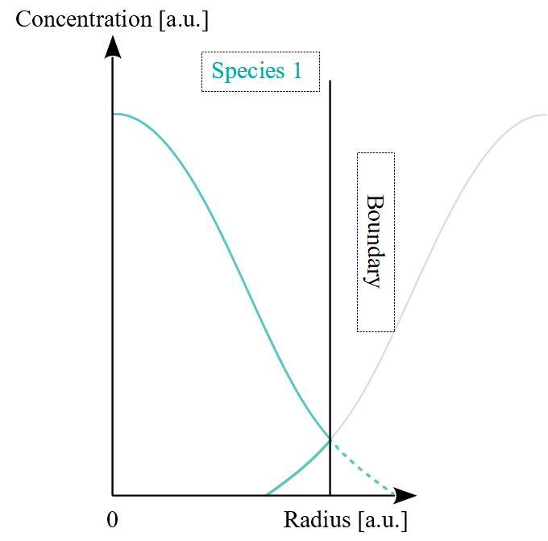
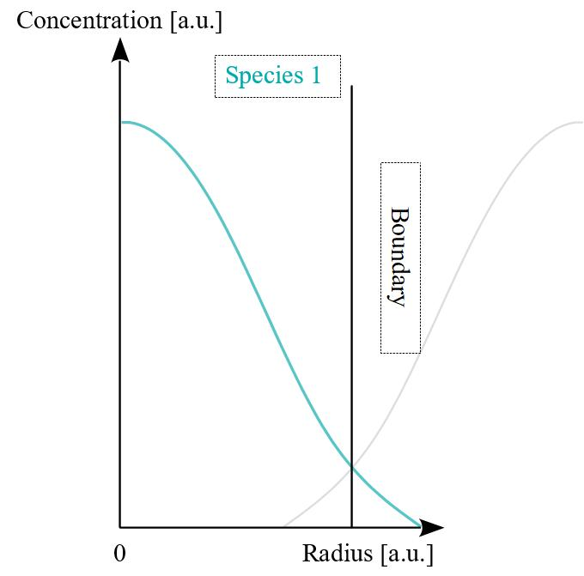
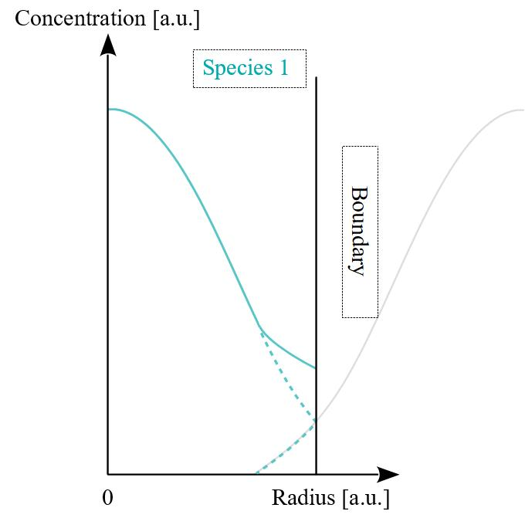
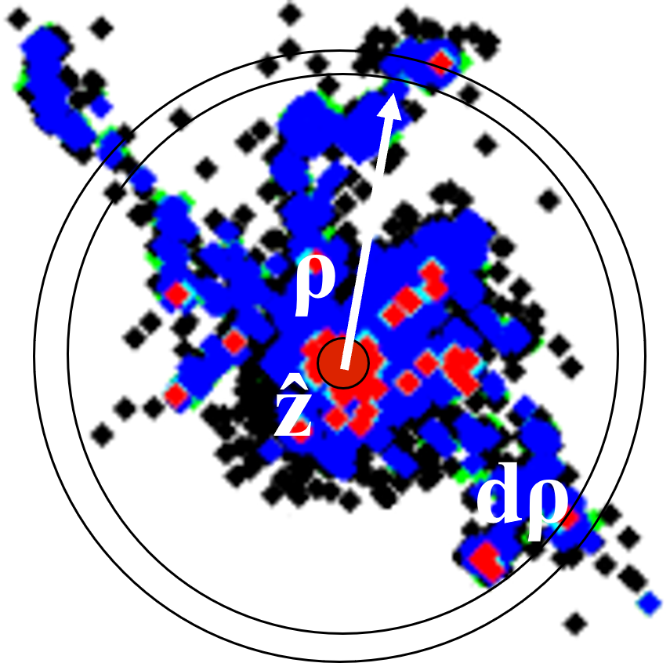
2.a Phases of the Extension
«PHASE II» – transition, reaction-diffusion model with concentration distributions
From a cloud of single positions to species concentration distributions (analogy with radial dose around physical track)
Especially relevant for ions, not homogeneous at 1μs
Still focus on one single track (average behaviour in one pulse), accounting (implicitly) for «neighbouring» tracks through boundary conditions

Slide 9
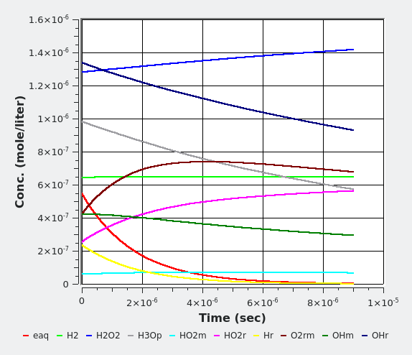
2.a Phases of the Extension
«PHASE III» – homogeneous, classical reaction model
Once concentration is flat, define one global value → diffusion step unnecessary, reactions simplified and sped up
Figure: Simulation obtained from the scientific software tool “Kinetiscope”.
Results at 10μs (t_{in} = 1μs) for a 90MeV/u Carbon ion in 2% pO2 water target.

Slide 10
2.b Code Implementation
New Reaction-Diffusion Model
Spatial information conversion
New diffusion and reactions approaches with concentration distributions
Validation in Water
Prove validity of new approaches with TRAX-CHEM
Find optimal transition time between TRAX-CHEM & extension
Benchmark with experimental data
Accounting for the Biological Environment
Classes of background species to include (in progress)
Introduction of pH & considerations on acid-base pairs (in progress)
Applications (outlook): LET effects, target oxygenation, FLASH dose rates

Slide 11
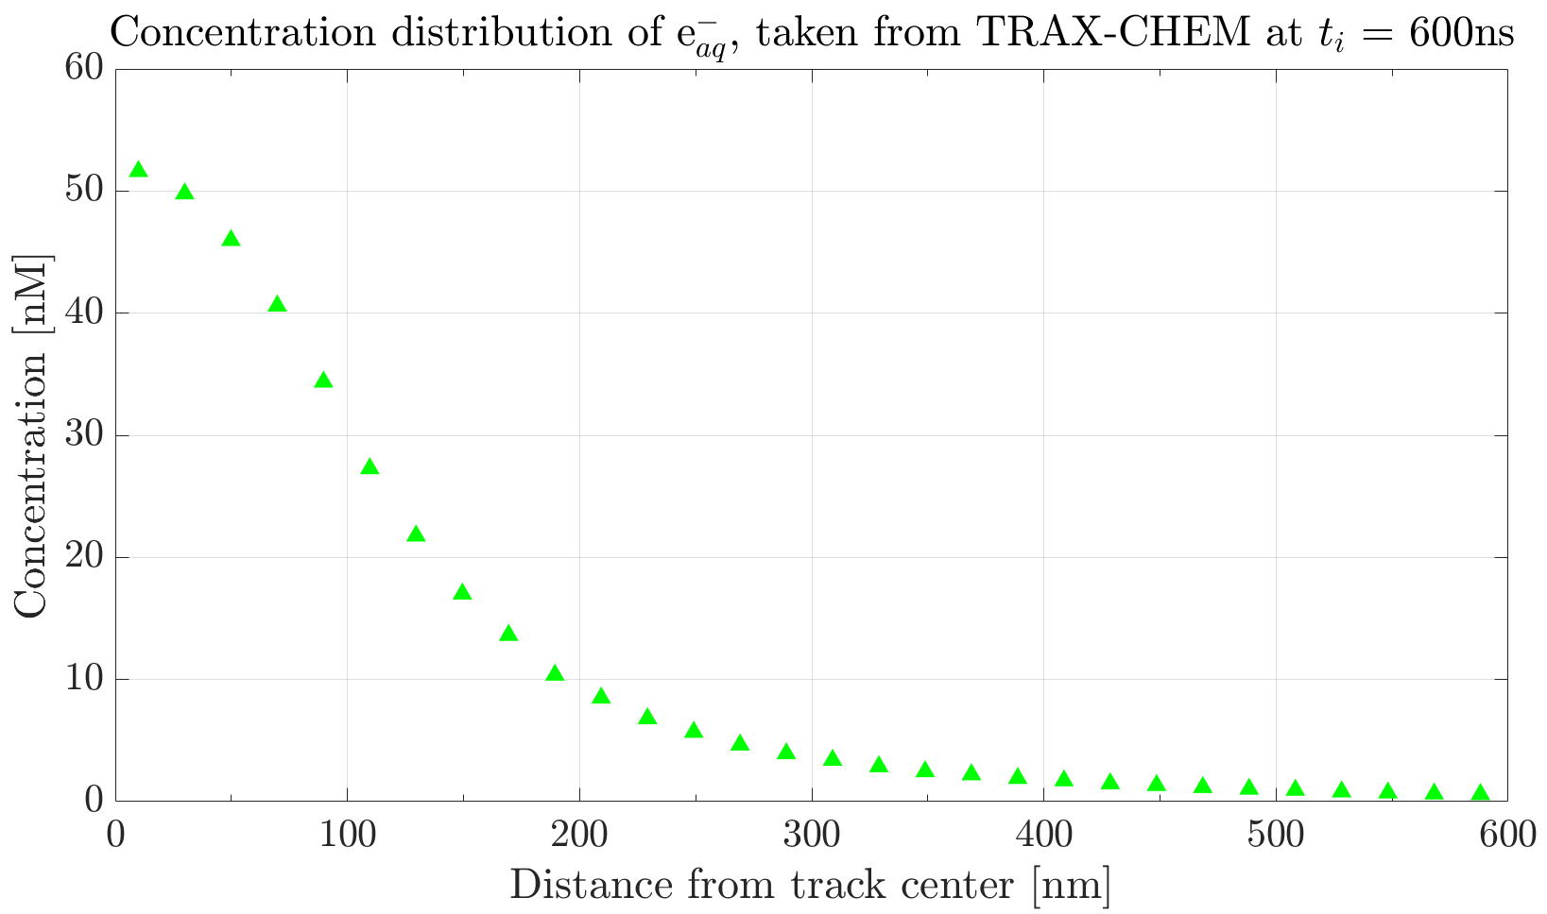
3.a New Reaction-Diffusion Model
y
Spatial information conversion
Primary projectile: 500 keV electron beam in 1% pO2 water target
Example of starting data
x

Slide 12
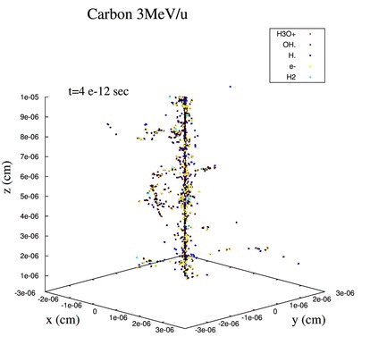
3.a New Reaction-Diffusion Model
Diffusion development – Matrix approach
Given the boundary value problem (Fick’s II law)
$∂_{t}\left[A\right]−D∂_{r}^{2}\left[A\right]− \frac{D}{r}∂_{r}[A]=0$
by approximating the derivatives, can recast it in a matrix ($M,N$) representation $$M\left[A_{n_{+}1}\right]=N\left[A_{n}\right] →\left[A_{n+1}\right]=M^{−1}N\left[A_{n}\right]$$
Reactions development
Given a simple reaction
$A+B →C$, rate $\frac{d[A]}{dt}=−k_{AB}[A][B]$
for species A at $n^{th}$ time step $dt$ have
$∆A=−k_{AB}\left[A_{n}\right]\left[B_{n}\right]dt$ $$\left[A_{n+1}\right]=\left[A_{n}\right]+∆A$$
Figure: Courtesy of Dr. Daria Boscolo.

Slide 13
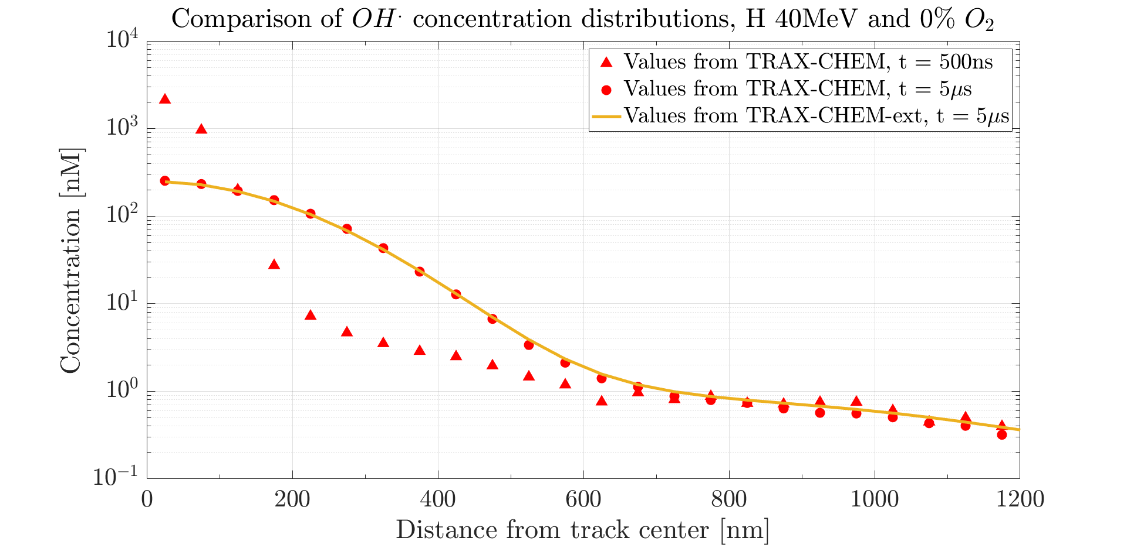
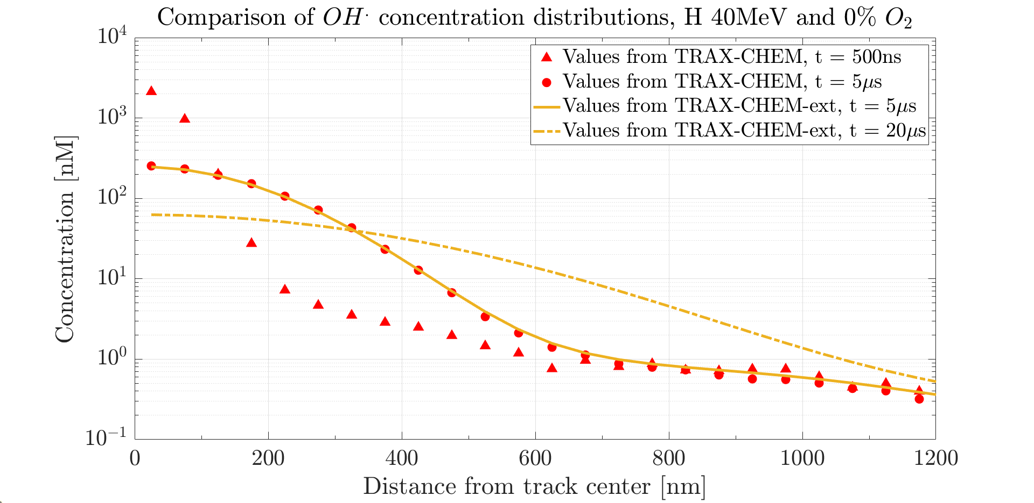
3.b Validation in Water
Computational time required
TRAX-CHEM (5μs): ≈ 19hrs
Computational time required
TRAX-CHEM (5μs): ≈ 19hrs
Extension (5μs): ≈ 28s
Computational time required
TRAX-CHEM (5μs): ≈ 19hrs
Extension (5μs): ≈ 28s
Extension (20μs): < 2mins
Full reaction-diffusion approach vs. TRAX-CHEM

Slide 14
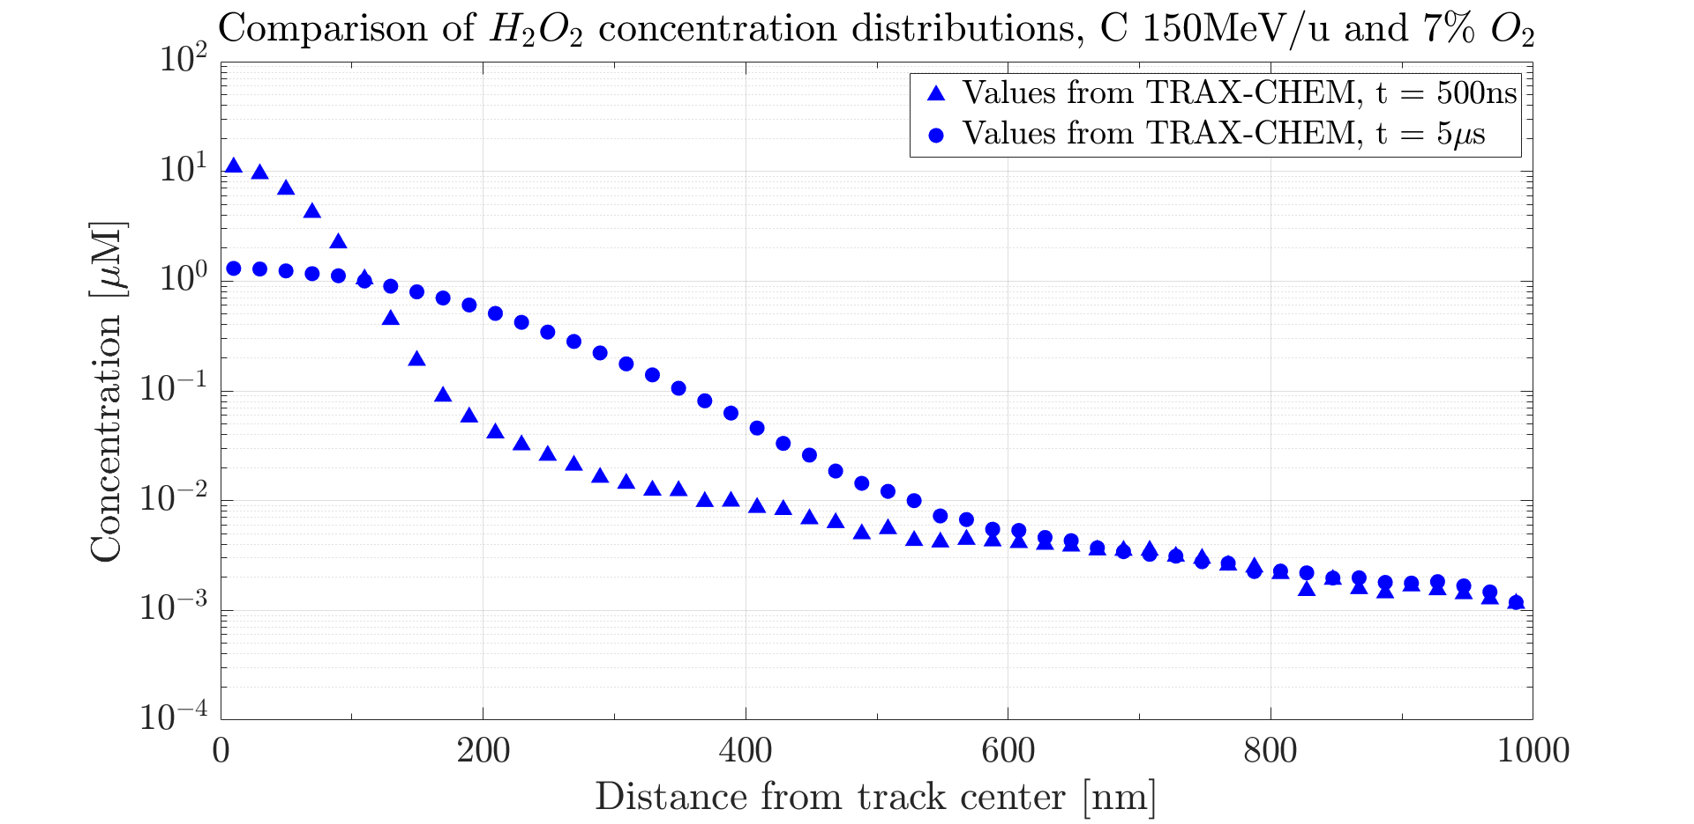
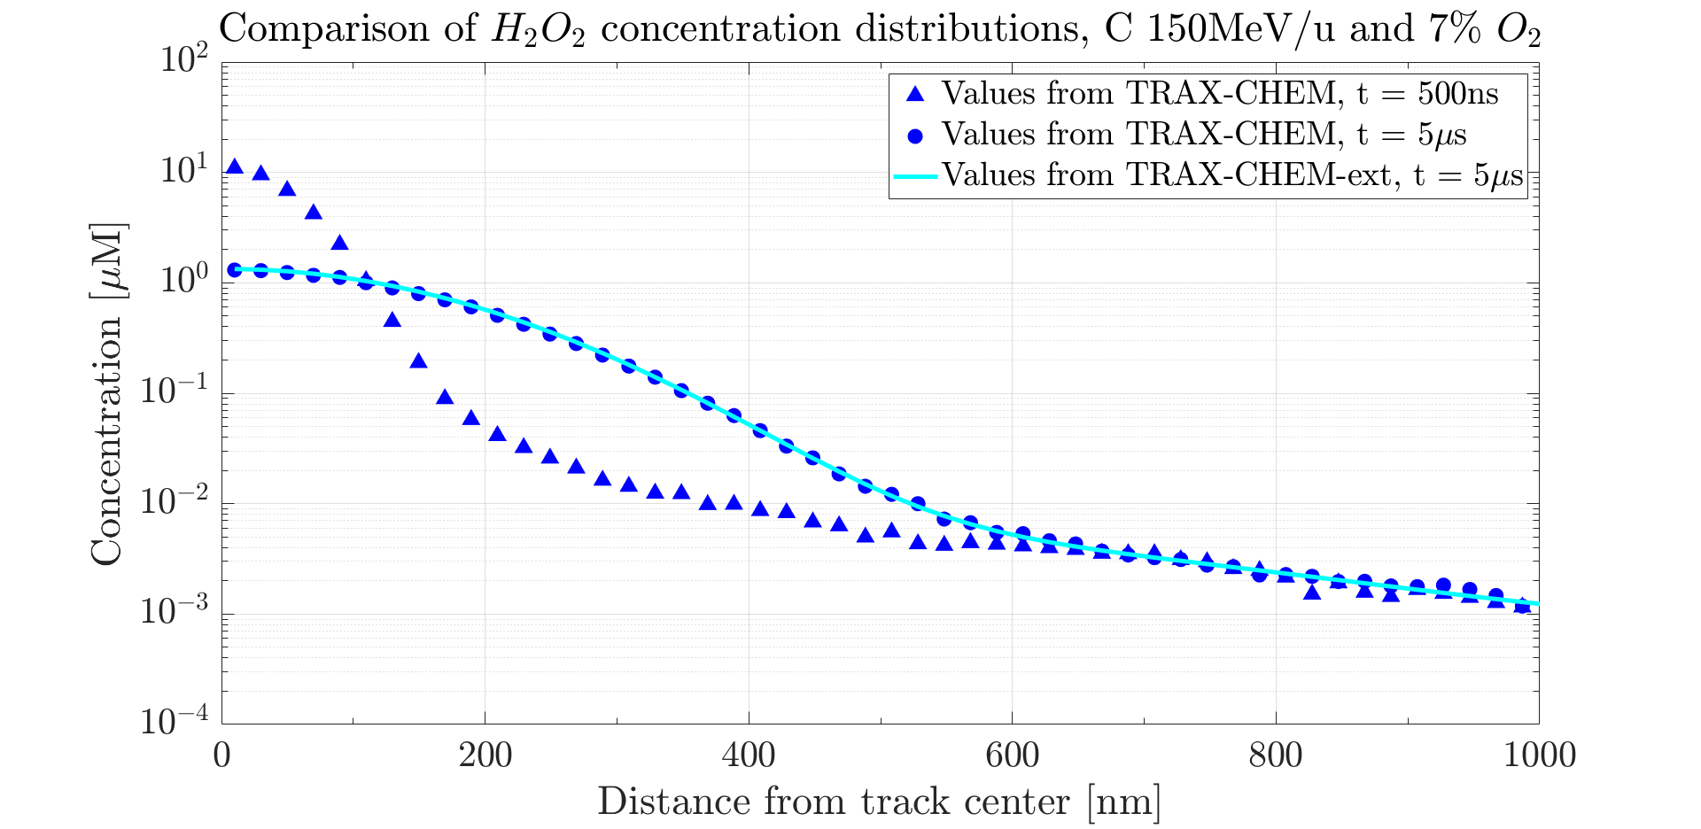
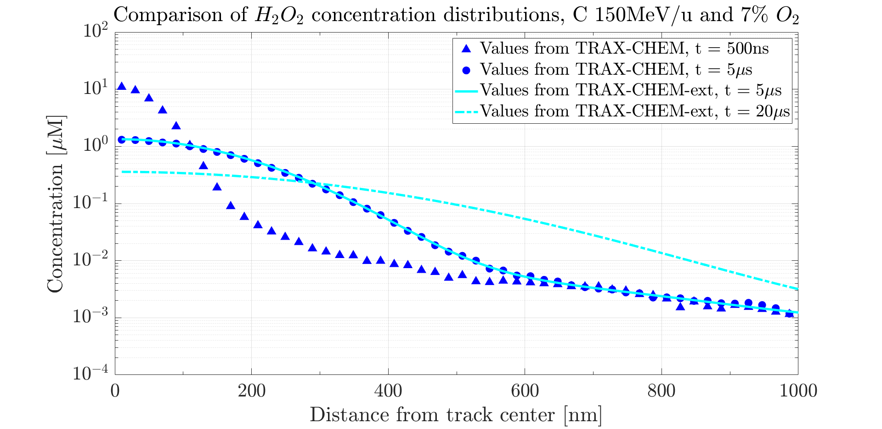
3.b Validation in Water
Computational time required
TRAX-CHEM (5μs): > 1d
Computational time required
TRAX-CHEM (5μs): > 1d
Extension (5μs): ≈ 1min
Computational time required
TRAX-CHEM (5μs): > 1d
Extension (5μs): ≈ 1min
Extension (20μs): ≈ 5mins
Full reaction-diffusion approach vs. TRAX-CHEM

Slide 15
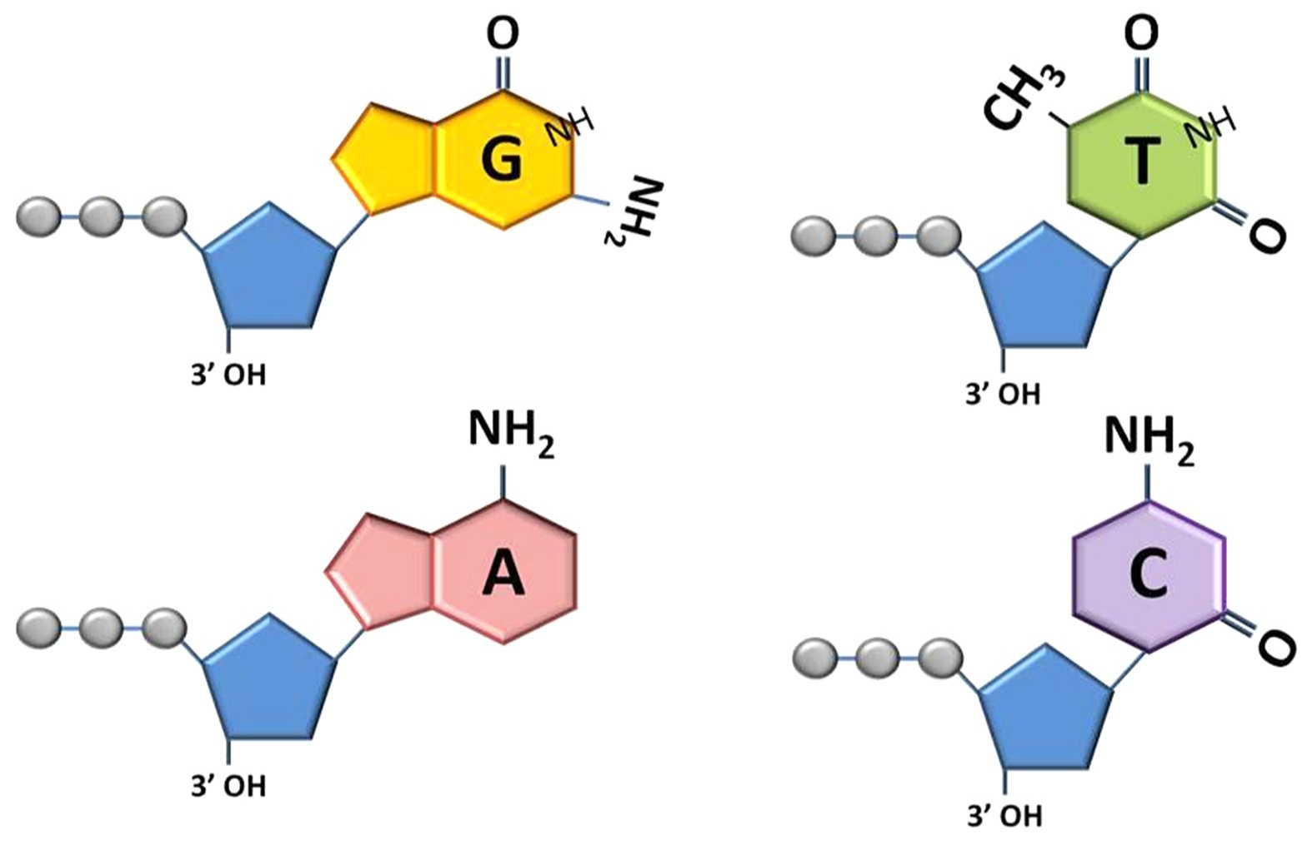
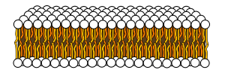
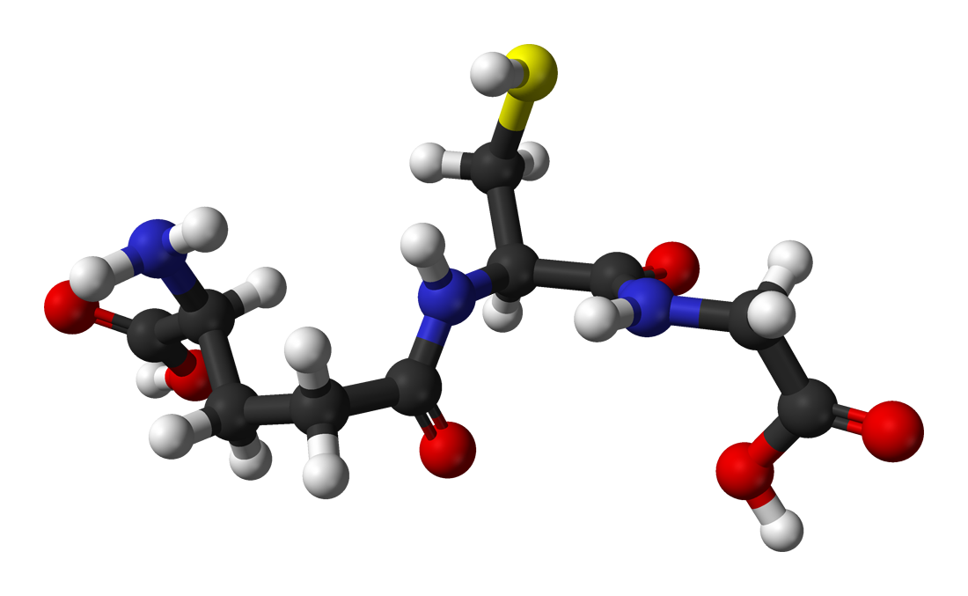
3.c The Biological Environment
Classes of background species to include (examples)
Nucleotides ([RH] = 0.032 M)¹: RH + OH• → R• + H₂O, k = 5E9 M⁻¹s⁻¹ RH + H• → R• + H₂, k = 2E8 M⁻¹s⁻¹ RH + e_{aq}⁻ + H₂O → R• + H₂ + OH⁻, k = 7E9 M⁻¹s⁻¹
Lipids ([RH] = 0.042 M)²: RH + OH• → R• + H₂O, k = 1E9 M⁻¹s⁻¹ (alkyl radical production) R• + O₂ → ROO•, 1E8 M⁻¹s⁻¹ < k < 1E10 M⁻¹s⁻¹ (organic peroxyl radical production)
Antioxidants (e.g. glutathione, [GSH] = 6.5E-3 M)²: GSH + OH• → GS• + H₂O, k = 1E10 M⁻¹s⁻¹
¹ Data from Michaels and Hunt, Radiat. Res. (1978)
² Data from Labarbe et al., Radiother. Oncol. (2020)

Slide 16
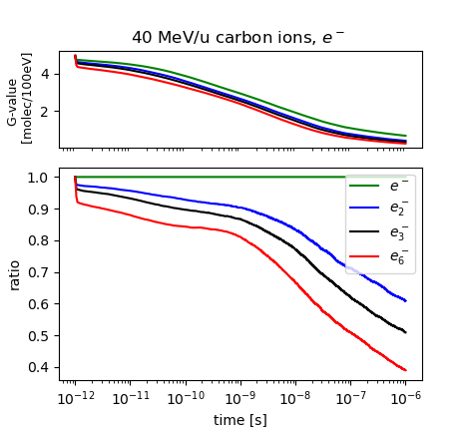
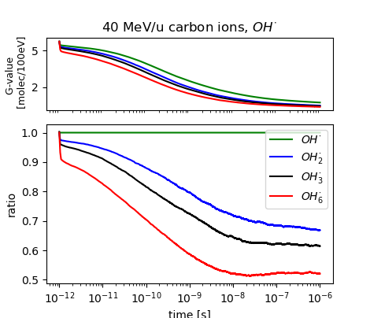
4. Work in Progress & Outlook
Benchmarks with experimental data & inclusion of biological environment
Study of (possible) intertrack effects (cf. Ramos et al., Radiat. Res. 2020)
Analysis of relevant chemical changes under different irradiation conditions (e.g. LET, oxygenation & ultra-high dose rates)
Figures: Courtesy of Lorenzo Castelli.

Slide 17
Acknowledgements
Dr. Martina Fuß, Dr. Daria Boscolo, PD Dr. Michael Krämer, Prof. Dr. Marco Durante
PD Dr. Alexander Dorn
M.Sc. Valentino Abram
Dr. Emanuele Scifoni, Dr. Francesco Giuseppe Cordoni, B.Sc. Lorenzo Castelli
GSI Biophysics Department and MPI for Nuclear Physics

Slide 18
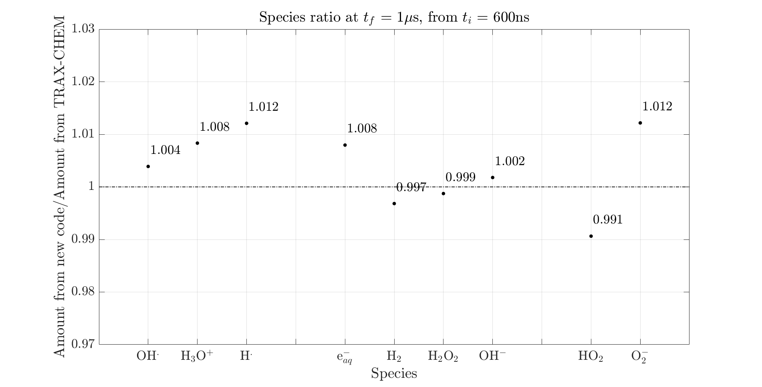
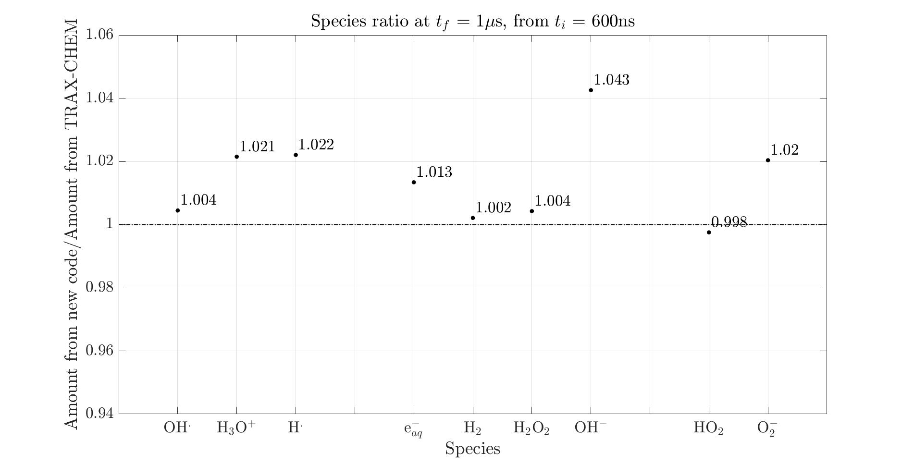
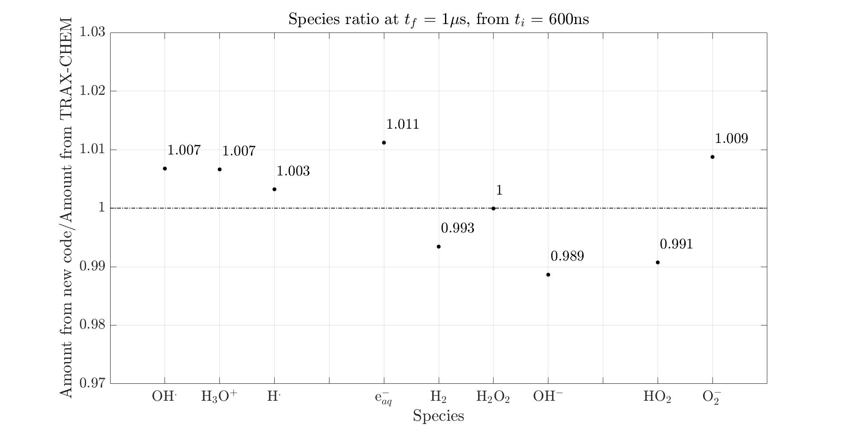
Backup – Ratios analysis
Reliability of optimal time point for smooth transition – 500 keV e, 1% pO2
Reliability of optimal time point for smooth transition – 90 MeV H, 4% pO2
Reliability of optimal time point for smooth transition – 90 MeV/u C, 2% pO2

