Slide 1
FRIDA meeting
Experimental Plan:
cell cultures and in vivo treatments
Institute of Neuroscience Pisa (CNR)
Dr. Mario Costa Dr. Enrica Strettoi
Consiglio
Nazionale delle
Ricerche
Pisa 27-28 Settembre 2022

Slide 2
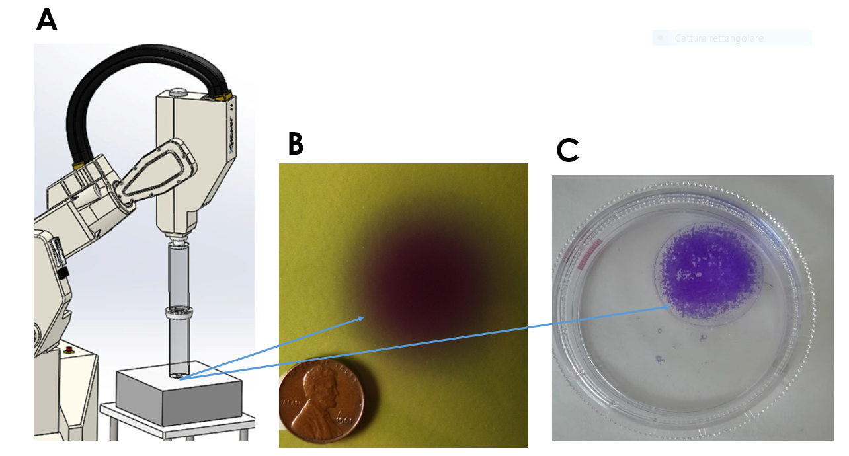
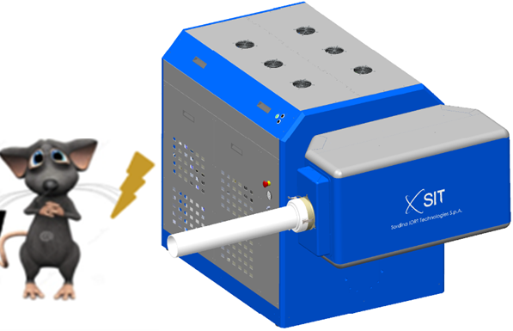
experimental device, irradiation dimension and cellular sample
modified IORT apparatus (Novac7)
The cells were growth in 1cm dish fitting in the homogenous area of irradiation
dimension of the irradiated area measured by radio chromic films EBT.

Slide 3
Paving the way for the in vivo experiments
Objective 1
Evaluation of FLASH treatments on cell culture of ARPE19
Objective 2
Evaluation of FLASH treatments on retina in vivo
Objective 3 (Perspective)
Evaluation of FLASH treatments on retina melanoma animal model

Slide 4
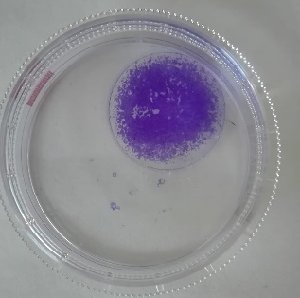
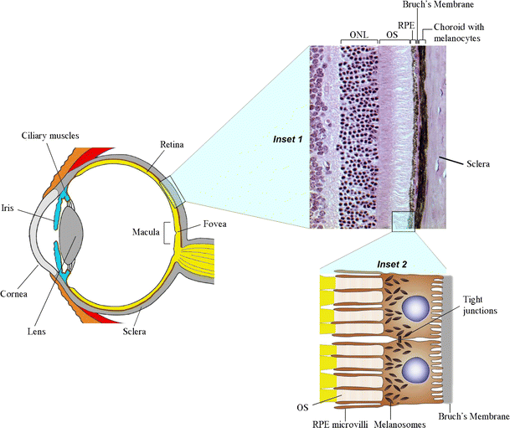
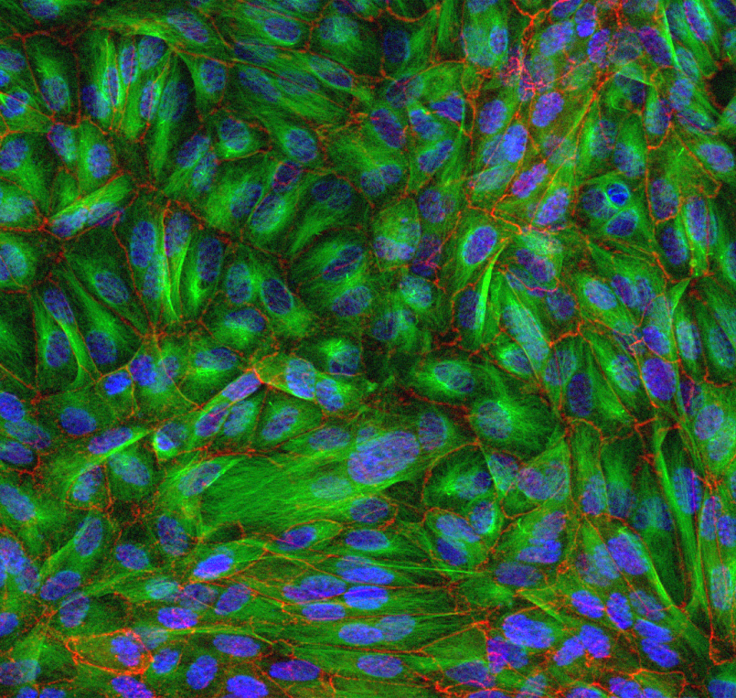
Evaluation of FLASH treatments on cell culture of ARPE19
Monolayer of polygonal cells located between the neural retina and the choroidal vessels.
RPE cells phagocyte and digest POS allowing the re-isomerization of all-trans-retinal into 11-cis-retinal (visual cycle).
RPE cells contain melanin granules which absorb the excess light focused on the retina avoiding photo-oxidative stress and dispersion of light, improving the quality of optical system.
Transports ions, water, and metabolic end products from the subretinal space to the blood and takes up nutrients from the blood delivering them to photoreceptors.
Produce and secrete growth factors, pro and anti-inflammatory species and express several membrane-associated adhesion molecules.
Constitutes the outer retinal blood barrier. The OBRB is formed by tight junctions between the RPE cells and is crucial for the maintenance of retinal homeostasis, immune response, and privilege.
ARPE19 stained with Ab against ZO1 and α tubulin proteins.
RPE stained with Ab, against ZO-1

Slide 5
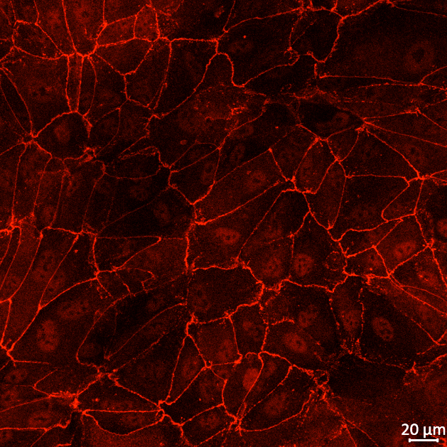
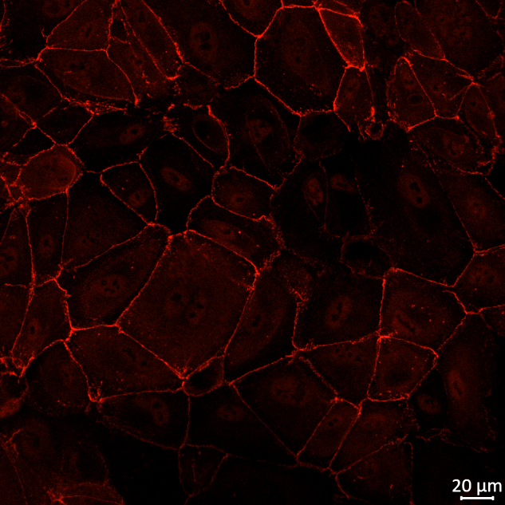
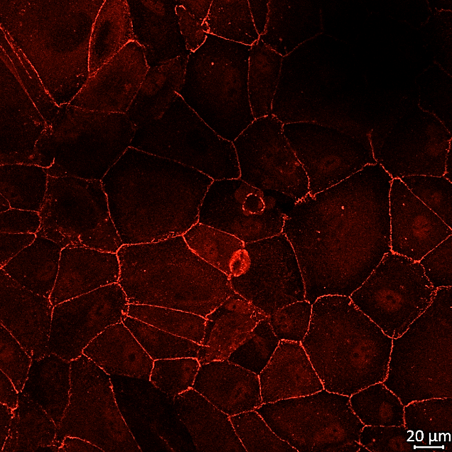
ARPE-19 radiation effects
We plan to repeat the experiments on ARPE19 cells to assess membrane integrity
CTRL CONFLUENTI
FLASH CONFLUENTI
RADIO CONFLUENTI
We identified the around of 6 Gy as a good starting point for in vivo experiments
CTRL CONFLUENTI
FLASH CONFLUENTI
RADIO CONFLUENTI

Slide 6
ARPE 19 at confluence (6 Gy)
ARPE 19 NON-confluence 6 (Gy)
post radiation
post radiation
15’
48 Hours
15’
48 Hours
****
****
Cellule/mm²
Cellule/mm²
Cellule/mm²
Cellule/mm²
P value <0,0001
P value <0,0001

Slide 7
Paving the way for the in vivo experiments
Objective 1
Evaluation of FLASH treatments on cell culture of ARPE19
Objective 2
Evaluation of FLASH treatments on retina in vivo
Objective 3
Evaluation of FLASH treatments on retina melanoma animal model

Slide 8
CONV/FLASH-RT
(1 dose, 10Gy)
IN VIVO
sacrificio
sacrificio
OBIETTIVO 2
Esperimento pilota
0
1
2
3
4
5
6
Arrivo animali e stabulazione armadio ventilato
I
I
N 3 animali per gruppo (età 4 settimane ceppo C57Bl6
I
Istologia (Attivazione microglia; integrità barriere; morfologia fotorecettori ed altre cellule)
T0/T6 = gruppo di controllo (N3)
Osservazione (danno cutaneo e stato dell’occhio)
T3 = in acuto (48 ore dopo RT) (N3 conv +N3 Flash)
T6 = a medio termine (N3 conv +N3 Flash)

Slide 9
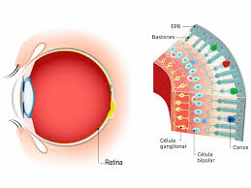
2) The retina as a CNS model for studying Flash effects
It is an outpost of the brain that can be studied non invasively with external examination
It is possible to exploit the retina to test acute events, such as apoptosis and microglial activation
It is irradiated during ocular cancer radio therapy

Slide 10
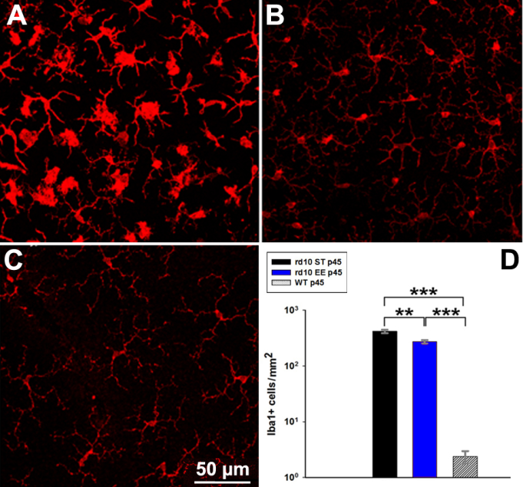
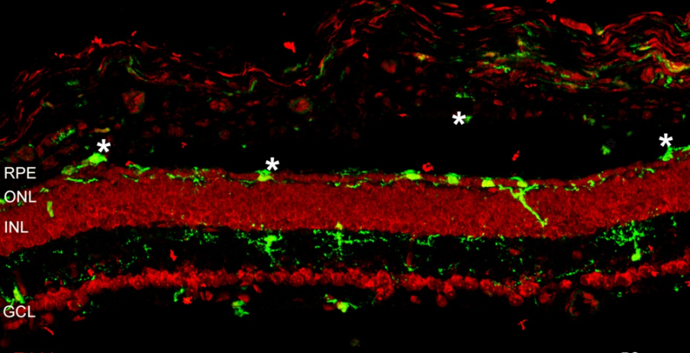
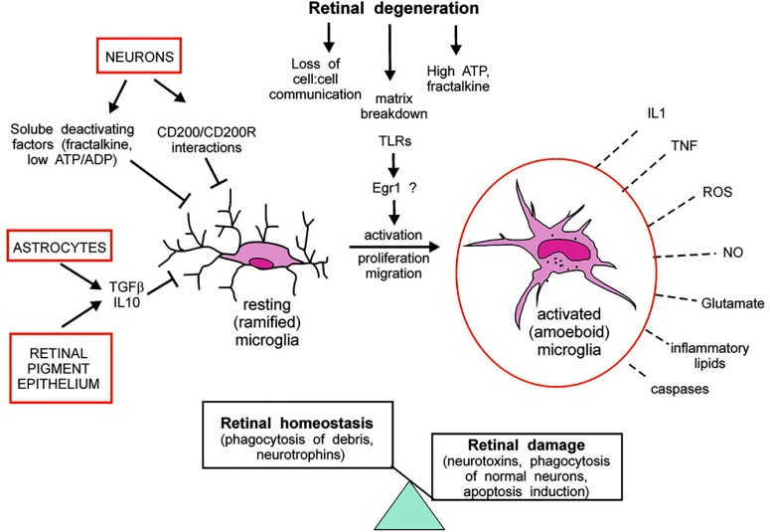
Retinal inflammation on the spot: recruitment and activation of microglia
P45
Langmann 2007
Notes:
So we examined the source of cytokines in the retina: microglia.
In retina there are three main types of glial cells: mulller astrocytes and microglia. In retina microglial cells are found in GCL and in both plexiform layers. We performed immuno with antibody for a microglial marker Iba1 (Aif1).
Microglia is know to be activated following tissue damage and to produce proinflammatory species, changing from ramified/quiescent state to amoeboid/active state. (indicare schema)
And this morphological change happens in rd10, outer retina where PRs are dying at the peak of cone death.
We analyzed retinas from WT,rd10 ST and rd10 EE with WM ICCH for Iba1 and noted a difference in morphology of cells between the three groups, level of microglial activation is lower in EE respect to ST retinas,

Slide 11
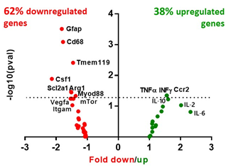
retinal microglial activation
Neuronal survival
qRT-PCR data: inflammatory genes

Slide 12
Paving the way for the in vivo experiments
Objective 1
Evaluation of FLASH treatments on cell culture of ARPE19
Objective 2
Evaluation of FLASH treatments on retina in vivo
Objective 3 (Perspective)
Evaluation of FLASH treatments on retina melanoma animal model

Slide 13
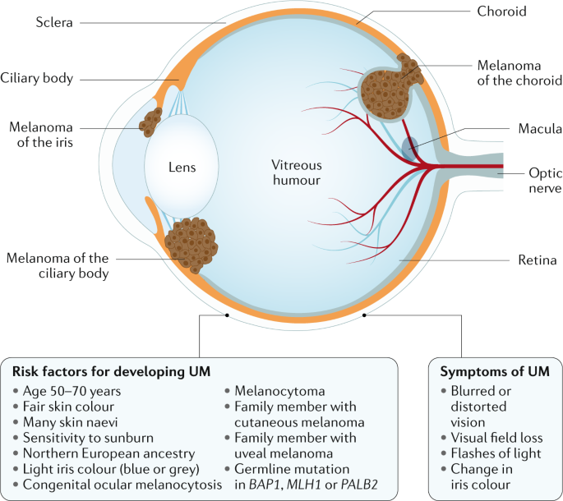
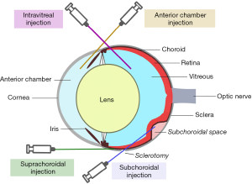
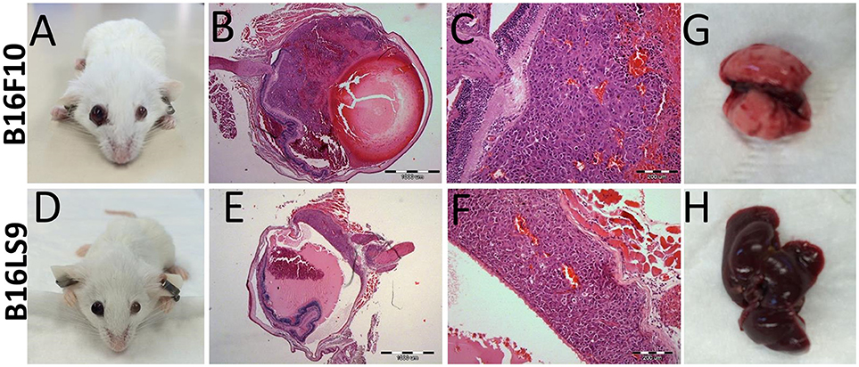
Perspectives:
Objective 3 Induction of ocular melanoma by intravitreal injection of tumor cells

Slide 14
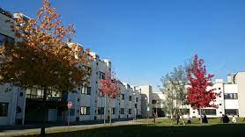
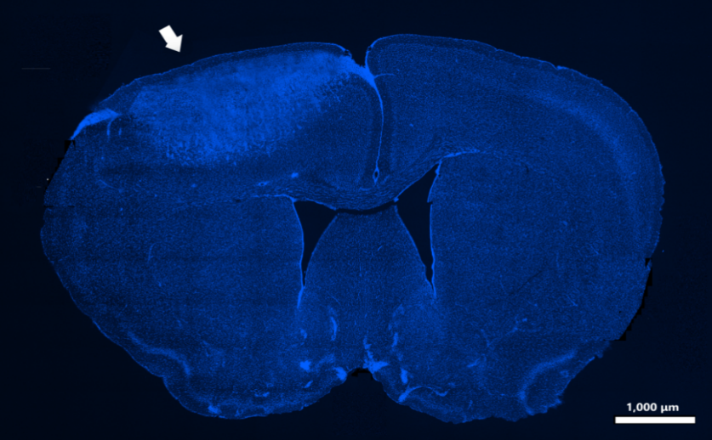
Mario Costa
Beatrice Di Marco
Elisabetta Mori
Enrica Strettoi
Eleonora Vannini

Slide 15
ARPE 19
48 hours post radiation

