Slide 1
Riunione WP acceleratore RD_FCC
M. Boscolo, L. Pellegrino, S. Lauciani, F. Fransesini, G. Sensolini

Slide 2
Mechanical design of the interaction region of the Future Circular Collider
Main activities:
Beam pipe design:
chamber engineering and prototyping;
bellows engineering and prototyping;
cooling system.
Component integration:
magnets;
shielding;
diagnostics;
detectors;
luminosity calorimeter;
vacuum system;
Design of supporting structures.
Mechanical IR assembly, disassembly & repair procedures.

Slide 3
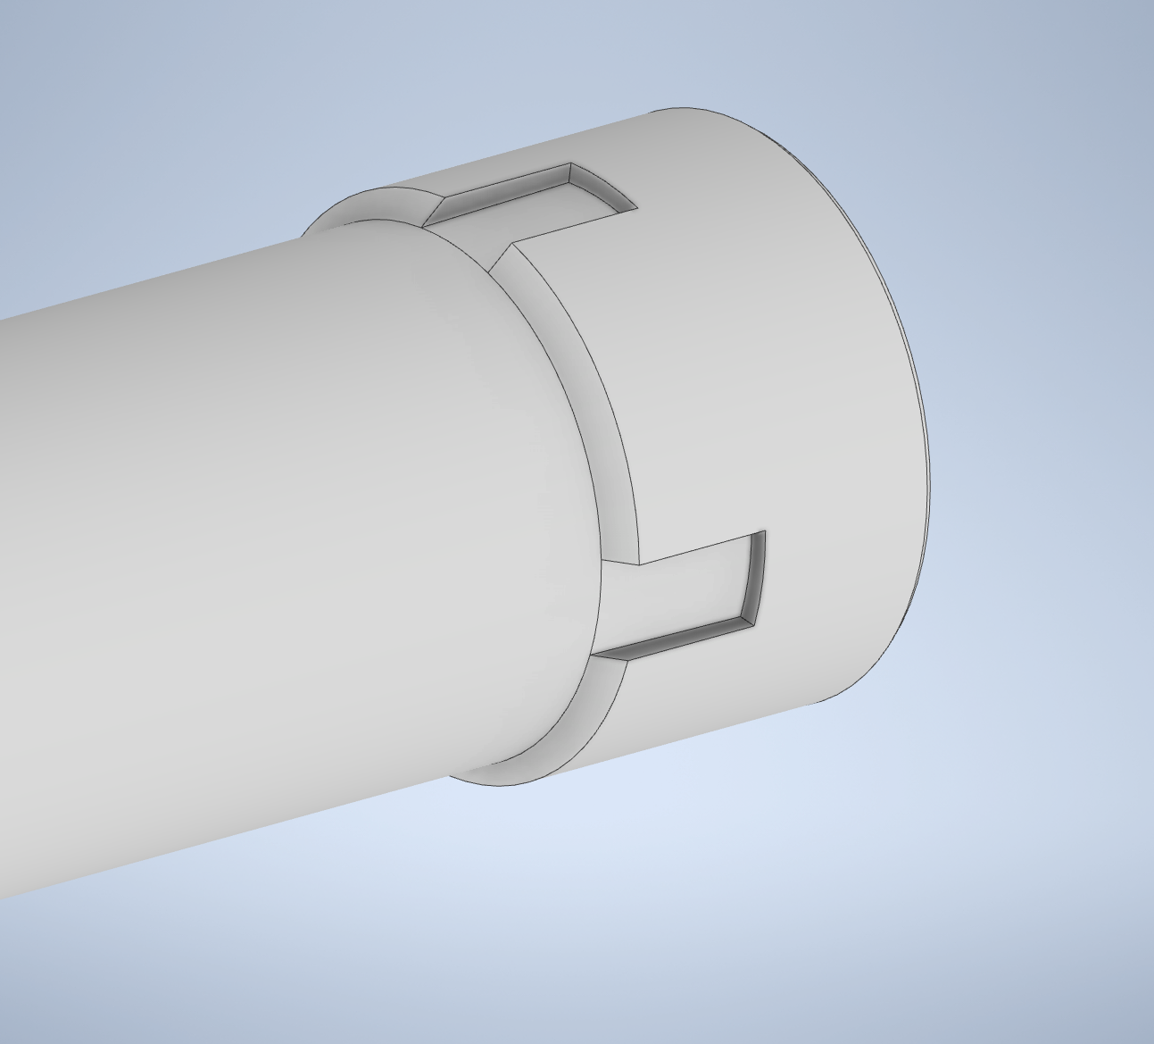
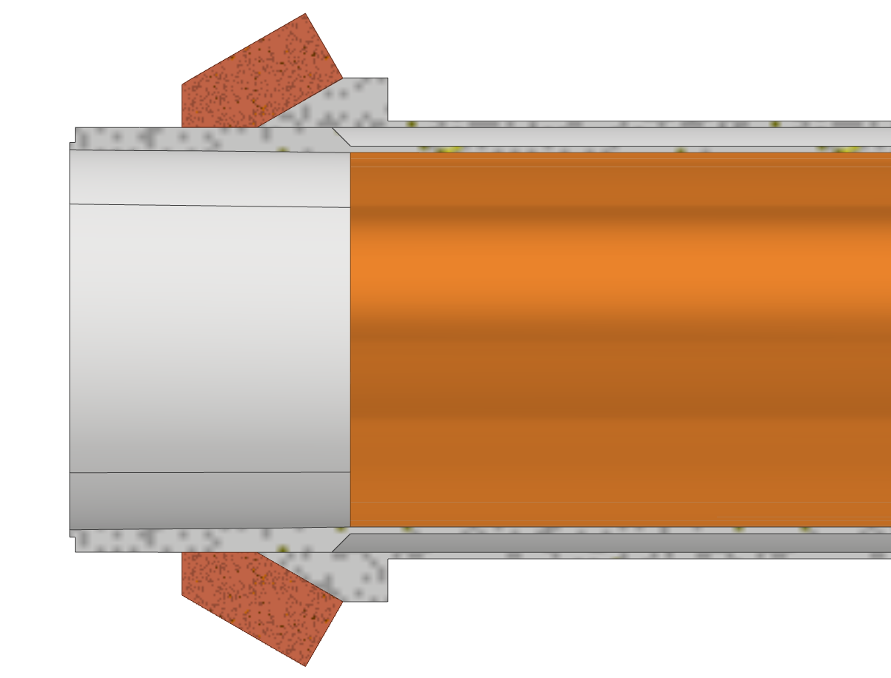
Central chamber
Insertion of the internal part
Thick copper deposition to create the cooling inlet and outlet
Section with cavities for the paraffin flow
The channel for paraffin is opened only in the part where the internal central chamber has cavities.
Using the “thick copper deposition” the
hydraulic tightness is assured in the parts in contact with AlBeMet
Hydraulic tightness

Slide 4
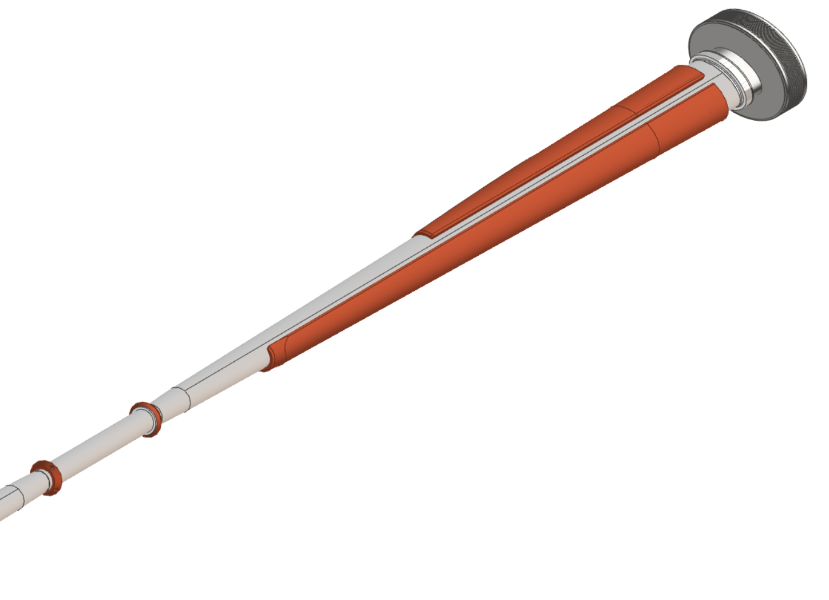
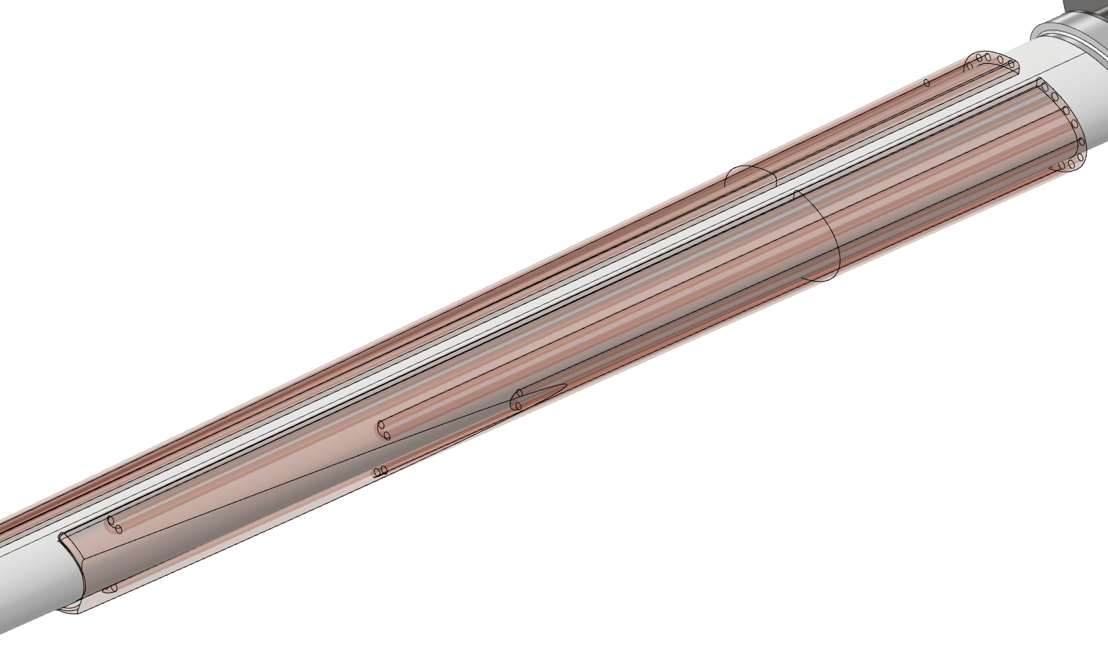
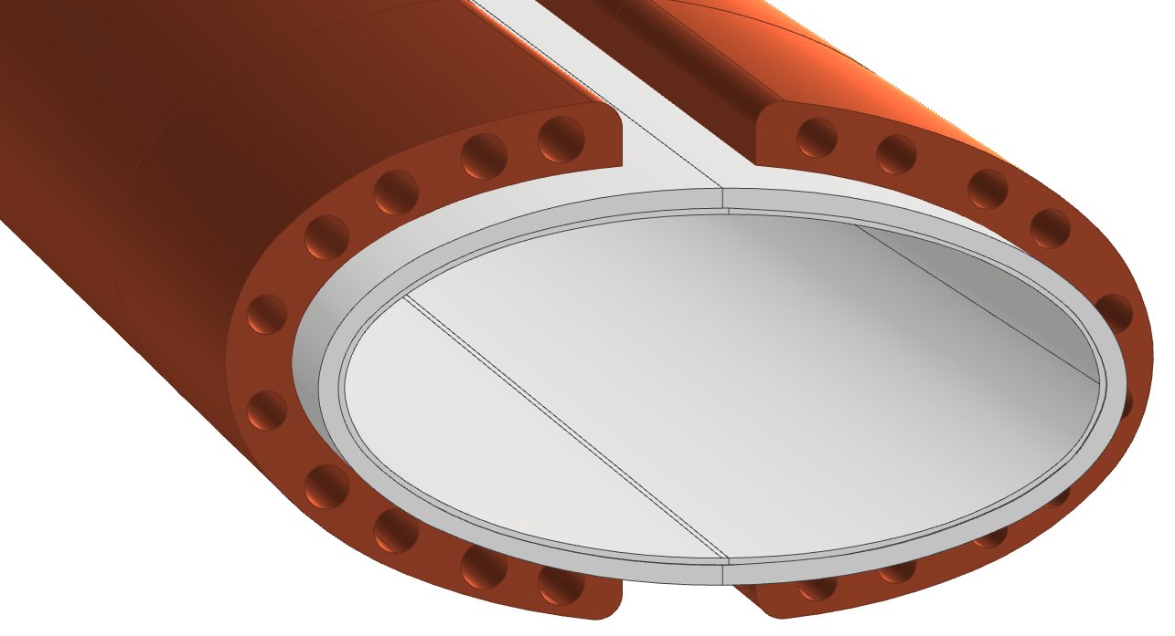
Trapezoidal chamber
Francesco Fransesini
The cooling is based on an asymmetric solution, using the 50 mrad cone as the cutting profile, to assure the respect of the spatial constraint.
To reduce the cooling material, the design provides five couples of channels for each side; in this way is possible to use the needed quantity of coolant and reduce the material, creating a light structure.
To create the channel embedded it is necessary an additive manufacturing technique, like the “thick copper deposition”.
Cooling channel
Prototype

Slide 5
Cooling
Francesco Fransesini
To assure the structural thickness of the cooling channels walls and to create the structure less massive possible, the channels start at different distance from the IP, creating the following design.
This solution creates an asymmetric behavior but still effective.

Slide 6
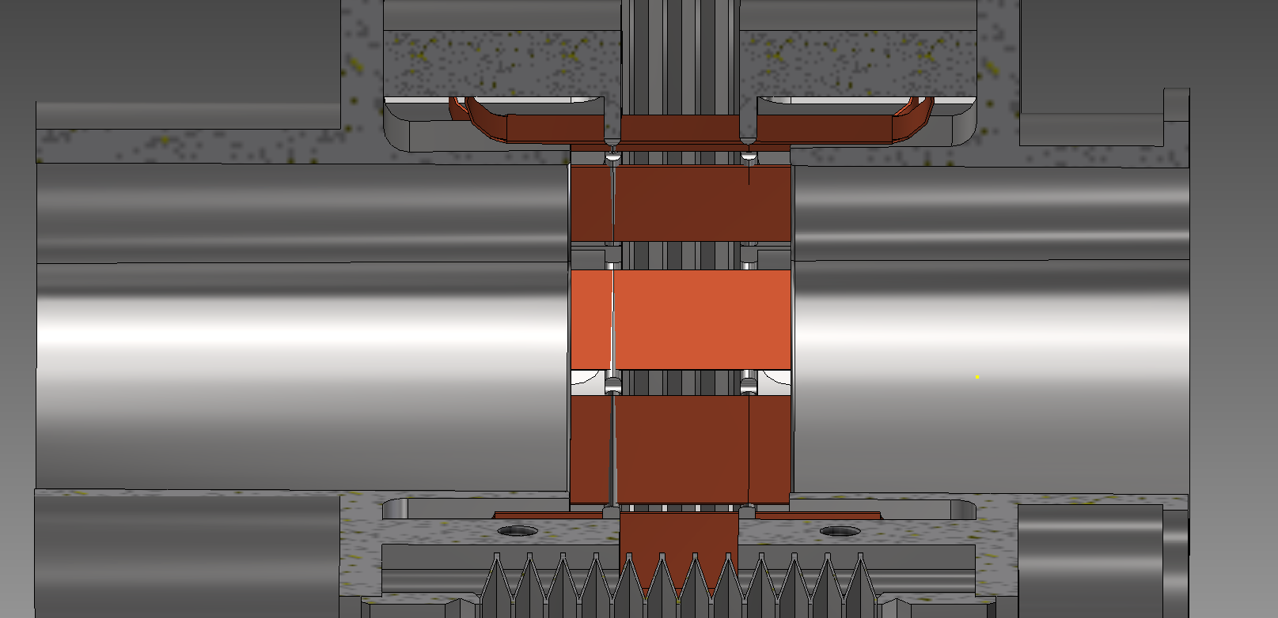
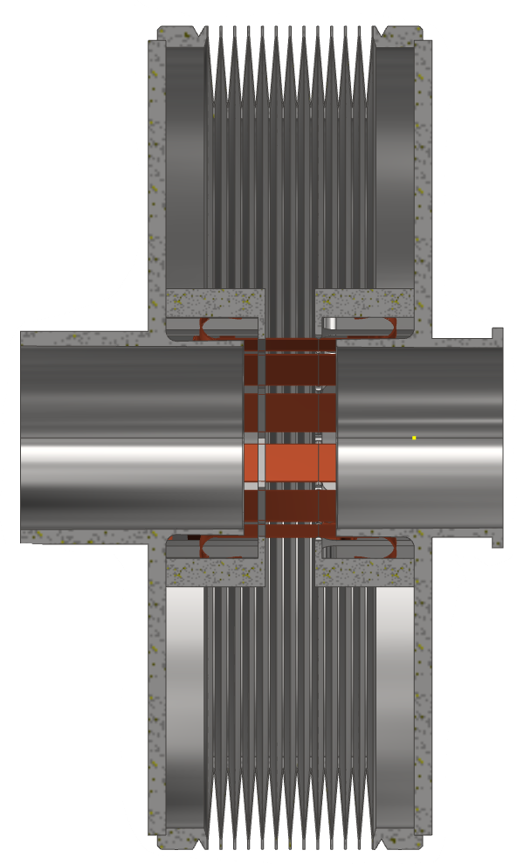
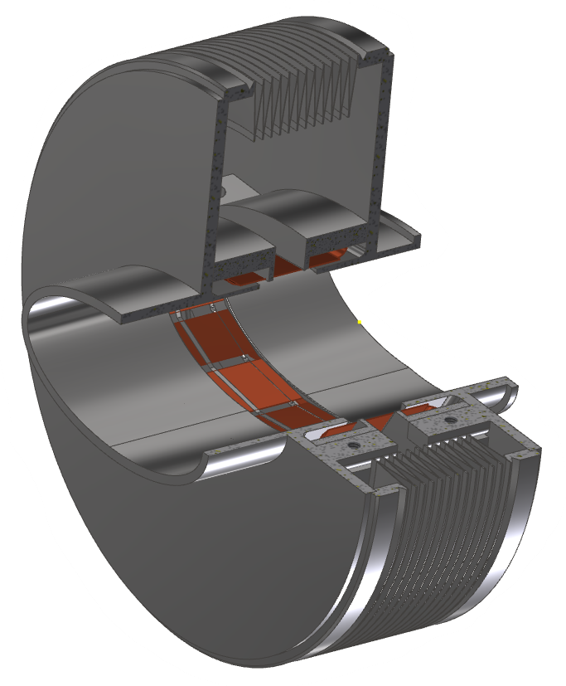
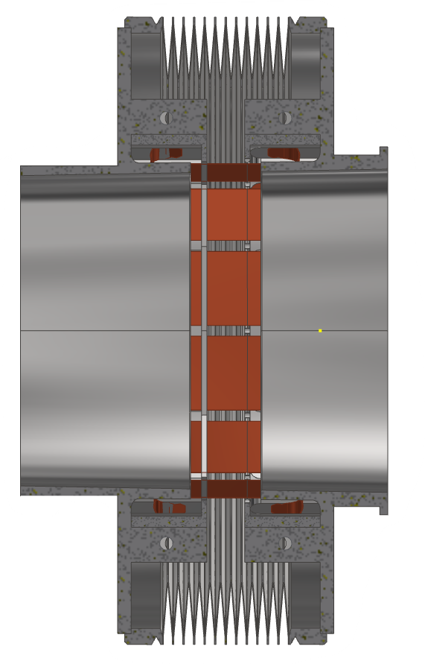
Bellow
02/06/2022 / FCC week 2022
Francesco Fransesini
12 RF copper spring (can be increased to 16)
Compact size in length
8mm stroke (-5mm +3mm)
Finger to ensure contact between RF-spring to bellow (like ESRF bellow)
Future steps for the bellow:
Simulation to validate the design
Optimization of the size and the convolutions number
Inclusion of cooling
Evaluation of different designs
Notes:
A preliminary design of the bellow is under investigation in order to stay in the space contraints

Slide 7
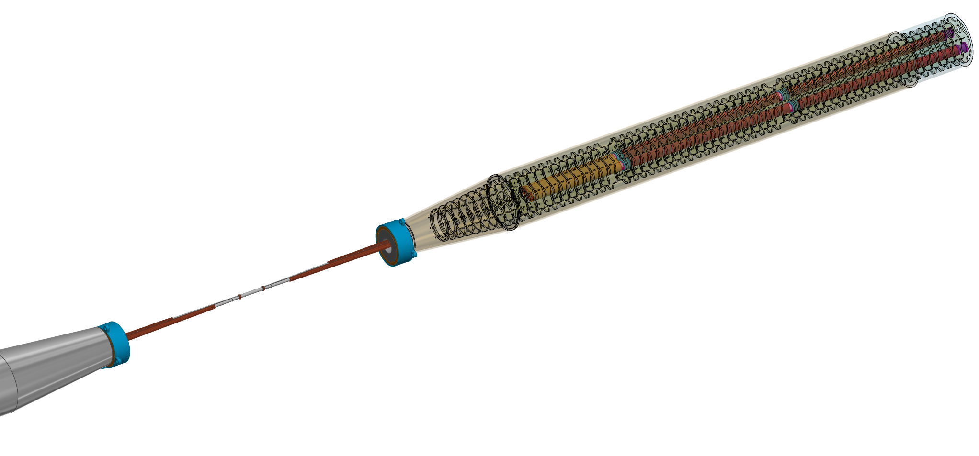
Assembly of IR
Assembly updated with the last design of the chamber and the last version of the components
Compensation solenoid
Screening solenoid
QC1L3
LumiCal
QC1L2
QC1L1
IP
BPM
Trapezoidal chamber
Central chamber

Slide 8
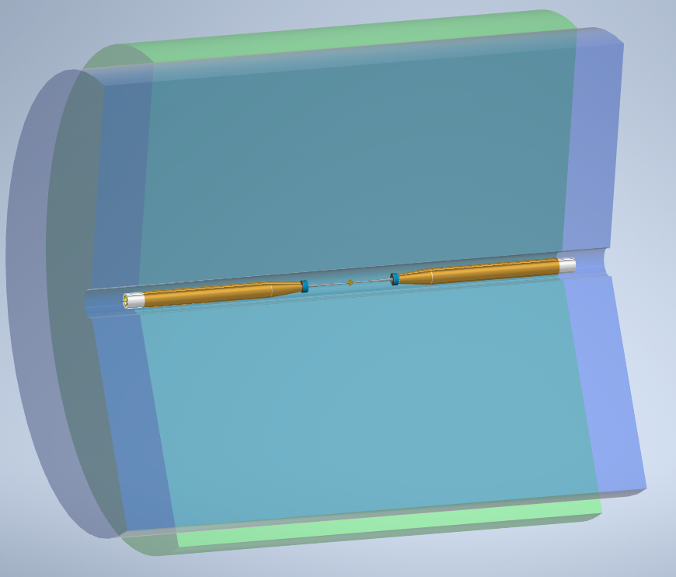
Assembly of the IR with the two concept of the detector
CLD
5300 mm
IDEA
6500 mm

Slide 9
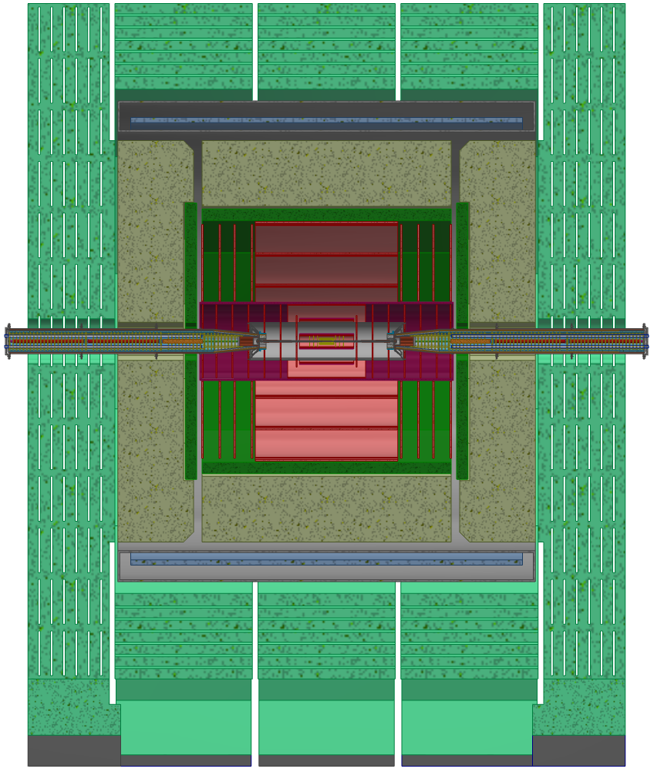
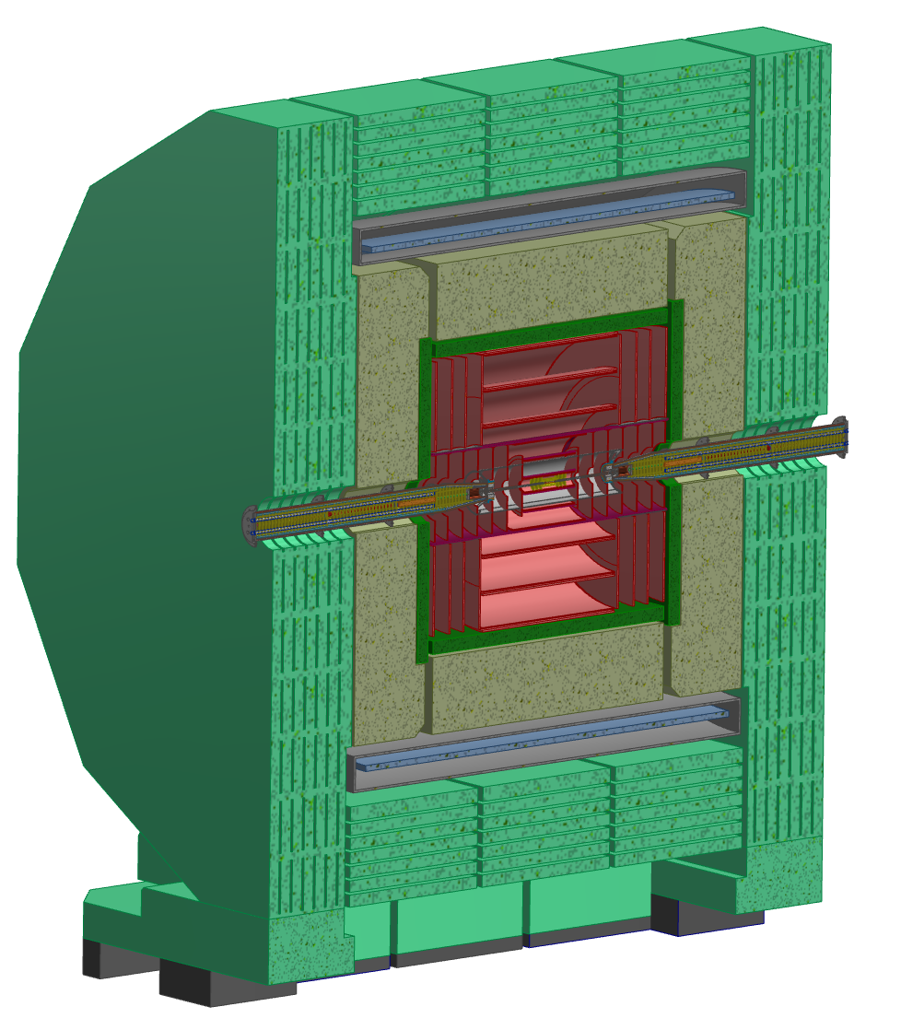
Assembly of the IR with CLD detector
13 m
10,6 m

