Slide 1
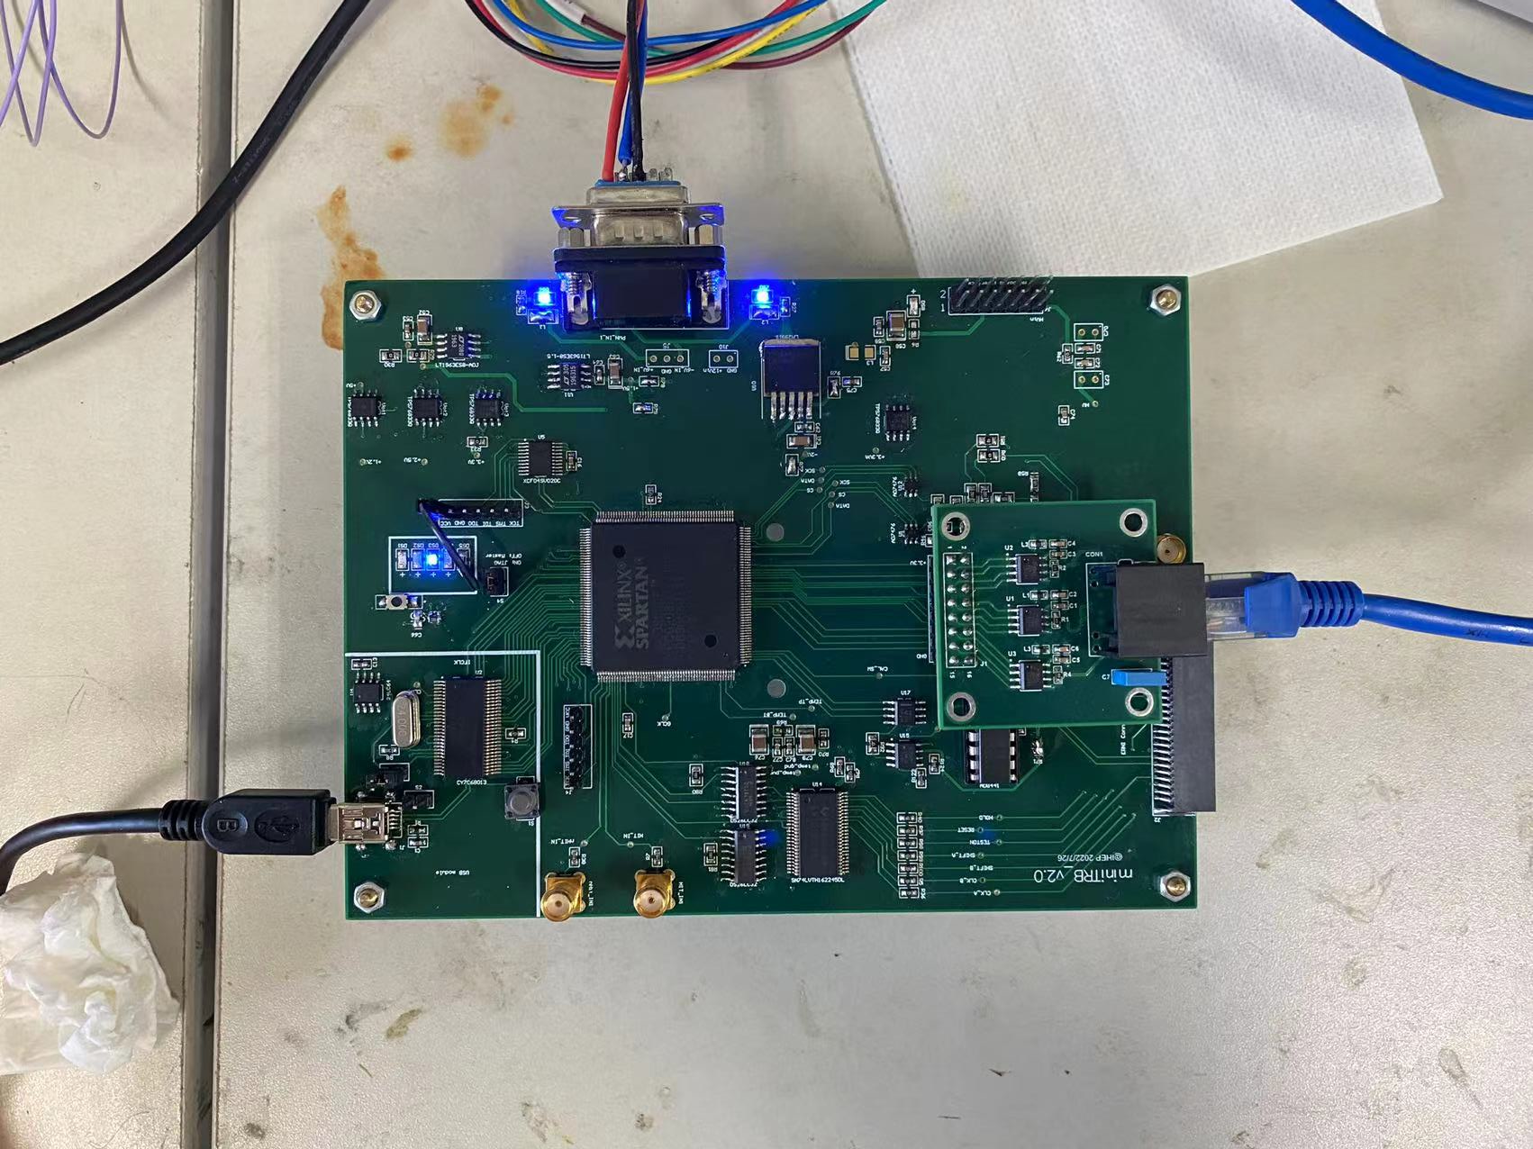
mini_TRB (IHEP) hardware
After installing the ladder, you need to connect and configure the DAQ system.
There are 4 different type of cables need to be connected to the mini_TRB.
1 .Power cable
2.Trigger cable
3.USB cable
4.Cable to the Ladder
all the DC power source , PC , connectors and cables will be provided by IHEP
Power
Trigger
USB
To Ladder

Slide 2
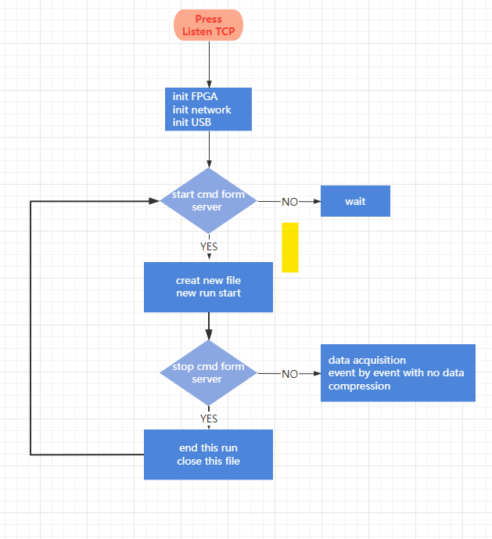
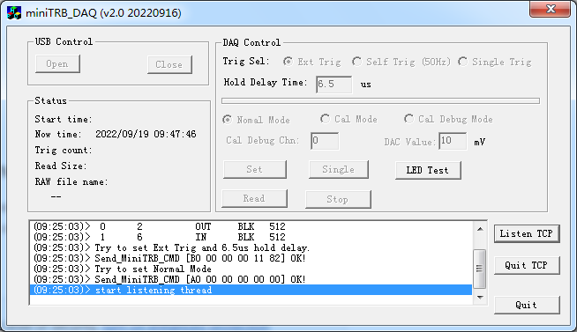
mini_TRB(IHEP) software
The use of the software is quit simple. Just Click the listen TCP button after each power on and then wait.
I will provide a more detailed operation manual before the beam test.

