Slide 1
EC Funded program to promote Transnational Access to Research Infrastructures for Nuclear and Particle Physics (Accelerators & Detector) R&D
HORIZON-INFRA-2021-SERV-01-07 - Research Infrastructures Services Advancing Frontier Knowledge
Grant Agreement 101057511 – EURO-LABS
EURO-LABS - WP3 Meeting – 05.09.2022
I. Efthymiopoulos, EURO-LABS, CERN

Slide 2
EURO-LABS Project Status – next steps
Jan 18, 2022
Preparation of
GA, CA, signatures
Feb-May, 2022
Project start-up
September 1, 2022
Kick-off Meeting
October 3-5, 2022
Project accepted by EC
Resolved issues with Associate Partner Laboratories : UK, CH, USA, PT, JPN, DE, IT

Slide 3
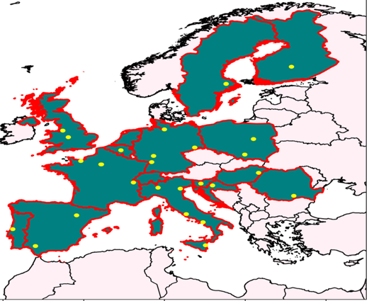
EURO-LABS Consortium Close Look
Coord | 1 | INFN | ISTITUTO NAZIONALE DI FISICA NUCLEARE | IT
Beneficiaries | 2 | GANIL | GRAND ACCELERATEUR NATIONAL D'IONS LOURDS | FR
 | 3 | CERN | ORGANISATION EUROPEENNE POUR LA RECHERCHE NUCLEAIRE | CH
 | 4 | JSI | INSTITUT JOZEF STEFAN | SI
 | 5 | IFJ PAN | THE HENRYK NIEWODNICZANSKI INSTITUTE OF NUCLEAR PHYSICS, POLISH ACADEMY OF SCIENCES | PL
 | 6 | DESY | DEUTSCHES ELEKTRONEN-SYNCHROTRON DESY | DE
 | 7 | UCL | UNIVERSITE CATHOLIQUE DE LOUVAIN | BE
 | 8 | RBI | RUDER BOSKOVIC INSTITUTE | HR
 | 9 | CNRS | CENTRE NATIONAL DE LA RECHERCHE SCIENTIFIQUE CNRS | FR
 | 10 | FBK | FONDAZIONE BRUNO KESSLER | IT
 | 11 | ITAINNOVA | INSTITUTO TECNOLOGICO DE ARAGON | ES
 | 12 | UNIWARSAW | UNIWERSYTET WARSZAWSKI | PL
 | 13 | GSI | GSI HELMHOLTZZENTRUM FUR SCHWERIONENFORSCHUNG GMBH | DE
 | 14 | IFIN-HH | INSTITUTUL NATIONAL DE CERCETARE-DEZVOLTARE PENTRU FIZICA SI INGINERIE NUCLEARA-HORIA HULUBEI | RO
 | 15 | USE | UNIVERSIDAD DE SEVILLA | ES
 | 16 | IST | INSTITUTO SUPERIOR TECNICO | PT
 | 17 | Atomki | ATOMMAGKUTATO INTEZET | HU
 | 18 | JYU | JYVASKYLAN YLIOPISTO | FI
 | 19 | UU | UPPSALA UNIVERSITET | SE
 | 20 | CEA | COMMISSARIAT A L ENERGIE ATOMIQUE ET AUX ENERGIES ALTERNATIVES | FR
 | 21 | KIT | KARLSRUHER INSTITUT FUER TECHNOLOGIE | DE
 | 22 | UMCG | ACADEMISCH ZIEKENHUIS GRONINGEN | NL
 | 23 | INCT | INSTYTUT CHEMII I TECHNIKI JADROWEJ | PL
 | 24 | CSIC | AGENCIA ESTATAL CONSEJO SUPERIOR DE INVESTIGACIONES CIENTIFICAS | ES
 | 25 | UMIL | UNIVERSITA DEGLI STUDI DI MILANO | IT
Associated Partners | 26 | PSI | PAUL SHCERRER INSTITUT | CH
 | 27 | RIKEN | RIKEN THE INSTITUTE OF PHYSICAL AND CHEMICAL RESEARCH | JP
 | 28 | MSU | MICHIGAN STATE UNIVERSITY | US
 | 29 | TUD | TECHNISCHE UNIVERSITAET DRESDEN | DE
 | 30 | LIP | LABORATORIO DE INSTRUMENTACAO E FISICA EXPERIMENTAL DE PARTICULAS LIP | PT
 | 31 | ENEA | AGENZIA NATIONALE PER LE NUOVE TECNOLOGIE, L'ENERGIA E LO SVILLUPPO ECONOMICO SOSTENIBILE | IT
 | 32 | UoB | THE UNIVERSITY OF BIRMINGHAM | UK
 | 33 | UKRI | UNITED KINGDOM RESEARCH AND INNOVATION | UK
33 participating Laboratories
Access to 43 Research Infrastructures (RIs)
Spread in 12 countries across Europe

Slide 4
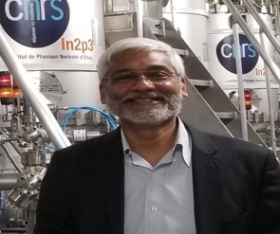
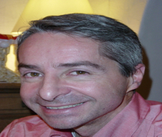
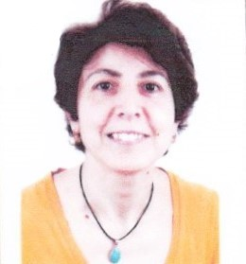
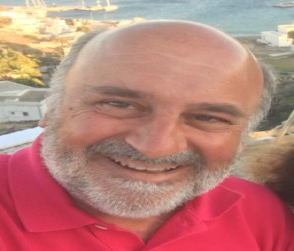
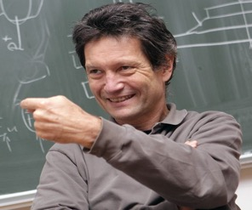
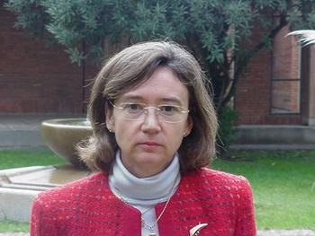
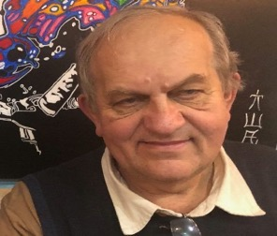
EURO-LABS Consortium Management Team
Project Office Manager
The Project Office will be organized by INFN Bologna with the collaboration of CERN
N. Alahari
GANIL
Scientific Coordinator
P. Giacomelli
INFN-BO
WP2 – Access for Physics
WP3 – Access for Accelerators
WP4 – Access for Detectors
WP5 – Open Diverse and Inclusive Science
M. Colonna
INFN-LNS
I. Efthymiopoulos
CERN
M. Mikuz
Univ. Ljubljana
M-J. Garcia Borge
CSIC
Deputy Scientific Coordinator
A. Maj
IFJ
Deputy Scientific Coordinator
Deputy Scientific Coordinator

Slide 5
Steering Committee (SC)
Governing Board (GB)
Management Team (MT)
WP1
Management
WP2
Access to RI for Physics
WP3
Access to RI for Accelerators
WP4
Access to RI for Detectors
WP5
Open Diverse and Inclusive Science
Task 1 | Project Management
Task 1 | Stable Beam Facilities
Task 1 | Material Testing Facilities
Task 1 | Test Beams
Task 1 | Diversity Dissemination
Task 2 | Information Flow
Task 2 | Radioactive Ion Beams
Task 2 | Technology Infrastructures
Task 2 | Detector characterization
Task 2 | Open Science and Data Management
Task 3 | Contacts
Task 3 | Neutron Beam Facilities
Task 3 | Electron & Plasma Beam Facilities
Task 3 | Irradiation Facilities
Task 3 | Machine Learning
Task 4 | Theoretical support for Experiments
Task 4 | Applications
Task 4 | Service Improvements
Task 4 | Training
Task 5 | Service Improvements

Slide 6
WP2
Access to RI for Physics
WP Coordinators: M. Colonna, A. Maj
Task 1 Paul Greenless - JYFL
Stable Beam Facilities
ALTO-CNRS (Orsay)
CLEAR (Debrecen, Lisbon, Seville)
INFN-LNL,LNS
GANIL
GSI
JYFL (Jyvaskyla)
NCL (SLCJ Warsaw, CCB Krakow)
IFIN-HH (Bucharest Romania)
Task 2 Julian Stefan - IJC
Radioactive Ion Beams
GANIL
GSI
ISOLDE@CERN
JYFL
INFN-LNL,LNS
ALTO-CNRS
Task 3 Albero Mengoni ENEA
Neutron Beam Facilities
nTOF-CERN
GANIL
CLEAR (Seville, Debrecen)
ALTO CNRS
Task 4 Gert Aarts - ECT
Theoretical Support for Experiments (TA & VA)
ETC* FBK (Trento)
Theo4Exp VA (Krakow, Seville, INFN-Milano)
Task 5 Marko Durante - GSI
Service Improvements
Streamlined procedures & Remote Access
Bio medical
Ion source improvements
Target developments
Travelling detectors (γ)

Slide 7
WP3
Access to RI for Accelerators
WP Coordinator: I. Efthymiopoulos
Task 1 N. Charitonidis - CERN
Material Testing Facilities
HiRadMat@SPS^{(*)}
Task 2 Sylvie Leray - CEA
Technology Infrastructures
FREIA^{(*)} (Univ. Uppsala)
INFN –LASA ^{(*)} (Milano)
INFN-THOR^{(*)} (Univ Salerno)
IJCLAB SUPRATECH
CEA Irfu-Synergium^{(*)}
XBOX CERN
Task 3 Anthony Gleesson - STFC
Electron Beam Facilities
KIT-ALFA (ANKA+FLUTE)^{(*)}
VELA/CLARA (Univ. Daresbury)
INFN – BTF Frascati
INFN – SPARC Frascati
CEA LiDyl LPA-UH100^{(*)}
Task 4 Urszula Gryczka - INTC
Applications
INTC –RAPID (Warsaw)
CLEAR CERN
(*) budget for service improvements assigned

Slide 8
WP4
Access to RI for Detectors
WP Coordinator: M. Mikuz
Task 1
Test Beams
CERN PS
CERN SPS
DESY DESY-II
PSI PiM1 & UCN
Task 2
Detector R&D and Characterization
RBI – AC (Croatia)
ITAINNOVA EMCLab (Spain)
Task 3
Irradiation Facilities
CERN IRRAD
CERN GIF++
JSI TRIGA (Slovenia)
IFJ PAN AIC-144 cyclotron (Poland)
CRC Univ Louvain (Belgium)
MC40 Cyclotron (Univ Birmingham – UK)
Task 4
Service Improvements
Database handling of beam time and irradiation requests
Precision motion stages for large detector setups
Beam monitor
Ion beam focusing lens
Cooling system and GUI for EMC test station
Beam profile monitors
Cadmium shielding in the tangential channel
2-D scanning table for irradiation
Test chamber for the heavy-ion irradiation facility
Scanning system upgrade for high-fluence delivery

Slide 9
WP5
Open Diverse and Inclusive Science
WP Coordinator: M-J. Garcia Borge
Task 1 P. Giacomelli – INFN-BO
Diversity and Dissemination
Across fields participation Tech and Info exchange in the use and potential of the Nuclear and HE facilities Applications outside the field
Task 2 Antoine Lemasson - GANIL
Open Data
Data availability from the facilities
Task 3 Sabrina Appel - GSI
Machine Learning
Innovative applications of ML techniques to beam control
Task 4 Livius Trache - NIPNE
Training
Hands-on training of University and Graduate students as well as Researchers to the facilities Learn how to optimally exploit their potential

Slide 10
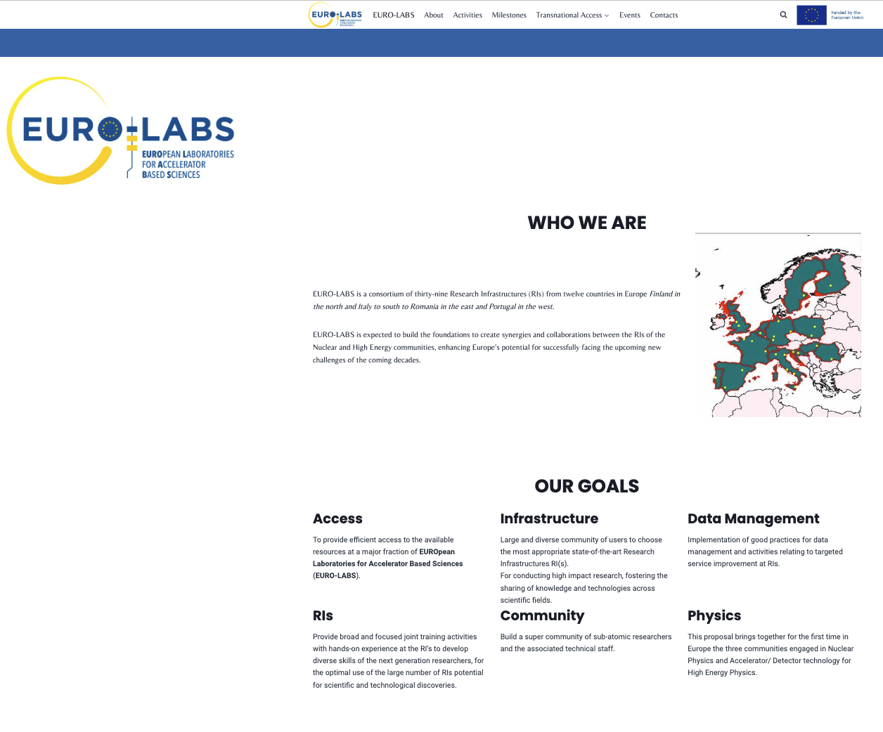
EURO-LABS Project
Web page : https://web.infn.it/EURO-LABS/
Work in progress
Sub-pages per WP with the RIs
Need to provide material and make sure the information in each facility is complete and correct
Next event : KOM 3-5/10 @ Bologna
https://agenda.infn.it/event/32088/

Slide 11
EURO-LABS Kick-Off Meeting – WP3 Contributions
Monday PM : WP3 Access to RI for Accelerators (I. Efthymiopoulos)
General description of the WP, goals within EURO-LABS – new facilities
Connection to ongoing Accelerator R%D projects
Review past experience, what can be improved now
Organization : USP, handling of requests
WP3 input to WP5
Tuesday AM : WP3 Task Leaders (N.Charitonidis, S. Leray, A. Gleeson, U. Cryczka)
Presentation of facilities in more detail – technical aspects, specialties
Targeted users, potential – possible collaboration/use by other WPs?
Handling or requests – organization of reporting to WPL/Project
WP3 Meeting Tuesday 17h30 – 18h30

Slide 12
WP3 – Access to RI for Accelerator R&D Organization
Mailing list : euro-labs-wp3-fc@cern.ch, euro-labs-wp3-tl@cern.ch
CERNbox space for document storage : https://cernbox.cern.ch/index.php/s/DIcHuBooLr3Gncx
A shared space for documents/reports at the project level will be provided by the PO
Issues to discuss – next slides:
Flow of TNA requests:
User Selection Panels (USP)
TNA forms and applications
WP3 organization

Slide 13
Trans-national Access Access Applications
Forms & Approval Path
WP/Project
Entry Application Form(EAF) in the Web page (per WP or project?)
Task
Review, verify validity of the proposed Facility
Facility
Complete EAF with other documents (safety, acess, ...) needed by the Facility → Final Application Form (FAF)
General description of the project: scientific interest, wished WP/Task/Facility, user team, dates
Assign to FC
Accept request, schedule/funds
The form is received by the WP/Task via e-mail
Discuss at the task level – USP

Slide 14
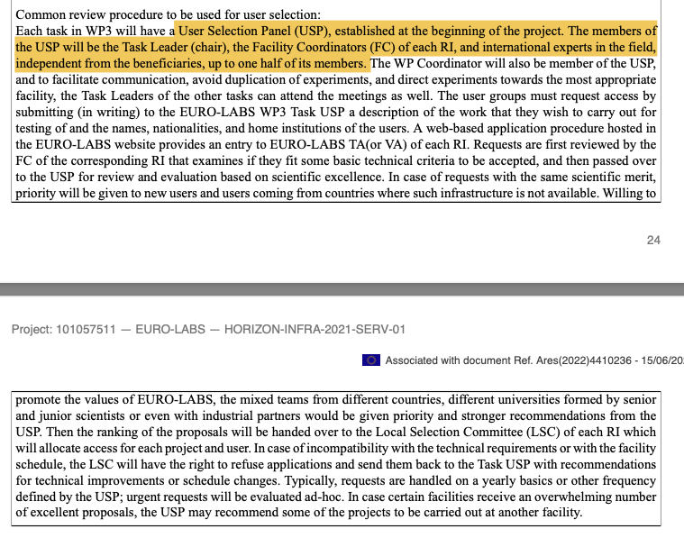
Trans-national Access User Selection Panels
USP/Task?
How was done in the past?
Membership?
Task | Task USP
3.1 | Task
3.2 | Task/Local
3.3 | ?
3.4 | Local

Slide 15
Trans-national Access Rules and conditions
Obligations
The access must be free of charge trans-national access to research infrastructure or installations for selected user-groups.
This access must include the logistical, technological and scientific support and the specific training that is usually provided to external researchers using the infrastructure.
The access provider must advertise widely, including on a dedicated website, the access offered.
The access provider must request written approval from the Commission for the selection of user groups requiring visits to the installation exceeding 3 months.
Selection Procedure
The user groups must be selected by a selection panel set up by the access providers, which:
must be composed of international experts in the field, at least half of them independent from the beneficiaries.
must assess all proposals received and recommend a short-list of the user groups that should benefit from access.
must base its selection on scientific merit, taking into account that priority should be given to user groups composed of users who have not previously used the installation and are working in countries where no equivalent research infrastructure exist.
will apply the principles of transparency, fairness and impartiality.
Courtesy : M Vretenar/ARIES

Slide 16
Trans-national Access Financial conditions
Reimbursement of costs
Grants for this type of action may reimburse — for the provision of access activity — the following types of costs:
‘access costs’ (the operating costs of the research installation and costs related to logistical, technological and scientific support for users, including ad-hoc user training and the preparatory and closing activities needed to use the installation). ‘Access costs’ may be declared as unit costs, actual costs or — under certain conditions — as a combination of the two.
users’ travel and subsistence costs
costs of advertising the trans-national access offered under the action
costs related to the selection procedure (e.g. the selection panel members’ travel and subsistence costs, logistical costs of meetings, fees, etc.)
costs of preparing the detailed access activity information that must be included in the periodic technical reports.
Capital investments (i.e. equipment costs for renting, leasing, purchasing depreciable equipment, infrastructure or other assets) will NOT be reimbursed.
Courtesy : M Vretenar/ARIES

Slide 17
Trans-national Access Evaluation – Measure of success!
Trans-national access must be measured (in ‘units of access’ as defined in the proposal).
The unit of access can be set per facility, but we can adopt a common unit: one hour of beam.
The beneficiaries must keep appropriate records and supporting documentation to justify the number of units of trans-national access for which they declare costs, including:
users’ names, nationalities and home institutions
the nature of access and
the number of units of access provided.
In addition, they must include detailed information on the provision of access activity in the periodic technical reports.
Users must acknowledge the EU support in their publications, web sites, etc. (standard acknowledgement sentence).
Courtesy : M Vretenar/ARIES

Slide 18
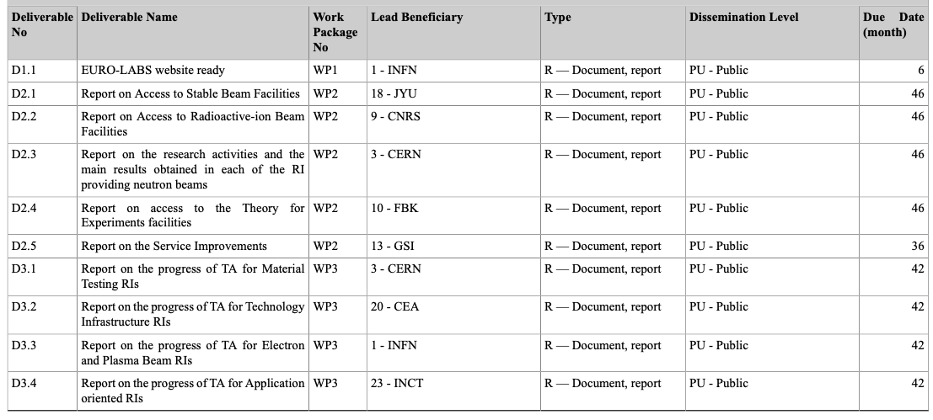
EURO-LABS - Project Milestones - Deliverables

Slide 19
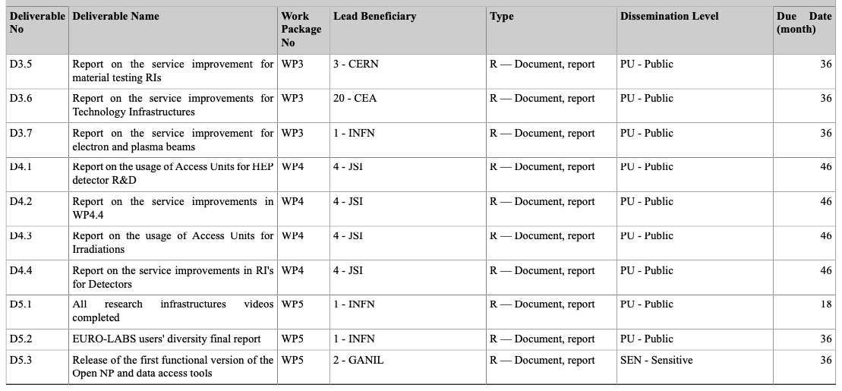
EURO-LABS - Project Milestones - Deliverables

Slide 20
EURO-LABS - Project Milestones - Deliverables

Slide 21
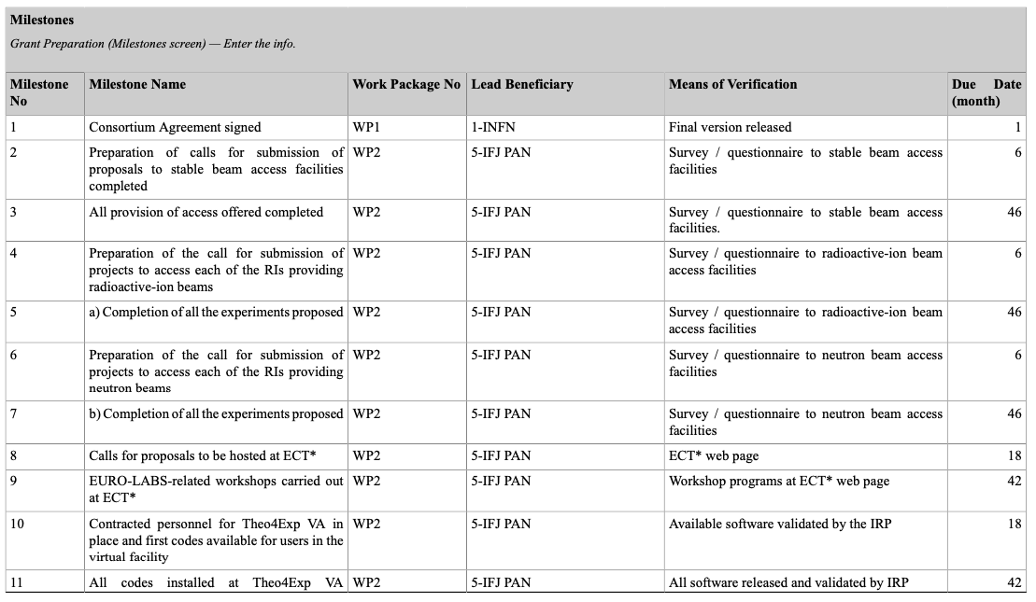
EURO-LABS - Project Milestones - Deliverables

Slide 22
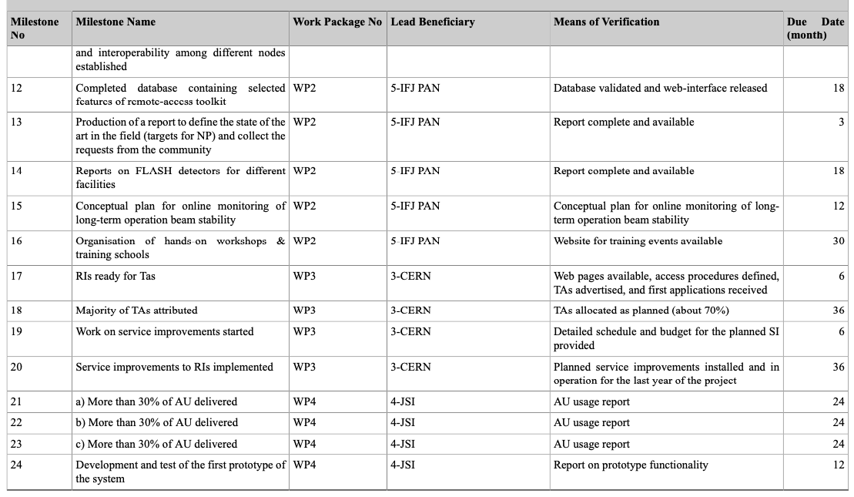
EURO-LABS – Project Milestones - Deliverables

Slide 23
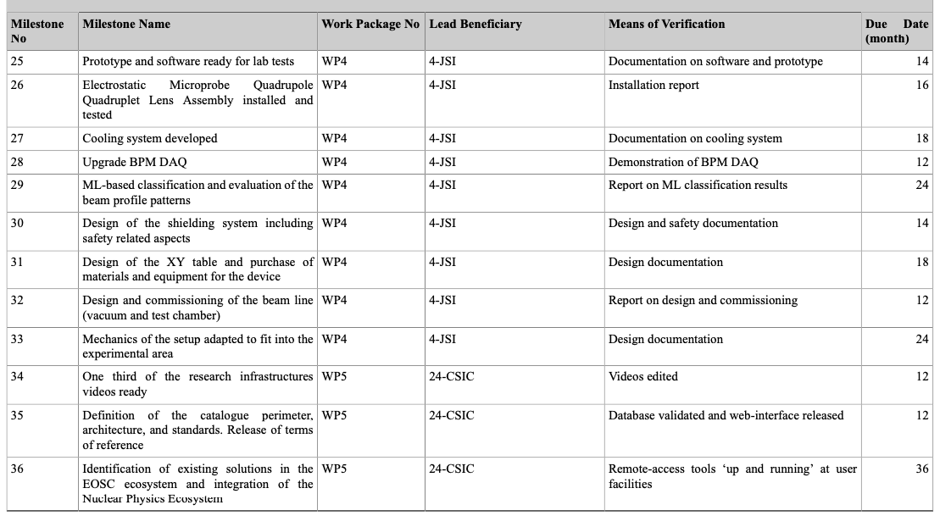
EURO-LABS - Project Milestones - Deliverables

Slide 24
WP3 – Access to RI for Accelerator R&D Organization
Facility
Implementation of TNA
Task
Task activities
WP
Follow-up of all tasks
TL Meetings (/6w)
WP Meetings (/6m)
Report/communication with the other WPs and Project Management
Follow-up of TNA & Service Improvements
User Selection Panel
Deliverables
Meetings with FC
Report to WP
Budget follow-up
Report on TNA status/usage
Implementation of Service Improvements
Local USP
User support

Slide 25
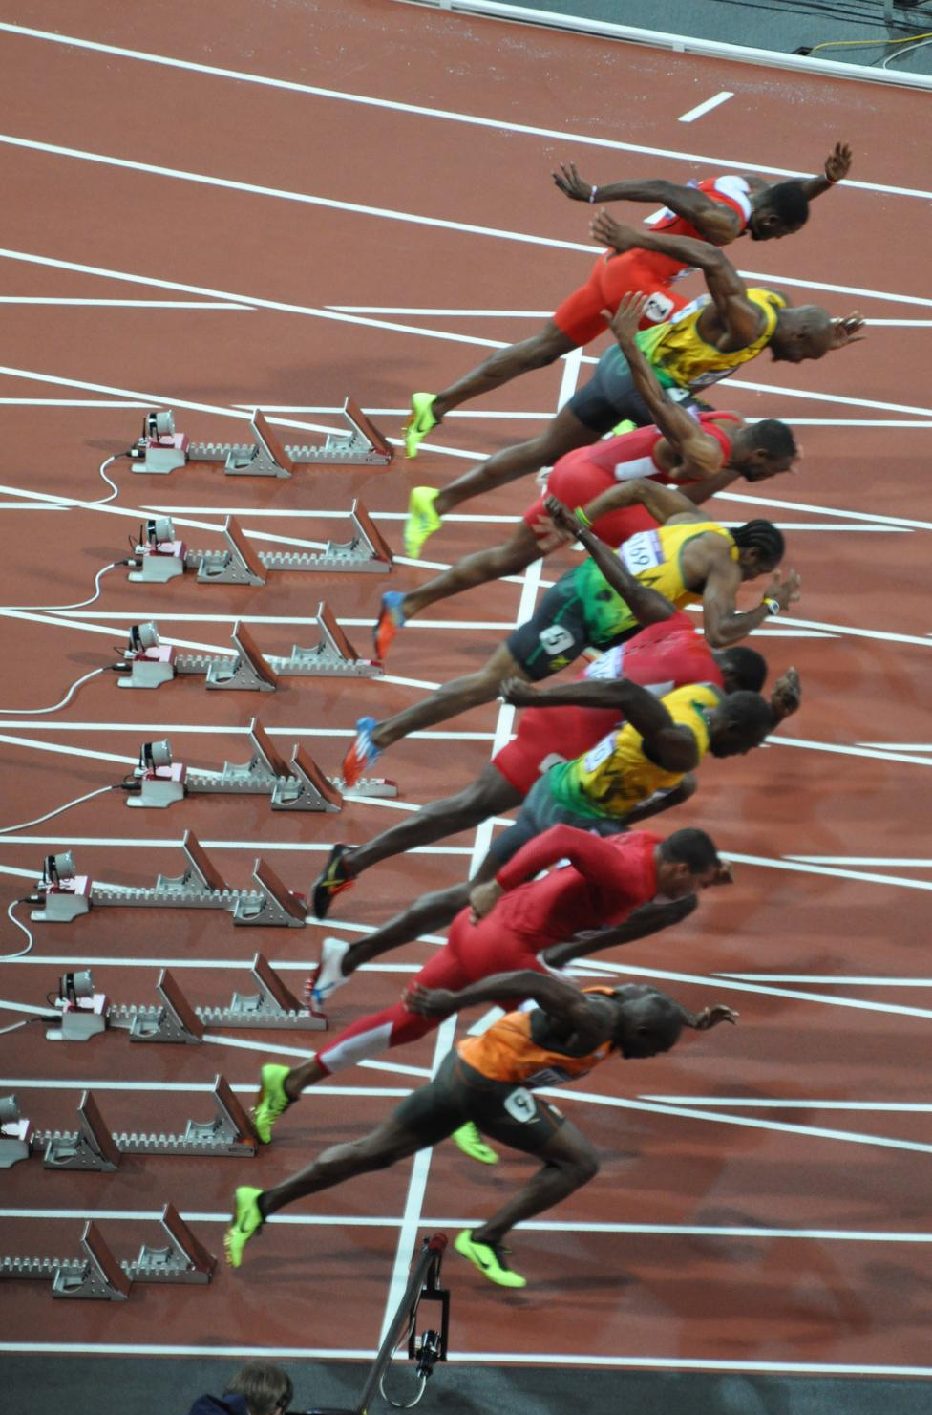
September 1st, 2022

