Slide 1
Detector R&D: tracking study plan
State-of-the-art
RSD path forward, RSD tracker
MuColl impact

Slide 2
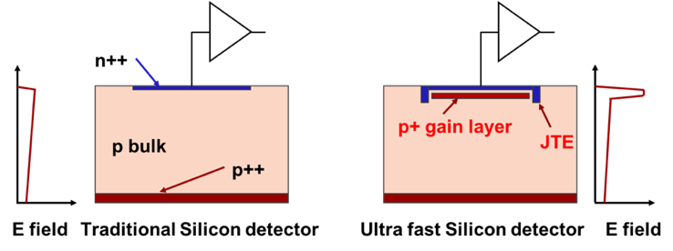
First design innovation: low gain avalanche diode (LGAD)
zoom
Drift area with gain
0.5 – 2 μm long
The gain layer:
a parallel plate capacitor with high field
LGAD Sensors optimized for timing are often called Ultra-Fast Silicon Detectors
Very important italian contribution to this novel approach:
INFN is in charge of this type of sensors for CMS
FBK is one the leading producers

Slide 3
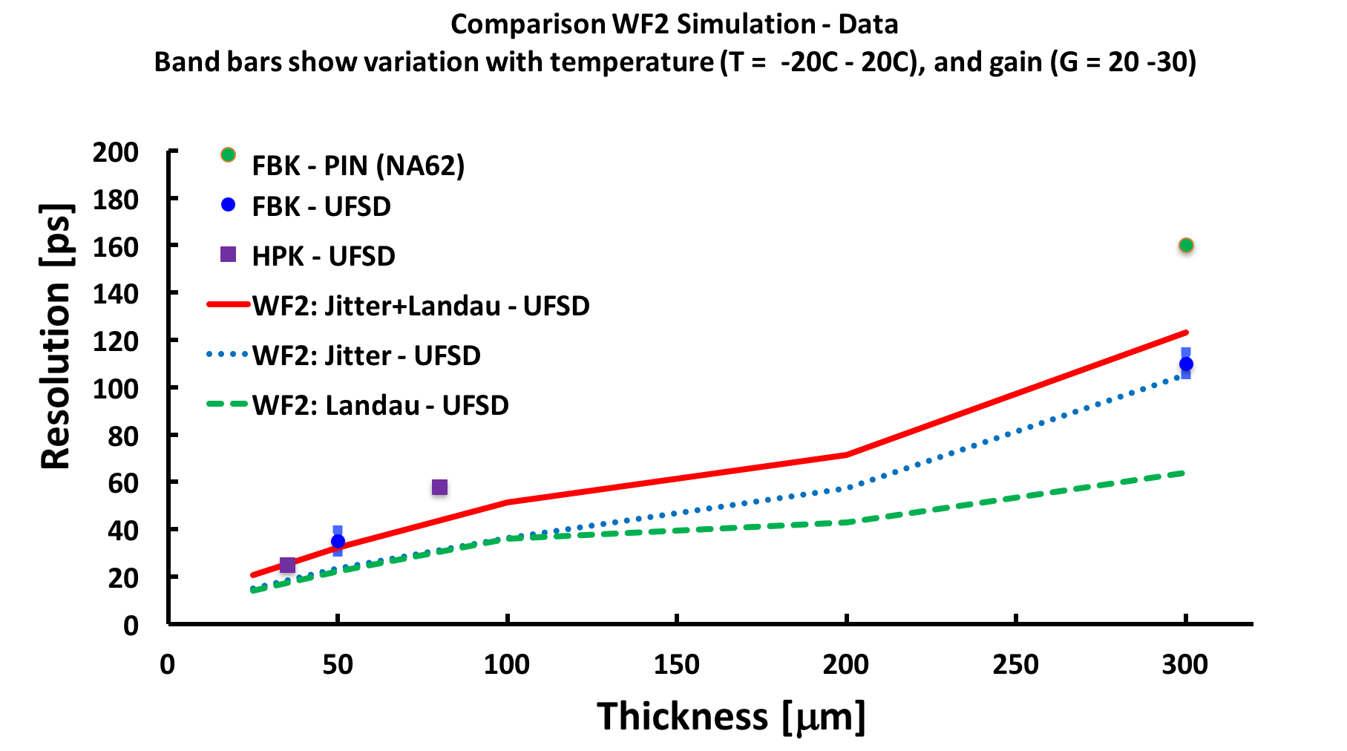
Summary of UFSD temporal resolution
Resolution without gain
It is “easy” for UFSD to achieve 30 ps temporal resolution

Slide 4
Second design innovation: resistive read-out
-+
-+
-+
-+
-+
-+

Slide 5
Second design innovation: resistive read-out
INFN has invented and developed RSD
Up to now, on the the AC-coupled version exists
FBK is one the leading producers
Lot’s of activities abroud to duplicate our results

Slide 6
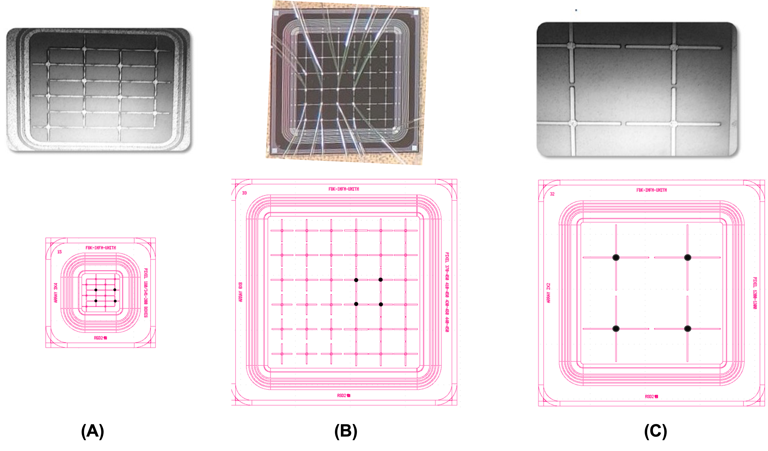
Latest FBK RSD production
RSD achieves a spatial precision of about 2-3% the pitch size:
30 μm for 1300 x 1300 mm²
5 μm for 450 x 450 mm²

Slide 7
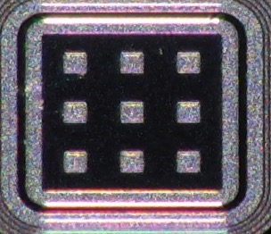
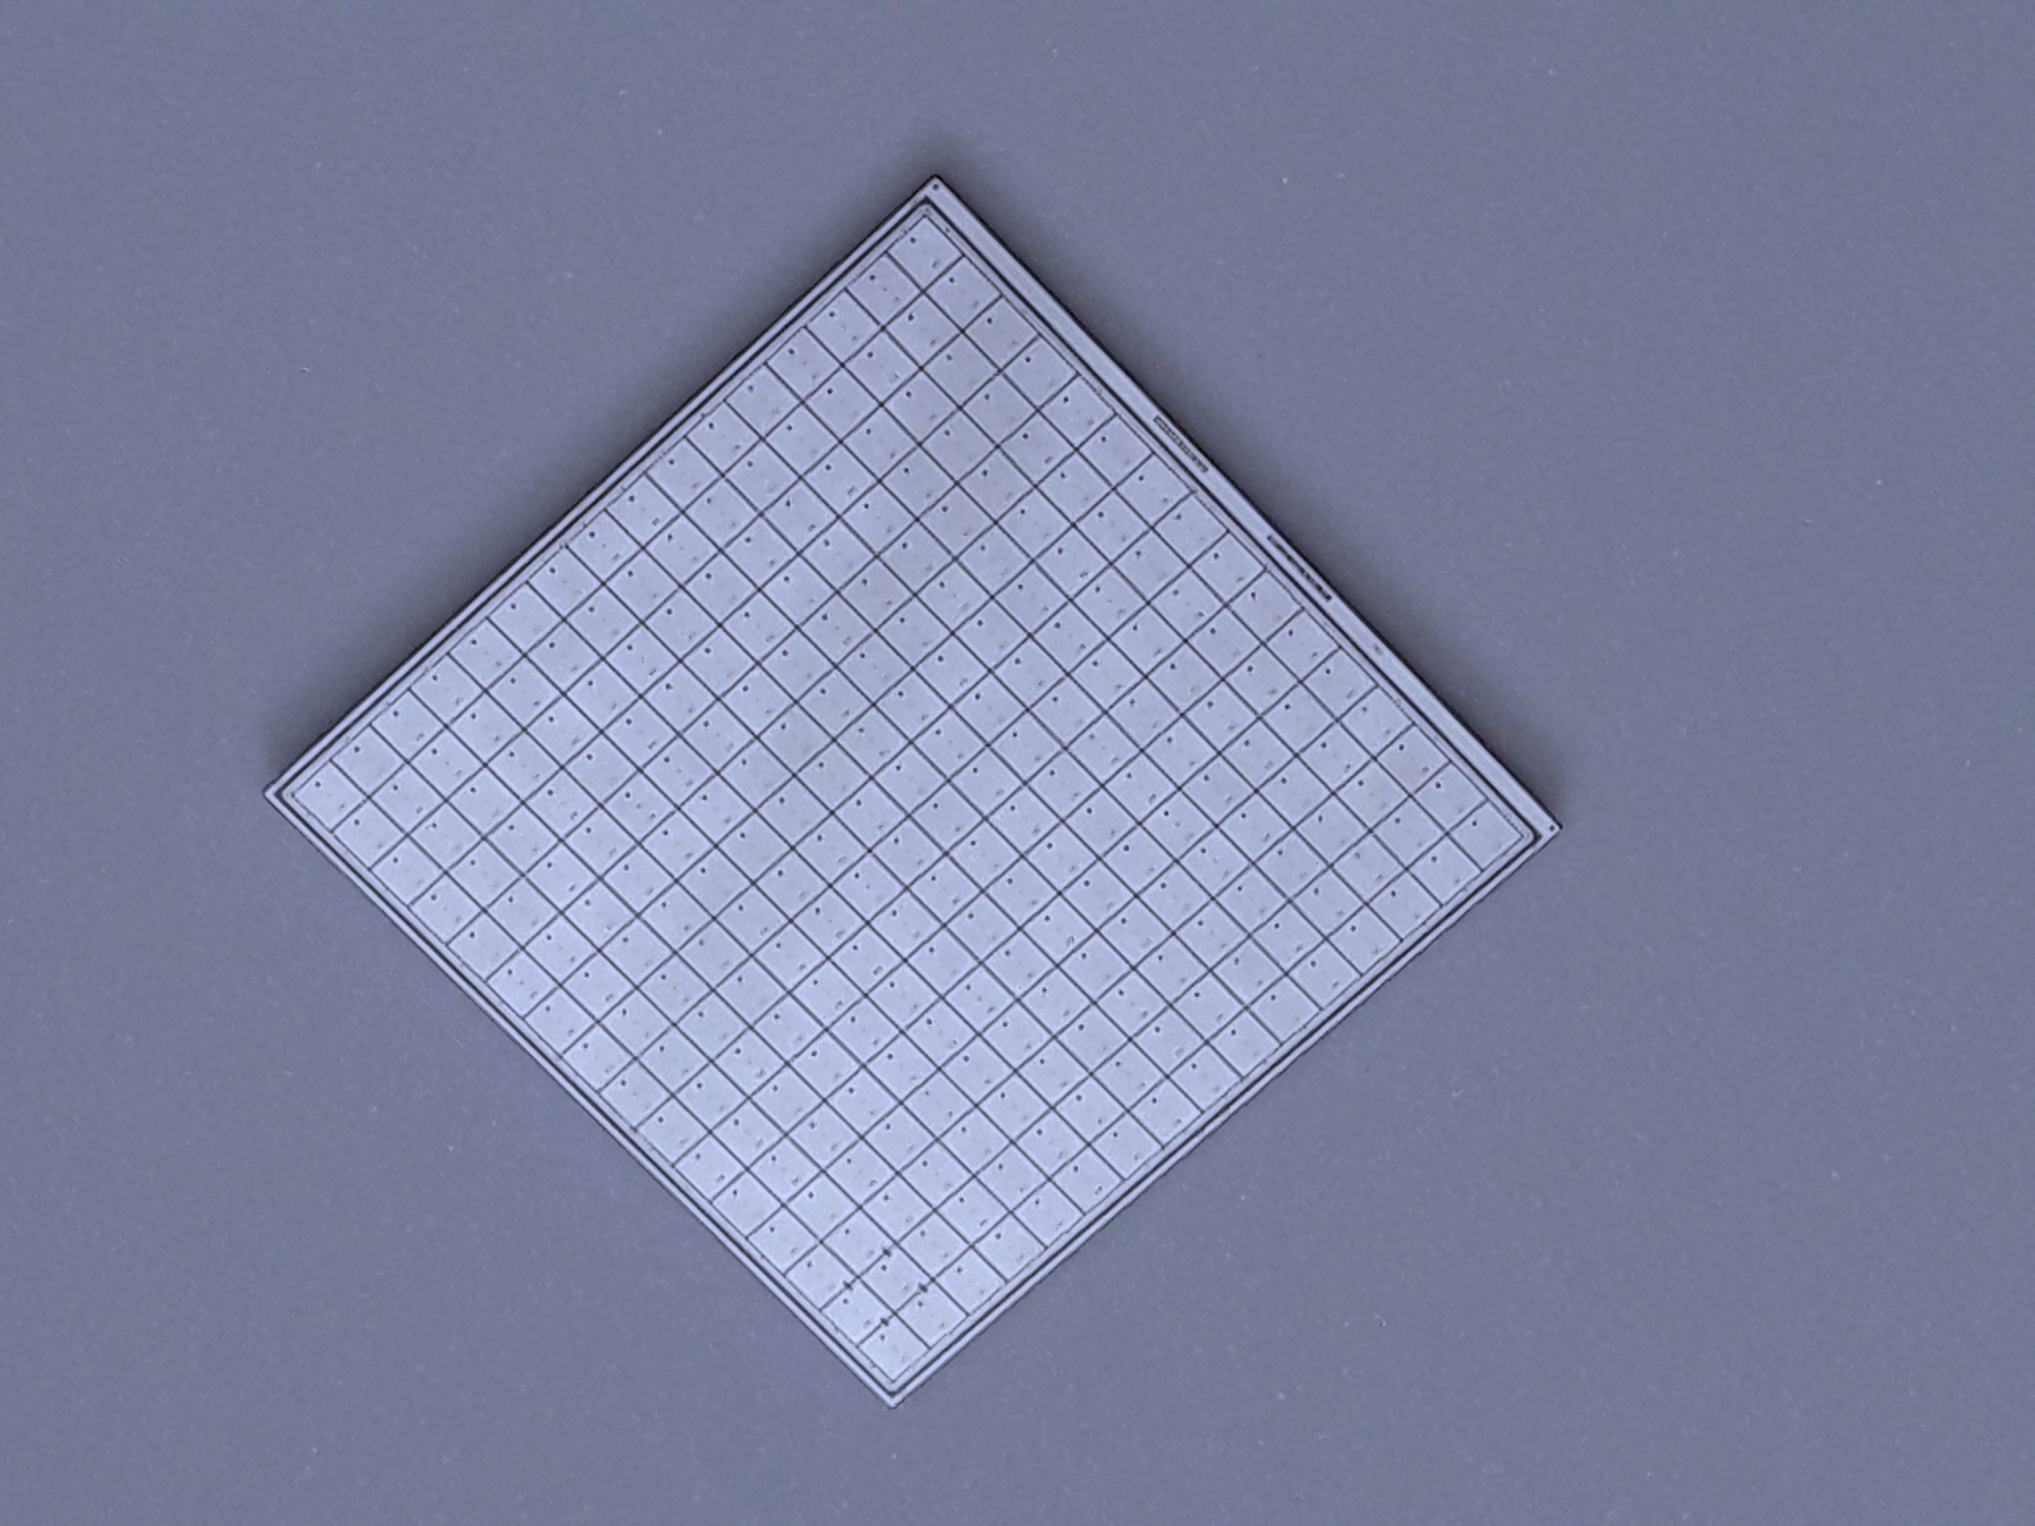
State-of-the art
Physicist
No gain area ~ 50 um
No gain area ~ 5 um
JTE + p-stop design Trench-isolated design RSD -- AC-LGAD
JTE/p-stop UFSD
CMS && ATLAS choice
Signal in a single pixel
Not 100% fill factor
Very well tested
High Occupancy OK
Rate ~ 50-100 MHz
Rad hardness ~ 2-3E15 n/cm2
UFSD evolution: use trenches
Signal in a single pixel
Almost 100% fill factor
Temporal resolution (50 μm) : 35-40 ps
High Occupancy OK
Rate ~ 50-100 MHz
Rad hardness: to be studied
RSD evolution: resistive readout
Signal in many pixels
100% fill factor
Excellent position resolution:
~ 5 μm with large pixels
Temporal resolution (50 μm) : 35-40 ps
Rate ~ 10-50 MHz
Rad hardness: to be studied
2.1 cm
HPK2
16x16 array

Slide 8
Final goal of RSD R&D: a completely new tracker
Standard tracker
RSD-based tracker
The design of a tracker based on RSD is truly innovative:
It delivers ~ 20 -30 ps temporal resolution
For the same spatial resolution, the number of pixel is reduced by 50-100
The electronic circuitry can be easily accomodated
The power consumption is much lower, it might even be air cooled (~ 0.1-0.2 W/cm²)
The sensors can be really thin

Slide 9
RSD R&D paths
MuCol requests:
30 – 60 ps temporal resolution
5x5 μm (VTX) and 7x90 μm (IT + OT) spatial resolution
These requests match very well RSD capabilities
Present situation
Single RSD pixels have been tested, no experience with large sensors
In present RSD, the signal leaks to neighboring pixels. We need to find a design that limits this effect
DC-RSD is a theoretical possibility
Need to carry on an intense optimization for radiation resistance
Need to gain experience with beam-test, data analysis (effort in using ML techniques is promising)
Couple RSD with front-end. In Torino we have a few options, no group has taken the lead yet

Slide 10
Way forward and synergies
We are in the infancy of RSD, it is a very new sensors, and almost everything needs to be studied/optimized
Presently, there are no additional “paid” productions for RSD.
The initial Gruppo V grant is concluded
AIDAInnova has choosen to produce TI-LGAD, not RSD
There is a new Gruppo V proposal (4DShare, PI R. Arcidiacono) under evaluation
2 productions in “convenzione”, very little extra costs

Slide 11
MuColl Impact
2022:
Contribution to the first 4DShare production (4DShare_I), allowing for expanded test of the RSD design (more wafers, larger numbers of variations, more technological solutions, more rad-hard investigation)
Testing:
we have a series of 3 test-beams booked at DESY in Q4/2022 and Q1/2023.
Lab test, material, man power
2023 - 2024
New RSD production, aiming at muColl geometry. Either a dedicated production, or a collaboration with 4DShare_II
Synergy in testing RSD with various front-ends (contribution to electronic boards, partecipation of beam-test, etc)

Slide 12
Backup

Slide 13
Towards 100% fill factor: Trench Isolated LGAD
No gain
50-80 μm
No-gain region ~ 50-80 μm
➔ cannot use UFSDs for small pixels
oxide
Gain layer
p-stop
JTE
JTE
p bulk
V_{Bias}
Solution: use trenches for pad isolation
➔ No-gain region ~ 5 – 10 μm
No gain
5-10 μm
oxide
Gain layer
trench
trench
JTE
p bulk
V_{Bias}

Slide 14
Irradiation effects
Irradiation causes 3 main effects:
Decrease of charge collection efficiency due to trapping
Doping creation/removal
Increased leakage current, shot noise
The main effect in LGAD is “acceptor removal”, i.e., the reduction of the gain implant doping
The electric field due to the gain implant decreases ➔ Compensated with higher bias
Main technique to decrease acceptor removal: carbon implantation in the gain layer
Carbon spoils the properties of silicon sensors.
However, in the right amount and only on the gain implant, it increases the sensor rad. resistance by a factor of 3
carbon implantation

Slide 15
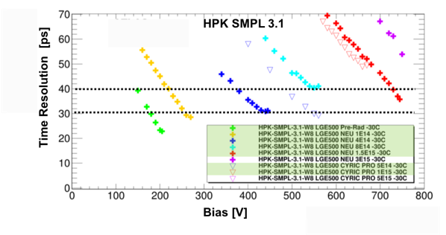
Irradiation effects
One example: Hamamatsu 1.3 mm² (no carbon)
2.5E15 n/cm²
new
1.5E15 n/cm²
Higher fluence ==> higher bias
Executive summary:
without carbon, unchanged temporal resolution up to 1-2E15 n_{eq}/cm²
Exploiting carbon implant: possible to reach 4-5E15 n_{eq}/cm²

