Slide 1
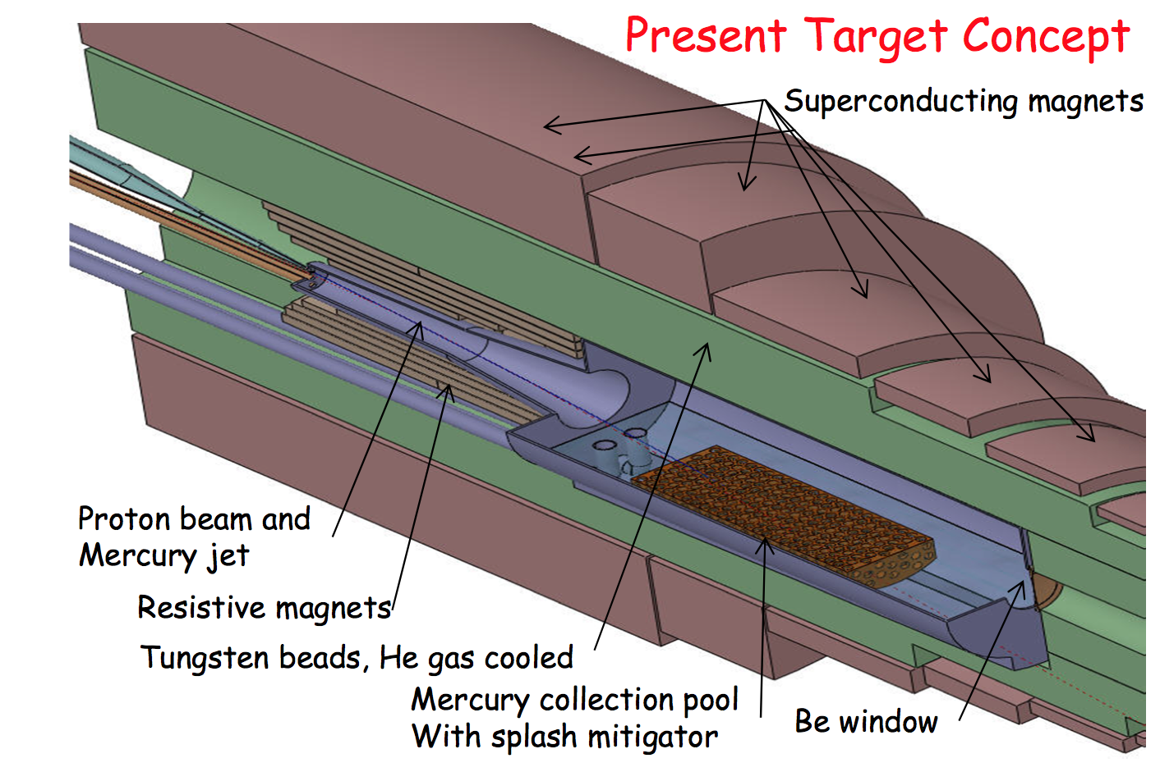
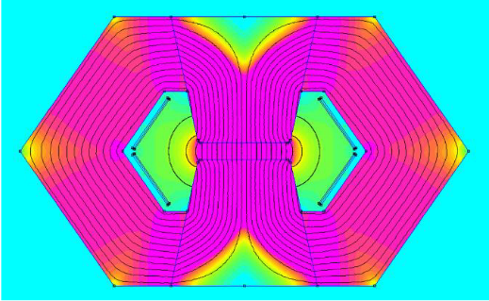
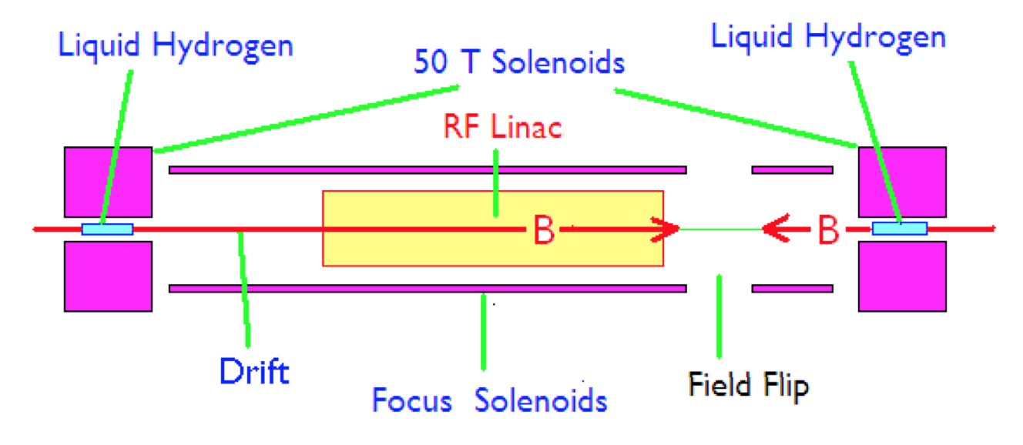
Magnet Demands
20 T, 150 mm
High-field and large aperture target solenoid with heavy shielding to withstand heat (100 kW/m) and radiation loads
Combination of DC SC magnets (10 T) and AC resistive magnets (± 2T)
±2 T, 400 Hz
80 mm x 40 mm
10 T
Ultra-high-field solenoids (40…60 T) to achieve desired muon beam cooling
Open midplane or large dipoles and quadrupoles in the range of 10…16 T, bore in excess of 150 mm to allow for shielding against heat (500 W/m) and radiation loads
16 T

Slide 2
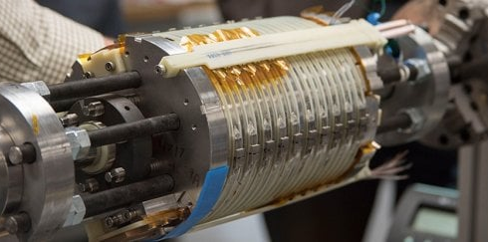
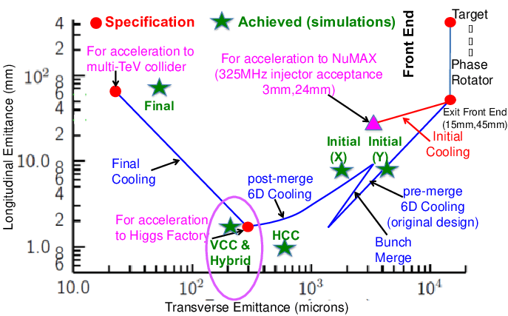
Cooling solenoids
A field of 40 T (minimum), up to 60 T (target) is needed to meet emittance specification at the end of the cooling stage
30 T assumed in MAP
40…60 T required
HTS insert of NHMFL all SC 32 T
32 T in 40 mm (15 T LTS + 17 T HTS)
Present state of the art is the 32T all-SC solenoid in operation at NHMFL.
Novel technology is required (NI/PI) for compact, UHF solenoids operating without (or minimal) helium
D. Neuffer, et al.
Solenoids for a muon collider need to be compact (reduce cost), mechanically strong (withstand extraordinary e.m. forces) and well protected against quench (large stored energy)
Targeted R&D is required to address these challenges

Slide 3
Cooling solenoids R&D plan
The conceptual design of UHF solenoids has started, exploring limits of performance (field and stress), operating efficiency (temperature), lean and compact designs (mass and cost)
We are defining a Solenoid Coil Demonstrator (SCD), a representative test configuration (20 T, 50 mm, 500 MPa) to support the conceptual design with a strong experimental basis. This configuration could be a basis for collaborative work across laboratories
Some 10 SCD’s per year will be needed (manufacturing and testing). Each SCD requires approximately 150 m of 12 mm HTS tape
HTS tape, initially in the range of 1 to 1.5 km (12 mm) is the single most critical item to start manufacturing and experimental work
Define initial experimental needs by performing material characterization
Provide material for the manufacturing of the first SCD’s
INFN-LASA engagement
1-1.2 km of HTS tape for SCD

Slide 4
Programma 2023
Partecipare al design delle bobine dimostratori (SCD).
Prendere la leadership nel procurement e qualifica dell’ HTS tape.
Contribuire alla costruzione della prima bobina (attività principalmente svolta al cern)
Collaborazione: CERN, INFN, Univ di Twente (NL), Univ. di Ginevra, KIT, CE ecc…
Il costo è valutato in ca 120 k€ per 1 km di tape (+ IVA) → ca. 150 k€ vedasi lettera allegata

Slide 5
RF cavities in the Cooling Channel
Operational experience as well as numerical studies suggest that the performance of a normal conducting cavity may degrade when the cavity is operated in strong magnetic fields.
The magnetic fields cause rf cavity breakdown at high gradients.
This aspect represents one of the more relevant technical challenge for the design of a high-efficient ionization cooling channel.
For the past decades, R&D efforts have been carried out to understand the breakdown mechanism in the presence of a
strong magnetic field. In this framework RF cavities has been designed, built and demonstrated stable operation at ~10 MV/m

Slide 6
RF cavities in the Cooling Channel
The experimental data available on the subject are related mainly to 201 MHz and 805 MHz cavities with different approaches involving the application of surface quality enhancements and low Z materials.
The contribution that we will provide in this scheme may be summarized in the following issues:
Design the compact multiple-cavity module, with efficient frequency tuning and RF power feeding systems. In the cooling channel, the voltage in each segment requires multiple cavities or one LINAC with multiple cells. In order to have strong solenoid fields, the cavity design should be as compact as possible in the transverse direction.

Slide 7
RF cavities in the Cooling Channel
Study the possibilities offered by improved copper surface qualities, new copper based alloys or low Z materials as Berillium to improve the braeakdown properties of a NC cavity.
Look into a suitable RF frequency choice (in the range 805 to 325 MHz) to define a trade off between the above discussed phenomena and the magnet design. This will contribute to the proposal of a demonstrator of a cooling channel section.

Slide 8
RF cavities in the Cooling Channel
The funds requested for the first year will address the following issues:
10 Keuro as a contribution for 1 year rent of a CST simulation package for RF cavity design (the full cost is of the order of 30 Keuro)
40 Keuro for the acquisition of materials, the machining of suitable test samples for surface treatments analysis, HV breakdown tests (possibility to work in a 1 T static magnetic field) and related laboratory elelemnts required for these activities.
20 Keuro for the machining of small size RF cavities details to verify the possibility to design a cavity without brazing joints and the possibility to substitute single parts damaged by a discharge
The RF group contribution is related to the operating units at: Milan, Naples, LNL and LNS

