Slide 1
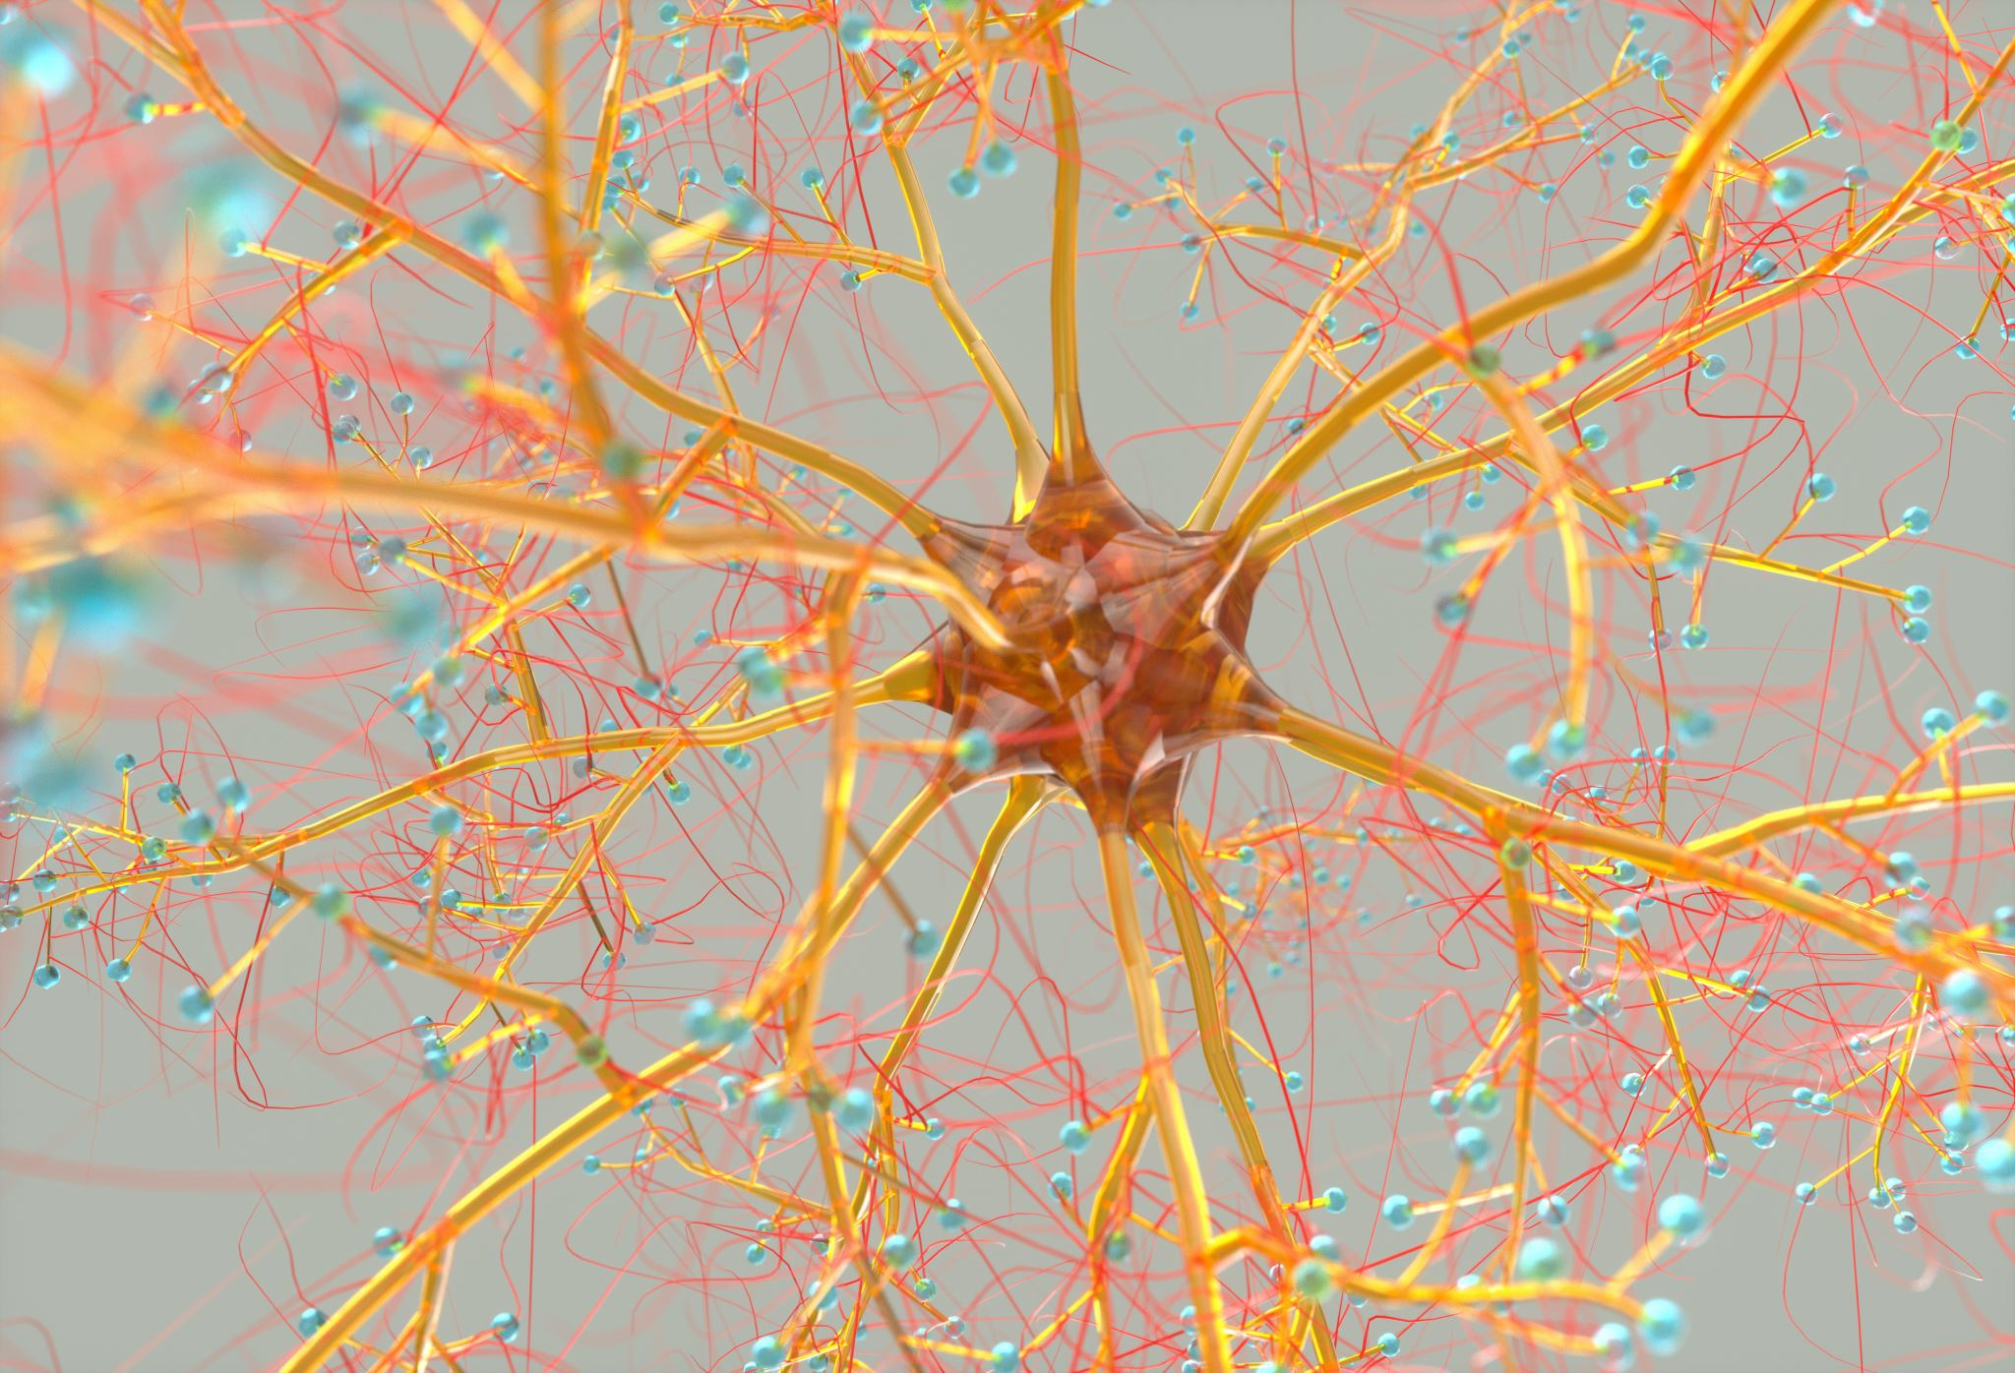

Convolutional Neural Networks
Corso di Formazione Nazionale INFN
"Introduzione alle reti neurali e applicazioni sui dispositivi elettronici"
Napoli, 17/11/2022
Silvia Auricchio & Francesco Cirotto
Università degli studi di Napoli "Federico II" - INFN sezione di Napoli​

Slide 2
Introduction to the course
This course is intended to give a fast overview on the basic aspects of Convolutional Neural Network
The covered topics are:
Digital image classification problem
An introduction to convolution in 1 and 2 dimensions
An overview on the different layers of a CNN
A brief explanation of the Data Augmentation
An example on how to build a CNN with Keras and TensorFlow
Silvia Auricchio & Francesco Cirotto, Università degli studi di Napoli "Federico II" - INFN Napoli

Slide 3
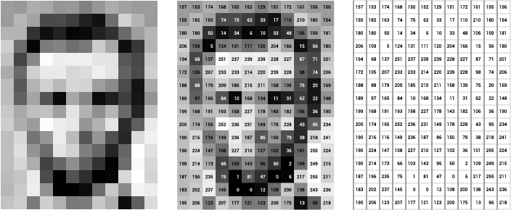
Digital images
Convolutional Neural Networks are a powerful family of neural networks that are specifically designed for the Images Processing Task
WHAT ARE IMAGES IN THE DIGITAL WORLD?
From Wikipedia: "A digital image is an image composed of picture elements, also known as pixels, each with finite, discrete quantities of numeric representation for its intensity."
Silvia Auricchio & Francesco Cirotto, Università degli studi di Napoli "Federico II" - INFN Napoli
Images can be greyscale, where each pixel value is the grey intensity, or colored

Slide 4
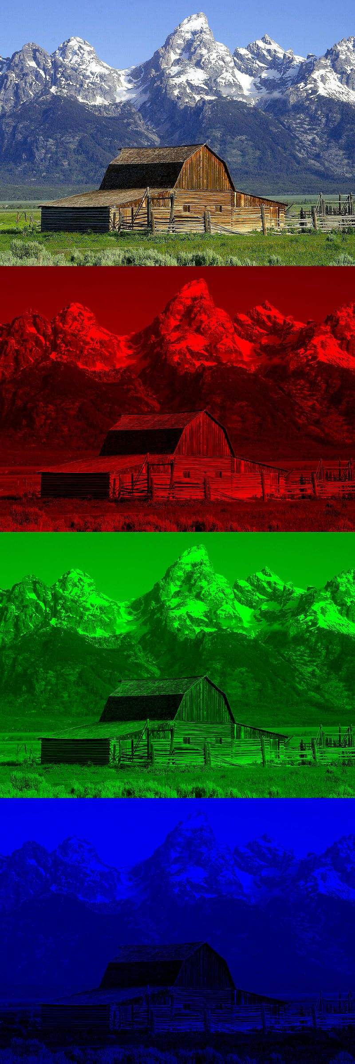
Digital images
Colored images are usually coded with the RGB color model: each pixel is associated to three numbers, corresponding to the Red, Green and Blue intensity
The image is obtained as the sum of the three components
Silvia Auricchio & Francesco Cirotto, Università degli studi di Napoli "Federico II" - INFN Napoli

Slide 5
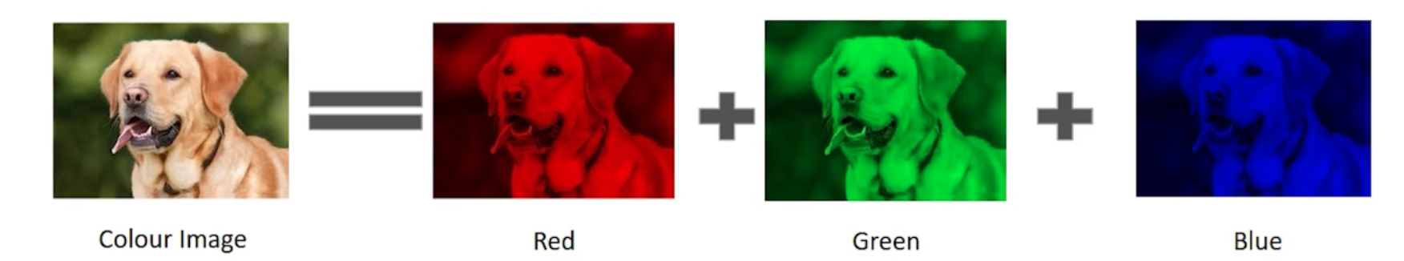
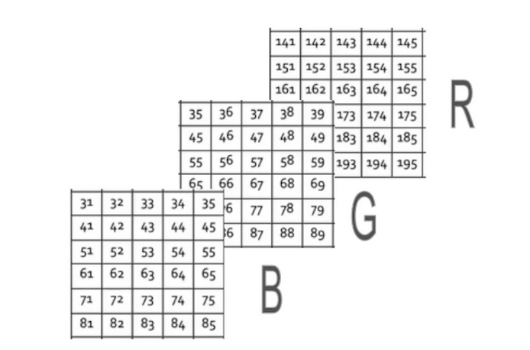
Digital images
Silvia Auricchio & Francesco Cirotto, Università degli studi di Napoli "Federico II" - INFN Napoli
An RGB image is therefore represented by a matrix (weight)x(height)x3
A greyscale image is (weight)x(height)x1

Slide 6

HOW DO WE CLASSIFY IMAGES?
Silvia Auricchio & Francesco Cirotto, Università degli studi di Napoli "Federico II" - INFN Napoli

Slide 7
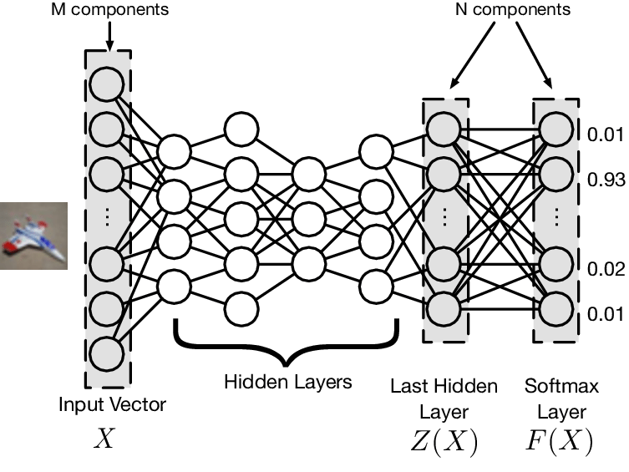
Images classification with DNN
As we saw in the previous tutorials, a classification problem can be easily addressed from a neural network.
  The more the problem is complex and not linear the better Deep Networks perform with respect to single layer networks.
Images can be given in input to DNN by flattening pixels to form a 1D array.
  DNNs are also invariant to input features order, therefore they could also be shuffled before being fed the network
Silvia Auricchio & Francesco Cirotto, Università degli studi di Napoli "Federico II" - INFN Napoli
with pixels content

Slide 8
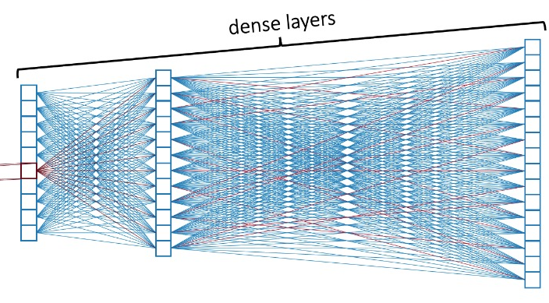
Images classification with DNN
Example:
  the input is a 64x64 grayscale image. Such an image can be represented by 64x64x1 = 4096 values
  the input layer of a DNN processing such an image has 4096 nodes
  if the (fully connected) inner layer has 500 nodes, we will have 4096x500 = 2048000 weights between the input and the hidden layer
  If the image were an RGB image the input layer would have 64x64x3 = 12288 nodes
  For complex problems, we usually need multiple hidden layers...
Silvia Auricchio & Francesco Cirotto, Università degli studi di Napoli "Federico II" - INFN Napoli
A DNN CANNOT SCALE TO HANDLE LARGE IMAGES. WE NEED A MORE SCALABLE ARCHITECTURE

Slide 9
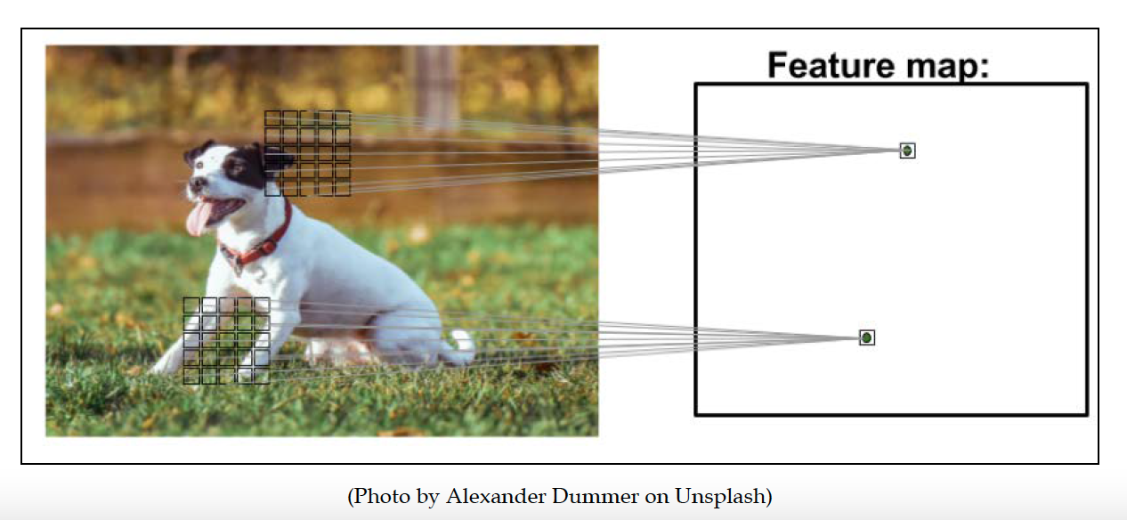
Convolutional Neural Networks
To flat an image into a 1D array is not the best way to model images
  any spatial relationship in the data is ignored
A Convolutional Neural Network (CNN) maintains the spatial structure of the data, and is better suited for finding spatial relationships in the image data
​The idea behind: to use filters that automatically learns the most discriminants features in an image, such as edges, filled patterns, specific geometric forms and so on
Silvia Auricchio & Francesco Cirotto, Università degli studi di Napoli "Federico II" - INFN Napoli

Slide 10
Convolutional Neural Networks
Silvia Auricchio & Francesco Cirotto, Università degli studi di Napoli "Federico II" - INFN Napoli
BASIC CONCEPTS:
Sparse connectivity: a single element in the feature map is connected to only a small patch of pixels.
Parameter-sharing: the same weights are used for different patches of the input image
from Spatial Invariance Principle: whatever method is used to recognize objects it should not be concerned with the precise location of the object in the image

Slide 11
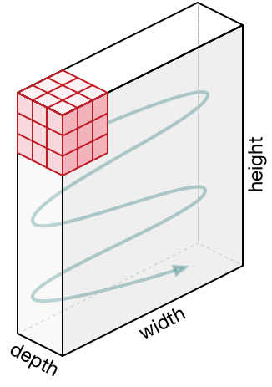
The Convolutional Layer
Let's start from the Convolutional Layer:
  It is the core building block of a Convolutional Network that does most of the computational heavy lifting
INTUITION WITHOUT BRAIN STUFF
The CONV layer’s parameters consist of a set of learnable filters.
Every filter is small​ spatially (along width and height) and extends through the full depth of the input volume.
The output is a single layer with a certain spatial size (width x height x1)
Silvia Auricchio & Francesco Cirotto, Università degli studi di Napoli "Federico II" - INFN Napoli

Slide 12
The Convolutional Layer
Let's start from the Convolutional Layer:
  It is the core building block of a Convolutional Network that does most of the computational heavy lifting
INTUITION WITHOUT BRAIN STUFF
Example:
  a typical​ filter on a first layer of a CNN has size 5x5x3
  Let's suppose we have a 28x28 pixel RGB image
  Convolution is the process of placing the filter 5x5x3 on the top left corner of the image, multiplying filter values by the pixel values and adding the results, moving the filter to the right one pixel at a time and repeating this process
Silvia Auricchio & Francesco Cirotto, Università degli studi di Napoli "Federico II" - INFN Napoli

Slide 13
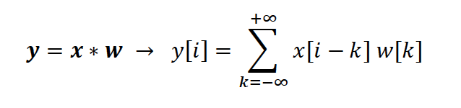
The Convolutional Layer
THE MATHEMATICAL VIEW
Now let's explain the convolution in more mathematical details
Discrete convolution in one dimension
A discrete convolution between two vectors with finite size, x and w, is mathematically defined as:
w is typically called the filter or kernel
The index i runs through each element of the output vector y
In machine learning applications we always deal with finite feature vectors
Let's assume that x and w have n and m elements respectively, where 𝑚 ≤ 𝑛.
Silvia Auricchio & Francesco Cirotto, Università degli studi di Napoli "Federico II" - INFN Napoli

Slide 14
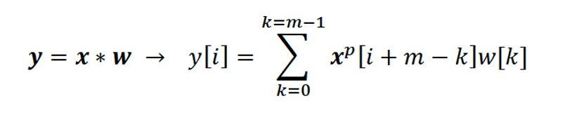
The Convolutional Layer
THE MATHEMATICAL VIEW
The convolution becomes:
It's important to notice that x and w are indexed in different directions in this summation.
Computing the sum with one index going in the reverse direction is equivalent to computing the sum with both indices in the forward direction after flipping one of those vectors
This operation is repeated like in a sliding window approach to get all the output elements.
Silvia Auricchio & Francesco Cirotto, Università degli studi di Napoli "Federico II" - INFN Napoli

Slide 15
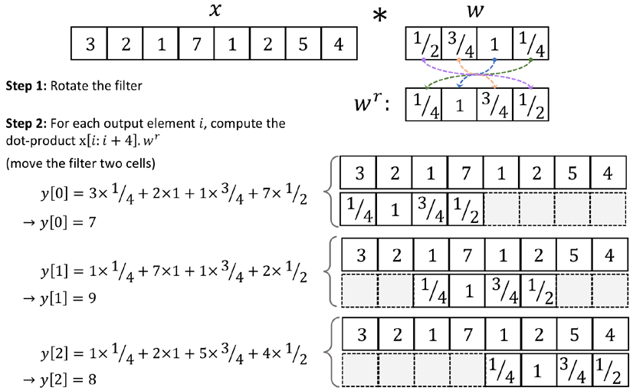
The Convolutional Layer
THE MATHEMATICAL VIEW
Example:
x = [3 2 1 7 1 2 5 4], w = [½, ¾, 1, ¼ ]
Silvia Auricchio & Francesco Cirotto, Università degli studi di Napoli "Federico II" - INFN Napoli

Slide 16
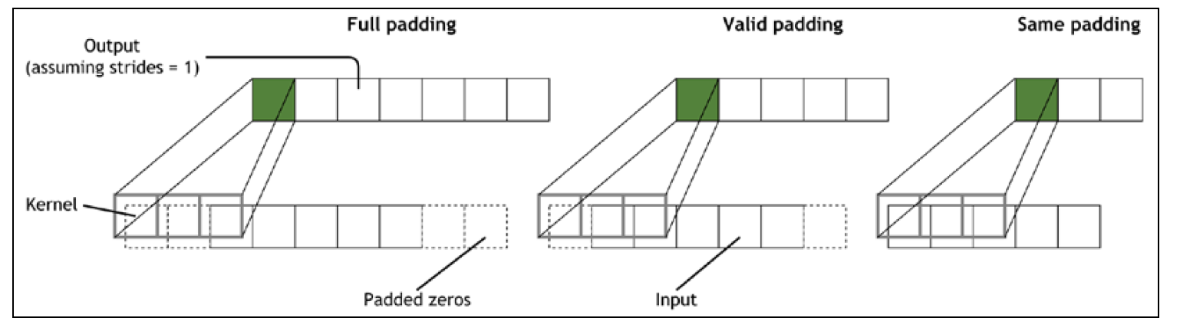


Padding Layer
The result of this convolution is a tensor with a smaller shape than the input one
To preserve/increase shape a padding procedure can be applied
  It consists in padding zero pixels to input tensor
  Usually, a same padding procedure is used, meaning that the output vector has the same size as the input one.
Silvia Auricchio & Francesco Cirotto, Università degli studi di Napoli "Federico II" - INFN Napoli
P = kernel size -1
P: input size = output size
P = 0

Slide 17
Strides
MOVING ALONG INPUTS
One concept introduced in the previous example is the number of cells the filter is moved when shifted across the vector x (to pass from a y index to another)
It is called strides
Silvia Auricchio & Francesco Cirotto, Università degli studi di Napoli "Federico II" - INFN Napoli
Example:
N=7, filter = 3
Stride = 1
Output = 5
Stride = 2
Output = 3

Slide 18
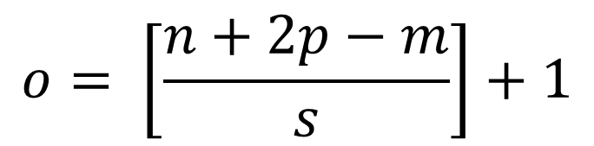
The output size
SIZE OF OUTPUT
The size of the vector obtained by a convolution can be calculated as follows:
$$o= \left[\frac{n+2p−m}{s}\right]+1$$
Silvia Auricchio & Francesco Cirotto, Università degli studi di Napoli "Federico II" - INFN Napoli
o = output dimension
n = input dimension
p = padding
m = kernel size
s = stride

Slide 19
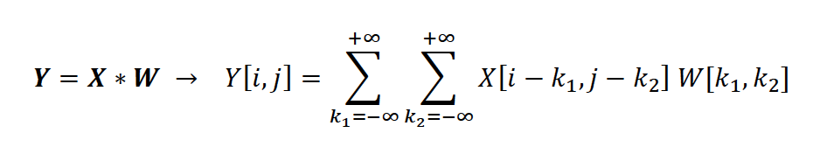
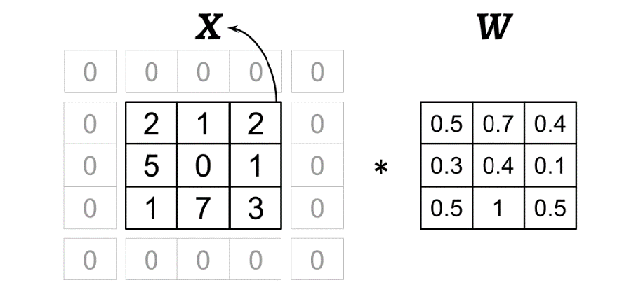
Convolution in 2D
THE MATHEMATICAL VIEW
The concepts we have now discussed are easily extendible to 2D case:
  𝑿_{𝑛1×𝑛2} and 𝑾_{𝑚1×𝑚2} are now two matrices -> Y is a 2D matrix as well
Silvia Auricchio & Francesco Cirotto, Università degli studi di Napoli "Federico II" - INFN Napoli
Example:
input matrix 𝑿_{3×3}
kernel matrix 𝑾_{3×3}
p=(1, 1)
stride s=(2, 2)

Slide 20
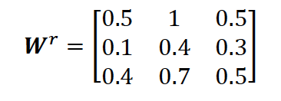
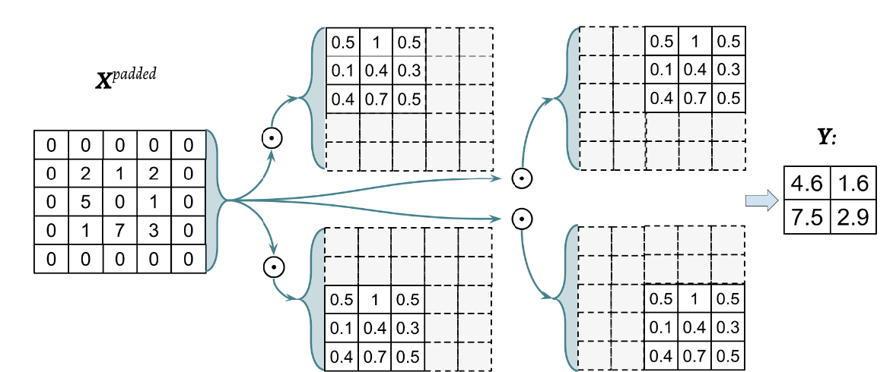
Convolution in 2D
THE MATHEMATICAL VIEW
We can rotate the filter to perform the sum on indices running in the same directions
Silvia Auricchio & Francesco Cirotto, Università degli studi di Napoli "Federico II" - INFN Napoli

Slide 21
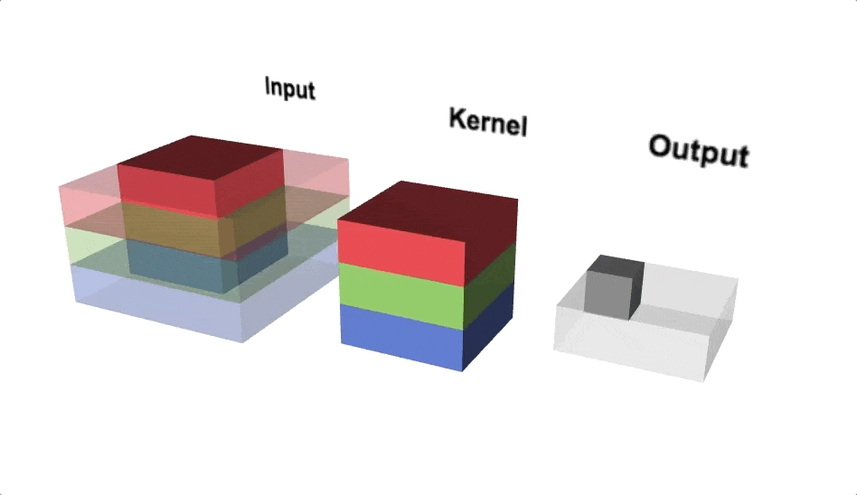
Convolution in 2D
How does a convolutional layer work on a RGB image?
  For each channel color there is a different filter
  The three outputs are added together
  The output of a convolutional layer with a multi-layer input is a single layer
Silvia Auricchio & Francesco Cirotto, Università degli studi di Napoli "Federico II" - INFN Napoli

Slide 22
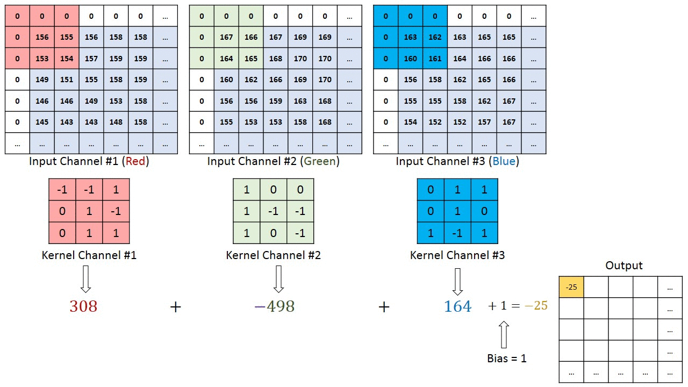
Convolution in 2D
Silvia Auricchio & Francesco Cirotto, Università degli studi di Napoli "Federico II" - INFN Napoli

Slide 23
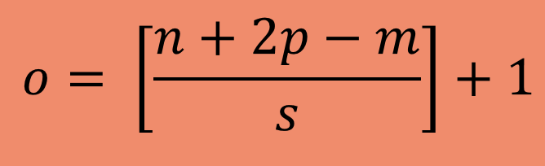
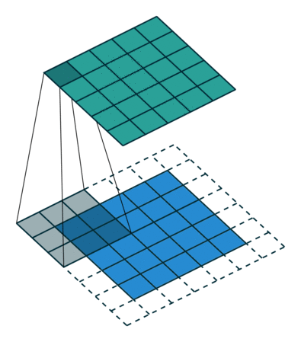
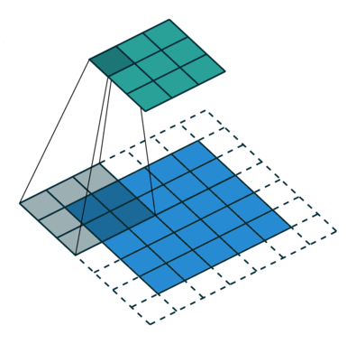
Strides and padding in 2D
Zero-padding and strides concepts are the same of 1D case
The output size of a 2D filter is still calculable with the formula seen before, applied on weight and height separately
Input dimension
Zero-padding
Kernel dimension
stride
Silvia Auricchio & Francesco Cirotto, Università degli studi di Napoli "Federico II" - INFN Napoli
padding (1,1)
strides (2,2)
padding (1,1)
strides 1
The input shape is preserved (padding 'same')

Slide 24
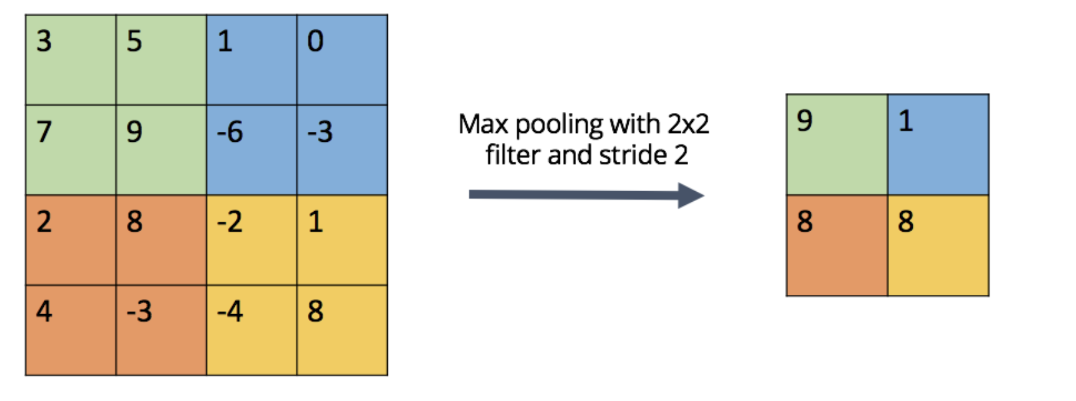
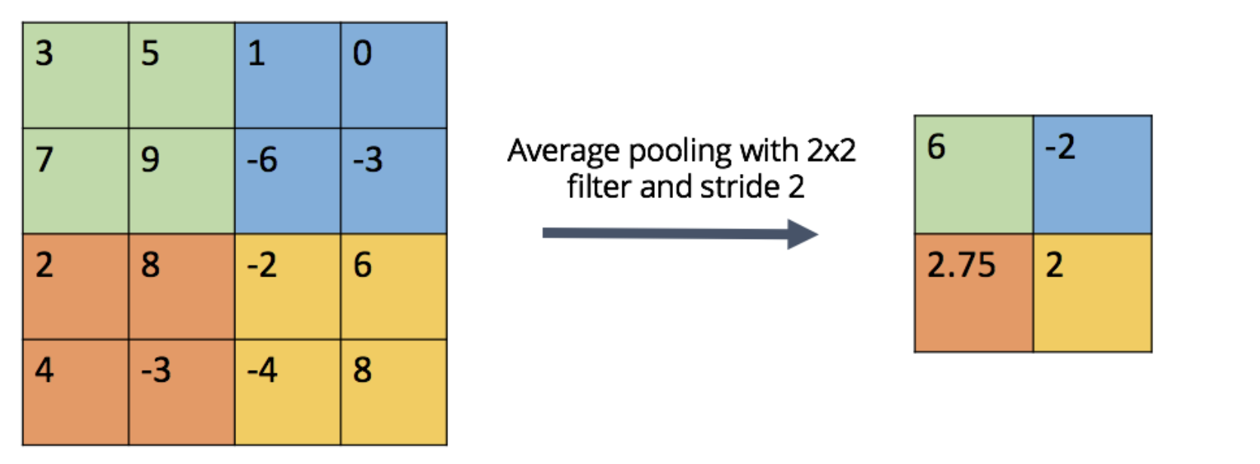
The Pooling Layer
According to zero-padding and strides it is possible to change (usually reduce) the input dimension
This task can be also performed with a "Pooling" layer
TWO KINDS OF POOLING:
Maximum Pooling (or Max Pooling): Calculate the maximum value for each patch of the feature map.
Average Pooling: Calculate the average value for each patch on the feature map.
Silvia Auricchio & Francesco Cirotto, Università degli studi di Napoli "Federico II" - INFN Napoli

Slide 25
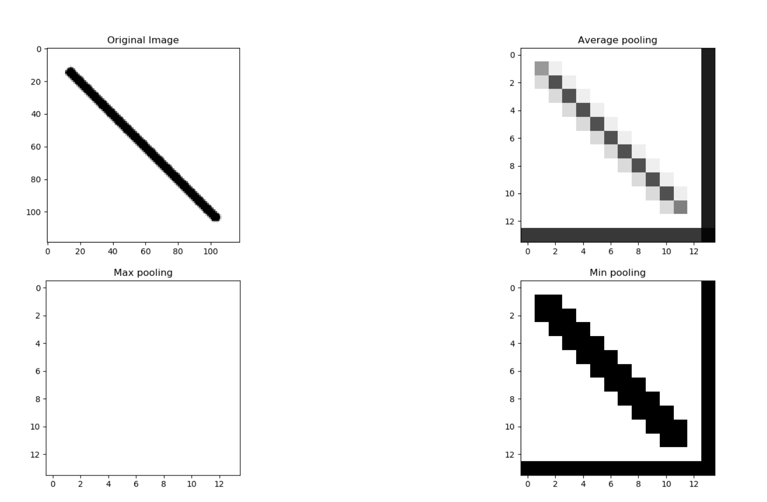
Different Pooling Layers
Silvia Auricchio & Francesco Cirotto, Università degli studi di Napoli "Federico II" - INFN Napoli

Slide 26
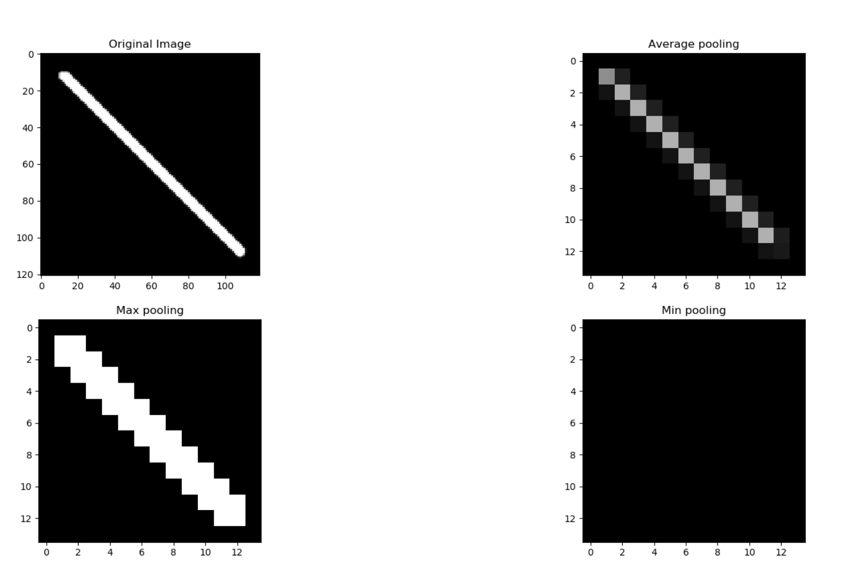
Different Pooling Layers
Silvia Auricchio & Francesco Cirotto, Università degli studi di Napoli "Federico II" - INFN Napoli

Slide 27
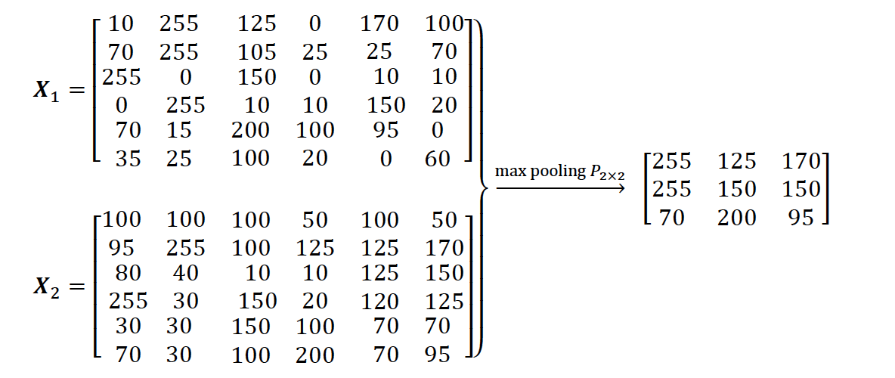
The Max Pooling Layer
MAIN ASPECTS:
Pooling (max-pooling) introduces a local invariance. This means that small changes in a local neighbourhood do not change the result of max-pooling
Pooling decreases the size of features, which results in higher computational efficiency. Furthermore, reducing the number of features may reduce the degree of overfitting as well.
Traditionally, pooling is assumed to be non-overlapping (pooling size = stride)
Silvia Auricchio & Francesco Cirotto, Università degli studi di Napoli "Federico II" - INFN Napoli

Slide 28
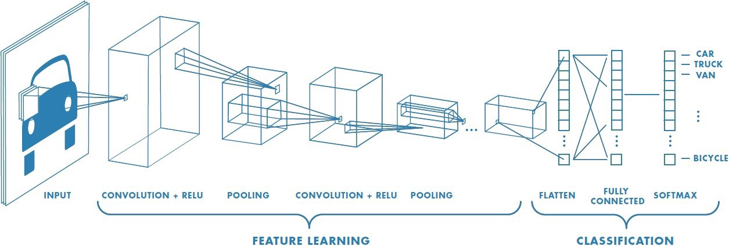
Putting everything together in a CNN
A convolutional neural network is a sequence of the following layers ordered in different ways:
  Convolutional
  Pooling
  Dense layer
Silvia Auricchio & Francesco Cirotto, Università degli studi di Napoli "Federico II" - INFN Napoli

Slide 29

FILTERS WEIGHTS ARE LEARNT FROM DATA DURING TRAINING
THE NETWORK LEARNS WHICH ARE THE MOST DISCRIMINANT PATTERNS
A CNN PERFORMS THE CLASSIFICATION BY READING THESE EXTRACTED FEATURES
A DNN READS ONLY PIXELS VALUES
Silvia Auricchio & Francesco Cirotto, Università degli studi di Napoli "Federico II" - INFN Napoli

Slide 30
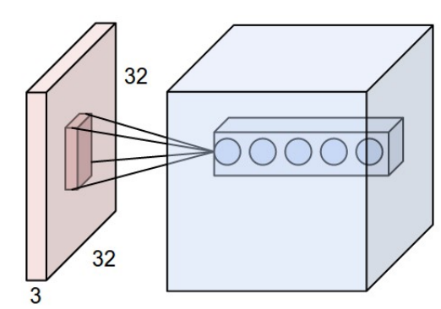
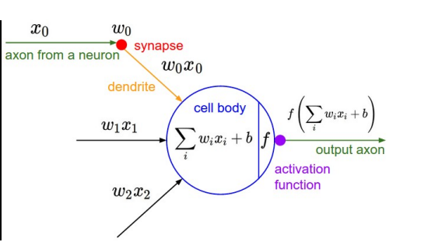
Putting everything together in a CNN
Typically, a convolutional layer is composed of:
N filters
In a convolution layer, usually, not only one but several filters are stacked together
Each filter learns some different information from the same image
Silvia Auricchio & Francesco Cirotto, Università degli studi di Napoli "Federico II" - INFN Napoli
Conv operation

Slide 31
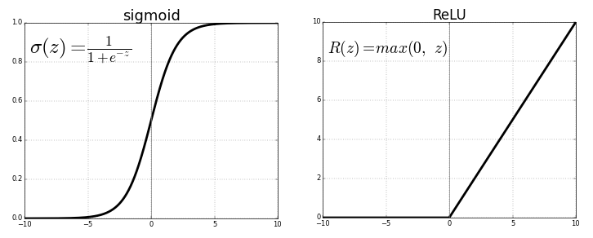
Putting everything together in a CNN
Typically, a convolutional layer is composed of:
N filters + activation function
+
Silvia Auricchio & Francesco Cirotto, Università degli studi di Napoli "Federico II" - INFN Napoli

Slide 32
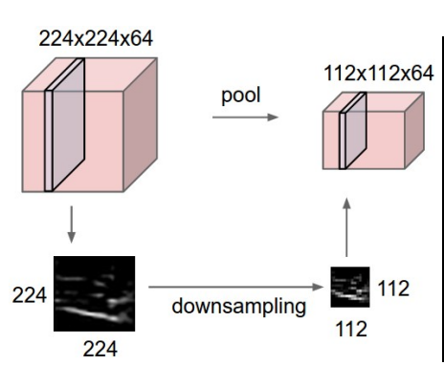
Putting everything together in a CNN
Typically, a convolutional layer is composed of:
N filters + activation function + pooling layer​
+
+
Silvia Auricchio & Francesco Cirotto, Università degli studi di Napoli "Federico II" - INFN Napoli

Slide 33
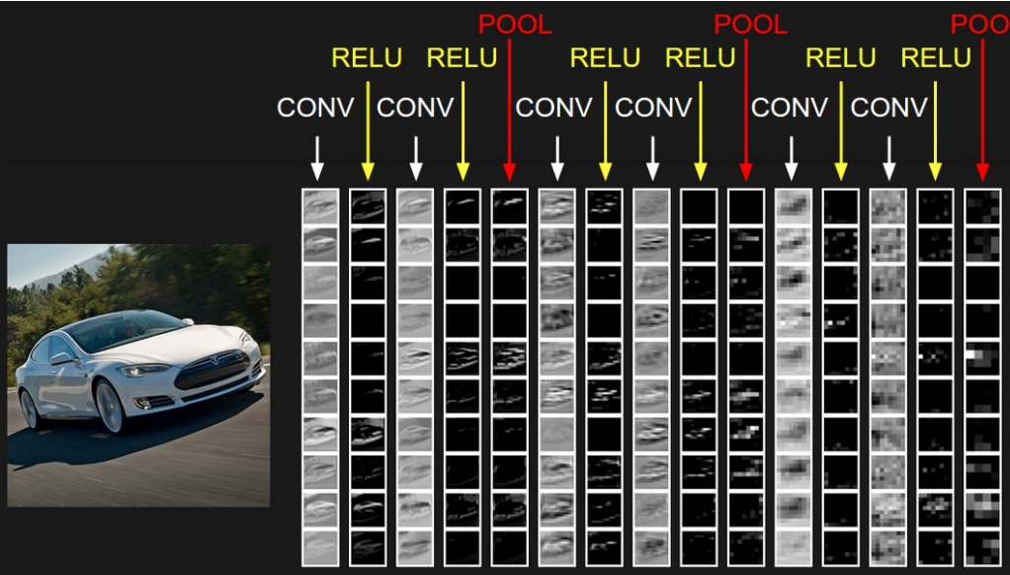
Putting everything together in a CNN
The sequence convolutional + pooling is not the only one possible choice
  Modern networks don't use pooling but adjust the output size by tuning the padding and strides of convolutional layers
Silvia Auricchio & Francesco Cirotto, Università degli studi di Napoli "Federico II" - INFN Napoli

Slide 34
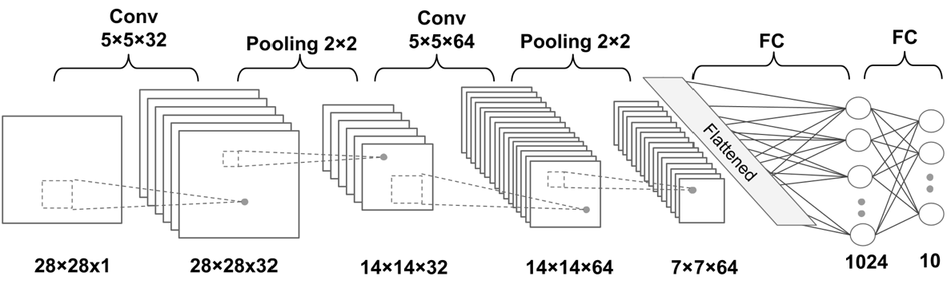
Dense layers for classification
Now we must flatten the final output and feed it to a regular Neural Network for classification purposes
Adding a Fully-Connected layer is a way of learning non-linear combinations of the high-level features (from filters)
  The image is flattened into a column vector
  then fed to a fully-connected neural network
Silvia Auricchio & Francesco Cirotto, Università degli studi di Napoli "Federico II" - INFN Napoli

Slide 35

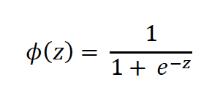
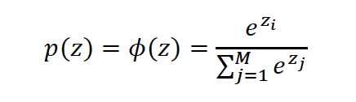
Activations and Loss functions for classification
Now what our model misses is the final probabilistic interpretation of the output Z to perform classification:
An activation function should be applied to the output of the last fully-connected layer:
  'Sigmoid' for binary classification
  'Softmax' for multi-classification
Recall: Sigmoid and Softmax are both probabilities for an event to belong to a given class, therefore they are used only in the outer layer. Other activation functions, like ReLU and tanh are mainly used in the intermediate (hidden) layers to add non-linearities to our model
Silvia Auricchio & Francesco Cirotto, Università degli studi di Napoli "Federico II" - INFN Napoli

Slide 36
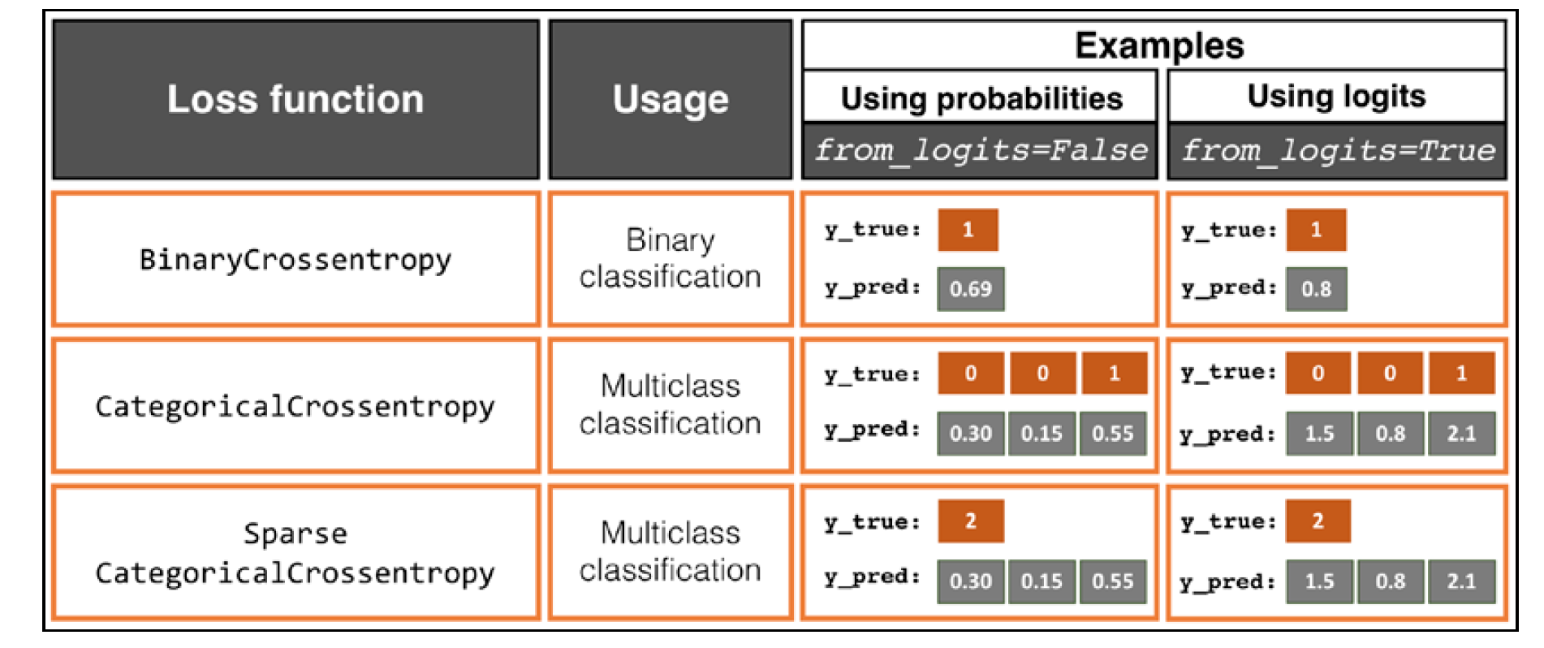

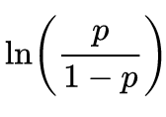
Activations and Loss functions for classification
Focusing on classification problems, depending on the type of problem and the type of output (logits versus probabilities), we should choose the appropriate loss function to train our model
With 'from_logits=True' logits are provided as inputs to the loss function (not the activation output), the inverse of the sigmoid function:
  It is preferred due to numerical stability reasons
Silvia Auricchio & Francesco Cirotto, Università degli studi di Napoli "Federico II" - INFN Napoli

Slide 37
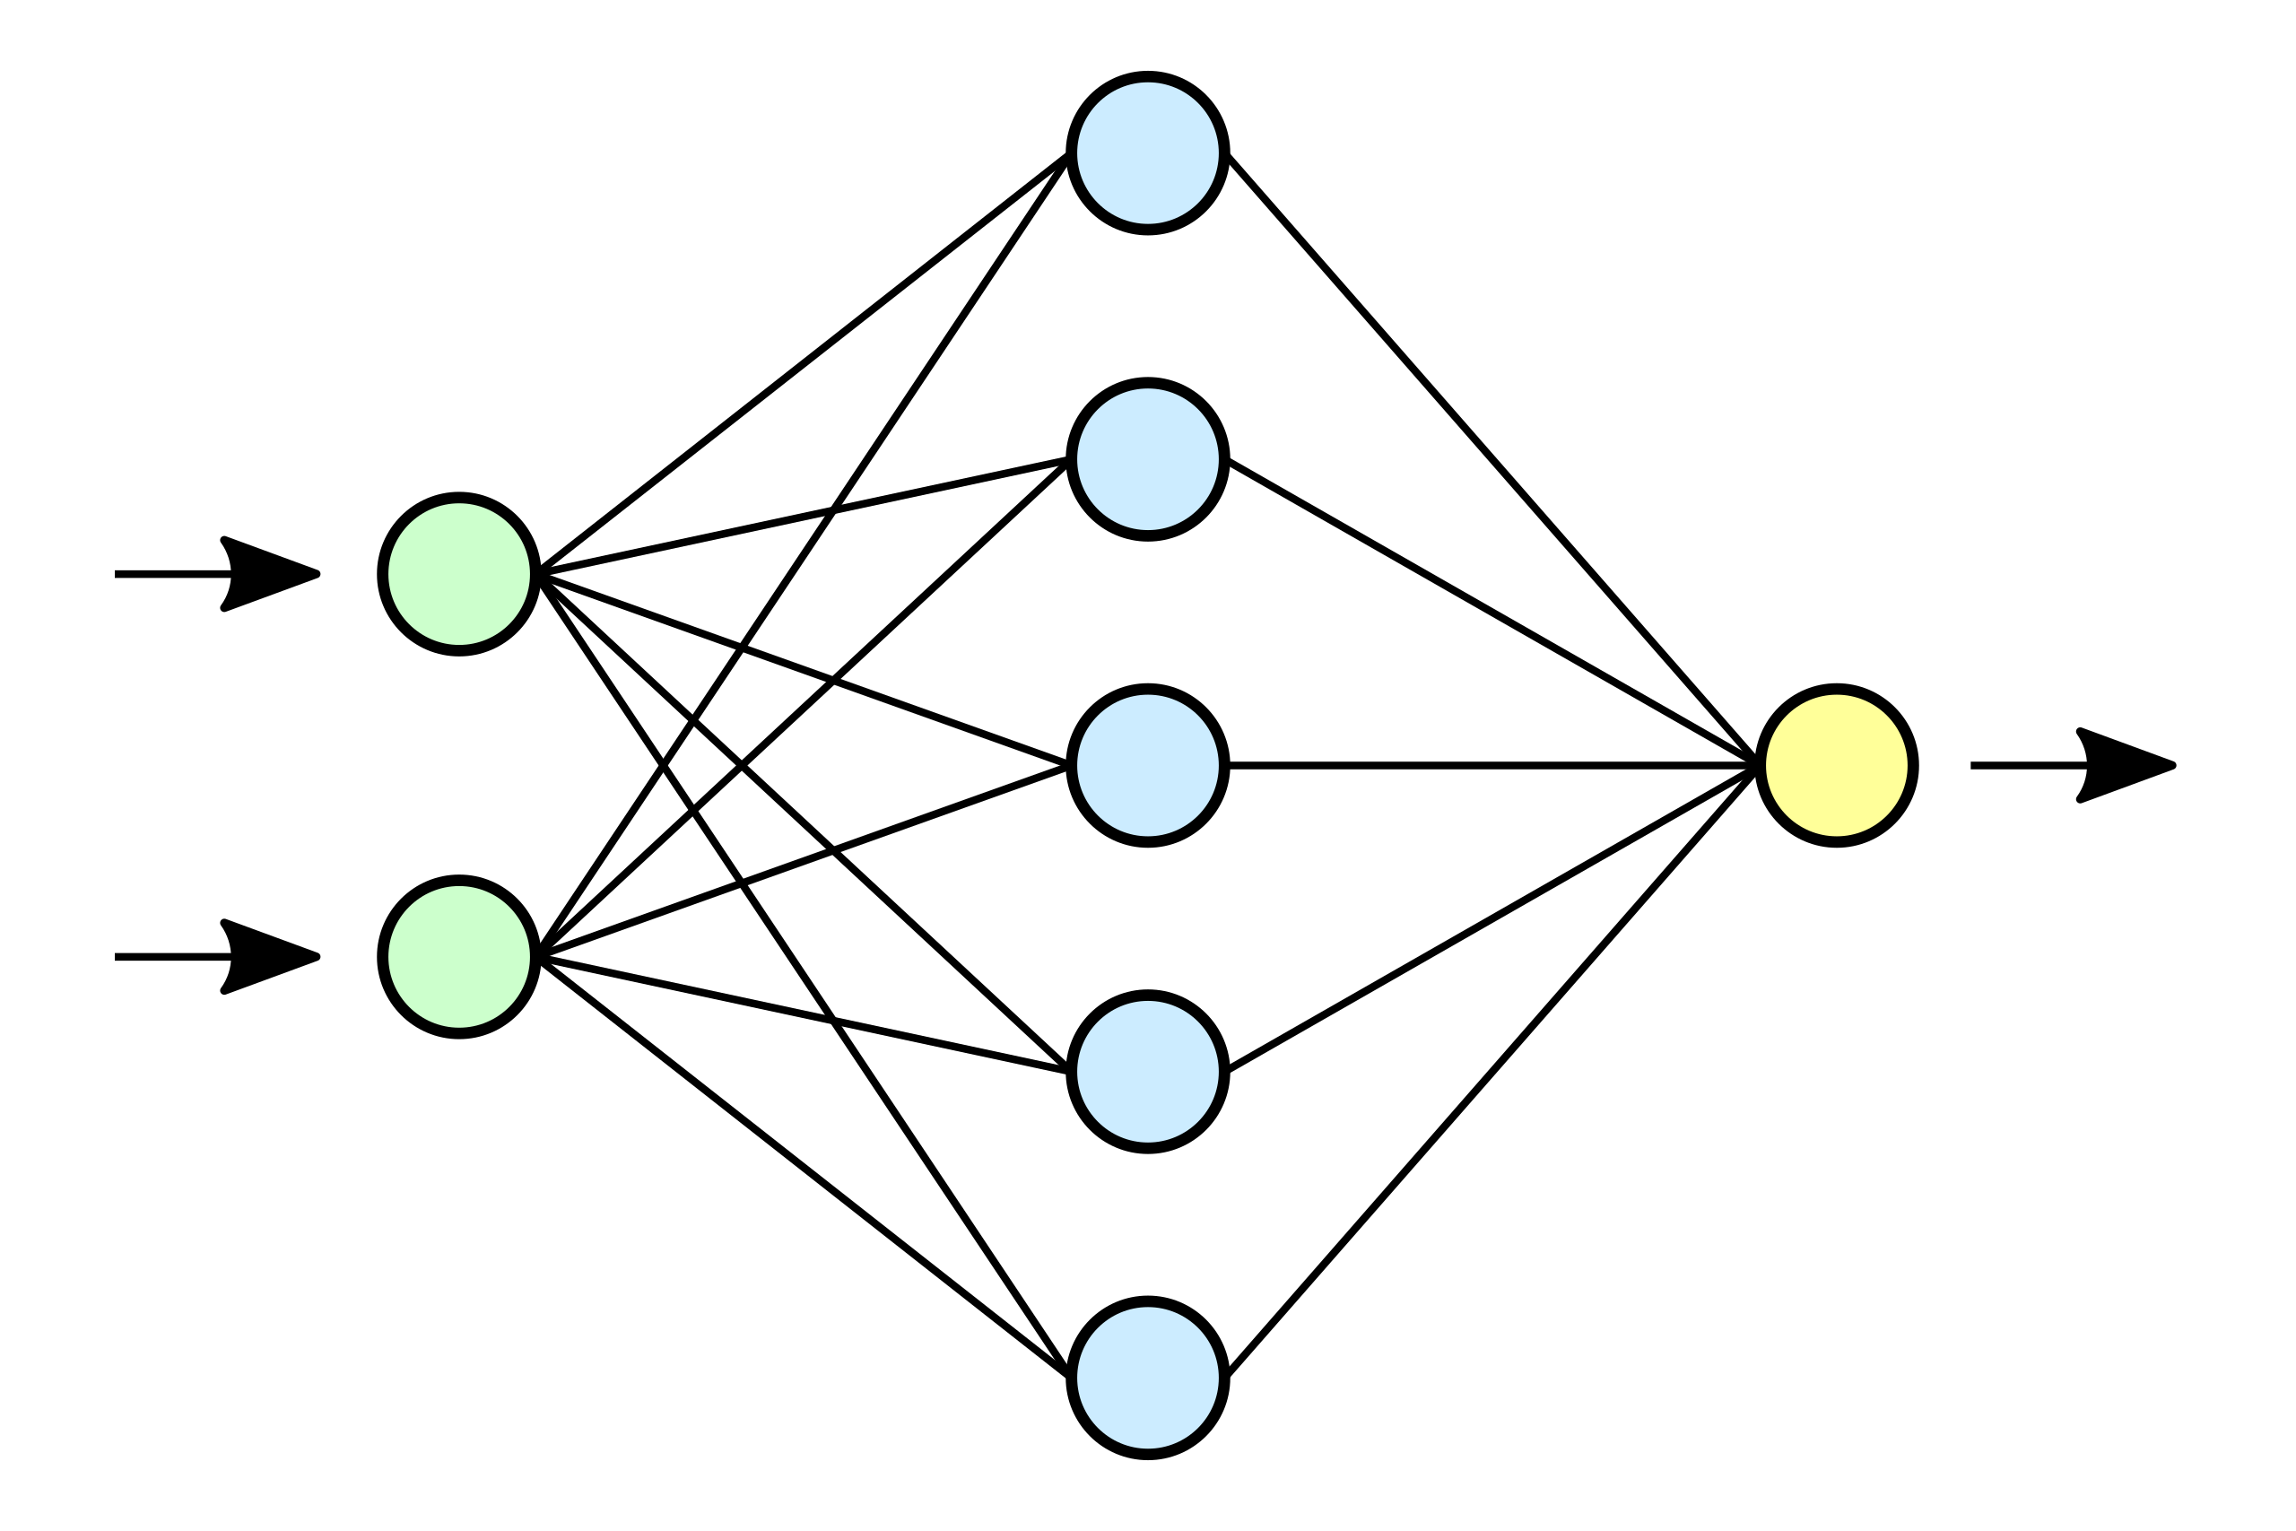
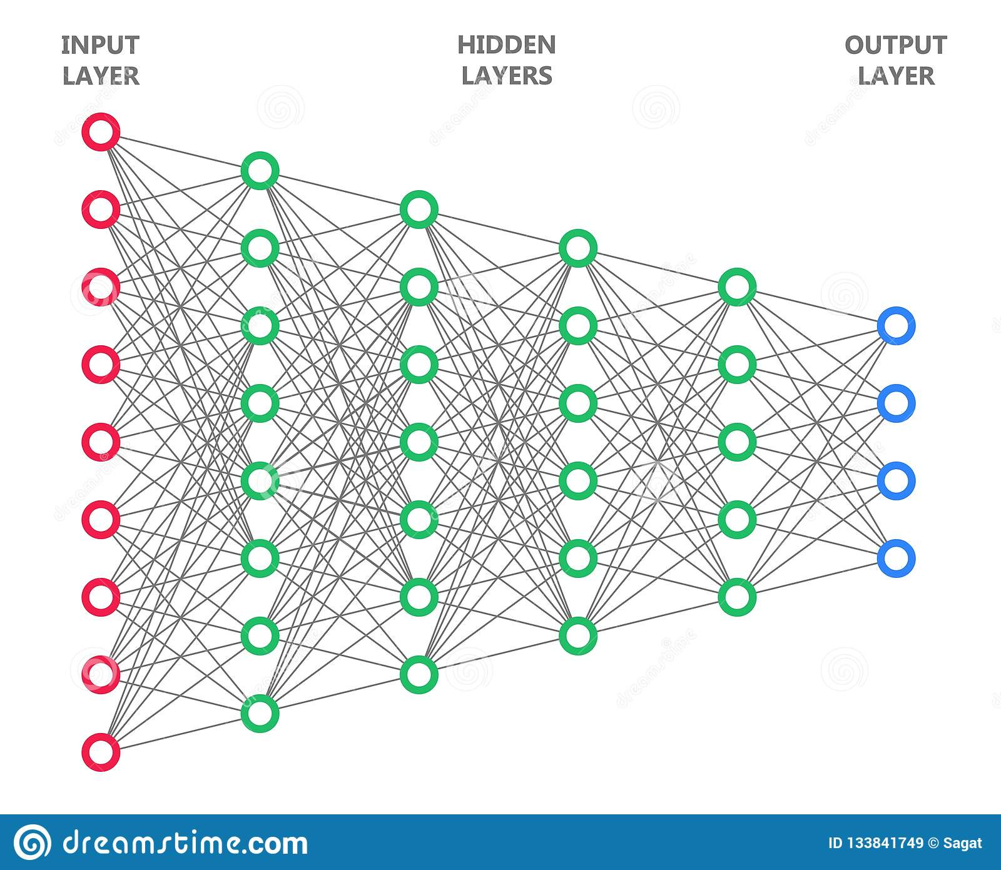
CNN regularization: Dropout
Choosing the size of a network has always been a challenging problem
  Small networks, or networks with a relatively small number of parameters, are likely to underfit, resulting in poor performance
  very large networks may result in overfitting, where the network will do extremely well on the training dataset while achieving a poor performance on the test dataset
One way to address this problem is to build a network with a relatively large capacity to do well on the training dataset, then to prevent overfitting we can apply one or multiple regularization schemes to achieve a good performance on new data
Silvia Auricchio & Francesco Cirotto, Università degli studi di Napoli "Federico II" - INFN Napoli
Too few parameters!
Too many parameters!

Slide 38
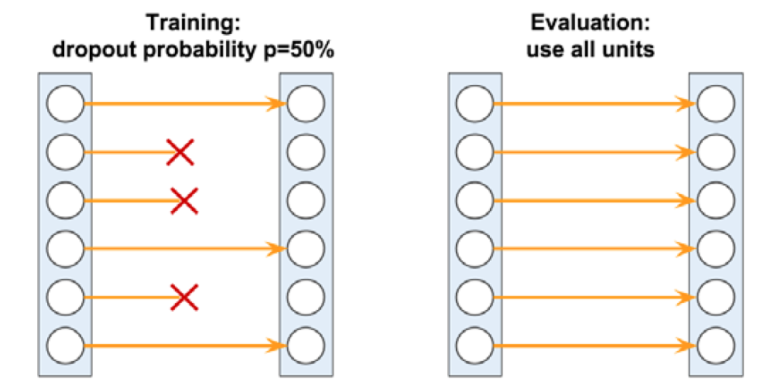
CNN regularization: Dropout
Dropout has emerged as a popular technique for regularizing: during the training phase a fraction of the hidden units is randomly dropped at every iteration with a certain probability (rate)​
During prediction, all neurons will contribute to computing the pre-activations of the next layer​
Silvia Auricchio & Francesco Cirotto, Università degli studi di Napoli "Federico II" - INFN Napoli

Slide 39
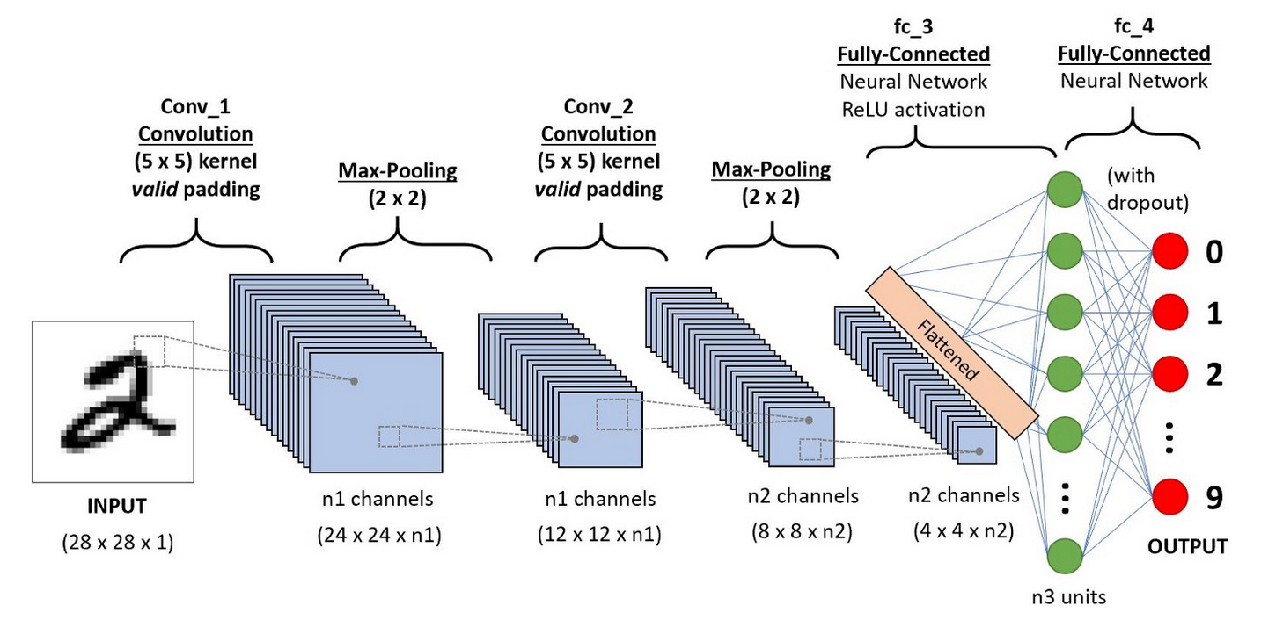
An ensemble view
Silvia Auricchio & Francesco Cirotto, Università degli studi di Napoli "Federico II" - INFN Napoli
Since the first convolutional filters learn high level features in the image in input and the input size is larger than in inner layers, the number of filters is relatively small to not insert too many weights
A good practice is to increment this number in the subsequent convolutional steps
Dropout can be inserted not only between dense layers but also between a Conv layer and its input

Slide 40
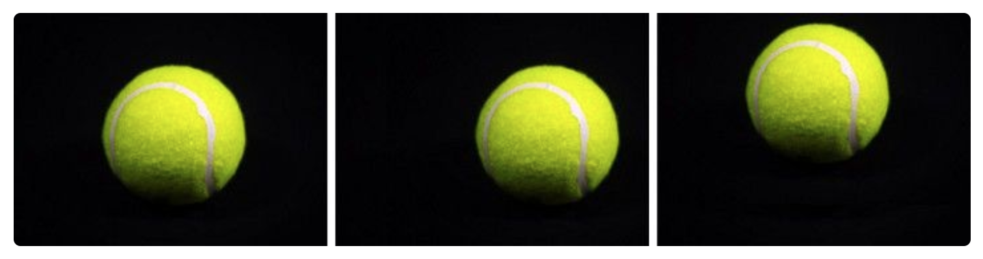
Data Augmentation
When the size of training dataset is small, a good practice to increase the fit performances is the Data Augmentation:
  It consists in replicating existent images by applying small changes to it (rotation, translation, resizing..)
In this way not only the number of training samples increases but each picture is fed to the network with different prospections
A poorly trained neural network would think that these three tennis balls shown below are distinct images, instead they are not
Silvia Auricchio & Francesco Cirotto, Università degli studi di Napoli "Federico II" - INFN Napoli

Slide 41
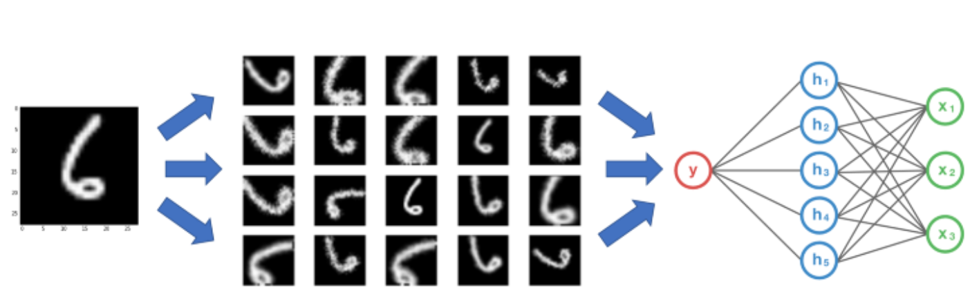
Data Augmentation
In the real-world scenario, we may have a dataset of images taken in a limited set of conditions, but our target application may exist in a variety of conditions, such as different orientation, location, scale, brightness etc.
A convolutional neural network that can robustly classify objects even if it is placed in different orientations is said to have the property called invariance to translation, viewpoint, size or illumination
We account for these situations by training our neural network with additional synthetically modified data
Silvia Auricchio & Francesco Cirotto, Università degli studi di Napoli "Federico II" - INFN Napoli

Slide 42
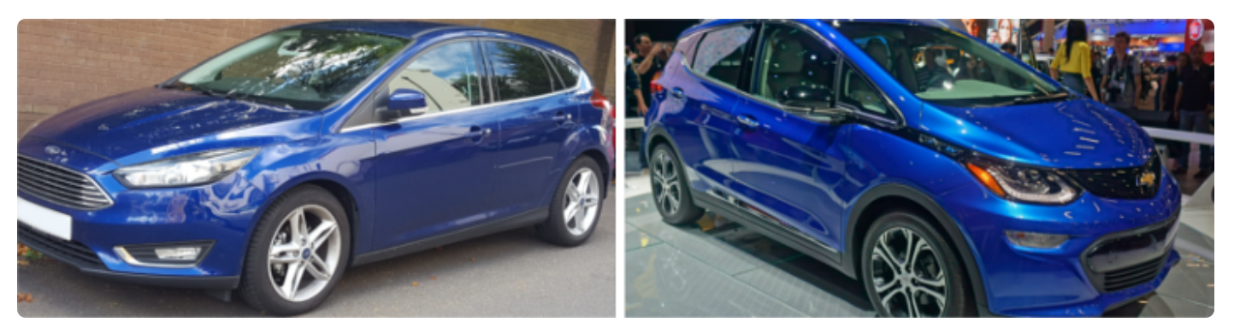
Data Augmentation
Data augmentation can help to increase the amount of relevant data in the dataset
Example:
Let's suppose you have to train a CNN for learning to distinguish between two car brands:
Brand A (Ford)
Brand B (Chevrolet)​
Silvia Auricchio & Francesco Cirotto, Università degli studi di Napoli "Federico II" - INFN Napoli
In the dataset all Brand A cars are facing left and all Brand B cars are facing right
Now, you feed this dataset to your “state-of-the-art” neural network, and you hope to get impressive results once it’s trained

Slide 43
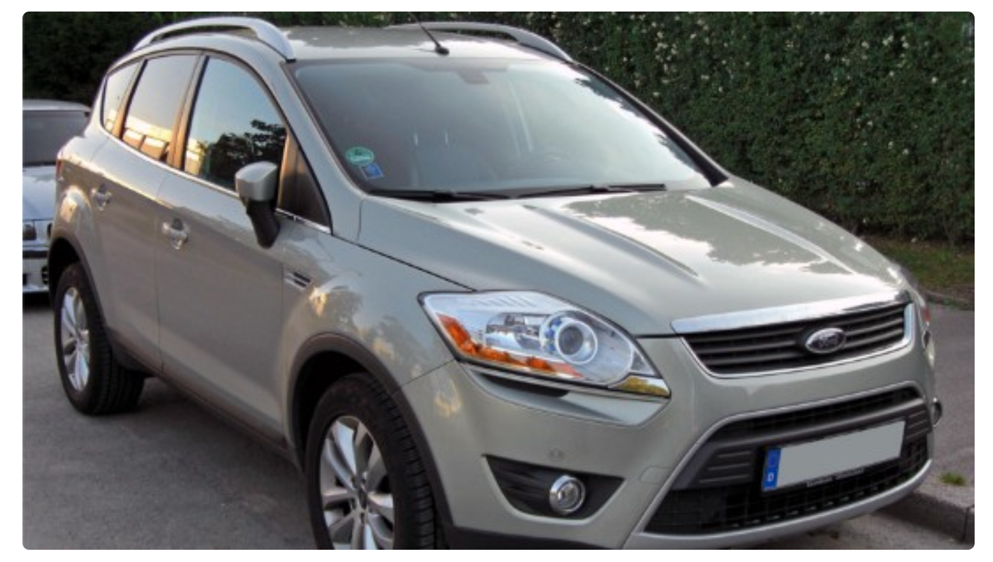
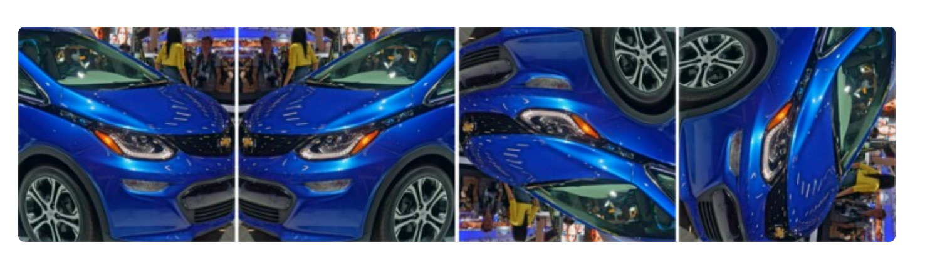
Data Augmentation
From training you get a 95% accuracy on your dataset
If you feed a Brand A car to the CNN ….
.... your neural network output is a Brand B car!
Why does this happen?
A CNN finds the most obvious features that distinguishes one class from another, here all cars of Brand A were facing left and all cars of Brand B were facing right
Silvia Auricchio & Francesco Cirotto, Università degli studi di Napoli "Federico II" - INFN Napoli
Solution

Slide 44
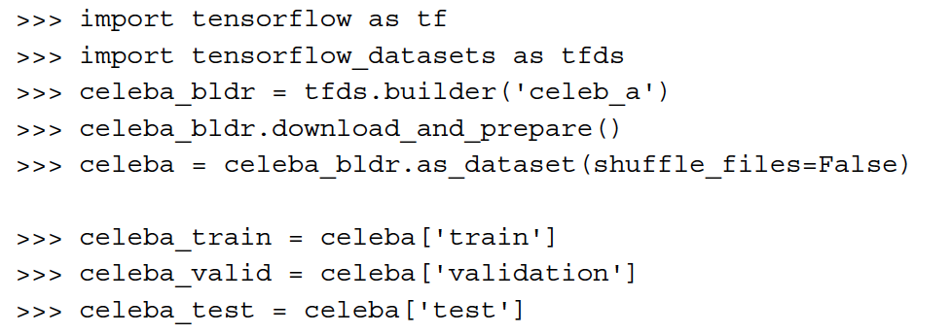
Implementation of a CNN with TensorFlow
We are now going to see the main steps to implement a CNN for gender classification
Dataset: CelebFaces Attributes Dataset (CelebA) is a large-scale face attributes dataset with more than 200K celebrity images (from TensorFlow)
LOADING THE DATASET
Silvia Auricchio & Francesco Cirotto, Università degli studi di Napoli "Federico II" - INFN Napoli

Slide 45
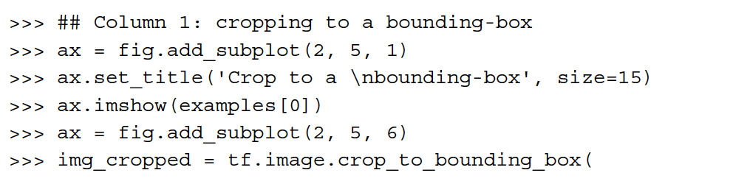


Implementation of a CNN with TensorFlow
2. DATA AUGMENTATION
Let's see some of the possible transformations that are available via the tf.image module
Cropping to a bounding box
Flipping horizontally
Silvia Auricchio & Francesco Cirotto, Università degli studi di Napoli "Federico II" - INFN Napoli
Adjust contrast
Adjust brightness
Cropping from image center

Slide 46

Implementation of a CNN with TensorFlow
2. DATA AUGMENTATION
Silvia Auricchio & Francesco Cirotto, Università degli studi di Napoli "Federico II" - INFN Napoli
TensorFlow has a method that automatically performs data augmentation 'online' per batch, instead of saving more pictures in the dataset​ (https://www.tensorflow.org/api_docs/python/tf/keras/preprocessing/image/ImageDataGenerator)
This is good for large datasets, but increases the computational time​

Slide 47

Implementation of a CNN with TensorFlow
3. BUILDING THE MODEL
Silvia Auricchio & Francesco Cirotto, Università degli studi di Napoli "Federico II" - INFN Napoli

Slide 48
Implementation of a CNN with TensorFlow
3. BUILDING THE MODEL
Input images of size 64 × 64 × 3 (the images have three color channels: RGB)
TensorFlow has a method for computing the shape of the output feature maps after applying all the CNN layers
There are 256 feature maps (or channels) of size 8 × 8
Now we can add a fully connected layer to get to the output layer with a single unit
  If we flatten the feature maps, the number of input units to this fully connected layer will be 8 × 8 × 256 = 16384
  >>> model.add(tf.keras.layers.Flatten())
  >>> model.add(tf.keras.layers.Dense(16384, activation='relu'))
Silvia Auricchio & Francesco Cirotto, Università degli studi di Napoli "Federico II" - INFN Napoli

Slide 49

Implementation of a CNN with TensorFlow
3. BUILDING THE MODEL
Alternatively, we can insert a global average pooling:
  a special case of average-pooling when the pooling size is equal to the size of the input feature maps
  It reduces the hidden units from 16384 to 256
Finally, we can add a fully connected (dense) layer to get a single output unit
  >>> model.add(Dense(1, activation='sigmoid'))
  >>> model.compile(optimizer=Adam(), loss=BinaryCrossentropy(), metrics=['accuracy'])
Silvia Auricchio & Francesco Cirotto, Università degli studi di Napoli "Federico II" - INFN Napoli

Slide 50


Implementation of a CNN with TensorFlow
3. BUILDING THE MODEL
By using model.summary() a table with the network layers and their hyperparameters is printed out:
Silvia Auricchio & Francesco Cirotto, Università degli studi di Napoli "Federico II" - INFN Napoli

Slide 51



Implementation of a CNN with TensorFlow
4. TRAINING THE MODEL
Let's now train the model, with the fit method
And let's visualize the learning curves:
hist['loss'], hist['val_loss'], hist['accuracy'] and hist['val_accuracy'] are the arrays with loss and accuracy for train and validation dataset, as a function of the training epochs
Silvia Auricchio & Francesco Cirotto, Università degli studi di Napoli "Federico II" - INFN Napoli

Slide 52


Implementation of a CNN with TensorFlow
4. TRAINING THE MODEL
The losses for the training and validation have not converged to a plateau region.
Using the fit() method, we can continue training for an additional 10 epochs
Once we are happy with the learning curves, we can evaluate the model on the holdout test dataset
Silvia Auricchio & Francesco Cirotto, Università degli studi di Napoli "Federico II" - INFN Napoli

Slide 53

Implementation of a CNN with TensorFlow
5. APPLYING THE MODEL
Finally, we can get the prediction results on some test examples using model.predict()​
Silvia Auricchio & Francesco Cirotto, Università degli studi di Napoli "Federico II" - INFN Napoli

Slide 54
Hands on CNN
Today you will create a CNN model for classifying dogs and cats
We will provide a dataset containing photos of dogs and cats
Pre-processing steps to images
Creating a model
Training and testing
Evaluating performances
Improving the model!
Silvia Auricchio & Francesco Cirotto, Università degli studi di Napoli "Federico II" - INFN Napoli

Slide 55
References
Raschka, Sebastian. Python machine learning. Packt publishing ltd, 2015
Dive Into Deep Learning
http://d2l.ai/chapter_preface/index.html

