Slide 1
Status EIC_NET initiative and EIC project
Status of EIC project e preview preventivi
P. Antonioli
INFN-Bologna

Slide 2
Outline
Status of EIC project: ultimi 3 mesi
EIC_NET initiative & our (growing) community
Our contribution to "Detector-1"
Preview preventivi
Planning incontro settembre
PD
TS
TO
PV
FE
GE
BO
(RM1)/RM2
LNF
BA
SA
last EIC_NET general meeting: 30 June – 1st July December 2022 CT/LNS:
https://agenda.infn.it/event/30932/
CS
CT/LNS
Salerno and Pavia groups and an "arrivederci" to RM1
A growing community with different background: COMPASS, JLAB/CLAS12, ALICE, ATLAS, CMS, STAR, DARK SIDE, ...

Slide 3
from networking to experiment mode
2023: the year of decisions likely last year as _NET
grow an EIC generation

Slide 4
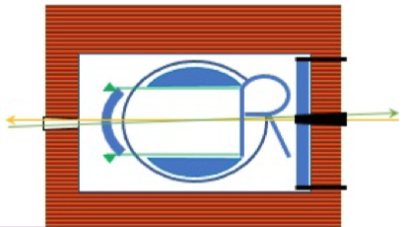
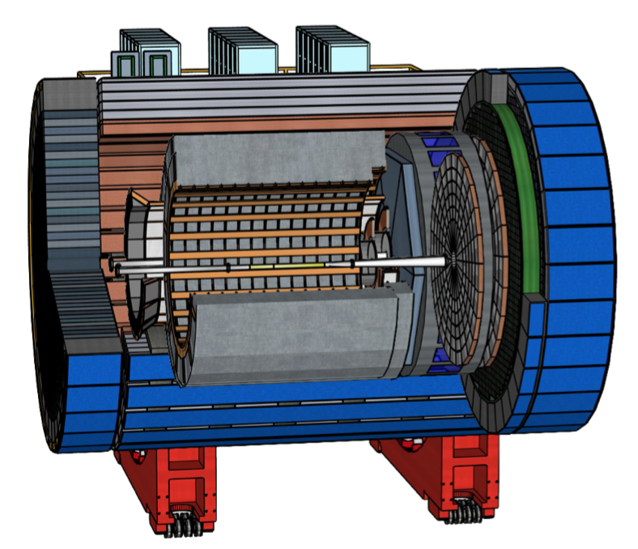
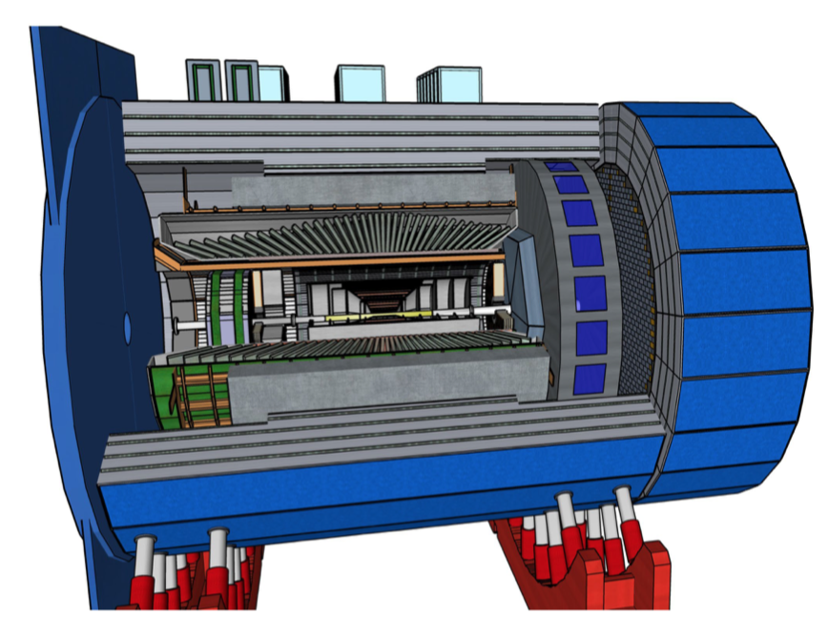
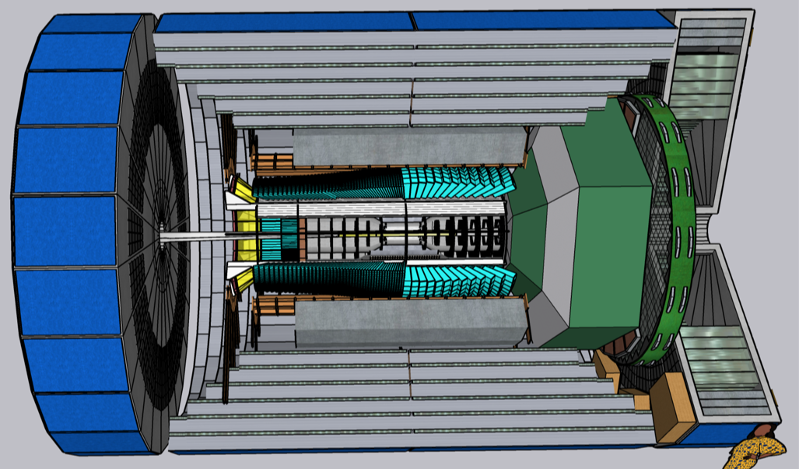
Detector proposals
ATHENA is general purpose (full EIC science) for IP6 with new 3T solenoidal magnet (and large bore diameter)
ECCE is general purpose detector for IP6 re-using 1.4 T Babar magnet (bore diameter 2.8)
CORE is a more "compact" proposal, potentially for IP8 (3T solenoid as well)
Design of all proposal driven by YR requirements, obviously with differences...

Slide 5
Last 6 months: a complicated journey!
January – February: waiting for DPAP report
March:
8th: DPAP report presented orally in a open session selecting ECCE as reference design
9th: EIC_NET EB
10th first ATHENA plenary meeting (with INFN "first reaction" presented)
11th first meeting between ATHENA management and EIC project (Jim/Rolf/Elke) + DoE (Tim Hallman) ("DPAP closeout followup meeting")
14th meeting responsabili locali EIC_NET
15th briefing to GE/CSN3 chair (Diego/Rosario) // President Biden signs the budget for FY22
17th ATHENA IB (with Rolf/Elke representing EIC project)
22th + 24th: first ECCE-ATHENA meetings (management)
24th ATHENA plenary meeting (again Elke attending)
28th EIC_NET general meeting (online): INFN has no interest for detector 2
31st first briefing to INFN EIC_NET referees (+ follow-up on Zoom 8th April)
April 21: Grant of eRD funds from EIC management
April 29 : First Detector-1 plenary meeting
"re-adjustment", including moving from 5 INFN conveners to 3 (thanks to Salvatore and Domenico!) and a SC made by 3 (ECCE) + 2 (ATHENA)
starting negotiations for the real detector

Slide 6
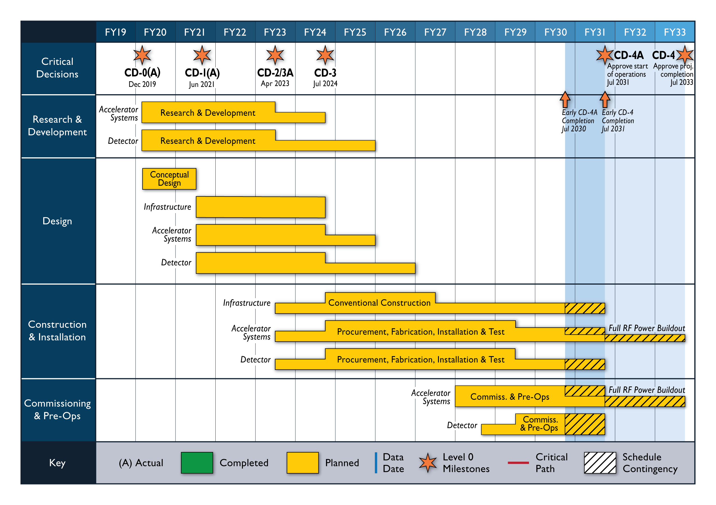
EIC timeline: the new-new schedule
Detector "ready": June 2031
Full-fledged accelerator: 2034
On the "short-term" pre-TDR October 2023
Status Update to Federal Project Director June 28-30, 2022, @BNL
Cost and Schedule Event(s) May-June 2022
Technical Subsystem Reviews January – December 2022
OPA Status Review January 2023
Preliminary Design Complete & Review May 2023
Final Design/Maturity Readiness for CD-3A Items May 2023
CD-2/3A review (expectation), requires pre-TDR ~October 2023
CD-2/3A (expectation) January 2024
CD-3 review (expectation) January 2025
CD-3 (expectation), requires TDR April 2025

Slide 7
Towards Detector 1
toward a new Collaboration
ATHENA & ECCE together "with equal dignity"
toward a (final) Detector proposal
BABAR / sPHENIX magnet assumed as reference/baseline → 3T magnet is no longer an option
INFN contribution (dRICH / Si-Vertex) firmly established in detector design
(and towards a new name):
EPIC - Electron Proton and Ion Collider experiment
ELECTRA (For: ELECTRon-A) --> "Electra is the goddess of stormy clouds, which draw their moisture up from the sea. They are charged with lightening and form around islands near the summits of mountains.“
ELEIDA - ELEctron Ion Detector Apparatus (name Eleida means "Rare beauty")
D1

Slide 8
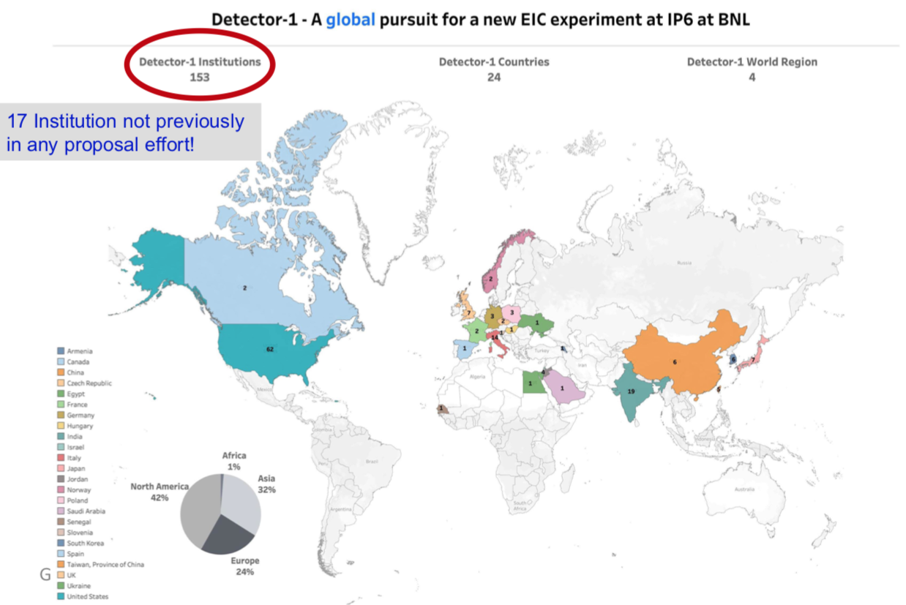
Towards Detector 1 → a new Collaboration
First International Representatives meeting 18/7
decision made to move to an Institutional Board
interim IB-chairs: Franck Sabatié (CEA/FR), Vicky Green (Vanderbilt Un./USA)
charter commitee will be appointed 27/7 by the IB
hopefully charter adopted by October → elections to follow (spokesperson/IB-chairs etc.)
160 this morning

Slide 9
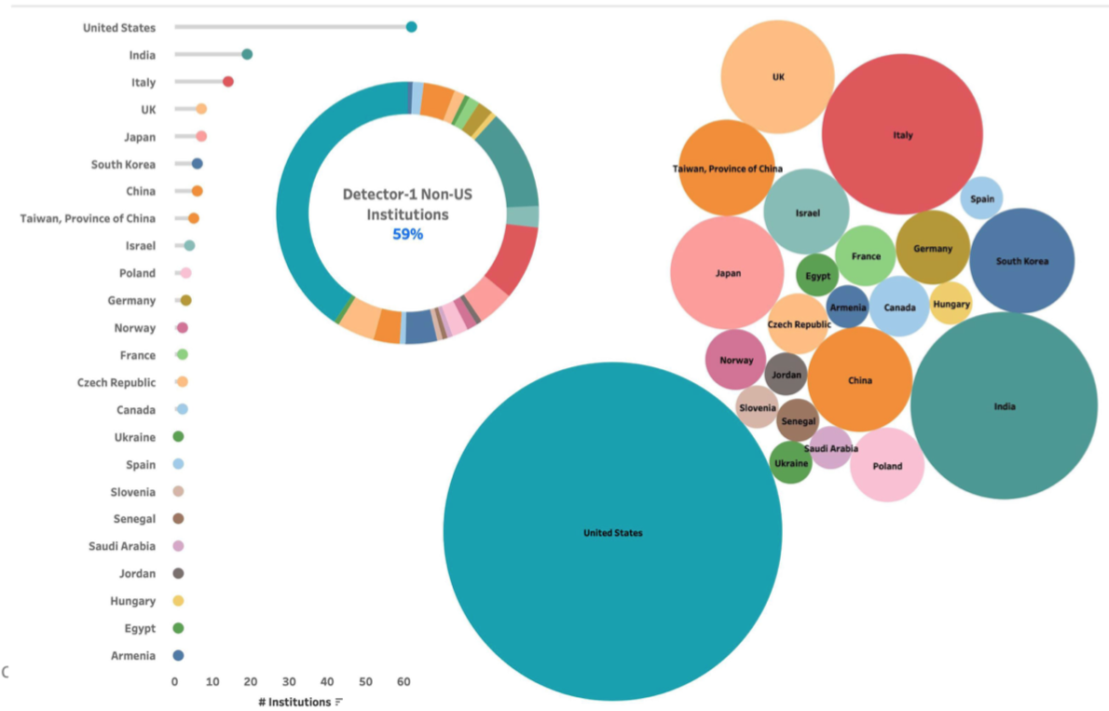
Towards Detector 1

Slide 10
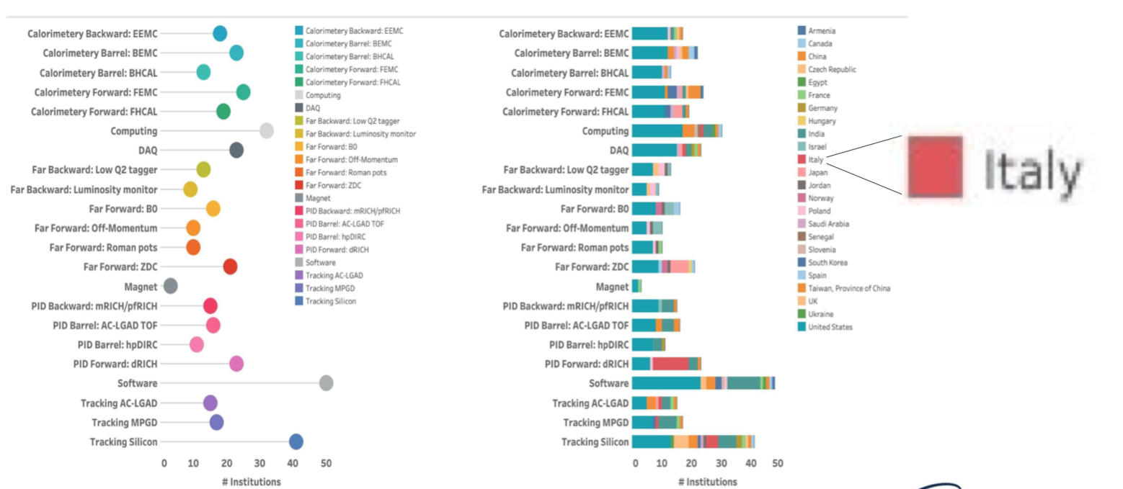
Towards Detector 1

Slide 11
The next big step → next week
First face-to-face meeting of the community since 3 years and fisrt meeting of the new Collaboration
The Collaboration will get a name! D1, EPIC or
We need to "convene" on dRICH and set our role in tracker, computing and DAQ
Key role of Silvia, Roberto, Andrea and Marco in SC or conveners (PID, computing, SIDIS) + Silvia/MarcoR in EICUG SC
13 from INFN attending

Slide 12
EIC & INFN (high-level governance)
Shown by Rolf & Elke, last 9th June Det-1 Gen. Meeting
DoE meeting with "main" funding agencies about EIC governance
8 April (D. Bettoni for INFN)
16 June INFN in-camera meeting with DoE (Washington)
→ good working relationship INFN-DoE
→ GE/CSN3 supporting EIC_NET initiative
→ next months we will need to see how it is practically shaped this "dual" bodies governance and actual role ("CERN-like but...")
→ agreement toward "sigla" in 2024

Slide 13
EIC_NET is improving its "footprint"
INFN2022: bi-annual CSN3 workshop https://agenda.infn.it/event/22084/
2 talks (Chandra, Simone) + 2 poster (Nicola, Shyam) + two invited talks connected to EIC too (Annalisa)
2+1 CSN3 grants opportunities for graduates/undergraduates (3 months in a lab) LNS, JLAB + CERN (via ALICE/ITS3)
1 INFN PhD (N. Rubini) attending CNFS School on EIC Physics: https://indico.bnl.gov/event/15003/
Invited talks at:
Otranto School: S. Fazio: https://agenda.infn.it/event/30254/
QCD@Work D. Elia https://agenda.infn.it/event/20170/
HFWINC P. Antonioli https://indico.cern.ch/event/883427/
R. Preghenella NDIP2022: https://www.ndip.fr/
Abstracts approved at RICH22: https://indico.cern.ch/event/1094055/
C. Chatterjee (talk)
R. Preghenella (talk)
S. Vallarino (poster)
ATHENA proposal accepted for publication on JINST

Slide 14
EIC_NET is attracting funds: from generic EIC R&D to "targeted" R&D
Focus on detector R&D common to protocollaboration proposals
Project | Topic
eRD101 | Modular RICH / aerogel RICH
eRD102 | Dual-radiator RICH
eRD103 | High-performance DIRC
eRD104 | Silicon service reduction
eRD105 | SciGlass
eRD106 | Forward EMCAL
eRD107 | Forward HCAL
eRD108 | Cylindrical / planar MPGD
eRD109 | ASICs / electronics
eRD110 | Photosensors
eRD111 | Silicon tracked (excluding electronics)
eRD112 | AC-LGAD (including ASIC)
BO-CT-FE-LNF-LNS-RM1-TO-TS: 165 k$
Resources finally allocated by EIC project in April 2022 (7 months delay due to US delayed approval of Federal Budget)
BA-TS
GE: 20 k$
Resources for post-doc and/or PhD positions
eRD projects as a space to build alliances/consortia for detectors
plans to apply for ALCOR
BO-FE-TO (60 k$) TS-GE (20 k$)
BA-TS
Agreed unique SoW for INFN → "sigla" EIC_RD as "external funds"
Negotiated INFN Statement of Work for the three projects where we got funding → July CD
Next call for FY23 by 1st October

Slide 15
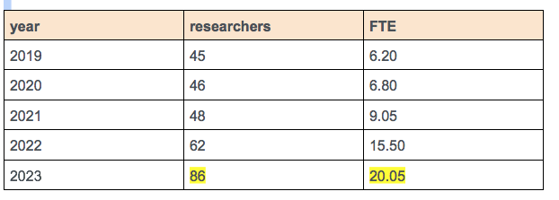
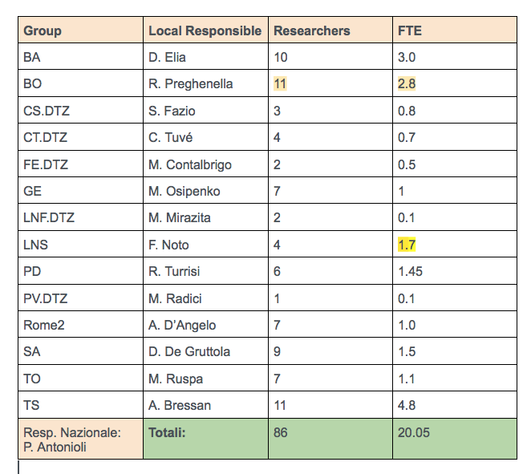
Preview preventivi (e anagrafica)
Note that as FTE we are largely exceeding agreed plan (EoI)
20 FTE was target for 2024
TO, PD, Rome2, SA → sigle (>= 1 FTE)
PV, SA → new groups

Slide 16
Moving to experiment mode from 2022...

Slide 17
to 2023: moving to experiment mode
dRICH
SiTracker
streaming readout
BA TS PD
GE RM2
FE TS LNF (RM1)
optics
mechanics
radiators
photosensors
MAPS 65 nm technology
El. cal. @JLAB + TRIDAS
BO FE
[CS-SA-CT]
aerogel
pressurized Argon vs C₂F₆
SiPM
LAPPD
DAQ for dRICH
FE BA
TS LNS + BL/JLab
GE TS
Toward detector definition and optimization, simulation capacity will be key: a big working space for all our groups
ALCOR
TO
TS BA LNS SA + Duke + NISER
PV CS TO
Simulation & computing
Physics (SIDIS, Exclusive tagging, diffractive, hadron spectroscopy and hadronization, ...)
TS CT CS BA

Slide 18
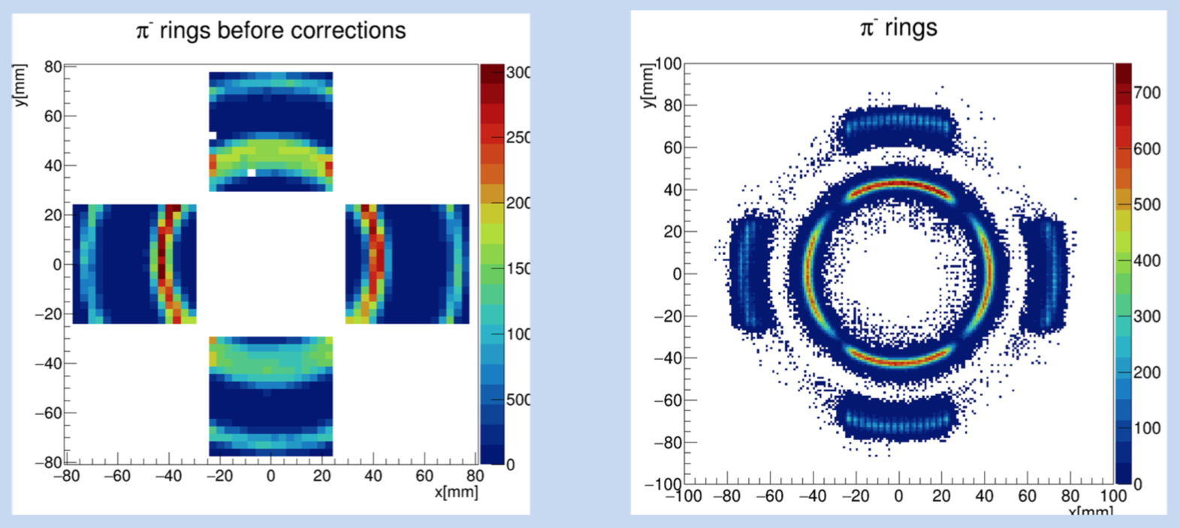
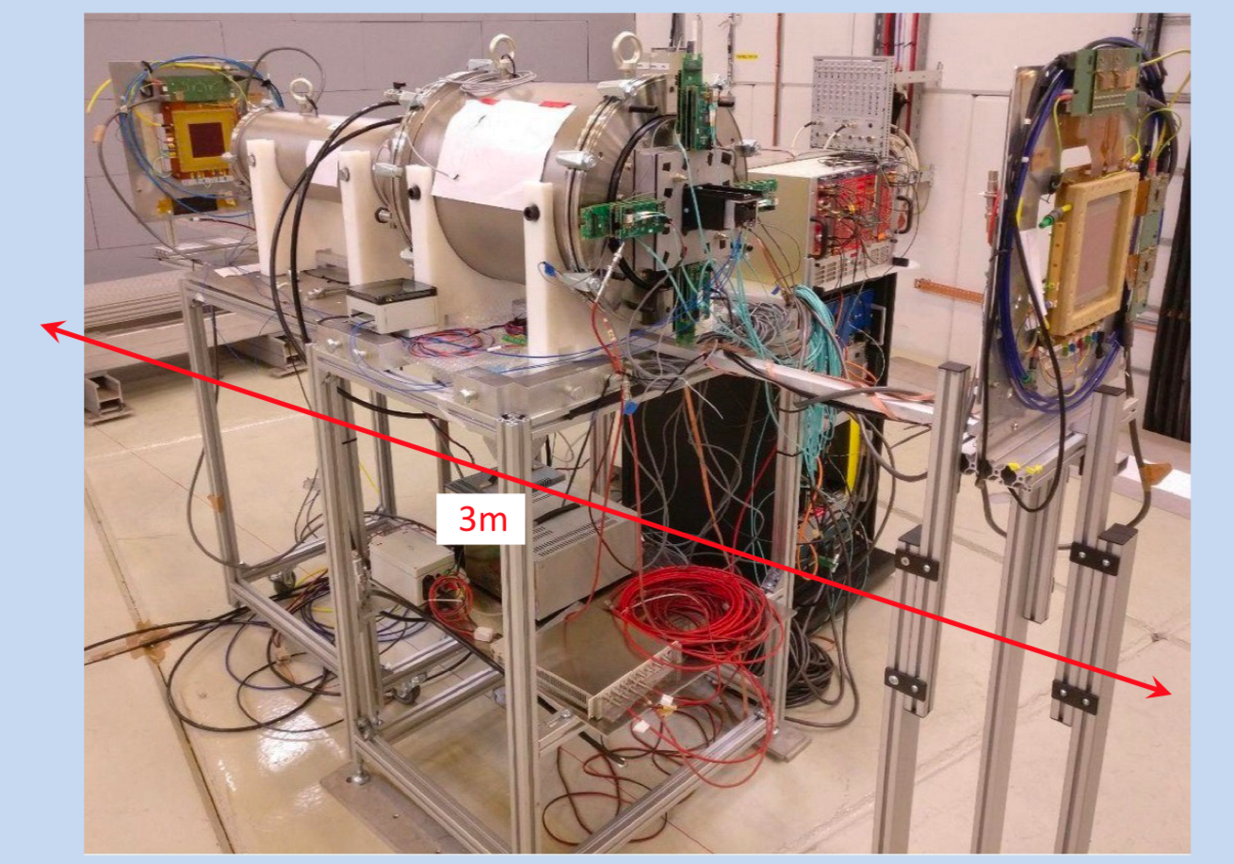
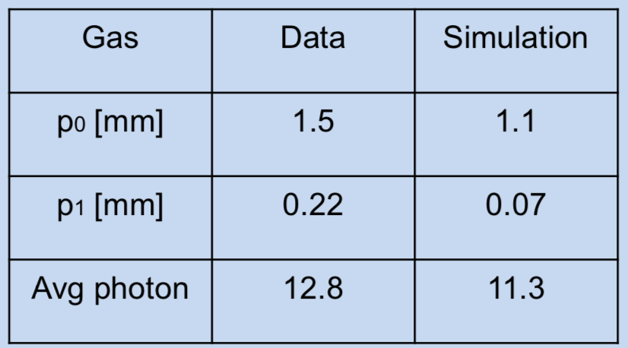
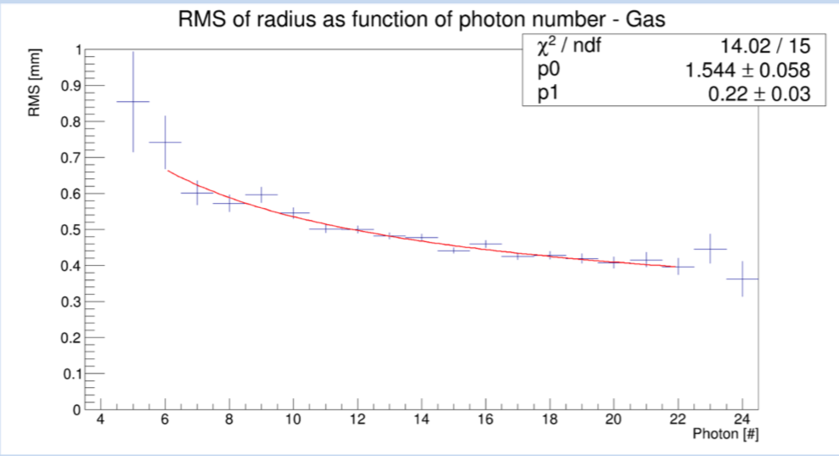
R&D highlight

Slide 19
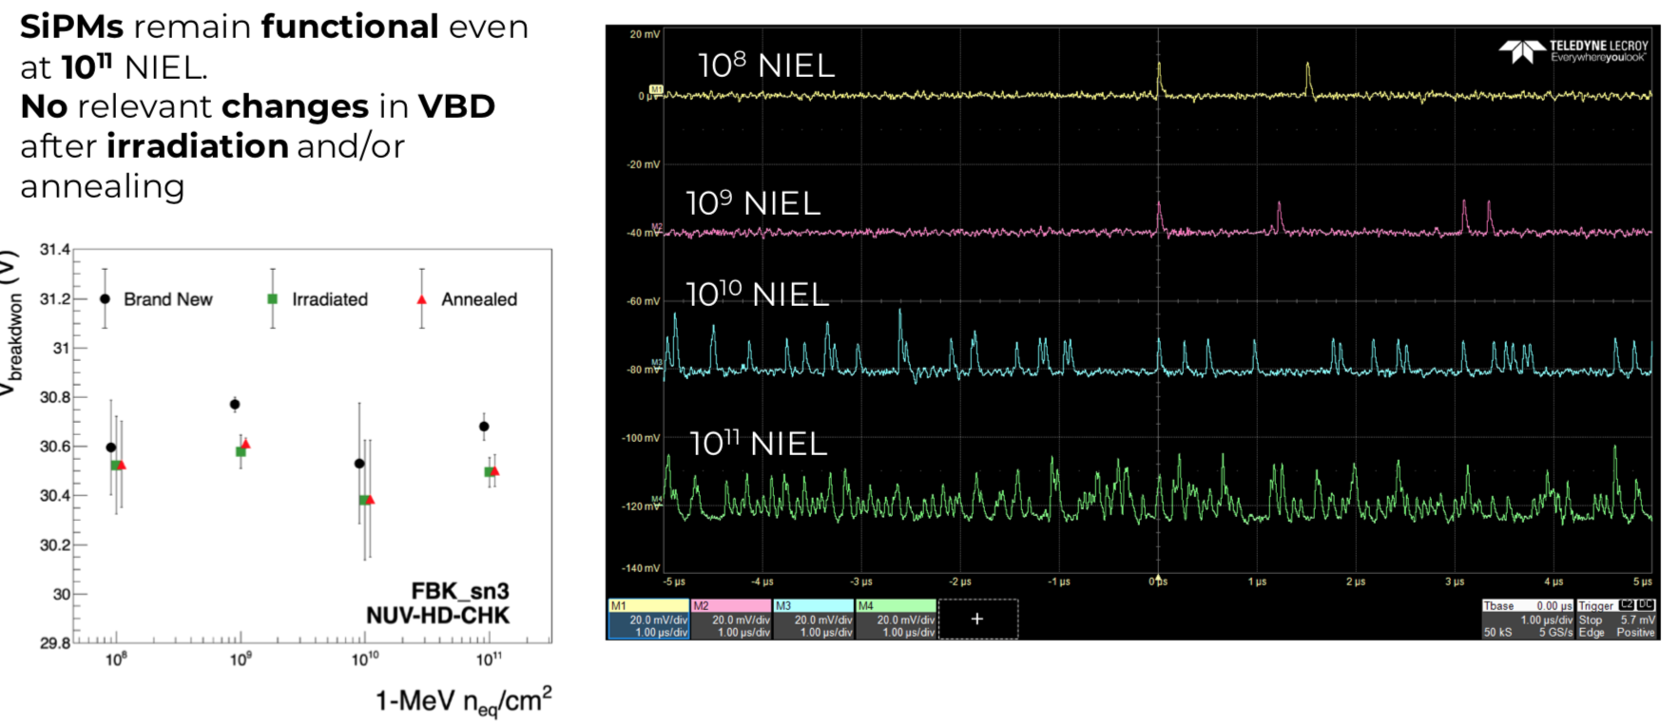
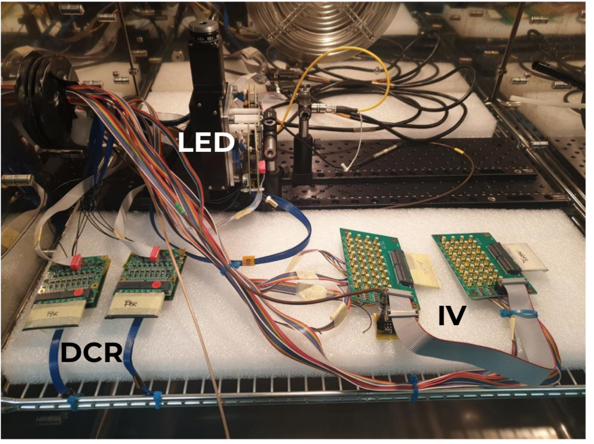
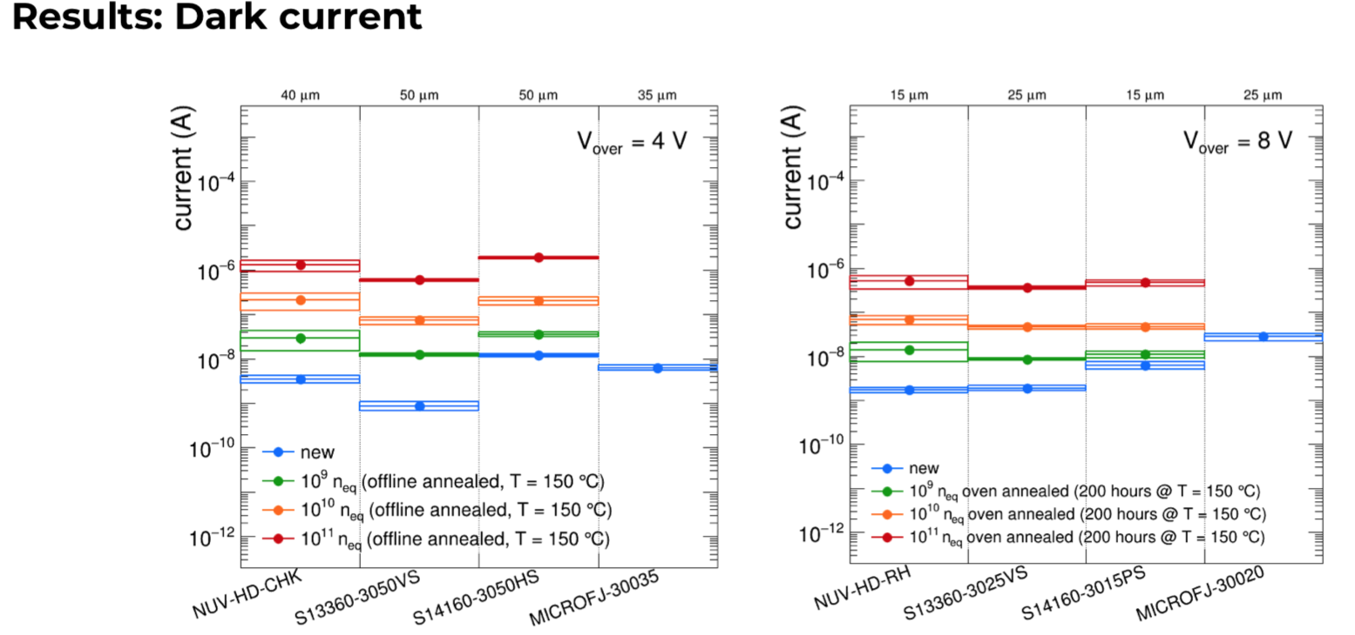
R&D highlights
More on L. Rignanese talk
@EIC_NET Catania

Slide 20
R&D highlight

Slide 21
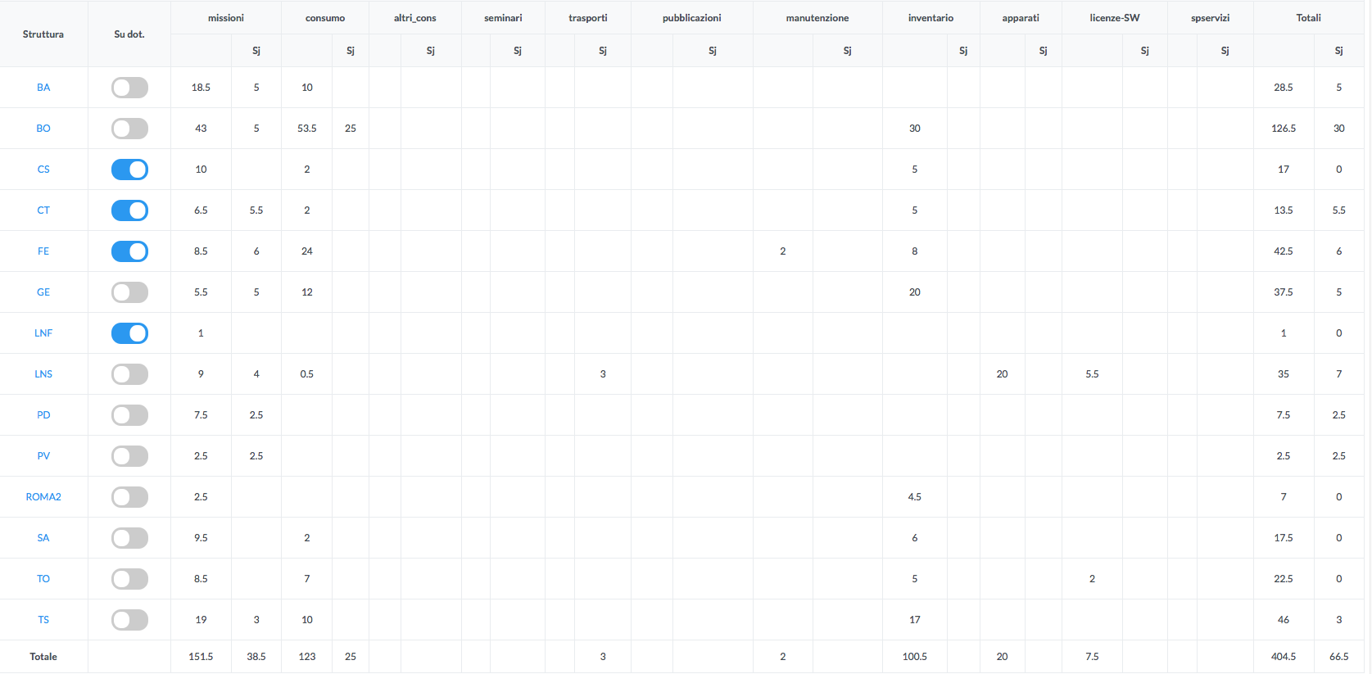
Preview richieste (highlight)
also cards for CT-CS-SA
FBK run
laser + chiller
dRICH prototype + aerogel (also BA)
SRO + LAPPD
vessel
SRO
LAPPD

Slide 22
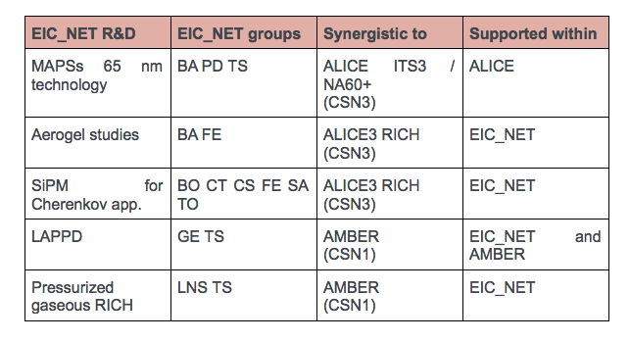
Preview richieste (sinergie)

Slide 23
Preview richieste (missioni) + EIC school
EICUG meeting 2023 in Europe (Warsaw) → 2 KEU each
EIC_NET giornate nazionali → 0.5 KEU each
meeting in USA (s.j.) → 2.5 KEU / one week
+ test beams e irraggiamenti a TN/LNF
small task RN (20 KEU): 15 KEU + 5 KEU (EIC school) → problemi centralizzazione
missioni di networking intra-italiano
CSN3 should have a look to its table/price list...
EIC school
"cultural" operation
format: 3 or 5 days
venue considered: Frascati (LNF), Bertinoro, Maratea, Vieste
May – July 2023
DIS and EIC lectures / hands-on sessions
"late" master students, graduated and PhD (first years)
interest of theory community
We ask some support from CSN3 (missions) as part of "networking".
Could be key to recruit young generations

Slide 24
Milestones
di "R&D"
di "progetto"
Solo una di networking

Slide 25
Meeting with referee
one day?
in-person (at least partially?)
29 August – 2 September
5 – 9 September
12-13 September? (then too late...)

Slide 26
Backup and useful stuff

Slide 27
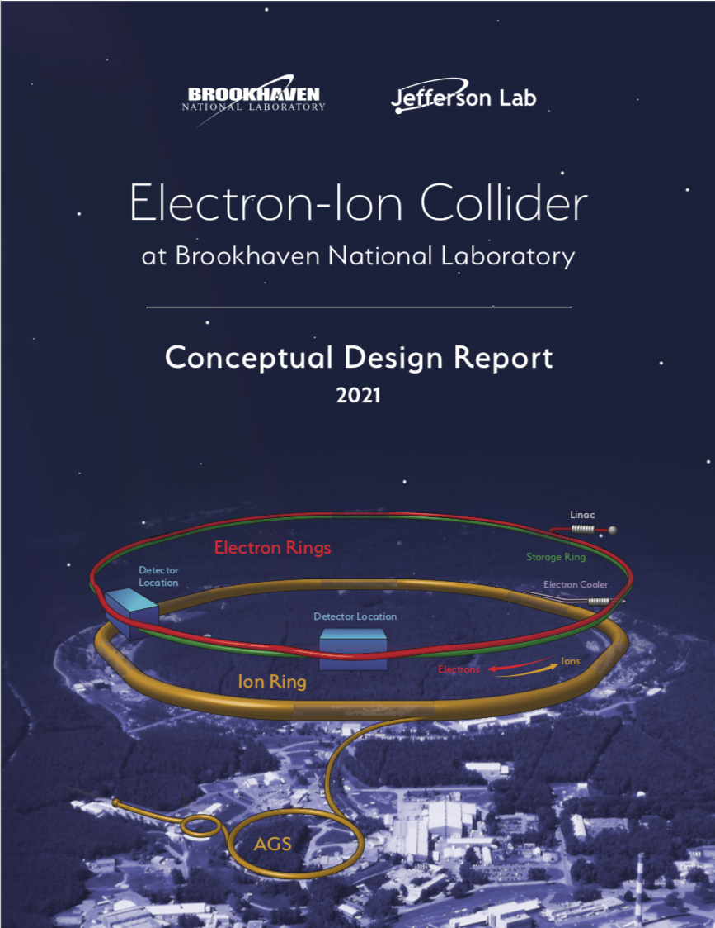
A very long journey through the pandemic (last 2.5 years)
CD-0 approved + BNL site selected (Dec2019/Jan2020)
All 2020: 4 online workshops to prepare Yellow Report + 1 EICUG meeting online
February 2021: EIC Conceptual Design Report: https://doi.org/10.2172/1765663
8 March 2021 Yellow Report released: https://arxiv.org/abs/2103.05419
March 2021: Call for detector proposals: https://www.bnl.gov/eic/CFC.php
March: First meetings of protocollaborations
28 June 2021: CD-1 passed "completion of the project Definition Phase and the conceptual design."
2-7 August 2021 EICUG (online) meeting: https://indico.bnl.gov/event/11463/
10 August 2021 call EIC Detector R&D FY22: https://indico.bnl.gov/event/10974/contributions/53172/attachments/36485/59965/Detector_RD_Plan_Aug10.2021.pdf
1st December 2021: experiment proposals sent to DoE (ATHENA, ECCE, CORE)
13-15 December 2021: first meeting of Detector Proposal Advisory Panel vis à vis proto-collaborations
https://indico.bnl.gov/event/13614/

Slide 28
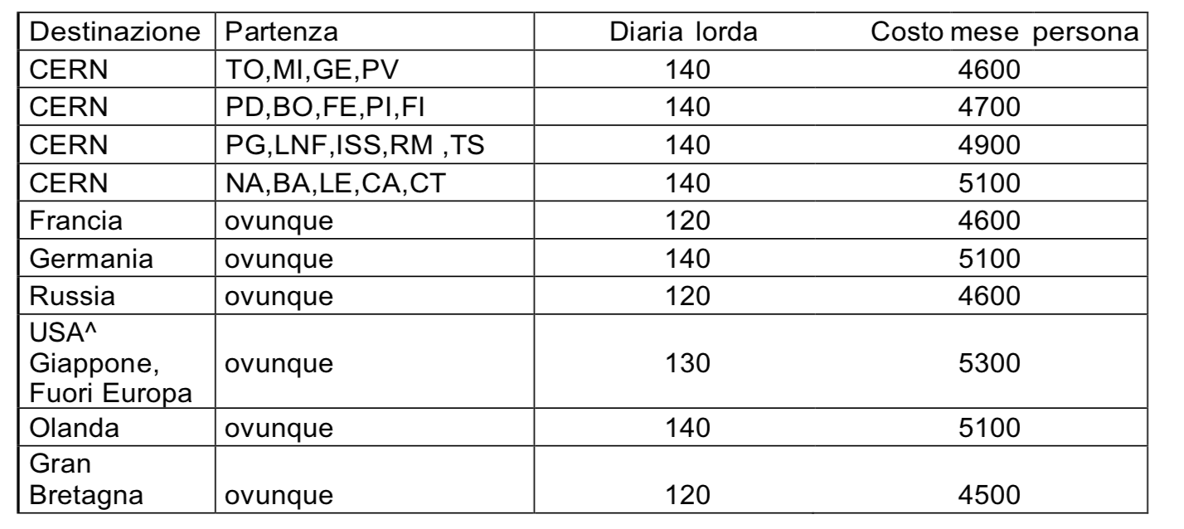
Missioni
Costo viaggio A/R
Costo mese – diaria*30
400
500
700
900
1100
900
1400
900
ma evidentemente
nel costo mensile
hanno messo in qualche modo confuso
anche il costo-vita.
Ma 5300/4=1325 per 1 settimana in USA compreso il viaggio
e' ridicolo. E 900 EU per andare in Germania e' troppo...
Se per una settimana si divide per 4 in USA 5300/4=1400 si rischia di neanche arrivarci...

Slide 29
Missioni
Costo USA:
biglietto 1000 EU (se autorizzato presto da direttore)
albergo 130 EU/notte (minimo) = 130 x 5 = 750
diaria/2 * 7 = 65*7 = 455
conference fee = 200
ESTA: 20
Assicurazione AIG: 100
2500 sono molto "al pelo"....
Costo CERN:
la differenza tra sedi e INFN e' dominata da esistenza o meno di voli low-cost
Costa meno andare al CERN da Roma che da Bologna!!!

