Slide 2
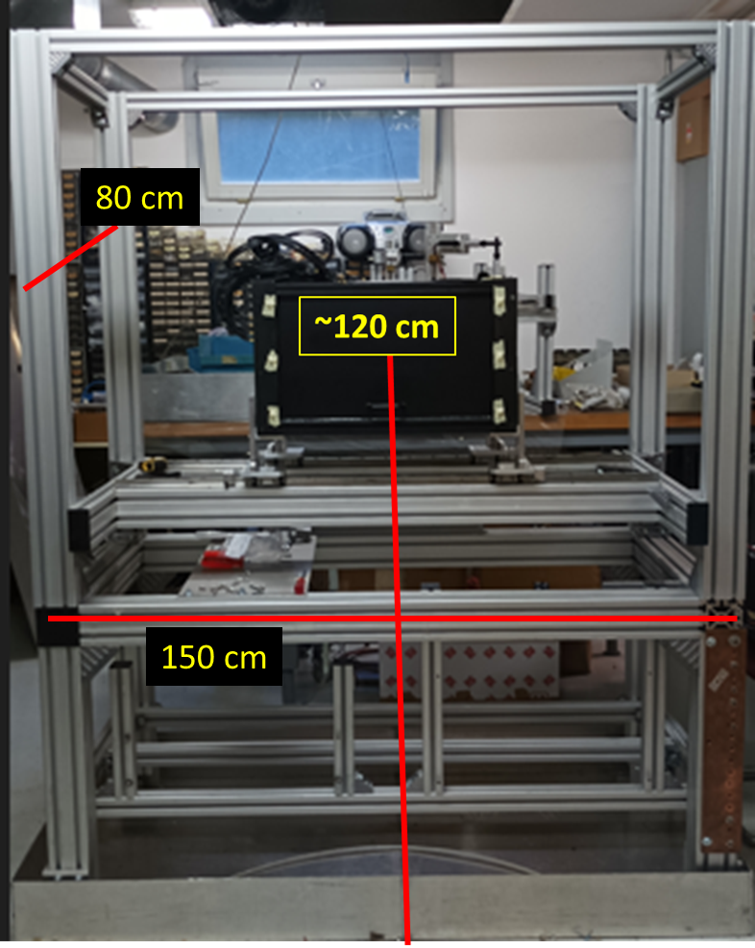
T10_Guide.pdf (cern.ch)
Is the nominal beam line around 2.505 m from the floor? → We need around 130 cm extension to reach the centre.

Slide 3
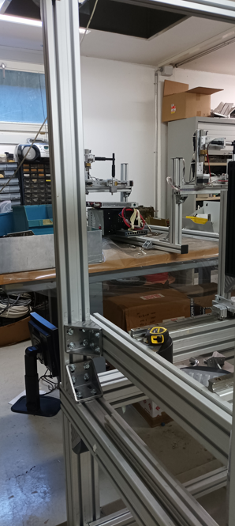
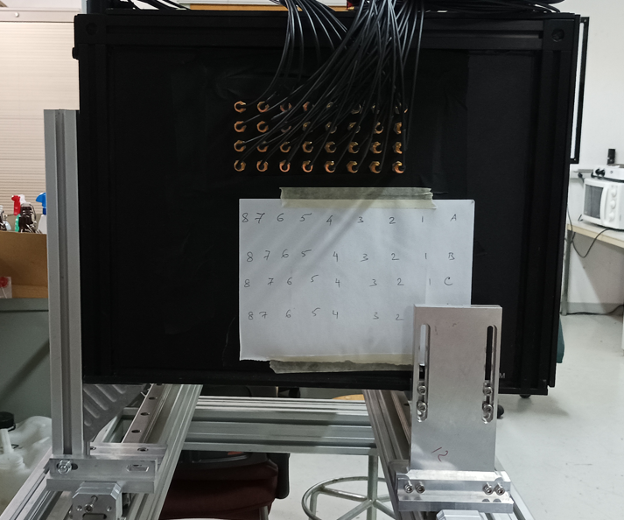
~10 cm fine adjustment

